Slide 1
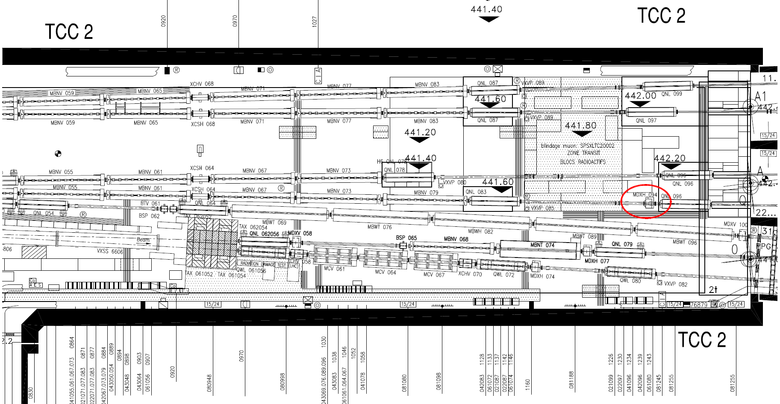
TCC2 new MDX.042.094

Slide 2
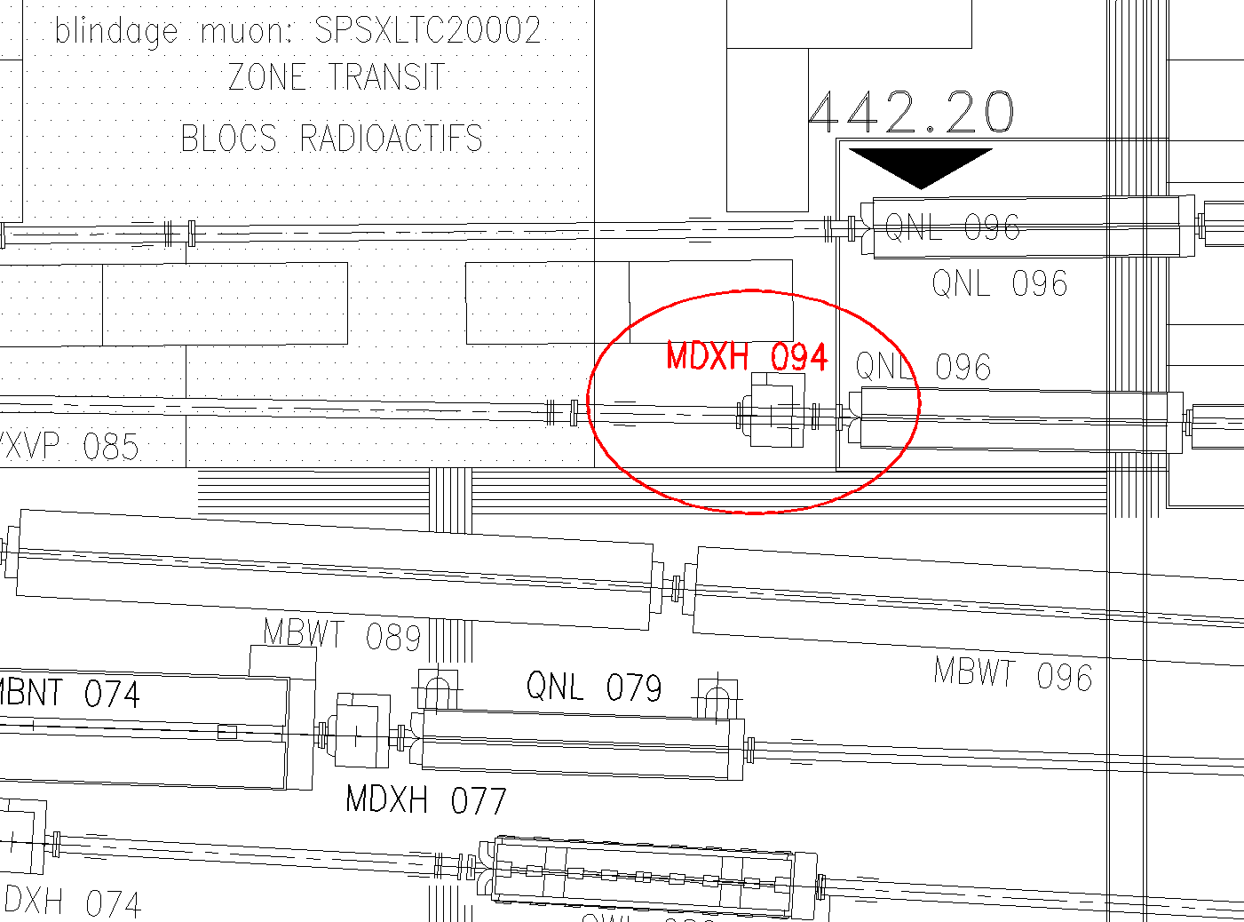
TCC2 new MDX.042.094

