Slide 1
Wakefield Experiments at AWA
Chunguang Jing
June 2015

Slide 2
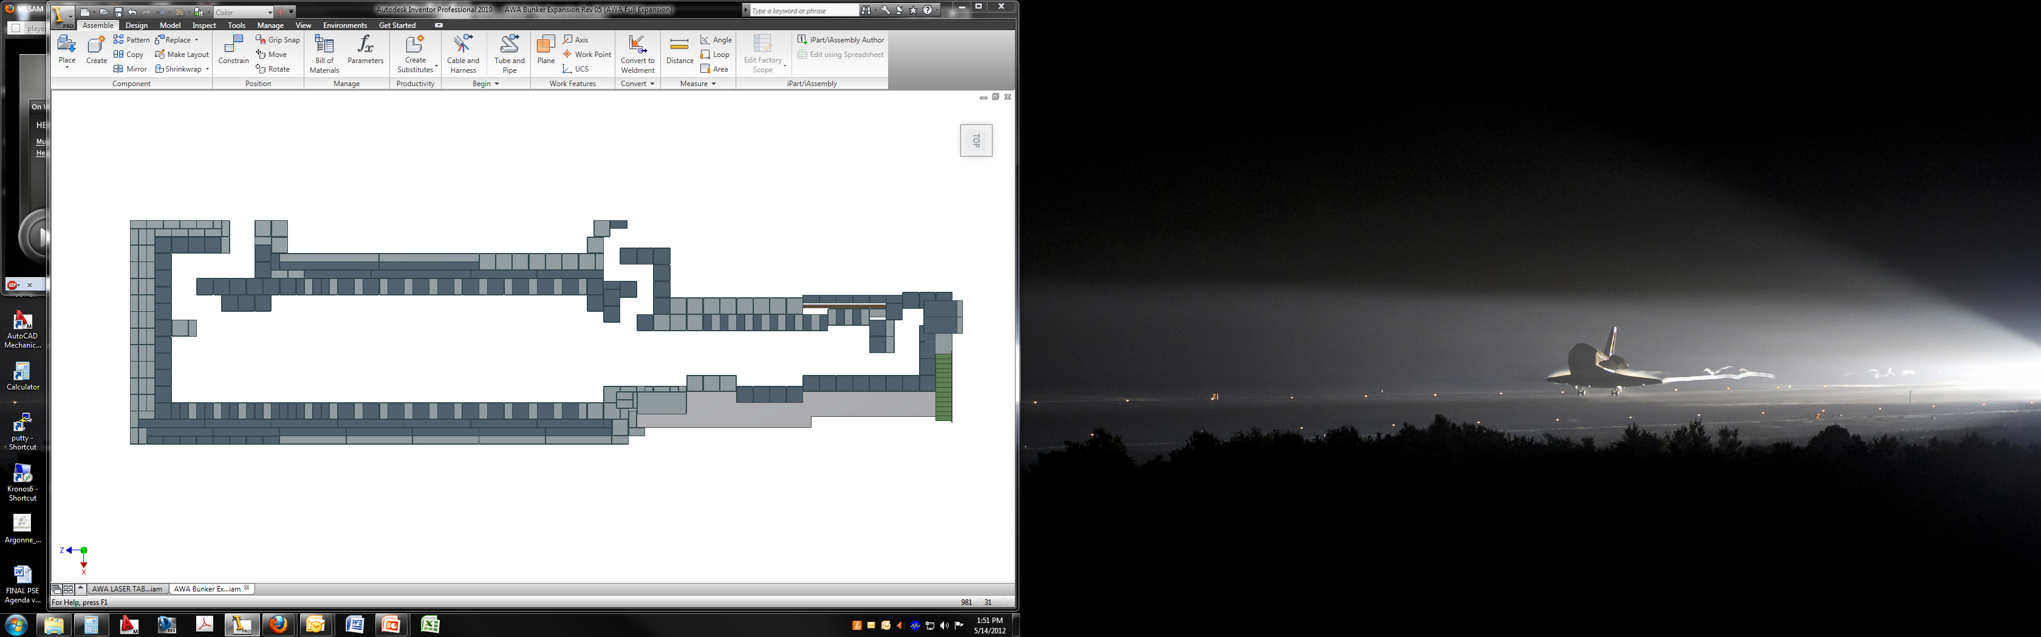
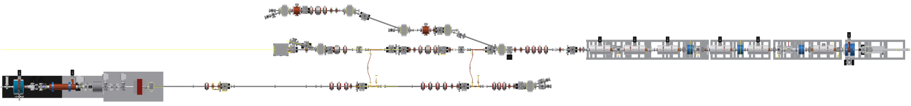
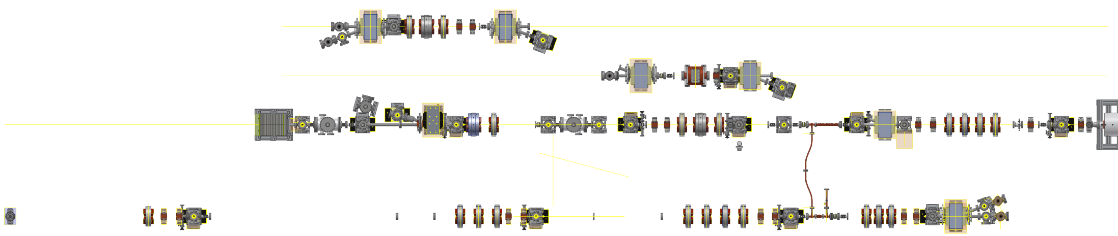
AWA Beamlines in 2015
1950 ft²
127 ft long
Drive
Switchyard
EEX beamline
Straight ahead beamline
Witness beamline

Slide 3
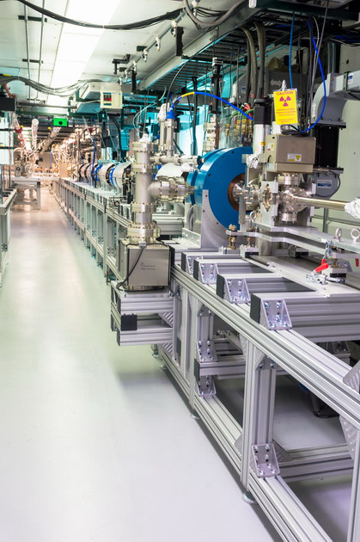
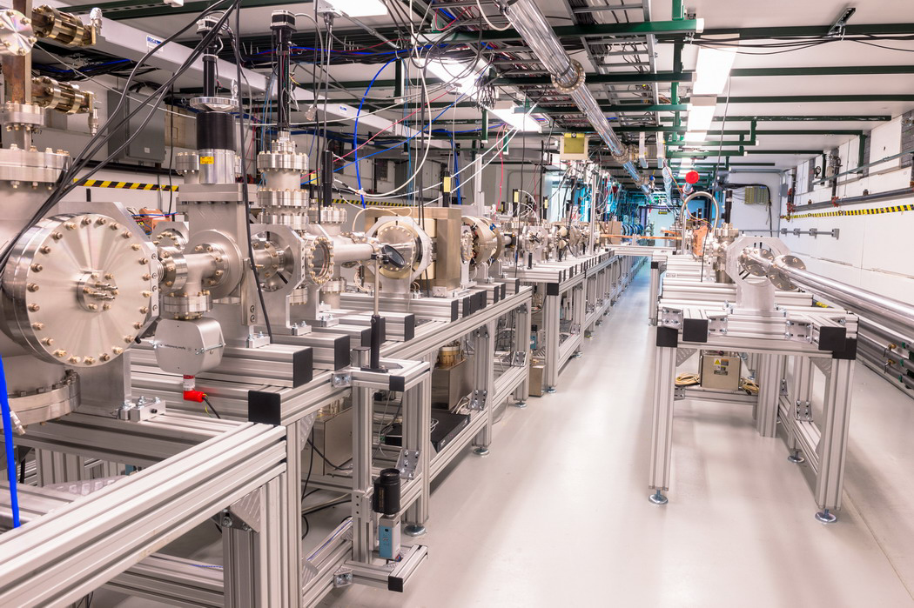
AWA Beamlines in 2015

Slide 4
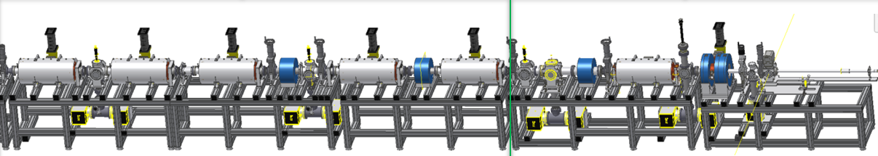
1. Drive linac: commissioning underway
GW Drive Beam Power
Single bunch operation
  19 MeV; Oct 2013
  70 MeV; Dec 2014
  Q = 0.1-100 nC
Bunch train operation (19 MeV)
  16 bunches x 35 nC (560 nC); Feb 2014
  32 bunches x 17 nC (544 nC) Apr 2014
Bunch train operation (70 MeV)
  8 bunches x 5 nC, (40 nC); Dec 2014
  8 bunches x 12 nC (~100nC); Jan 2015
  8 bunches x 50 nC (~400nC); Mar 2015 (0.2 Hz)
  8 bunches x 50 nC (~360nC); Apr 2015 (1 Hz)

Slide 5
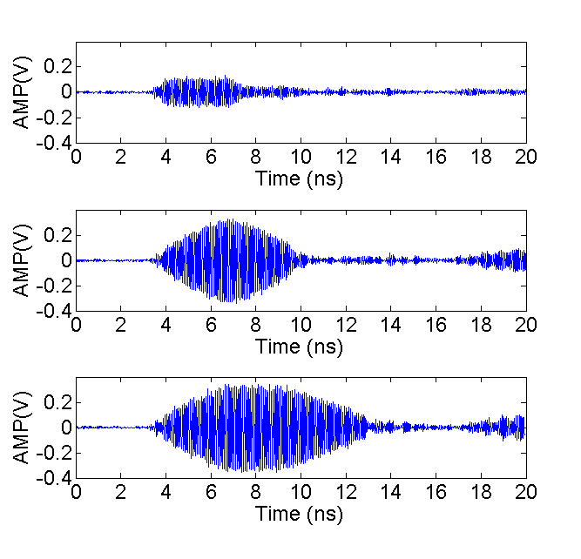
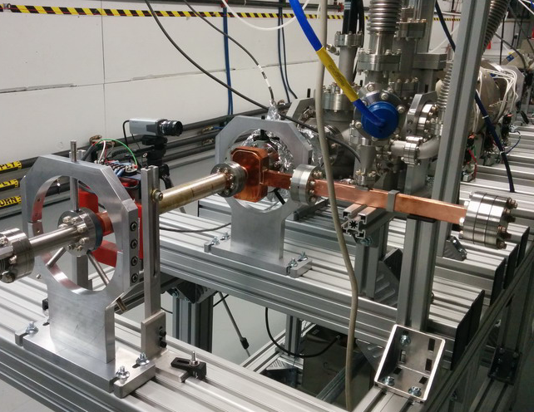
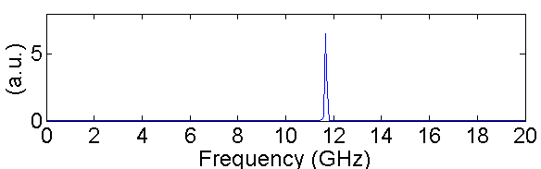
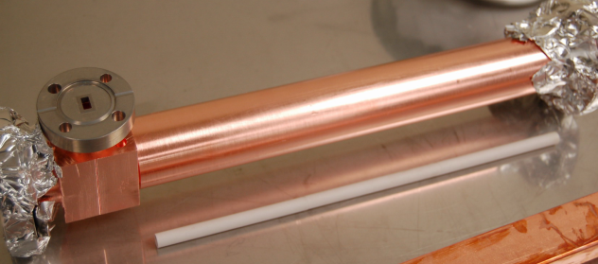
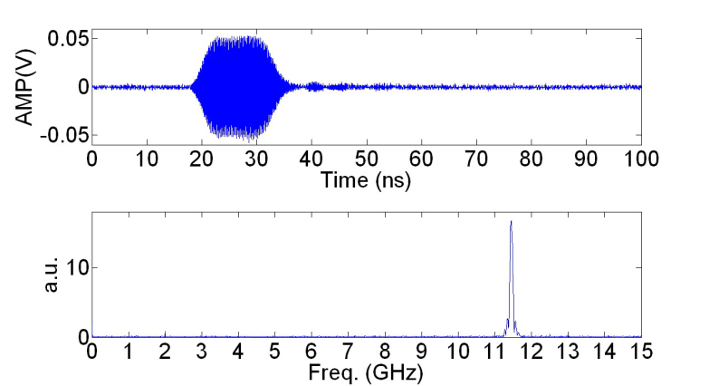
Development of Wakefield Power Extractors
X-Band Metallic Wakefield Power extractor
RF Generation of bunch train (25MW meas. to date )
K-Band Dielectric Wakefield Power extractor
16ns,1MW & 10ns, 20MW 26GHz rf pulse produced
Downconverted signal
11.44+14.576=26.016 GHz

Slide 6
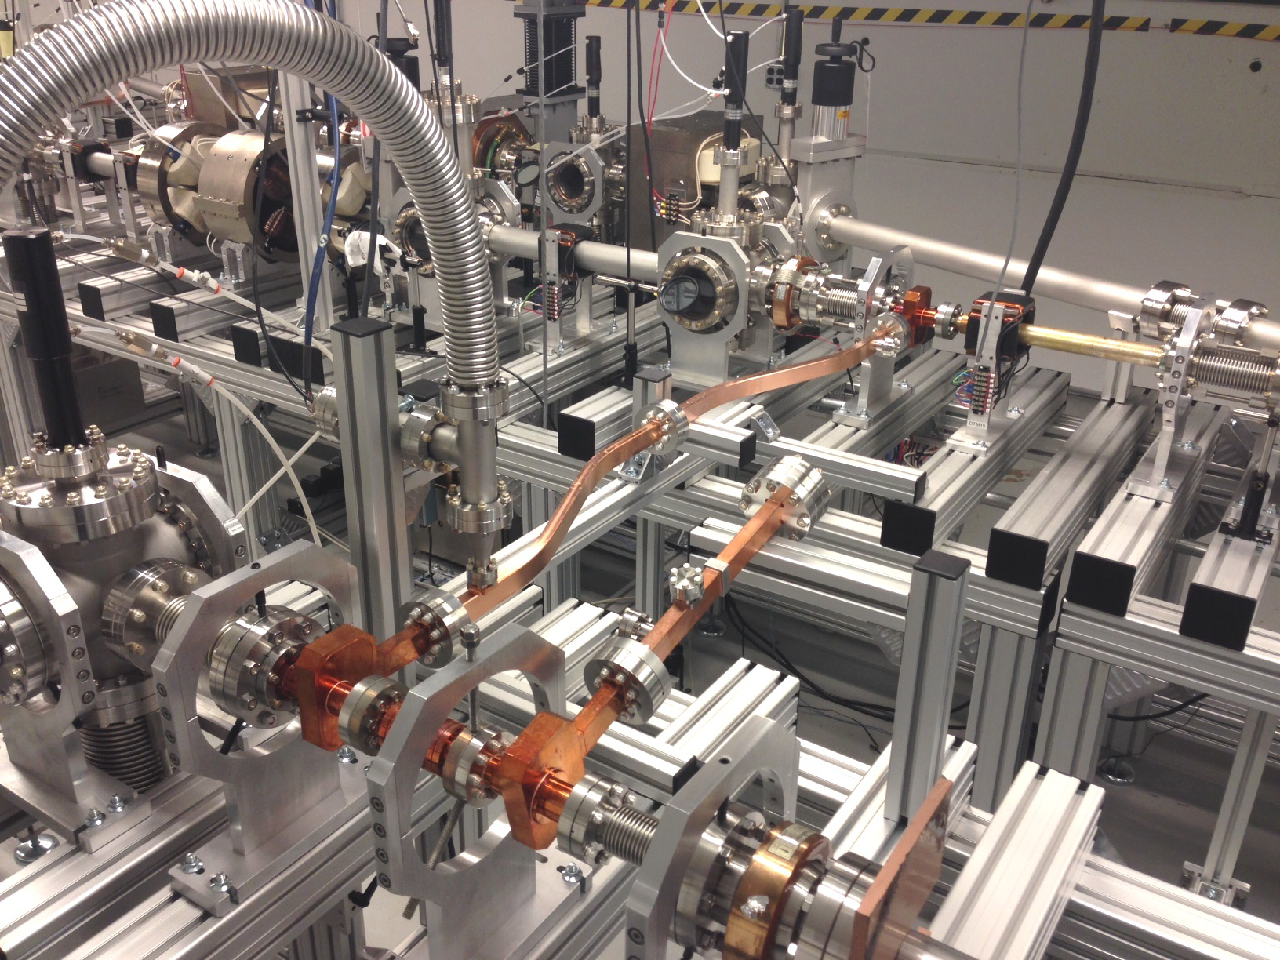
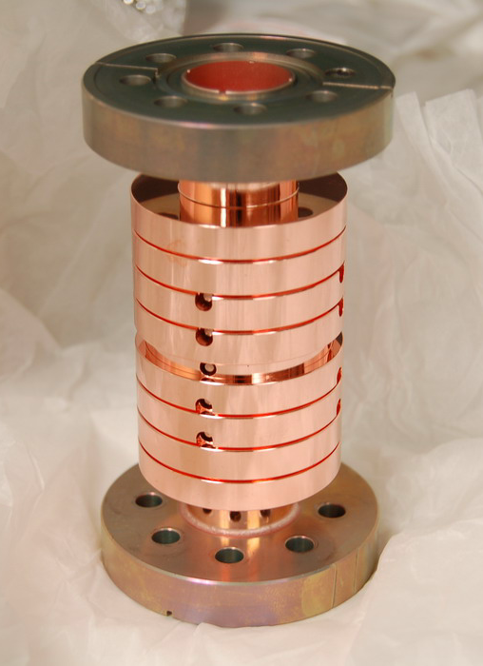
Current Setup for TBA
Drive Beam
RF
Witness Beam

Slide 7
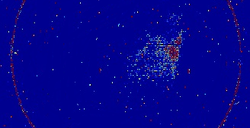
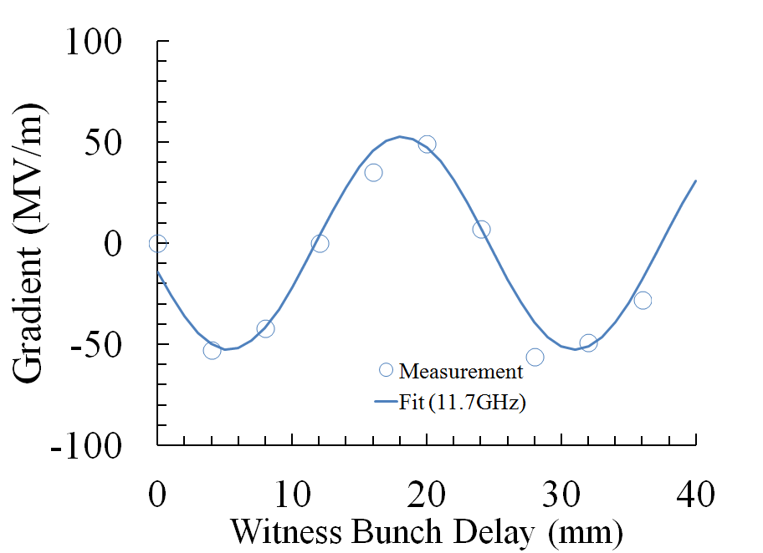
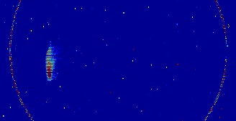
TBA Experiment at AWA (ongoing efforts)
Drive off
Drive on
Higher energy

Slide 8
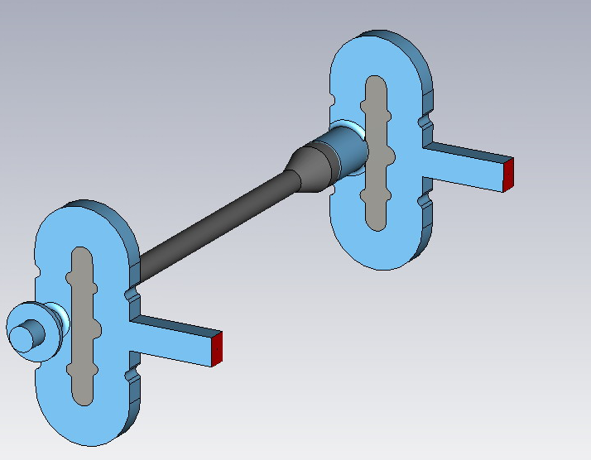
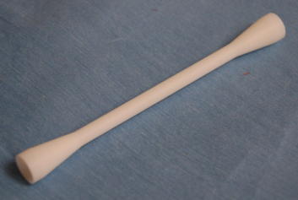
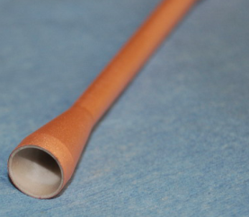
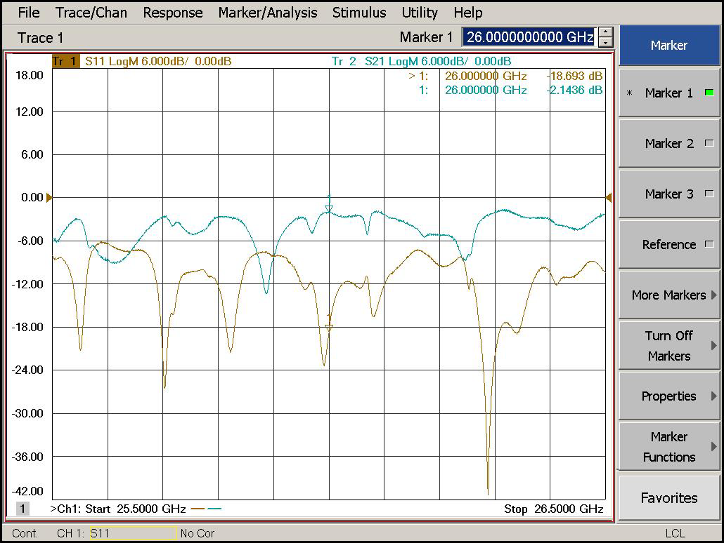
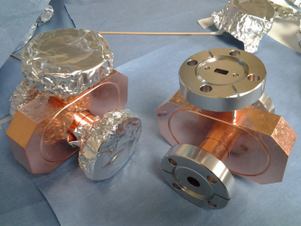
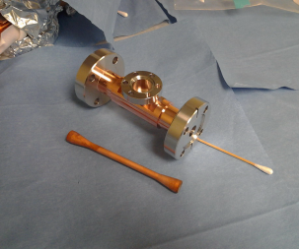
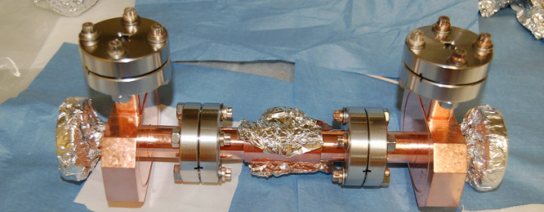
Fabricated 26GHz short pulse DLA Structure
parameters | value
ID / OD of dielectric tube | 3 mm /5.025 mm
Dielectric constant | 9.7
Length of dielectric tubes | 105 mm
Vg | 11.13%c
R/Q | 21.98 kΩ/m
Q (loss tan=10^-4) | 2295
Shunt impedance | 50.44 MΩ/m
E_{acc} for 316MW input | 158 MV/m
S21=-2.1dB S11=-18.9dB@26GHz

Slide 9
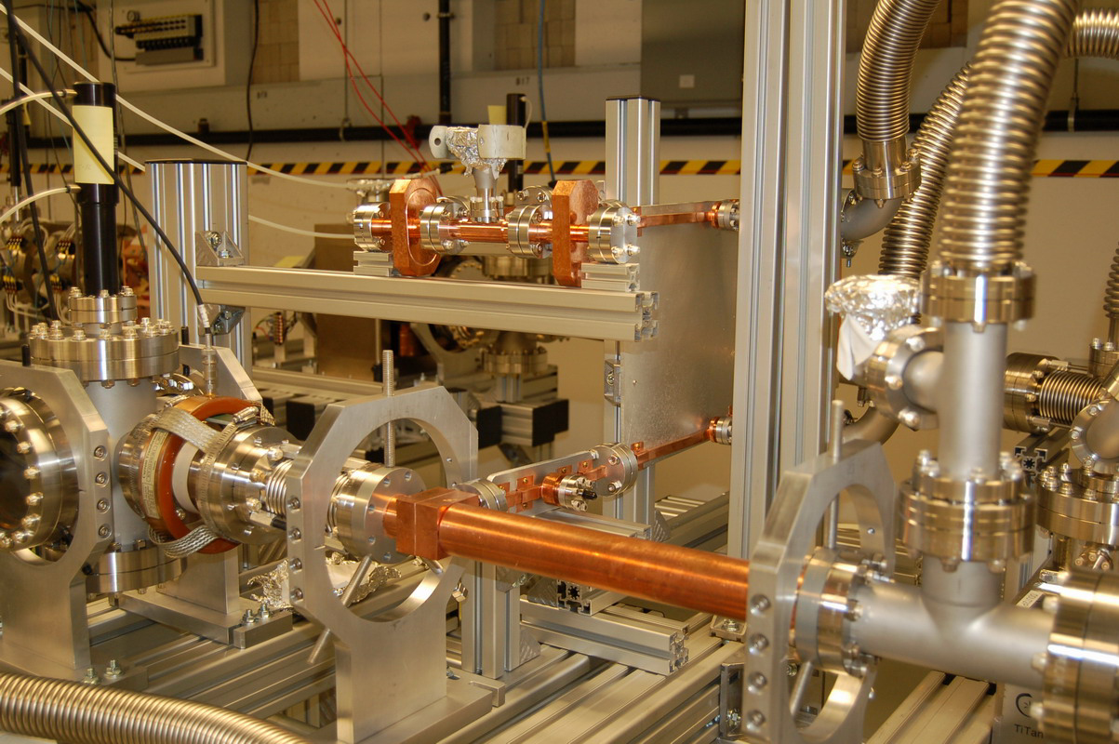
Ongoing experiment @AWA---High power rf test of 26GHz DLA
RF
RF
Drive Beam
9

Slide 10
Bunch Shaping and High Transformer Ratio @AWA

Slide 11
High Efficiency Wakefield Acceleration
W
+
ρ
(z)
Ramped Bunch Train
z
W
-
R=2.3@PRL 98, 144801, 2007.
R=3.4. @PR ST-AB, 14, 021302, 2011.
d
d
d
Ramped Bunch
(Trailing bunch)
Transformer Ratio:
(driving bunch)
Directly related to efficiency;
>>2 is preferred;
temporal shape of the bunch determined;
favors ramped charge profile and its variations;

Slide 12
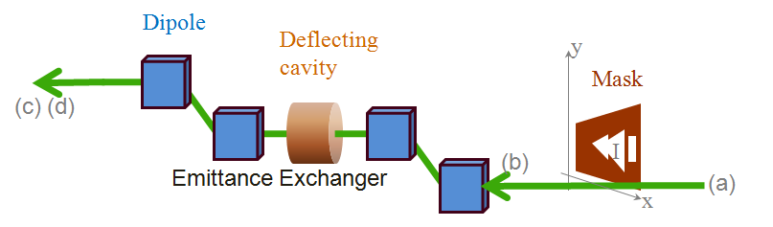
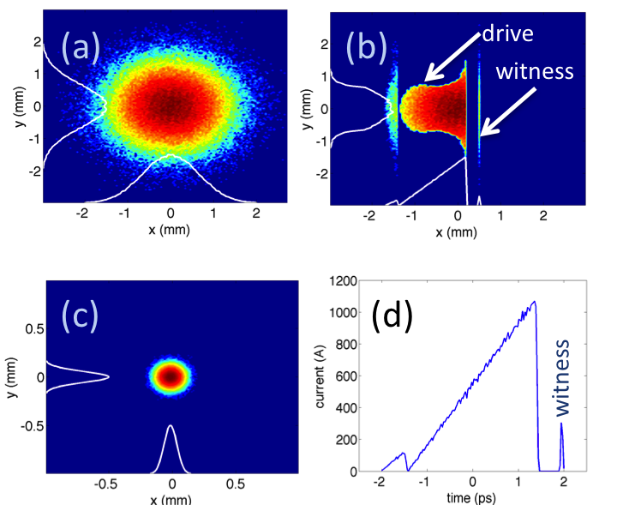
Bunch shaping for high transformer ratio
Works well for a few nC charge after mask;
flexible with mask shape
witness bunch can be produced with the same mask to avoid the timing jitter;
Simulation by P. Piot (NIU)

Slide 13
First EEX-Bunch Shaping Experiment (Gwanghui Ha)
Transverse Profile after the mask
Longitudinal Profile after EEX
time correlated direction

Slide 14
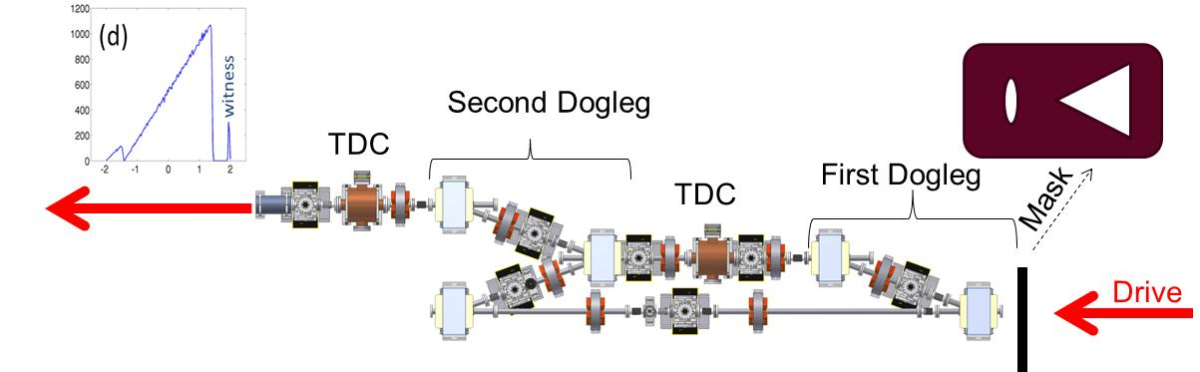
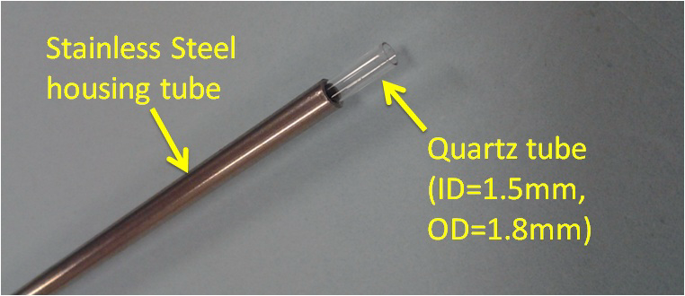
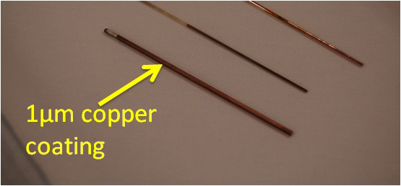
High Transformer Ratio Collinear Wakefield Experiment
TR~10
200GHz DWA

Slide 15
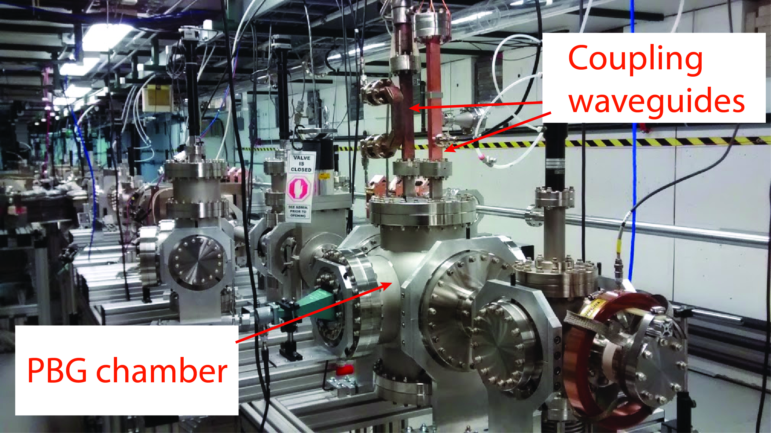
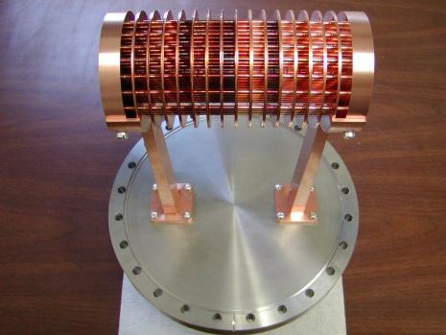
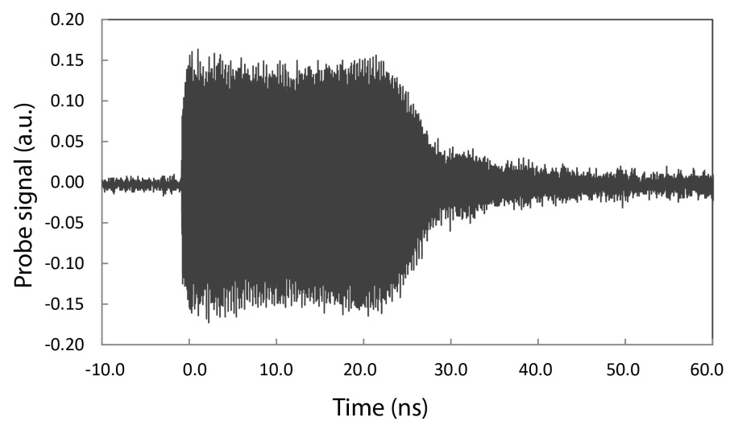
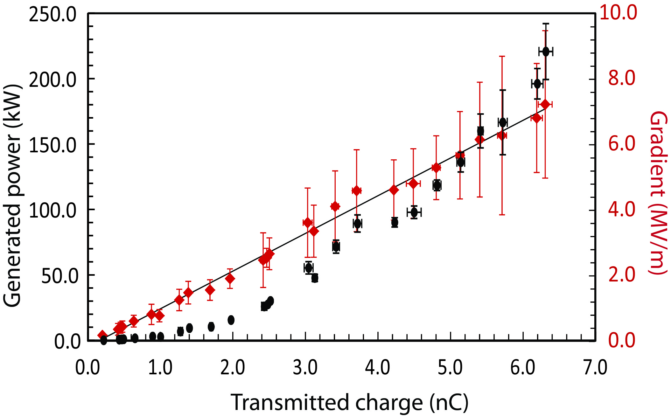
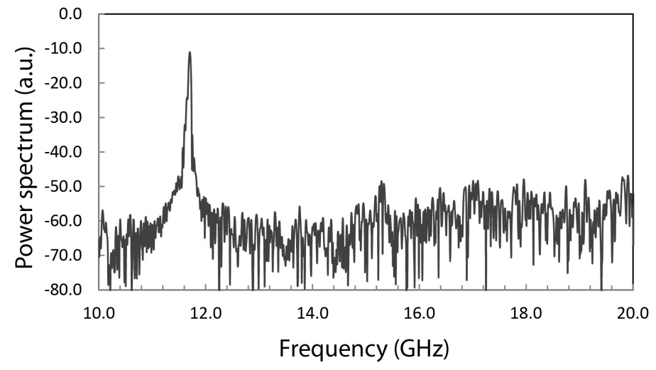
PBG Experiment
Fundamental mode

Slide 16
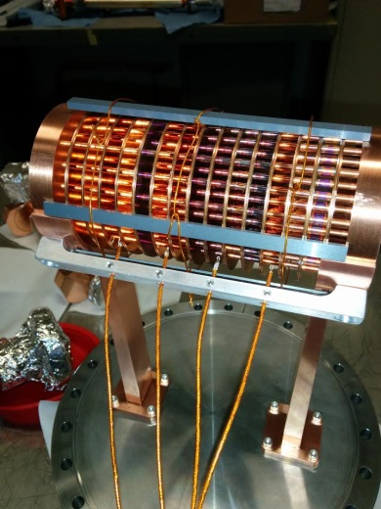
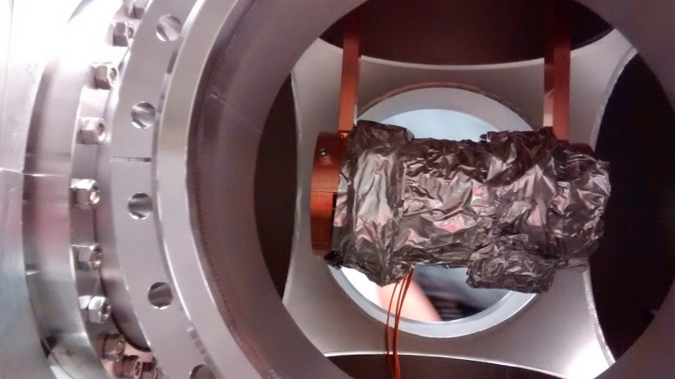
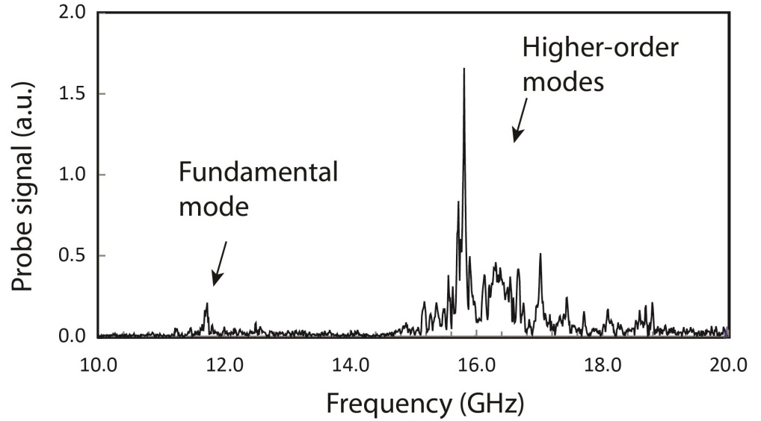
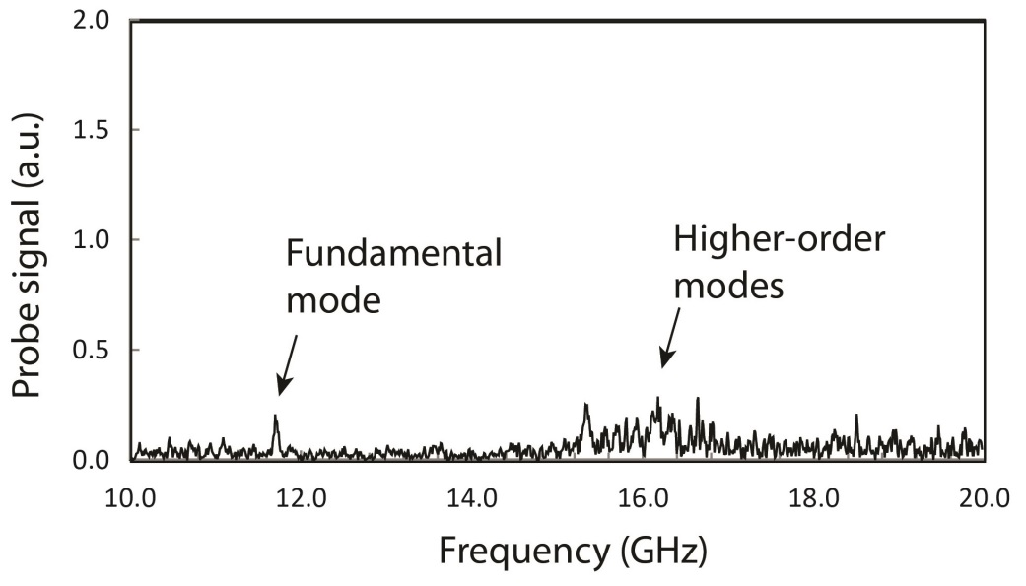
Higher Order Modes
HOMs were measured with 4 loop antenna probes installed at the periphery of the structure.
PBG structure wrapped in foil:
Open PBG structure with 6 SiC slabs:

Slide 17
Experiments in the next 3 Years
High power rf generation beyond X-band
Staging
High Gradient TBA
Ultrahigh Transformer Ratio
Others

Slide 18
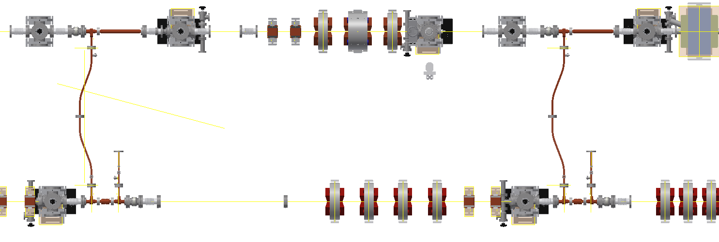
Staging Experiment at AWA--- Simplified Staging
Two Drive trains
1.50M
59.055”
Witness bunch
4.156M
163.62”

Slide 19
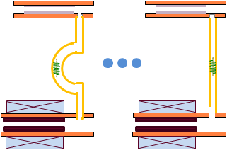
Full Staging
2L /c
Drive beam
photons
Stage 2
Stage 1
rf delay 1
rf delay m
rf delay 1
rf delay m
1.3GHz SW Linac
L
L
Main beam
rf delay1=0;
rf delay2=2L_{s}/c;
rf delay m=2*(m-1)*L_{s}/c,
m is the # of structures in each stage,
L_{s} is the length of a single structure.

Slide 20
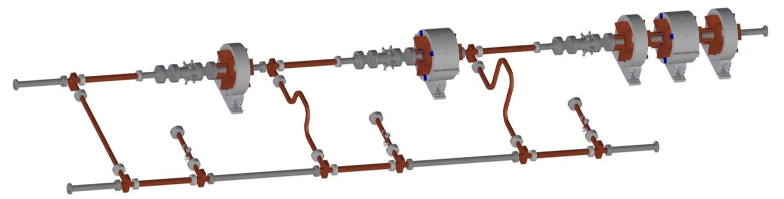
Goal of Two Beam Acceleration @ AWA in near term
16X40nC
100MeV
15MeV
1nC

Slide 21
SUMMARY
Developing and demonstrating the key technologies for Future Accelerators. Potential applications of Argonne’s wakefield technology include Linear Colliders and future light sources.
In the recent past, the effort in the group has been balanced between the major upgrade of the AWA facility and maintaining an active Experimental program with excellent progress on both fronts.
As the upgrade finished, the AWA program is entering a new phase, which concentrates on demonstration of Staging, High Efficiency Collinear Wakefield Acceleration, and High Gradient Acceleration. The Argonne technology may open up a path to new accelerator applications reliant on compact and efficient acceleration schemes.

