Slide 1



R&D on u-strpip sensors @ SDR
E. Currás, M. Fernández, J. González, R. Jaramillo, D. Moya, I. Vila.
Instituto de Física de Cantabria(CSIC-UC)
P. Fernández, S. Hidalgo, V. Greco, G. Pellegrini, D. Quirion.
Centro Nacional de Microelectrónica at Barcelona (CSIC)

Slide 2
Outline
Motivations for the R&D.
A 2D position sensitive microstrip sensor.
  Laser, radioactive source and particle beam characterization
Improving the design
  Integrated signal routing lines (Crosstalk suppression).
  Incrementing the signal: Low Gain Avalanche Detectors.
Summary

Slide 3
R&D Motivation
Charge division in microstrips:
  Long microstrips ladders (several tens of centimeters) proposed for the ILC tracking detectors.
  Getting the particle hit coordinate along the strip using the charge division method.
  Avoid the complexity of double sided sensors and the additional material of a second layer of sensors.
Low gain segmented p-type pixels (strips)
  Implementing a small gain in the segmented diode so we can reduce the thickness of the sensors without reducing the signal amplitude
  Smaller contribution to the material budget.

Slide 4
Charge Division in uStrips
S₁
S₁
Simple single-side AC-coupled microstrip detectors
with resistive coupling electrodes.
X-coordinate: cluster-finding algorithms for strip detectors.
Y-coordinate: Resistive charge division method.
Resistive material
Aluminium
y
Aluminium
x
x
L
** Electrode resistance >> preamplifier impedance.
L
S₁=f(y)
S₂=f(L-y)
y A₂
L A₁+A₂
=
Resistive material: high doped polysilicon
S₂
** V. Radeka, IEEE Transaction on Nuclear Science NS-21 (1974) 51

Slide 5
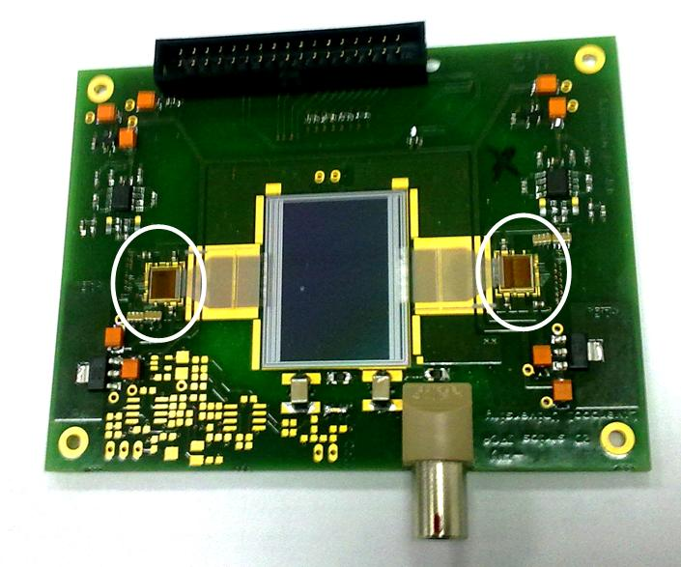
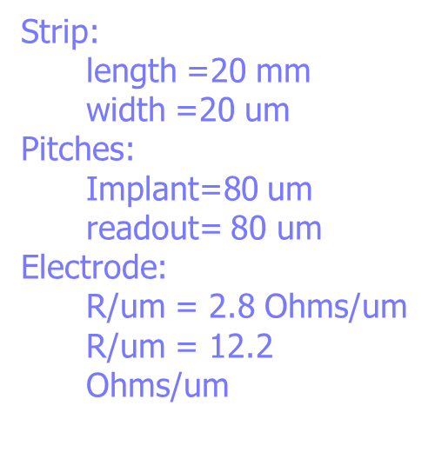
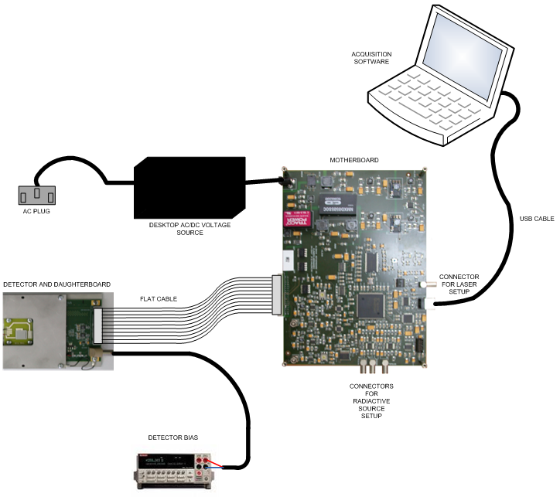
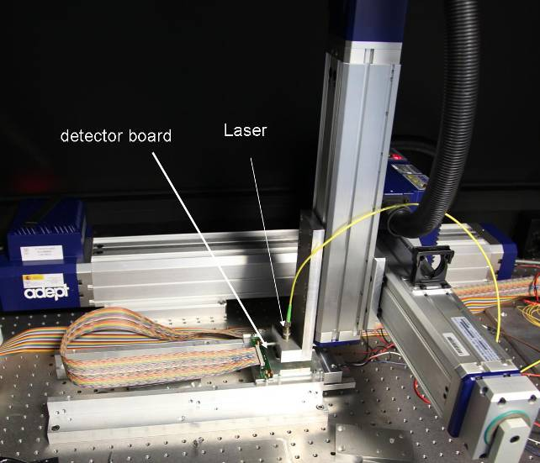
Proof-of-Concept Prototype
2 Beetle chips
ALIBAVA DAQ system for microstrip detectors, based on the Beetle analogue
readout ASIC
3D axis stage with displacement accuracy ≈ 10 μm
Pulsed DFB laser λ=1060nm
Gaussian beam spot width ≈ 15 μm
pulse duration 2ns
256 channels
peaking time = 25ns
S/N≈20 for standard no irradiated detectors
Clean room laboratory at IFCA, Santander

Slide 6
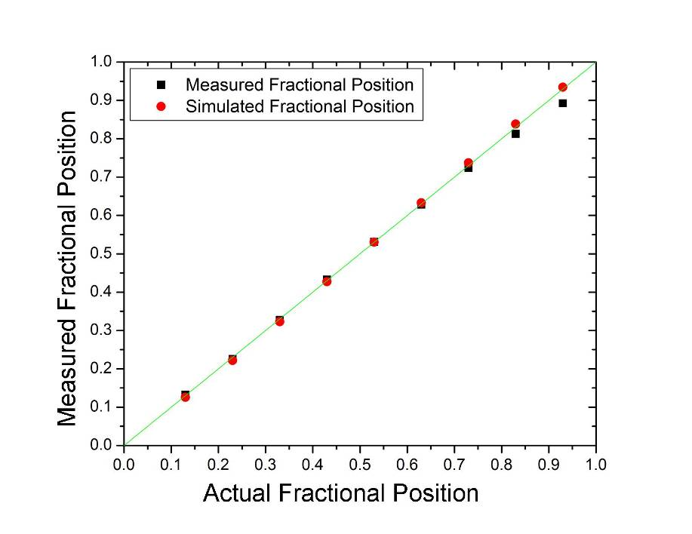
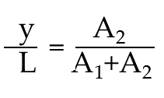
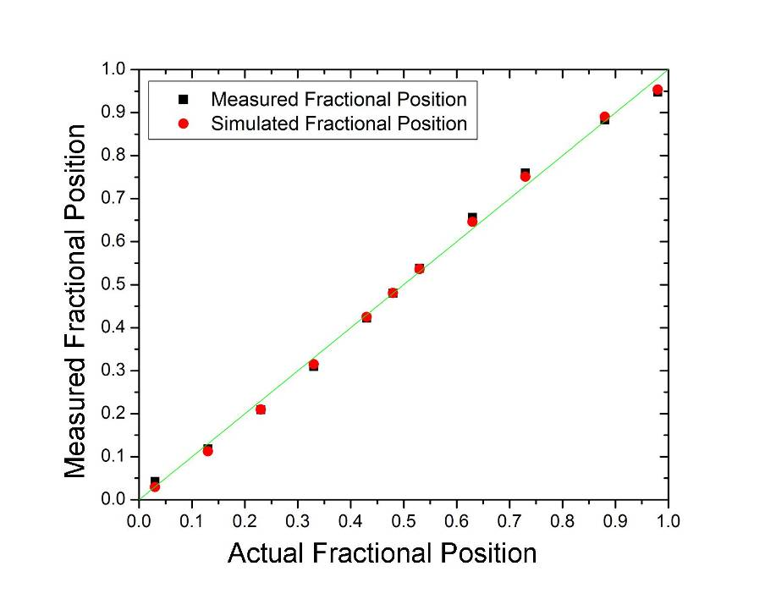
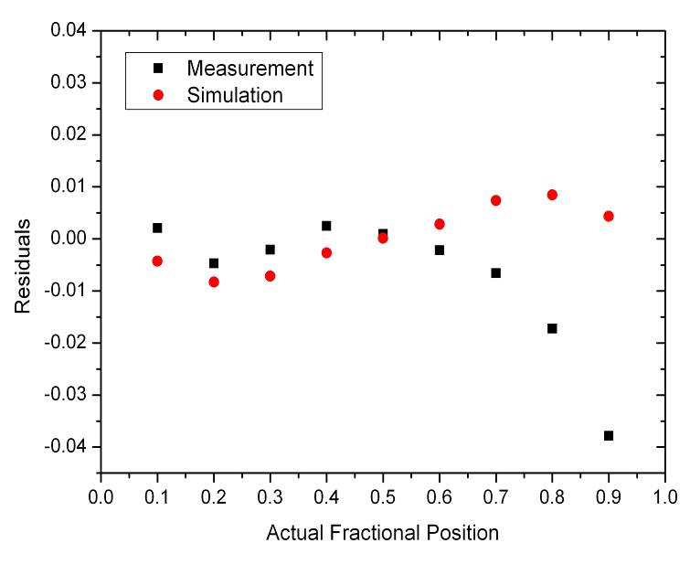
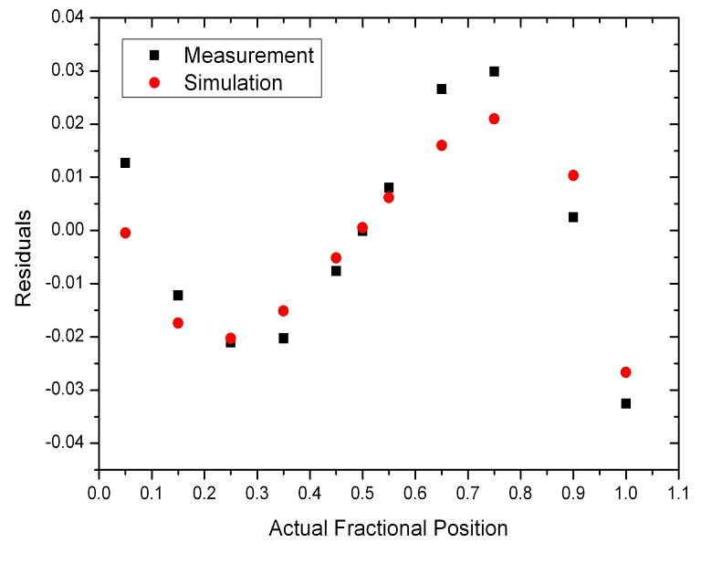
R/l=2.8 Ω/μm
R/l=12.2 Ω/μm
20000 events ∀ measurement
Systematic error
=>
Ballistic deficit

Slide 7
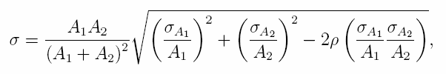
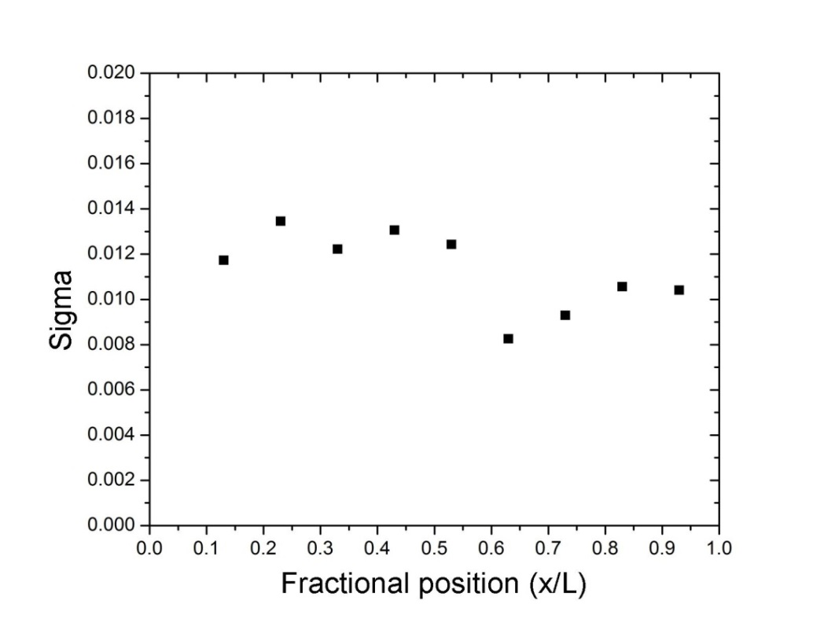
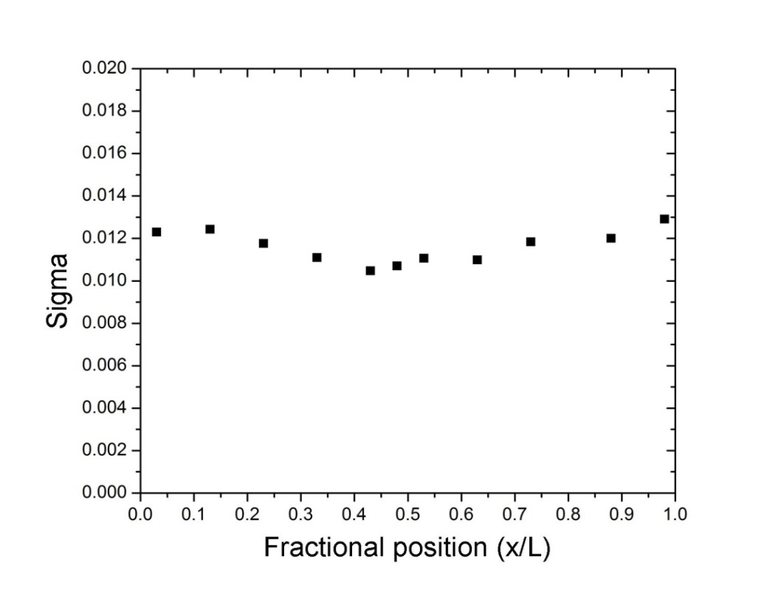
Longitudinal spatial resolution for 6 MIPs signal
A₂
A₁+A₂
1.1% L => 220 μm
1.2% L => 240 μm
R/l=2.8 Ω/μm
R/l=12.2 Ω/μm
σ_{A1}=1.83 ADU
σ_{A2}=1.80 ADU

Slide 8
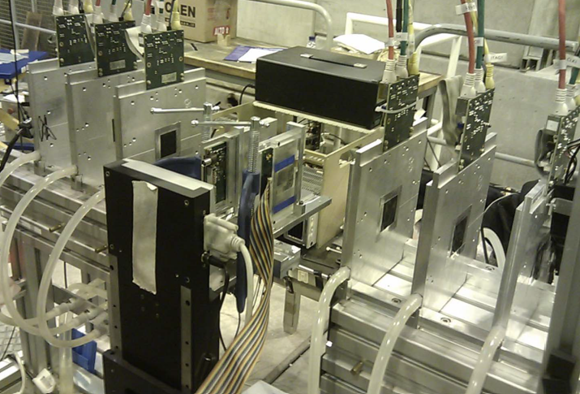
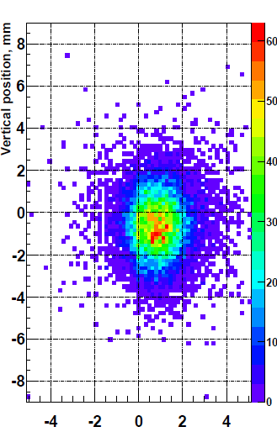

Test Beam Characterization
Test beam at CERN SPS Pion Beam, Nov 2012
First successful integration and synchronization with AIDA MIMOSA pixel telescope

Slide 9
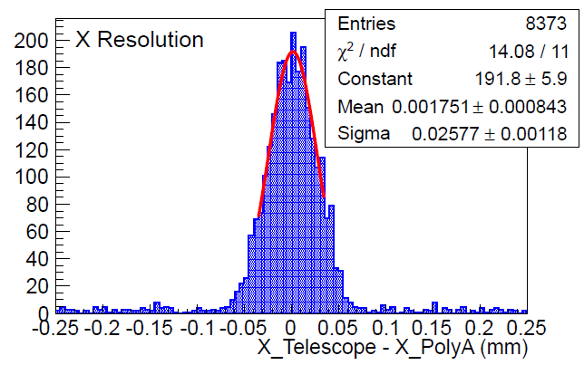
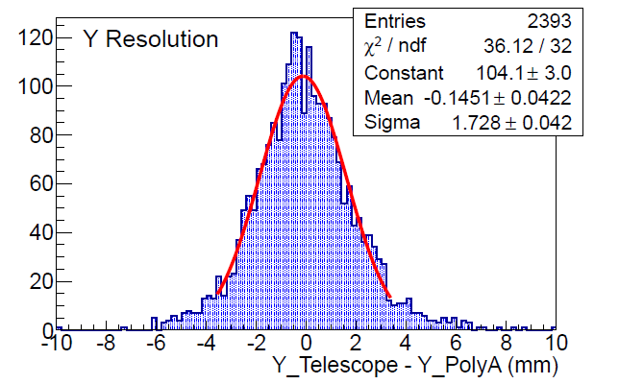

Test Beam: Spatial Resolution
Trans. Coordinate X ∼ 25 μm (pitch/$√12$= 23 μm)
Long. Coordinate Y ∼ 1.7 mm ( 8.5% strip length)

Slide 10
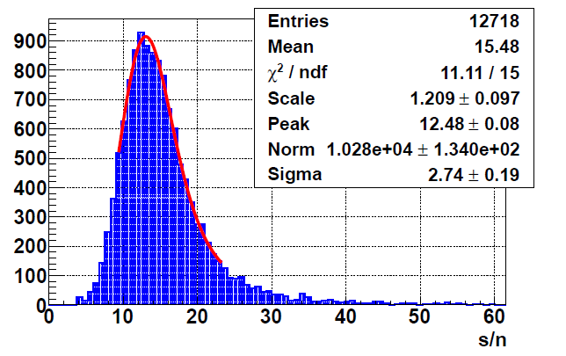
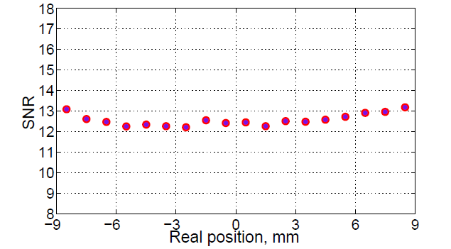
Radioactive Source: SNR estimation
Defined as $SNR≡(S1+S2)/\sqrt{σ1+σ2}$ (drives the spatial resolution)
Sr90
Collimator
2 mm
x
Sensor
x
Support
x
Trigger PMT
SNR for non-resistive sensor
20% drop

Slide 11
Charge-division sensor: Intermediate summary
The charge-division concept on microstrips has been confirmed experimentally, two limitations:
  Both ends readout difficult to integrate in long ladder (need to combine the information from both ends)
  Signal attenuation due to the strip resistance (current prototypes 20% signal loss for 2cm length sensor).
Proposed solutions:
  Integrated signal lines in the sensor to route the signals to the same end.
  Reduce the strip resistivity (limited by the amp. charge resolution) and/or integrate charge amplification mechanism in the sensor.

Slide 12
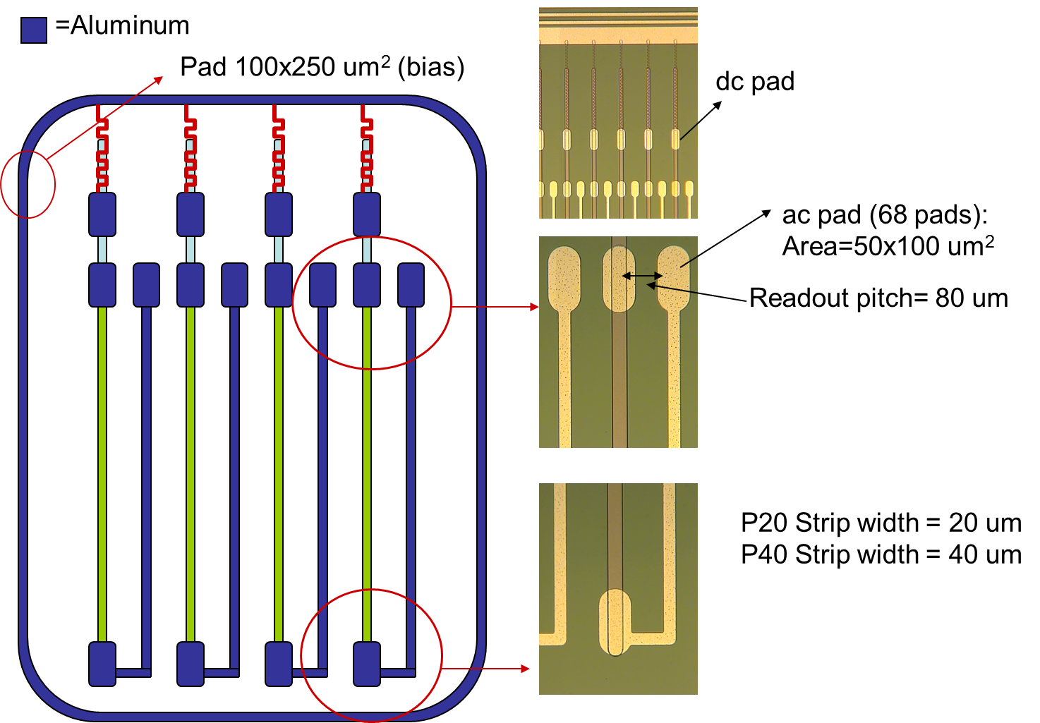
Resistive strips with internal signal routing

Slide 13
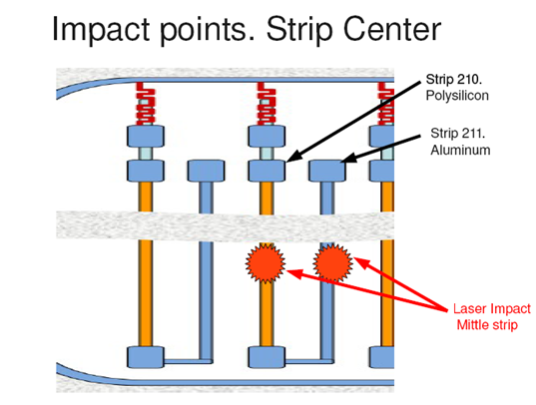
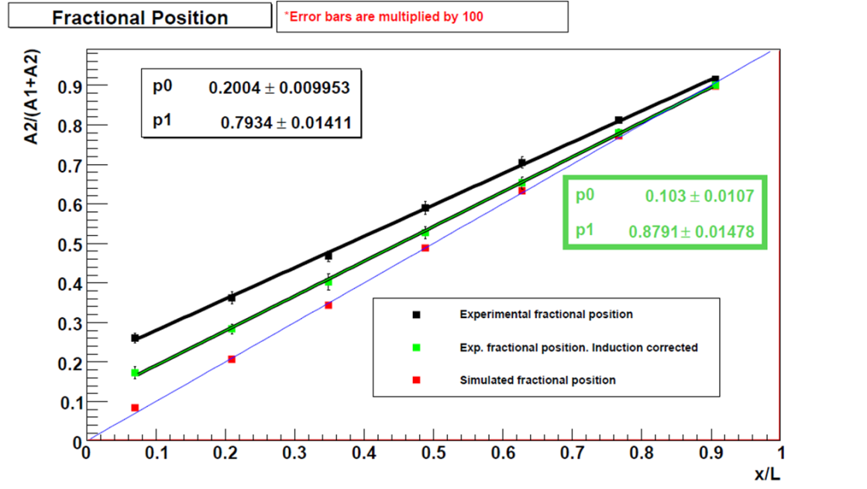
Resistive strips with internal signal routing (2)
Induced signal on metallic vias superposed to “direct signal” propagated through polysilicon electrode.
Measured Fractional position shows a clear bias

Slide 14
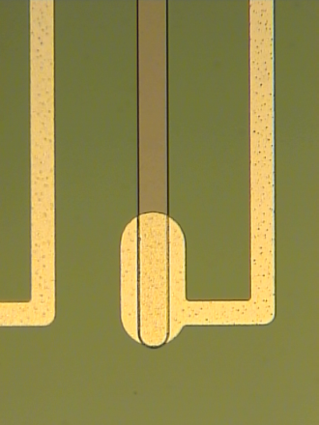
Isolation structures for cross-talk suppression
Poly-Si
Al
Poly-Si
Al
Poly-Si
p+
p+
p+
OLD DESIGN
n-
n++
Al
Poly-Si
Al
Poly-Si
Al
Poly-Si
Al
Poly-Si
NEW DESIGN
Common P-stop and field plates
n+
p
n+
p
n+
p-
p++
Spin-off of FOSTER sensors proposed by KIT at CMS

Slide 15
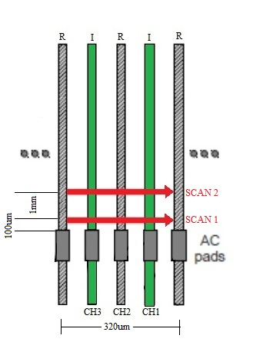
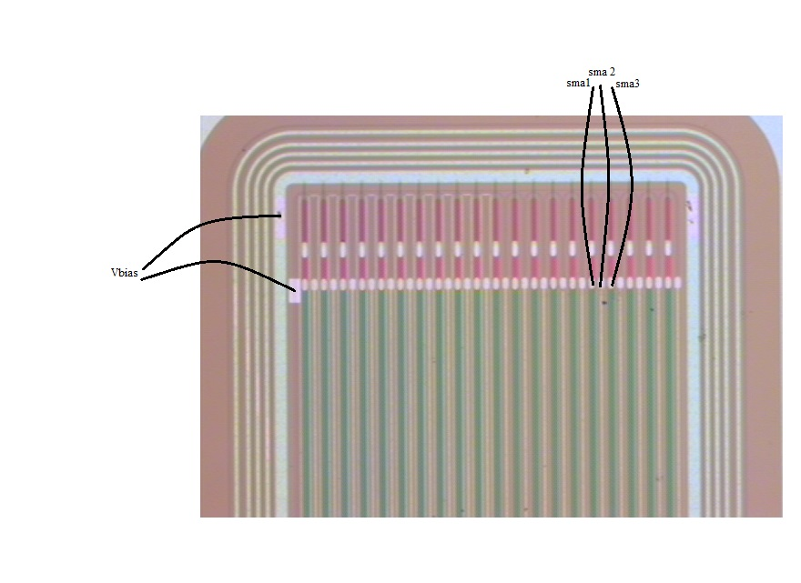
Crosstalk suppression (common stop)
Time Resolved Readout IR-laser induced (e-TCT like measurement)
S8
No grid Al. Implant – Al routing – Implant

Slide 16
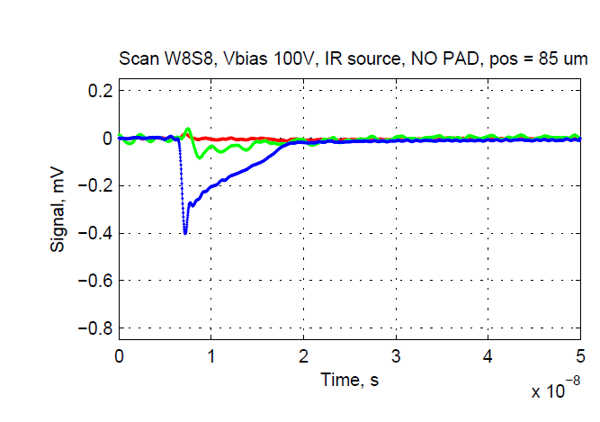
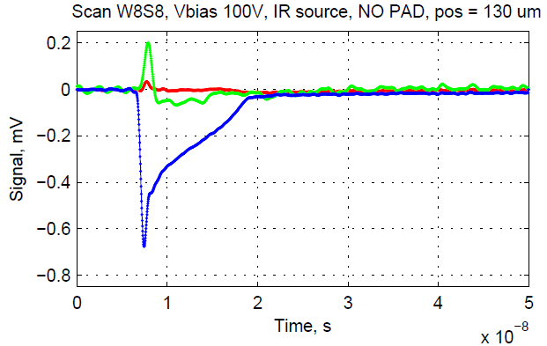
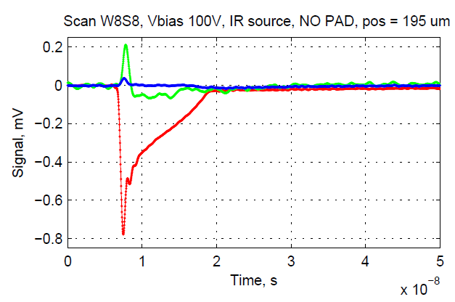
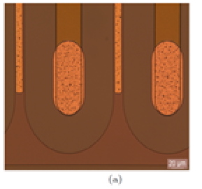
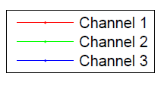
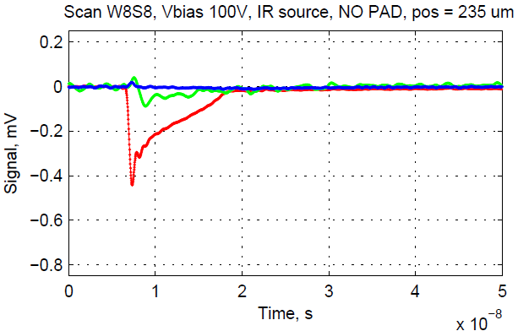
Crosstalk Suppression: Current pulses
Infrared pico second laser
(fast, 1GHz readout channel)
A
Poly-Si
Al
Poly-Si
Al
Poly-Si
n+
p
n+
p
n+
B
p-
p++
C
A
B
C
D
CH1
CH2
CH3
D

Slide 17
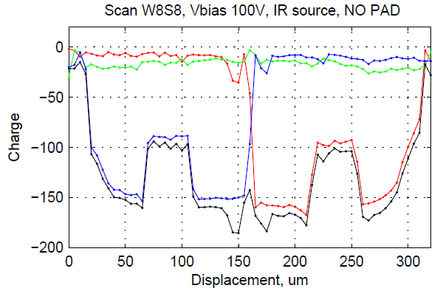
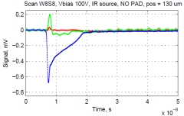
Cross-talk suppression: Integrated charge
Flat charge pedestal for Al routing track, suppressed by calibration
Poly-Si
Strip
Poly-Si
Strip
Aluminum
Strip
17

Slide 18
Signal Attenuation studies
Time-resolved study of the pulse shape and charge
Laser longitudinal scan
(42 points, 500um steps
0 mm from r/o pad
5 mm from r/o pad
10 mm from r/o pad

Slide 19
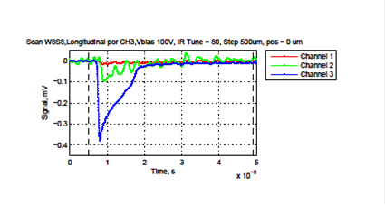
Signal Attenuation studies (2)
Charge and amplitude vs. distance
Reduced
Amplitude
Constant charge

Slide 20
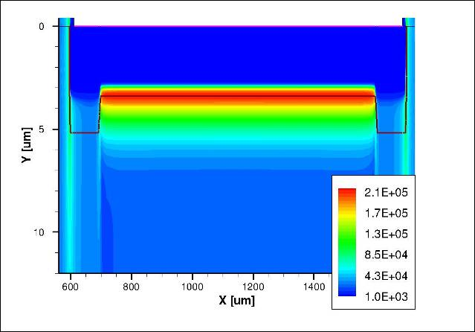
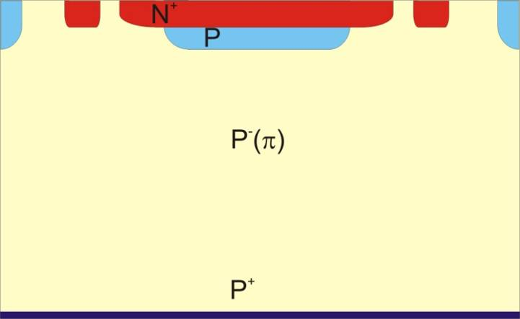
Increasing the signal: LGAD
Implanting an n++/p+/p- junction along the centre of the electrodes. Under reverse bias conditions, a high electric field region is created at this localised region, which can lead to a multiplication mechanism (impact Ionization).
Advantages = Thinning while keeping same S/N as standard detectors.
High Electric Field region leading to multiplication
N⁺
285 um
P
P. Fernandez et al, “Simulation of new p-type strip detectors with trench to enhance the charge multiplication effect in the n-type electrodes” , Nuclear InstrumentsandMethodsinPhysicsResearchA658(2011) 98–102.

Slide 21
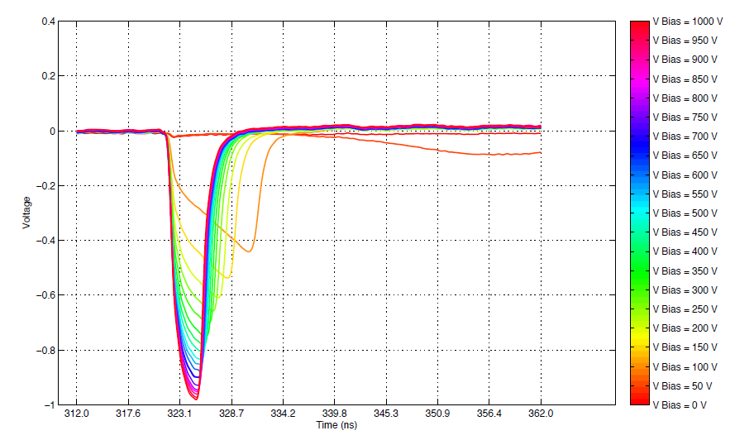
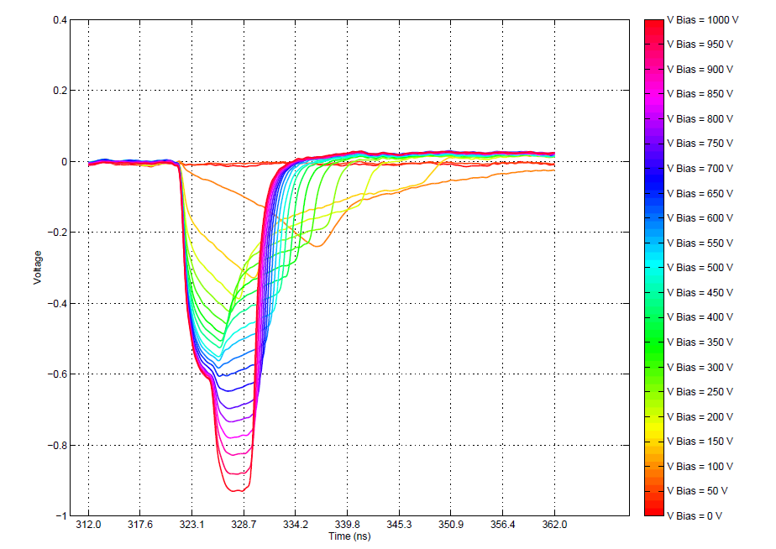
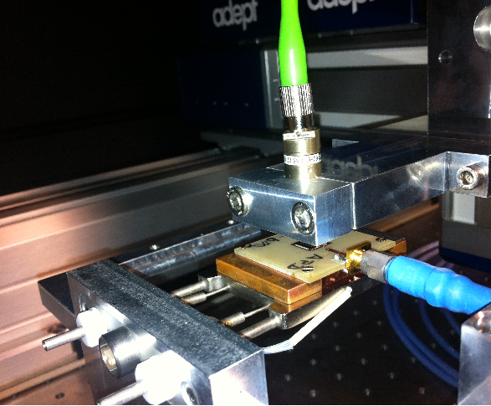

PAD LGAD: Red laser TCT characterization
Bottom injection
Standard diode n on p
P-type diffusion diode
5ns
h+
e-
285 um
Red laser (1060 nm)

Slide 22
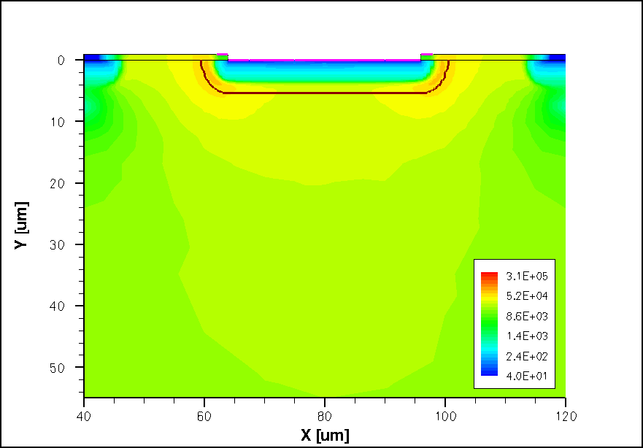
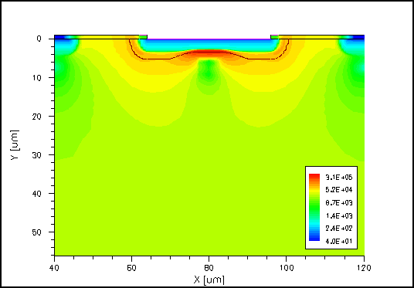
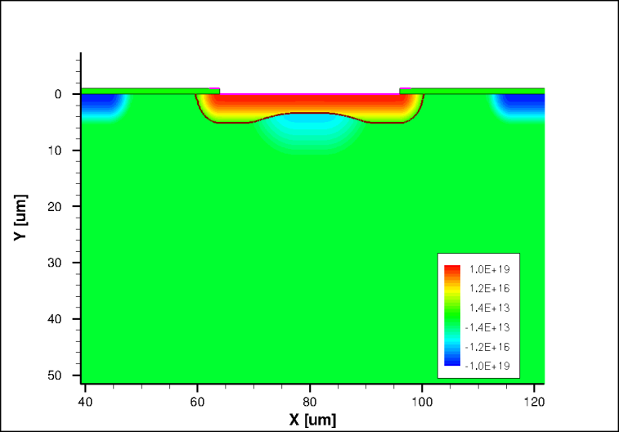
Strip LGAD: Electric Field
- To obtain the manufacture parameters (doping profiles)
Standard Strip
Strip with P-type diffusion
Strip with P-type diffusion: 2D and 1D doping profiles

Slide 23
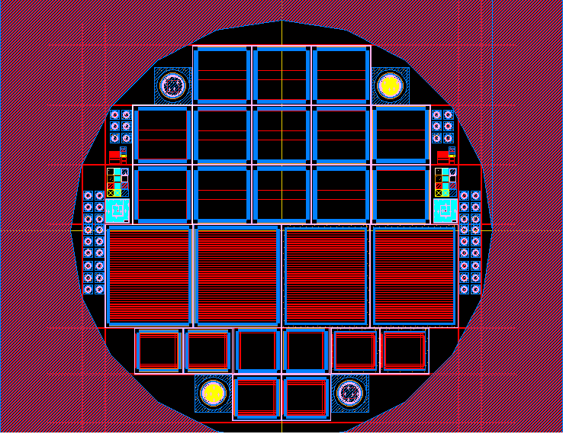
Current status: preliminary results on strips
Very preliminary test do not show signal amplification.
New run in progress and new concept to implement: p-on-p sensor (holes readout with electron amplification in a non-structured anode (pad-like) to ensure uniform amplification
RD50 LGAD GROUP
(CERN, CNM, Barcelona, Torino, Ljbljiana, Santander, SCIPP, Freiburg, Glasgow, Liverpool)

Slide 24
Summary
A novel 2D position-sensitive semiconductor detector concept based on the resistive charge-division readout method and manufactured using standard semiconductor planar techniques has been introduced.
A full testing cycle of this technology has been successfully completed: laser, RS and test beam source.
To be used as a tracking sensor suitable:
  Single end readout → the integration in the sensor of signal routing tracks
  Increase SNR → Reduction of the strip resistivity and Linear gain of the signal
The first issue has been tackled integrating isolation structures (preliminary results are positive).
New detector designs aim to fabricate detectors with moderate gain (RD50) and p-on-p strip LGAD.

Slide 25
THANK YOU !

Slide 26
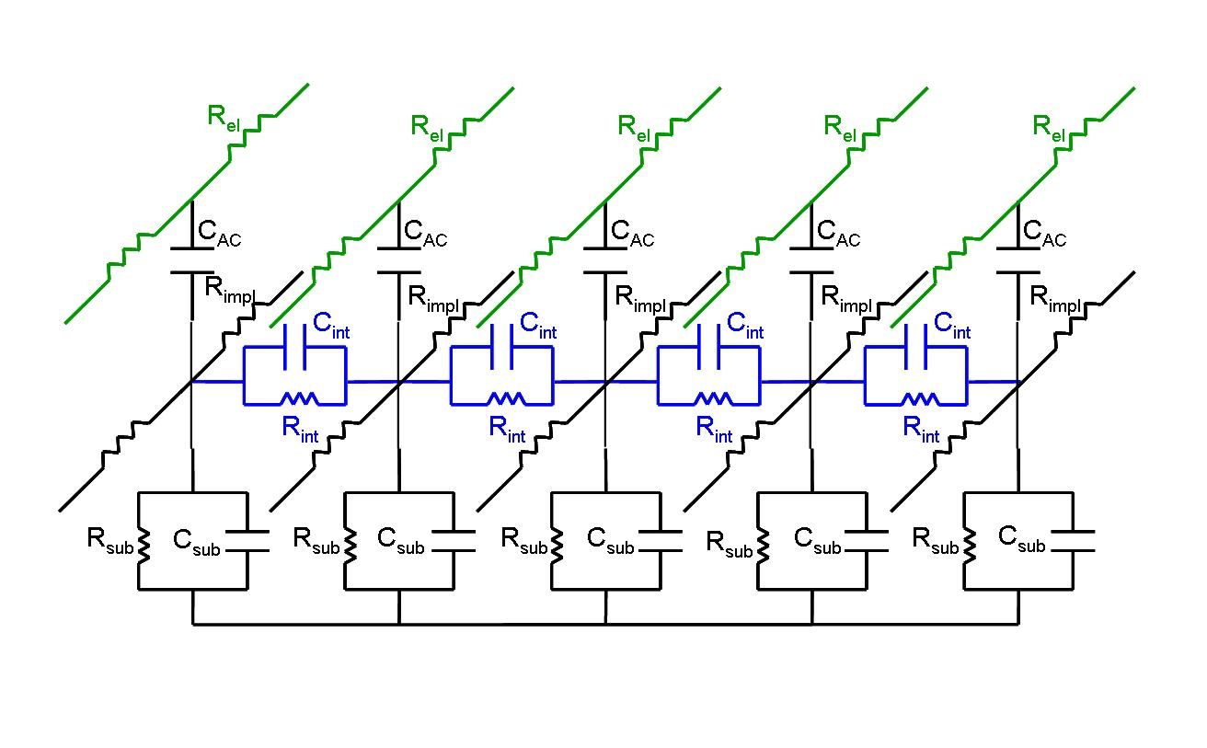
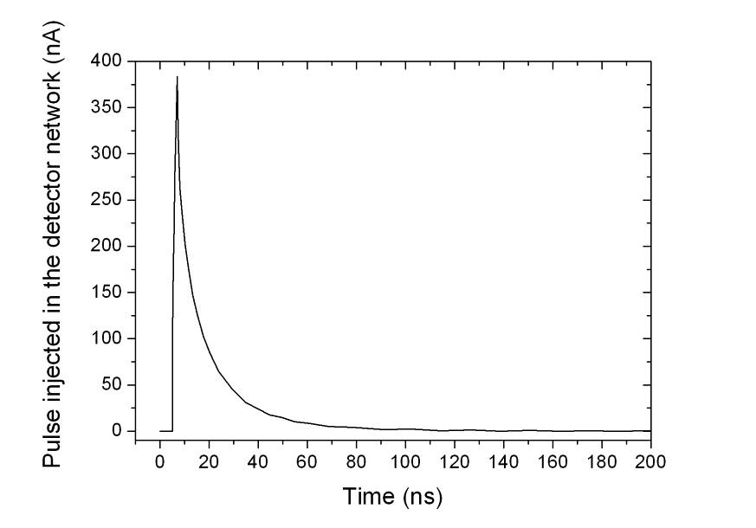
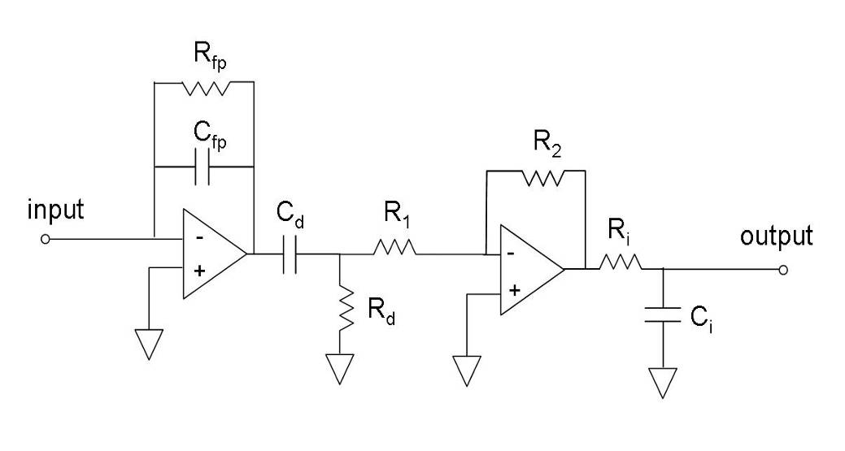
Equivalent Electrical Circuit
Detector (p⁺-on-n) model ***
80 cells 250 μm long
p
e⁻
h⁺
V_{bias}
Peaking time 25ns (Beetle chip ALIBAVA DAQ system).
rise time 2ns
Q~4fC

Slide 27
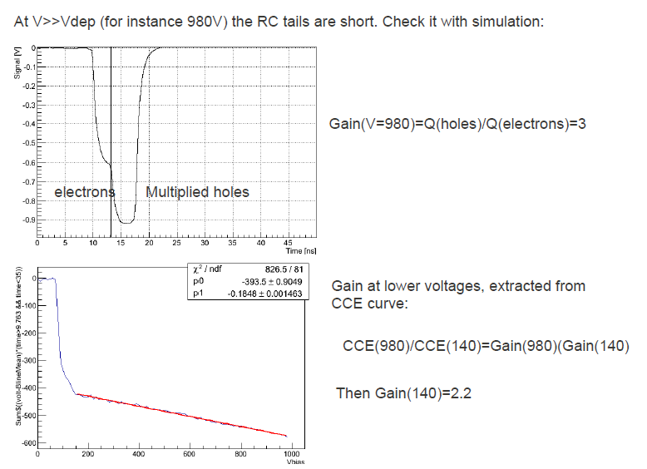

Slide 28
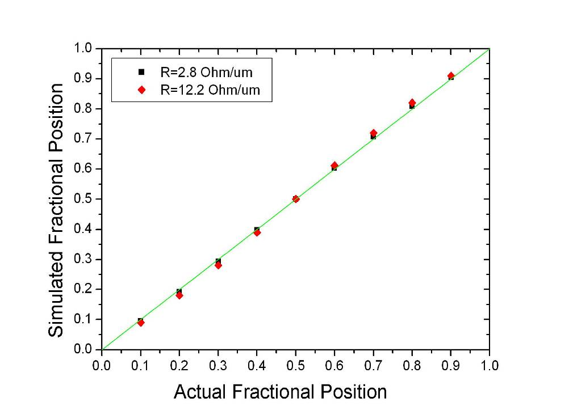
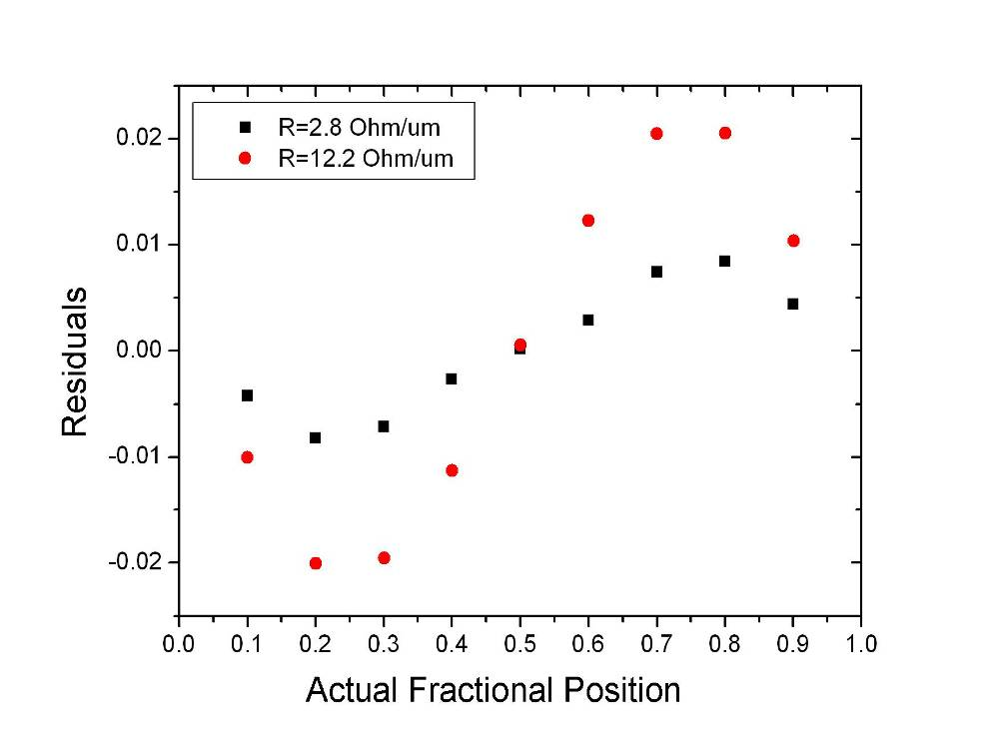
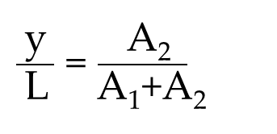
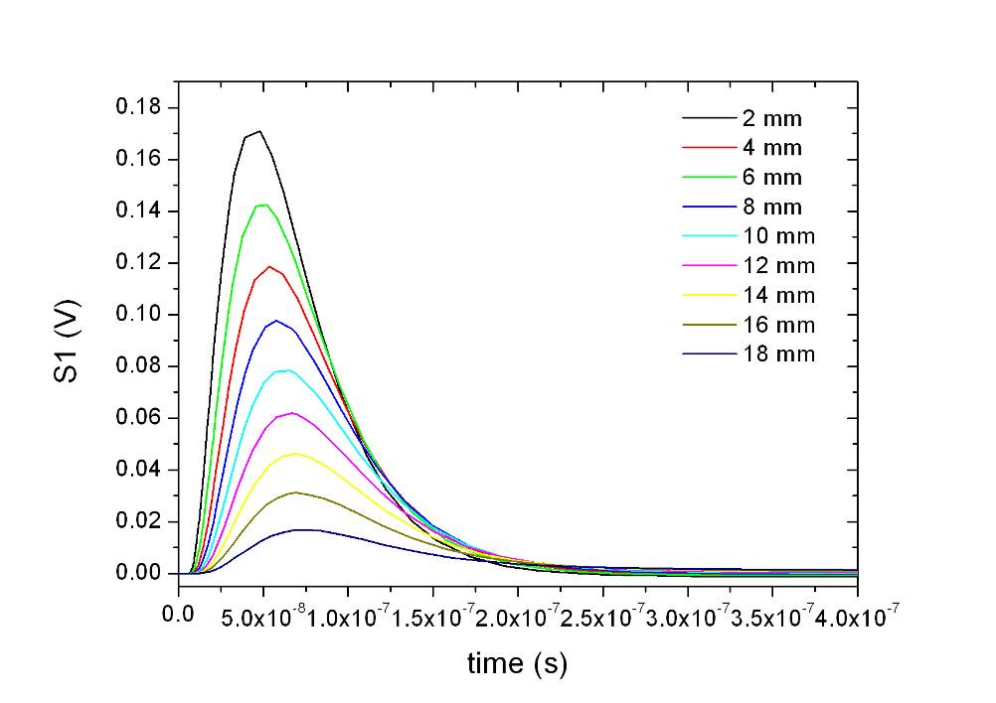

Signal Propagation – Linearity (Simulation)
S₁
S₁
Particle
S₂
t
2 mm
t₁
t
t₂
y
V
S₂
18 mm

Slide 29



Red laser TCT characterization
Charge collection efficiency
Standard diode
P-type diffusion diode

