Slide 1

System level issues at Depfet subdetector
XI Meeting of the Spanish Network for Future Linear Colliders
Barcelona, Spain, 15-16 January 2015
Mateo Iglesias / Fernando Arteche

Slide 2

OUTLINE
1. Introduction
2. Belle II: PXD System: Electronic integration aspects (Electromagnetic Compatibility)
  2.1) Noise emission studies
    2.1.1 System level emission noise
    2.1.2 Trigger effects
  2.2) Noise propagation studies
3. Conclusions
XI th. Meeting of the Spanish Network for Future Linear Colliders
Barcelona, Spain, 15-16 January 2015
2 de 25

Slide 3
1. Introduction
ITA has been carrying out several R&D activities for future High Energy Physics
The activities are focused on two aspects:
  Electromagnetic compatibility issues
  Power supply distribution system design
These studies are part of 3 projects:
  ILC
  HL- LHC (CMS Phase II)
  Belle II
XI th. Meeting of the Spanish Network for Future Linear Colliders
Barcelona, Spain, 15-16 January 2015
3 de 25

Slide 4
1. Introduction
ILC: Activities mainly focused on power pulsing systems ( ILD-FTD-CALICE):
  DC-DC vs Super-capacitors
  Super-capacitors RAD assessment
  Prototype development of Forward Tracker Detector power system based on SC
HL-SLHC: Activities focused on EMC & Power issues (CMS 2-Pixel )
  Hybrid power systems - Serial & DC-DC power systems
Belle II: Activities focused on EMC (PXD )
  Electronics integration aspects
XI th. Meeting of the Spanish Network for Future Linear Colliders
Barcelona, Spain, 15-16 January 2015
4 de 25

Slide 5
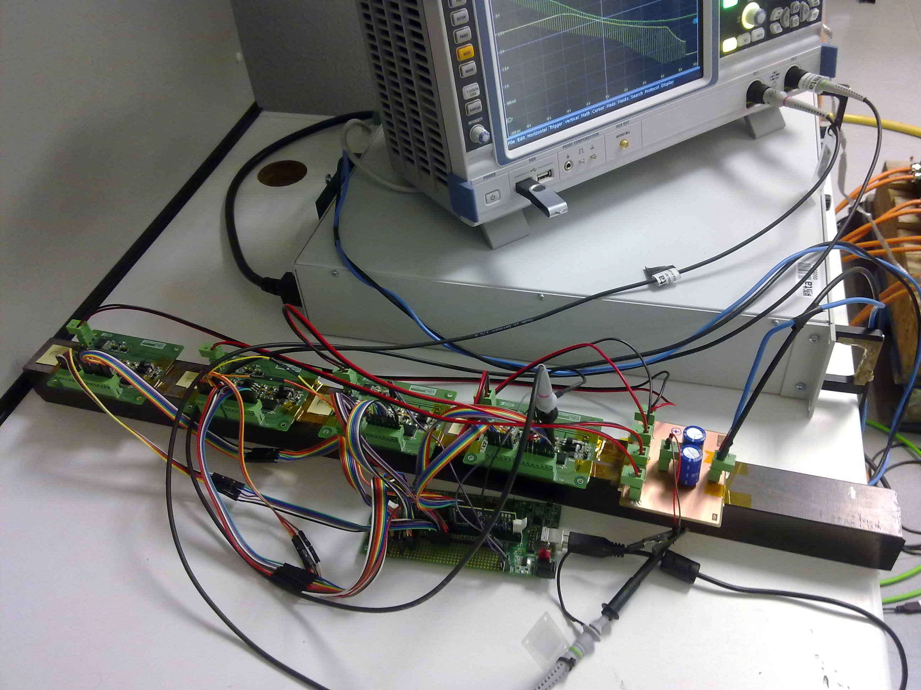
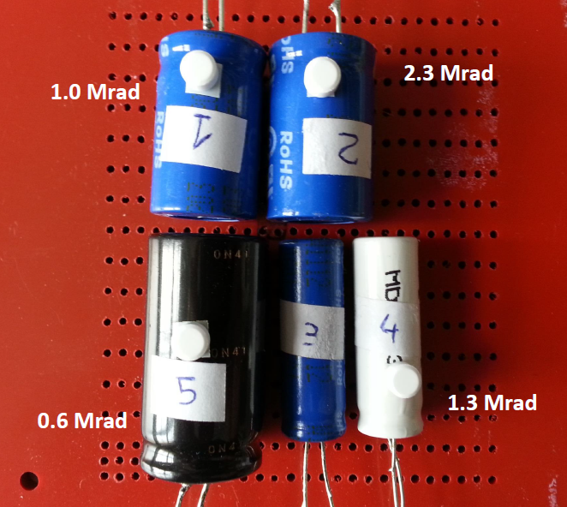
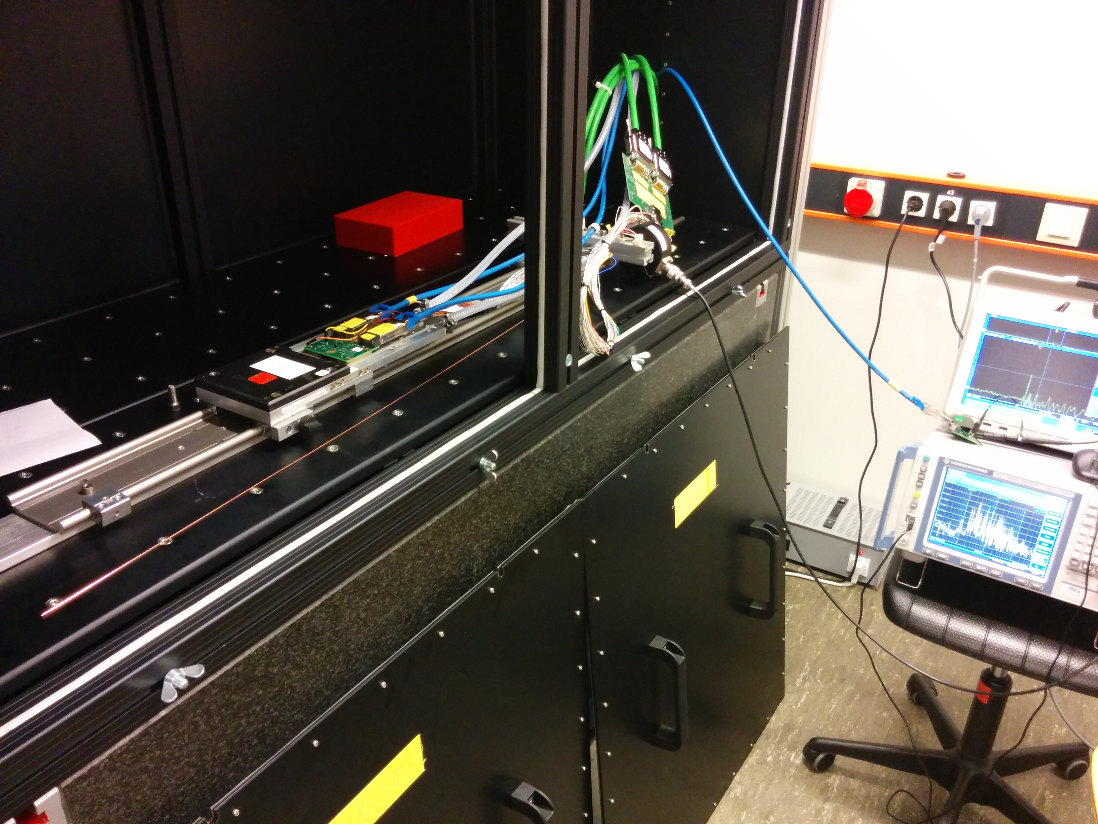
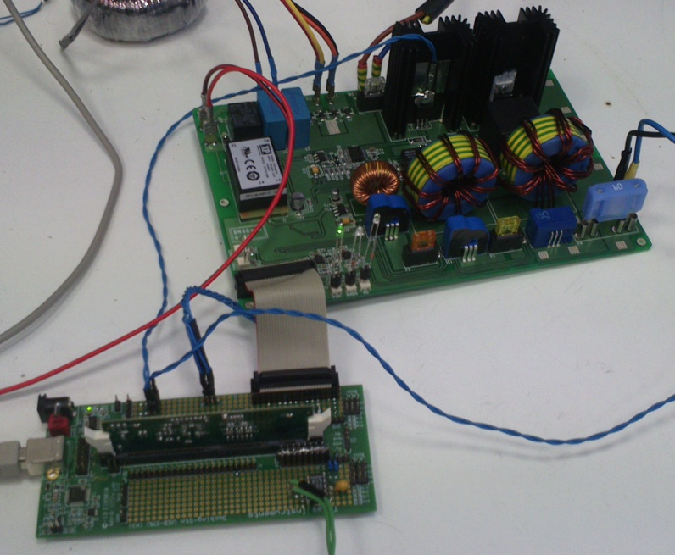
1. Introduction
ILC
ILC - FTD
DEPFET -PXD
ILC
XI th. Meeting of the Spanish Network for Future Linear Colliders
Barcelona, Spain, 15-16 January 2015
5 de 25

Slide 6
2.1 Belle II: PXD System: electronic integration aspects
Noise emission studies: INTRODUCTION
A year ago the noise emission of PS units of PXD system was measured (ITAINNOVA LAB-Zaragoza-Spain)
  PS unit loaded by a set of resistances.
  Noise emission spectra totally characterized.
A new noise test campaign has been carried out first week of December in order to continue the characterization of the PXD noise. (MAX PLANK INSTITUTE- Munich-Germany)
The main goal of this test has been to characterize:
  System noise level of PXD system.
    PS units + power cables + EMCM
  The Trigger effects on noise emission level.
    Digital and analogue lines
XI th. Meeting of the Spanish Network for Future Linear Colliders
Barcelona, Spain, 15-16 January 2015
6 de 25

Slide 7
2.1 PXD system: noise emission studies
TEST SET-UP
System test :
  EMCM module
  Power cables
  PS units (LV)
  Bench PS unit (24V)
Noise current has been measured with :
  Current probes
  Spectrum analyzer
  Frequency range :
    20Hz up to 50 MHz.
The noise on the power cables has been measured in several operation conditions.
EMCM module
Oscilloscope
Current probes
Spectrum analyzer
TEST SETUP (Max Plank lab)
XI th. Meeting of the Spanish Network for Future Linear Colliders
Barcelona, Spain, 15-16 January 2015
7 de 25

Slide 8
2.1 PXD system: noise emission studies
TEST CONDITIONS
The noise current in the power cables has been measured under four different conditions :
  PS standby
  PS on - Voltage set to 0V
  PS on - Voltage set to nominal values: Analogue OFF
  PS on - Voltage set to nominal values: Analogue ON
Frequency range :
  10 kHz up to 50 MHz
  BW : 1kHz
CM from 3 DC-DC converters has been measured as well as noise level in other conductors (CM+DM)
  DHP_VDD, etc.
XI th. Meeting of the Spanish Network for Future Linear Colliders
Barcelona, Spain, 15-16 January 2015
8 de 25

Slide 9
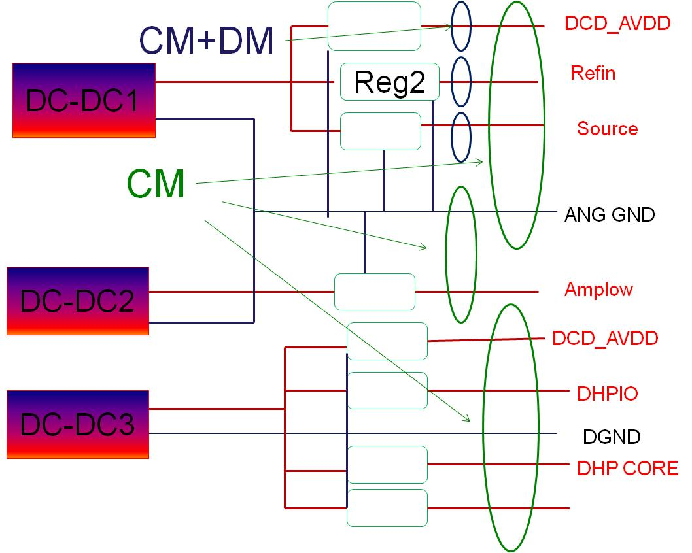
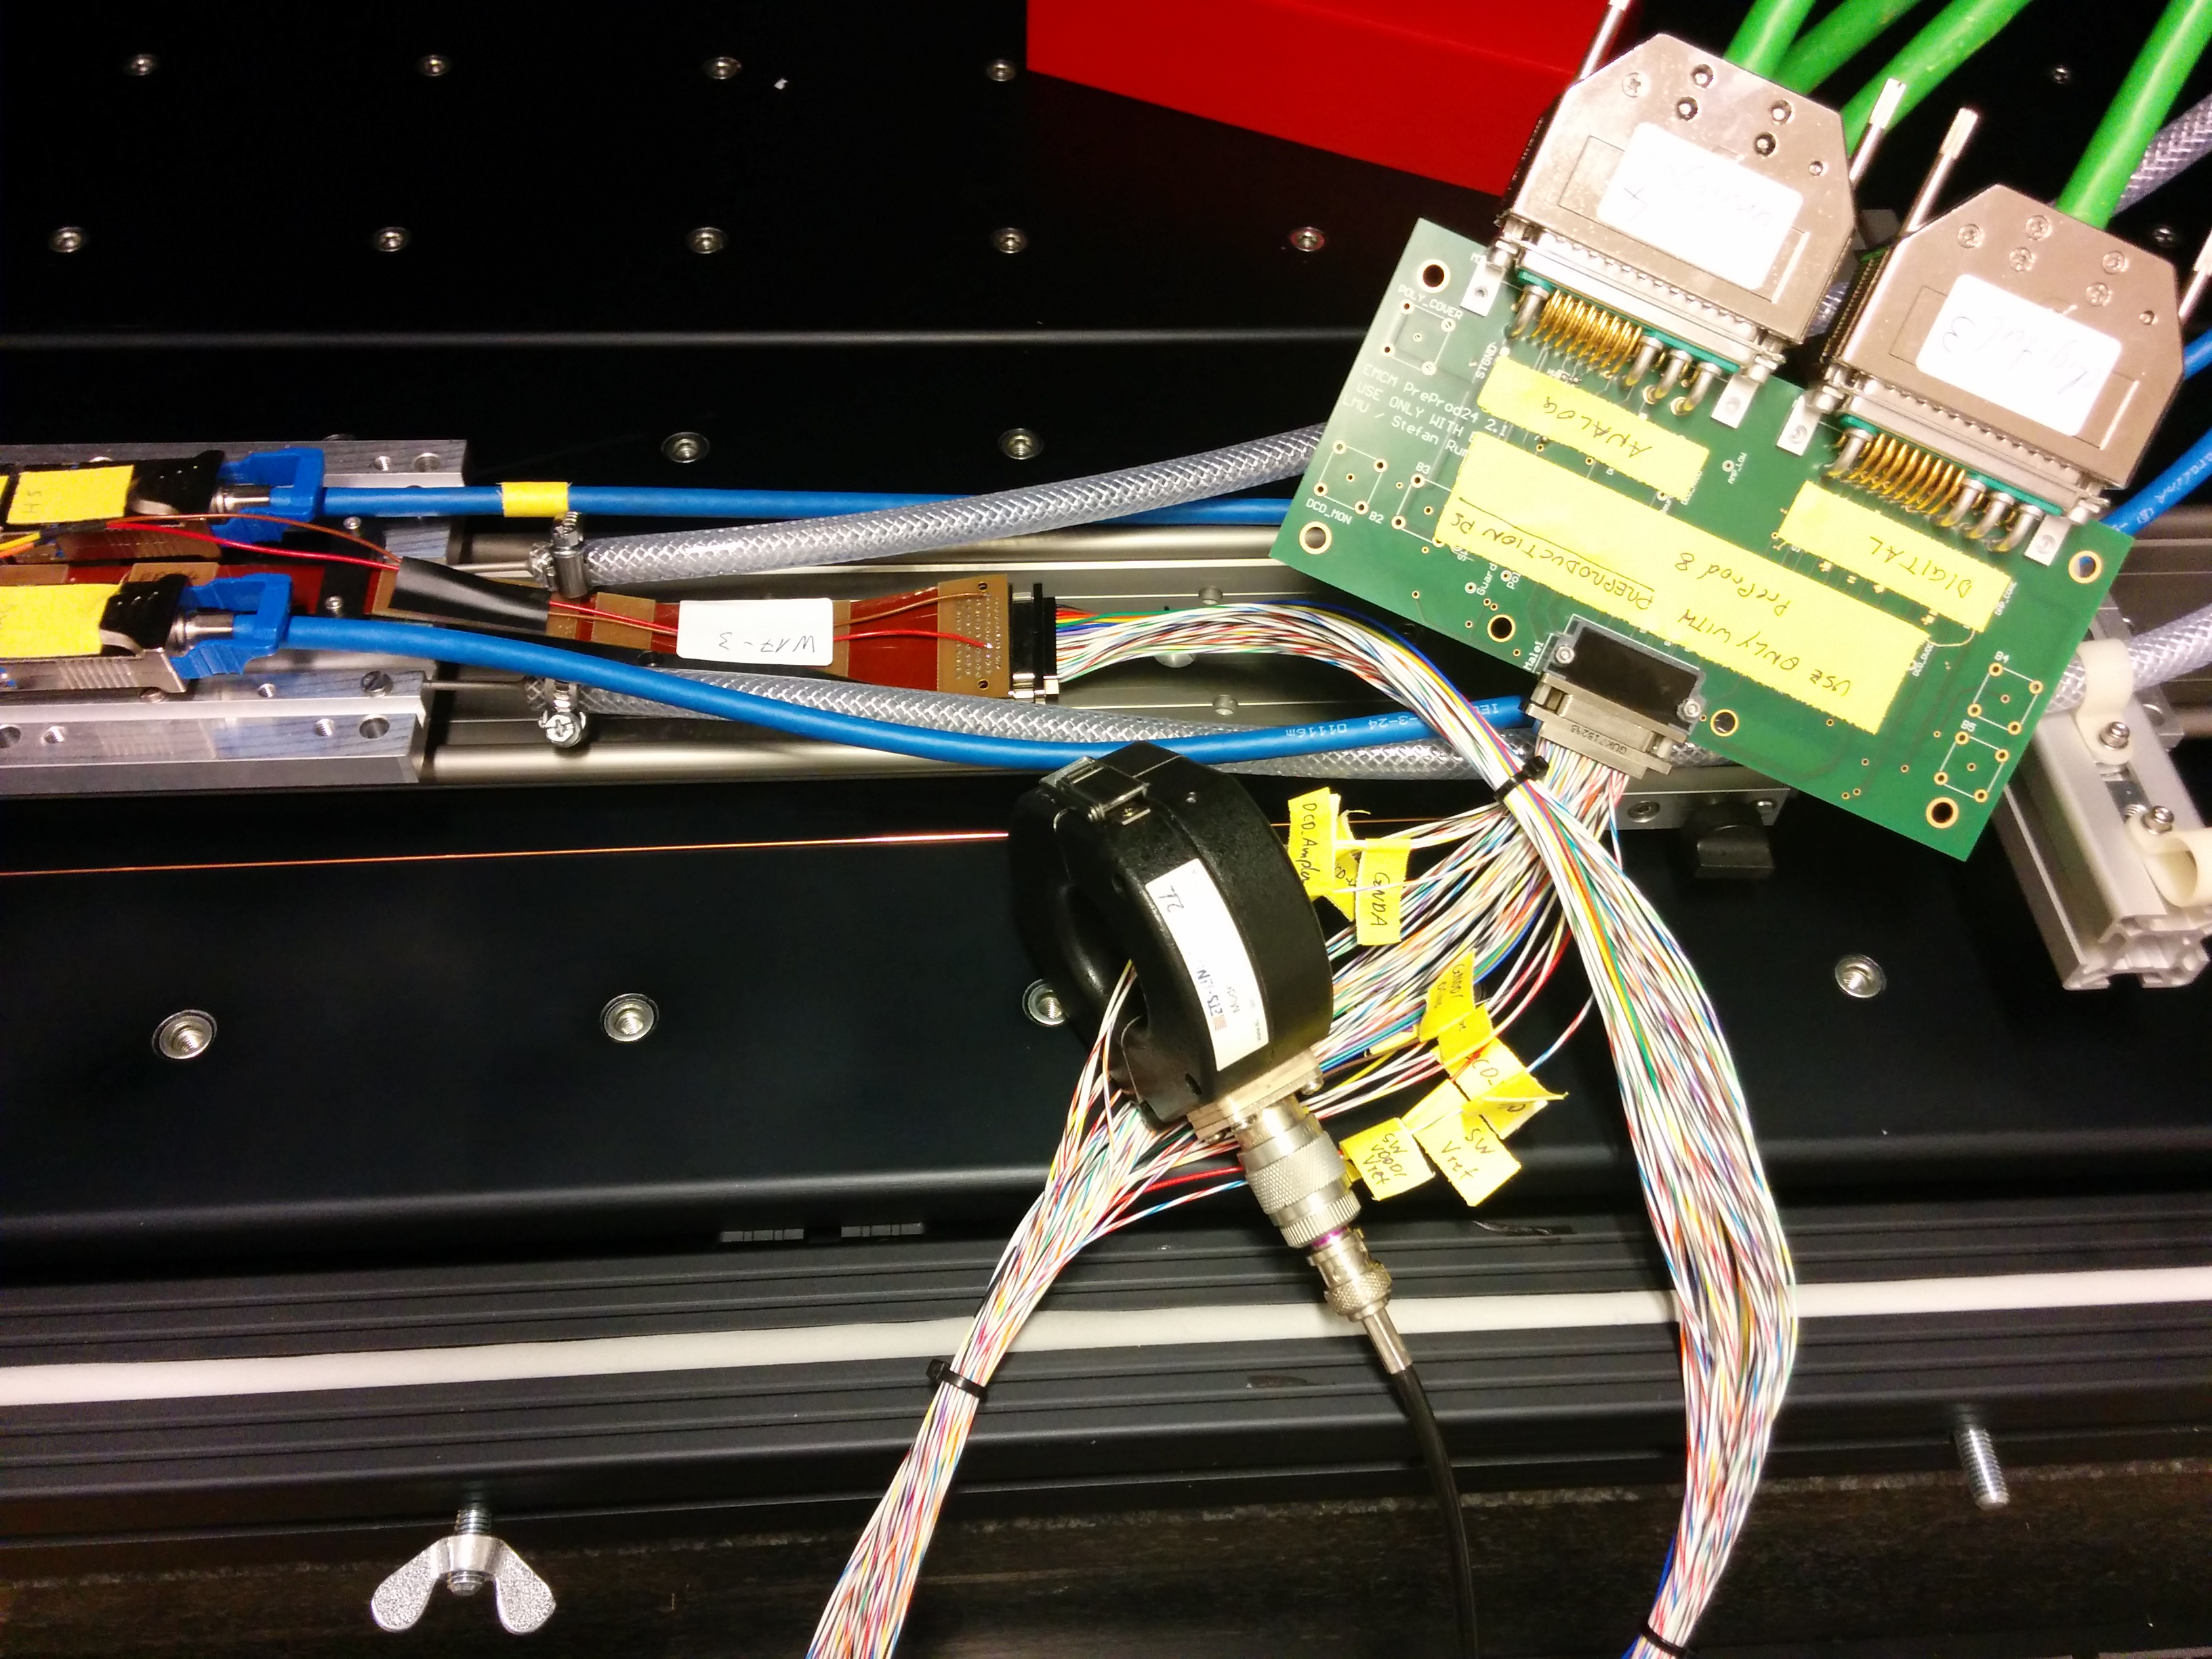
2.1 PXD system: noise emission studies
TEST POINTS
CM: COMMON MODE MEASURES
CM+DM: COMMON MODE + DIFFERENTIAL MODE MEASURES
XI th. Meeting of the Spanish Network for Future Linear Colliders
Barcelona, Spain, 15-16 January 2015
9 de 25

Slide 10
2.1.1 PXD system: noise emission studies
RESULTS
All OFF - Background noise – CM DC-DC1
  CM : (DCD_AVDD+Refin +Source+ ANG_GND)
XI th. Meeting of the Spanish Network for Future Linear Colliders
Barcelona, Spain, 15-16 January 2015
10 de 25

Slide 11
2.1.1 PXD system: noise emission studies
RESULTS
On – V=0
standby
400 kHz-4 MHz
200 kHz-7 MHz
CM: DC-DC 1
1 MHZ-7 MHZ
100 KHz-500 kHz
5 MHZ-7 MHZ
On – Vnom – Ang off
On – Vnom – Ang on
XI th. Meeting of the Spanish Network for Future Linear Colliders
Barcelona, Spain, 15-16 January 2015
11 de 25

Slide 12
2.1.1 PXD system: noise emission studies
RESULTS
CM DC-DC2
CM+DM
(1 line of DC-DC 2)
XI th. Meeting of the Spanish Network for Future Linear Colliders
Barcelona, Spain, 15-16 January 2015
12 de 25

Slide 13
2.1.2 PXD system: noise emission studies
RESULTS
STAND-BY
STAND-BY
CM
DC-DC 2
ON
ON
ITA LAB
MAX PLANK LAB
ITA LAB
MAX PLANK LAB
13 de 25

Slide 14
2.1.2 PXD system: trigger effects
INTRODUCTION
The noise current in the power cables has been measured under two different conditions :
  With and without trigger signal
Frequency range
  100Hz – 20 kHz
Four lines have been measured :
  2 digital lines : DHP_VDD & DCD_VDDD
  2 analogue lines: DDvDDA & SOURCE
XI th. Meeting of the Spanish Network for Future Linear Colliders
Barcelona, Spain, 15-16 January 2015
14 de 25

Slide 15
2.1.2 PXD system: trigger effects
Digital lines
DHP_VDD
Trigger On - green
Trigger Off - blue
DCD_VDDD
Trigger Off - green
Trigger On - blue
XI th. Meeting of the Spanish Network for Future Linear Colliders
Barcelona, Spain, 15-16 January 2015
15 de 25

Slide 16
2.1.2 PXD system: trigger effects
Analogue lines
DDvDDA
Trigger on - green
Trigger Off - blue
SOURCE
Trigger on - green
Trigger Off - blue
XI th. Meeting of the Spanish Network for Future Linear Colliders
Barcelona, Spain, 15-16 January 2015
16 de 25

Slide 17
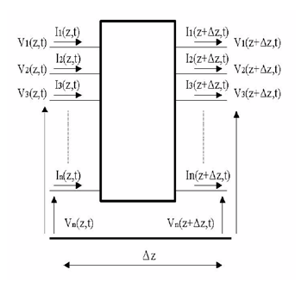
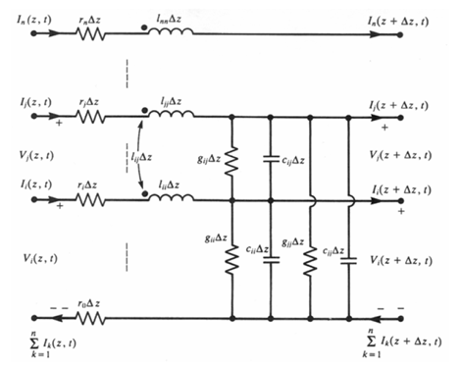
2.2 Noise propagation studies
Objective: study of noise propagation in the power cables of the PXD system for DEPFET:
Simulations to analyze the coupling mechanism within the cable bundle: Multi-conductor Transmission Line model (MTL)
MTL model
Distributed MTL model
L,C,R G values per unit length (NxN matrix)
Z position along the transmission line:
Z(0) phasor at z=0
Z(L) phasor at z=L
Z=Impedance
Y=Admitance
T=complex eigen-vectors of Y and Z
FREQUENCY DOMAIN SOLUTION
17 de 25

Slide 18
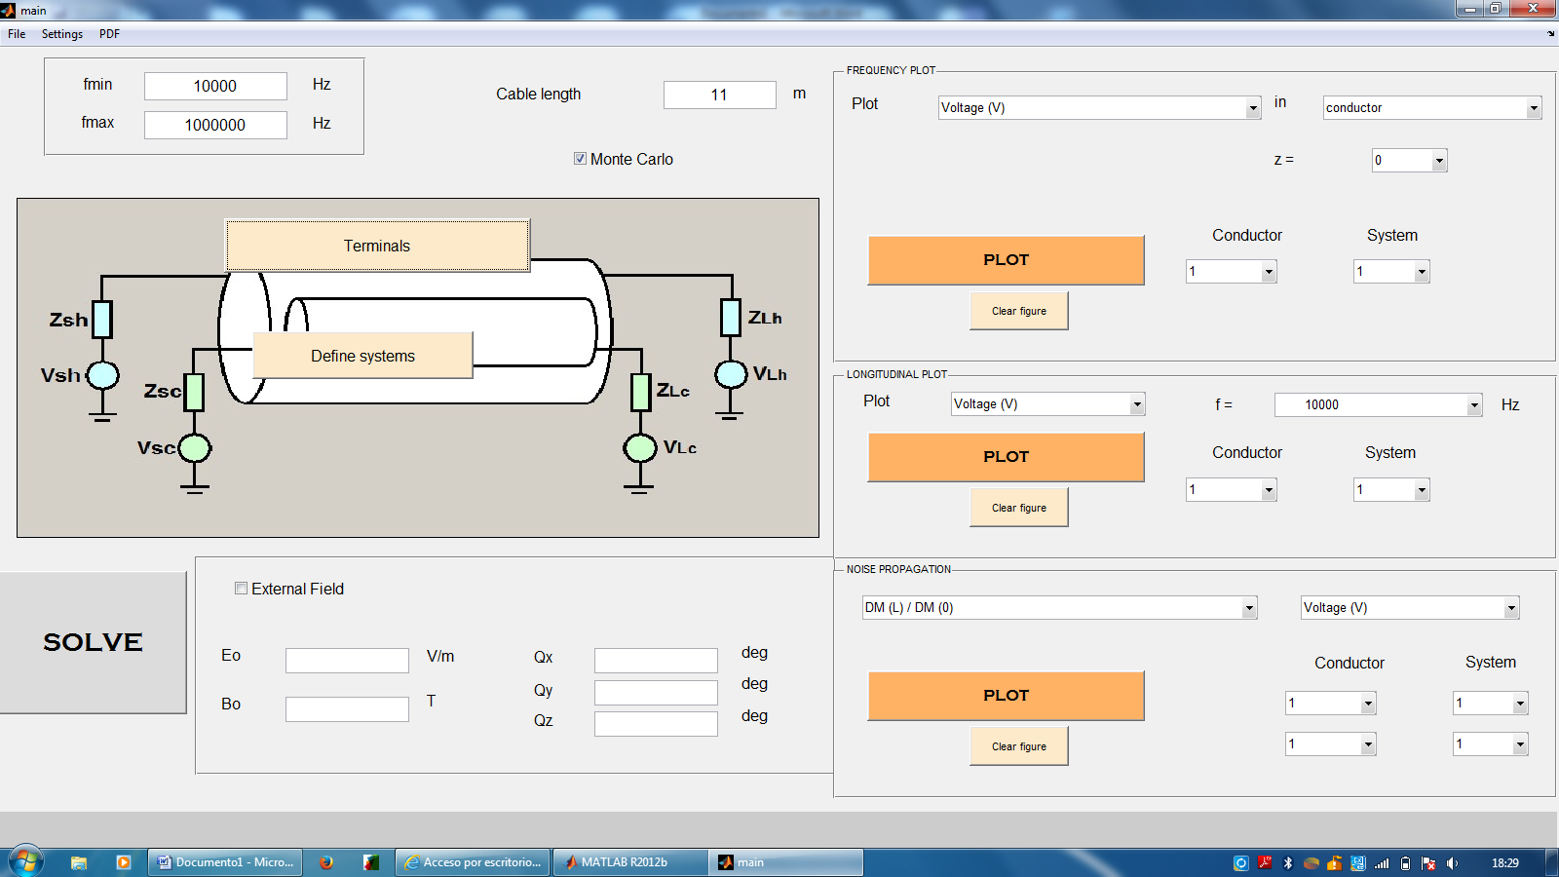
2.2 Noise propagation studies
MATLAB INTERFACE
XI th. Meeting of the Spanish Network for Future Linear Colliders
Barcelona, Spain, 15-16 January 2015
18 de 25

Slide 19
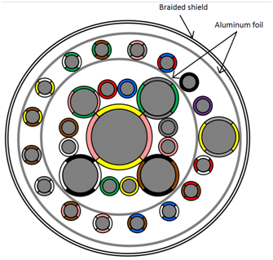
2.2 Noise propagation studies
CABLE UNDER STUDY:
Extremely complex
Hybrid cable used for digital and analogue signals:
3x18 AWG+14 AWG+20 AWG+4x2x26 AWG+18AWG+4x2x26 AWG+4x2x26 AWG
Connection cable between FEE and Power Unit
STRUCTURE:
  --External system: Outer shield
  (External tinned copper braid shield+ Aluminum foil wrapping shield)
  -- Intermediate system: 17 conductors and the inner shield
  (Aluminum foil shield)
  - - -- Internal system: 13 conductors
XI th. Meeting of the Spanish Network for Future Linear Colliders
Barcelona, Spain, 15-16 January 2015
19 de 25

Slide 20
2.2 Noise propagation studies
NOISE PROPAGATION STUDIE PROCEDURE
PHASE 1: LCR matrix measurements
  Inductance measurement: Self and mutual inductance L
  Capacitance measurement: Self and mutual capacitance C
  Resistance measurement: each conductor and shield R
    External system: Matrix 1x1 for each L,C,R,G
    Intermediate system: Matrix 18x18 for each L,C,R,G
    Internal system: Matriz 13x13 for each L,C,R,G
XI th. Meeting of the Spanish Network for Future Linear Colliders
Barcelona, Spain, 15-16 January 2015
20 de 25

Slide 21
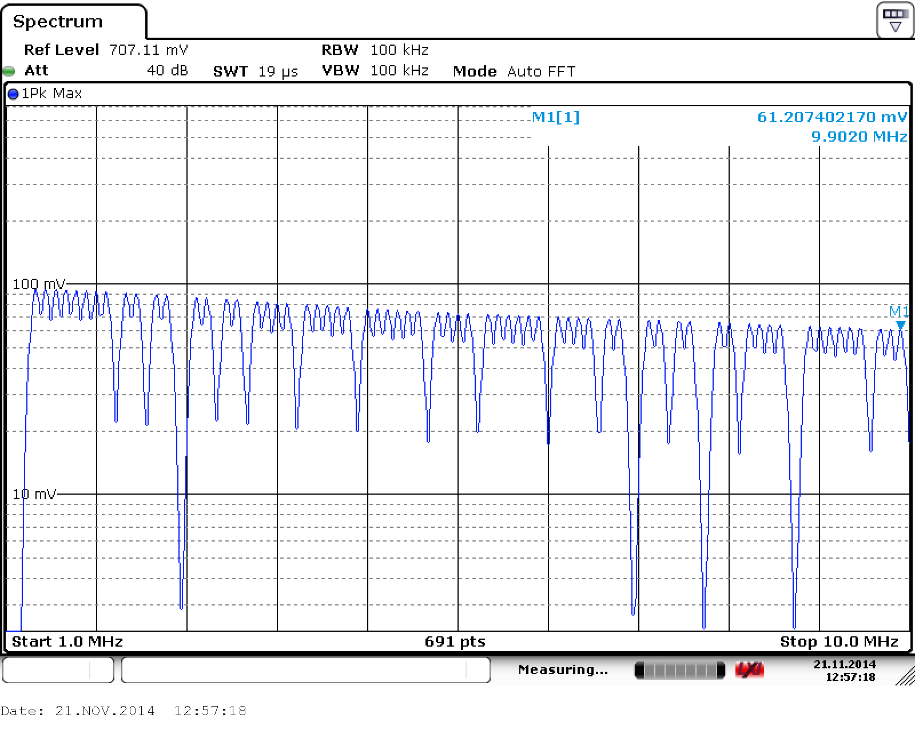
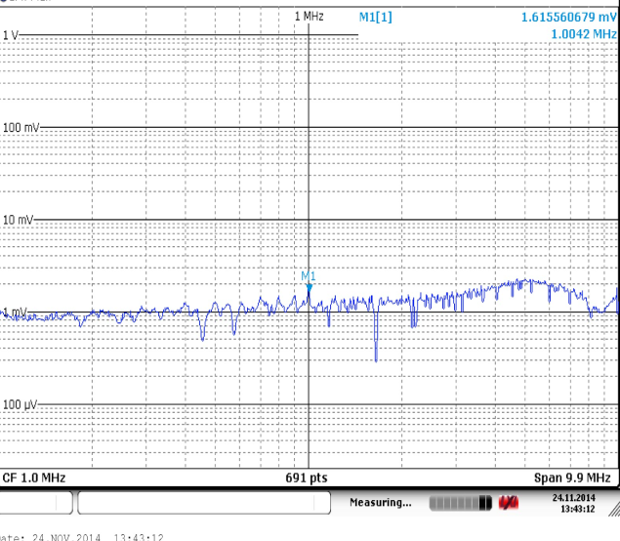
2.2 Noise propagation studies
VALIDATION MTL MODEL
Noise inyection on return cable
Example:
Voltage in STGND/GGND return cable (z=L)
100 kHz to 10 MHz
SIMULATED
MEASURED
VALIDATION MTL MODEL
Noise inyection in shield
Example:
Voltage in Sense+(CLEAR HIGH) cable (z=L)
100 kHz to 10 MHz
SIMULATED
MEASURED
XI th. Meeting of the Spanish Network for Future Linear Colliders
Barcelona, Spain, 15-16 January 2015
21 de 25

Slide 22
2.2 Noise propagation studies
NOISE PROPAGATION STUDIE PROCEDURE
PHASE 2: Simulation with Montecarlo approach
  Stochastic approach with Montecarlo method.
  Way for estimate the deviation in the output results of a complex system (uncertainly not easy analyze analytically)
  MTL model + Monte Carlo algorithm
  Density probability function of noise can be obtained.
XI th. Meeting of the Spanish Network for Future Linear Colliders
Barcelona, Spain, 15-16 January 2015
22 de 25

Slide 23
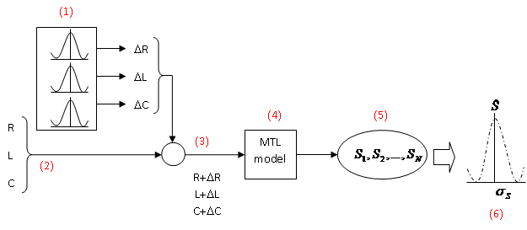
2.2 Noise propagation studies
    Figure: Simulation procedure including Montecarlo approach
    (1) Uncertainty of each measured matrix.
    (2) R, L ,C: measured values
    (3) New values for R,L,C used in the MTL model
    (4) MTL model
    (5) Computed solutions (N times=number of samples)
    (6) Result: N solutions (S=average value with deviation) represent the probability distribution of the final solution, including the variation in the measured values (cable position), tolerances, testing setup, measuring uncertainty.
XI th. Meeting of the Spanish Network for Future Linear Colliders
Barcelona, Spain, 15-16 January 2015
23 de 25

Slide 24
2.2 Noise propagation studies
  SIMULATION CONDITIONS
  Terminal connections on both sides of the cables are modeled (source terminal and load terminal)
  10 samples simulated
  Range 100 kHz to 10 Mhz
  SIMULATION CASES
  CM in DC-DC converters
  CM in a reference conductor (gnd)
  Effects of currents in the shield
  Effects of external electromagnetic fields
    No external shield
    External shield grounded at both ends
    External shield grounded at one end
XI th. Meeting of the Spanish Network for Future Linear Colliders
Barcelona, Spain, 15-16 January 2015
24 de 25

Slide 25
2.2 Noise propagation studies
  EXAMPLE RESULTS: DC-DC1
  CM voltage propagation
  CM current propagation
  Voltage on conductor at source
  CM impedance at source
  CM impedance at load
XI th. Meeting of the Spanish Network for Future Linear Colliders
Barcelona, Spain, 15-16 January 2015
25 de 25

Slide 26
3. CONCLUSIONS
Noise emission study:
  Test campaign has been very useful
  Common mode noise predominant
  Common mode noise similar profile (differents DC-DC converters and differents signals)
  The noise level of PXD system under normal operation condition is much higher than the noise level at Standby condition.
  There is a clear influence of the trigger system on the noise emission level on the digital lines
    It is shown in the low frequency region
    There is not any effect on the analogue lines
  The noise level of PXD system with electronic is much higher (measured in Munich) than the noise level without electronic (measured in Zaragoza).
XI th. Meeting of the Spanish Network for Future Linear Colliders
Barcelona, Spain, 15-16 January 2015
26 de 25

Slide 27
3. CONCLUSIONS
Simulation study:
Analysis carried out with Multi-conductor Transmission Line model
Parameter uncertainties are taken into account through a Monte Carlo approach
The results show than common mode currents resulting from noise injected in a DC-DC converter gets amplified mainly around 1 MHz, while it gets damped above this frequency. The same effect is observed when noise is injected into a power group referenced to a same return line.
The effects of an incident radiated field have also been simulated. Again, major amplifications in current noise is observed in the few MHz range.
  A detailed analysis of noise propagation is ongoing
XI th. Meeting of the Spanish Network for Future Linear Colliders
Barcelona, Spain, 15-16 January 2015
27 de 25

