Slide 1
CONECTA: Coordinación Nacional Española para la Ciencia y Tecnología de Aceleradores
Francis Perez
on behalf of CONECTA

Slide 2


CONECTA
Coordination of the activities of the Accelerator community in Spain
Contribute to the implementation of R&D Plans
Provide technical consultancy
Provide support to education and training
Help to coordinate the rationalization of the available resources
Help to consolidate and recognize professional careers
Serve as consultant to the industry, in coordination with official bodies
Provide knowledge and support to the Spanish participation in international collaborations
Gather the needs on accelerator technologies on different scientific fields
SCOPE

Slide 3
CONECTA
National Accelerator Facilities and Groups
IFIC Accelerator Group - CSIC-UV
CIEMAT Accelerator Group
ALBA 3rd Generation Light Source
LRF Linac Research Facility – UHU
CNA Centro Nacional de Aceleradores - US
CMAM Centro de Microanálisis de Materiales - UAM
ESS Bilbao
Institute of Energy Technologies - UPC

Slide 4
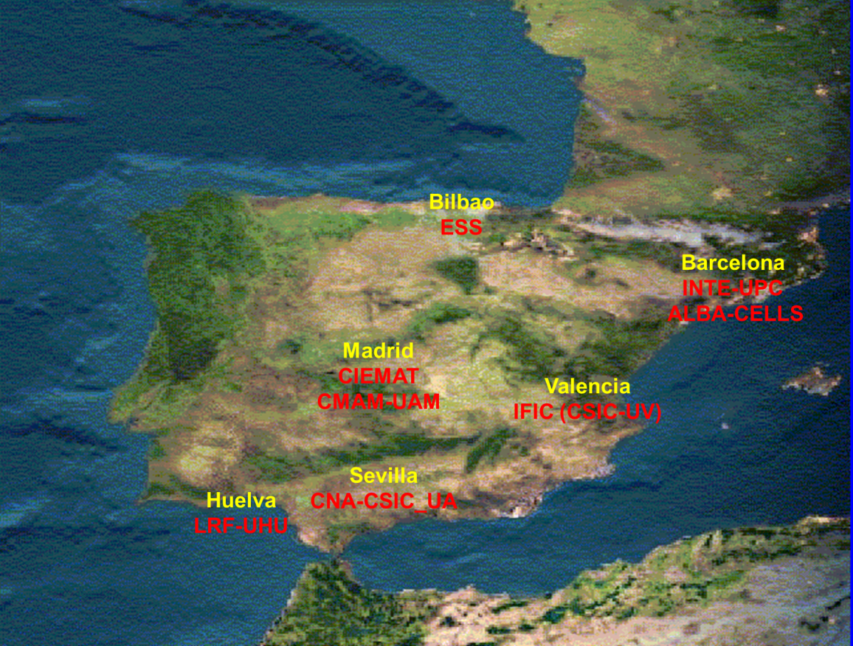
CONECTA
National Accelerator Facilities and Groups

Slide 5





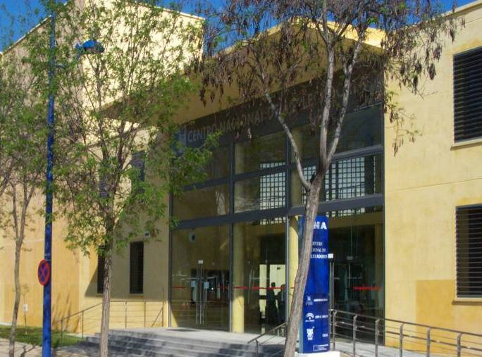
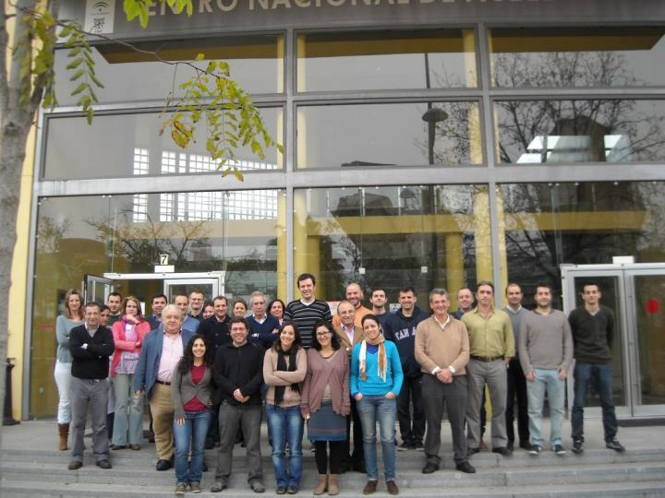
MINISTERIO
DE EDUCACION Y CIENCIA
Parque Tecnológico Cartuja’93, Avda.Thomas Alva Edison nº 7, E-41092 – Sevilla. Spain
Phone: +34.95.4460553, Fax: +34.95.4460145 cna@us.es
The CNA Team
We are today ~48
Notes:
Centro mixto U.Sevilla-J.Andalucia-CSIC
Instalaciones principales: 4 aceleradores, 1 irradiador, 1 Tomógrafo PET-CT.
ICTS: Instalación orientada a usuarios. Más de 100 solicitudes de uso al año. Comité científico regula el acceso al centro.
Personal: 48 trabajadores.
19 fijos. 20 temporales. 9 en formación.
13 doctores de plantilla (12 US, 1 CSIC),
10 doctores contratados (2 R&C, 8 postdocs).
Financiación externa por empresas: SAS, IBA, ALTER, ENRESA …además de proyectos autonómicos, nacionales y europeos, y facturación por el uso de las instalaciones.

Slide 6
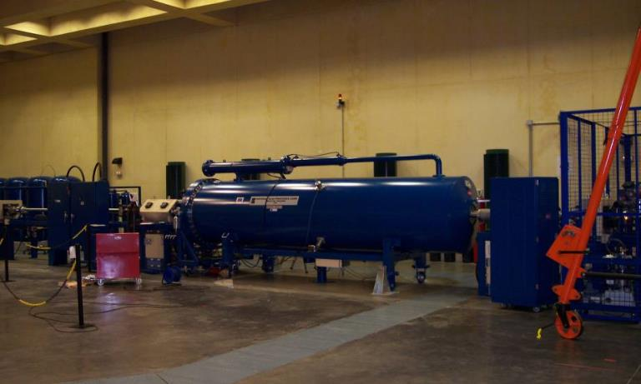
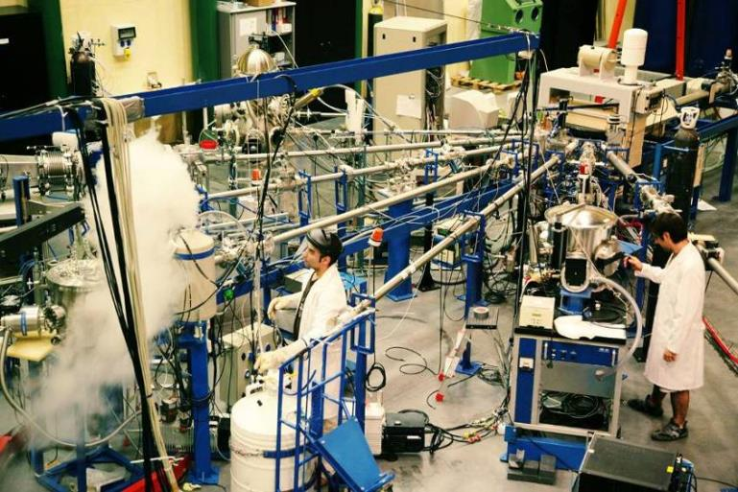
3MV Tandem accelerator
Nuclear physics and Instrumentation (Nuclear and Particle Physics)
IEM-CSIC, IFCA-CSIC, IFIC-CSIC, I3M-CSIC, U-Huelva, U-Granada
IBA techniques (Material Science)
IO-CSIC, ICMSE-CSIC, ICMM-CSIC, ICMB-CSIC
TRINOS, AVS, CRIOLAB, ATI-Sistemas, INDO, ACERINOX

Slide 7
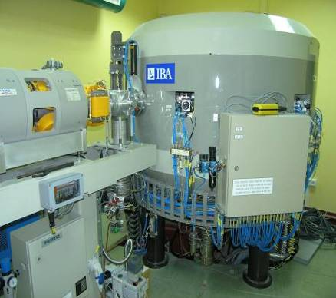
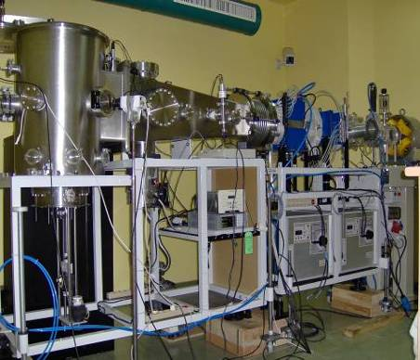
Cyclotron
18 MeV (p), 9 MeV (d)
Radiopharmaceutical production (Molecular Imaging)
IBA Molecular
Irradiation (Space technology)
ALTER, TRAD, INTA

Slide 8
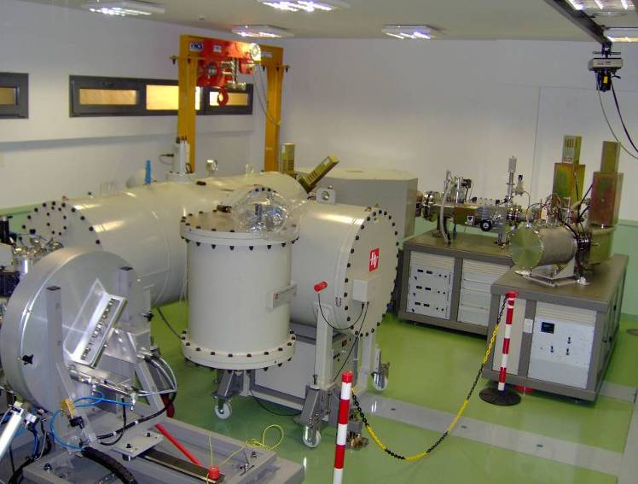
SARA, AMS system
Precise AMS isotope measurements (Nuclear physics applied to environment)
ENRESA, DUCARES, CIEMAT, UAB, UEX, U-Lund

Slide 9
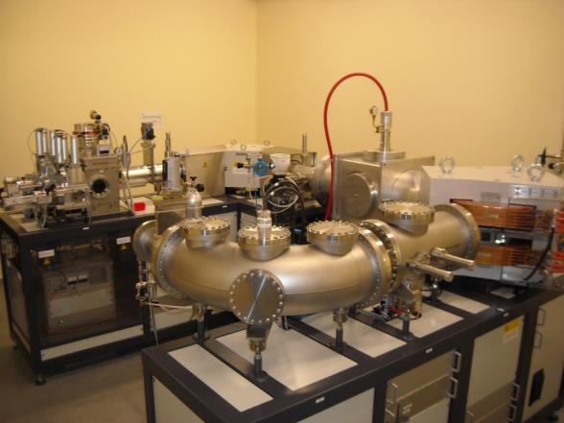
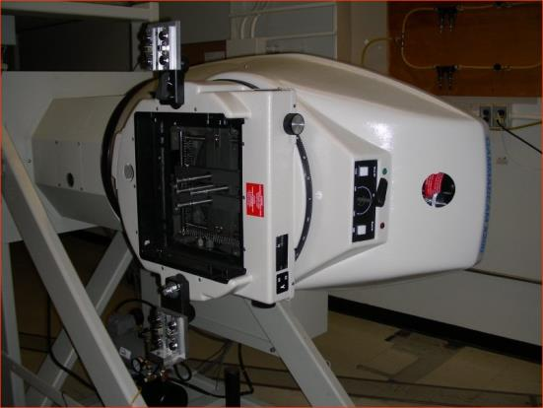
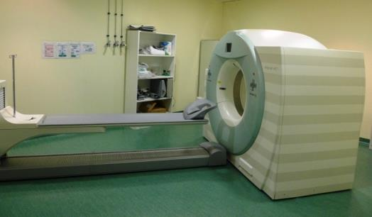
MICADAS compact 14C accelerator:
60Co Irradiator
14C dating (Nucl Phys applied to arqueology and cultural heritage)
IPE-CSIC, IMF-CSIC, UAB, UEX,
CEPSA
Photon irradiation (Space technology, Biophysics)
INTA, USE, UC3, ALTER, Hisparroz,
Unidad de Imagen del CNA-HUVR
PET-CT Molecular Imaging (Molecular Imaging applied to Oncology and neurology)
HUVR-SAS, HUVM-SAS, IBIS-CSIC, SIEMENS, IBA, PIRAMAL

Slide 10

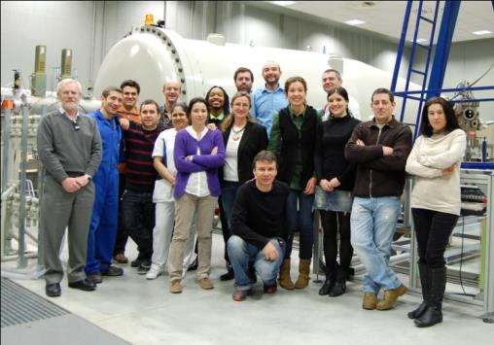
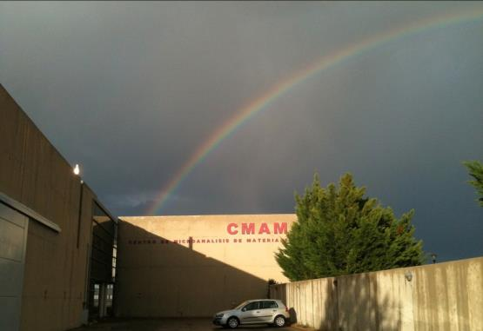
Belonging to UAM
Located in the Cantoblanco Campus
In operation since March 2003
11 M€ of technological investment
A team of 22+: 10 scientists,
8 technicians, 2 administration, 2 service, + PhD and other students

Slide 11
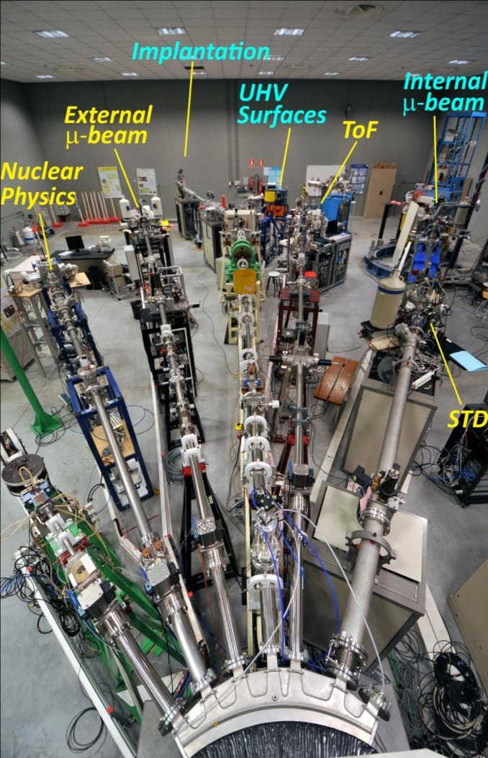
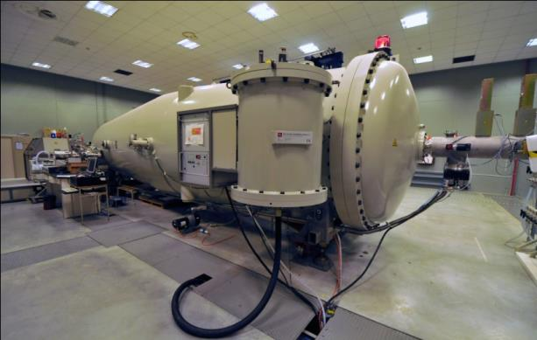
CMAM accelerator & Beamlines
Tandem accelerator, 5MV, HVEE.
The first, High Current, Tandetron Accelerator using the Coaxial Cockcroft-Walton power supply system to reach 5MV.
Seven beamlines.
Six are in operation, including two micro-beams. One is under development (UHV for LEIS-low energy ion scattering)

Slide 12
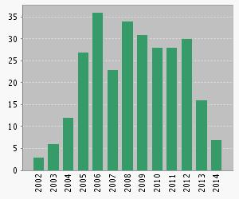
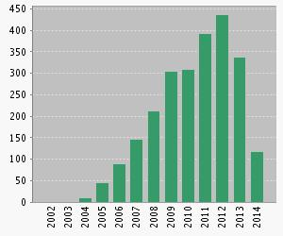
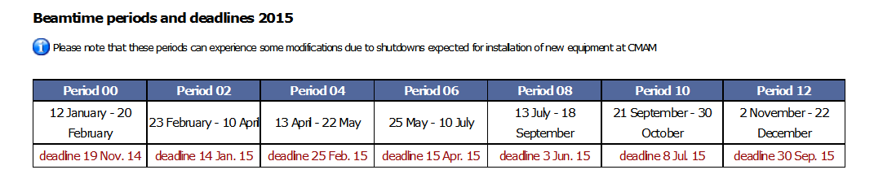
Research fields at the CMAM
CMAM
CMAM Research Fields
Archaeometry
Photonics
Energy Related Materials
Ion-Solid Interactions
Surface Physics
Nuclear Physics
Biophysics
H=23
Publications
Citations

Slide 13
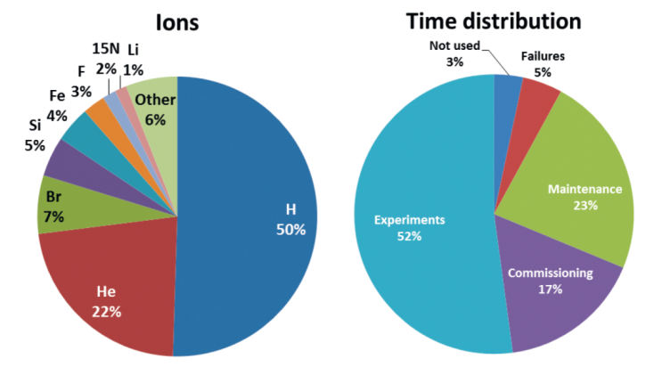
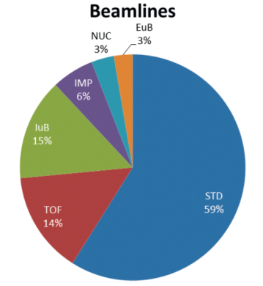
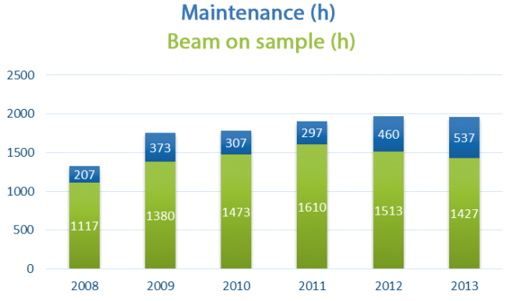
CMAM performance
The statistics of Ions production, Time distribution and Beamlines use for the period 2012-2013
ASSIGNED | CMAM & Collaborators |  |  | Access via Service
Year | Exper. # | Accept.% | IP # | Exper. # | Accept.% | IP #
2009 | 91 | 60 | 13 | 37 | 80 | 18
2010 | 101 | 69 | 14 | 28 | 78 | 13
2011 | 84 | 55 | 15 | 39 | 87 | 16
2012 | 72 | 53 | 13 | 28 | 70 | 19
2013 | 76 | 78 | 13 | 17 | 89 | 14
Number of experiments approved each year with an acceptance rate and number of researchers in charge (IP)
The distribution of Maintenance and Beam on Sample

Slide 14

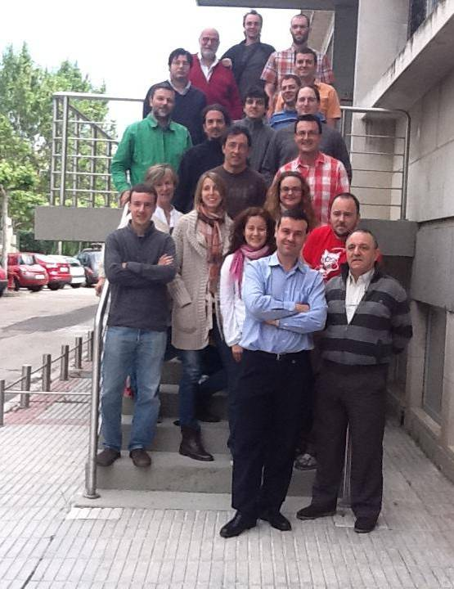
Accelerator R&D activities: CIEMAT
CIEMAT Accelerator Technology group
In the year 2008, CIEMAT created a Particle Accelerators Unit with 25 people up to now. It absorbs the former Applied Superconductivity Group and the facilities located at another Institute, CEDEX. Presently it is part of the Electrical Engineering Unit where other activities such as Energy Management, are also developed.
Manpower
Notes:
14

Slide 15
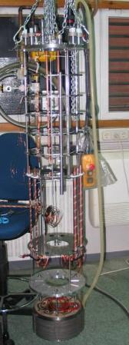
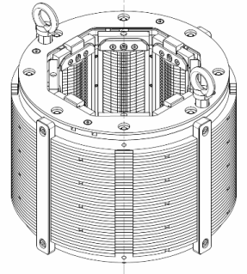
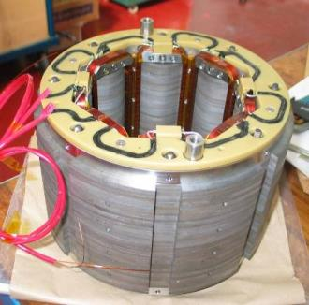
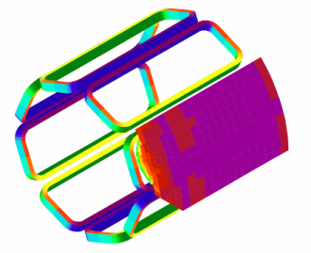
Accelerator R&D activities: CIEMAT
CIEMAT Accelerator Technology group
Calculations: electromagnetic, thermal and mechanical and beam dynamics simulations
Engineering design: 3-D model, fabrication techniques, drawings
Prototyping: fabrication and assembly of magnets, RF structures and other accelerator devices
Tests: two vertical cryostats, one cryocooler and low power RF measurements
Capabilities

Slide 16
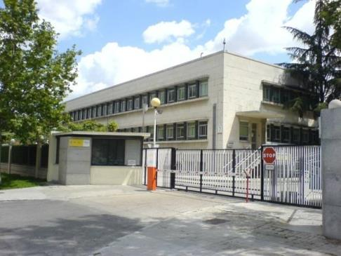
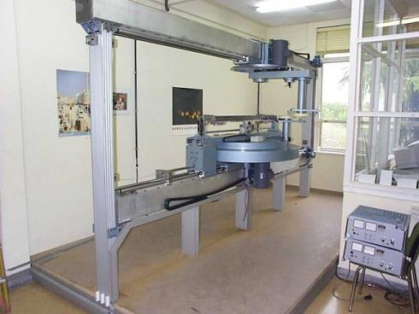
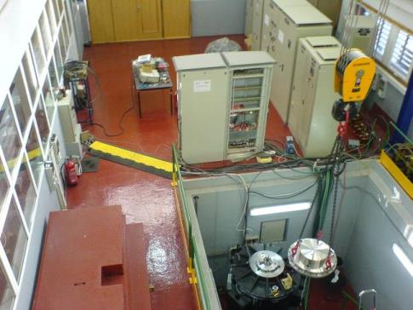
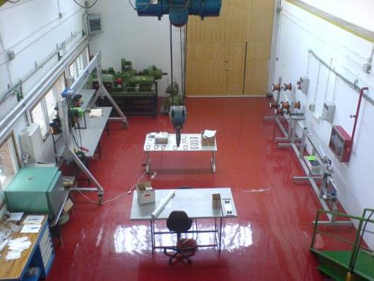
Accelerator R&D activities: CIEMAT
Facilities
Main Offices (Moncloa)
CIEMAT Winding Machine
Energy & Superconductivity (J. Camarillo)
Accelerators Components (J. Camarillo)

Slide 17
Accelerator R&D activities: CIEMAT
CIEMAT Accelerator Group Activities
Accelerators | Energy
Large Facilities | Storage
XFEL | SA²VE
FAIR | ACEBO
CLIC | TRAIN2CAR
HL-LHC | EERA
ILC | Production
IFMIF | SuperTURBINES
TIARA | SeaWEDGE
Small Accelerators | UNDIGEN
MICROTRON | IISIS
CYCLOTRON (AMIT)

Slide 18









Accelerator R&D, IFIC
http://gap.ific.uv.es/
PEOPLE
Dr. Angeles Faus-Golfe (CSIC researcher)
Dr. Daniel Esprante Pereira (Electronical engineering at CERN)
César Blanch Gutiérrez (Mechanical engineering at CERN)
Carolina Belver Aguilar (PhD FPI)
Alfonso Benot Morell (PhD Especialización Infraestructuras Científicas y Organismos Internacionales)
Núria Fuster Martínez (PhD Student UV)
Jorge Giner Navarro ( Doctoral student CERN)
Natalia Galindo Muñoz (PACMAN student)
COLLABORATORS
Notes:
18
The Accelerator group at IFIC
IFIC participation in CLIC starts in 2002 with the collimation studies for the BDS; in 2004 the group initiates the collaboration with the CTF3 facility. In 2006 IFIC in collaboration with the Universitat Politecnica de Catalunya (UPC) and CERN, undertook the design, construction and performance tests of a series of 16 Beam Inductive Position Monitors (BPM) for the CTF3. The BPMs are installed in the TBL of CTF3 and working successfully since October 2009 .
These studies have been extended with the BPMs studies for the Drive Beam of CTF3, and are being made under the Spanish Programme of European Large Infrastructures. The work started in June 2011 and it is being made in collaboration with the Beam Instrumentation Group of CERN. The first prototype of a stripline BPM has been designed constructed and tested at the CERN labs.
Since October 2010 in the framework of the DR Working Group of CLIC, the IFIC and CIEMAT groups are developing a first prototype of a stripline kicker for the DR kickers in close collaboration with CLIC group at CERN, under the Spanish Research Programme of the Centro de Desarrollo Tecnologico e Industrial (CDTI) in collaboration with the company G&P Vacuum projects. The first prototype is being designed and constructed and it will be tested at CERN labs at the beginning of 2014. This prototype will also be tested with beam and with the corresponding power supply, an inductive Adder type being constructed by CERN, in ATF2 test facility. Yesterday the prototype has arrived at CERN!!!!!
The measured vertical emittance in the EXT of ATF was larger than expected . This motivated the study of the possible sources of emittance growth; IFIC started a collaboration with KEK in 2007, jointly with Laboratoire de l’Accelerateur Lineaire (LAL), the Science & Technology Facilities Council (STFC), in order to carry out this study.
This study has permitted the presentation of a proposal in combination with the accelerator group of SLAC in June 2009 for constructing a multi-Optical Transition Radiation (mOTR) system, consisting of four monitors, in the EXT line of ATF2. This system is being used routinely since 2011 and has demonstrated to be a reliable and stable diagnostic tool for fast beam size measurement and emittance reconstruction. Similar mOTR system can be deployed at FLC and linac-based synchrotron light sources. For instance, we have studied the feasibility of using mOTR systems in diagnostic sections of the Ring to Main Linac (RTML) of FLC.
In April 2013 jointly with LAL, we have started the study of the halo collimation in ATF2. Preliminary studies has been made in collaboration with LAL and this studies will be the starting point for making a proposal in collaboration with LAL, for the design, construction and implementation of a retracting halo collimator system in ATF2.

Slide 19
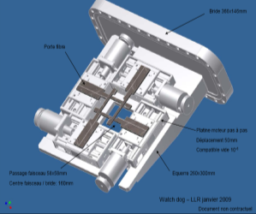
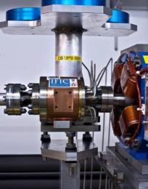
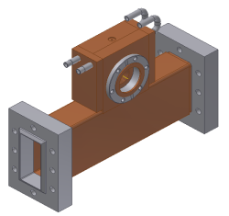
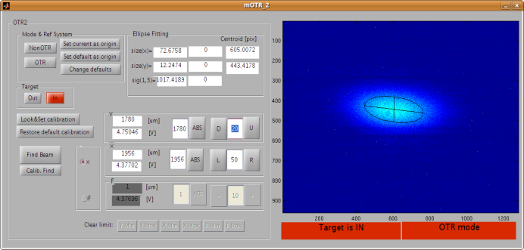
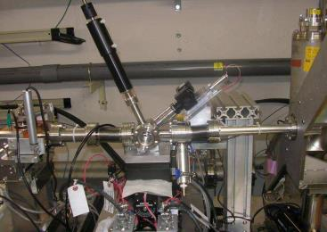
Accelerator R&D, IFIC
http://gap.ific.uv.es/
RESEARCH ACTIVITIES
Collimation systems studies for Future Linear Colliders (CLIC), halo collimation in ATF2
Optics Design and Beam Instrumentation studies for the Beam Delivery System of Future Linear Colliders (ILC and CLIC).
Beam Dynamics studies for the EXT line of ATF-ATF2.
Design and Construction of Beam Instrumentation:
  Inductive Beam Position Monitors for CTF3;
  Stripline Beam Position Monitors for the CLIC Drive Beam.
  Optical Transition Radiation Monitors for ATF-ATF2;
  Stripline Kickers for CLIC Damping and Pre-Damping Rings;
  Cyclinacs for hadrontherapy applications, high gradient studies
Notes:
19
The Accelerator group at IFIC
IFIC participation in CLIC starts in 2002 with the collimation studies for the BDS; in 2004 the group initiates the collaboration with the CTF3 facility. In 2006 IFIC in collaboration with the Universitat Politecnica de Catalunya (UPC) and CERN, undertook the design, construction and performance tests of a series of 16 Beam Inductive Position Monitors (BPM) for the CTF3. The BPMs are installed in the TBL of CTF3 and working successfully since October 2009 .
These studies have been extended with the BPMs studies for the Drive Beam of CTF3, and are being made under the Spanish Programme of European Large Infrastructures. The work started in June 2011 and it is being made in collaboration with the Beam Instrumentation Group of CERN. The first prototype of a stripline BPM has been designed constructed and tested at the CERN labs.
Since October 2010 in the framework of the DR Working Group of CLIC, the IFIC and CIEMAT groups are developing a first prototype of a stripline kicker for the DR kickers in close collaboration with CLIC group at CERN, under the Spanish Research Programme of the Centro de Desarrollo Tecnologico e Industrial (CDTI) in collaboration with the company G&P Vacuum projects. The first prototype is being designed and constructed and it will be tested at CERN labs at the beginning of 2014. This prototype will also be tested with beam and with the corresponding power supply, an inductive Adder type being constructed by CERN, in ATF2 test facility. Yesterday the prototype has arrived at CERN!!!!!
The measured vertical emittance in the EXT of ATF was larger than expected . This motivated the study of the possible sources of emittance growth; IFIC started a collaboration with KEK in 2007, jointly with Laboratoire de l’Accelerateur Lineaire (LAL), the Science & Technology Facilities Council (STFC), in order to carry out this study.
This study has permitted the presentation of a proposal in combination with the accelerator group of SLAC in June 2009 for constructing a multi-Optical Transition Radiation (mOTR) system, consisting of four monitors, in the EXT line of ATF2. This system is being used routinely since 2011 and has demonstrated to be a reliable and stable diagnostic tool for fast beam size measurement and emittance reconstruction. Similar mOTR system can be deployed at FLC and linac-based synchrotron light sources. For instance, we have studied the feasibility of using mOTR systems in diagnostic sections of the Ring to Main Linac (RTML) of FLC.
In April 2013 jointly with LAL, we have started the study of the halo collimation in ATF2. Preliminary studies has been made in collaboration with LAL and this studies will be the starting point for making a proposal in collaboration with LAL, for the design, construction and implementation of a retracting halo collimator system in ATF2.

Slide 20

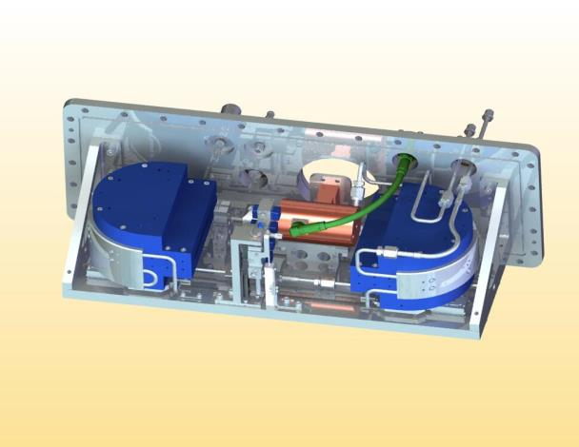
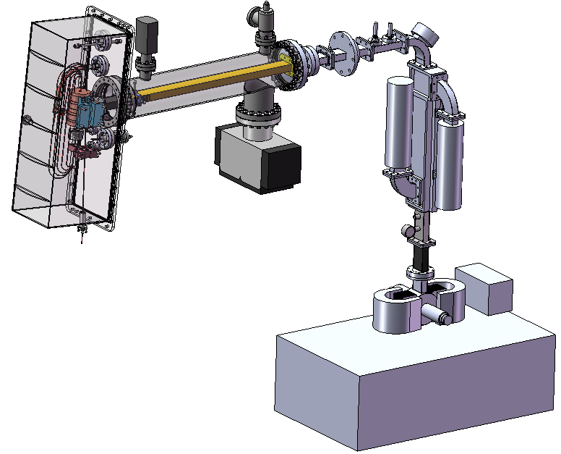
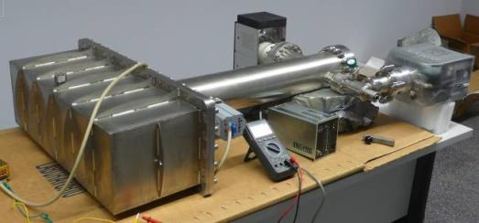
Microtron project at the UPC
The Institute of Energy Technologies (INTE) of the Technical University of Catalonia (UPC) in collaboration with CIEMAT and Skobeltsyn Institute of Nuclear Physics of Moscow State University is carrying out a project of design and construction of a compact accelerator of electrons of energies from 6 MeV to 12 MeV of the race-track microtron (RTM) type.
3D image of the interior of the accelerator head
Vacuum chamber and pumping /supporting tube with the pumps connected during vacuum tests

Slide 21

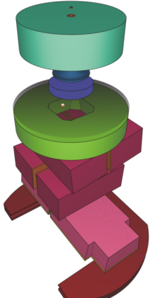
PRIMO - Advanced tool for linac simulation
Development of automated software tools based on the PENELOPE/penEasy code for the Monte Carlo simulation of clinical linacs
Simulation of most Varian and Elekta linacs currently available in the market for radiotherapy treatments
Simple graphical user interface inspired on those from commercial treatment planning systems
In collaboration with Universitätsklinikum Essen
Academic activities in the field of particle accelerators at the UPC
Course “Engineering of particle accelerators” at the School of Industrial Engineering
University diploma thesis, Master thesis
Student training at ALBA synchrotron light facility

Slide 22
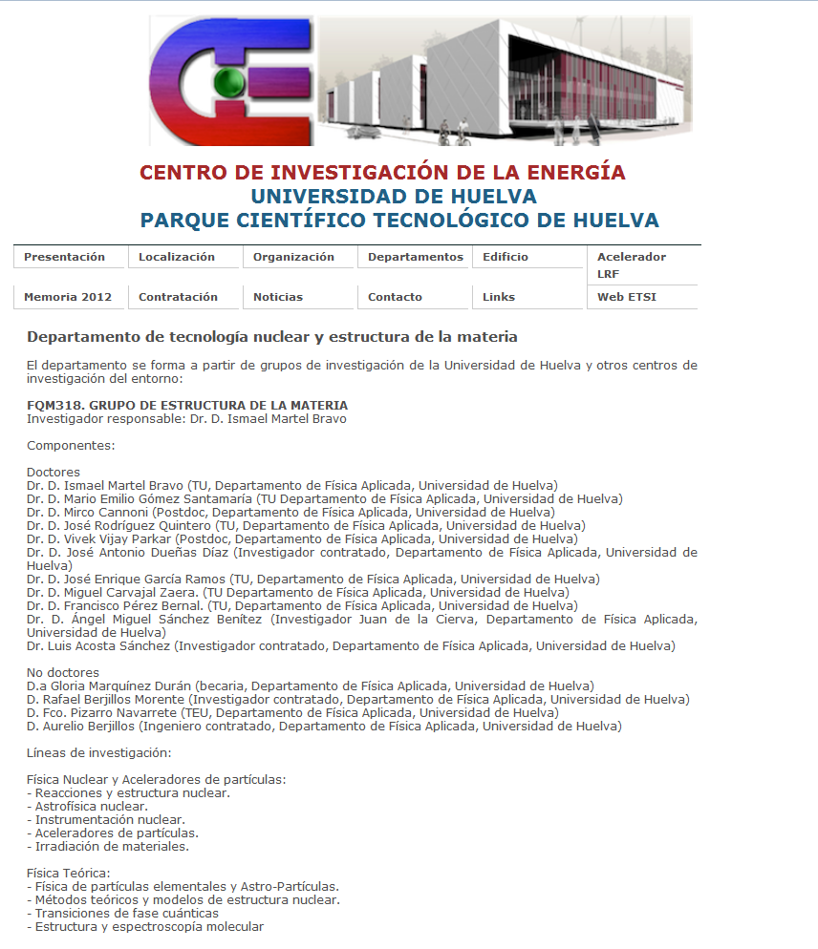

Slide 23

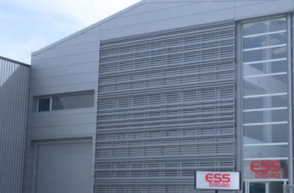
  ESS BILBAO
Funded by the Spanish and Basque Country Governments (90 M€)
Main Objective: Spanish in-kind contribution to European Spallation Source, located at Lund, Sweden (around 70 M€: 50% accelerator/target systems, 50% neutron instruments)
A team of ~60 (including researchers, technicians, administration)
Close collaboration with University and Industry
CAPABILITIES: design, prototyping, manufacturing and test
FIELDS: Accelerator, Target, Neutron Instruments
TECHNOLOGIES: ion sources, cavities, magnets, RF design and test, control and diagnostics, high vacuum, neutronic design, mechanical design and manufacturing, welding,…
ESS Bilbao headquarters
Poligono Ugaldeguren III
P. A, 7B, 48170-Zamudio
Bizkaia (SPAIN)

Slide 24
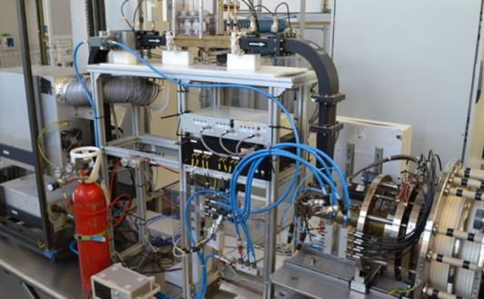
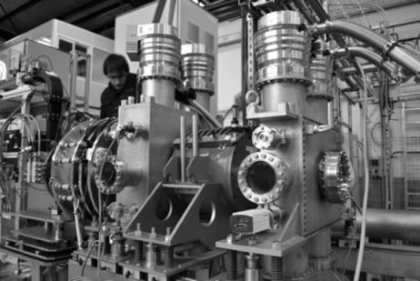
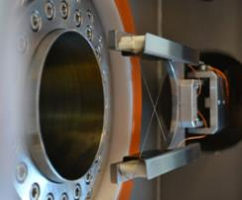
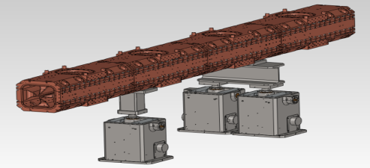
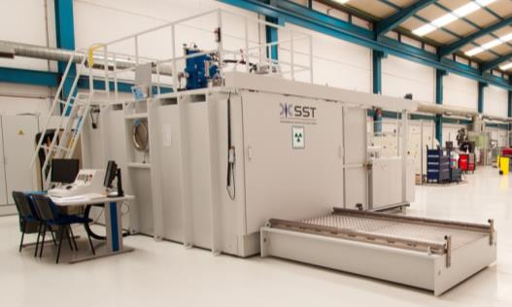
  CURRENT FACILITIES
  AND DEVELOPMENTS
ISHP
ECR proton ion source, 45 keV, 40 mA
LEBT
Focusing and beam diagnostics
RFQ
Four-vane, 3 MeV, 3.2 m long, at 352 MHz
AWF
Advanced Welding Facility: E-beam, brazing furnace, metallography, metrology,…

Slide 25
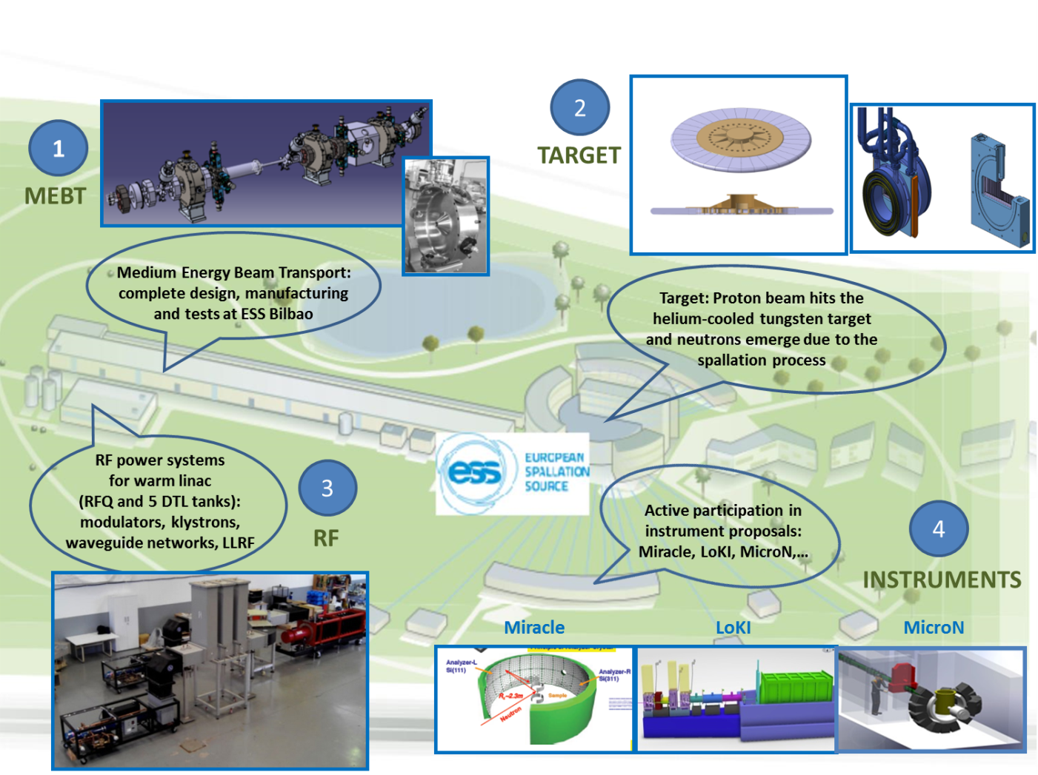
SPANISH CONTRIBUTION TO ESS (SWEDEN)
Notes:
25

Slide 26



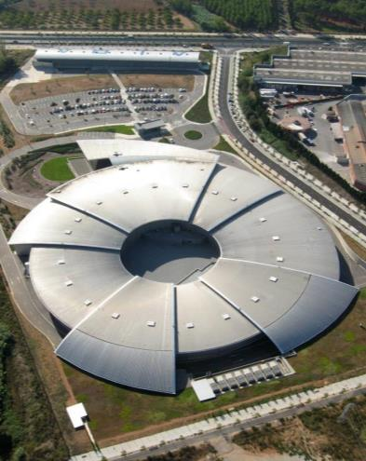
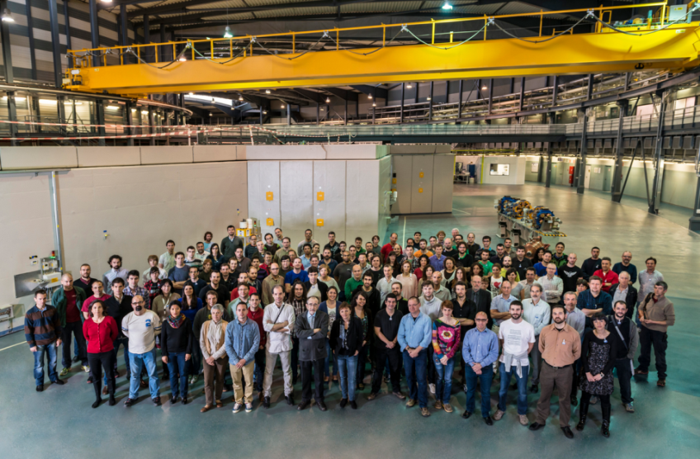
ALBA,
Synchrotron Light Source
The ALBA Team
We are today ~170
Francis Perez

Slide 27
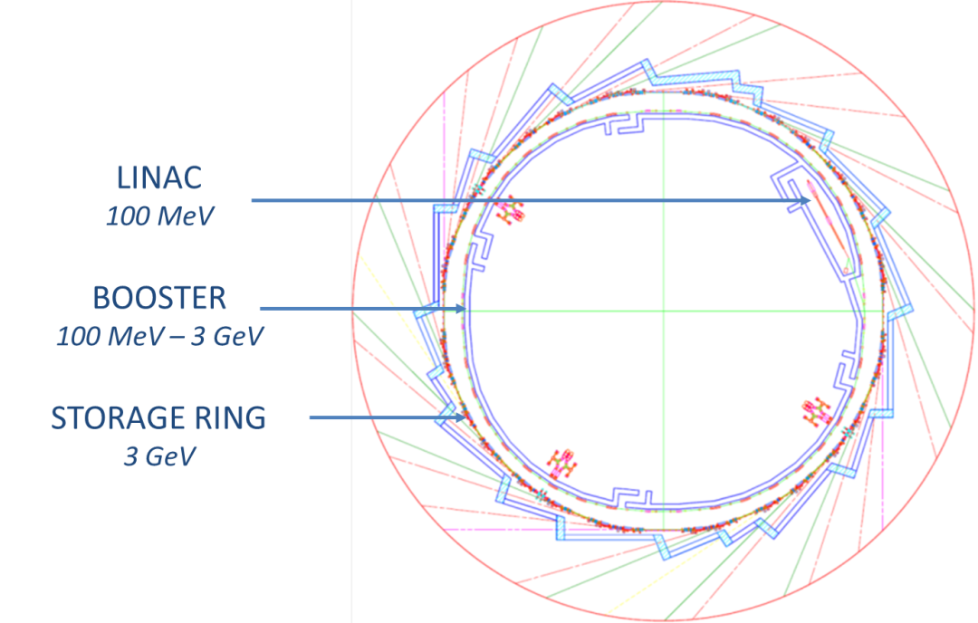
ALBA Accelerators
Electron beam energy 3.0 GeV
Storage Ring Circumference 268.8 m
Number of cells 16
Symmetry 4
Straight sections: 4 Long 8.0 m for 3 ID & Injection
12 Medium 4.4 m for 12 ID
8 Short 2.6 m for 2 ID & RF & Diagn
Beam current 250 mA
Emittance 4.3 nm.rad
Lifetime > 10 h

Slide 28



ALBA
Accelerators
Linac
Accelerate electrons from rest to 100 MeV RF cavities 3 GHz
Repetition rate of 3 Hz
Booster
Accelerate e- from 100 MeV to 3 GeV
1 x RF cavity at 500 MHz
Repetition rate of 3 Hz
Storage Ring
Keep electrons at 3.0 GeV
Magnets and correctors to keep the orbit (sub-μm)
Vacuum Pumps (10⁻¹⁰ mbar)
6 x RF cavities at 500 MHz
Circulating current: 250 mA

Slide 29


ALBA BEAMLINES
7 phase I - BLs (6xID + 1xBM)
2 phase II - BLs (1xID + 1xBM)
Spectral range: from UV (80 eV) to hard x-rays (50 keV)
High brilliance: 10²⁰ at 2 keV

Slide 30
ALBA BEAMLINES
7 phase I - BLs (6xID + 1xBM)
2 phase II - BLs (1xID + 1xBM)
Beamline | Beamline use | Field of activity | Light source
MSPD BL | Powder Diffraction | Materials science | Superconducting wiggler
NCD BL | Non-Crystalline Diffraction | Life sciences, Materials science | In-vacuum undulator
XALOC BL | Macromolecular Crystallography | Life sciences | In-vacuum undulator
CLAESS BL | X-Ray Absorption/Emission Spectroscopies | Materials science | Wiggler
CIRCE BL | Photoemission spectroscopy and microscopy | Polarized electron spectroscopies | Helical undulator (Apple II type)
BOREAS BL | Soft X-Ray Magnetic Circular Dichroism, Resonant scattering | Polarized electron spectroscopies | Helical undulator (Apple II type)
MISTRAL BL | Soft X-Ray Microscopy beamline | Life sciences, Materials Science | Bending magnet
MIRAS | Infrared microspectroscopy | Life sciences, Chemistry | Bending magnet
LOREA | Angle-resolved photoemission | Polarized electron spectroscopies | Helical undulator (Apple II type)

Slide 31




ALBA BEAMLINES
Some pictures
Xaloc
Mistral
NCD
CLAESS

Slide 32




ALBA BEAMLINES
Some pictures
CIRCE
BOREAS
MIRAS
MSPD

Slide 33

ALBA Operation
24/24h 7/7days
 | 2012 | 2013 | 2014 | 2015
Accelerator operation [h] | 3280 | 4464 | 5250 | 5730
Scheduled user beam [h] | 2387.3 | 3539.5 | 3888.0 | 4320.0
Availability [%] | 77.0 | 83.8 | 96.5*
Delivered beamtime [h] | 1838 | 2967 | 3752
MTBF [h] | 21.0 | 25.0 | 31.0
MTTR [h] | 1.0 | 0.8 | 1.1
Beam for BLs: scheduled user beam, including injection time
MTBF: Mean time between failures
MTTR: Mean time to have the beam back

Slide 34
CONECTA
We include facilities and research groups related with accelerators.
We are getting organized
  2 meetings / year
  MoU ready, signatures in process
  Capability document in progress
We work through consensus.
We are cross-disciplinary (interaction with biology, chemistry, materials science, nuclear physics, particle physics …).
We want to be useful to industries, researchers, academics and society in general, answering questions about accelerators.

Slide 35

Thanks for your attention

