Slide 1
Comparing current waveforms and shielding options for SMH42
Zsolt Szoke
LIU-PS Meeting, 16/12/2014

Slide 2
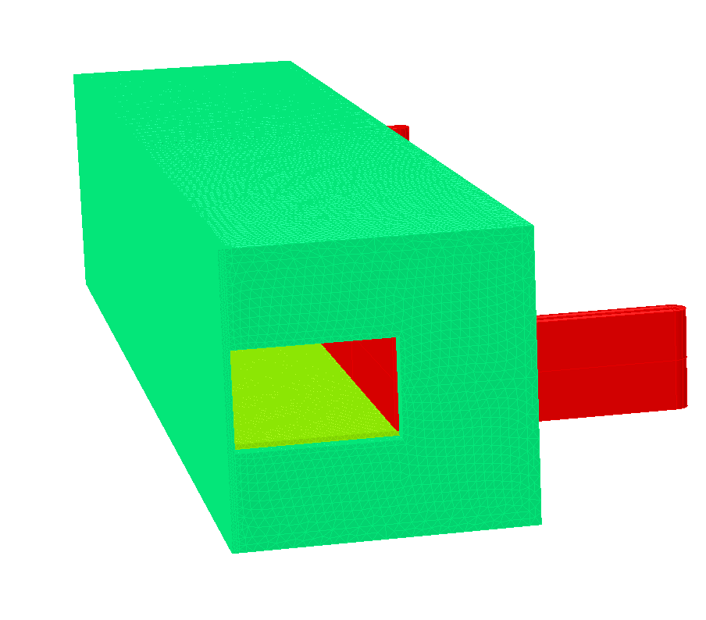
Overview
Present and future straight section 42
Proposed principal septum parameters
Comparing different coil current waveforms
Comparing different shielding options

Slide 3
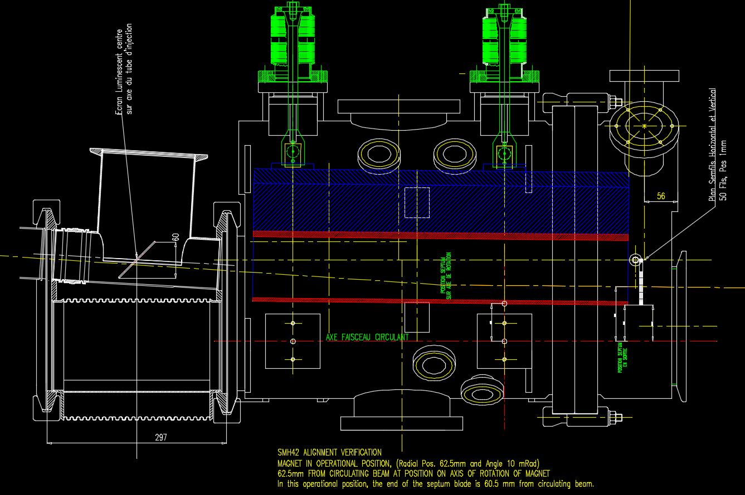
Present straight section 42

Slide 4
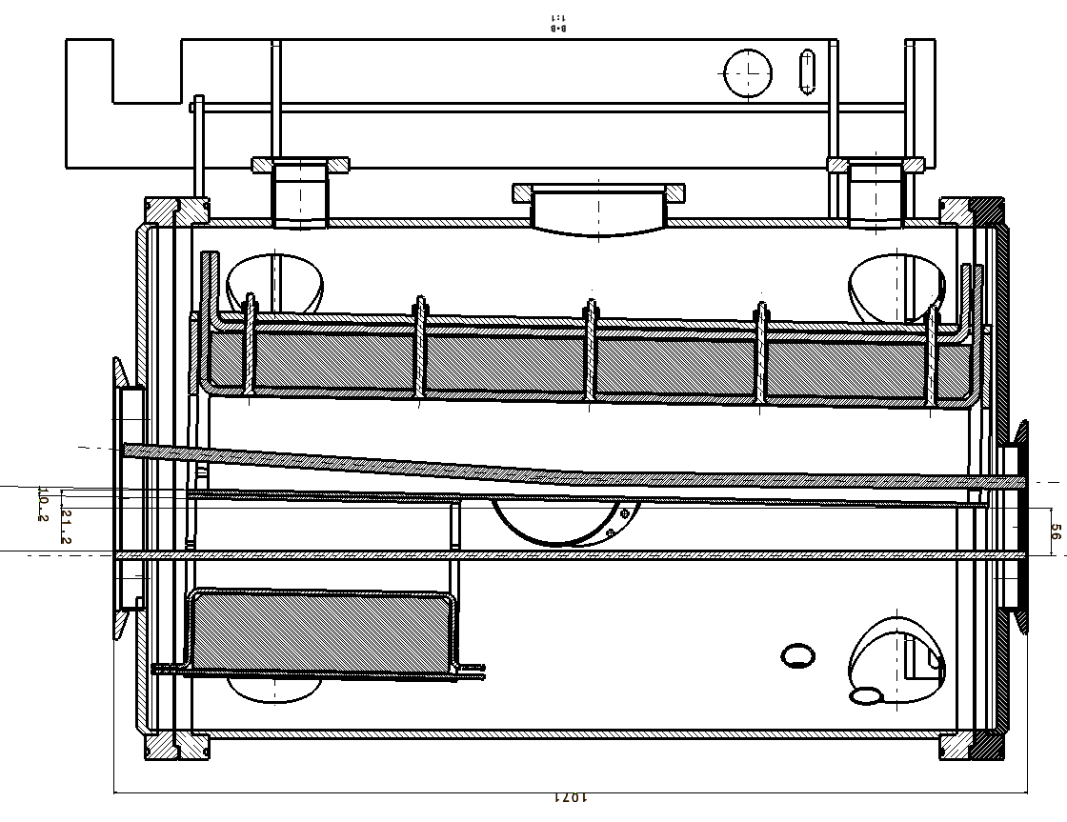
Future straight section 42

Slide 5
Principal PS injection septum parameters: present (1.4 GeV) and future (2 GeV)
 | Future | Present
Nominal beam energy [GeV] | 2.0 | 1.4
Physical length [mm] | 940 | 610
Magnetic length [mm] | 942 | 567
Septum thickness [mm] | 5 | 5
Nominal septum position w.r.t orbing beam centre [mm] | 56 | 64 (2012)
Septum position range [mm] | 49 – 63 | 52-72
Nominal angular septum position [mm] | 10.2 | 10
Angular septum position range [mrad] | 8-12 | 1-13
Magnet gap height [mm] | 70 | 60.4
Magnet gap width [mm] | 113 | 102
Nominal deflection angle [mrad] | 55 | 54.7
B_{gap} [T] | 0.54 | 0.689
Integrated field strength [Tm] | 0.51 | 0.390
Peak current for nominal deflection [kA] | 30.3 | 33.5
Integrated leak field @ 10 mm from septum [mTm] | ≤3.6 | ≤2.8
Integrated leak field @ 55 mm from septum [mTm] | ≤0.65 | ≤0.5
Field homogeneity in gap w.r.t angular deflection in H [%] | ± 1.5 | n.a.
Pulse width, (full sine, no filtering [ms] | 2 | n.a.
Pulse width, (half sine with 3rd harmonic and active filter) [ms] | n.a. | 3.2
Magnet inductance [µH] | 1.9 | 1.5
Magnet resistance [mΩ] | 0.1 | n.a

Slide 6
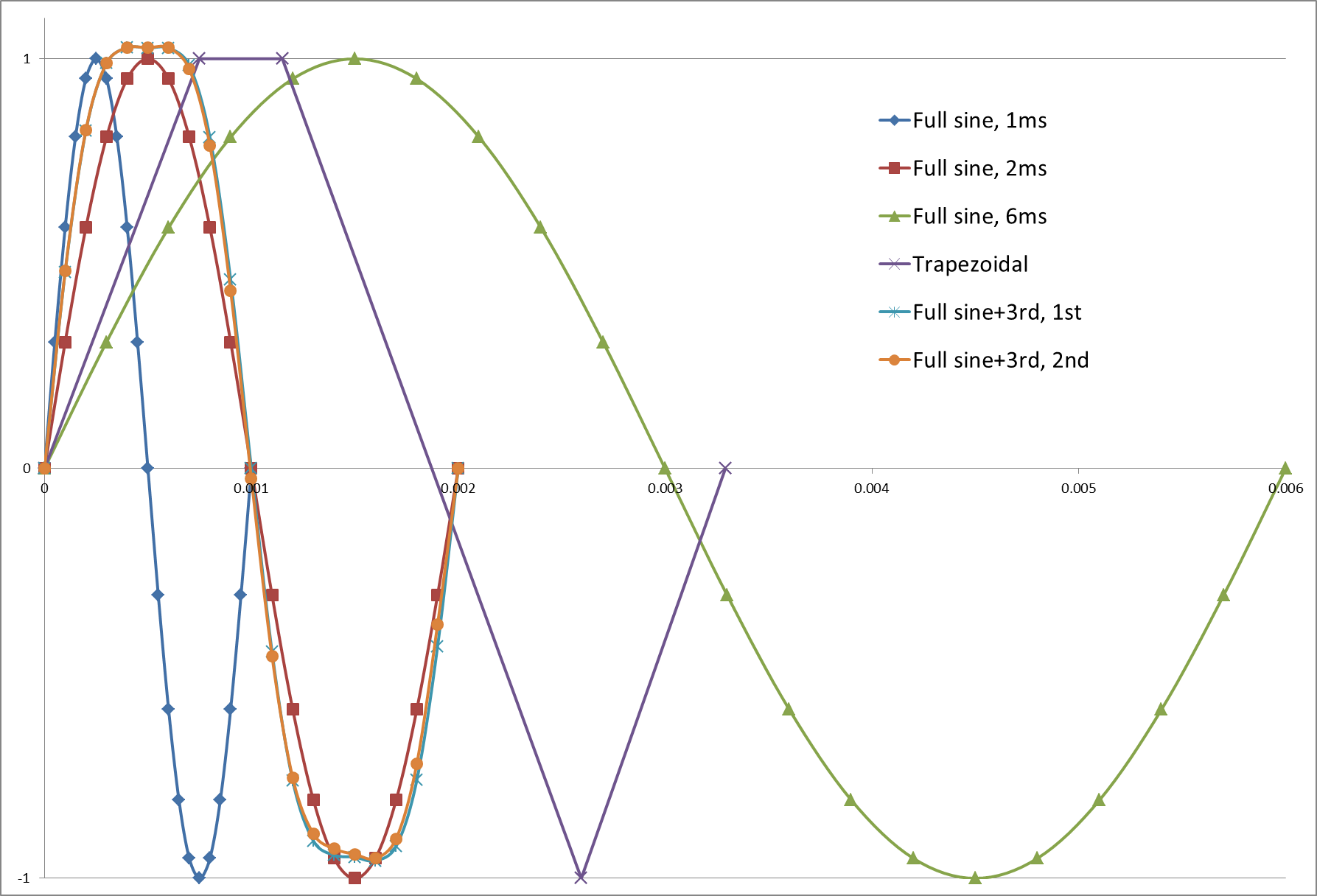
Excitation current waveforms
3D simulations with time domain analysis
Comparing the integrated field values, 10 mm from the septum, without shielding
Overview of current waveforms:
1: full sine, 1 ms
2: full sine, 2 ms
3: full sine, 6 ms
4: trapezoidal
5: full sine, 2 ms with 3rd harmonic, 1st version
6: full sine, 2 ms with 3rd harmonic, 2nd version
t (s)

Slide 7
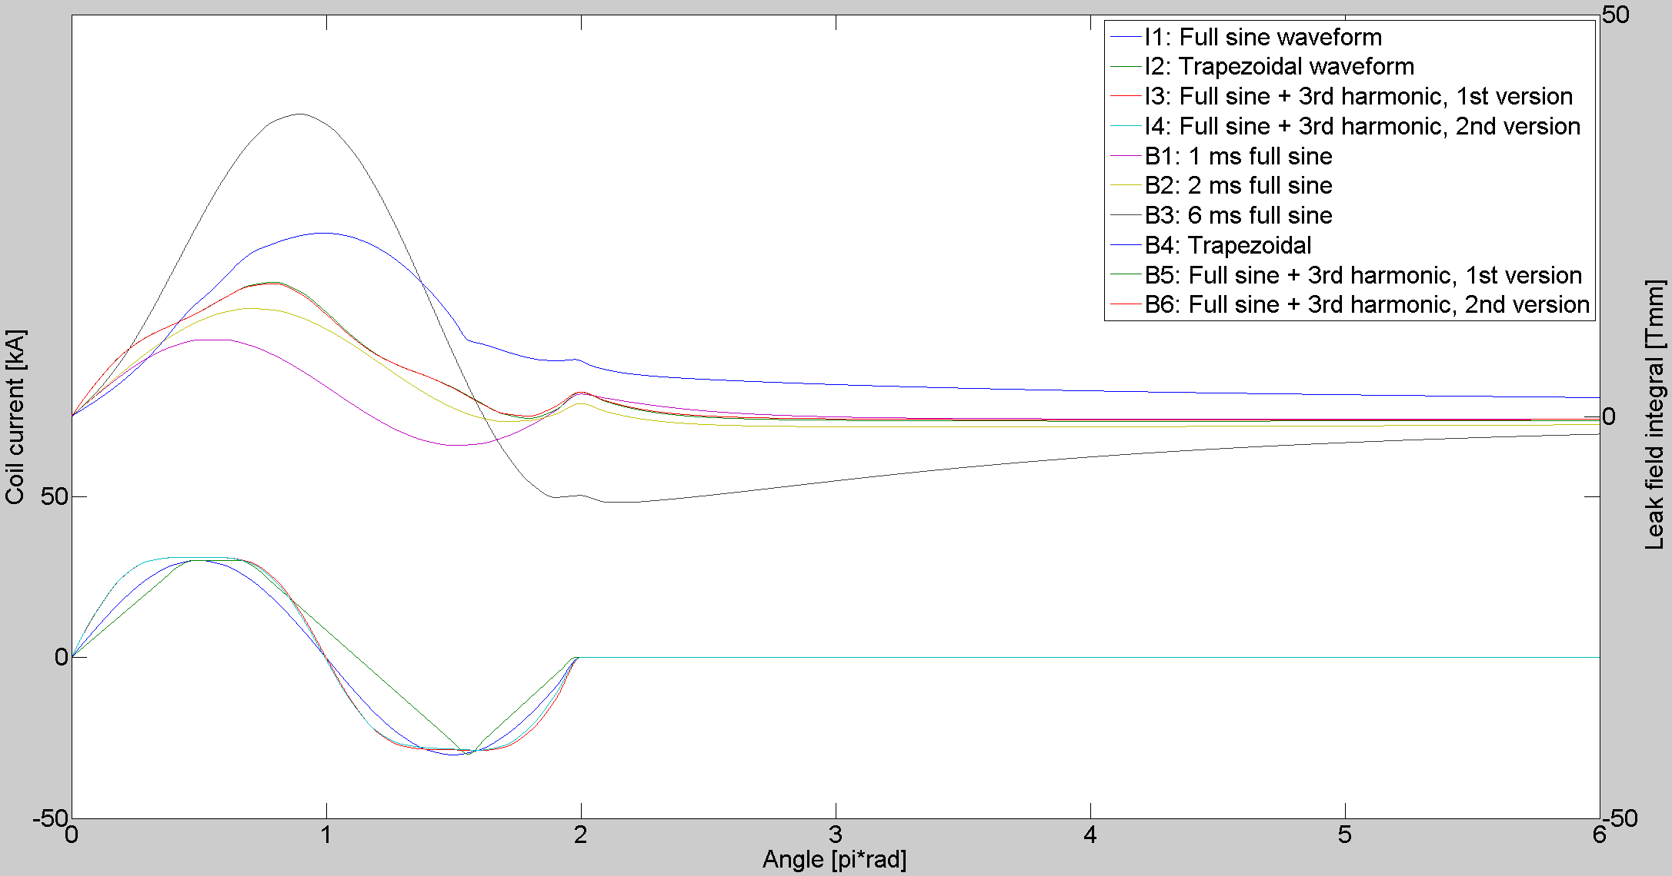
Leak field @ 10 mm, as function of excitation current, without shielding

Slide 8
Leak field values
Coil current waveform | Fringe field @ 10 mm |  | Fringe field @ 55 mm
 | Peak ʃB∙dl [mTm] | @ [ms] | Peak ʃB∙dl [mTm] | @ [ms]
1 ms full sine | 9.62 | 0.277 | 5.96 | 0.259
2 ms full sine | 13.44 | 0.718 | 6.69 | 0.574
6 ms full sine | 37.63 | 2.672 | 11.61 | 2.211
Trapezoidal | 25.21 | 1.698 | 8.57 | 1.200
2 ms full sine + 3rd harmonic, 1st version | 16.74 | 0.779 | 7.65 | 0.695
2 ms full sine + 3rd harmonic, 2nd version | 16.59 | 0.773 | 7.61 | 0.686

Slide 9
Waveform preference
The shorter the waveform the lower the leak field.
1 ms full sine would require very thin laminations: very difficult to achieve good vacuum.
2 ms can be done with 0.35 mm steel laminations (as presently used under vacuum septa in PS).
The closer the waveform approaches a full sine, the better the performance (the lower the leak field) is.
The performance is not good enough without shielding.

Slide 10
Comparing different shielding options
2D simulations with time domain analysis.
Comparing the punctual field values, with 2 ms full sine excitation, 10 mm from the septum.
Overview of shielding options (insulation: 0.25 mm Kapton):
1: septum only
2: septum + Kapton + 0.5 mm mu-metal screen
3: septum + Kapton + bumper
4: septum + Kapton + 0.5 mm mu-metal screen + Kapton + bumper
5: non-uniform thickness (5-10 mm) septum
6: septum + Kapton + 0.35 mm thick mu-metal box in the size of the bumper beam acceptance

Slide 11
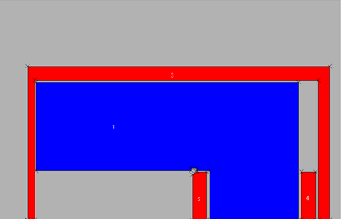
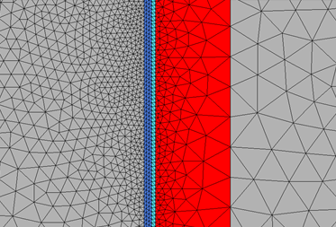
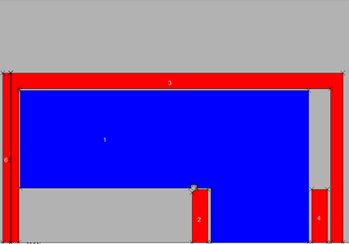
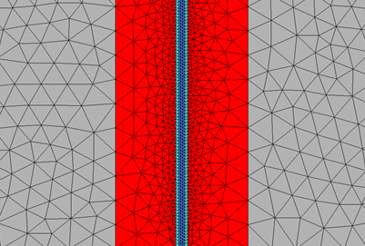
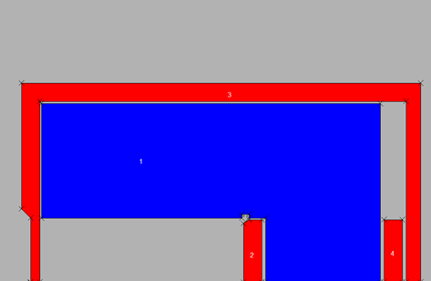
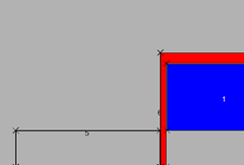
The arrangement in 2D simulations
1: septum only
2: septum + Kapton + mu-metal screen
3: septum + Kapton + bumper
4: septum + Kapton + mu-metal screen + Kapton + bumper
5: non-uniform thickness septum
6: septum + Kapton + mu-metal box

Slide 12
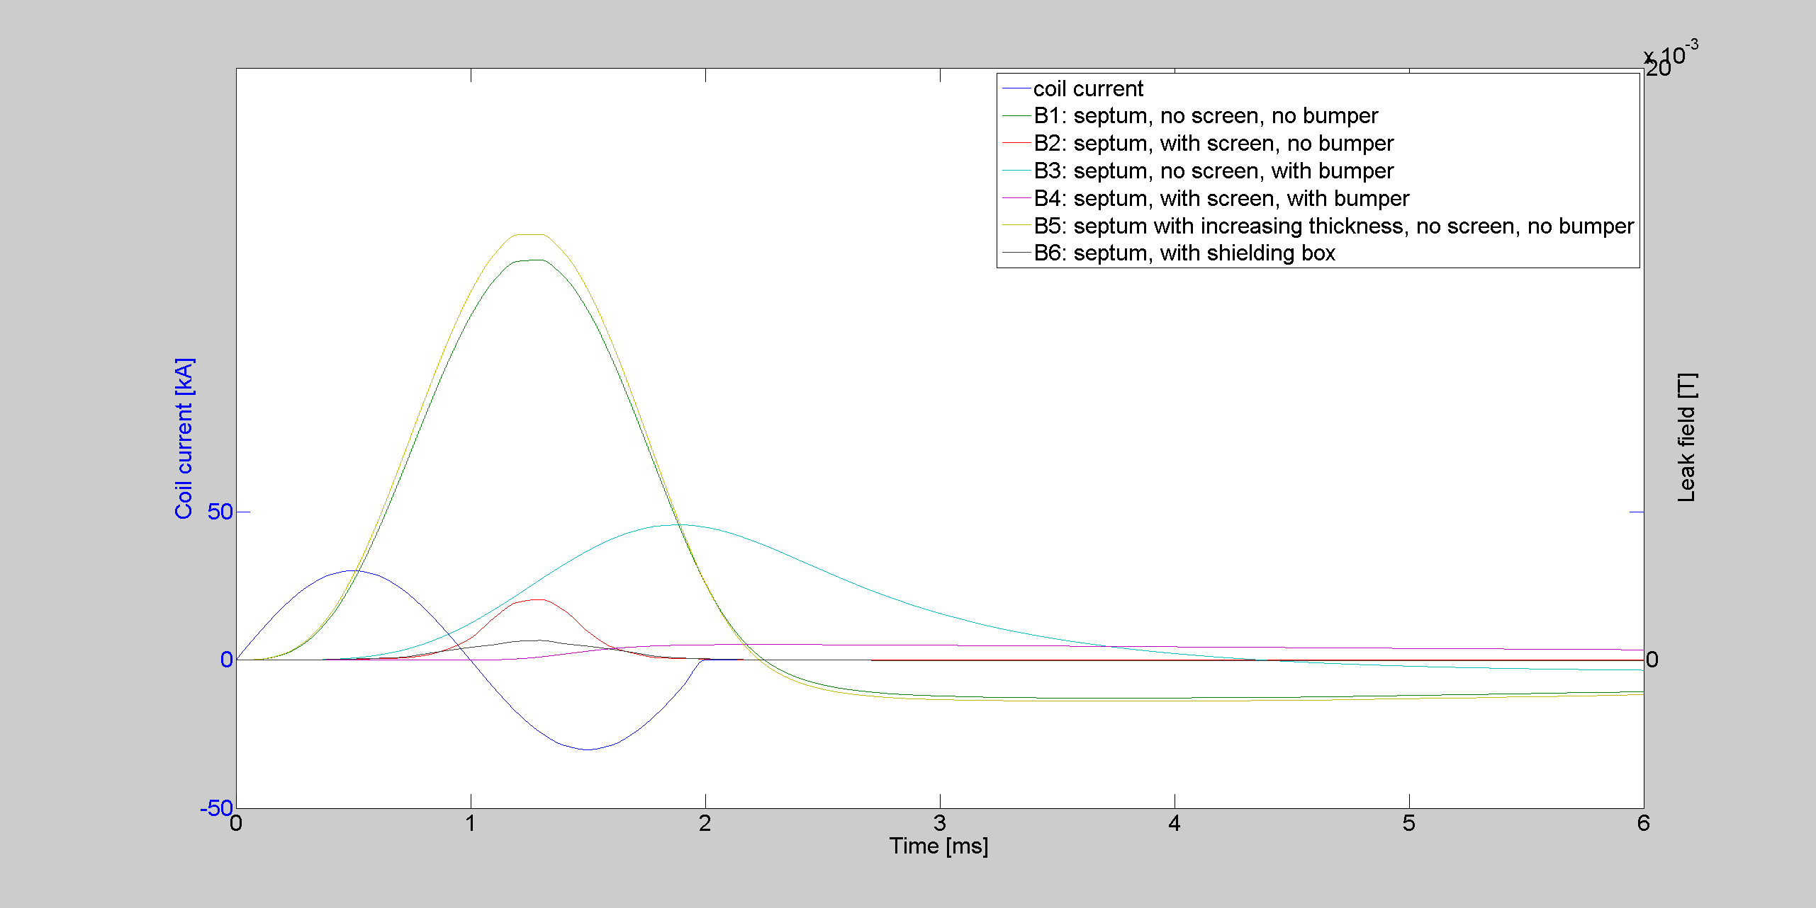
Leak field @ 10 mm, as function of shielding, using 2 ms full sine wave excitation

Slide 13
Leak field values
Shielding version | Fringe field @ 10 mm |  | Fringe field @ 55 mm
 | Peak B_{y} [mT] | @ [ms] | Peak B_{y} [mT] | @ [ms]
Septum only | 13.57 | 1.258 | 4.33 | 1.250
Septum + mu-metal screen | 2.07 | 1.271 | 0.74 | 1.265
Septum + bumper | 4.57 | 1.881 | 1.48 | 1.877
Septum + mu-metal screen + bumper | 0.53 | 2.252 | 0.11 | 2.125
Septum with non-uniform thickness | 14.46 | 1.253 | 4.17 | 1.249
Septum + mu-metal box | 0.67 | 1.271 | 0.41 | 1.268

Slide 14
Conclusions on shielding
The best shielding is the box, and could be used downstream of bumper.
Also a full height screen likely achieves the requirements for the leak field at 10 mm as well (3D calculations still to be done).
At the bumper, to obtain the required performance, a shield between septum and bumper is needed.

Slide 15
References
Z. Szoke: “Eddy Current Septa Magnet Optimization”, LIU-PS Meeting, 19/8/2014
J. Borburgh, M. Hourican, M. Thivent: “A New Set of Magnetic Septa in the CERN PS Complex”, CERN / PS 99-023 (CA)
J. Borburgh: “Magnetic Measurements on PIS MH 42 Lead Ion”, CERN PS / PA / Note 95-24
FE simulations: Cobham Opera 16 & 17
Data processing: MATLAB R2013b

