Slide 1
Signal and Power Integrity Design Practices
Csaba SOOS
PH-ESE-BE

Slide 2
Outline
Introduction
Signal and interconnect bandwidth
Time and frequency
  Scattering parameters
Transmission lines
  Theory
  Losses, ISI, discontinuities, crosstalk, mode conversion
Power Delivery Network
Related activities in the group

Slide 3
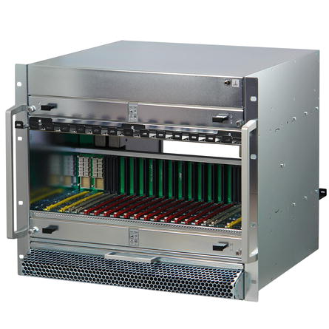
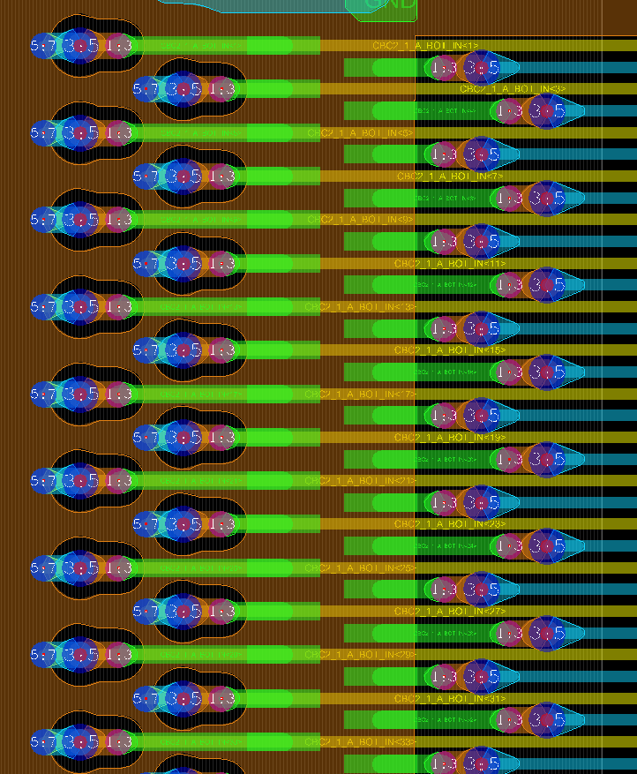
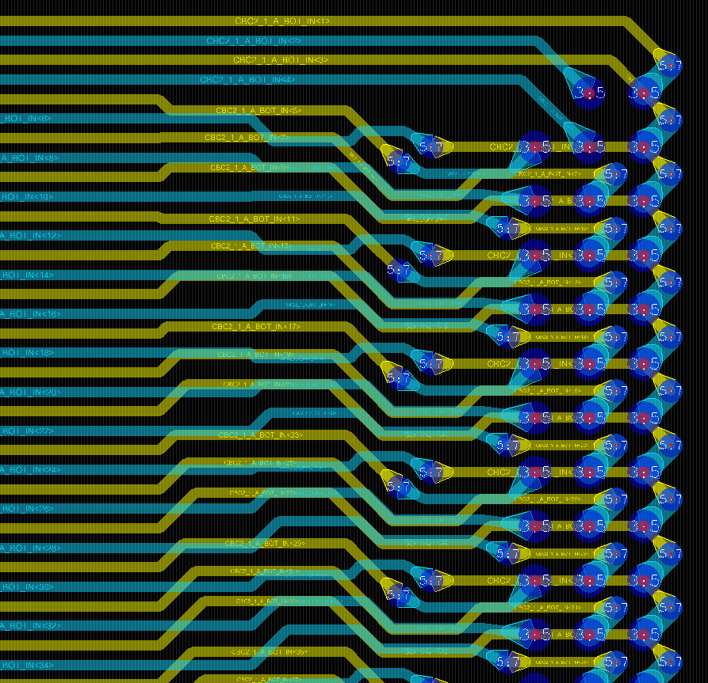
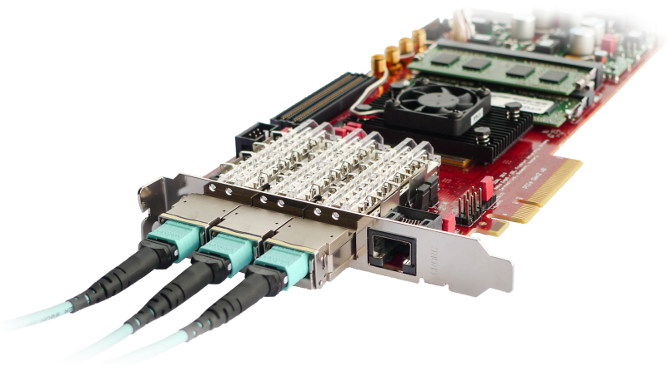
Introduction
High-speed design challenges:
  Front-end electrical links: very light cables and flexible circuits
  Readout and control systems: complex FPGA boards, backplanes
Data rate from 100’s of Mbits to 10Gbits per sec per channel
  Maximum speed increases rapidly in back-end systems, >10Gb/s soon
Design iterations cost money and take extra time (=money)
Activities in the group offer the possibility to gather, share and preserve know-how
High-speed boards
HDI on flex
Crate systems

Slide 4

Sources
Istvan Novak’s courses
  Signal Integrity: Advanced High-Speed Design and Characterization
  Power Distribution Design
Eric Bogatin’s courses
  Essential Principles of Signal Integrity
  Advanced Gibabit Channel Design
  http://www.bethesignal.com/bogatin/
Eric’s book
  ISBN-13: 978-0132349796

Slide 5
Signal bandwidth
Time domain: periodic signal (e.g. clock)
  Period, T
  Rise/fall times, t_{r}/t_{f}
  Duty cycle, D
Time-domain to frequency domain using Fourier
transformation
Spectrum of an ideal square wave (D=0.5, t_{r}/t_{f} = 0)
  DC (0th harmonic) + infinite odd harmonics (1,3,5…)
  Amplitudes decrease with 1/f (-6dB/octave), A_{n}=(2 x A)/(π x n)
A = Vhi - Vlo
tr
tf
Vhi
DT
(1-D)T
Vlo
T = 1/Fo

Slide 6
Signal bandwidth
Trapezoidal signal (duty cycle D, t_{r}/t_{f} > 0)
DC (0th harmonic) + infinite harmonics
If D is not 0.5, we have even harmonics too
First corner frequency (f₁) depends on the duty cycle, but has less impact than rise/fall times
Second corner frequency (f₂) depends ONLY on rise/fall times, f₂ = 1/(π x t_{r})
log
G(f)
-6dB/octave
-12dB/octave
f₀
f₁
f₂
log f

Slide 7
Signal bandwidth
How many harmonics should be preserved ?
First approach
  Use only harmonics which are more than 70% of the amplitude (-3dB) of the equivalent ideal square wave => e.g. up to 5th harmonic
Second approach
  Sum up harmonics until the rise/fall time reaches required value => BW=0.35/t_{r(10-90)}, or BW=0.22/t_{r(20-80)} which is about the same as the second corner frequency
Do not use higher bandwidth than required, because it costs money

Slide 8
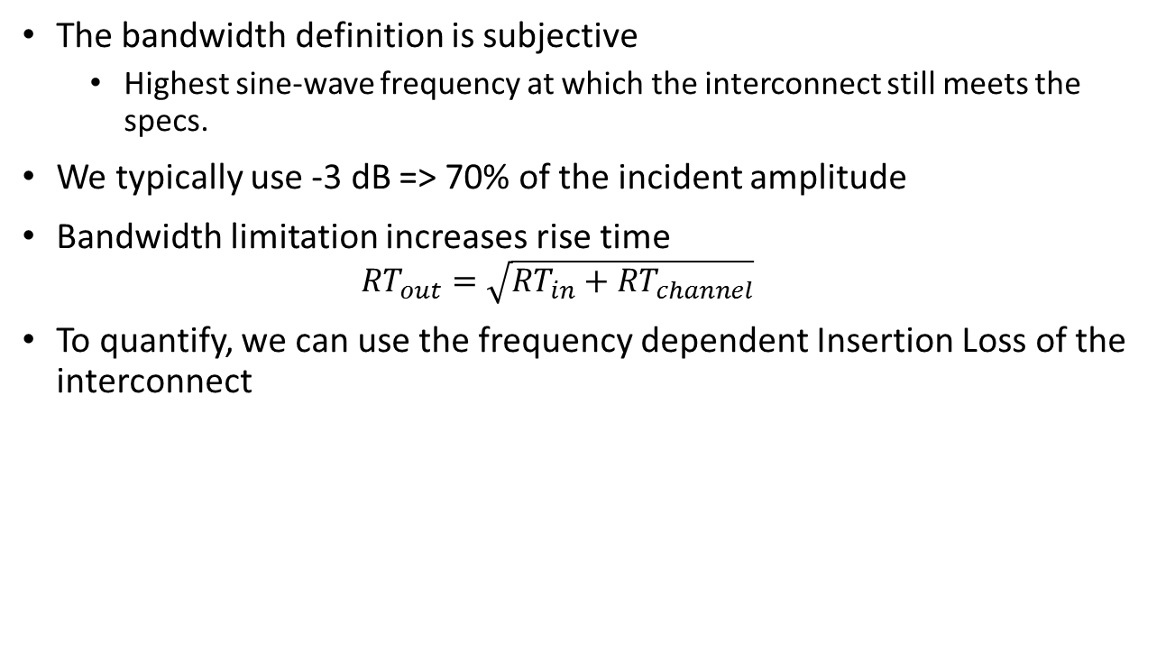
Bandwidth of the interconnect
The bandwidth definition is subjective
  Highest sine-wave frequency at which the interconnect still meets the specs.
We typically use -3 dB => 70% of the incident amplitude
Bandwidth limitation increases rise time
  $${RT}_{out}=\sqrt{{RT}_{in}+{RT}_{channel}}$$
To quantify, we can use the frequency dependent Insertion Loss of the interconnect
log
G(f)
-6dB/octave
log
H(f)
-12dB/octave
+
= ?
f₀
f₁
f₂
log f
f

Slide 9
Time-domain and frequency-domain
Time-domain is our real world where the design has to meet the specifications
Frequency-domain is a mathematical ‘world’ where we can solve some problems faster than in the time-domain
Different interpretations of the SAME thing
Fourier transform links the two domains
Time
FT
Frequency
IFT

Slide 10


Scattering or S-parameters
Behavioural model of N-port linear electrical networks
Frequency domain description
  Sine wave in, sine wave out
Inherited from RF and now widely used by SI/PI engineers
a₁
N-port
Network
2-port network
$$\left[\begin{matrix}b_{1} \\ b_{2}\end{matrix}\right]=\left[\begin{matrix}S_{11} & S_{12} \\ S_{21} & S_{22}\end{matrix}\right]\left[\begin{matrix}a_{1} \\ a_{2}\end{matrix}\right]$$
$$b_{1}=S_{11}a_{1}+S_{12}a_{2}$$
$$b_{2}=S_{21}a_{1}+S_{22}a_{2}$$
b₁
S_{ij}
a_{N}
b_{N}
output
input
$$\vec{b}=S\vec{a}$$

Slide 11
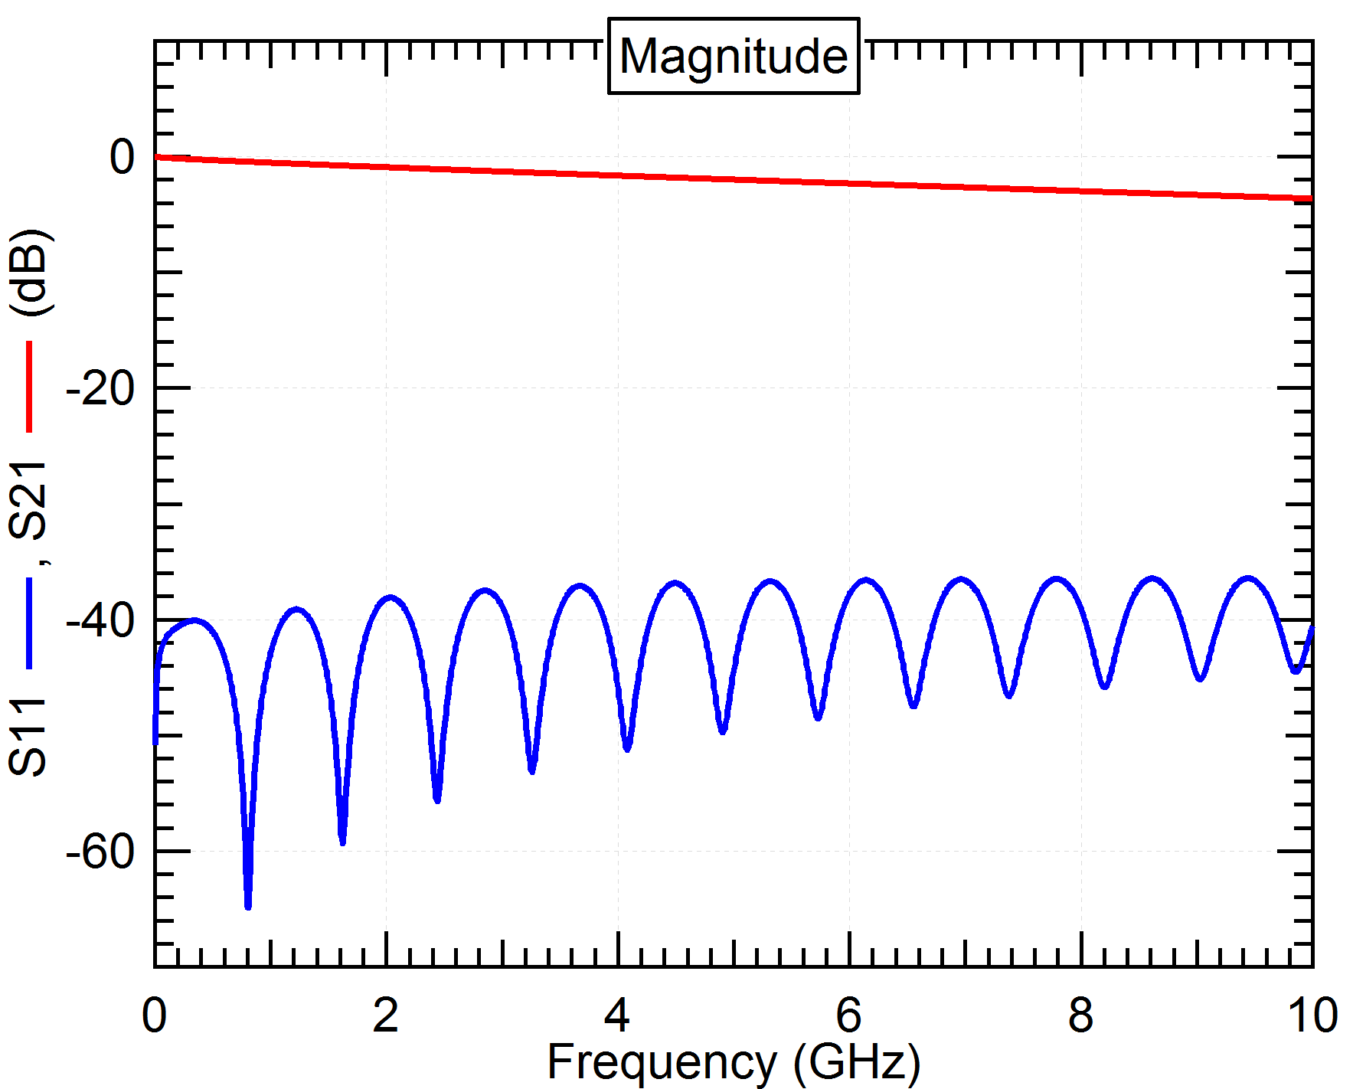
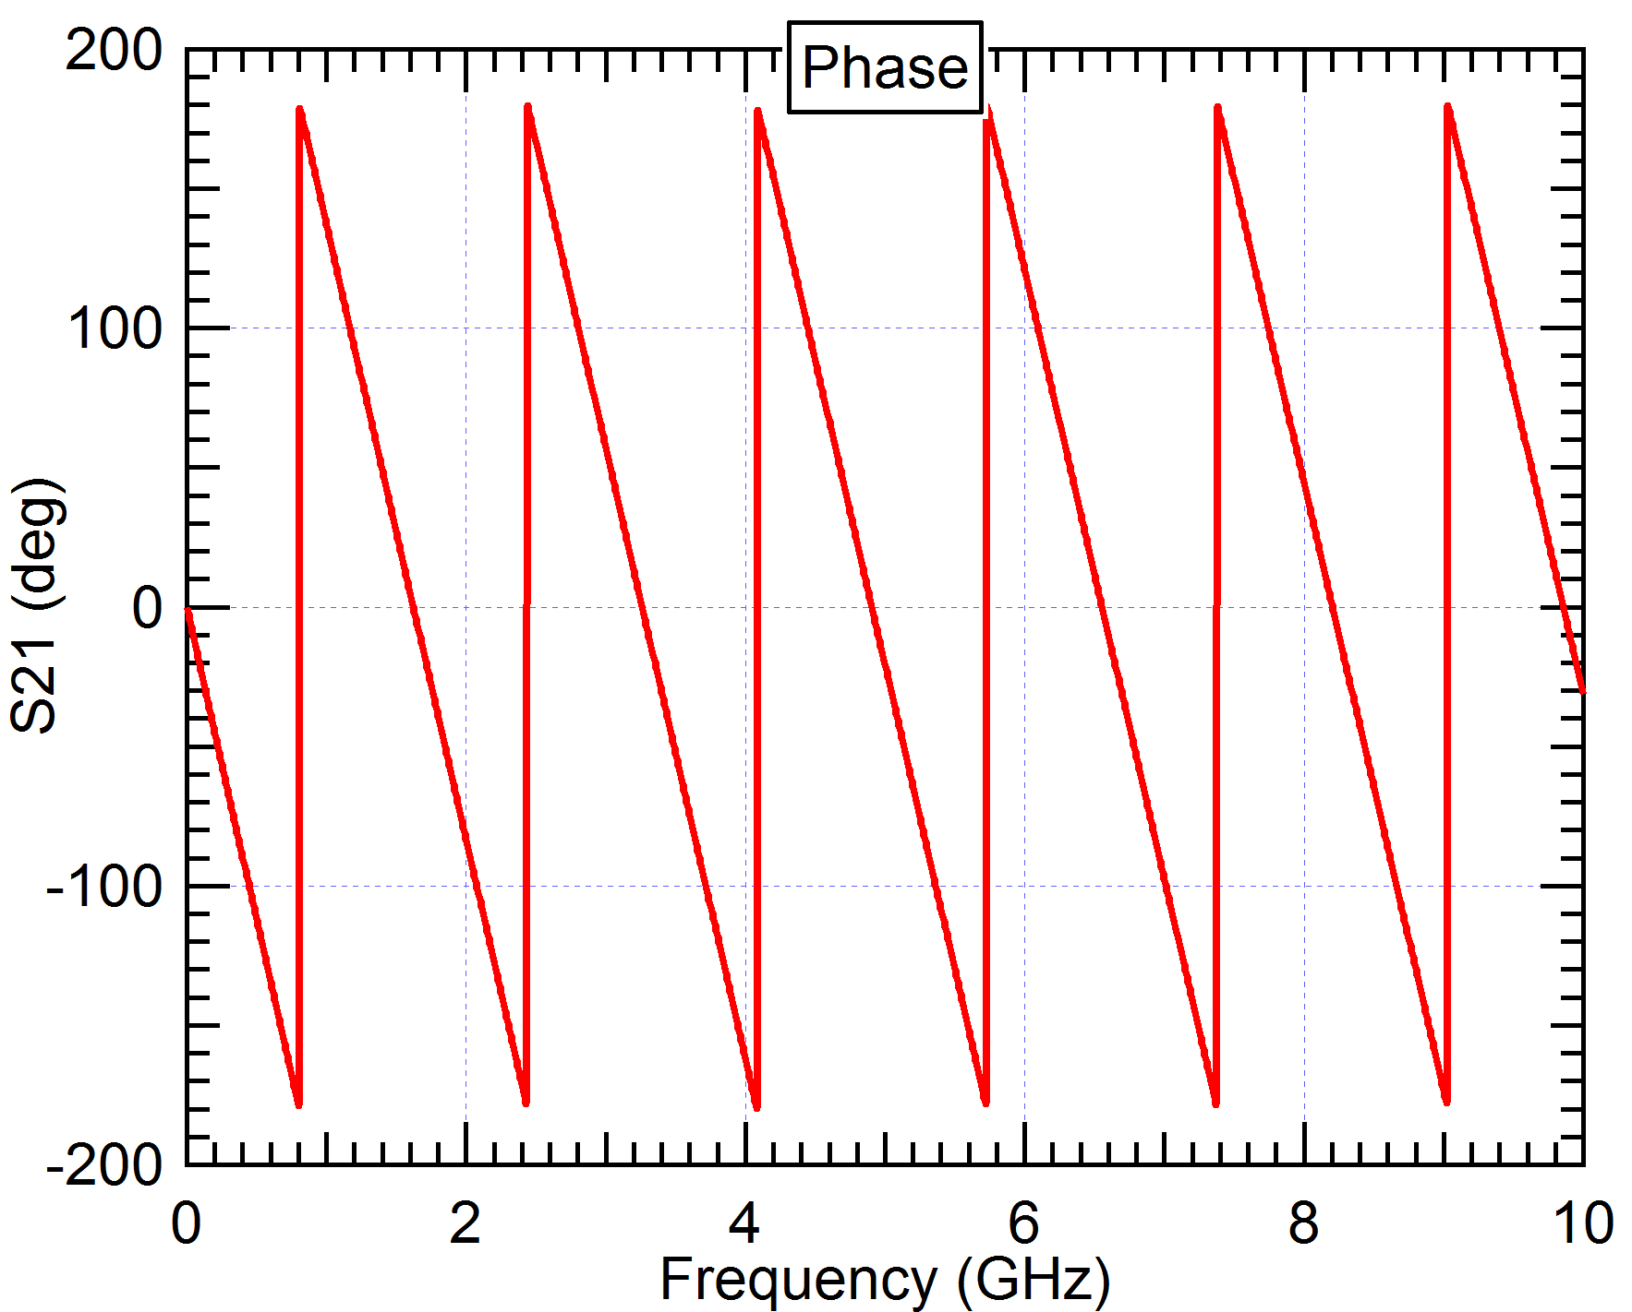
S-parameter plots (frequency domain)
S11 should be large negative number if the port is matched to the reference impedance
Mag(S21) shows the frequency dependent loss (FOM dB/inch/Hz)
Ang(S21) should start from 0 and decrease with increasing frequency (saw tooth)

Slide 12
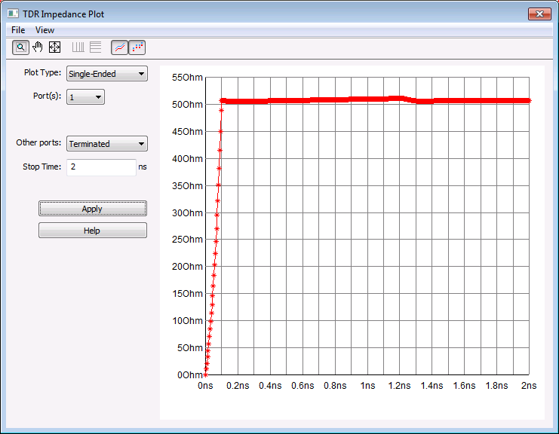
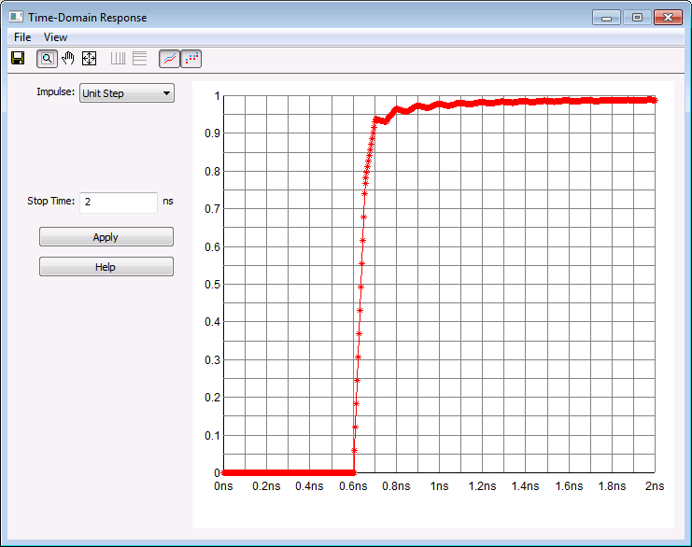
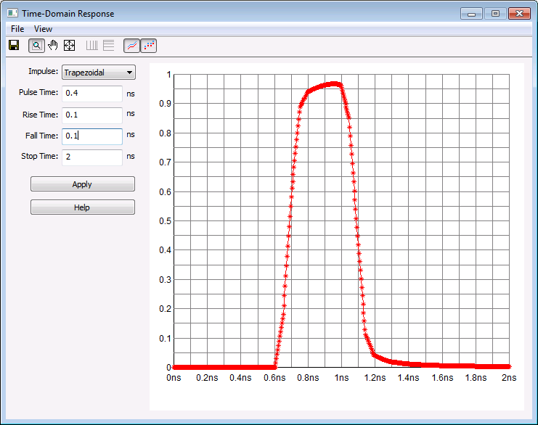
S-parameters (time domain)
S parameters can be converted back to time domain (IFFT). Some artifacts may
appear if the S parameter data does not meet certain criteria.
Impedance (TDR)
Step response (TDT)
Impulse response (TDT)

Slide 13
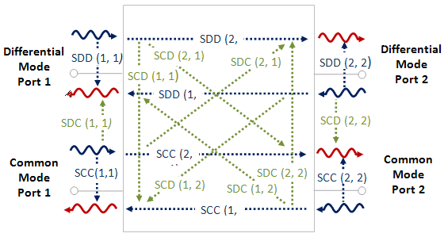
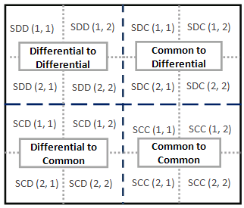
Mixed-mode S-parameters
Single-ended S parameters can be converted to mixed-mode S parameters
to describe differential signals.

Slide 14
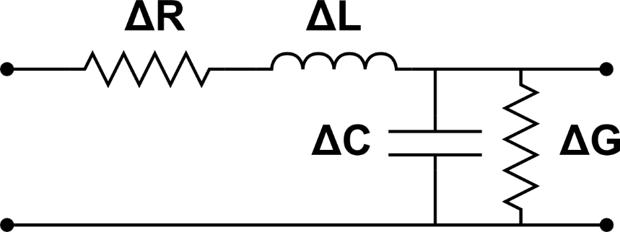




Transmission line
Critical part of the channel that connects the source (driver) to the destination (receiver)
It can be described with its electrical characteristics: Z₀, t_{pd}, loss, etc.
  Do not uniquely determine the geometry (no solution or many solutions)
Typical aspect ratio (trace width/dielectric height) of 50 ohm traces: from 2 (microstrip) to 1 (stripline)
$$Z_{0}=\sqrt{\frac{∆R+jω∆L}{∆G+jω∆C}}$$
$$γ=\sqrt{(∆R+jω∆L)(∆G+jω∆C)}$$
$$γ=α+jβ=α+jωt_{pd}$$
Lossless case (R = 0, G = 0)
$$Z_{0}=\sqrt{\frac{L}{C}}$$
$$t_{pd}=\sqrt{LC}$$
$$t_{pd}=\frac{l}{v}, v=\frac{c}{\sqrt{ε_{eff}}}$$
Equivalent circuit of a TL segment, length = Δx

Slide 15
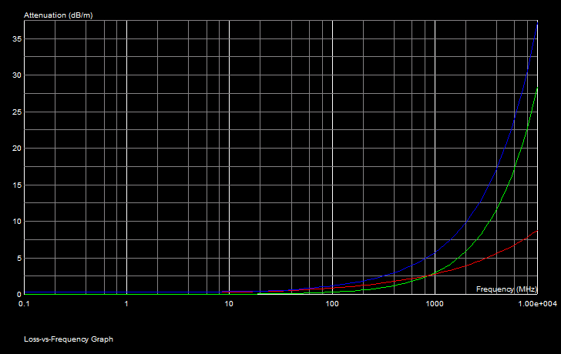
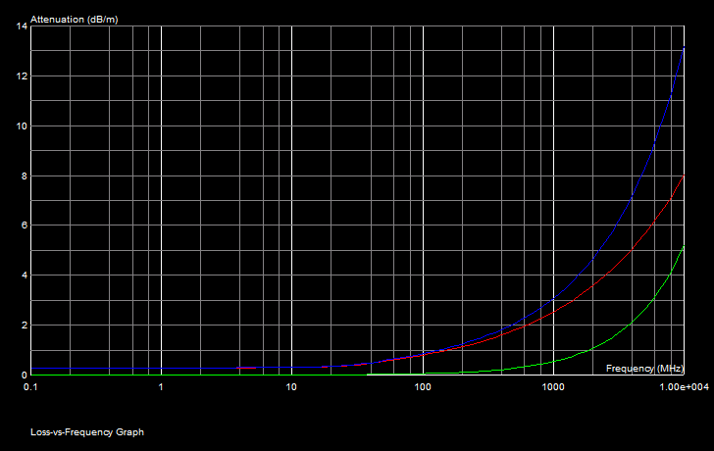
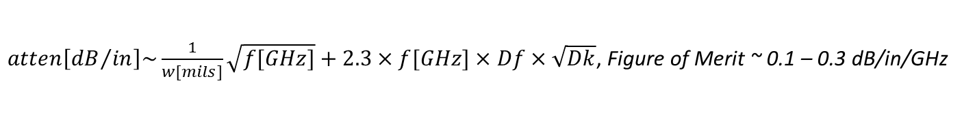
Losses, resistive vs. dielectric
Standard FR4 dielectric, Dk=4.3, tanδ=0.02
h=150um, w=250um, Z₀ ~ 50 Ohm
dielectric loss dominates above 900MHz
Better dielectric, Dk=3.7, tanδ=0.002
h=150um, w=300um , Z₀ ~ 50 Ohm
conductor loss dominates, wasting the expensive dielectric
with tight coupling and surface roughness it gets worse
Surface roughness of the conductor increases the resistive loss at higher frequency. Use wider
traces to reduce the impact.
$atten\left[{dB}/{in}\right]\sim \frac{1}{w[mils]}\sqrt{f[GHz]}+2.3×f[GHz]×Df×\sqrt{Dk}$, Figure of Merit ~ 0.1 – 0.3 dB/in/GHz

Slide 16
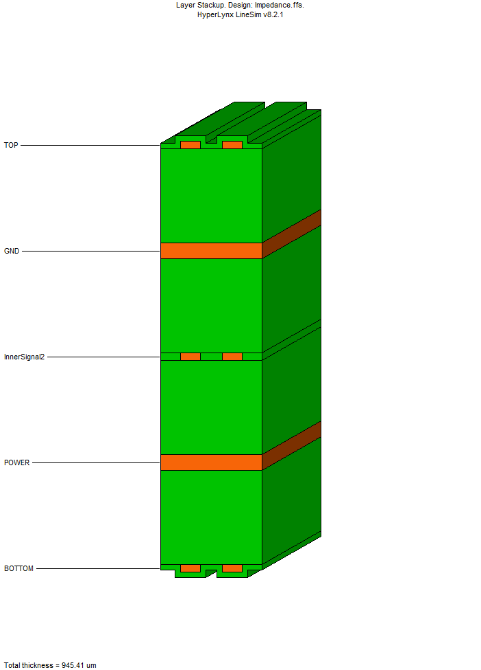
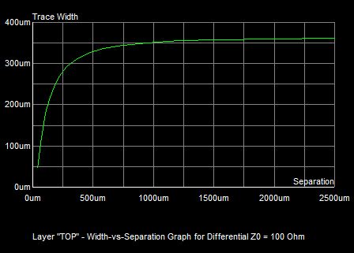
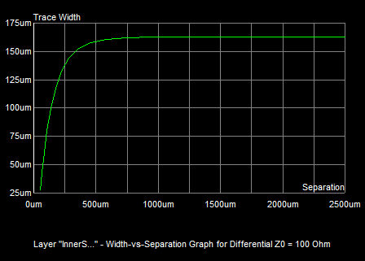
Coupled traces, differential impedance
200um
Coupled microstrip traces
400um
Coupled stripline traces
FR4, Dk=4.3, tanδ=0.02

Slide 17
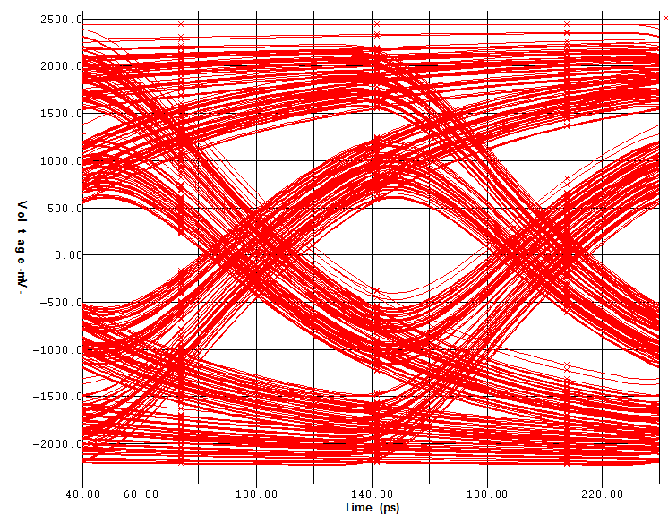
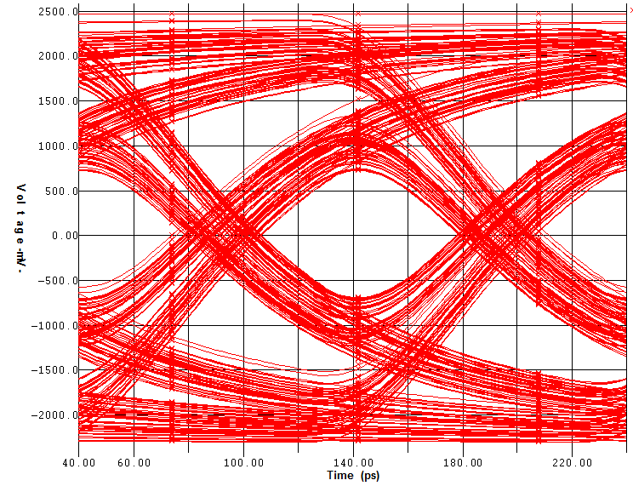
Tight vs loose coupling
h=150um
w=180um
s=150um
Zdiff=100.8ohm
h=200um
w=350um
s=1000um
Zdiff=100.3ohm
Tight coupling decreases differential impedance. Need either narrower traces, or higher
dielectric. This may lead to more losses. Loose coupling may compromise routing density.

Slide 18
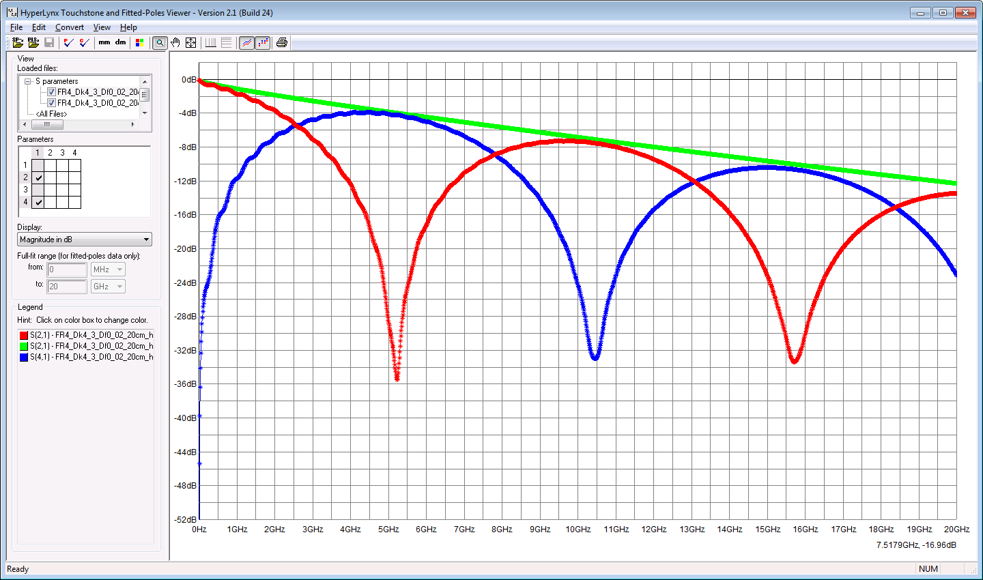
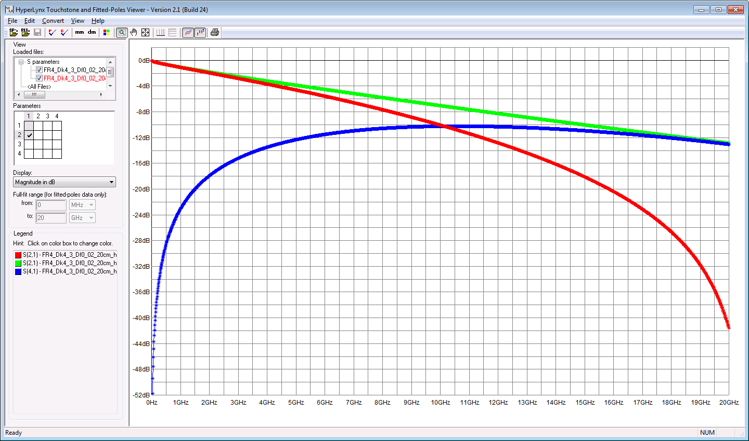
Loss in coupled microstrip traces
Sdd21
Sdd21
S41
S21
S21
S41
Tight coupling
Loose coupling
Judging the loss of the interconnect using only S21 is difficult, if traces are coupled.
If the coupling is intentional (differential trace), use SDD21 instead.

Slide 19
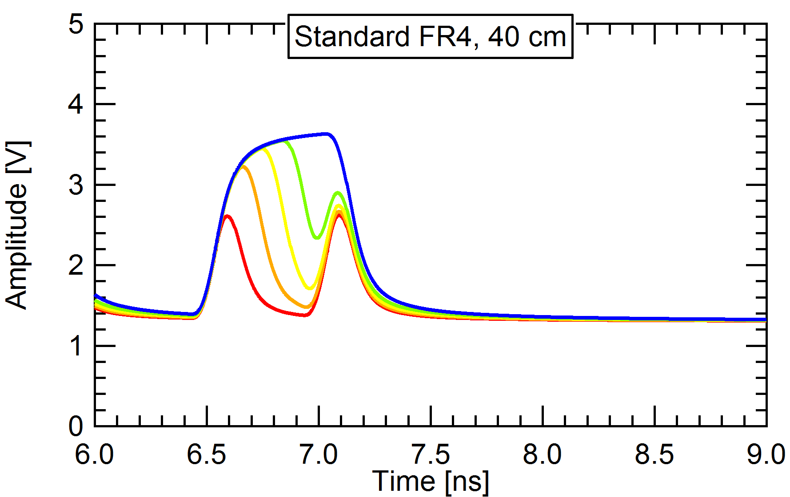
Inter-symbol Interference (ISI)
Frequency dependent (!) loss causes rise time degradation.
Rise time degradation causes vertical and horizontal eye collapse. State of the signal is influenced by previously transmitter bits.

Slide 20
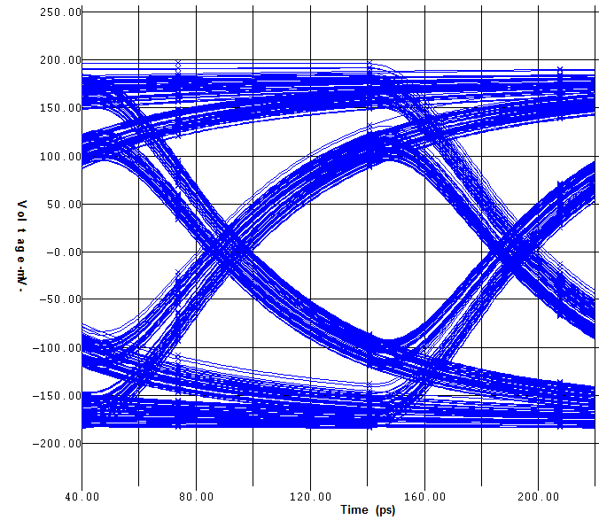
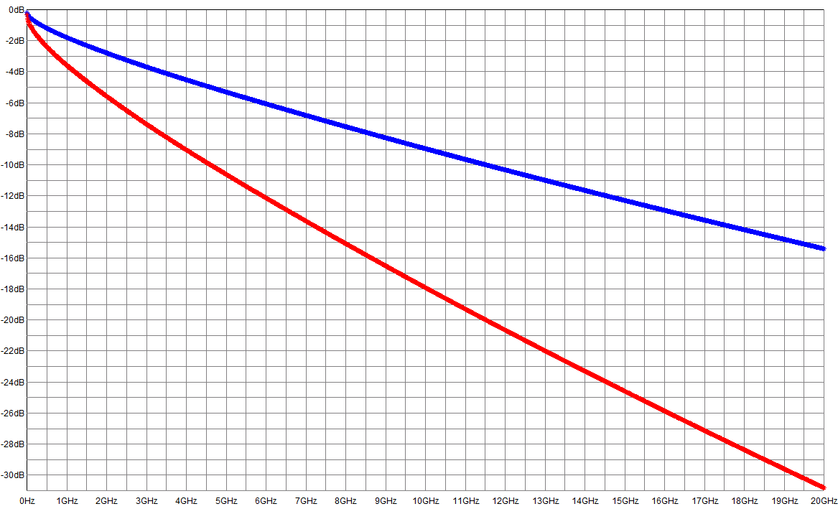
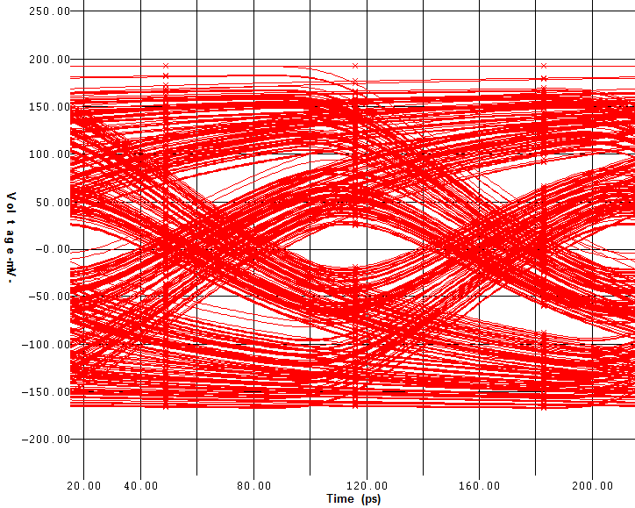
Attenuation at Nyquist
Sdd21
20cm, FR4 microstrip
40cm, FR4 microstrip
10Gb/s, 5GHz Nyquist
Practical limits:
-8dB limit without EQ,
-15dB CTLE,
-25dB CTLE+FFE+DFE

Slide 21
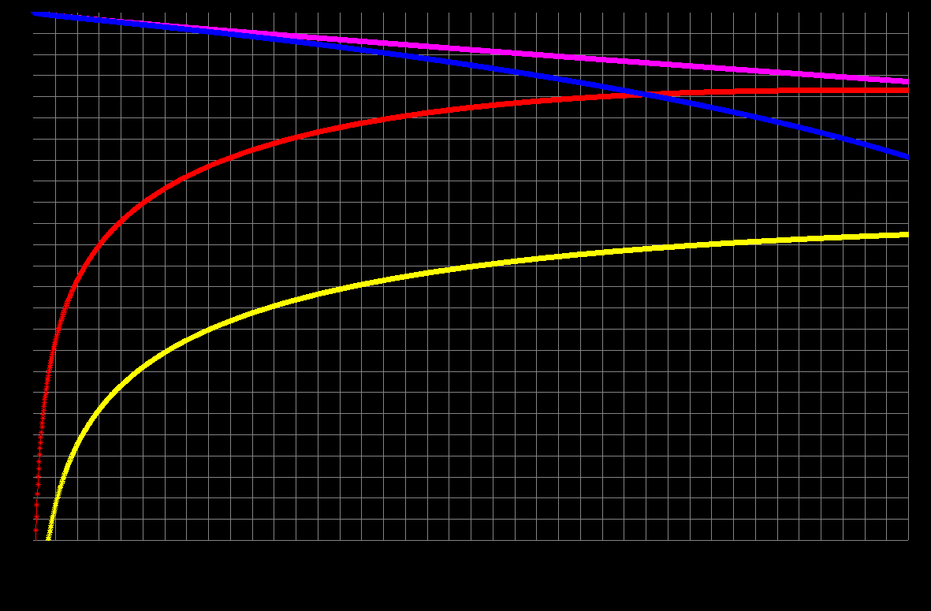
Mode conversion, frequency domain
Mode conversion (differential skew), check SCD terms
Mixed-mode S parameters
SDD21_3ps
SDD21_18ps
SCD21_18ps
SCD21_3ps

Slide 22
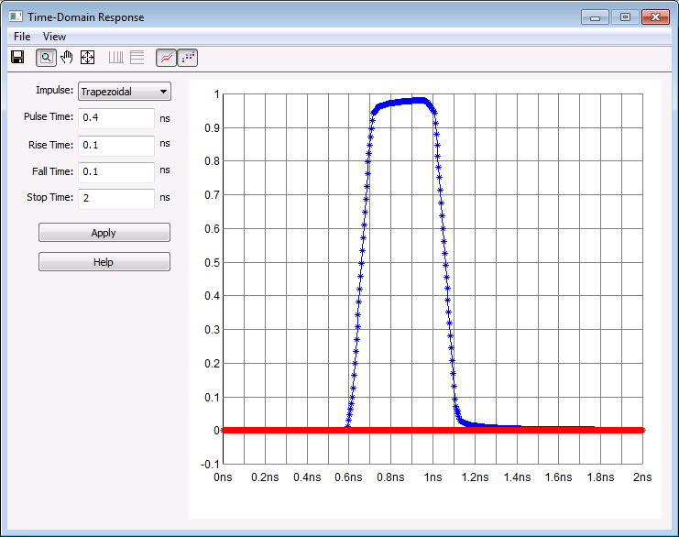
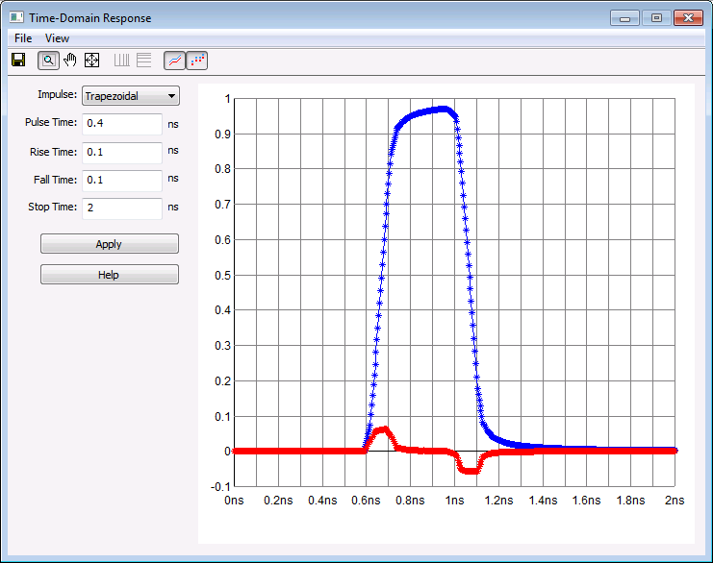
Mode conversion, time domain
Differential
Differential
Common
Common
No skew
18ps skew

Slide 23
Mode conversion summary
There is no perfect interconnection, there is always mode conversion
  Skew (driver, traces, connectors, PCB dielectric etc.), asymmetries
Issues related to mode conversion
  Distorted differential signal, EMI, ISI (reflected common signal converts back to differential)
Solutions
  Reduce skew to achieve << 10% UI, match near mismatch
  Terminate common signal (no conversion back to differential)
  Use symmetrical ground return vias (GSSG)
  Use better dielectric glass weave (1086, 3313), better glass fill or zig-zag routing

Slide 24
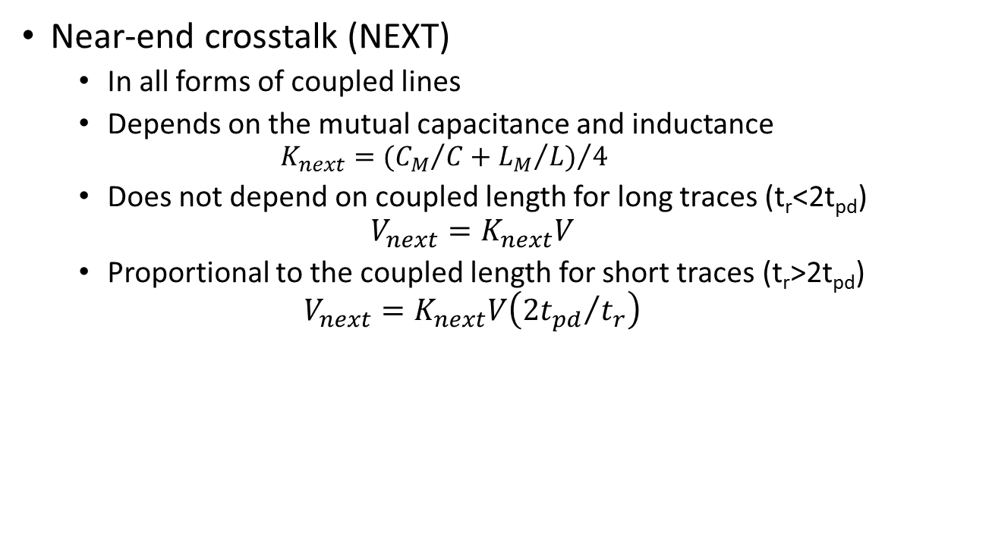
Crosstalk
Near-end crosstalk (NEXT)
  In all forms of coupled lines
  Depends on the mutual capacitance and inductance
    $$K_{next}={({C_{M}}/C+{L_{M}}/L)}/4$$
  Does not depend on coupled length for long traces (t_{r}<2t_{pd})
  $$V_{next}=K_{next}V$$
  Proportional to the coupled length for short traces (t_{r}>2t_{pd})
  $$V_{next}=K_{next}V\left({2t_{pd}}/{t_{r}}\right)$$
aggressor
TX
RX
victim
RX
TX

Slide 25
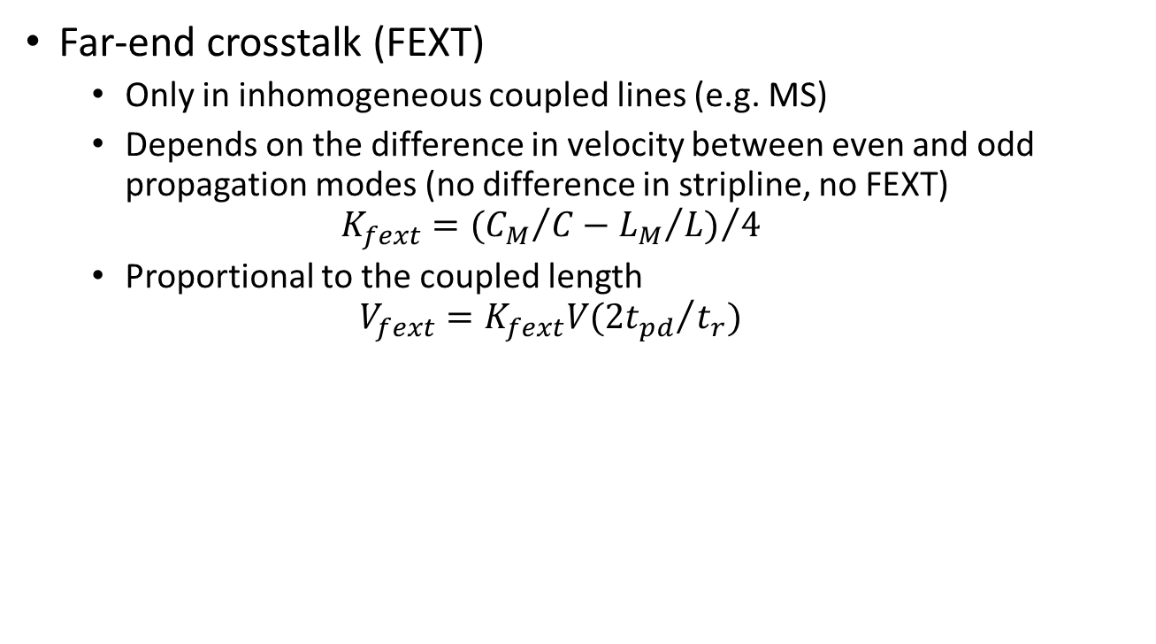
Crosstalk
Far-end crosstalk (FEXT)
  Only in inhomogeneous coupled lines (e.g. MS)
  Depends on the difference in velocity between even and odd propagation modes (no difference in stripline, no FEXT)
  $$K_{fext}={({C_{M}}/C−{L_{M}}/L)}/4$$
  Proportional to the coupled length
  $$V_{fext}=K_{fext}V({2t_{pd}}/{t_{r}})$$
aggressor
TX
RX
victim
TX
RX

Slide 26
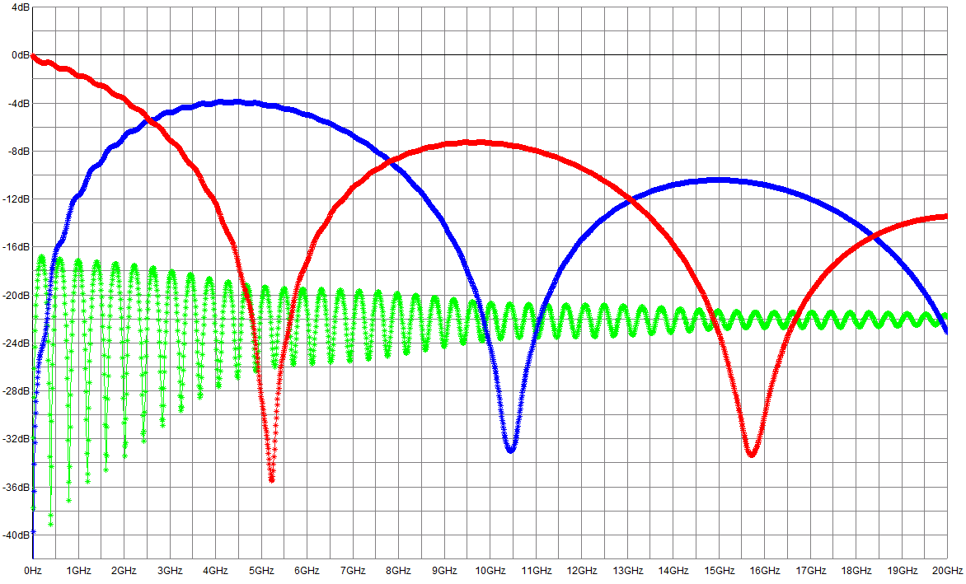
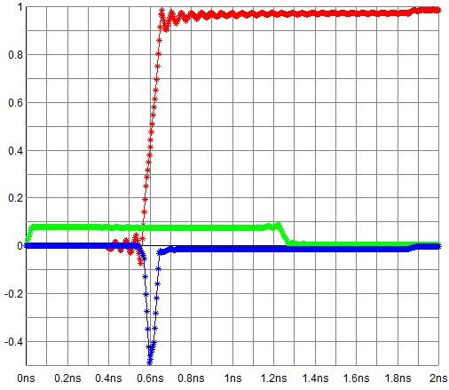
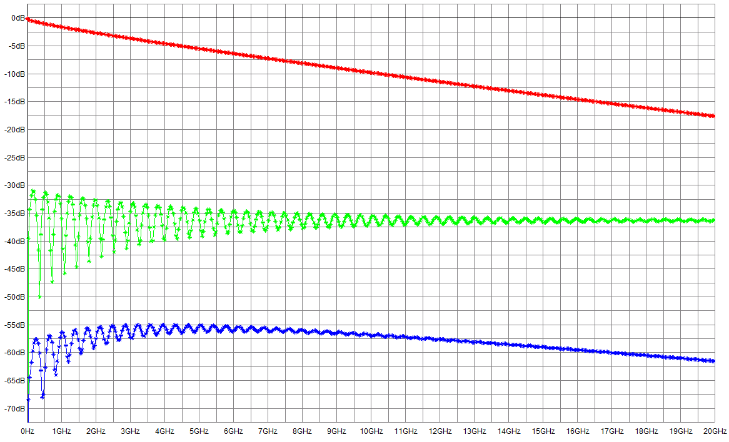
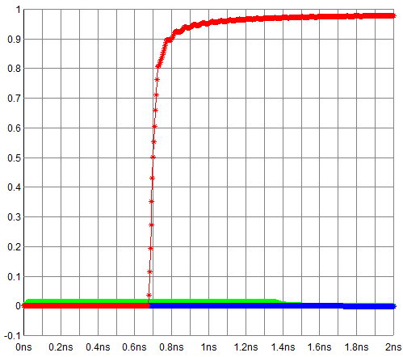
Crosstalk, frequency and time domain
S21
NEXT lasts for 2TD
Microstrip
S41
S31
S21
S31
Stripline
S41

Slide 27
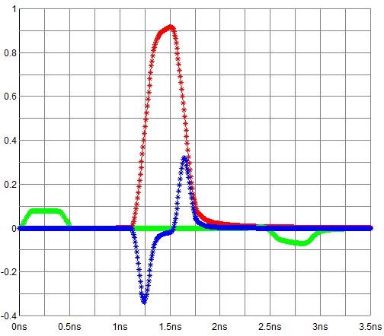
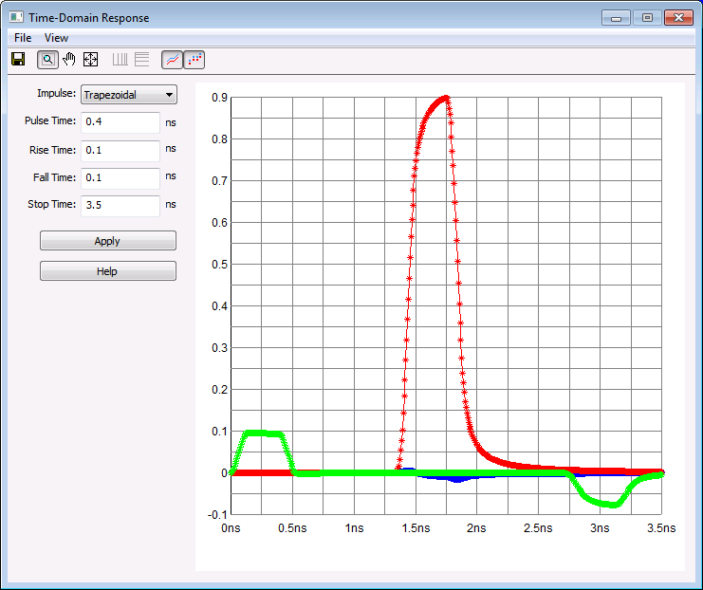
Crosstalk, frequency and time domain
S21
Microstrip
FEXT in UI
S41
S31
S21
S31
Stripline
S41
No FEXT

Slide 28
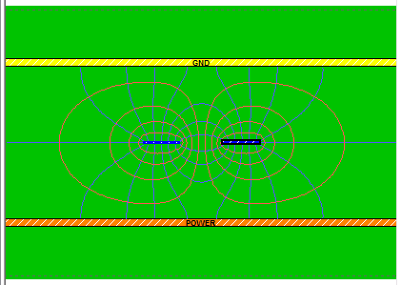
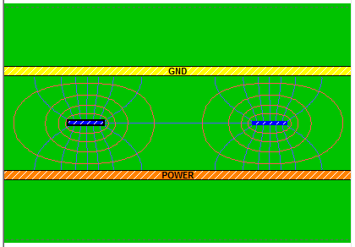
Crosstalk, mitigation
Use stripline, no FEXT
  Loosely coupled allows to reduce dielectric height, less fringe fields
Microstrip should be very short
  If you need microstrip traces, use large separation (s > 3w)
  Reduce coupled length as much as possible
Use 2D field solver for estimating the crosstalk

Slide 29
Discontinuities
Discontinuities cause reflections
  May impact the channel for MANY bit periods (difficult to compensate with equalization)
Depends on many factors
  Rise time, data rate, length and location of the discontinuity, losses
Single reflection is tolerated if driver is terminated
  Multiple discontinuities are much worse
Losses could help, if you cannot avoid a discontinuity make the reflected signal travel longer
Typical discontinuities
  Stubs (routing, termination), via, imperfect return, connectors, packages

Slide 30
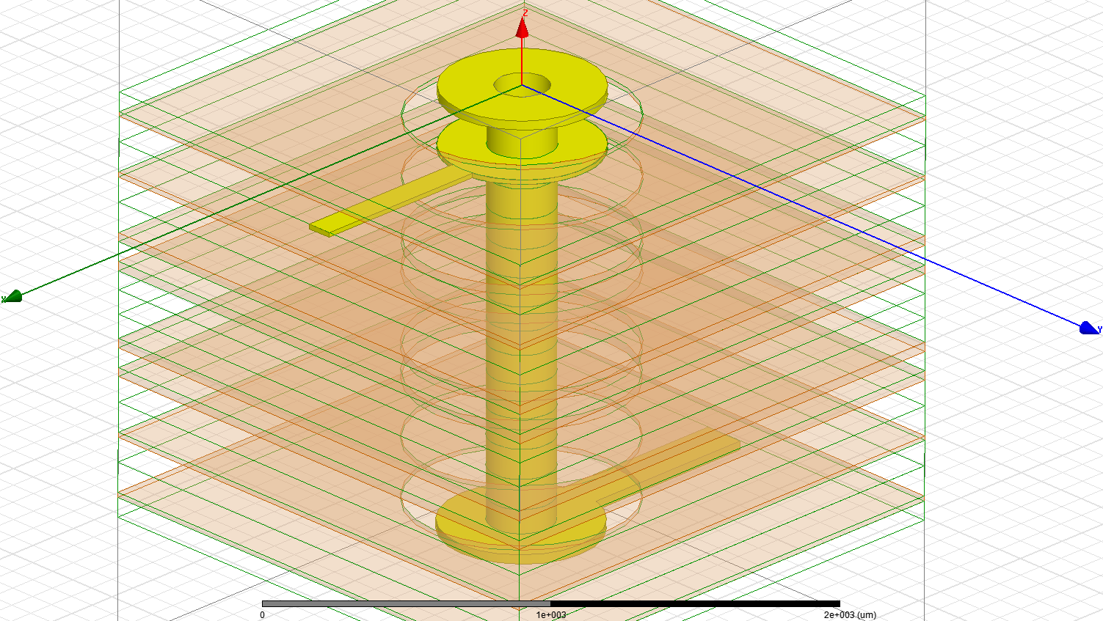
Routing via
Provide connection between different PCB layers
Consists of the thru and stub part
Features:
  Hole diameter
  Capture pad size
  Clearance diameter
  Non-functional pads (NFP)
  Differential via pitch
  Via length
LC pi approximation only
at low frequencies
Use 3D field solver to explore design space

Slide 31
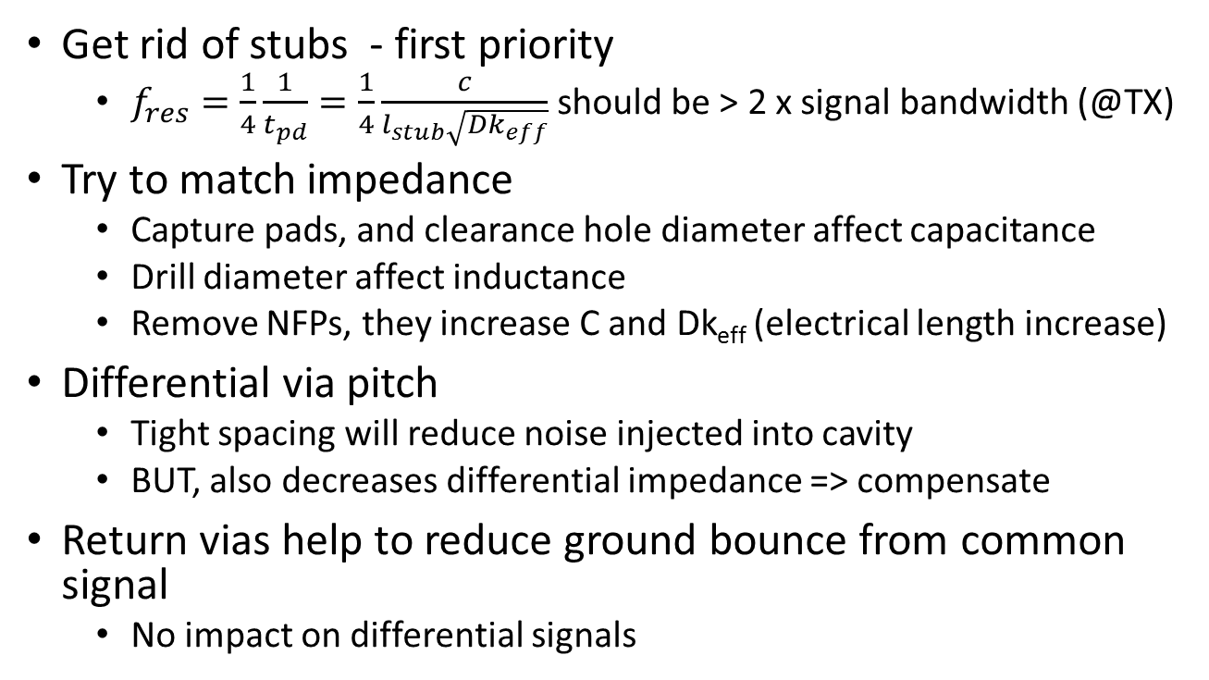
Via optimization
Get rid of stubs - first priority
  $f_{res}=\frac{1}{4}\frac{1}{t_{pd}}=\frac{1}{4}\frac{c}{l_{stub}\sqrt{{Dk}_{eff}}}$ should be > 2 x signal bandwidth (@TX)
Try to match impedance
  Capture pads, and clearance hole diameter affect capacitance
  Drill diameter affect inductance
  Remove NFPs, they increase C and Dk_{eff} (electrical length increase)
Differential via pitch
  Tight spacing will reduce noise injected into cavity
  BUT, also decreases differential impedance => compensate
Return vias help to reduce ground bounce from common signal
  No impact on differential signals

Slide 32
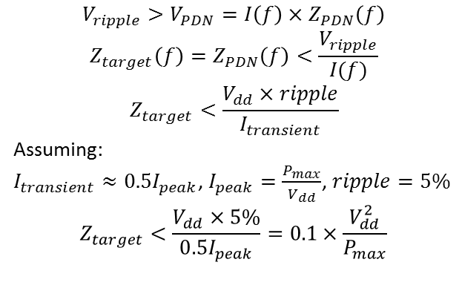
Power Delivery Network
Deliver power from source to ICs
Provide return path for signals
Keep radiation within EMI limits
Complex system consisting of:
  Voltage Regulator Module(s) (VRM)
  Decoupling capacitors
  Vias, traces, planes on the PCB
  Packages, etc.
Need to design Z(f) according to the power rail requirements =>
Take into account the limits set
by the package and chip
PDN
Z_{PDN}
V
VRM
IC
$$V_{ripple}>V_{PDN}=I\left(f\right)×Z_{PDN}\left(f\right)$$
$$Z_{target}\left(f\right)=Z_{PDN}\left(f\right)<\frac{V_{ripple}}{I(f)}$$
$$Z_{target}<\frac{V_{dd}×ripple}{I_{transient}}$$
Assuming:
$I_{transient}≈0.5I_{peak}$, $I_{peak}=\frac{P_{max}}{V_{dd}}$, $ripple=5\%$
$$Z_{target}<\frac{V_{dd}×5\%}{0.5I_{peak}}=0.1×\frac{V_{dd}^{2}}{P_{max}}$$

Slide 33
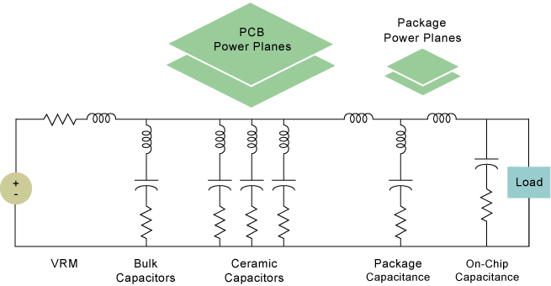
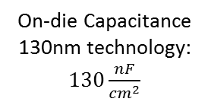
PDN design challenge
Package inductance:
~nH - ~pH
DC-10kHz
10-100kHz
100kHz-100MHz
Beyond 100MHz
On-die Capacitance
130nm technology: $130\frac{nF}{{cm}^{2}}$
We can influence this region.

Slide 34
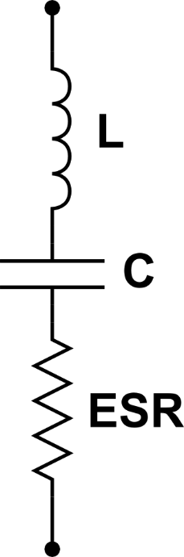

Decoupling
Bulk capacitors
  Electrolytic: high C, high ESR, high L
  Tantalum: high C, medium ESR, medium L
Multi-layer Ceramic Capacitors (MLCC)
  Medium C, low ESR, low L
  Low ESR could mean high Q, which is not always good
  ESL depends also on mounting
  How to achieve ESL = 0.5-2nH
    We have to reduce parasitic inductances
  Bring planes close to the IC
  Use thin dielectric between planes
  Use short and wide surface traces

Slide 35

Ansys Capacitor Library Browser
Define VRM
Define target Z
Select capacitors
  Vendor
  Size
Use automatic
optimization
Adjust manually

Slide 36
Tools
Impedance calculators
  Quick answer but not always accurate, good for estimation
  PCB Saturn, Qucs
Field solvers
  2D/3D, hybrid
  Slightly more complicated to set up, but accurate
CERN
  ANSYS EM (HFSS, Q3D, Siwave, Designer, Via wizard, PI advisor)
  HyperLynx (not supported)
  Cadence
  Other tools: CST (3D EM solver), Qucs

Slide 37


Measurement
TDR uses voltage step with certain rise time (=> BW)
TDR has a broadband receiver
  Higher noise floor
TDR source power roll-off limits dynamic range
VNA uses single-tone sine wave
VNA has narrow IF bandwidth
  Lower noise floor
  Higher dynamic range
TDR
VNA

Slide 38






TDR vs VNA, dynamic range
S-parameters (measurement)
Eye diagram (simulation, ANSYS)
5Gb/s PRBS-7
(PNA)
5Gb/s PRBS-7
(TDR)

Slide 39




Controlled impedance on very high density flex circuits
G. Blanchot, M. Kovacs, T. Gadek, Gianluca Traversi, Francesco De Canio
Investigated the impedance of various routing topologies
Built test board to measure impedances and compared with previously calculated values
Edge coupled microstrip
Edge coupled stripline
Broadside coupled stripline
Broadside coupled offset stripline
Shorter test line = 101 mm
Longer test line = 113 mm

Slide 40

Controlled impedance on very high density flex circuits, measurement
Impedance measurements are well in line with simulation results, small difference observed for the broadside coupled striplines.
Edge-coupled microstrip and stripline differential pairs showed 80 Ω – 90 Ω impedance, close to the target 100 Ω value.

Slide 41



Light weight readout cable for inner barrel pixel readout

Slide 42

Light weight readout cable for inner barrel pixel readout, S parameters

Slide 43




Light weight readout cable for inner barrel pixel readout, time domain
Eye diagram simulation on built-in cable model, L=2.7m TD=0.008, 1.2Gbps
Eye diagram simulation using FFE on built-in cable model, L=2.7m TD=0.008, 1.2Gbps
Simulation
Simulation
Eye diagram simulation on measured S parameters, L=2.7m TD=0.008, 1.2Gbps
Eye diagram simulation using FFE on measured S parameters , L=2.7m TD=0.008, 1.2Gbps
Simulation using
measured model
Simulation using
measured model

Slide 44
ALICE ITS upgrade, Outer Barrel
Gianluca Aglieri, Antoine Junique
Transmission lines on Flexible Printed Circuits (Al/Polyimide or Cu/Polymide)
  specifications, design, modelling
  identification of critical parameters (resistive losses in ITS case)
  identification of architectural trade-offs e.g. bit-rate vs physical constraints (material, thickness, lengths) and definition of system specs
Frequency domain synthesis/analysis, S parameters models transient domain simulation (including the "virtual" eye-diagrams)

Slide 45




ALICE ITS upgrade, Outer Barrel
Frequency domain
Al, L=1500 mm, Roughness=5 um
Cu, L=1500 mm, Roughness=5 um
Time domain
PRBS @ 320Mb/s, no pre-emphasis
PRBS @ 320Mb/s, no pre-emphasis

Slide 46
ALICE ITS upgrade, Outer Barrel
Transmission of 1.2 Gb/s on Al Flex over 27cm robust
Transmission of 160 Mb/s on Al/Cu Flex over 1.5m robust
    Pre-emphasis desirable
Transmission of 320 Mb/s on Flex over 1.5m possible
    Pre-emphasis necessary
    Copper and differential microstrips facilitate

Slide 47


GBTx test board PDN
4-port sensing (Kelvin method) for measuring low impedance (plane)
Simulation carried out using Ansys
SIwave
Nice match above 1 MHz
Mismatch at low frequency could be
due to capacitor model
David Porret

Slide 48


PCIe40 PDN, current density
Jean-Pierre Cachemiche, Fred Rethore (CPPM)
Cadence Sigrity
Current density too high
Reshaping and splitting planes to
reduce current

Slide 49


PCIe40 PDN, IR drop
Jean-Pierre Cachemiche, Fred Rethore (CPPM)
Cadence Sigrity
VCCT (0.9V, 5A) ~ 60mV
VCCR (0.9V, 13A) ~ 160mV
Redesigned shapes to reduce drop
VCCT (0.9V, 5A) ~ 15mV
VCCR (0.9V, 13A) ~ 50mV

Slide 51
Backup slides

Slide 52


PDN analysis, mounting inductance
Bottom
Top
Capacitor | Model | Mounting Quality | Total Mounting Inductance, nH | Estimated ESL, nH | Actual Resonance Frequency, MHz | Resonance Frequency w/o Mounting, MHz
C6 | C=0.1uF, ESL=Auto, ESR=25mOhms | good | 1.52 | 0.31 | 12.89 | 27.71
C10 | C=0.1uF, ESL=Auto, ESR=25mOhms | good | 0.63 | 0.28 | 19.98 | 27.71
Bottom
Top

Slide 53

PDN analysis, laminate thickness
Thinner laminate helps to reduce the impedance, but watch out for anti-resonance (Cplane + decoupling inductance)
Anti-resonance
Thinner laminate

Slide 54

Unwanted coupling seen on S21

Slide 55



HyperLynx, PCIe Gen3 channel

