Slide 1
Quantitative data analysis #2: practical examples
Domenico Giordano, Andrea Valassi (CERN IT-SDC)
With contributions from and many thanks to Hassen Riahi
White Area Lecture, 3rd June 2015
(Follow-up to the previous White Area Lecture on 18th February 2015)

Slide 2
Outline (WA #1)
REMINDER!
(WA#1 Feb 2015)
Measurements and errors
  Probability and distributions, mean and standard deviation
  Introduction to tools and first demo
Populations and samples
  What is statistics and what do we do we do with it?
  The Law of Large Numbers and the Central Limit Theorem
  Second demo
Designing experiments
Presenting results
  Error bars: which ones?
  Displaying distributions: histograms or smoothing?
Conclusions and references

Slide 3
Conclusions (WA #1)
REMINDER!
(WA#1 Feb 2015)
Statistics has implications at many levels and in many fields
  Daily needs, global economy, HEP, formal mathematics and more
  Different fields may have different buzzwords for similar concepts
We reminded a few basic concepts
And we suggested a few tools and practices

Slide 4
Take-away messages? (WA #1)
REMINDER!
(WA#1 Feb 2015)
Do use errors and error bars!
  When quoting measurements and errors, check your significant figures!
  Different types of error bars for different needs! Say which ones you are using!
    Descriptive, width of distributions – standard deviations σ, box plots…
    Inferential, population mean estimate uncertainty – standard errors σ/√n, CIs…
    [Why do we use σ/√n? Because of the Central Limit Theorem!]
    [Ask yourself: are you describing a sample or inferring population properties?]
Beware of long tails and of outliers!
  More generally: we all love Gaussians but reality is often different!
    [Why do we love Gaussians? Because maths becomes so much easier with them!]
    [Why do we feel ok to abuse Gaussians? Because of the Central Limit Theorem!]
Before analyzing data, design your experiment!
  Aim for reproducibility, reduce external factors – and it is an iterative process
Make your plots understandable and consistent with one another
  Label your axes and use similar ranges and styles across different plots
  Be aware of binning effects (do you really prefer KDEs to histograms?)

Slide 5
Outline (WA #2)
Follow-up about IPython, tools, repositories...
Data analysis in practice
  Data analysis is an iterative process!
  Data samples
  Data granularity
Practical examples as meta-analyses (with demos)
  Hassen’s case study: FTS transfer monitoring and optimization
  Domenico’s case study: analysis of Ganglia metrics
Conclusions

Slide 6
Python analysis tools on AFS at CERN
Goal: one-click script for anyone to setup the full environment
  DONE! (details on next slide) – already used successfully by LucaMe
A consistent set of Python packages is now installed on AFS
  Many thanks to Patricia Mendez Lorenzo from PH-SFT
  SLC6 and CC7, part of same software stack as ROOT, CORAL, COOL
    Better out-of-the-box build integration between Python tools and ROOT
This is being continuously maintained and improved
  Missing some packages (e.g. pandas), will be added in a next iteration
  For this iteration I added these packages on another public AFS area
  You can also easily complement this setup using python easy-install

Slide 7

Useful tools on gitlab.cern.ch
http://letsgo.gorizia.it/ristorazione/ricette/gubana
NB: No pythons were harmed to make this pie!
Committed all tools to gitlab as package ipypies
  one-click setup script
  one-click startup script (but you may prefer your own configuration)
  the notebooks used for these two White Area lectures
View notebooks from any public URL on nbviewer.ipython.org
  added direct links in the README.md of the relevant directories
    example::http://nbviewer.ipython.org/urls/gitlab.cern.ch/avalassi/ipypies/raw/master/NOTEBOOKS/WhiteArea2015/Lecture1_Feb2015/WA_AV/Hello_World.ipynb
  GitHub provides better integration with nbviewer than GitLab
    directory navigation within nbviewer, links to nbviewer within GitHub
    discussed this with IT-PES (need own nbviewer for private notebooks)
(yummy!)

Slide 8
Other news related to IPython
Major changes in IPython v3: two separate components
  Jupyter is now the language-agnostic part, including notebooks
  IPython is the language-specific kernel (non-Python kernels also exist)
  This is the version included in the ipypies setup
The ROOT team are also interested in IPython and notebooks
  As new GUI, as new parallel processing engine (ROOT-as-a-service)…
    Investigating ROOT as a new non-Python kernel within Jupyter
    See Pere Mato’s talk at the recent LHCb Computing Workshop
  We had a chat with them last week and plan to follow up

Slide 9
Data analysis is an ITERATIVE process!
It starts with questions!
(You would not even store data if you did not think that it could eventually be useful to address some questions → data model)
There is often a “default” loop, but may also take sub-loops
The more you analyse the data, the more you have new questions!
(And the more you will need to rethink your data model and your data storage and processing strategies…!)
Questions
Findings,
Answers
Data
production
& storage
Data analysis
Data reduction,
Subsets

Slide 10
Data granularity and aggregation
Storing all data generated by an experiment is often impossible
  HEP experiments use “triggers” to select the relevant data to keep
    Some triggers may even be “downscaled” to randomly select a data fraction
    And even after triggering they may store only pre-reduced data
  For the IT “monitoring” data we are most concerned with, some raw data are kept, some are thrown away and then only sums/averages are kept
Aggregate data contains less information than individual data
  By only storing sums and averages, you are likely to lose information about the differences between the categories of data in your sample
  Kind of obvious, but related to very fundamental concepts in statistics (sufficient statistics in parameter estimation, Fisher information…)

Slide 11
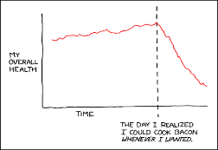
Data samples and data processing
Questions
“Experiments”
Raw data
Findings,
Answers
Data
production
& storage
Data indexes
Data analysis
Data reduction,
Subsets
Batch processing
Interactive analysis
Reduced data
Computer program,
may be CPU intensive
(have a coffee and wait!)
Pattern recognition by a human!
(fast turnaround)
These WAs focus on interactive analysis (e.g. IPython)
  but we will also cover the other phases as they are very relevant too!

Slide 12
HEP data samples and data processing
Questions
LHC experiment data taking
Raw data
Findings,
Answers
Data
production
& storage
Event indexes
Data analysis
Data reduction,
Subsets
DSTs
mini DSTs
micro DSTs
user ntuples
Interactive user analysis (ROOT)
Reconstruction
Stripping
User analysis jobs
For a very good talk about “From raw data to physics results” in HEP, see G. Dissertori’s CERN Summer Student Lecture 2010

Slide 13
FTS transfer analysis data samples
Questions
FTS monitoring
Oracle data
(summaries!)
Findings,
Answers
Data
production
& storage
Oracle indexes
Data analysis
Data reduction,
Subsets
CSV or JSON
Oracle data extraction
Interactive user analysis (IPython)
This is the analysis model for Hassen’s case study that will be presented later

Slide 14
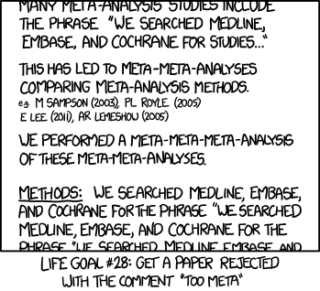
Case studies (as “meta-analyses”)
We now present some case studies as practical examples
NB: DISCLAIMER! The point here is only to describe the analysis process, not to present any actual results!!
This is why I used the term “meta-analysis”, an analysis of the analysis
  (even if this term is actually used in statistics with a slightly different specific meaning...)
http://xkcd.com

Slide 15
Hassen’s case study – FTS transfers
FTS entered production in August 2014
Changed an algorithm during September
  Question: did this lead to an improvement?
Hassen’s presentation:
  compared transfers for files >2 GB over ~1 month, Aug vs Nov
  average transfer time decreased by ~30%
  Question: does this prove that the new algorithm is better?

Slide 16
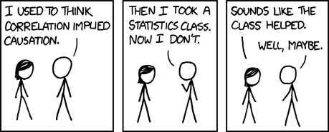
Correlation does not imply causation
In the FTS transfer time case study:
  did anything else change from Aug to Nov, apart from the algorithm?
  are there other variables more relevant than the algorithm choice?
  are (average) transfer times the most relevant metric?
Remember: by aggregating data you may lose information
  look at distributions, not only at averages
  look at multiple variables (multi-D distributions), not at a single metric
http://xkcd.com

Slide 17
Overview of the analysis
Extracted a data subset from Oracle for interactive analysis
  first in ~json from detailed tables (1 row per transfer)
    understood this is only available for the last month, gave up
    lesson on ~json: keep one row per line and make sure you can read back!
  then in csv from summary tables (1 row per 10 minutes per channel)
    only aggregate info available (e.g. average file size in 10 minutes > 2GB)
    good enough to identify some interesting patterns, but granularity could be improved if necessary (file categories by size? downscaled full detailed?)
Analysis using pandas DataFrame’s (~ntuples)
  transfer time vs file size – better use throughput?
  transfer time or throughput vs channel categories

Slide 18
“Demo”
... or rather, scroll through the notebooks in nbviewer...
(notebook1 – read from Oracle and create csv)
(notebook2 – load the csv into pandas and analyse data)

Slide 19
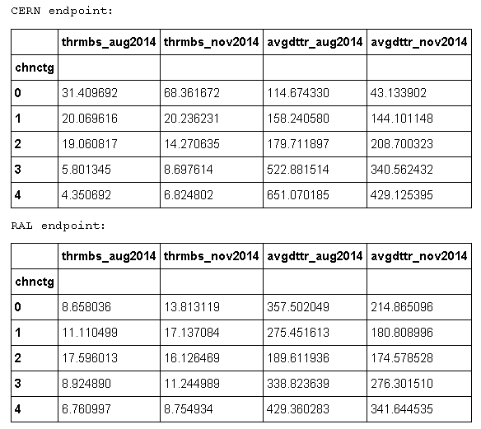

Summary of the FTS case study (1)
Average transfer time (all channels)
~ 300s CERN Nov
Different channel categories have very different behaviours!
  seems to be an improvement in all categories, but still too soon to tell
  the fraction/weight of each category in the overall average is important!

Slide 20
Summary of the FTS case study (2)
Many things could be studied
  1-D distribution showing contributions of different categories
  why CERN and RAL endpoints are so different?
  better and finer-grained categorization of channels
  box plots (y axis) grouped by channel categories (x axis)
  relevance of #streams (the actual thing that changed in the algorithm)
The point was to discuss a method, not the results...

Slide 21
Summary (before Domenico’s part)
Data analysis is an iterative process
  You start with questions, don’t know what you’ll find, apart from more questions – you need to review your process at each step
  Use small data sets for fast interactive data analysis!
Aggregating data you may lose some relevant information
  Look at individual data (if available, else review raw storage policies)
  It is often difficult to draw conclusions from a single number
Correlation does not imply causation
  Look at what else changed – look at multidimensional distributions

Slide 22

Questions?
Caravaggio – I bari (1594)

Slide 23
Backup slides

Slide 24
HEP data analysis chain in one slide
A brilliant talk that I highly recommend!
G. Dissertori, CERN Summer Student Lectures 2010

Slide 25
Raw data → Intermediate data → Plots
*
*Distinction between online and offline is getting more blurred in HEP these days!
G. Dissertori, CERN Summer Student Lectures 2010

Slide 26
An HEP example from LHCb
Raw data vs reduced data
Research is an iterative process!!!

