Slide 1
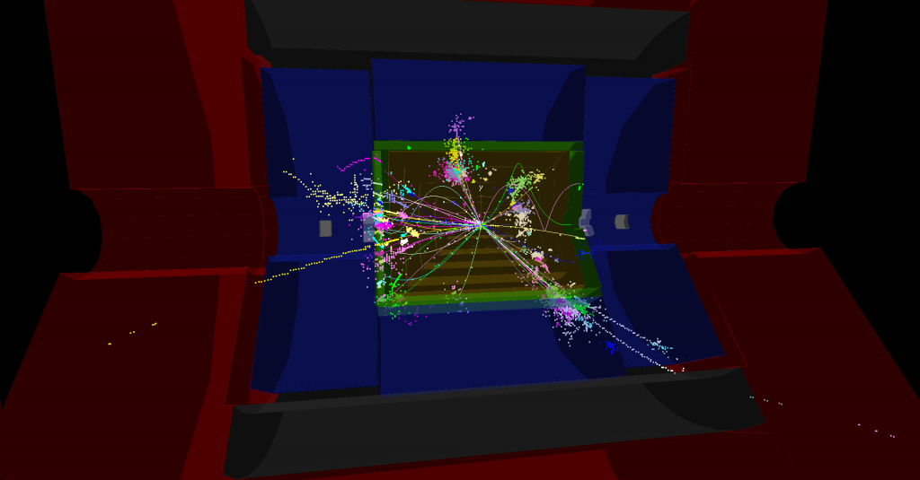
Preliminary new detector layout

Slide 2
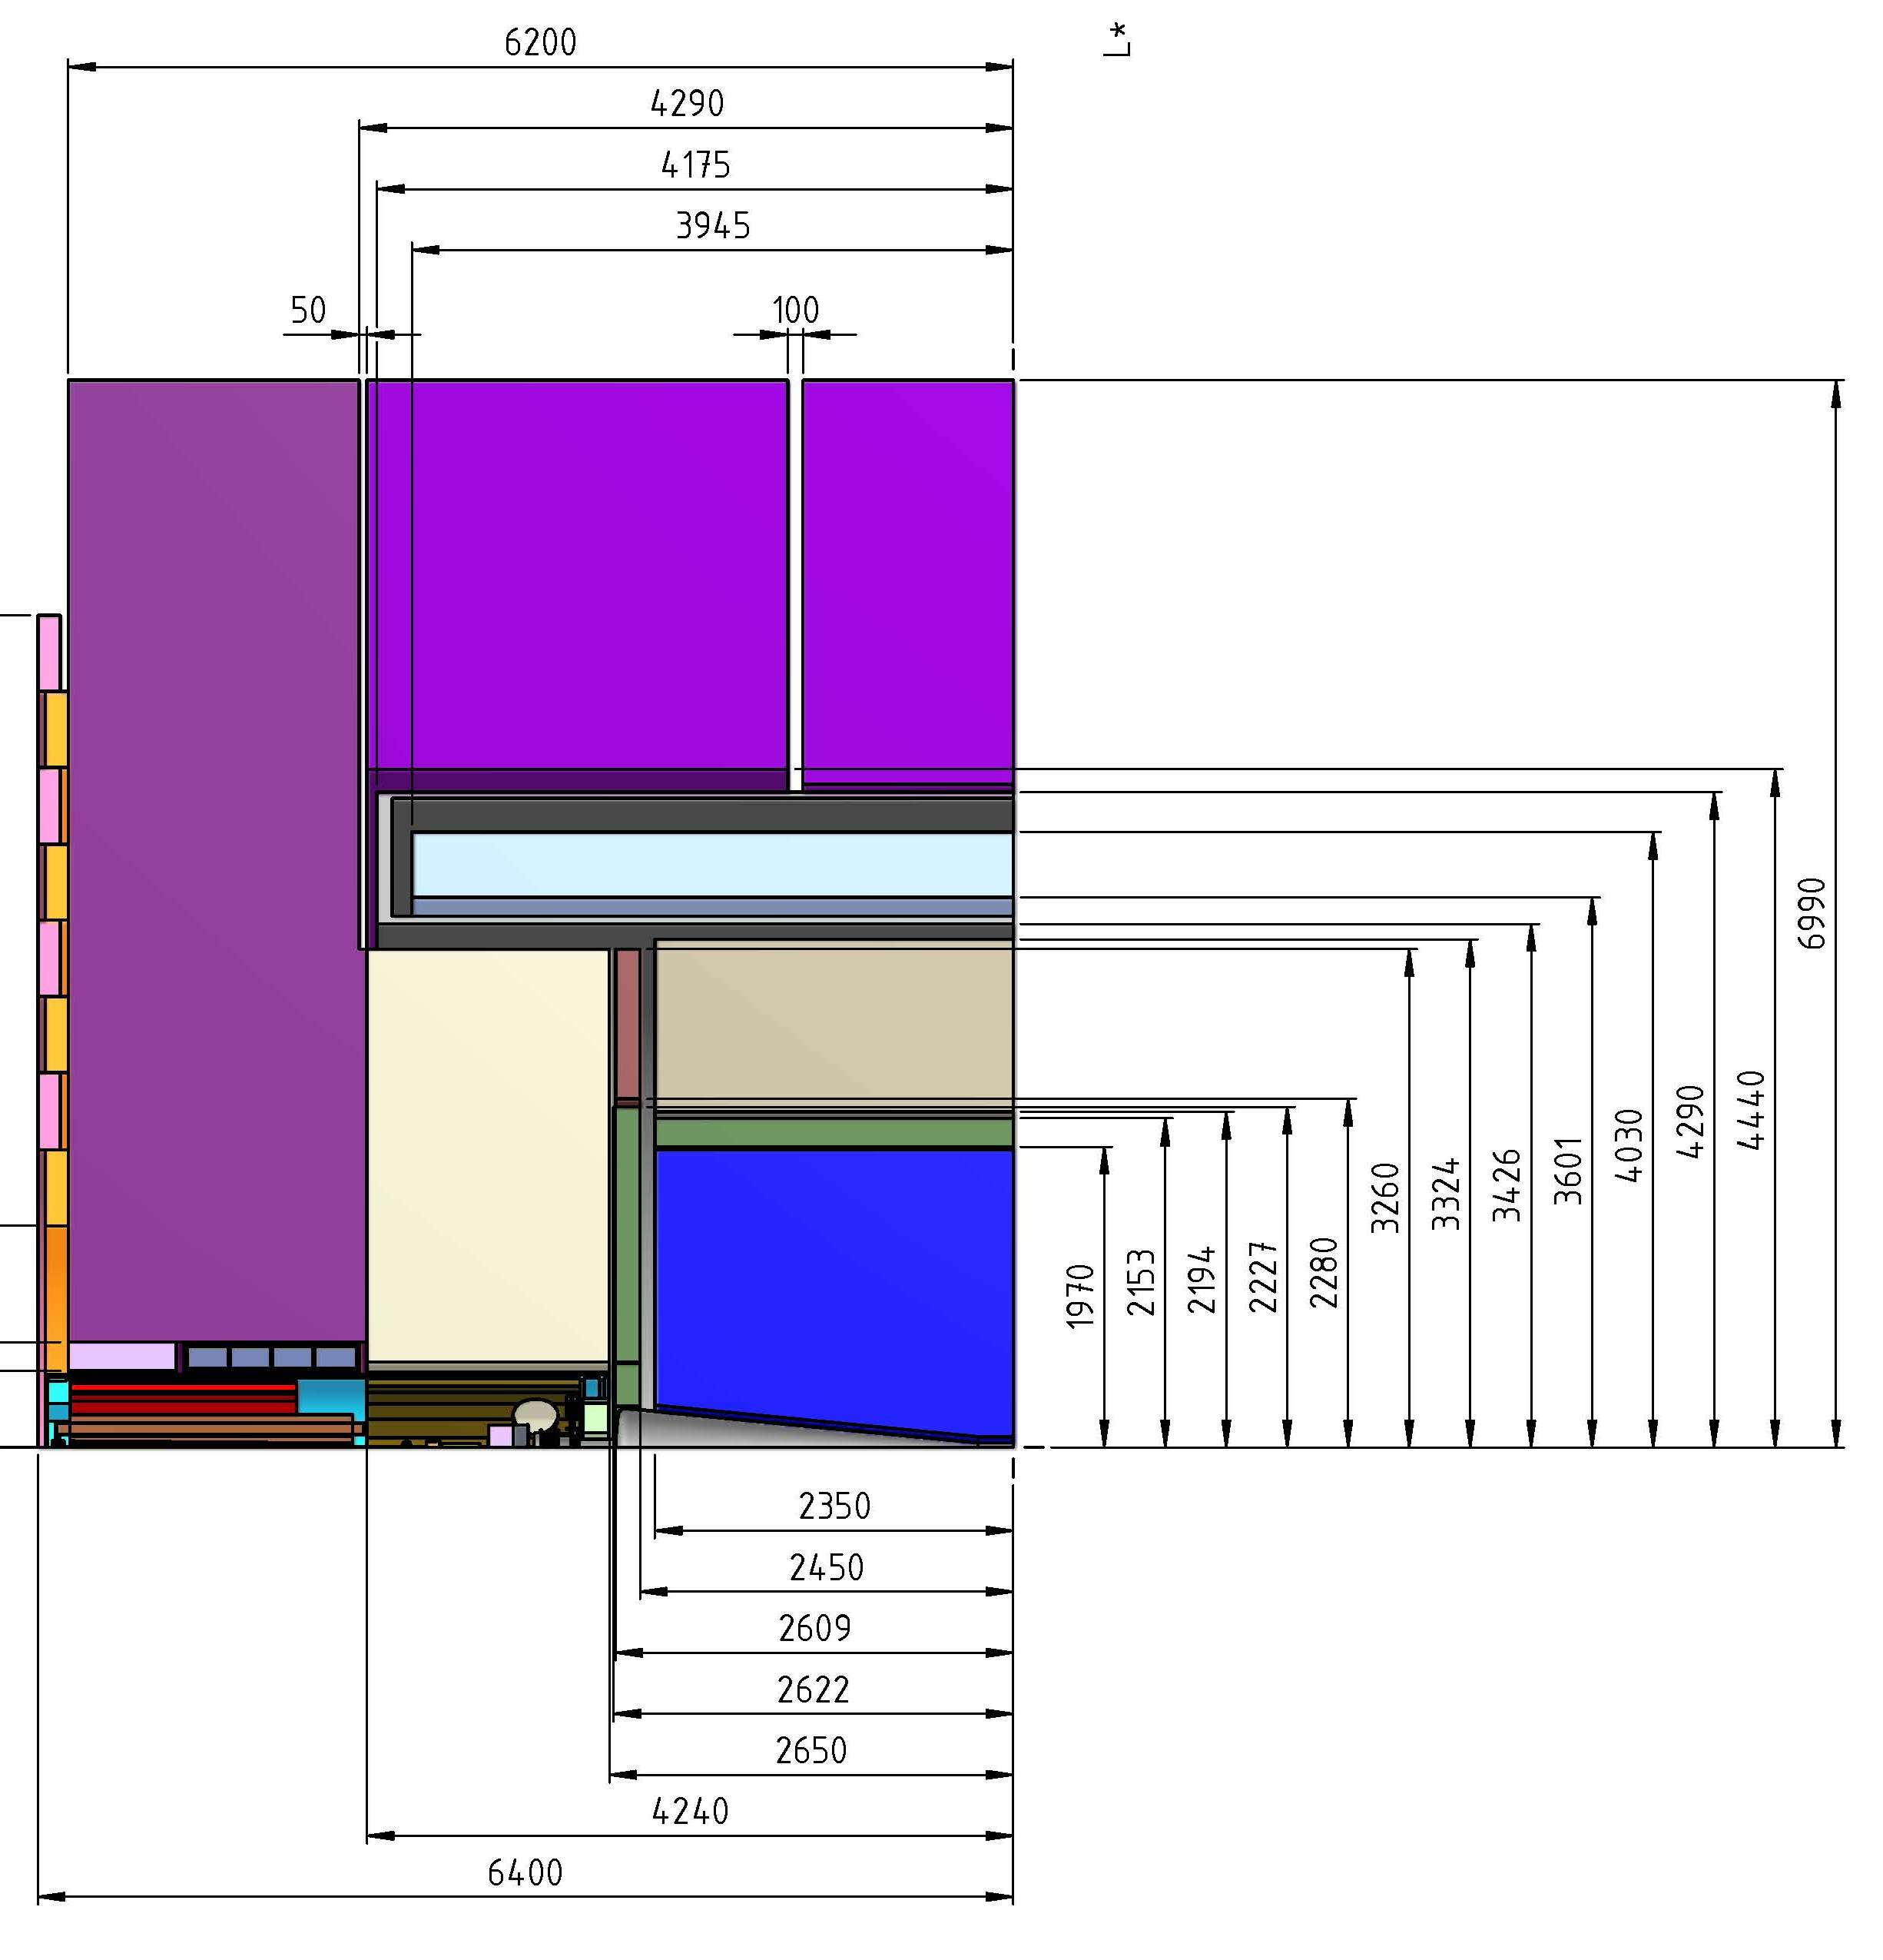
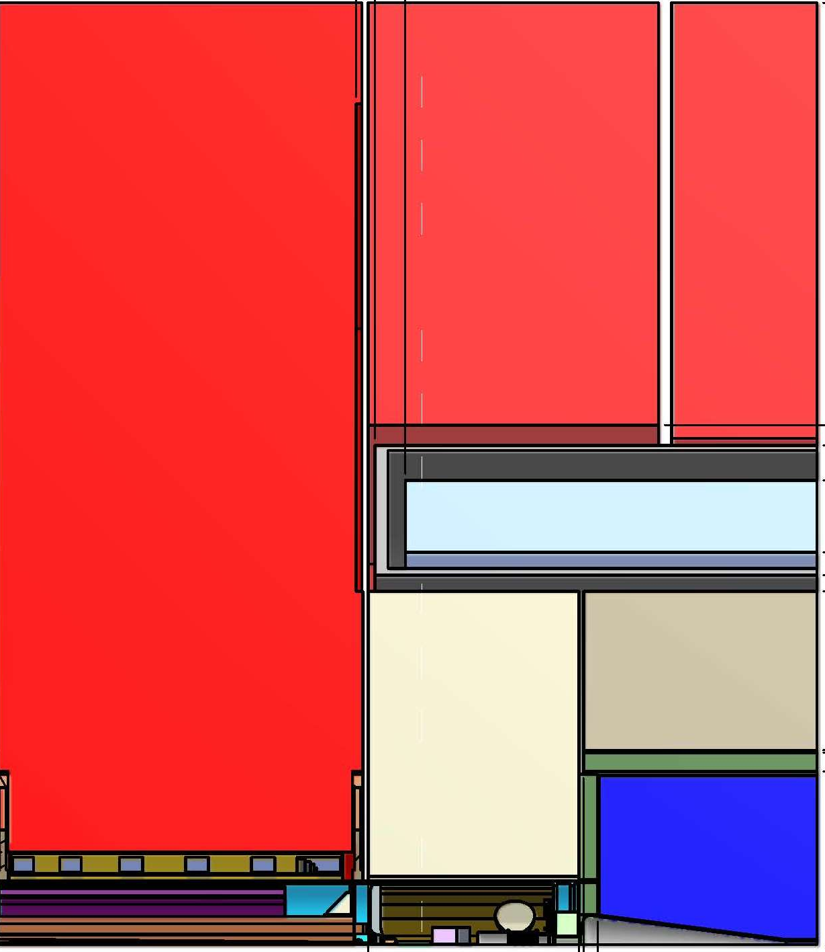
“old” CLIC detector concepts (CDR)
CLIC_ILD ( B = 4 T)
CLIC_SiD ( B = 5 T)
L* = 4.4 m
L* = 3.5 m

Slide 3
Changes to the detector model - introduction
a few things are “just decided”, concerning our next CLIC detector model
(“decided” for this stage of the study, may be revised in a few (?) years)
for example: only one detector at CLIC (no push-pull)
(i.e. only one new CLIC detector model – is also “less work”!)
other things have become evident during and after the CDR studies
for example: a TPC tracking detector is not feasible at CLIC
(time structure, backgrounds)
-> CLIC detector with all-silicon tracking system
NEXT SLIDES: status of work on a new CLIC detector model

Slide 4
FROZEN / IN WORK by end of 2014
VERTEX detector
double layers (3x2 barrel layers, 3x2 end-cap layers)
spiralling end-caps (needed due to the air-cooling concept)
innermost barrel layer at R=31 mm (-> links to B-field, see below)
TRACKING detector
Silicon tracker; tracking volume radius 1.5 m, half-length 2.3 m
tracker layout + technology (number of layers, cell sizes, cooling…)
B-Field
4 Tesla, solenoid inner bore radius approx. 3.2 m
shorter and/or slimmer iron yoke -> end-coils etc.

Slide 5
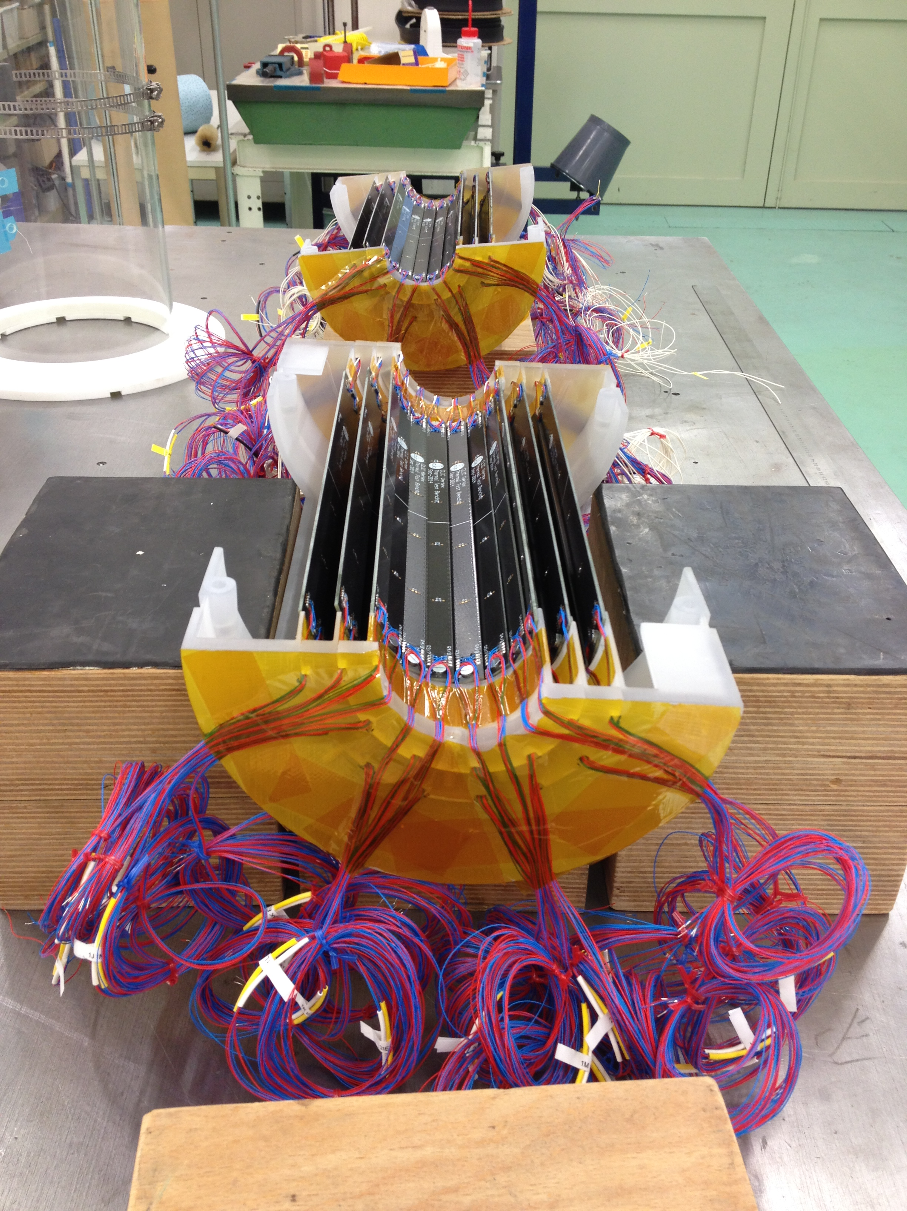

Slide 6
FROZEN / IN WORK by end of 2014
Electromagnetic Calorimeter (ECAL)
Silicon-Tungsten sandwich calorimeter with 25 layers (used to be 30 – but keep X_{o})
5x5 mm² cell size
details of engineering design (low priority – much work done by ILC detectors)
Hadronic Calorimeter (HCAL)
Scintillator-Steel sandwich calorimeter with 7.5 int. length (barrel HCAL used to be W)
HCAL cell size
HCAL acceptance (low angle limit ?)
details of engineering design (… later …)
Muon detection system
basic layout frozen (RPCs inside iron yoke)
details depend on decision re: reduced yoke radius/length

Slide 7
FROZEN / IN WORK by end of 2014
Very Forward Region, LumiCal, BeamCal, QD0, L* …
all very much linked
impossible to progress with “all elements at once”
pragmatic approach for now:
work with a hypothesis - “what if” there is no QD0 inside the detector
N.B. this does not immediately give a new value for L* …

Slide 8
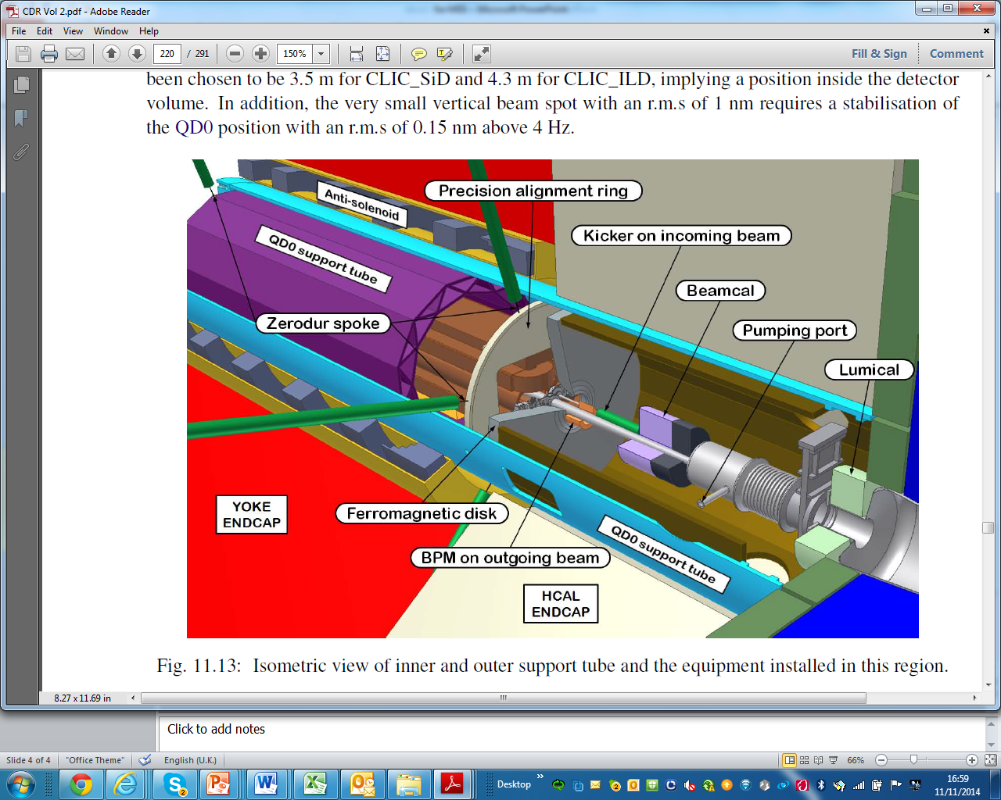
N.B. LumiCal and BeamCal outer radii as shown here do not include readout electronics

Slide 9
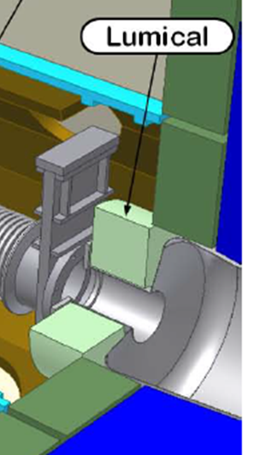
WITHOUT a QD0 …
the diameter of the support tube can be reduced
the HCAL forward coverage can be improved (how much?)
next obstacles are
-> the vacuum valve (gone ! Not needed w.o. push-pull,
see slides by L. Gatignon)
-> the LumiCal and its readout (-ring)
propose to work with an HCAL slightly less “deep”
than the standard 7.5 interaction length; start HCAL
after LumiCal

Slide 10
… WITHOUT a QD0 …
(cont.)
-> the pumping port
can be moved to a location further away from the IP
-> the BeamCal and its readout (-ring)
-> BPM and kicker (small diameters)
-> ferromagnetic disk (probably not needed)
-> anti-solenoid … (outside HCAL, but will surely be much smaller diameter

Slide 11
Next Steps
HCAL studies (improved acceptance at small angles) are under way
-> initial approach: no engineering constraints -> inner radius 150 mm vs. 350 mm
and since a “real” physics case study would take year(s)…
-> study a simplified physics case – hope to get indications of possible
improvements faster (but will we learn what we need to learn ?)
… work in progress …
---------------------------------------------------------------------------------------------------------------------------------------------------------------------------------------------------------
Engineering layout:
-> sit together discuss
-> must start with engineering drawings (again), also for (options of) forward region
L* and luminosity (loss):
-> what is a good way forward ??
-> can we be pragmatic, give one (new) value for L* and ask for the corresponding
modified BDS and the resulting luminosity (loss)

Slide 12
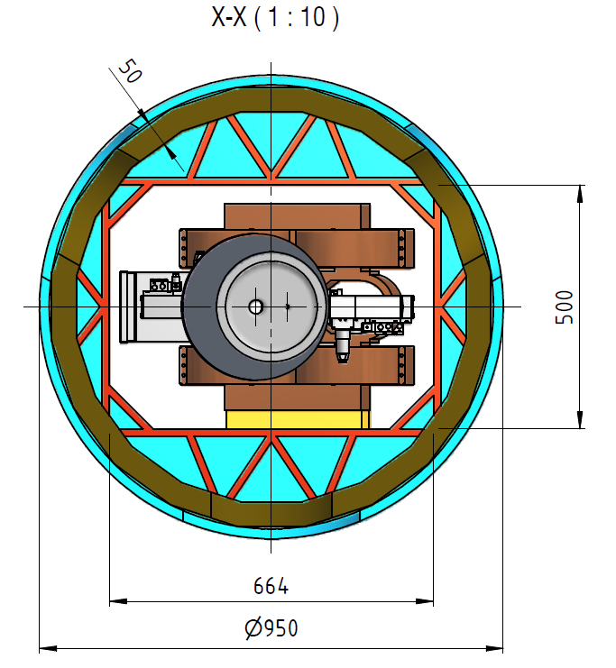
CLIC_ILD simulations (800 x 800 mm²)
R=350 mm
R=150 mm

Slide 13
Spare Slides

Slide 14
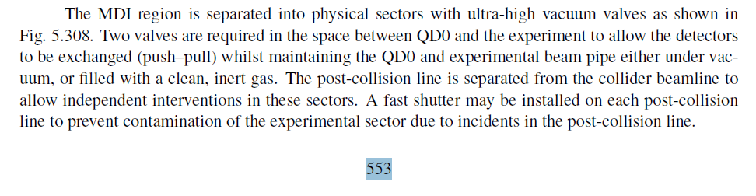
From CLIC CDR Vol. 1, section 5.12.4.2 “Vacuum system” (page 553)

Slide 15
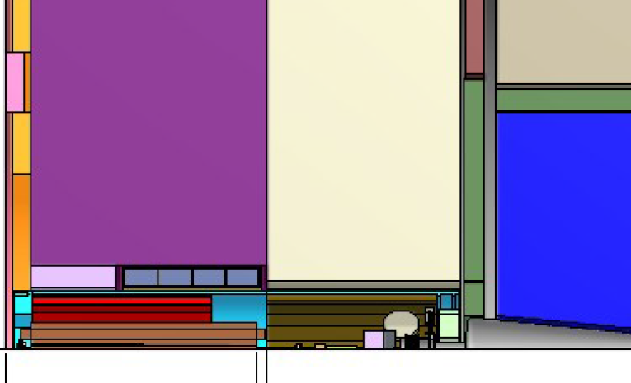

Slide 16
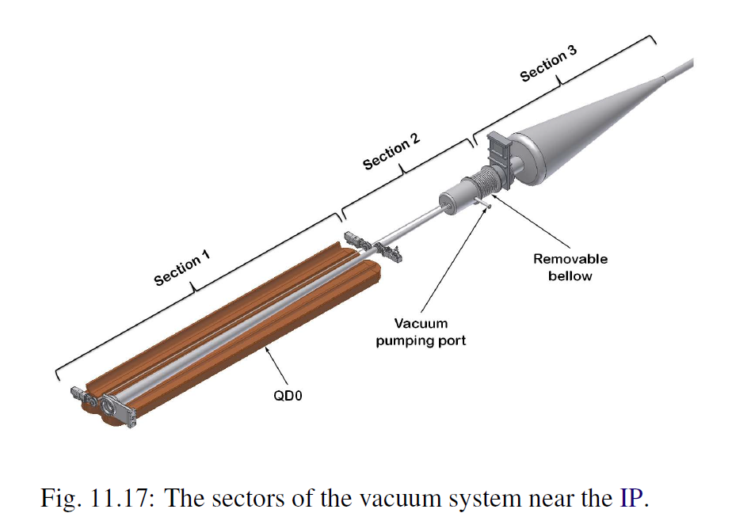

Slide 17
Beam Line Sectorisation Scheme
Short L*:
Detector
Post-Collision Vacuum line
Machine Vacuum line
QD0
QD0
Machine Vacuum line
Post-Collision Vacuum line
= Pumping ports*
= Sector valve
Long L*:
Detector
QD0
QD0
*Pumping port number and position could change depending on pressure requirements or space constraints…
MDI meeting
Cedric Garion

Slide 18
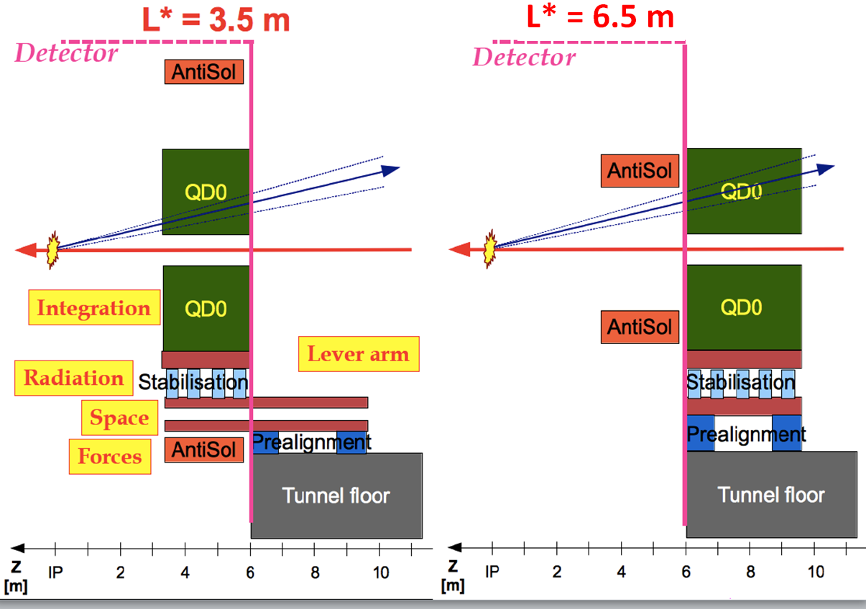

Slide 19
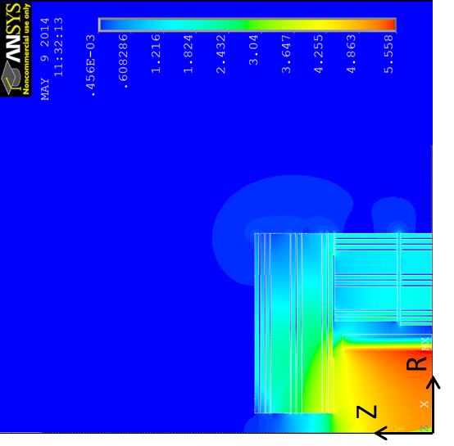
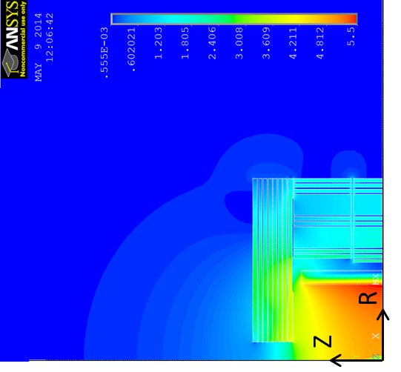
Studies by B. Curé: reduce the Yoke endcap
CLIC_SiD: half-length 6.2 m new model: half-length 5 m
Comparison of the two layouts (no ring coils): B field vector sum map
B-field 2D map : Area most affected is around the detector axis and outside the yoke.
Far region : Less significant effect, Bmax=9mT at R=15m.

Slide 20
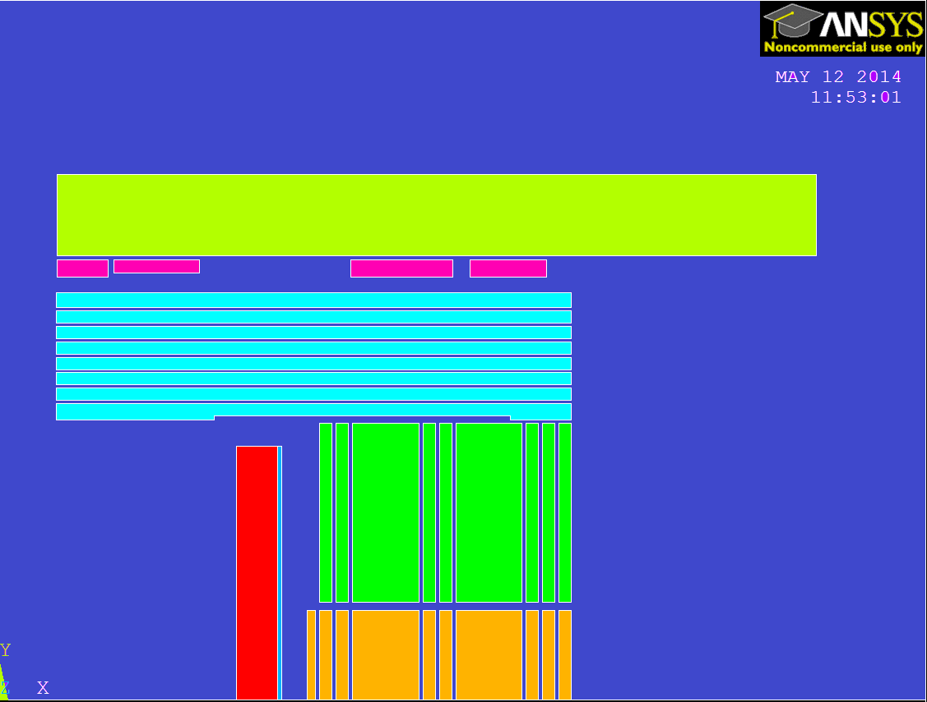
Studies by B. Curé – cont.
Characteristics of the ring coils on the cavern wall with L=5m :
Arbitrary gap from RC to yoke end cap: 192mm (RC1, RC3 & RC4) and 244mm (RC2),
Space available for radiation chicane,
Same copper conductor for all RCs,
Total copper weight : 250 tons (for 2 end caps). Suppressed steel mass wrt. L=6.2m (2 end caps)≈ 2800 tons,
Total electrical power of RCs (2 end caps): 2 x 2260 kW.
Water cooling system characteristics:
Estimated temperature increase ≈ 45°C,
Total water flow (2 end caps): 2 x 57 m³/hour.
Coil | Nb. turns | Copper mass (ton) | Resistance (1e-3 ohm) | Voltage drop (V) | Power (kW)
RC1 | 4x12 | 5.6 | 2.7 | 16.5 | 101
RC2 | 3x20 | 13.3 | 6.4 | 39.1 | 240
RC3 | 4x24 | 54.4 | 26.2 | 160.4 | 984
RC4 | 4x18 | 51.7 | 24.8 | 152.2 | 934
Z
R

Slide 21
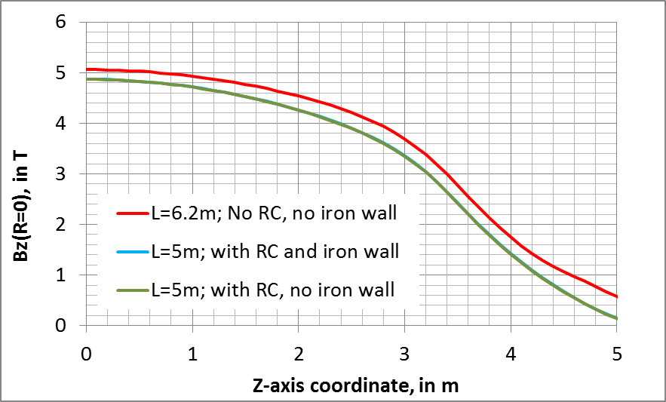
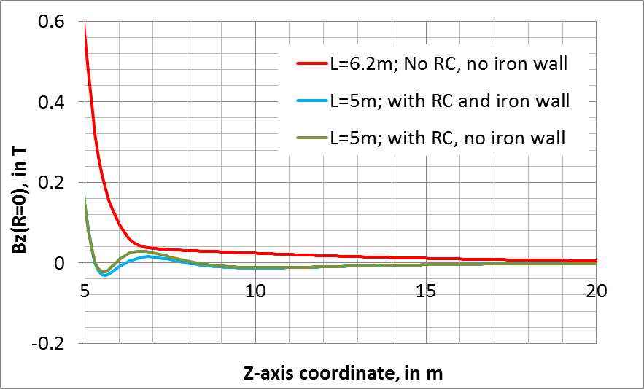
Studies by B. Curé – cont.
Ring coils with L=5m:
Axial B-field component on the detector axis
Bfield on detector axis at Z=5m: 150 mT

Slide 22
Studies by B. Curé – cont.
https://indico.cern.ch/event/314222/manage/session/1/contribution/6/material/
(Also briefly looked into: case half-length 4.2 m and “no iron yoke endcap”)
Conclusions:
Reduced end cap in length is feasible with ring coils, provided the field homogeneity in the central volume is acceptable for physics.
The end cap is still useful to provide support for muon stations, radiation shielding, and magnetic field shaping.
The yoke material + manufacturing budget can be considerably reduced with ring coils.
The cost estimate for manufacturing, infrastructure and operation of the ring coils should be compared to the saving on the yoke cost.
The barrel yoke could also be reduced in diameter:
the fringe field is reduced by the ring coils,
If there is only one detector in the experimental cavern (no access to cavern during beam run), then it can be compatible with radiation due to accidental beam loss.

Slide 23
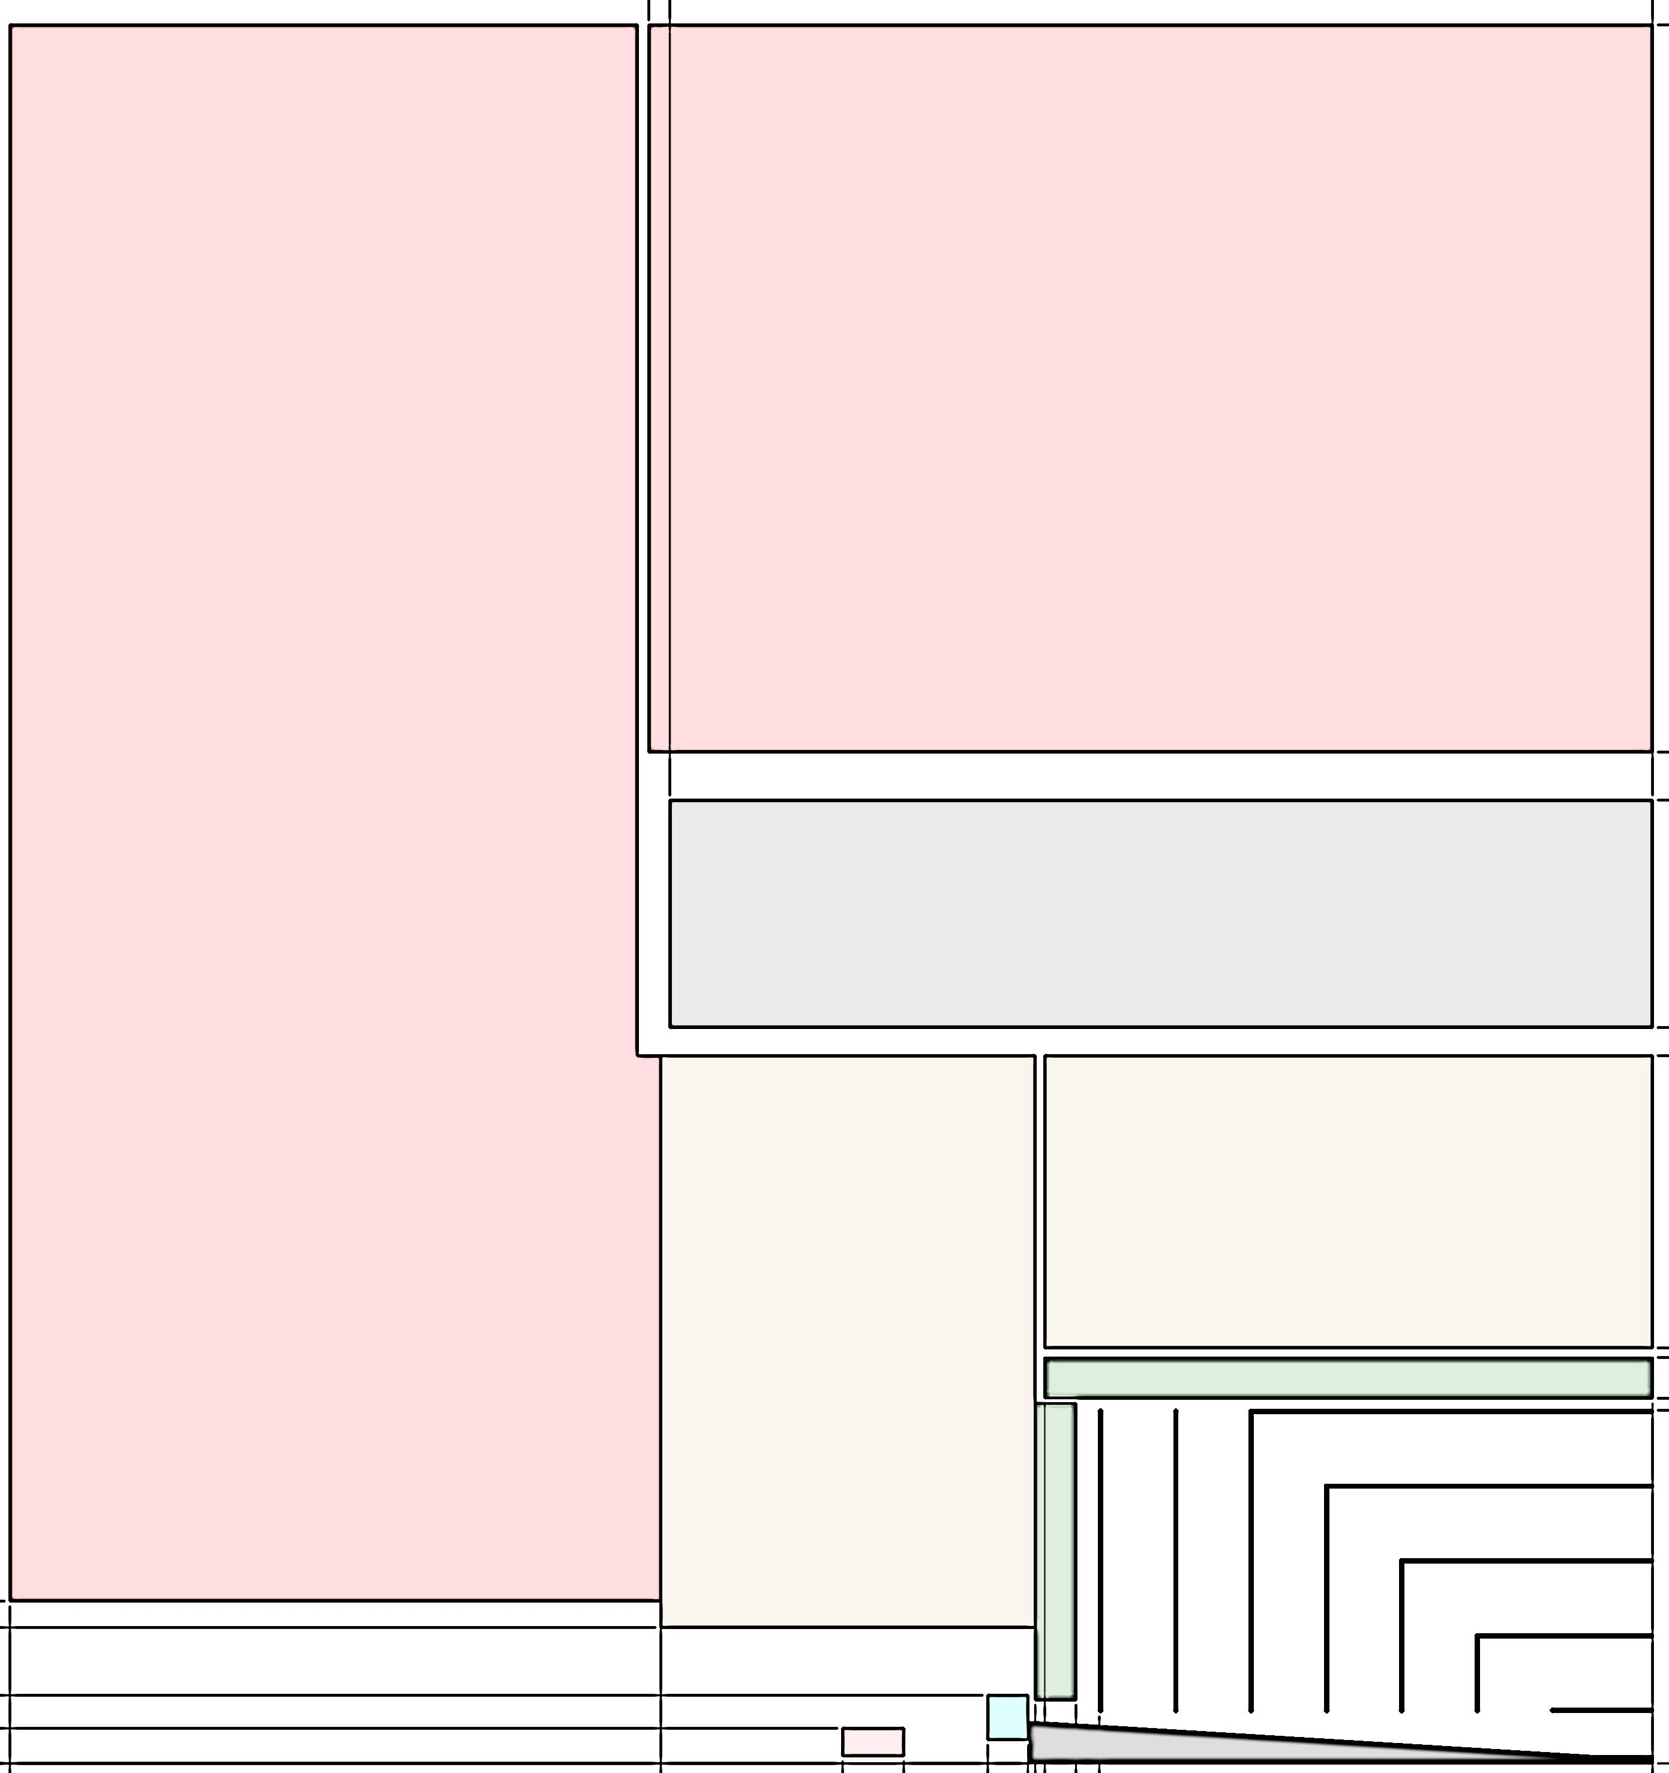
New_CLIC_1 (May 2014)
7 m

Slide 24
