Slide 1
Direct Dark Matter Safari
Basics, Status 2015, Outlook
Rafael F. Lang
Purdue University
rafael@purdue.edu
Rencontres de Blois, June 4, 2015

Slide 2
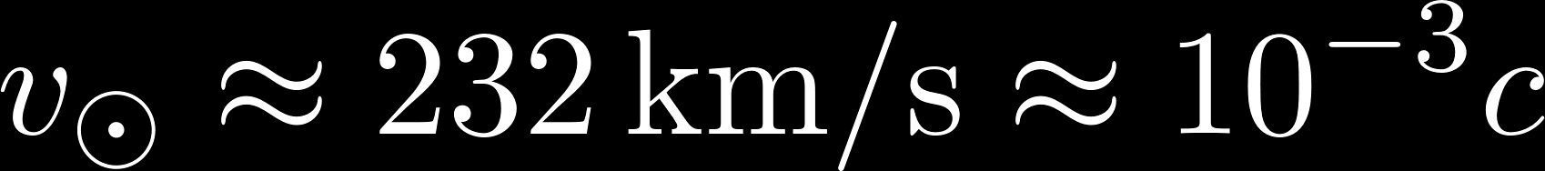
Evidence for Dark Matter in Your Lab
v_{rot} in km/s
Sofue 1110.4431
dark halo
disk
buldge
you are here
radius in kpc
Local density
Fly through Dark Matter halo,
Detect scattering in laboratory target
Pato,Iocco,Bertone 1504.06325

Slide 3
Axions and ADMX

Slide 4

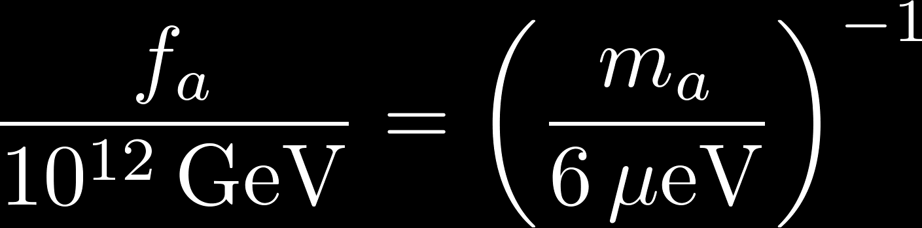
Axions
Idea: effective strong CP violating term is small because it’s a field. Corresponding particle is the Axion.
Interaction strength
If : a Dark Matter candidate
With to prevent overclosure
Detect via Primakov-effect:
Peccei & Quinn 1977, Wilczek 1978, Weinberg 1978
a
γ
Sikivie 1983
B

Slide 5
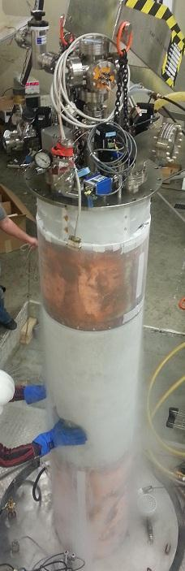
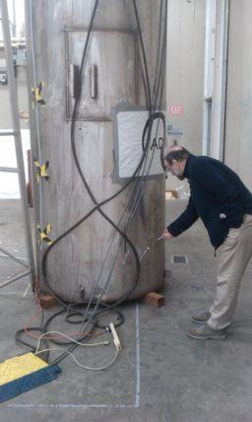
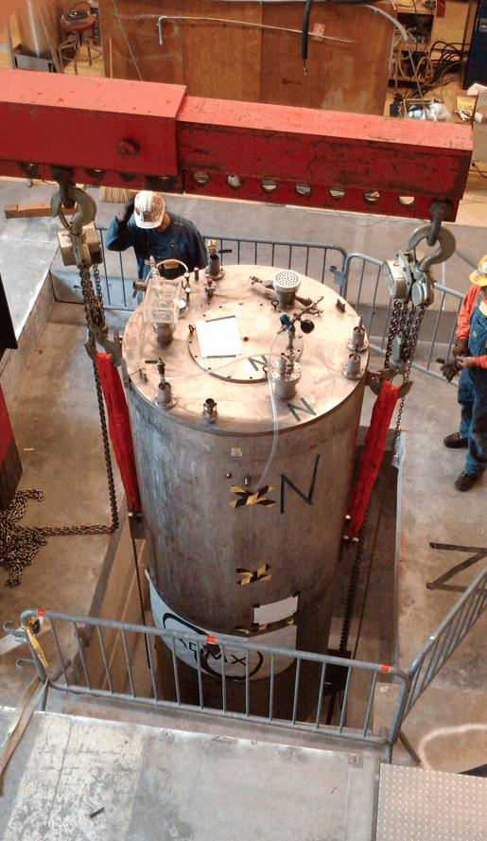
ADMX Resonant Axion Search
Microwave cavity, up to 8T, down to 100mK
Rosenberg UCLA2014
Carosi Aspen2013

Slide 6
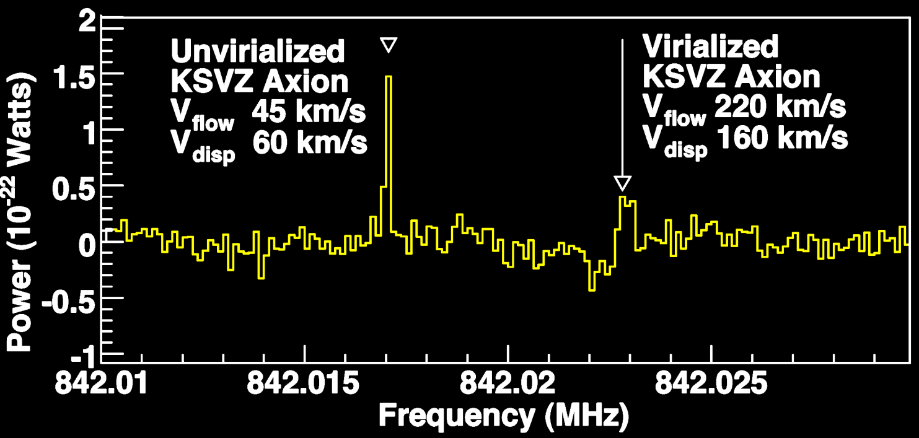
ADMX Resonant Axion Search
Microwave cavity, up to 8T, down to 100mK
Very rich signature
simulated signal:
Rosenberg UCLA2014
Carosi Aspen2013

Slide 7
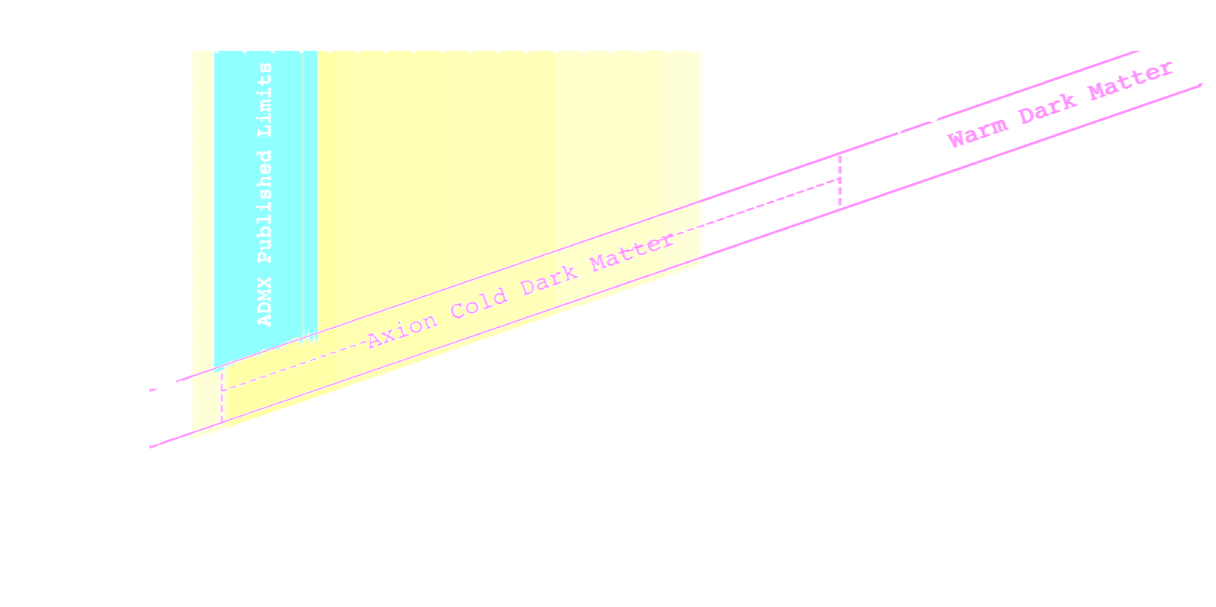
ADMX Resonant Axion Search
Microwave cavity, up to 8T, down to 100mK
Very rich signature
Initial data this summer, then scan frequencies
Rosenberg priv. comm. 2015
Carosi Aspen2013

Slide 8
WIMP Search Basics

Slide 9



Thermal Relic Particles
Production:
collider searches
Annihilation:
indirect searches
Scattering:
direct detection

Slide 10
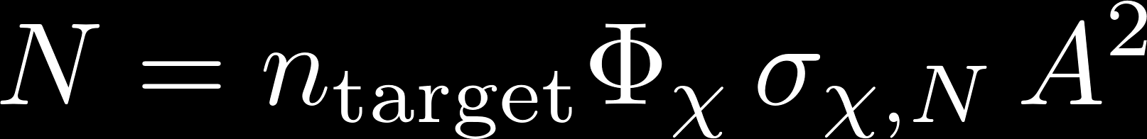
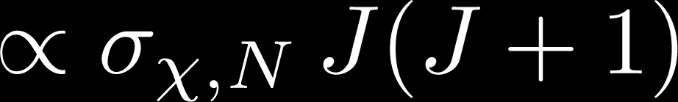
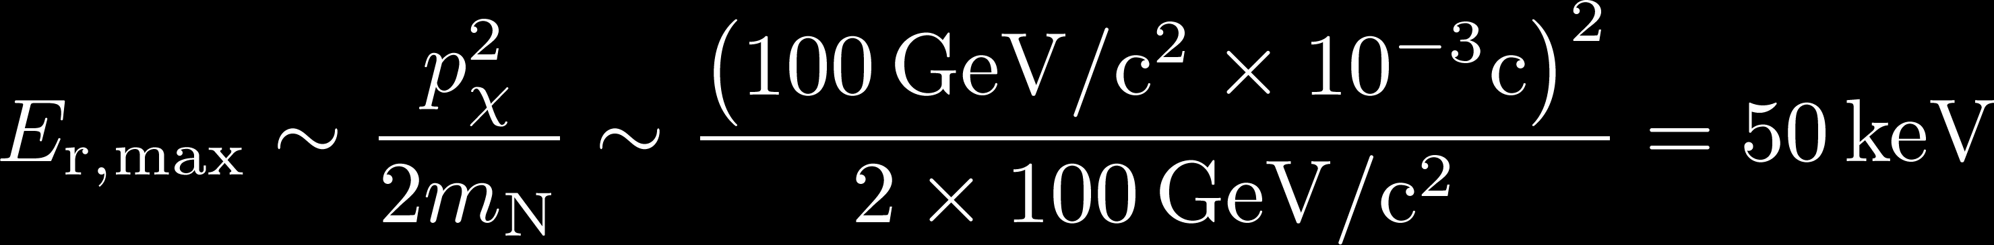
WIMP Scattering Basics
Coherent Scattering:
Rate:
few events per year, per kg or ton of target
or
low rates
Simple non-relativistic kinematics. Recoil:
low energies
Spectrum falls exponentially:

Slide 11
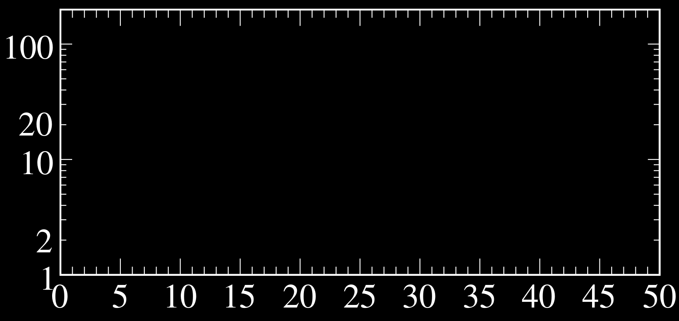
Spectrum: Xe target, σ =10⁻⁴⁴cm²
m_{χ} = 1000 GeV
m_{χ} = 100 GeV
m_{χ} = 10 GeV
Rate
[keV ton year]⁻¹
Recoil Energy [keV]
Acceptance necessarily drops to 0 at E_{r}=0:
Measured signal is a bump after all.

Slide 12
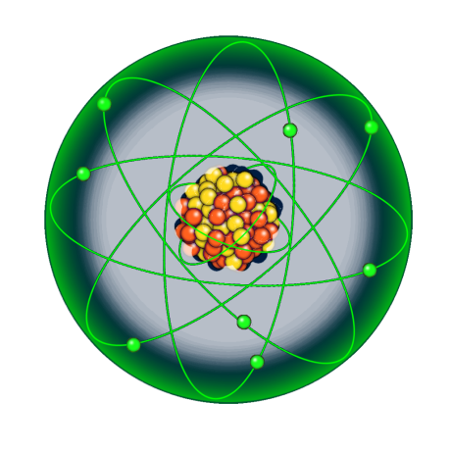
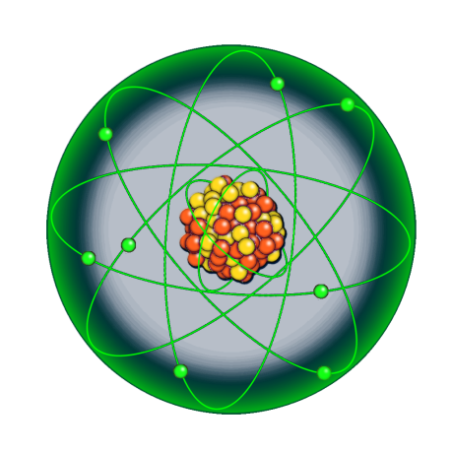
Discrimination: Need Information
WIMP Signal:
Nuclear recoils
Low energy
Single scatter
Homogeneous
Particle Backgrounds: Known in advance
Mostly electronic recoils (β,γ)
Also at high energy (α,β,γ)
Also multiple scatters (γ,n)
Detector artefacts: Sometimes surprising
Surface events
Pathological pile up
Noise

Slide 13
XENON100 Candidate, E~3keV_{nr}
Ample information even at lowest energies:
Scintillation S1 size and PMT pattern
Ionization S2 size and PMT pattern
Single/Multiple Scatter
Electronic/Nuclear Recoil
Vertex position
S2 width
Time
S1
S2
S1
S2

Slide 14
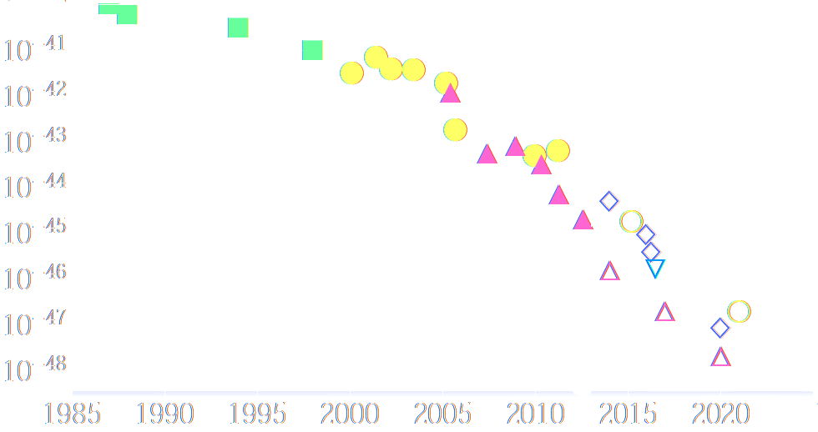
Outstanding Performance
Sensitivity doubles every year (exceeding Moore’s law)
Very good control of systematic uncertainties (%-level)
Elaborate & versatile analyses (many other channels)
2ν0β
5TeV SI limit / cm²
CDMS
XENON
SWONMASS 1310.8327
1990
2000
2010
2020
year

Slide 15
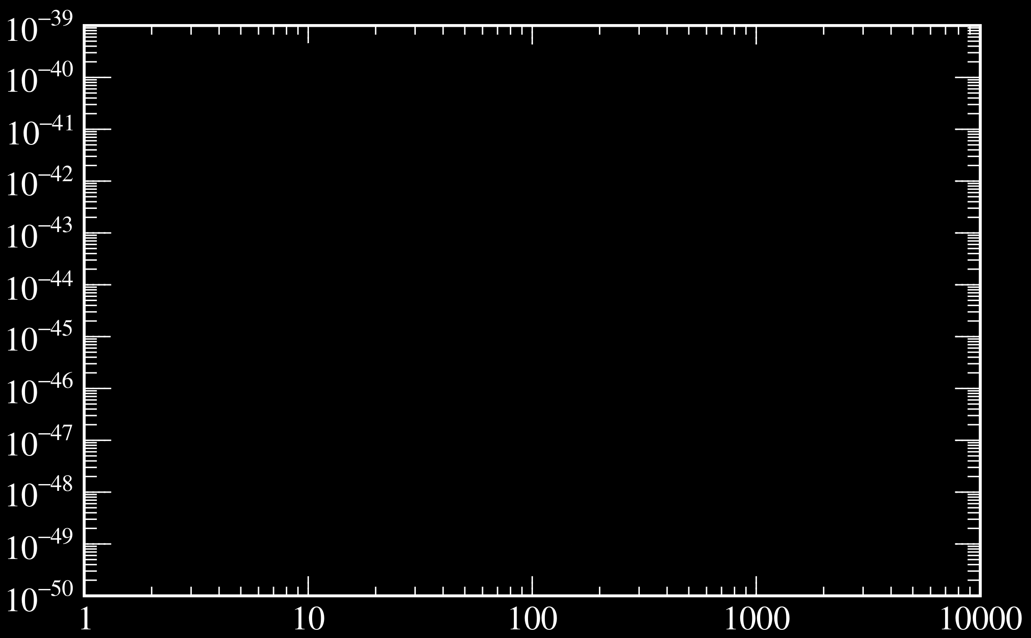
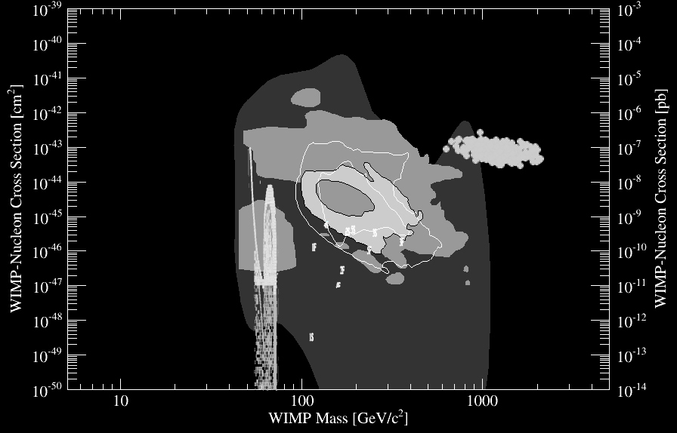
Spin-Independent Channel
CRESST-II
ruled out
SuperCDMS,
EDELWEISS
LUX,
XENON
WIMP-nucleon cross section [cm²]
e.g. asymmetric Dark Matter
e.g.
Higgs mediated coupling
Baltz&Gondolo,Roszkowski+,
Kadastik+,Buchmueller+,Burgess+
SNOWMASS 1310.8327
WIMP mass [GeV/c²]

Slide 16
CaWO₄, Ge, Xe

Slide 17
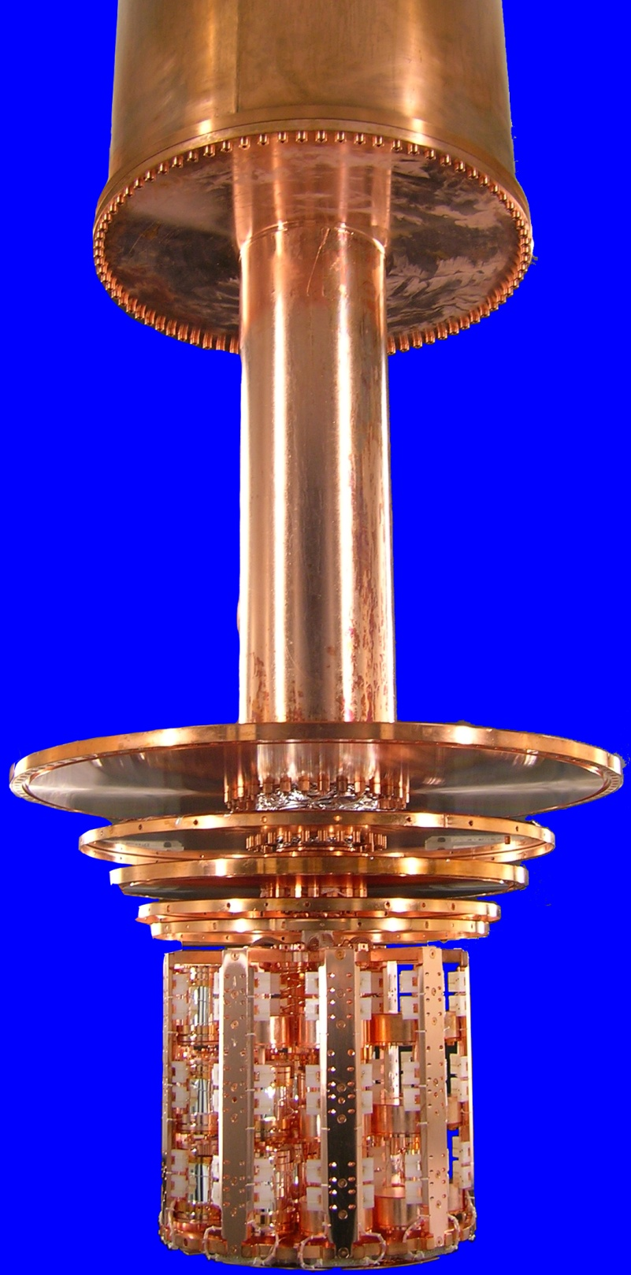
CRESST-II @Gran Sasso
Scintillating 300g CaWO₄ calorimeters
thermometer
threshold <20eV
light
absorber
CaWO₄ clamps
& target
phase
transition
thermometer
~10mK
scintillating
reflector

Slide 18
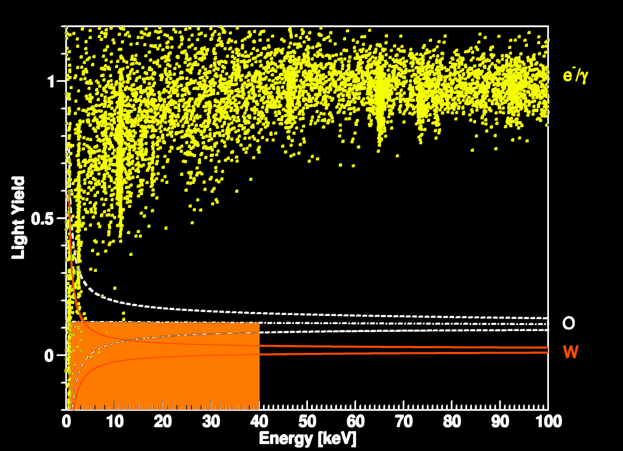
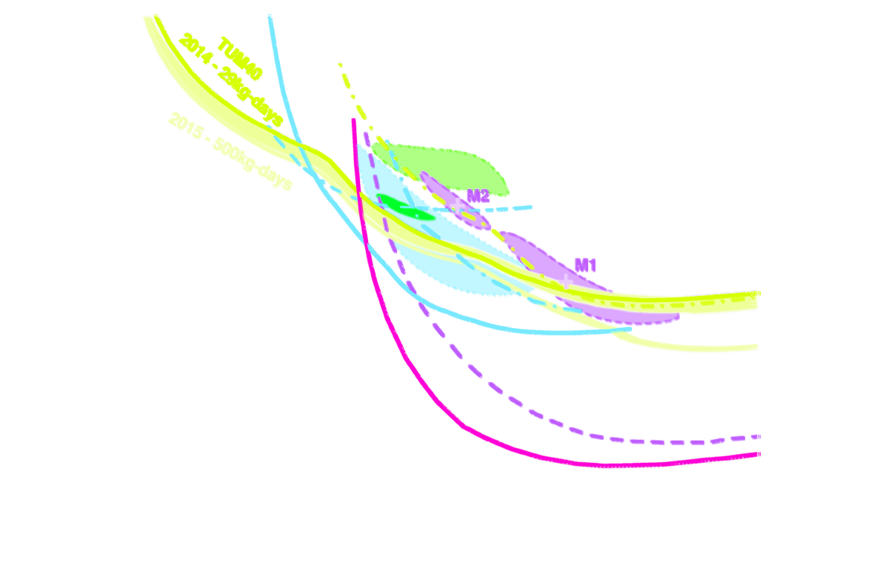
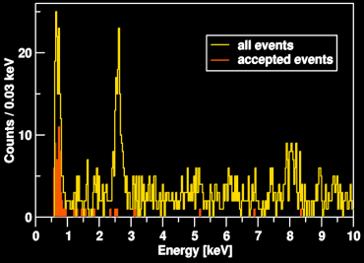
CRESST-II: Multi-Target Built-In
29 kg days
Ca, O for light WIMPs, W for heavy WIMPs
Threshold ~600eV
Expect better limit 2015
CRESST 1407.3146
CDMSLite
¹⁷⁹Ta(M1)
CRESST
2014/15
F. Petricca priv.comm. 2015
Cu(Kα)
LUX/XENON

Slide 19
EDELWEISS & SuperCDMS
Segmented detector, up to 1.4kg Ge each & 60kg total
Germanium or Silicon calorimeters
Cooled to mK to collect phonons
Interleaved electrodes
for ionization
collect
veto
+4V
-1.5V
+4V
-1.5V
fiducial
volume
cdms.berkeley.edu
phonon
sensor
-4V
+1.5V
-4V
+1.5V
collect
veto

Slide 20
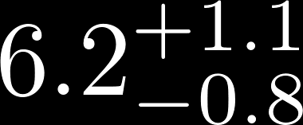
SuperCDMS first analysis
577 kg days optimized for ~GeV WIMPs:
Expect events
Observe 8 (11-3)
Excludes CoGeNT
(and CDMS-Si) excess
CoGeNT 2013
> Order
of magnitude
B. Cabrera priv. comm. 2015
CDMSLite
Expect more data from
EDELWEISS and
CDMSLite this year
SuperCDMS 1402.7137
SuperCDMS

Slide 21

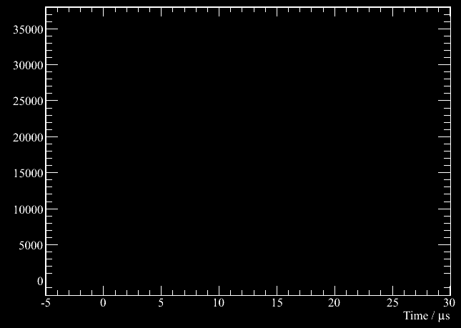
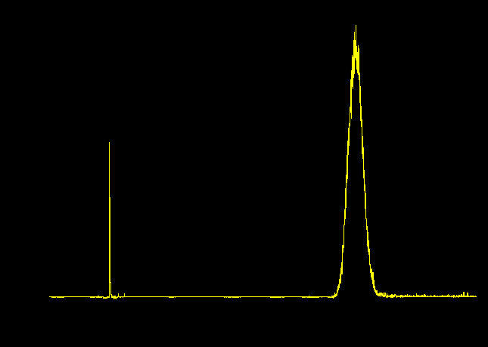
Xenon Time Projection Chambers
top
PMT array
(position)
Vertex position from S2 hit pattern & drift time
anode
+
gas xenon
liquid xenon
e⁻
e⁻
e⁻
hν
cathode
-
hν
bottom
PMT array
(S1, S2)
S1
drift time
S2

Slide 22
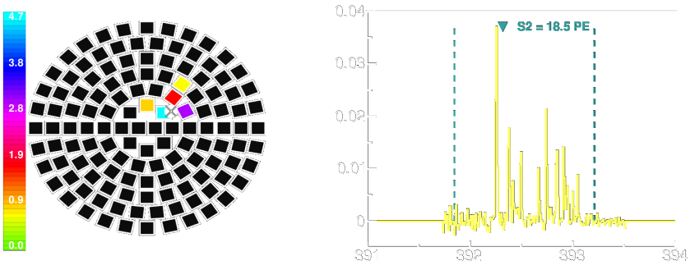
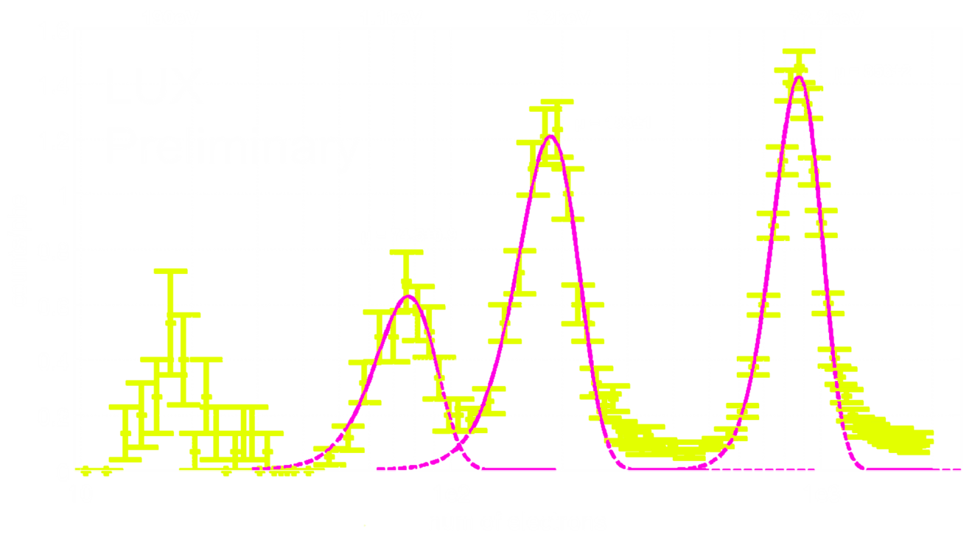
Extreme Low-Energy Sensitivity
Detect even individual electrons liberated in an interaction:
amplitude [V]
XENON100 1311.1088
time [μs]
¹²⁷Xe EC calibration as low as 190eV
LUX D.Huang APS2015

Slide 23
LUX @Soudan
in situ nuclear recoil energy calibration
tritium electronic recoil background calibration
Verbus UCLA2014
(LUX preliminary)
LUX 1310.8214

Slide 24
LUX @Soudan
first results: 85 live days, 118 kg
non-blind analysis, strongest limit to-date
expect re-analysis this month
& 300 days data late this year
LUX 1310.8214

Slide 25
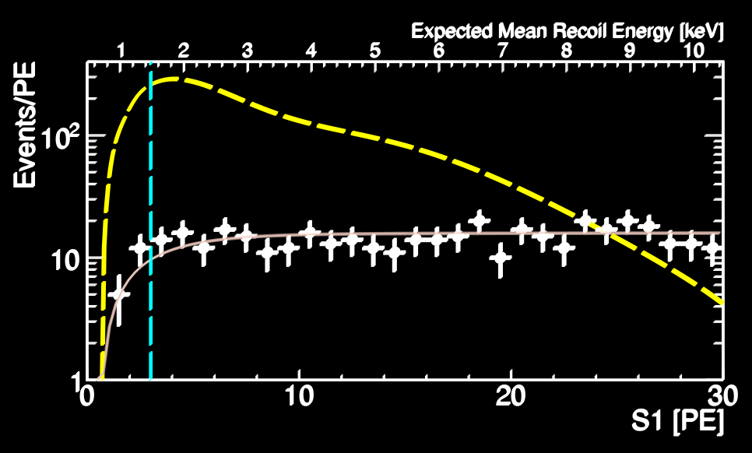
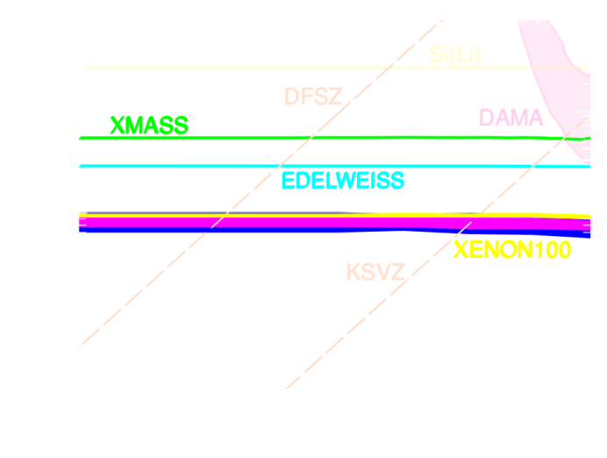
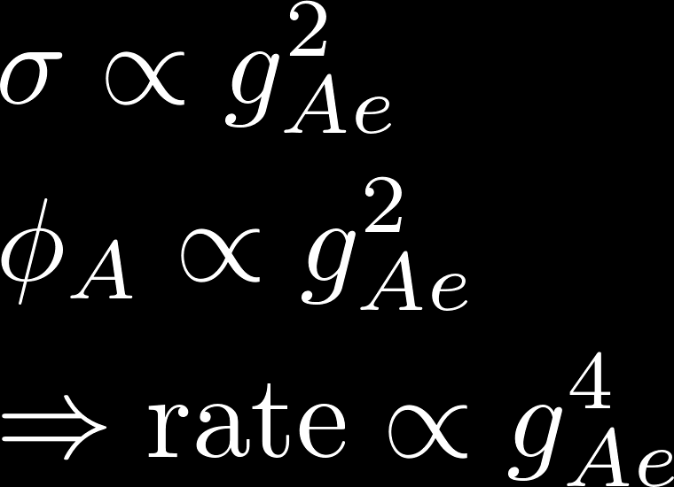
XENON100 Solar Axion Search
use ER background
to search for axions
coupling via
axio-electric effect g_{Ae}
exclude QCD axions
> 0.3 eV (DFSZ)
> 80 eV (KSVZ)
also derived limit on ALPs
XENON100 1404.1455

Slide 26
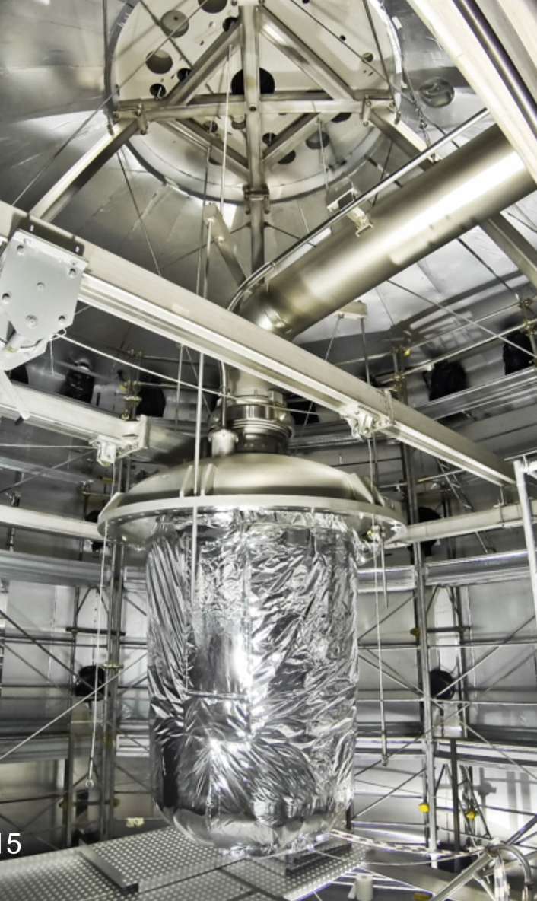
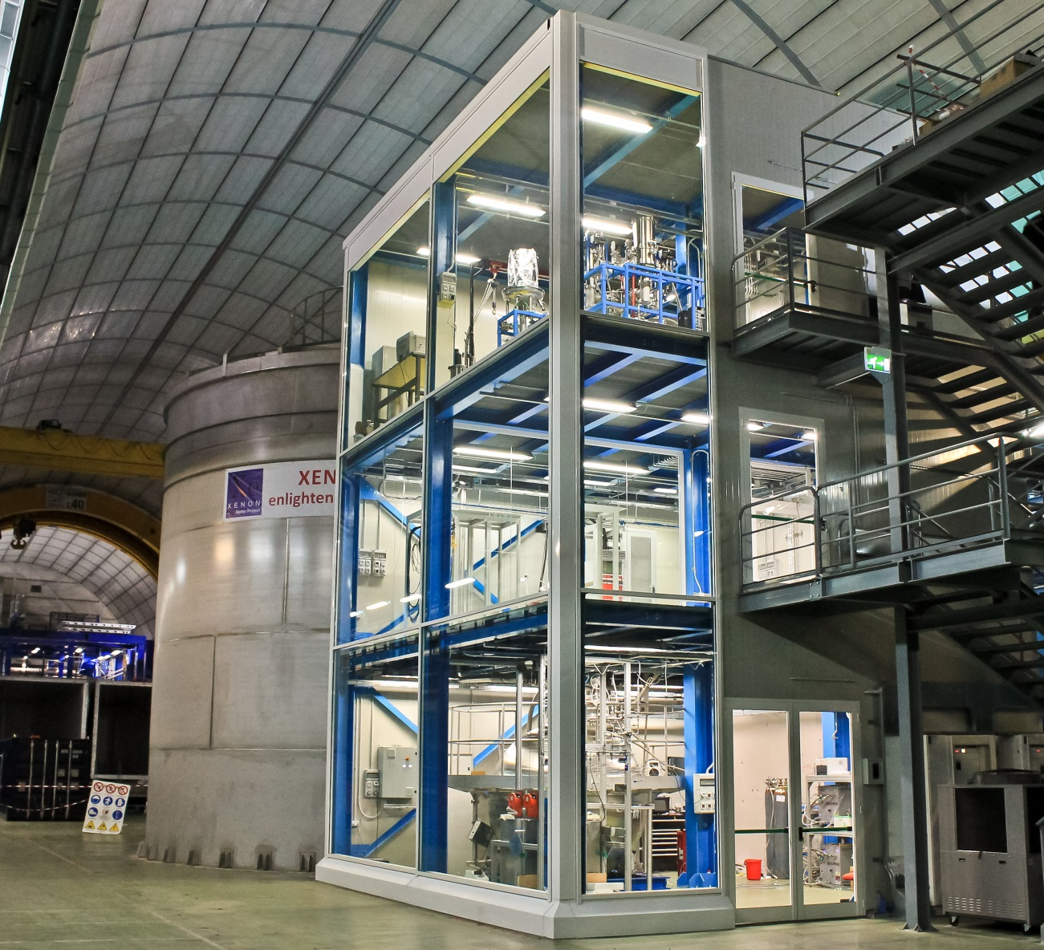
Expect XENON1T Data this Year
2000kg target, 2 orders of magnitude better sensitivity

Slide 27
Marching Forward
ruled out
EDELWEISS
2015+
SNOWMASS 1310.8327
CDMS*
2017+
LUX 2014+
WIMP-nucleon cross section [cm²]
⁷Be
⁸B
XENON1T 2015+
CNNS with XENON1T next year
>4 orders of magnitude
XENONnT, LZ 2018+
DARWIN 30t
Billard, Strigari & Figueroa 1307.5458
atm&DSNB
coherent neutrino-nucleus scattering signal
WIMP mass [GeV/c²]

Slide 28
Marching Forward
ruled out
EDELWEISS
2015+
SNOWMASS 1310.8327
CDMS*
2017+
LUX 2014+
WIMP-nucleon cross section [cm²]
⁷Be
⁸B
XENON1T 2015+
CNNS with XENON1T next year
>4 orders of magnitude
XENONnT, LZ 2018+
DARWIN 30t
Billard, Strigari & Figueroa 1307.5458
atm&DSNB
coherent neutrino-nucleus scattering signal
WIMP mass [GeV/c²]

Slide 30
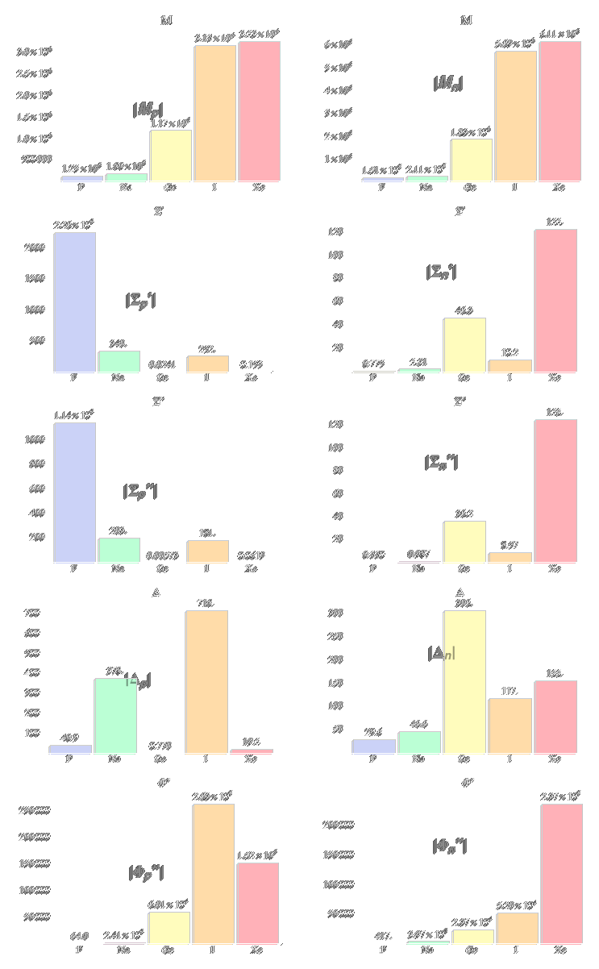
Effective Theory
Vastly different sensi-tivities of various targets: Variety indispensable
Some require dedicated analyses
Use relativistic or non-relativistic operators?
Present results for each operator individually?
Fitzpatrick+ 1203.3542
F Na Ge I Xe
F Na Ge I Xe

Slide 31
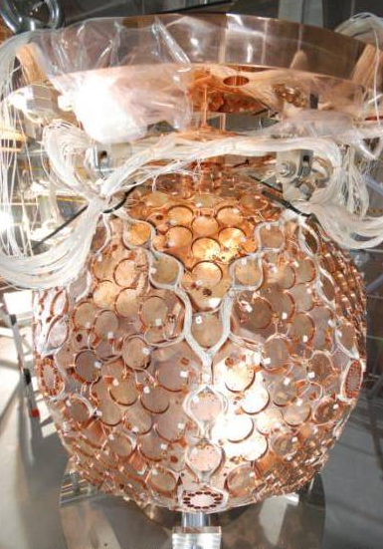
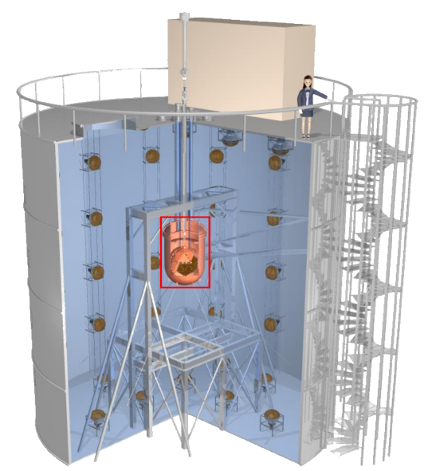
XMASS @ Kamioka
Single-phase liquid xenon
642 2.5” hex PMTs
830kg total, 100kg fiducial
Position from PMT hit pattern; self-shielding
Patched after initial run, data taking since Nov 2013, rate ~1 evt/keV/ton/day
Moriyama, IDM2010

Slide 32
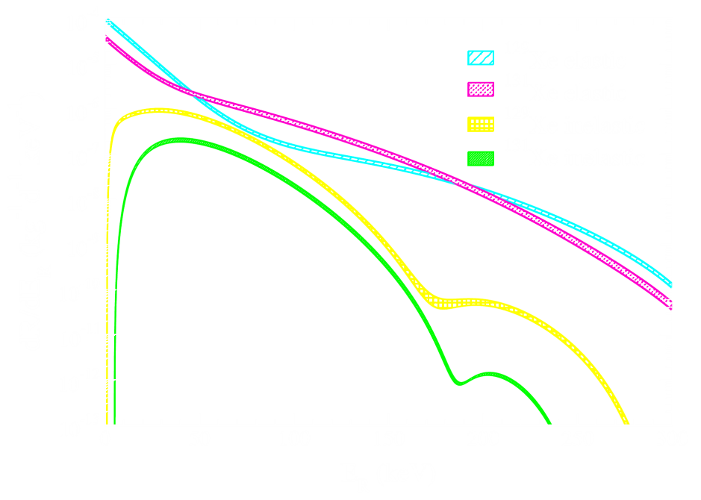
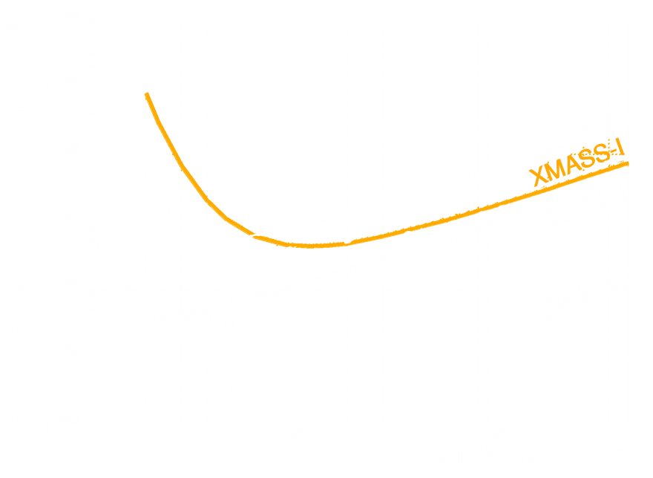
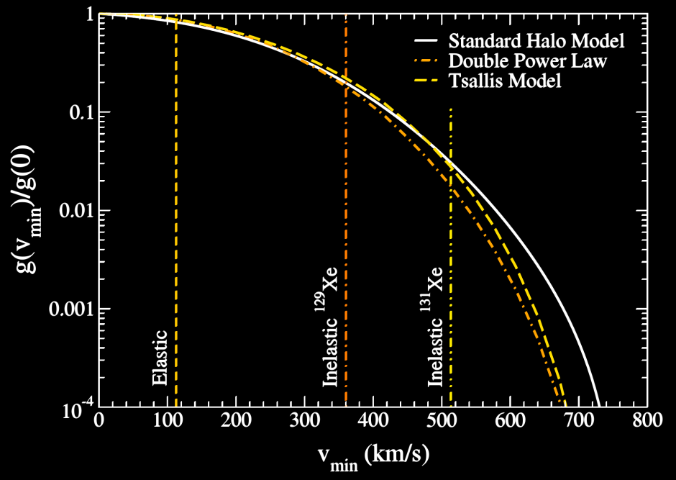
Inelastic Scattering
cross-check limits, measure halo
¹²⁹Xe
¹²⁹Xe*
¹²⁹Xe+γ_{40keV}
Baudis+ 1309.0825
XMASS 1401.4737

Slide 33
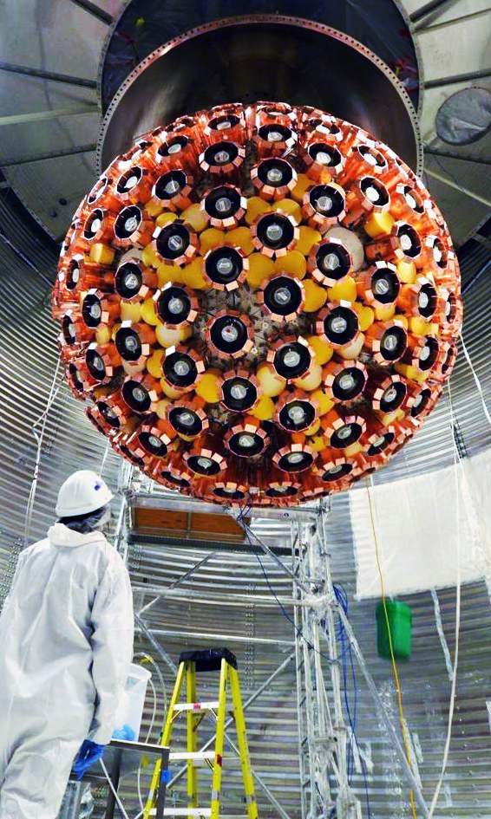
DEAP-3600 @ SNOLAB
Single phase liquid argon
Acrylic vessel
3.6t argon total, 1t fiducial
255 8” PMTs
Pulse shape discrimination
10⁻⁴⁶cm² sensitivity after 3 years
LAr data this summer
Twitter @SNOLABscience

Slide 34
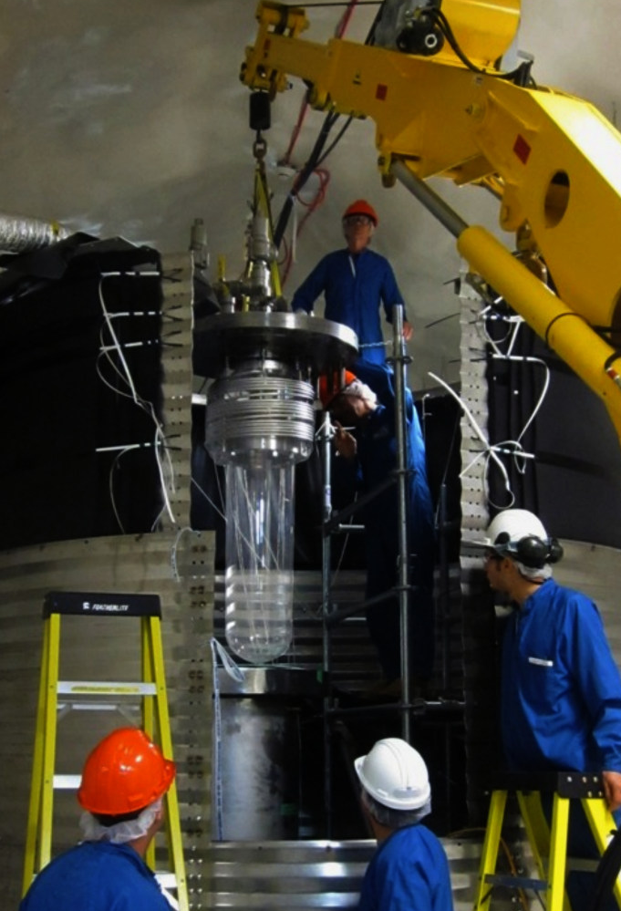
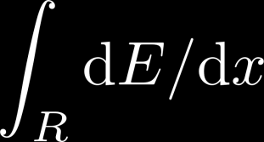
PICO @SNOLAB (=COUPP/PICASSO)
Bubble chambers
CF₃I or C₃F₈ targets:
spin-dependent / light WIMPs
Nucleate if sufficient
detector blind (<10⁻¹⁰)
to electronic recoils
Only integral energy spectrum; measure with different thresholds
H. Lippincott TAUP2013

Slide 35
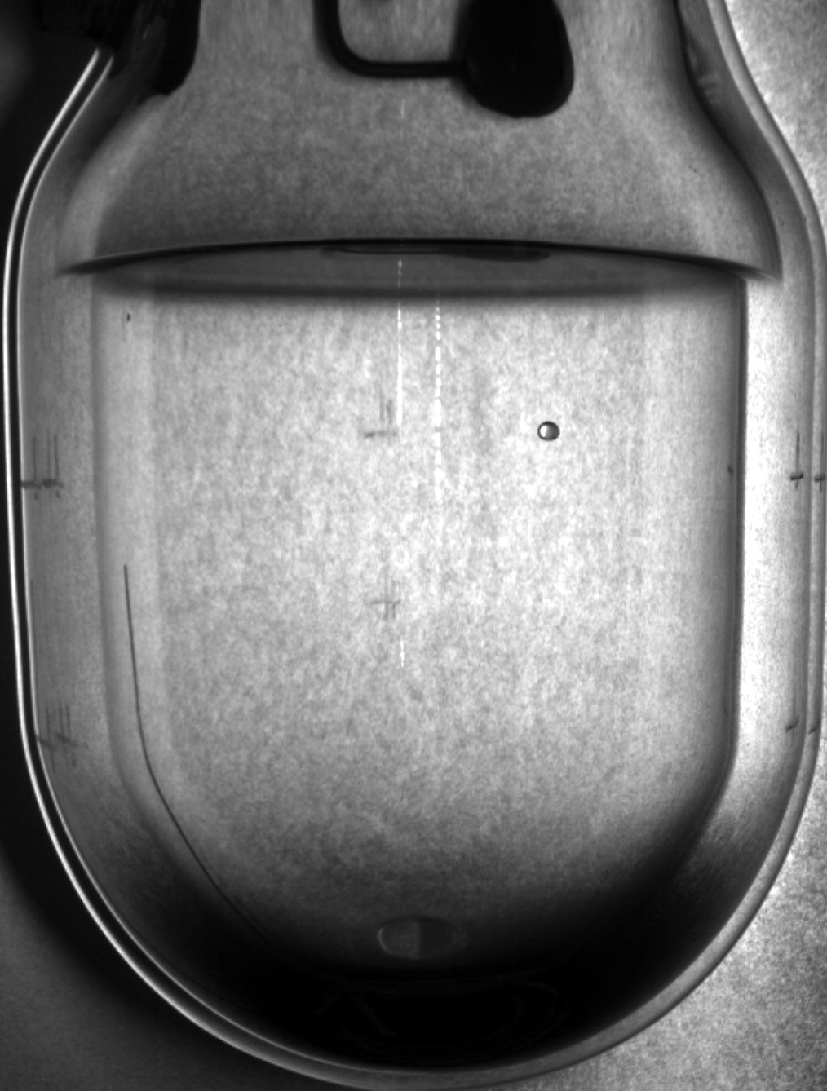
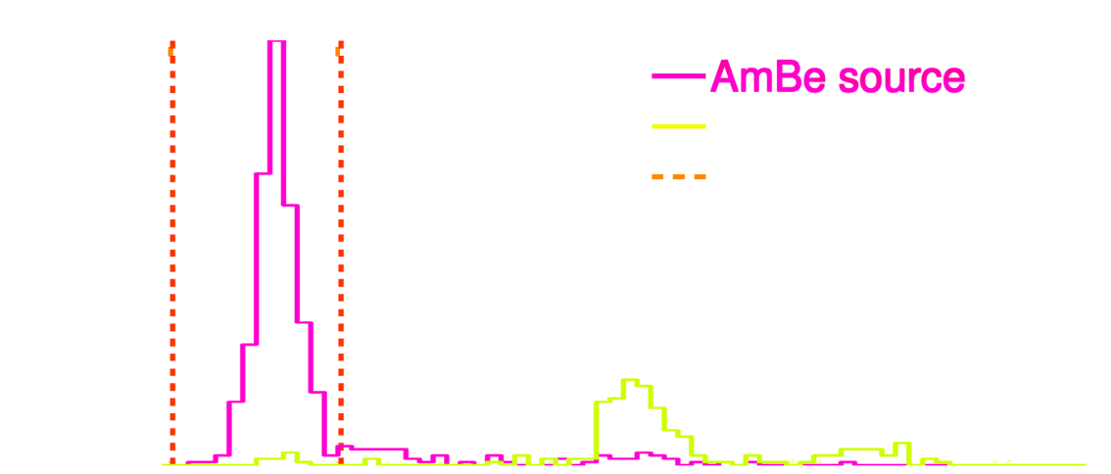
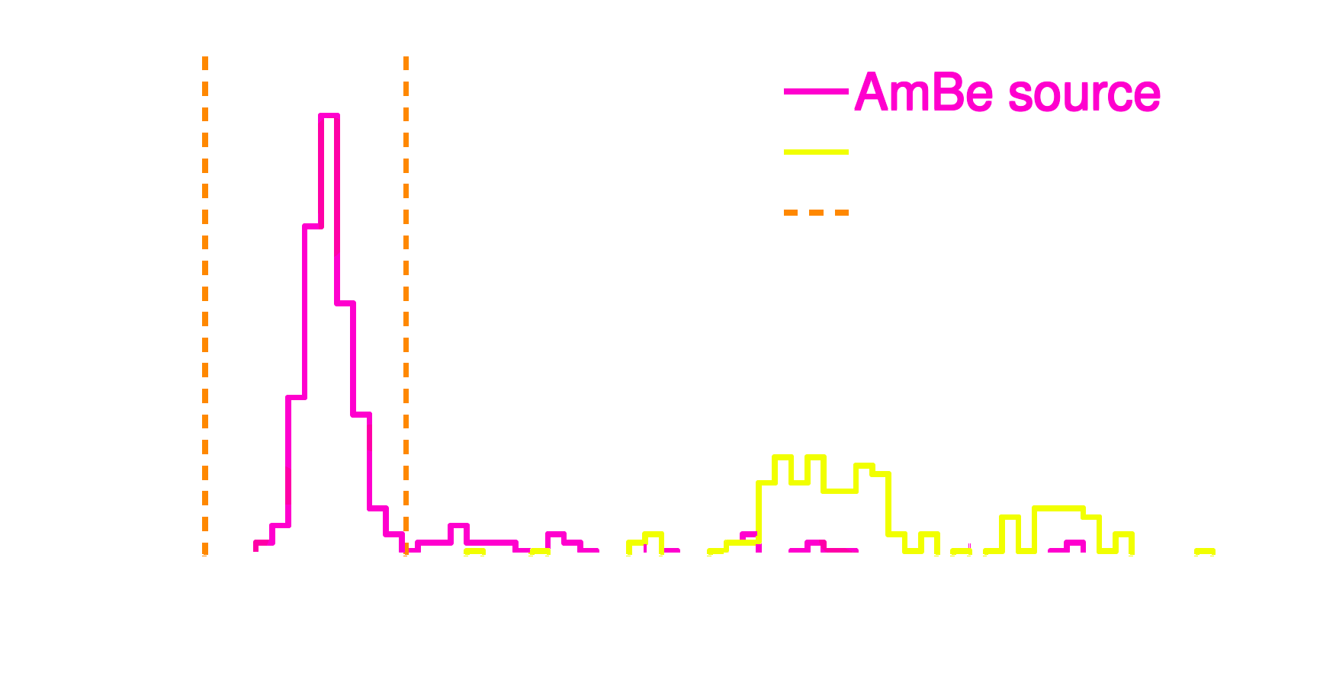
PICO Results 2015
Photograph:
Acoustic signal: Alphas pop louder than nuclear recoils, discriminate >98%
O.Harris LLWI2015
3keV threshold
preliminary
4.4keV threshold
PICO 1503.00008
O. Harris LLWI2015

Slide 36
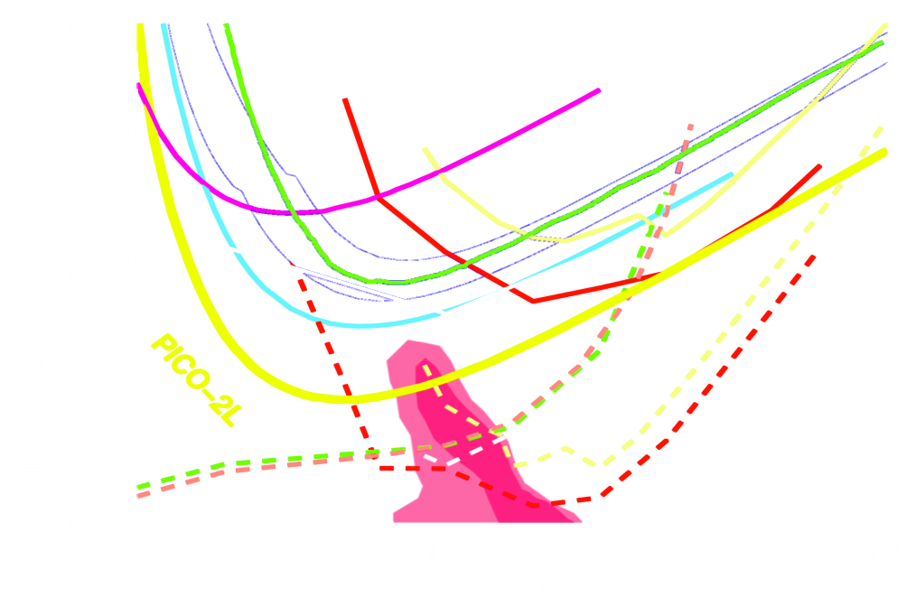
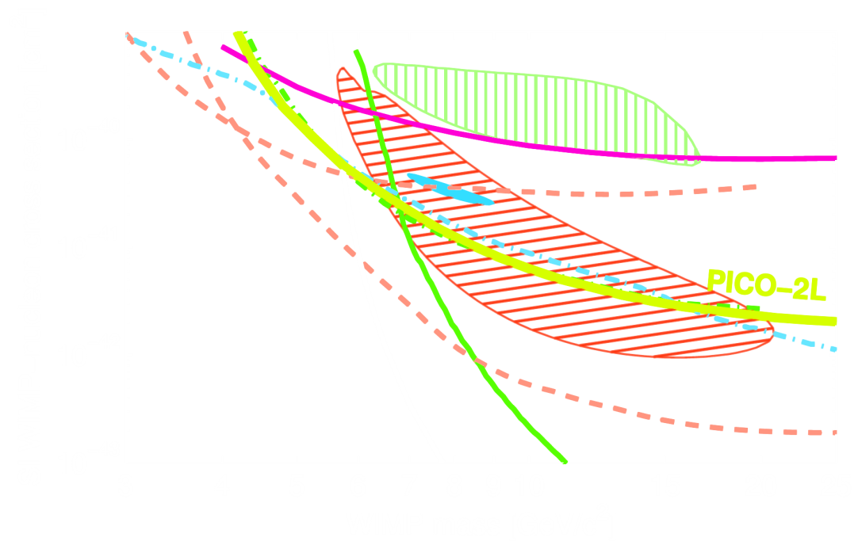
PICO recent limit and outlook
Limits from 2.9kg C₃F₈ chamber
211 kg days total at 4 thresholds (3-8keV)
12 events observed (1 expected),
correlated with expansion cycles (corrosion particles?)
Leading spin-dependent (proton only) limits
PICO 1503.00008
SD
SI
Soon: >3000 kg days from 25kg CF₃I chamber (PICO 60)

Slide 37
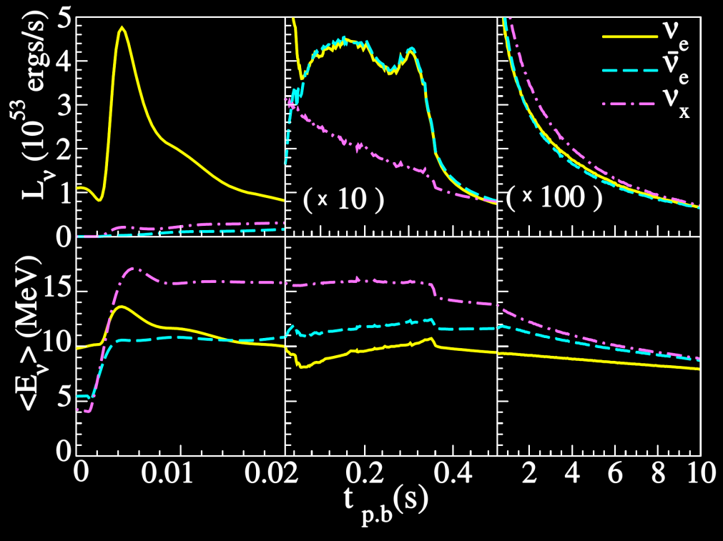


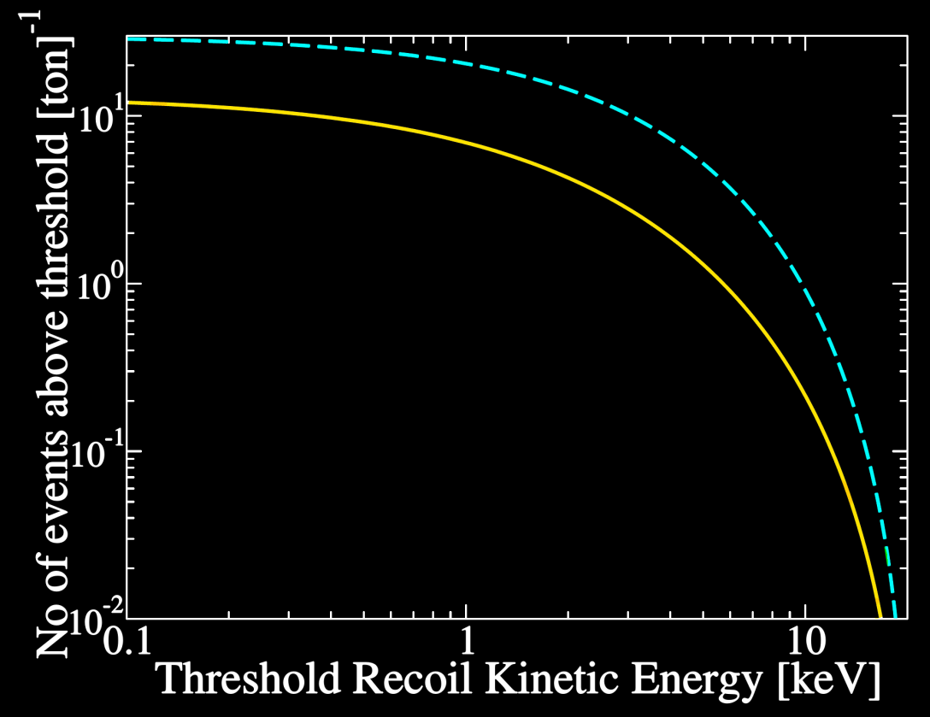
Yes, Even Supernovas
Assume Galactic Supernova
(10kpc, Basel/Darmstadt)
CC: per ton
CNNS: per ton
Chakraborty, Bhattacharjee & Kar 1309.4492
Flavor-independent: complementary information

