Slide 1
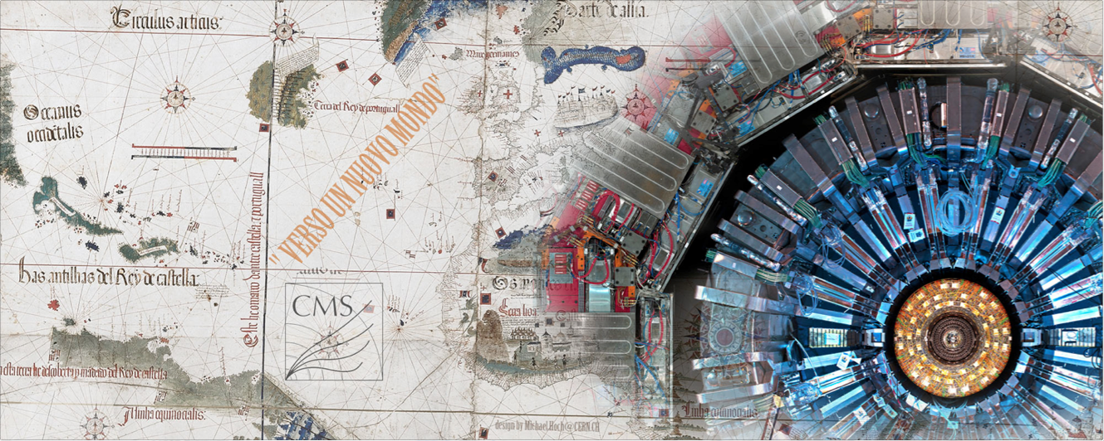
CMS :RRB report
Physics analysis from Run1
Readiness for Run2
Phase 1 Upgrade: status
Phase 2 Upgrade overview
CERN-RRB-2015-005
T. Camporesi, RRB-40, 27 April 2015

Slide 2
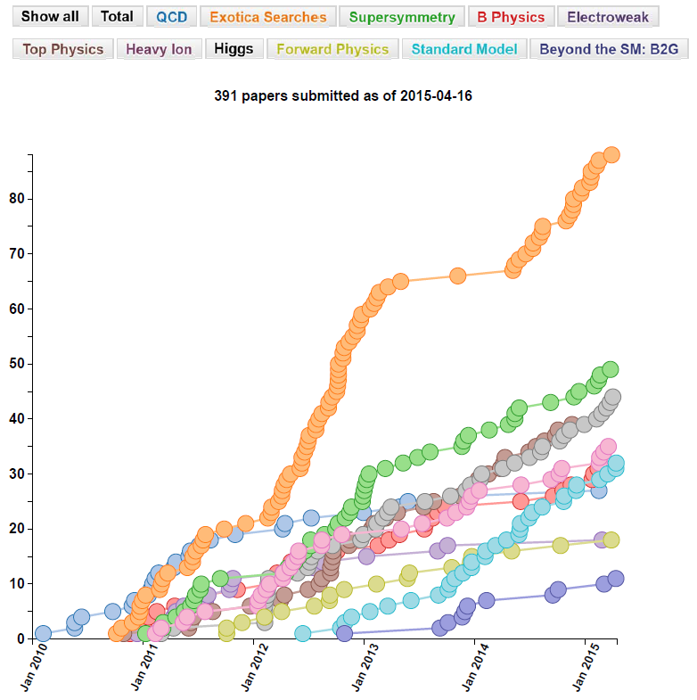
CMS publications
Pub rate steady, ~2.5/week
391 papers submitted:
+23 CRAFT based
+25 ready for CWR or later
+6 PubDraft
In review process (159):
97 GoingToPreApp or higher
62 in AanalysisWorkGroup
391 papers submitted
Steady progress, we are now over the hump!
Bulk of remaining Run 1 measurements targeting publication by summer (to avoid overlap with Run 2)
27 April 2015
CERN-RRB-2015-005

Slide 3
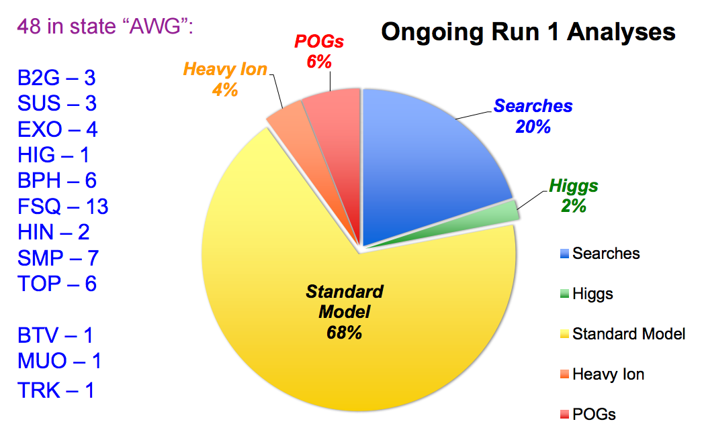
Ongoing analyses
27 April 2015
CERN-RRB-2015-005

Slide 4
Recent results highlights
27 April 2015
CERN-RRB-2015-005

Slide 5
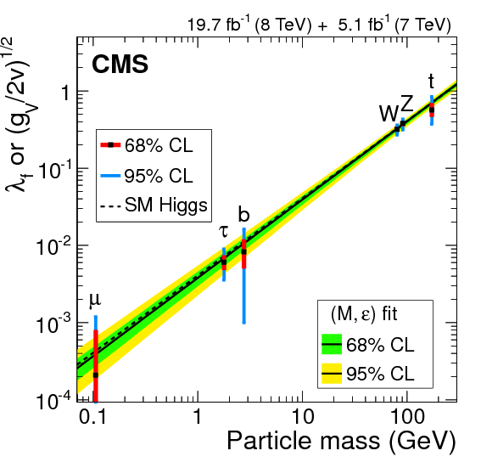
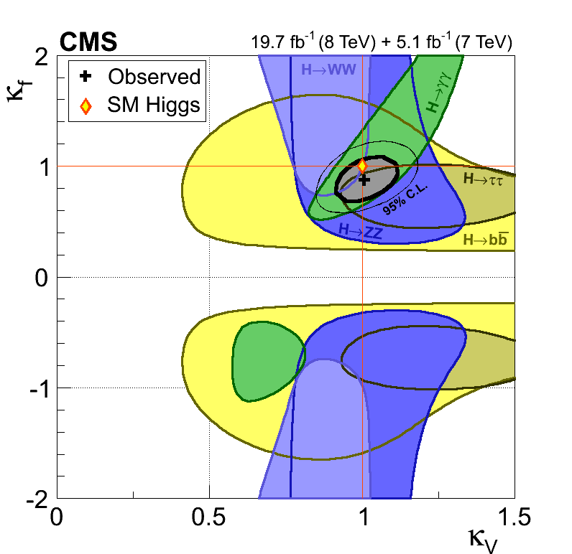
Higgs Combination
HIG-14-009
Five main decay channels all published
Combination submitted Dec 30
All results consistent with SM Higgs
Channel | Obs (σ) | Exp (σ)
H → ZZ | 6.5 | 6.3
H → γγ | 5.6 | 5.3
H → WW | 4.7 | 5.4
H → ττ | 3.8 | 3.9
H → bb | 2.0 | 2.6
H → μμ | < 0.1 | 0.4

Slide 6
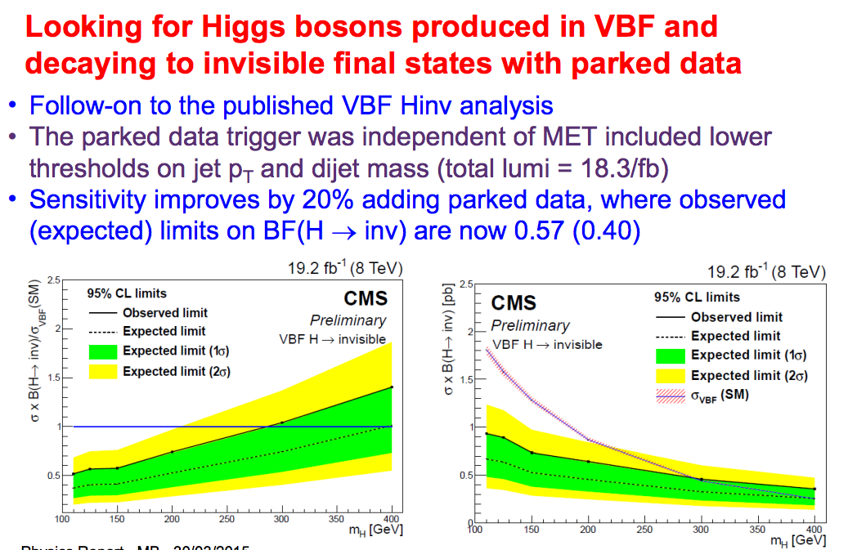
Parked data: VBF invisible Higgs

Slide 7
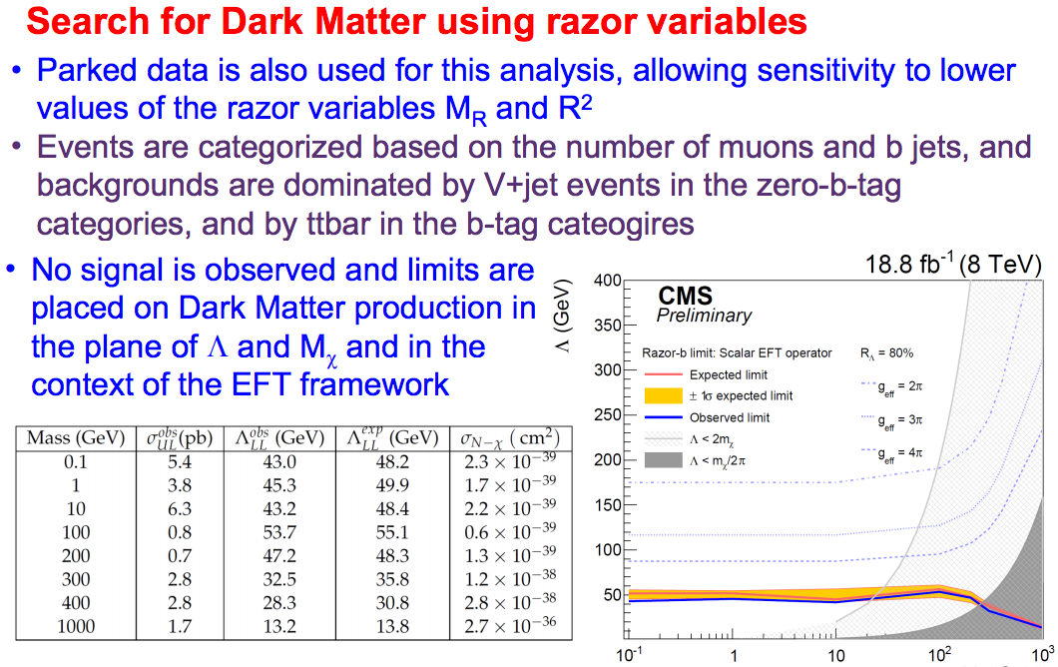
Parked data: Razored Dark Matter
M_{x}
27 April 2015
CERN-RRB-2015-005

Slide 8

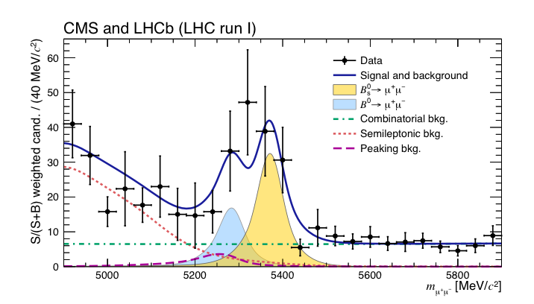
Our second Nature paper
Accepted two weeks ago and being published

Slide 9
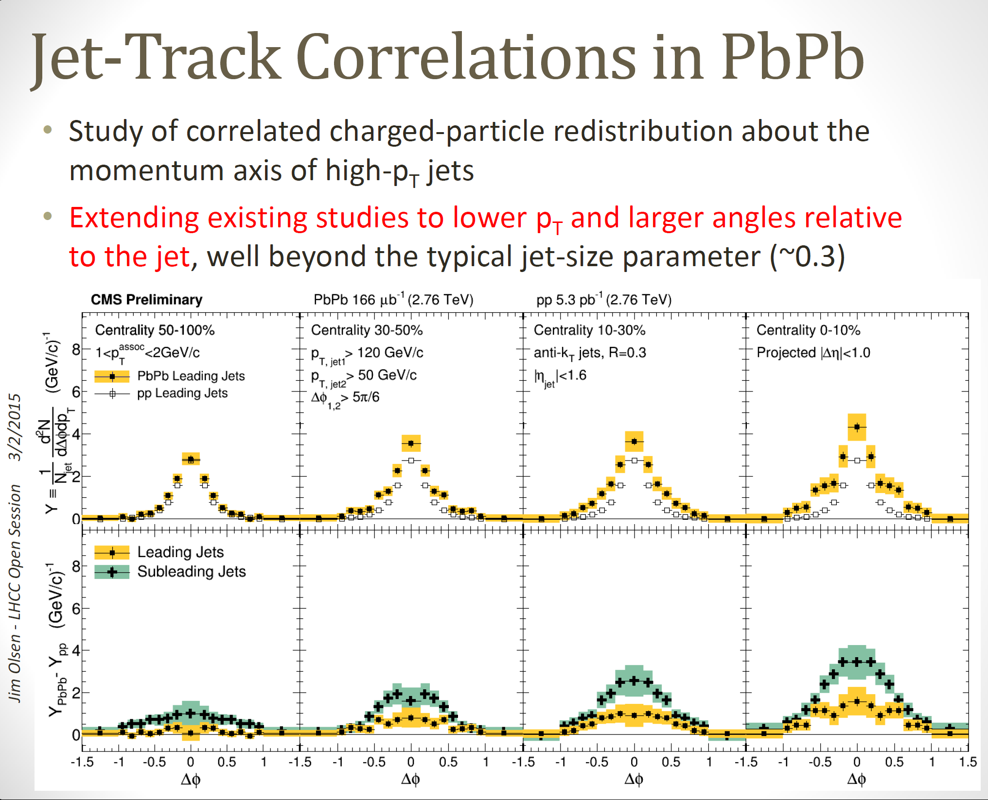
Heavy Ions
Pb
Pb
Pb
Pb
Pb
Pb
Pb
Pb
HIN-14-016

Slide 10
Run 2 Readiness
27 April 2015
CERN-RRB-2015-005

Slide 11
Executive summary
In short: all subsystems, DAQ, dataflow, reconstruction software ready
Have been in global data taking 24/7 for the last 8 weeks accumulating cosmic rays with and without field for alignment, synchronization and calibration
This has followed 10 periods of 3 days global running started in June which progressively validated the commissioning of the new DAQ, Timing and Control distribution, the changes in the detector setups and more …
27 April 2015
CERN-RRB-2015-005

Slide 12
LS1 detector work
GOAL: Prepare for 13-14 TeV, ~100fb⁻¹ and ~1-2 x 10³⁴cm⁻²s⁻¹, 25ns
Summary status
Tracking region:
Beampipe --> remove 59.6mm central beampipe/ install 45.0mm.
Yoke and Tracker bulkhead humidity seal revision + new dry gas system
(for colder Tracker operation)
CO₂ system + cabling + demonstrators for Phase-1 pixel upgrade
New PixelLumiTelescope + BeamHaloMonitor, revised BCM
Calorimeters:
HF calorimeters PMT --> multi-anode PMT
HO calorimeter HPD --> SiPM
HB/HE control module replacement, cable/fibre installation for LS2
Minor revisions and repairs of EB/EE
ES removal, repair and re-installation (unexpected)
Muon detectors:
Yoke Endcap disk 4 construction at +z and –z ends in situ.
4’th muon endcap stations +z and –z (CSC & RPC)
1’st endcap station (CSC) readout granularity restoration +z and –z
Muon barrel electronics consolidation
-move sector collectors to USC55, replace ΜΒ1 θ TRB
Installed, baked out,vac10⁻¹⁰
Tracker OK at -20deg C,
Det. dry gas system installed
Final pressure tests done
PLT/BCM BHM done,
PMT’s & cabling done
All wheels done
Done
Done
Done
+z &-z done incl -z pushback
Both ends commissioned
Both ends commissioned
Complete for all wheels

Slide 13
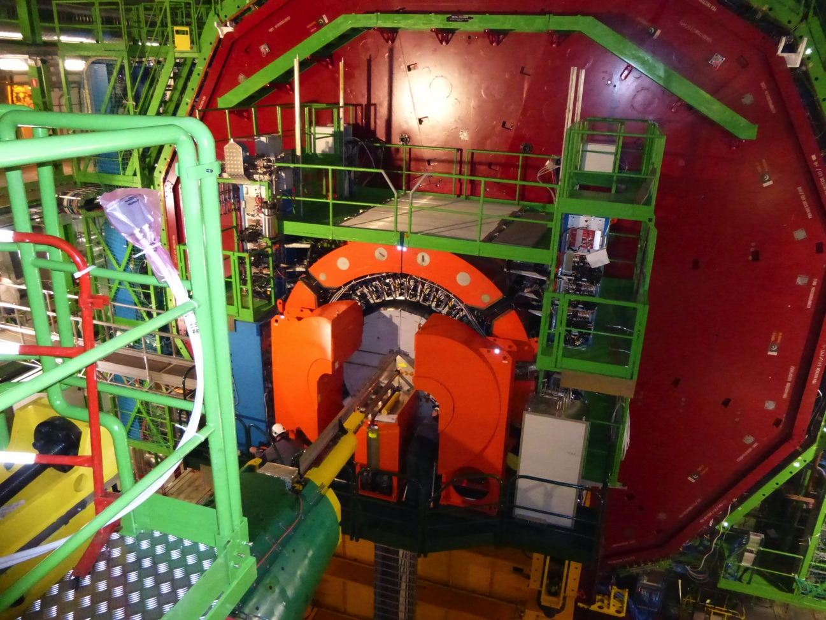
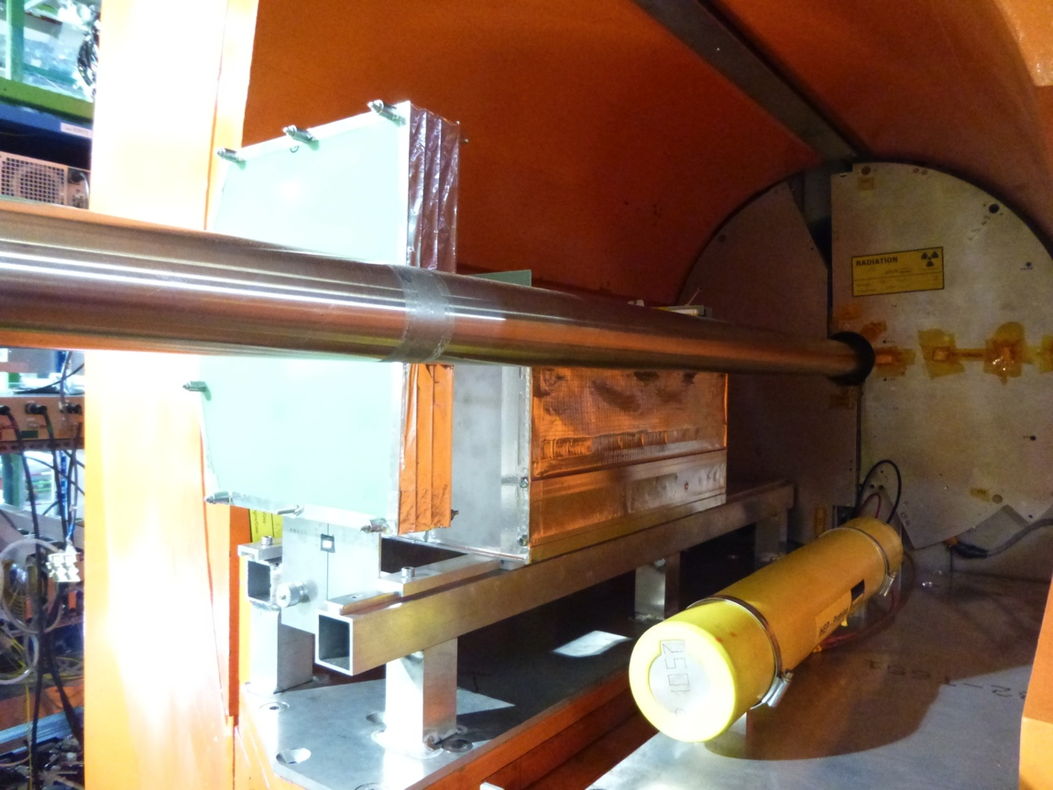
Test bench for the future
‘Realistic’ irradiation facility: easily removable box housing detector and electronics samples for irradiation studies installed on Forward calorimeter table

Slide 14
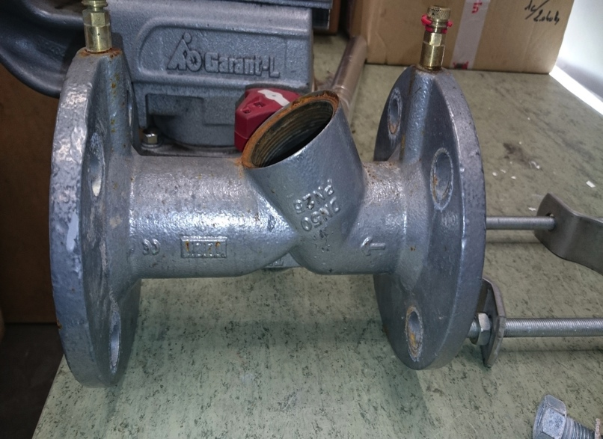
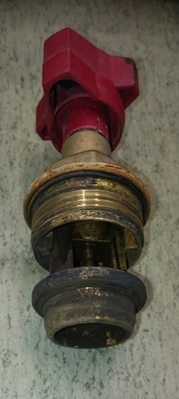
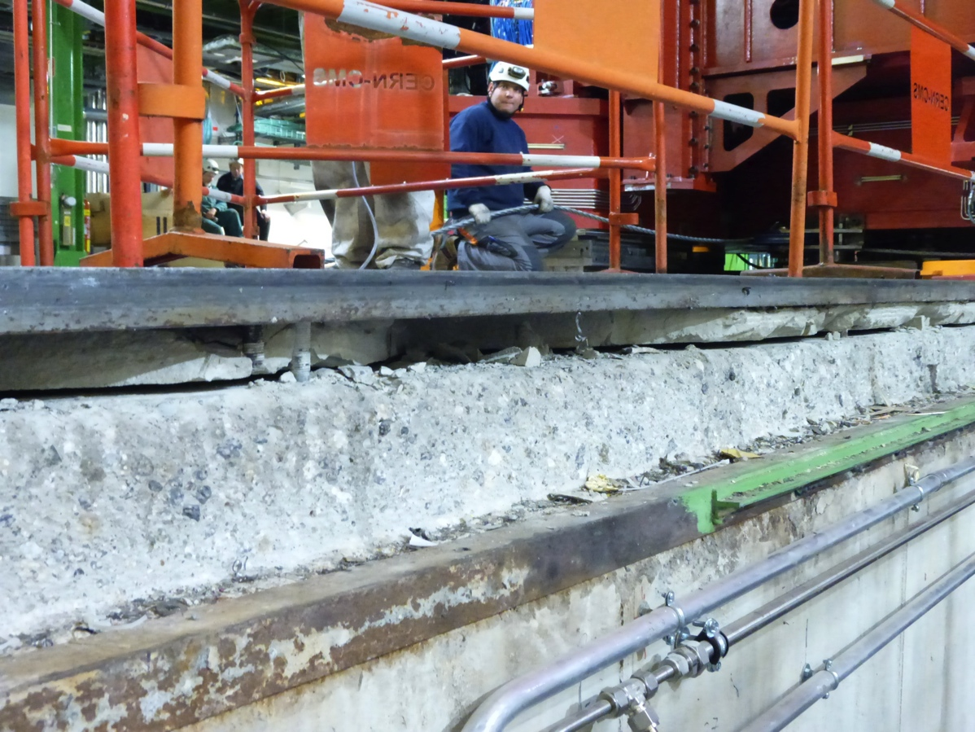
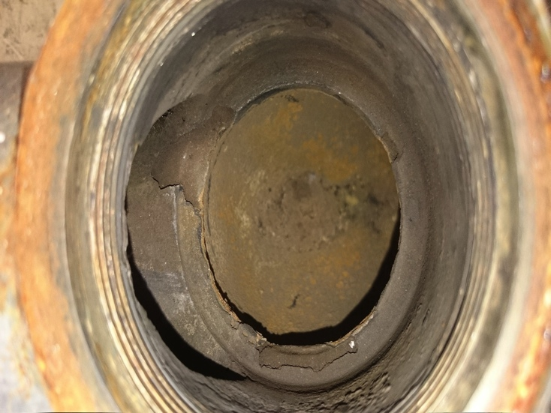
LS1: Basic Infrastructure concerns
LS1 hints that more serious study needed of what has to replaced for HL-LHC era
B
Deteriorating concrete fill beneath UXC
floor at – z end (where heavy elements received)
A
Flow
B
Water circuit reg/shut-off valve: corrosion

Slide 15
Preparing for the next ones…
Year End Tech Stop 2015-16, 2016-17
2015 TechStop’s: remove CASTOR, commission ZeroDegreeCalo crane,
replace CASTOR, Prepare Irradiation tests zone
YearEndTechStop 2015-16 is < 8 months away
- HF Front end readout refit to allow dual cathode readout
YearEndTechStop 2016-17 is just 21 months away:
- the experience of the last 3 months confirms our planning eg
opening ~ 1 month, closure ~ 5 weeks.
Phase 1 pixel installation early 2017
- there is a lot of preparation to do eg
upgrade of surface pixel lab to same control standard as vac tank

Slide 16
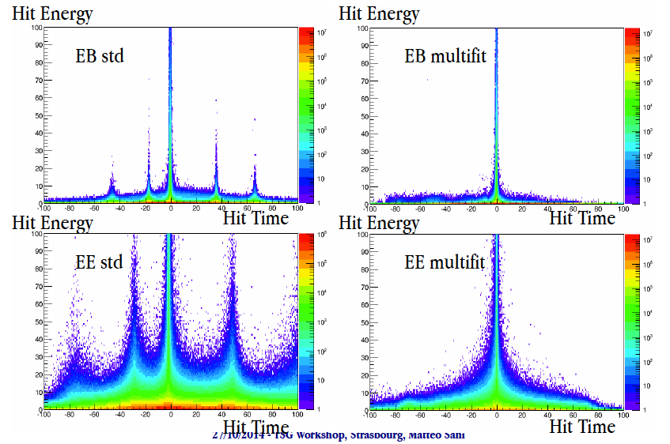
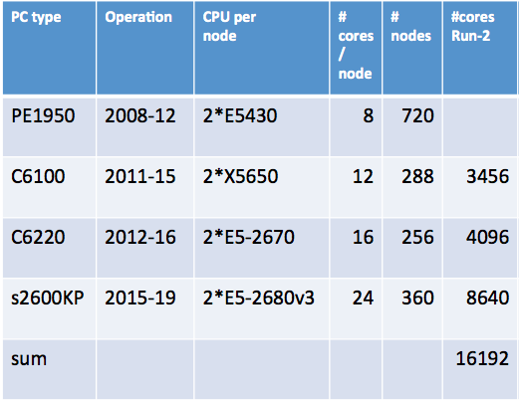
DAQ, Trigger, Reconstruction
DAQ: new data flow fabric + renewed HLT:
Budget 170ms/evt at 1.4 10³⁴ lumi
Focus on Out-of-time pileup both Online and Offline

Slide 17
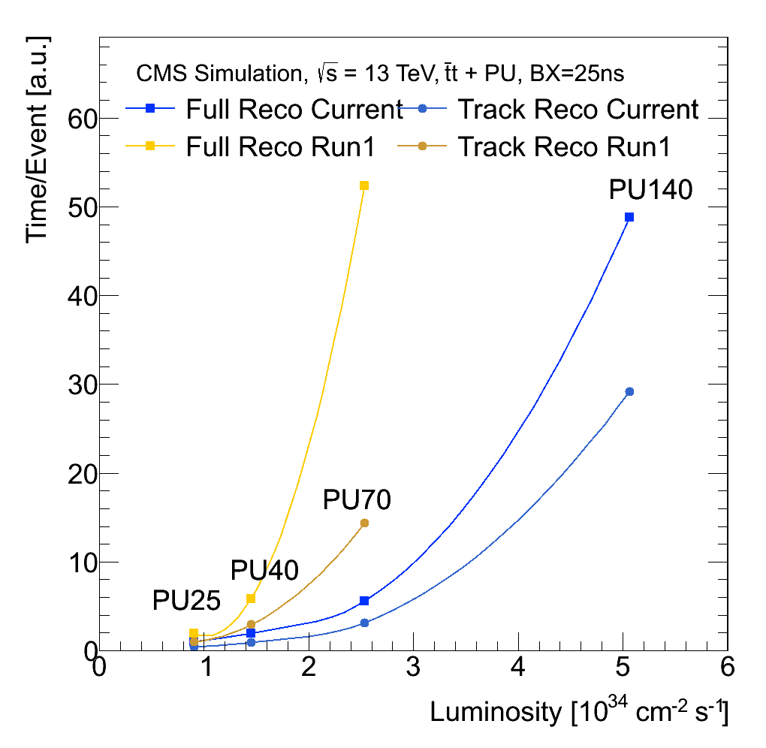
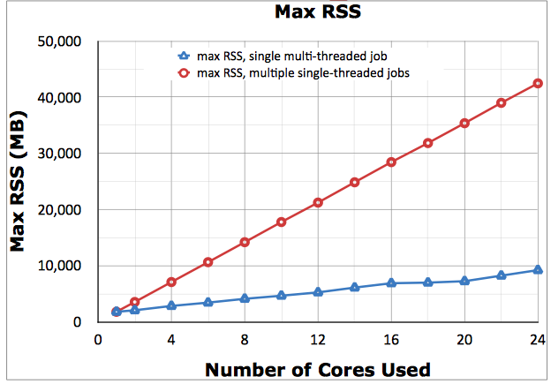
Software and Computing
Commissioning of Higher Level Trigger Farm for Production
Move to multi-core queues at CERN and Tier-1s
Refactoring Tier-0 for Distributed Prompt Reconstruction and use of Agile Infrastructure
Improvements in Data Access and AAA
Improvements in Data Management and Dynamic Data Placement
Improvements in Distributed Analysis (CRAB3)
Work towards Opportunistic Computing (HLT now routinely used ‘opportunistically’ for offline tasks)
Major progress: reco CPU
Multithreading now standard

Slide 18
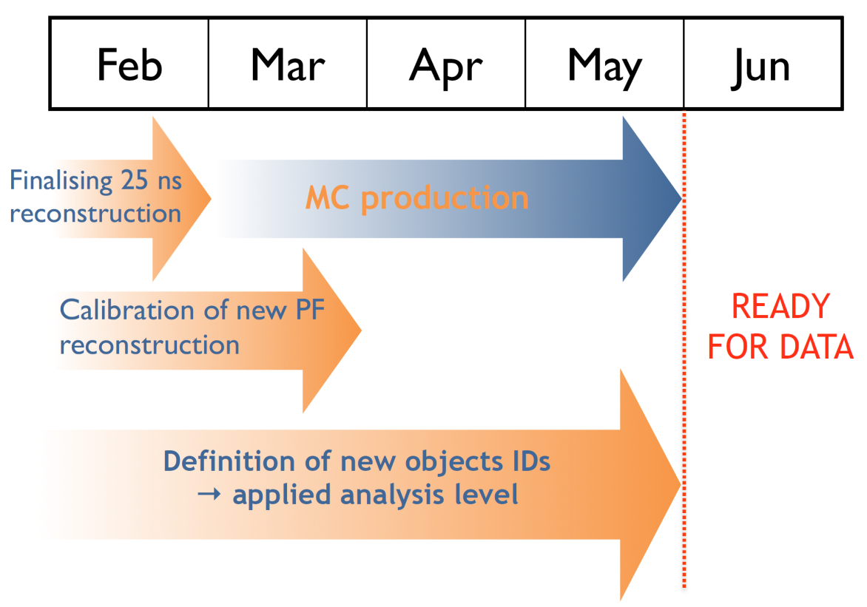
Physics preparations for Run 2
Two major ‘timed’ exercises:
CompSoftAnalysis-challenge14 (2 months in summer): focus on validation of new software framework, new miniAOD and validation of Physics Object reconstruction with 25 ns bunch spacing and higher Pileup at 13 TeV
PHYS14 (2 months in fall) : end to end ‘run’ on High Priority Analysis for first 1-5 fb⁻¹ at 13 TeV
Monte Carlo production
1B events for startup (reconstructed twice: for 50ns and for 25 ns)
PYTHIA8 samples already produced (~1/3 of overall budget)
LO & NLO generators validated with 8 TeV data

Slide 19
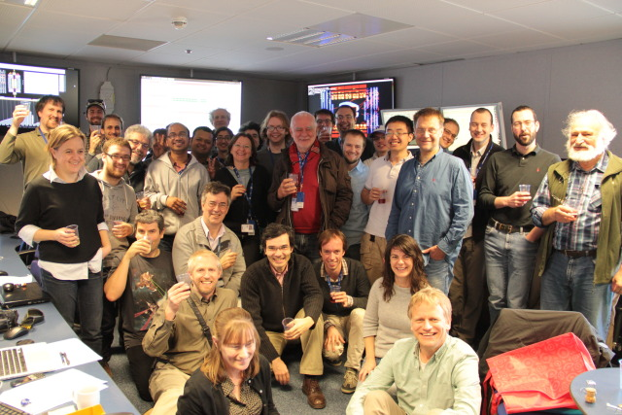
Beam is back

Slide 20
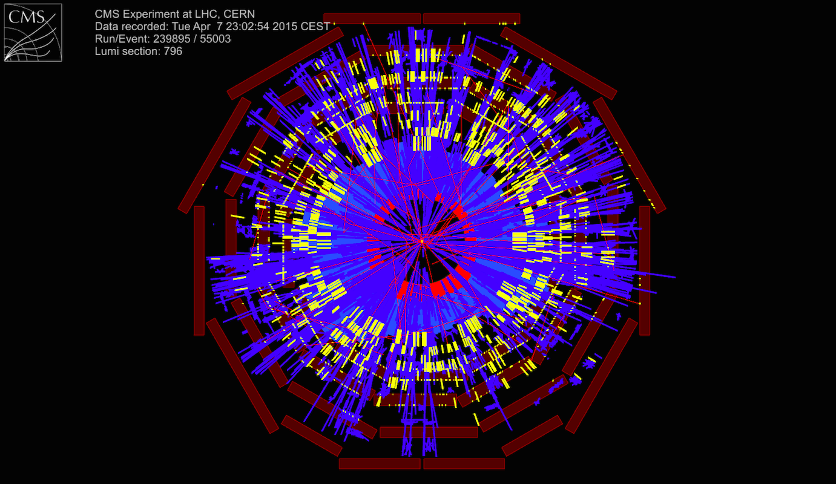
Splashes in CMS
Beam splashes very useful to refine timing

Slide 21
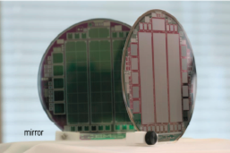
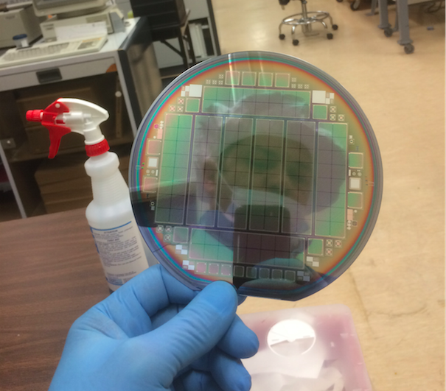
Upgrade phase 1
Executive summary:
Trigger on Schedule: both “Stage 1” (intermediate stage of the) calo-trigger and Full Upgrade for 2016 operation.
HCAL on or ahead of schedule.
PIXEL: 100% ROC chips, 100% BPIX HDIs, 80% Barrel sensors delivered, forward delivery started; 100% DC-DC chips in hand; CO2 cooling station installed in IP5. Resubmission of Token Bit Manager chip puts pressure on module production, mitigated by change of schedule. Barring unforeseen problems, it should be ready for Insertion during the Extended Year End Technical stop 2016-2017
Barrel Pixel
FWD Pixel
27 April 2015
CERN-RRB-2015-005

Slide 22
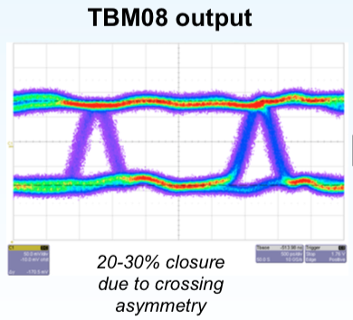
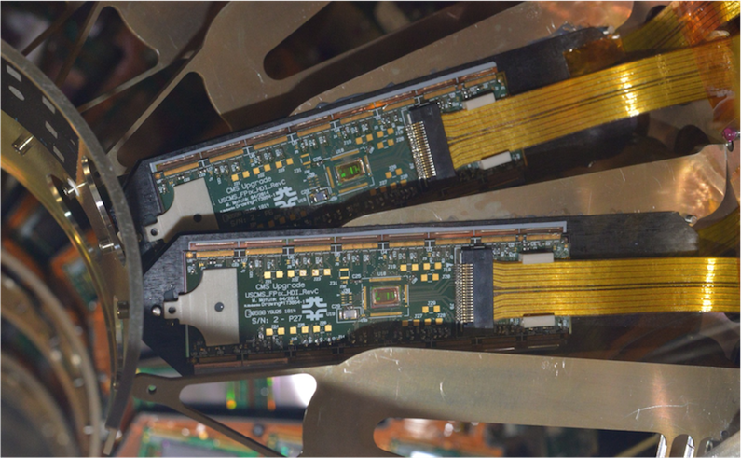
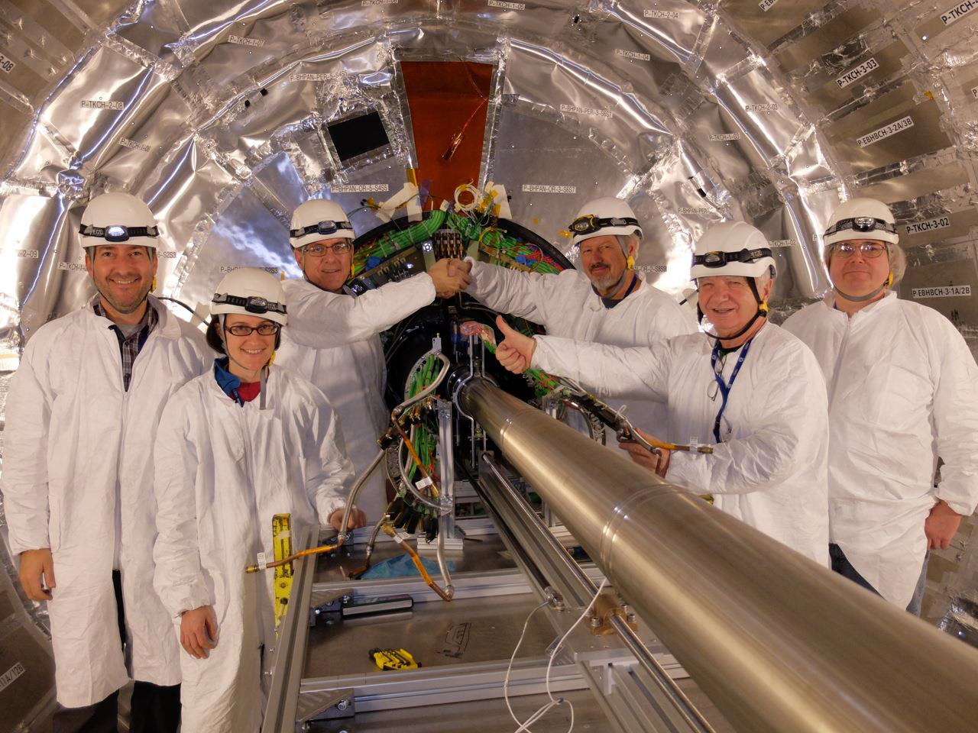
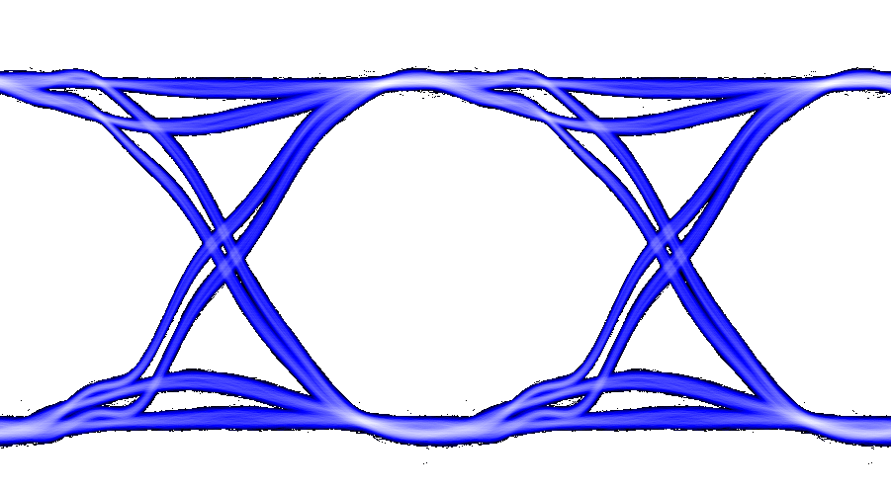

Pilot Detector
During LS1
FPIX reinstalled in CMS, with Pilot Detector for 2017
  Pilot: crucial for understanding problem with original design of readout of upgraded pixel detector (clock jitter issue)
    8 FPIX-style modules
  New version of Token Bit Manager TBM chip (with more output margin) delivery this week
  Earlier than anticipated
Symmetric Output

Slide 23
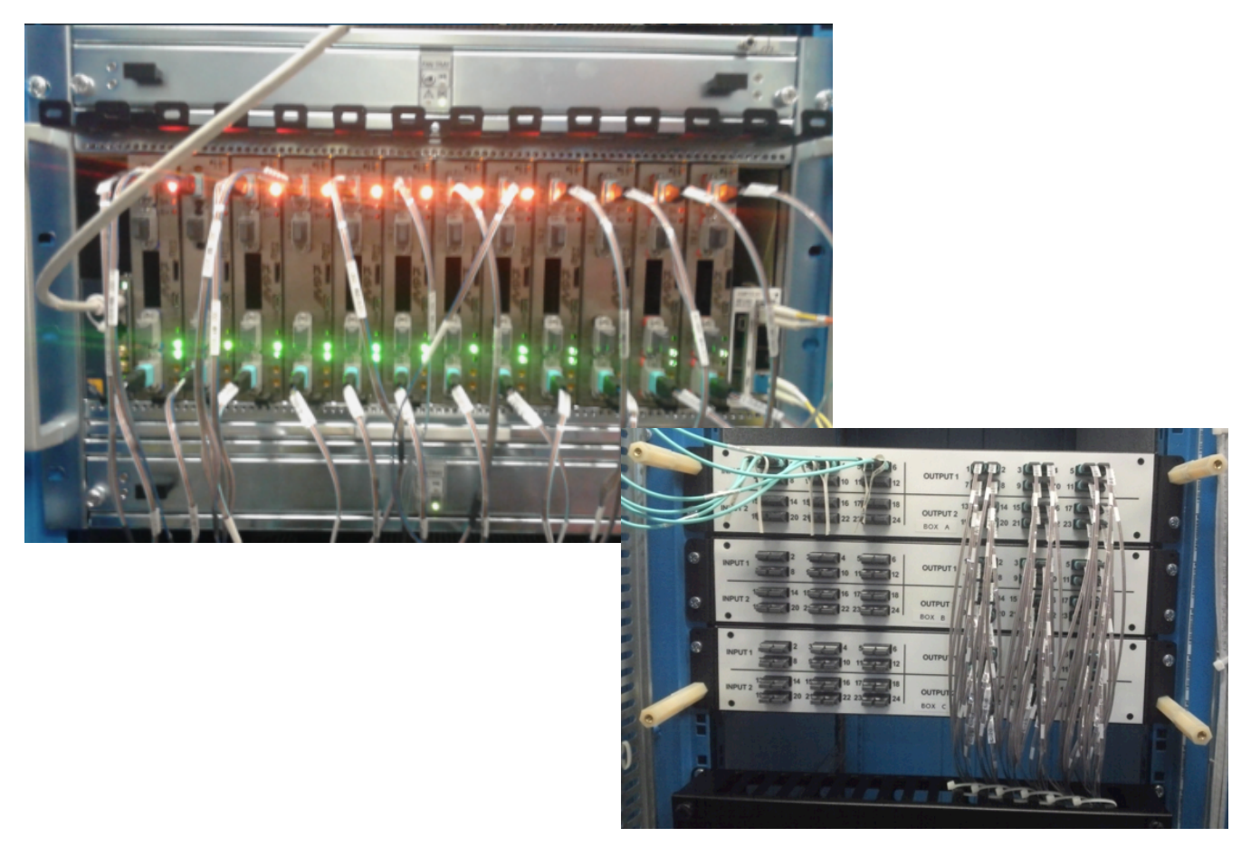
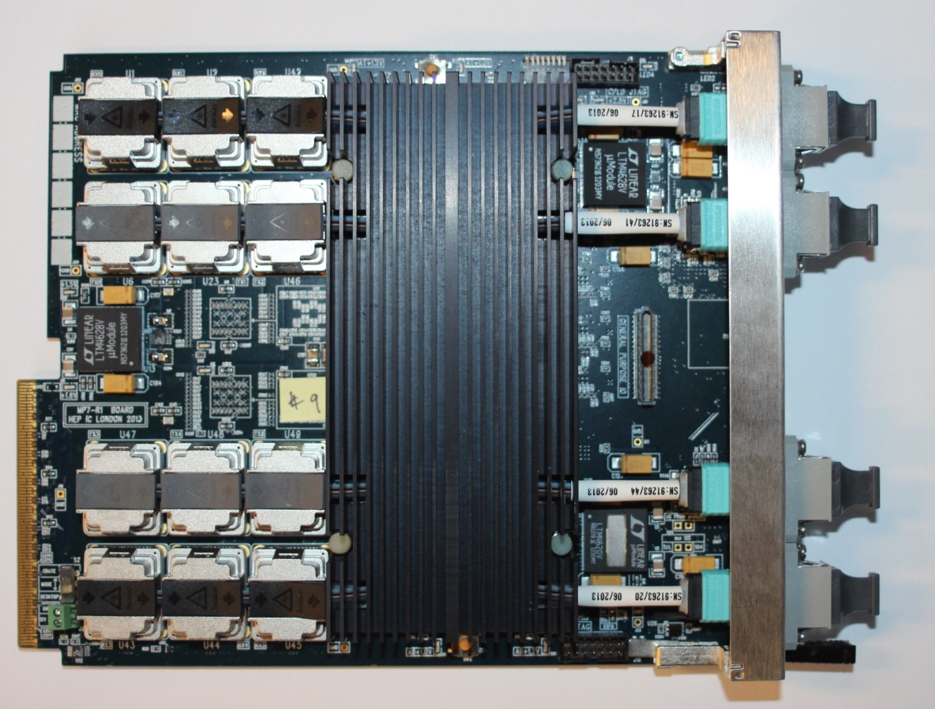
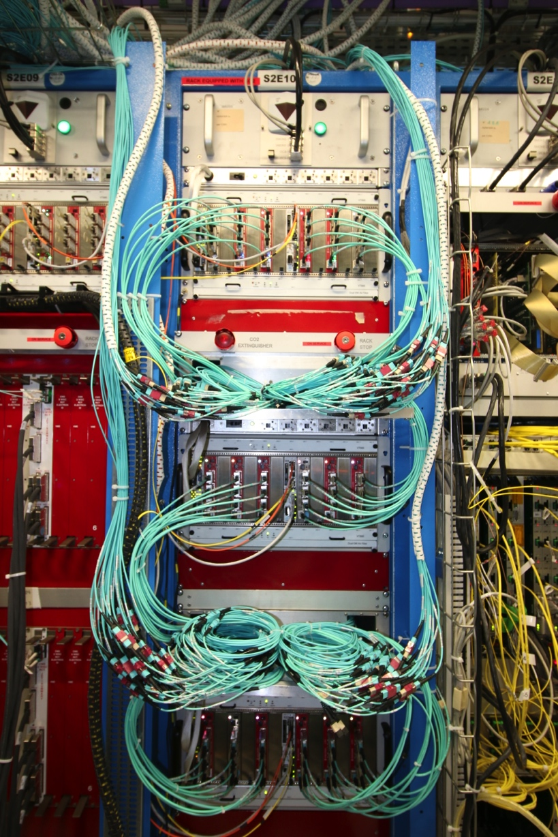
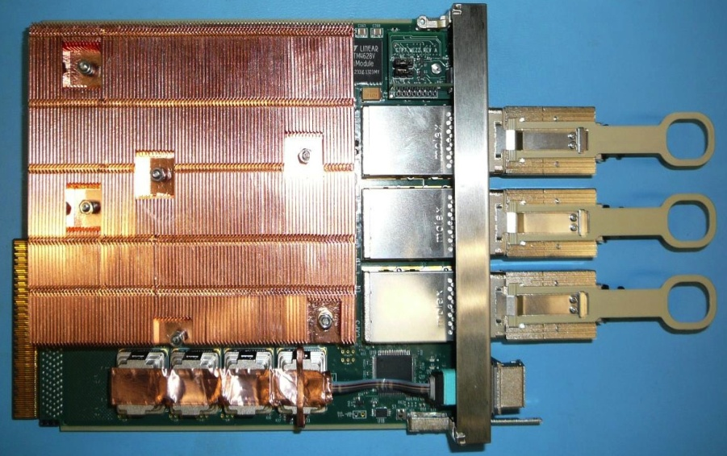
Trigger Upgrade: Calorimeter Trg status
MP7
Layer-2: 12/12 MP7s (UK) installed, with
layer-1/layer-2
interconnection patch panel
On schedule for Parallel Running from September 2015
CTP7
layer-1 CTP7s (US): 18 installed, 36 ( out of 36 expected) now available at CERN.
Notes:
Goal Jan 2016

Slide 24
Phase 2 upgrade
27 April 2015
CERN-RRB-2015-005

Slide 25
Executive Summary
Technical Proposal to be submitted to June LHCC
Tracker upgrades well defined: extended pixelated coverage in forward region to |η|=4
Trigger: baseline has Track-Trigger at Level 1; basic parameters to cope with peak Lumi at 7.5 10³⁴Hz/cm² defined
Calorimeter:
  Barrel electronics consolidation defined
  Forward Calo: choice of the technology to be done next week
Muons: first Upgrade (GEM station to consolidate trigger and redundancy in critical forward region) TDR presented at March LHCC: aiming to installation in LS2. Upgrade of barrel electronics and improved forward robustness/rate capability defined

Slide 26
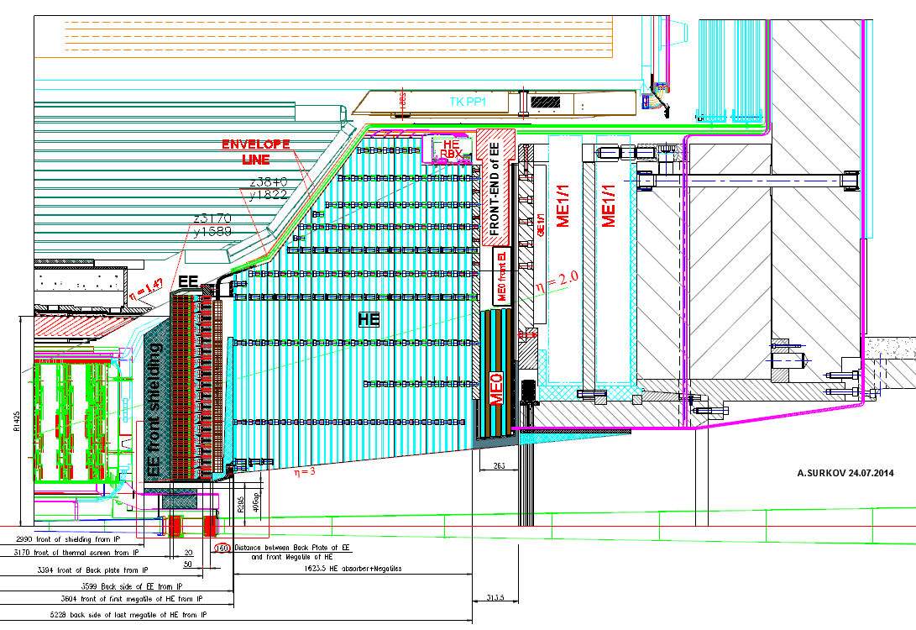
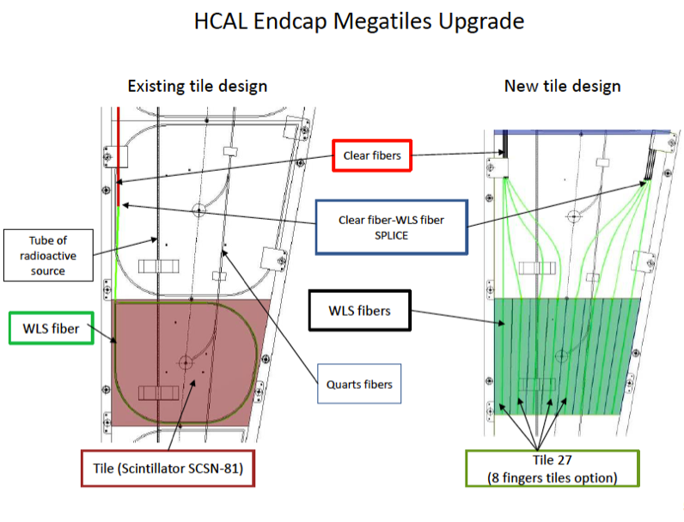
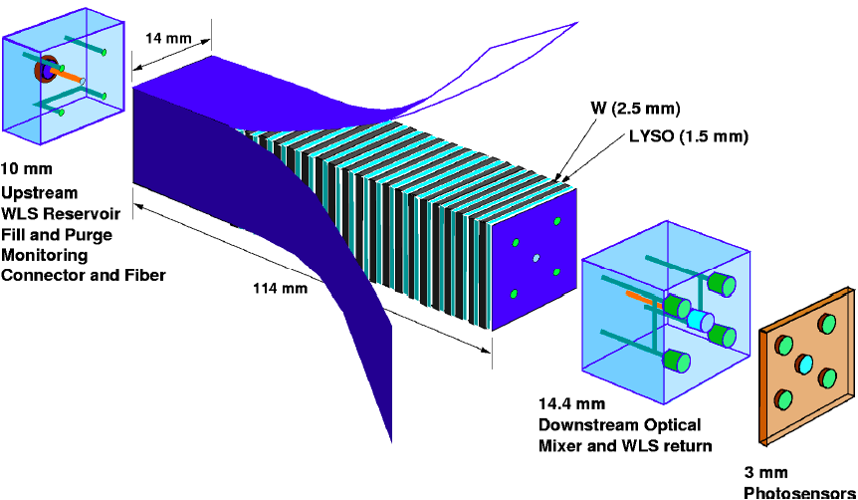
EndCap calo concept: Shashlik
EM Calorimeter
Compact Pb/LYSO Shashlik using WLS based quartz capillaries and readout using clear fibers+ “SiPMs”
Hadron Calorimeter
Scintillator-based hadron calorimeter with 30% of
volume replaced by “finger tiles” and 10% by a
solution with high radiation tolerance (liquid SC
being considered)

Slide 27
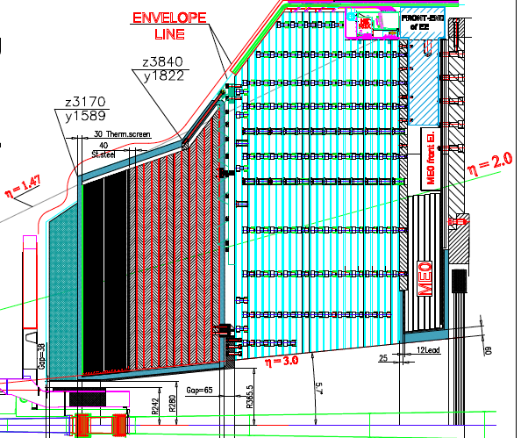
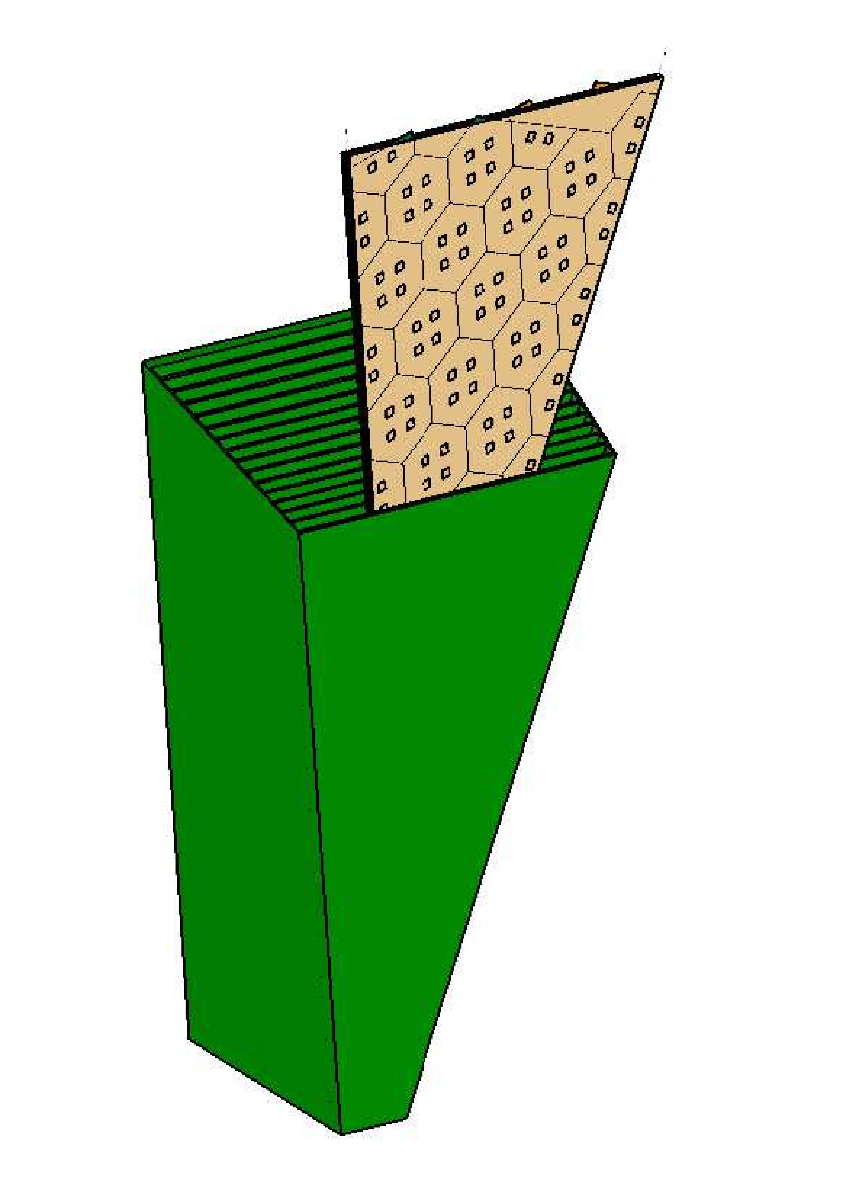
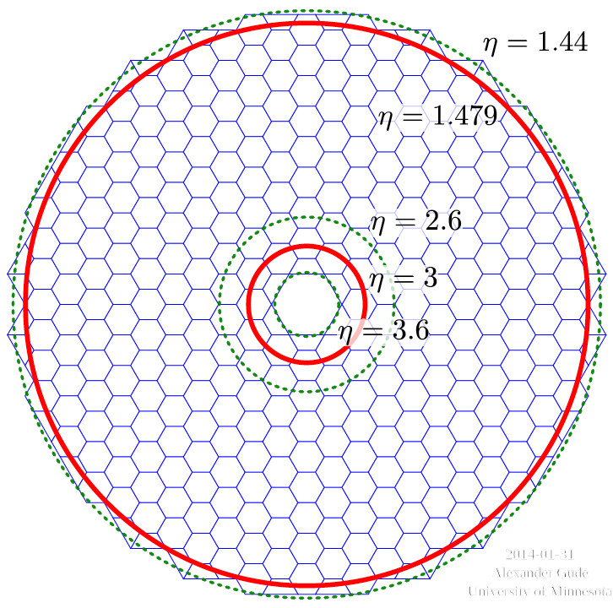
EC calo concept: High Granularity Calo
Silicon-tungsten/lead/copper EM (25 X0, 1λ) and silicon/brass front hadron (3.5λ) calorimeter
6.2M channels, pad sizes 1cm² or 05 cm² depending on η
Scintillator-brass backing calorimeter (5.5λ, low radiation environment)

Slide 28
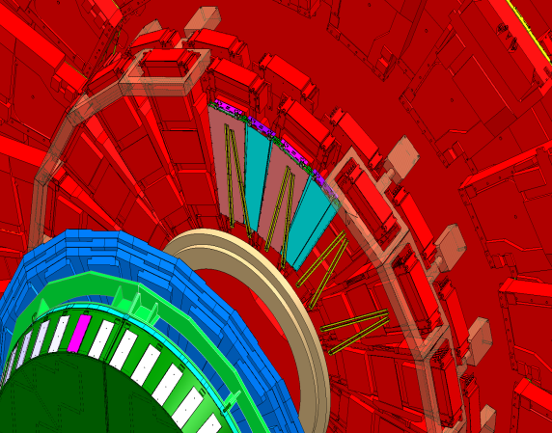
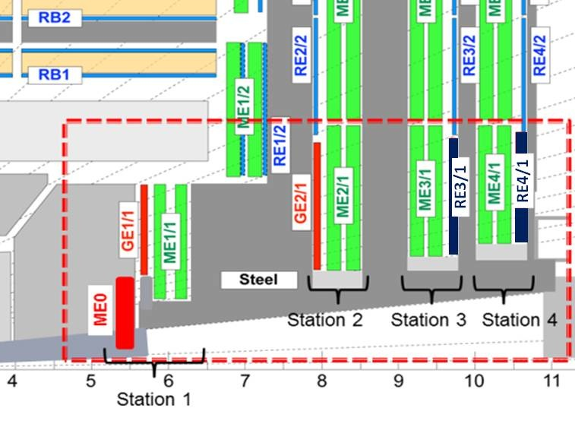
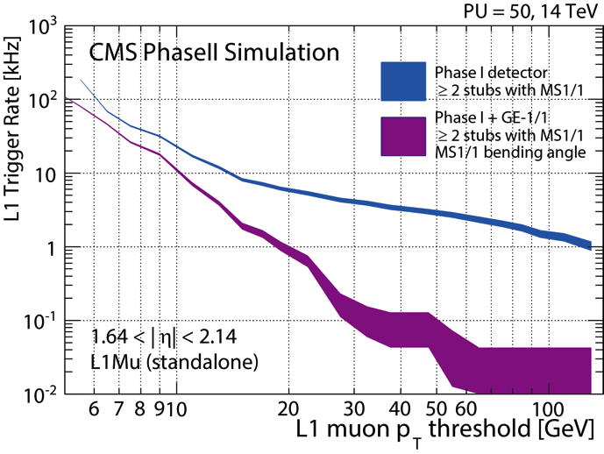

Muons
Improvements of existing detectors
  Electronics: DT minicrates,
  CSC inner MEx/1 readout
Forward 1.6 < |η| < 2.4 upgrades
  L1 trigger rate reduction, enhanced redundancy
  GEMs: GE1/1 and GE2/1
  iRPCs: RE3/1 and RE4/1
    operation in higher rate
Very forward extension
  ME0 with GEMs
TDR presented at last LHCC
Trigger rate
reduced by 3 at 15 GeV

Slide 29
FA Expressions Of Interest for R&D
FA preliminary expected R&D contributions in M&S & equipment are reasonably matching project need estimates

Slide 30
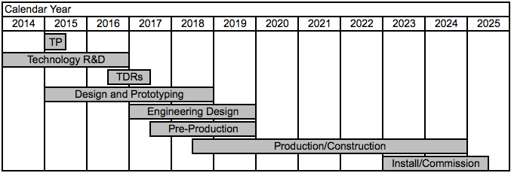
Planning and cost profile
From October RRB, to be updated for TP
Total cost 270M
Following request from CERN DG: we are developing a scope document for three funding scenarios: 270, 235, 200 MCHF.
CMS confronted (also in comparison with ATLAS) with not structuring upgrade into ‘baseline’ and ‘options’. Reason: necessity of rebuilding the Endcap Calorimeter: we felt we could not afford ‘options’…
We have nevertheless studies ongoing on possible enhancements of CMS for the long term future.

Slide 31
Scope document
Main areas for possible cost reductions *
Tilted Outer Tracker modules
Muon DT readout (L1-Trigger rate ≤ 300 kHz - operation risk)
CSC readout stations 3 & 4 (limit L1 rate ≤ 500 kHz)
Muon forward stations (2 to 4)
Track-Trigger Back End electronics
Pixel extension to η ≃ 4
BRIL
DAQ (L1-Trigger rate and ability to operate at 200 PU)
EB VFE and cooling
Muon extension to η ≃ 3
Tracker number of layers (layer 4 in Barrel)
Encap Calorimetry (also design optimization)
*Cost reduction categories
Design/technical optimizations - marginal perf. degradation - limited cost gain
Recoverable de-scoping - substantial impact on perf. and/or risk for operation - mitigated if funds become available (for LS4) and HL ramp-up is not steep
Irrecoverable de-scoping - substantial impact on perf. and/or risk for operation
Options for cost reductions are incremental: we will group them in order to achieve the target de-scoping scenarios
Some of the options are clearly going to affect the essential physics reach like the fwd pixel extension or the ECAL VFE
They are listed only because we cannot reach the largest descoping scenario otherwise
NO silver Bullet
Identified!

Slide 32
Options for upgrades
We are also studying the following options, in case we get more resources than our baseline:
  timing plane in front of calorimeters ( to improve associations of tracks /showers to pileup vertices via Time of Flight): this is a very active area of R&D with applications not only in HEP and has seen very promising advances in recent years
  And exploring the possibilities of the Extension of muon coverage to |η|=4: in terms of surface of muon chambers this is a minimal extensions and cost would be limited, but the issues linked to the radition fields are non neglible
27 April 2015
CERN-RRB-2015-005

Slide 33
A warm thanks
We would like to thank all of you, as well as the funding agencies you represent, for the long-standing and sustained support of the CMS experiment.
It is thanks to this support that CMS is able to pursue its excellent research program.
27 April 2015
CERN-RRB-2015-005

Slide 34
Summary
CMS has emerged successfully from the first major shutdown of the LHC, Long Shutdown 1, with an improved detector, data acquisition, trigger, and software.
The Phase1 upgrades are proceeding according to plan.
We are looking forward to taking data at 13 TeV.
We are finalizing our Upgrade plans for the High-Luminosity LHC.
27 April 2015
CERN-RRB-2015-005

Slide 35
Backup

Slide 36
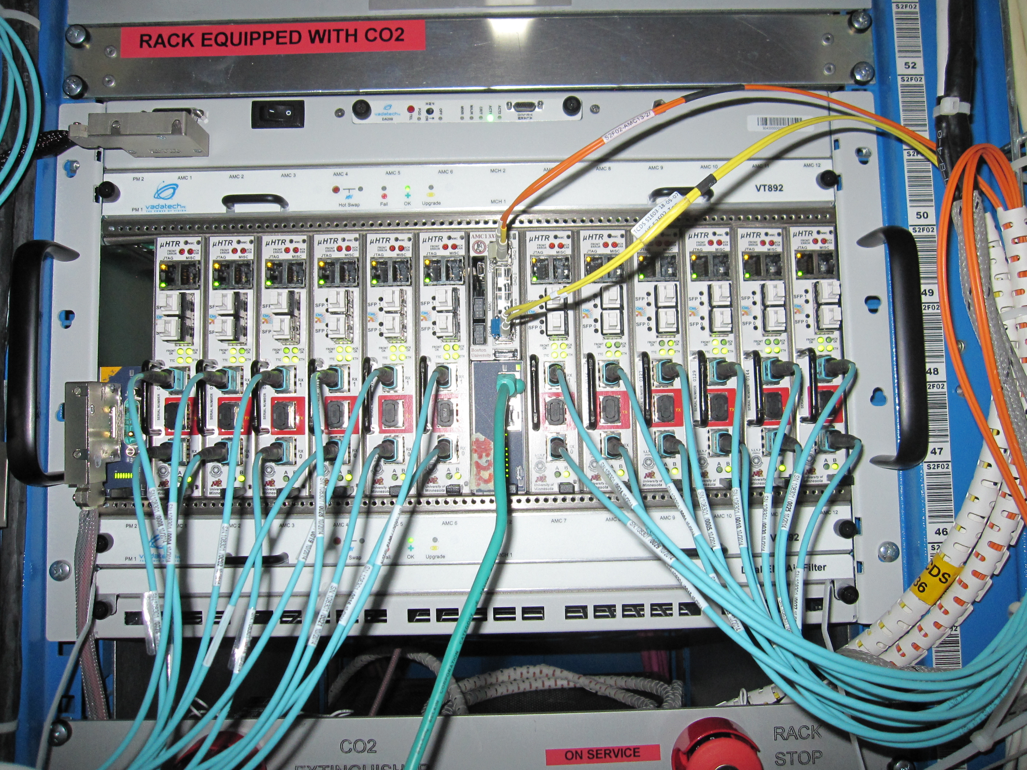
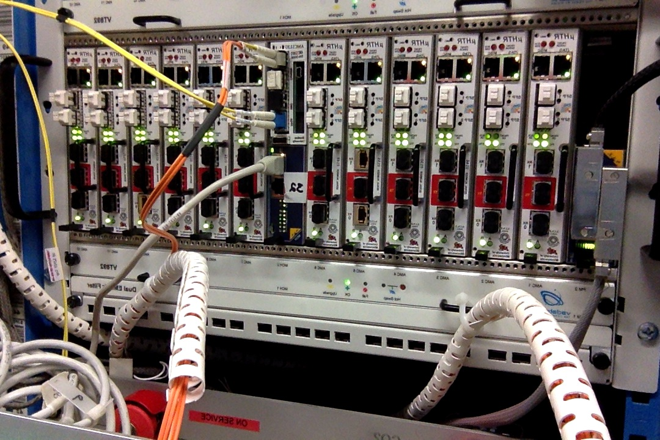
HF Back-End
All HF Backend hardware installed
  3 μTCA crates
  Each crate: 12 μHTR cards, 1 AMC13 card
Status of Commissioning
  1 uTCA crate receives data from HF frontend fibers
    - data is currently split between μTCA and VME
  Commissioning in LOCAL (HCAL-only) completed
    – data via VME and μTCA is identical
  Commissioning in GLOBAL (CMS-wide) continues (DAQ and Trigger links)
  Once the last item is completed, we will move all frontend fibers to the 3 μTCA crates, and decommission the VME backend
B
B
A
2 of the 3 installed uTCA crates, one with and one without connected frontend fibers

Slide 37
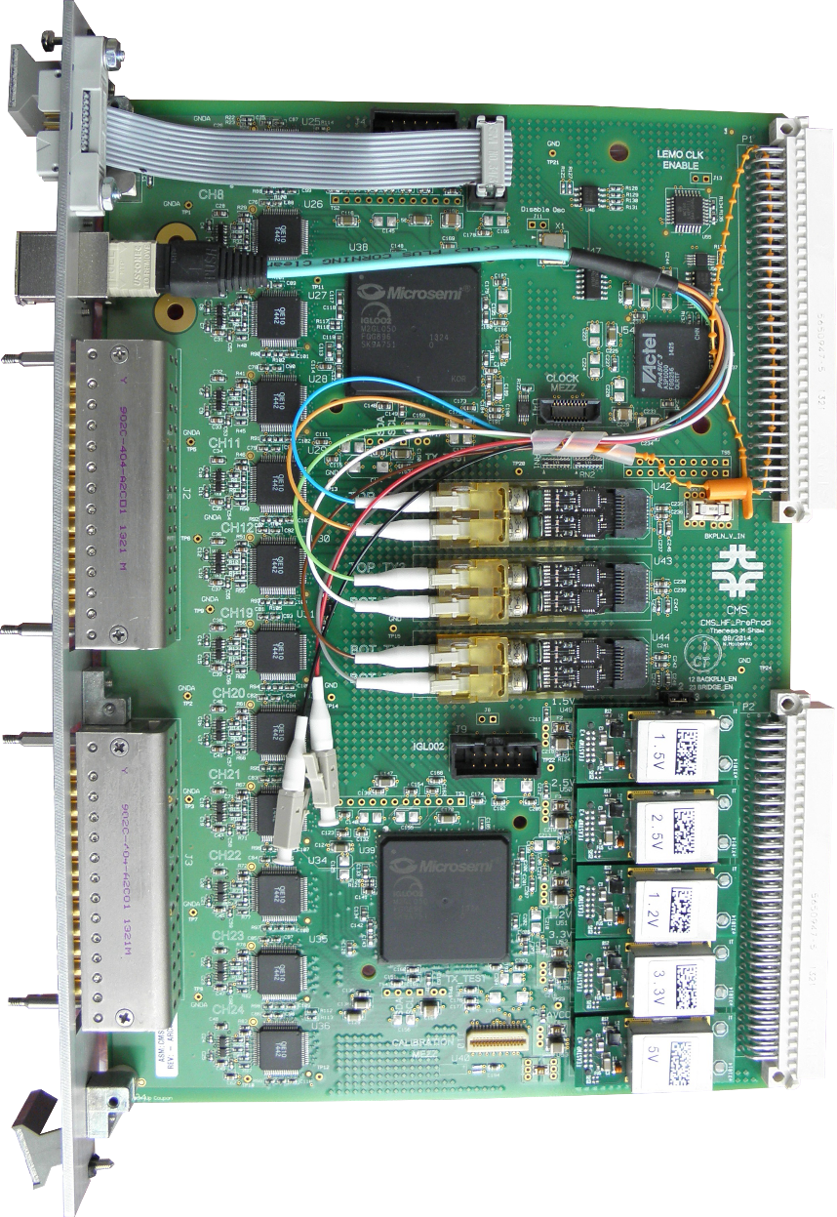
HF Front-End
QIE10 ASIC
  We have one wafer worth of packaged chips in hand, chips from remaining wafers are expected within a month.
HF QIE and ngCCM (new-generation Clock and Control Module) cards
  Preproduction cards were successfully tested.
  We are now assembling QIE cards in Brazil and Turkey to qualify the production assembly houses. We expect production cards to be delivered to CERN in July 2015.
Testing, burn-in, and installation plans
  Testing and burn-in will take place at CERN from July to December
  Installation will take place during YETS 2015/16:
    Rework PMT boxes to change from 4 anodes/ch. to 2 anodes/ch.
    Install HF FE crates and associated infrastructure
  Commissioning in February/March 2016
B
B
A
Preproduction QIE card

Slide 38
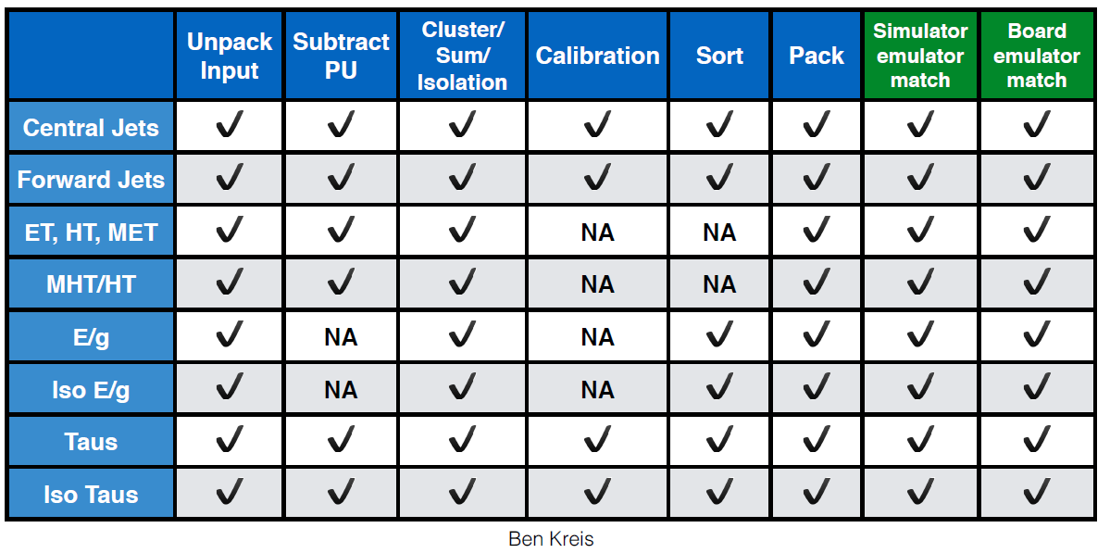
Calorimeter Trigger Stage-1 Upgrade
All pp algorithms are now implemented in firmware and agree with a software emulator in data pattern tests
Firmware for heavy ion run has started
Mind, you do NOT see the blue MC lines!
Now doing data pattern tests in situ at P5 all the way to the test crate of the Global Trigger.
Initial comparisons look very good.

Slide 39
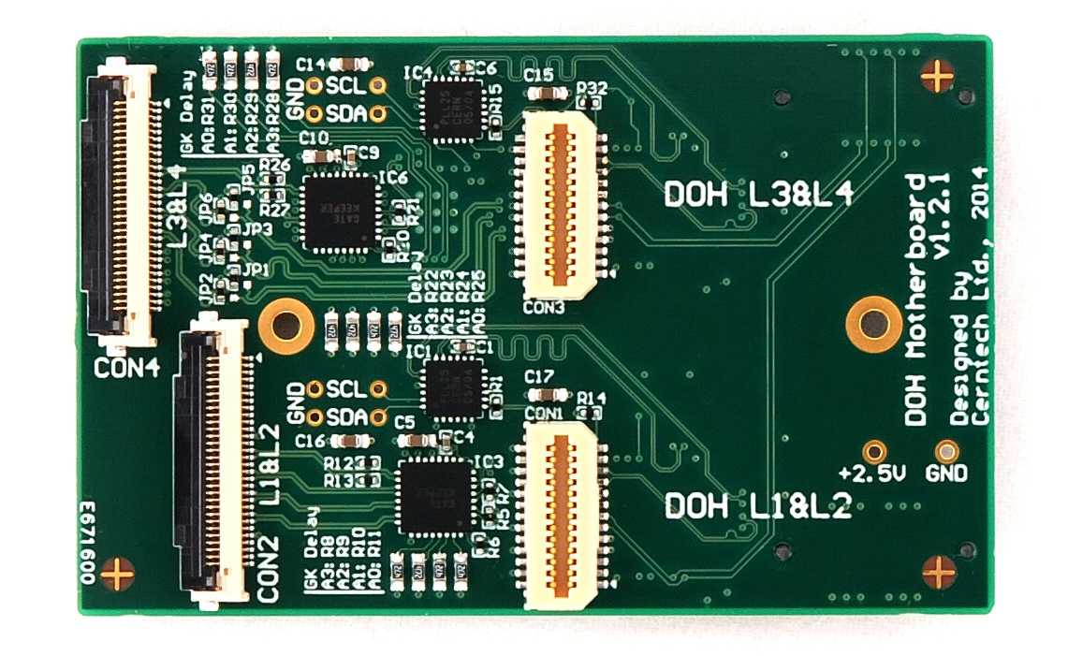
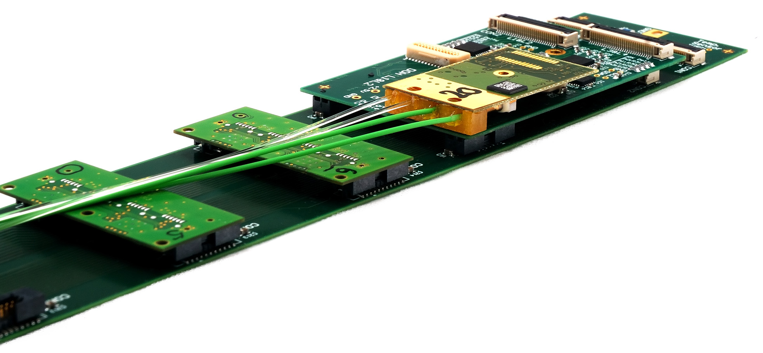
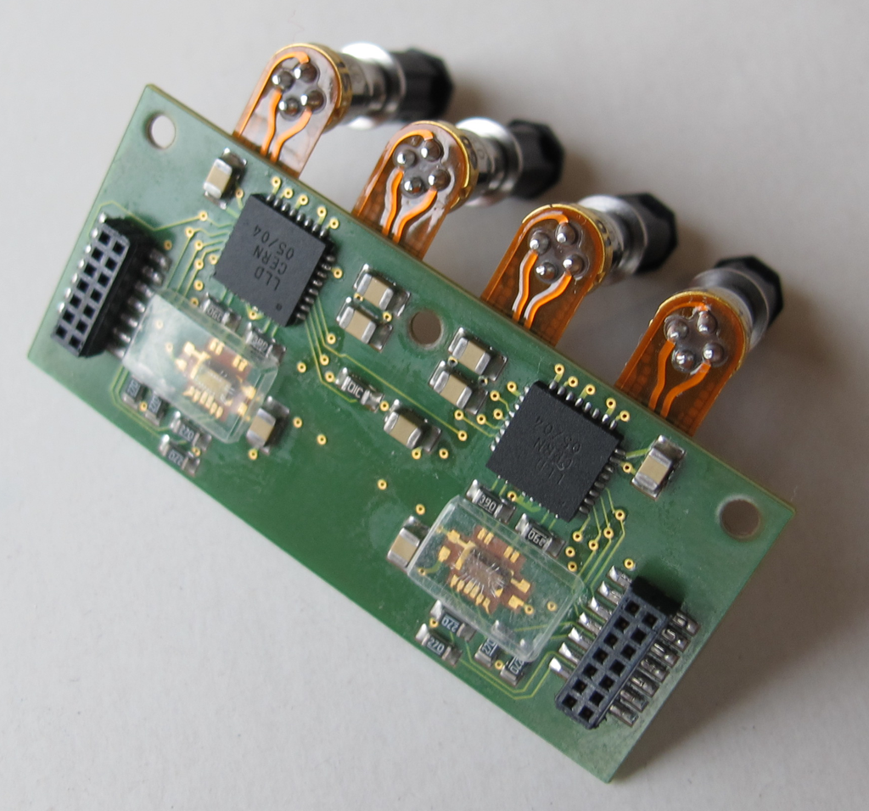
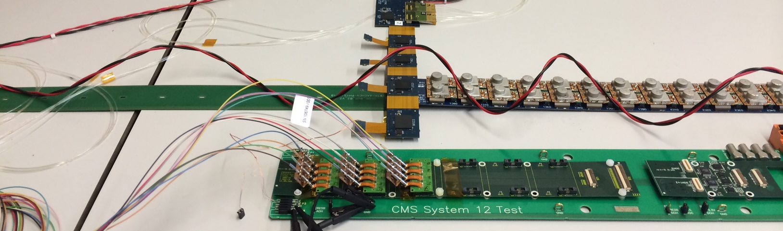
Electronics boards - BPIX
DC-DC converter production started
  for BPIX & FPIX
    Featuring FEAST2
DC-DC motherboards production starting March→ ready early September
BPIX Supply Tube Boards
  Prototypes of all but one board in hand – looks good
    One board to be adapted to hold 2 QPLLs plus 2 quartzes
  Streamlining production to finish in September
BPIX POH prototype looks OK
  Final review next Monday
  Reminder: lasers already all in hand

Slide 40


Electronic Boards - FPIX
Port cards
  New 4 channel prototypes being populated (use in system test stands, optimize connectivity of QPLL, inform design of final port card and similar printed circuit board for BPIX)
  Design of 7+7 channel port card in progress (define geometrical envelope)
    Production in June (simple PCB)
Pixel Opto Hybrids
  Ready for production, waiting for review at CERN, joint with BPIX (next Monday)
    Reminder: lasers already all in hand
DC-DC
  Converter production started
  DC-DC converter motherboards: currently making prototypes, will launch production in May after testing
Digital Opto-hybrid production ongoing
Notes:
portcard: still in the prototyping phase (4 channel prototypes). Design of
set of two 7-channel stacked port cards to be done in March, first round
of prototypes in April, production in June (simple PCB)

Slide 41



BPIX mechanics
We are bit late here and have to speed up production!
Problems of leaks in 3D replica of cooling loops just overcome (tbc)
  Delivery of system at CERN this week to make final pressure drop measurements
    This will confirm the design and unlock mechanics production
  We will still need to review the brazing process
Design of supply tube ready – workshop ready to start
BPIX mechanics to be started
  Basic design ready
Photo of old prototype
3D replica of cooling loops
Notes:
We will also look again to FPIX system which had NO PROBLEMS

Slide 42



Mechanics - FPIX
Half-Cylinder
  Started purchases of production quantities for
    Carbon fiber for half cylinder support
    Submitted order for all cooling tubes and grounding strips for half cylinder
  Will manufacture 2 cylinders in parallel at two different companies
Half Disks
  Production quantities for Graphite for half disk shells (delivered)
  First phase of machining of thermal pyrolitic graphite for half disk blades 30% complete
  Ready to submit orders for machining of half disks

Slide 43


Background hits rate
A large contribution is due to hadronic interactions activating materials and producing neutron background which interact with nuclei and produce in cascade photons and electrons/positrons.
- Hit rates are a convolution of fluxes with the detector sensitivities
Prompt particles provide also, even if small, contribution to the total rate
Expected hit rate 250 Hz – 1.5 kHz/cm² well within the margin of safe operation for GEM technology

Slide 44
Upgrade Cost estimate
Estimated CORE cost in MCHF (2014)
 | Pixel Detector | 27
 | Outer Tracker | 93
Tracking System |  | 120
 | Barrel Calorimeters (EB electronics, HB tiles) | 14
 | Endcap Calorimeters (see text) | 65
Calorimeters |  | 78
 | DT and CSC electronics | 10
 | Muon stations:GE11,GE21, RP31 and RP41 | 10
 | Muon extension ME0 | 5
Muon Systems |  | 24
Beam Monitors and Luminosity |  | 4
 | L1 Trigger | 6
 | HLT | 6
 | DAQ + Trigger Control System | 6
Trigger and DAQ |  | 18
Common Infrastructure, Systems and Support |  | 25
Total |  | 270
Estimated CORE cost in MCHF (2014)
Shashlik EE | 43
Full HE-rebuild (including radiation-tolerant tiles) | 17
Shashlik + HE | 61
HGCAL (EE and front-HE section) | 55
Partial HE-rebuild back-HE section | 10
HGCAL + back-HE | 65

Slide 45
Tracker upgrade CORE Cost estimate - Sept. 2014
Estimated CORE cost in MCHF (2014)
 |  | Outer Tracker | Pixel Detector
Modules | 2S | 32.5 | 15.3
 | PS | 23.1
Mechanics |  | 4.5 | 3.1
BE Electronics |  | 11.9 | 1.6
Power System |  | 6.2 | 1.4
Services (cabes, pipes) |  | 5.5 | 1.1
Cooling |  | 4.2 | 0.6
Infrastructure and Installation |  | 5.4 | 3.6
Total |  | 93 | 27

Slide 46
Calorimeter upgrades CORE Cost estimates - Sept. 2014
Estimated CORE cost in MCHF (2014)
Front end electronics | 8.1
Off-detector Services | 4.2
EB Total | 12
Rebuild tiles | 1.1
Optical distribution and installation | 0.3
HB Total | 1.4
Barrel Calorimeters
Estimated CORE cost in MCHF (2014)
Mechanical Structures | 1.8
Shashlik Modules (LYSO, W, WLS fibers) | 31.5
On-detector electronics and services | 4.8
BE Electronics and Controls | 1.5
Power System | 0.5
Calibration System | 1.5
Cooling System | 0.2
Assembly and Installation | 1.7
Total Shashlik EE | 43
Absorber | 8.3
Scintillating Tiles and WLS fibers | 5.6
Readout and on-detector electronics | 2.2
BE Electronics and Controls | 0.5
Power System | 0.2
Assembly and Installation | 0.4
Total Rebuild HE | 17
Total Endcap Calorimeters | 61
Estimated CORE cost in MCHF (2014)
Mechanical Structures | 6.5
Silicon Modules | 27.3
On-detector electronics and services | 3.4
BE Electronics and Controls | 2.9
Power System | 5.9
Cooling System | 7.5
Assembly and Installation | 1.7
Total HGCAL | 55
Absorber | 6.0
Scintillating Tiles and WLS fibers | 1.2
Readout and on-detector electronics | 1.7
BE Electronics and Controls | 0.3
Power System | 0.1
Assembly and Installation | 0.4
Total Back HE | 10
Total Endcap Calorimeters | 65
EE Shashlik and HE-rebuild Concept
HGCAL and B-HE Concept

Slide 47
Muon upgrades CORE Cost estimates - Sept. 2014
Estimated CORE cost in MCHF (2014)
DT Electronics
Minicrate Electronics | 3.3
Trigger Electronics | 1.9
Opto-links | 0.7
Total | 5.8
CSC Electronics
Electronics boards | 3.0
Low voltage system | 0.2
Opto-links | 0.4
Total | 3.7
Estimated CORE Cost for DT and CSC Electronics Upgrades
Estimated CORE cost in MCHF (2014)
GE11 and GE21
Chamber assembly | 2.5
Electronics | 3.1
Power system | 1.2
Services | 0.7
Installation | 0.3
Total | 7.7
RE31 and RE41
Chamber assembly | 1.2
Electronics | 0.3
Power system | 0.5
Services | 0.2
Installation | 0.2
Total | 2.3
Estimated CORE cost in MCHF (2014)
ME0 Muon Extension
Chamber assembly | 1.2
Electronics | 1.9
Power system | 1.0
Services | 0.3
Installation | 0.2
Total | 4.5
Estimated CORE Cost for ME0 Muon Extension
Estimated CORE Cost for GEM and RPC Muon Stations

Slide 48
BRIL upgrade CORE Cost estimate - Sept. 2014
Estimated CORE cost in MCHF (2014)
Luminosity Measurement | 1.9
Beam Conditions Monitor/Protection | 0.7
Beam Background Monitoring | 1.0
Radiation Monitoring | 0.3
Total | 3.9

Slide 49
L1 Trigger, DAQ/Control and HLT upgrades CORE Cost estimates - Sept. 2014
Estimated CORE cost in MCHF (2014)
Track Correlation Trigger | 1.4
Calorimeter Trigger | 3.1
Muon Track Finder (Barrel and Overlap) | 0.5
Muon Track Finder (Endcap) | 0.9
Global Trigger | 0.5
Total | 6.5
Estimated CORE cost for the L1-Trigger
Estimated CORE cost in MCHF (2014)
TTC System | 1
DAQ read out, network, storage | 5
HLT computing nodes | 6
Total | 12
Estimated CORE cost for the Trigger Control System, DAQ, and HLT computing

Slide 50
Infrastructure and LS work support CORE Cost estimate - Sept. 2014
Estimated CORE cost in MCHF (2014)
Magnet power and cryogenics | 1.6
Beam pipe | 1.7
Infrastructure | 6.1
Test Facilities | 0.4
Surface Facilities | 0.3
Safety Systems | 2.3
Electronics integration | 0.9
Engineering integration | 3.2
Technical Support | 8.7
Total | 25

Slide 51
Trigger upgrade: Calo Stage1 (2015)
63 x Legacy Source Cards
22 x 12 Fiber
Ribbons
216 Fibers @
2.0 GBps Asynch.
Now disconnected
Optical
Patch
Panel
Legacy
GCT
Legacy GT
108 80 MHz
SCSI CABLES
The Legacy Trigger at P5
4 Ribbons
3 GBps
216 Fibers 2.0 GBps Asynch.
22 x 12 Fiber
Ribbons
18 x ORSc in
RCT Crates
Optical
Patch
Panel
All installed at P5
Optical
Patch
Panel
1xMP7
4 Ribbons
3 GBps
108 80 MHz
SCSI CABLES
36 Fibers at 10.0 GBps Asynchronous (2/RCT Crate)
The Stage-1 System at P5
“GCT in ONE chip”
Shore up existing calorimeter trigger to add:
  pile-up energy subtraction, improved tau trigger, e/g isolation, etc.
Replace Global Calorimeter trigger with ONE new µTCA card
Notes:
Final f/w for MP7 expected March 31.

Slide 52



Muon Trigger Upgrade Status
MTF7 card production has launched for endcap and overlap TF regions
  Completion end June for installation
MP7 card procurement (same as calo trigger) for barrel TF
  Order placed
Muon Trigger optical fiber split for parallel operation:
  CSC full split: Done
  DT slice: Done
  RPC full split:
    A pilot RPC trigger crate with splitters installed at P5, rest ordered
Data concentration:
  Production of “TwinMux” for barrel DT and RPC is launched. PCBs already received.
MTF7
➔ Project Completion Oct. 2015 : parallel running in with Legacy trigger
Notes:
Goal Feb 2016

Slide 53





HCAL phase 1 upgrade
Improved photodetectors
  HB/HE: HPD → SiPM (allows longitudinal segmentation of readout)
  HF: single-anode PMT → dual-anode readout PMTs (improved discrimination of anomalous signals)
New front-end electronics - including TDC
New back-end electronics (μTCA) - supporting larger data volumes
HPDs
SiPMs
QIE10 (HF)
QIE11 (HBHE)
New µTCA Back-end
Single to dual readout PMTs
A
B
B
A

Slide 54


HCAL upgrade timeline
HF
Front-end:
YETS 2015/16
Igloo2 FPGA
Back-end
2014/15 (LS1)
Installation completed,
commissioned
HB
HE
Front-end:
2019 (LS2)
QIE11
Igloo2 FPGA
Back-end:
2015 ( started)
(parasitically to data taking)

Slide 55


Pixel Upgrade
Pixel Upgrade:
Baseline L = 2x10³⁴ cm⁻²sec⁻¹ & 25ns → 50 pileup (50PU) with very small efficiency loss
Tolerate L = 2x10³⁴ cm⁻²sec⁻¹ & 50ns → 100 pileup (100PU) with reduced performance
Survive Integrated Luminosity of 500 fb⁻¹
(Evolutionary upgrade with) minimal disruption of data taking
Same detector concept: higher rate readout, data link & DAQ w/ less material forward
Robustify tracking : 4 hit coverage; 2 disks to 3 disks (can compensate point losses in strips)
(To be installed in January 2017 extended technical stop)
New

