Slide 1

Development of a track trigger based on parallel architectures
Felice Pantaleo
PH-CMG-CO
(University of Hamburg)
Supervisors:
B. Hegner (CERN)
V. Innocente (CERN)
A. Meyer (DESY)
A. Pfeiffer (CERN)
A. Schmidt (University of Hamburg)

Slide 2
Outline
Track Trigger
Parallel Computer Architectures
Trigger framework
Conclusion and Outlook

Slide 3
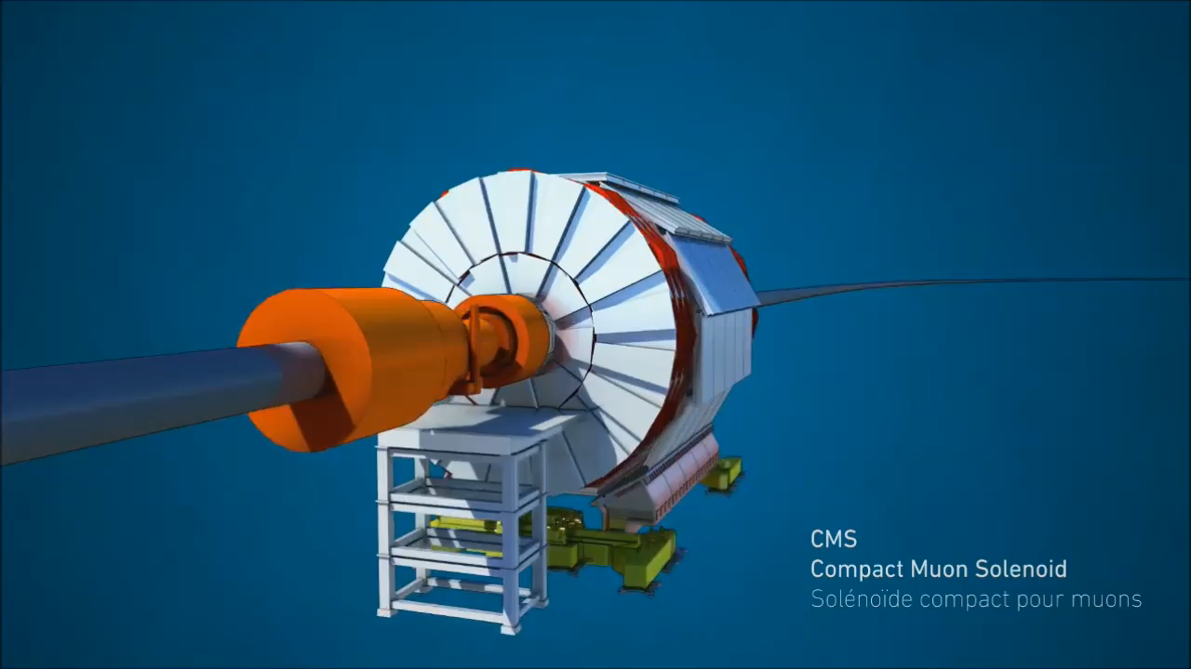
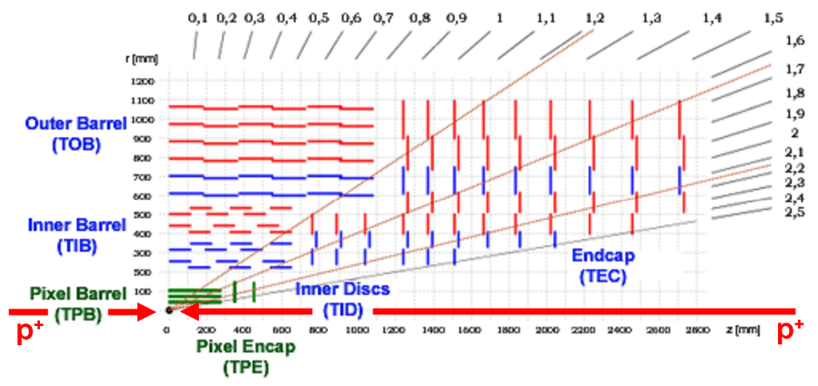
Tracking at CMS
Particles produced in the collisions leave traces (hits) as they fly through the detector
The innermost detector of CMS is called Tracker
Tracking: the art of associate each hit to the particle that left it
The collection of all the hits left by the same particle in the tracker along with some additional information (e.g. momentum, charge) defines a track
Pile-up: # of p-p collisions per bunch crossing

Slide 4
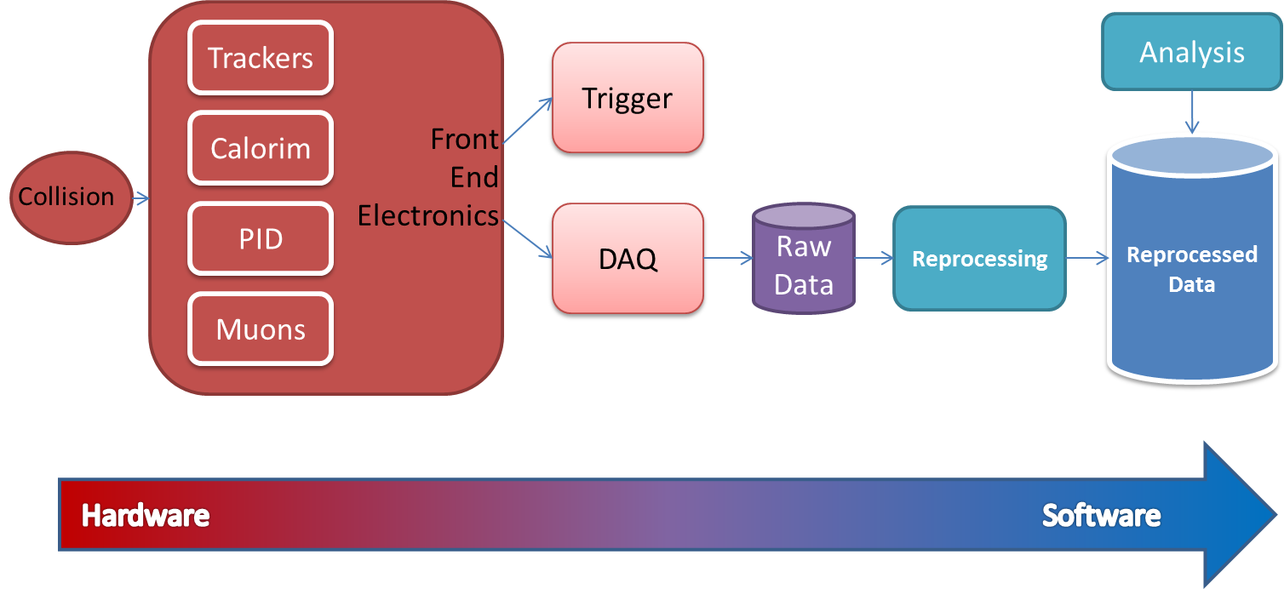
Detector structure
25ns
1us
1ms
sec
hours+

Slide 5
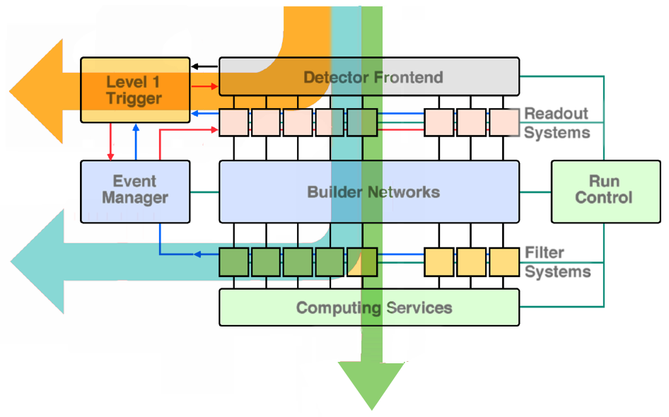
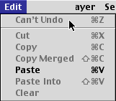
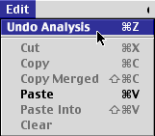
Event Selection Flow
10⁹ Ev/s
99.99 % Low Level Trigger
0.01 %
10⁵ Ev/s
0.1 %
99.9 % High Level Trigger
10² Ev/s

Slide 6
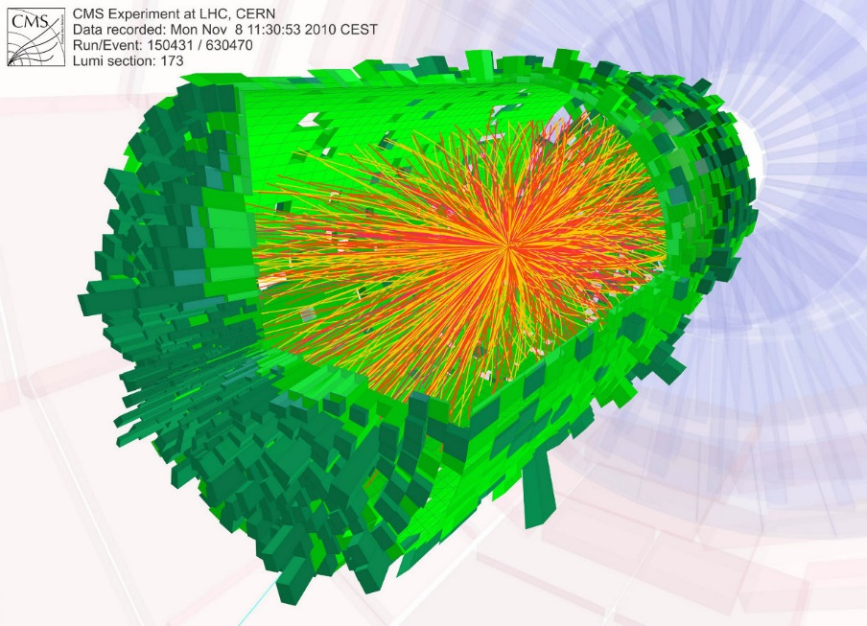
Future plans for the LHC: HL-LHC
High Luminosity LHC
  Luminosity increased to 5 10³⁴ cm⁻² s⁻¹
  Pile-up increased to 140
CMS @ HL-LHC
  Huge amount of information
  The current approach does not scale with the pile-up
  Coping with this amount of data possible if tracking information available at trigger level
  Many hardware implementations in development

Slide 7
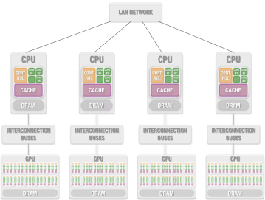
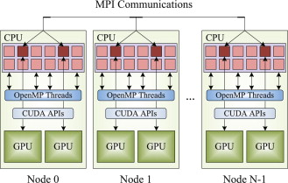
Meanwhile in HPC…
Use several platforms containing GPUs to solve one single problem
Programming challenges:
  Algorithm parallelization
  Perform computation in GPUs
  Execution in a distributed system where platforms have their own memory
  Network communication.

Slide 8
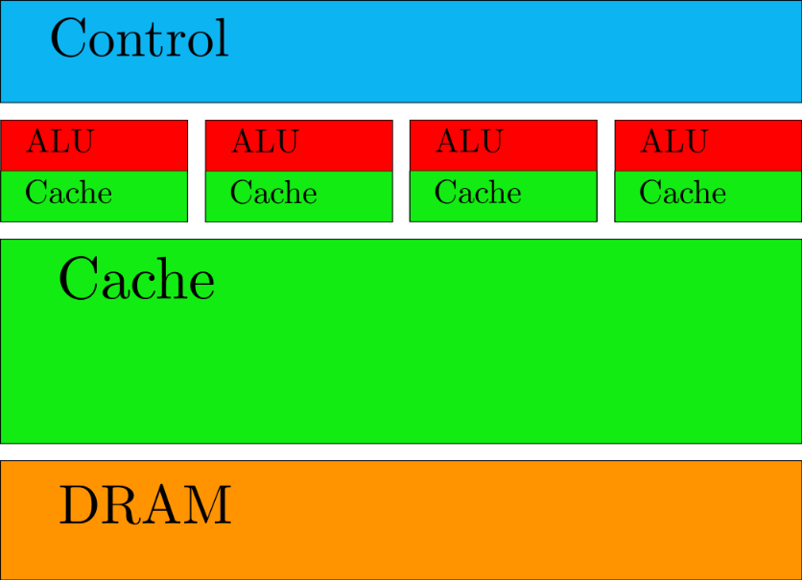
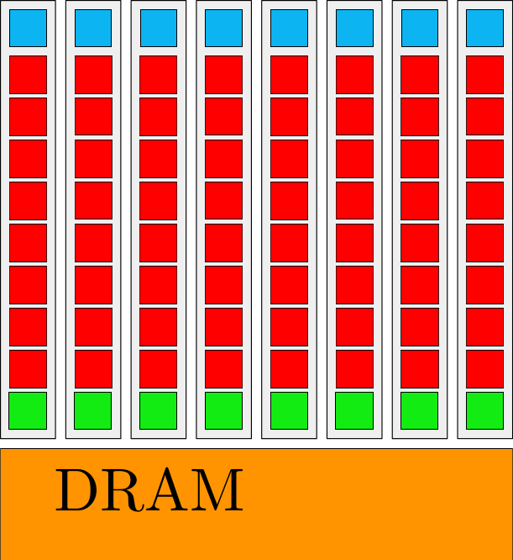
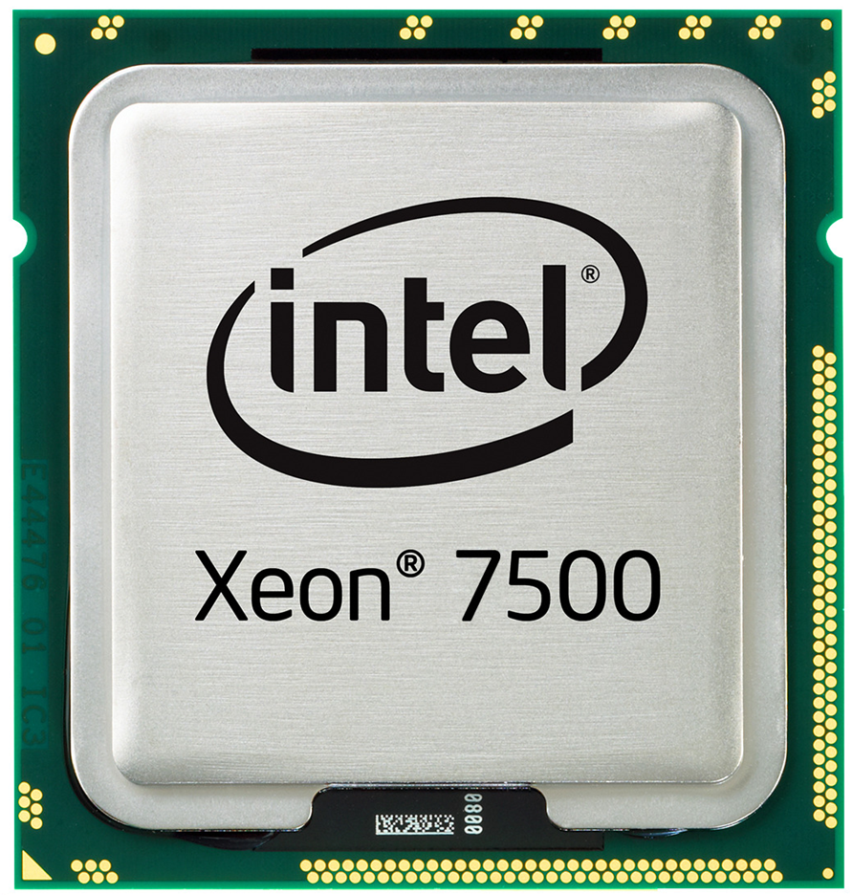
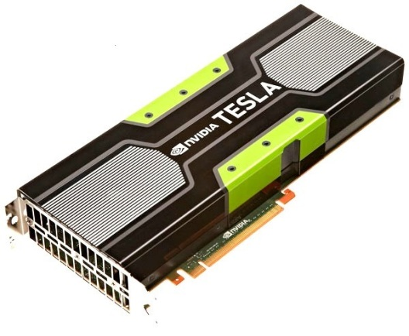
CPU and GPU architectures
SMX* executes kernels (aka functions) using hundreds of threads concurrently.
SIMT (Single-Instruction, Multiple-Thread)
Instructions pipelined
Thread-level parallelism
Instructions issued in order
No Branch prediction
Branch predication
Cost ranging from few hundreds to a thousand euros depending on features (e.g. NVIDIA GTX680 400 euros)
Large caches (slow memory accesses to quick cache accesses)
SIMD
Branch prediction
Data forwarding
Powerful ALU
Pipelining
CPU
GPU
*SMX = Streaming multiprocessor

Slide 9
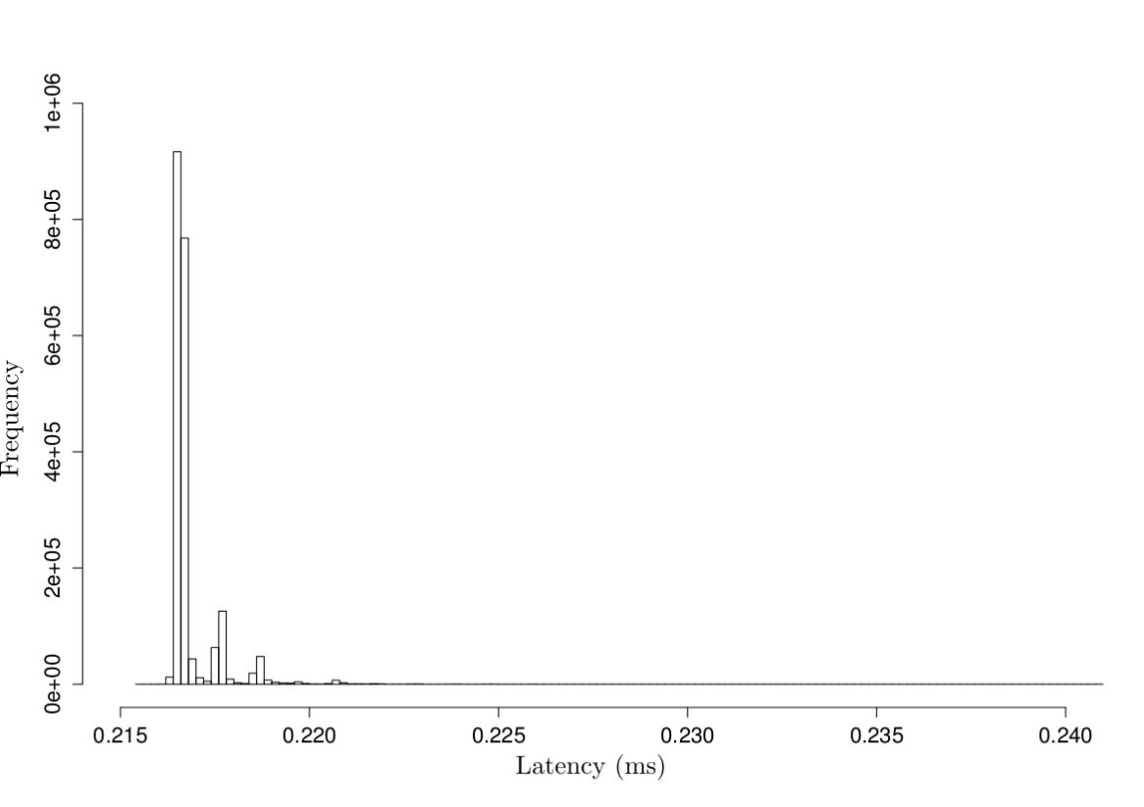
Exploiting GPU in trigger
x86 CPUs are not direct competitors of GPUs in embedded applications
  Latency stability
  Power efficiency
  Performance

Slide 10
Parallel Track Trigger framework
Tracker data partitioning
  The information produced by the whole tracker cannot be processed by one GPU
Data needs to be transferred between network interfaces and multiple GPUs
Data crunching must be fast
Execution kernel has to be already waiting to be fed to avoid overhead

Slide 11
Partitioning
Tracks ~straight if seen from a longitudinal perspective (z,R) plane
Number of tracks approx. uniform in eta

Slide 12
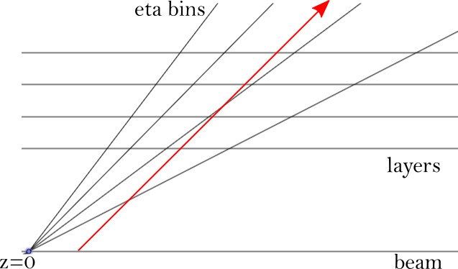
Partitioning (ctd.)
Eta bins could have been treated independently
  Pile-up and longitudinal impact parameter (displacement of the collision point along the z-axis) limit this hypothesis
  Area on the next layer that needs to be evaluated for hit searching not obvious

Slide 13
Partitioning (ctd.)
Simulation for different longitudinal impact parameters
Lists of segments on subsequent layers evaluated beforehand
Each streaming multiprocessor on a GPU is in charge of one list

Slide 14
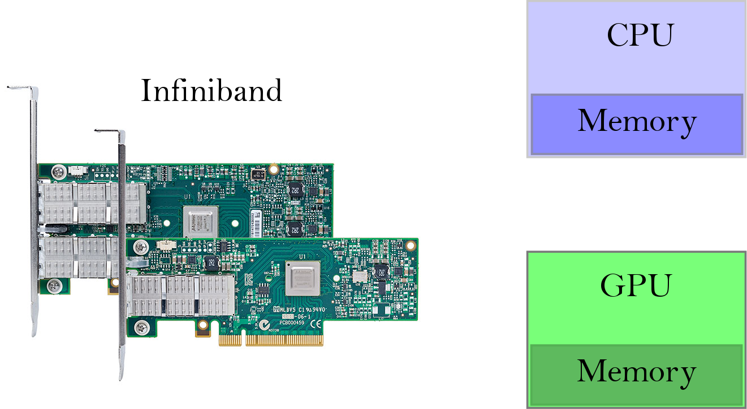
Data movement without GPUDirect
Copy to the main memory managed by the CPU (kernel space)
Copy to userspace pinned memory
Copy to GPU memory
GPU pattern recognition to be launched by the CPU

Slide 15
Data movement with GPUDirect
GPUDirect accelerated communication with network and storage devices
GPUDirect supports RDMA allowing latencies ~1us and link bandwidth ~7GB/s

Slide 16
Always hungry kernel
GPU pattern recognition function in a while(true) loop
  In order to reduce the overhead given by the CPU launching a function to be executed by the GPU
GPU polling and checking for new data to crunch

Slide 17
Conclusion and outlook
GPUs seem to represent a good opportunity, not only for analysis and simulation applications, but also for more “hardware” jobs
Fast test and deployment phases
Possibility to change the trigger on the fly and to run multiple triggers at the same time
Hardware development by Computer Graphics industry
Trigger framework in test with an external data sender
Data format under evaluation
Replacing custom electronics with affordable fully programmable processors to provide the maximum possible flexibility is a reality not so far in the future
Evaluation of fast parallel pattern recognition algorithms to be run on each GPU streaming multiprocessor

