Slide 1

Gentner Programme
Started October 2007
    after CERN visit of State Secretary Meyer-Krahmer from German BMBF (Federal Ministry of Education and Research)
  special German Doctoral Student Programme
    in addition to the existing CERN Doctoral Student Programme
    (almost) identical conditions
    basic difference: funding (subsistence) by BMBF, also extra funds for travel to Germany
  mid- and long term goals
    better usage of CERN resources by Germany
    better connection between German Universities and CERN
    more German staff at CERN (long-term)
      presently only ~7.5% German staff (but ~20% contribution of Germany to CERN budget)
3 parties involved: CERN – BMBF – DESY
    Programme Coordination by DESY

Slide 2
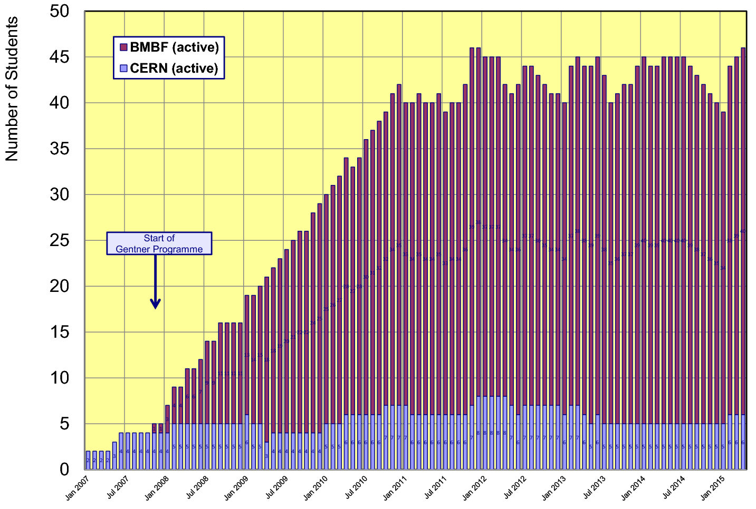
Status Gentner Programme
Presently 40 active Gentner Students (11 female = 28%)
    + 6 Germans in regular CERN Programme
    Number of Gentner Students ~stable since 2011

Slide 3
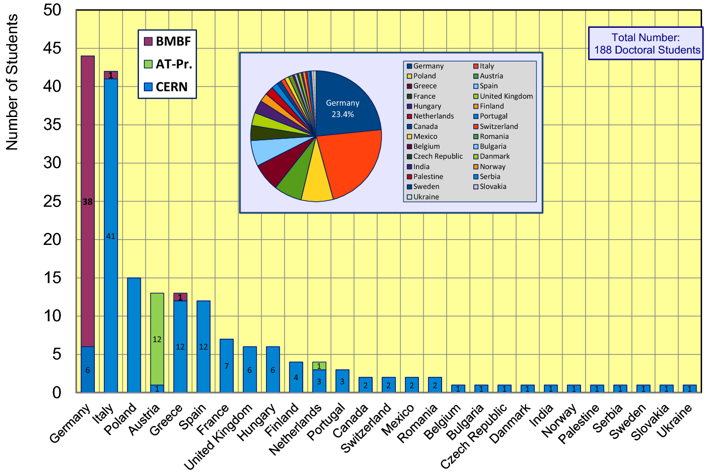
CERN Doctoral Students
Nationalities of all Doctoral Students at CERN
  Germany + Italy are dominating (23-24% each)

Slide 4
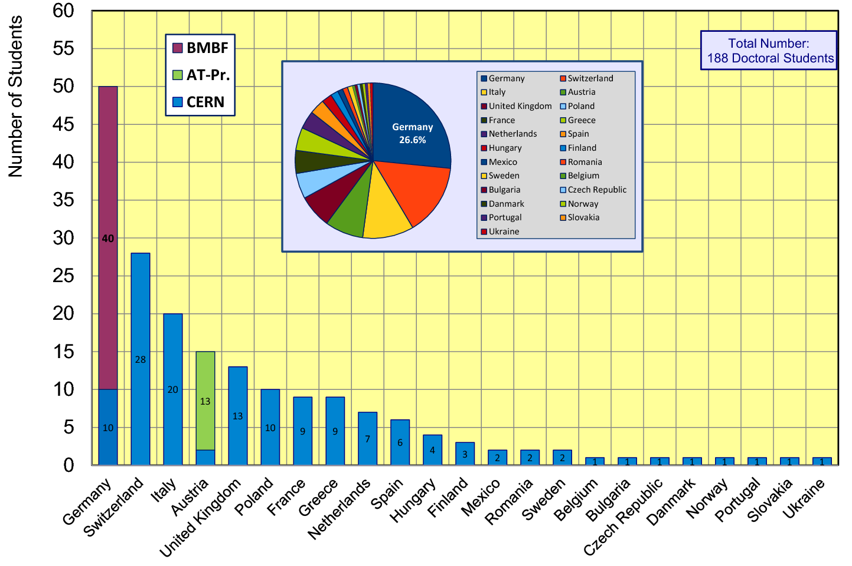
CERN Doctoral Students
Institute Country of all Doctoral Students
  Germany ahead of other countries (~27% at an institute in Germany)

Slide 5
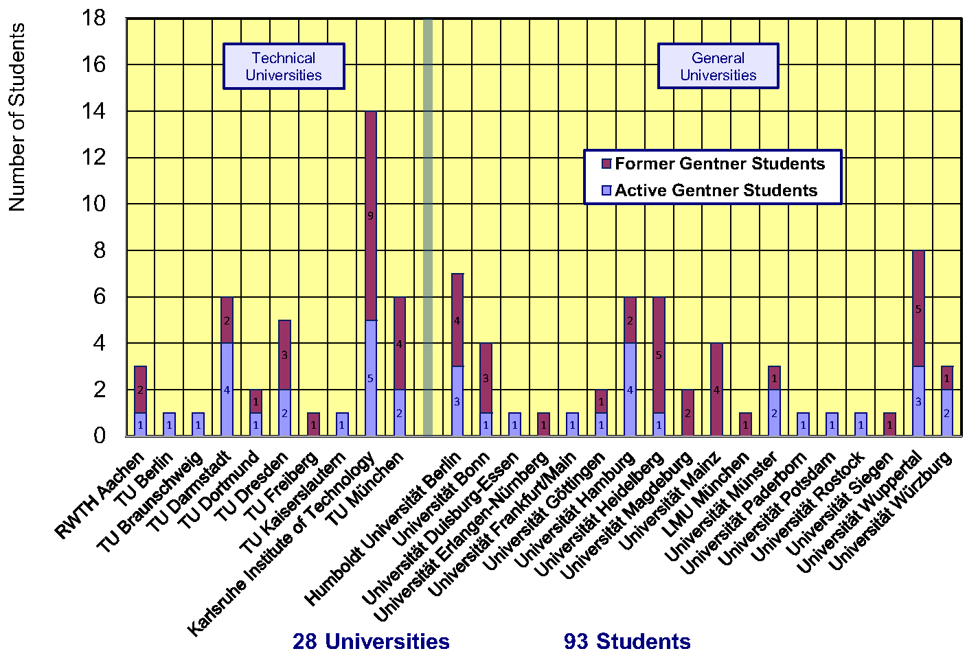
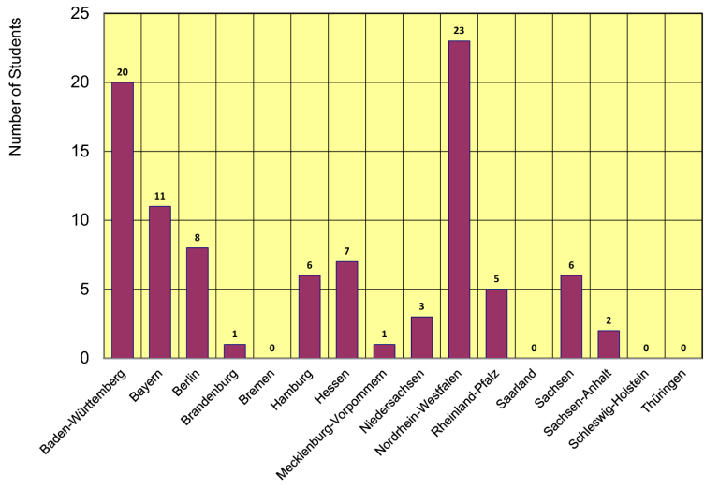
Gentner Students
  coming from 28 different Universities in DE
    also from university groups who had no or only little CERN contacts
  43% of Gentner Students from Technical Universities
  12 German States
    NRW and BW are dominating
    only a few small(er) States are missing

Slide 6
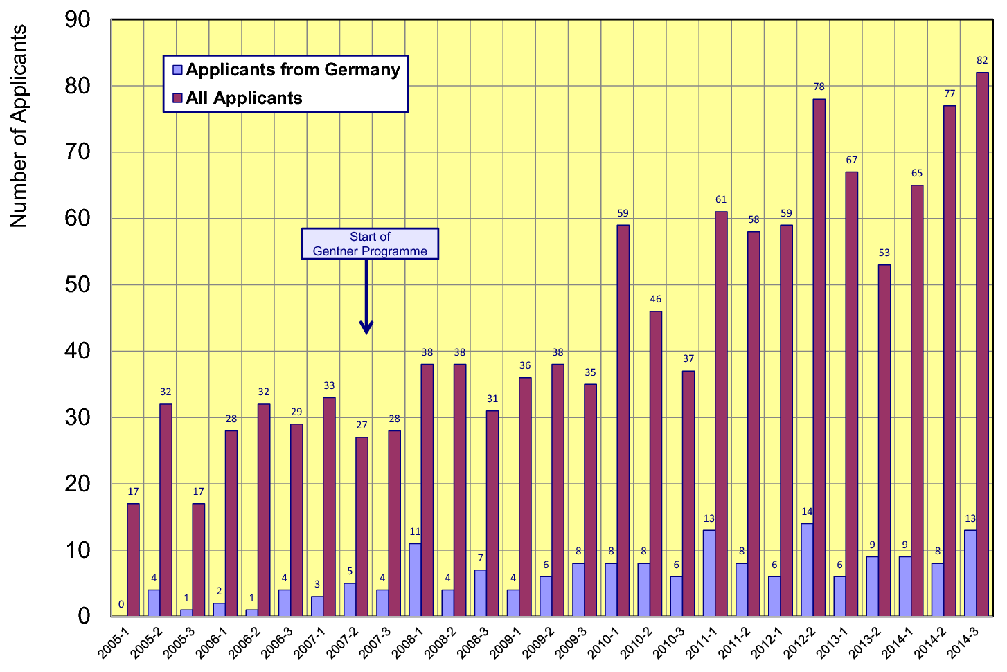
Doctoral Student Applications
  pre-Gentner (before 2007) about 8% from Germany
  post-Gentner (since 2008) about 16% from Germany

Slide 7
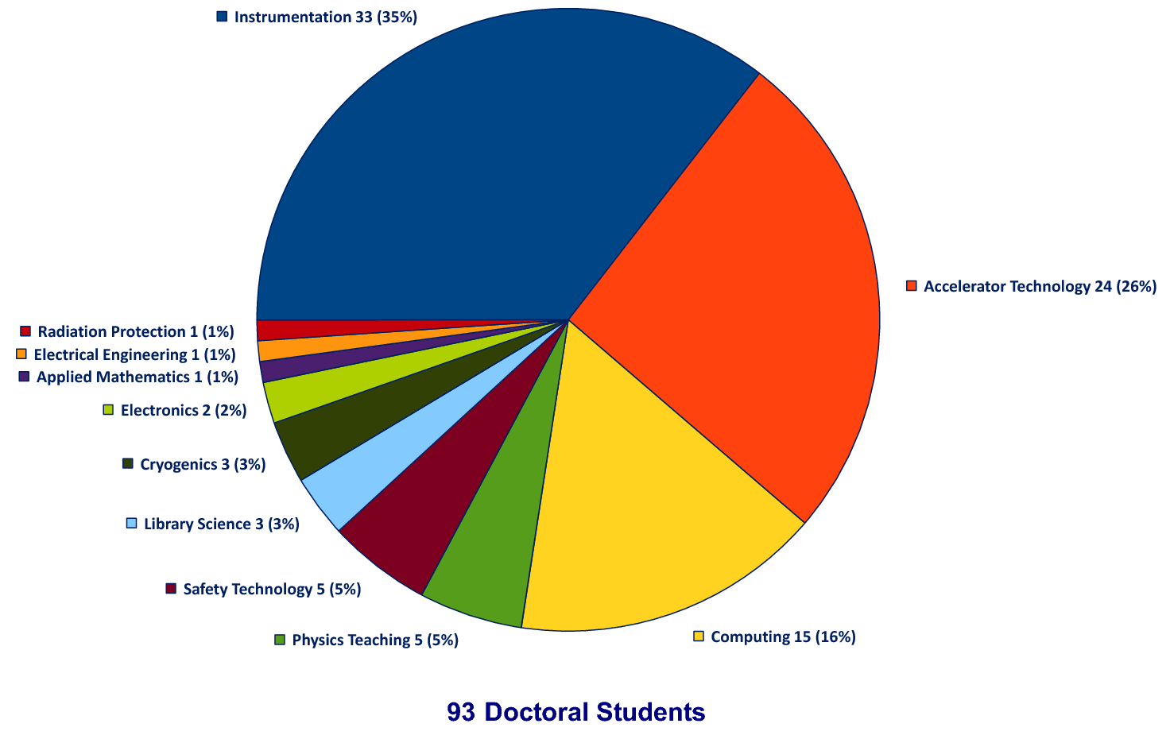
Thesis Topics of Gentner Students
(active + former)
Majority of topics in Instrumentation (35%), Accelerator Technology (26%), Computing (16%)

Slide 8
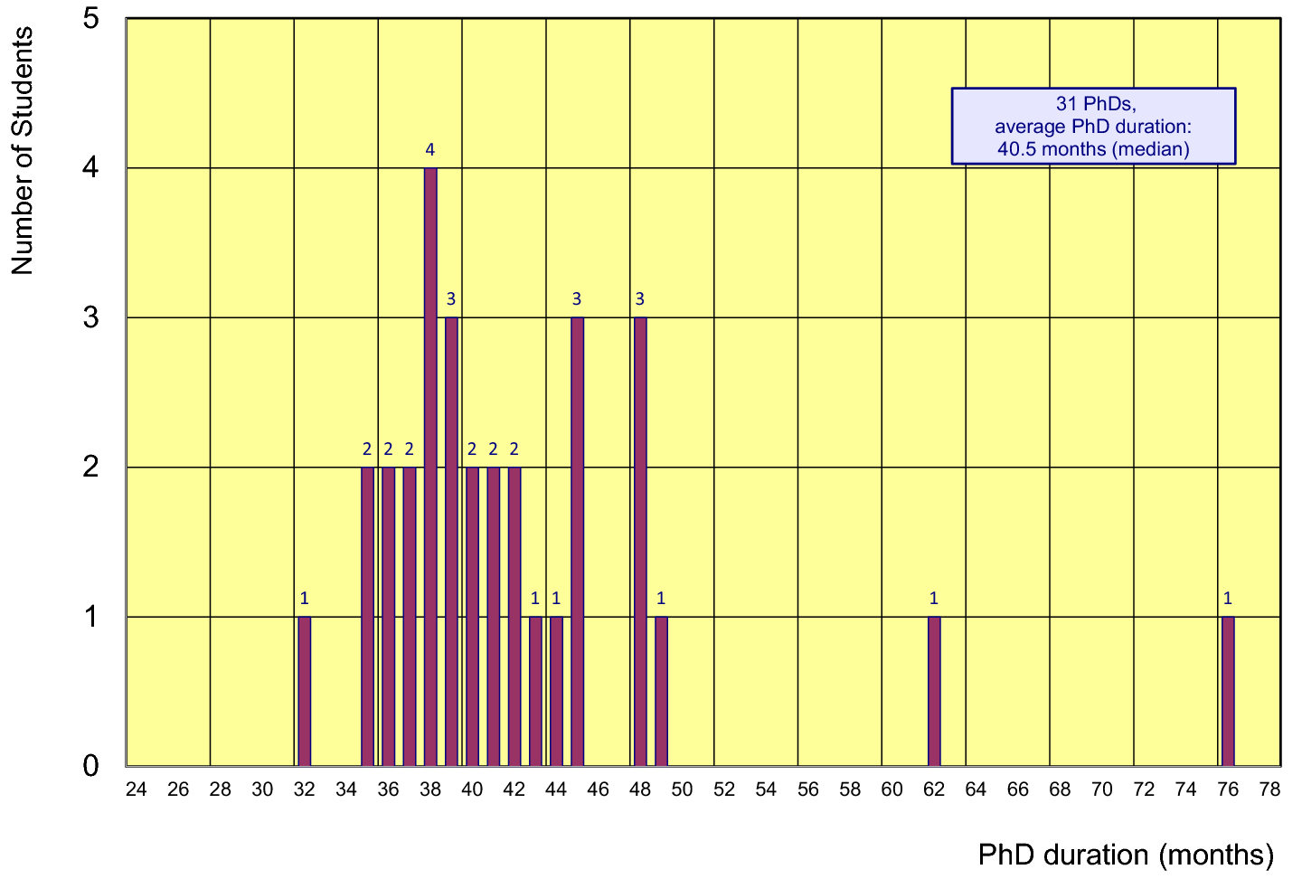
Former Gentner Students
31 PhDs so far (3 Students have aborted their PhD)
    average age at PhD (defense): 30.7 years (median)
    average duration of PhD: 40.7 months (median)
      = 4.7 months after end of CERN 3-years contract
Physics PhDs in Germany (2013)
20% of PhDs students female
30.6 years (median) at PhD
48 months (median) duration of PhD

Slide 9
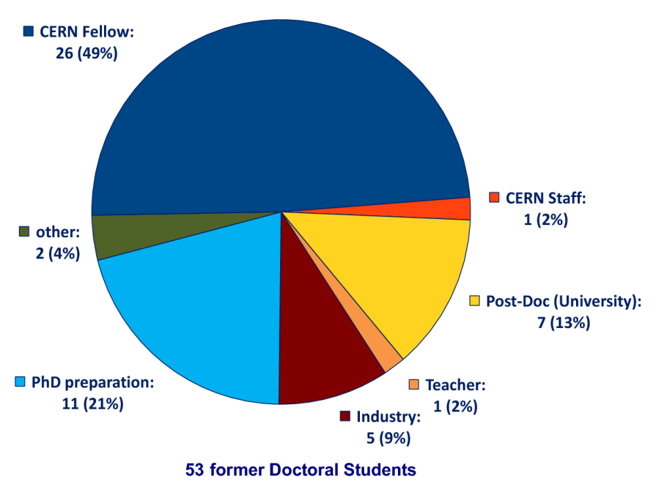
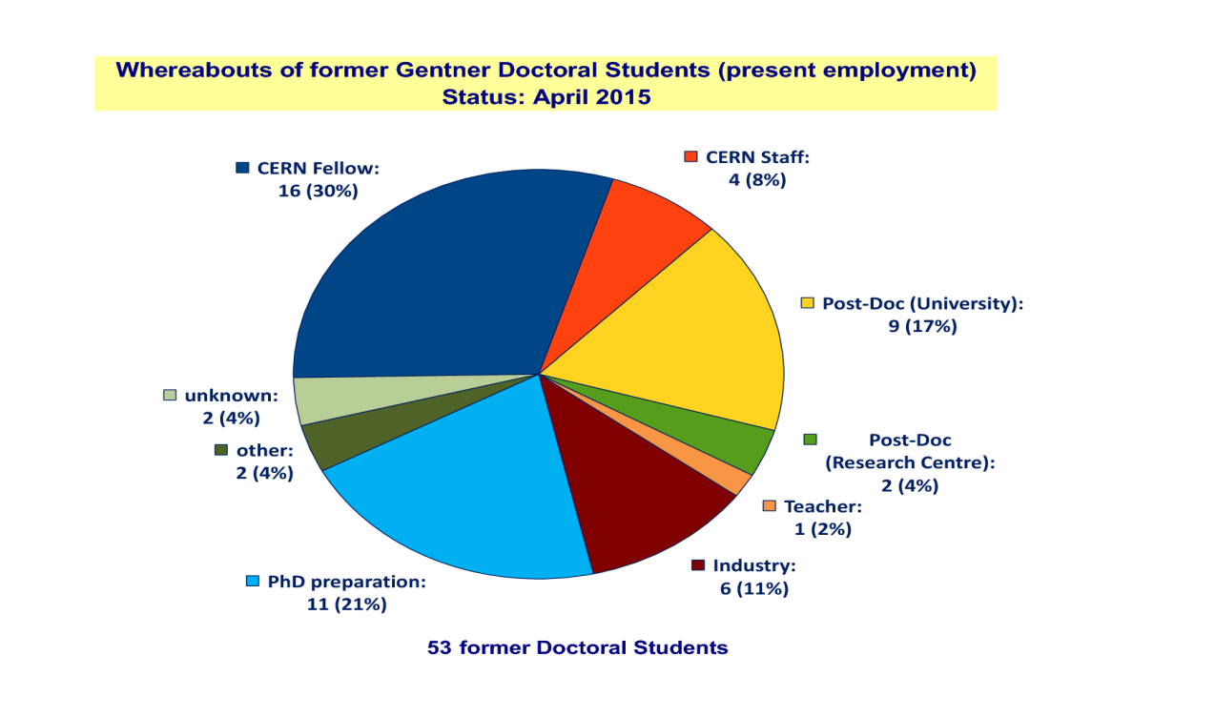
Whereabouts of Gentner Students
  First employment of ~half of the Gentner Students: CERN Fellow
First Employment
Present Employment
presently 4 Staff + 1 more future Staff in 2015
= 5 CERN Staff so far

Slide 10
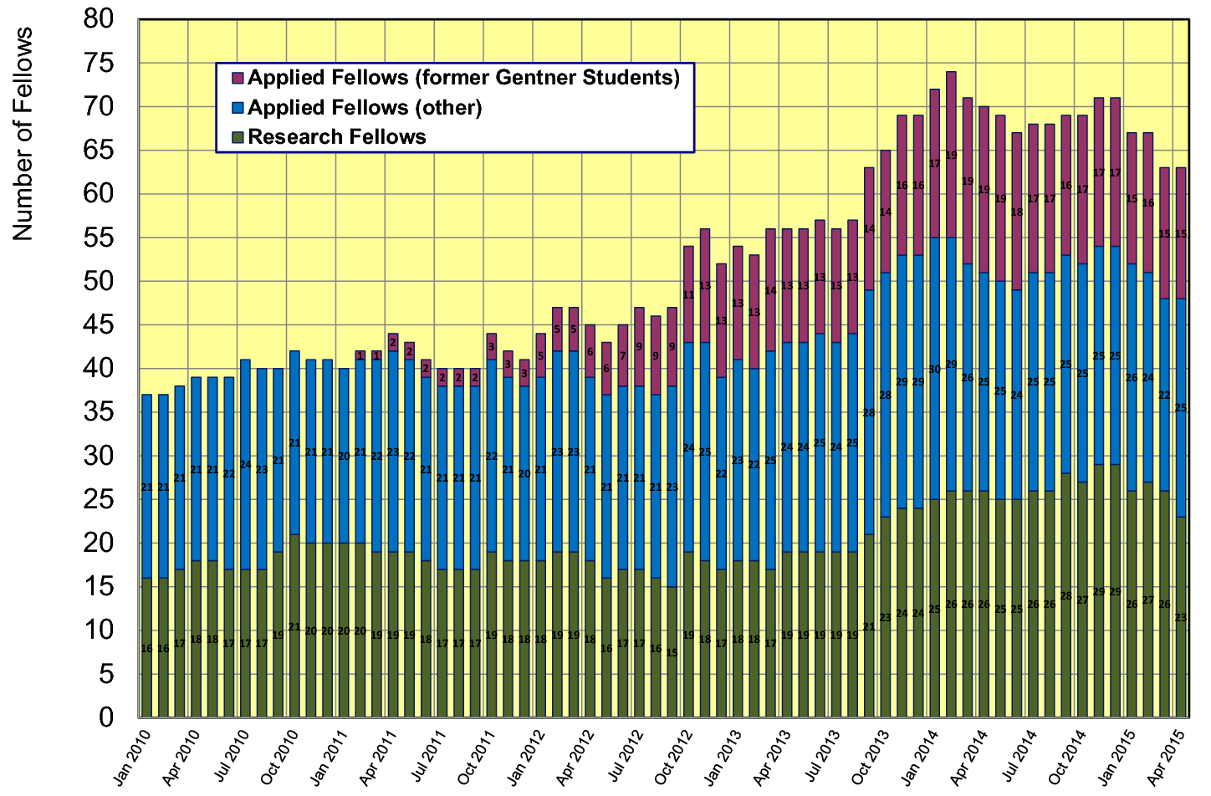
Gentner Students → Fellows
  significant increase of DE Fellows by former Gentner Students
    about 40% of German Applied Fellows are former Gentner Students

Slide 11
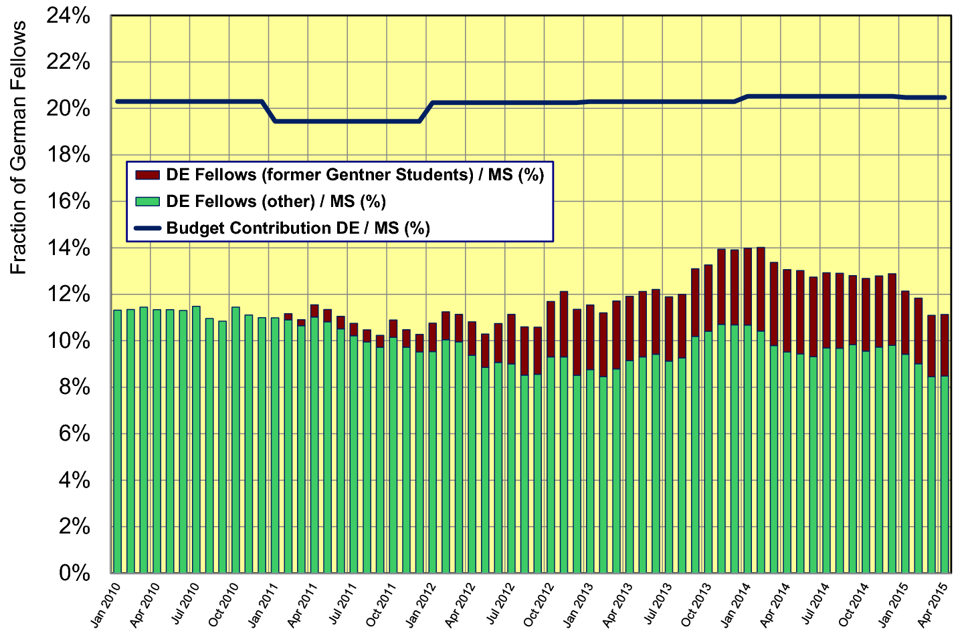
Gentner Doktoranden → Fellows
  despite additional former Gentner Students fraction of German Fellows slowly decreasing (to be watched)

Slide 12
Gentner Programme Continuation
Extension + funding secured until end of 2017
  contract renewal needed after 2017
  funding in 2015 - 2017: 5.15 M€
  funding was based on 1 € = 1.20 CHF, sufficient for (on average) 39 Students
Consequences of discontinuation of CHF–EUR minimum exchange rate by Swiss National Bank (if continueing on present level)
  no extra funding from BMBF to mitigate impact
  long-term: need to reduce number of Students
    reduction depends on CHF–EUR exchange rate
    no consequences to present Students (don‘t be afraid): noone will be „fired“, support continues on same level for 3 years max.
  short-term: fewer new Gentner Students at next selection round
    deadline for applications: 28 April, selection board: 3 Juni, earliest start in August

Slide 13
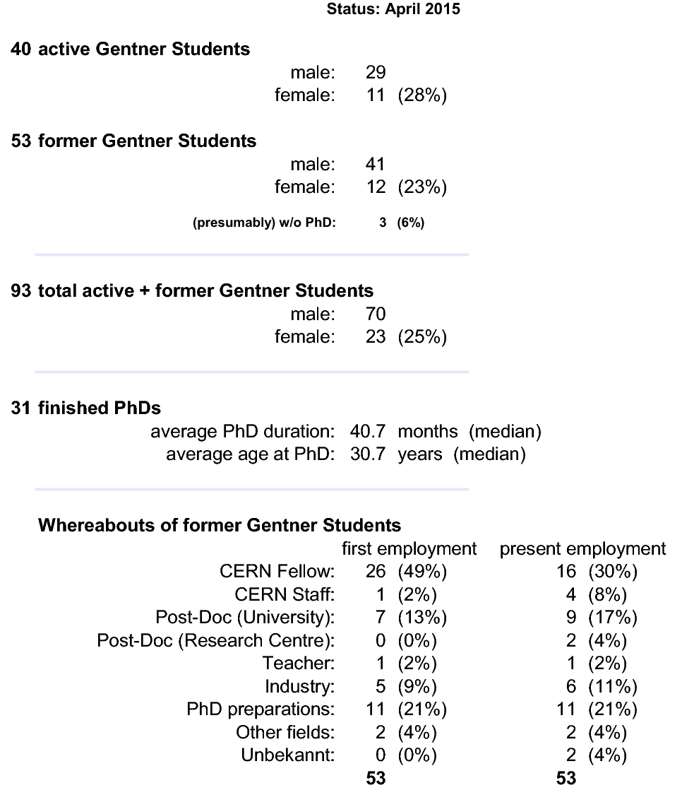
Summary Gentner Programme
Physics PhDs in Germany (2013)
20% of PhDs students female
30.6 years (median) at PhD
48 months (median) duration of PhD
CERN Fellows
≈ 40% of German Applied Fellows
are former Gentner Students

