Slide 1
From Ferrite Characterization to Preliminary Design of Ferrite Loaded Accelerating Cavity
Johannes Eberhardt
CERN, Beams Department / TU Darmstadt, TEMF Institute
PhD project:
Development of a Ferrite-Loaded Accelerating Cavity
CERN Supervisor: Dr.-Ing. Christine Völlinger
TEMF Supervisor: Prof. Dr.-Ing. Harald Klingbeil

Slide 2



Motivation: Ferrite Loaded Accelerating Cavity
Idea: Same RF system to accelerate different types of particles
→ Accelerating Cavity with frequency swing 18 – 40 MHz
Cavity design with electromagnetic simulation program
→ Relative permeability and losses of ferrite
as input for simulations
$${\text{Δ}H}_{bias}$$
$${\text{Δ}\text{μ}}_{r}$$
$${\text{Δ}\text{f}}_{res}$$
Ferrite
Cavity

Slide 3
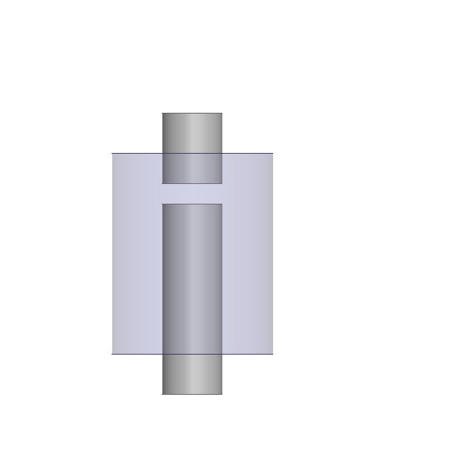
Introduction –
How does an accelerating cavity work?
cylindrical structure
accelerating gap
beam pipe
H_{RF}
E_{RF}
λ/4

Slide 4
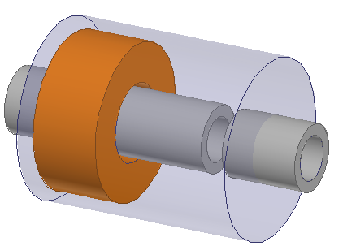




Introduction – Why Ferrite Loaded?
$$H_{RF}$$
$$H_{RF}$$
∆$f_{res}\text{\sim }\frac{1}{\sqrt{{∆μ}_{r}}}$
Tuning 18 – 40 MHz →$r_{μ}=\frac{μ_{r}(18 MHz)}{μ_{r}(40 MHz)}\text{ ≈ }\text{5}$
ferrite ring
$$H_{┴}$$

Slide 5
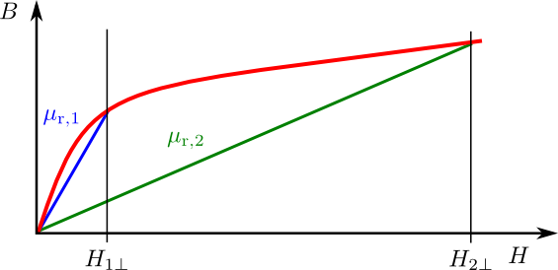

Introduction – Relative Permeability
$$μ_{r}=\frac{B}{H μ_{0}}$$
Depends on:
RF frequency

Slide 6
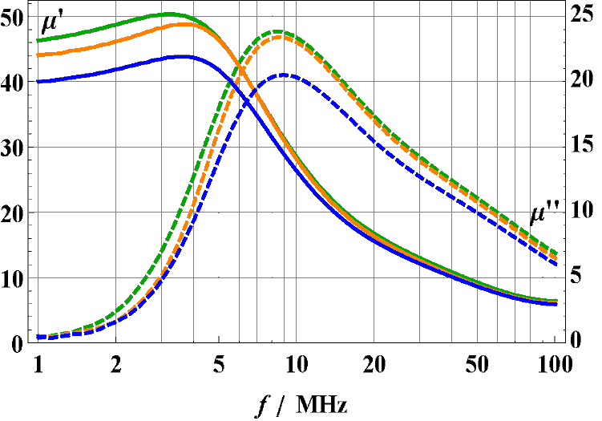


Introduction – Lessons learned
$\text{μ}\text{r}\text{ = }\text{μ}\text{′}\text{ − }\text{j}\text{μ}\text{′′}$, $Q_{μ,ferr}=\frac{\text{μ}\text{′}}{\text{μ}\text{′′}}$
Sample 1
Sample 2
Sample 3
Depends on:
RF frequency
Magnetic bias history
Temperature
Location in ferrite
Bias field orientation
Dispersive characteristics
Random – degaussed
Room temperature
Average over volume
Perpendicular to RF magnetic field

Slide 7









From Ferrite Characterisation to FLC
1-Port Reflection
Measurement
Resonant
Measurement
/
B
mT
Reflection Measurement
$$\text{µ’}$$
$${\text{f}}_{res}$$
$${\text{Q}}_{total}$$
µ’
(
f
)
res
Simulation of
Resonant
Measurement
Resonant Measurement
f
/MHz
res
$${\text{f}}_{res}(μ\text{′})$$
Q
total
$${\text{Q}}_{total}{(Q}_{Ω}, Q_{ε,teflon},Q_{µ,ferr})$$
Eigenmode
Simulation
f
/MHz
Calculate $Q_{µ,ferr}$
res
d
fres
/%
Calculate
Q
$$µ,ferr$$
$${\text{Q}}_{µ,ferr}$$
Q
$$µ,ferr$$

Slide 8
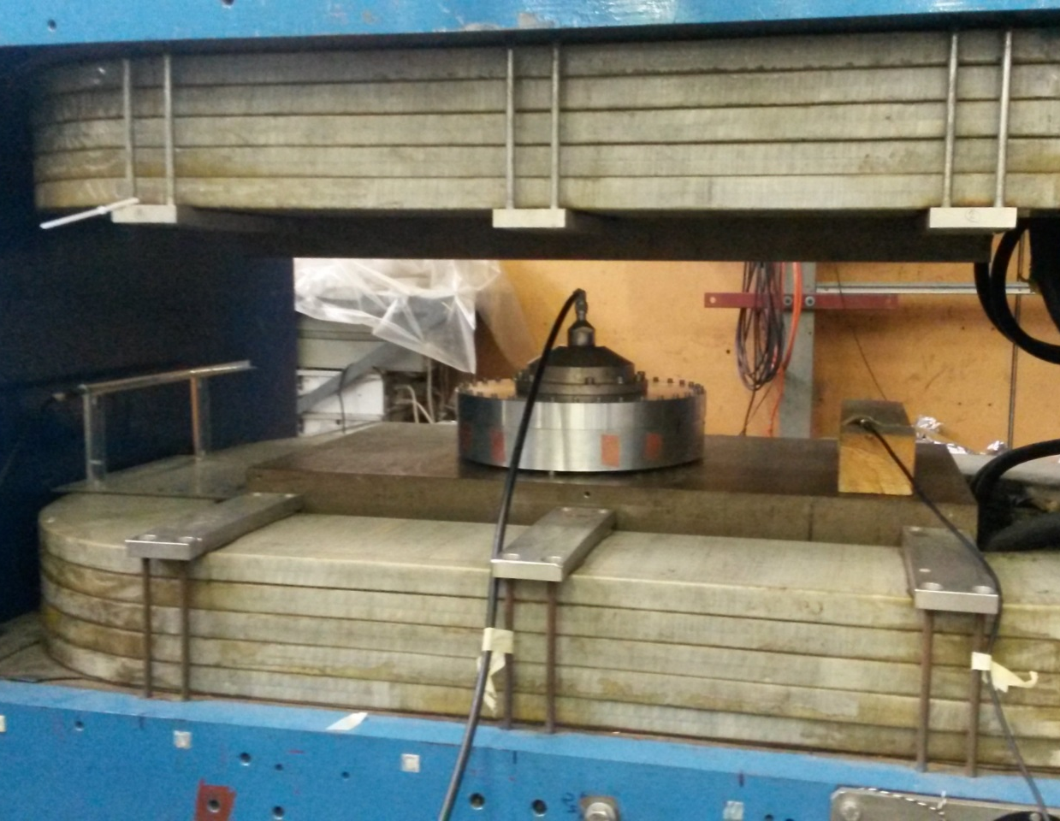
Reflection Measurement
/
B
mT
35
40
300
Reflection Measurement
µ’
(
f
)
res
Resonant Measurement
B_{bias}
f
/MHz
res
Q
total
Eigenmode
Simulation
I_{bias}
f
/MHz
res
d
fres
/%
Calculate
Q
$$µ,ferr$$
Q
$$µ,ferr$$

Slide 9
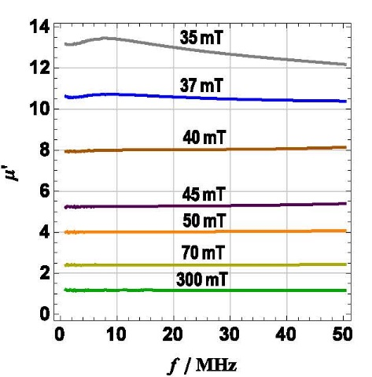
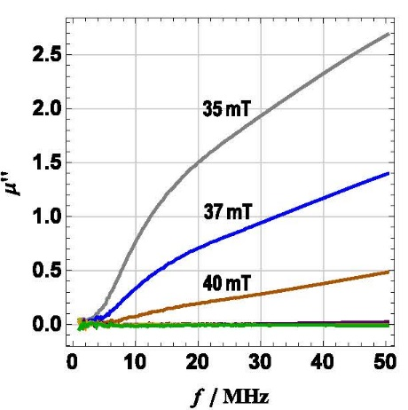
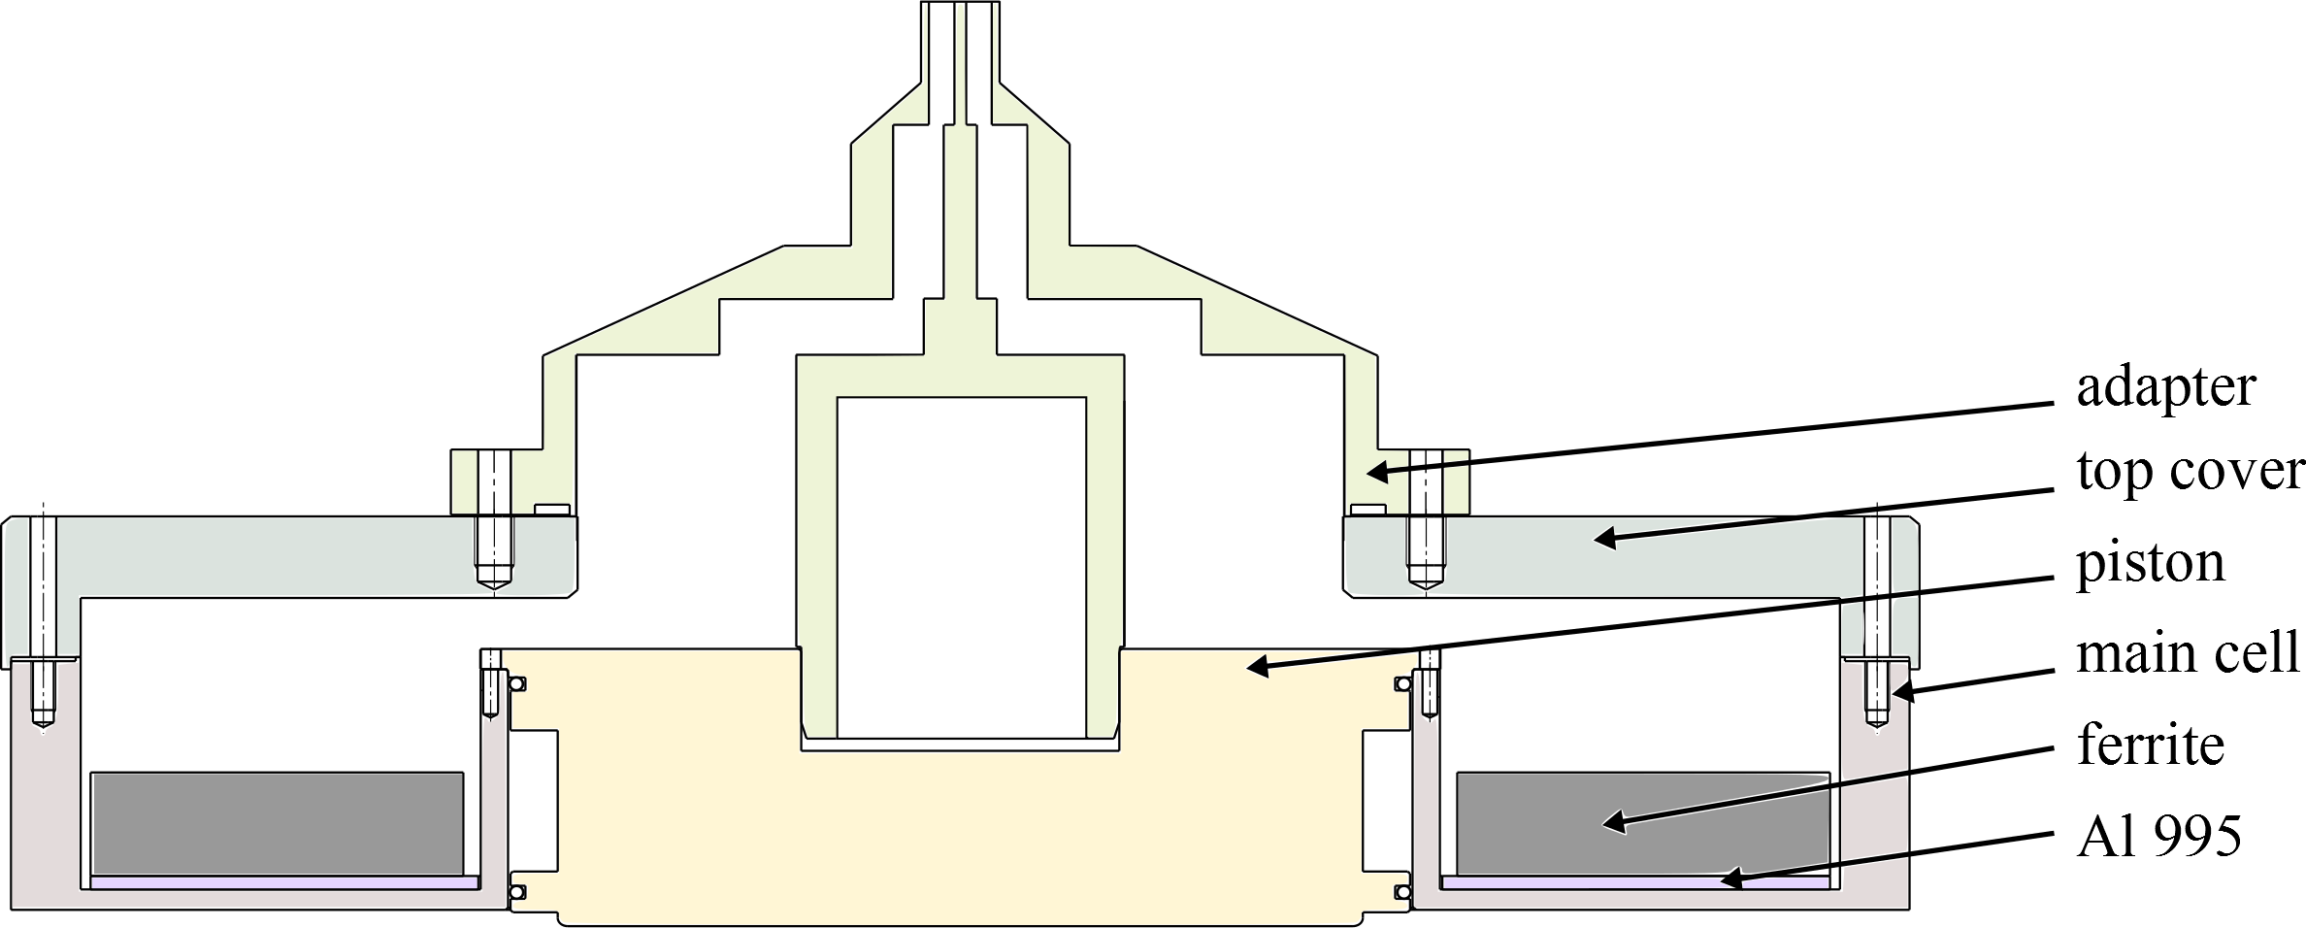

Reflection Measurement
Coaxial short-circuit technique to determine $\text{μ}\text{r}$
Measuring S₁₁(f) of empty and filled SH
Analytical calculation of $\text{μ}\text{r}$(S₁₁(f))
/
B
mT
35
40
300
Reflection Measurement
µ’
(
f
)
13
8.0
1.17
res
Resonant Measurement
f
/MHz
res
Q
total
Eigenmode
Simulation
f
/MHz
res
d
fres
/%
Calculate
Q
$$µ,ferr$$
Q
$$µ,ferr$$

Slide 10
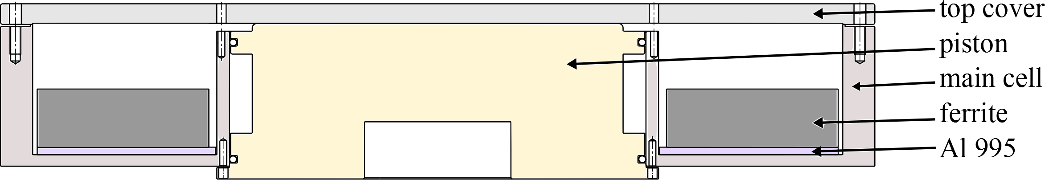
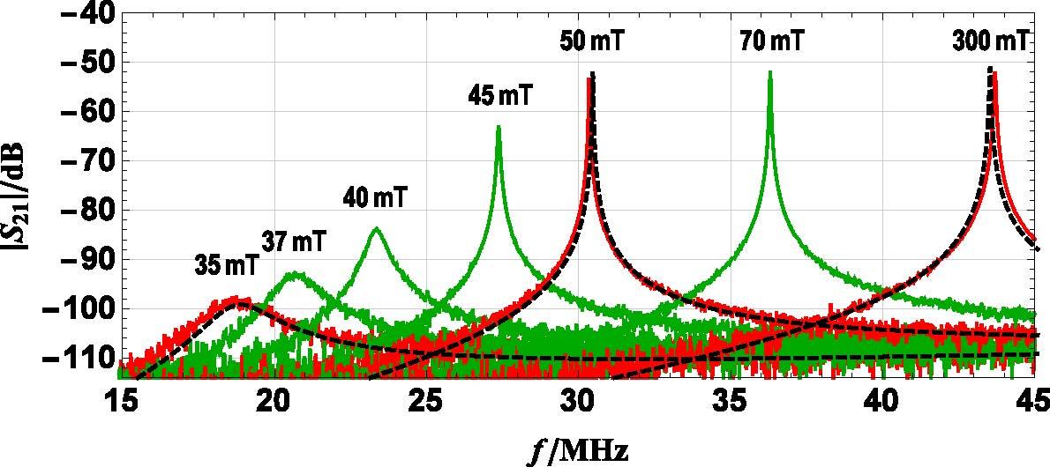
Resonant Measurement
/
B
mT
35
40
300
Reflection Measurement
µ’
(
f
)
13
8.0
1.17
res
Resonant Measurement
f
/MHz
18.8
23.4
43.7
res
Q
total
9
40
1046
Eigenmode
Simulation
f
/MHz
res
d
fres
/%
Calculate
Q
$$µ,ferr$$
Q
$$µ,ferr$$

Slide 11
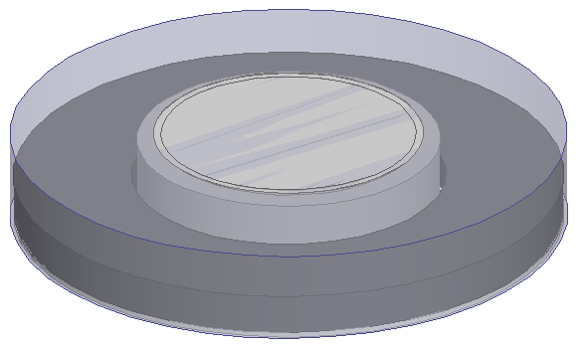
Numerical Simulation Results
/
B
mT
35
40
300
Reflection Measurement
µ’
(
f
)
13
8.0
1.17
res
Resonant Measurement
f
/MHz
18.8
23.4
43.7
res
Teflon foil
Outer conductor
Q
total
9
40
1046
Eigenmode
Simulation
Ferrite ring
Inner conductor
f
/MHz
18.6
23.1
43.3
res
d
fres
/%
1.1
1.3
0.9
Calculate
Q
$$µ,ferr$$
Q
$$µ,ferr$$
8
35
5000

Slide 12
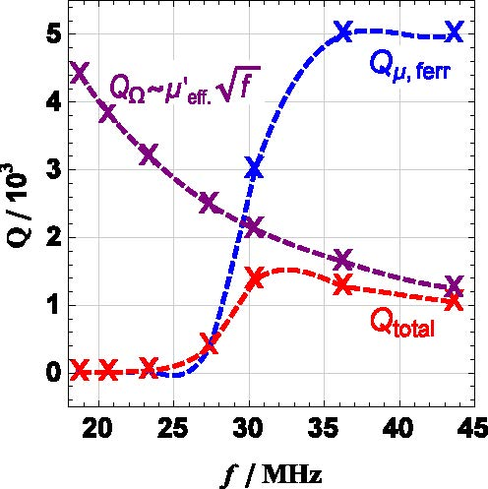

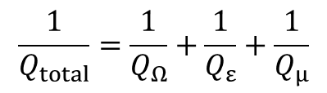

Numerical Simulation Results
low $B_{bias}: Q_{total}$ is dominated by $Q_{μ,ferr}$
once $Q_{μ,ferr}$ exeeds $Q_{Ω}, Q_{total}$ has maximum
high $B_{bias}: Q_{total}$ is dominated by${ Q}_{Ω}$
$$=\frac{1}{Q_{Ω}}+\frac{W_{el, teflon}}{W_{el, total}}\frac{1}{Q_{ε,teflon}}+\frac{W_{mag, ferr}}{W_{mag, total}}\frac{1}{Q_{µ,ferr}}$$
$$\frac{1}{Q_{total}}=\frac{1}{Q_{Ω}}+\frac{1}{Q_{ε}}+\frac{1}{Q_{µ}}$$

Slide 13
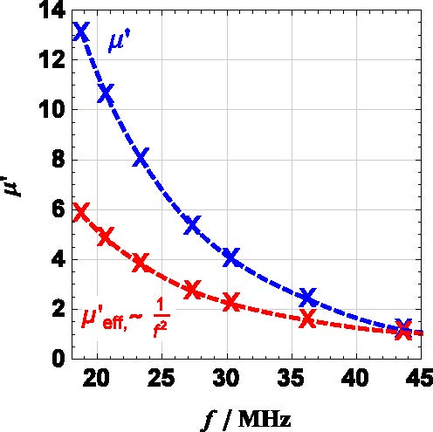
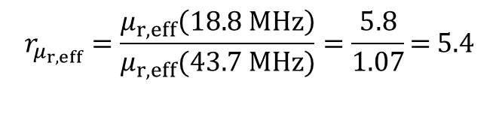

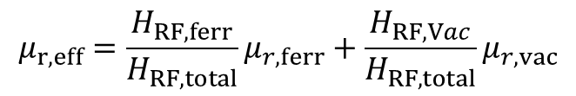
Numerical Simulation Results
Resonance frequency depends on $μ_{r,eff}$ with ∆$f_{res}\text{\sim }\frac{1}{\sqrt{{∆μ}_{r,eff}}}$
Required $r_{μ_{r,eff}}>5$ can be achieved, but for relative low $Q_{μ,ferr}$
$$μ_{r,eff}={\frac{H_{RF, ferr}}{H_{RF, total}}μ}_{r,ferr}+{\frac{H_{RF, Vac}}{H_{RF, total}}μ}_{r, vac}$$
$$r_{μ_{r,eff}}=\frac{μ_{r,eff}\left(18.8 MHz\right)}{μ_{r,eff}(43.7 MHz)}=\frac{5.8}{1.07}\text{= 5.4}$$

Slide 14
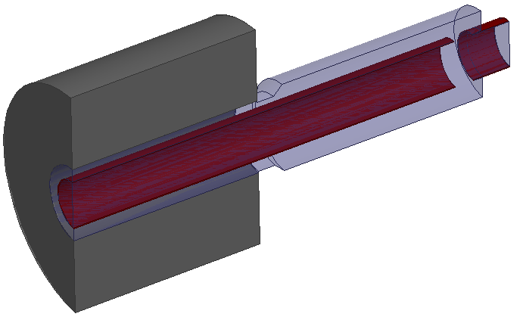
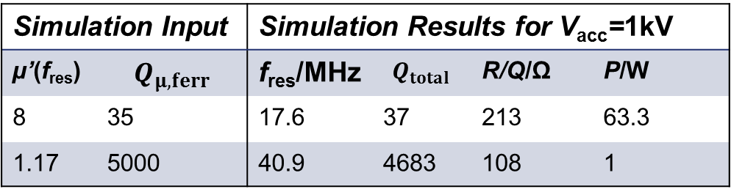
Preliminary Design of FLC 18 – 40MHz
Ferrite stack
Accelerating gap
Beam pipe
1125mm
Simulation Input |  | Simulation Results for V_{acc}=1kV
µ’(f_{res}) | $$Q_{μ,ferr}$$ | f_{res}/MHz | $$Q_{total}$$ | R/Q/Ω | P/W
8 | 35 | 17.6 | 37 | 213 | 63.3
1.17 | 5000 | 40.9 | 4683 | 108 | 1
Example
V_{acc}/kV | P/kW
8.3 | 4.4
62.5 | 3.9

Slide 15
Conclusion and Outlook
Measurement of relative permeability and losses of ferrite material
Simulation model of resonant measurements setup
Preliminary design of ferrite loaded accelerating cavity
Influence of non-uniform µ’ has to be analysed
RF power measurements have to be done
FLC model will be further elaborated

Slide 16
Thank you for your attention!

Slide 17
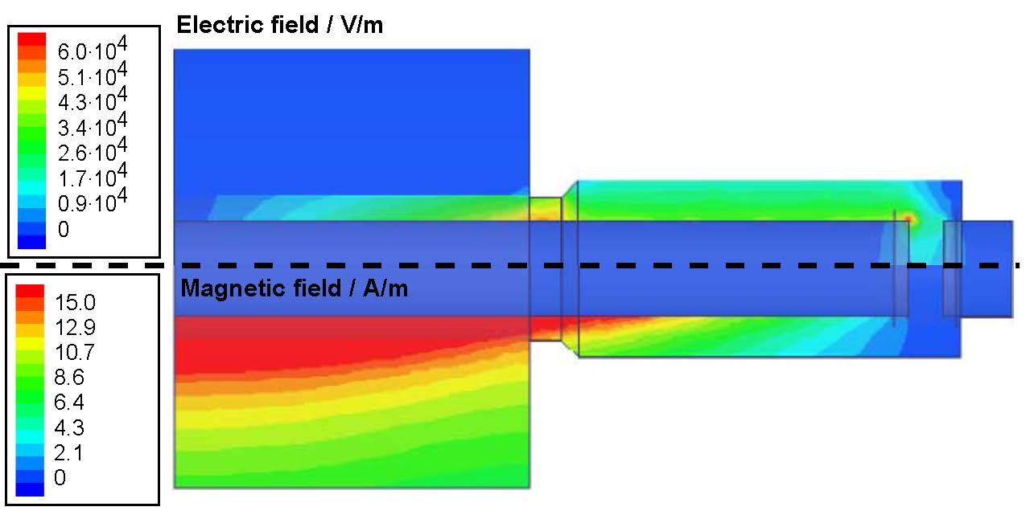

Preliminary Design
For 4kW RF power with $P=\frac{V^{2}}{2R}$
8.3kV accelerating voltage at 18MHz
62.5kV accelerating voltage at 40MHz

Slide 18
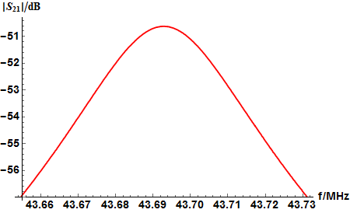


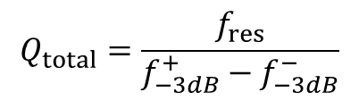


Resonant Measurement
$Q_{total}$ measurement for 300mT bias field
/
$$Q_{total}=\frac{f_{res}}{f_{−3dB}^{+}−f_{−3dB}^{−}}$$
B
mT
35
40
300
Reflection Measurement
µ’
(
f
)
13
8.0
1.17
res
Resonant Measurement
f
/MHz
18.8
23.4
43.7
res
Q
total
9
40
1046
Eigenmode
Simulation
f
/MHz
res
d
fres
/%
$$f_{−3dB}^{−}$$
$$f_{res}$$
$$f_{−3dB}^{+}$$
Examined
Q
ferr
Q
ferr

