Slide 1
Photoionization of diamond interacting with 30fs intense laser field
Boyan Obreshkov
and
Tzveta Apostolova
INRNE-BAS

Slide 2
Motivation
Laser engineering of diamond for writing conductive paths is an important subject of research for its application in radiation detection (3D detectors)[1,2].
[1] S. Lagomarsino et al Appl. Phys. Lett. 103, 233507 (2013)
[2] S. Lagomarsino , et al Diamond & Related Materials 43 (2014) 23–28
A deep insight of the process of laser graphitization of diamond is critical to tune at best the laser parameters and obtain low resistivity channels with minimum damage of the surrounding diamond lattice.
Laser ablation and nano-structuring of diamond.
Simulate ultra-short laser-induced electronic excitation, absorption and relaxation processes in CVD monocrystalline diamond and compare to the experiment.

Slide 3
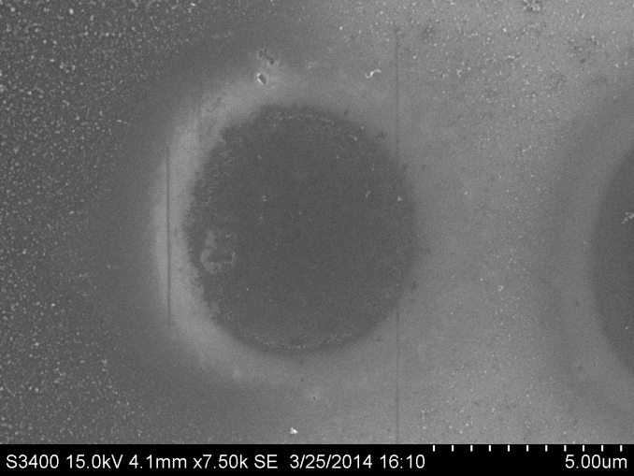
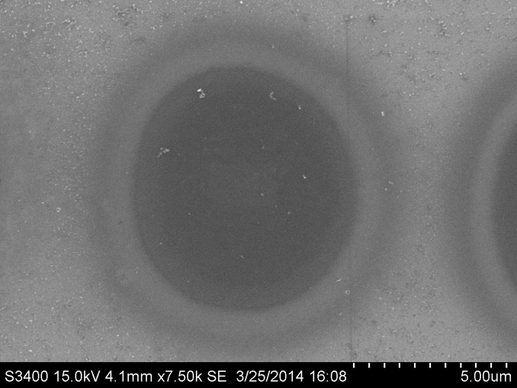
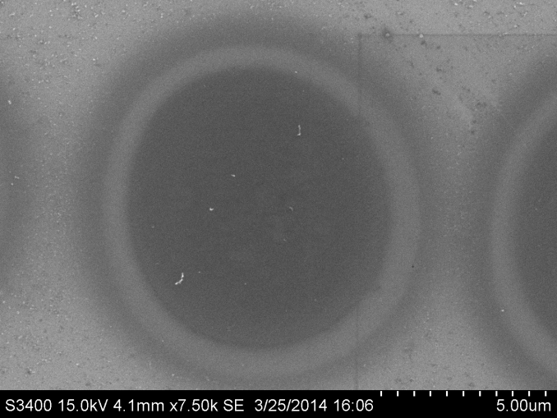
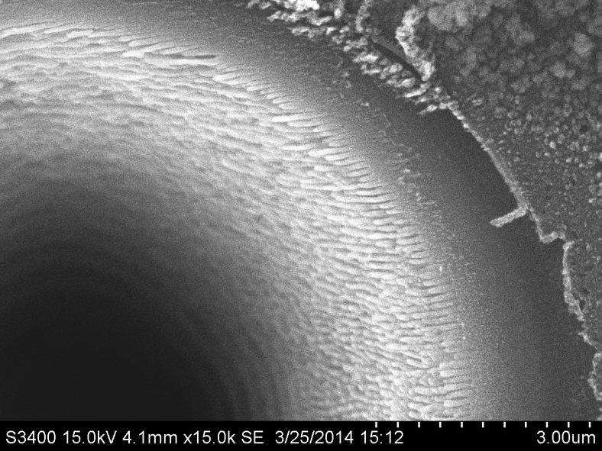
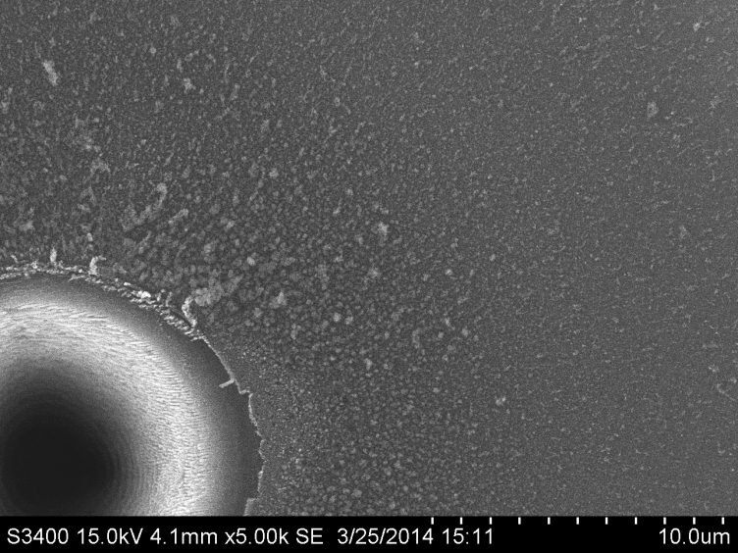
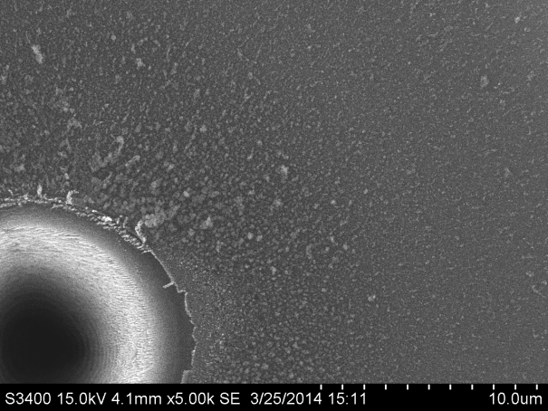
515 nm, 0.2 ps (FWHM), 35 TW/cm2, natural diamond
Spallative ablation + graphitization (?) Single-shot threshold – 20 TW/cm2
Micro-Raman
N=1
N=2
N=3
N>1000

Slide 4
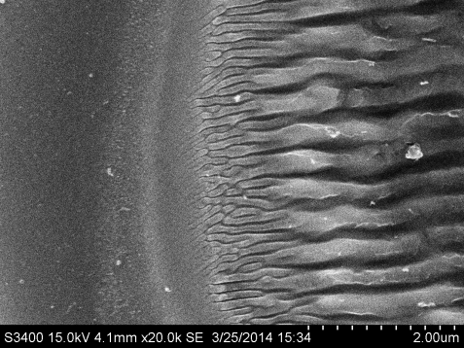
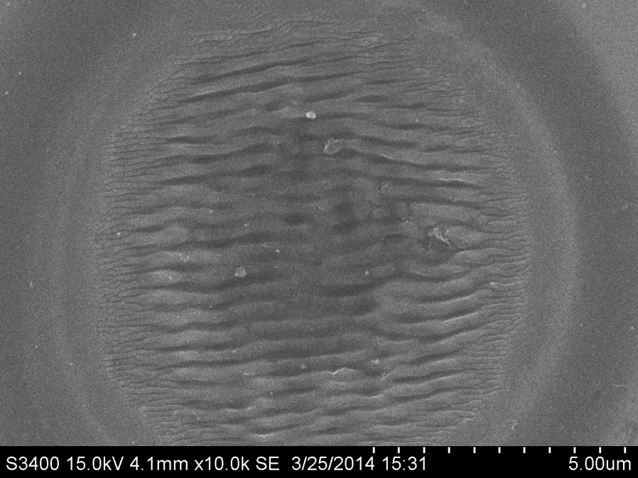
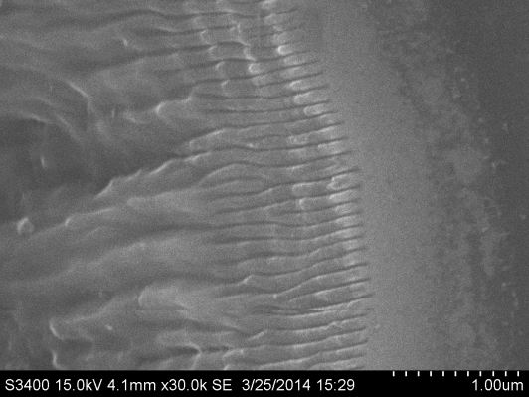
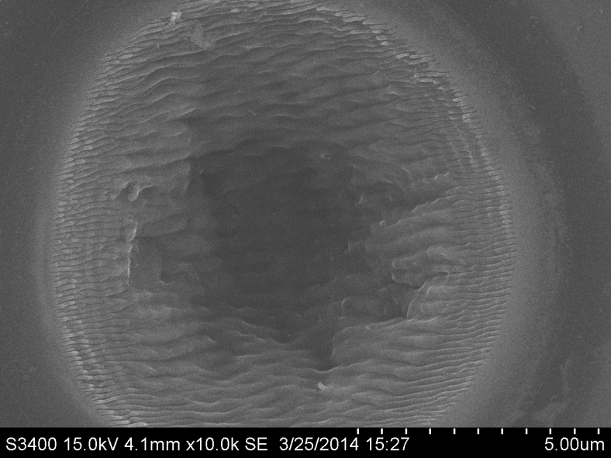
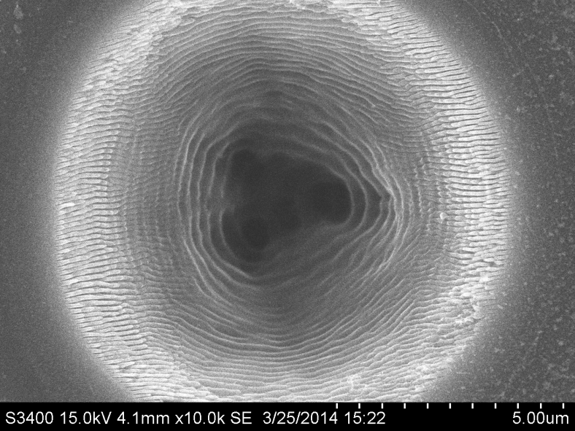
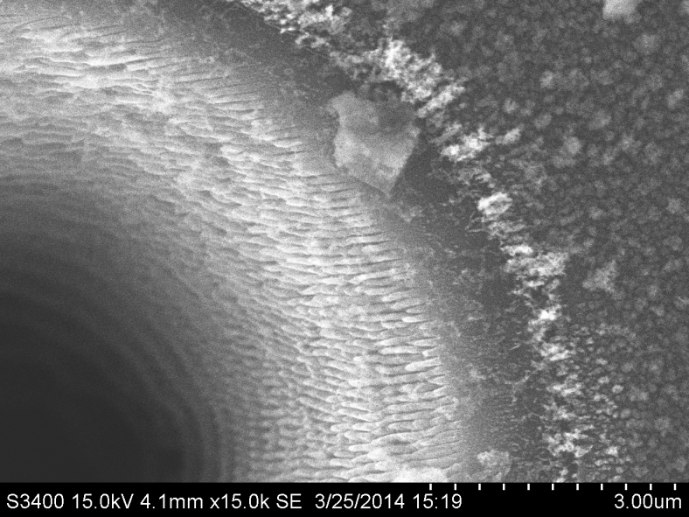
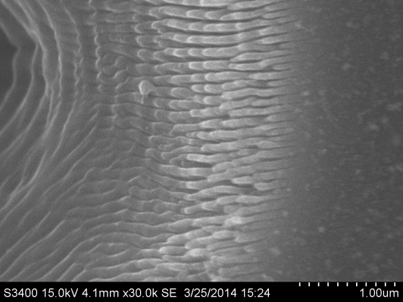
515 nm, 0.2 ps (FWHM), 35 TW/cm2
Nanostructuring, multi-shot threshold – 20 TW/cm2
N=100
N=30
N=300
N=1000
N=1000
crater

Slide 5
IB, II, E-E
Conduction band
AR, XF, XD,E-PHN
electron
Laser radiation
Laser -PI, MPI
Forbidden band
PI
hole
Valence band
CVD diamond

Slide 6
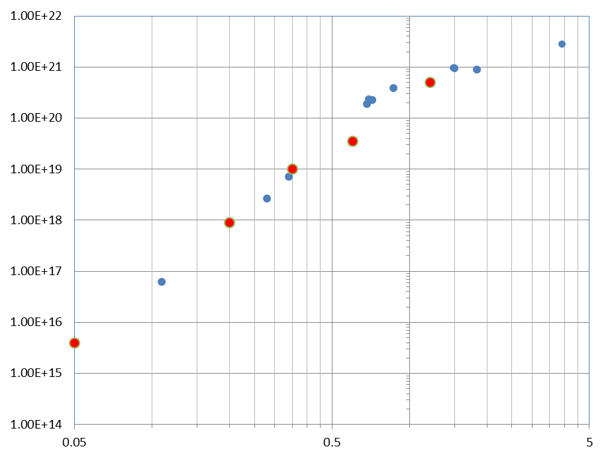
Photoionization yield (expt. vs. theory) CVD diamond
measurements
Log Q_{meas.} (a.u.)
n=4.4
model
Log n_{calc.}(a.u.)
Energy (μJ)
L.V. Keldysh, JETP 20, 1965, Apostolova et al in press NIMA, 2014, Otobe et al, PHYSICAL REVIEW B 77, 165104, 2008 (interpretation in terms of MPI, good agreement with the experiment)

Slide 7
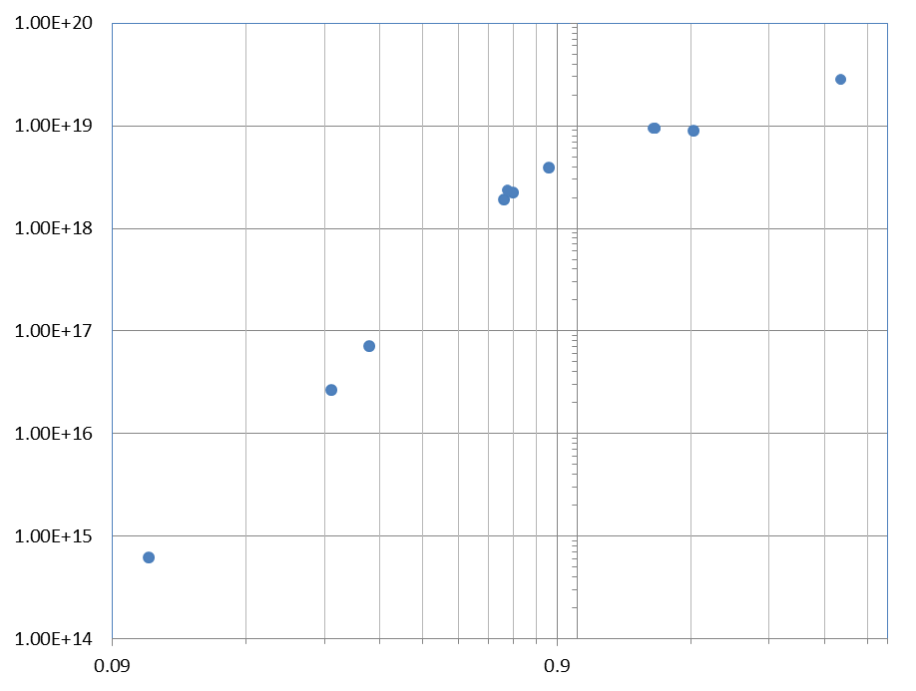
PI yield (expt), lower intensities
Change of slope
(suggesting electron-hole recombination after pulse irradiation)
n (cm⁻³)
MPI, n=4
E (μJ)

Slide 8
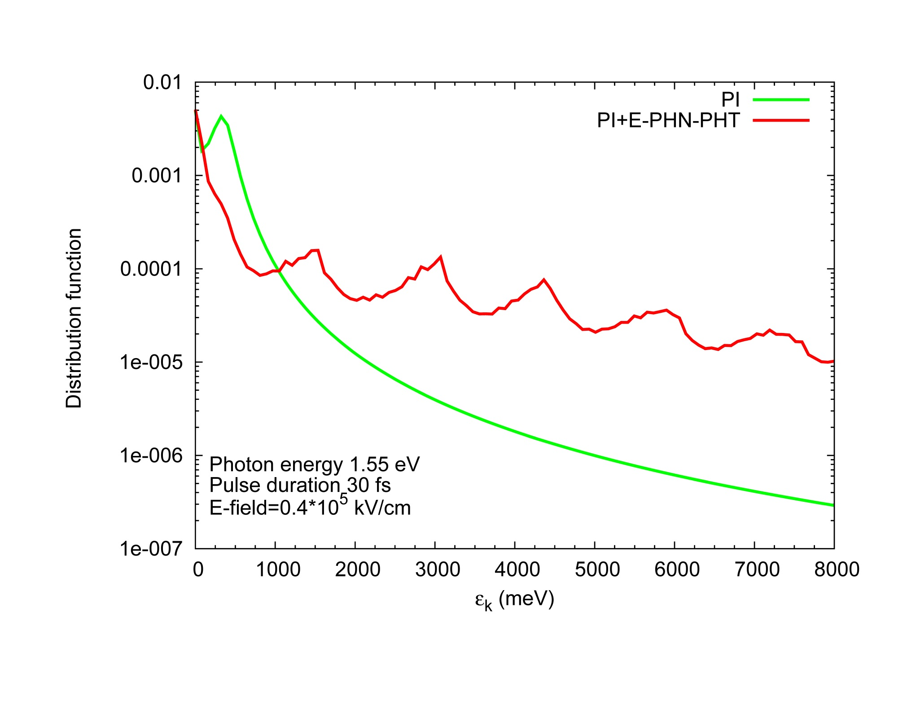
Density of states
Boltzman equation including direct and phonon-assisted photoionization

Slide 9
Theoretical model
(empirical pseudopotential model)
(Schrӧdinger picture)
(gauge freedom)
(electron density)
(adiabatic representation)

Slide 10
Static band structure
Band gap
Indirect gap 5.42 eV. Gap at k=(0,0,0) is 7 eV, requires minimal number of photons n=5 to undergo a transition (multiphoton ionization)

Slide 11
(Bloch orbitals)
|n=1,k=0> (ground state)
|n=2,k=0> (three fold degenerate)
|n=5,k=0> - lowest conduction band

Slide 12

Electron dynamics
red – parallel to C-C bond
black - perp. to C-C bond
$$I_{0}=2.5 ∗ {10}^{12}W/{cm}^{2}$$

Slide 13
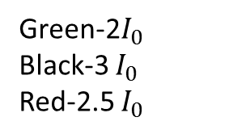
Nonadiabatic fraction
Green-2$I_{0}$
Black-3 $I_{0}$
Red-2.5 $I_{0}$
red-nonadiabatic

Slide 14
Photoionization yield (2 band model)
Predicts strong dependence on the polarization of the laser field. Adiabatic approximation predicts 6-photon process and gives lower densities)

Slide 15
Polarization dependence
Emission of longwavelength electrons (small k). Charge density - polarization independent, current density - polarization dependent.

Slide 16

Photoionization yield
I=${10}^{13} W/{cm}^{2}$

Slide 17
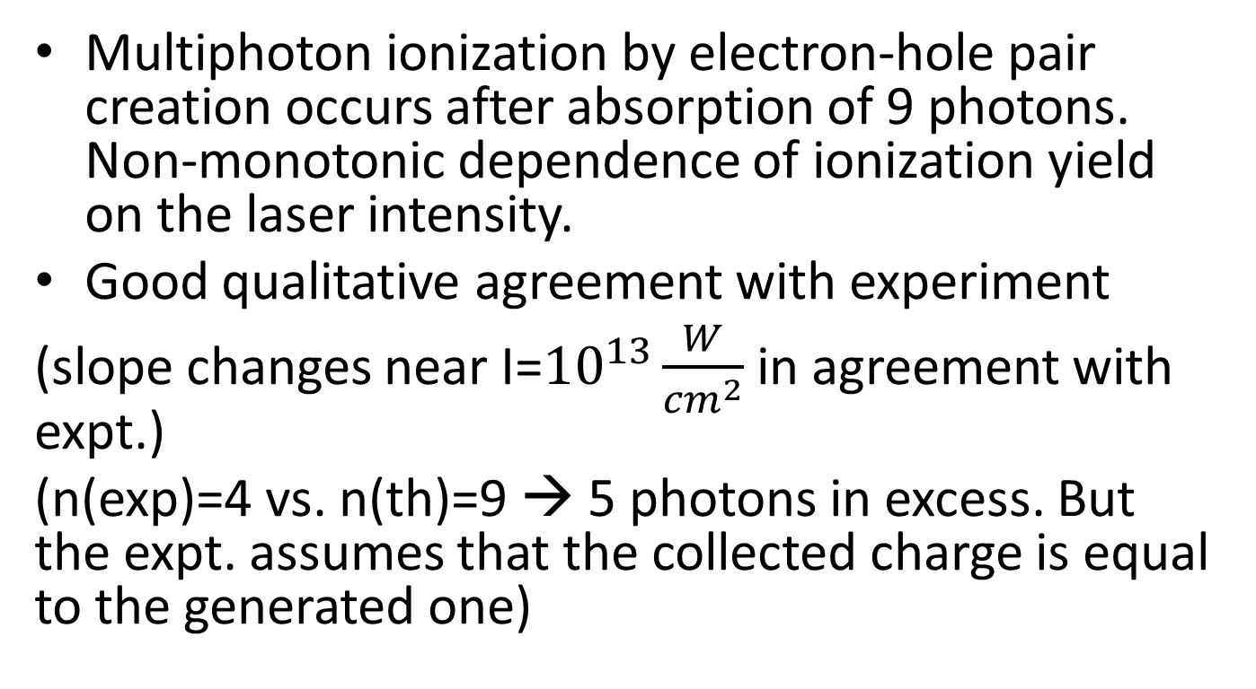
Conclusion
Multiphoton ionization by electron-hole pair creation occurs after absorption of 9 photons. Non-monotonic dependence of ionization yield on the laser intensity.
Good qualitative agreement with experiment
(slope changes near I=${10}^{13}\frac{W}{{cm}^{2}}$ in agreement with expt.)
(n(exp)=4 vs. n(th)=9 → 5 photons in excess. But the expt. assumes that the collected charge is equal to the generated one)

