Slide 1


Welcome – Benvenuti
Carlo Verdone
to Accelerating Science and Innovation
Notes:
1

Slide 2
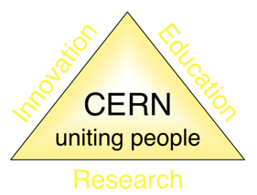
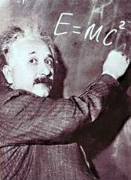
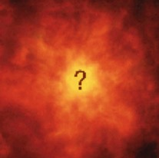
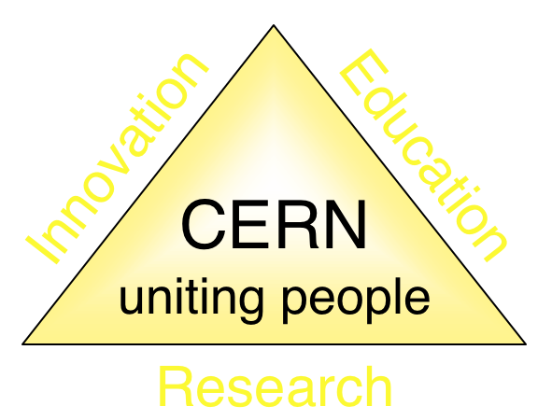


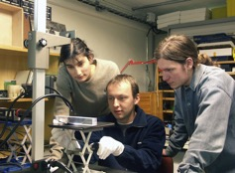
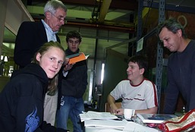
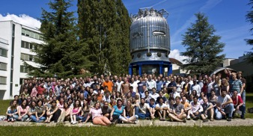
The Mission of CERN
Push back the frontiers of knowledge
E.g. the secrets of the Big Bang …what was the matter like within the first moments of the Universe’s existence?
Develop new technologies for accelerators and detectors
Information technology - the Web and the GRID
Medicine - diagnosis and therapy
Train scientists and engineers of tomorrow
Unite people from different countries and cultures
Notes:
2

Slide 3
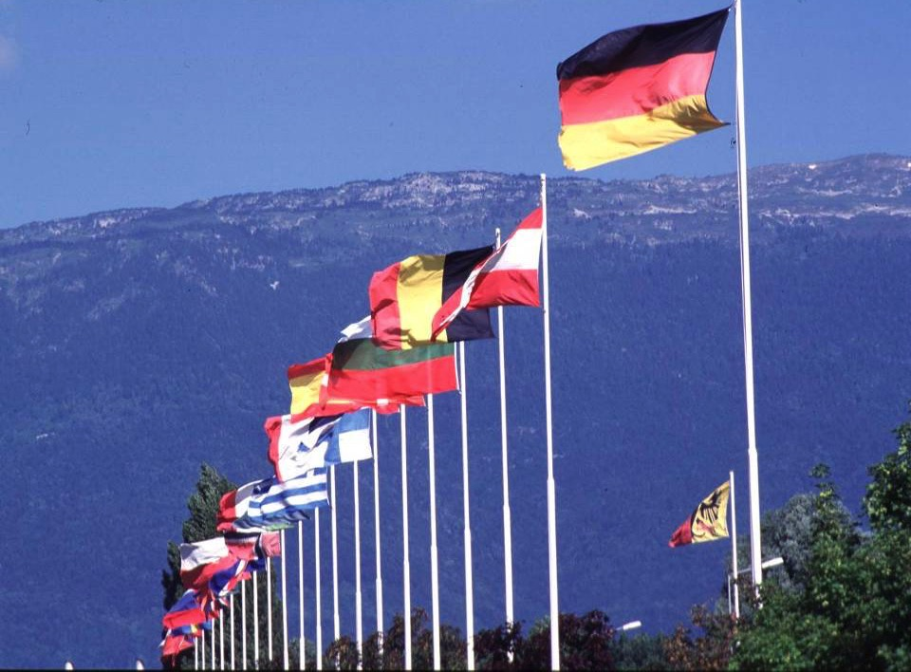

CERN was founded 1954: 12 European States
“Science for Peace”
Today: 21 Member States
~ 2300 staff
~ 1600 other paid personnel
~ 10500 users
Budget (2014) ~1000 MCHF
Member States: Austria, Belgium, Bulgaria, the Czech Republic, Denmark, Finland, France, Germany, Greece, Hungary, Israel, Italy, the Netherlands, Norway, Poland, Portugal, Slovakia, Spain, Sweden, Switzerland and
the United Kingdom
Candidate for Accession: Romania
Associate Member in Pre-Stage to Membership: Serbia
Applicant States for Membership or Associate Membership:
Brazil, Cyprus, Pakistan, Russia, Slovenia, Turkey, Ukraine
Observers to Council: India, Japan, Russia, Turkey, United States of America; European Commission and UNESCO
3
Notes:
3
----- Meeting Notes (09/01/2013 14:16) -----
nnn

Slide 4
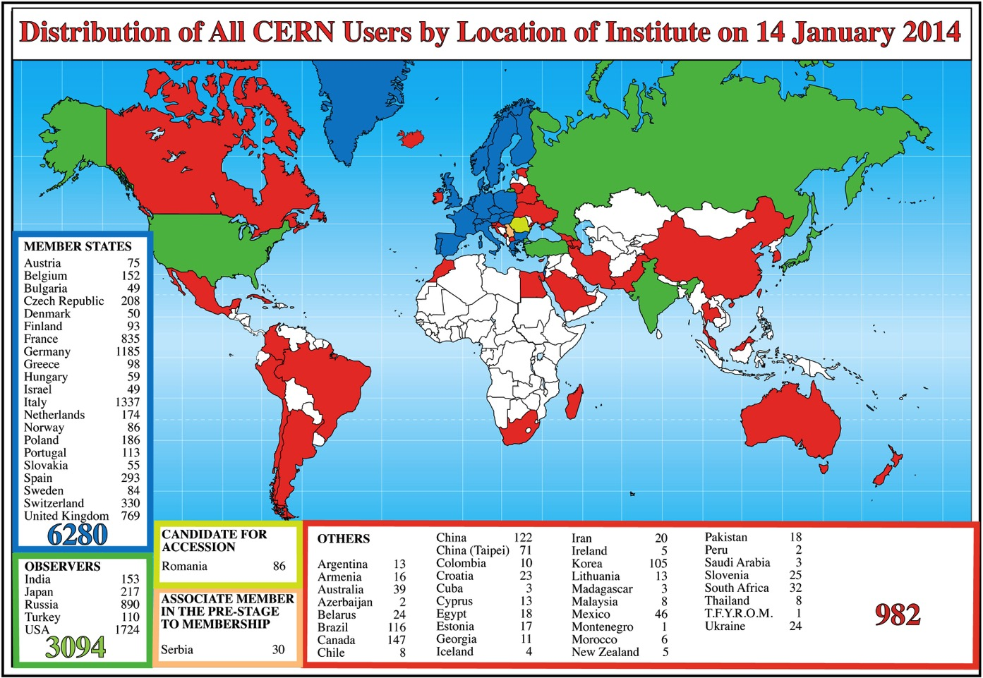
Science is getting more and more global
CERN: 307 staff, 89 fellows, 60 students
Notes:
4
4

Slide 5
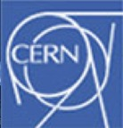
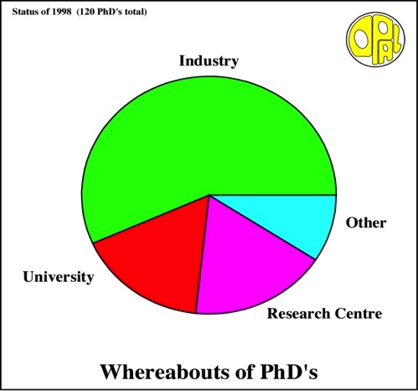
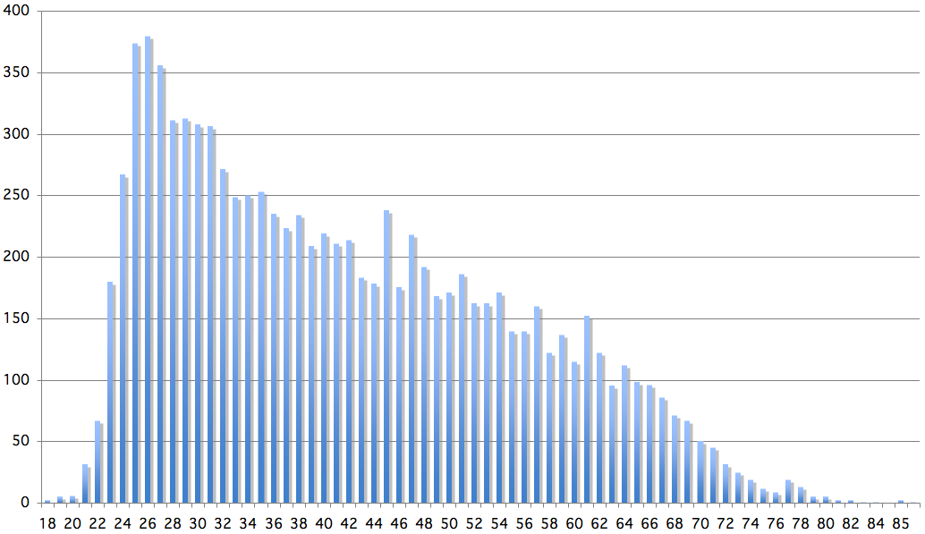
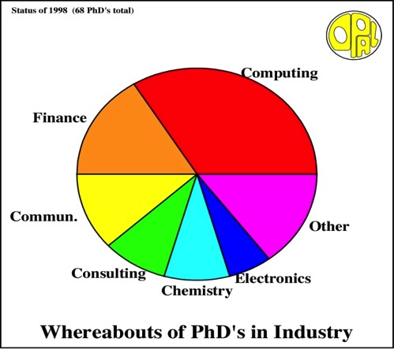
Age Distribution of Scientists
- and where they go afterwards
Survey in March 2009
26
Today:
∼2500 PhD students
in LHC experiments
65
They do not all stay: where do they go?

Slide 6
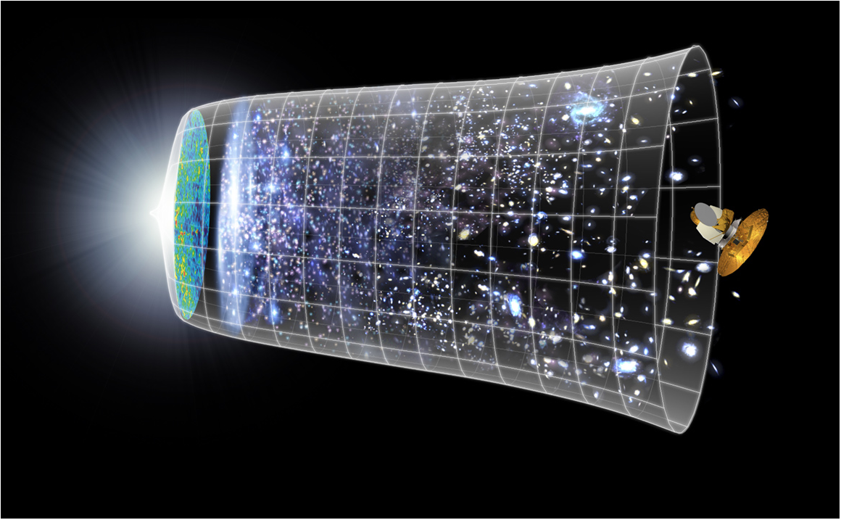
Next Scientific Challenge:
to understand the very first moments of our Universe after the Big Bang
Big Bang
WMAP
13.8 Billion Years
Today
10²⁸ cm

Slide 7
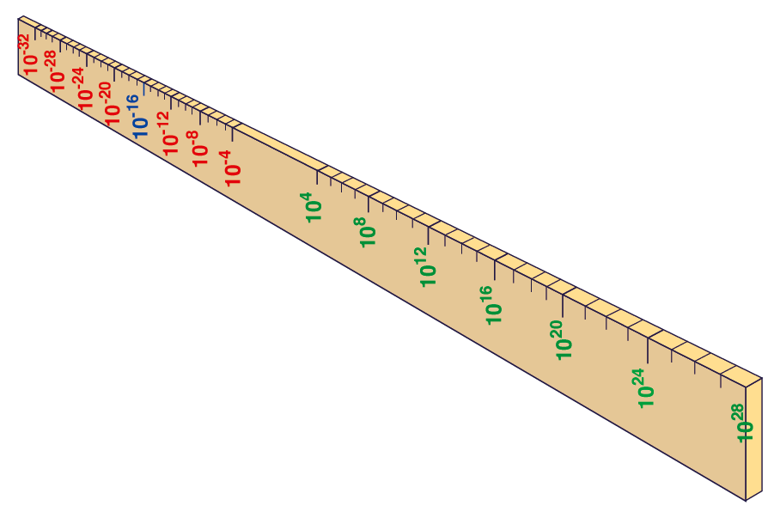
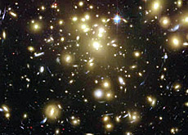
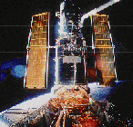
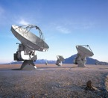
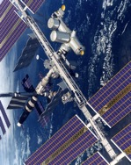
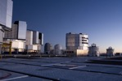
Big Bang
Proton
Atom
Radius of Earth
Earth to Sun
Radius of Galaxies
Universe
Hubble
ALMA
cm
AMS
VLT
Notes:
7
60 Grössenordnungen

Slide 8
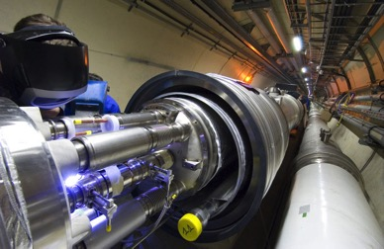
Big Bang
Proton
Atom
Radius of Earth
Earth to Sun
Radius of Galaxies
Universe
LHC
Super-Microscope
Hubble
ALMA
cm
Study physics laws of first moments after Big Bang
increasing Symbiosis between Particle Physics,
Astrophysics and Cosmology
AMS
VLT
Notes:
8
60 Grössenordnungen

Slide 9
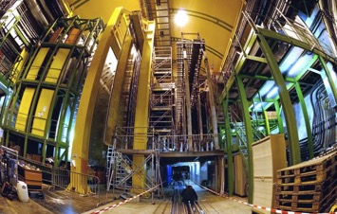
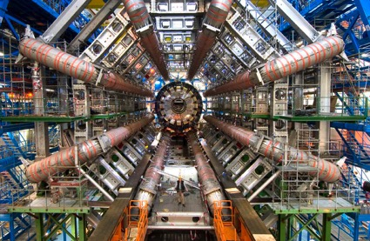
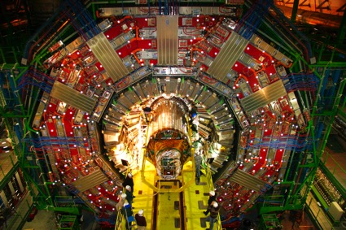
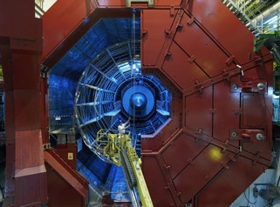
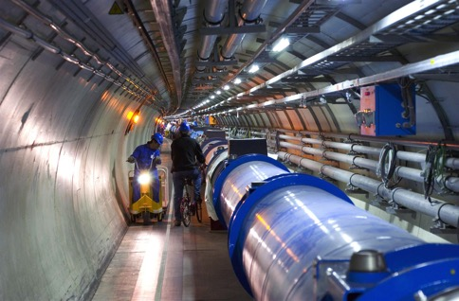
2010: a New Era in Fundamental Science
LHCb
CMS
ATLAS
Exploration of a new energy frontier
in p-p and Pb-Pb collisions
ALICE
LHC ring:
27 km circumference
Notes:
9

Slide 10
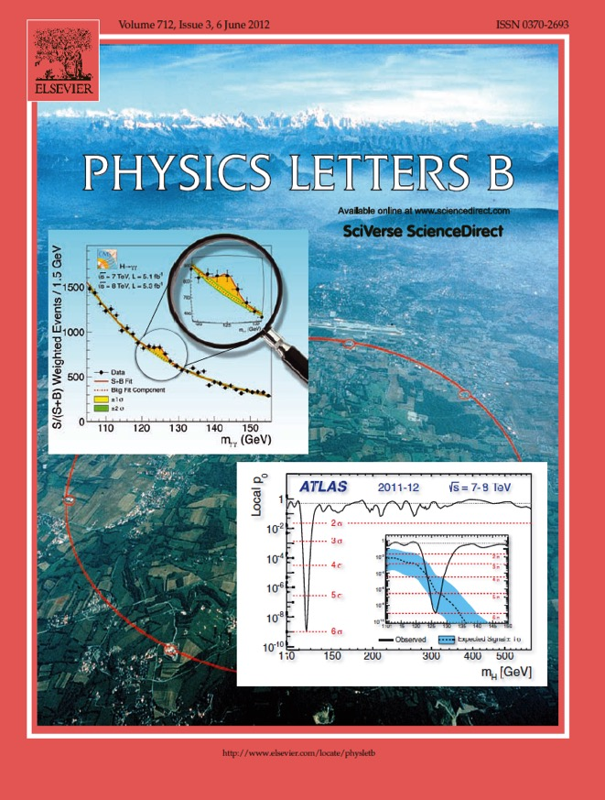
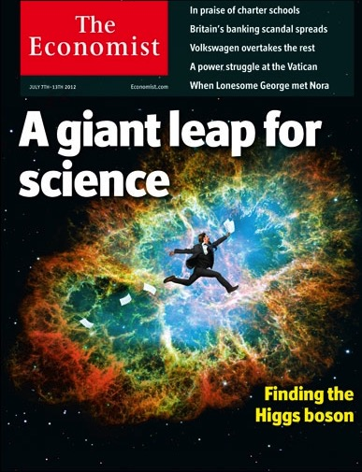
The highlight of a remarkable year 2012

Slide 11
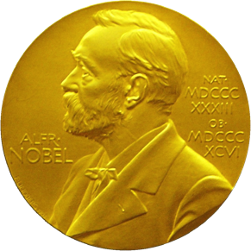
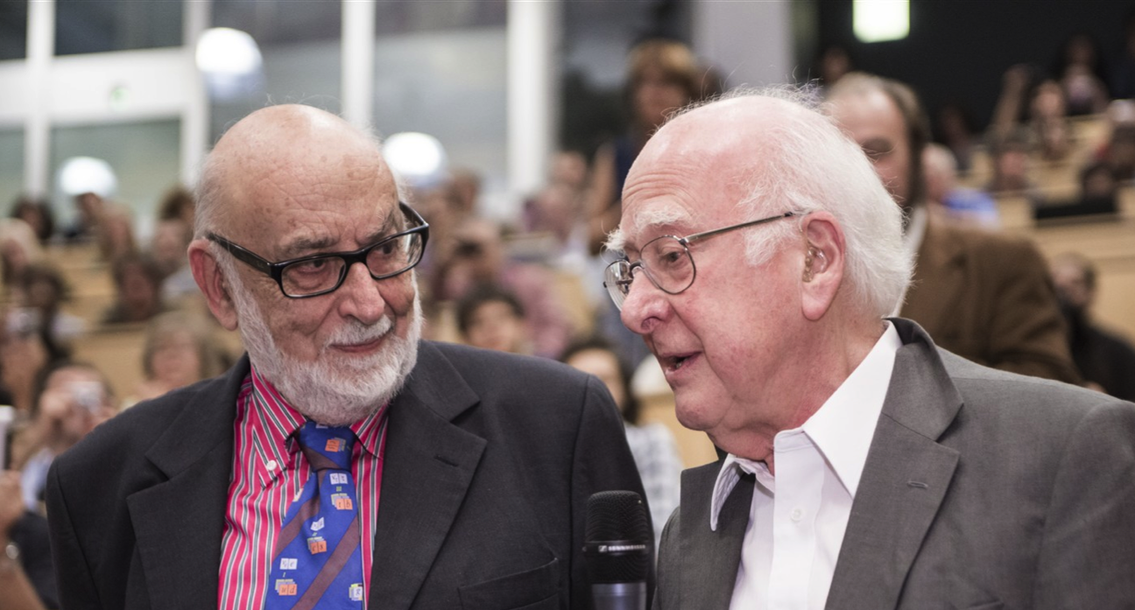
Nobel Prize in Physics 2013
The Nobel Prize in Physics 2013 was awarded jointly to François Englert and Peter W. Higgs "for the theoretical discovery of a mechanism that contributes to our understanding of the origin of mass of subatomic particles, and which recently was confirmed through the discovery of the predicted fundamental particle, by the ATLAS and CMS experiments at CERN's Large Hadron Collider”.

Slide 12
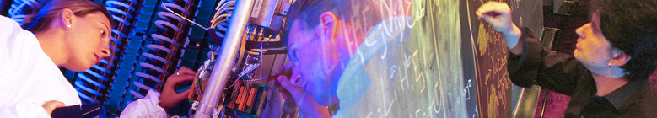
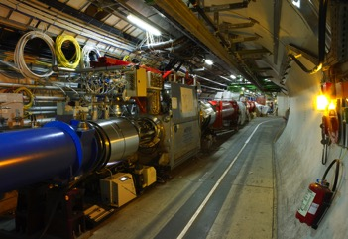
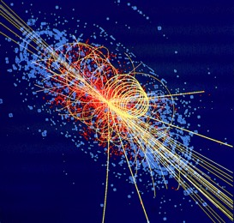

CERN: Particle Physics and Innovation
Interfacing between fundamental science and key technological developments
CERN Technologies and Innovation
Accelerating particle beams
Detecting particles
Large-scale computing (Grid)
Notes:
12

Slide 13
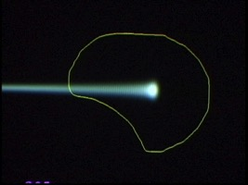
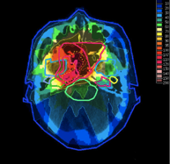
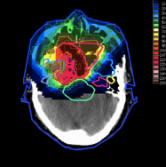

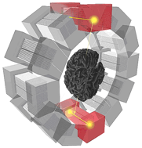
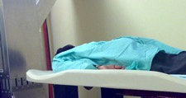
Medical Application as an Example of Particle Physics Spin-off
Combining Physics, ICT, Biology and Medicine to fight cancer
Hadron Therapy
Tumour Target
Leadership in Ion Beam Therapy now in Europe and Japan
Protons
light ions
Accelerating particle beams
~30’000 accelerators worldwide
~17’000 used for medicine
X-ray
protons
>100’000 patients treated worldwide (45 facilities)
>50’000 patients treated in Europe (14 facilities)
Imaging
PET Scanner
Clinical trial in Portugal, France and Italy for new breast imaging system (ClearPEM)
Detecting particles
Notes:
13

Slide 14

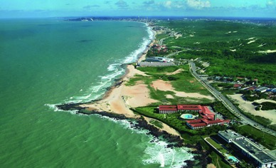
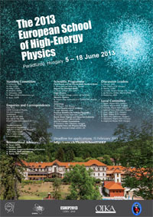
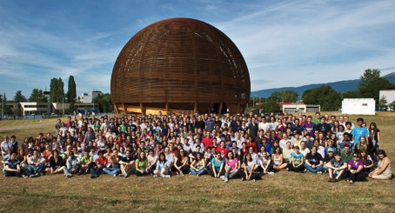
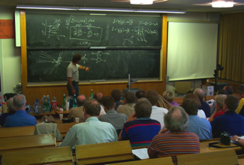
CERN Education Activities
Latin American School
Natal, Brazil, 2011
Arequipa, Peru, 2013
NEW:
Asia-Europe-Pacific School of High-Energy Physics
Fukuoka, Oct 2012
India, 2014
Scientists at CERN
Academic Training Programme
Young Researchers
CERN School of High Energy Physics
CERN School of Computing
CERN Accelerator School
CERN School of Physics
Hungary, June 2013
Physics Students
Summer Students
Programme
CERN Teacher Schools
International and National Programmes

Slide 15
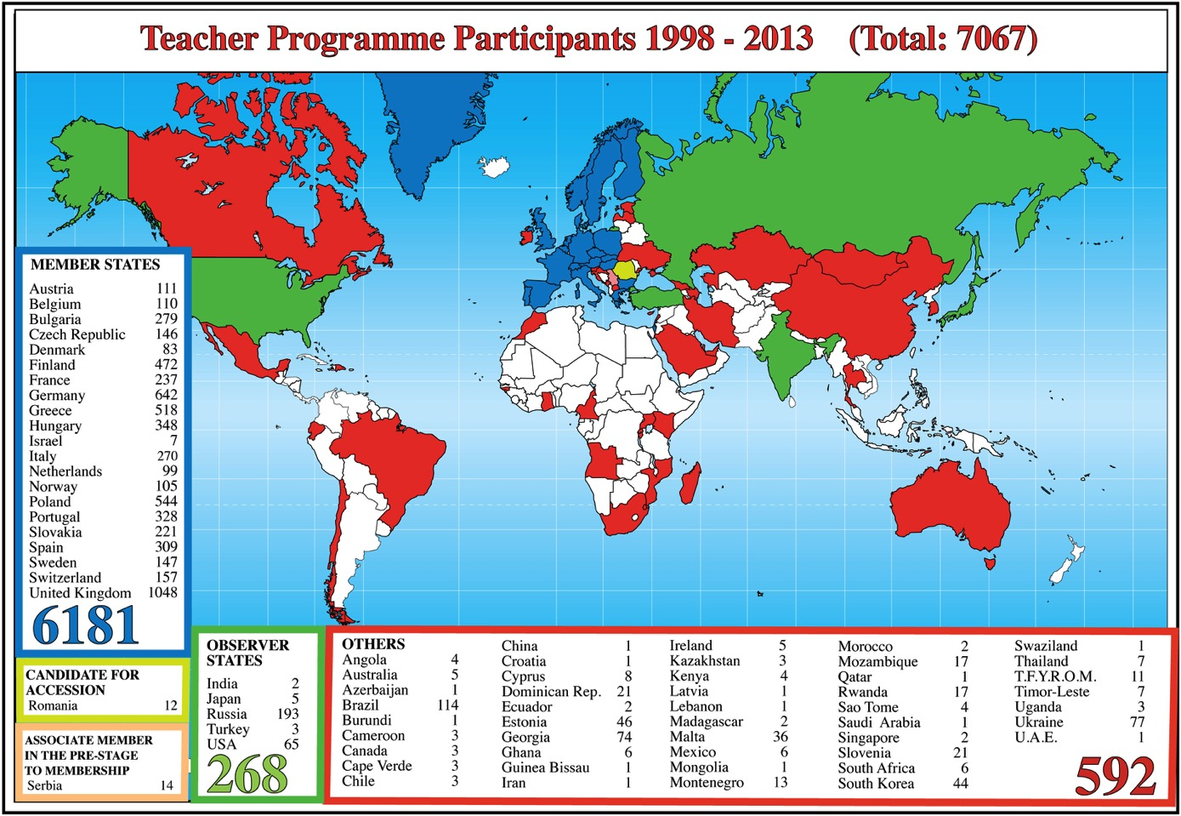

CERN Teacher Programme

Slide 16
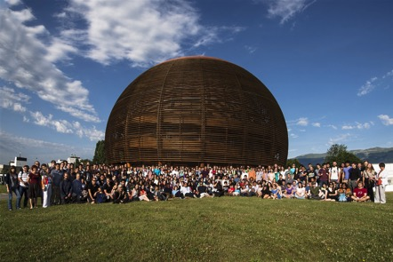
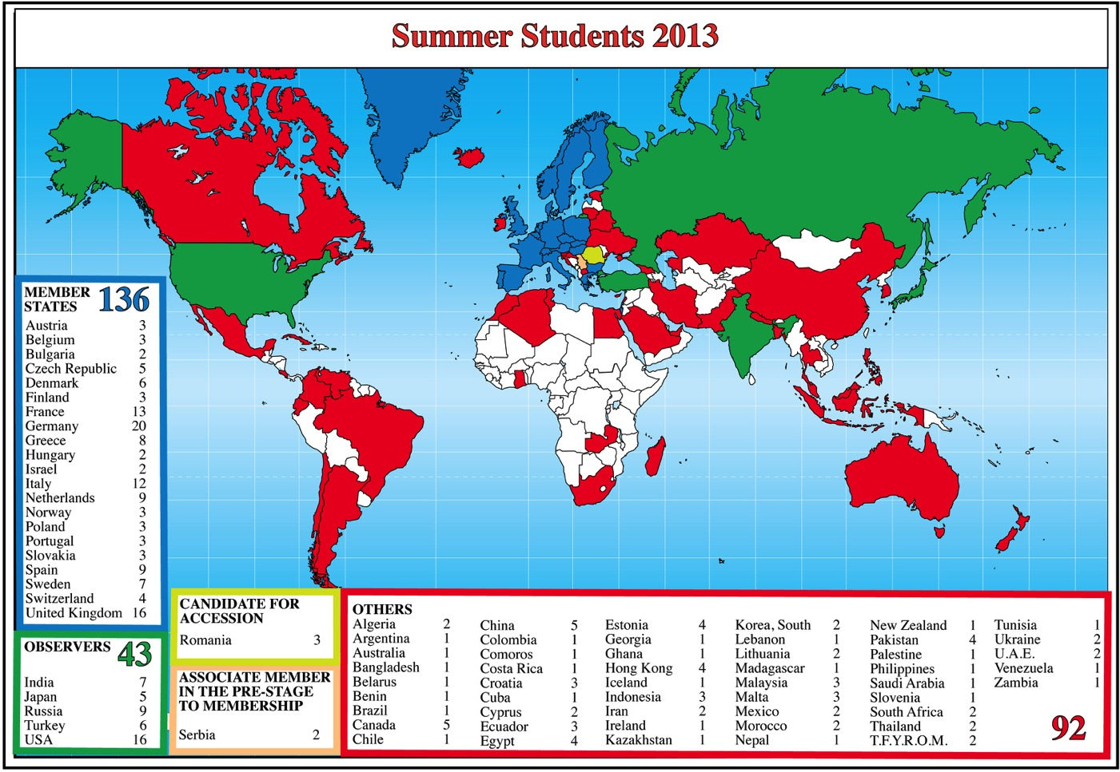
Summer Students 2013

Slide 17

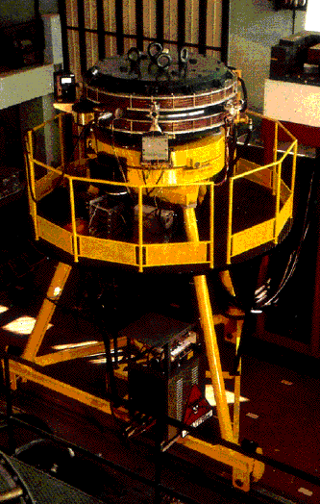
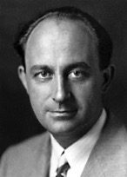
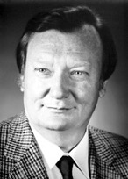
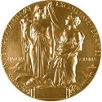
Italy and CERN
Italy is a founding member of CERN with a strong tradition in particle physics
Eduardo Amaldi: one of the founding fathers of CERN and interim Secretary General
Two Directors General from Italy:
Carlo Rubbia and Luciano Maiani
ADA: the common ancestor of all particle colliders
first storage ring for an electron and a positron beam rotating
in opposite directions operated at Frascati in 1961
Nobel Prizes in Physics:
related to advance of Particle Physics:
    1938: E. Fermi
    1984: C. Rubbia
ADA
Anello Di Accumulazione
Notes:
17

Slide 18

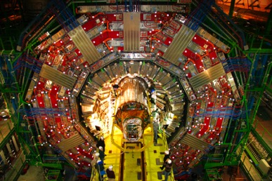


Italy and CERN
INFN brings together some 5000 researchers
Approximately 600 Italian physicists have collaborated
on the realisation of the LHC and on the research conducted with the LHC many hold key positions
in the collaborations
Examples:
Atlas and CMS
Italian industries have constructed some extremely important components for the LHC project, using very advanced technology
Examples:
CMS coil
delivered to CERN in December 1997
Notes:
18

Slide 19
Grazie!
Accelerating Science and Innovation
Notes:
19

Slide 20

Safety Information for Visitors
Safety is our highest priority
We are confident that you have read the Safety Information provided prior
to the visit and ask that you take the time to read the document placed
in front of you once more before embarking on the site visit.
By taking part in the site visit you are deemed to have understood and accepted the Safety Information provided to you.
Please always follow the instructions given by your guide
and do not hesitate to ask if you have any questions.

