Slide 1
LDM: Status & Outlook
M. Palm, S. Mazzoni (BE-BI-PM)

Slide 2
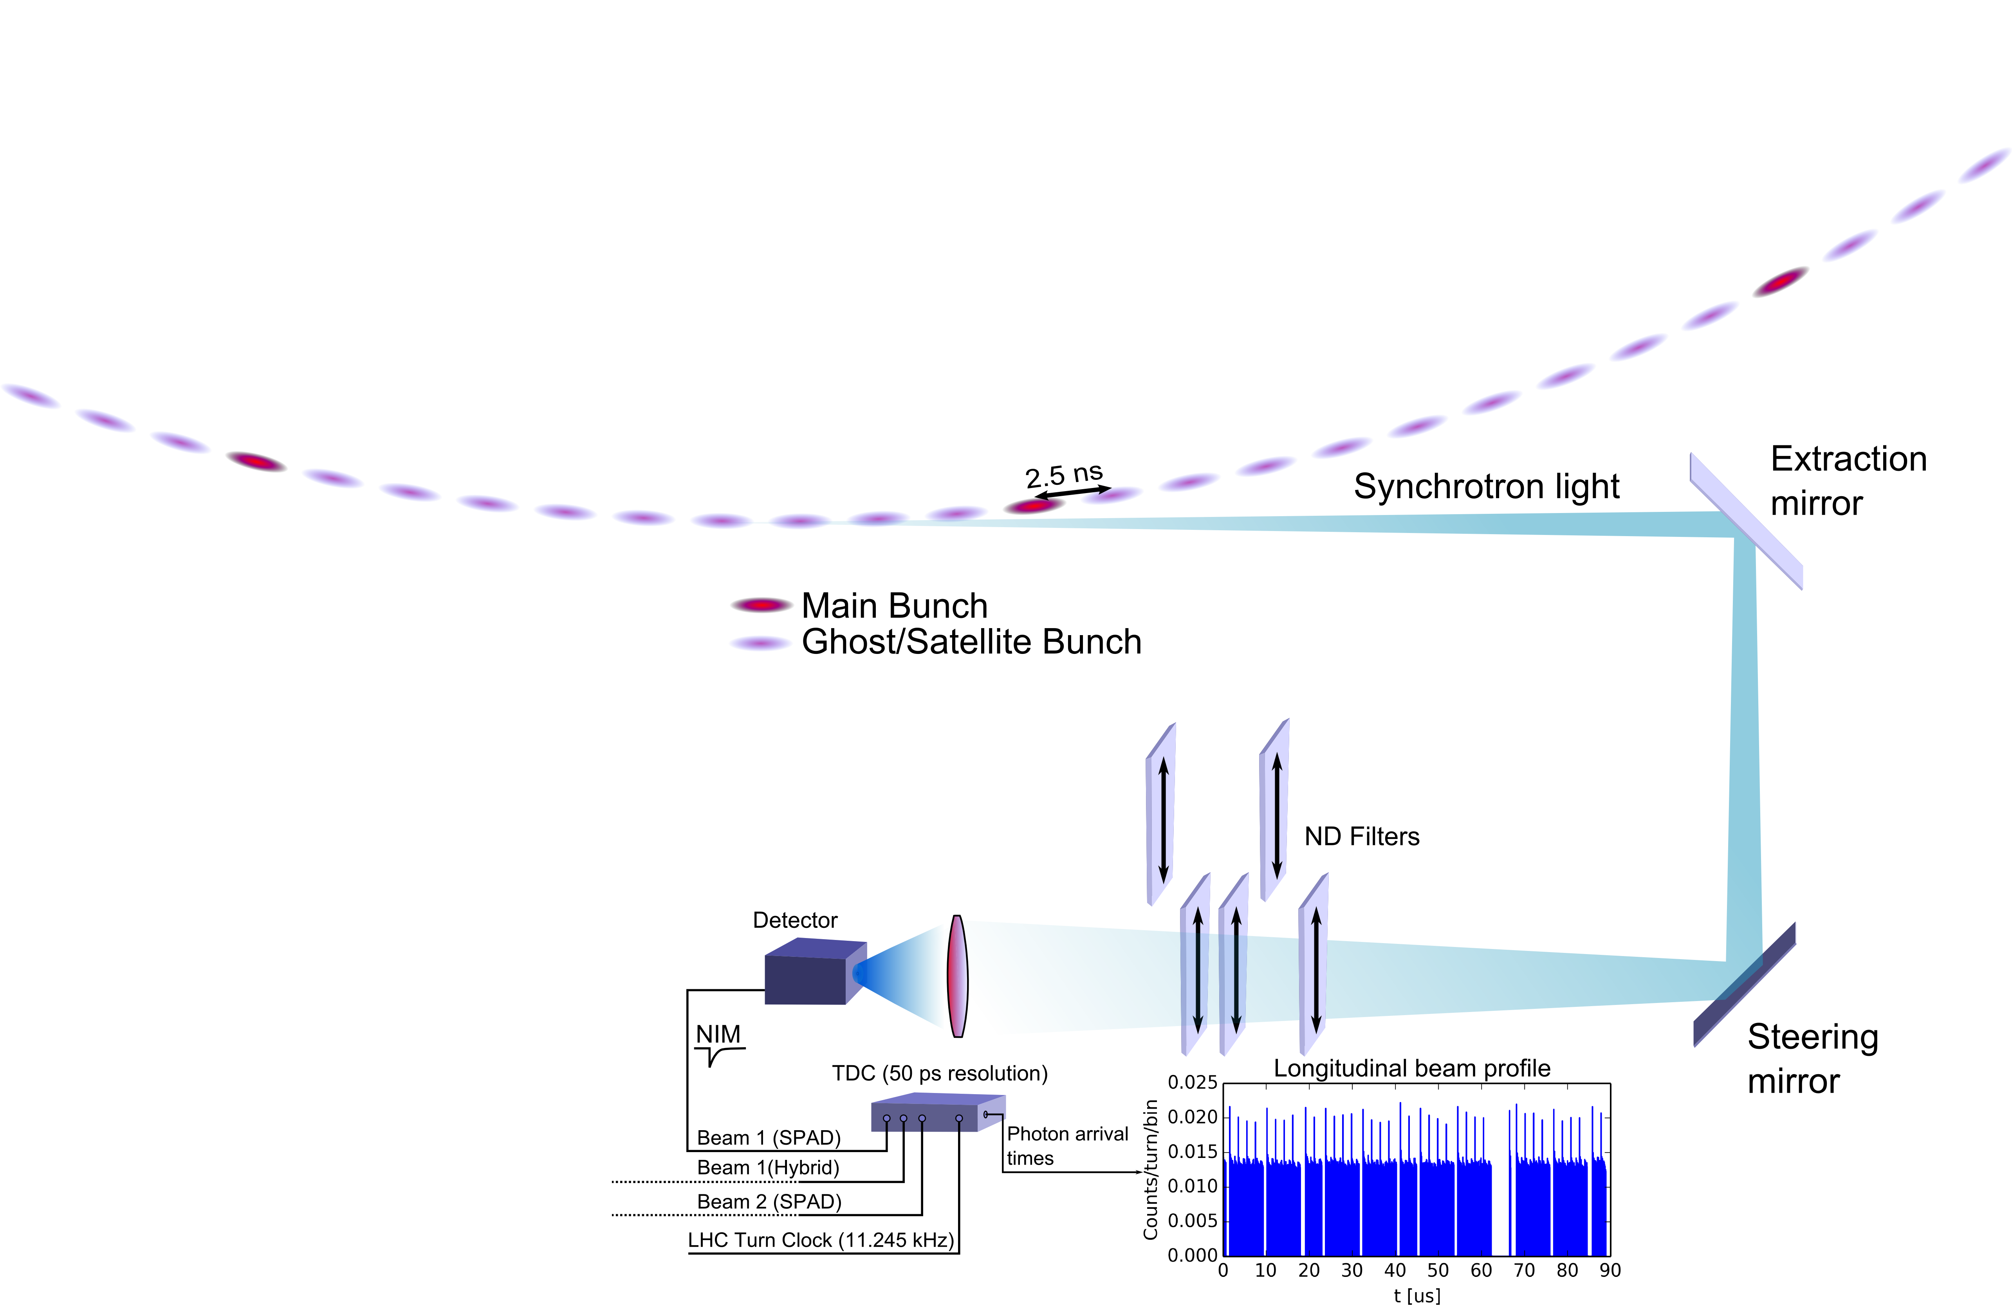
LDM Overview
Purpose
Longitudinal beam profile monitoring of LHC beams
Measure relative population of Main and Ghost/Satellite bunches
High dynamic range!
Principle
Time-correlated single photon counting of synchrotron light from LHC beams
Lens focuses light on sensor
ND-filters to control amount of light on sensor
TDC generates histogram of photon arrival times ⬄ Beam profile (50 ps resolution)

Slide 3
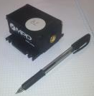
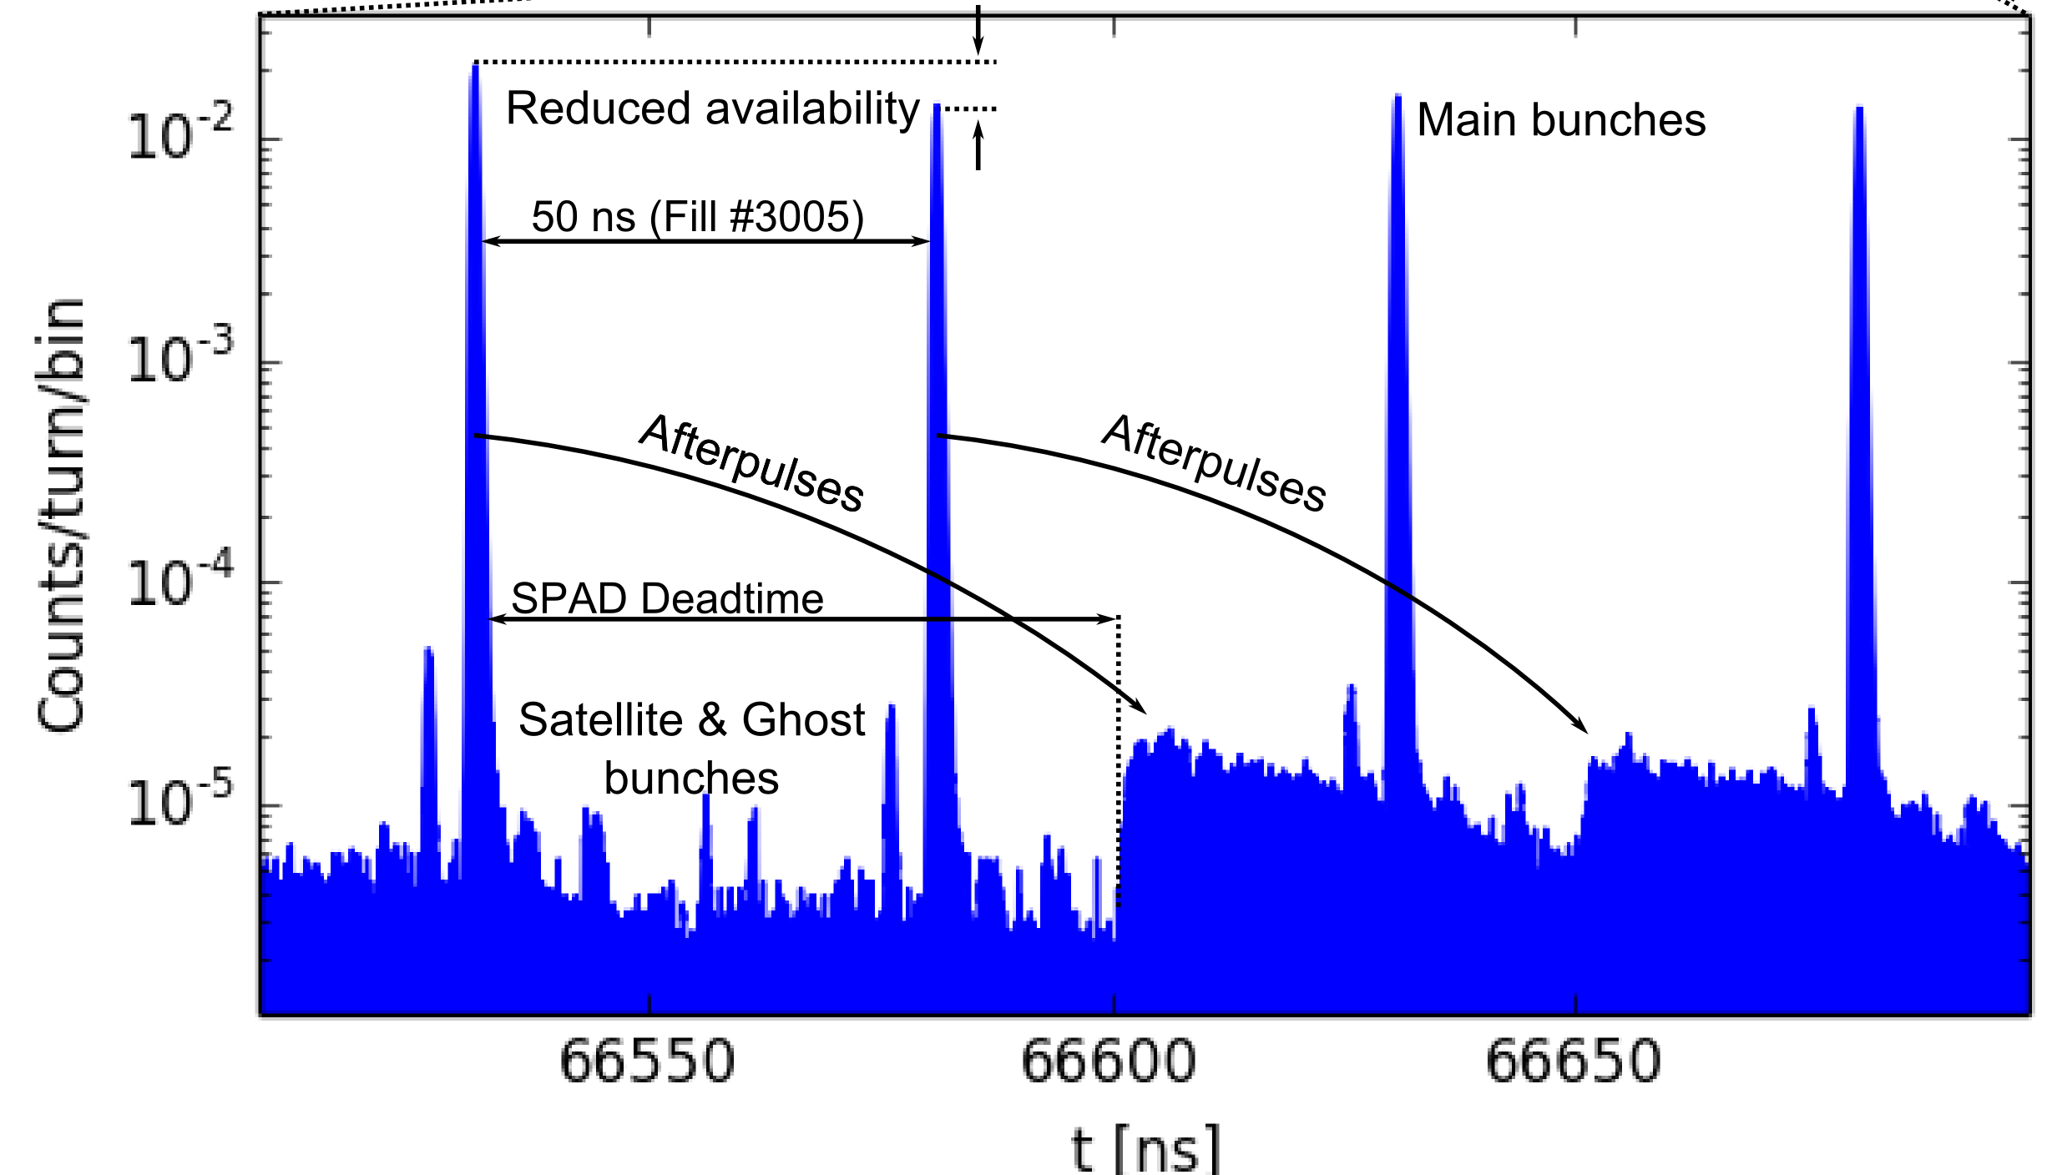
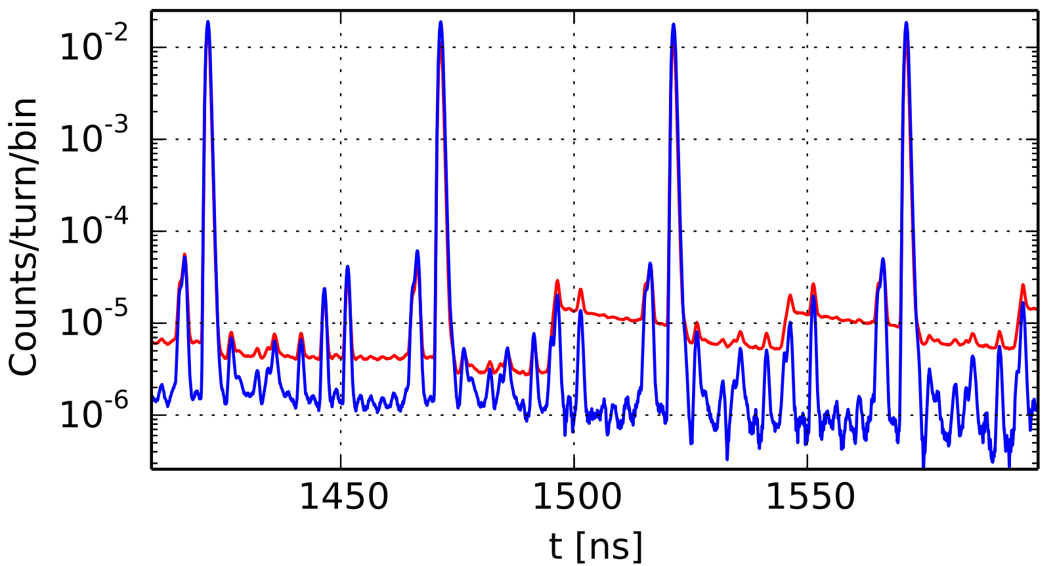
Detectors: SPAD
Single Photon Avalanche Diode (x2)
(+) Reliable, narrow IRF
(-) Afterpulsing, deadtime
Improvements
Afterpulse & deadtime correction method implemented [IBIC’14: MOPD11]
Detector deadtime adjusted by manufacturer to avoid LHC main bunch spacing
LS1 Characterization
Afterpulsing, deadtime, sensitivity
Erratic behaviour if struck by photon at the end of the deadtime
PDM model from Micro-Photon Devices
Long-lived trap states measureable after 100’s of $μ$s.
Long-lived trap states measureable after 100’s of 𝜇s.
Dynamic range improved by ~1 order of magnitude
“Baseline” variation suppressed
[LHC Data from
Fill #3005]
Raw
Corrected

Slide 4
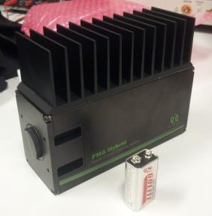
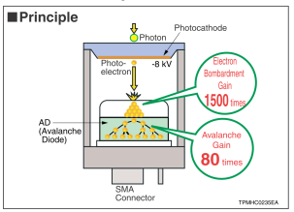
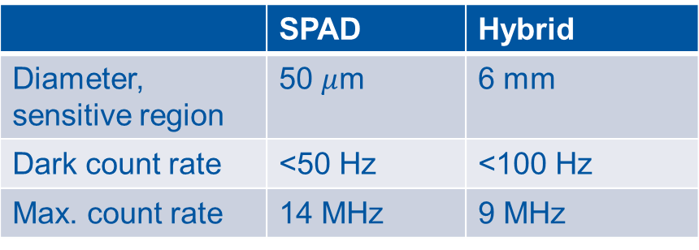
Detectors: Hybrid
PMA Hybrid from PicoQuant (x1)
Advantages
Characteristics
Electron bombardment + avalanche
Afterpulsing “negligible”
Disadvantages
Deadtime < Double pulse resolution of TDC
Current limit at 9 MHz count rate (shutter protection)
Large sensor: $φ$=6 mm
Large sensor: 𝜙=6 mm
 | SPAD | Hybrid
Diameter, sensitive region | 50 $μ$m | 6 mm
Dark count rate | <50 Hz | <100 Hz
Max. count rate | 14 MHz | 9 MHz

Slide 5
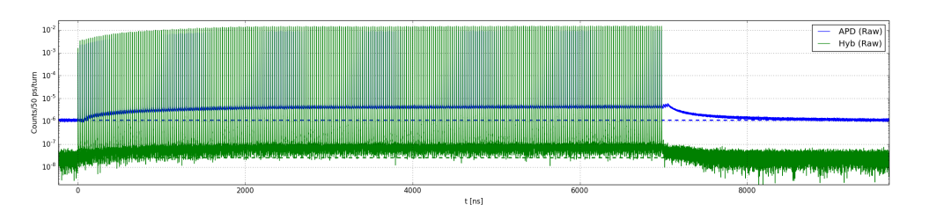
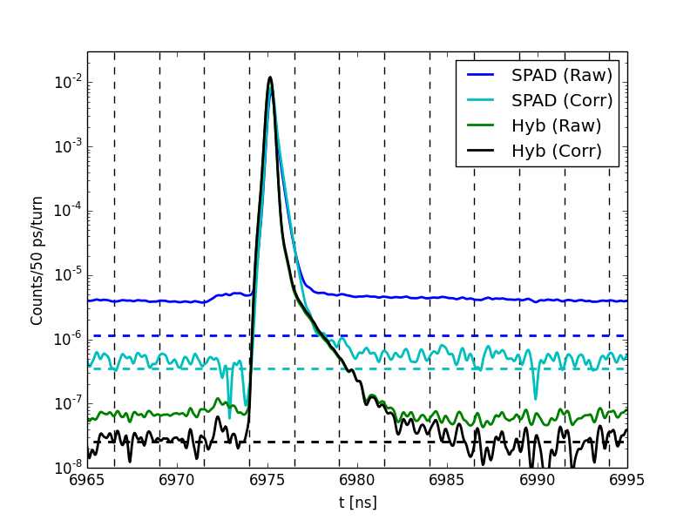
SPAD vs. Hybrid
Lab test: LHC-like pulse train (pulsed sub-ns laser)
Raw data
>10⁵
SPAD
x100
Hybrid
Signal level at end of “abort gap”
Observations
Conclusions
Hybrid “afterpulsing” visible
… but correction algorithm works also for Hybrid!
Overall: Hybrid seems very promising
Hybrid raw data even better than corrected SPAD
LDM baseline (=signal between main bunches) more stable with Hybrid
Less signal spill-over from main bunch to next RF-bucket
FWHM similar (Hybrid better from ~FW@0.01M)
Dynamic range > ${10}^{5}$
Dynamic range > 〖10〗^5
2.5 ns
Last pulse: raw and corrected data

Slide 6
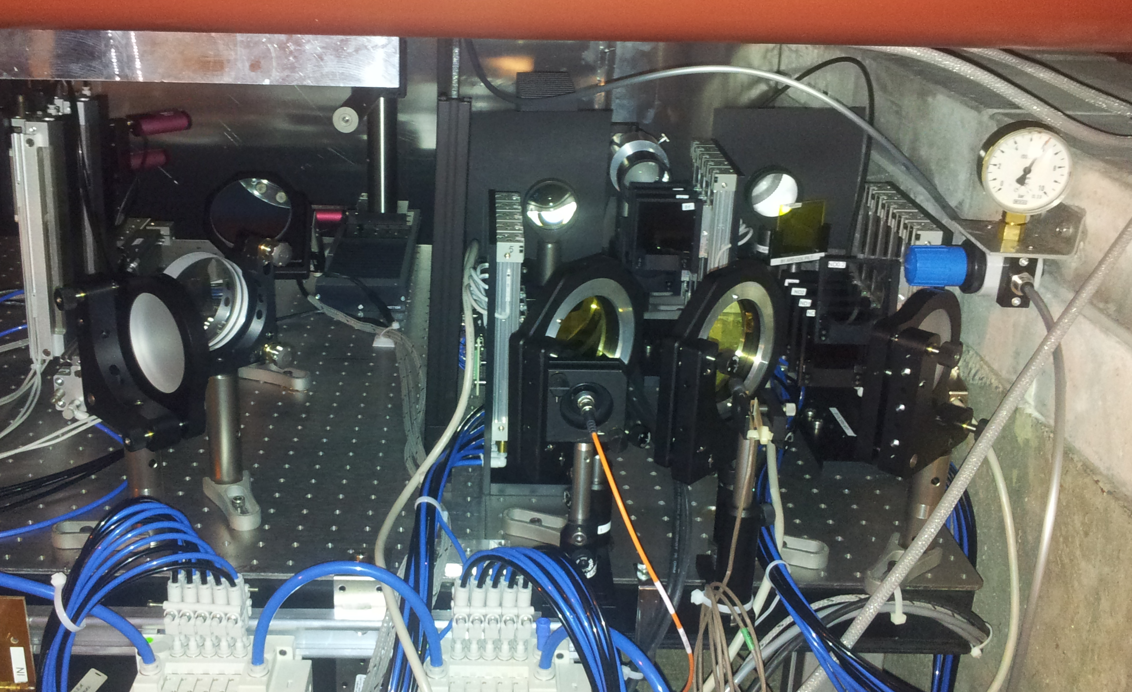
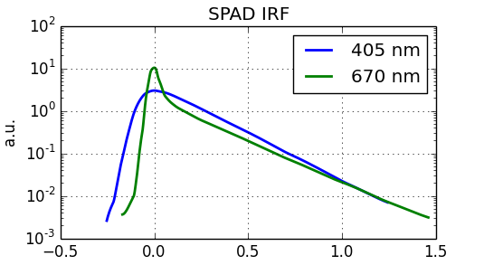
Installation
Diffuser (SPAD)
Reduce impact (signal variation) of extraction mirror movement
Neutral density filters
Analytical estimation of filter range from SR photon emission (0.45-7 TeV), T/R along light path, detector QE and light collection efficiency
Avoid saturation: factor x100 safety margin
5 filters (Attenuation up to 10⁷)
Synchrotron light
Hybrid
SPAD
Color filter (SPAD)
IRF widens at shorter wavelengths
Filter $→$Better signal at high energies
Filter → Better signal at high energies
Pulsed laser
Fiber-coupled sub-ns pulsed laser installed in gallery
SPAD afterpulse calibration
System sanity check
[Courtesy MPD]

Slide 7
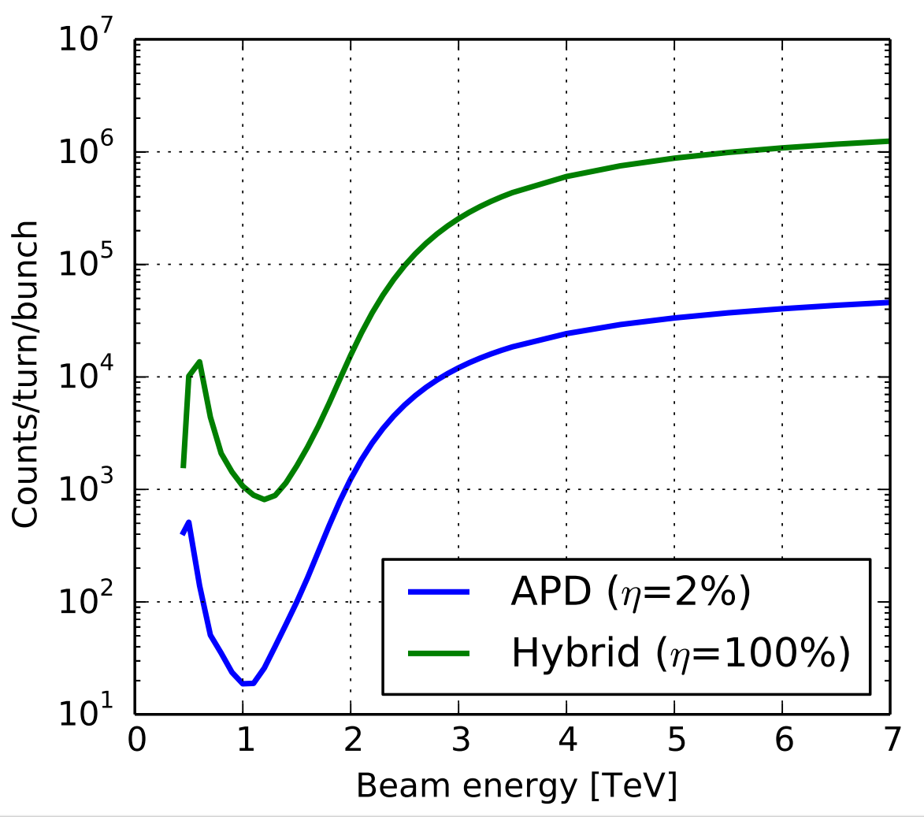
Conclusions
Count rate
Expectations
Light collection efficiency on SPAD sensor improved from Run 1
Current status
Sufficient signal at “1 GeV-dip” (undulator/dipole transition region)
System ready for beam!
Outlook
Improve software for control, acquisition and analysis
TBC: Hybrid > SPAD…
Improved afterpulse correction

Slide 8
Thank you for your attention!
Questions?

