Slide 1
Filtering, aggregating and histograms
A few complete examples with MR, Spark
luca menichetti, vag motesnitsalis

Slide 2
Overview
  Extraction script updates
      Twiki
      logging
      experiment dashboard
  Hadoop example
      Hadoop Architecture
      MapReduce Logic
      WordCount
      EOS Speed Histograms
      Results
  Spark example

Slide 3
Extraction script - twiki
awgrepo script: with all data available in the cluster (read this twiki page for Data Access), it is possible to use the script to browse availabilities and extract/query data.
In this twiki page you can find a detailed description about how to use the script:
  instructions and examples
  milestones
  supported projects list
  ETL procedure description
  git repository links
  …

Slide 4
Extraction script - updates
With the following command (in a node of the cluster)
./awgrepo –e projectname –o outputpath –p period –q query
a selection and/or a projection can be performed. At the moment just one equality selection can be done.
For example, an EOS project schema
path,ruid,rgid,td,host,fid,fsid,ots,otms,cts,ctms,rb,wb,sfwdb,sbwdb,sxlfwdb,sxlbwdb,nrc,nwc,nfwds,nbwds,nxlfwds,nxlbwds,rt,wt,osize,csize,sec.name,sec.host,sec.vorg,sec.grps,sec.role,sec.app
with the query parameter the amount of data to analyze can be reduced like this :
… -q "path,fid=1350239,otc,cts,rb,wb"

Slide 5







Extraction script - logging
Logging is local, but if the execution triggers a spark/mapreduce job information about execution will be stored remotely (in addiction to the classic Hadoop framework logging functions). It is used a openstack virtual machine that runs a REST web application with tomcat, storing data with mongodb.
1
AFS
ssh analytix ... ./awgrepo.py
2
REST API
Content-Type: Collection+JSON
3

Slide 6
Experiment dashboard data
Now CMS and ATLAS job information, retrieved from experiment dashboard, are available inside the cluster (csv format) and automatic daily import is set up.
Soon the awgrepo script will support also the extraction of these data.
To have a look:
hdfs fs -ls -R /project/awg/experiment-dashboard/
Description about experiment job monitoring data can be found at this link.

Slide 7
Overview
  Extraction script updates
      Twiki
      logging
      experiment dashboard
  Hadoop example
      Hadoop Architecture
      MapReduce Logic
      WordCount
      EOS Speed Histograms
      Results
  Spark example

Slide 8

Hadoop Architecture
An open-source scalable software framework for distributed storage and processing on Big Data.
Written in Java.
The core consists of two things:
  The storage part (Hadoop Distributed File System - HDFS)
  The processing part (Hadoop MapReduce)
Hadoop MapReduce executions consist of two phases:
  The Map phase
  The Reduce phase
Apart from Java, other languages such as Python can be used to write programs in Hadoop.

Slide 9
HDFS
It is the open-source version of GFS (Google File System) from Apache.
Helps towards “execution next to the data”
Supports replication (3 for CERN cluster)
HDFS is suitable for *big* files (Default chunk for CERN cluster: 256 MB)
It consists of:
  a namenode: preserves information about data positions
  a secondary namenode: saves snapshots of namenode to help restores.
  many datanodes: save the actual files

Slide 10
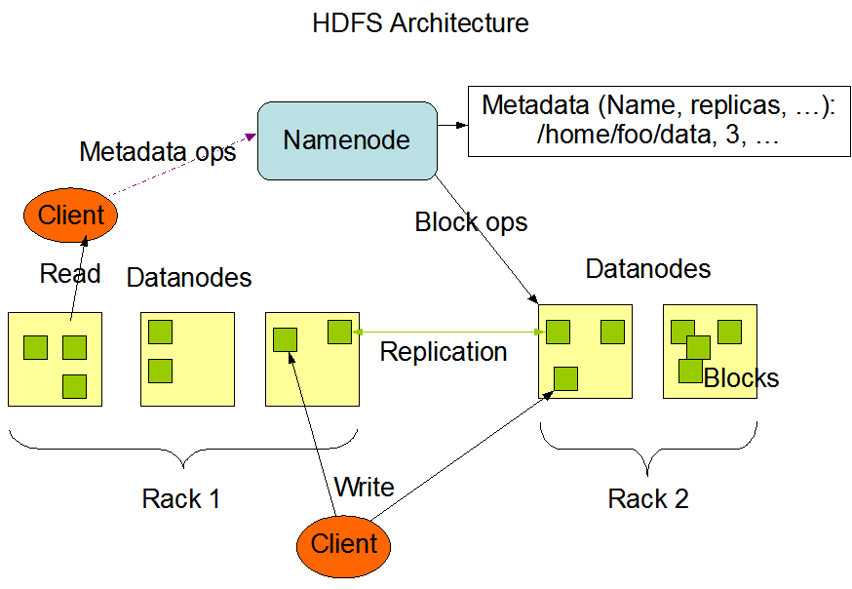
HDFS

Slide 11
Introduction to MapReduce Programs
The programmer *only* needs to construct Map and Reduce functions. The system takes care of optimizing map and reduce phases by parallelizing on the hardware.
Hadoop replicates the map/reduce functions over multiple nodes and automatically give each line of a file as input
No need to open streams or deal with file management
Mappers have a startup time of ~20 sec , thus need to do something substantial over a large set of files
Hadoop automatically tries to optimize data locality as Mappers tend to work close to the data they need access to

Slide 12
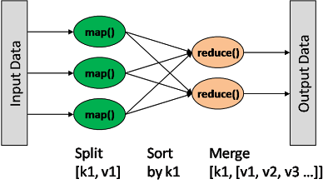
Introduction to MapReduce Programs
CORE LOGIC
Each Mapper takes as input a <key, value> pair and produces an intermediate <key, value> pair which is passed to a Reducer.
In the same way, each Reducer takes as input the <key, value> pairs with the same key and produces the set of final <key, value> pairs for the output.

Slide 13
The WordCount Example
This example refers to as the “Hello World” of Hadoop MapReduce.
Our goal:
To count the number of occurrences for each word on a large text file.
Idea:
Each mapper splits the input line into words.
Then, the mapper emits an instance of <wordX, 1> for each word.
The reducer takes all the <wordX,1> pairs and sums them.

Slide 14
The WordCount Example
TEXT FILE:
Line1: We attend the amazing Line2: amazing presentation at Line3: the AWG meeting.
Mapper 1
Mapper 2
Mapper 3
We attend the amazing
amazing presentation at
the AWG meeting.
R1
R2
R3
R4
R5
R6
R7
R8
FINAL RESULT:
We,1
attend,1
the, 1
amazing,1
presentation,1
at,1
AWG,1
meeting,1
the,2
amazing,2
the, 1
amazing,1

Slide 15
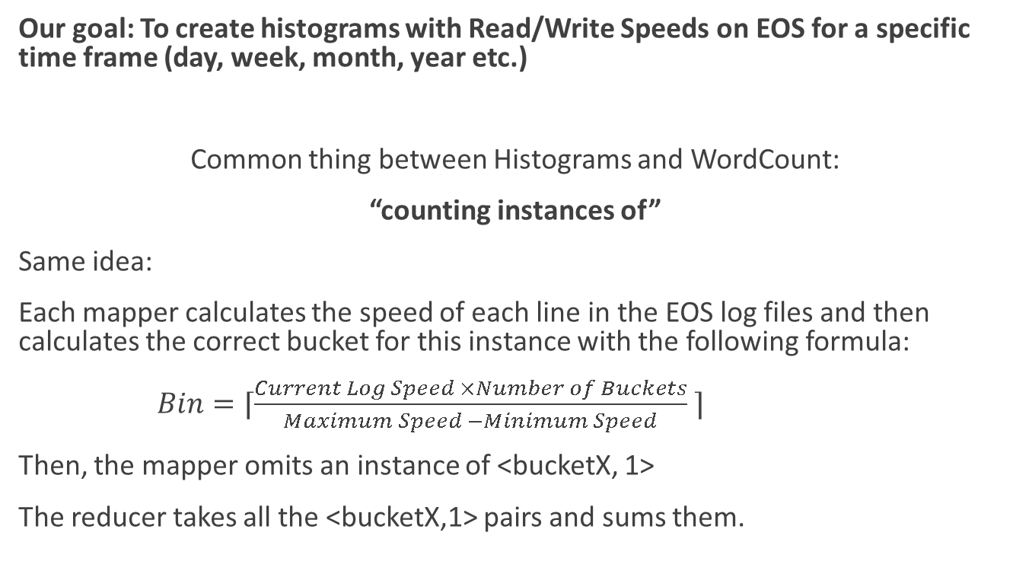
From WordCount to EOS Access Speed Analysis
Our goal: To create histograms with Read/Write Speeds on EOS for a specific time frame (day, week, month, year etc.)
Common thing between Histograms and WordCount:
“counting instances of”
Same idea:
Each mapper calculates the speed of each line in the EOS log files and then calculates the correct bucket for this instance with the following formula:
$Bin=⌈\frac{Current Log Speed ×Number of Buckets}{Maximum Speed −Minimum Speed} ⌉$
Then, the mapper omits an instance of <bucketX, 1>
The reducer takes all the <bucketX,1> pairs and sums them.

Slide 16
Basic Source Code of EOS Access Speed Analysis
public class Mapping extends Mapper<Object, Text, IntWritable, IntWritable>{
  public void map(Object key, Text value, Context context){
  //calculate bin
  context.write(bin, ONE);
  //
  }
}
public class Reducing extends Reducer< IntWritable, IntWritable, IntWritable, IntWritable>{
  public void reduce(IntWritable bin, Iterable<IntWritable> values, Context context){
  //sum up all bin instances
  context.write(bin, sum);
  }
}

Slide 17
Extraction script from awgrepo
We used the awgrepo script in order to extract the data needed for our use case.
We needed:
Time Related Entries (ots, otms, cts, ctms)
Bytes Read/Written (rb, wb)
Thus we used the following query:
./awgrepo.py -e eos-atlas -o atlas-20141201 -p "2014 dec 01" -q "ots,otms,cts,ctms,rb,wb"

Slide 18
Running
EOS Access Speed Analysis
Step-by-step details on how to compile a MapReduce program and produce the final jar can be found on this link.
The full source code of this example can be found on this link.
After transferring the jar in the cluster, it can be executed with the following command:
$ hadoop jar example.jar inputpath outputpath
$ hadoop jar histogram.jar /user/evmotesn/projection_project-awg-eos-processed-atlas-2014-12 output-001

Slide 19
Results on EOS Atlas Logs
Bucket | Day (01-12-2014) | Month (12-2014) | Year (2014)
0.0-0.2 | 1530368 | 48484569 | 2314606522
0.2-0.4 | 2580 | 86860 | 1014547
0.4-0.6 | 13 | 3999 | 25152
0.6-0.8 | 11 | 1756 | 12228
0.8-1.0 | 2 | 467 | 2414
1.0-1.2 | 1 | 37 | 698
1.2-1.4 | 0 | 4 | 95
1.4-.1.6 | 0 | 0 | 5

Slide 20
Histograms
logs
bins

Slide 21
Running Times and Memory Consumption
 | Day (01-12-2014) | Month (12-2014) | Year (2014)
Initial Raw Size | 1007.2MB | 30GB | 1.4TB
Initial Processed Size | 503.3MB | 14.1GB | 644.6GB
Reduced Size | 59MB | 1.8GB | 87.5GB
Awgrepo Running Time | 41s | 4m26s | 38m10s
Histogram Running Time | 39s | 1m58s | 18m38s
Total Time | 1m20s | 6m24s | 56m48s

Slide 22
Overview
  Extraction script updates
      Twiki
      logging
      experiment dashboard
  Hadoop example
      Hadoop Architecture
      MapReduce Logic
      WordCount
      EOS Speed Histograms
      Results
  Spark example

Slide 23
Spark introduction
Spark is a cluster computing platform, designed to be fast and general purpose, that extends the Hadoop MapReduce model, with an in-memory computation approach.
The Spark project contains multiple components, the most important two are
  the core: that defines two roles, the Driver, to manage (dispatching, scheduling) distributed tasks and the Worker, with basic I/O functionalities.
  RDDs: (Resilient Distributed Dataset) that are a logical collection of data partitioned across machines.
Programming in Spark is possible leveraging the RDD manipulation like a normal collection is manipulated during a local execution. Language integrated API are Java, Python and Scala.

Slide 24
Spark example – create jar
Goal: launch a Spark job on the cluster.
How: submitting a JAR using Spark tools. The JAR is built with Maven from a Eclipse project, written in Scala.
spark-submit SparkEosExample.jar args...
Detailed instructions of how to create a Spark project and to build a JAR can be found on the twiki at this link.
All details about the following example can be found here and the code of the object class here.

Slide 25
Spark example
Considering an EOS project and we want to list all files in a given period that have more than a certain amount of byte read.
From the EOS schema then we want to parse this two values:
path,ruid,rgid,td,host,fid,fsid,ots,otms,cts,ctms,rb,wb,sfwdb,sbwdb,sxlfwdb,sxlbwdb,nrc,nwc,nfwds,nbwds,nxlfwds,nxlbwds,rt,wt,osize,csize,sec.name,sec.host,sec.vorg,sec.grps,sec.role,sec.app
and sum for each "fid" all respective "rb"s.

Slide 26
Spark example – part 1
import org.apache.spark.SparkContext
import org.apache.spark.SparkContext._
import org.apache.spark.SparkConf
object SparkEosExample {
  def main(args: Array[String]) {
    // …
  }
}

Slide 27
Spark example – part 2
val conf = new SparkConf().setAppName("SparkEosExample")
val sc = new SparkContext(conf)
val path = args(0)
val output = args(1)
val limit = 10E10
val files = sc.textFile(path) // RDD[String]
val mappedRDD = files
.map(line => line.split(",")) // RDD[Array[String]]
.map(x =>(x(5),x(11).toDouble)) // RDD[(String,Double)]

Slide 28
Spark example – part 3
val mappedRDD = files
.map( line => line.split(",")) // RDD[Array[String]]
.map(x =>(x(5),x(11).toDouble)) // RDD[(String,Double)]
val filteredRDD = mappedRDD
// (String, Array[Double]) -> RDD[(String,Double)]
.reduceByKey((curr,next) => curr+next)
.filter(_._2 > limit) // RDD[(String,Double)]
filteredRDD.saveAsTextFile(output)

Slide 29
Spark example – result
After creating the project, build the jar with this command
mvn package
execute it
spark-submit SparkEosExample.jar /project/awg/eos/processed/cms/2015/01/*/* eos-sum-files-rb
and retrieve the result
hdfs fs –getmerge eos-sum-files-rb result
(59065022,1.27574311908E11)
(15562709,1.45614924261E11)
(167985733,2.570045808286E12)
...
Compare the Scala code with the Java code.

Slide 30
Analytics Working Group 2015

