Slide 1
FCAL silicon sensors at INP PAN Cracow
Current status
Our plans
Some remarks

Slide 2
Currently we have in our Lab:
Hamamatsu silicon sensors - 15 pcs;
Dummies of these sensors - 1 pcs;
Kapton fan outs - 2 pcs.

Slide 3
Our plans:
First of all we want to eliminate bonding between kapton fan out and sensor, what allows to make „sensor module” thinner. According to former plans, electrical connection should be established with conducting glue. That is why we want to serch for proper glue, proper automatic dispenser and proper diameter of contact holes in fan out.

Slide 4
2) In next step we will try to design and manufacture mechanical stage (holder) allowing easy alignment and gluing of PCB, sensor and fan out.
3) We also plan to participate in the frame of FCAL in designing and manufacturing of new kapton fan out.
4) We are also interested in conceptual design of new silicon sensor (edgeless one?), if so.

Slide 5
Some remarks:
We think that it is time to define our understanding of “sensor module”.
As the first approach we present sketches in two next slides.
In the opposite to “historical” concept presented
in last slide, we propose kapton fan out outstanding over sensor and not bowed,
because of the “valley” in PCB.

Slide 6
Place for fixing bolt
Electronics
Sensor
Sketch of sensor module

Slide 7
Sketch of module assembly
epoxy glue
wire bond
kapton fan out
conducting glue
sensor
PCB

Slide 8
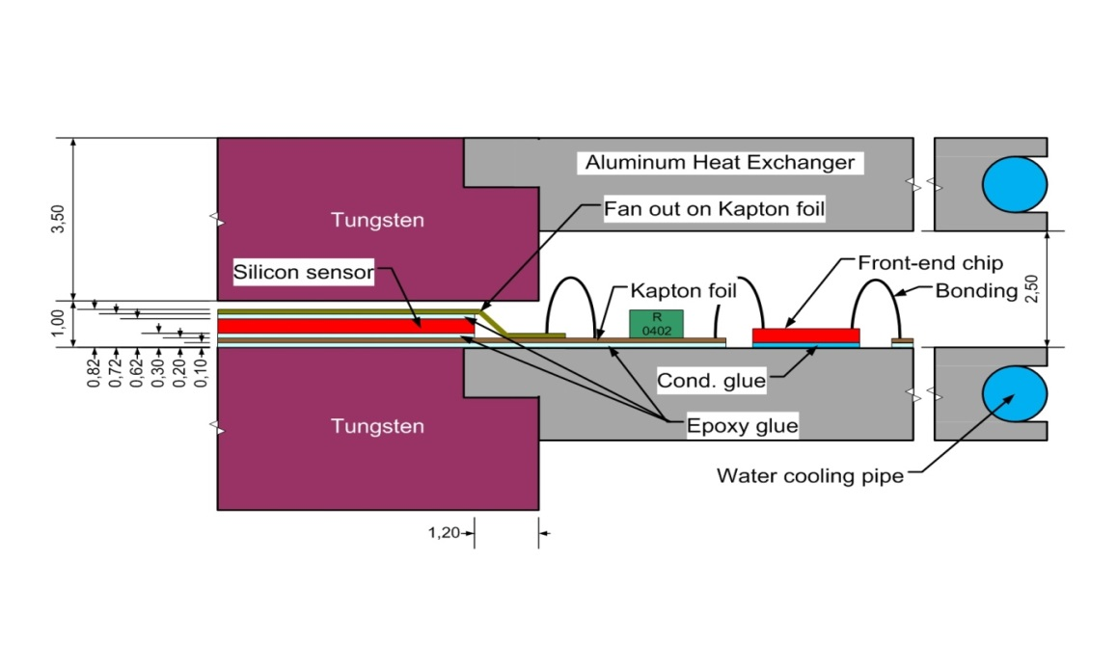
2010 year concept

