Slide 1
Field Mapping: Magnetic axis of FC2, SSU & SSD
Field Mapping, CM41
1/44
V. Blackmore
CM41
9th February, 2015

Slide 2
The problem
Field Mapping, CM41
2/44
Alignment
Geometric, magnetic and mapper axes

Slide 3





Magnet Alignment
Field Mapping, CM41
3/44
Survey point
Coil
Bellows
Reference particle

Slide 4


Co-ordinate systems
Field Mapping, CM41
4/44
Survey point
Coil
Mapper
Hall probe
Geometric axis
$$y_{g}$$
The co-ordinate system defined with respect to the survey points on the magnet exterior.
NB: Not the co-ordinate system of the MICE Hall…
$$z_{g}$$

Slide 5


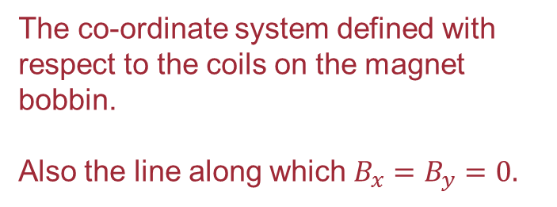
Co-ordinate systems
Field Mapping, CM41
5/44
Survey point
Coil
Mapper
Hall probe
Magnetic axis
$$y_{c}$$
The co-ordinate system defined with respect to the coils on the magnet bobbin.
Also the line along which $B_{x}=B_{y}=0.$
$$z_{c}$$

Slide 6


Co-ordinate systems
Field Mapping, CM41
6/44
Survey point
Coil
Mapper
Hall probe
Mapper axis
The co-ordinate system defined with respect to the centre of the measurement disc on the CERN field mapper.
$$y_{m}$$
$$z_{m}$$

Slide 7





Co-ordinate systems
Field Mapping, CM41
7/44
Survey point
Coil
Mapper
Hall probe
$$y_{g}$$
$$y_{c}$$
Measure the magnetic axis with the mapper
Transform from mapper to geometric co-ordinates
$$y_{m}$$
$$z_{c}$$
$$z_{g}$$
$$z_{m}$$
Sounds easy!
… right?

Slide 8
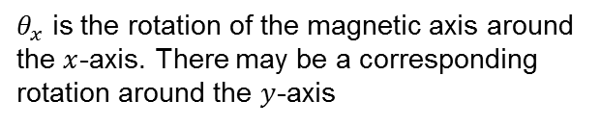




Co-ordinate systems
Field Mapping, CM41
8/44
Coil
Mapper
Hall probe
$$y_{c}$$
Catch: We measure the field components in the mapper system.
$B_{y,m}$=
$$z_{c}$$
$$z_{m}$$
$$θ_{x}$$
$$y_{m}$$
$θ_{x}$ is the rotation of the magnetic axis around the $x$-axis. There may be a corresponding rotation around the $y$-axis

Slide 9





Co-ordinate systems
Field Mapping, CM41
9/44
Coil
Mapper
Hall probe
$$y_{c}$$
Catch: We measure the field components in the mapper system.
$$B_{m,y}$$
$B_{y,m}$=
$$z_{c}$$
$$B_{y}$$
$$z_{m}$$
$$θ_{x}$$
$$B_{m,z}$$
$$θ_{x}$$
$$B_{z}$$
$$y_{m}$$
Notes:
SOH CAH TOA

Slide 10

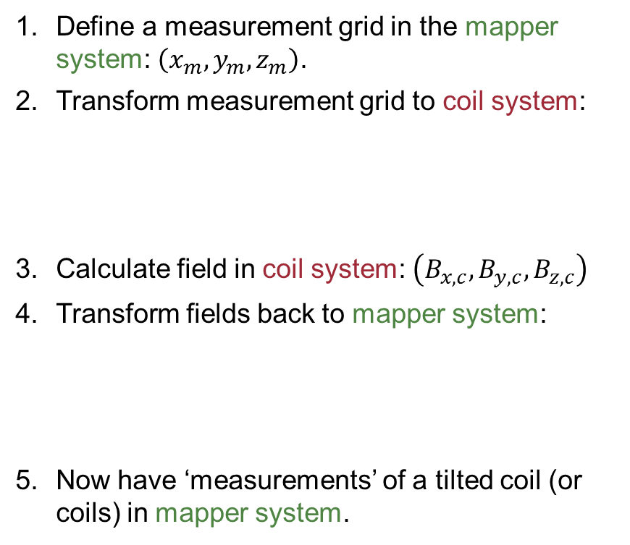

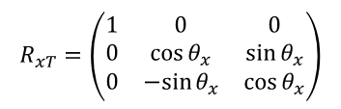
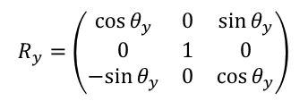
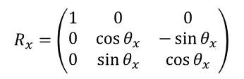
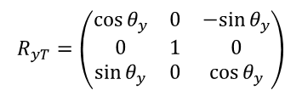
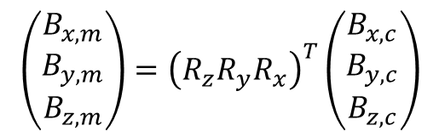

Test field maps*
Field Mapping, CM41
10/44
$$R_{x}=\left(\begin{matrix}1 & 0 & 0 \\ 0 & \cos{θ_{x}} & −\sin{θ_{x}} \\ 0 & \sin{θ_{x}} & \cos{θ_{x}}\end{matrix}\right)$$
Define a measurement grid in the mapper system: $\left(x_{m}, y_{m}, z_{m}\right)$.
Transform measurement grid to coil system:
Calculate field in coil system: $\left(B_{x,c}, B_{y,c}, B_{z,c}\right)$
Transform fields back to mapper system:
Now have ‘measurements’ of a tilted coil (or coils) in mapper system.
$$R_{xT}=\left(\begin{matrix}1 & 0 & 0 \\ 0 & \cos{θ_{x}} & \sin{θ_{x}} \\ 0 & −sin{θ_{x}} & \cos{θ_{x}}\end{matrix}\right)$$
$$\left(\begin{matrix}x_{c} \\ y_{c} \\ z_{c}\end{matrix}\right)=R_{z}R_{y}R_{x}\left(\begin{matrix}x_{m} \\ y_{m} \\ z_{m}\end{matrix}\right)$$
$$R_{y}=\left(\begin{matrix}\cos{θ_{y}} & 0 & \sin{θ_{y}} \\ 0 & 1 & 0 \\ −sin{θ_{y}} & 0 & \cos{θ_{y}}\end{matrix}\right)$$
$$R_{yT}=\left(\begin{matrix}\cos{θ_{y}} & 0 & −sin{θ_{y}} \\ 0 & 1 & 0 \\ \sin{θ_{y}} & 0 & \cos{θ_{y}}\end{matrix}\right)$$
$$\left(\begin{matrix}B_{x,m} \\ B_{y,m} \\ B_{z,m}\end{matrix}\right)={\left(R_{z}R_{y}R_{x}\right)}^{T}\left(\begin{matrix}B_{x,c} \\ B_{y,c} \\ B_{z,c}\end{matrix}\right)$$
$$R_{z}=\left(\begin{matrix}\cos{θ_{z}} & −sin{θ_{z}} & 0 \\ \sin{θ_{z}} & \cos{θ_{z}} & 0 \\ 0 & 0 & 1\end{matrix}\right)$$
$$R_{zT}=\left(\begin{matrix}\cos{θ_{z}} & \sin{θ_{z}} & 0 \\ −sin{θ_{z}} & \cos{θ_{z}} & 0 \\ 0 & 0 & 1\end{matrix}\right)$$
* Here just look at rotations, offset in $(x, y, z)$ would be a constant shift.
Notes:
SOH CAH TOA

Slide 11
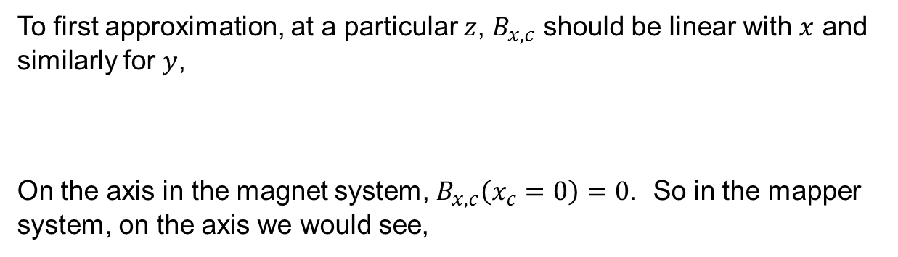
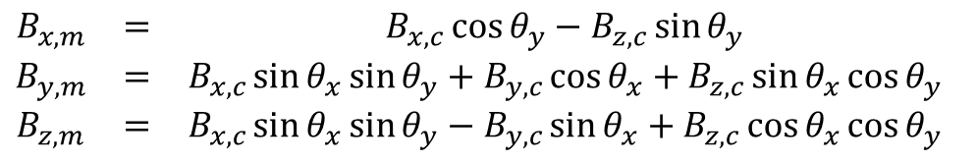
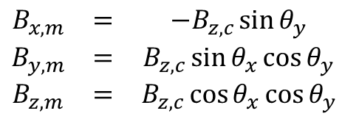


Test field maps
Field Mapping, CM41
11/44
$$\begin{matrix}B_{x,m} & = & B_{x,c}\cos{θ_{y}}−B_{z,c}\sin{θ_{y}} \\ B_{y,m} & = & B_{x,c}\sin{θ_{x}}\sin{θ_{y}}+B_{y,c}\cos{θ_{x}}+B_{z,c}\sin{θ_{x}\cos{θ_{y}}} \\ B_{z,m} & = & B_{x,c}\sin{θ_{x}}\sin{θ_{y}}−B_{y,c}\sin{θ_{x}}+B_{z,c}\cos{θ_{x}}\cos{θ_{y}}\end{matrix}$$
To first approximation, at a particular $z$, $B_{x,c}$ should be linear with $x$ and similarly for $y$,
On the axis in the magnet system, $B_{x,c}\left(x_{c}=0\right)=0$. So in the mapper system, on the axis we would see,
If we were offset from the axis, $C$ would represent that offset. In the perfectly aligned magnet system, $C=0$.
$$B_{x,c}=m_{x}x_{c}+C$$
$$\begin{matrix}B_{x,m} & = & −B_{z,c}\sin{θ_{y}} \\ B_{y,m} & = & B_{z,c}\sin{θ_{x}\cos{θ_{y}}} \\ B_{z,m} & = & B_{z,c}\cos{θ_{x}}\cos{θ_{y}}\end{matrix}$$

Slide 12
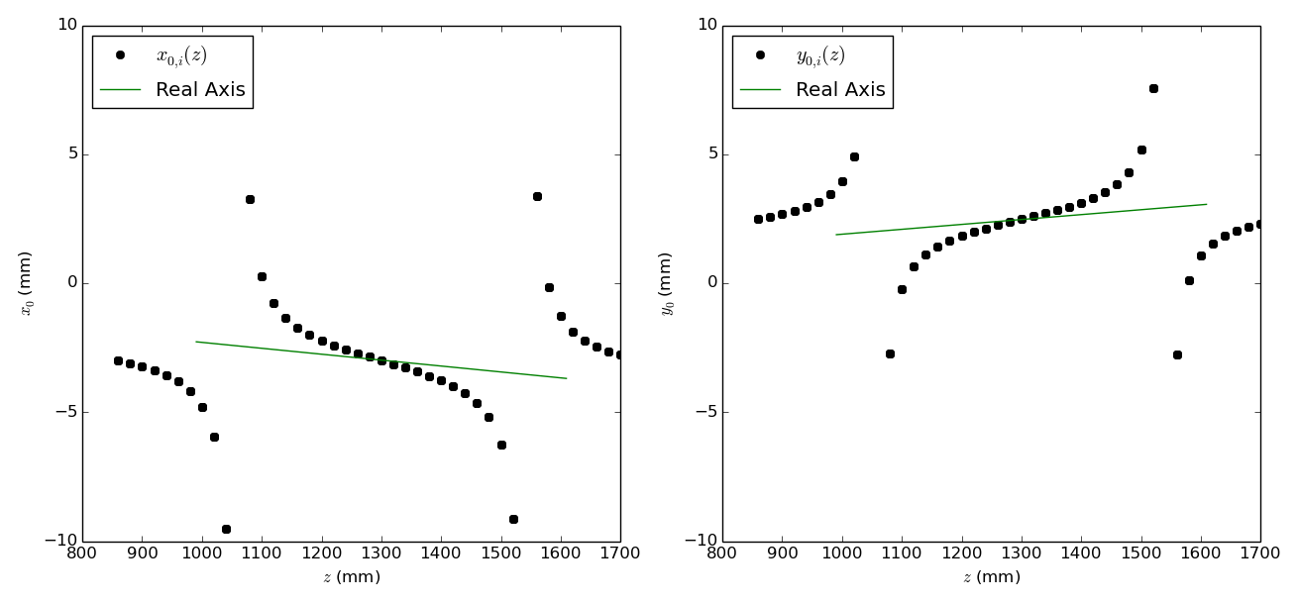



Test Magnet: “FC-like”
Field Mapping, CM41
12/44
Anyone who remembers this talk at CM40 might recognise this “feature”!
Assume that there is no rotation and that the mapper and magnetic axes are aligned.
  At each $z$, fit $B_{x,c}=m_{x}x_{c}+C$
  Then $x_{0,m}=−\frac{C}{m_{x}}$ is the position of the axis at that $z$. (Similar for $y$)
Know the real position of the magnetic axis for this test case.
$$B_{x,m}≠B_{x,c}$$
Pulled away from true axis by $B_{x,c}$ and $B_{z,c}$ contributions

Slide 13
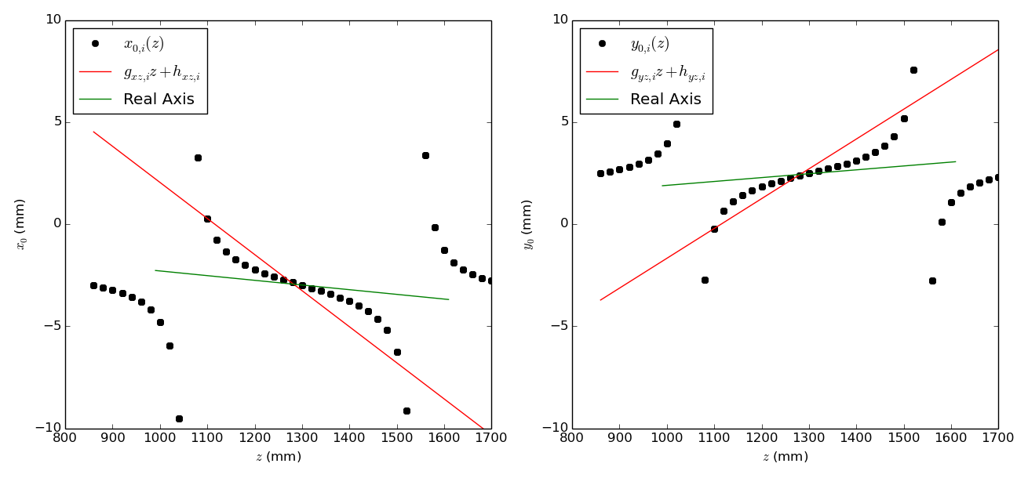

Test Magnet: “FC-like”
Field Mapping, CM41
13/44
Assume that there is no rotation and that the mapper and magnetic axes are aligned.
  At each $z$, fit $B_{x,c}=m_{x}x_{c}+C$
  Then $x_{0,m}=−\frac{C}{m_{x}}$ is the position of the axis at that $z$. (Similar for $y$)
Best fit line $≠$ real axis

Slide 14
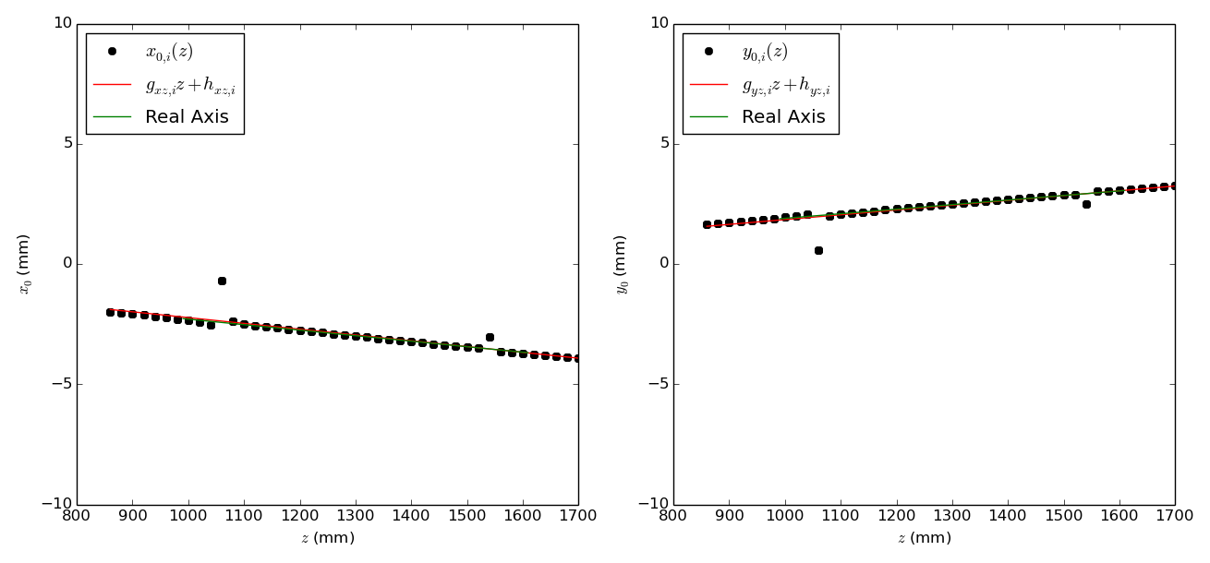

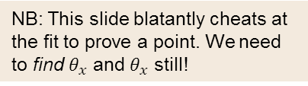
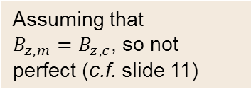
Test Magnet: “FC-like”
Field Mapping, CM41
14/44
NB: This slide blatantly cheats at the fit to prove a point. We need to find $θ_{x}$ and $θ_{x}$ still!
$B_{z}$ is large, so axis tilts gain a non-negligible contribution
  Fit again, but with true $θ_{x}$ and $θ_{y}$:
$$B_{x,m}=B_{x,c}\cos{θ_{y}}−B_{z,c}\sin{θ_{y}}=\left(m_{x}+C\right)\cos{θ_{y}}−B_{z,c}\sin{θ_{y}}$$
Can’t ignore this
Assuming that $B_{z,m}=B_{z,c}$, so not perfect (c.f. slide 11)

Slide 15
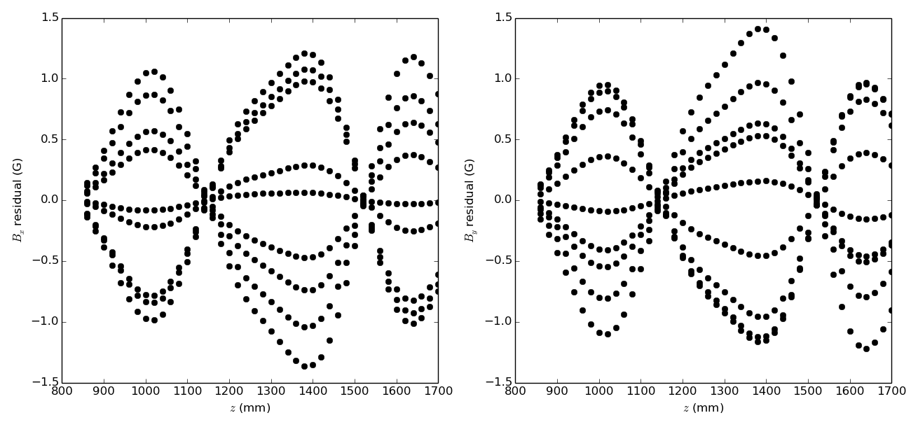

Test Magnet: “FC-like”
Field Mapping, CM41
15/44
NB: This slide blatantly cheats at the fit to prove a point. We need to find $θ_{x}$ and $θ_{x}$ still!
Using fitted values of $m_{x},C,θ_{x},θ_{y}$, estimate $\left\langle B_{x,m}\right\rangle$ (and similarly for $y$) and plot the residual
  Getting$θ_{x}$ and $θ_{y}$ perfectly, still limited by knowledge of $B_{z,c}$ at the level of 1G ($\sim$ error on Hall probe)

Slide 16
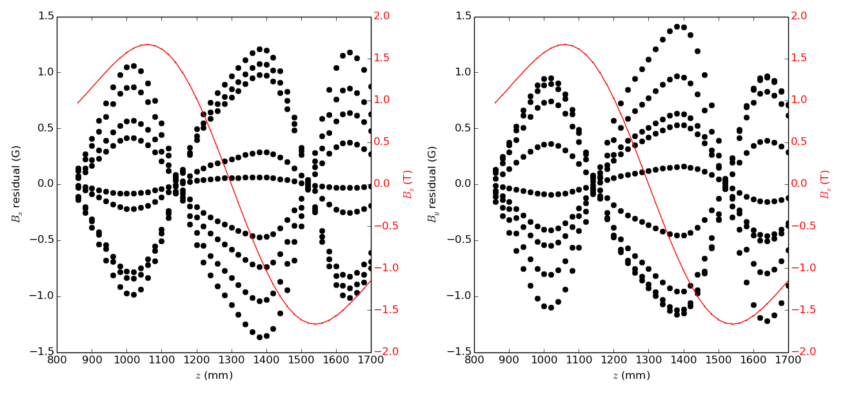

Test Magnet: “FC-like”
Field Mapping, CM41
16/44
NB: This slide blatantly cheats at the fit to prove a point. We need to find $θ_{x}$ and $θ_{x}$ still!
Using fitted values of $m_{x},C,θ_{x},θ_{y}$, estimate $\left\langle B_{x,m}\right\rangle$ (and similarly for $y$) and plot the residual
  Even if$θ_{x}$ and $θ_{y}$ are found perfectly, still limited by knowledge of $B_{z,c}$ at the level of 1G ($\sim$ error on Hall probe)

Slide 17
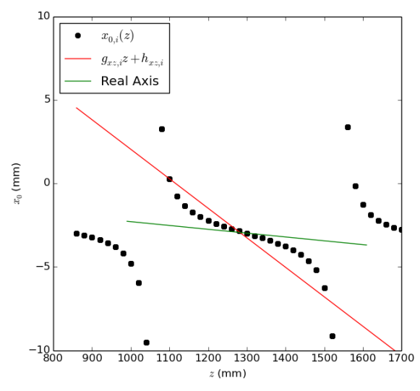
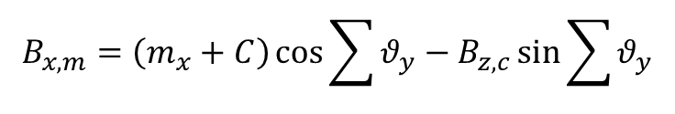

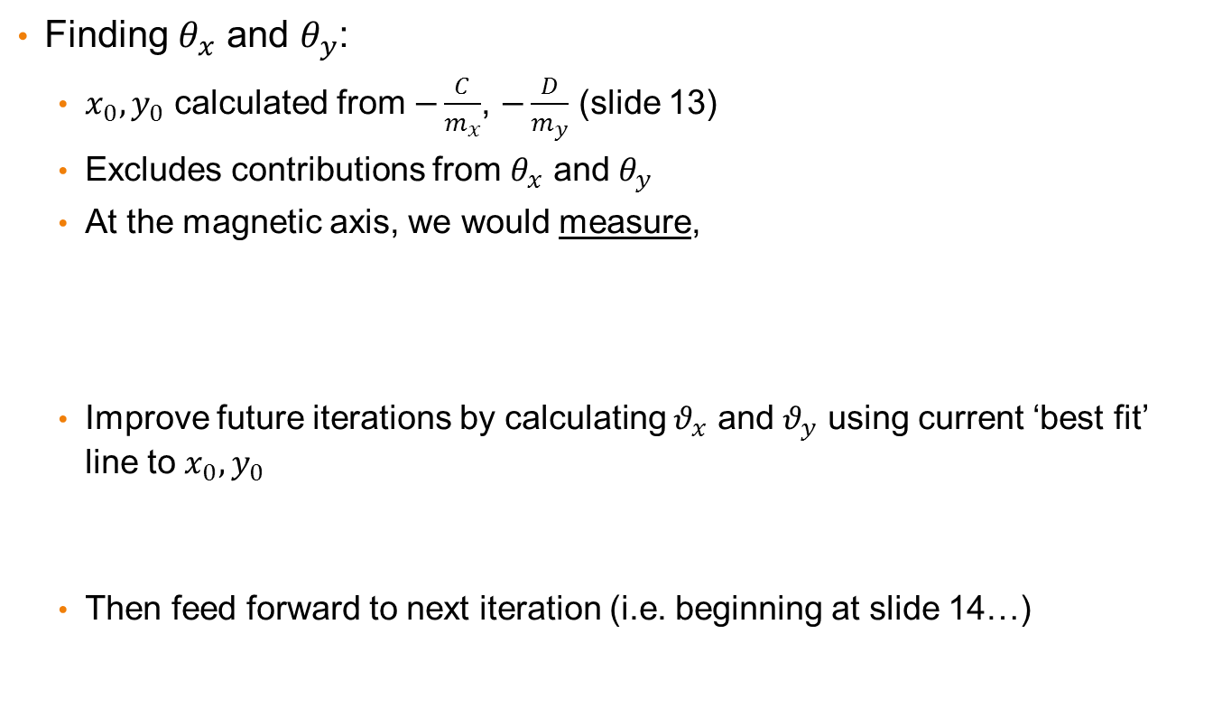



Test Magnet: “FC-like”
Field Mapping, CM41
17/44
Finding $θ_{x}$ and $θ_{y}$:
  $x_{0},y_{0}$ calculated from $−\frac{C}{m_{x}}$, $−\frac{D}{m_{y}}$ (slide 13)
  Excludes contributions from $θ_{x}$ and $θ_{y}$
  At the magnetic axis, we would measure,
  Improve future iterations by calculating $θ_{x}$ and $θ_{y}$ using current ‘best fit’ line to $x_{0},y_{0}$
  Then feed forward to next iteration (i.e. beginning at slide 14…)
$$B_{x,m}\left(x_{o}\right)=−\sin{θ_{y}}B_{z,c}$$
$$B_{y,m}\left(y_{o}\right)=+\sin{θ_{x}\cos{θ_{y}}}B_{z,c}$$
$$θ_{x}=\sum{θ_{x}}$$
$$θ_{y}=\sum{θ_{y}}$$
$$B_{x,m}=\left(m_{x}+C\right)\cos{\sum{θ_{y}}}−B_{z,c}\sin{\sum{θ_{y}}}$$

Slide 18
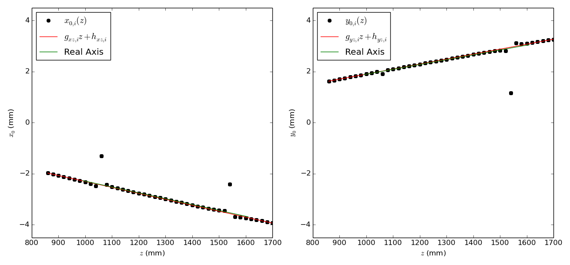






Test Magnet: “FC-like”
Field Mapping, CM41
18/44
No cheating this time – attempt to retrieve $θ_{x}$ and $θ_{y}$
$$x_{0}(z)=−0.00233z−2.972×{10}^{−5}$$
$$θ_{x}=0.1106°$$
$$θ_{x, true}=0.1088°$$
$$y_{0}(z)=0.00196z−5.815×{10}^{−5}$$
$$θ_{y}=0.1324°$$
$$θ_{y,true}=0.1316°$$

Slide 19

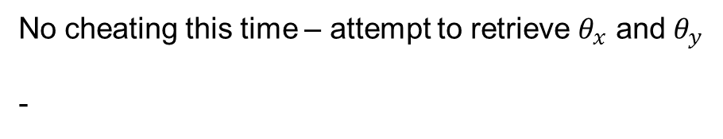
Field Mapping, CM41
19/44
Test Magnet: “FC-like”
No cheating this time – attempt to retrieve $θ_{x}$ and $θ_{y}$
-
$$x_{0}(z)=−0.00233z−2.972×{10}^{−5}$$
$$θ_{x}=0.1106°$$
$$θ_{x, true}=0.1088°$$
$$y_{0}(z)=0.00196z−5.815×{10}^{−5}$$
$$θ_{y}=0.1324°$$
$$θ_{y,true}=0.1316°$$

Slide 20
FC1
Field Mapping, CM41
20/44
Finding the axis of FC1
Run 3
100 A
Flip mode

Slide 21
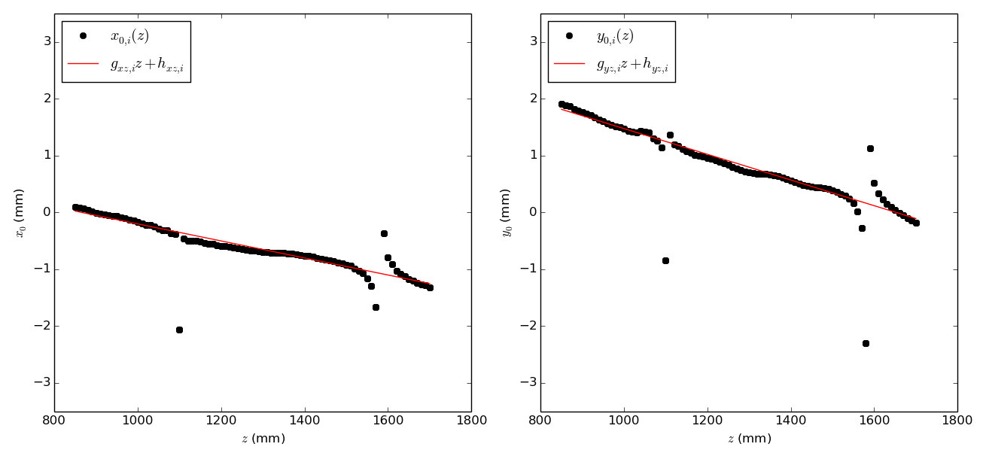
Try on FC1
Field Mapping, CM41
21/44
(Run 3, 100A, flip mode)
More ‘wiggly’ than model data

Slide 22
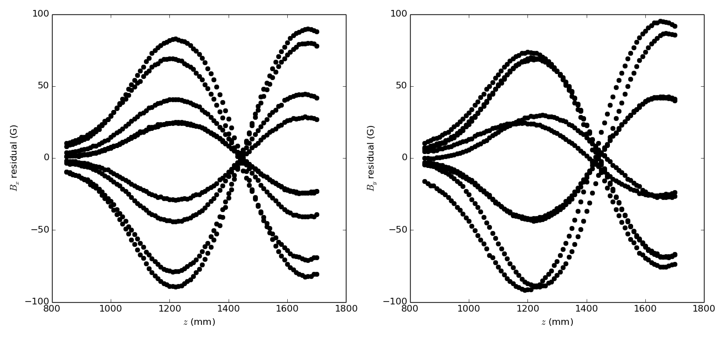
Try on FC1
Field Mapping, CM41
22/44
(Run 3, 100A, flip mode)
→ Residuals are much larger than expected – so what’s going on…

Slide 23
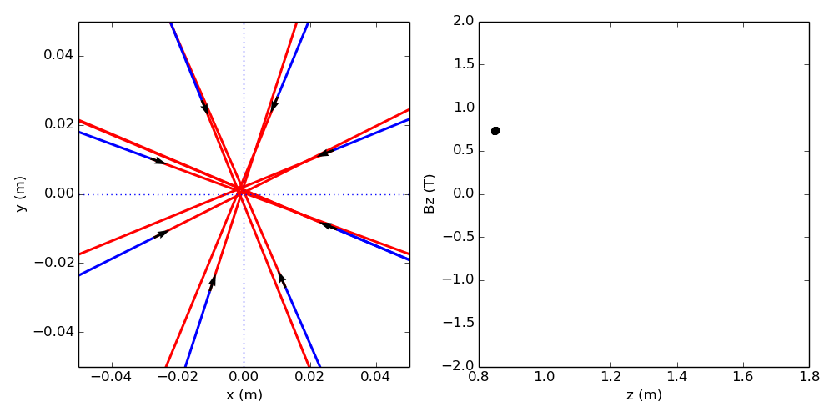


Transverse vector field
Field Mapping, CM41
23/44
A Maxwellian field’s vectors should all point to the axis
→ some systematic effect (possibly additionally tilted probes)
Field vector, $\vec{B_{t}}=\left(B_{x,m},B_{y,m}\right)$
Points along vector
Points behind vector
This plot indicates a $z$ position for reference.

Slide 24
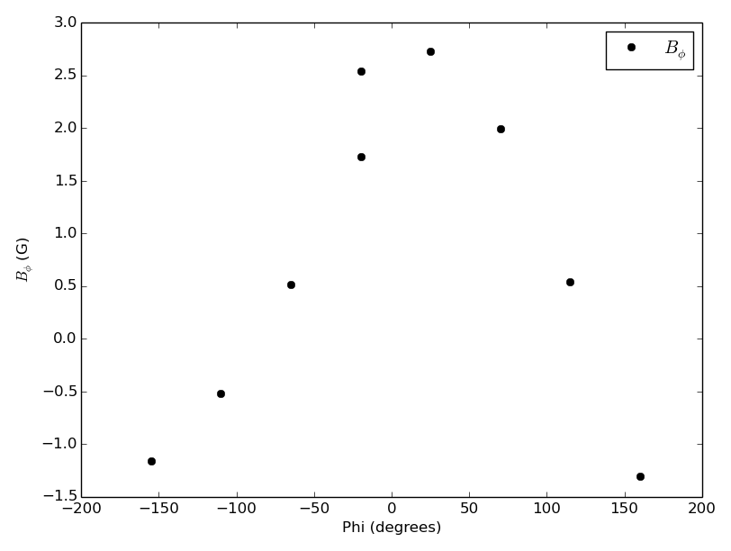
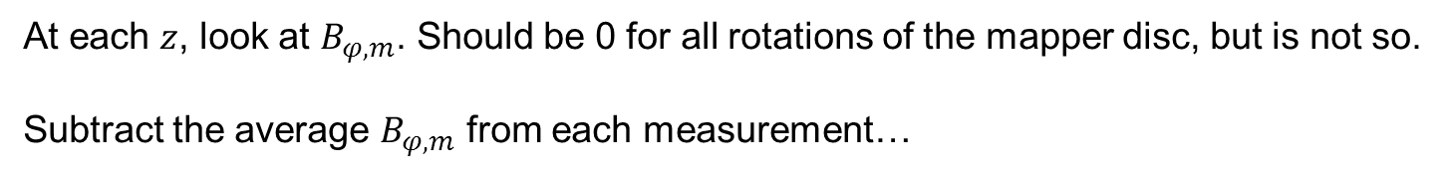
Correction?
Field Mapping, CM41
24/44
At each $z$, look at $B_{φ,m}$. Should be 0 for all rotations of the mapper disc, but is not so.
Subtract the average $B_{φ,m}$ from each measurement…

Slide 25
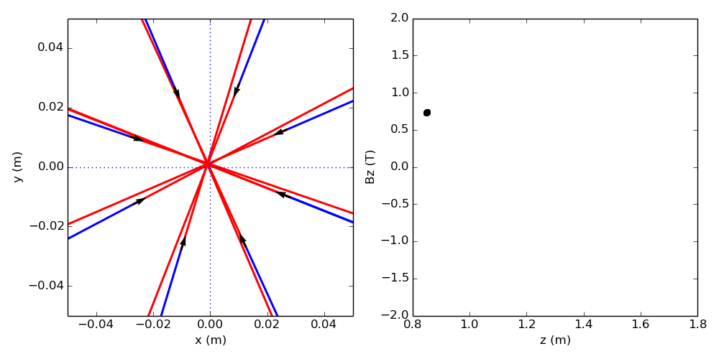
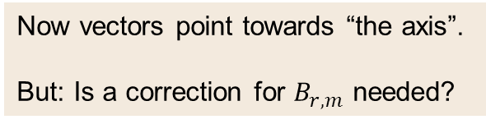
Transverse vector field
Field Mapping, CM41
25/44
Field vector, $\vec{B_{t}}=\left(B_{x,m},B_{y,m}\right)$
Now vectors point towards “the axis”.
But: Is a correction for $B_{r,m}$ needed?
Points along vector
Points behind vector
This plot indicates a $z$ position for reference.

Slide 26
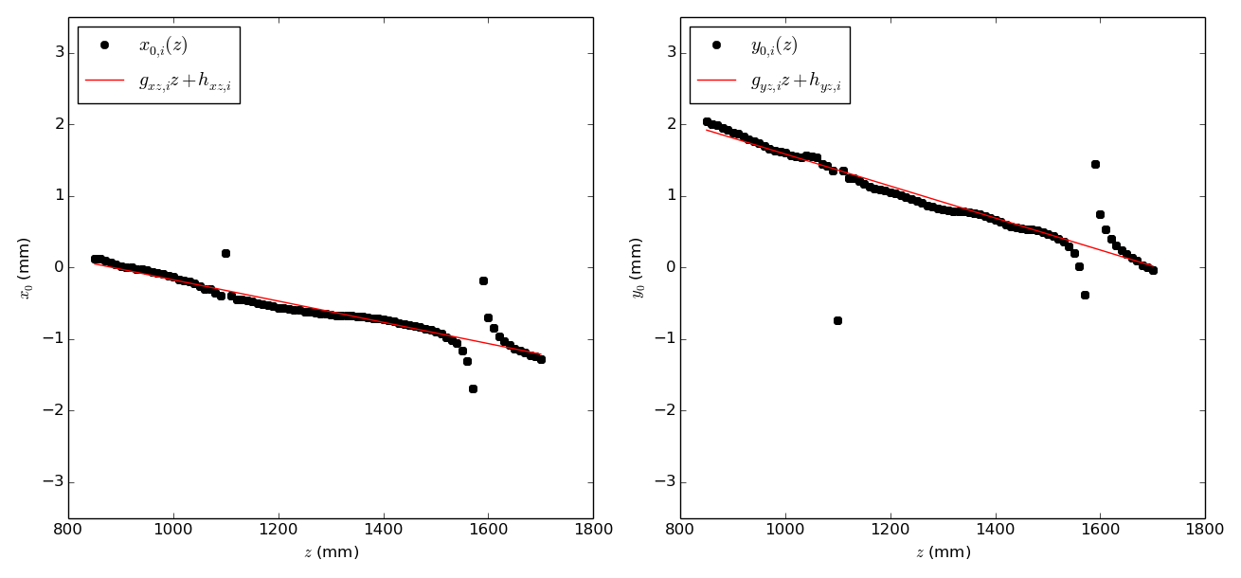
Try on FC1 (again)
Field Mapping, CM41
26/44
(Run 3, 100A, flip mode)
More ‘wiggly’ than model data

Slide 27
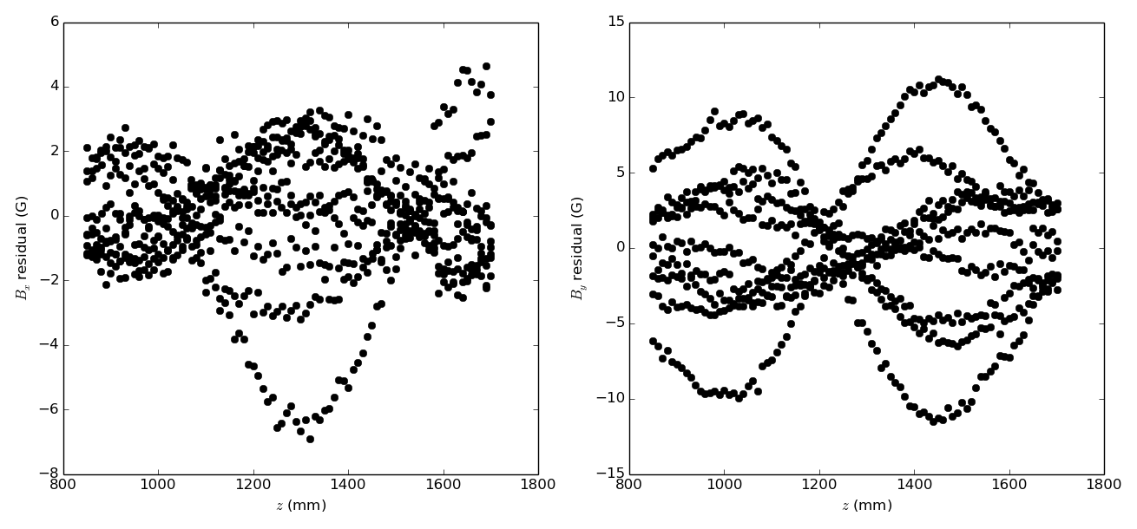
Try on FC1 (again)
Field Mapping, CM41
27/44
(Run 3, 100A, flip mode)
→ Better! Can compare axes with and without correction to get an idea of overall effect…

Slide 28
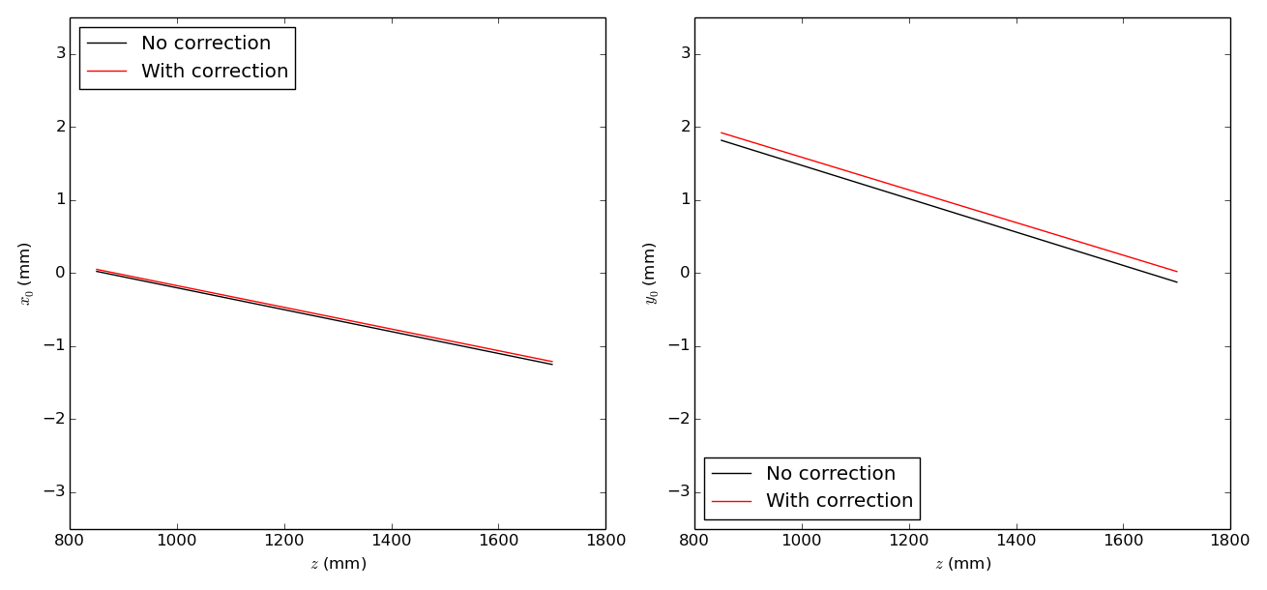
FC1
Field Mapping, CM41
28/44
Correction had largest effect on $y$-axis result, but still small.

Slide 29
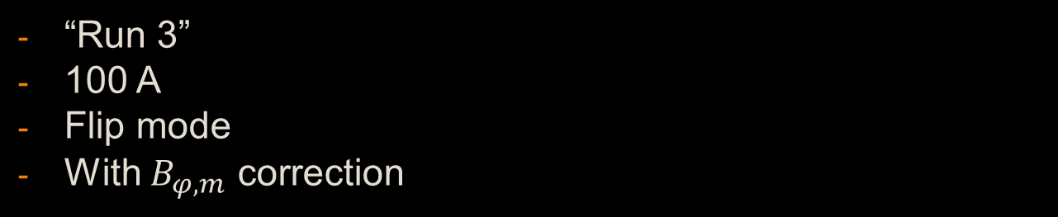
FC2
Field Mapping, CM41
29/44
“Run 3”
100 A
Flip mode
With $B_{φ,m}$ correction

Slide 30
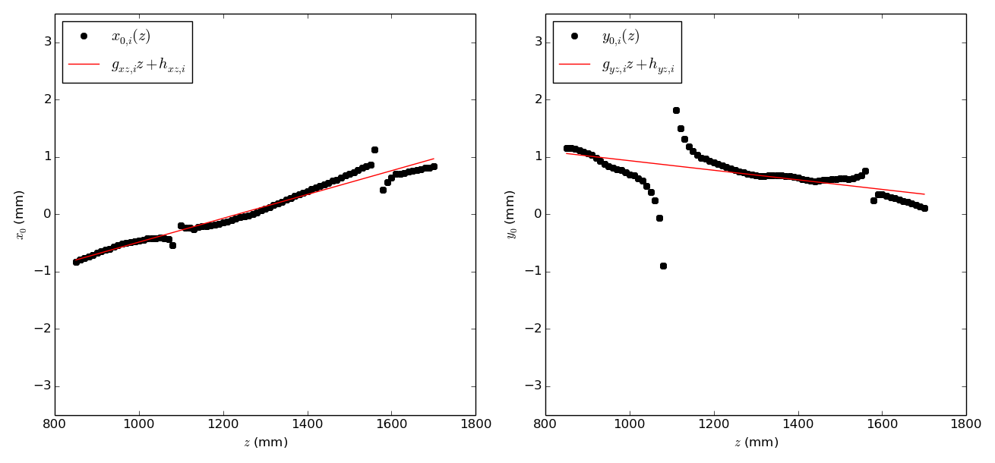
FC2
Field Mapping, CM41
30/44
Reminder: All lines are in the mapper co-ordinate system.
(Run 3, 100A, flip mode)
Has more ‘character’ than FC1

Slide 31
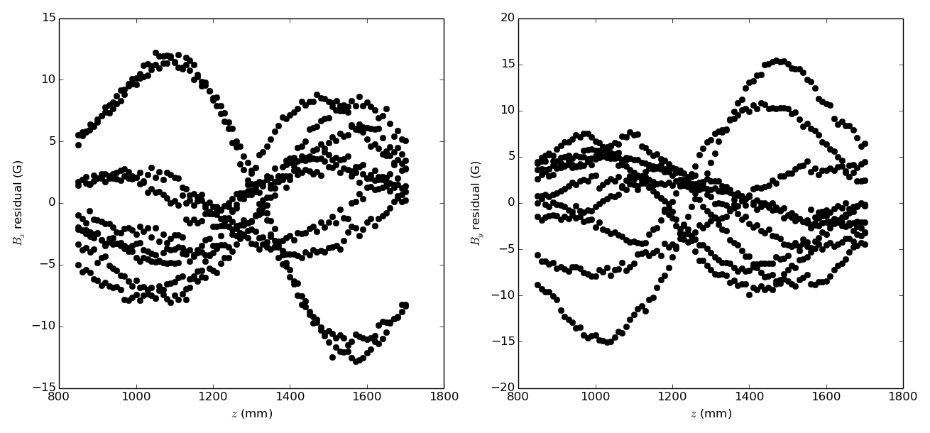
FC2
Field Mapping, CM41
31/44
(Run 3, 100A, flip mode)

Slide 32
Spectrometer Solenoids
Field Mapping, CM41
32/44
Ode to awkward magnets

Slide 33
The ‘SS’ Saga
Field Mapping, CM41
33/44
Q1: In the 4T ‘flat field’ region...
  Where is the axis of a uniform solenoid?
  Will exclude this region from fits
The mapper carriage is different for the SS mapping
  Longer (~5m, rather than 3)
  More flex and wobble
  More difficult to align to the bore before measurements begin (?)
Measurements taken slightly differently (a complete loop of the Hall probes is two “runs”
Survey of the mapper movement during measurements for FC1 & FC2 show ~0.1mm movement.
Much worse for SS’s… for example!

Slide 34
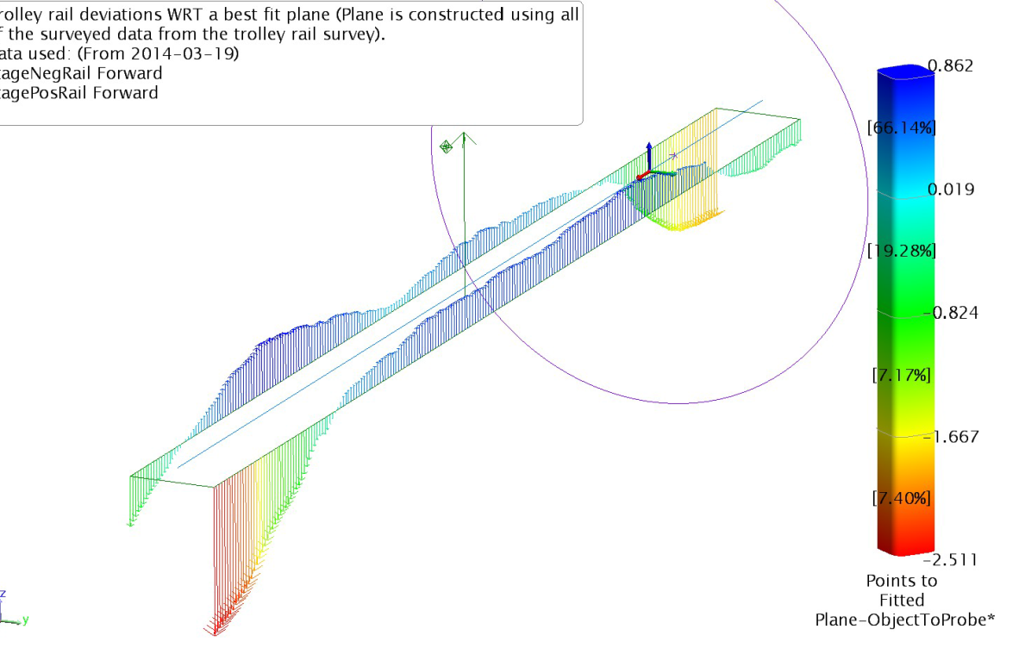
Beautiful survey plots from LBNL
Field Mapping, CM41
34/44
The mapper’s movement is fairly complex – still digesting!

Slide 35
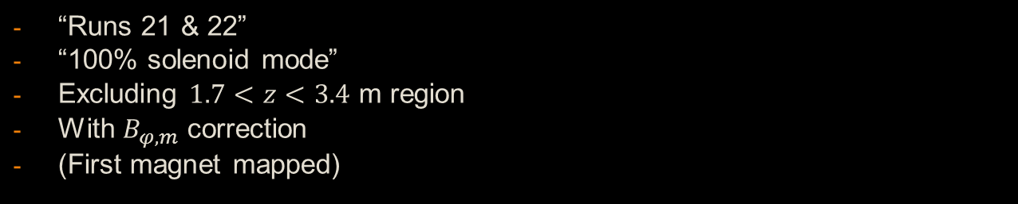
USS
Field Mapping, CM41
35/44
“Runs 21 & 22”
“100% solenoid mode”
Excluding $1.7<z<3.4$ m region
With $B_{φ,m}$ correction
(First magnet mapped)

Slide 36
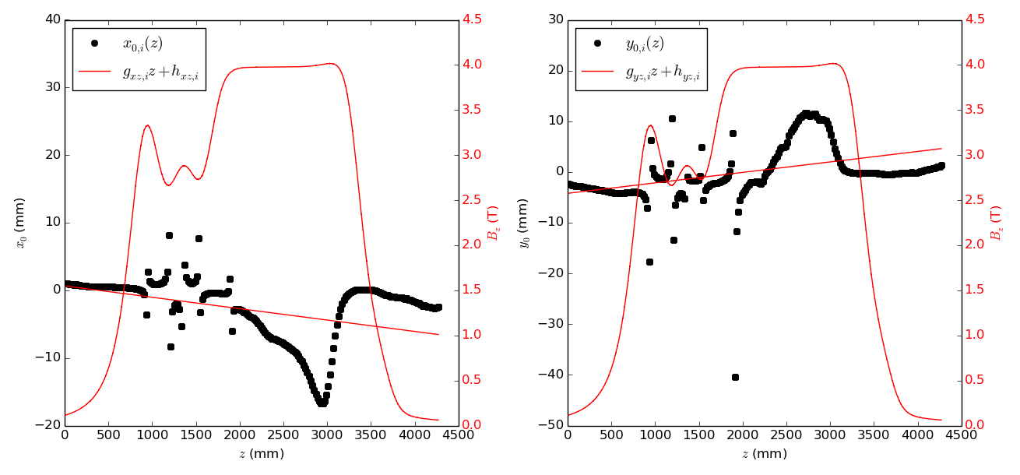

USS, fitting over full $z$-range
Field Mapping, CM41
36/44
Non-uniform, E2 needs turning down
(see DSS for ‘tweaked’ flat field) – Also see this in MAUS with ‘default’ currents.
Axis fit
Field

Slide 37
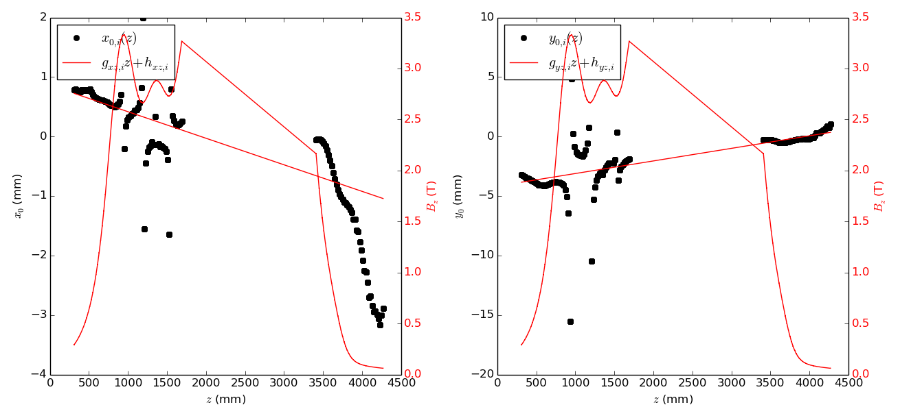

USS, excluding $1.7<z<3.4$ m region
Field Mapping, CM41
37/44
Scale change
Excluded field points here, this is a plotting artifact.
Axis fit
Field

Slide 38
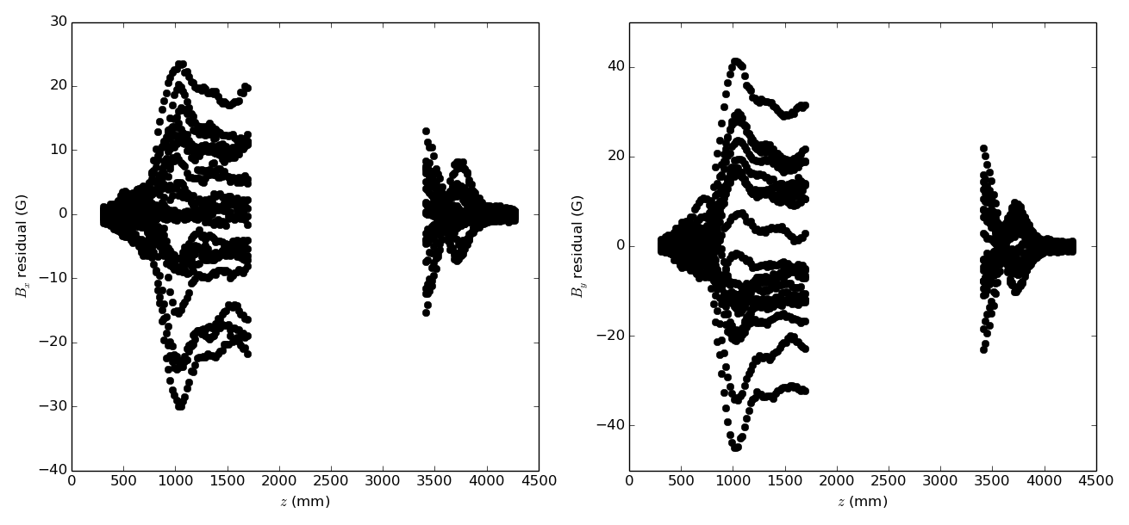
USS, excluding $1.7<z<3.4$ m region
Field Mapping, CM41
38/44
Larger residuals than for FC1 & FC2.
Still some oddities in transverse vector plots (see supporting material)
Excluded region
Excluded region

Slide 39
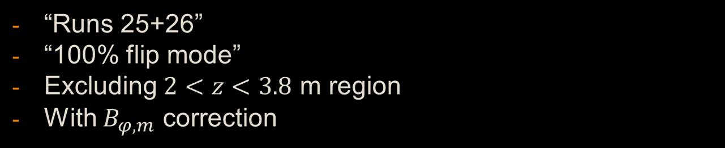
DSS
Field Mapping, CM41
39/44
“Runs 25+26”
“100% flip mode”
Excluding $2<z<3.8$ m region
With $B_{φ,m}$ correction

Slide 40
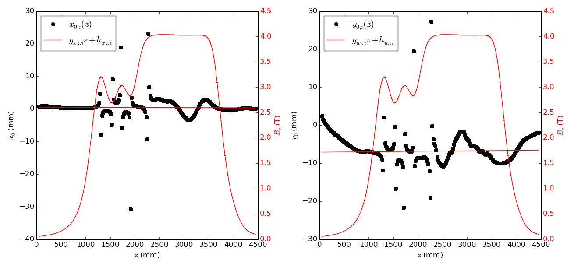

DSS, fitting over full $z$-range
Field Mapping, CM41
40/44
Much flatter with tweaked currents.
DSS has smaller ‘wiggle’ here than USS

Slide 41
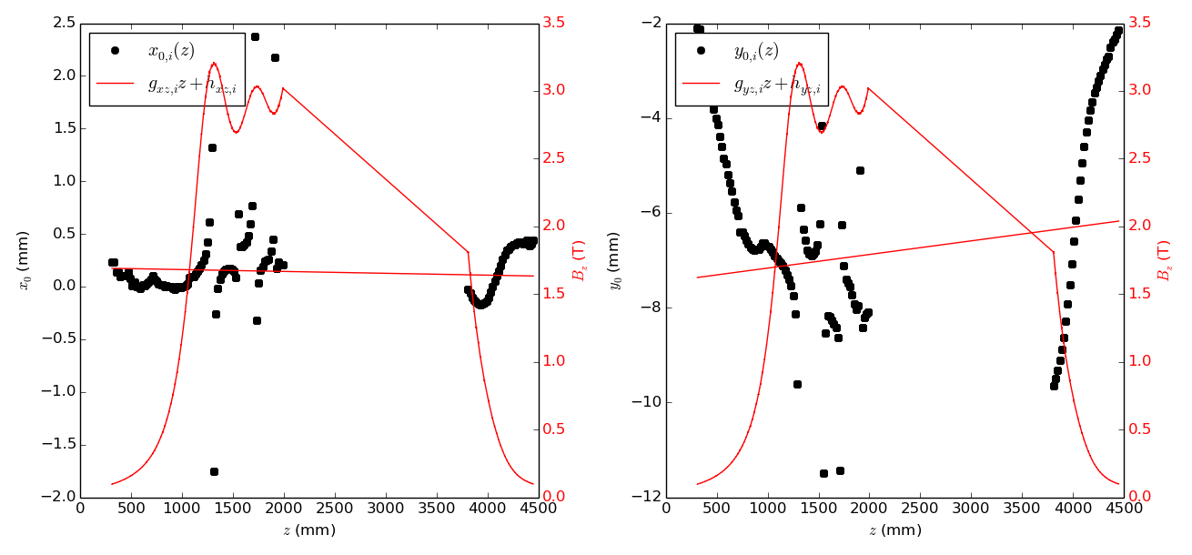

DSS, excluding $2<z<3.8$ m region
Field Mapping, CM41
41/44
Scale change

Slide 42

DSS, excluding $2<z<3.8$ m region
Field Mapping, CM41
42/44
Residuals on par with FC2 (still worse than FC1)
Excluded region
Excluded region
Still more to learn (and still need error bars)

Slide 43

“Results”
Field Mapping, CM41
43/44
Equations describing current (Feb 2015) best fit to magnetic axis in mapper co-ordinate system (units are m!)
FC1
$$x$$ | $$−0.001485z+0.001312$$
$$y$$ | $$−0.002235z+0.00383$$
FC2
$$x$$ | $$0.002076z−0.002563$$
$$y$$ | $$−0.000835z+0.001769$$
DSS (Excluding $2<z<3.8$ m region)
$$x$$ | $$−1.7656×{10}^{−5}z+0.000179$$
$$y$$ | $$0.000287z−0.007454$$
USS (Excluding $1.7<z<3.4$ m region)
$$x$$ | $$−0.000446z+0.000863$$
$$y$$ | $$0.001057z−0.004170$$

Slide 44

To do:
Field Mapping, CM41
44/44
Investigate vector plots from SS’s more thoroughly
Correction to $B_{r,m}$ necessary?
  One Hall probe cube ‘contains’ 3 independent Hall sensors
Apply survey
  ‘Swingy’ travel through SS’s needs help!
Think really, really hard about the errors
… Then the remaining field map exercise!

