Slide 1
Introduction

Slide 2
Contents:
MICE rebaselined
Step IV:
  Progress snapshot
  Commissioning
  Operations
Publications
Public information and conference contributions
Organisation and outreach

Slide 3
MICE rebaselined
Introduction

Slide 4
Reprise: 1 slide from August DOE debrief:
VC 22Aug14

Slide 5
MICE:
ISIS
RAL
MICE

Slide 6
Cooling demonstration; performance:
Transmission
Cooling

Slide 7
Ionization cooling demonstration:
Rebaselined!
  A great success;
  My congratulations to all involved!
My view:
  We’ve reset the clock; our future is once again in our hands. That is:
    We can and must
      Deliver Step IV on schedule
      Measure the cooling properties of LH2 and LiH in a timely manner
        And publish!
    So that we can deliver the ionization-cooling demonstration that underpins muon accelerators for particle physics in 2017

Slide 8
Step IV: progress update
Introduction

Slide 9
Update:
MICE Hall:
  Floor plates etc. installed:
    Ready for delivery of PRY legs
  Rack Room 2:
    Spectrometer and focus-coil racks delivered from DL …
      … and installed
    Cabling and other preparation work now underway
PRY:
  First set of legs …
    On UK soil …
  Machining of magnetic-shielding plates underway:
    Parallelisation of manufacture to expedite completion
Services etc.:
  Many “small” items:
    Particular examples include:
      Flushing water for West Wall compressors; rerouting cables, …
S/w&C:
  Global-track reconstruction (and Pid) (CP, JK, MU):
    Broken ground! Initial results presented in parallel … important step on the way
  Data challenge and automatic processing (RB, JM, HN, et al):
    Critical component of ensuing high-quality data taking

Slide 10
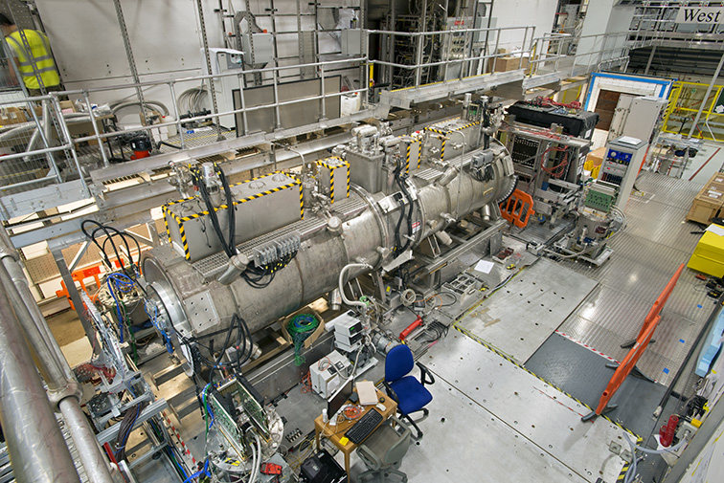
Step IV:
Commissioning
Introduction

Slide 11
Commissioning:
Mock data run: 21Jan15:
  Success!
    Much achieved;
    List of issues identified that need to be resolved
      Essential first step!
  Concerted effort!
    In preparation and in execution …
  More in CR’s MOM report
List of issues has been classified by operations team:
  Priority (following PMH, present MOM):
    Required for Step IV; Important for Step IV; …
    Degree of coordination with:
      Construction team;
      Other detector/magnet systems
Future success rests on careful planning:
  To inject maintenance/operations “jobs” into construction teams plan:
    Experiment Integration Scientist (P. Hanlet)
    Beamline Integration Scientist (J. Pasternak)
    Project Engineer (A. Nichols)
    Operations Engineer (C. Macwaters)
    Or, S. Boyd, R. Preece, or KL
Please be part of the solution:
  Plan your work early and send in the request …
    … minimise your stress by passing on your requirements before they become issues!

Slide 12
Commissioning continued:
08Mar15:
  Details from SB, but:
    Search/lock Hall on Friday or Saturday 06/07 Mar15
      Ready for data taking start on Sunday
  Two shifts for MICE in ISIS run-up:
    08:30 – 16:00 and 16:00 – 24:00
  Goal:
    Time in target and detectors as far as TOF1;
    Leave in state such that calibration of TOFs could begin:
      Implies full data chain, including batch processing on GRID within 24 hours
Weekend operation from 21Mar15:
  Again, details from SB, but:
    Construction team will be doing two shifts/day Monday to Friday;
      On Friday, construction work will end 14:00 …
    Hall available for operations team from 15:00 on Friday
      Friday afternoon available for shift training and preparation
      Lock and search Hall on Friday before end of working day to be ready for operation start Saturday
  Saturday/Sunday:
    Two shits per day: 08:00—16:00 and 16:00—24:00
Coordination:
  Fridays 11:00:
    In person Operations meeting (no phone connection):
      Personnel involved in weekends operations required participants
  Monday 15:00:
    Debrief/planning Operations meeting
    In person for those involved in weekend’s operations, phone connection to allow participation of system experts and those involved in the following weekend’s operations

Slide 13
Step IV:
Operations
Introduction

Slide 14
Operations:
Goals for the first two ISIS User Runs:
  User Run 2014(03); “now” to 01May15:
    MICE Muon Beam commissioning;
    TOF2, KL, EMR commissioning with beam;
    Alignment and calibration;
  User Run 2015(01a): 02Jun15 to 05Jul15;
    Tracker commissioning with beam in parallel to magnet training;
More detailed planning required:
  C. Rogers will organise a meeting in March to collect inputs to the detailed run plan
Much to do!

Slide 15
Preparation for for data taking:
Shifts:
  Data taking time reduced by a factor of two if we have to run 16/5 rather than 24/7
  Shift tool CHEESE released to Group Leaders (CB):
    Good take-up:
      We set ourselves the goal to decide on our mode of operation at CM41 (now!)
        “This is a hard deadline for a hard decision!”
      Shifter sign-up in CHEESE has been good:
        Await SB analysis; CB will need to take stock this evening

Slide 16
Papers:
Introduction

Slide 17
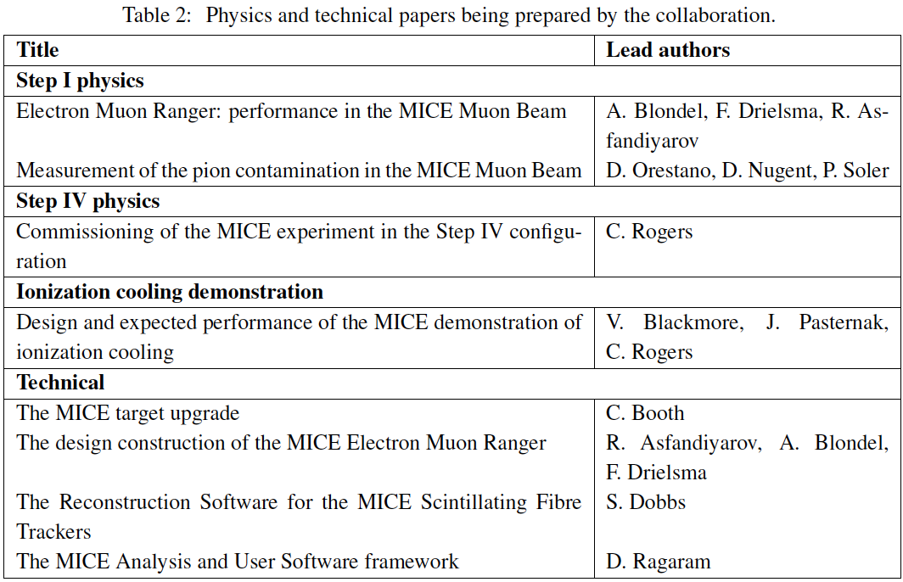
Papers:
Status at Jan15 VC in green: hope to move some of the papers
to the “final draft” stage this CM!
Progress/drafts will be presented at CM41
Work organised; focus on getting experiment off the ground
18Dec14; lattice freeze (milestone, complete)
(final tweaks now underway); JBL editor.
Draft being assembled.
Draft being assembled.
Updated draft to be presented at CM41
Draft being
assembled.

Slide 18
Public information and conference contributions
Introduction

Slide 19
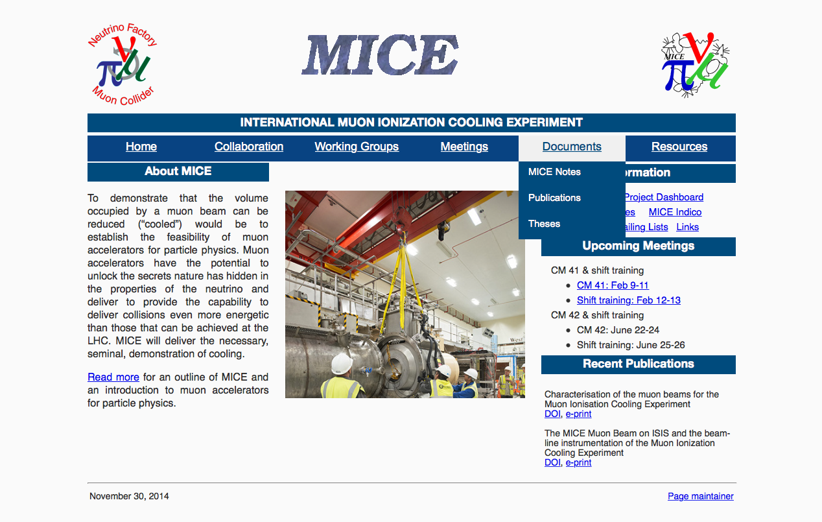
Add: public information;
e.g. Publications and public information

Slide 20
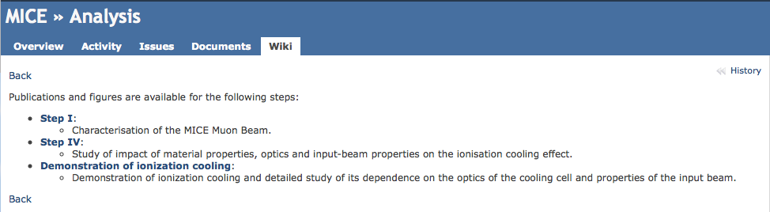
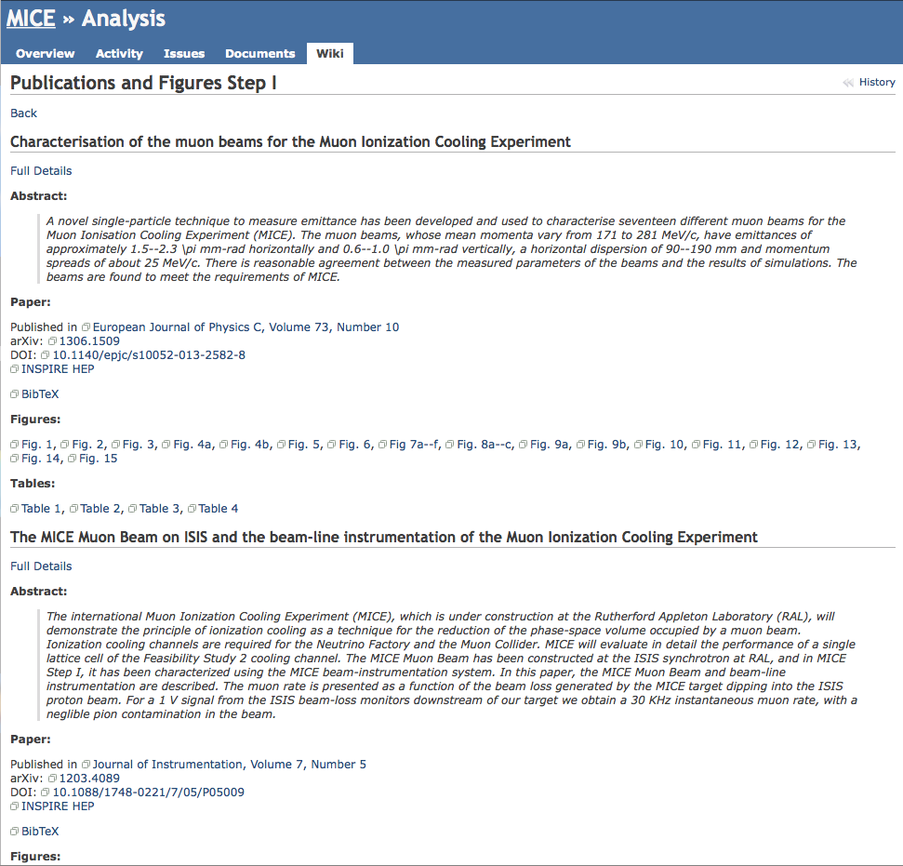
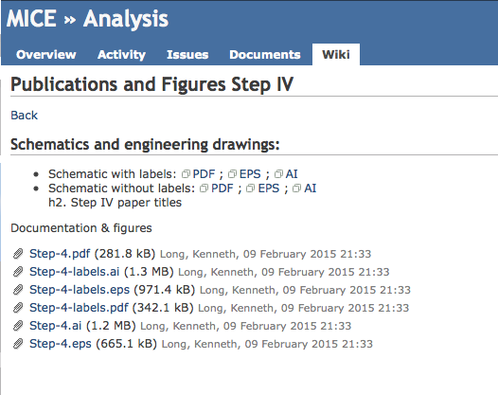
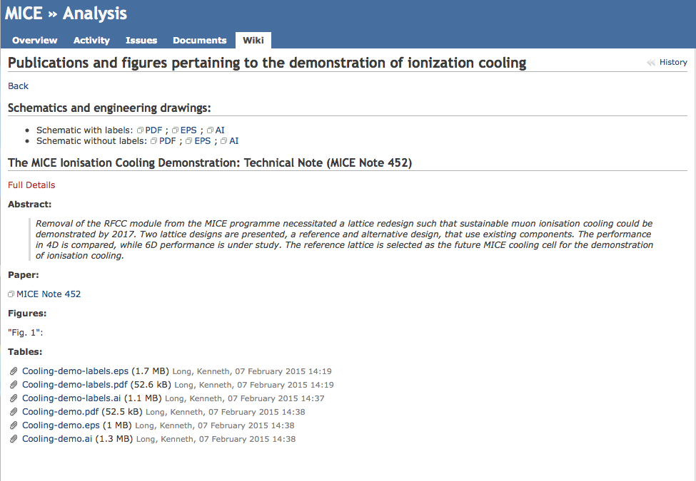

Slide 21
Public information:
In 6—9 months we will have the “crown jewels”:
  The data that we’ll be preparing for publication;
    So we need to remind ourselves of our rules
      [and make it easy to get the up-to-date public information]
Results, plots and figures must be presented to, and agreed by, collaboration:
  Our policy (agreed ages ago by CB) is that this is normally done at the CM:
    Exceptional cases by VC/email
Step I paper, cooling-demonstration configuration (and Step IV performance) speakers have all been asked to flag the information that the collaboration is asked to make public:
  When agreed, it will be prepared, reviewed and posted

Slide 22
Conference contributions:
CB has agreed a definition for a “MICE” contribution:
  Typically when you write “… on behalf of MICE”
Last summer and autumn we had:
  Last minute:
    Abstract submission, talk/poster and procedings preparation
      With insufficient time for collaboration to comment;
  We need to be more disciplined:
    In view of:
      The imminent arrival of Step IV data; and
      Our raised profile
So, the EB has agreed:
  MICE contributions (abstract, poster/talk and proceedings) must be circulated for comment two weeks before the conference deadlines

Slide 23
Organisation and outreach
Introduction

Slide 24
Version date: 26th October 2014; revision E
Software and computing
S/w & C coordinator
D. Rajaram (IIT)
Online Group Manager
P. Smith (Sheffield)
Offline Group Manager
A. Dobbs (Imperial)
Controls & monitoring
P. Hanlet (IIT)
Software Infrastructure
[Warwick post-doc from Jan15]

Slide 25
Version date: 9th February 2015; revision F
Software and computing
S/w & C coordinator
D. Rajaram (IIT)
Online Group Manager
Y. Kharadzhov (Geneva)
Offline Group Manager
A. Dobbs (Imperial)
Controls & monitoring
P. Hanlet (IIT)
Software Infrastructure
[Warwick post-doc from Jan15]

Slide 26
MICE in the ISIS User database:
“MICE User letter” agreed with STFC Feb15:
  “Signed off” by A. Taylor
Clears the way for MICE entry in ISIS User Database:
  Roll-out will begin in the near future
  All must register:
    Will hold:
      Usual personal details
      Records of Lab and MICE inductions etc.

Slide 27
Outreach:
From Paul Kyberd:
MICE group photo:
  On lawn outside R68 13:00:
    Be there!
Communication plan:
  Includes:
    Portraits of MICE members so that when contacts are made from outside interviewers know who they will meet:
      Photo sessions:
        Coffee break: 10:30 – 11:00 (KL will guide)
        Tea break: 15:30 – 16:00 (PK will guide)

Slide 28
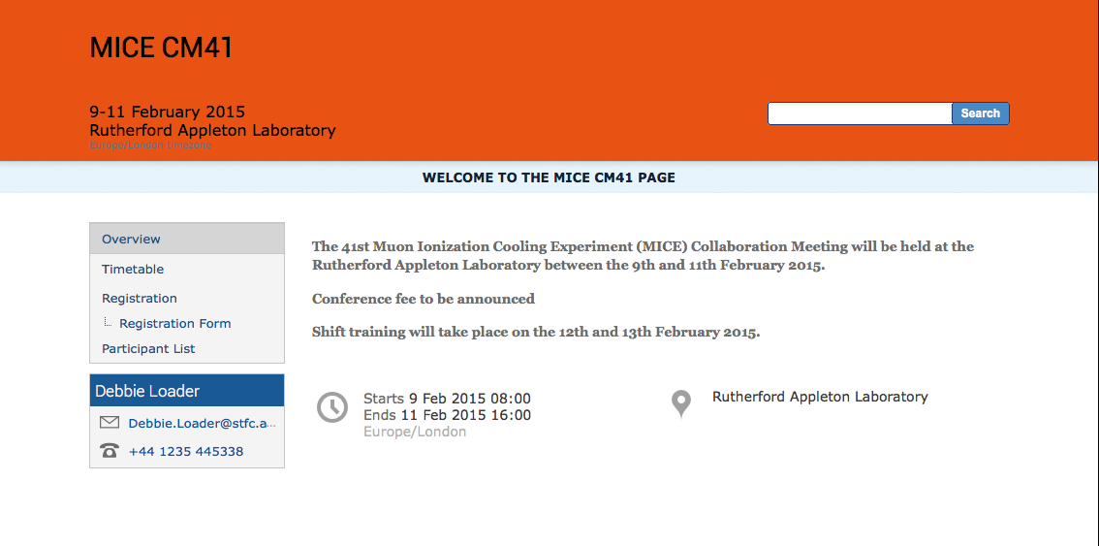
Over to you!

