Slide 1
RF Layout 3pi/2 for Discussion

Slide 2
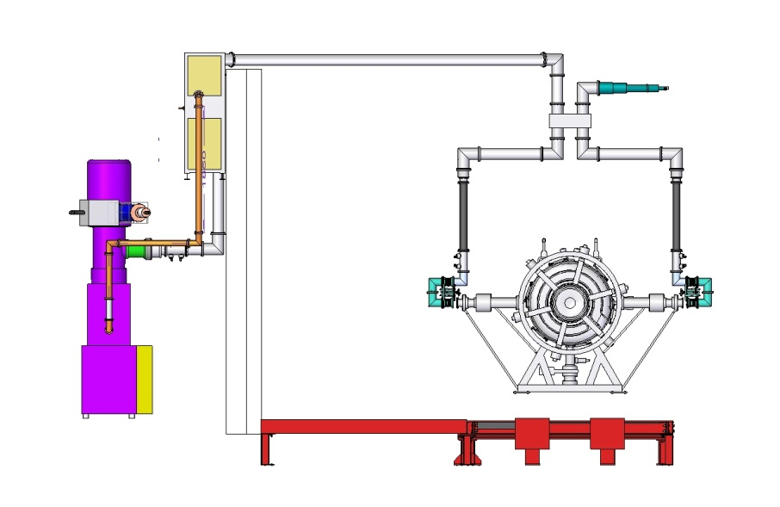
Output line from amplifier is lower than the PRY, needs to go high to clear PRY to couple to South RF couplers
Already have the 6” coax to go over the wall
No advantage in going through the wall
4616 Pre Amplifier
500kw Dummy Load
Hybrid Splitter
Directional
Coupler in
each line
Flexible coax
Directional
Coupler 6 inch
Line Trimmers
TH116
Amplifier
RF Distribution CM41 11/2/15
2

Slide 3
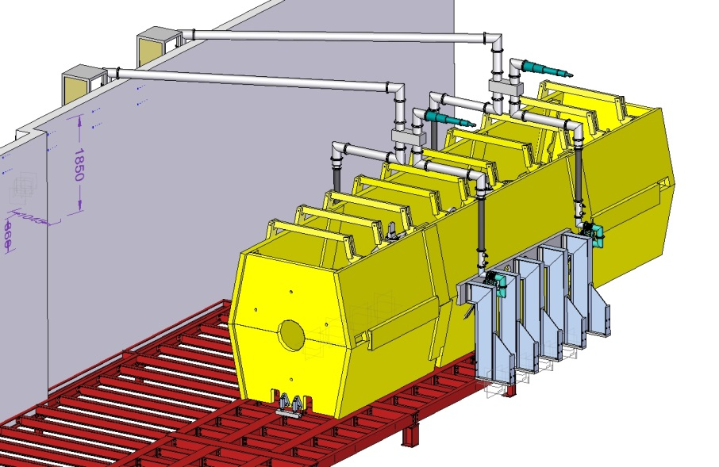
RF Distribution – Neglecting Vacuum Support Platform
MTA advised not to use ‘T’ splitters, suggested hybrid splitter was a far better solution as it isolated the cavity couplers from each other.
Propose to have 1off dummy load on the hybrid splitter to each RF cavity.
Crane hook height fully retracted does not clash with the coax over the wall.
RF Distribution CM41 11/2/15
3

Slide 4
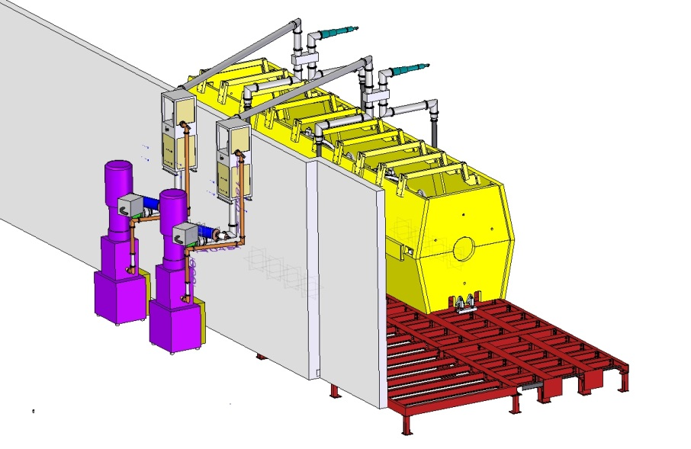
2nd TH116 amplifier moved to 3rd position behind wall to use the space and ease installation in congested area
Sufficient space on wall for additional identical water services panel……John Govans would like to modify existing panel.
RF Distribution CM41 11/2/15
4

Slide 5
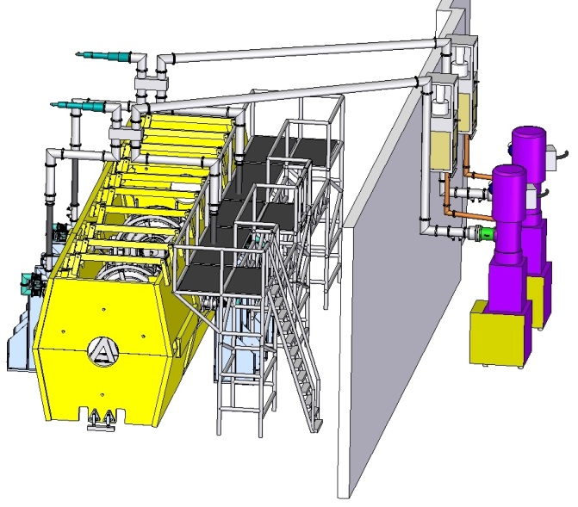
Platform scaffolding rqd to gain access to equipment and services running on top of the cooling channel
RF Distribution CM41 11/2/15
5

Slide 6
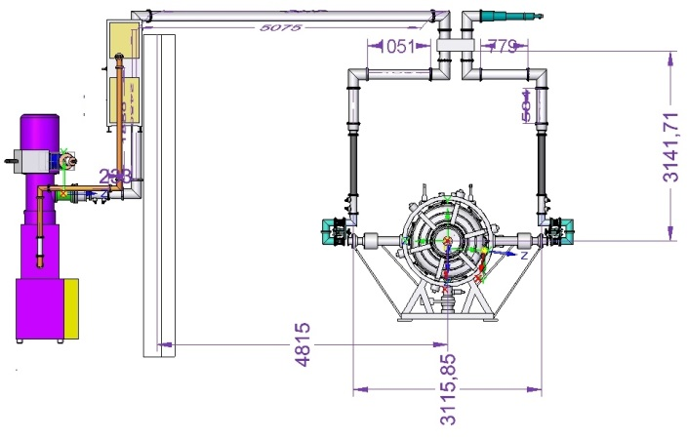
RF Distribution – With Vacuum Support Platform
Coax over the wall raised to avoid clash with vacuum support platform
Crane hook height fully retracted may cause a potential clash with the coax……need to check
Option for crane operation maybe to skate equipment under high level coax line
Services to dummy loads not yet been considered……need to speak to Jason
RF Distribution CM41 11/2/15
6

Slide 7
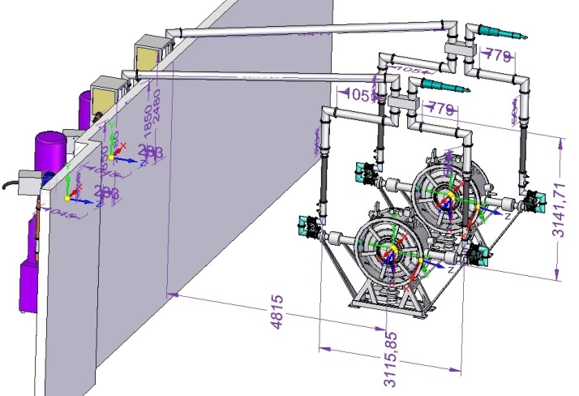
RF Distribution CM41 11/2/15
7

Slide 8
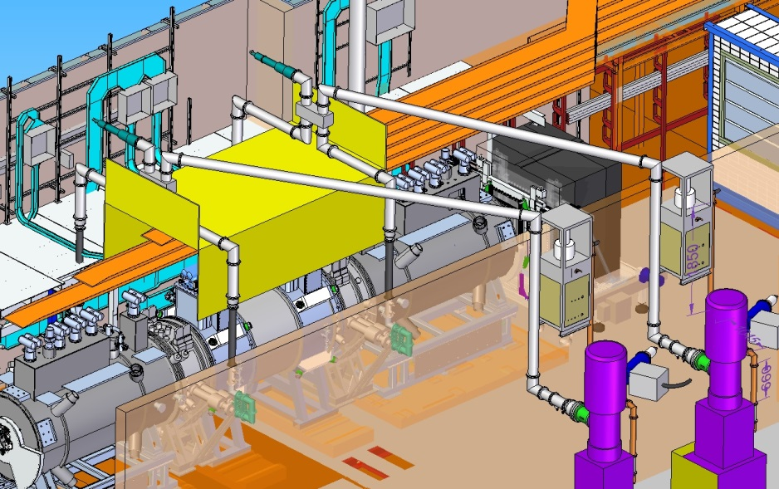
RF components routed over SS vacuum support platform “Dog Kennel”
“Dog Kennel” can provide shielding for RF components
Raised the height of the coax line over the wall from 242mm to 410mm…….will have to check crane height (potential clash)
Hybrids splitters can move upstream & downstream & lowered to avoid any potential clashes, achieved by setting correct rotation angles on coax lines
Suggest mounting coax supports off PRY steel work & “Dog Kennel”…….need to liaise with Jason & Steve Plate
RF Distribution CM41 11/2/15
8

Slide 9
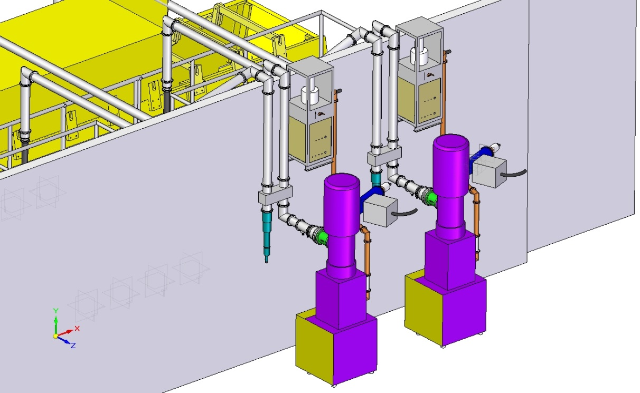
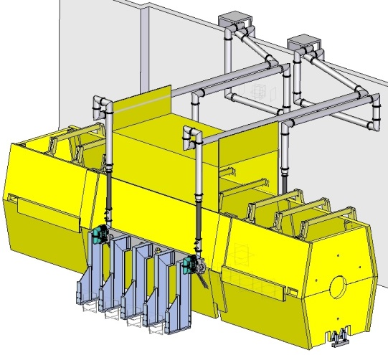
RF Distribution – Hybrids Behind North Wall
Pros
Hybrids and elbows no longer above cooling channel reducing stray field effects…….if stray field is a problem!!!
Coax can run lower once over the wall
Services to dummy loads might be easier
Cons
More coax required to match lengths to each side of the cavity
More elbows required……need same number of elbows to each side of the cavity to equalise the loses to both sides
Generally more loses due to increased lengths of runs
Larger SF6 volume required
RF Distribution CM41 11/2/15
9

Slide 10
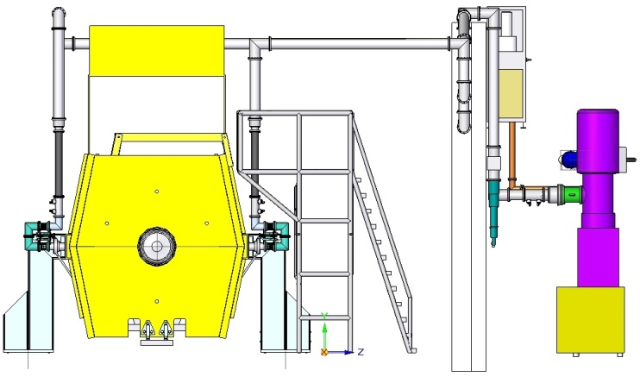
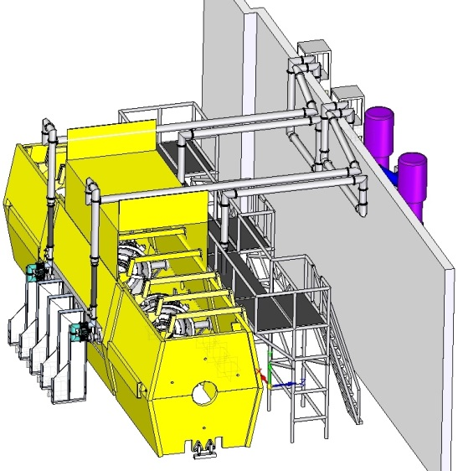
RF Distribution – Hybrids Behind North Wall
RF Distribution CM41 11/2/15
10

Slide 11
Comments
Output line from amplifier is lower than the PRY, so needs to go high to clear PRY to couple to South RF couplers. True for all options.
No advantage of going through the wall.
Crane hook height fully retracted may clash with the coax. Original height of coax above wall was 242mm, increases to 410mm for vac services platform option. May need to skate loads under high level coax lines to avoid venting and refilling with SF6.
Directional couplers included in layout 3 in total (1 off 6 inch, 2off 4 inch)…..these have been delivered
4” flexible coax 1m long shown in vertical lines…..these have been delivered
Line trimmers to take up any length corrections…..these have been delivered
Hybrid shown with existing 500KW loads (2off) …..these have been delivered
Moved the second amplifier to position 3 behind wall to allow more space
Run coax in 6inch as far as possible to the flexible coax line
Will require additional and/or modified 6inch coax line lengths
Current scheme is 4” coax under floor, be very difficult to run 6” coax under the floor
RF Distribution CM41 11/2/15

