Slide 1
CERN openlab Technology Transfer Program
Fons Rademakers, CERN openlab Chief Research Officer
CERN openlab Collaboration Board, 11/3/2016

Slide 2
Introduction
CERN openlab, a science – industry partnership to drive R&D in IT
CERN openlab is a driver of innovation, education and entrepreneurship in IT
Working on multi-disciplinary projects exploiting the latest IT techniques
Development of educational projects

Slide 3

The Human Brain Development Project

Slide 4
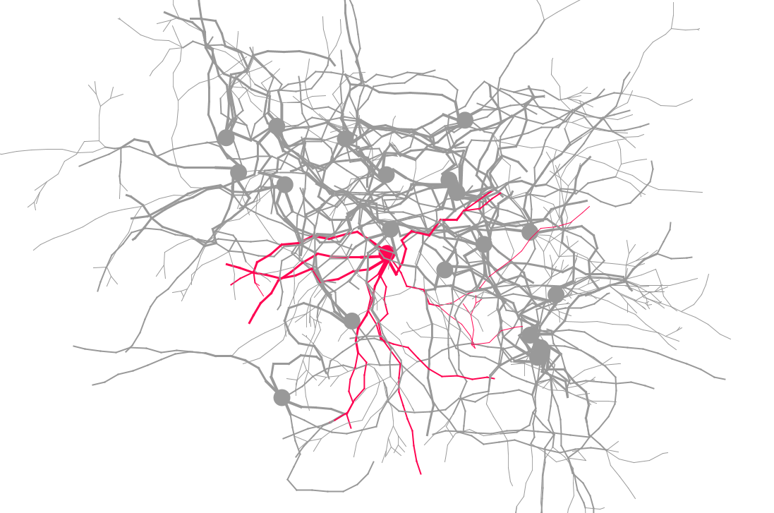
Why Simulate Brain Development
Neuroscience
Gene expression and external environments generates brain development
Medicine
Understanding factors that lead to brain diseases (epilepsy, schizophrenia, tumour growth, …)
Technology
Artificial intelligence

Slide 5
BioDynaMo — The Biology Dynamic Modeller
Platform for high-performance computer simulations of biological dynamics
Involves detailed physical interactions in biological tissue
Highly optimised and parallelised code
To be run both on HPC and Cloud environments
Cortical column: 10k neurons - brain cancer (multi-core)
Cortical sheet: 10m neurons - epilepsy (HPC)
Cortex: 100m - 10bn neurons - schizophrenia (Cloud?)

Slide 6
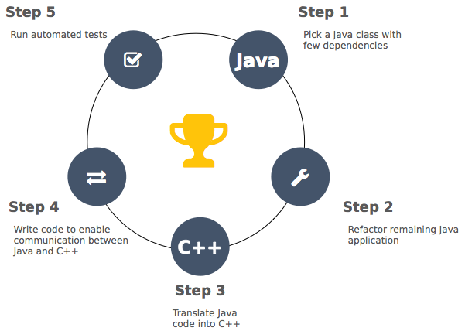
From Cx3D to BioDynaMo
Original Cx3D code in Java (20 kLOC)
Porting to C++, using ROOT for I/O and graphics
Scalar, serial optimisations
Vectorisation
Parallelisation
Co-processor and GPU optimisations

Slide 7
CERN openlab BioDynaMo Technology Transfer Benefits
Ideal project for code modernisation effort, code not too large but very relevant
CERN openlab provides technical student who gains valuable experience
Experience very valuable for much larger CERN code modernisation projects
BioDynaMo code will boost the neuroscience brain simulation capabilities
Project is joint effort between CERN openlab, CERN medical applications group, Newcastle University, Kazan University, Innopolis University and Intel

Slide 8
Using ROOT for Genomics Data Analysis

Slide 9
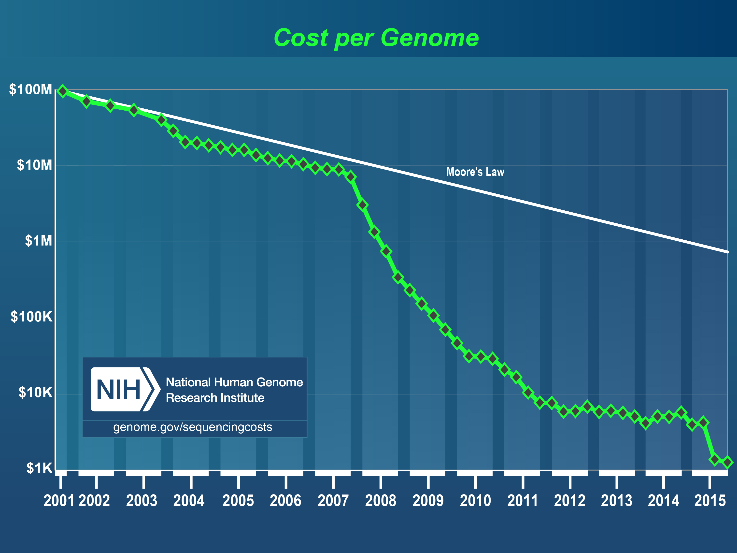
Rapidly Increasing Amount of Genomics Data
Next generation Sequencing (NGS)
Dramatic increase in the amount of data
Improved data confidence
NGS is enabler for more sophisticated research questions in Genomics
Issue: Leaps in sequencing technology have outperformed advances in computing
Source https://www.genome.gov/sequencingcosts/

Slide 10
The TwinsUK Project
The TwinsUK resource is the biggest UK adult twin registry (more than 11000 twins, 300 TB genomics data)
Evaluate if the optimised ROOT file format and analysis features are more efficient for this type of studies than BAM and standard genomic analysis tools
Evaluate Seagate Kinetics key/value storage facility
Partners
Formal interface: King’s College London
Behind KCL: entire consortium working on Twins UK (~ 50 institutes)
https://www.twinsuk.ac.uk/

Slide 11
CERN openlab TwinsUK Technology Transfer Benefits
Additional use case for CERN’s ROOT and Seagate’s Kinetics technologies
Return flow of know-how benefiting the ROOT User community
Entire Omics community would benefit from improved analysis tools to handle rapidly growing amounts of data
Project is joint effort between CERN openlab, CERN medical applications group, King’s College London and Seagate

Slide 12
Community Access to CERN openlab Technology

Slide 13
Providing Wider Access to CERN openlab Equipment
CERN IT has mechanisms to test off-the-shelf hardware
However, we are aware of community interest in evaluating next-generation hardware and software tool with their use cases
Several vendors expressed an interest in having their next generation equipment tested in a lightweight project structure
We are investigating how to best make this equipment available and how to handle any required NDA’s, as well as how to share the results with the broader community

Slide 14
Intel Modern Code Developer Challenge

Slide 15
The Challenge - Speedup Brain Cell Simulation Kernel
About 500 lines of non-trivial C++ code was used for the Challenge
Intel provided tools and hardware
This kernel took 45 hours to run with the target set of parameters on a single Xeon-Phi CPU

Slide 16
The Prizes
1 Grand Prize: CERN openlab fellowship
3 First Prizes: visit to CERN
3 Second Prizes: visit to SC’16

Slide 17
Contestant Engagement
17000 students reached
2077 students registered for the challenge
130 universities
19 countries
Over 1200 code downloads
1000 students accessed free training

Slide 18
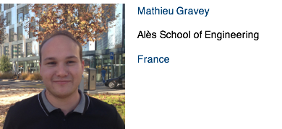
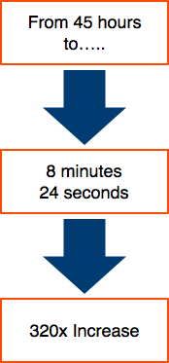
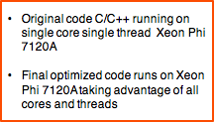
Grand Prize Winner

Slide 19
Mathieu’s Optimisations
Change from AoS to SoA to allow vectorisation and improved cache layout
Custom memory allocator, reuse memory for many small memory allocations
Use OpenMP for parallelisation over all Xeon-Phi cores
Use icc Cilk+ scatter/gather intrinsics
Code Modernisation Can Payoff Big Time

Slide 20
The Continuous CERN openlab Code Modernization Challenge
Find critical pieces of code in CERN programs
Put them up for the acceleration challenge
Keep running scores of fastest times to create competition
Allow students to refine their submissions till the end of the challenge
Thinks of some nice prizes
Every three months a new piece of code
Also a perfect recruitment tool ;-)

Slide 21
Conclusions
CERN openlab, a science – industry partnership to drive R&D and innovation
A number of very interesting projects underway, with a lot of potential
Some technologies will change the way programs are written
New languages, memory, disc, network and CPU technologies
Very interesting times, indeed

Slide 22
EXECUTIVE CONTACT
Alberto Di Meglio, CERN openlab Head
alberto.di.meglio@cern.ch
TECHNICAL CONTACTS
Maria Girone, CERN openlab Chief Technology Officer
maria.girone@cern.ch
Fons Rademakers, CERN openlab Chief Research Officer
fons.rademakers@cern.ch
COMMUNICATION CONTACT
Andrew Purcell, CERN openlab Communications Officer
andrew.purcell@cern.ch
ADMIN CONTACT
Kristina Gunne, CERN openlab Administration Officer
kristina.gunne@cern.ch

