Slide 1
CERN openlab
Technical Achievements and Challenges
CERN openlab
Collaboration Board
March 11th 2016
Maria Girone
CERN openlab CTO

Slide 2
Introduction
CERN openlab has been created to support the computing and data management goals set by the LHC
  15 years of innovative projects between CERN and leading IT companies
In its phase V, CERN openlab is working to solve some of the key technical challenges facing the LHC in Run3 and Run4
  Mutual benefit for industry and research communities
Ever-increasing interest in CERN openlab
  well established mechanism of partnership between industry and research communities
  a path to common developments for future challenges
This talk gives a general project overview, highlighting some (but not all) of the achievements.
For more details, please refer to the Technical Workshop, 5-6 November 2015 at https://indico.cern.ch/event/452614/ and to specific project reports
Maria Girone, CERN openlab CTO
Maria Girone, CERN openlab CTO

Slide 3
LHC Run3 and Run4 Scale and Challenges
2009
2010
2011
2011
2013
2014
2015
2016
2017
2018
2019
2020
2021
2022
2023
2024
…
2030?
PB
…
First run
LS1
Second run
LS2
Third run
LS3
HL-LHC
FCC?
Courtesy of P. Buncic
Raw data volume for LHC increases exponentially
  And with it processing and analysis load
  Current estimate by Run4 for technology improvements for flat budget is an increase of a factor 8-10
LHCb and ALICE have big upgrades in Run3
  Event rate x 40-100 and factor 10 in volume
ATLAS and CMS upgrade for Run4
  Event rate x 10 and big increase in volume

Slide 4
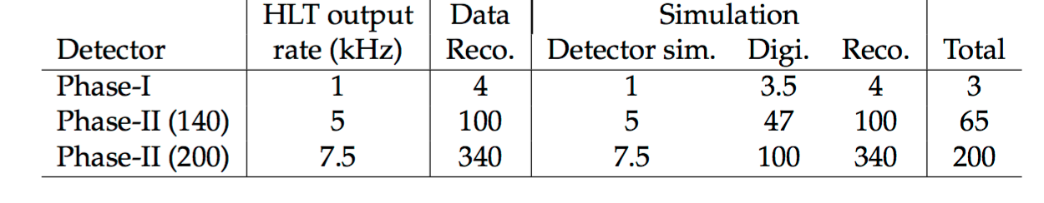
Run3 and Run4 Scale and Challenges
The increased data volume is combined with an increase of event complexity
  Resulting in a huge processing challenge
    Example from CMS, but other experiments are similar
  Total computing needs go up by a factor of 65-200 (wrt Run2)
    Technology improvements only solve a factor of 10
    Code optimization and technology revolutions are needed
https://cds.cern.ch/record/2020886

Slide 5
CERN openlab and WLCG
Recently WLCG presented some goals for solving the gap
Some CERN openlab projects directly contribute to the goal
Others are more directly linked to experiments activities and IT services
Computing Management
and Provisioning
Computing Platforms and
Code Optimization
Data Analytics
Data Acquisition
Networks and Connectivity
Data Storage
Notes:
How and where

Slide 6
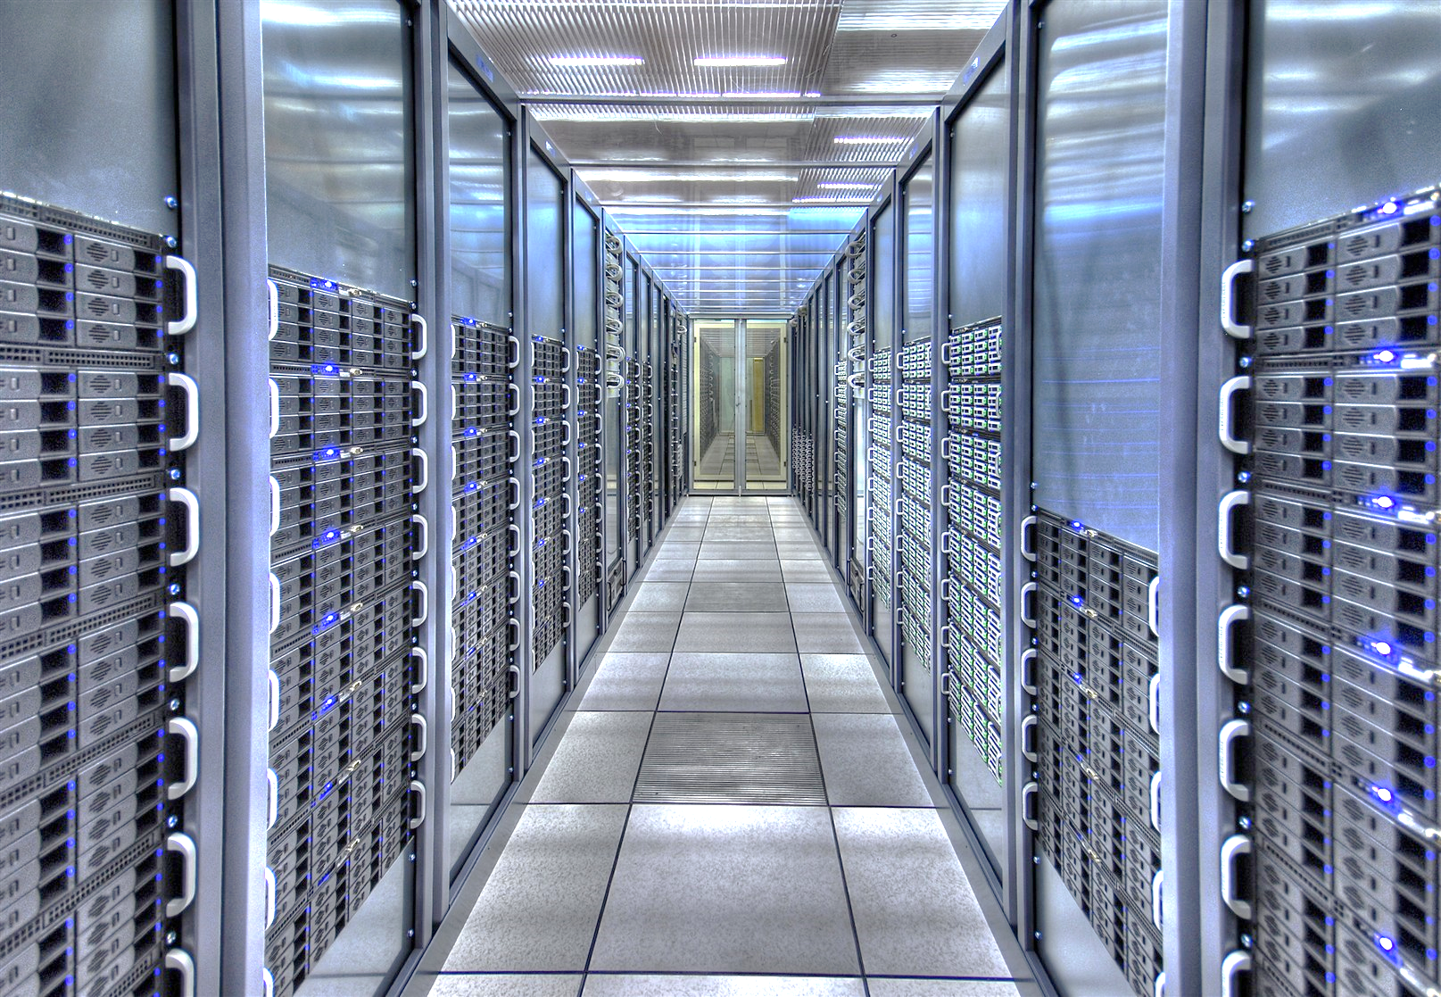
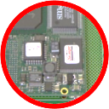

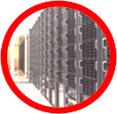
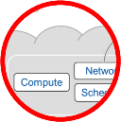
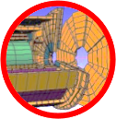
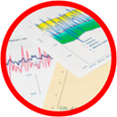
Information Technology Research Areas
Data acquisition and filtering
Collecting data
Networks and connectivity
Connecting resources
Data storage architectures
Storing and serving data
Compute management and provisioning (cloud)
Managing resources for processing
Computing platforms, data analysis, simulation
Improving processing and code efficiency
Medical applications
Data analytics
Extracting information
Maria Girone – CERN openlab CTO

Slide 7
Information Technology Research Areas
Data acquisition and filtering
Collecting data
Networks and connectivity
Connecting resources
Data storage architectures
Storing and serving data
Compute management and provisioning (cloud)
Managing resources for processing
Computing platforms, data analysis, simulation
Improving processing and code efficiency
Data analytics
Extracting information
Maria Girone – CERN openlab CTO

Slide 8

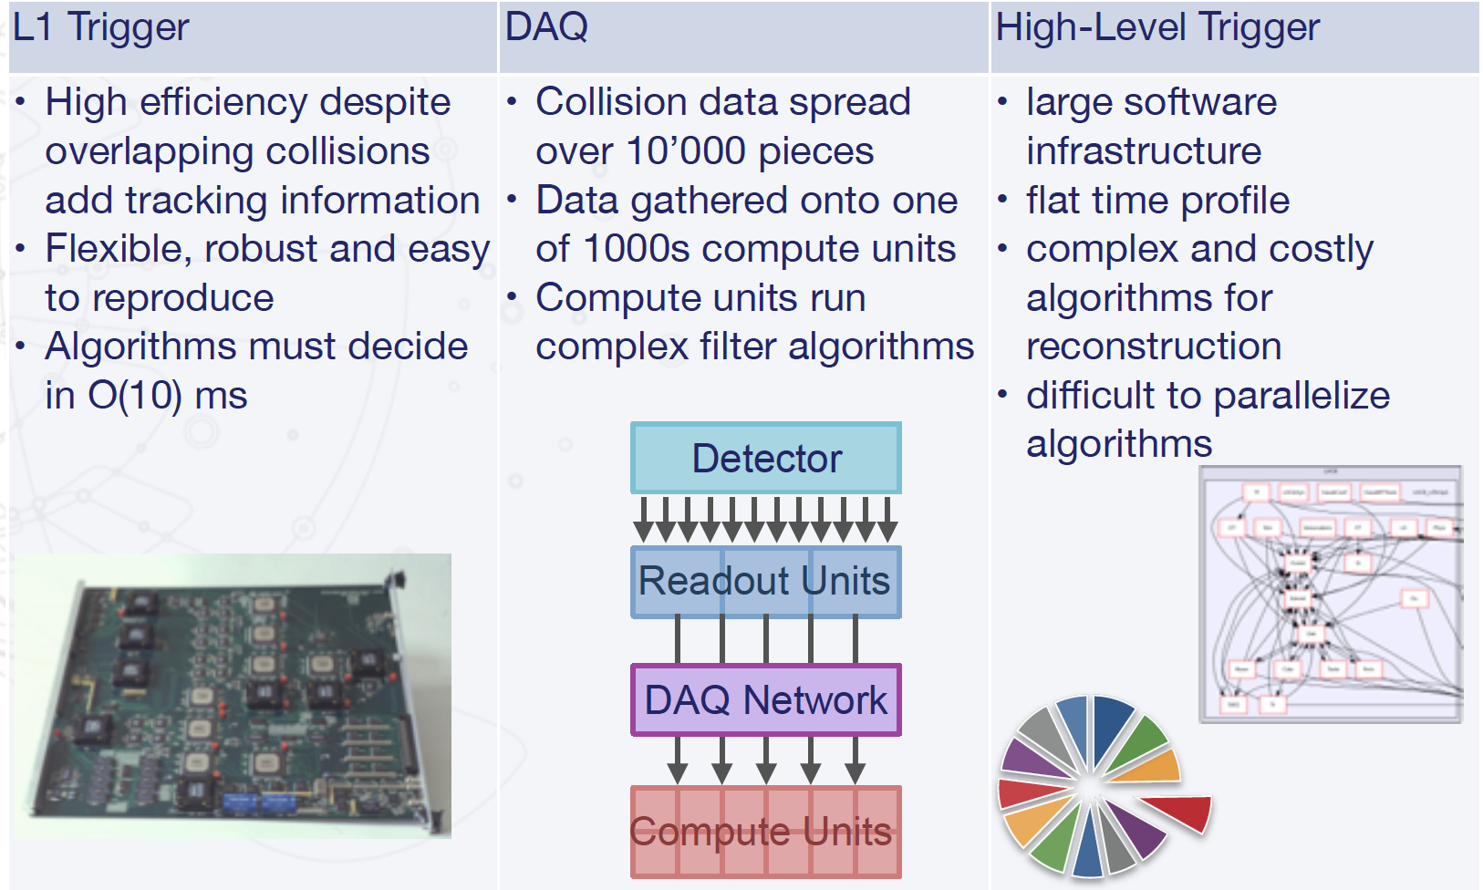
The HTCC Project
The next runs at LHC represent technical challenges in real time filtering, data movement and networking, high level trigger (event selection) and partial reconstruction
The High Throughput Computing Collaboration investigates the use of Intel technologies in trigger and data acquisition (TDAQ) systems
  Investigate benefits of Xeon/FPGA, Omni-Path interconnect, Xeon Phi (KNL)
~10000x
~1000x
~3000x
Notes:
Xe

Slide 9
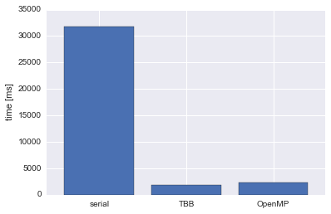
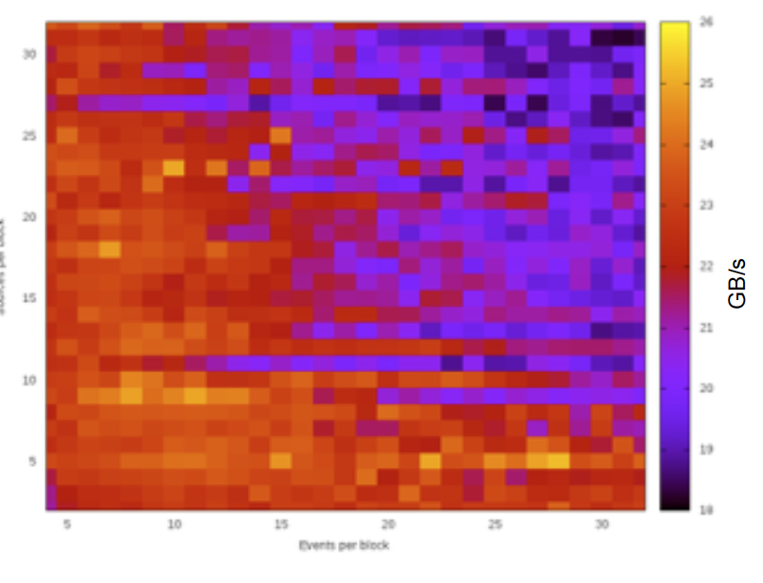
HTCC - Selected Results
Real time filtering calculations
Xeon FPGA computing accelerator results
Sorting : a factor 50 faster
Mandelbrot : a factor 12 faster
Cubic root : a factor 35 faster
Accelerating the HLT using many cores
Use Intel next-gen Xeon Phi to speed up big consumers of computing cycles
  Pattern recognition & tracking
  Particle identification
Pattern recognition and tracking with OpenMP and Intel Thread Building Blocks (TBB) code (Velopixel demonstrator)
More than a factor 10
Parallel event sorting and building results
Benchmark for many core parallel collision event grouping
  On KNC, up to 26GB/s bandwidth measured
Benchmarks of Intel Omni-Path and Infiniband EDR
Already observing 75 Gb/s on EDR

Slide 10
HTCC Next Steps
Xeon FPGA
  Implement and test the acceleration of other high-level trigger parts, e.g. tracking, Kalman Filter
  Test the use of platform for rawdata encoding for calorimeter upgrade.
Xeon Phi
  Perform benchmarks on next-gen hardware for high-level trigger and event sorting codes
  Implement other parts of high-level trigger using OpenMP or TBB
DAQPIPE
  Scalability tests (on Gallileo at INFN and Curie for a 500 node scale test).
  Some short studies on failure recovery

Slide 11

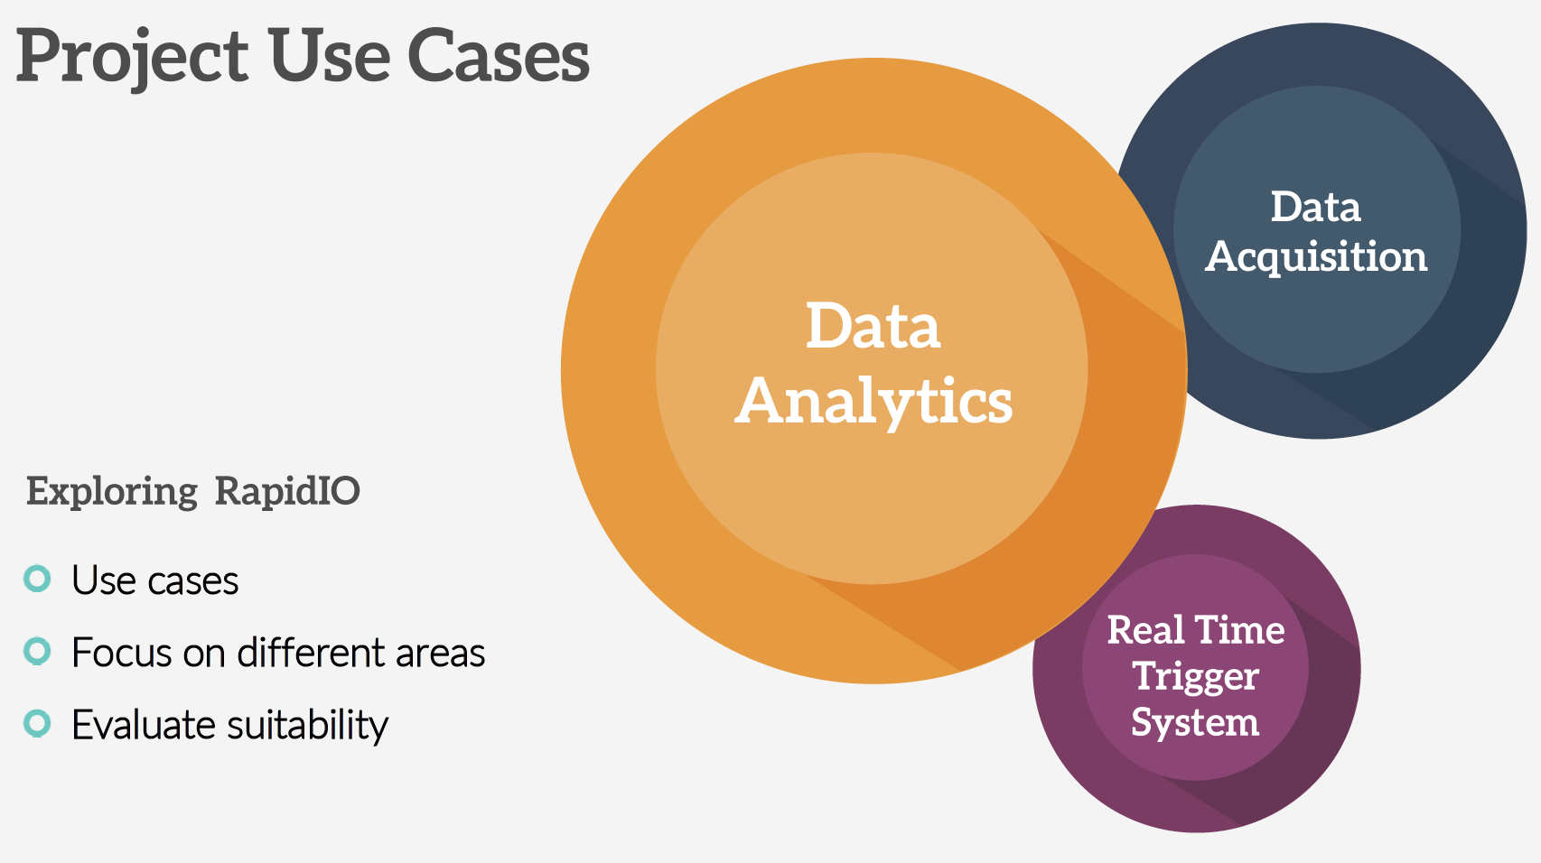
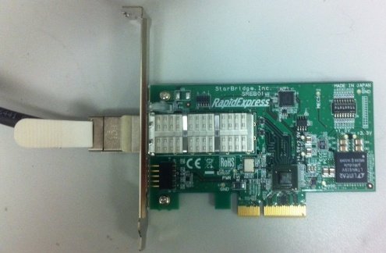
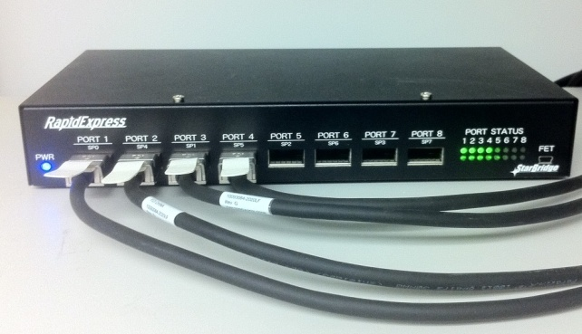
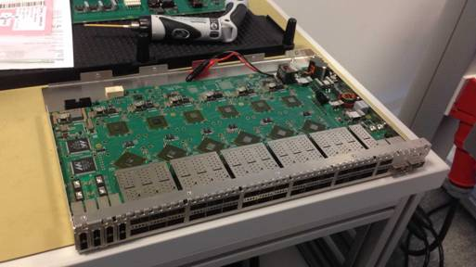
RapidIO for DAQ, Trigger, and Data Analytics
Data Analytics use case
Evaluate throughput using low latency and low power RapidIO interconnect
  IT infrastructure monitoring and logging data
  Exploring direct reads from ROOT
Finalize use-cases for analytics and start use-cases for DAQ

Slide 12
Information Technology Research Areas
Data acquisition and filtering
Collecting data
Networks and connectivity
Connecting resources
Data storage architectures
Storing and serving data
Compute management and provisioning (cloud)
Managing resources for processing
Computing platforms, data analysis, simulation
Improving processing and code efficiency
Data analytics
Extracting information
Maria Girone – CERN openlab CTO

Slide 13

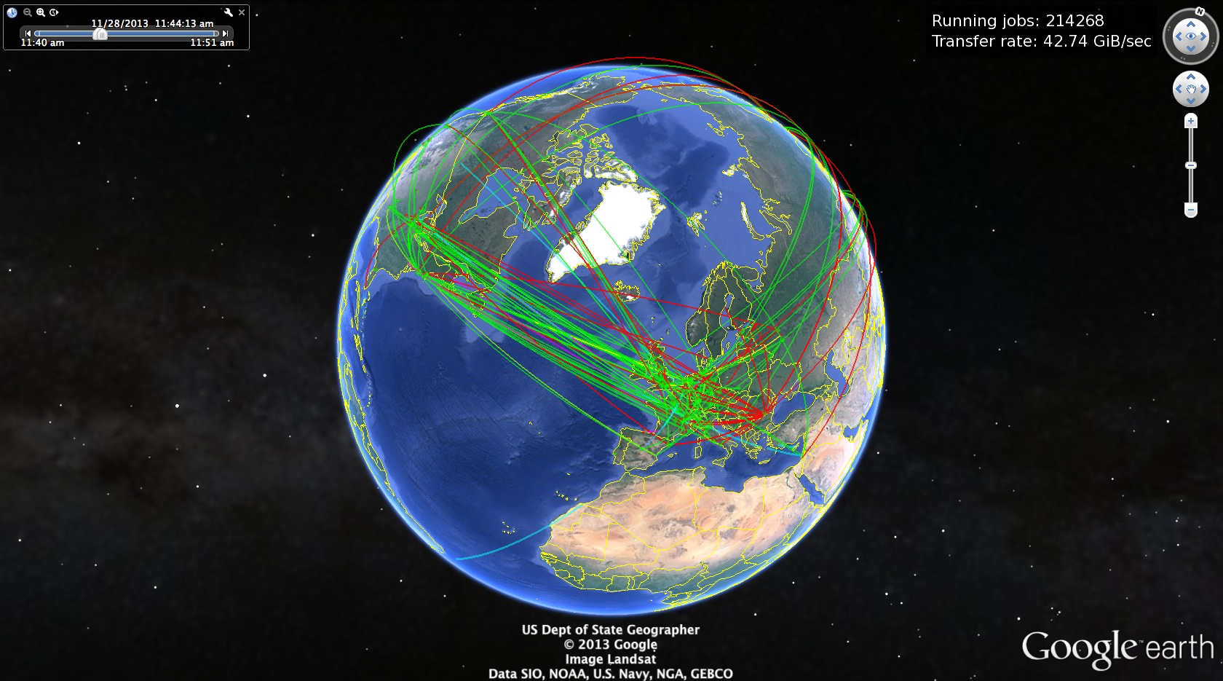
Networking and Connectivity
Working on more predictable use of networking through reservation of bandwidth and advanced techniques
  The openlab project with Brocade is working to bring the Brocade Flow Optimizer (BFO) to CERN applications
    better filtering and processing of network data
    optimize the routing of data traffic entering and leaving an organisation and drop network attacks
Achievements
  BFO 1.1 released early November 2015
    Partially addressing CERN use cases with support for MIRROR and METER OpenFlow protocol actions
  BFO 1.2 planned early April 2016
    Already a strong candidate for production deployment at CERN as part of the IDS system
  Long-term enhancements proposed by CERN and accepted by Brocade
Plans
  BFO testing for Intrusion Detection System deployment:
    Collaboration with the security team
    Test setup to be prepared at one of major starpoints
    Need to evaluate stability and performance
CERN and LHC have been drivers of wide area networking
Notes:
Industry has passed HEP in several areas including scale of processing and storage, but CERN and LHC still lead in data in motion

Slide 14
Information Technology Research Areas
Data acquisition and filtering
Collecting data
Networks and connectivity
Connecting resources
Data storage architectures
Storing and serving data
Compute management and provisioning (cloud)
Managing resources for processing
Computing platforms, data analysis, simulation
Improving processing and code efficiency
Data analytics
Extracting information
Maria Girone – CERN openlab CTO

Slide 15

Achievements
Data Analytics
  Machine learning on sensor data analysis
    Anomaly detections of cryogenics valves and beamscreen
  Data visualization and discovery
    FCC reliability and availability studies with BDD and Hadoop
Database evolution and monitoring
  Active participation on beta programs
  Evaluation of new database features:
  In-memory, sharding, …
Performance gain using In-Memory database
Notes:
Data Analytics
Assesment of Oracle R Enterprise (ORE) for machine learning on sensor data analysis in the database. Implementation of several use cases for anomaly detection using ORE: cryogenics valves, cryogenics beamscreen.
Study Oracle technologies for data visualization and discovery (Oracle Endeca and Big Data Discovery) for multiple CERN use cases (HR, BE-CO, FCC RAMS). Deployment of dev environment for FCC reliability and availability studies (FCC RAMS) with BDD and Hadoop.
Database evolution and monitoring
Oracle 12.2 beta program and Oracle Enterprise Manager(OEM) 13c beta program
In-memory feature tested for AIS applications, allows to change the architecture, being investigated for other LHC experiments as ATLAS and CMS.

Slide 16
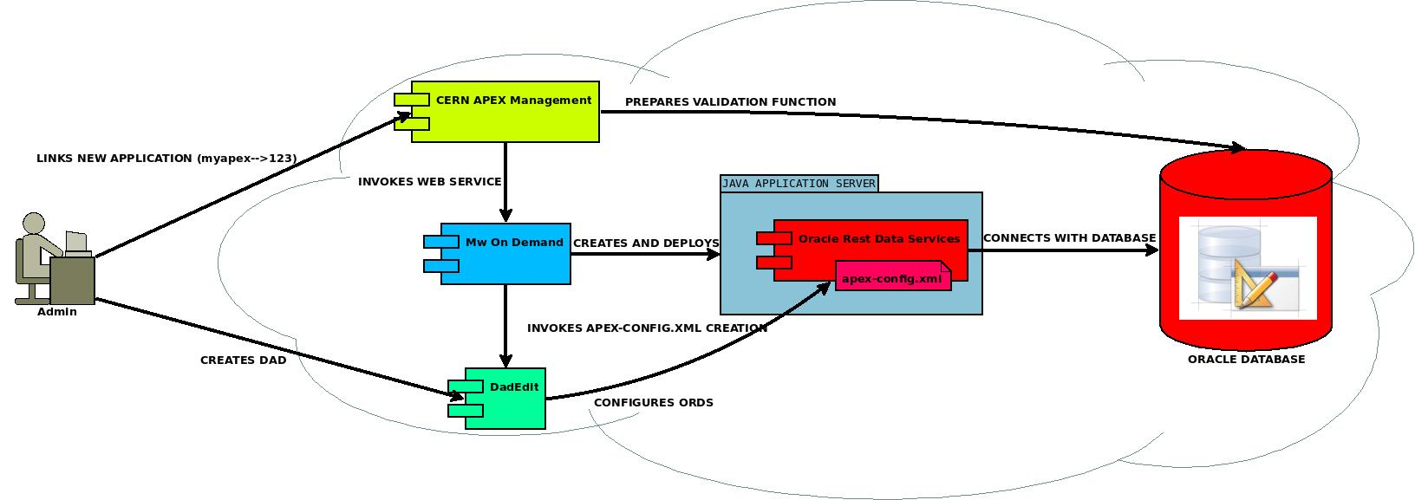
Achievements
Java, Cloud and Virtualization
  Evaluation of Oracle-supported virtualization stacks integration with the CERN private cloud
  Oracle Weblogic beta evaluation
    Multitenancy to improve efficiency and responsiveness
  Integration of the Oracle Rest Data Services web application with the CERN Middleware On Demand Java PaaS
    Build an Oracle APEX infrastructure in the cloud
Notes:
Build Oracle APEX infrastructure in the cloud
http://viewer.zmags.com/publication/cdb0833d#/cdb0833d/62
Oracle Application Express (APEX) – rapid development tool for Web applications on the database.

Slide 17
2016 Plans
Data Analytics
  Deploy Oracle analytic and streaming technologies for predictive maintenance on sensor data
  Further deploy visualization and discovery technologies
Database evolution and monitoring
  Database in-memory and sharding for CERN use cases
  Deploy OEM 13c in production, integration with CERN SSO
  Containers for databases
  Evaluate ZFS appliance
Java, Cloud and Virtualization
  PoC Linux Containers based system for Weblogic
  Test Oracle Public Cloud (IaaS & PaaS) as platform for a "Disaster Recovery Plan”
  Work towards a fully supported and interoperable cloud/virtualization stack
Notes:
Data Analytics
Implement and deploy Oracle analytic and streaming technologies (ORE, ORAAH, OSX) for predictive maintenance on sensor data.
Deploy BDD integrate visualization and discovery technologies and integrate it for FCC RAMS and open it to more users.
ORE: Oracle R Enterprise
ORAAH: Oracle R Advanced Analytics for Hadoop
OSX: Oracle Stream Explorer
BDD: Oracle Big Data Discovery

Slide 18

Data Storage Architectures
In 2016 LHC has 300PB of disk storage and 400PB of tape
  Increasing selection rate in Run3 and Run4 pushes this exponentially
    Looking at expansion ideas and new architectures
Concluded Huawei/S3 storage project in 2015
  performed and documented comparison of ROOT workloads with different IO patterns
  confirmed importance of S3 vector reads for sparse / random analysis workload
  implemented S3 backend to CVMFS systems and evaluated performance and stability in a prototype setup for the LHCb experiment
Notes:
starting study with 300 TB genome data in ROOT (check if worth mentioning)

Slide 19

Storage Technology R&D
Object-disks (Seagate/Kinetic) are now available and offer
  Semantics matched to shingled recording (required for volume growth)
  An open API (supported by all major vendors - Seagate, Toshiba, WD)
  Since March 2015:
    Transparent integration with EOS system achieved
  Planned for 2016:
    Evaluate TCO gain within a EOS prototype system and Active Disk with ROOT
The Storage Technology team is also looking at Non-Volatile Memory
  NVRAM is available now - may allow to solve some persistent meta-data problems at DRAM speed
  Evaluating gains for EOS catalogue
  Comparison to lower performance alternatives like Flash/SSD
Maria Girone, CERN openlab CTO
Notes:
looking now also to other possibilities with other vendors

Slide 20

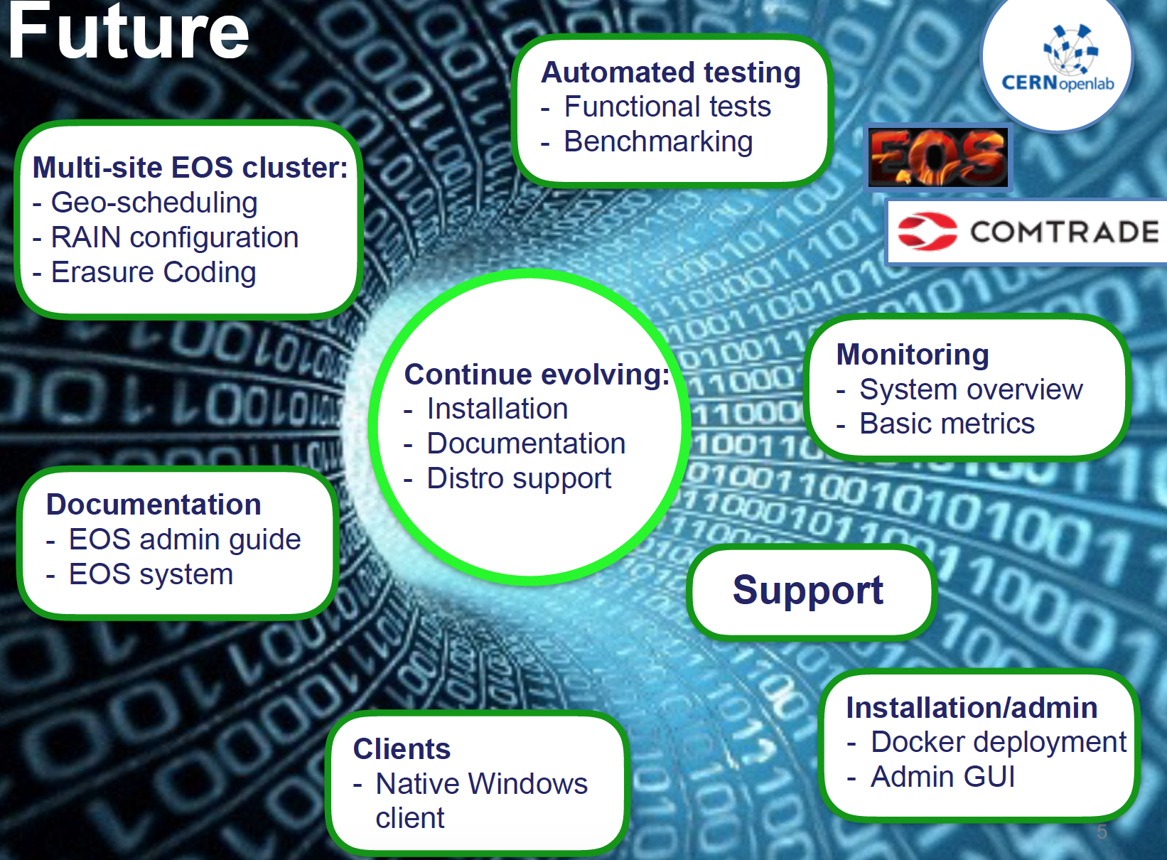
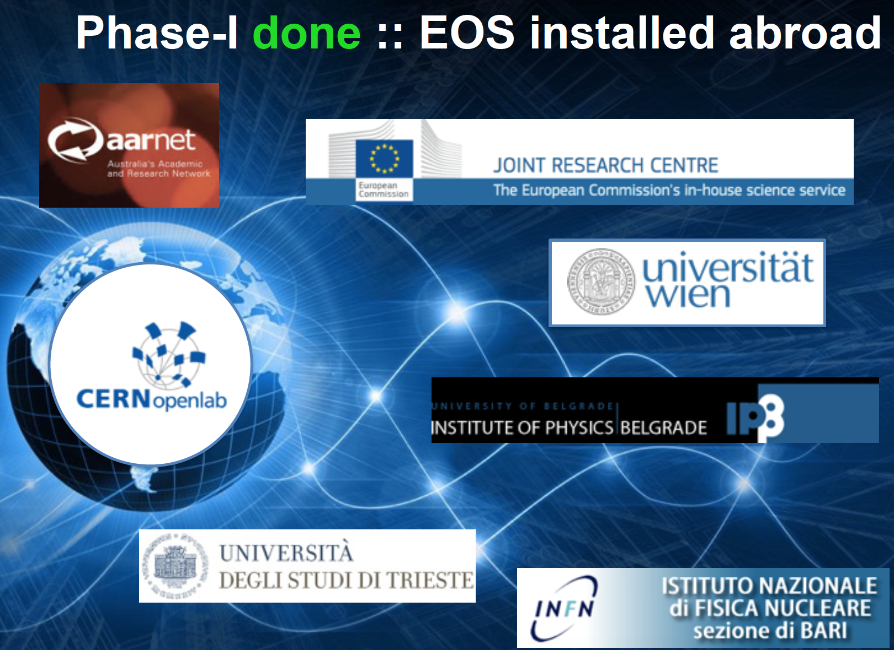
EOS Productization
140 PB of disk space and 480M files
Maria Girone, CERN openlab CTO

Slide 21
Information Technology Research Areas
Data acquisition and filtering
Collecting data
Networks and connectivity
Connecting resources
Data storage architectures
Storing and serving data
Compute management and provisioning (cloud)
Managing resources for processing
Computing platforms, data analysis, simulation
Improving processing and code efficiency
Data analytics
Extracting information
Maria Girone – CERN openlab CTO

Slide 22

Computing Management and Provisioning
WLCG has more than half a million processor cores
  OpenStack is heavily used at CERN
  The community is looking at expanding to dynamically provisioned resources
Rackspace Collaboration – 2H 2015
Collaboration on cloud federation with the upstream OpenStack community
Keystone-to-Keystone bursting capabilities
  Allows multiple OpenStack clouds to trust each others’ identity management which simplifies configuration
  Service provider filtering allows only certain cloud services to be exposed to the collaborating clouds such as only exposing the object store and not the compute resources
Shadow users
  Unify the local and federated users so authentication tokens are identical and auditing/billing is consistent

Slide 23
Computing Management and Provisioning
Rackspace Collaboration - 1H 2016 Plans
Federation functionalities are now evolving smoothly with new releases
Focus now shifting to enhancing container support in OpenStack for scientific computing
  Magnum is a recently started project integrating docker, kubernetes, mesos into OpenStack
  Uses existing OpenStack components for provisioning, security, metering, networking and storage
  Follows the same upstream first model as for Federation with the plans to be defined during the Austin OpenStack summit in April

Slide 24
Information Technology Research Areas
Data acquisition and filtering
Collecting data
Networks and connectivity
Connecting resources
Data storage architectures
Storing and serving data
Compute management and provisioning (cloud)
Managing resources for processing
Computing platforms, data analysis, simulation
Improving processing and code efficiency
Data analytics
Extracting information
Maria Girone – CERN openlab CTO

Slide 25

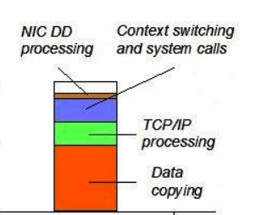
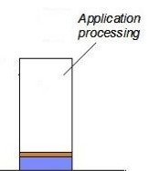
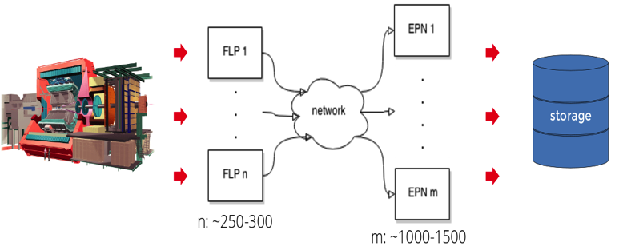
Alice O² Upgrade
By Run 3 most of the ALICE detectors and its computing system are expected to inspect and read-out all the interactions up to a rate of 6TB/s and storing up to 90GB/s
  This is a major processing and data handling challenge and unprecedented in a Heavy Ion detector
  FLPs (First Level Processor) receive data from the detector readout, preprocess it (FPGA), chop it into manageable pieces (time frames) and send it out to EPNs
  EPNs (Event Processing Node) collect sub-time frames from all FLPs to build a full time frame for reconstruction (on the EPN nodes)
6 TB/s
90 GB/s
Goal: Reduce the I/O latency, avoid memory copy, context switching and system calls

Slide 26
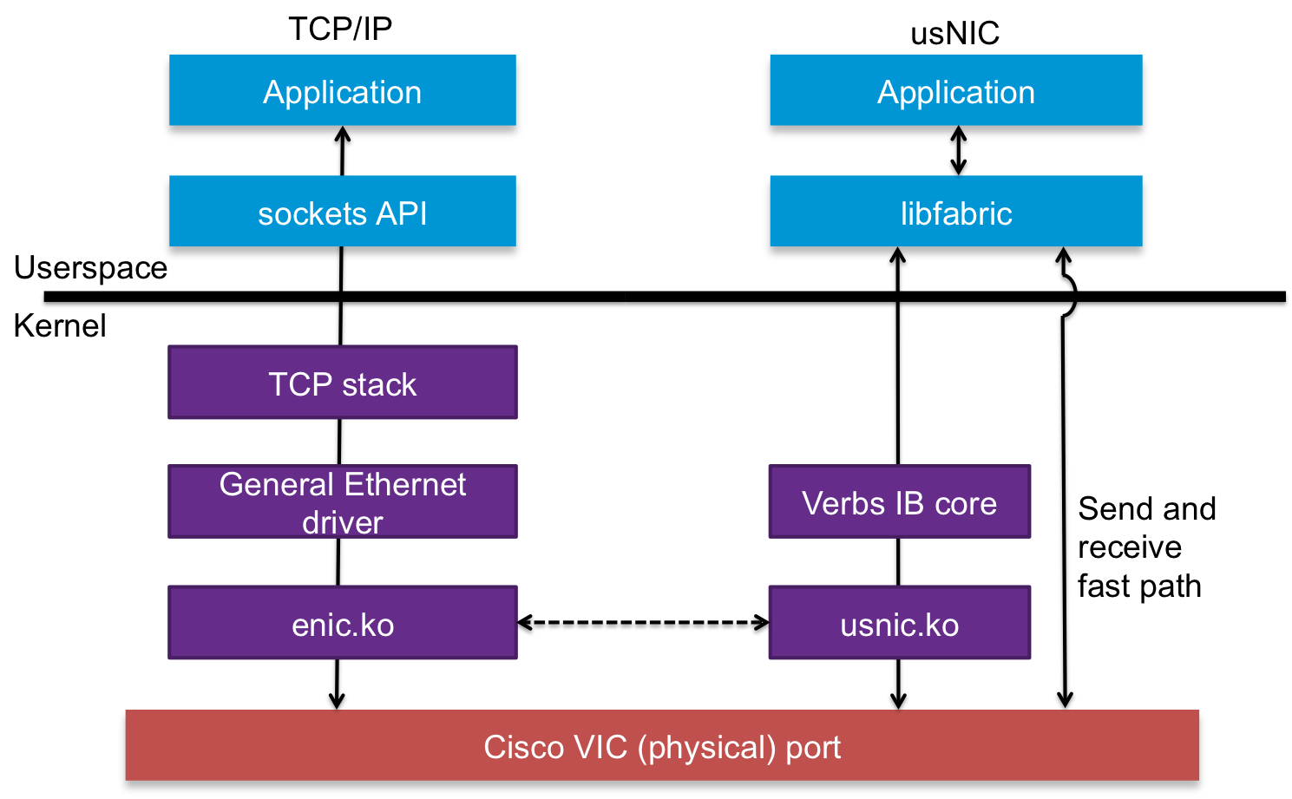


Data Plane Computing System
Investigating impact of removing kernel mediation from the data path on distributed applications
Implement support for Cisco’s usnic in nanomsg framework
  40Gbps throughput, 2µs p2p latency, low CPU load
Measure impact on O2’s
applications in the ALFA framework
nanomsg
ofi://
libfabric
usnic
Maria Girone, CERN openlab CTO
26
Notes:
Contributed to usNIC improvements
Implemented realistic benchmarks based on O2 software stack
Identified performance issues in the usnic driver of libfabric
We addressed them in collaboration with CISCO developers and we are waiting for a new driver & firmware release
Improved performance
Reducing the nanomsg overhead by enforcing the zero-copy principle throughout the data path
Contributed to the open-source community
The new libfabric transport will allow nanomsg users to interface with usNIC and other transports (ex. Omnipath, Infiniband) with off-the shelf code.

Slide 27


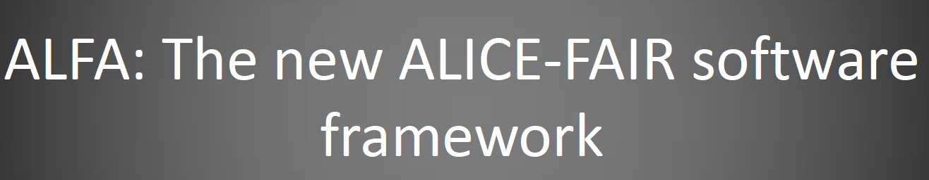


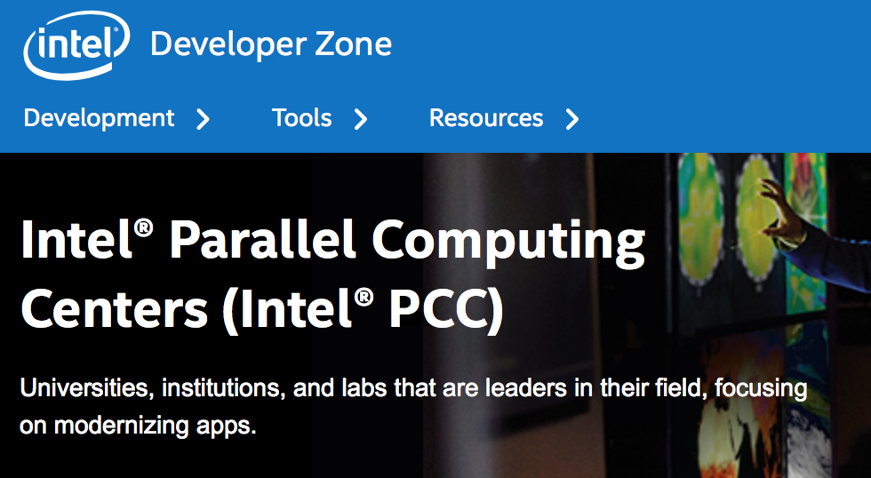



Code Modernization Project
The increasing need for computing has prompted an effort to optimise scientific codes for the new computing architectures
  Possible to achieve enormous improvements in code performance using modern techniques
  One of the few areas with enough potential for improvement to close the resource gaps in the upgrade program
The Code Modernization Project is an umbrella for addressing several use cases in different disciplines
  Possible extensions currently under discussion
Lets work together
Maria Girone, CERN openlab CTO

Slide 28
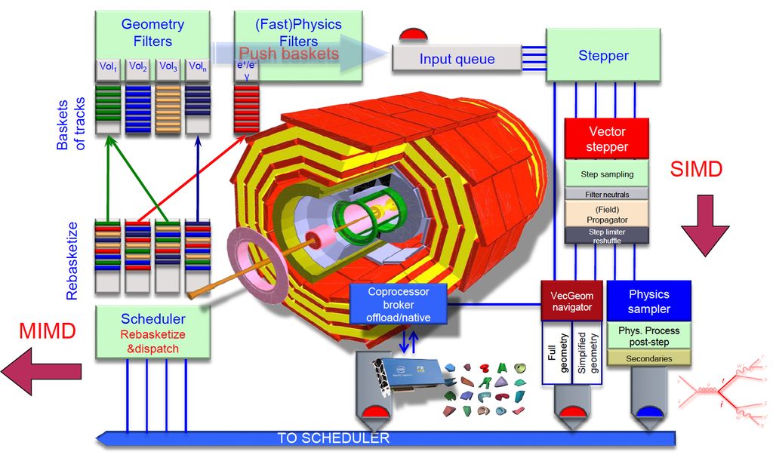
The GeantV project
Rethinking particle transport
HOW
Intel expertise and tools through a IPCC program
Rethink particle transport in detector simulations
R&D on the vertical scalability to profit from multiple levels of parallelism and use of accelerators.
Code improvements are applicable to all fields that use this simulation framework
  Medical applications
WHY
Detector simulation is one of the most CPU intensive tasks in modern HEP
  50% of the WLCG cycles are used by simulation
  Improving the simulation by factors would allow for customized samples, more simulation, and more potential for discovery
Maria Girone, CERN openlab CTO

Slide 29
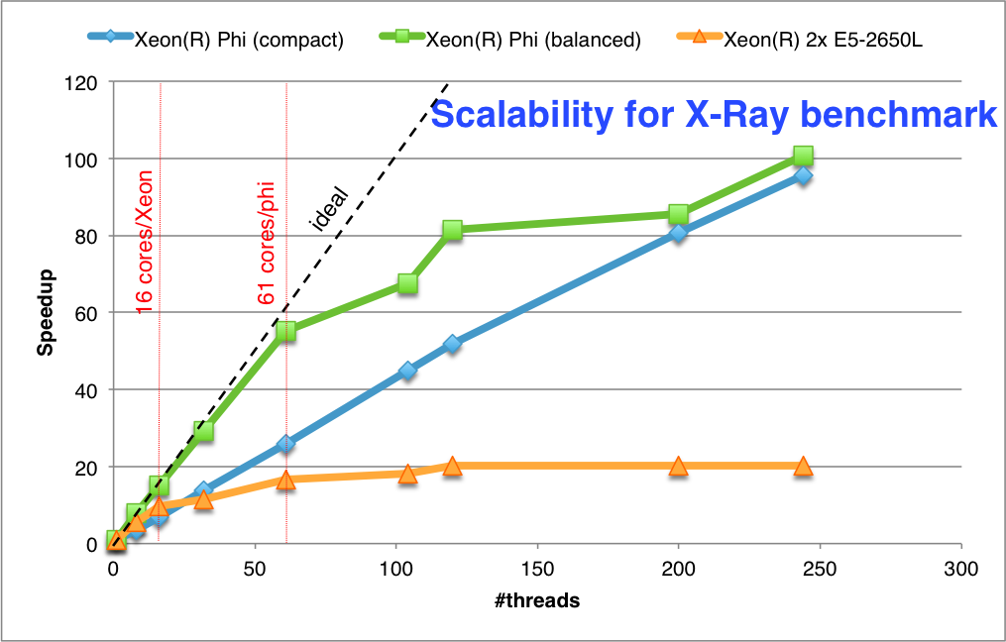
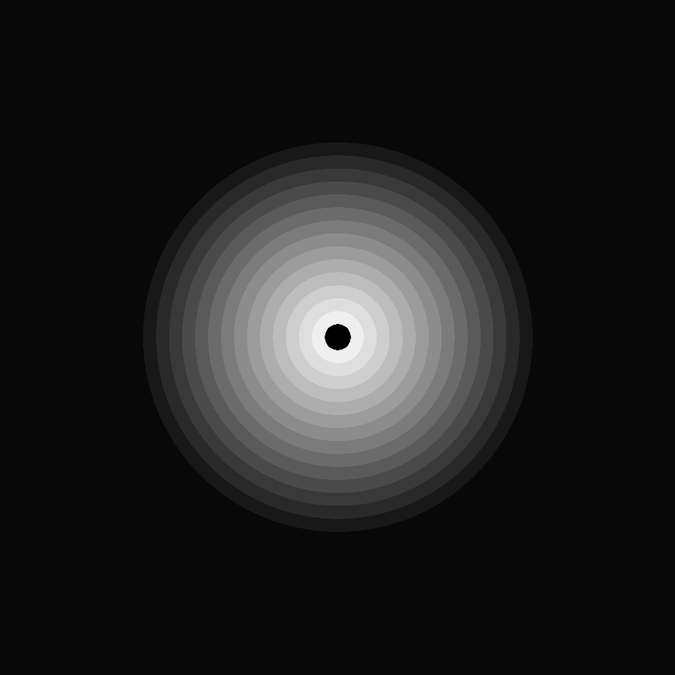
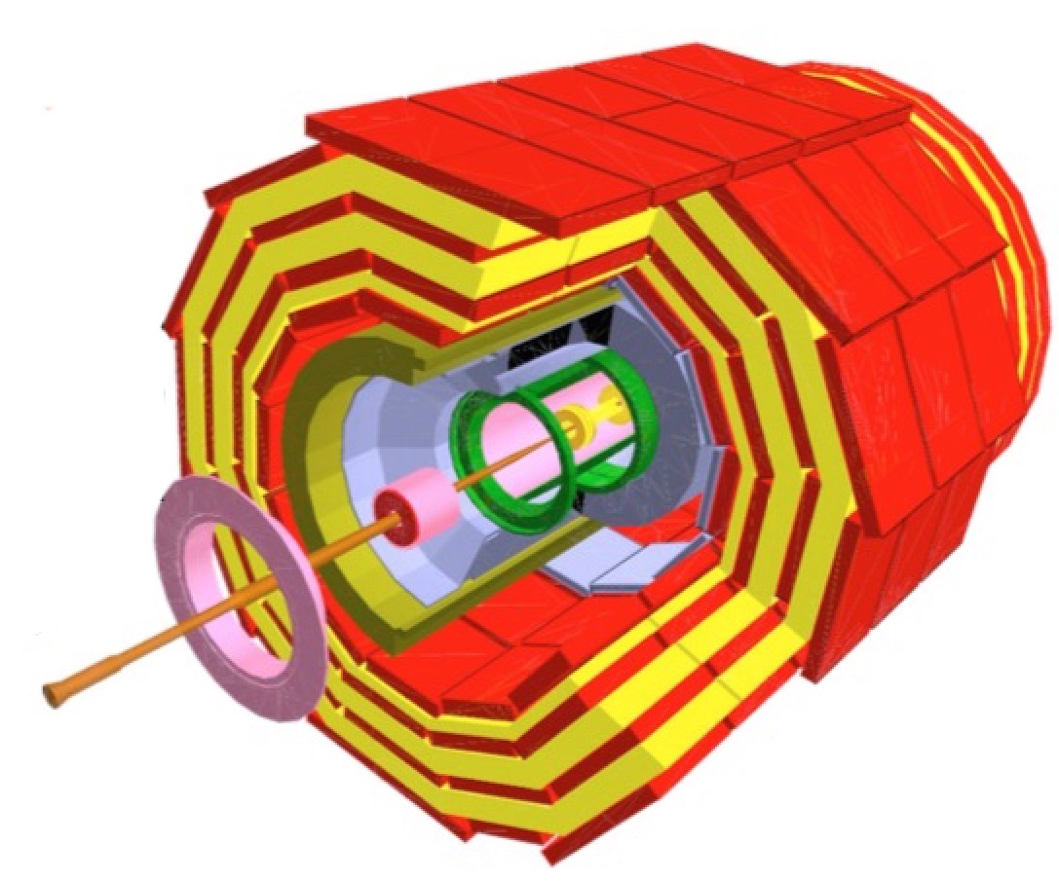
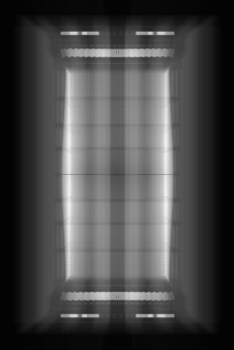
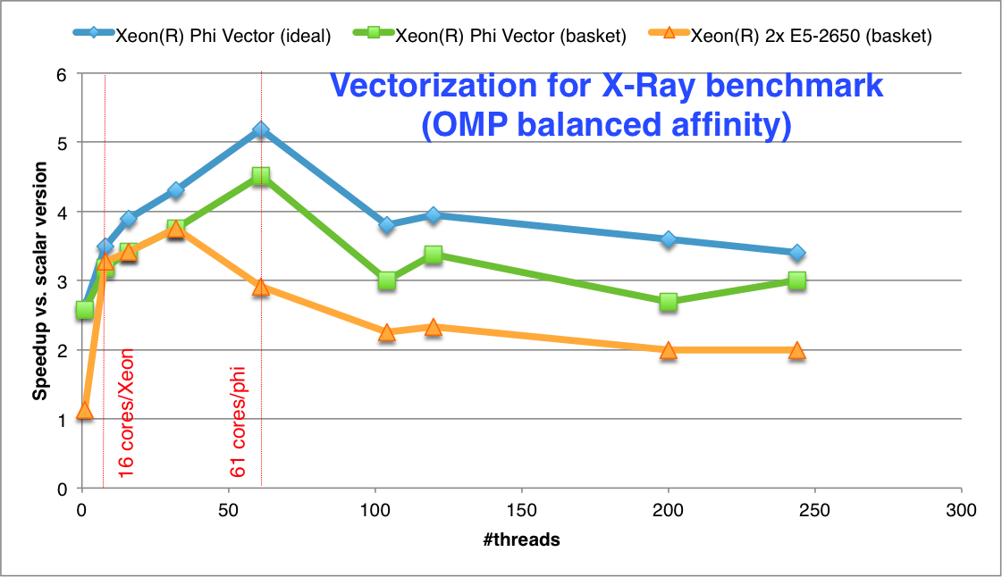
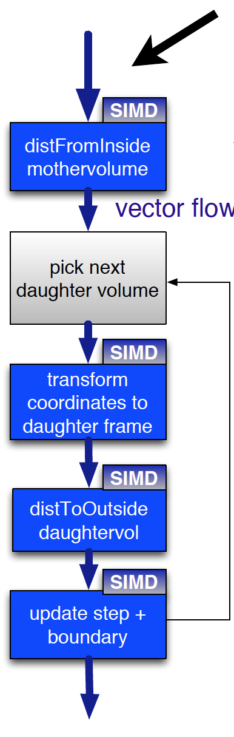
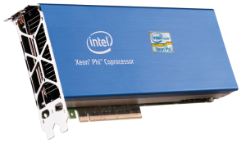
GeantV results on Xeon Phi
X-Ray benchmark
The X-Ray benchmark tests geometry navigation in a real detector geometry
X-Ray scans a module with virtual rays in a grid corresponding to pixels on the final image
Probed the vectorized geometry elements + global navigation as task
Balanced model better
Saturation beyond 2x cores
Geometry is 30-40% of the total CPU time in Geant4
A library of vectorized geometry algorithms to take maximum advantage of SIMD architectures
Basketized performance approaching ideal (N times same) case
 | 16 particles | 1024 particles | SIMD max
Intel Ivy-Bridge (AVX) | ~2.8x | ~4x | 4x
Intel Haswell (AVX2) | ~3x | ~5x | 4x
Intel Xeon Phi (AVX-512) | ~4.1 | ~4.8 | 8x
Vector/scalar profit maximized for nthreads≈core_count
OMP threads
Overall performance for a simplified detector vs. scalar ROOT/5.34.17
Maria Girone, CERN openlab CTO
Notes:
Approaching well the ideal curve up to native cores count

Slide 30
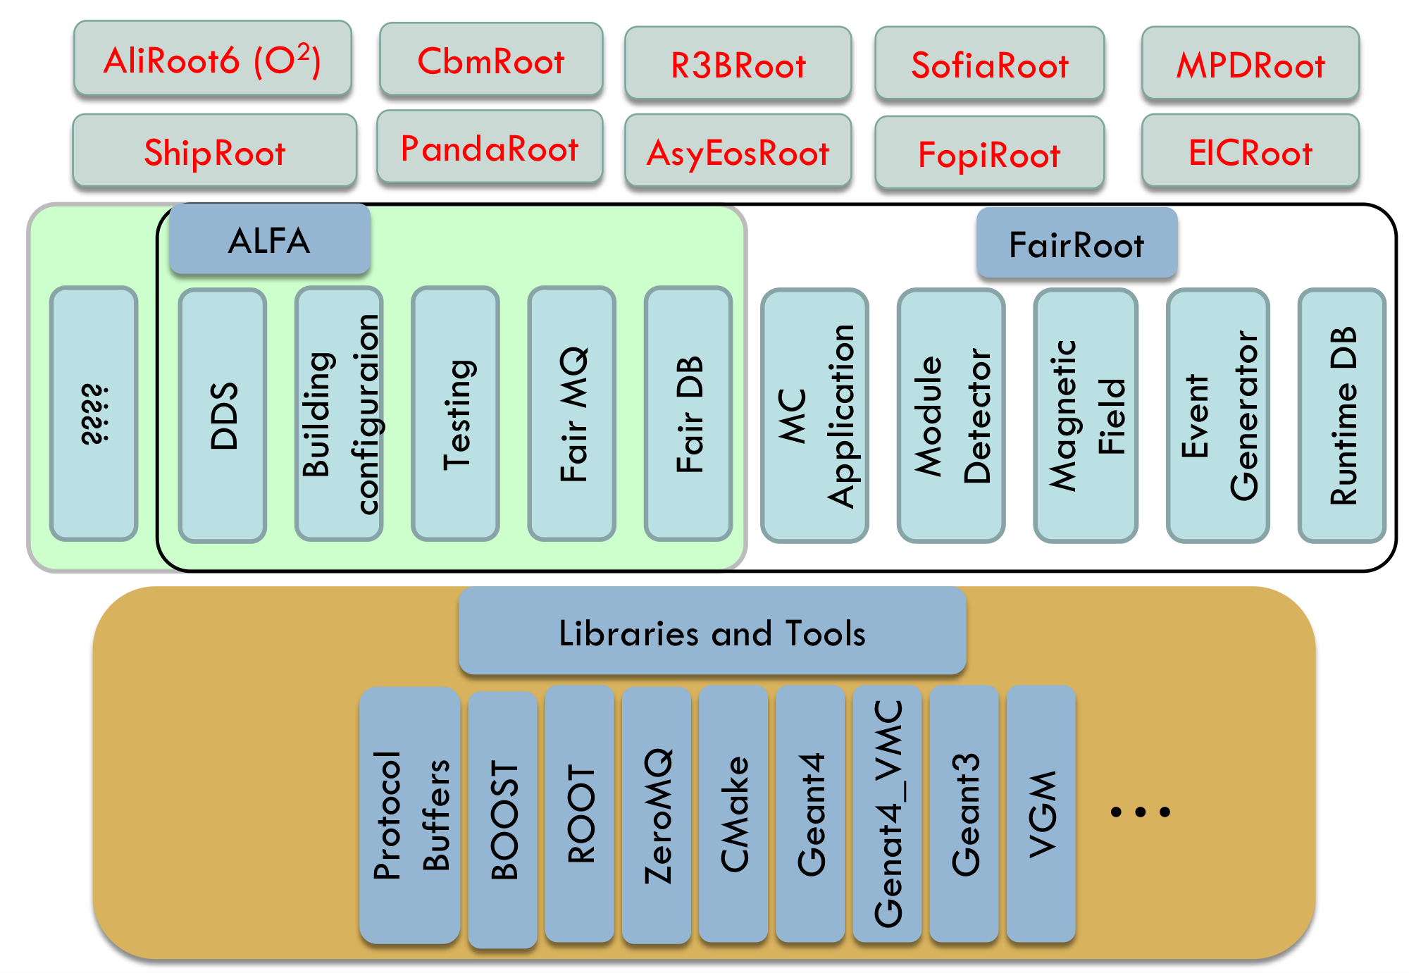
The ALFA project hardware accelerators within the experiments software frameworks
As part of their upgrade ALICE is collaboration with FAIR (an ION accelerator in Germany). ALICE-FAIR project aiming to massive data volume reduction by (partial) online reconstruction and compression
  tighter coupling between online and offline reconstruction software
FairRoot/ALFA allows the use of hardware accelerators to improve performance by treating tasks separately
GPUs, Phi’s, etc.
Work is ongoing to improve the transport performance to/from the Phi with FairMQ
Lets work together
ALFA constitutes a framework that contains:
  Transport layer (FairMQ, based on: ZeroMQ, nanomsg)
  Configuration tools
  Management and monitoring tools
  A data-flow based model (Message Queues based multi-processing)
  Provide unified access to configuration parameters and databases
FairRoot is a common system for reconstruction and simulation
https://fairroot.gsi.de
Maria Girone, CERN openlab CTO

Slide 31
Information Technology Research Areas
Data acquisition and filtering
Collecting data
Networks and connectivity
Connecting resources
Data storage architectures
Storing and serving data
Compute management and provisioning (cloud)
Managing resources for processing
Computing platforms, data analysis, simulation
Improving processing and code efficiency
Data analytics
Extracting information
Maria Girone – CERN openlab CTO

Slide 32
Data Analytics
How to make more effective use of the data collected is critical to maximise scientific discovery and close the resource gap
  There are currently ongoing projects in
    System controls
    Data Storage and quality optimizations
  Organising projects on
    Data reduction
    Optimized formats
    Investigations for machine learning for analysis and event categorization
Maria Girone, CERN openlab CTO

Slide 33
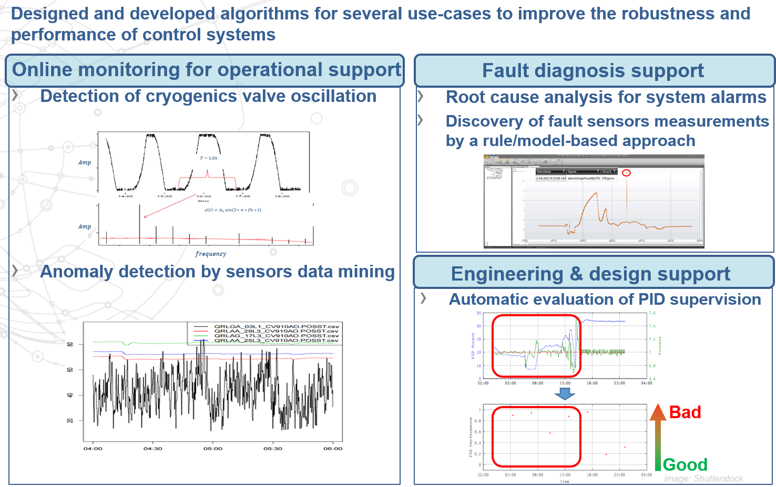

Data analytics for industrial control systems
The LHC is the largest piece of scientific apparatus ever built
There is a tremendous amount of real time monitoring information to assess health and diagnose faults
The volume and diversity of information makes this an interesting application of big data analytics.
Notes:
The LHC is the largest piece of scientific apparatus ever built. There is a tremendous amount of real time monoting information to asses health and diagnose faults. The volume and diversity of information makes this an interesting application of big data analytics.

Slide 34

Data Analytics for Storage and Data Quality Optimization
Data Storage Optimization
  Developed and tested interpretable algorithm that allows saving up to 40% of disk storage
    Data placement based on popularity
Data quality management (anomalies detection)
  Developed algorithm for unmanned anomalies detection for rare anomalies
    Tested on 2015 data
General issues for the experiments and sites

Slide 35
Physics Data Analytics
After the upgrade LHC will collect large datasets. Investigating ways to more efficiently select events from the stream of data using “big data” techniques
  Traditional methods in HEP for deriving a rich data sample from a big data sample have not changed much in high energy physics computing
  Need to reduce multi-petabyte datasets by a factor of 1000 based on physics selection criteria
    Performance, reproducibly, and completeness are all important
Maria Girone, CERN openlab CTO

Slide 36
Looking Forward
2009
2010
2011
2011
2013
2014
2015
2016
2017
2018
2019
2020
2021
2022
2023
2024
…
2030?
First run
LS1
Second run
LS2
Third run
LS3
HL-LHC
FCC?
CERN openlab V has completed its first year
  Consolidation of the ongoing projects, while ensuring innovation and technology evolution are key
Run3 and Run4 represent significant technical challenges
  Big gap in processing need vs what can be procured with flat budgets and expected technology improvements. Solutions will need to be found.
    New architectures and fabrics show potential for big gain
    Software parallelization and vectorization can dramatically improve performance
    Dynamically provisioned resources and improved virtualization grow computing resources
    Better use of the data through improved analysis using big data analytics techniques

Slide 37
Executive contact
Alberto Di Meglio, CERN openlab Head
alberto.di.meglio@cern.ch
Technical contact
Maria Girone, CERN openlab CTO
maria.girone@cern.ch
Fons Rademakers, CERN openlab CRO
Fons.rademakers@cern.ch
Communication contact
Andrew Purcell, CERN openlab Communication Officer
andrew.purcell@cern.ch
Mélissa Gaillard, CERN IT Communication Officer
melissa.gaillard@cern.ch
Admin contact
Kristina Gunne, CERN openlab Administration Officer
kristina.gunne@cern.ch

