Slide 1



The CMS Beam Halo Monitor detector system
Kelly Stifter, University of Minnesota
08/04/15
2015 DPF Meeting, Ann Arbor

Slide 2
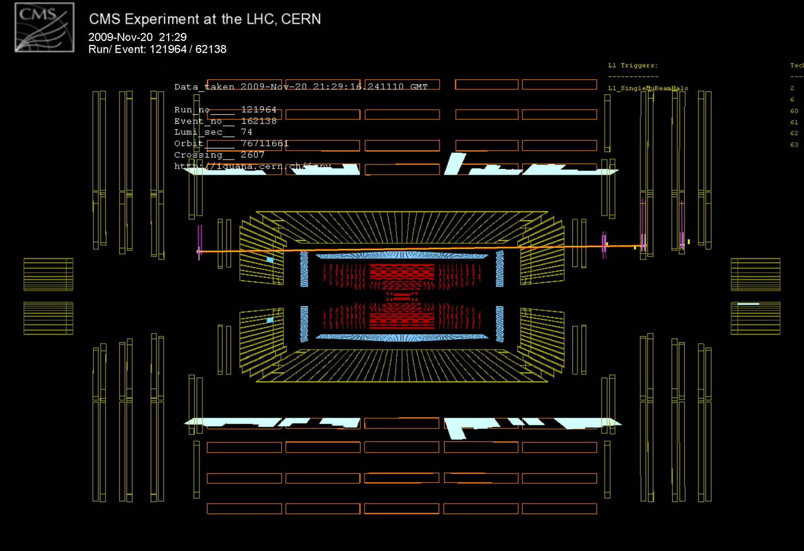
Machine-induced background

Slide 3





CMS BHM Group
A. Dabrowski¹, M. Giunta¹, R. Loos¹, S. Orfanelli^{1,2}, D. Stickland³, F. Fabbri⁴, A. Manna⁴, A. Montanari⁴, N. Tosi^{4,} M. Ambrose⁵, J. Mans⁵, R. Rusack⁵, K. Stifter⁵
1. CERN,
Switzerland
2. National Technical University of Athens, Greece
3. Princeton University, USA
4. INFN Bologna, Italy
5. University of Minnesota, USA

Slide 4
Outline
Machine-induced background
Beam Halo Monitor detector
Detector system
  Detector units
  Electronics
First results
  Splashes
  Correlation to collimator movement
  Commissioning data

Slide 5
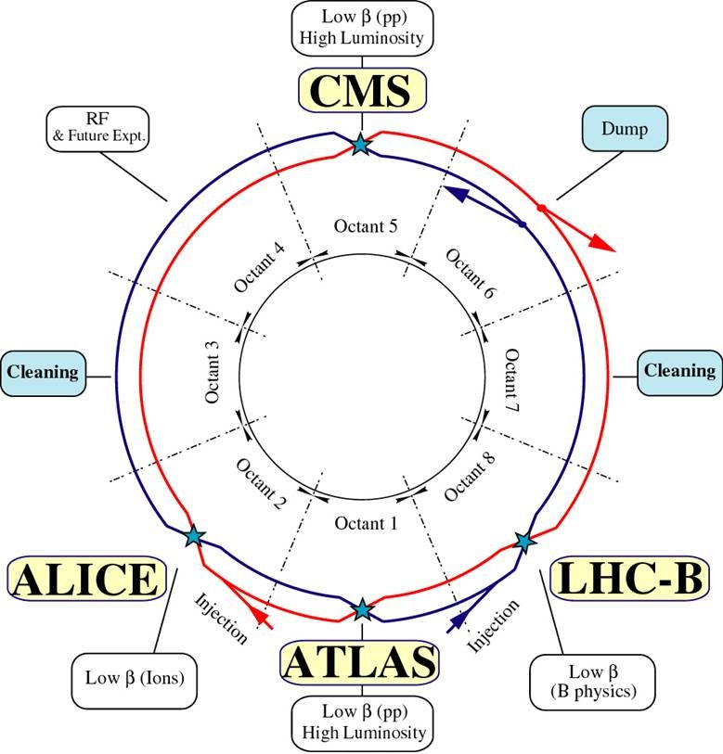
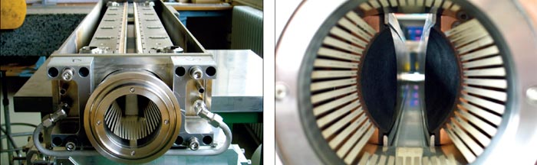
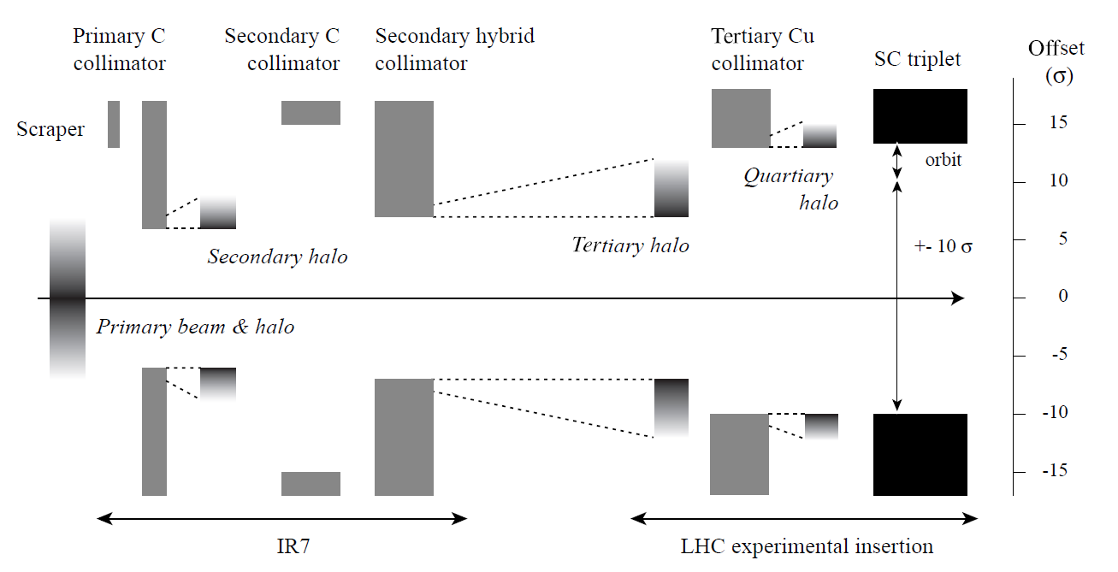
Machine-induced background (MIB)
Interactions with collimators
Beam gas
UFOs

Slide 6
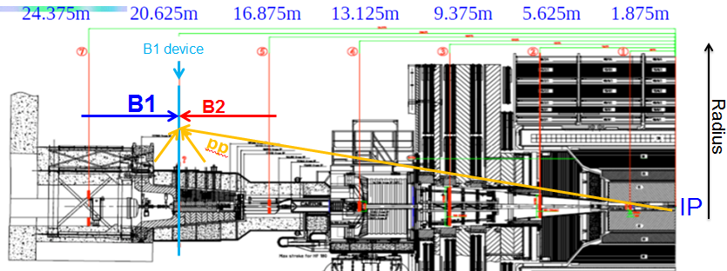
Beam Halo Monitor
Purpose: Provide an online, bunch-by-bunch, per beam MIB rate arriving at CMS at high radius

Slide 7
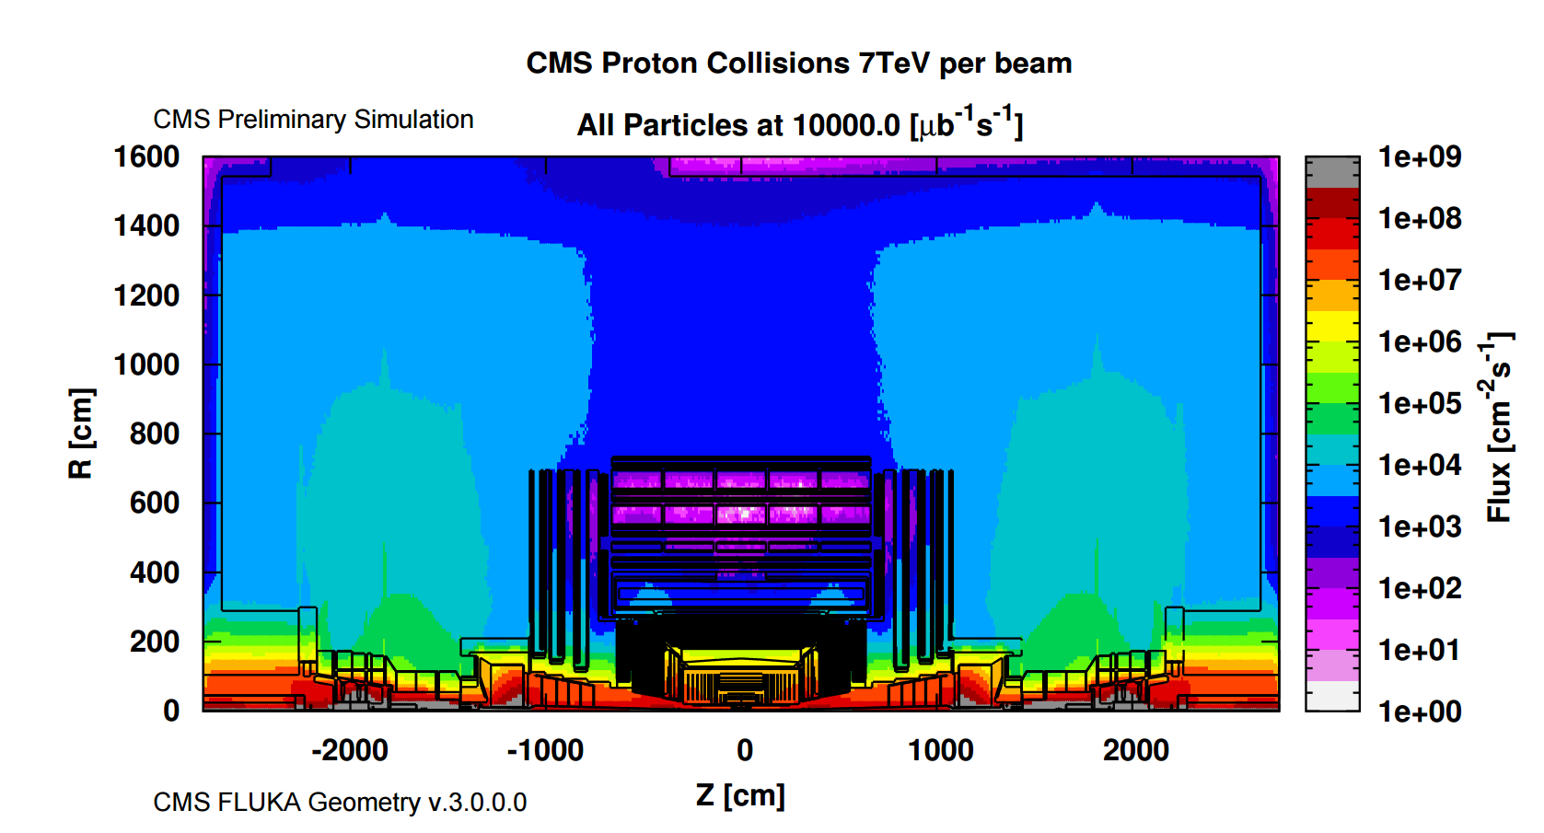
Problem
Many more collision products (~10⁴Hz/cm²) than MIB particles (~1Hz/cm²)
Must find MIB signal amidst collision products ➔ factor of ≥10⁴ suppression required
Solutions: DIRECTION-SENSITIVITY and PRECISION TIMING
BHM Location

Slide 8
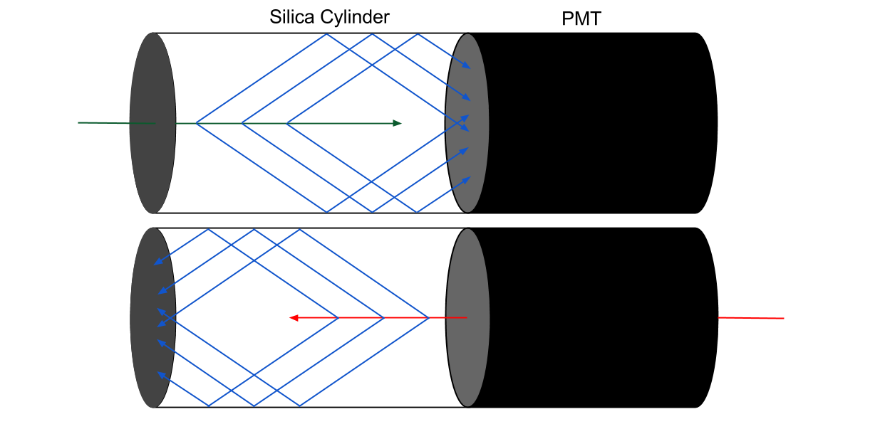
Direction sensitivity
MIB muon: Arrives with incoming beam. Cherenkov radiation is seen by PMT.
Collision product: Arrives in opposite direction. Cherenkov radiation is absorbed by black paint.
Cherenkov radiation:
Insensitive to neutron and gamma backgrounds
Prompt signal in time with incoming particle
Use quartz, radiation hard & UV transmissive
Large signals – ~60 p.e./cm for forward particle
Black paint
2014 DESY test beam: Background rejection of >99.99%
With forward acceptance of >98%

Slide 9

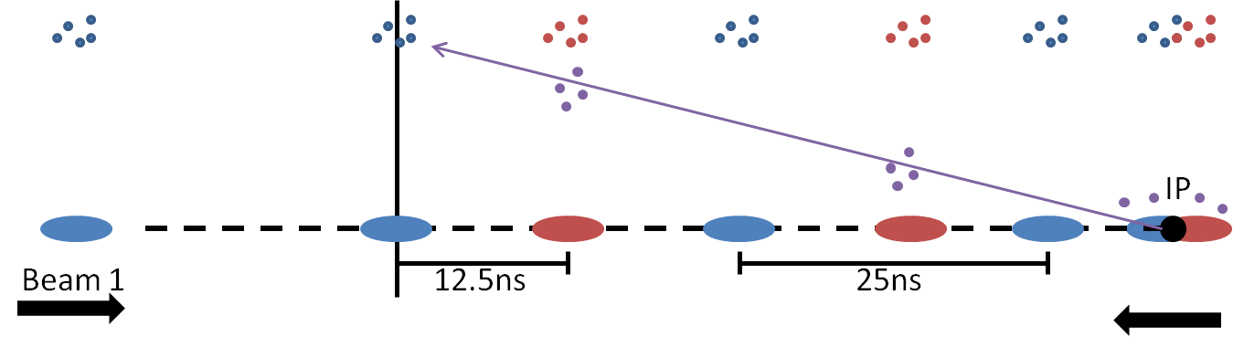
Timing
Golden locations allow for maximum separation in timing
12.5ns
25ns
Beam 2

Slide 10
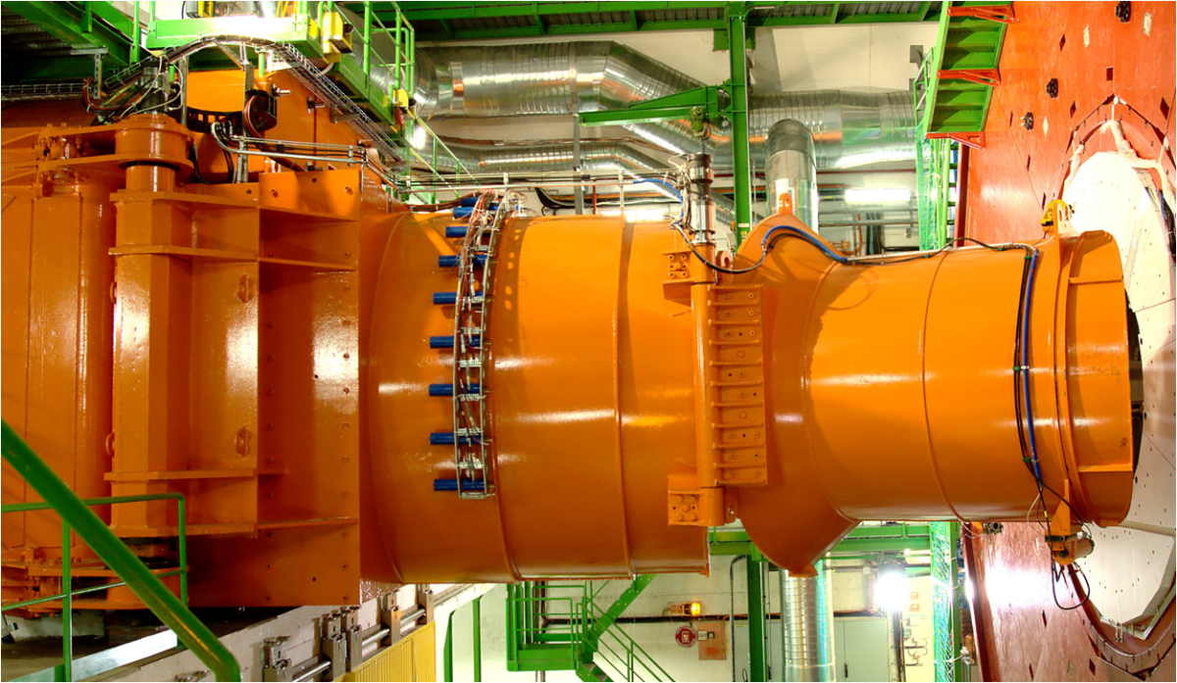
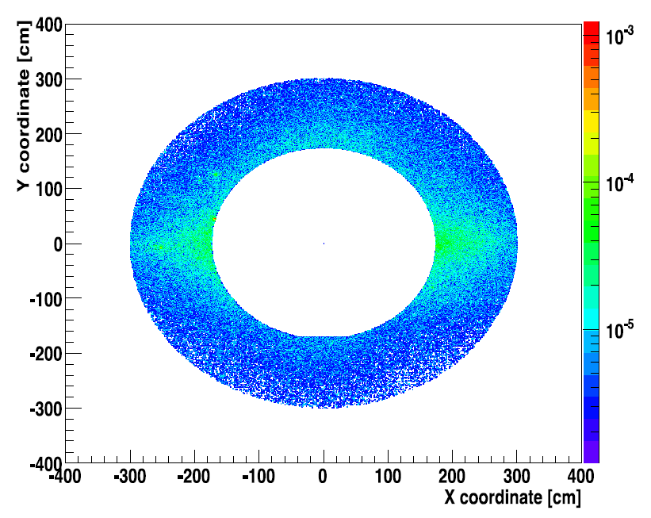
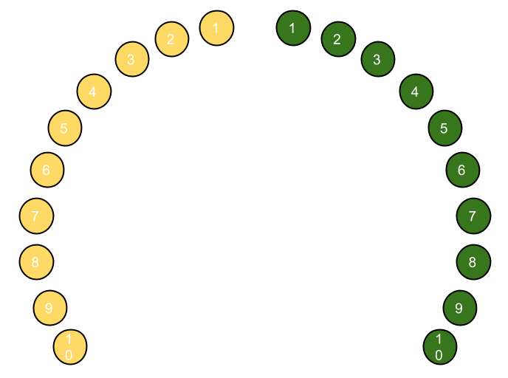
Detector placement
Golden location 6 – 20.6m from IP
40 detectors, 20 at each end
Acceptance of
21.2 cm²/unit,
424 cm²/beam
Installed at radius of 1.8m from beam
Placed in φ-region of highest flux

Slide 11
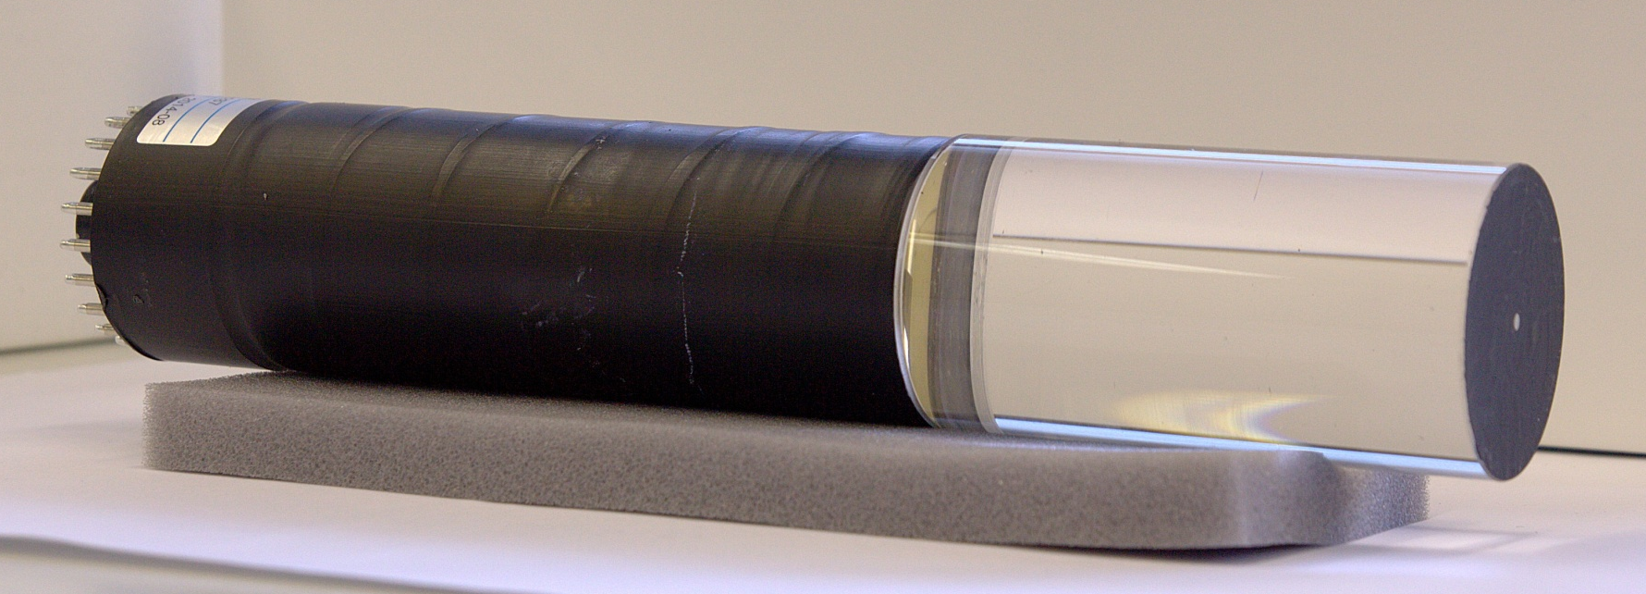
Detector units
SQ0 synthetic fused silica: 10 cm long, 5.2 cm diameter, UV transmissive, radiation hard
Optically coupled to UV sensitive Hamamatsu R2059 PMT
3 layers of magnetic shielding: Permalloy, mumetal, iron

Slide 12
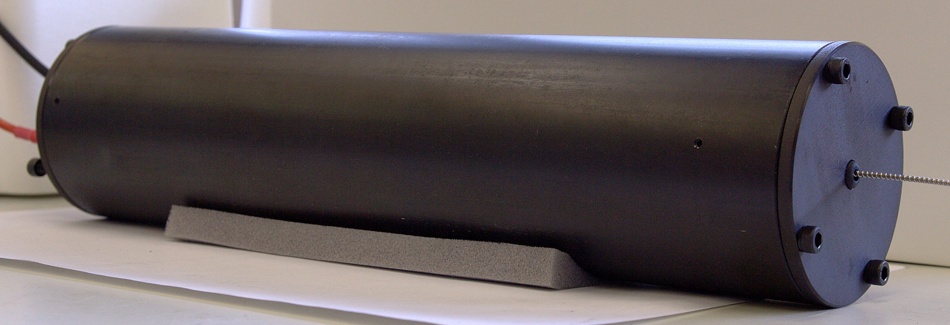
Detector units
SQ0 synthetic fused silica: 10 cm long, 5.2 cm diameter, UV transmissive, radiation hard
Optically coupled to UV sensitive Hamamatsu R2059 PMT
3 layers of magnetic shielding: Permalloy, mumetal, iron

Slide 13
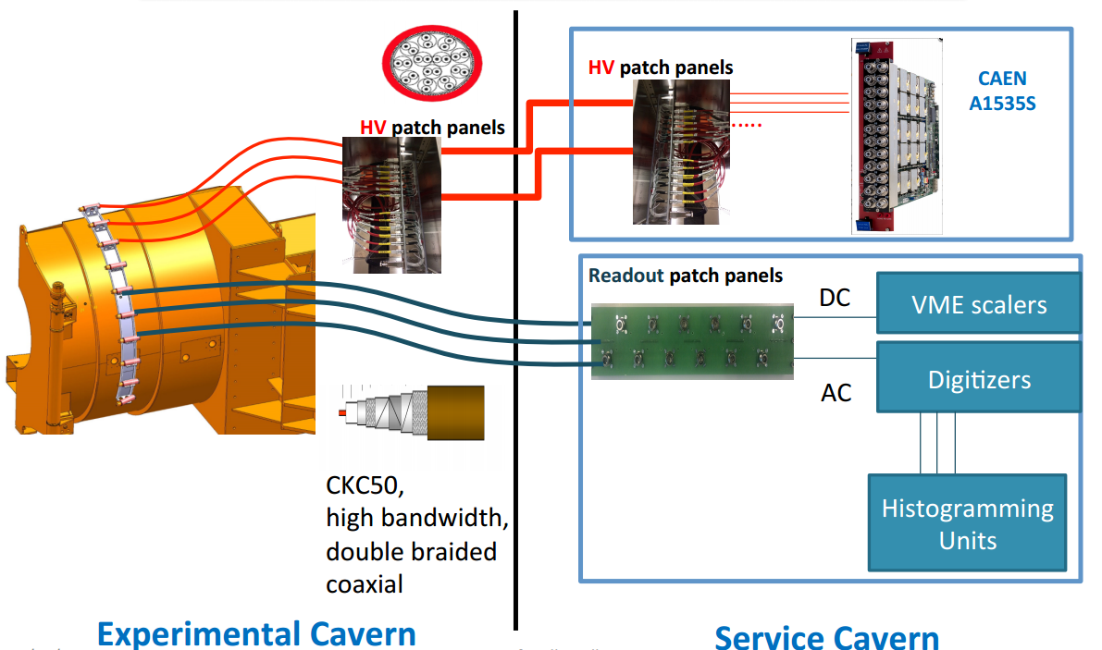
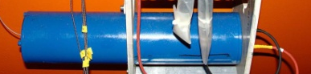
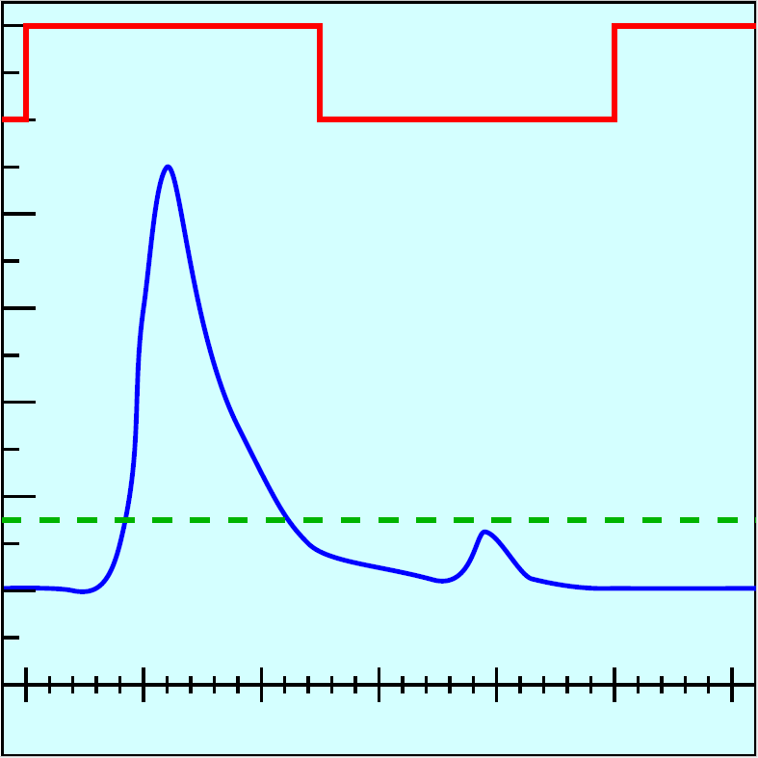
Read-out chain
Patch panel: N-type to LEMO
Service Cavern
Experimental Cavern
VME QDC
DAQ
Discriminator/Scaler
CKC50: high bandwidth, double braided coaxial
QIE10
μHTR
DAQ
CMS Standard – HCAL Phase I upgrade readout
Every BX, every detector ➔ get 8-bit charge and 6-bit timing information
  Histogram (μHTR)
Calculate flux
  Published to CMS and LHC operations every ~23s
12.5ns
Amplitude

Slide 14
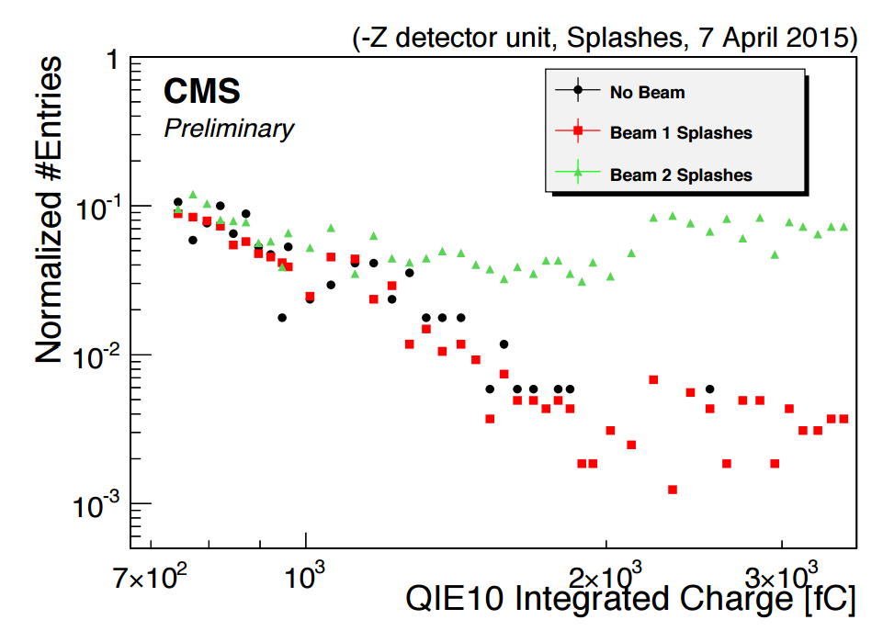
Splashes
Indication of directionality: a unit measuring beam 2 sees only beam 2 splashes, no beam 1 splashes
(Beam 2

Slide 15
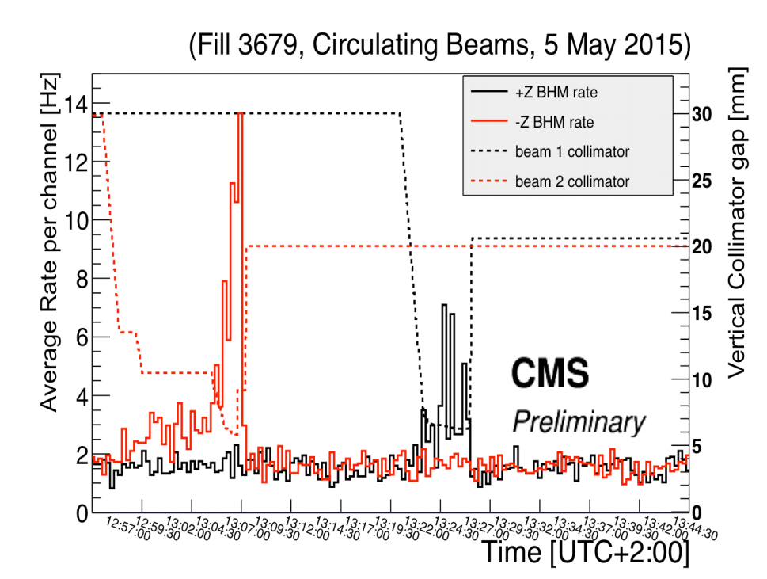
Correlation to collimator movement

Slide 16
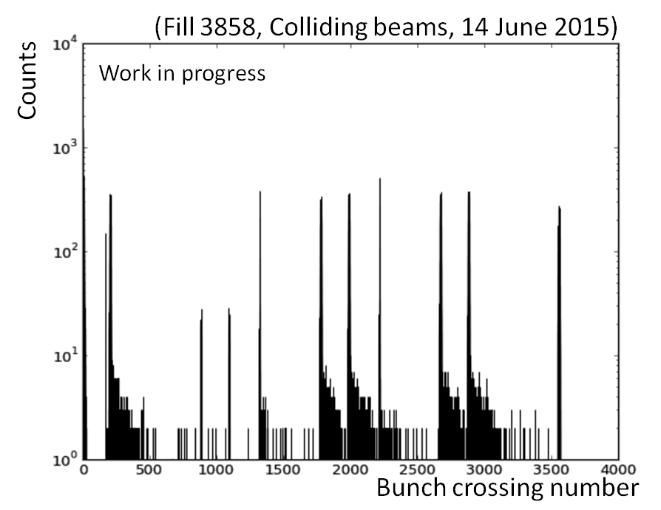
Detector commissioning
Commissioned with low detector thresholds
Detailed bunch structure seen
Tail consistent with albedo from cavern
~88μs

Slide 17
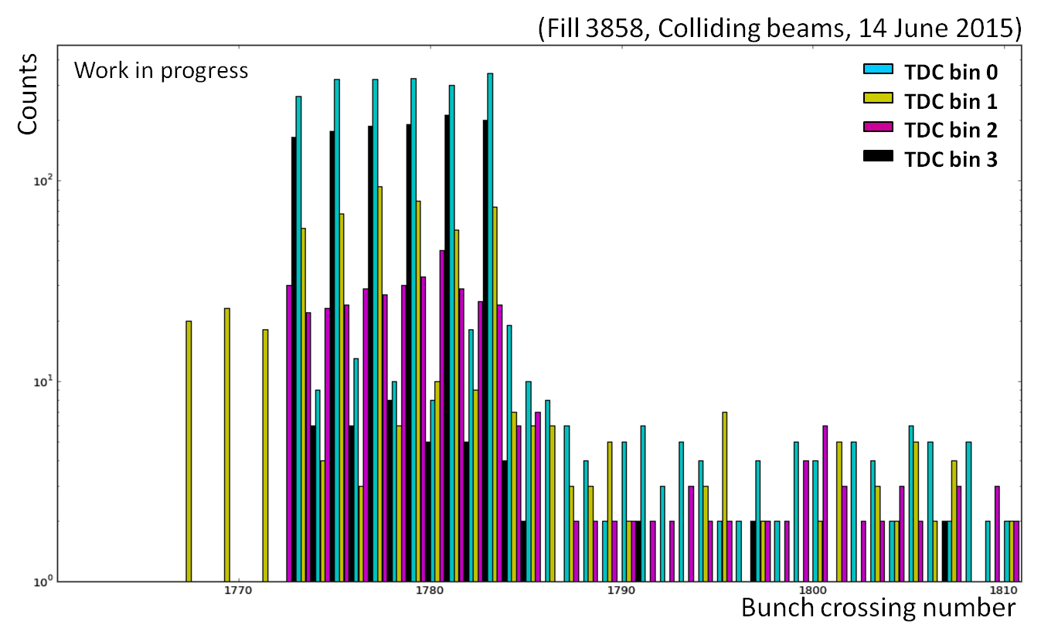
Detector commissioning
Three bunches of pure background
5.5
0
2
4

Slide 18
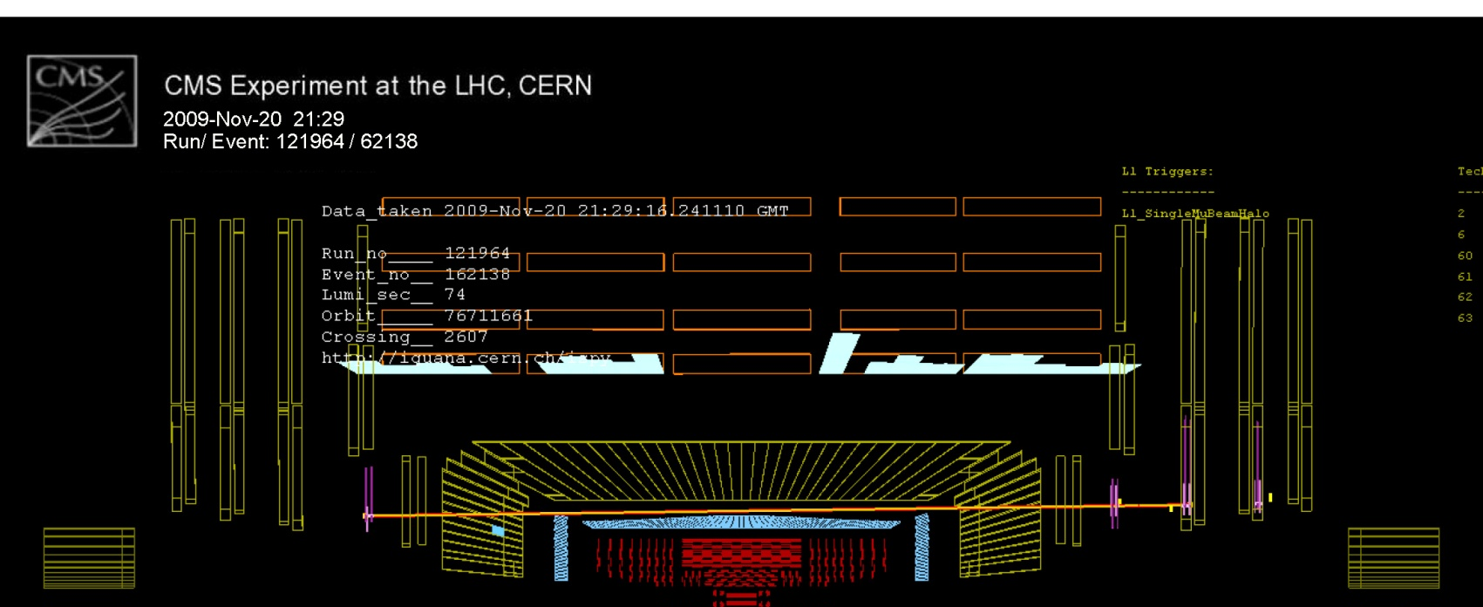
Summary
New Beam Halo Monitor (BHM) will provide an online, bunch-by-bunch, per beam MIB rate arriving at CMS at high radius
Takes advantage of directional nature of Cherenkov radiation and golden location timing to separate MIB from collisions product signals

Slide 19
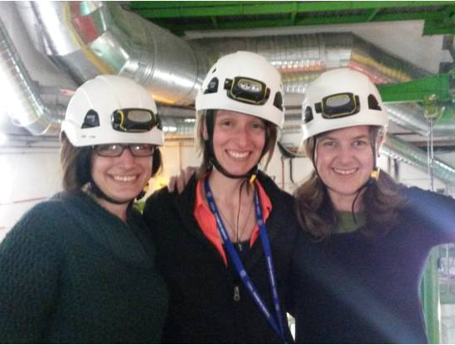
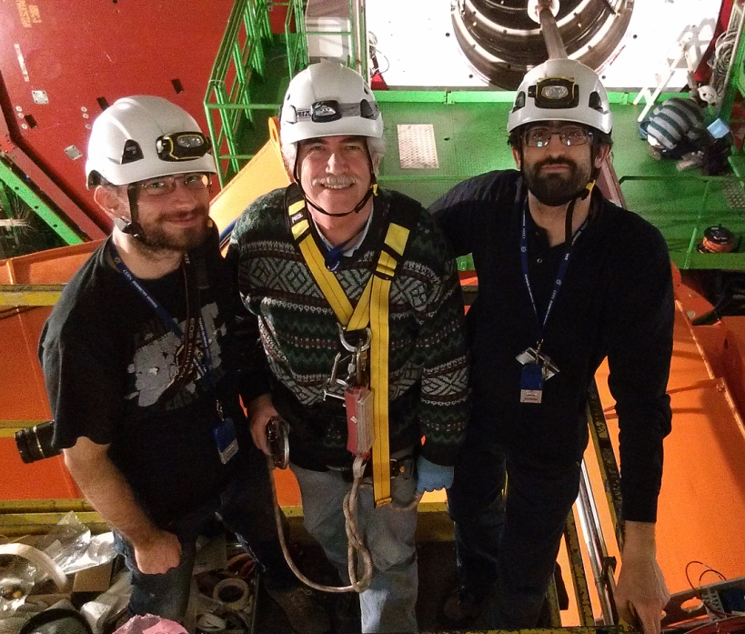
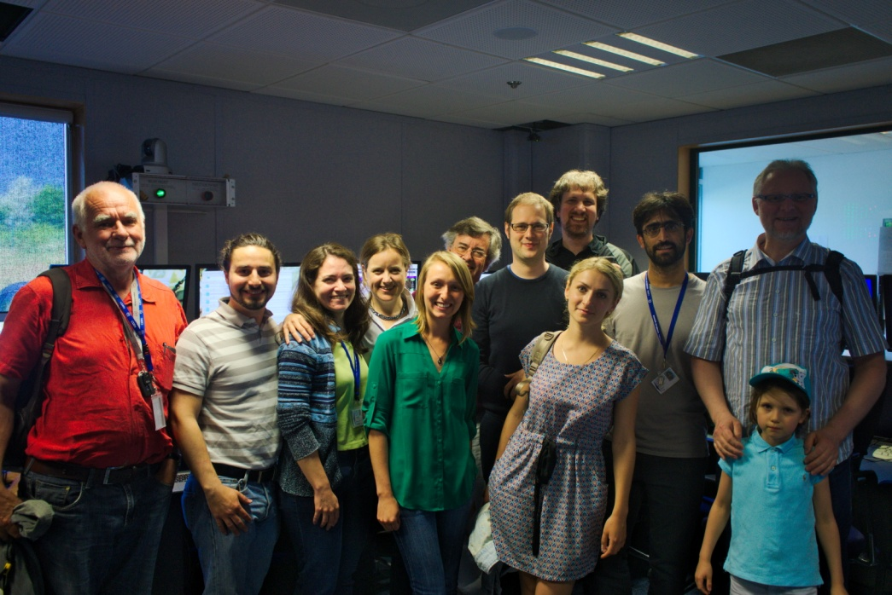
Acknowledgements
University of Minnesota: R. Rusack, J. Mans
BRIL: A. Dabrowski
BHM: N. Tosi, S. Orfanelli
Other UMN, CERN, and Bologna students and technicians

Slide 20
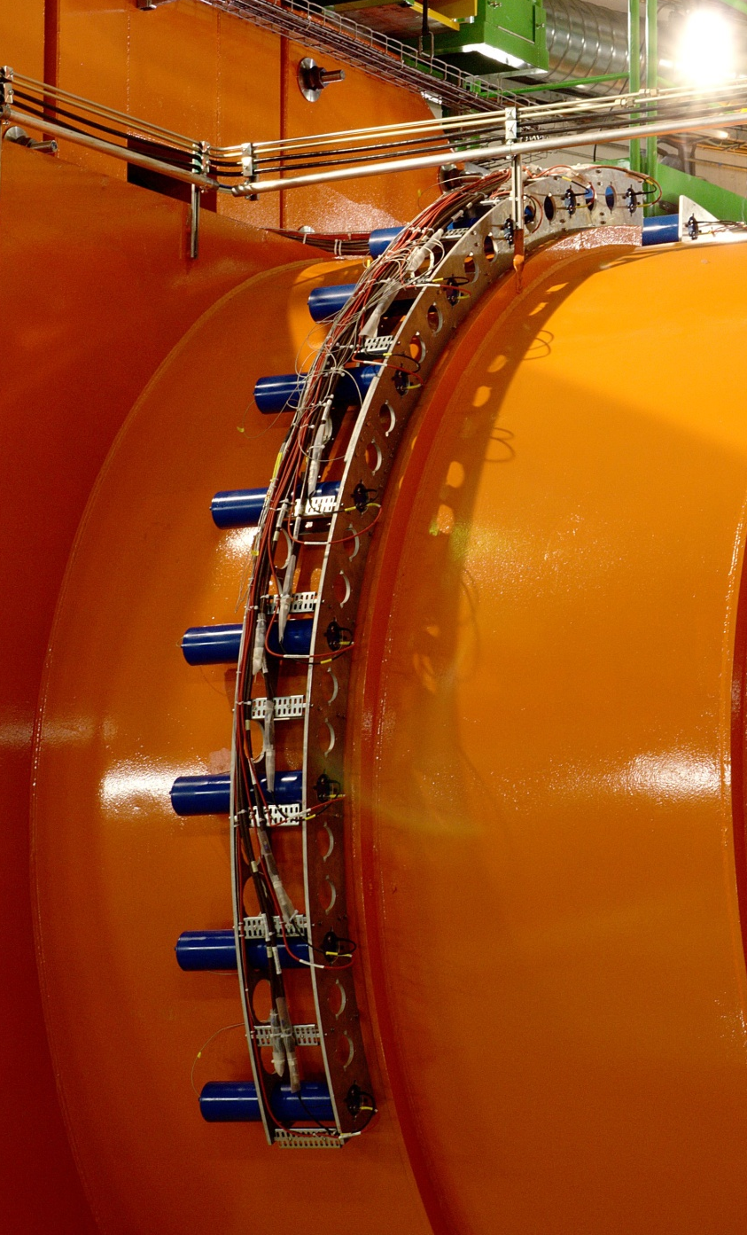
Additional Slides

Slide 21
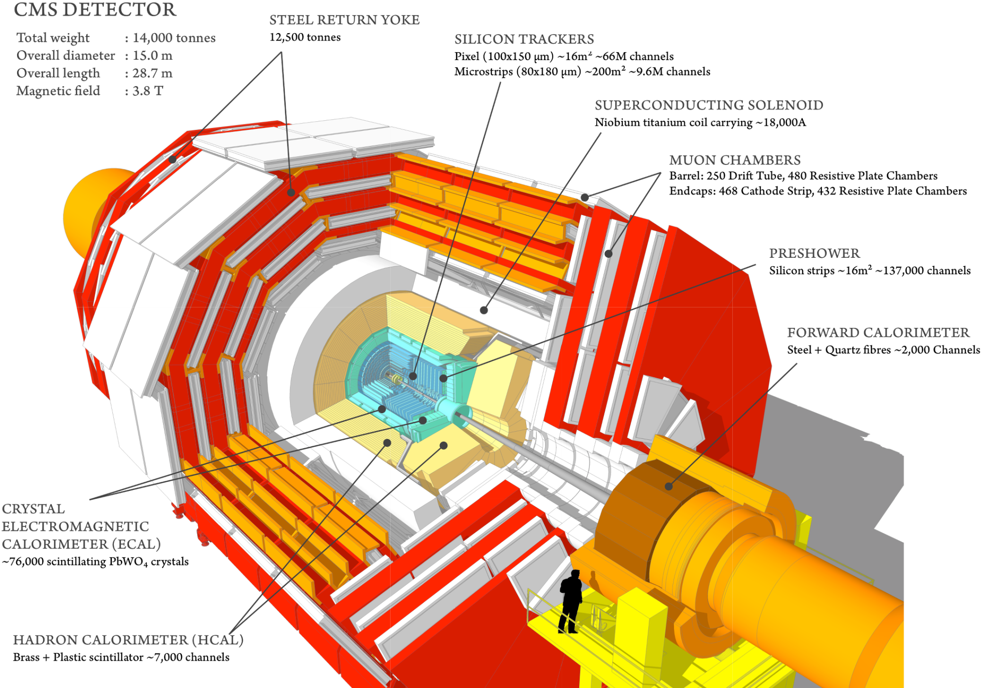
The CMS detector

Slide 22
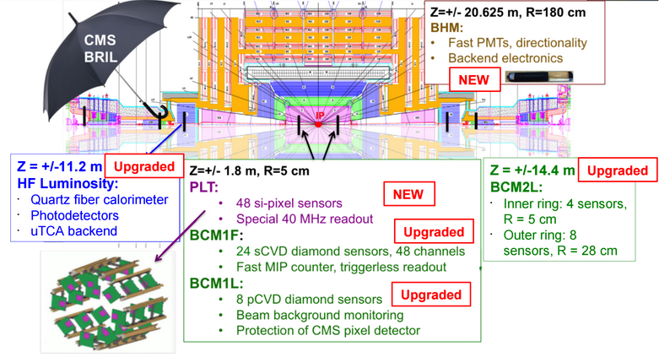
Beam, Radiation, Instrumentation, and Luminosity

Slide 23
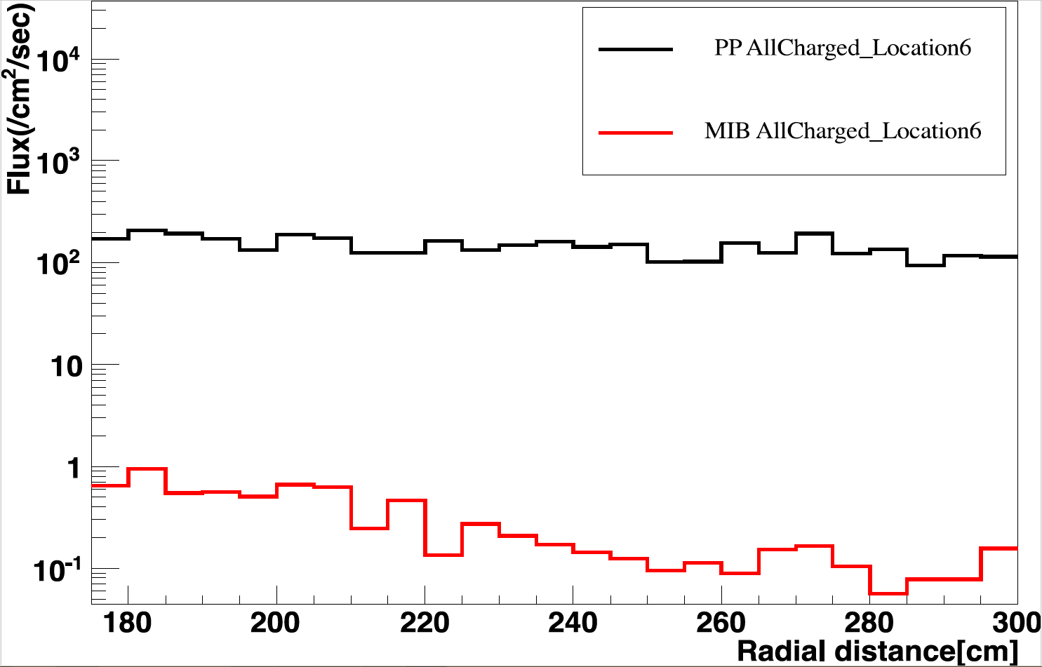
MIB vs. PP
MIB
PP

Slide 24
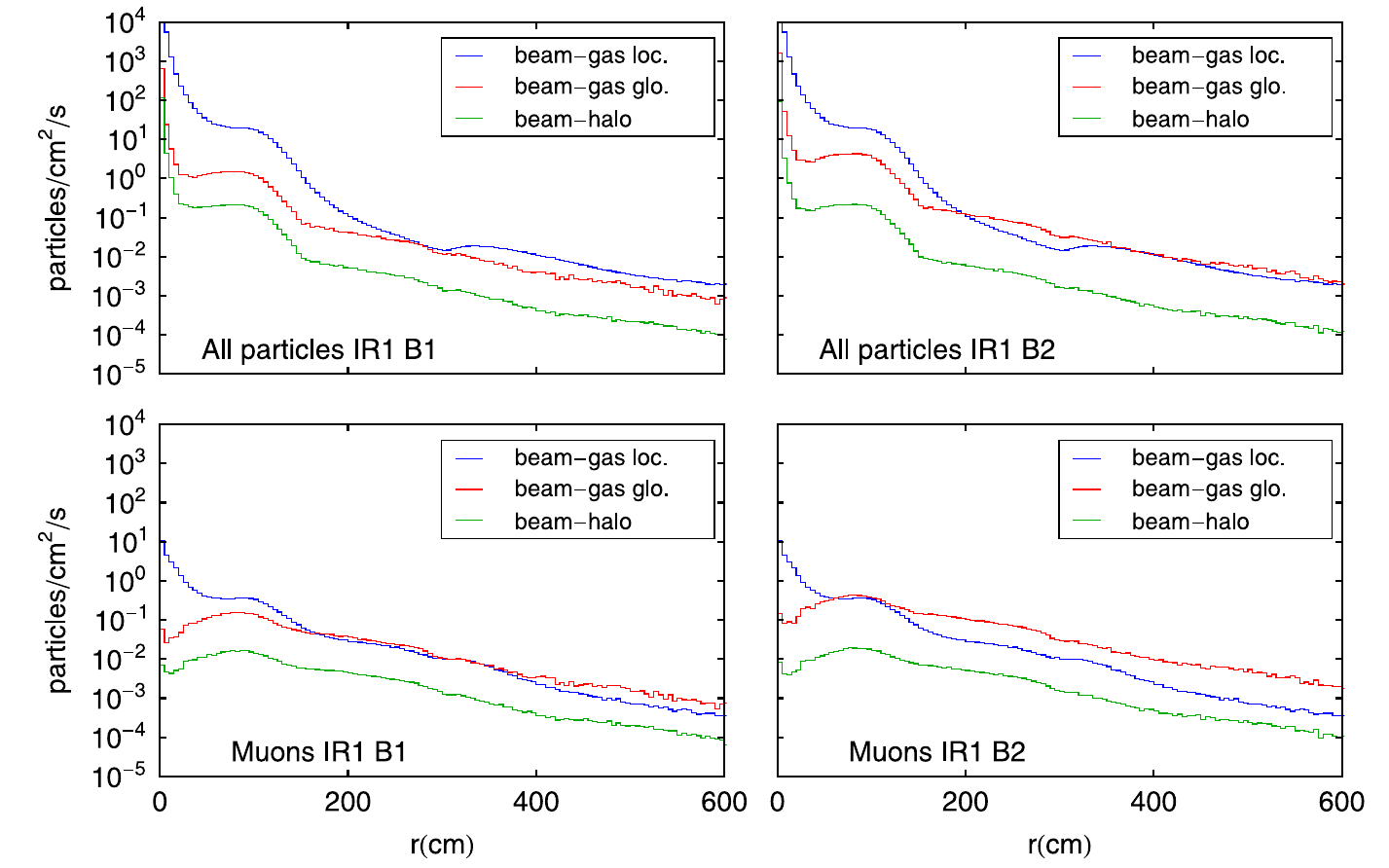
Beam halo contributions

Slide 25
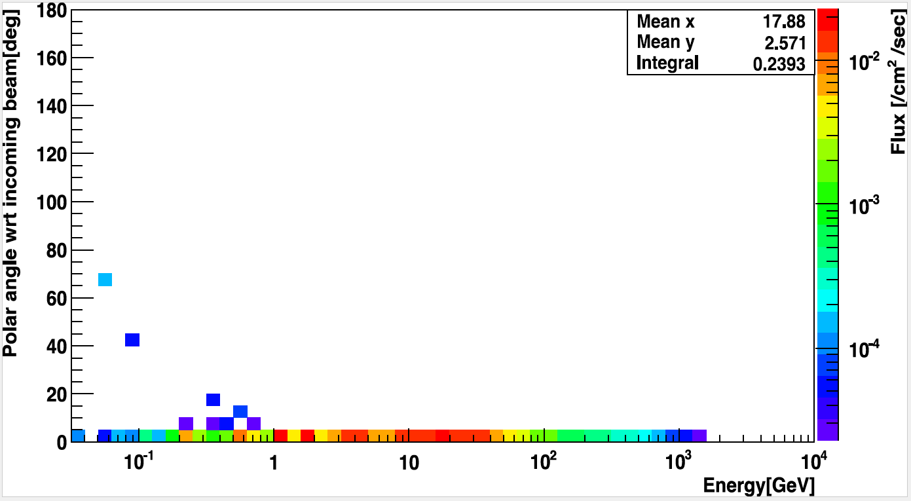
MIB muons

Slide 26
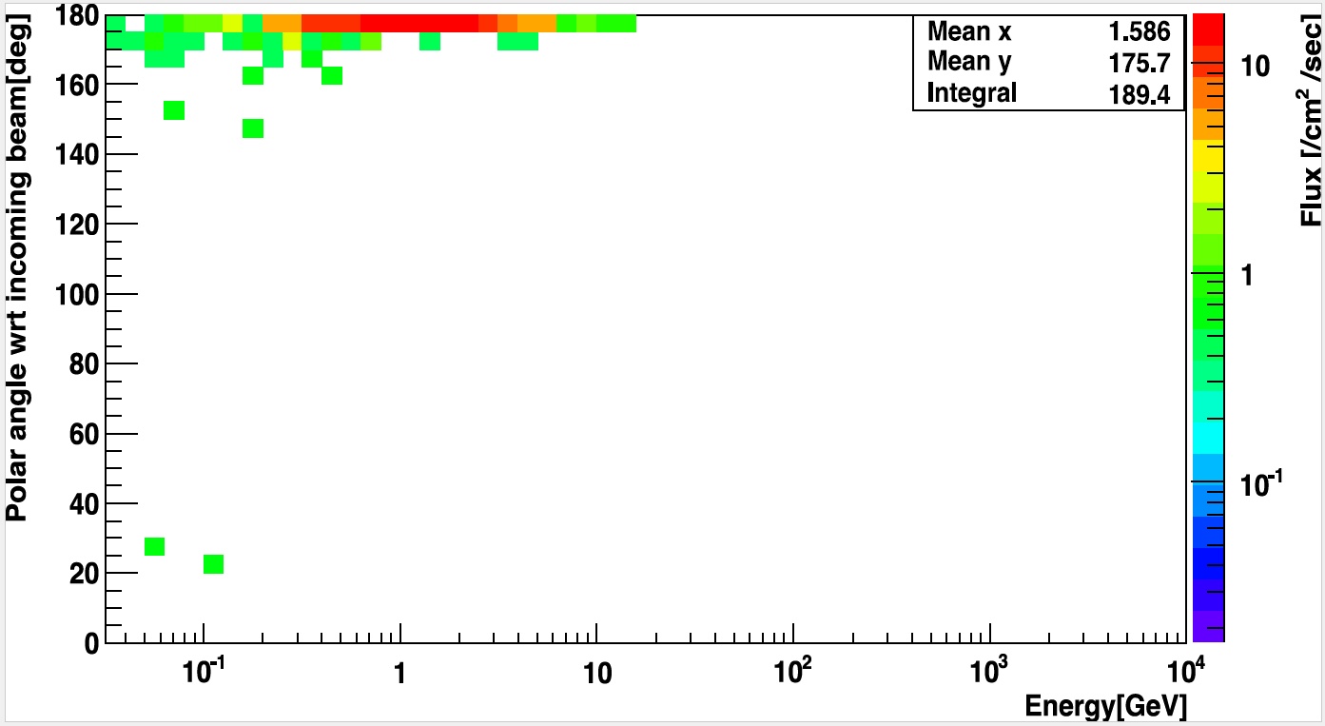
PP muons

Slide 27
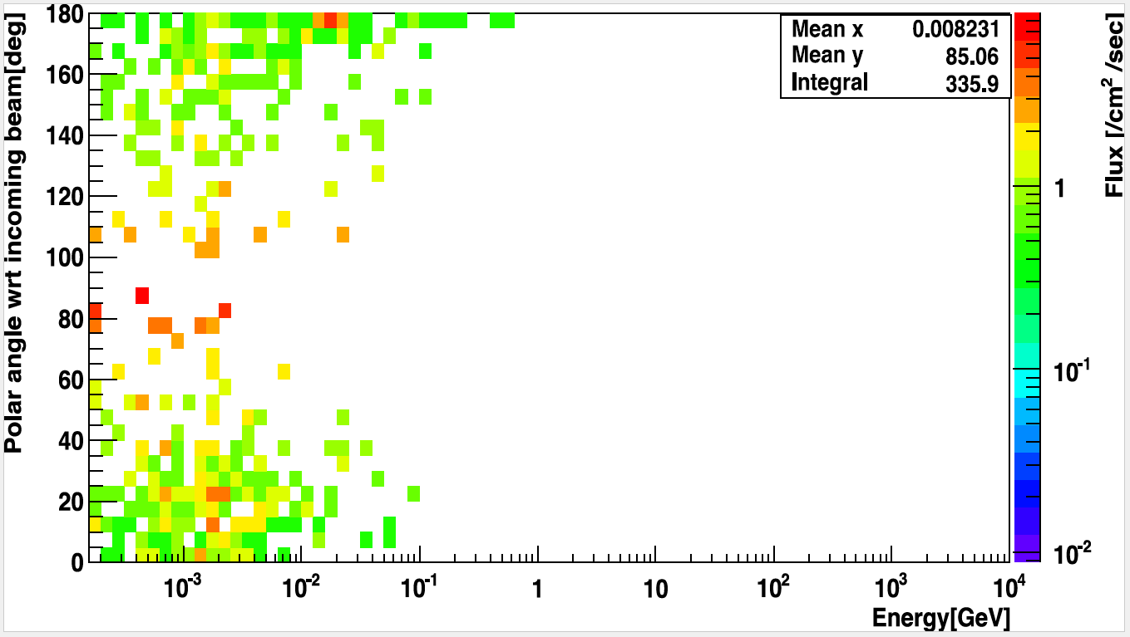
PP electrons

Slide 28
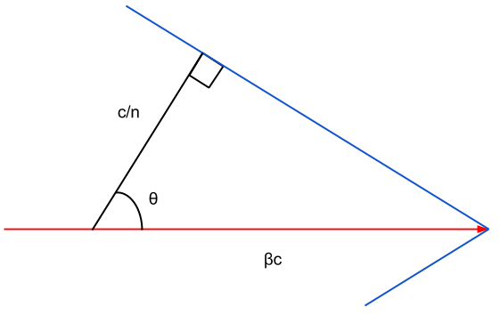
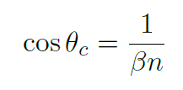
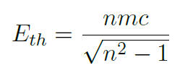
Cherenkov angle
2
≈ 142 MeV for muons

Slide 29
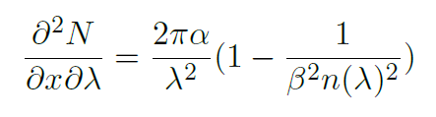
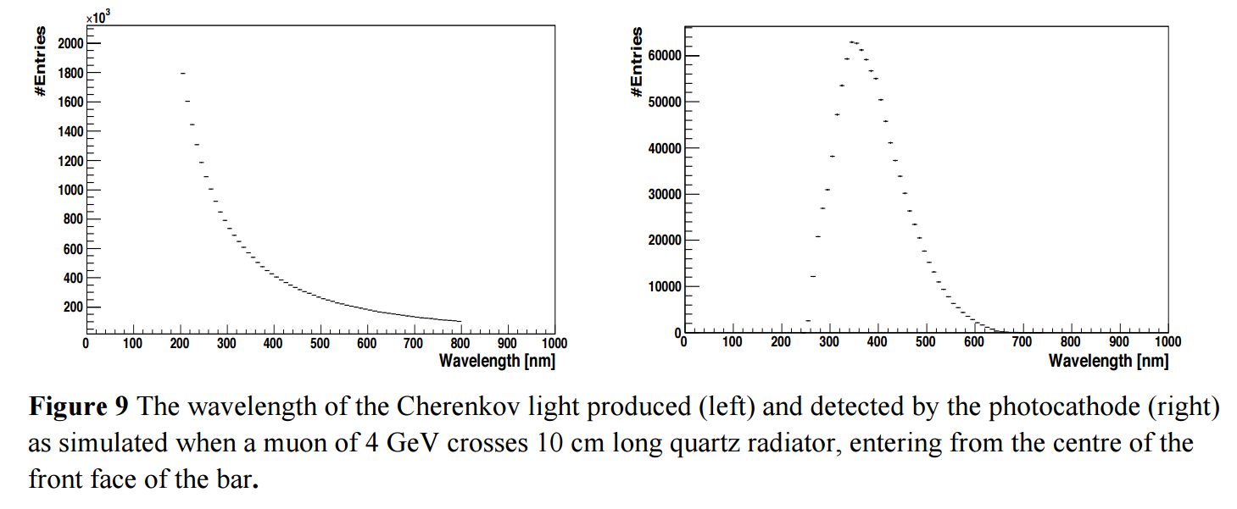
Cherenkov radiation

Slide 30
Timing
Golden locations allow for maximum separation in timing
IP
6.5
3.75
1
5.75
2
4.75
3
Beam 1
Beam 2

Slide 31
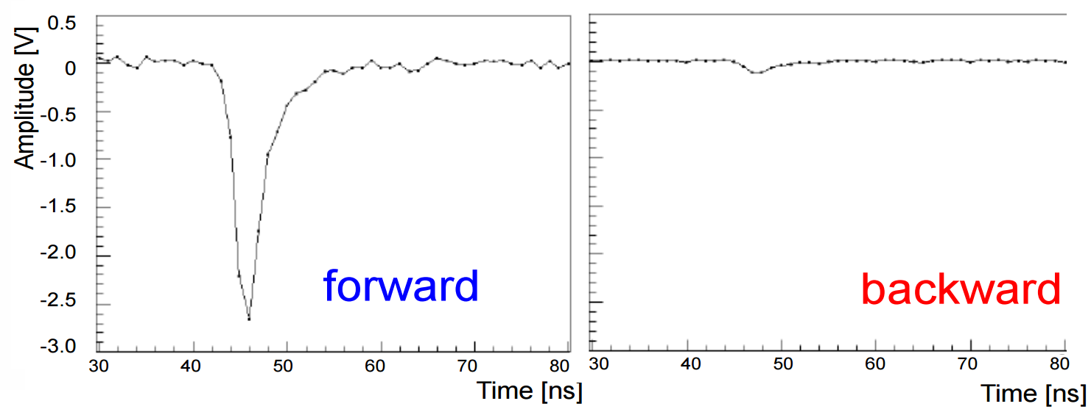
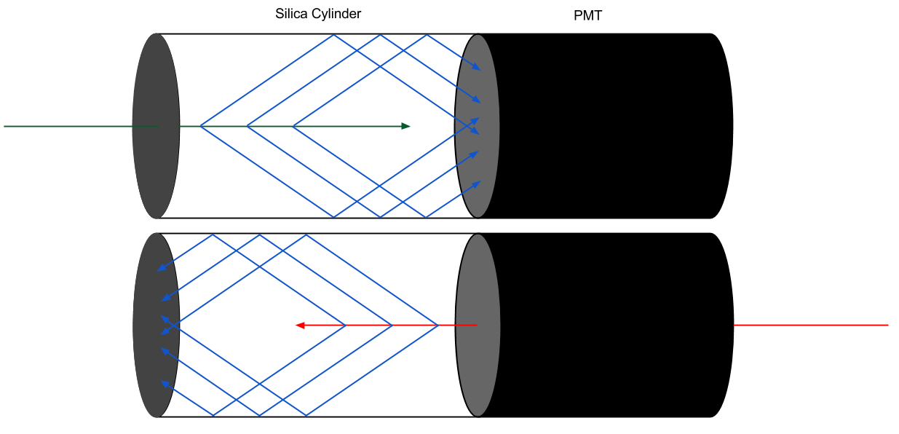
Test beam results
Test beam studies performed at CERN in 2012
forward
backward

Slide 32
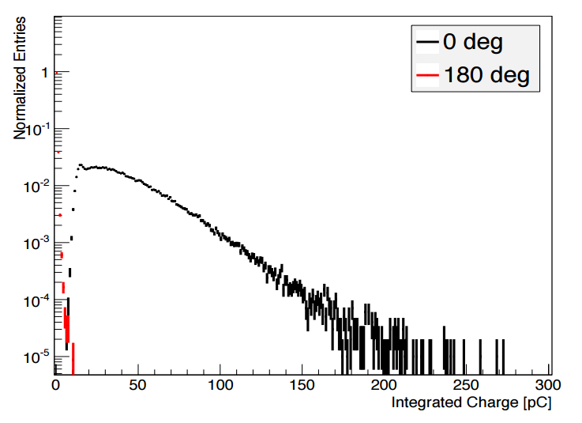
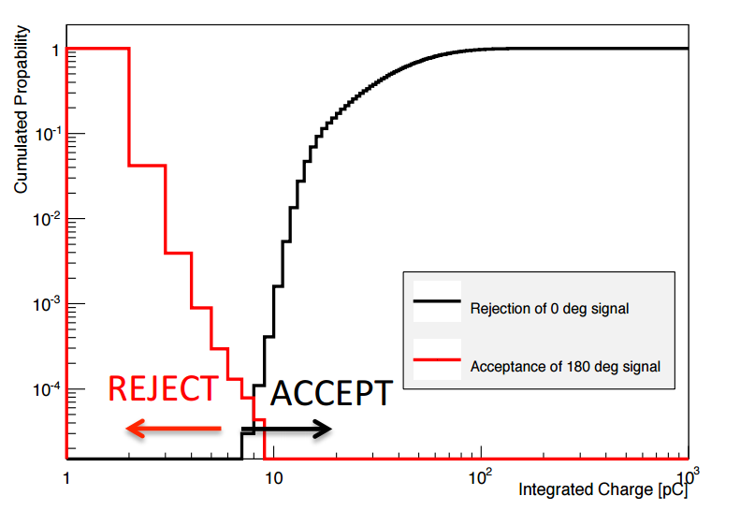
Test beam results
Test beam studies performed at DESY in 2014
Amplitude cut: Backward suppression to 0.01%, forward acceptance 100%

Slide 33
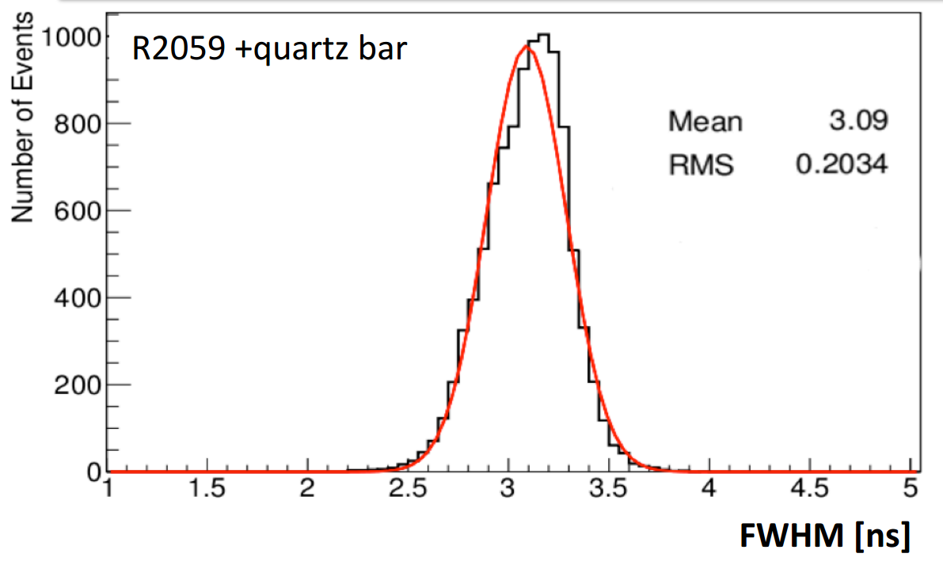
Test beam timing

Slide 34
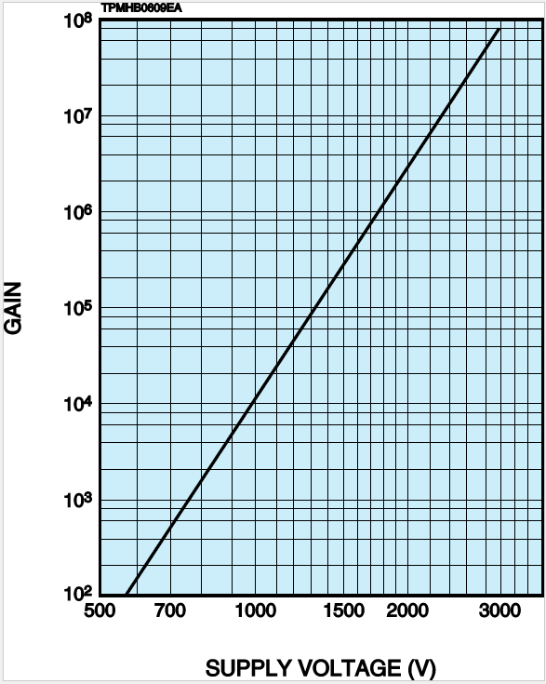
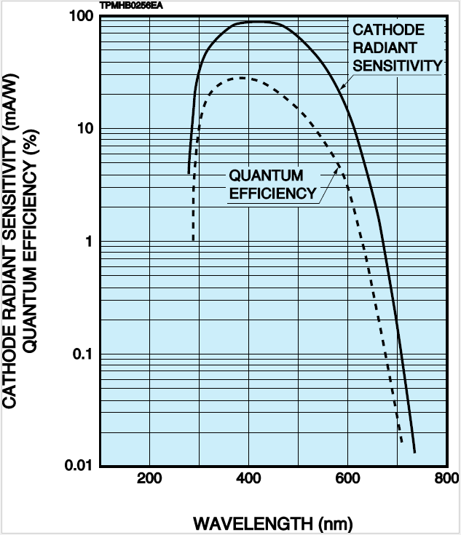
Hamamatsu R2059

Slide 35
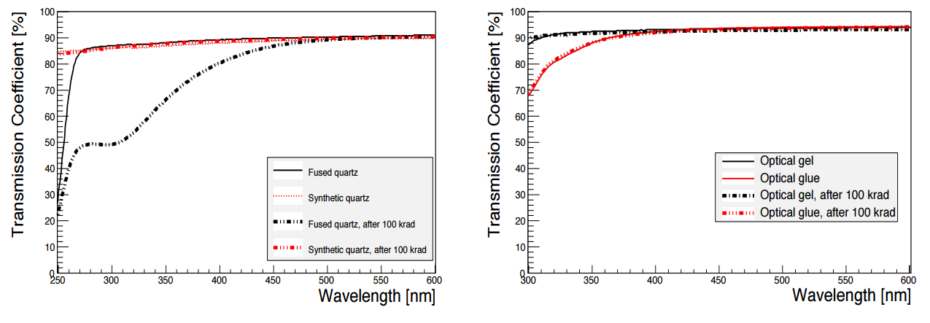
Radiation studies
Unit irradiated with 3000 fb⁻¹ of γ rays

Slide 36
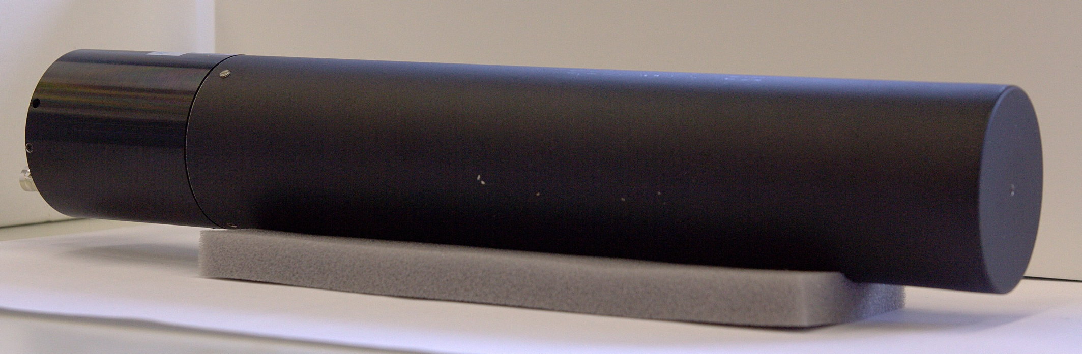
Detector units
Permally layer

Slide 37
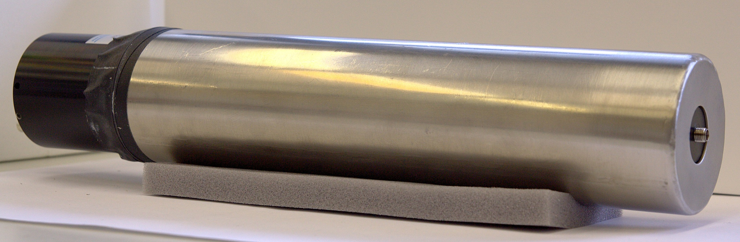
Detector units
Mumetal layer

Slide 38
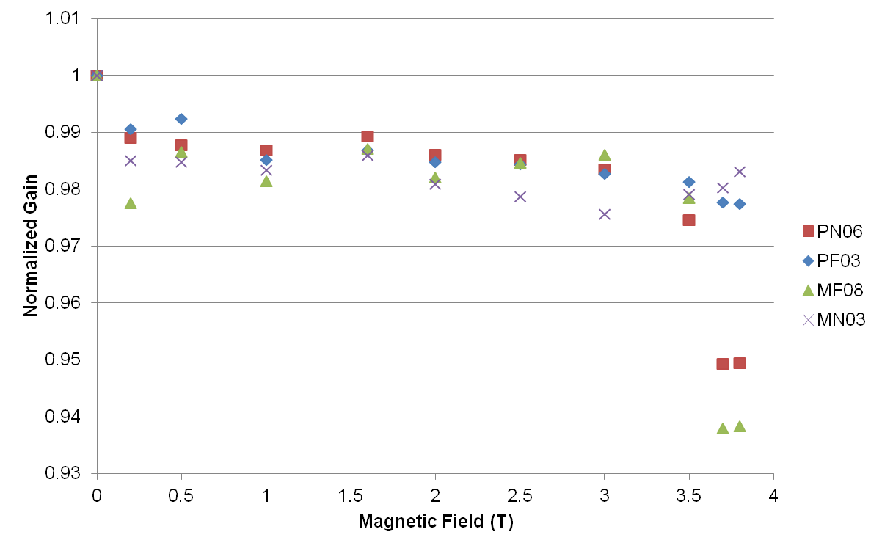
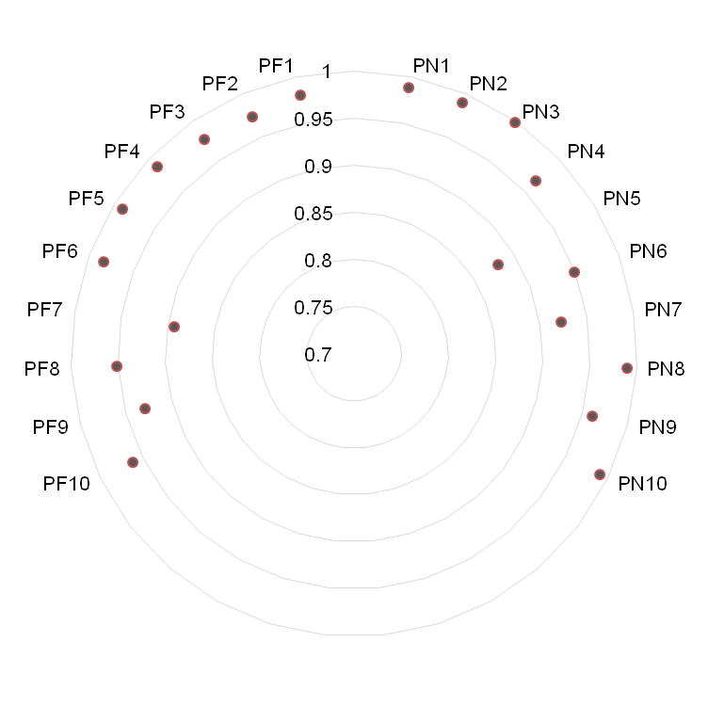
Magnetic shielding efficiency
Gain decreases as field increases
Largest decrease ~10%
% decrease at 3.8T

Slide 39
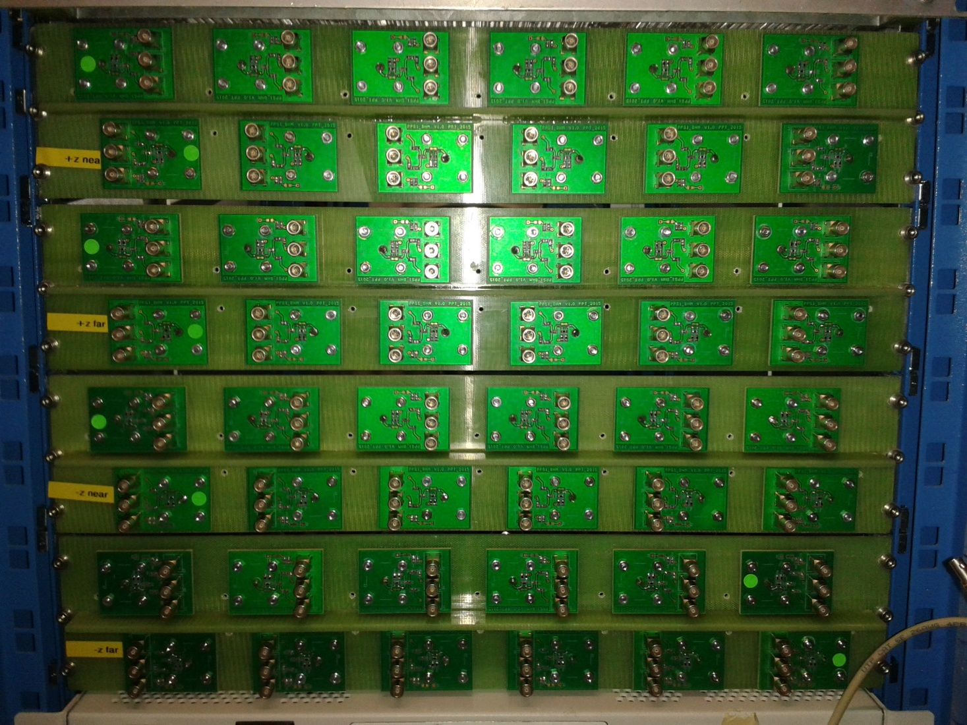
Patch panel
Acts as passive splitter and attenuator
To VME readout
To QIE10 readout
Reference, required by QIE10

Slide 40

Read-out electronics
QIE10: digitizer
uHTR: histogramming unit
Other units: power, clocks, slow control, data read-out

Slide 41

Electronics Overview

Slide 42


QIE10
Reads analog PMT signal
24 QIE10 ASICs:
Integrates charge over 25ns, produces 8-bit ADC value (0-340pC)
Produces 6-bit TDC value based on fixed-threshold leading edge measurement (.5ns resolution)
Igloo2 FPGAs:
Collect and format data
Data sent to back-end via 5Gbps asynchronous optical link

Slide 43

QIE10 Range

Slide 44

QIE10 input

Slide 45

QIE10 block diagram

Slide 46

uHTR block diagram

Slide 47

Setting thresholds
Cut out majority of PP events, in addition to cosmics

Slide 48

Setting thresholds

Slide 49

Read-out electronics: VME
Background rate:
  Fan out
  Discriminator
  Scaler
Amplitude measurement:
  Fan out
  QDC

Slide 50





Calibration system
Measures health of system over time
UV LED pulses of known timing and amplitude distributed to all PMTs, plus reference

Slide 51



Temporary calibration system
Measures health of system over time
UV LED pulses of known timing and amplitude distributed to all PMTs, plus reference

Slide 52

Calibration system
Delivers pulses of expected signal size, ~600 photoelectrons

Slide 53

BHM in BrilDAQ
BrilDAQ: based on xDAQ publisher/subscriber framework
bhmsource – reads out histograms from uHTRs
bhmprocessor – calculates background rate for each beam, publishes every lumi section (2¹⁸ orbits = ~23s)

Slide 54
System overview
HV power supply
40 units
BrilDAQ

Slide 55

Splash events
Send a bunch directly into the TCTs – creates a ‘splash’ of particles in one direction
Splash

Slide 56

Splashes

Slide 57



Beam losses

Slide 58
VME results

