Slide 1
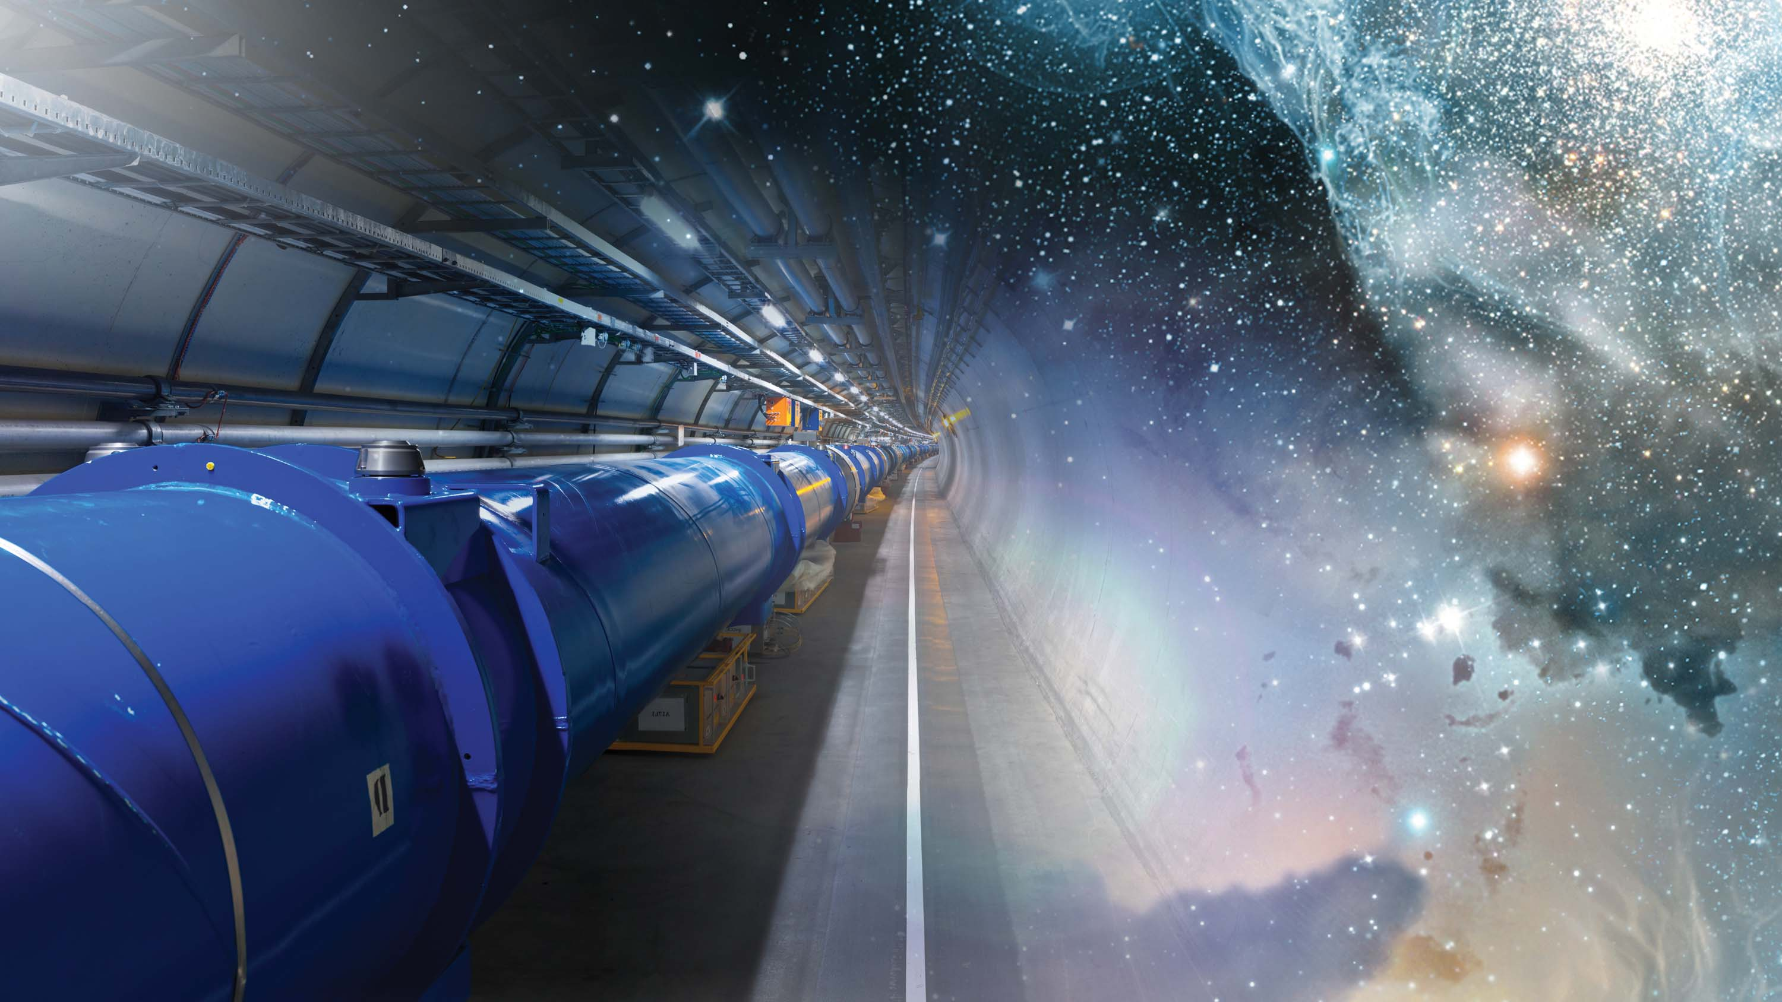
CERN
A glimpse of the very early universe
Dr. Rolf Landua

Slide 2

Old questions by philosophers - new answers by scientists

Slide 3
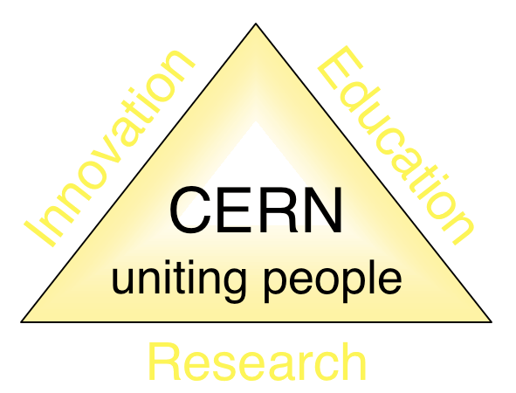
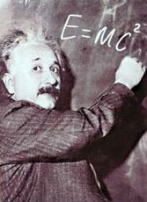
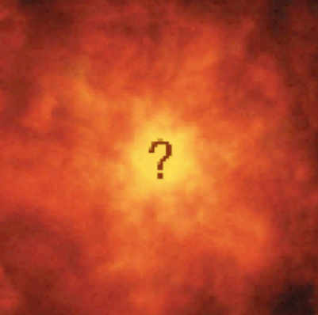

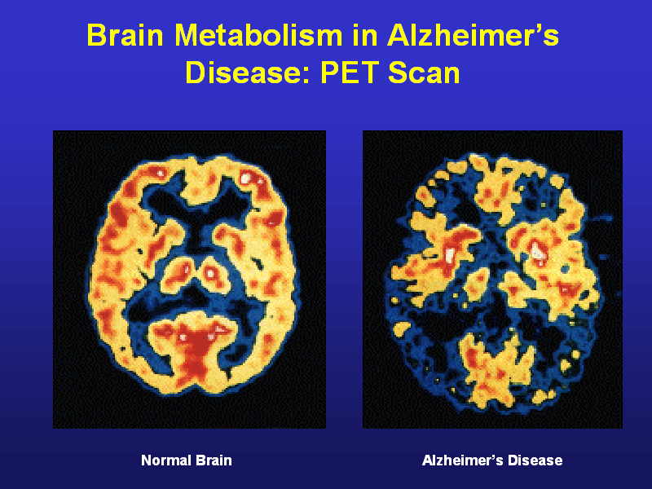
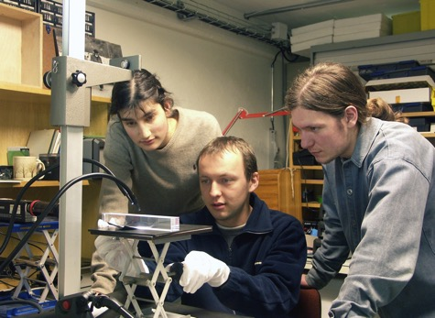
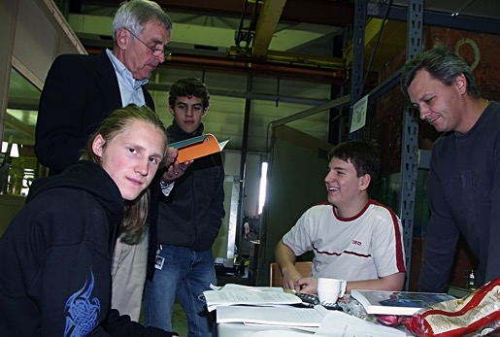
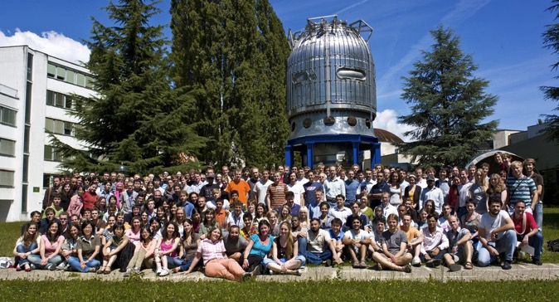
The Mission of CERN
Push forward the frontiers of knowledge
E.g. the secrets of the Big Bang …what was the matter like within the first moments of the Universe’s existence?
Develop new technologies for accelerators and detectors
Information technology - the Web and the GRID
Medicine - diagnosis and therapy
Train scientists and engineers of tomorrow
Unite people from different countries and cultures

Slide 4
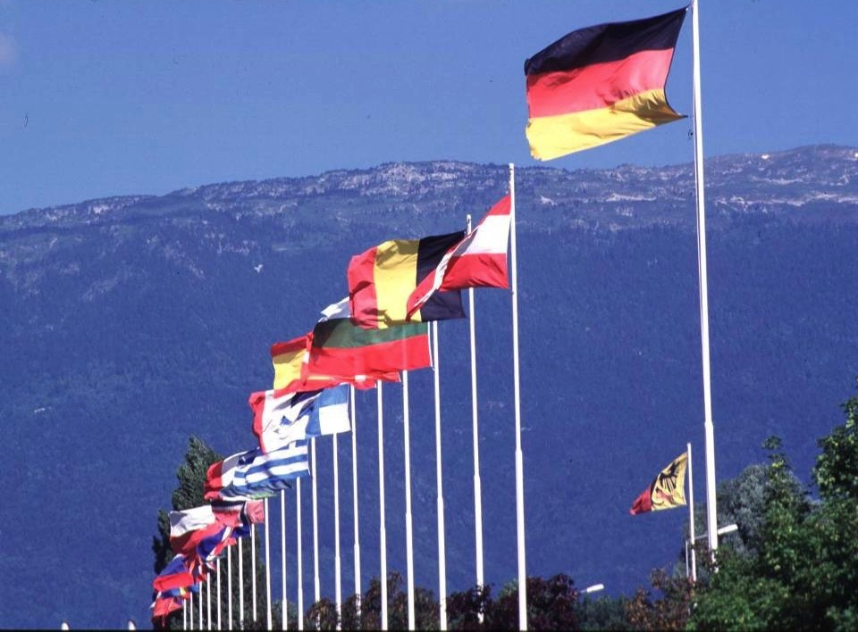

CERN was founded 1954: 12 European States
“Science for Peace”
Today: 21 Member States
~ 2300 staff
~ 1620 other paid personnel
~ 10500 users
Budget (2014) ~1000 MCHF
Member States: Austria, Belgium, Bulgaria, the Czech Republic, Denmark, Finland, France, Germany, Greece, Hungary, Israel, Italy, the Netherlands, Norway, Poland, Portugal, Slovakia, Spain, Sweden, Switzerland and
the United Kingdom
Candidate for Accession: Romania
Associate Member in Pre-Stage to Membership: Serbia
Applicant States for Membership or Associate Membership:
Brazil, Cyprus, Pakistan, Russia, Slovenia, Turkey, Ukraine
Observers to Council: India, Japan, Russia, Turkey, United States of America; European Commission and UNESCO
3
Notes:
----- Meeting Notes (09/01/2013 14:16) -----
nnn

Slide 5
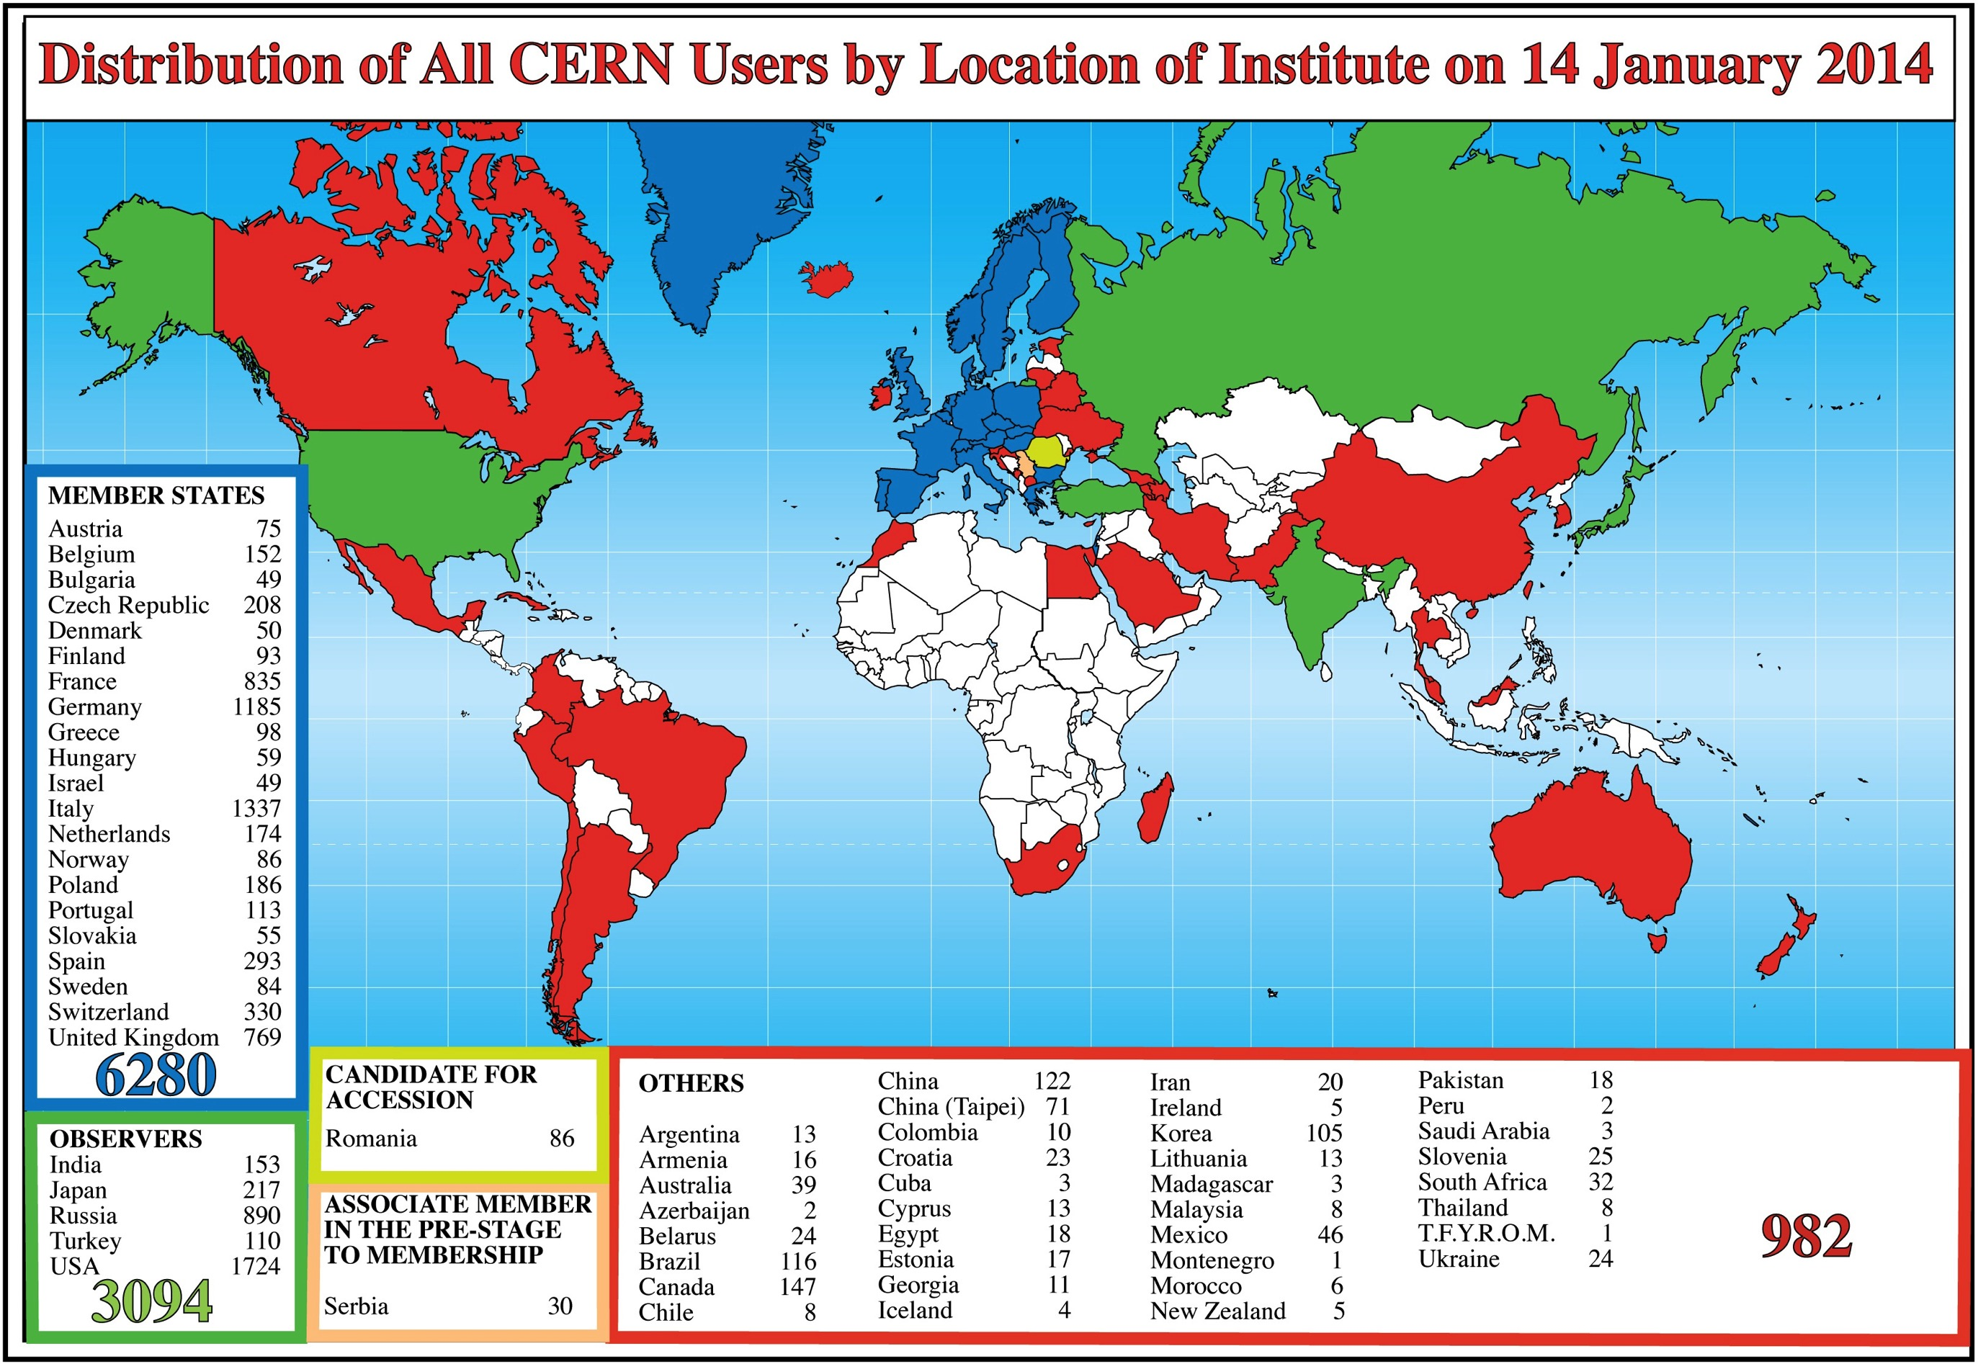
Science is getting more and more global

Slide 6

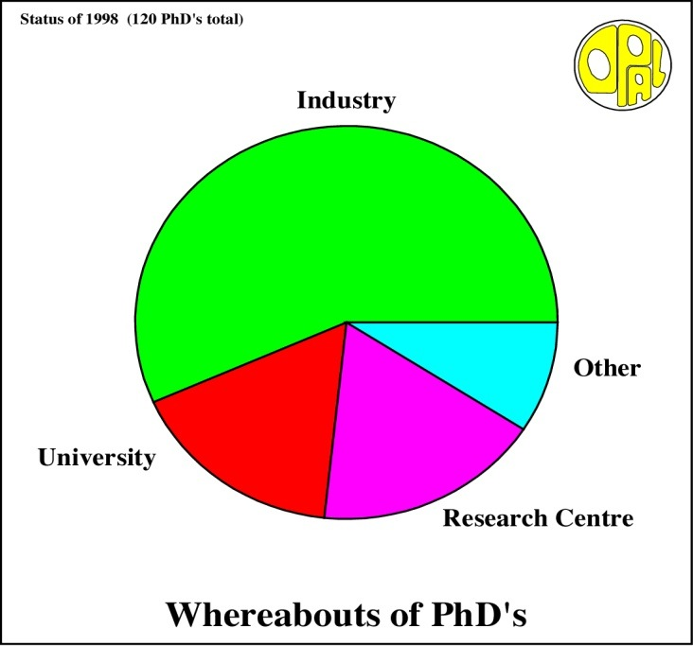
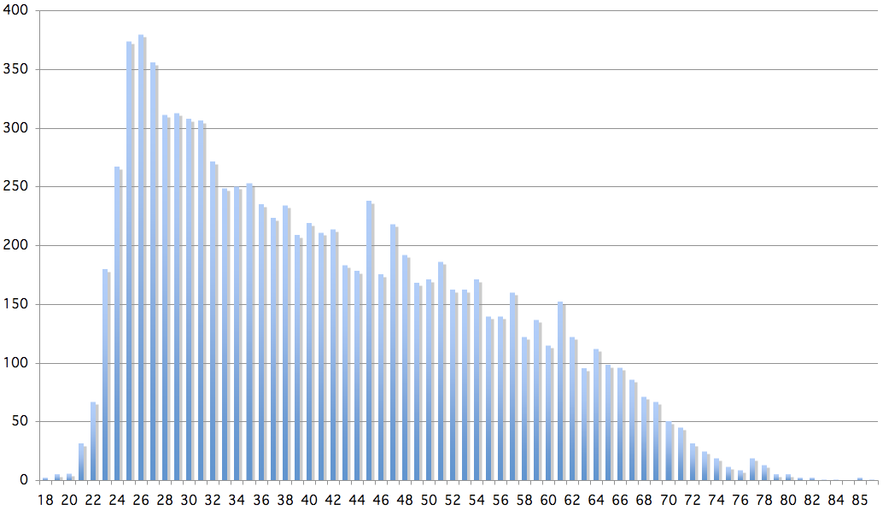
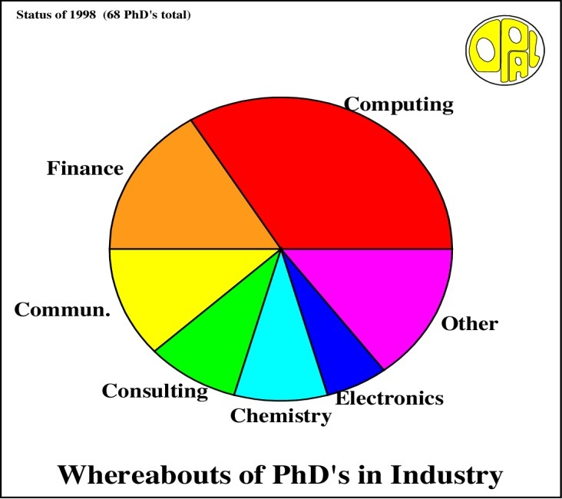
Age Distribution of Scientists
- and where they go afterwards
Survey in March 2009
26
Today:
∼2500 PhD students
in LHC experiments
65
They do not all stay: where do they go?

Slide 7
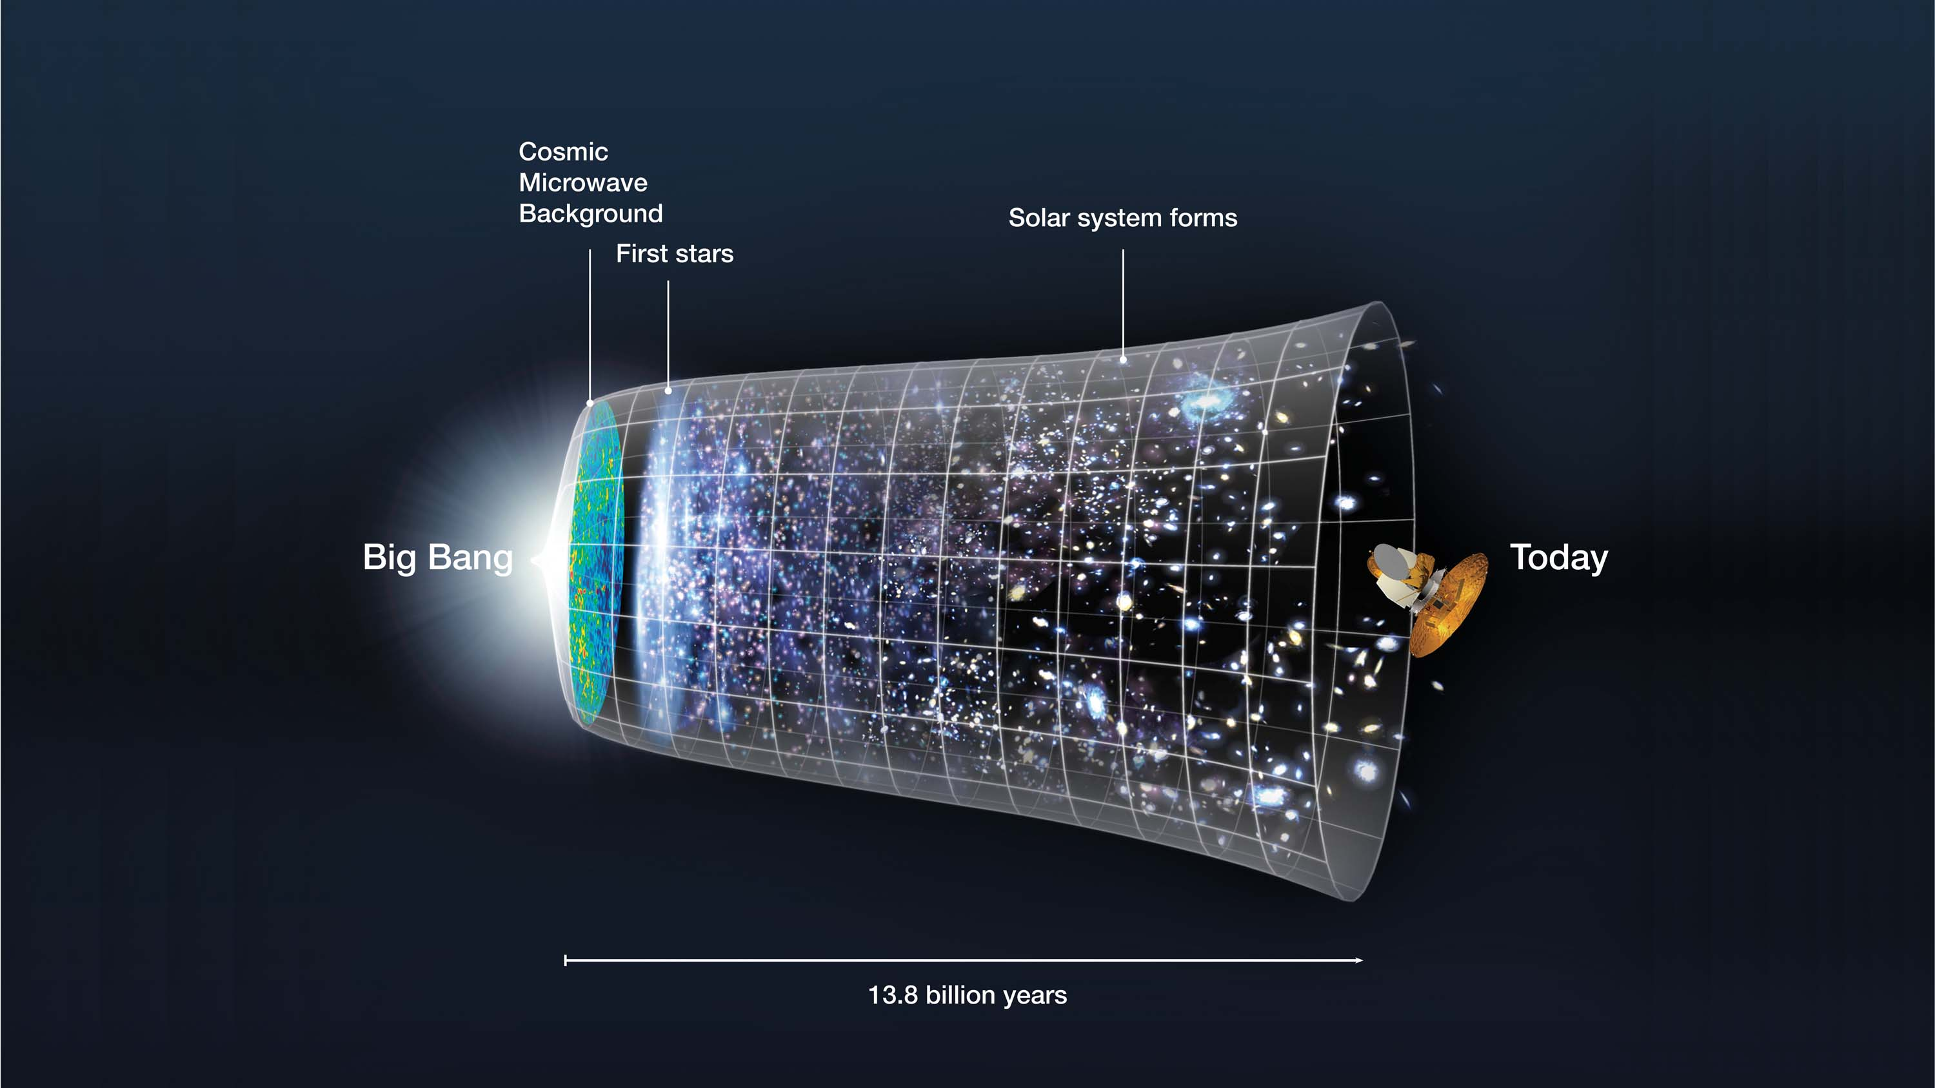
Cosmic evolution: 13.8 billion years

Slide 8
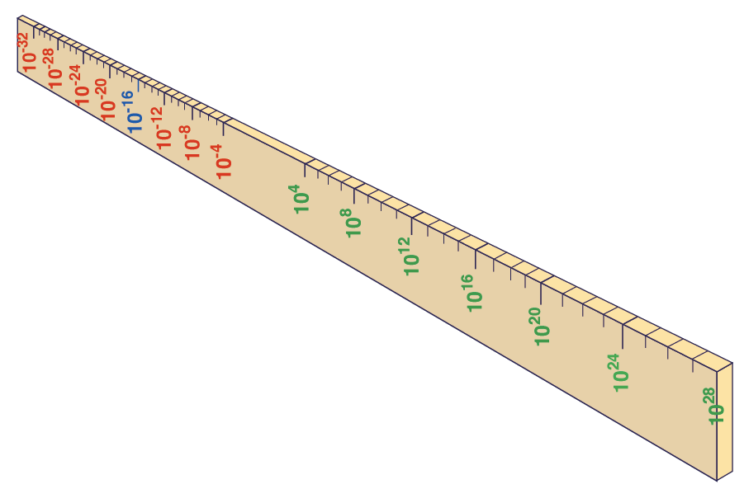
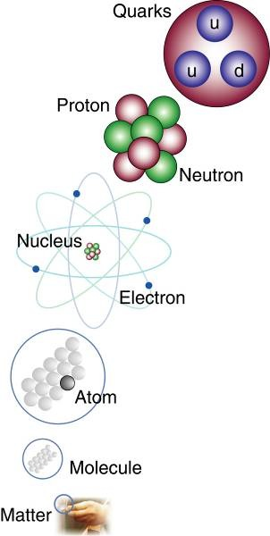
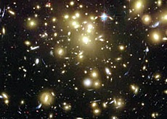
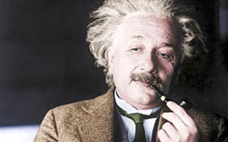


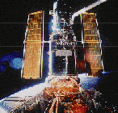
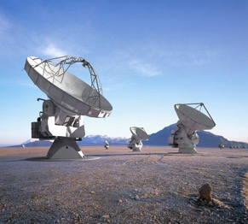
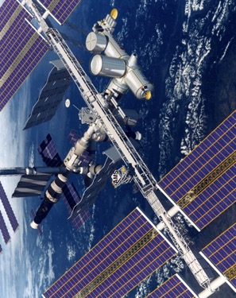
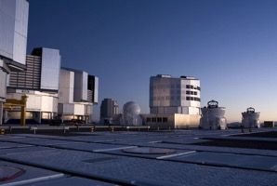
Big Bang
Proton
Atom
Radius of Earth
Earth to Sun
Radius of Galaxies
Universe
LHC
Super-Microscope
Hubble
ALMA
cm
Study physics laws of first moments after Big Bang
increasing Symbiosis between Particle Physics,
Astrophysics and Cosmology
AMS
VLT
Notes:
60 Grössenordnungen

Slide 9
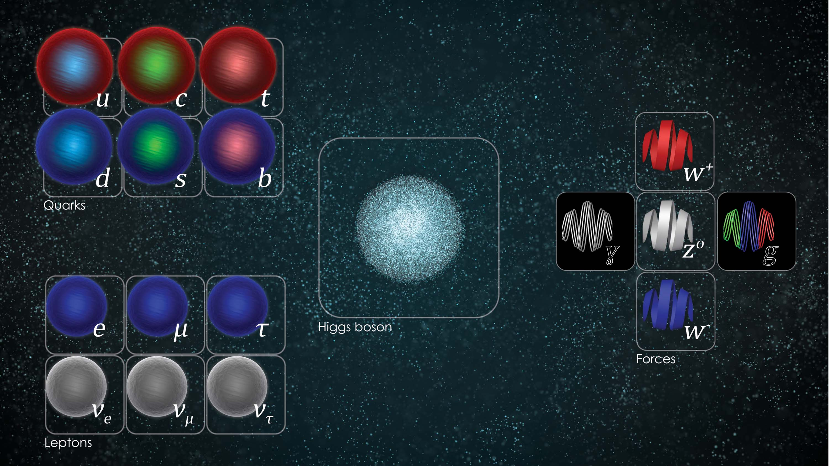
Origin of particles and forces
FORCES
MASS
PARTICLES

Slide 10
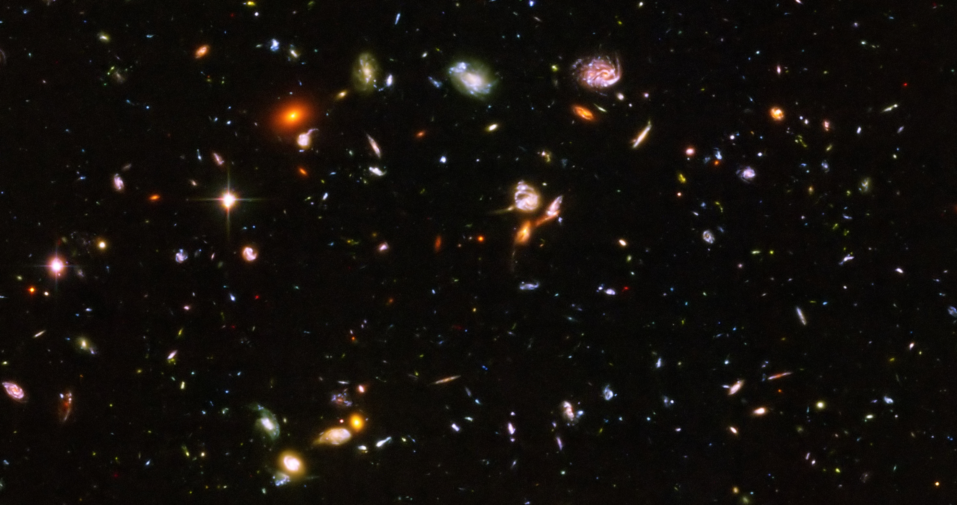
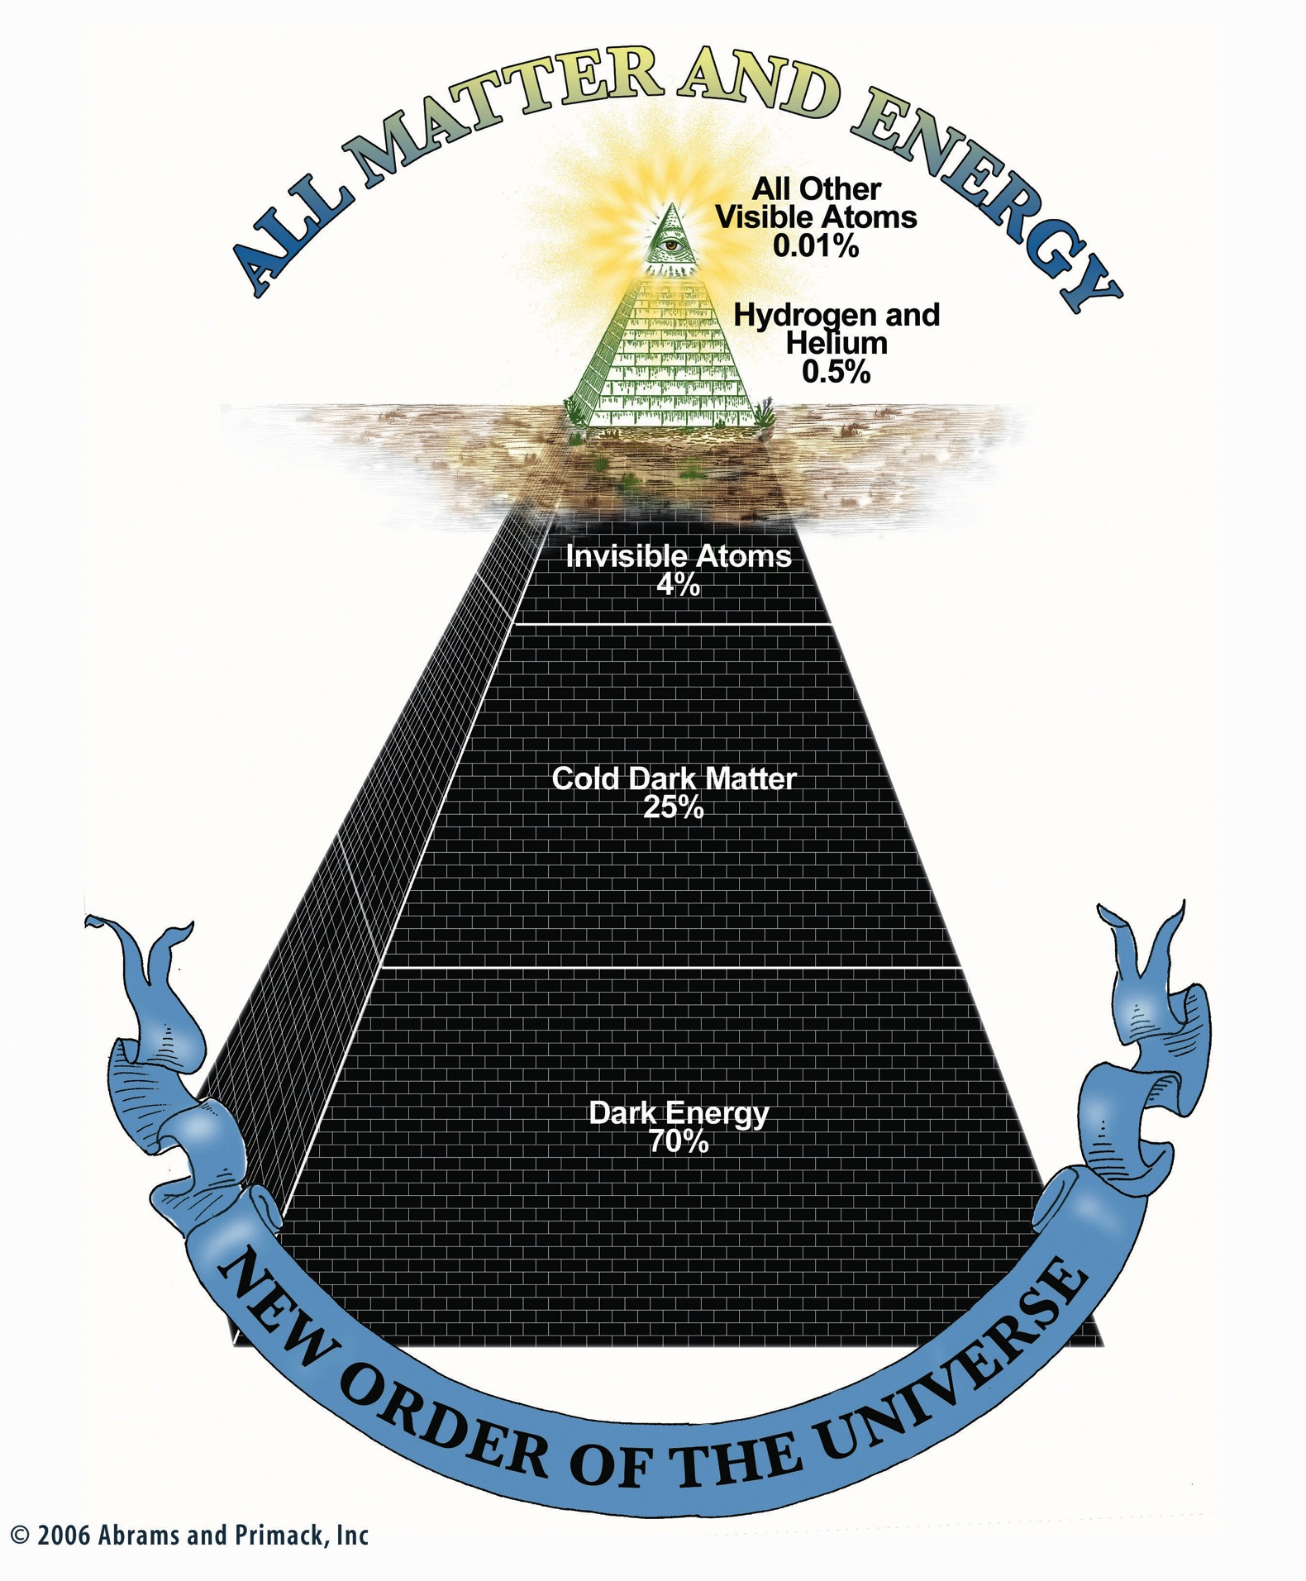
The mysteries of the universe - today

Slide 11
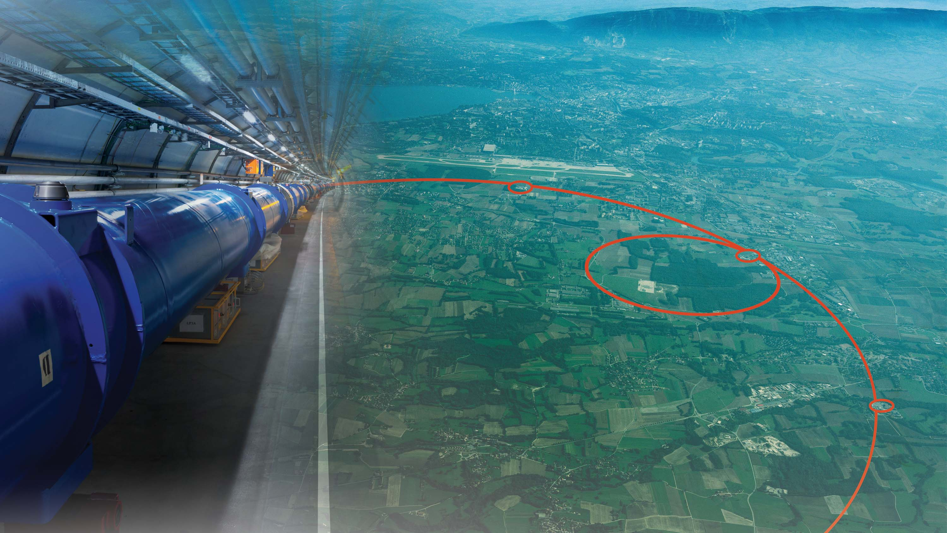
CERN

Slide 12
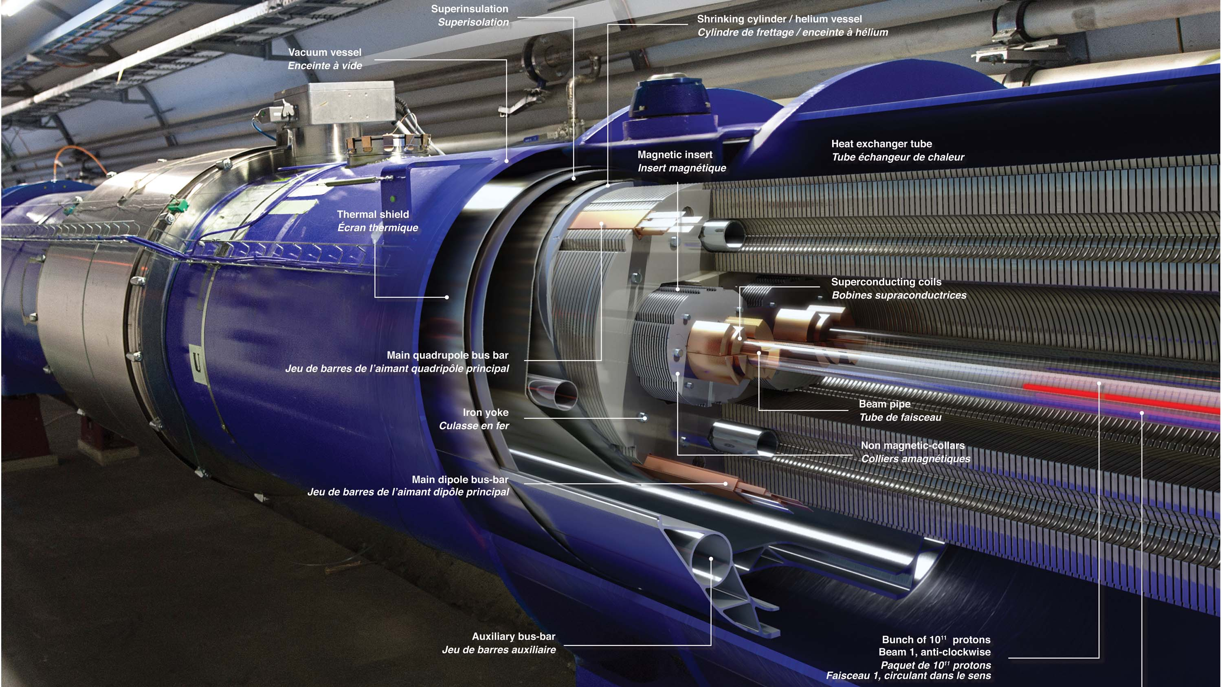
Large Hadron Collider - LHC

Slide 13
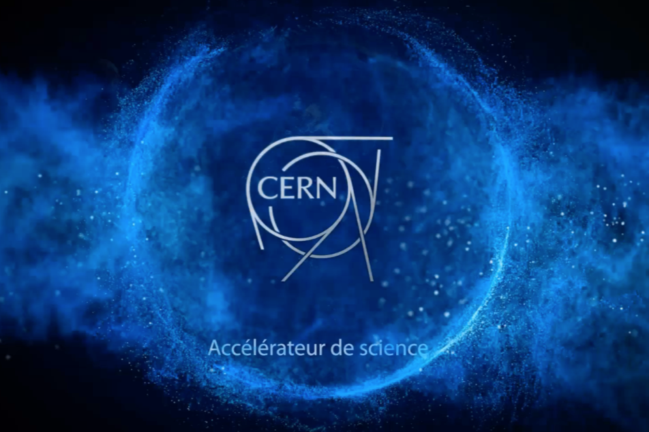
CERN Accelerators
All animations can be downloaded from:
http://cern60.web.cern.ch/en/cern-exhibitions-content

Slide 14

LHC experiments - huge detectors

Slide 15
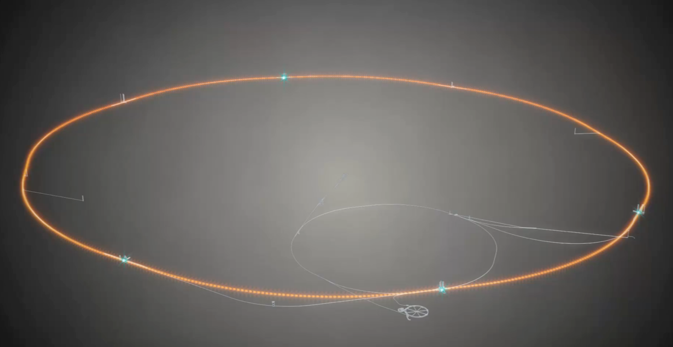
Collisions in ATLAS detector: 600 million per second

Slide 16
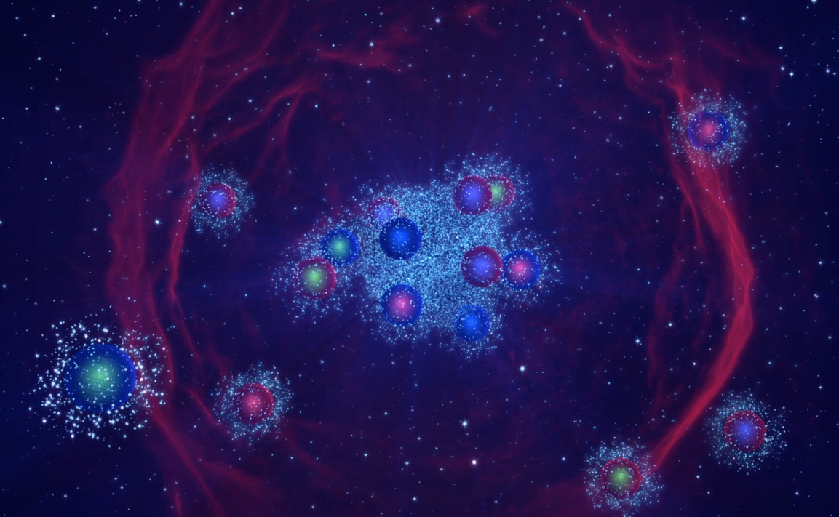
Higgs boson production: 1 in 10,000,000,000 events

Slide 17
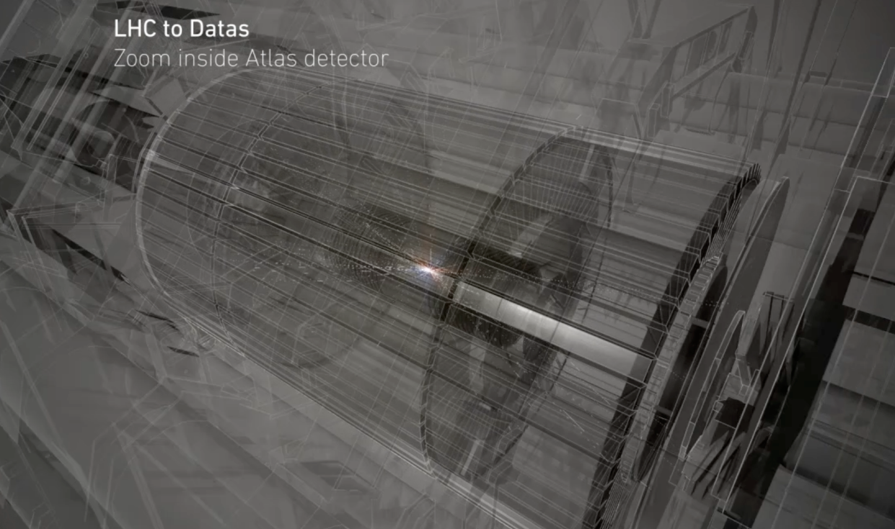
LHC data flood: primary rate ~ 1000 TB/sec

Slide 18
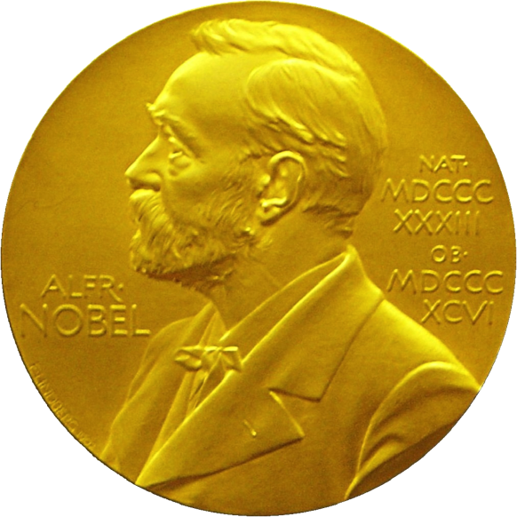
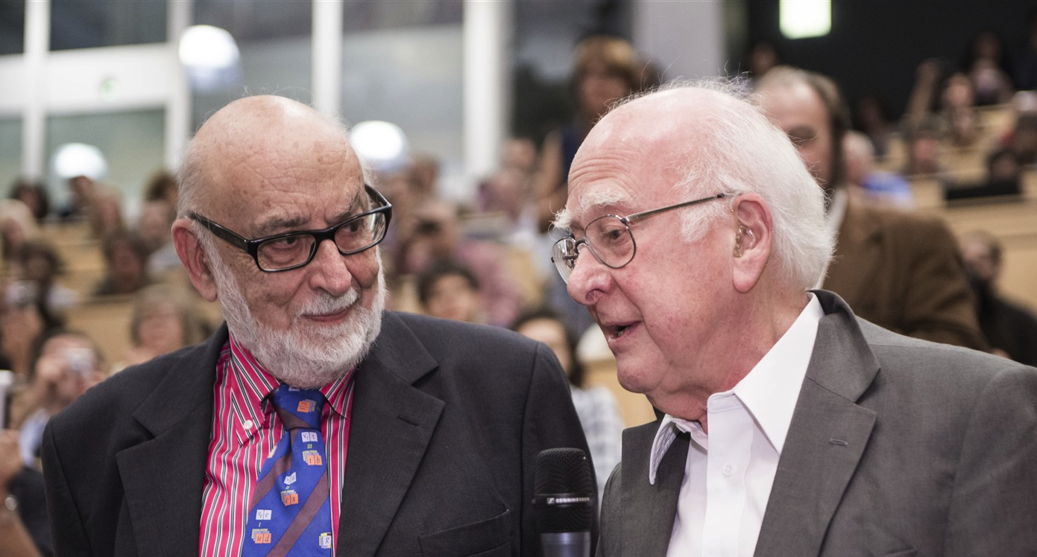
Nobel Prize in Physics 2013
The Nobel Prize in Physics 2013 was awarded jointly to François Englert and Peter W. Higgs "for the theoretical discovery of a mechanism that contributes to our understanding of the origin of mass of subatomic particles, and which recently was confirmed through the discovery of the predicted fundamental particle, by the ATLAS and CMS experiments at CERN's Large Hadron Collider”.

Slide 19
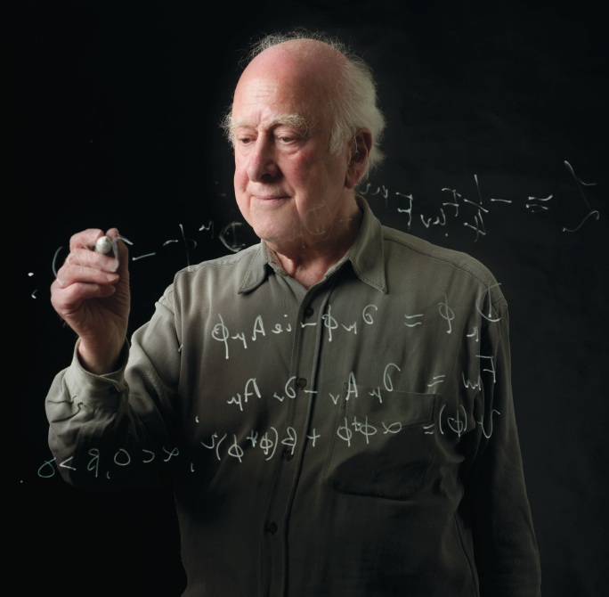
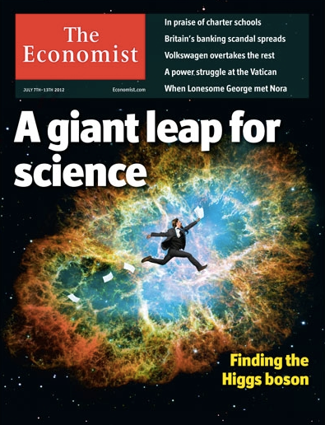
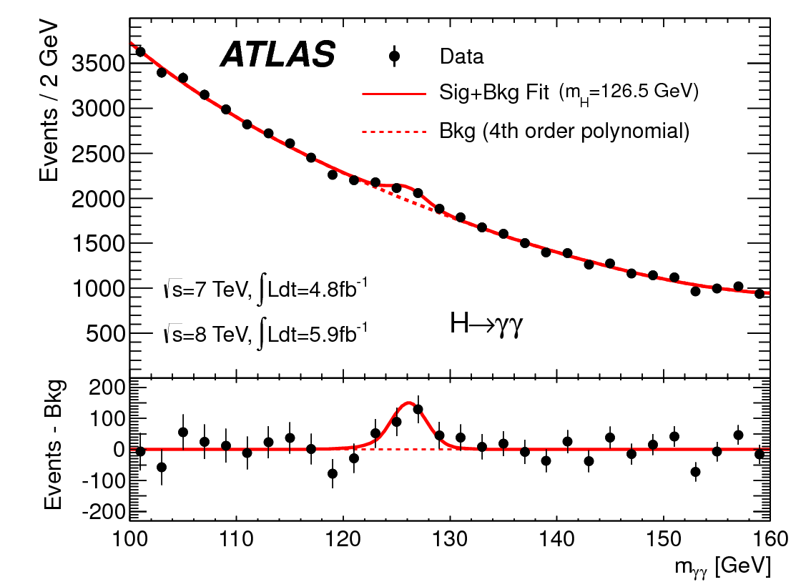
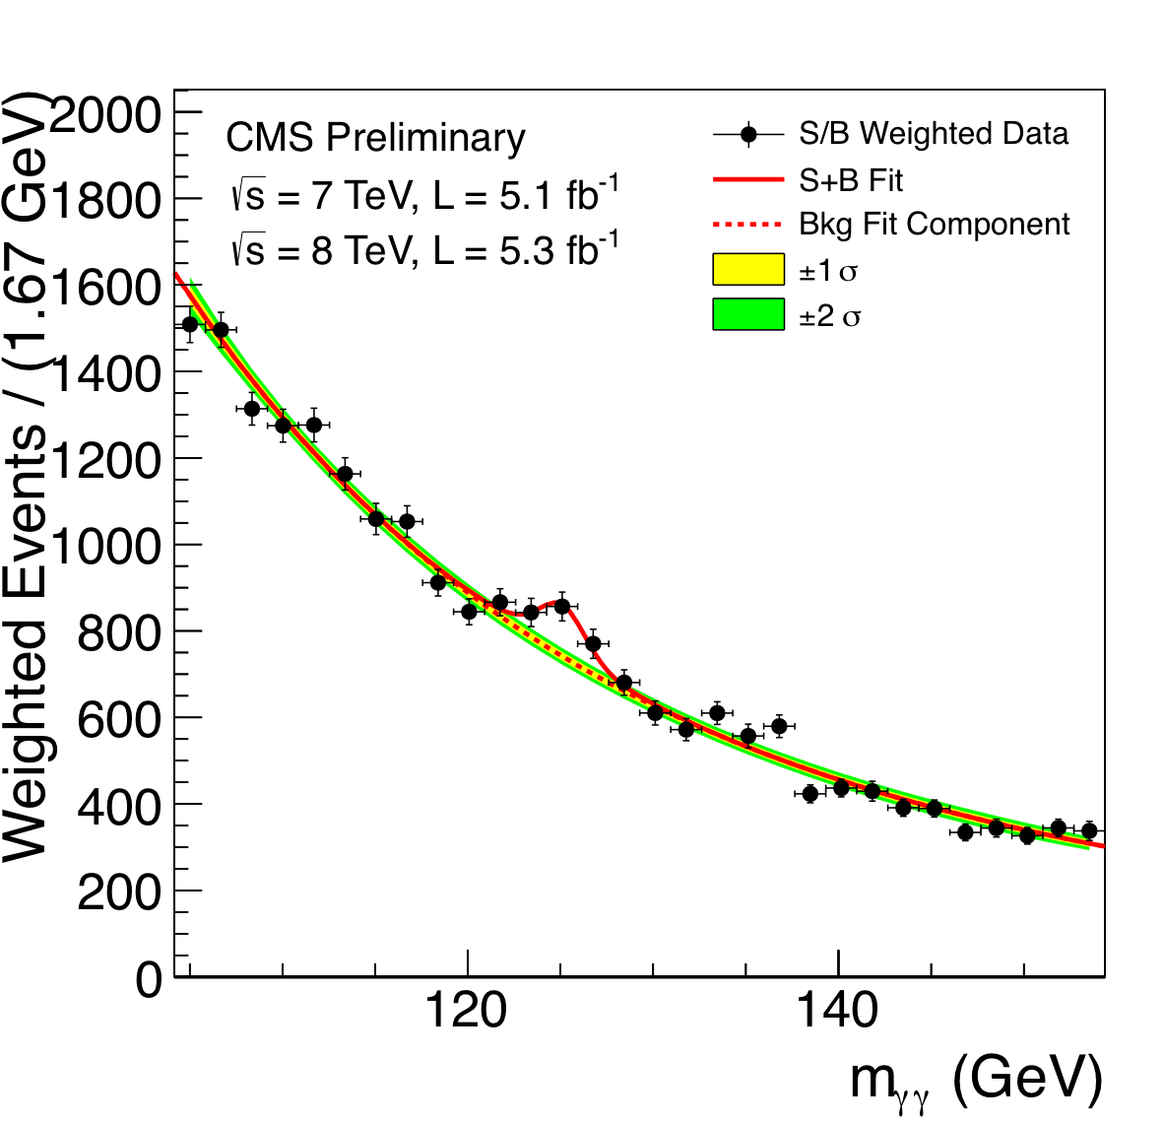
The discovery of a Higgs boson
1964
2012

Slide 20

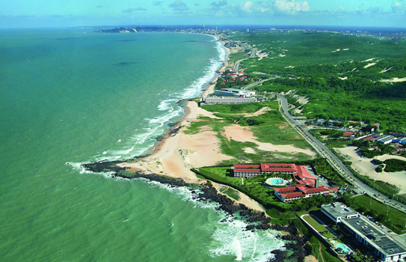
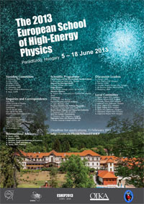
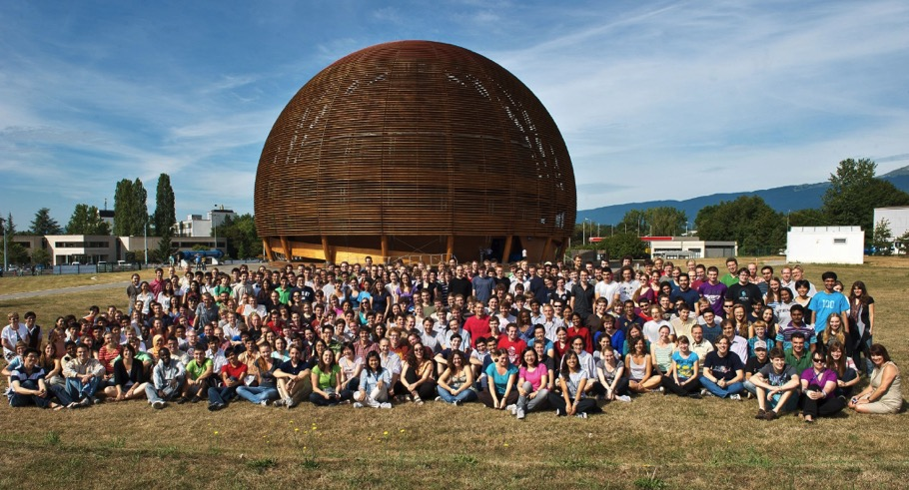
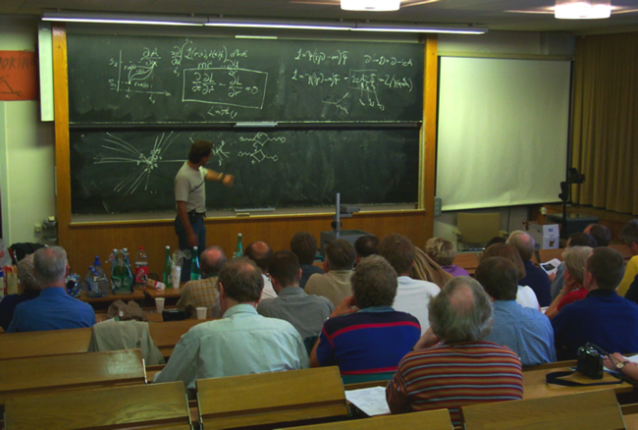
CERN Education Activities
Latin American School
Natal, Brazil, 2011
Arequipa, Peru, 2013
NEW:
Asia-Europe-Pacific School of High-Energy Physics
Fukuoka, Oct 2012
India, 2014
Scientists at CERN
Academic Training Programme
Young Researchers
CERN School of High Energy Physics
CERN School of Computing
CERN Accelerator School
CERN School of Physics
Hungary, June 2013
Physics Students
Summer Students
Programme
CERN Teacher Schools
International and National Programmes

Slide 21
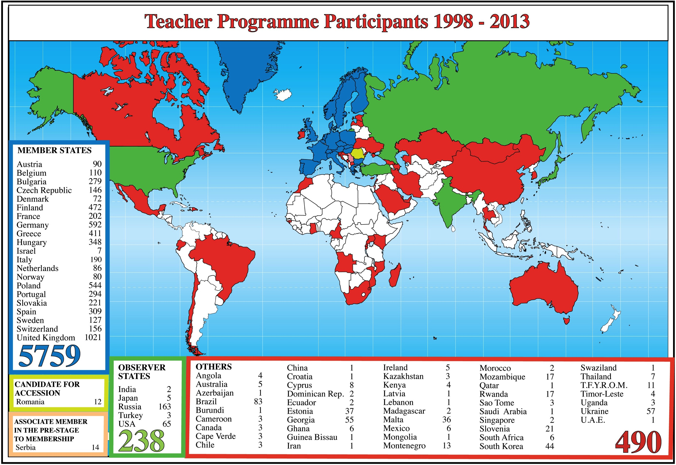
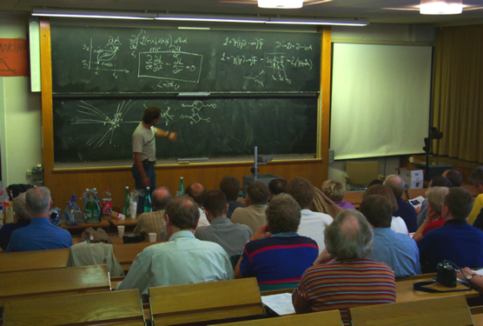
CERN Teacher Programme

Slide 22
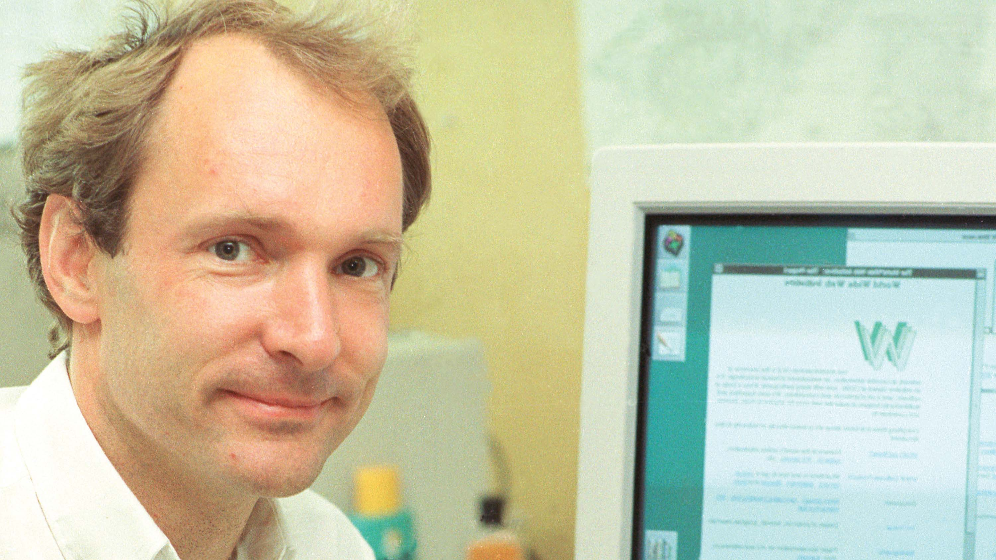
Pushing the frontiers - the World-Wide Web is 25 years old

Slide 23
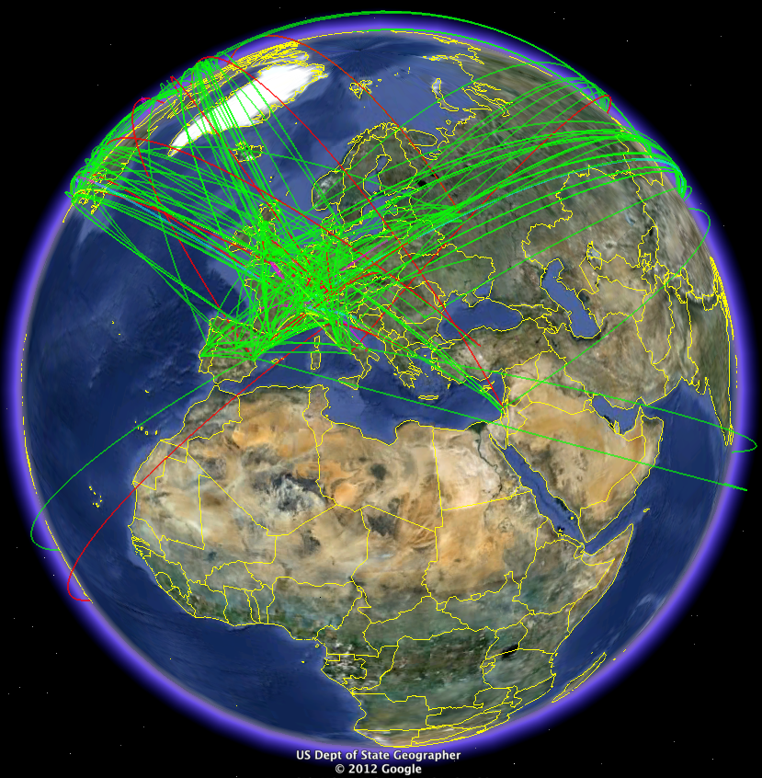
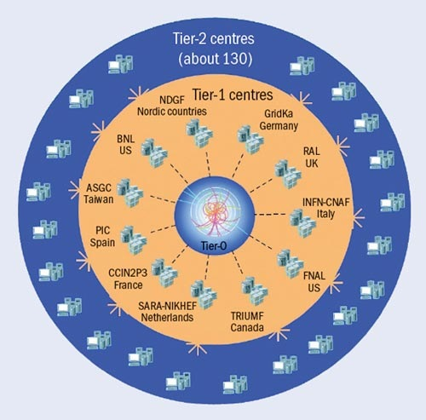
The Worldwide LHC Computing Grid
Tier-0
(CERN and Hungary):
data recording, reconstruction and distribution
nearly 160 sites,
35 countries
~250’000 cores
Tier-1: permanent storage, re-processing,
analysis
173 PB of storage
> 2 million jobs/day
Tier-2: Simulation,
end-user analysis
10 Gb links
WLCG:
An International collaboration to distribute and analyse LHC data
Integrates computer centres worldwide that provide computing and storage resource into a single infrastructure accessible by all LHC physicists

Slide 24
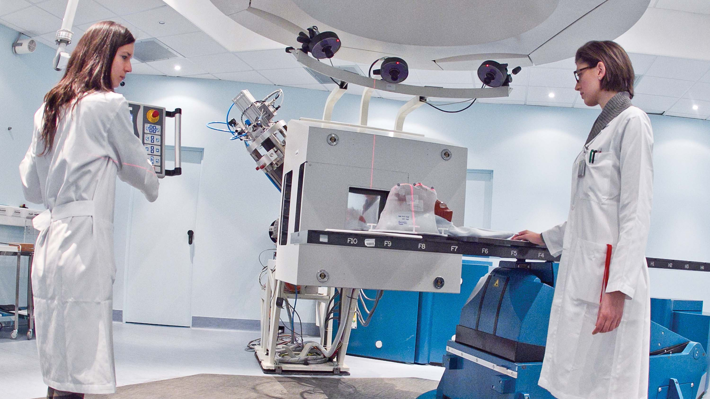
Pushing the frontiers - medical diagnostics and therapy

Slide 25
Pushing the frontiers: new discoveries are waiting
2015: Energy increase from 8 to 13 TeV + higher intensity

