Slide 1
Discussion of the arcs and overall lattice integration
FCC meeting 8th of January 2015 Antoine Chance

Slide 2
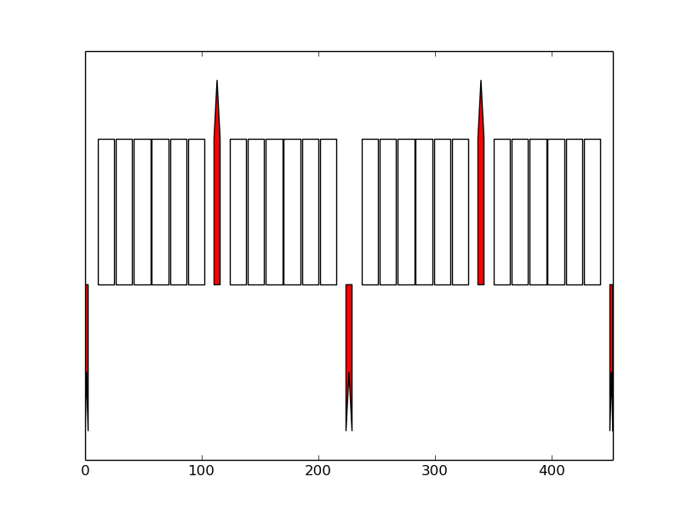
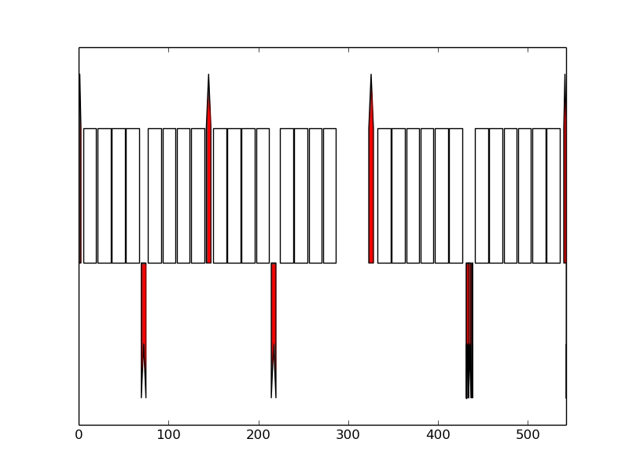
Status of arc optics
  Python script written to generate automatically arc optics with some constraints:
      /afs/cern.ch/user/a/anchance/public/FCC/hh/LATTICE_V4/2014_11_12_RING
      Ring circumference.
      Length of the insertion regions.
      Dispersion suppressor type. 2 kinds of dispersion suppressor were considered:
      Minimal spacing between elements.
      Variation range for the length of the FODO cells.
      …
  Some assumptions were made:
      Antisymmetry of the betatron function between the entrance and the exit of the insertion sections (β_{x,start}=β_{y,end}, β_{y,start}=β_{x,end}).
      The interaction region is made with a very rough matching with quadrupoles.
      The other insertions are FODO lattices (the cell length has been adjusted).
      Half-bend
      LHC-like

Slide 3
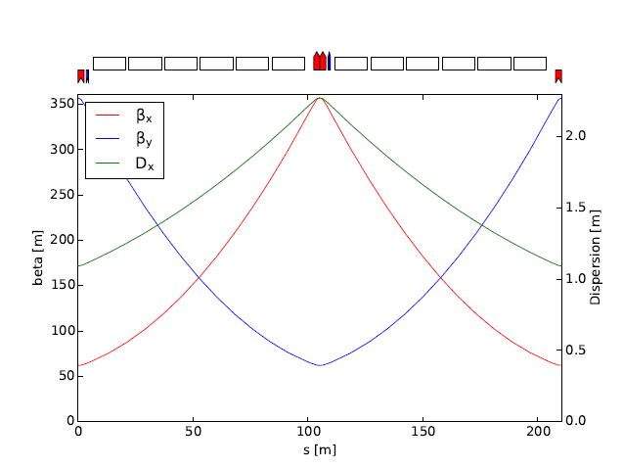
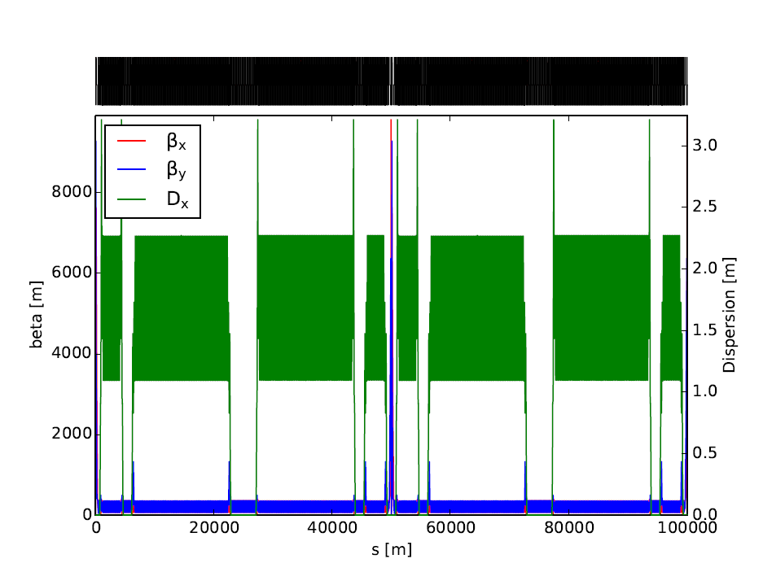
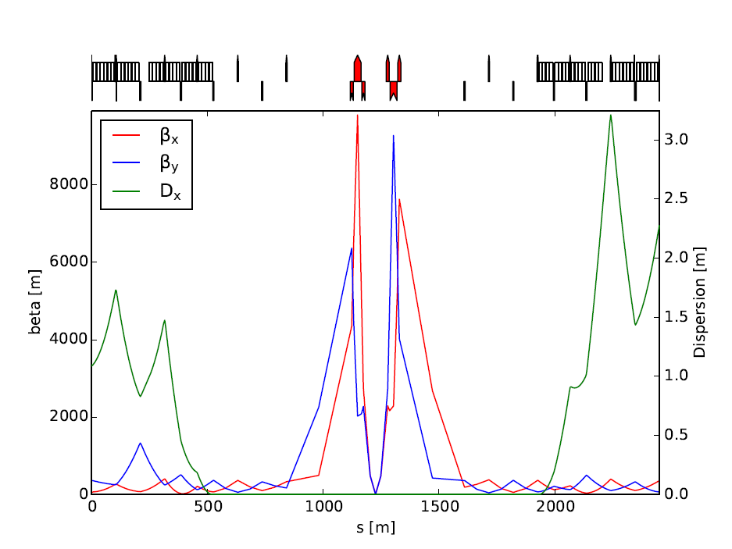
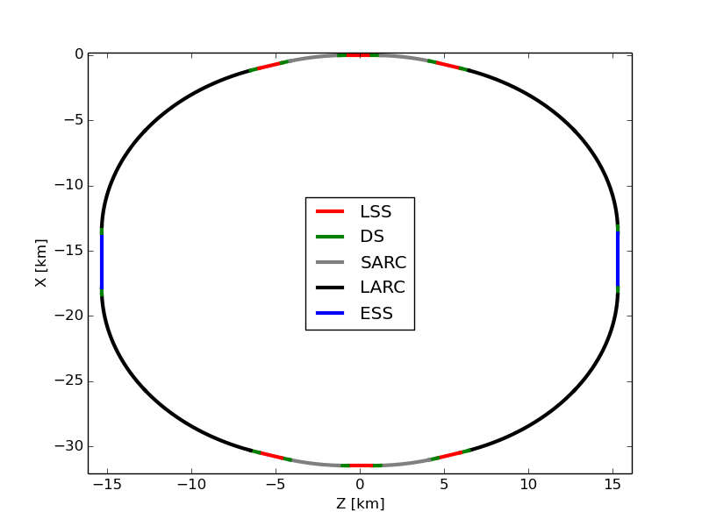
Example: Arc 100 km, Dipoles 14.2 m

Slide 4
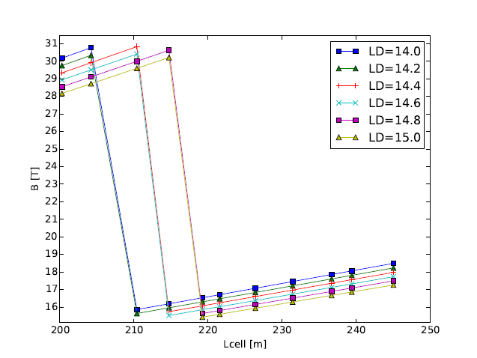
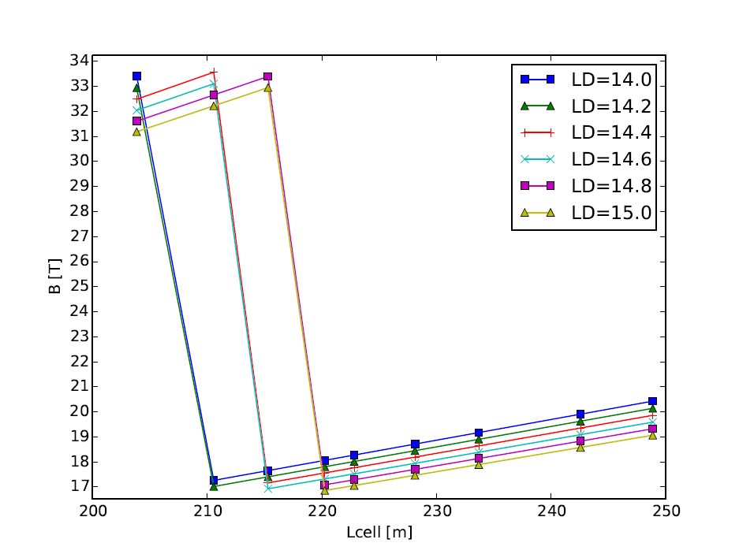
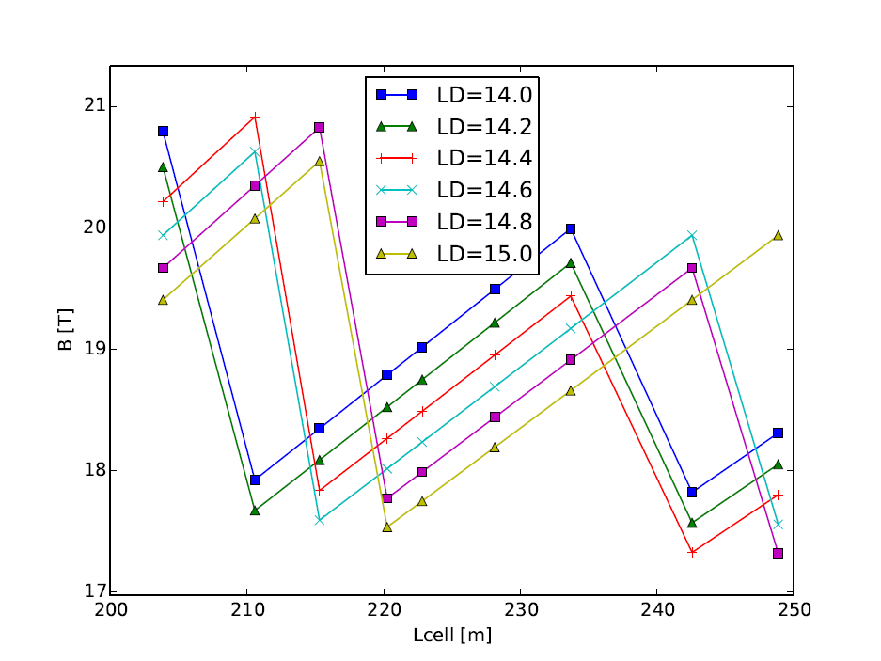
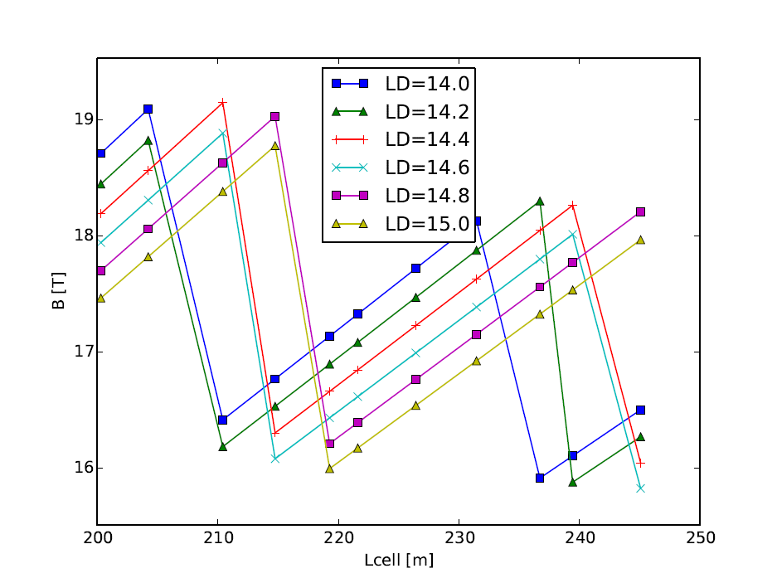
PARAMETER VARIATION: 100 TeV c.m.
Arc:100 km, DS LHC
93.45 km, DS LHC
Arc:100 km, DS half-bend
93.45 km, DS half-bend

Slide 5
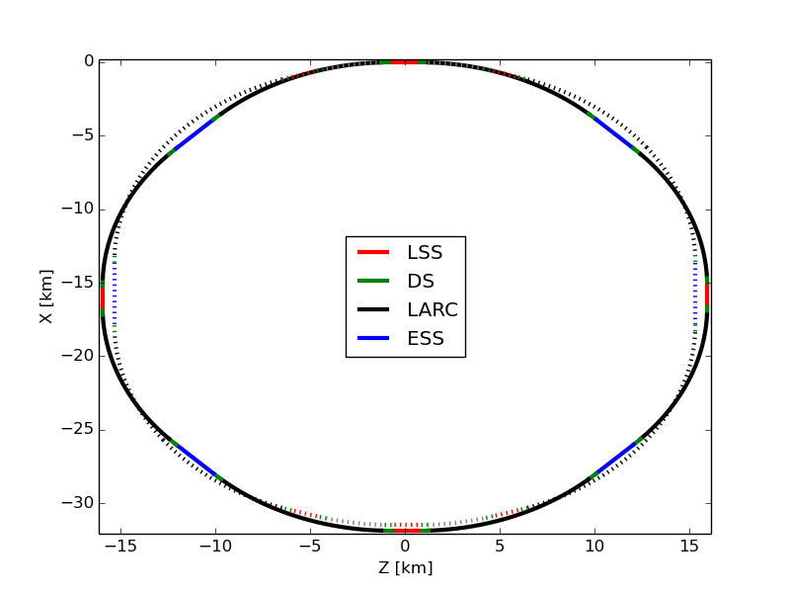
PROPOSAL: a ring with a superperioD of 4
Survey baseline
Injection + extraction
Collimation
  The extraction section is moved from the section where the collimation occurs to the section where the injection is located.
  We have now 4 extended straight sections of 2,8 km (against 2 of 4,2 km in the baseline) and 4 long straight sections of 1,4 km (against 6 in the baseline)

Slide 6
Pros and cons of this layout
  Pros:
      Superperiodicity of 4.
        Some resonances should be mitigated.
        Better for the dynamic aperture.
        Could be a better option for beam-beam effects.
        To be checked.
      The 2 additional Ips are separated by a diameter.
        Synchronism between both beams: same path length.
      Same number of dispersion suppressors as in the baseline,
        Same filling factor.
  Cons:
      The number of arcs is increased.
        We may need more technical shafts.
      The geometry of the layout is a bit modified.
        Compatible with geological constraints?

Slide 7
For discussion
  Some inputs come from other work packages:
      Minimum spacing between elements.
  Necessary to create some interfaces between the arcs and the insertions:
      Replacement of the fake insertions (FODO lattices) by right insertions.
      Matching module between the arcs and the insertions.
      Naming convention for the elements.
      Additional constraints on the optics?
  Other layout proposed:
      The automatic python tool enables to generate some MAD-X lattices for the baseline or this alternative.
      Reasons to keep (in this case alternative layout) or give up this layout?

Slide 8
DSM
Irfu
DIR
Commissariat à l’énergie atomique et aux énergies alternatives
Centre de Saclay | 91191 Gif-sur-Yvette Cedex
T. +33 (0)1 69 08 xx xx | F. +33 (0)1 69 08 99 89
  Etablissement public à caractère industriel et commercial | RCS Paris B 775 685 019

