Slide 1
Superconducting septa for FCC? Jotting down some thoughts…
W. Bartmann
BT R&D meeting, 4th Dec 2014

Slide 2
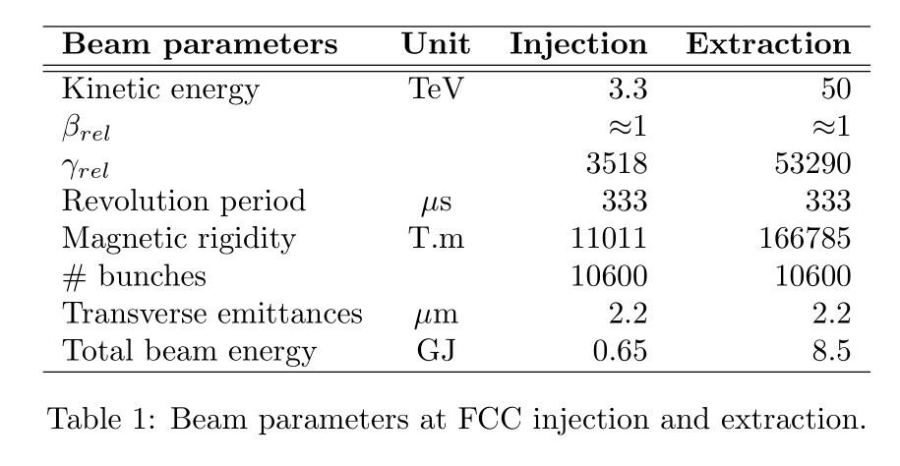
Beam parameter recap

Slide 3
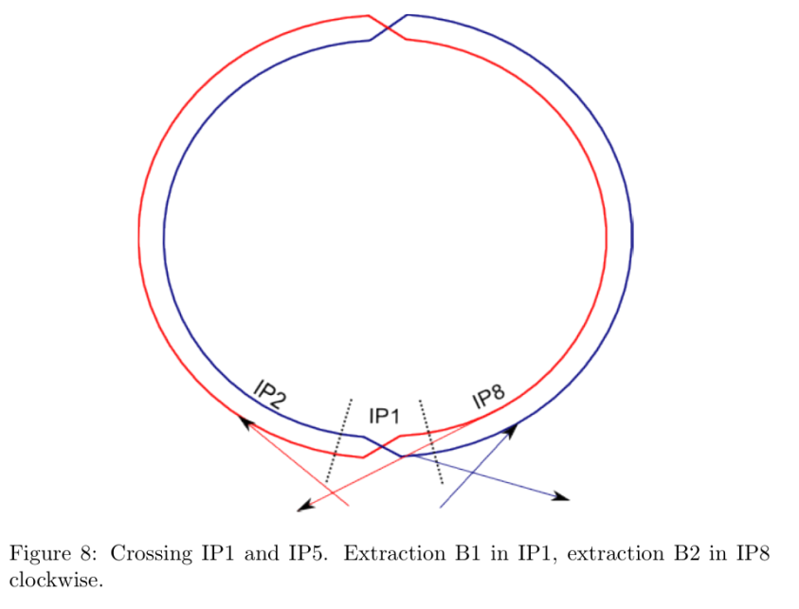
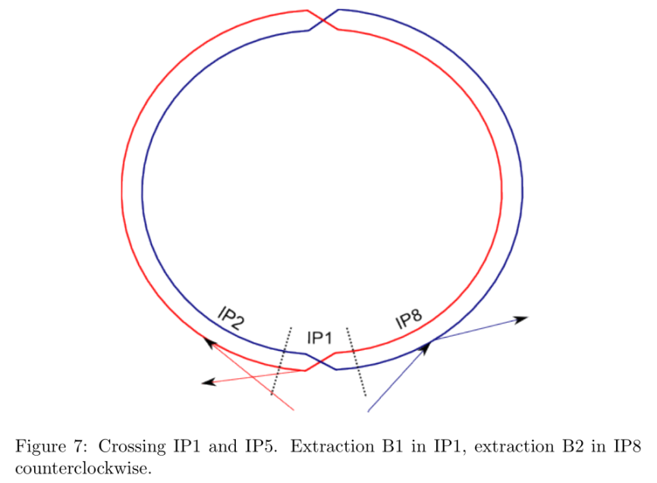
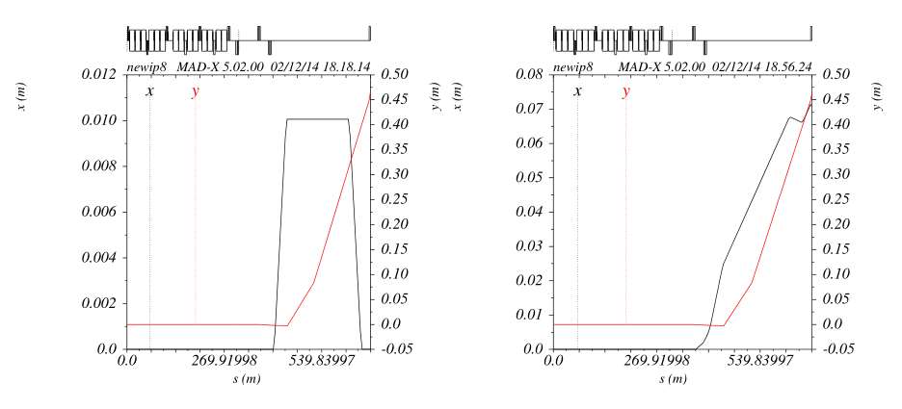
LHC extraction
Counter-clockwise
Clockwise
This option with two different kickers in a row (MKI, MKE) is clearly more demanding
- to be studied
Looks like existing septa allow extraction up to 7 TeV

Slide 4
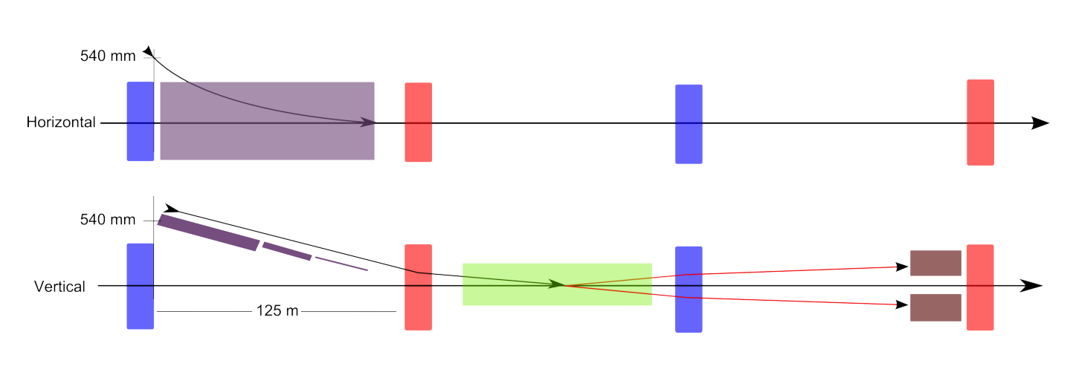
FCC injection - NC
Lambertson septum
QF
MKI
QD
TDI
500 m quad half width → clearance of 540 mm
Rms beam size at inj of 0.6 mm, +/-10 sig, +/- 3 mm orbit → beam clear 18 mm
Beam offset in quad is 18 mm, required quad diameter inside chamber 36 mm
First septum blade 6 mm, requires beam separation of 24 mm at septum entrance

Slide 5
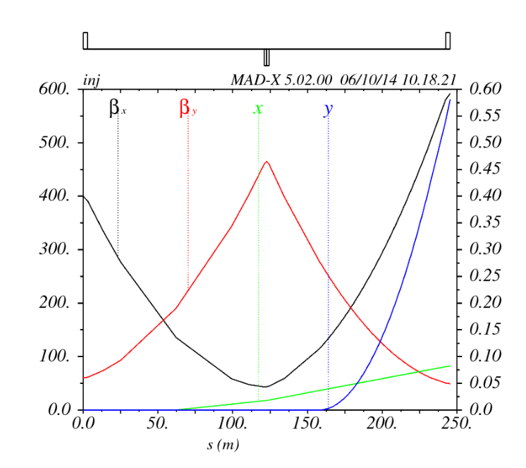
Optics

Slide 6
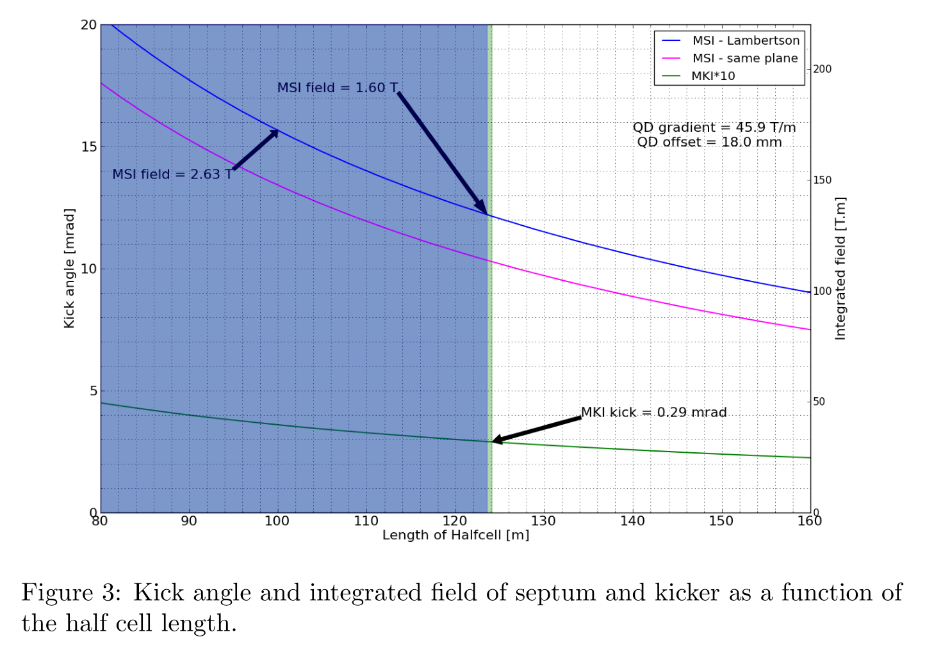
FCC injection - NC

Slide 7
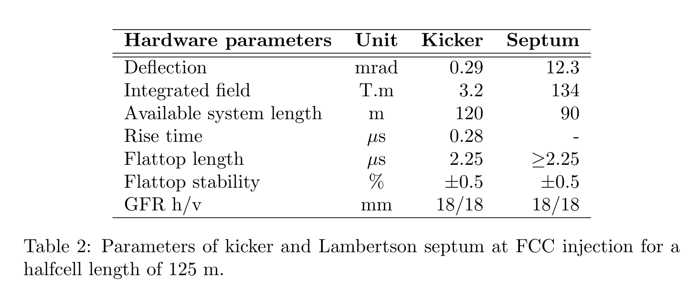
FCC injection - NC

Slide 8
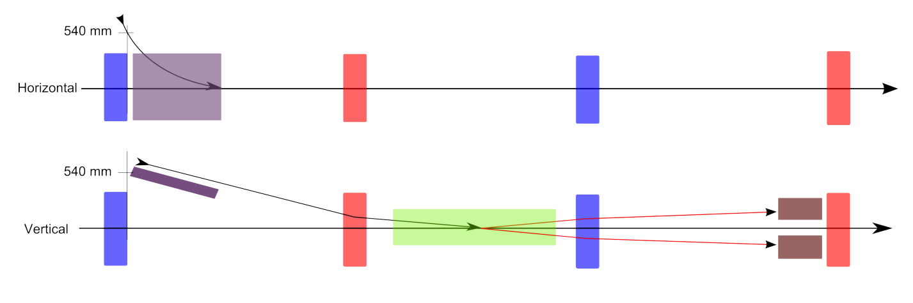
FCC injection - SC
Septum width 24 mm

Slide 9
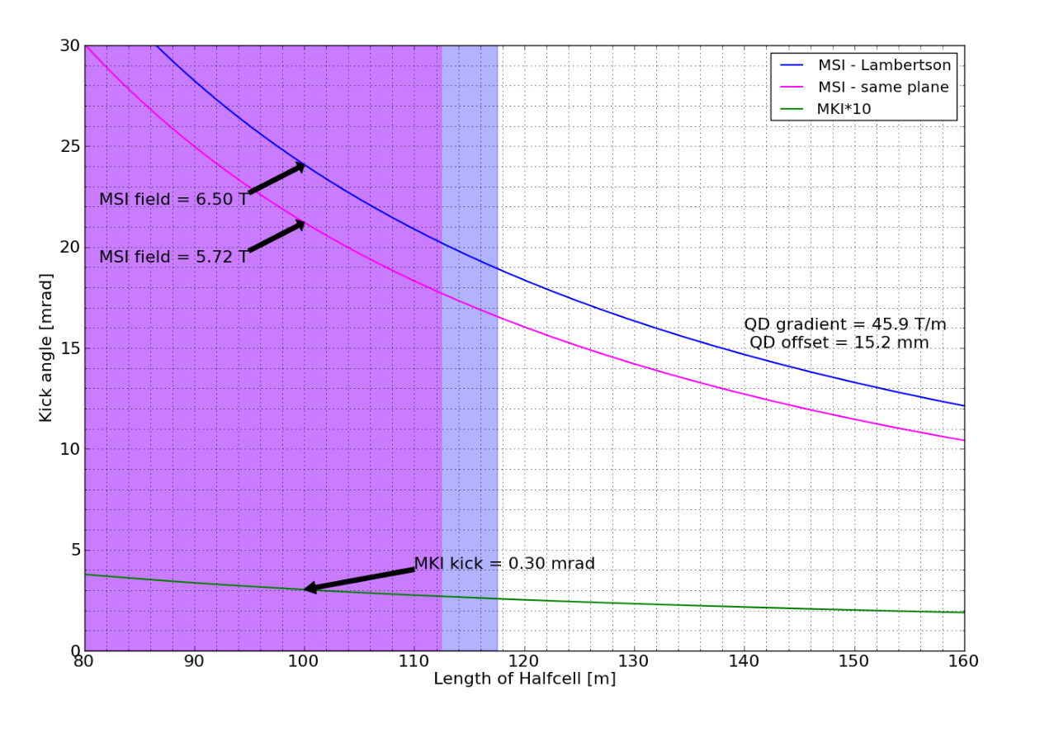
FCC injection - SC
4 T: 113 and 118 m resp.

Slide 10
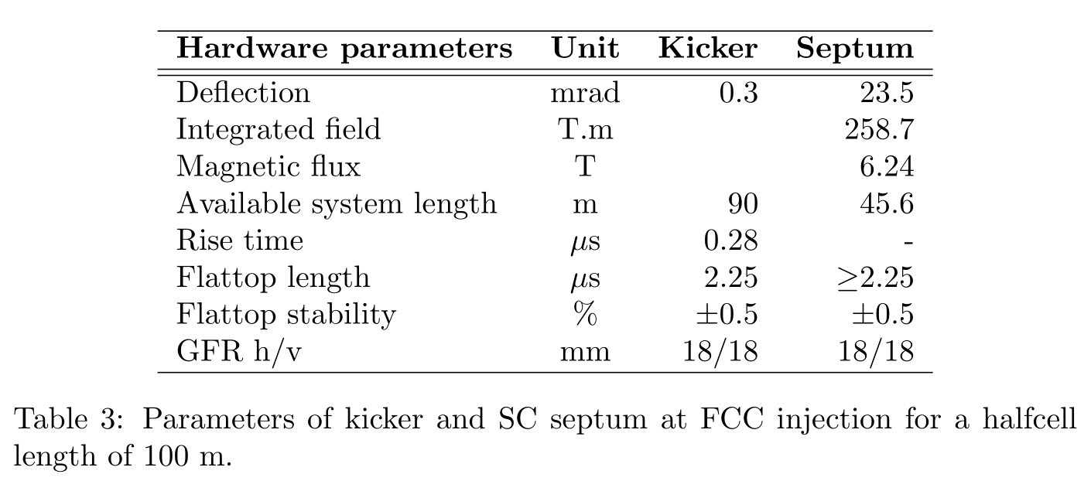
FCC injection - SC

Slide 11
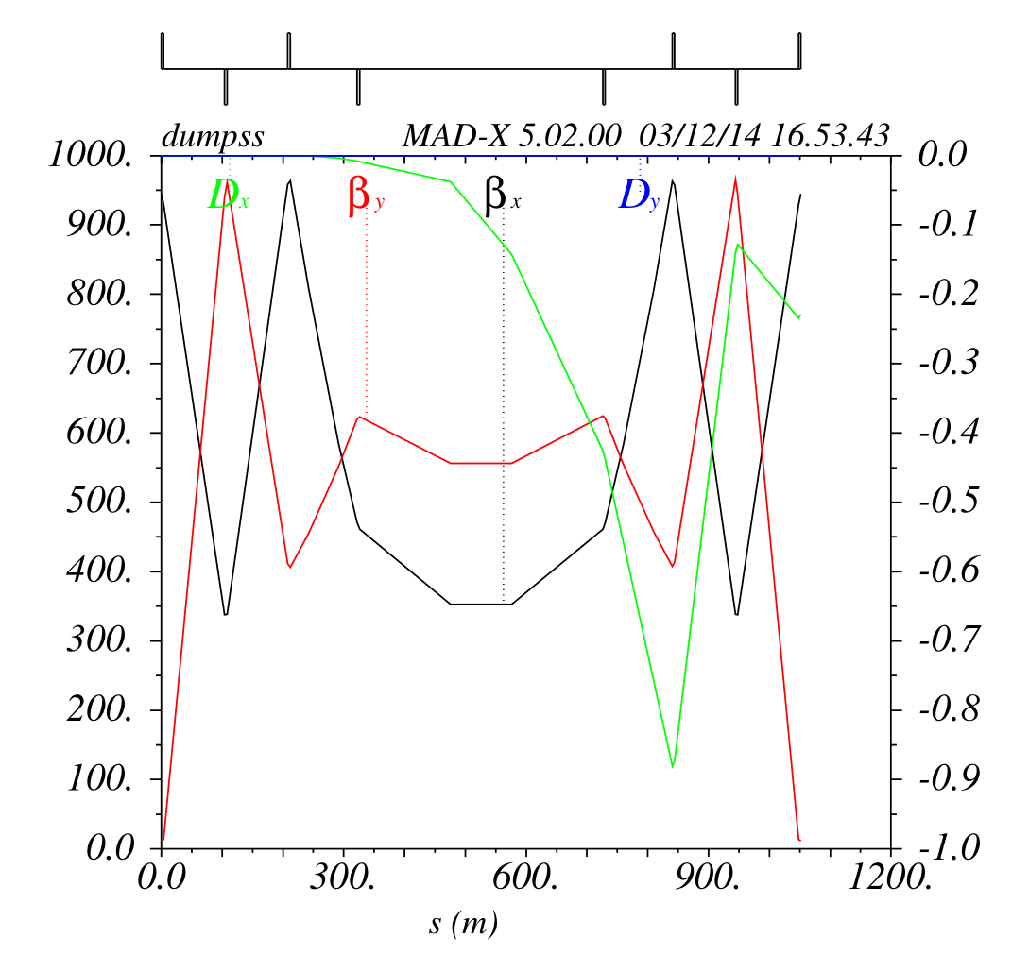
FCC dump straight section
110 m
400 m
Rms sigma ~ 1 mm
Assume otherwise max of 0.5 mm
100 m
Quads of 4m length
500 T/m
Extract the two beams from different straight sections
Same plane deflections - or is Lambertson preferred?

Slide 12
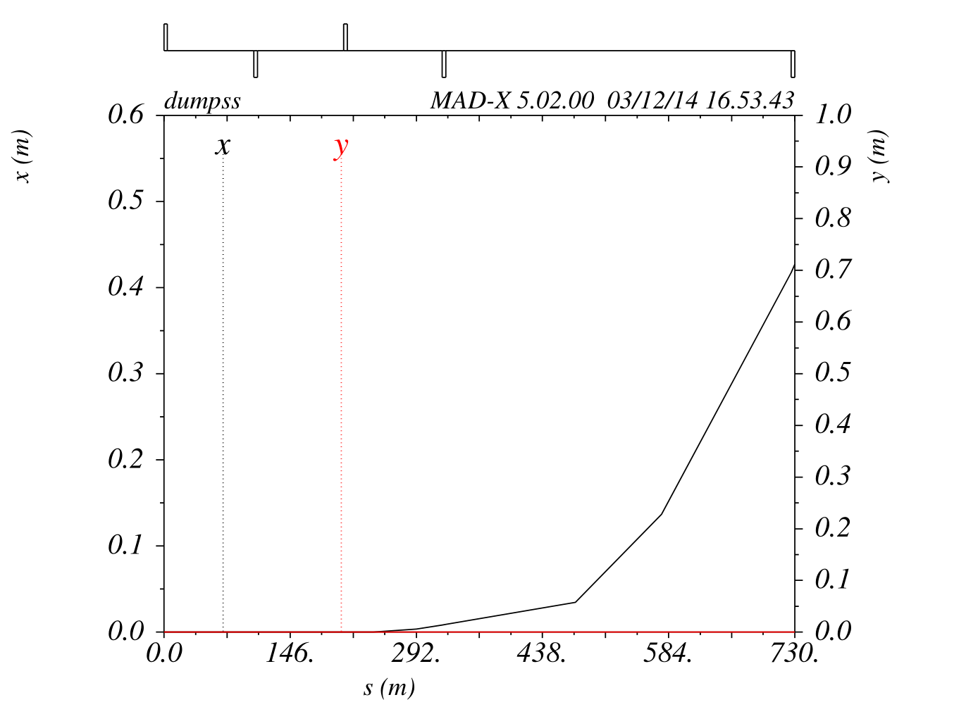
Extraction trajectory – no bump
MKE:
0.15 mrad
110 m drift
Q5:
9 mm offset
MSE:
35 mm offset at entrance
150 m drift to MSE
17 mm septum width
50 m for TCDQ
200 m for MSE
417 mm Q4 clearance
1.7 mrad, 284 T.m, 1.42 T

Slide 13
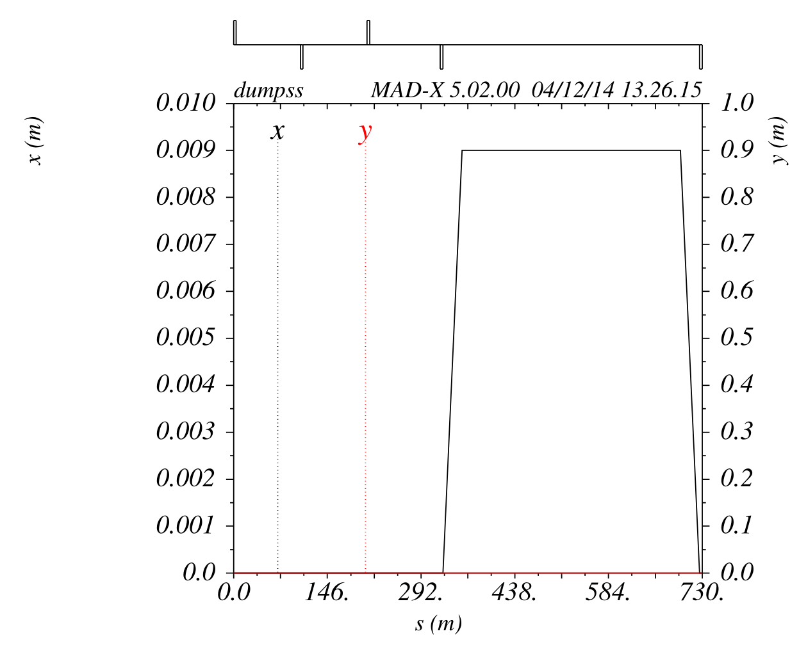
Extraction bump

Slide 14
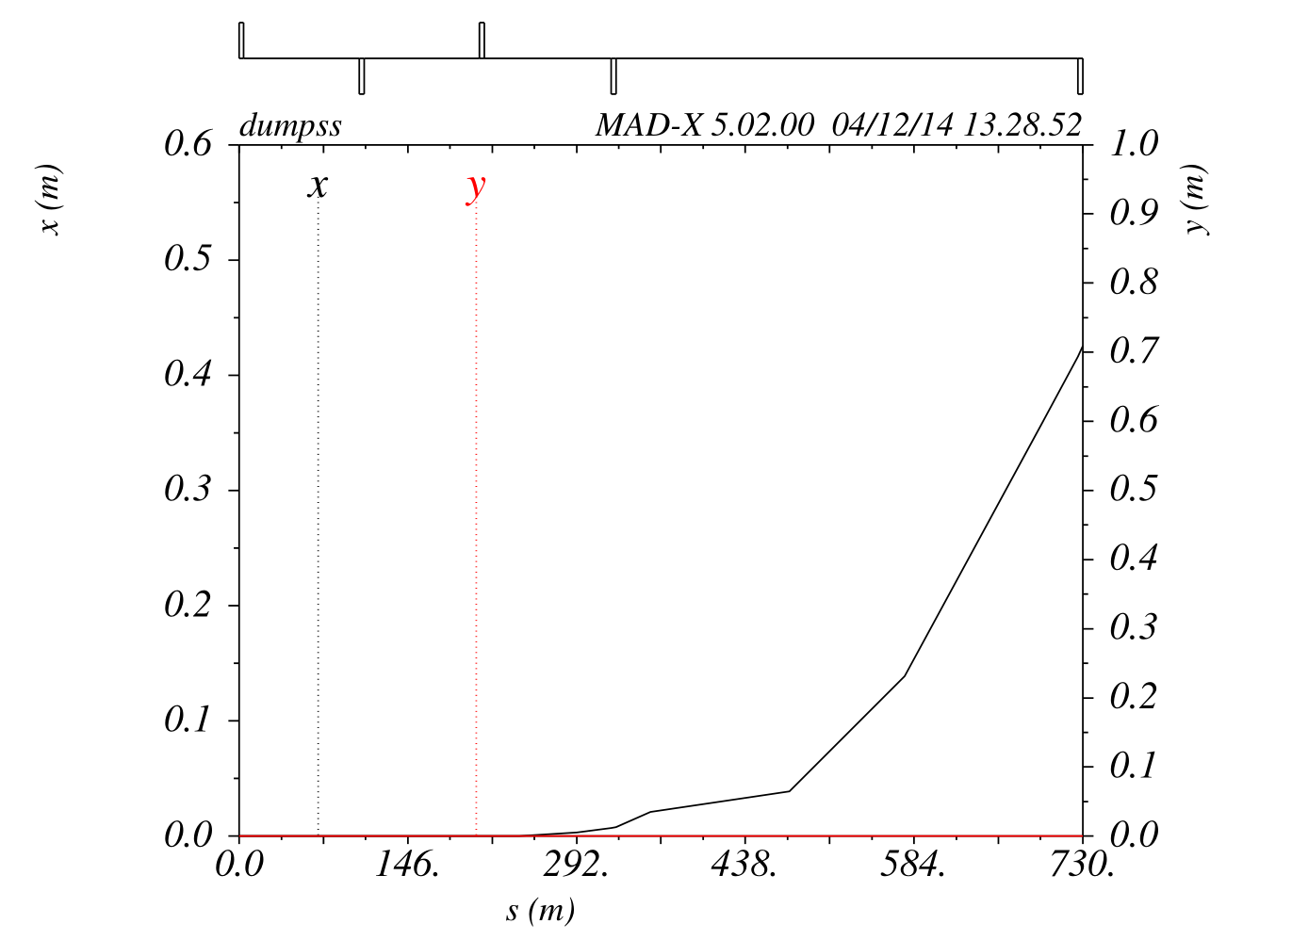
Extraction trajectory with bump
MKE:
0.15 → 0.13 mrad
110 m drift
Q5:
9 mm offset
Bump:
9 mm
0.3 mrad → 50 T.m
360 mm beam sep at bumper3
MSE:
35 mm offset at entrance
150 m drift to MSE
17 mm septum width
50 m for TCDQ+2 bumpers
200 m for MSE
417 mm Q4 clearance
1.7 mrad, 284 T.m, 1.42 T

Slide 15
For discussion
LHC extraction
Clockwise seems feasible with existing MSDs
Counterclockwise difficult, possible use of SC septa
FCC Injection
If standard half cell length of 100m can be opened to 125 m, NC septa become thinkable
100 m require ~6 T septa
FCC Dump
NC septum for dump not excluded
increase kick angle, QD5 strength, drift length
Combination of NC + SC septum
increase beam separation with thin NC septum
increase clearance at downstream QF4 with ~4 T SC septum
shorten drift → smaller betas → higher acceptance
SC septum parameters
Septum width ~ gap height?
1 T, 4 T, 6 T?

