Slide 1
LHCb
Infrastructure meeting
SciFi- installation
R. Walet on behalf of SciFi group
2015-02-19/20 Rev_01

Slide 2
Introduction
DISCLAIMER
The SciFi group is starting looking into the installation procedure
What I present in next slides is very preliminary
The goal is to provide timely input to the LHCb technical team rather than to give a definite installation scheme
PLAN OF THE TALK
Remind you how the Outer Tracker installation went
Sketch the main lines of SciFi installation

Slide 3
OT Installation steps
Produce and assemble C-Frames
@Nikhef, 4 FTEs + 1 student for 9 months
(2 C-Frames in parallel)
Equip them with cables and pipes
Install patch panels for all cables and pipes
Prepared C-frames transported to CERN
Installation modules on C-Frames
Testing
In the cavern, 4 FTEs + 3 phys. + 4 st. for 1 year
(2 C-Frames in parallel)
Move C-Frame + Modules to nominal position
Alignment & Survey
Installation cables and pipes in rolling ducts
In situ, 3 FTEs + 1 phys. for 1 year
Installation FE Boxes

Slide 4
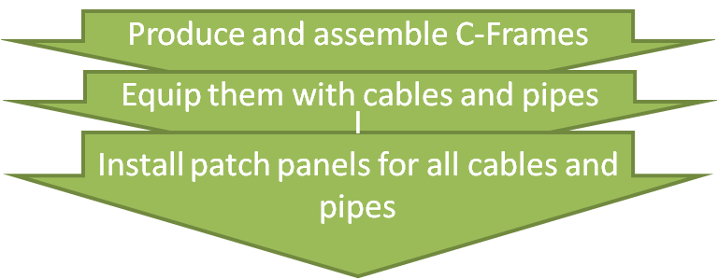
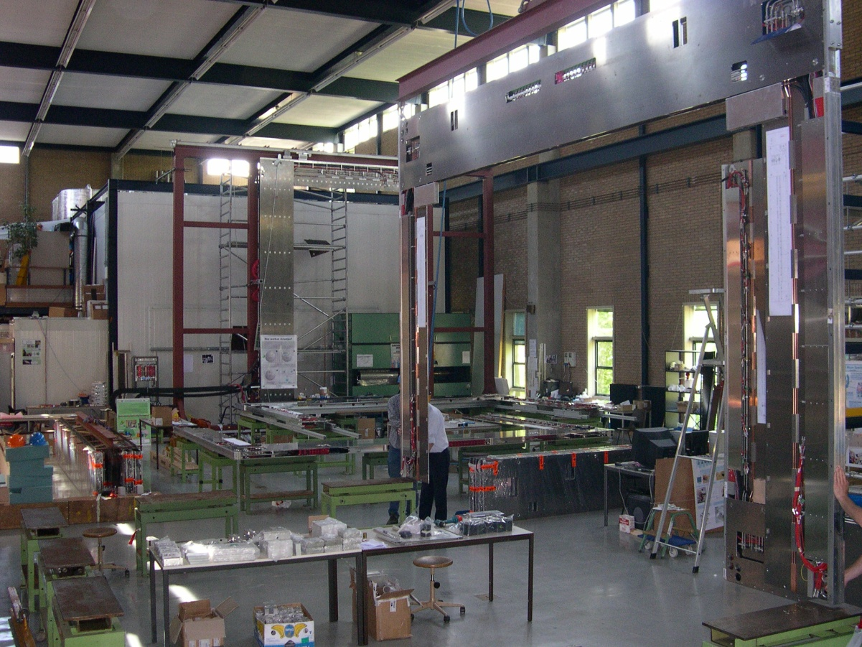
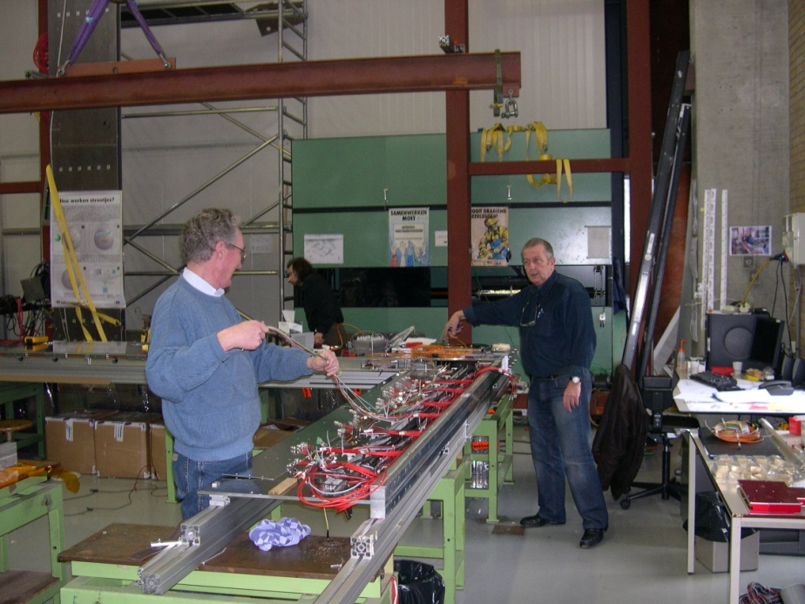
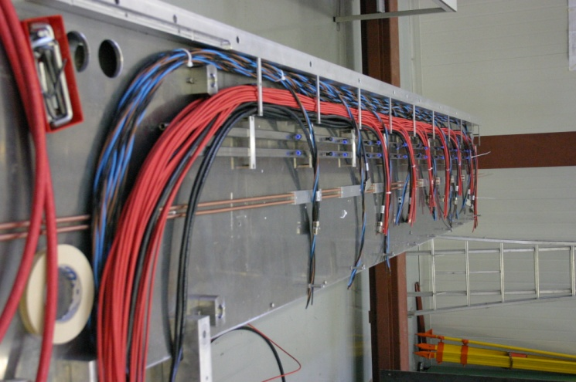
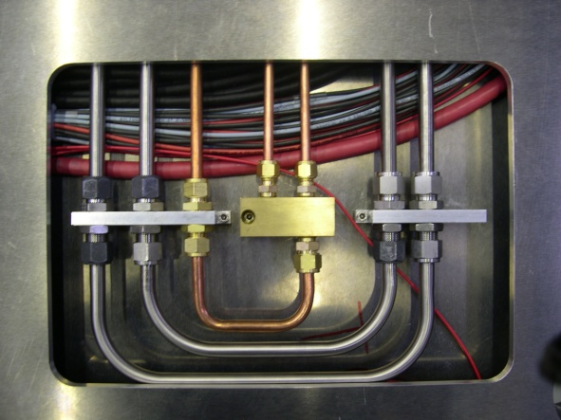
Pre-assembly C-Frames
~8 x 12 m in Nikhef assembly hall
Notes:
Scintillating Fibre Tracker, 2.5 m long fibres read out by silicon photomultipliers at the edge of the acceptance

Slide 5
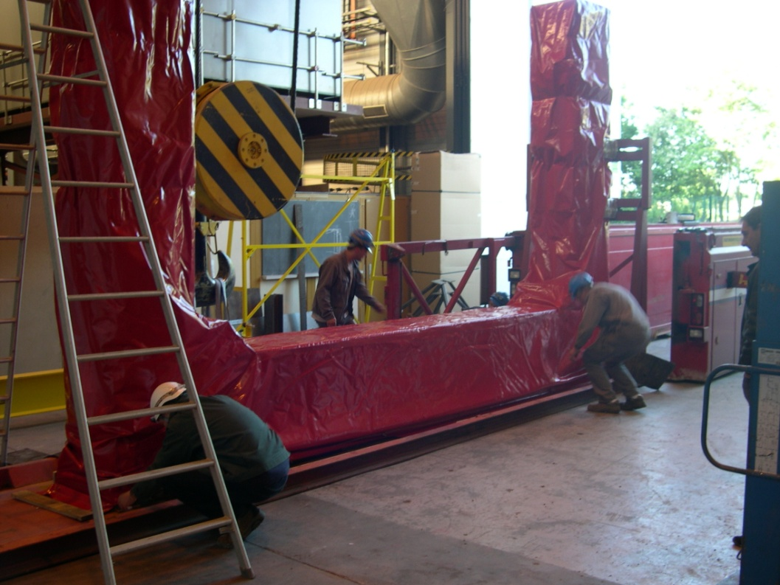
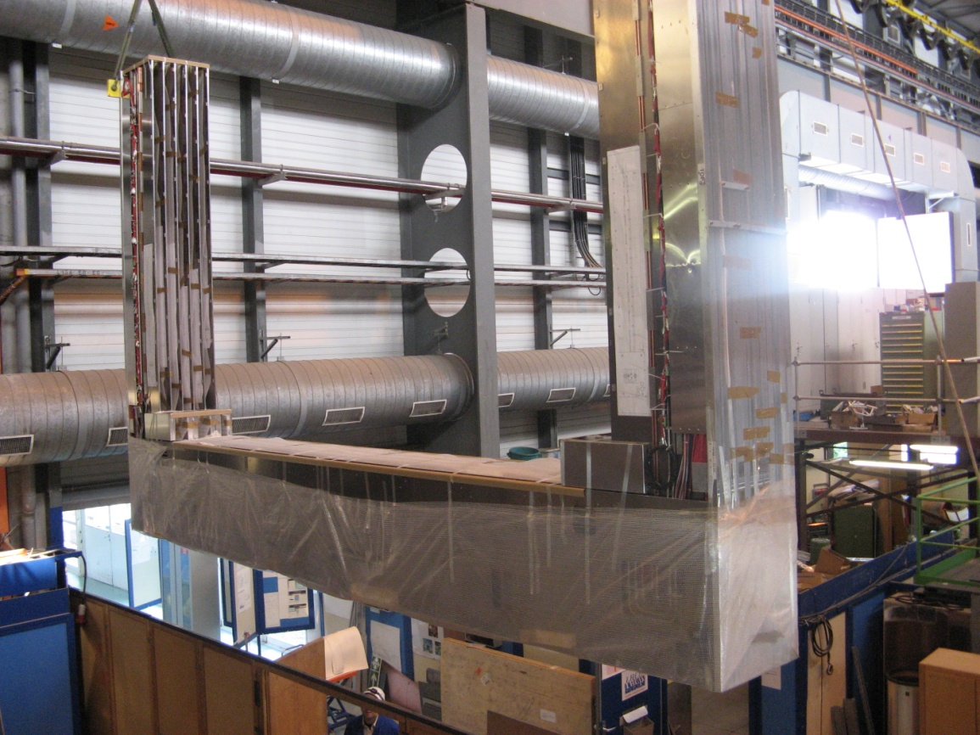
C-Frames to CERN
prepared C-frames transported to CERN
Notes:
Scintillating Fibre Tracker, 2.5 m long fibres read out by silicon photomultipliers at the edge of the acceptance

Slide 6
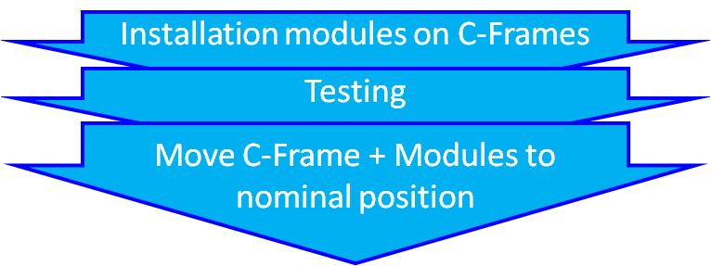
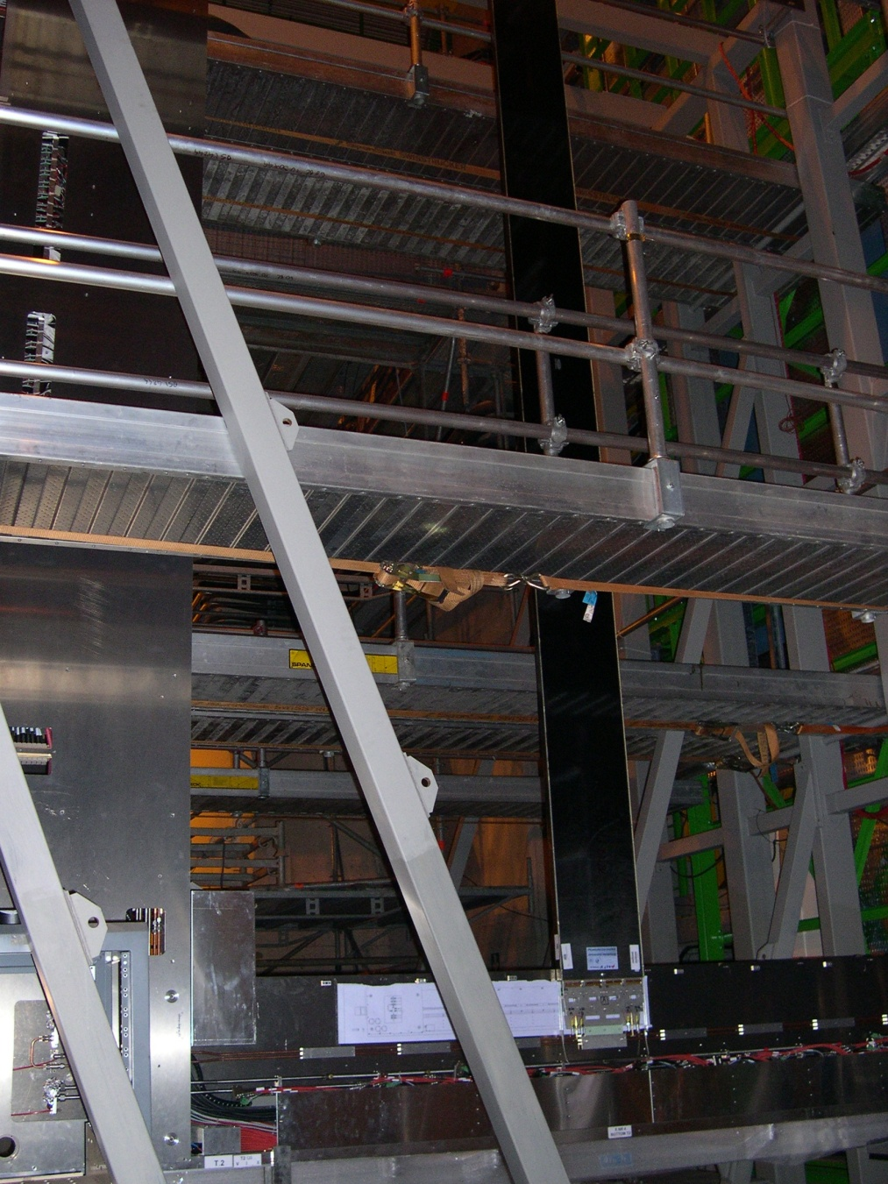
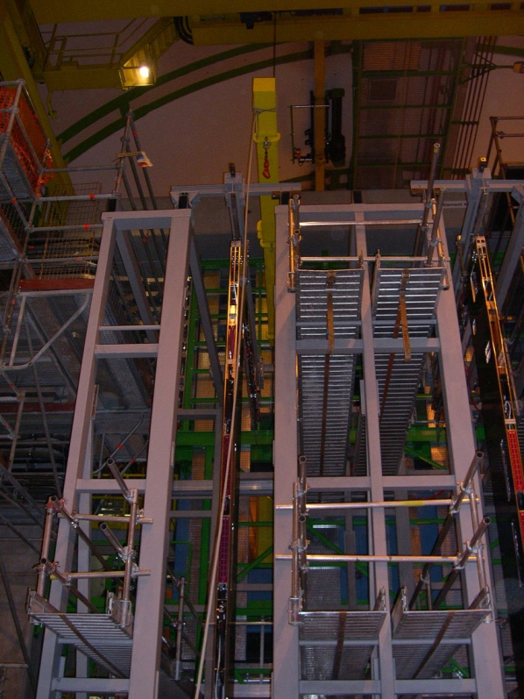
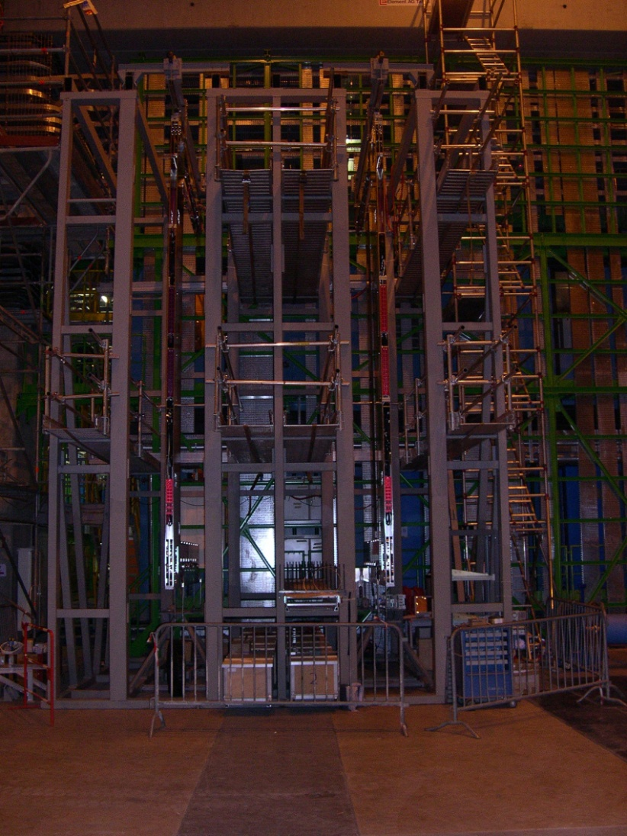
Modules on C-Frames
Notes:
Scintillating Fibre Tracker, 2.5 m long fibres read out by silicon photomultipliers at the edge of the acceptance

Slide 7
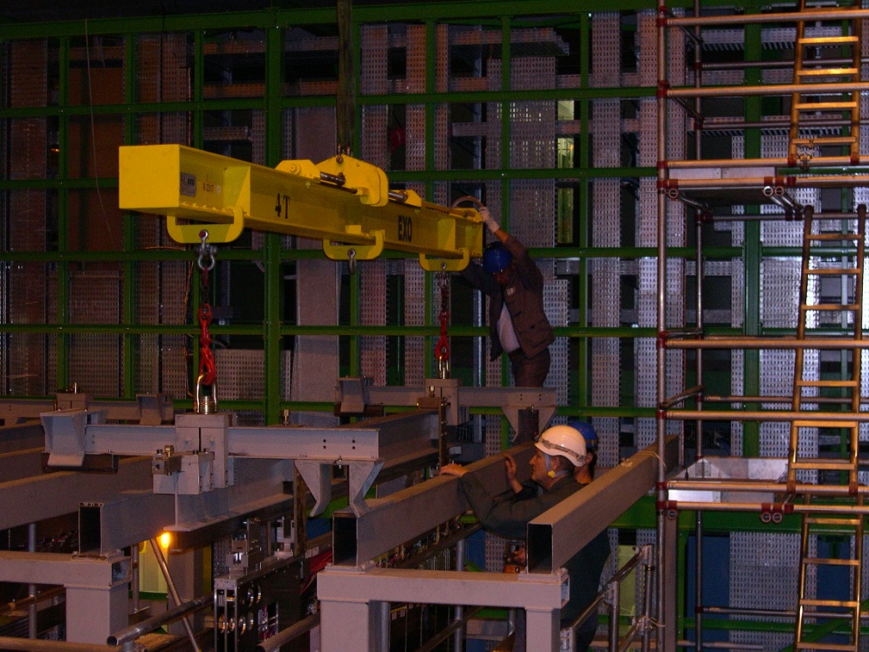
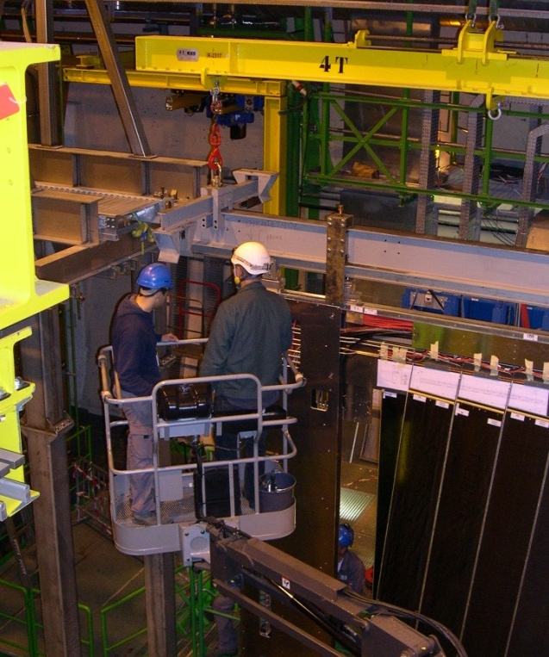
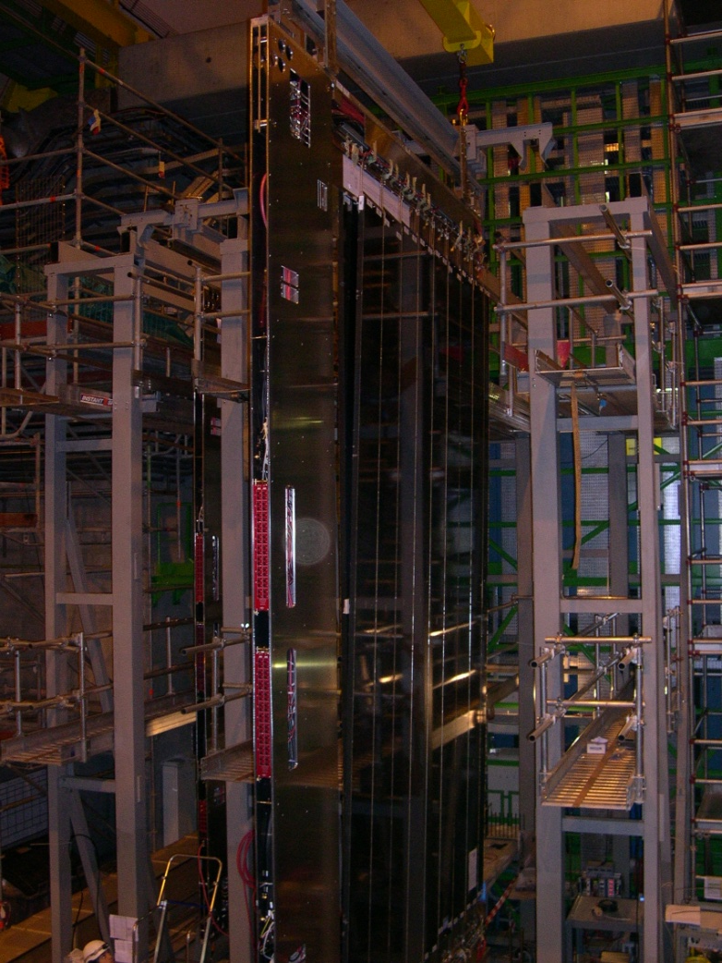
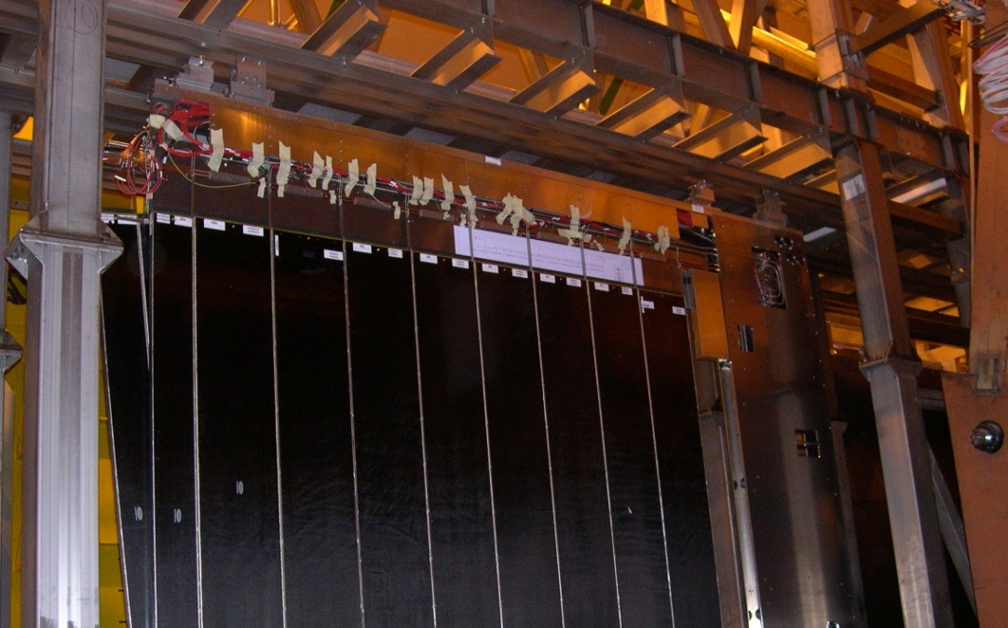
C-Frame to Bridge
(1)
(3)
(2)
(4)
Notes:
Scintillating Fibre Tracker, 2.5 m long fibres read out by silicon photomultipliers at the edge of the acceptance

Slide 8
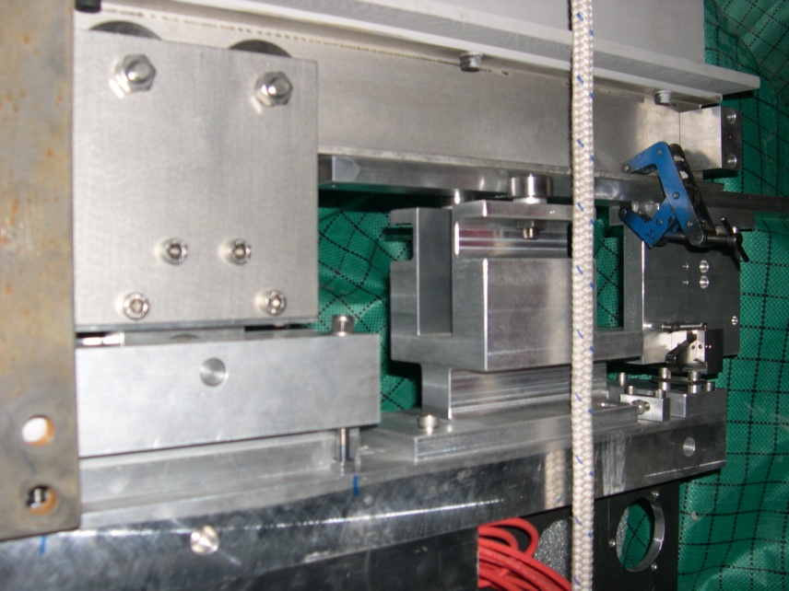
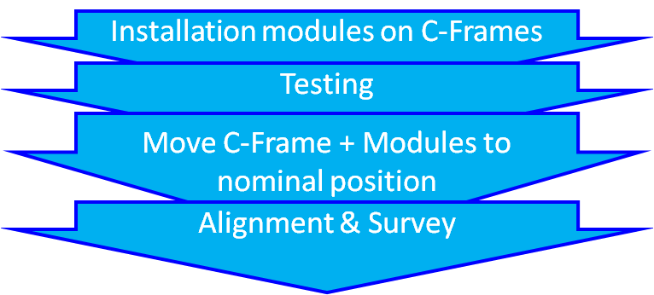
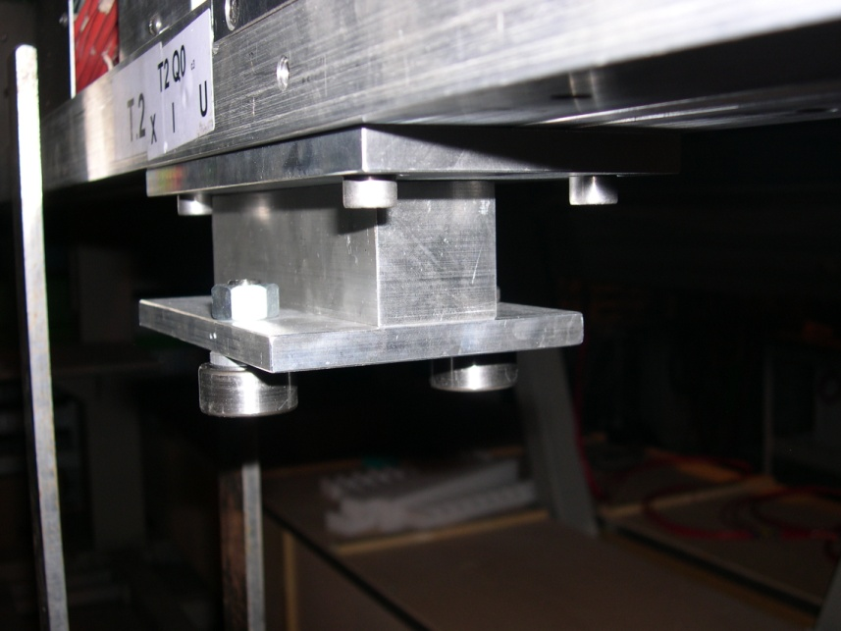
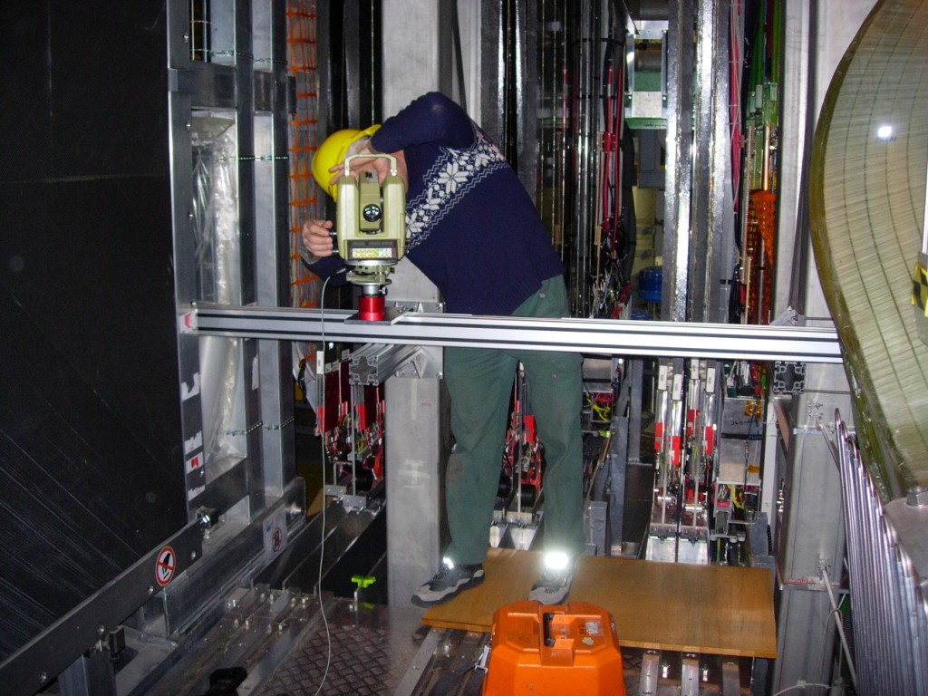
Alignment & Survey
Notes:
Scintillating Fibre Tracker, 2.5 m long fibres read out by silicon photomultipliers at the edge of the acceptance

Slide 9
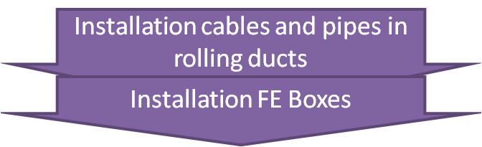
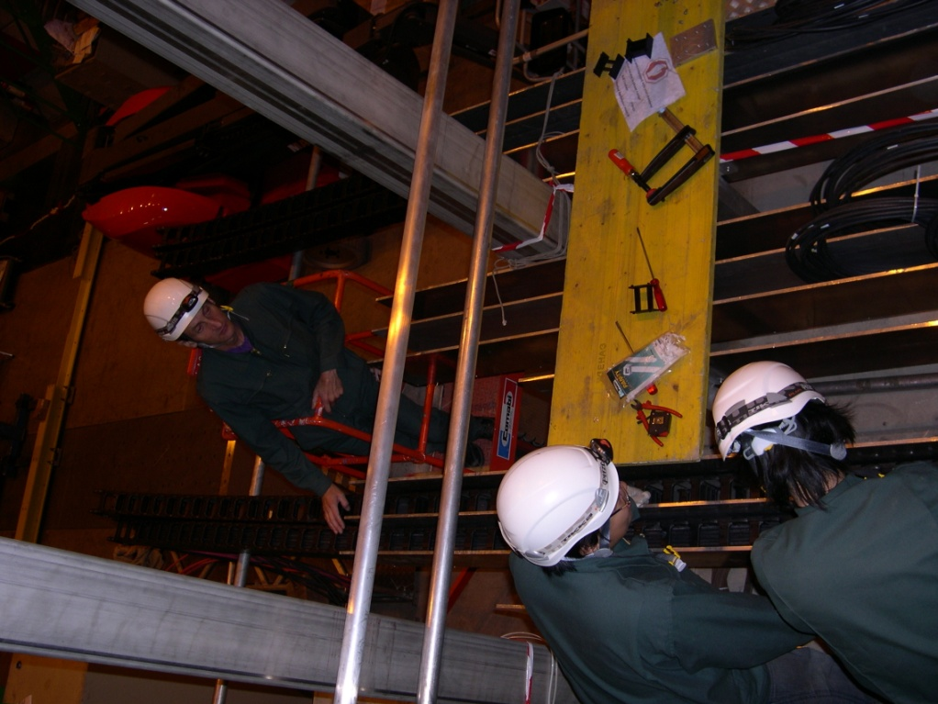
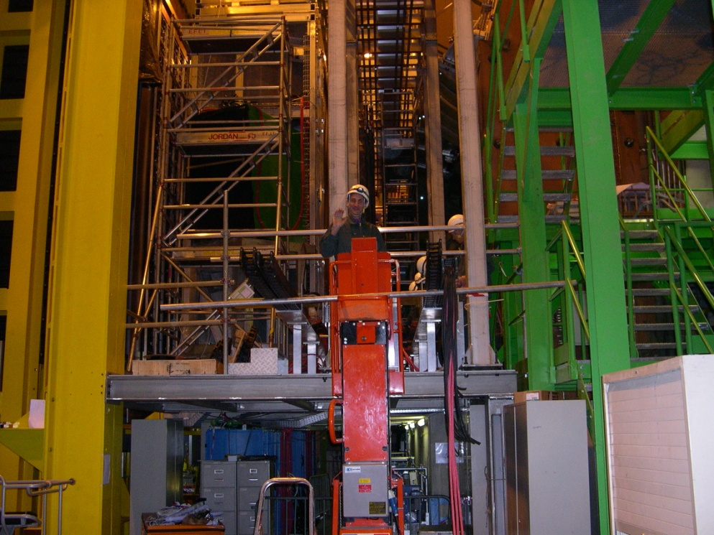
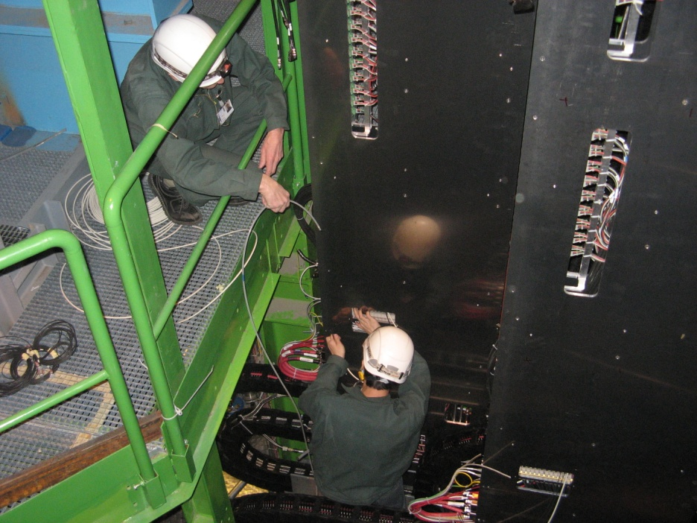
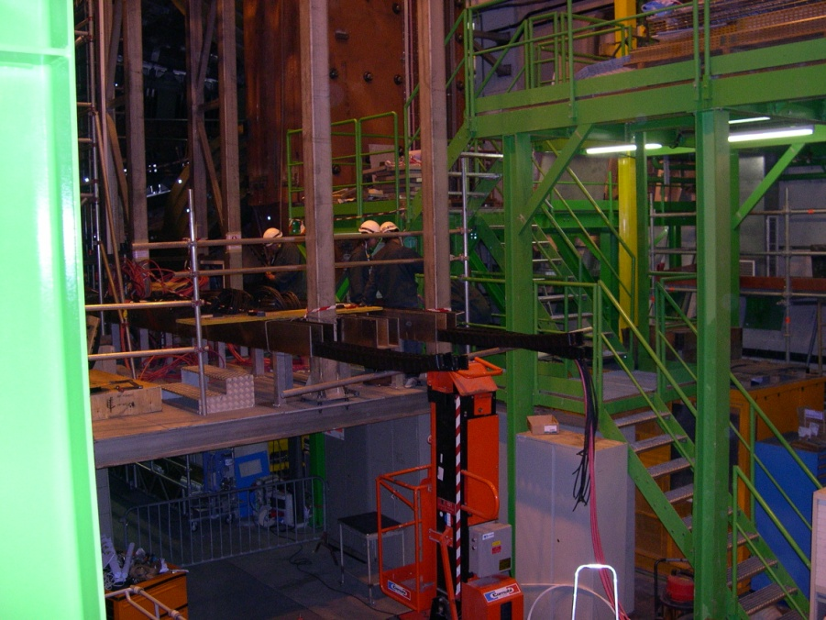
Rolling Ducts & Cabling
Notes:
Scintillating Fibre Tracker, 2.5 m long fibres read out by silicon photomultipliers at the edge of the acceptance

Slide 10
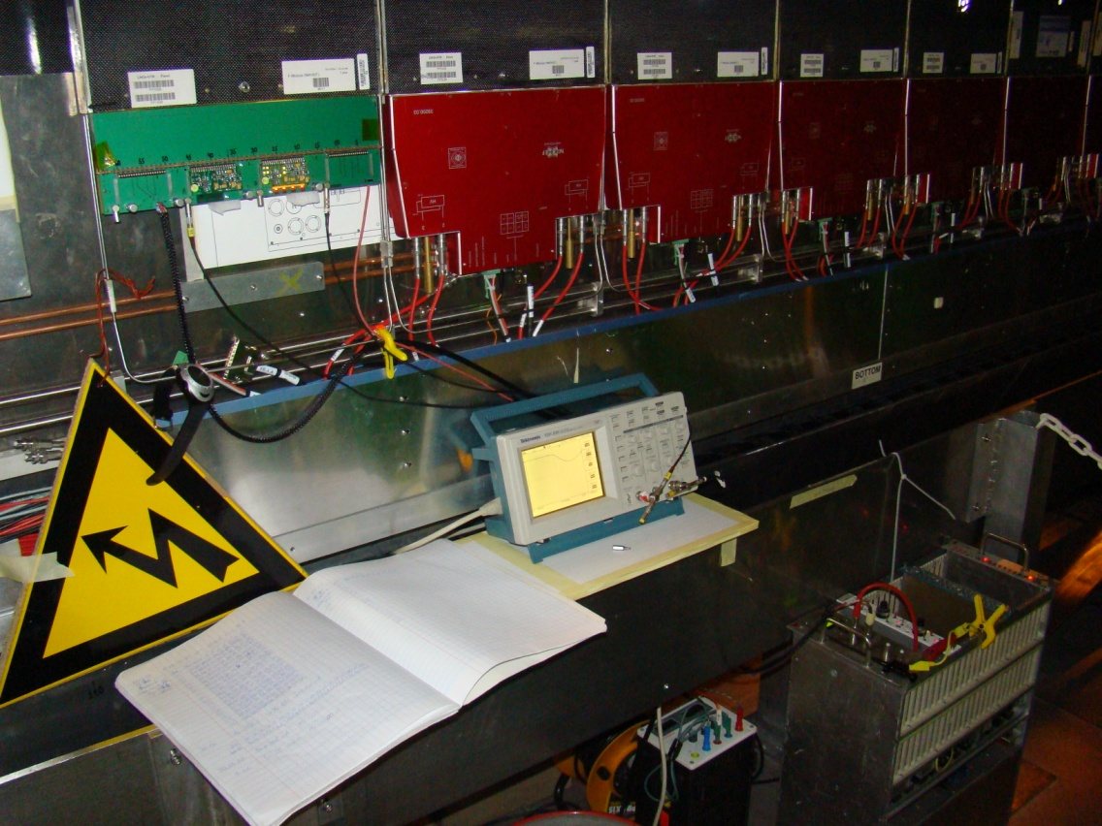
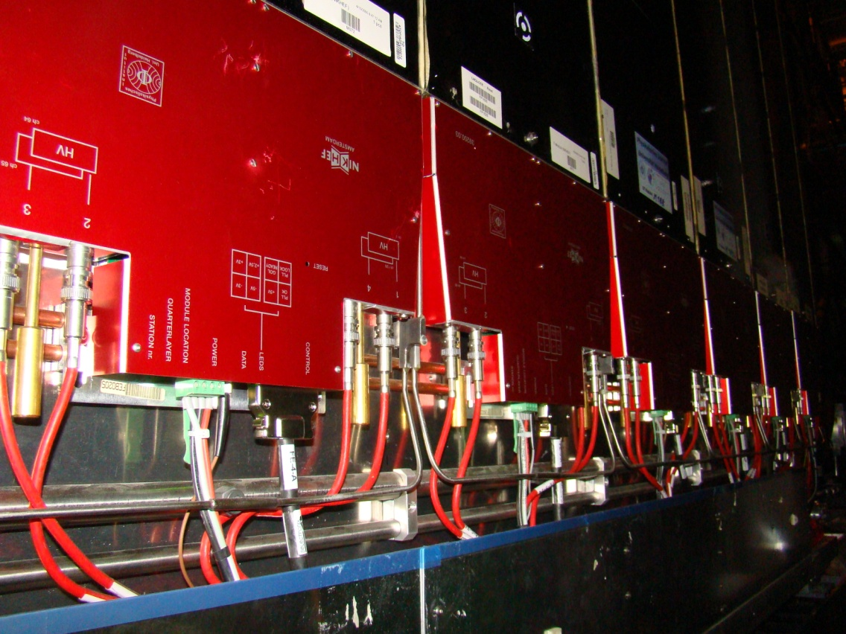
FE Installation
Done in situ, because FE production was late
Notes:
Scintillating Fibre Tracker, 2.5 m long fibres read out by silicon photomultipliers at the edge of the acceptance

Slide 11
So what about SciFi Installation?
In many respects similar to OT installation (shares same location, Bridget, Table, etc.)
…but also many differences:
  time constraints tighter (Q3 2018 – Q3 2019)
  no space available to install a “C-cage” in the cavern
  pre-assemble C-Frames at CERN
Notes:
Scintillating Fibre Tracker, 2.5 m long fibres read out by silicon photomultipliers at the edge of the acceptance

Slide 12
It could go like this
Above ground
Underground
Preparation Work area
Assembly C-Frame Jigs
Preparation
Installation C-Frames on Jigs
Installation cables & pipes on C-frames
Installation modules on C-Frames
Dismantling existing Detector
Adding rolling duct and piping,cabling
Preparation Work area
Testing
Transport complete C-frames with modules and cabling
Installation (Q3 2018 – Q3 2019)
Installation transfer lines and all open connections
Installation of the complete
C-Frames, including cable tray and cooling
TESTING AND COMMISIONING

Slide 13
Requests to Technical Team
Assembly hall(s) at ground level
  scaffolding and mobile work platforms
  Test Facilities for C-Frame system tests (cooling, power, control & DAQ)
Lab space (maintenance and repairs)
Help in design and construction of jigs
    e.g. safety issues
usage of cranes and transport
etc.
Notes:
Scintillating Fibre Tracker, 2.5 m long fibres read out by silicon photomultipliers at the edge of the acceptance

Slide 14
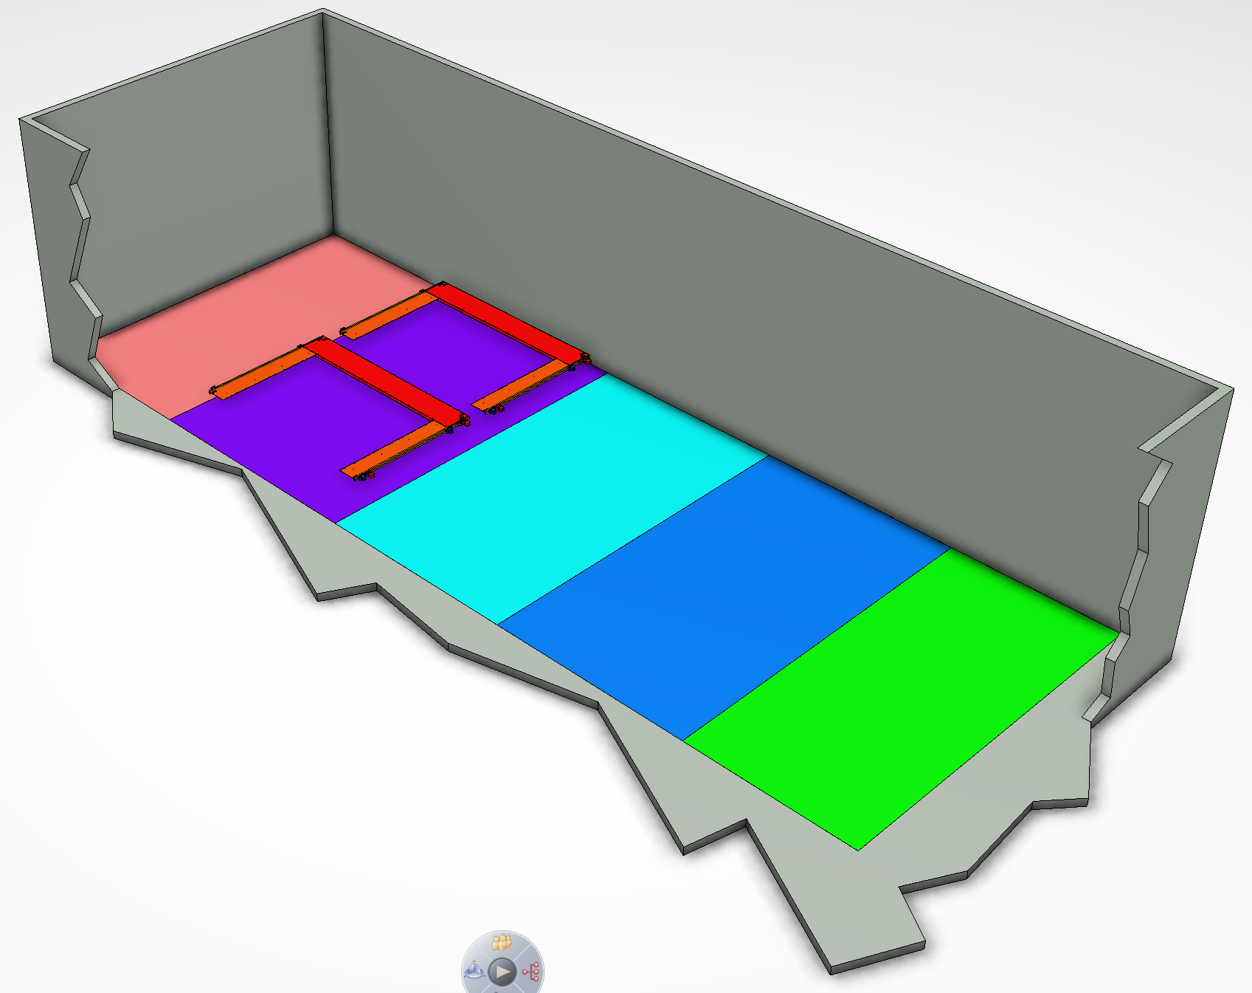
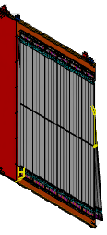
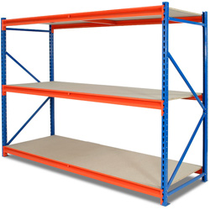
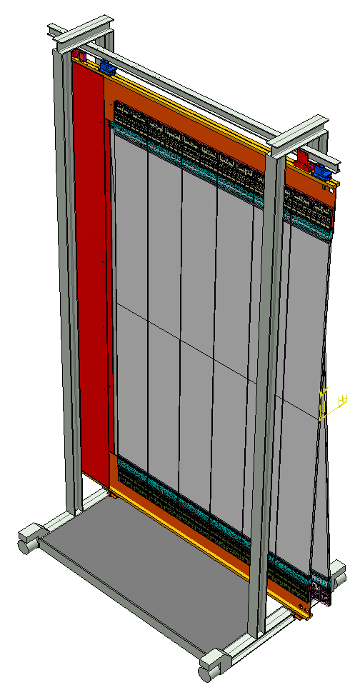
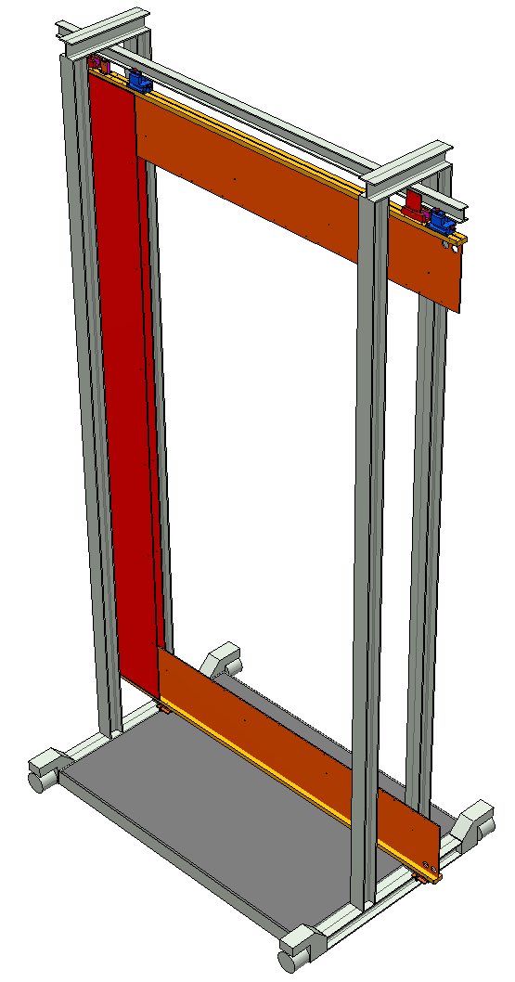
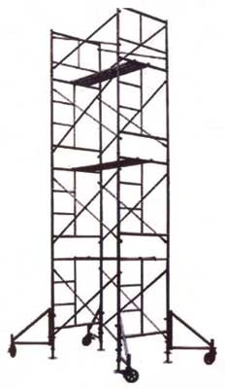
11[m]
Assembly Hall
5[m]
4.2[m]
8[m]
30[m]
6.3[m]
6[m]
6[m]
5[m]
Storage
C-Frame, cabling and cooling assembly
8[m]
Module installation on C-Frame
Test and commisioning
Storage

Slide 15
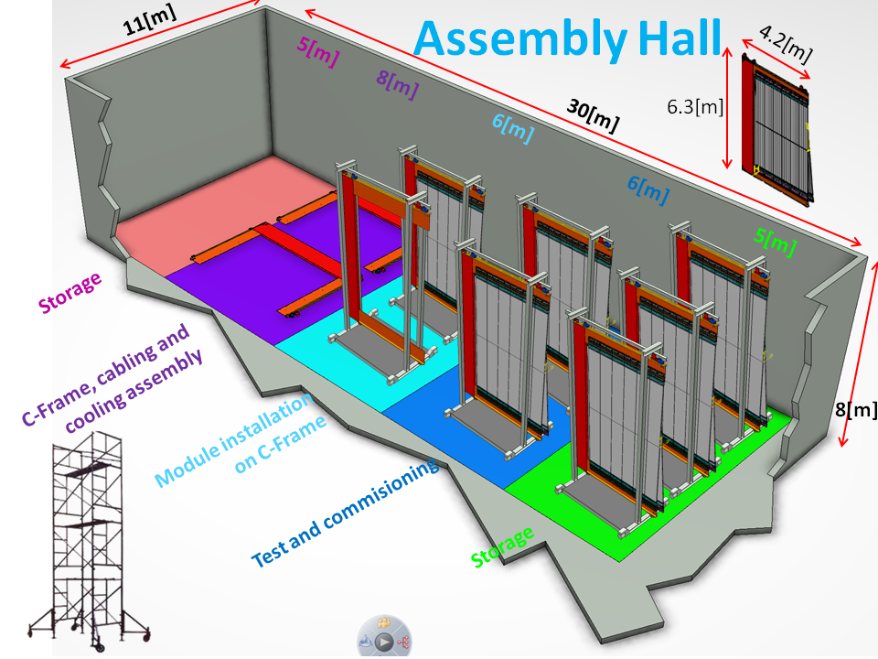
Space Requirements
large assembly hall 11 × 30 m² h=8m
  alternatives?
  high ceiling and doors
  cranes
Lab space (maintenance and repairs)
Notes:
Scintillating Fibre Tracker, 2.5 m long fibres read out by silicon photomultipliers at the edge of the acceptance

Slide 16

C-Frame System Test
Overview
2×12 Modules, this contains 4×6 ROBs
Needed interfaces
power (SiPM and FE bias)
water cooling
SiPM cooling
  already have? Buy new one?
    Nikhef would like to borrow it for next 2 years?!
control & mini-DAQ
environmental monitoring
compressed air and dry gas
usage of radioactive sources
nearby lab to repair broken parts
etc.
data
cooling
power
control
Notes:
Scintillating Fibre Tracker, 2.5 m long fibres read out by silicon photomultipliers at the edge of the acceptance

Slide 17
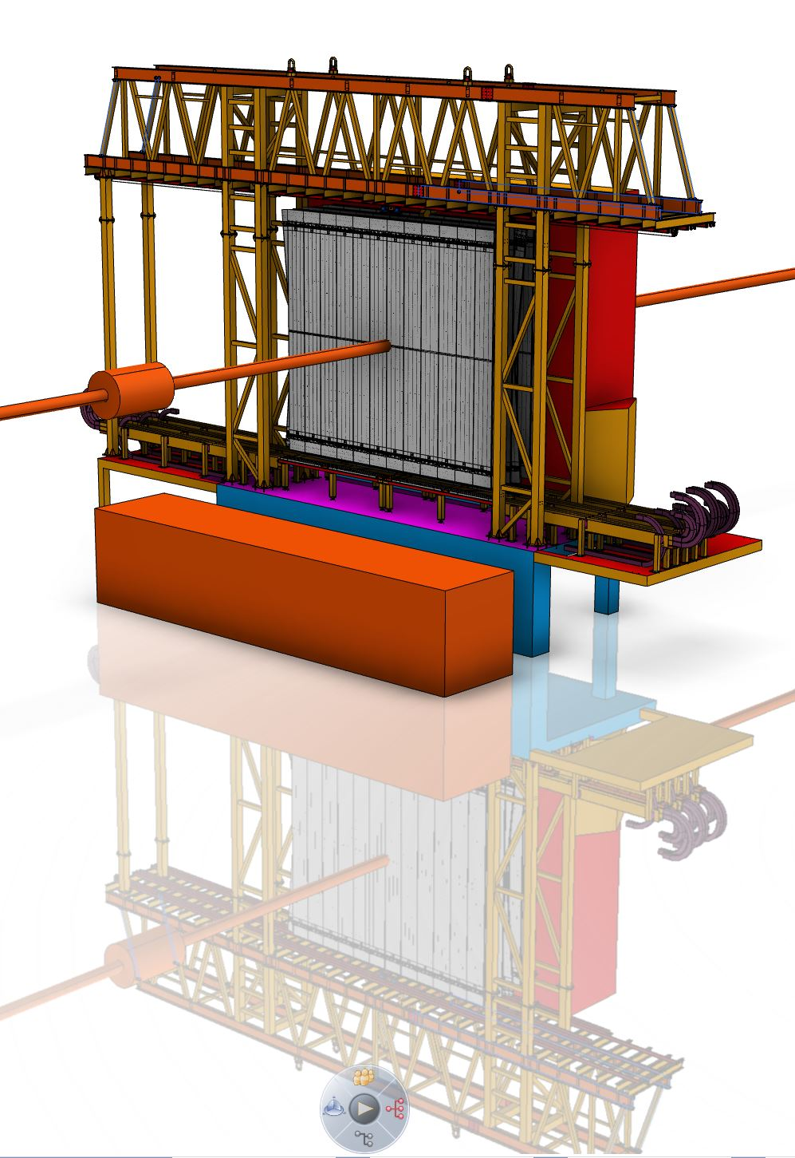

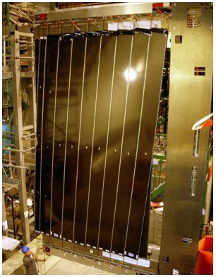
Dismantling OT
RE-USE; Bridge
5 [m]
NEW;
C-Frames
Detector
Cable tray
Etc.
re-use parts?
  e.g. rollers
keep the rest for ~1 year…
  where?
…then dispose of it?
  how?
RE-USE; Table
Notes:
Scintillating Fibre Tracker, 2.5 m long fibres read out by silicon photomultipliers at the edge of the acceptance

Slide 18
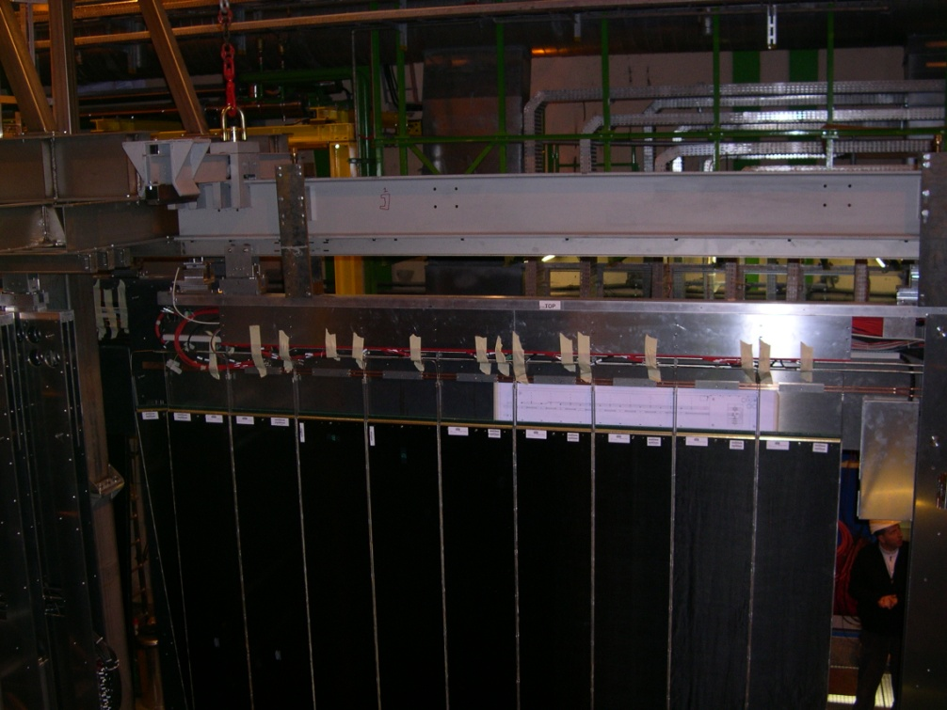
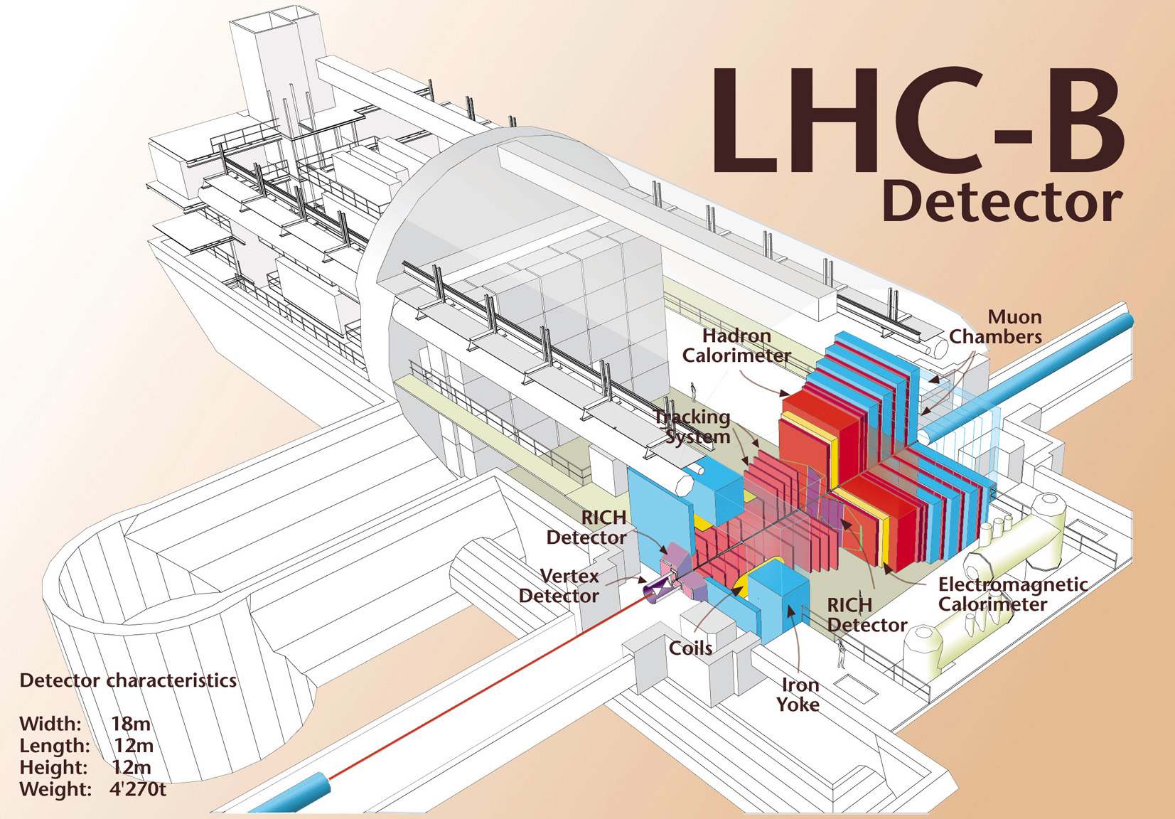
Move to Position
Lower fully assembled frame
insertion beam/concept (re-use?)
insert
move next to detector
Notes:
Scintillating Fibre Tracker, 2.5 m long fibres read out by silicon photomultipliers at the edge of the acceptance

Slide 19
Outlook
SciFi installation will in many respects be similar to OT
  re-use Bridge and Table
  insert fully assembled C-Frames connecting to Bridge rails from A side
main difference is that SciFi C-Frames will be fully assembled at the surface
  space requirements at the surface
  define procedure to lower fully-assembled C-Frames
we sketched first ideas, obviously preliminary
interact with technical team to define boundary conditions
  update SciFi infrastructure document
Notes:
Scintillating Fibre Tracker, 2.5 m long fibres read out by silicon photomultipliers at the edge of the acceptance

