Slide 1


Power, electronics, cabling.
Infrastructure of LHCb upgrade workshop.
J. Buytaert.
19 February 2015

Slide 2
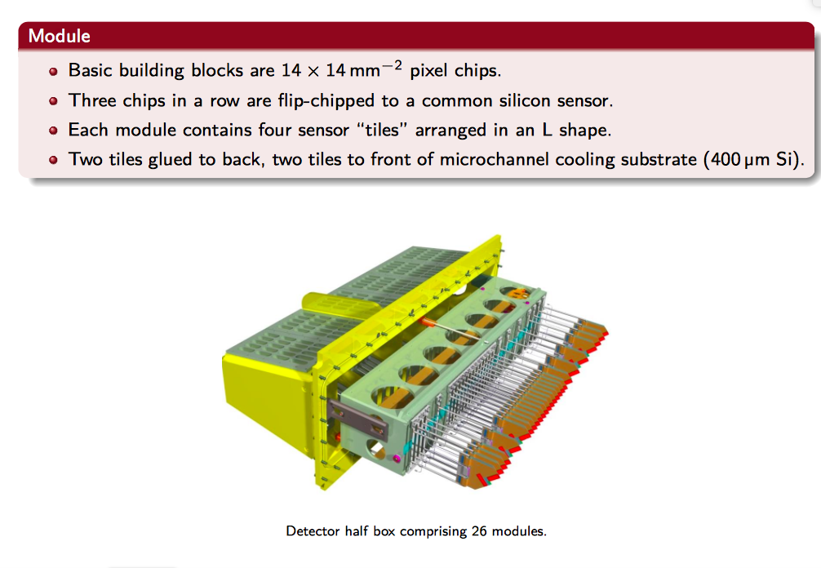

Slide 3
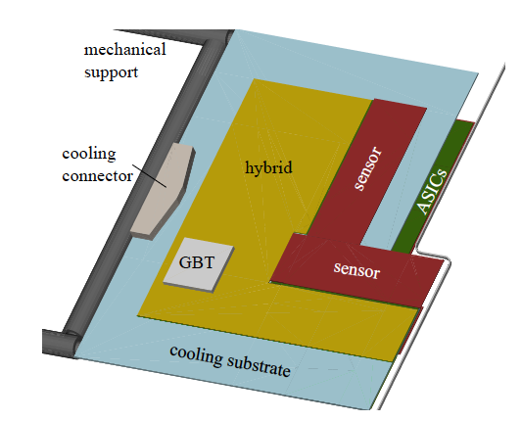
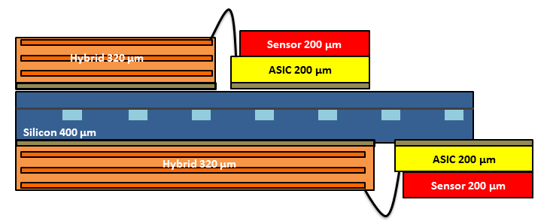
ASIC/sensor/hybrid/module
~42 mm
Sensor tile
ASIC
ASIC
ASIC
~14 mm
‘Hybrid circuit’
‘module’
sensor tile = 3 ASICs + sensor (a.k.a. triple / assembly)
hybrid = kapton pcb for 2 tiles (= 6 ASICs)
  hosts the GBTx for slow and fast control signals (ECS/TFC)
  maybe hosts the GBT-SCA (providing ADC + reset) t.b.d.
module = cooling substrate with hybrid and tiles on both sides
  all module connection are electrical (not optical), basically power and high speed links

Slide 4
Detailed overview of a ‘slice’ & locations
52 slices in the whole VELO.
‘Cabling’
Inside vacuum vessel
Periphery of vacuum vessel
Surface P8
1 module =
2 x front-end hybrids
off-detector electronics
(remote)
< 1 m
1 x opto & power board “OPB”
vacuum feed-through
3 data links
GBLD
3 x VTRx
SOL40
T_{1,2}
2 x GBLD
reset
GBTx
V_{MON}
SCA?
Flex cables
2 x SCA
4 x DC/DC
Optical fibers
6 x ECS
6 x CLK
6 x TFC
GBTx
Interlock
T_{OPB}
10 x VTTx
PCIe40
2 x (10) data links
7 data links
LV
12 x DC/DC
LV PS
HV
HV PS
4 x HV
Note: no more use of ‘balcony’
Barrack
D2 UX85A

Slide 5
Low voltage power
Reuse of existing CAEN Easy system (in D2).
  It is able to deliver the power for the upgrade.
  It has high number of channels. Need 52*3=156.
  It is stable.
  Lifetime of power supplies can be >15 years.
  As long as maintenance contract is in place. (cfr ATLAS & CMS).
Reuse of existing LV long distance cables.
  60 meter, ~0.5 Ohm. Acceptable voltage drop 2V-3V.
  Possible need to adapt patch panel on detector side.

Slide 6
Low voltage power.
Power requirements (maximal):
  1 full station: 64W
    Module : ~33W
    OPB board: ~31W
  52 stations: 3.3 kW
    Module : ~1.7 kW
    OPB board: ~1.6 kW
All voltages(1.2V, 1.5V, 2.5V) for OPB and module are derived by DC-DC converters from 3 incoming 5V ‘bulk’ supplies.
OPB cooling: forced air cooling probably necessary.

Slide 7
High Voltage power.
Upgrade needs twice more channels than current VELO.
  1 individual HV per sensor tile. (208 tiles).
  Need to reach 1000V. (current ISEG <700V)
  Requires new HV supplies.
  Additional long distance HV cabling. Existing cables can be reused.
  New patch panels on both ends.

Slide 8
Optical long distance cabling.
Data.
  Unidirectional (GWT serial format @ 5.12Gbps)
  20 (22?) links per station.
  full VELO:
    Needed : 1040 (1144?) links.
    Installed : 9 ‘trunk cables’, i.e. 1296.
      2 x MPO (=24 fibres) per station. (4 fibres unused).
    Spare: 24% (13%?).
    Reduce to 8 trunk cables ?
      Requires ‘shuffling’ of fibres at detector & Tell40 side. (cassettes). Equal cost ?
      Less “elegant”: MPO fibres shared between modules.

Slide 9
Option 2 for DATA
UX85 caverne
PM85 pit
Surface
1
2
3
4
5
6
7
8
9
10
11
12
13
14
15
16
17
18
19
20
21
22
LC
5-10m
MPO-MPO Adaptors Path Panel
MPO-MPO Adaptors Path Panel
MPO-MPO Adaptors Path Panel
1-3m
MPO 1
MPO
5-10m
12f
MPO
11 used
12f
MPO
MPO 1
330-350m
AMC40
PCIe
2 MPO Input
Module 1
Spare
MPO 2
12f
MPO
11 used
12f
MPO
MPO 2
Ex:48f?
for Module 1
??
??
144f
Spare
Trunk 1
MPO-MPO Adaptors Path Panel
1
2
3
4
5
6
7
8
9
10
11
12
13
14
15
16
17
18
19
20
21
22
LC
MPO 3
MPO
12f
MPO
11 used
AMC40
PCIe
2 MPO Input
12f
MPO
MPO 3
Module 2
MPO 4
12f
MPO
11 used
Spare
for Module 2
12f
MPO
MPO 4
??
??
…
…
for Module 3
Spare
…
…
Total 26 Modules / side
MPO 12

Slide 10
Optical long distance cabling.
ECS & TFC.
  Standard GBT serial format @ 4.8Gbps. Bidirectional.
  3 links per station:
    1 for each of 2 hybrids
    1 local OPB control & monitoring
  Full VELO:
    Needed: 156 x 2=312 links
    Installed: 3 trunk cables. (432 links)
    Spares: 38%. Could be shared with other sub-detector (RICH or UT?)

Slide 11
for TFC
LC Duplex
UX85 caverne
PM85 pit
Surface
1
2
3
1f
MPO-MPO Adaptors Path Panel
5-10m
MPO-MPO Adaptors Path Panel
1-3m
MPO
5-10m
12f
12f
MPO
MPO 1
330-350m
MPO 1
MPO
MPO
SOL40
Module 1
1f
1
2
3
MPO 2
12f
MPO
Module 2
MPO
MPO 2
Ex:48f?
…
144f
1
2
3
Trunk TFC/ECS 1
MPO 3
MPO
MPO
Module 3
MPO
MPO 3
MPO 4
1
2
3
1f
…
Module 4
MPO
MPO 4
…
…
Total 26 Modules / side
MPO 12

