Slide 1
Online system
Infrastructure for LHCb Upgrade workshop - Session I: Power, electronics, cable
19/2/2015
Niko Neufeld PH/LBC

Slide 2
Online Architecture
Detector front-end electronics
UX85B
8800
Versatile Link
Clock & fast commands
ECS
Clock & fast commands
500
Eventbuilder PCs (software LLT)
TFC
throttle from PCIe40
Eventbuilder network
6 x 100 Gbit/s
6 x 100 Gbit/s
Point 8 surface
subfarm switch
subfarm switch
Online storage
Eventfilter Farm
up to 4000 servers

Slide 3
Design considerations in the Online system
DAQ cost is driven by
  number and type of interconnects
    shorter → cheaper
    faster → cheaper per unit of data transported
  price of switching technology
    telecom (feature-rich and expensive) vs data-centre (high-volume and inexpensive)
Data-centre operation much easier on the surface in a non-controlled area
  Current LHCb data-centre is in UX85A
Data-centre cost is definitely lowest for pre-fabricated (“container”) solution

Slide 4
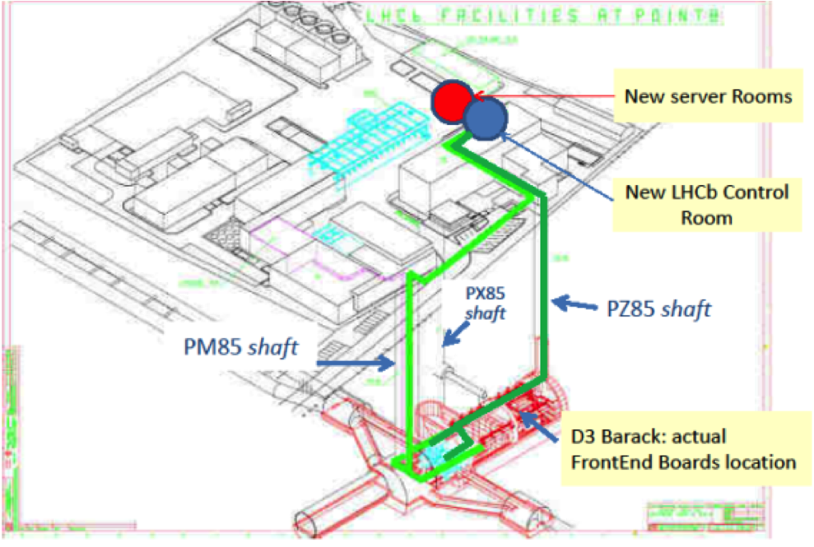
Location of Online system from LS2
Most compact system achieved by locating all Online components in a single location
Power, space and cooling constraints allow such an arrangement only on the surface: containerized data-centre
Versatile links connecting detector to readout-boards need to cover 300 m
Container data-centre
D2 & D1 (current ECS & farm
long-distance optical fibres

Slide 5
Online system upgrade in numbers
9000 links from detector
Eventbuilder system of 500 – 600 servers and O(10) switches
Eventfilter farm of up to 4000 servers, will start with ~ 1000 servers, O(100) switches
Experiment Control System infrastructure, O(100) servers, storage O(10) Petabyte
Power for cooling and air-conditioning systems
  Depends on adopted cooling solution (→ tomorrow)
  But certainly < 10% of total
Item | Power (per item)
Eventbuilder server | 500 W
Eventbuilder switch | 5 kW
Eventfilter server | up to 350 W
Eventfilter / Controls switch | 300 W
Controls server | 300 W
Storage | 25 kW

Slide 6
Power needs in new data-centre S8
Data-centre will house event-builder, part of ECS and TFC and event-filter farm + required network equipment
No central storage
Require up to 2 MW (min 800 kW)
3-phase current (220 V)
Mandatory 20 kW EOD for 30 min for critical ECS & TFC services
Desirable – but not mandatory - ~ 400 kW EOD for 2 minutes for event-builder nodes for clean shutdown (custom electronics inside)
Power should be available with the arrival of the containers starting from 2017

Slide 7
Power needs in UX85A for Online
Base-line scenario
  Very little – some ECS infrastructure in D2 / D3 barracks
  More than covered with 100 kW EOD (available today) ✔
Plan B in case of problem with long-distance versatile link
  No indication of any problem yet → should know by the end of the year
In that case need additional 400 kW (available today)
Battery backup would be desirable to ensure clean shutdown of servers (2 minutes)

Slide 8
Power needs in SX85
Existing infrastructure
  70 kW on EOD (dual-feed, redundant)
  Used for critical services (ECS and storage)
  Will be kept for Run3 and beyond
A small increase (30 kW) in the same configuration is desirable (30 kW) but not mandatory
More on-site storage
Cooling should be made redundant (→ tomorrow)

Slide 9
Summary: power
Location | Max. Load [kW] | out of which on battery
UX85A D1 & D2 | 200 | 100
2885-R-007 (SX85) | 70 + 30 (additional) | 70 + 30 (additional)
Data-centre S8 | 2000 (800 kW min) | 20
The upgraded LHCb online system has significantly larger power-needs than the current one, in particular in the event-building and event-filter.
All new power-needs are in the to-be-built new data-centre from 2017
For existing, re-used location current power and battery backup are sufficient

Slide 10
Optical cabling
Long-distance optical fibres from UX85B via PM to S8 data-centre
  won’t talk about patch-cords here (SD responsibility)
Successfully verified installation with the collaboration of EN/EL and EN/MEF (thanks!)
Verified for both types:
  pre-connectorized cables
  blown fibres with spliced pig-tails
Long distance fibres are OM3 with MPO12 elite connectors
Will need between 1000 and 1200 MPO12 fibres
Needed as soon as possible after the start of LS2 because indispensable for commissioning.
Clearly this is a major cost-factor in the upgrade: need a competitive price

