Slide 1
Plans for the UT Cooling
LHCb infrastructure workshop February 19+20
Burkhard Schmidt for the UT group
Input provided by Simone Coelli, Ray Mountain and Thomas O’Bannon

Slide 2
Overview
Cooling needs:
  On-detector (stave) cooling → C0₂
  Cooling for PEPI electronics → most likely chilled water
  OFF-detector cooling (LV regulators, Maratons, HV etc.) → mixed water, as TT
Gas needs:
  The detector has to be operated in a controlled environment with very low humidity → dry air, as for TT

Slide 3
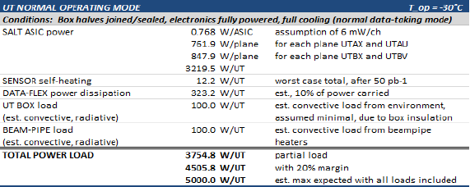
On-detector Cooling (CO₂)
Cooling requirements (EDMS document in preparation):
  Cooling system: 2-Phase Accumulator Controlled Loop
  with CO₂ as fluid
  Cooling power: 5000 W
Fluid filtration: accessible and replaceable in technical stop
UPS: All control parts and part of the system
Pressure parts: Max design Pressure: 100 bar
On stave stability: 1-2 °C

Slide 4

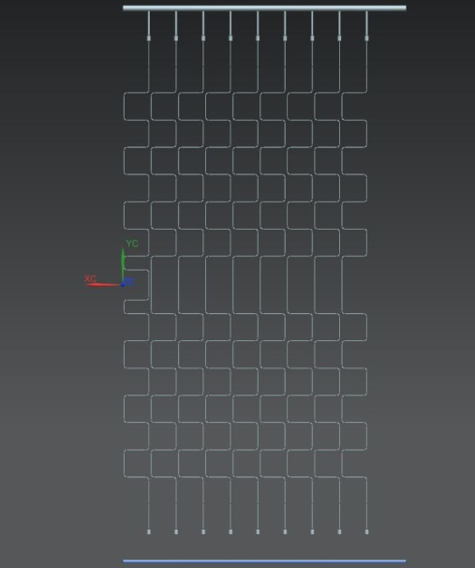
Development and definition of the evaporator system
Design and test of the UT evaporator with vertical staves
  A basic design together with a test program exists
Output manifold
The goal for the cooling distribution is to give the correct flow, using balanced pressure drop in the circuit.
The degree of freedom in the design is in the input cooling line diameter and length
Individual input lines

Slide 5
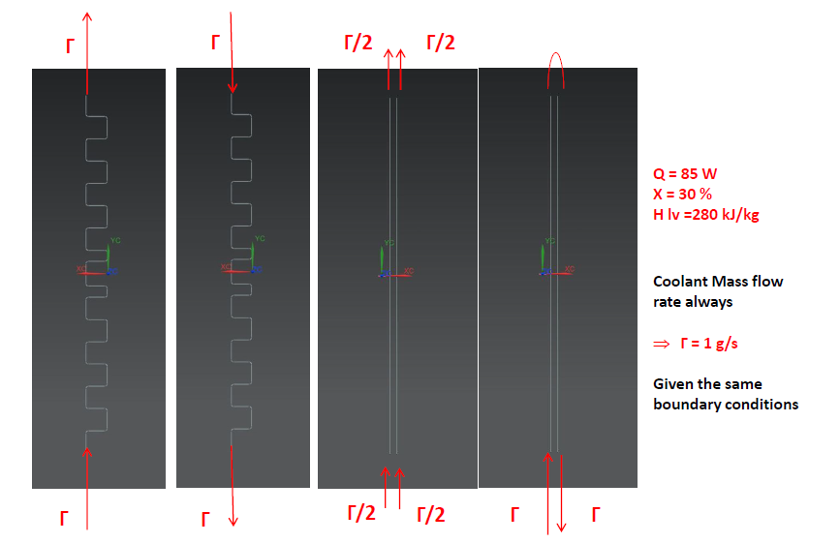
Cooling pipe and flow configurations
baseline
central stave

Slide 6
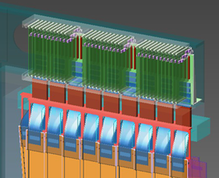
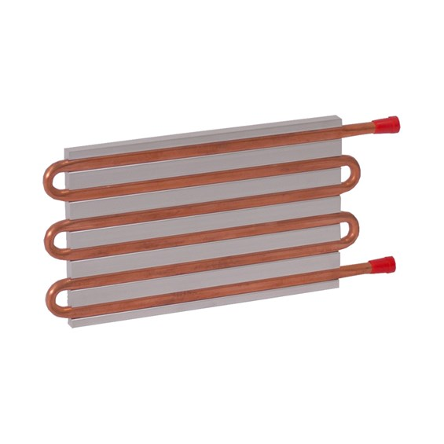
Cooling for Peripheral Electronics
Power estimation:
Total thermal load: < 3 kW distributed over 8 chassis.
Max power per chassis: < 400 W
Max power per DCB: < 15 W
Thermal management:
Studies on thermal behaviour are planned this summer at Maryland:
  evaluate the thermal resistances based on conduction cooled boards and wedge-locks
Present Plan:
eliminate heat via coolant circulation, cold plates mechanically attached to the custom chassis sides with wedge lock guides

Slide 7
Conclusions
Important studies on the thermal behaviour of the staves are planned for the coming months
  They will allow us to finalize the design of the evaporator system
  They form an important input to the Process and Instrumentation design (P&ID) of the cooling plant
Studies are planned as well for the cooling of the peripheral electronics (PEPI)
  They will have an impact on the integration of the PEPI system on the top and bottom of the detector

