Slide 1

EN-EL and LS2
Gerard CUMER, EN-EL
february 2014

Slide 2
Presentation outline
Part 1 : Overview of CERN’s electrical network
Part 2 : Power Quality _ Statistics
Part 3 : Maintenance plan - Availability
Part 4 : EN-EL LS2 organization – methods - constrains

Slide 3
Overview of
CERN’s electrical network
Part 1

Slide 4
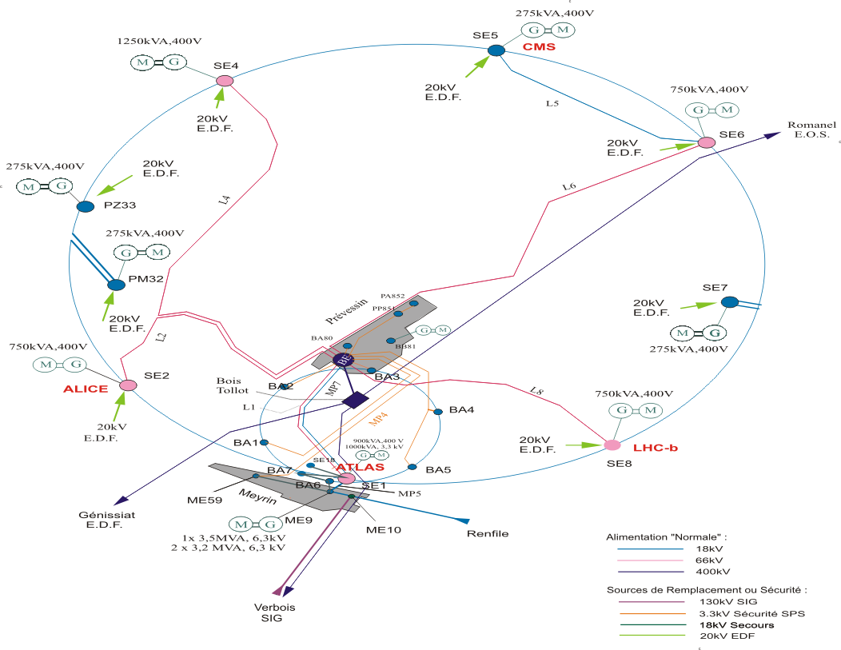
CERN’s Electrical Network (geographical overview)
Chamoson (Alpiq)
Chamoson (Alpiq)
400 kV
Bois-Tollot (RTE)
400 kV
Génissiat (RTE)
130 kV
400 kV
Verbois (Alpiq/SIG)

Slide 5
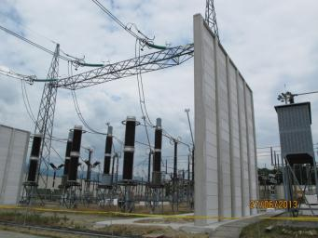
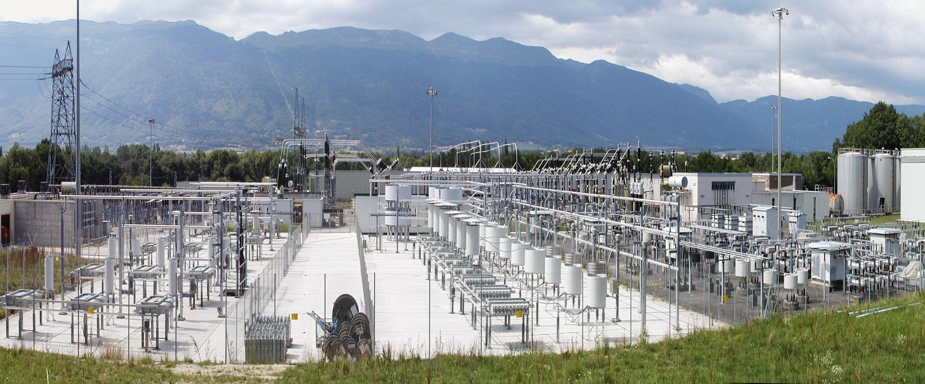
Equipment : HTB (400 kV & 66 kV)
6 feeders 400 kV
3 transformers 400/18 kV 3*90 MVA
2 transformers 400/66 kV 2*110 MVA
15 feeders 66 kV
7 underground transmission lines (66 kV)
3 transformers 66/18 kV 3*70 MVA
5 transformers 66/18 kV 5*38 MVA

Slide 6
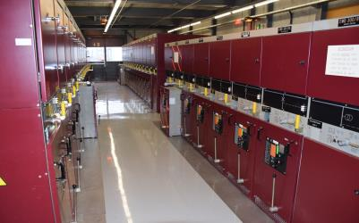
Equipment : HTA (20 kV to 3.3 kV)
8 stations 20 kV
100 stations 18 kV
22 stations 3.3 kV
1000 protection relays
900 feeders 18 kV
220 feeders 3.3 kV
600 Transformers 18/0.4 kV & 18/3.3 kV 900 MVA
7 Thyr. controlled Compensators 18 kV 458 MVAr
1 Saturated Reactor Compensator 18 kV 120 MVAr
12 Harmonic filters 18 kV 357 MVAr
6 diesel generators 6.3 kV & 3.3 kV 13 MVA
LHC8 _18 KV substation

Slide 7
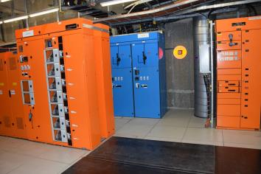
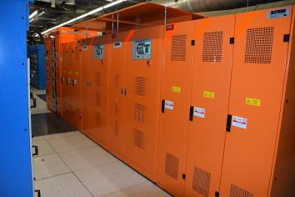
Equipment : LV
400V distribution
  26000 feeders regular power distribution
  4300 feeders diesel generators distribution (safety)
  2200 feeders UPS distribution (uninterruptible)
  3200 feeders machine distribution
  10 diesel generators totalling 5.5 MVA
  250 UPS
Control
  430 battery chargers 48 VDC
  13 battery chargers 110 VDC
  300 Ni/Cd batteries
  100 open & sealed lead acid batteries
  1700 feeders 110/48 VDC distribution
LHC8 _LV substation

Slide 8
Supervision & control
Electrical SCADA supervision
    Electrical alarms interfaced to CCC
    All electrical equipment scanned by electrical SCADA
    Electrical alarms and faults stored in a safe server
    Remote control available but not used
    Analogue measurements and counters
    100,000 digital input channels for electrical equipment
75 installed PLCs
    Auto-transfer system
    Diesel generators
    Switching from Regular → Safety networks
    48 VDC redundancy

Slide 9
CERN’s Electrical Network SINGLE LINE DIAGRAM
Main supply
Planned 2018
Normal Network
Safety Network
Pulsed Network
Machine - Exp Network
Backup supply (only for Normal and Safety networks)

Slide 10
Type of loads
General services (infrastructure)
Fire/Smoke/Gas detection and extraction…
Alarms transmission and communications systems…
Ventilation/pressurization systems, lifts, safety lightings…
Power converters
Magnets
Klystrons for Radio Frequency
Cryogenic compressors
Cooling tower pumps
Chilled water pumps
Vacuum pumps
Electronic racks
Heating
Power converters
Normal Network
Safety Network
Pulsed Network
Machine - Exp Network

Slide 11
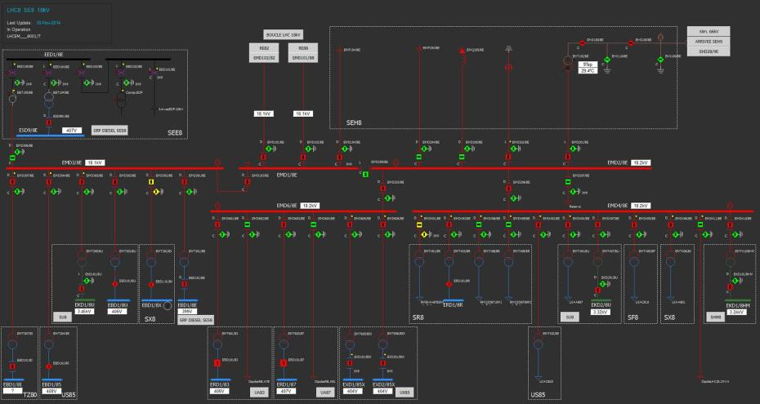
LHC8 – LHCb : HV Electrical Network Single Line Diagam
20 kV
Loop 18 KV
66 kV Machine network
18 kV Normal Infrastructure
18 kV Machine and Experiment Network

Slide 12
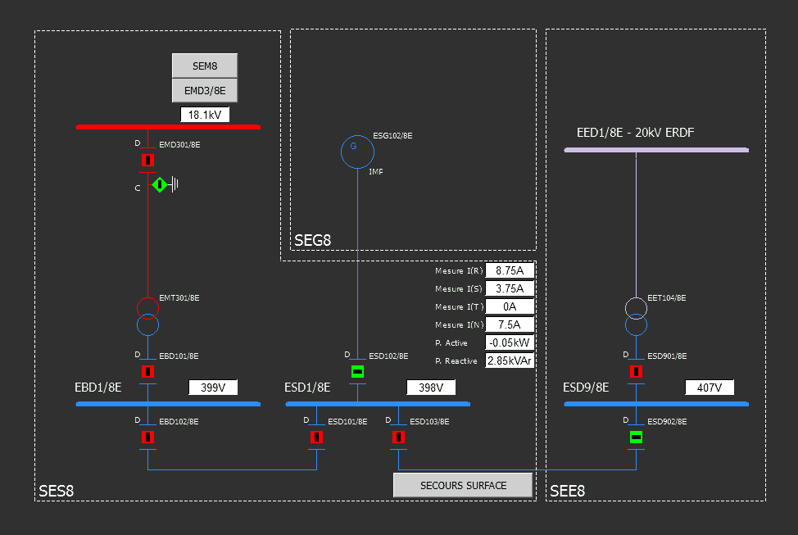
LHC8 – LHCb : LV Electrical Network Single Line Diagam
18 kV Normal Infrastructure
400 V DIESEL Generator
Back-up network 20 kV
400 V Normal Network
400 V safety Network
400 V safety backup

Slide 13
Power Quality
Part 2

Slide 14
Transient disturbances (< 1s) : LHC response
CERN strengthening efforts

Slide 15
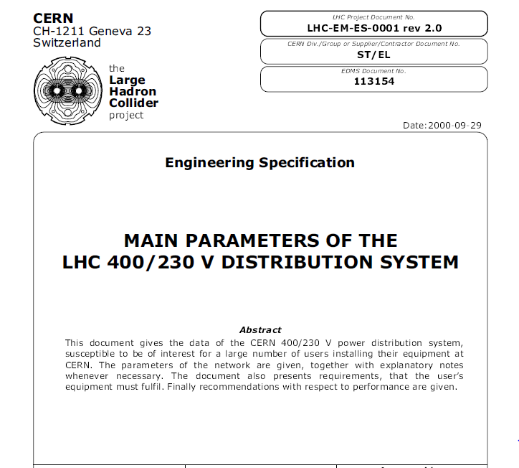
Main parameters of the LHC LV distribution system
This document provides information about CERN 400/230V power distribution system. It allows user to design their equipment with proper margins. It contains requirements and recommendations.

Slide 16
Transients & Power cuts : stats and duration
5 h
~ 5 unexpected events over 20 years
Long power cuts :
machine and experiments networks
UPS networks (end of autonomy batteries)
Standby service intervention needed ~several hours
3 min
Duration
power cuts
infrastructure Normal network
1 unexpected event per year
30 s
Re-Supply by backup source autotransfert 130 kV CH
Short power cuts
safety network
Re-Supply by Generator set
1 unexpected event per year
1 s
Transients (depth > 10%)
all networks except UPS
Main cause = thunderstorms ansd internal Faults
~10-20 per year
(previous slide)
0

Slide 17
Maintenance _ availability
Part 3

Slide 18
Powercuts for safety tests and maintenance
Safety tests :
system | Maintenance plan | powercut
CERN safety networks | every year | 10 mn (except UPS)
Emergency Stops tests | every year | 1 day
Maintenance
Equipement | Maintenance plan | powercut
Transformers | every 3 years | 1 day
HV switchboards | every 6 years | 1 day
LV switchboards | every 9 years | 1 day
UPS | every year | 1 day _ no powercut, charge not protected
Generator set Diesel | every year | 1 day _ no powercut, charge not protected
48V batteries | every year | 1 day _ no powercut

Slide 19





Type of LV networks and their availability
AUG
Types | See mains perturbations ? | Switched off by AUG ? | Back up by Diesel set ? | Downtime ?
Normal EBD | Yes | Yes | No | Yes Mains downtime
Machine ERD - EZD | Yes | Yes | No | Yes Mains downtime
Experience racks EXD | Yes | Yes | No | Yes Mains downtime
Assured EAD | Yes | Yes | Yes | Yes ~ 15s
Safety ESD | Yes | No | Yes | Yes ~ 15s
UPS EOD | No | Yes or No | Yes or No | No Battery autonomy
48 VDC ECD | No | No | Yes | No Battery autonomy

Slide 20
EN-EL LS2 Organization & methods
Part 4

Slide 21
EN-EL Mandate
The EL group is responsible for the CERN electrical distribution network from 400kV to 400/230V. Its main missions are to operate, maintain, extend and renovate the network, analyse and make projections for CERN electrical energy consumption and manage relations with the energy suppliers.
The group is also in charge of making modifications and extensions to the network as required by new projects, in terms of project studies, equipment procurement, installation, supervision and commissioning.
A section of the group is responsible for providing all cable installations for accelerators and experiments. This includes a great variety of HT and LV cables distributed over the entire CERN site and LHC ring. Optical fibres installation is also provided by this section

Slide 22
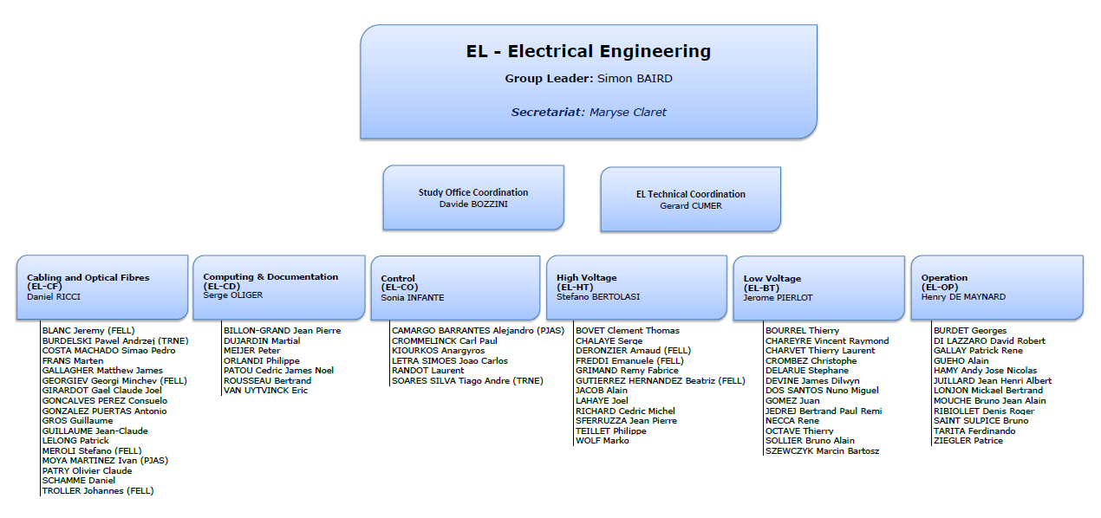
EN-EL organization
Entry point
to analyse new request / project

Slide 23
EN-EL _ LS2 ( Marzia Bernardini _ Chamonix 2014, 25th Sept. )
  Electrical group EN-EL has a huge and heavy plan around consolidation. It is a long term plan [2025] , which will be implemented step by step during YETS, EYETS and Run 2. The plan has major activities also in the frame of LS2
Jura Station consolidation: ME9,
SPS, Meyrin Machine network consolidation (HV, LV)
Additional CERN station 400/66 kV near Bois Tollot [CERN 2 400kV _220MVA]
Heavy maintenance plan (400 kV – 66 kV – 18 kV – LV – UPS…)
Automatism of control and regulation consolidation for Diesel LHC
Partial replacement of 18 kV protection relays and 48VDC systems on LHC surface
All users projects (Machine, Experiments, Infrastructure…)
Very tight and heavy schedule → on the critical path !!!

Slide 24
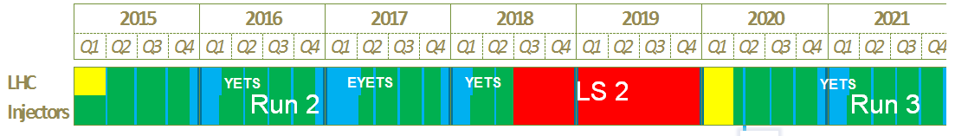
Run 2 and LS2 _ EN/EL constrains
Modifications on the network possible only during YETS, EYETS and LS2
AND
EN/EL needs at least ONE YEAR between user’s request and delivery
EN/EL
Request deadline

Slide 25
Stratégie pour un projet de câblage (signal cuivre & fibres)
Estimation du
volume de
câbles/fibres
par système
T – 12 mois
Etude des besoins avec les utilisateurs
Approvisionnement
Layout
Infrastructure
générale
Câblage
T – 9 mois
Demandes
d’Installation
de Câbles
(DIC/DIF)
Calcul des
quantités
Dimensions des
cheminements
Estimations
financières
Layout d‘implantation des
Positions Fonctionnelles
Passages
Génie Civil
Séquence
d‘installation
T – 6 mois
Achat du matériel
Nomenclature des
Positions
Fonctionnelles - Boîtiers
Dessin 3D des
échelles
à câbles
Découpage en
campagnes
de tirage
Installation des
échelles
Préparation dossiers
techniques
T
Préparation
du chantier

Slide 26
Conclusions
  Electrical group has a huge and heavy plan around consolidation, mainly dedicated to injectors.
      A long term plan, which will be implemented step by step during YETS, EYETS, Run 2 and LS2.
  EN-EL LS2 : very tight and heavy schedule, on the critical path
  EN-EL needs at least 1 year between user’s request and commissioning, but more if modifications of infrastructure are necessary.
  EN-EL-CF outlines the need to receive the requests of copper cabling at least 1 year before LS2
  EN-EL to be contacted - informed of project since the earliest phase !

