Slide 1
LHC Interaction Region Upgrade Phase I: the WP4

Slide 2
Summary
Organization and management of the work for the WP4
Status of the quadrupole conceptual design
Status of the workshop and tooling preparation for the tests and the model fabrication
MCS run collaborations

Slide 3
LHC Interaction Regions Upgrade – Phase-I: the present involvement of AT-mCS

Slide 4
WP4 definition
4 | Low-beta quadrupoles and correctors
 | 4.1 | Design and construction of model quadrupole magnet
 | 4.2 | Design and construction of prototype quadrupole
 | 4.3 | Design and production of correctors
 | 4.4 | Production of quadrupole cold masses
 | 4.5 | Cryostating
 | 4.6 | Interconnections for the new triplet installation excluded
Guide-lines
Maximum use of material that has been purchased for the LHC construction, but not used (we need to keep safety margins).
Use of existing tooling to be modified, but in such a way to be fully operational for the original use (if needed for LHC).
Exploitation of LHC used techniques possibly limiting R&D efforts and reducing technological risks
For the moment no official request for the de-interconnection of the present triplet nor for the interconnection of the new one has been placed. As consequence the budget and the plan and the possible technique for these activities (personnel , external personnel support, material) has not been done and taken into account in the group planning.

Slide 5
WP4 organization and budget
Paolo Fessia
Quadrupole
 | total
Job BE | CHF 1,236,303
FSU | CHF 7,912,444
Specific tooling | CHF 1,939,000
Components | CHF 9,386,230
Travels different tasks | CHF 160,000
Travels central team, comp follow up | CHF 220,000
Total (CERN Budget) | CHF 20,853,977
External Contribution (component + tooling) | CHF 4,515,000
Material budget | CHF 25,368,977
SLHC-PP WP6 CEA quad
Lloyd Williams
Cryostat
SLHC-PP WP6 CNRS
Paolo Fessia
Mikko Karppinen
WP 4 leader
Correctors
SLHC-PP WP 6
White Paper French contribution
SLHC-PP WP6 CIEMAT, STFC
J. P. Tock
Interconnection design and components
Frederic Savary
Long magnet and cold mass assembly line and series production

Slide 6
Magnet program planning
Phase | Task | Start | Completion
Model | Tooling installation | 01/02/2008 | 01/02/2009
 | Models construction | 01/09/2008 | 01/07/2009
Prototype | Prototype and series tooling installation | 01/02/2008 | 01/01/2010
 | Prototypes construction | 01/10/2009 | 01/09/2010
Series | Series production | 01/10/2010 | 01/06/2012 Date of completion or delivery of last quadrupole. Production sequence optimized for installation and construction
Procurement | Specifications and invitation to tender for prototype and series components | 01/02/2009 | 01/09/2009
 | Delivery of components | 01/10/2009 | 31/12/2011

Slide 7
What is needed
Extensive study on the feasibility of the magnets with different apertures have been performed.
It is now necessary to fix the aperture in order to be able to start detailed optimization and detailed engineering (tooling …). The aperture, fixing the length, will also provide the key information for the modification of the existing tooling being installed in building 180 and start serious work for the cryostat

Slide 8
AT-MCS resource re-allocation for 2009
 | CI |  |  | MF |  |  | MDE |  |  | ML |  |  | Total |  |  | Sum
 | available | lacking | diff APT | available | lacking | diff APT | available | lacking | diff APT | available | lacking | diff APT | available | lacking | diff APT
E-F | 1.0 | 0.5 |  | 0.5 | 0.5 | 0.1 | 0.8 | 0.5 | 0.3 | 0.3 | 0.5 |  | 2.7 | 2.0 | 0.4 | 5.1
D | 0.3 | 0.3 |  |  |  |  |  |  |  | 0.2 | 0.4 |  | 0.5 | 0.7 | 0.0 | 1.2
C |  |  |  | 0.3 | 0.7 | 1.0 | 0.2 |  | 0.6 | 0.3 | 0.4 |  | 0.8 | 1.1 | 1.6 | 3.5
A-B |  |  |  | 0.2 |  |  |  |  |  | 0.6 |  |  | 0.8 | 0.0 | 0.0 | 0.8
total | 1.3 | 0.8 |  | 1.0 | 2.3 | 1.1 | 1.0 |  | 0.9 | 1.4 |  |  | 4.8 | 3.8 | 2.0 | 10.6
Changes respect to the group APT have been determined by changes in the technical content of the WP 4: for example the dipole corrector was intended to be designed and the model built by CIEMAT that later on declined.
After revision of the projects in which it is involved, AT-MCS is re-allocating the resources according to CERN priority: LHC exploitation and upgrade of phase I. As consequence other projects will see the allocated resources reduced. For the upgrade of phase I extra engineering resource will be re-allocated to the triplet design and to the service module design

Slide 9
MQX1 conceptual design status and program

Slide 10
Section Summary
Status of the quadrupole conceptual design:
  What we will re-use: available material and constraints
  Cable selection
  Material dose consideration
  Cable insulation:
    available choices
    test program
    status of tests
  Magnetic design:
    Cross section for a 110-120-130 mm aperture
    Effect of internal large heat exchanger
  Protection
  Mechanical design
  General magnet and cold mass concepts

Slide 11
What we want to re-use
20 quaDrupole cold masses and 5 corrector packages (5 triplet)

Slide 12
What we will re-use
Material | Availability | Constraints on | Need of extra purchase
SC cables: LHC-MD inner and outer cable | 205 inner U.L. (448 m) 172 outer U.L. (760 m) | Conductor distribution design | no
Steel for collars | 136 ton YUS 130 | Mechanical design | Ap. 110 mm-> need 83 ton Ap. 120 mm-> need 106 ton Ap. 130 mm-> need 133 ton
Iron for yoke laminations | 262 ton Magnetil | Max outer diameter of cold mass. Probably mix of different iron lamination thicknesses | Ap. 110 mm-> need 445 ton-> 450 KCHF (190 tons) Ap. 120 mm-> need 510 ton-> 620 KCHF (270 tons) Ap. 130 mm-> need 570 ton-> 800 KCHF (330 tons)
Spare shells | 12 pairs 12 m long in 304 L | Cold mass stiffness | Foreseen cost for rest of material 1MCHF
MD tooling | Curing press Welding press | Max cold mass outer diameter, max coil length | Modification for flexible use

Slide 13
MQX1 conceptual design:
SC cable use and availability

Slide 14
Selection of type 1 cable

Slide 15
Selection of type 2 cable

Slide 16
Summary of cable situation
Aperture diameter [mm] | Magnetic length [m] | Inner layer turns | Outer layer turns | Total cable inner layer [m] | Inner layer unit length [m] | Total Outer layer [m] | Outer layer unit length [m]
110 | 9 | 15 | 19 | 320 | 448 | 400 | 740
120 | 10.3 | 18 | 19 | 420 | 448 | 445 | 740
130 | 11.5 | 18 | 24 | 445 | 448 | 590 | 740
LHC dipole cable is available for the production of all the needed coils
We are lucky enough to be able to have cables that for both layers
  Are among the best of the production
  Are coming from the same producer and quite near among them in production sequence. This should help to achieve a better uniformity in magnet fabrication
The cable performances used in the computations are derived from the subset of measurement performed on the cable extrapolating the worst strand measured:
  Cable 01 (inner layer): 14800 A @ 10T (slope of 4680 A/T)
  Cable 02 (outer layer): 14650 A @ 9T (slope of 4050 A/T)

Slide 17
Material dose considerations based on the work of F. CerrutI E. wildner and the FLUKA team

Slide 18
Max dose spot
Aperture 130 mm with 8 mm thick
SS shielding in Q1. bin of 2.5 mm radial width
Energy deposited in most exposed cable
3.5 mw/Cm^3 . Resulting dose 9MGy/y
Scaled to 100 fb^-1 3MGy/ 100 fb^-1
Aperture 110 mm with 8 mm thick
SS shielding in Q1. bin of 2.5 mm radial width
Energy deposited in most exposed cable
4.3 mw/Cm^3 . Resulting dose 11.5MGy/y
Scaled to 100 fb^-1 4.5 MGy/ 100 fb^-1
We need to stand at least
5 MGy/ 100 fb^-1 X 600 fb^-1 X S.F. 2
= 60 MGy
Ad hoc computations with bins correctly representing different materials in the most exposed regions are necessary

Slide 19
Polyimide (CERN 96-05)
Polyimide seems suitable for our use
We cannot rely on the glue see CERN 82-10

Slide 20
G11 (CERN 96-05 and 98-05)
We are probably near the G11 limit:
we need to
Investigate end spacer mechanical loads (Ansys 3D)
Buy material according to quality and not price
Study local shielding
Possible bi-material or metallic spacer
Verify radiation resistance of filling resins and glues between spacers and cables
Re-compute dose maps with 3D magnetic field maps

Slide 21
MQX1 conceptual design: insulation development based on the work of Pier Paolo Granieri, S. Luzieux, S. Sgobba,
A. Gerardin, R. Lopez, M. Guinchard and D. Tommasini

Slide 22
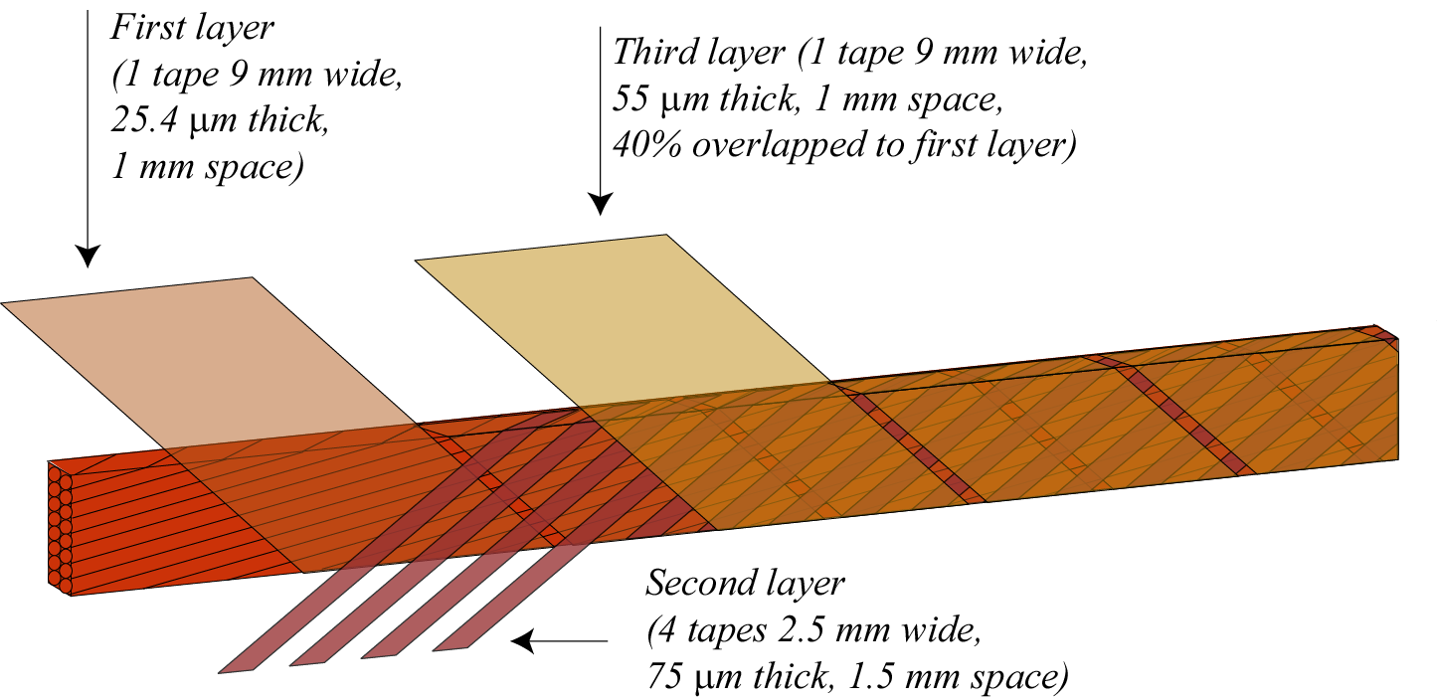
Development of new insulation topology: aim
Provide adequate electrical insulation
Increase the heat removal in order to better cope with the energy deposited by the I.P. debris
E-modulus should be not be too much reduced and the coil should be creep stable
Suitable to be industrialized:
  Commercially available material
  Possible use on Alstom recovered insulating machine
Third layer 1 tape 9 mm wide 69 µm thick and 1 mm space
50 µm
Second layer 1 tape 3 mm wide 50 or 75 µm thick and 1.5 mm space

Slide 23
Cable insulation: development story
Type | 1st layer | 2nd layer | 3rd layer | Theoretical Thickness | Cured measured thickness
LHC MD | 50 µm 11 mm wide 50 % overlapped with 2nd layer | 50 µm 11 mm wide 50 % overlapped with 1st layer | 69 µm 9 mm wide 2 mm spaced (glue) | 169 µm | 120 µm
LHC MQ | 50 µm 11 mm wide edge to edge | 37.5 µm 11 mm wide edge to edge | 55 µm 9 mm wide 2 mm spaced (glue) | 142.5 µm | 110 µm
Porous test 1 | 25 µm 11 mm wide spaced 1 mm | 75 µm 2.5 mm wide spaced 1.5 mm cross wrapped | 55 µm 9 mm wide 3 mm spaced (glue) | 155 µm
Porous test 2 | 50 µm 11 mm wide spaced 1 mm | 50 µm 2.5 mm wide spaced 1.5 mm cross wrapped | 55 µm 9 mm wide 3 mm spaced (glue) | 155 µm
Porous test 3 | 25 µm 11 mm wide spaced 1 mm | 50 µm 2.5 mm wide spaced 1.5 mm cross wrapped | 50 µm 11 mm wide 3 mm spaced + 4th layer 55 µm 2.5 mm wide spaced 1.5 mm cross wrapped | 180 µm
Porous dev. 50 | 50 µm 9 mm wide spaced 1 mm | 50 µm 3 mm wide spaced 1.5 mm cross wrapped | 69 µm 9 mm wide 1 mm spaced (glue) | 169 µm
Porous dev. 75 | 50 µm 9 mm wide spaced 1 mm | 75 µm 3 mm wide spaced 1.5 mm cross wrapped | 69 µm 9 mm wide 1 mm spaced (glue) | 194 µm

Slide 24
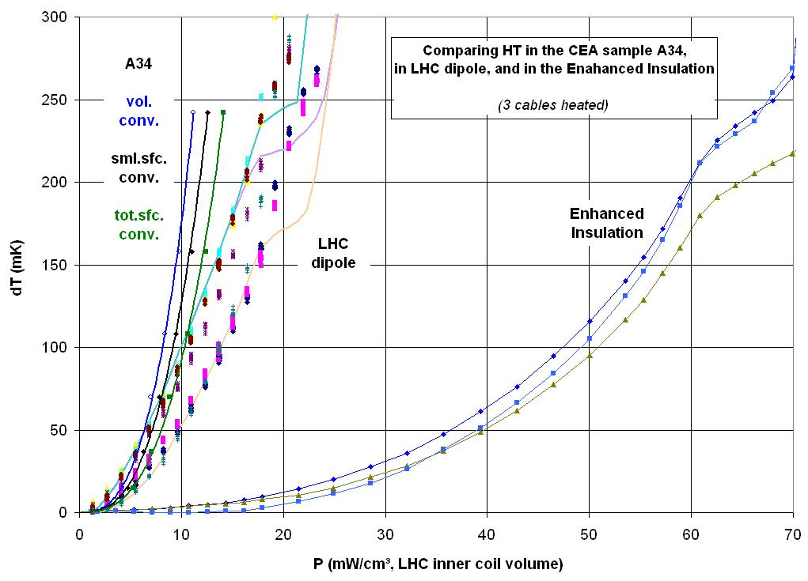
Heat transfer measurements
Solid cables
Piece of BNN SC coil
Cu-Ni cables with
better
instrumentation
Cu-Ni cables insulation
schemes type porous test 1
but with larger spacing

Slide 25
Next step for heat transfer measurements
Questions to be answered
  Confirm the increased heat transfer capacity using commercially available tapes
  Verify effect of pre-compression on the heat transfer
A new way to integrate the thermo-couples has been defined (machining the strands) that is
  Less invasive
  Should allow measurements under significant pre-stress preserving the thermo couples under load
New measurement of a dipole stack with the new sensor set up and at higher pre-stress (stack being instrumented)
Measurement of the stacks with the
new insulation with a couple of different
pre-stress (stacks ready)

Slide 26
Cable insulation: 1st results of electrical tests on plane stacks of 2 cables
Type | Sample 1 | Sample 2
LHC MD | 30KV | 25 KV
LHC MQ | 18 KV | 20KV
Porous test 1 | 18KV | 8KV
Porous test 2 | 9KV | 12KV
Porous test 3 | 15KV | 12KV
Porous dev. 50 | Not yet measured | Not yet measured
Porous dev. 75 | Not yet measured | Not yet measured
We are confident that the new insulation will provide also satisfactory results (>3.5 KV).
In the dipole production the max test voltage between turns has been set to 120V on cured layers (1.8 KV discharge inner and
3 KV discharge outer)

Slide 27
Development approach electrical soundness
Winding of small 4 turns coils with the LHC dipole configuration to be submitted to electrical tests:
Phase A on mandrel
Before curing: measurement of leakage current to ground. Voltage applied for 300 seconds. Measurement of insulation resistance at 1KV, 2KV and 4KV Max acceptable leakage current 1µA
After curing: measurement of leakage current to ground. Voltage applied for 300 seconds. Measurement of insulation resistance at 1KV, 2KV and 4KV Max acceptable leakage current 1µA
Phase B:
removal of coil from the mandrel and pole. Application of discharge test. Delta V between turns 80V, 120V and
then increase of 100V till breakage

Slide 28
Test campaign
N | Cable type | Insulation | Curing pressure | Insulation thickness measurement | E mod measurement 293 K | E mod measurement 77 K | Stress relaxation
1 | Inner layer | naked | 80/130 MPa
2 | Inner layer | dipole | 80/130 MPa | X (169µm-135µm-125µm) | X | X | X
3 | Inner layer | quadrupole | 80/130 MPa | X (142µm-107µm-103µm) | X | X
4 | Inner layer | Porous dev 50 | 80/130 MPa | X (169µm-117µm-111 µm) | X | X
5 | Inner layer | Porous dev 75 | 80/130 MPa | X (194µm-136µm-130 µm) | X | X | X
6 | Outer layer | naked | 80/130 MPa
7 | Outer layer | dipole | 80/130 MPa | X | X | X | X
8 | Outer layer | quadrupole | 80/130 MPa | X | X | X
9 | Outer layer | Porous dev 50 | 80/130 MPa | X | X | X
10 | Outer layer | Porous dev 75 | 80/130 MPa | X | X | X | X

Slide 29
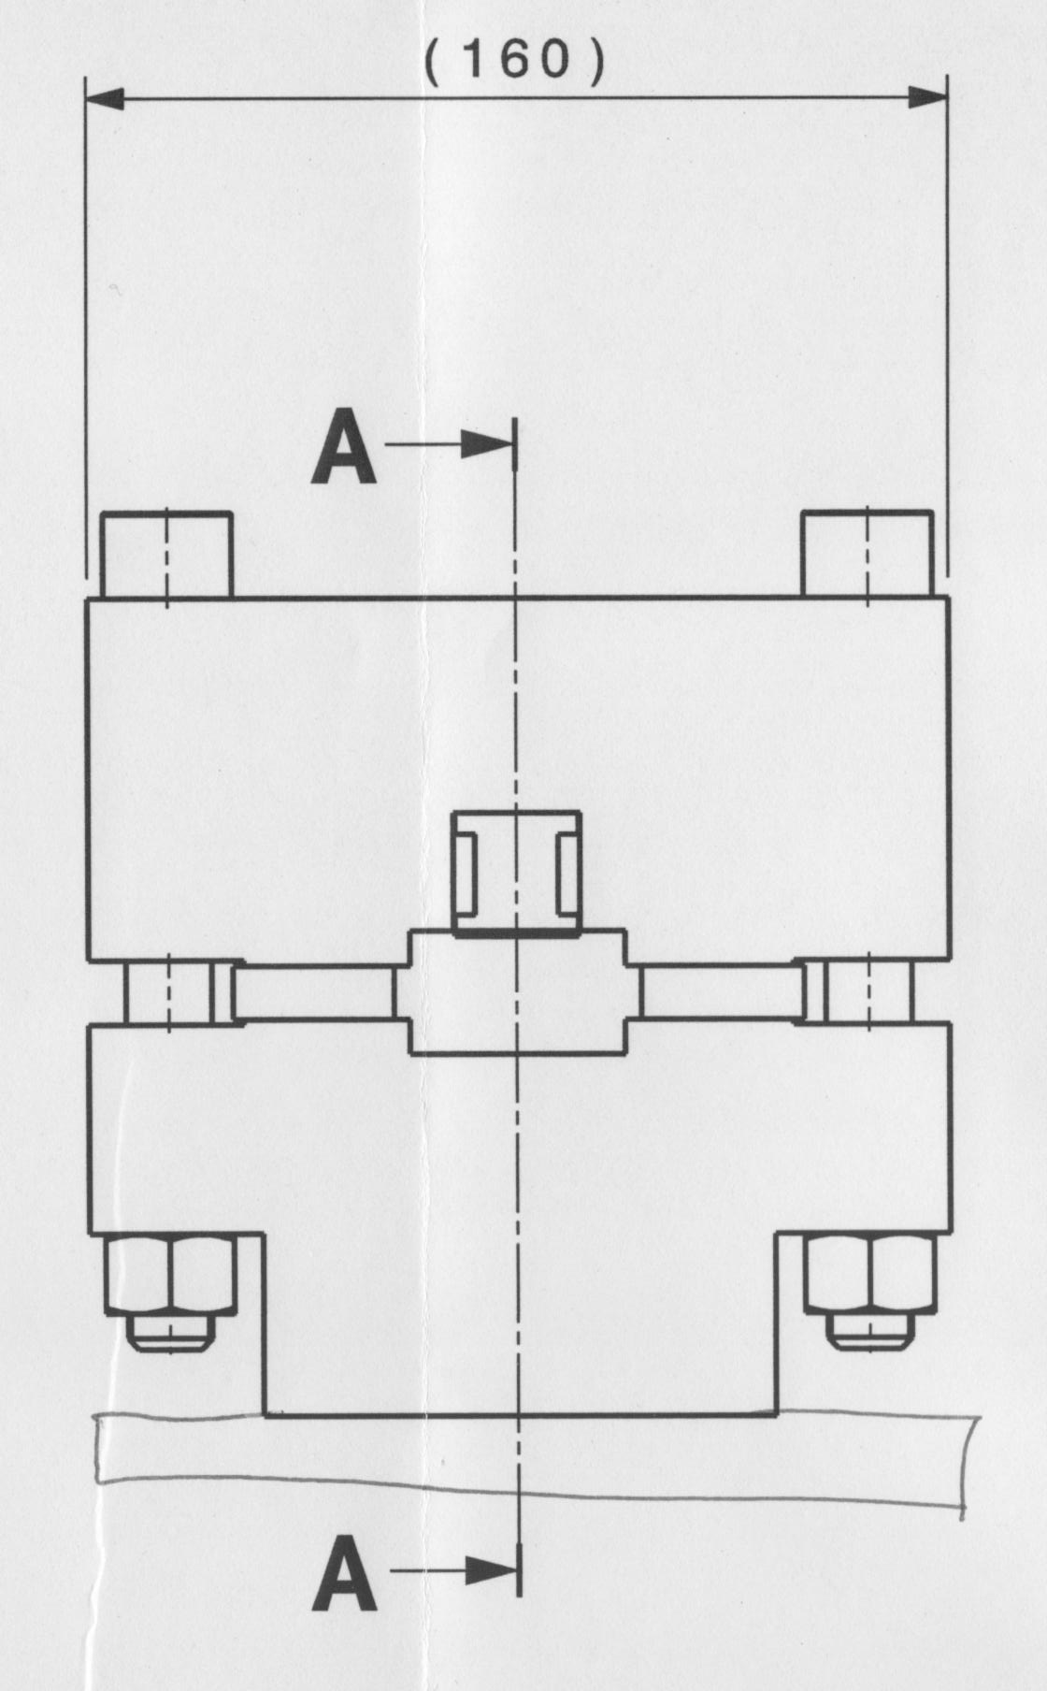
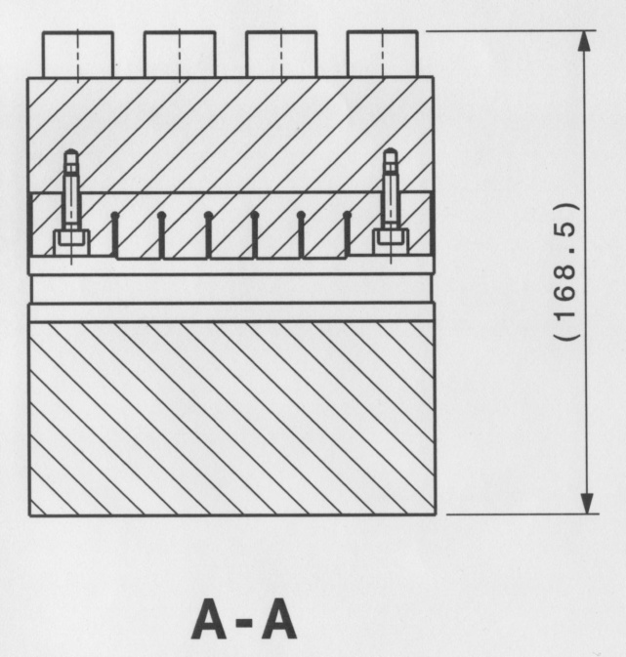
Mechanical tests

Slide 30
MQX1 conceptual design: magnetic design
Based on the work of F. borgnolutti and E. todesco

Slide 31
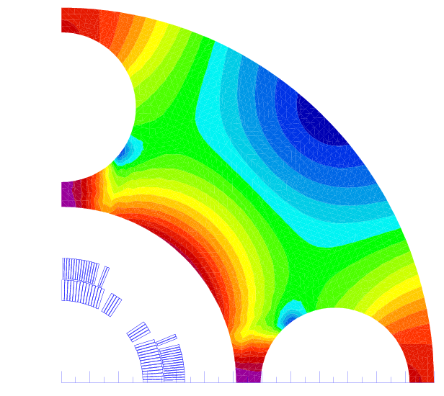
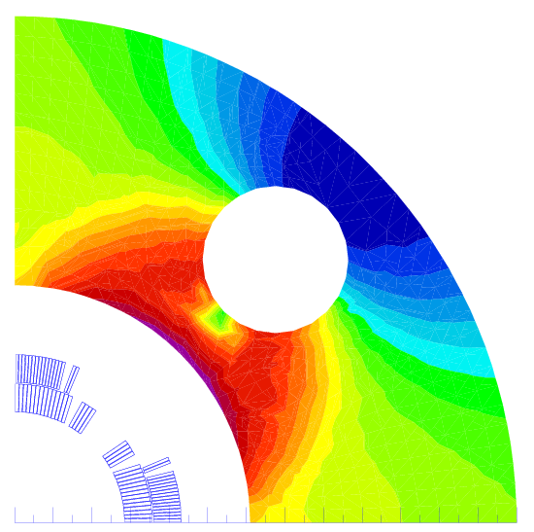
MQX1 cross sections and iron yoke with heat exchanger(s) I
Two possible solutions for heat exchanger proposed by the cryogenic team:
2 heat exchanger in parallel inner diameter 71 mm (1st eval. wall thickness 2.5 mm). Hole diameter 80 mm
1 heat exchanger inner diameter 100 mm (1st eval. wall thickness 3.5 mm). Hole diameter 110 mm
Both are large holes in the iron that affect transfer function and field quality
We can consider 2 possible configurations
Holes along the 2 mid-planes (larger effect on the transfer function)
Holes at 45 ⁰
We prefer solution with 1 heat exchanger on the vertical mid plane because of
Simpler interconnect
Standardization of cold masses respect 1 heat exchanger at 45 ⁰

Slide 32
MQX1 cross sections and iron yoke with heat exchanger(s) II
Due to the presence of the holes the short sample parameters have to be re-computed
  The presence of 110mm holes at the mid-plane only reduces the short sample gradient by 0.2-0.5%
Transfer function of the 4 MQX1 cross-sections
The reduction of the transfer function of the 4 MQX1 cross- sections is in between what we have for the MQXA and MQXB
 |  | Full iron |  | 110 mm hole at the vertical mid-plane |  | ΔGss | ΔIss
magnet | ap (mm) | Gss (T/m) | Iss (A) | Gc (T/m) | Iss (A) | (%) | (%)
MQXC V13 | 110 | 158.4 | 15213 | 158.0 | 15375 | -0.2 | 1.1
MQXC V8 | 120 | 148.6 | 15900 | 147.9 | 16113 | -0.5 | 1.3
MQXC V2 | 130 | 138.7 | 14805 | 138.0 | 15088 | -0.5 | 1.9

Slide 33
Gradient respect cable used in the cross section

Slide 34
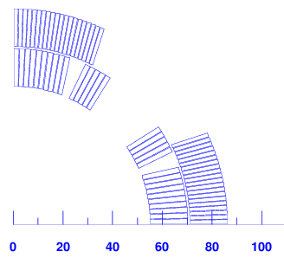
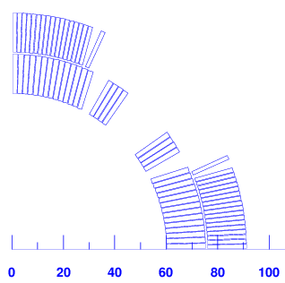
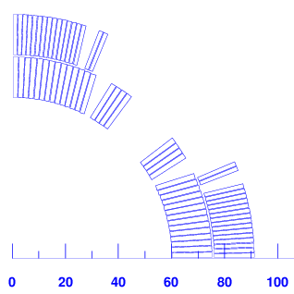
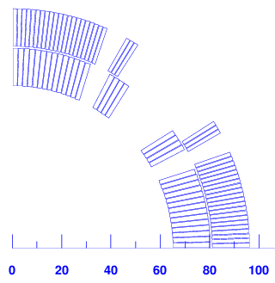
Cross section design
 |  | Ironless coil |  |  |  |  |  |  |  | With iron yoke place at 37mm from the coil
 |  | nb turn |  | short sample |  |  |  |  | Gmax | without hole |  | With 110 hole at mid-plane
 | Magnet | cable 01 | cable 02 | Gss (T/m) | I ss(A) | b6 | b10 | b14 | expected | Gss (T/m) | Iss (A) | Gss (T/m) | Iss (A) | Gn (T/m) at 80%
110 mm | MQXC V13 | 15 | 19 | 154 | 16330 | 0.70 | 0.34 | 0.76 | 157 | 158.4 | 15213 | 158.0 | 15375 | 126
120 mm | MQXC 120V3 | 18 | 19 | 145 | 16860 | -0.50 | 0.32 | 1.23 | 148 | 149.3 | 15661 | 148.5 | 15861 | 119
 | MQXC 120V8 | 18 | 17 | 144 | 17110 | -0.06 | 0.04 | -0.71 |  | 148.6 | 15900 | 147.9 | 16113 | 118
130 mm | MQXC 130V3 | 23 | 20 | 135 | 16035 | -0.01 | 0.01 | -1.70 | 138 | 139.0 | 14750 | 138.2 | 12000 | 111
110mm (MQXC V13)
120mm (MQXC 120V3)
120mm (MQXC 120V8)
130mm (MQXC 130V3)

Slide 35
MQX1 conceptual design:
Protection studies
Based on the work of Erwin BIELERT & Nikolai SCHWERG

Slide 36
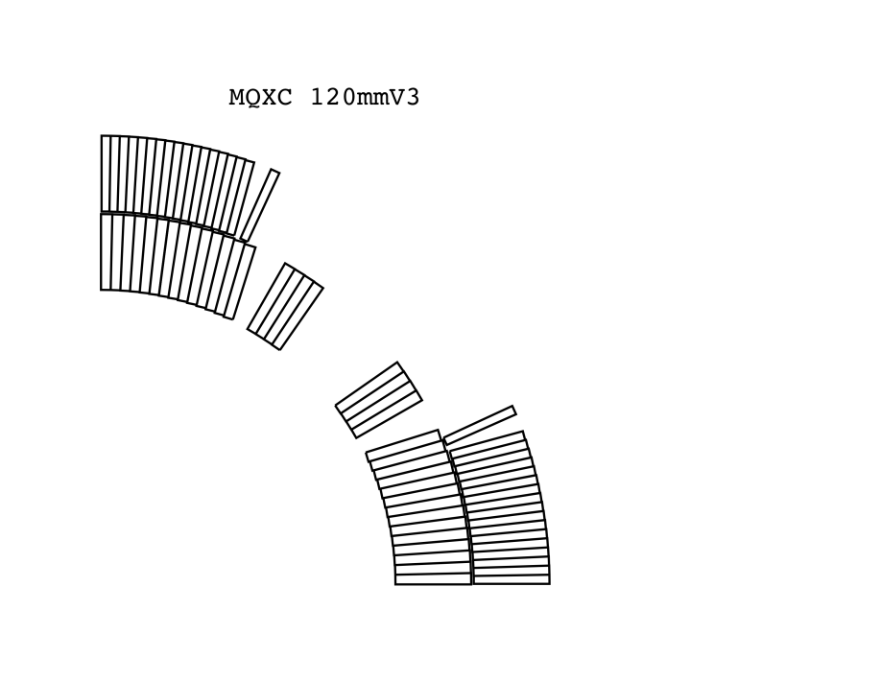
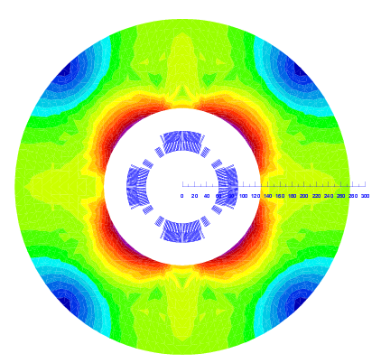
Quench Study : MQX1 120 mm V3
Design features:
  LHC MB cable with 10% higher critical current density,
  Magnet length 10.3 m (magnetic length
  10.0 m),
  Electrical circuit consists only of magnet, power supply bridged by crow bar and eventually dump resistor, and
  Quench heater delays as in LHC MB (MQ).
Studies:
  Selecting dump resistor,
  Quench heater study,
    Different heater setups
    Redundancy
  Quench origin study.

Slide 37
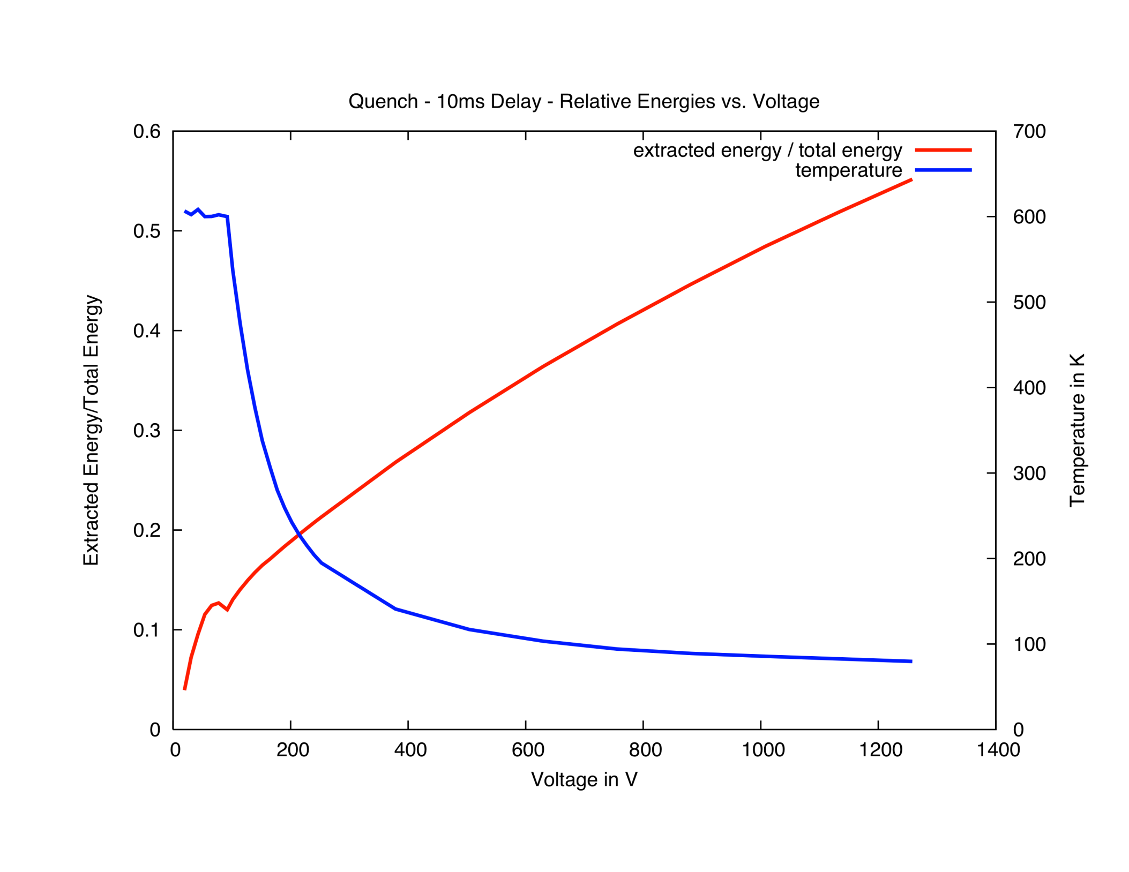
Dump Resistor Study
Simulation stop due to excessive temperature
500 V
40 mOhm

Slide 38
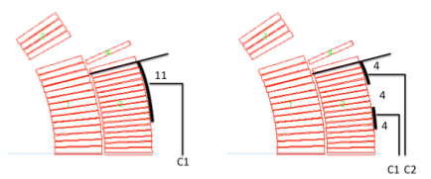
Protection Study
 |  | Nominal Current |  | Half Current
Setup |  | T peak | MIITs | T peak | MIITs
Dump resistor 40 mOhm, 10 ms delay |  | 117 | 33.6 | -- | --
 |  | 157 | 33.3 | 78 | 23.0
 | 20ms extra delay | 157 | 36.4 | 78 | 23.7 | Hot spot in outer layer
 | only half of the heaters | 220 | 38.1 | 103 | 27.5
 |  | 180 | 35.2 | 86 | 24.5
 | 20ms extra delay | 217 | 38.0 | 104 | 27.6
 | only half of the heaters | 221 | 43.4 | 102 | 30.8
 | + Dump Resistor | 118 | 29.4 | 50 | 15.2 | Hot spot close to heater
 | + Dump Resistor, half of heaters | 136 | 29.8 | -- | -- | Heater failure uncritical

Slide 39
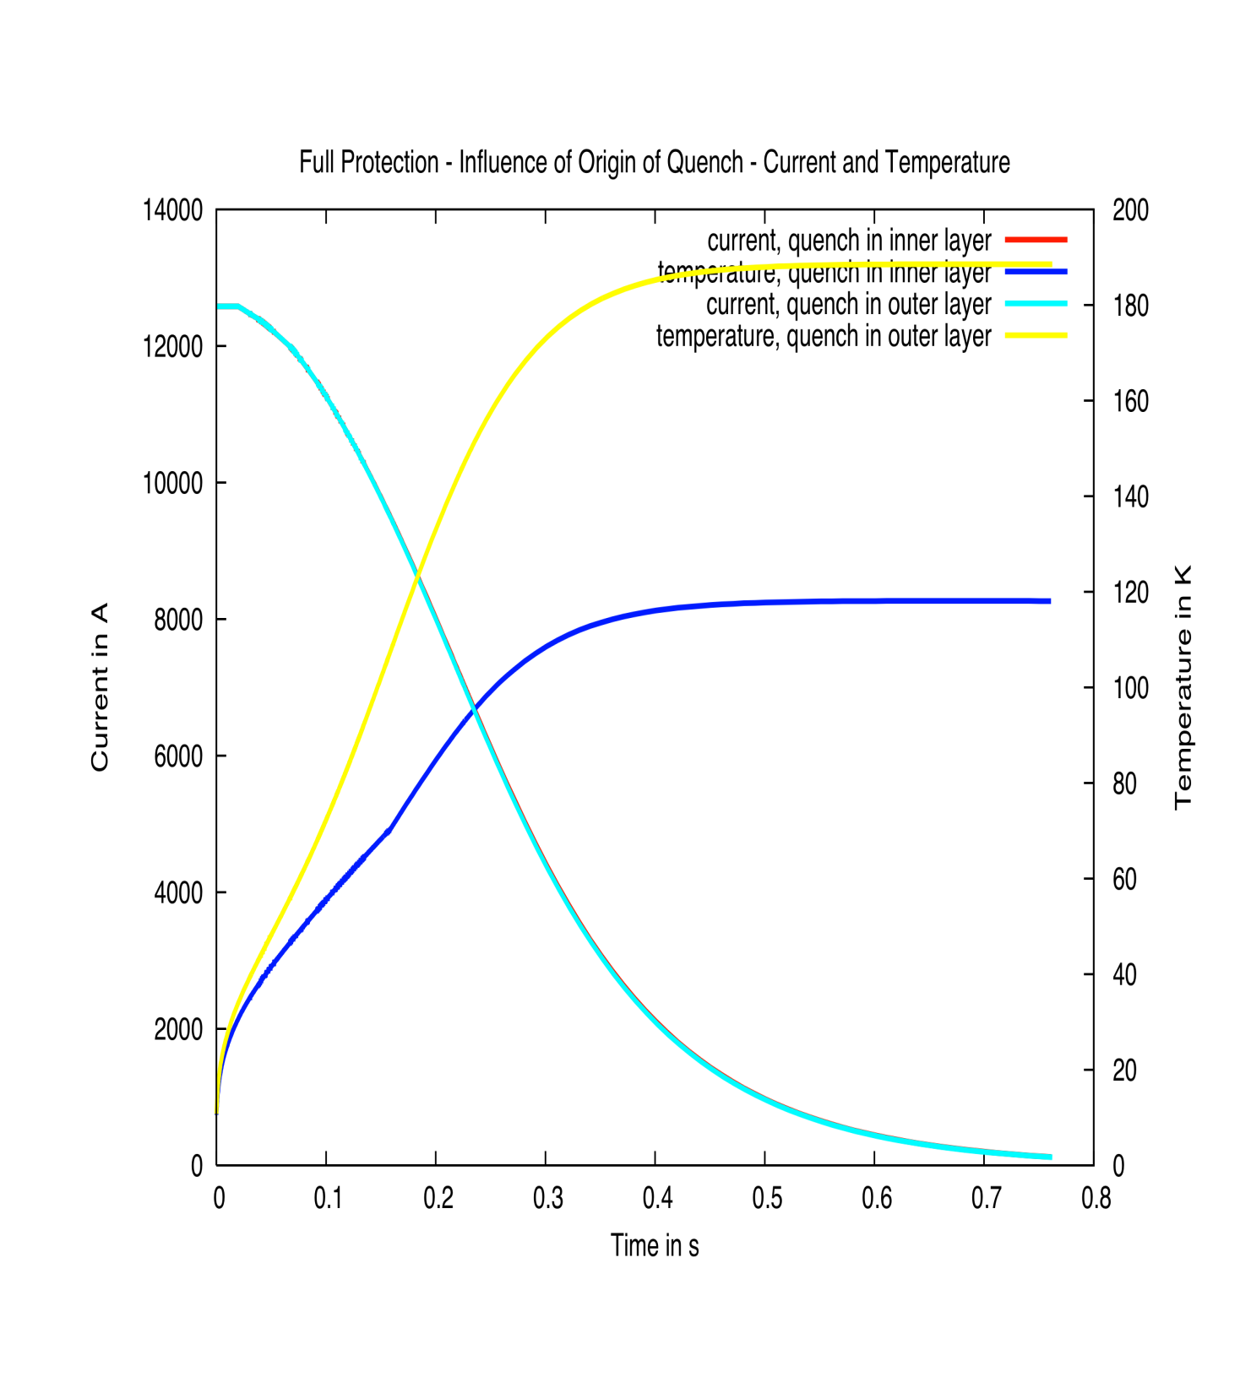
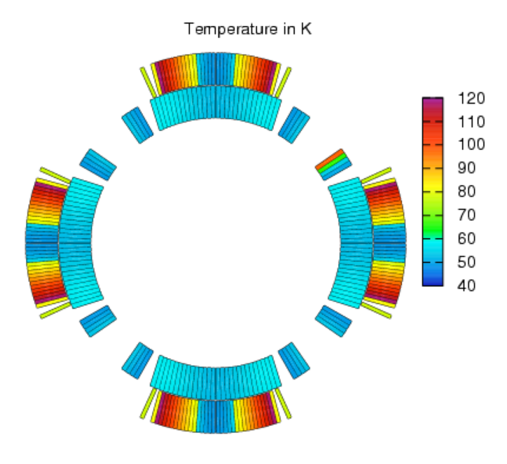

Quench Origin Study
Notes:
Quench Origin in 18,34,35,36:
Full Current
T PEAK PEAK 0.118092E+03
T PEAK PEAK 0.180635E+03
T PEAK PEAK 0.186823E+03
T PEAK PEAK 0.188537E+03
Full current, extra 20ms delay
T PEAK PEAK 0.110106E+03
T PEAK PEAK 0.208858E+03
T PEAK PEAK 0.215051E+03
T PEAK PEAK 0.217553E+03
Half Current
T PEAK PEAK 0.496341E+02
T PEAK PEAK 0.562652E+02
T PEAK PEAK 0.573543E+02
T PEAK PEAK 0.577908E+02
Half Current, extra 20ms delay
T PEAK PEAK 0.484824E+02
T PEAK PEAK 0.572392E+02
T PEAK PEAK 0.583825E+02
T PEAK PEAK 0.588700E+02

Slide 40
Summary
Dump resistor shows to be most efficient,
Quench heaters:
  Design 1 most favorable at nominal current,
  Both designs safe at half current, and
  Heater failure almost doubles the peak temperature in both designs.
A quench in the outer layer results in much higher temperatures (less copper in cable).
The use of longer delay time was meant as 1st simulation of the solution adopted for the MQ where the Q.H. polyimide foil towards the coil was thicker then MB and in addition an intermediate ground insulation foil was placed between QH. And coil
Note: The calculated temperatures depend strongly on input parameters. For the present calculations validated parameters of the LHC MB have been applied.
The ROXIE quench model is documented in (and ASC08 contribution):
[SAR08a] Nikolai Schwerg, Bernhard Auchmann, and Stephan Russenschuck. Quench simulation in an integrated design environment for superconducting magnets. IEEE Transactions on Magnetics, 44(6):934–937, June 2008.
[SAR08b] Nikolai Schwerg, Bernhard Auchmann, and Stephan Russenschuck. Validation of a coupled thermal-electromagnetic quench model for accelerator magnets. IEEE Transactions on Applied Superconductvity, 18(2):1565–1568, June 2008.

Slide 41
MQX1 conceptual design: mechanical design with the contribution of F. Regis

Slide 42

Collar thickness scaling based on MQXB
    Scaling based on radial collar displacement
    The collar width is obtained by solving:
Aperture radius [mm] | Collar thickness [mm]
55 | 35
60 | 39
65 | 42

Slide 43
Forces in few quads per octant

Slide 44
Coil pre-stress
We analytically study the pre-load that is necessary to counter-act the magnetic forces in function of the aperture and considering 25MPa of safety factor at cold. No show stopper appears, but coil behavior for stress relaxation need to be checked taking into account the real insulation.

Slide 45
Key layout analysis
Forces repartition on keys according to
1key or 2key layout per quadrant structure
24 degrees
15 degrees

Slide 46
Key layout analysis
    Coil radial displacement in function of the angular distance between keys

Slide 47
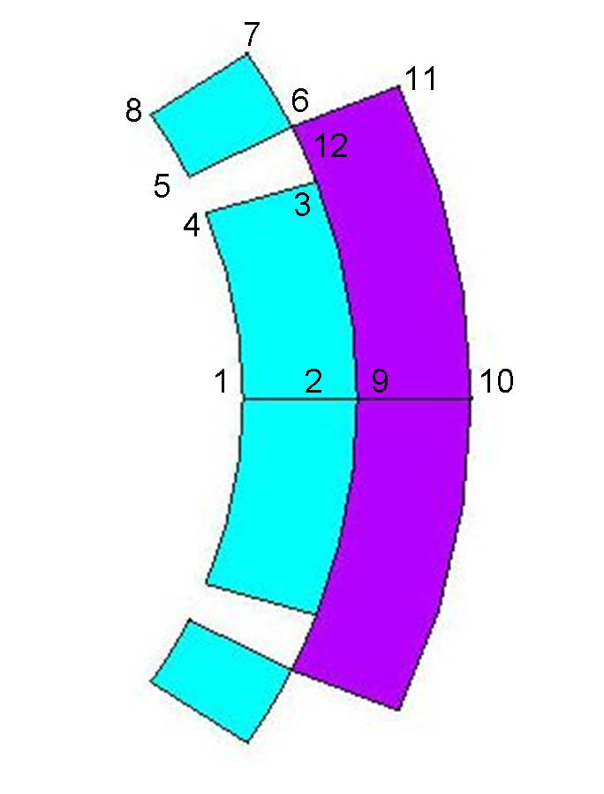
FE analysis – radial displacement

Slide 48
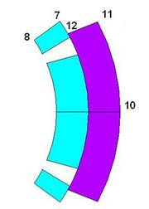
FE analysis – bending effect
∅=120mm I.L.
Notes:
48

Slide 49
FE analysis – collar thickness
Aperture | Collar thickness, δr = 60μm | Collar thickness δr=60μm, key MQXB | Estimated collar thickness MQXB scaling | Proposed collar thickness (key15º)
120mm | 33mm | 35-37mm | 39mm | 35mm
130mm | 36mm | 38-40mm | 42mm | 38mm

Slide 50
Magnet and cold mass concept

Slide 51
Magnet and cold mass concept
 | Solution | Remarks
Coil | 2 layers independently cured with a splice and layer jump | Best use of available SC material. Re-use of LHC MB experience for layer jump
Collar | Thick self standing collars | Reduce cost of fine- blanking for collars and yoke due to mechanical de-coupling. Reduced influence of cold mass assembly on field quality a part from iron saturation and alignment
Yoke | 1 Lamination to make the yoke | Reduce cost of fine blanking for yoke
Cylinder | 10 mm thick shells not contributing to mechanical efforts. No pre-stress | Possibility to use other steels then 316 LN
Cylinder weld | No stress in the cylinder and therefore reduced stress in the weld | It is leak tight weld for which whatever weld process can be chosen and for which we can release acceptance criteria

Slide 52
Magnet and cold mass concept
 | Solution | Remarks
Ground insulation | Same scheme as MQ or MB ground insulation with 4 layers of 0.125 polyimide. Double G.I. on mid plane to provide handle for field quality and increase insulation between 1st and 2nd layer (as MB)
Q. H. | Use of intermediate G.I. foil between coil and Q.H. Use of connection without omegas | Increase reliability
Heat exchanger position | 1 large internal heat exchanger 100 mm i.d. 110 mm hole in yoke. Position vertical mid plane. Available He volume for control from 95 cm^2 to 285 cm^2 | Allows interchangeability of magnets
Cold mass support | Possibly 2 feet. With 10 m long cold masses with cylinder 10 mm thick a 1st estimation gives a max deflection of -0.35 mm with an average of -0.16 mm. This is the preferred choice for the moment for the cryostat design

Slide 53
Workshop and tooling installation based on the work of J. C. perez, J. Mazet and g. Trachez for 927.
F. savary, H. prin, P. seraphin and P. Canard for the 180

Slide 54
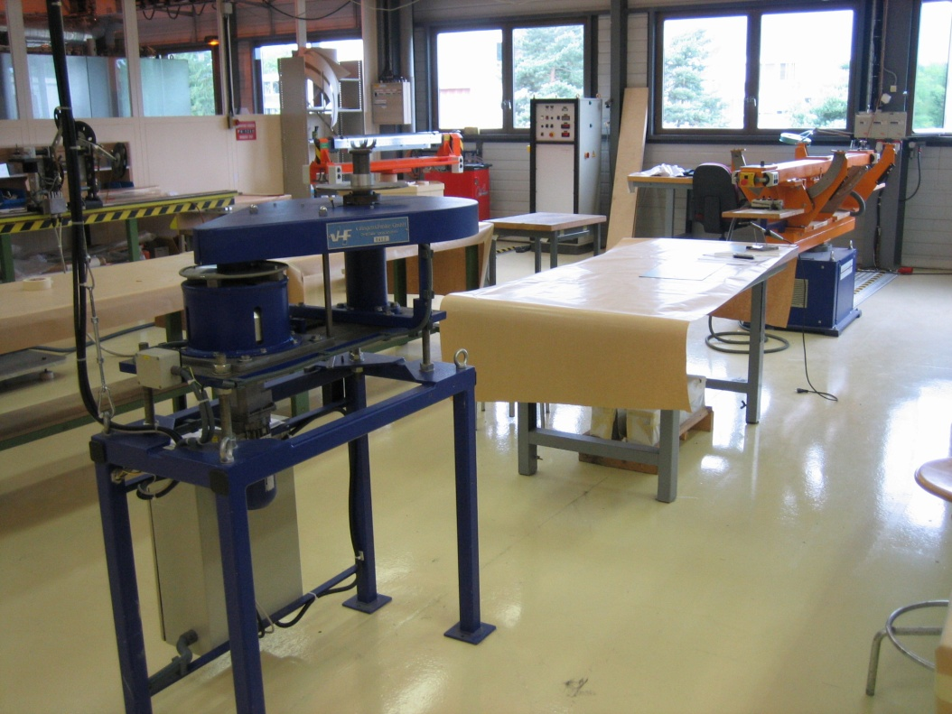
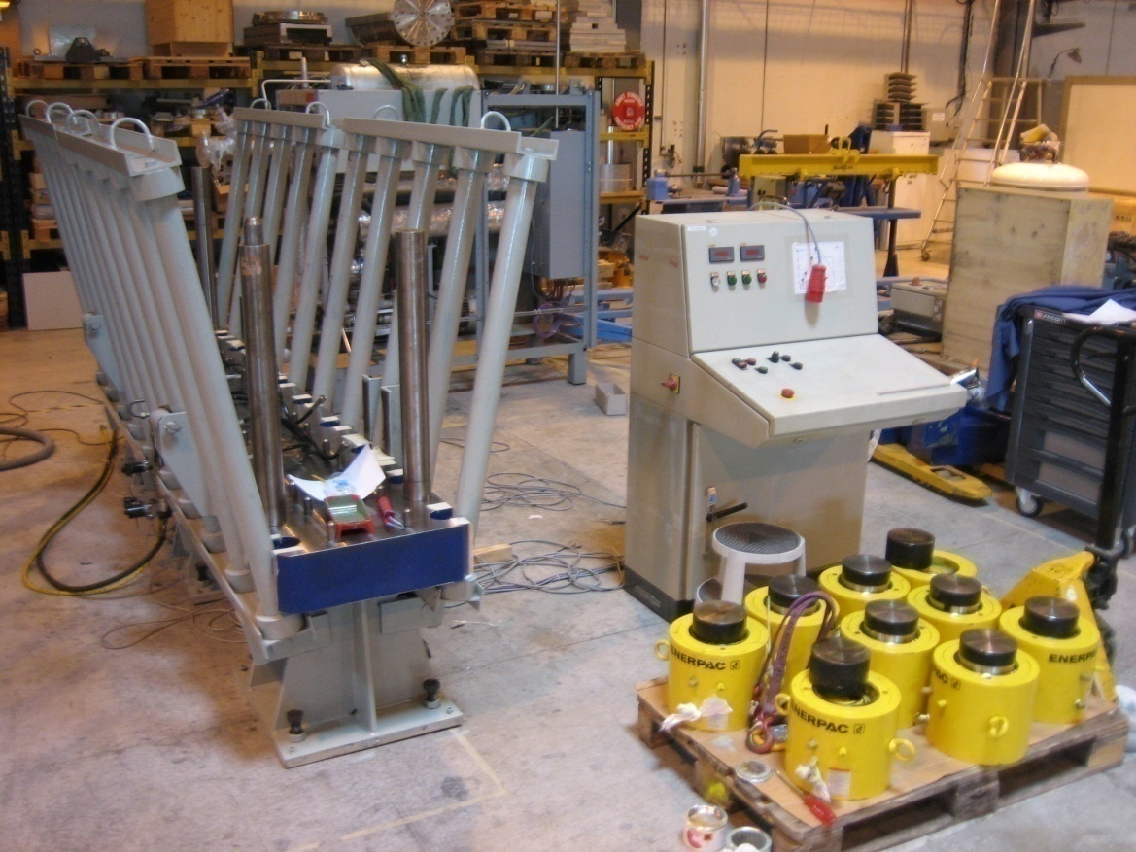
927 installation

Slide 55
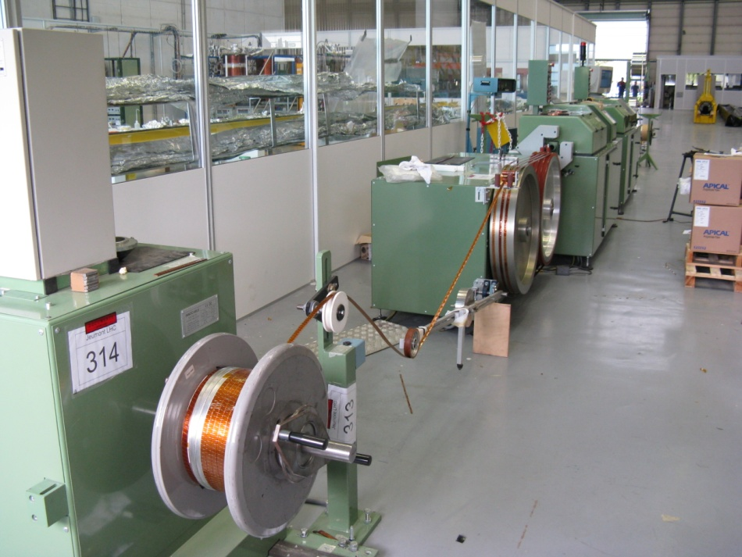
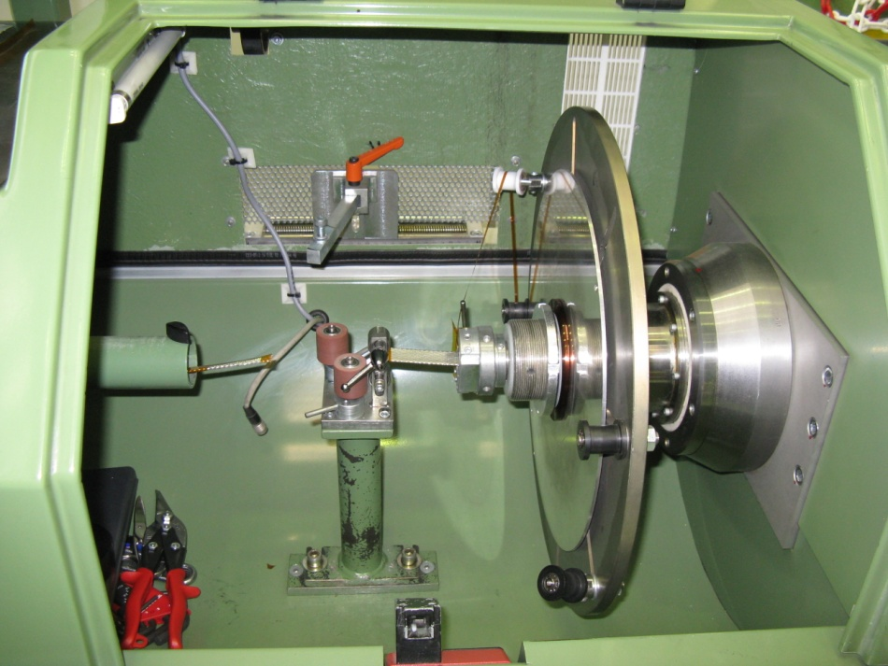
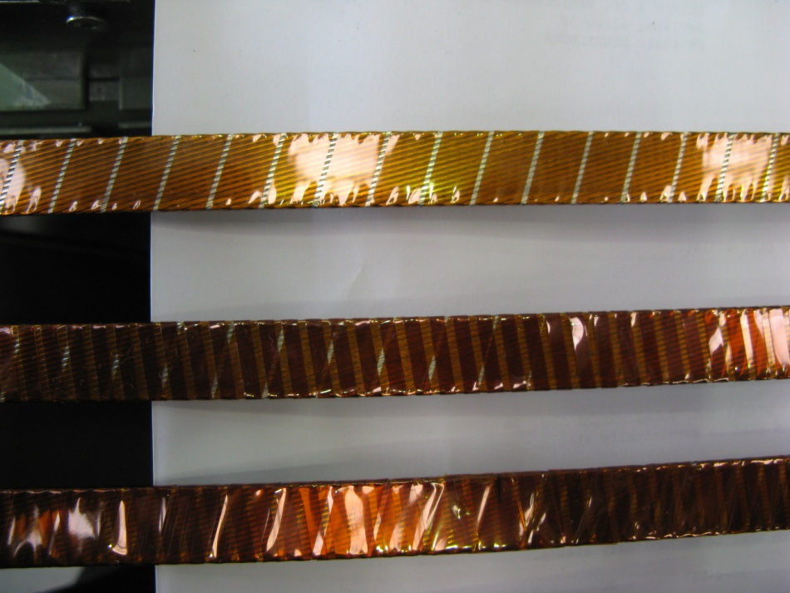
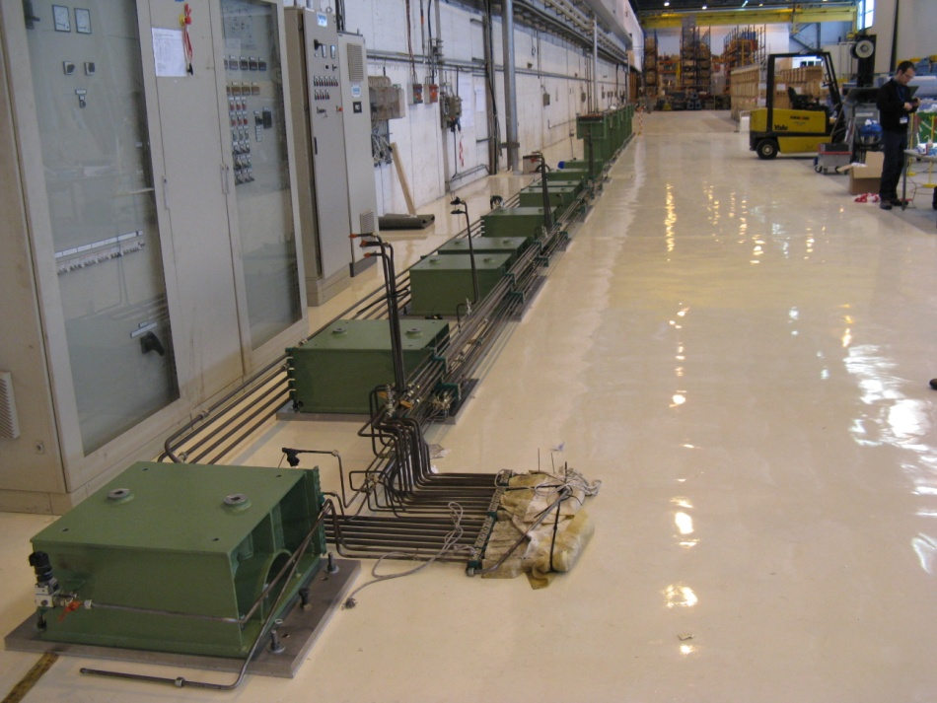
180 installation

Slide 56
AT-MCS run collaborations

Slide 57
A joint R&D and construction effort
CNRS-IN2P3 France
CIEMAT
Spain
STFC
U.K.
CEA-Saclay France
EU-FP 7
SLHC-PP program WP6
Integrated project team
CERN-CEA-CNRS
LHC IR upgrade phase I
Special contribution
France

Slide 58
Collaborations
OBJECT | Institute | Frame | Involved man power | Task leader | WP leader
Participation in quadrupole design and model coil fabrication | CEA | SLHC-PP FP7 | 49 man months | P. Fessia | P. Fessia
Sextupole corrector design, model and proto fabrication | CIEMAT | SLHC-PP FP7 | 30 man months | M. Karppinen
Design of modification of tooling for cryostating and design of the prototype cryostat | CNRS | SLHC-PP FP7 | 18 man months | L. Williams
Skew quadrupole design: model and proto fabrication | STFC | SLHC-PP FP7 | 24 man months | M. Karppinen

Slide 59
White paper special contribution from France

Slide 60
Conclusions
WP4 has been structured, a detail planning and budget have been prepared. The aperture is needed to go ahead in an effective way. Resources are being reallocated in order to cope with the need of the WP4. Purchasing efforts not to be under-estimated
SC cable is available and the required U.L. have been reserved.
The dose in material needs more detailed analysis. To cope with that it should be possible, but it will require extra efforts in design or material selection.
A comprehensive program for the insulation development has been set that should provide all the information necessary for well educated choice.
2D magnetic design has well advanced but it needs aperture to refine study and start detailed 3D design. A large heat exchanger placed on the vertical axis seems a viable solution.
Protection with dump resistor and Q.H. seems to provide adequate redundancy. Measured delays on the MQs needs to be integrated.
Conceptual mechanical design has been carried out. Detailed analysis needs to start taking into account detailed cable properties and the final aperture
Tooling installation has well started. Tooling design needs aperture and magnet lengths
Collaborations have been set. Adequate follow up needs to be put in place with adequate resources and few of the institutes need to be put in motion.

