Slide 1
Cold Powering Options
Conceptual Design Review of the
LHC Interaction Regions Upgrade –Phase I
Amalia Ballarino

Slide 2
Cold power transfer system
Transfer of power from RT to liquid helium temperature in the magnet cryostat.
Preferred powering scheme (24/07/2008)

Slide 3
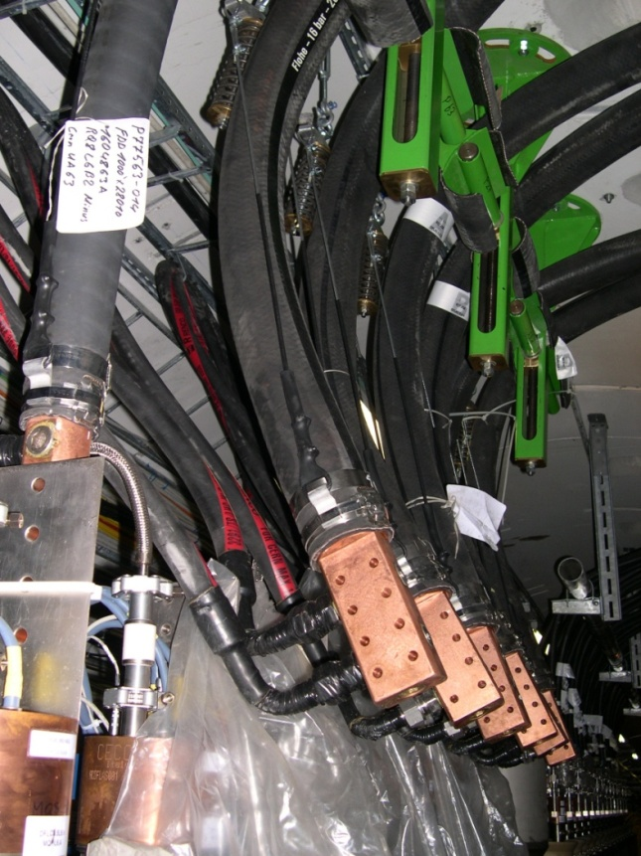
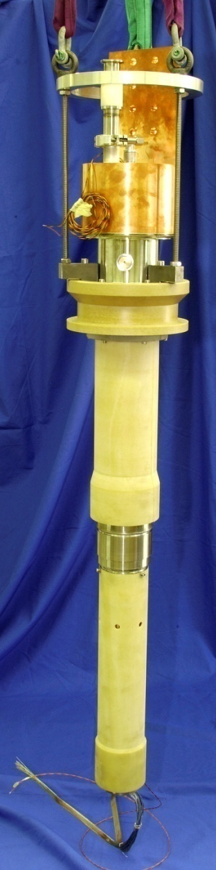
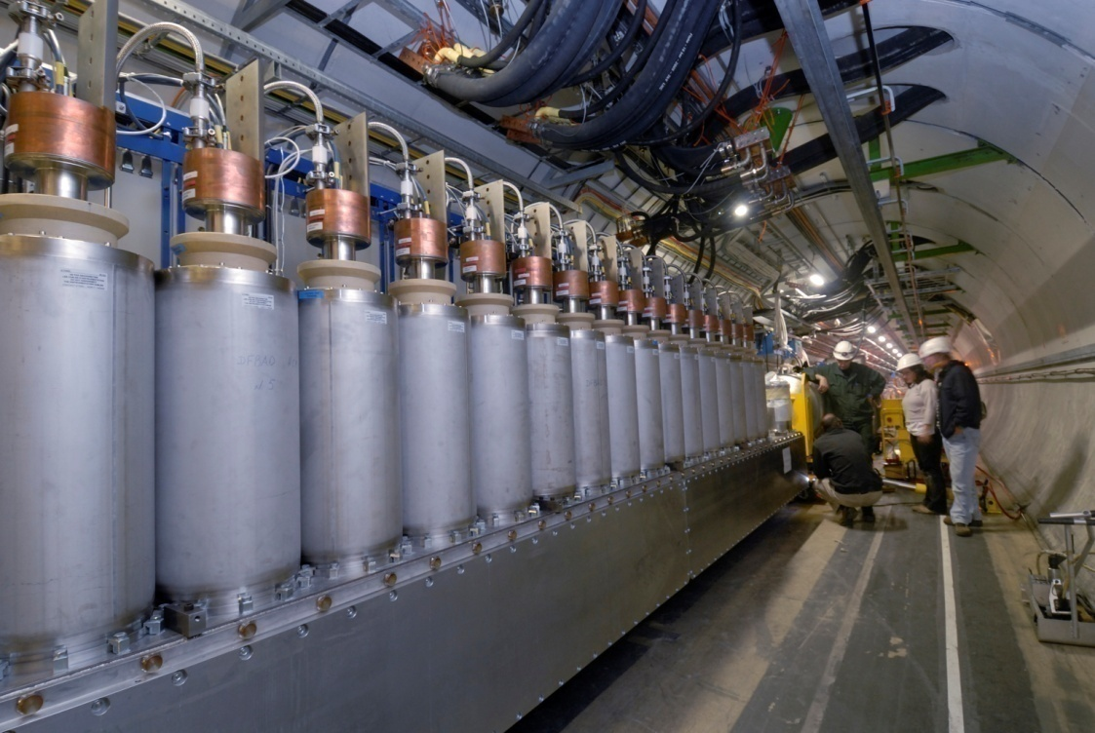
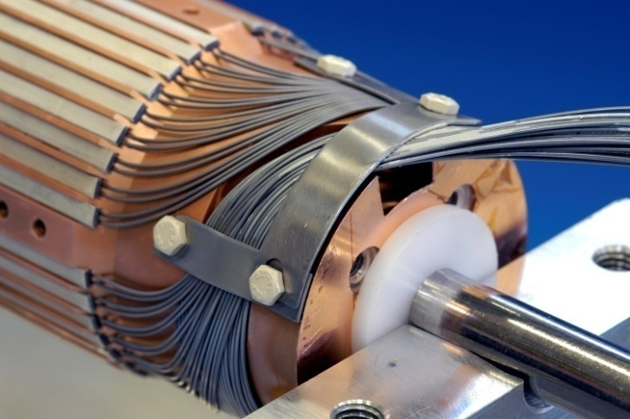
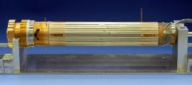
Cold power transfer system (LHC)
Nb-Ti bus
Nb-Ti
BSCCO 2223

Slide 4
The DFB contains active elements that need to be accessed (connection
of power cables, voltage test of the magnet circuits) and that require occasional
maintenance .
Close to the Insertions, these devices will be irradiated .
There would therefore be an advantage in removing the lead boxes from the tunnel.
This requires the use of a superconducting link. Such links exist using Nb-Ti conductor,
but if an HTS material could be used, this would lead to a number of advantages for the
system:
higher temperature margin on the conductor;
less costly leads;
simplified cryostat.

Slide 5
Cold power transfer system

Slide 6
Cold power transfer system
D1 Q3 Q2 Q1
Magnets
Busbars in cryostats
Nb-Ti to MgB₂ joints (5 K)
Cold power transfer system
Link (5 to 15 K)
MgB₂ to Cu joints (15 K),
Leads (20 to 300 K) & box
Protection, energy extraction and power conversion

Slide 7
Alternative powering scheme
D1 Correctors Q3 Q2 Q1
Nb-Ti to MgB₂ joints
Cold power transfer system
Link (5 to 15 K)
MgB₂ to Cu joints
Leads (20 K to RT)
Corrector and trim power converters

Slide 8
Cold power transfer system
  Current leads (from RT to 20 K)
  – 6 high-current power leads capable of passing full current in steady state
  – 2 safety power leads capable of passing trim current (2 kA) in steady state and full current during discharge
  – 14 corrector power leads (0.6 kA)
  Current leads cryostat (DFBX1)
  HTS link (from 20 K to 5 K)
  – 8 heavy current cables through the link
  – 14 corrector cables through the link
  Electrical connection box (link to magnet cold mass, from 5 K to 1.8 K)

Slide 9
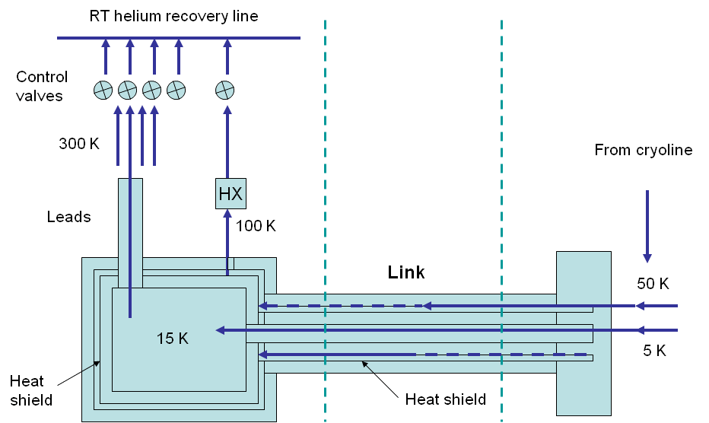
The system

Slide 10
Connection box on magnet side - schematic

Slide 11
End view of the tunnel termination box

Slide 12
Cross section of the link
Q ≤ 1.5 W/m
L ∼ 60 m, Δ_{THe} ∼ 10 K
m_{min}∼ 2 g/s (stand-by
operation)
m_{max}∼ 10 g/s

Slide 13
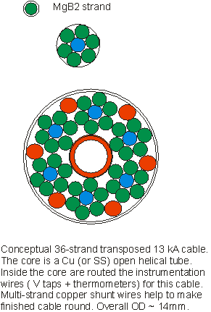
Cross-section of a 13 kA cable segment
360 A/wire @ Tmax=20 K

Slide 14
Cross-section of the cable
-
+
+
-
-
+
-
+

Slide 15
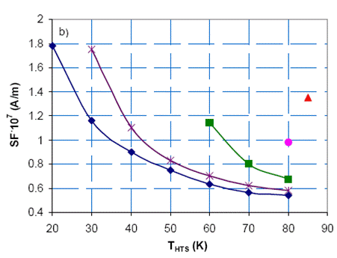
The leads
– The HTS part of the leads will be “replaced” by the HTS link. The leads will have to be
designed for this operation: from RT to 20 K, with heat conducted at the cold end
absorbed by the cooling gas recovered from the link. This will require appropriate
study and design.
– The temperature at the bottom end of the resistive part of the lead will be used for the
control of the gas inside the lead and passing through the MgB₂ cable.

Slide 16
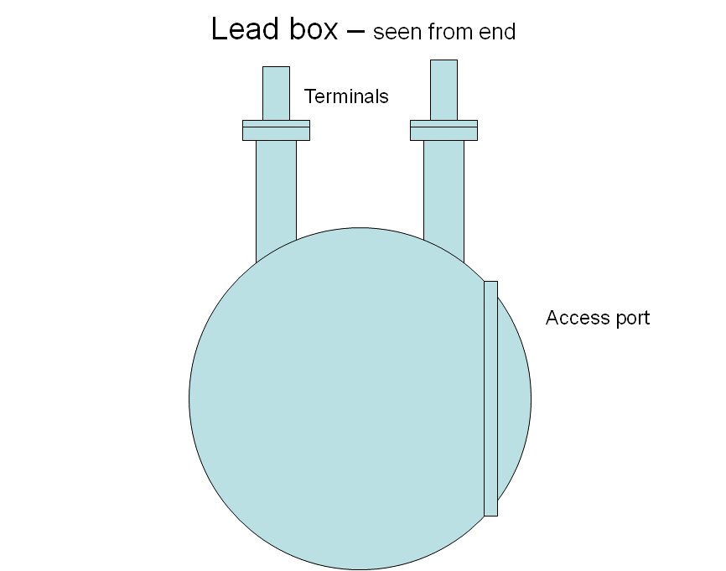

Slide 17
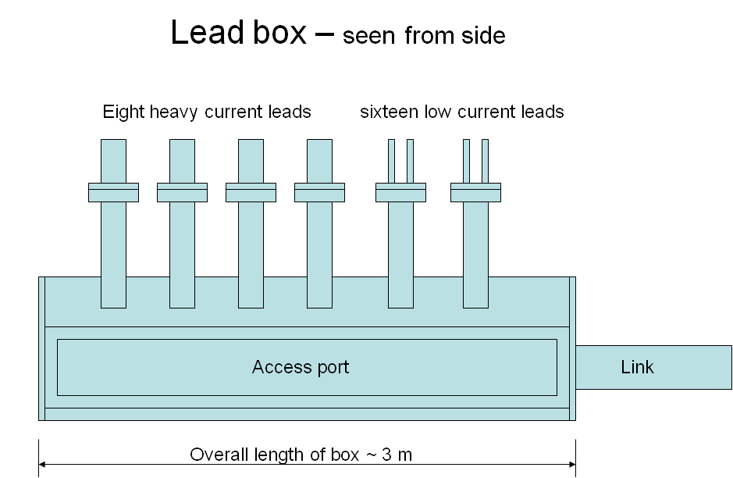

Slide 18
Control and interlock signals
– Temperature sensors at the bottom end of each lead for controlling the opening of
the valves that determine the corresponding flow of He gas.
– Voltage taps across each lead for protection against overheating.
– Voltage taps at either end of the link for protection in case of quench.
The instrumentation is routed out to the room temperature environment via the link and
the leads. No use helium-to vacuum insulating breaks.
To avoid Paschen problems in the system during voltage testing or quenching of magnets,
no live parts are present in the vacuum insulation (potential problem in case of He leaks
Into the vacuum).

Slide 19
Installation
  The superconducting link (L ∼ 60 m) would be completely assembled on surface and connected to the tunnel connection box.
  The leads will be installed in the DFBX1 at the surface.
  The DFBX1 will be installed in the caverns near the power supplies.
  The link will be transported to the tunnel (bending Φ ∼ 3 m), and installed (like a
  “semi-flexible” cable). The mass is ∼ 5 kg/m.
  The link will be connected to the DFBX1 and the cables to the bottom of the leads
  (MgB₂ to Cu). At the magnet side, the connection box will be connected to the
  magnet cryostat and the Nb-Ti cables to the Nb-Ti bus in the magnet cold mass.

Slide 20
MgB₂ vs. other -commercially available- HTS conductors
Lower temperature margin (Tc = 39 K, instead of Tc > 90 K), but:
It is available in the form of wire (Bi-2212 in a Ag matrix would not be suitable for this application);
At 20 K, it has a good cost/performance ratio if compared to Bi-2223 tape in Ag matrix, to Bi-2212 wire in Ag matrix, and t Y-123 tape on a metallic substrate. The low cost of raw materials and the relative simple fabrication process -when compared to other HTS conductors- enables a low cost of the conductor;
It is isotropic - at least at low fields;
It has good electrical performances at the low fields needed for this application - efforts are being made for increasing Ic at high field (> 3 T).

Slide 21
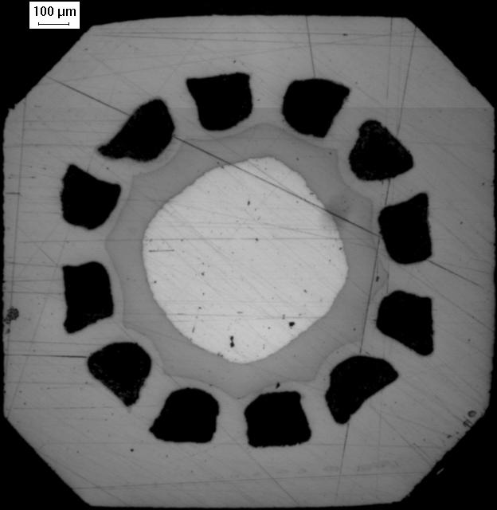
MgB₂ conductor: geometry and composition
Collaboration with Columbus, who developed for this project two wires available in long (up to 3 km) lengths:
• D1=1.6 mm. Ic(24 K, 0.4 T)>550 A. J_{ce}>240 A/mm²
• D2=1.1 mm. Ic(24 K, 0.4T)=436 A. J_{ce}=357 A/mm²
f= 14 %, 12 MgB₂ filaments (Each filament ∼0.019 mm² for D1 and ∼ 0.03 mm² for D2 )
Twist pitch=300 mm
Rb_{min} ∼100 R
Inner core of copper (∼ 15%)
Electrical (Ic(B-T), ρ(T)), thermal (K(T)) and mechanical properties (Rb) of the wires were measured
MgB₂
Cu
Ni
Fe

Slide 22
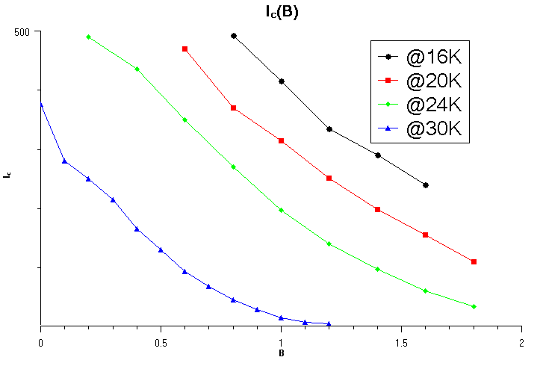
MgB₂ conductor: electrical properties
Ex-situ, 1.1 mm Φ MgB₂ wire (Columbus)
Ic (A)
B (T)
Measurements performed by Columbus
Measured at CERN an Ic ∼ 800 A (4.2 K, 1.5 T)

Slide 23
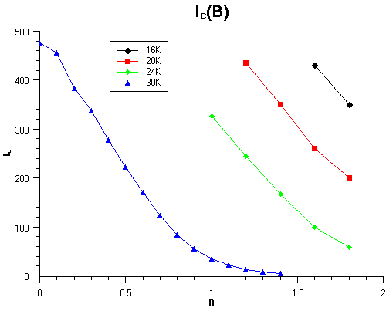
MgB₂ conductor: electrical properties
Ex-situ, 1.6 mm Φ MgB₂ wire (Columbus)
Ic (A)
B (T)
Measurements performed by Columbus
The n value strongly depends on the field:
∼ 90 up to 1 T, ∼ 30 at 4 T (measured at CERN at 4.2 K)

Slide 24
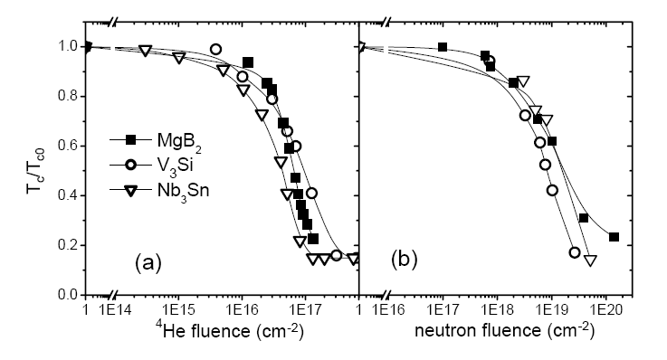
MgB₂ conductor: radiation resistance properties
Neutron irradiation tests were done at very high fluences (up to 3.9·10¹⁹ n·cm^{-2,} INFM and
University of Genova).
Up to fluences of 1·10¹⁸ n·cm⁻² no degradation of Tc was observed. Tests were also
performed on isotopically pure ¹¹B.

Slide 25
Required studies
This project is presently at the design concept stage, with global and /or order of magnitude checks of major parameters. Before embarking on the project a number of studies and tests are required.
Work is in progress to qualify the MgB₂ strands;
Based on these results and on forthcoming decisions with regard to operating currents and circuit time constants, the cable layout will be refined;
Stability and protection will be addressed
Short lengths will be assembled to confirm feasibility;
Insulation will be optimized, and validated with thorough testing;
Full cable cross-section will be assembled;
Thermo-dynamic performance will be optimized (pressure drop, flow rates and heat exchange);
Pressure drop will be measured on assembled units;
The designs of low-resistance MgB₂ conductor connections – both to copper (lead ends) and to Nb-Ti cables – will be refined, and tests will be made. The design of the connection between bus and lead will call for particular attention to ensure sufficient cooling in the gaseous environment;
A full-length single 13 kA cable will be assembled and tested.
In parallel, studies of the semi-flexible cryostat envelope will be made with Nexans, following which a representative (full) length should be purchased for assembly and test.

Slide 26
Schedule
In order to be able to install in 2013, and to have the equipment ready for the String
Test in 2012, all the studies and tests mentioned in the previous slide have to be brought to
a satisfactory conclusion by end 2009.
In 2010 drawings, prototypes and specifications have to be made, and orders placed.
In 2011 reception and testing of the equipment for the String (1st item).
In 2012 reception and testing of the equipment for the series.
In 2013 installation and commissioning.
This is a BIG project, and time is very short.

Slide 27
Resources
To satisfy the schedule, the resources discussed last February –15 FTEY over a period of
4 years, not including the Workshop and/or Industry personnel for prototypes and assembly – should be made available (1.5 FTE in 2008).
At this stage, the total cost is estimated to be ∼ 5 MCHF for 4 systems. This includes the cost of the R&D, but it does not include the above manpower. The cost of the link itself
Is estimated to be ∼ 1.5 kCHF/m.

Slide 28
Conclusion
A preliminary conceptual design study has been made. A more detailed study and validation tests need to be carried out in the next months.
The use of MgB₂ brings a number of advantages in the cold powering scheme:
higher temperature margin;
simplified cryostat (no LHe);
no need for cold cryogenic lines in the caverns (only recovery of He gas at room temperature).
The HTS bus development is a new and challenging device that could be embedded in the Insertion Upgrade Project, but which requires real development work. The optimization of the system requires close collaboration with the magnet, magnet protection, cryogenics and installation activities. In a long-term CERN-wide goal, one could think to install the power converters at the surface using such a system.
The system using MgB₂ should cost less one based on Nb-Ti.
However, the success of the HTS link project is subjected to two constraints: proper allocation of resources (both human and material) and appropriate recognition and integration within the upgrade project.

