Slide 1
HCAL Analysis
Yalcin Guler
Serdal Damarseckin, Emine Gurpinar
Shuichi Kunori, Isa Dumanoglu,
Bayram Tali, Merve Ince, Hasan Huseyin Isik, Samet Lezki

Slide 2
Introduction
2012D minimum bias data is analysed
We have trigger Plots. Thanks to Emine ☺
We have checked some samples but not all of them yet.
Our plan is check to code for trigger information and run to other samples (JetHT_RECO and JetHT_RAW)

Slide 3
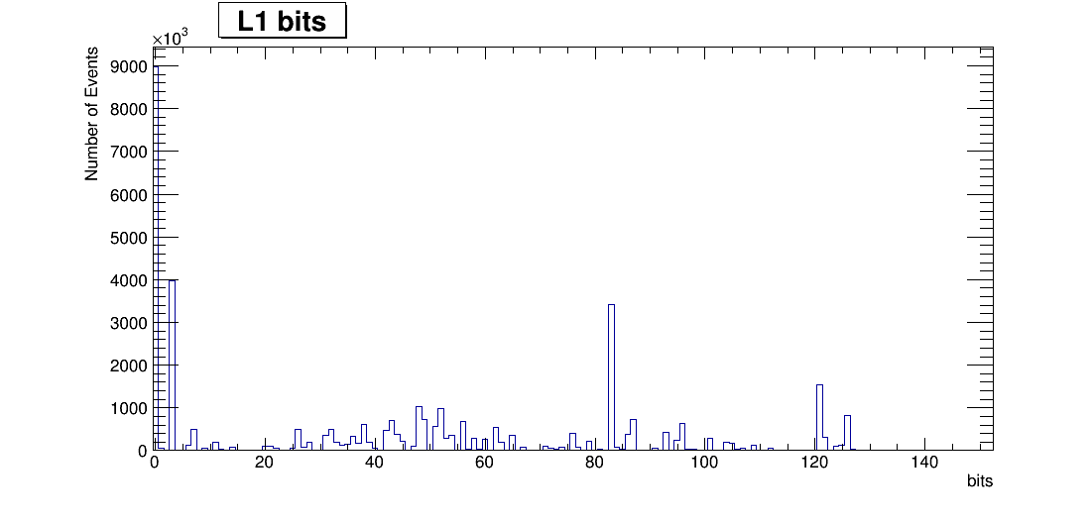
L1 Trigger bits

Slide 4
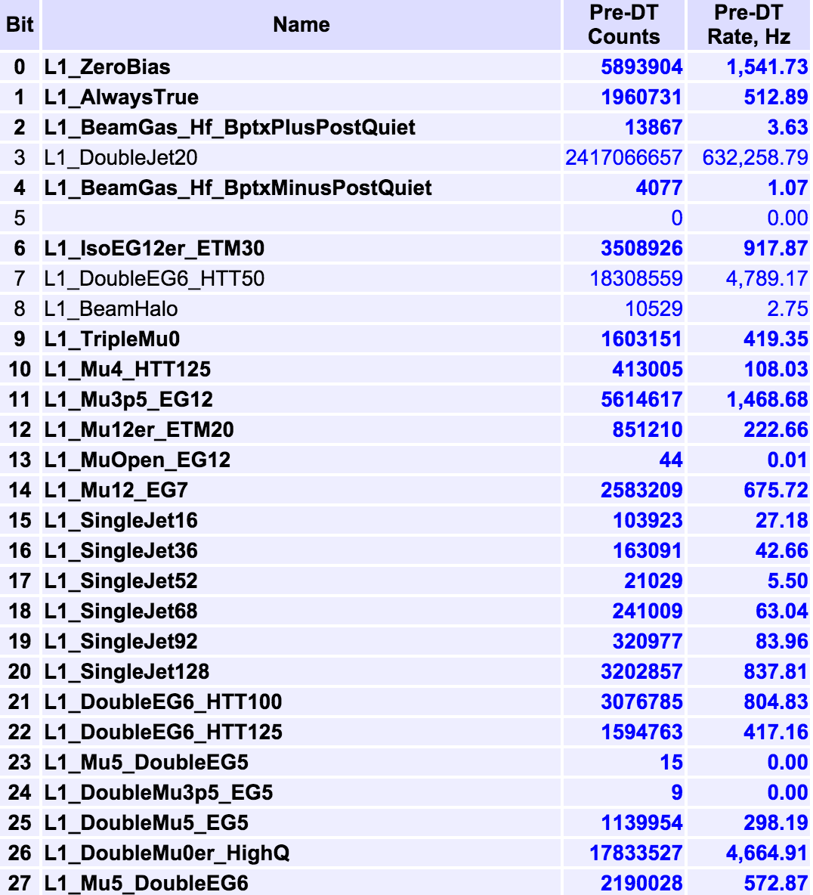
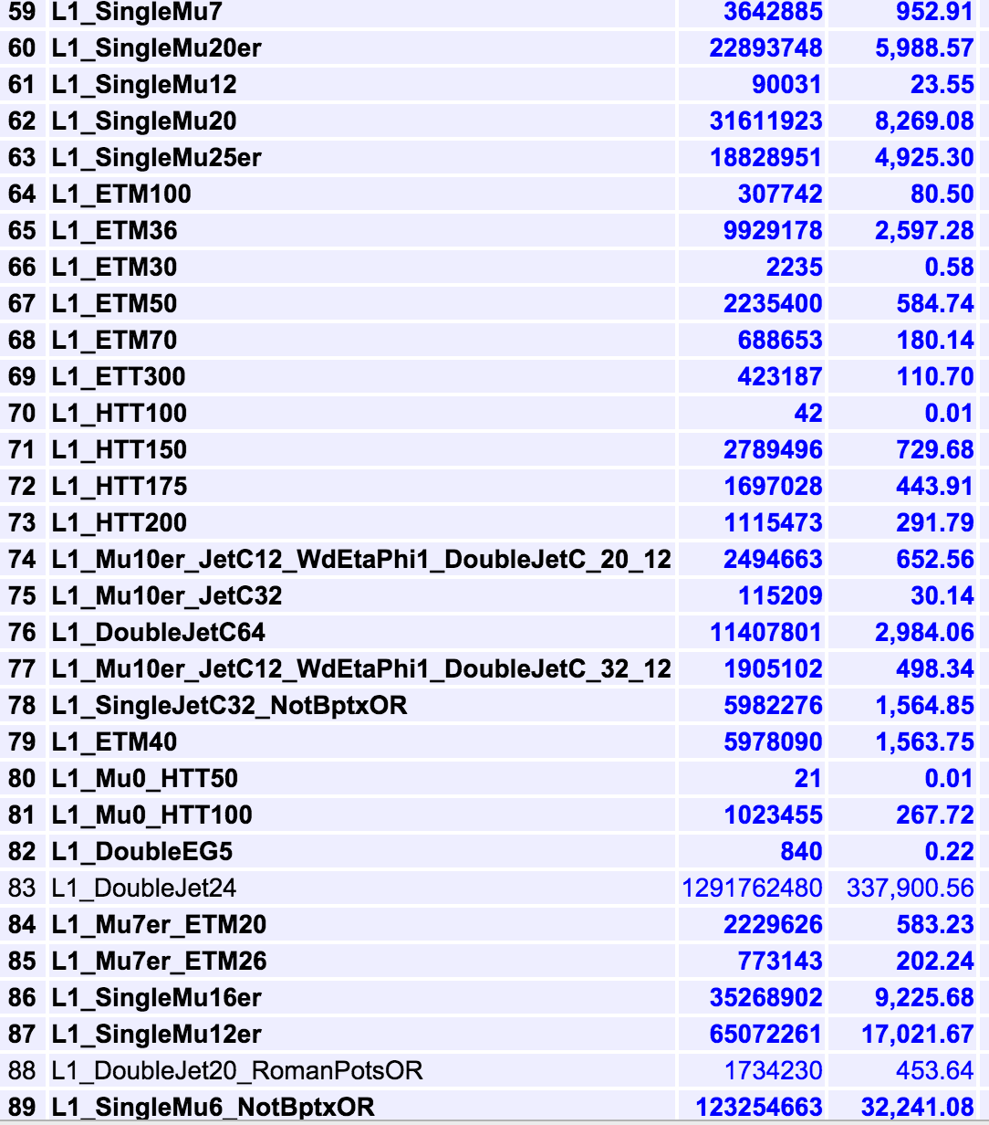
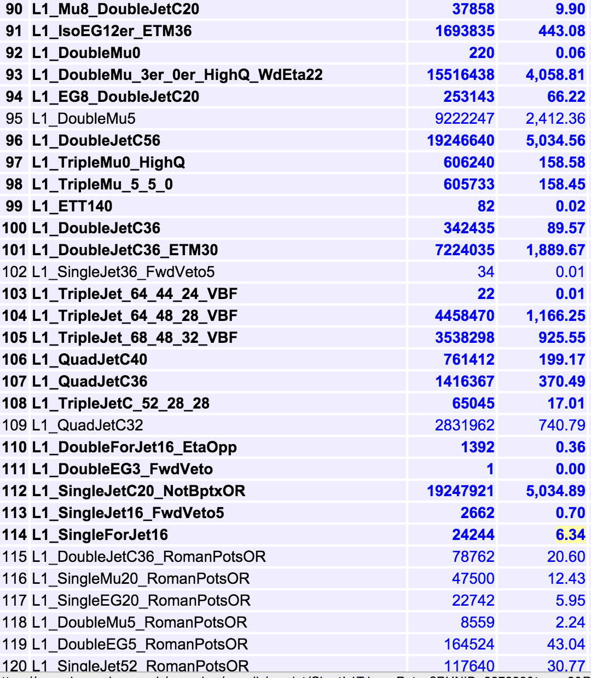
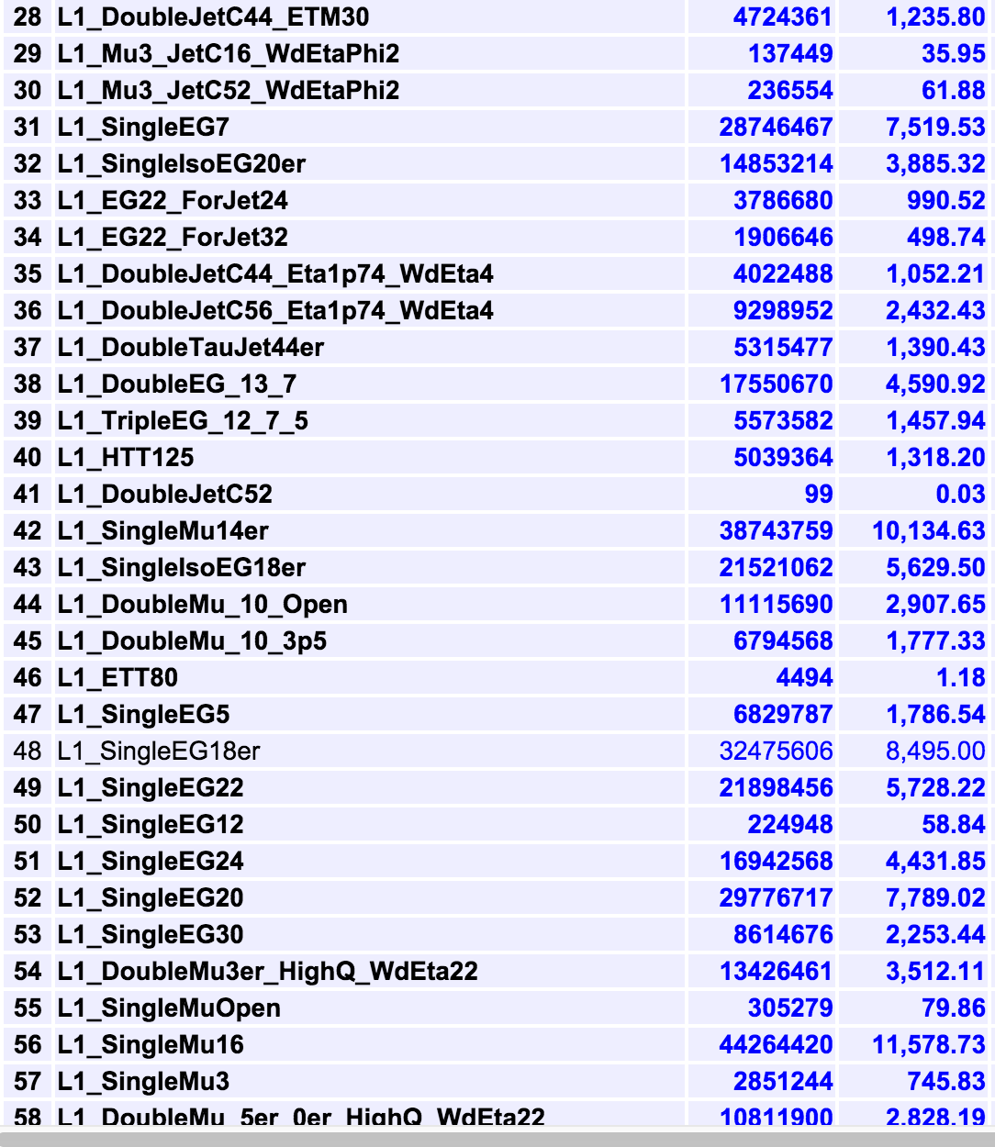
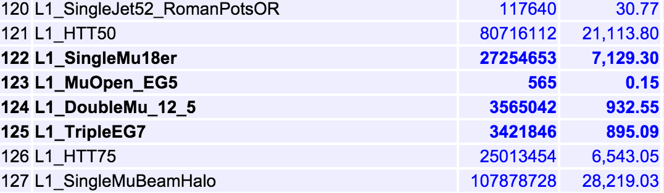
L1 Trigger bits

Slide 5
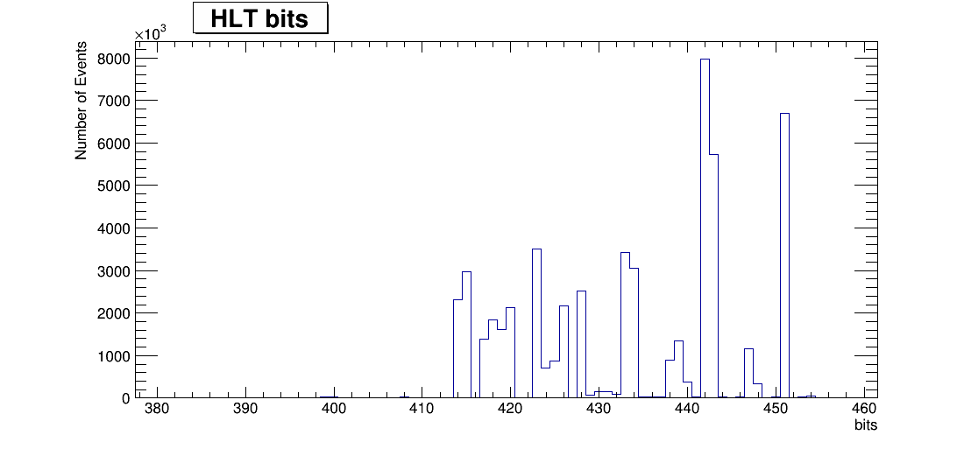
HLT Trigger bits

Slide 6
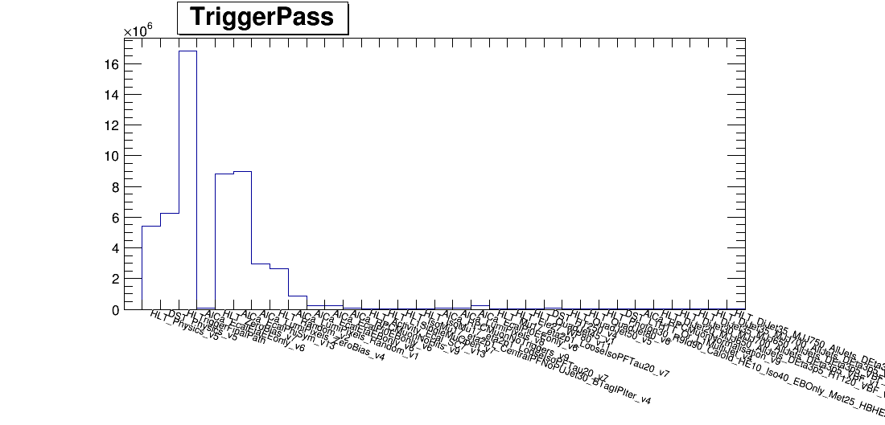
HLT Trigger Names

Slide 7
HLT Trigger Names
HLT_Physics_v5
DST_Physics_v5
HLTriggerFinalPath
HLT Trigger name
AlCa_EcalEtaEEonly_v6
HLT_ZeroBias_v7
AlCa_EcalphiSym_v13
AlCa_LumiPixels_ZeroBias_v4
HLT_Random_v2
AlCa_LumiPixels_Random_v1
AlCa_EcalEtaEBonly_v6
AlCa_RPCMuonNoHits_v9
HLT_Activity_Ecal_SC7_v13
HLT_L1SingleMuOpen_v7
HLT_IsoMu17_eta2p1_Central
HLT_IsoMu17_eta2p1_Looselso
AlCa_RPCMuonNoTriggers_v9
AlCa_LumiPixels_v8
AlCa_EcalPi0EEonly_v6
HLT_Mu17_eta2p1_Loosel
HLT_Ele27_WP80_v11
HLT_QuadJet45_v1
DST_HLT250_v4
HLT_Quadjet50_v5
HLT_QuadJet80_v6

Slide 8
Summary
We have presented some trigger plots all 2012D minimumbias data set.
We will check JetHT data sets.
We will check specific areas for triggers. For example; 800 GeV for minbias data and 300 Gev for JetHT data samples.
/afs/cern.ch/work/y/yalcin/public/Hcal/CMSSW_7_1_7/src/HcalAnalyzer/HcalRecHitAnalyzers/plugins/HcalRecHitAnalyzers.cc
/afs/cern.ch/work/y/yalcin/public/Hcal/CMSSW_7_1_7/src/HcalAnalyzer/HcalRecHitAnalyzers/test/Results/

