Slide 1
HIE-ISOLDE
CERN-ISOLDE towards the future!
Mats Lindroos
Acknowledgements to all in the HIE-ISOLDE family

Slide 2
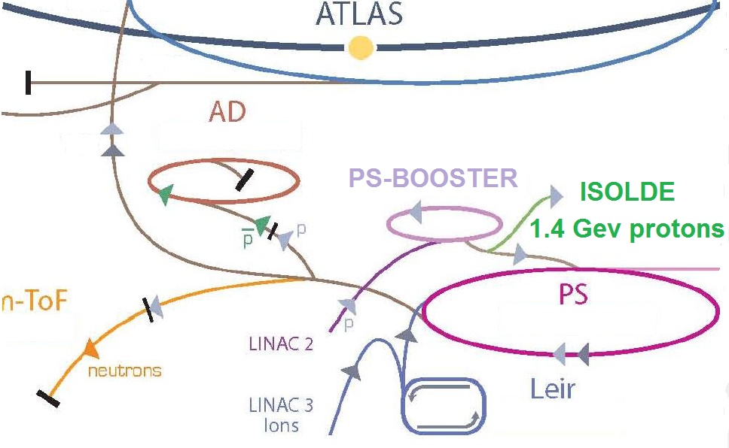
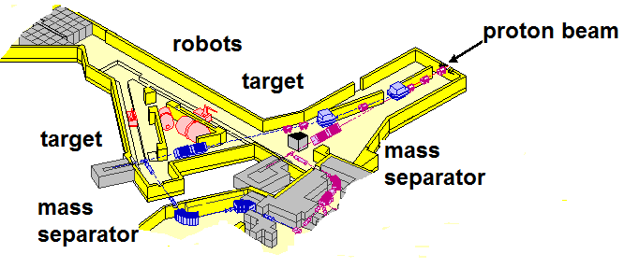
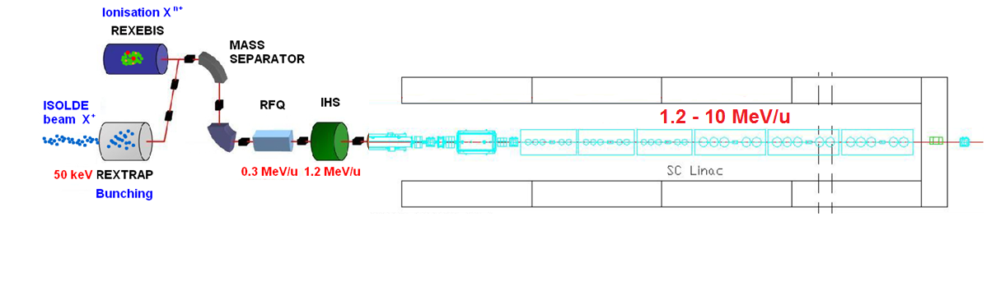
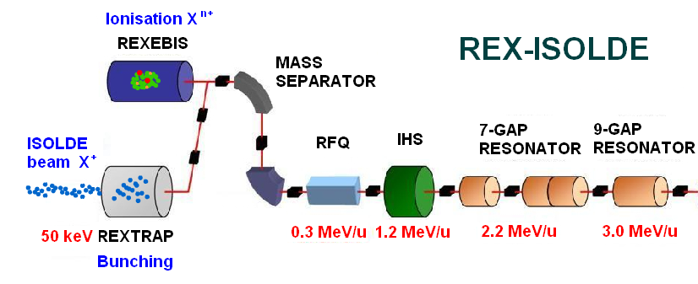
ISOL method of radioactive ion beam production
DRIVER ACCELERATOR
PRIMARY TARGET
Upgraded
target stations
LINAC 4
Isobaric
mass separator
solid-state laser
for ionisation
High intensity
EBIS
POST-ACCELERATOR
HIE-LINAC
HIE-ISOLDE upgrades
P. Butler

Slide 3
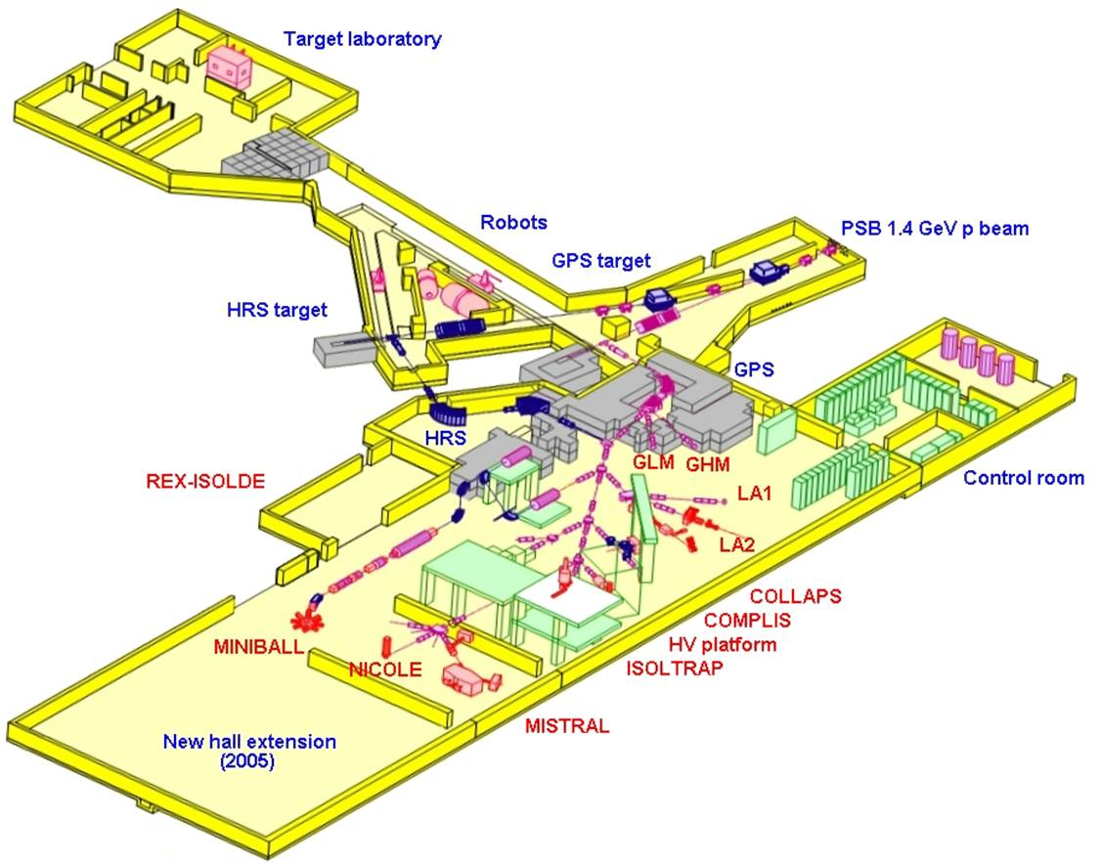
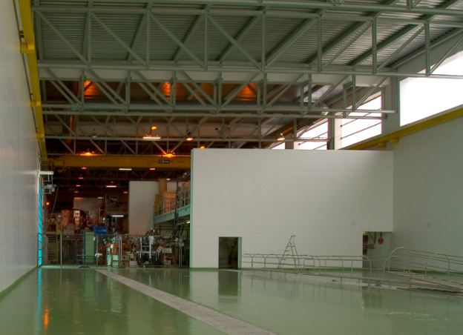
ISOLDE: ~£20M
2008
current equipment
P. Butler

Slide 4
HIE-ISOLDE: Next step with three objectives
REX energy upgrade and increase of current capacity (Matteo Pasini)
  Energy upgrade in 3 stages: 5.5 MeV and 10 MeV/u and lower energy capacity
ISOLDE proton driver beam intensity upgrade - strongly linked to PS Booster improvements including linac4 (Richard Catherall)
  Faster cycling of the booster
  New target stations for ISOLDE
  New targets
  New target handling system
ISOLDE radioactive ion beam quality – more than half already financed through the ISOLDE collaboration
  Smaller longitudinal and transverse emittance
    Done – RFQ cooler operational
  RILIS upgrade and LARIS construction
    Done
  Charge breeder upgrade
  Better mass resolution
  Continue target and ion source developments

Slide 5
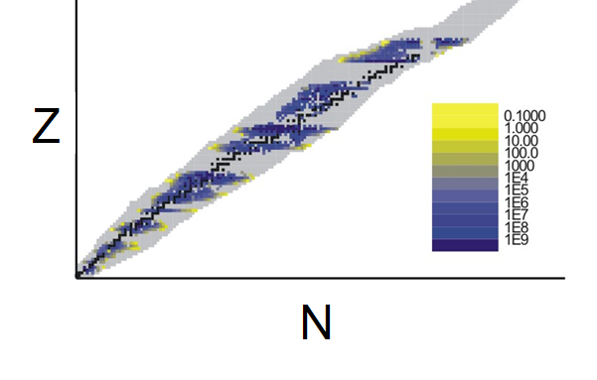

Yields from HIE-LINAC
~ 65 elements
> 700 nuclides
HRIBF
(Oak Ridge)
E < 5 MeV/u
shape co-
existence
octupoles
ISAC-2
E < 6 MeV/u
shell
structure
n-p
pairing
rp-
process
shell
structure
SPIRAL-2
SPES
P. Butler

Slide 6
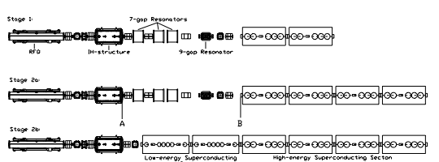
The proposed HIE-LINAC
3 stages installation
1.2 MeV/u
3 MeV/u
5.5 MeV/u
10 MeV/u
Standing group for the upgrade of the ISOLDE facility meeting TTC Meeting, Geneva Nov. 4, 2008

Slide 7
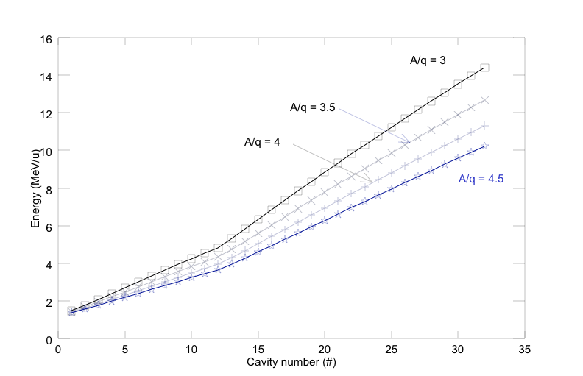
LINAC energy variability
Standing group for the upgrade of the ISOLDE facility meeting TTC Meeting, Geneva Nov. 4, 2008

Slide 8
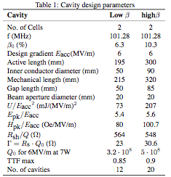
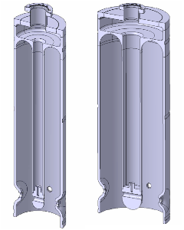
101.28 MHz Nb sputtered QW cavities
Low β
High β
Beam axis
Standing group for the upgrade of the ISOLDE facility meeting TTC Meeting, Geneva Nov. 4, 2008

Slide 9
Nb sputtering cavity development
High β cavity prototype in fabrication
Sputtering chamber design complete and in fabrication
Chemical treatment facility refurbished and ready for tests with dummy cavity
Clean room refurbished (there was a problem with floor tiles)
Tools for handling and manufacturing in fabrication
Standing group for the upgrade of the ISOLDE facility meeting TTC Meeting, Geneva Nov. 4, 2008

Slide 10
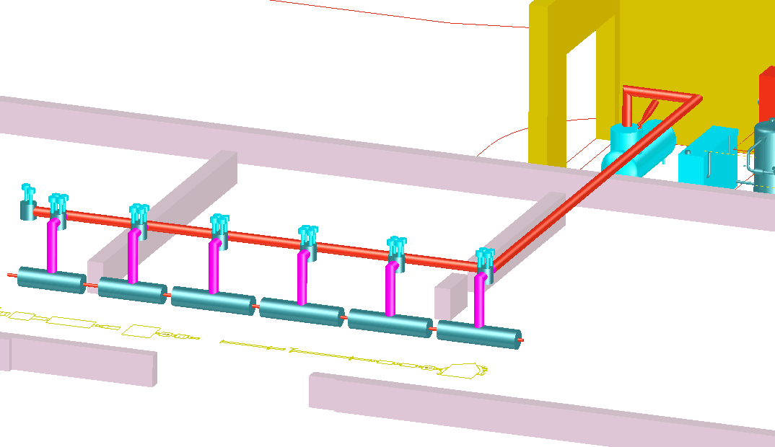
Cryogenics
New building
ALEPH cold box
1 « jumper » for each cryo-module
New transfer line
2+4 cryo-modules
Existing building 170
Courtesy of J. Metselaar

Slide 11
Option 2
Beam1
Beam2
57 quad,
5 dipoles,
~30 correctors magnets
Beam3
Standing group for the upgrade of the ISOLDE facility meeting TTC Meeting, Geneva Nov. 4, 2008

Slide 12
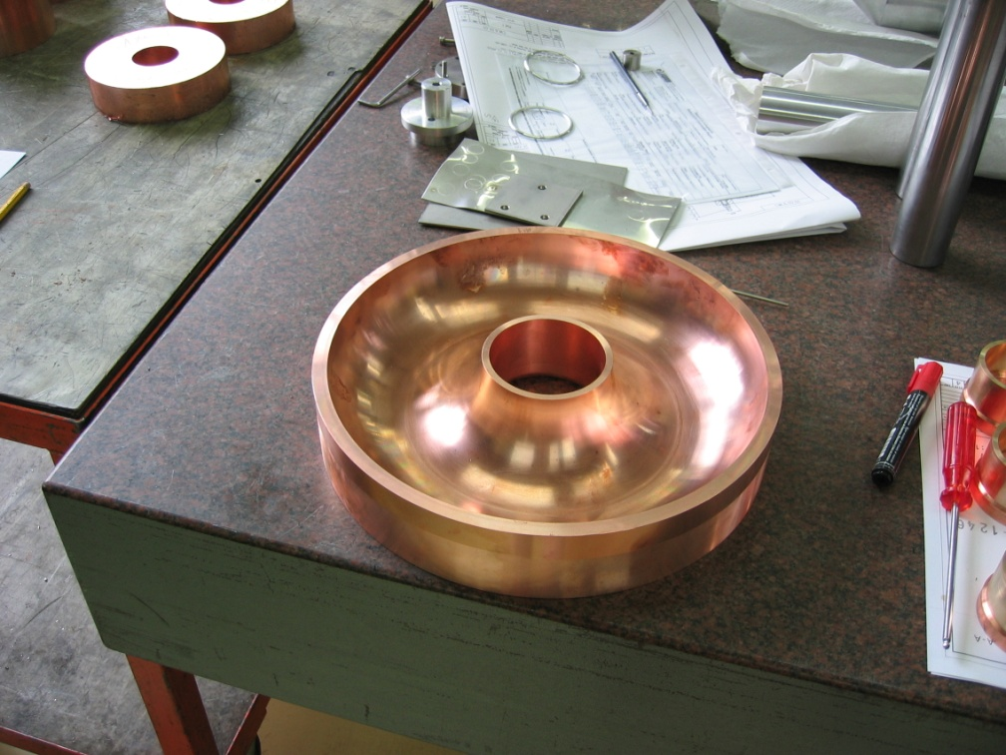
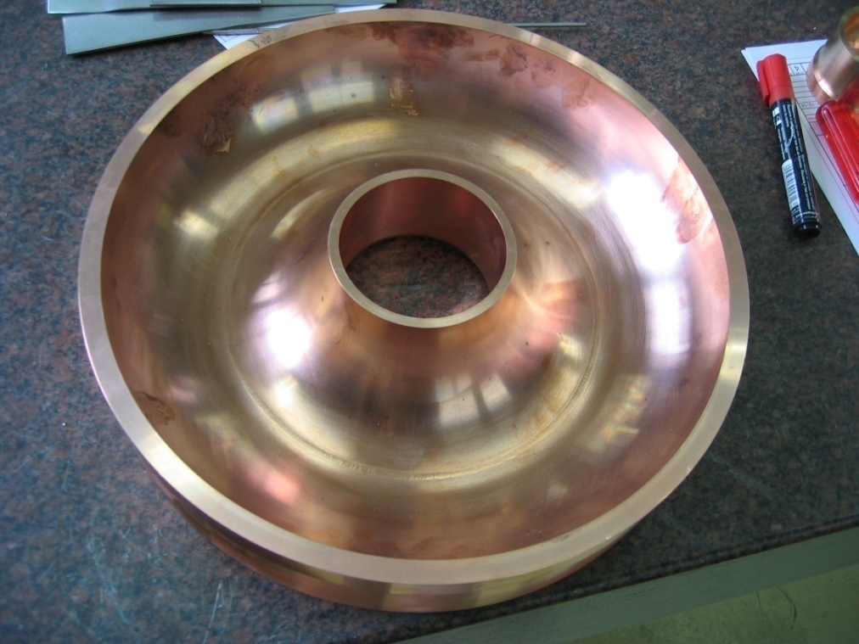
Welding test: 1000 mm distance e-beam
Roughness test performed after SUBU chemical polishing, 20 µm removed
Achieved Ra ≤ 0.8 µm, target value
Standing group for the upgrade of the ISOLDE facility meeting TTC Meeting, Geneva Nov. 4, 2008

Slide 13
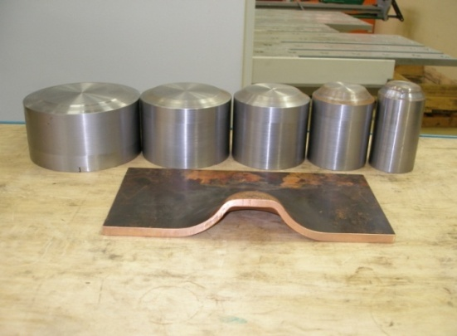
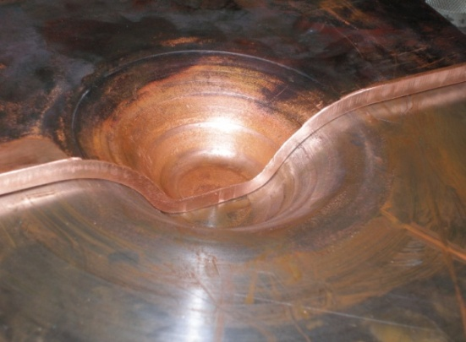
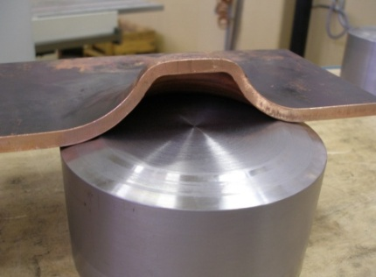
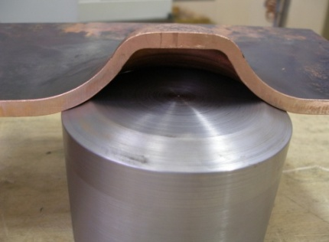
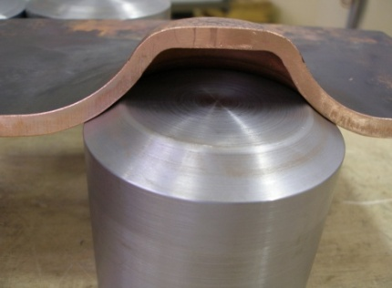
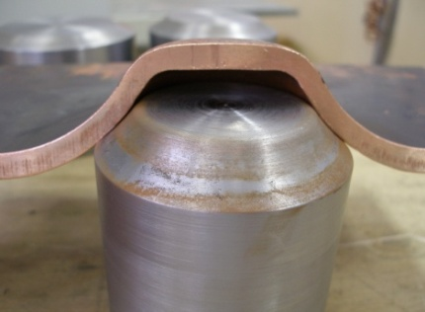
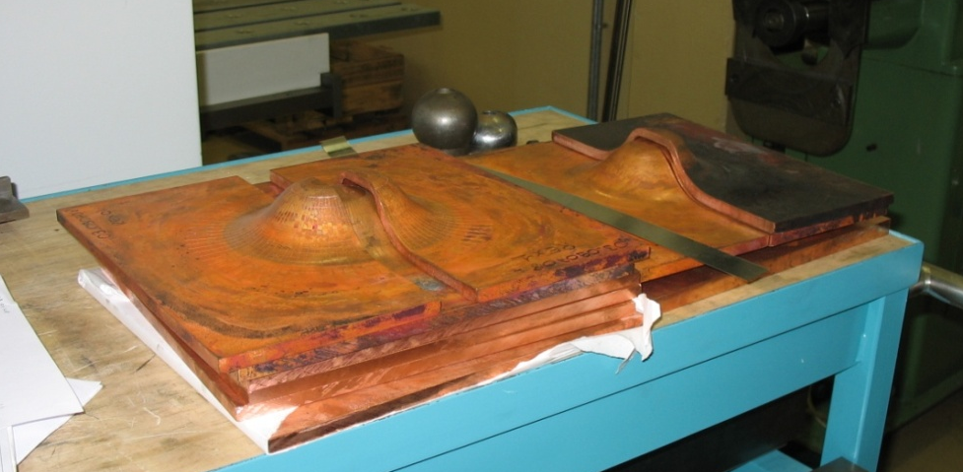
Manufacturing of beam ports: flat test
Starting thickness 10 mm
Residual thickness > 8 mm
Standing group for the upgrade of the ISOLDE facility meeting TTC Meeting, Geneva Nov. 4, 2008

Slide 14
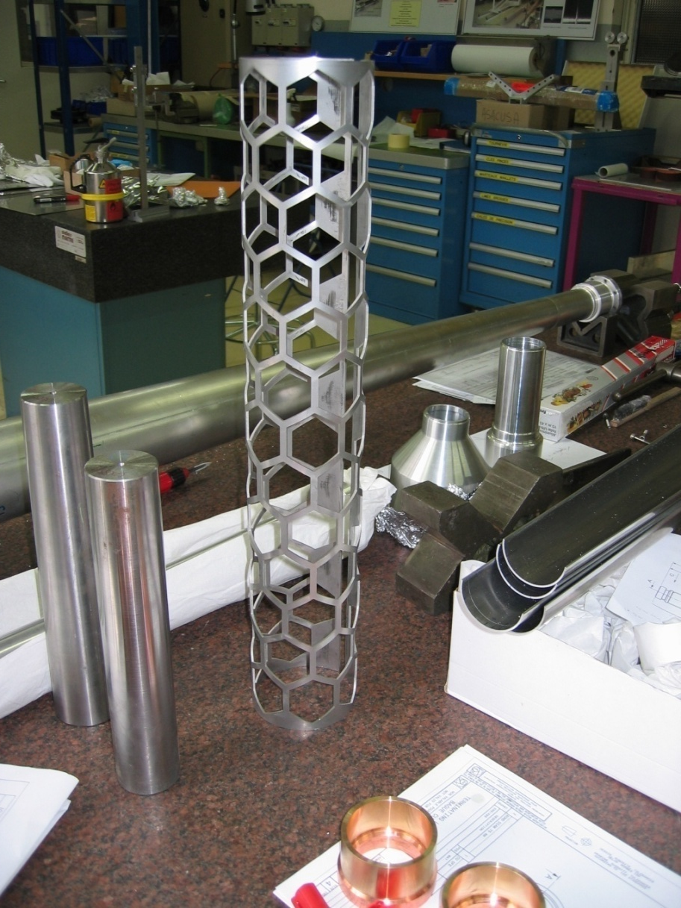
Bias electrode by water jet cutting
Standing group for the upgrade of the ISOLDE facility meeting TTC Meeting, Geneva Nov. 4, 2008

Slide 15
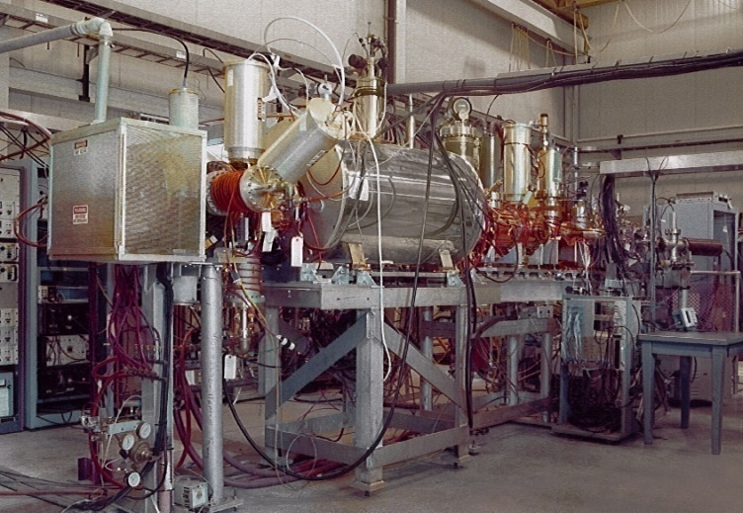
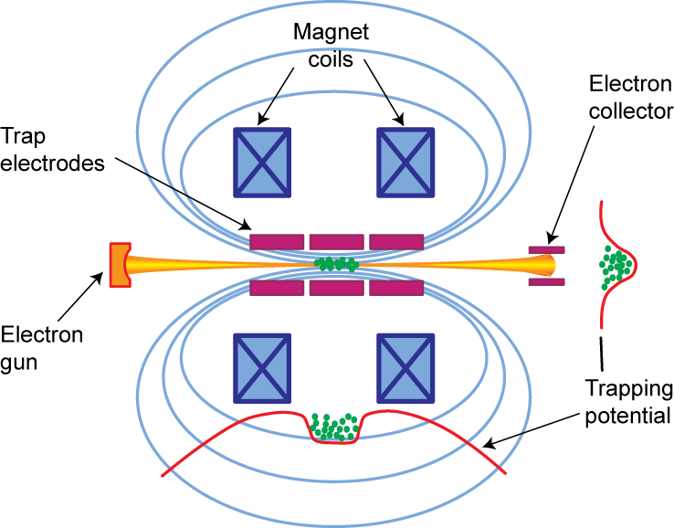
REX space charge limits – REX trap and chargebreeder
The low energy stage at REX can today not handle the full intensity of some ISOLDE beams:
  A new EBIS with higher fields and higher electron currents
  A RFQ cooler for operation in continuous injection mode (ACCU mode) with the EBIS
  Proposal submitted to the DOE in collaboration with MSU, TRIUMF, LLNL, MPI-K and ORNL

Slide 16
DOE proposal - Comparison EBIS/ECR/1+
 | Proposed High-Intensity EBIT | MSU EBIT | TITAN EBIT | BNL test EBIS | REX-EBIS
Electron beam energy (keV) | < 60 | < 30 | < 60 | <30 | < 6
Electron beam current (A) | < 10 | < 5 | <5 | <20 | < 0.5
Central current density (A/cm²) | <10⁵ | <10⁴ | <10⁴ | <600 | <200
Magnet design | Helmholtz Coil + Solenoid | Helmholtz Coil + Solenoid | Helmholtz Coil | Solenoid | Solenoid
Maximum magnetic field (T) | 9 | 6 | 6 | 5 | 2
Trap length (m) | 1 m | 0.5 m | 0.1 m | 0.7 m | 0.8 m
O. Kester et al.

Slide 17
Higher driver beam intensities
Cost for the faster cycling of the booster included in this proposal
  Linac 4 will have major impact on the ISOLDE “targetry” and the project includes necessary modifications for linac 4 (but not the cost of linac 4!)
Target handling, targets, waste handling and general safety in target area
  Major improvement of working conditions for radiation workers compared to present situation and fully in line with European legislation

Slide 18
Manipulator concept design
6-DOF Manipulator mounted on ceiling monorails
Equipped with tool changer for mounting different tools
Recoverable by decoupling (remotely) rail gear drive
High lifting capacity (FFE)
Target & electrode accurate / sensitive operations
Options:
  Teleoperation with force reflection into Master
  ...

Slide 19

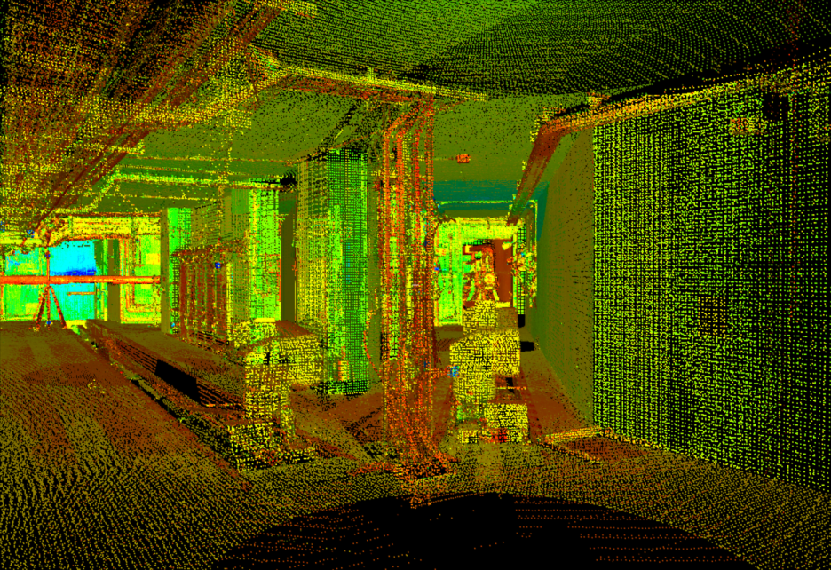
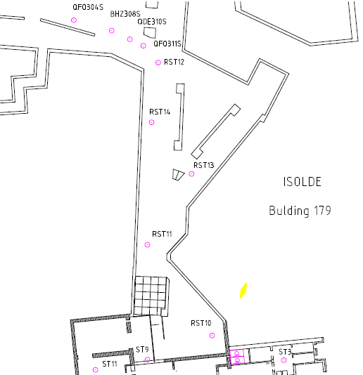
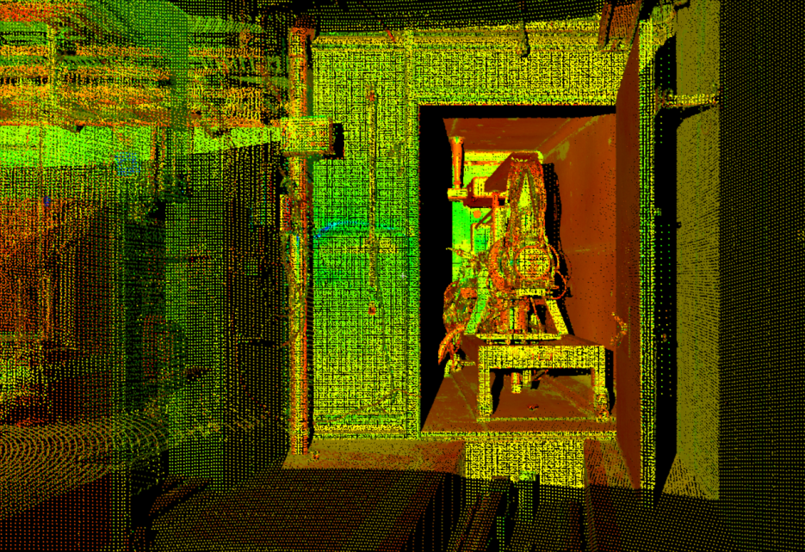
1.5 - The 3D Laser Scan
Cloud of point in the CERN coordinate system
Reference Points
J. Sarret, L. Bruno

Slide 20
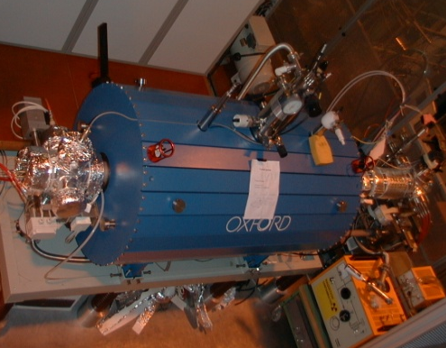
Beam quality
Beam manipulation with traps and ionization with lasers permits tailoring of RI beams for Users
Essential to strengthen target R&D to keep ISOLDE as a world leading ISOL lab.
Major contribution received from UK and Sweden for RILIS and RFQ cooler (2655 kCHF)

Slide 21
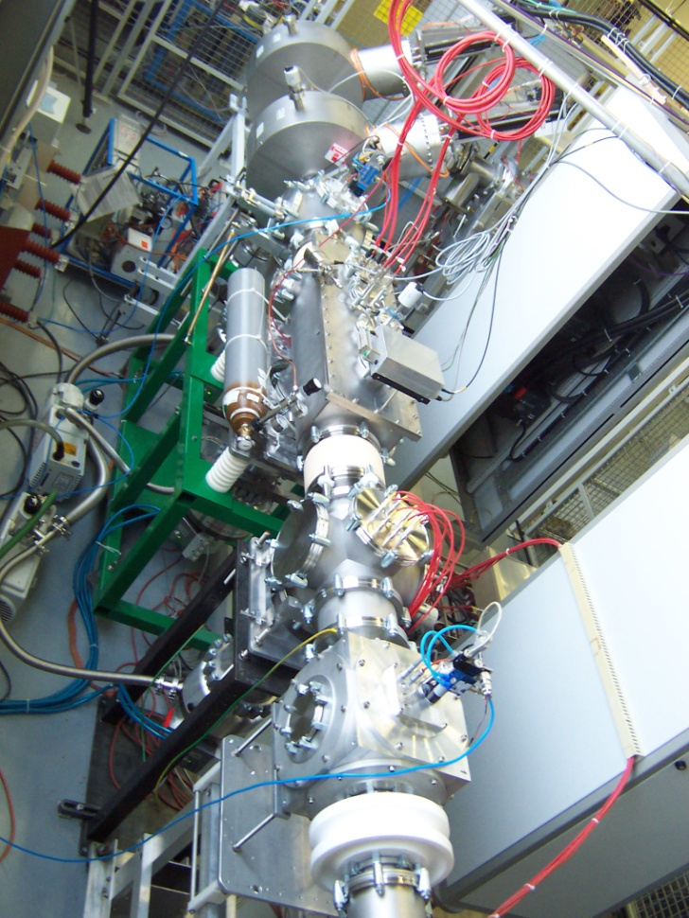
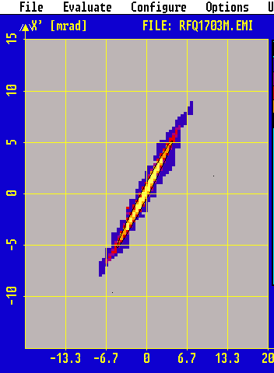
RFQ cooler “ISCOOL”
EPSCR grant (Manchester, Birmingham)
Emittance meter
Continuous mode
~5π·mm·mrad 90% emittance
RFQ cooler
~30π·mm·mrad 90% emittance as input
Alkali ion source

Slide 22
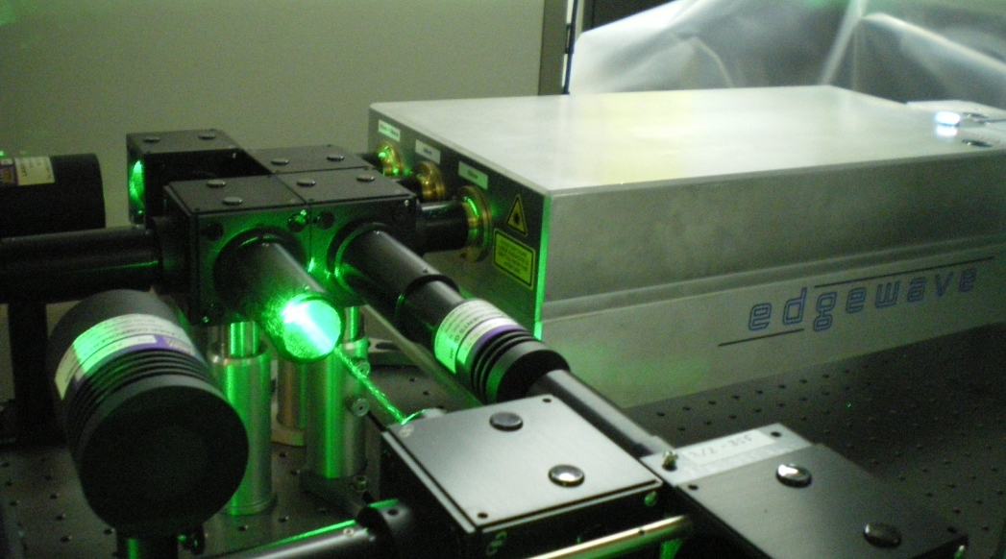
Nd:YAG lasers installed at RILIS
Diode Pumped Solid State Nd:YAG Lasers as replacement of Copper Vapor Lasers:
CVL
SSL
15 ns @ 11 kHz 8 ns @ 10 kHz
Green Beams
80 - 100 W @ 532 nm
Green Beams
45 W @ 511 nm
UV Beam
18 W @ 355 nm
Yellow Beams
35 W @ 578 nm
IR Beam
35 W @ 1064 nm
Ion beam produced with the SSL in 2008:
Ga, Tl, Be, Nd, Cu, Mg, Pb
CVL scheme
SSL scheme
Improvement of Ga ionization efficiency by SSL :
Two dye lasers were applied at 1st step of excitation - x 2
More power could be delivered to HRS target at the 2nd step of excitation
Better power stability
54%
46%
46%
V. Fedosseev

Slide 23
HIE-ISOLDE external contribution: Where are we?
External grant from Belgium
Second grant from Belgium approved for both physics programme and SC linac construction for HIE-ISOLDE
Proposal submitted in the UK for HIE-linac
Approved WP in EUCARD for R&D on thin film techniques
RFQ cooler WP and RILIS WP financed and (almost) completed
Proposal being prepared in the US to DOE for joint development of new high-intensity EBIS
Discussions with CERN Mgt on CERN contribution.

Slide 24
Total all parts of project
 |  | Swiss Francs
 |  | Still required |  | Received
 |  | Staff | Material | Staff | Material
 |  | FTE | kCHF | FTE | kCHF
1a * | LINAC prototyping and cryo design | 0.0 | 425 | 5.5
1b * | LINAC 3.0 - 5.5 MeV/u | 25.5 | 2,416 |  | 4,472
1c | Linac 5.5 - 10 MeV/u | 19.0 | 3,350
1d | LINAC lower energies | 9.5 | 1,325
1e * | Beam lines for experimental area | 1.0 | 0 |  | 500
2 | REX trap and charge breeder | 12.1 | 2,238
3 * | TS consolidation |  | 2,000
 | REX UPGRADE | 67.1 | 11,754 | 5.5 | 4,972
4 | Targets & Front-ends | 25.8 | 8,040 |  | 60
5 | PSB 900 ms | 9.0 | 2,000
 | PROTON DRIVER BEAM | 34.8 | 10,040 | 0.0 | 60
6 * | RFQ cooler | 0.0 | 0 |  | 500
7 * | RILIS upgrade | 0.0 | 0 |  | 2,400
8 | High-charge state beams | 1.1 | 800
9 | New HRS | 0.8 | 1,100
 | BEAM QUALITY | 1.9 | 1,900 | 0.0 | 2,900
10 * | Radiation protection consolidation | 1.0 | 750
11 | Vacuum consolidation | 8.5 | 2,408
 | CONSOLIDATION | 9.5 | 3,158 | 0.0 | 0
 | TOTAL | 113.3 | 26,852 | 5.5 | 7,932
 | Total Material | 34,784
 | Total Personnel | 10,000
 | PHASE I | 27.5 | 5,591 | 5.5 | 7,932
 | Total Material Phase I | 13,523
 | Total Personnel Phase I | 2,778

Slide 25
Next steps
The HIE-ISOLDE project
  Presentation for Research Board in spring
  Organization, responsibilities and structure fixed
New grant proposals and in-kind contributions
  HIE-linac
  New EBIS construction, commissioning and installation
  New High Resolution Mass separator
  Study and engineering support for intensity upgrade

Slide 26
Conclusions
HIE-ISOLDE is the future for Radioactive beam physics at CERN
  Participative project
  Well defined sub-projects with scientific and R&D return for labs and research foundation in charge
Radioactive beam physics is just in the beginning...
  Future facilities such as EURISOL offers exciting research opportunities and interesting technical challenges

