Slide 1

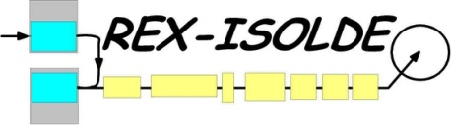
Coulomb Excitation at REX-ISOLDE with MINIBALL
J. Van de Walle for the MINIBALL- and REX-ISOLDE collaborations
OUTLINE
1/ The Experimental Setup
A. (REX-)ISOLDE
B. MINIBALL
2/ Some Physics Cases
A. Shell Model Interest
B. Shape Co-existence

Slide 2
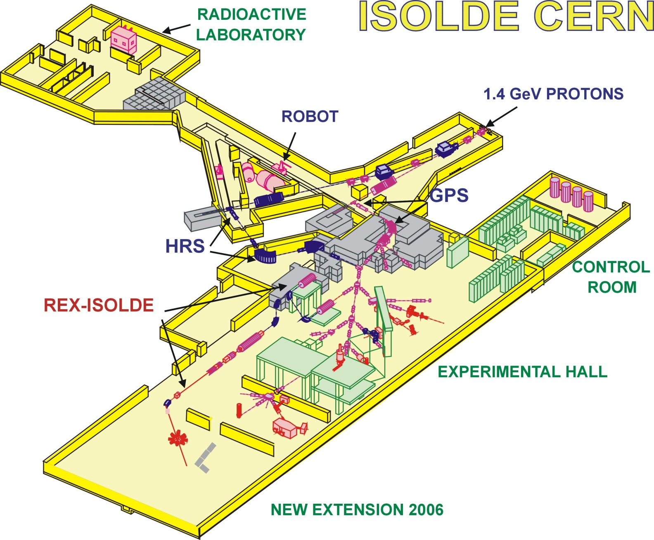
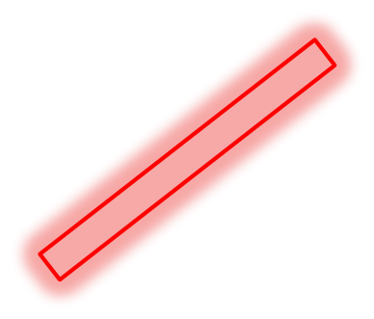

1/ The Experimental Setup : (REX-)ISOLDE
1st post-accelerated beam and Coulomb excitation in 2001

Slide 3
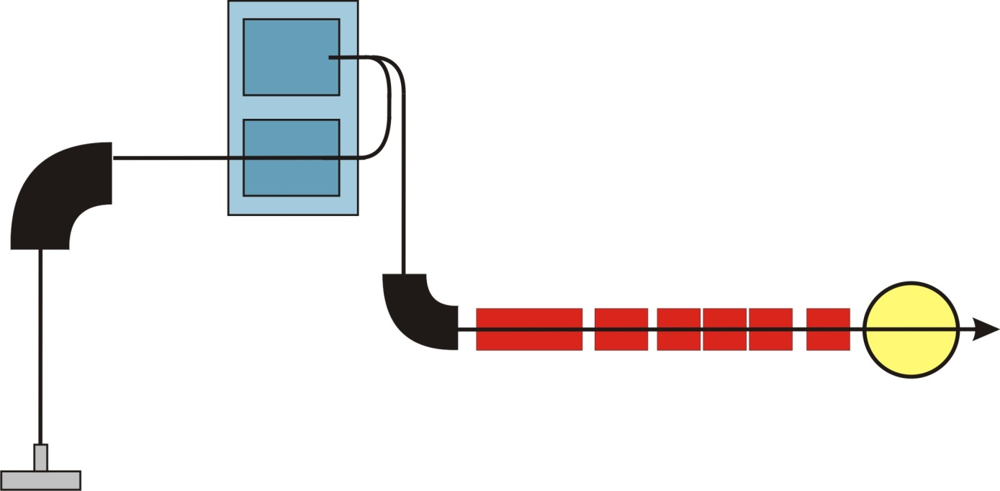
1/ The Experimental Setup : (REX-)ISOLDE
Specific time structure of REX-ISOLDE
EBIS
Mass Separation
(HRS or GPS)
REX
TRAP
REX linear accelerator : ≤ 3 MeV/u
A/q separator
(A/q < 4.5)
Miniball
CERN PS Booster
1.4 GeV protons

Slide 4
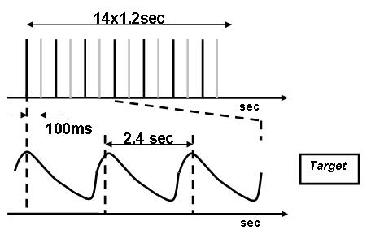

1/ The Experimental Setup : (REX-)ISOLDE
Time Structure
EBIS
REX
TRAP
PSB : 1.4 GeV pulsed proton beam

Slide 5
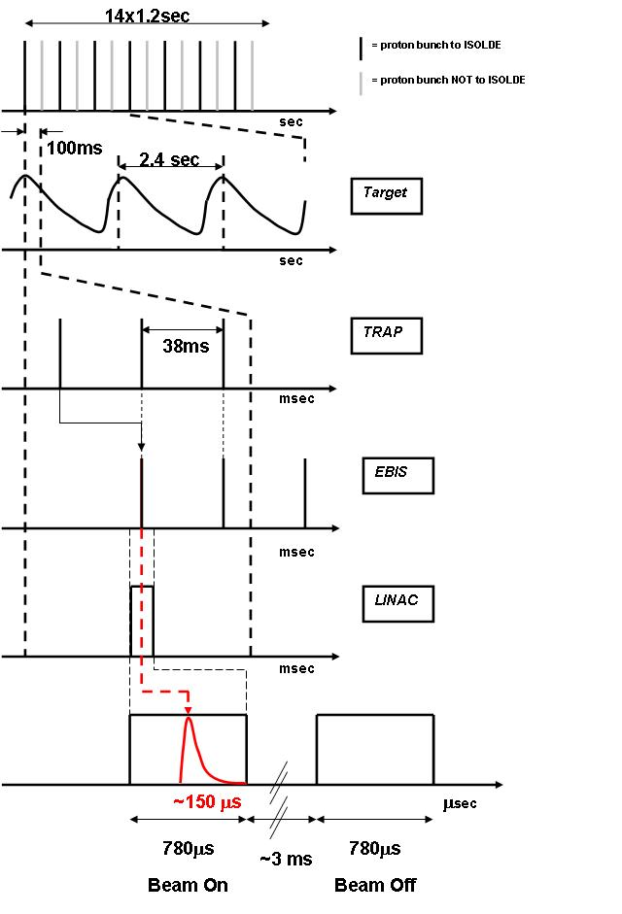
1/ The Experimental Setup : (REX-)ISOLDE
Time Structure
EBIS
REX
TRAP
Trapping
Charge Breeding

Slide 6
1/ The Experimental Setup : (REX-)ISOLDE
Time Structure
EBIS
REX
TRAP
Trapping
1 shift at REX
=
19 min actual measuring time
Charge Breeding
Post Acceleration
Bunched beam : high instantaneous rate !
  deadtime …
Good signal/background …

Slide 7
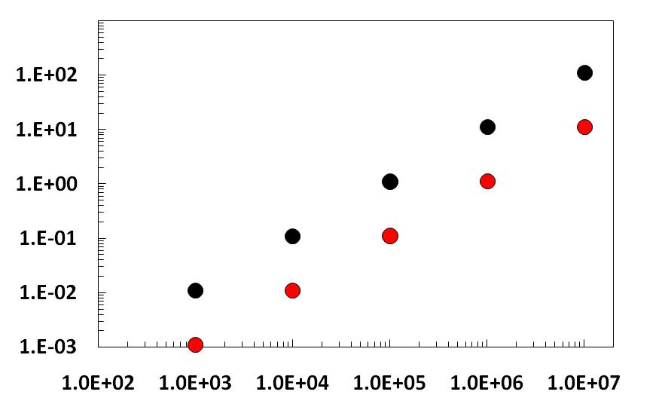
1/ The Experimental Setup : (REX-)ISOLDE
Efficiency and Count Rates
50 Hz
5 Hz
Scattered particles in Silicon
per 10 μsec
Beam intensity [pps]
Bunched beam : high instantaneous rate !
  deadtime …
Good signal/background …

Slide 8
1/ The Experimental Setup : MINIBALL
Efficiency and Count Rates
REX efficiency = 6-16 %
(TRAP+EBIS+A/q = 10-20% Linac transmission = 60-80%)
… depends on mass, A/q, energy … (experience and a bit of luck)
Bunched beam
Good signal/background …

Slide 9
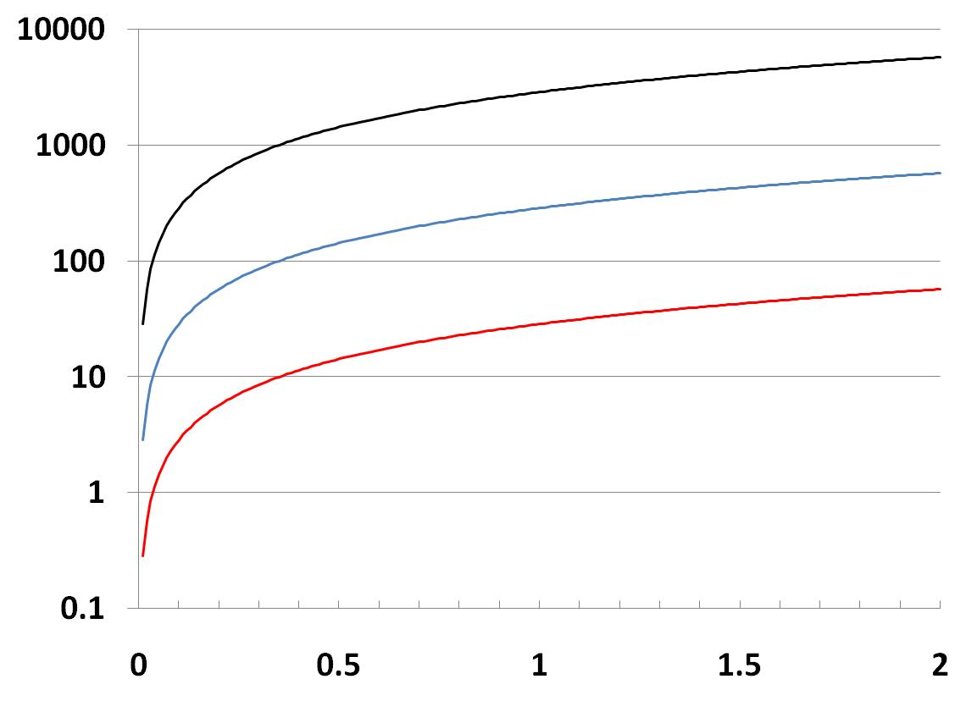
1/ The Experimental Setup : MINIBALL
Efficiency and Count Rates
REX efficiency = 1 % (nowadays very conservative)
10⁵ particles/second
NUMBER OF GAMMA RAYS
OBSERVED PER SHIFT (8h)
10⁴ particles/second
10³ particles/second
CROSS SECTION [barn]
Bunched beam
Good signal/background …
Typically 10% gamma detection efficiency – 2 mg/cm² –
A target = 120 – REX efficiency 1%

Slide 10
1/ The Experimental Setup : MINIBALL
Efficiency and Count Rates
REX efficiency = 1 % (nowadays very conservative)
10⁵ particles/second
NUMBER OF GAMMA RAYS
OBSERVED PER SHIFT (8h)
10⁴ particles/second
10³ particles/second
1 example :
⁸⁰Zn : 0.05 b - 3300 pps – 4 days running – 50 counts
CROSS SECTION [barn]
Bunched beam
Good signal/background …
Typically 10% gamma detection efficiency – 2 mg/cm² –
A target = 120 – REX efficiency 1%

Slide 11
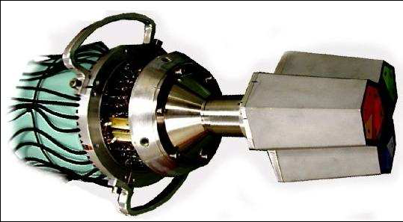
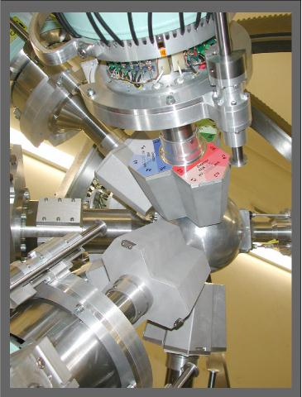
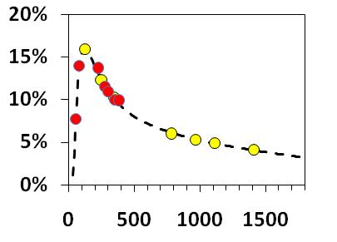
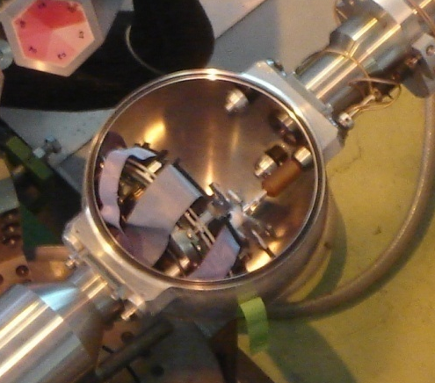
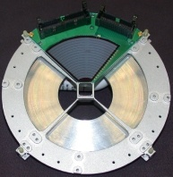
1/ The Experimental Setup : MINIBALL
Absolute Efficiency [%]
Energy [keV]

Slide 12
1/ The Experimental Setup : MINIBALL
9-gap radiation background

Slide 13
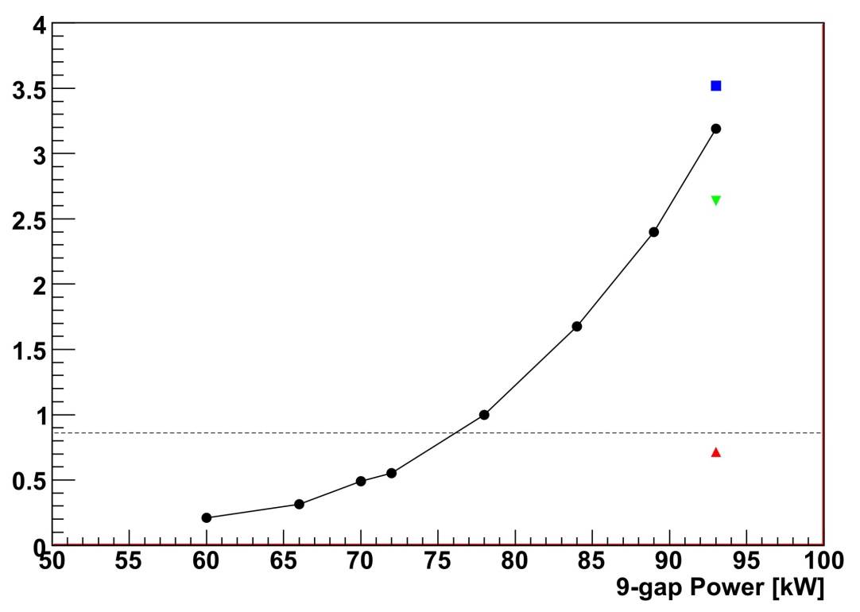
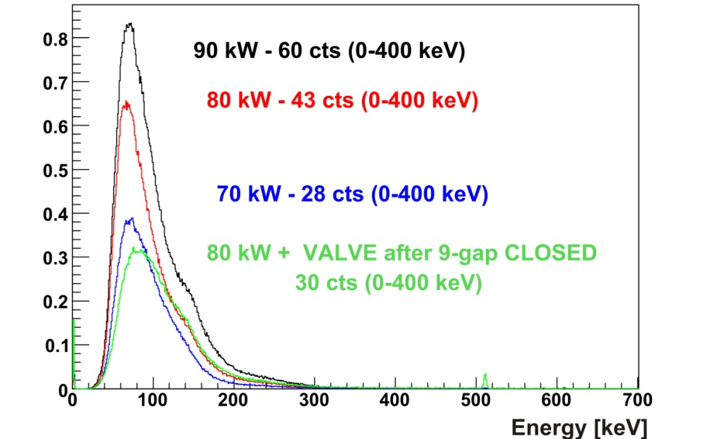
1/ The Experimental Setup : MINIBALL
9-gap radiation background
Counts / Crystal / EBIS pulse
Counts / EBIS pulse
Bunched beam
Good signal/background …
γ-ray energy [keV]

Slide 14
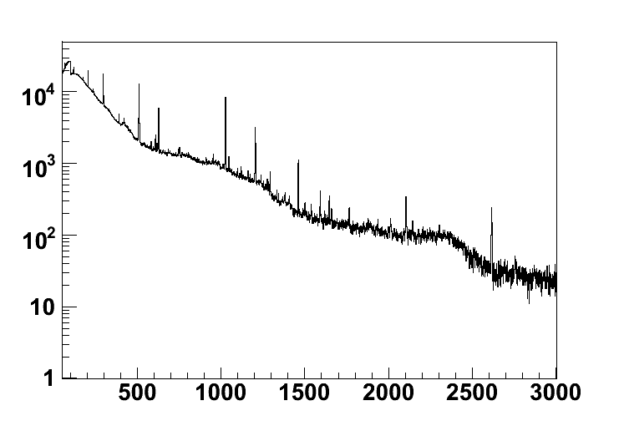
1/ The Experimental Setup : MINIBALL
9-gap radiation background
⁶¹Mn 2.87 MeV/u
Counts
γ-ray energy [keV]

Slide 15
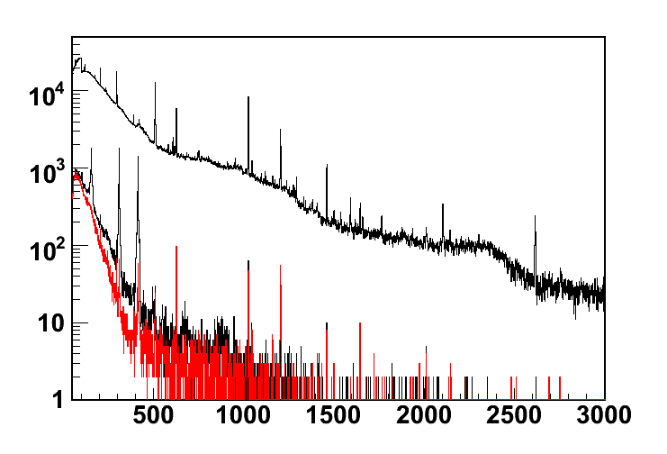
1/ The Experimental Setup : MINIBALL
9-gap radiation background
⁶¹Mn 2.87 MeV/u
Counts
γ-ray energy [keV]

Slide 16
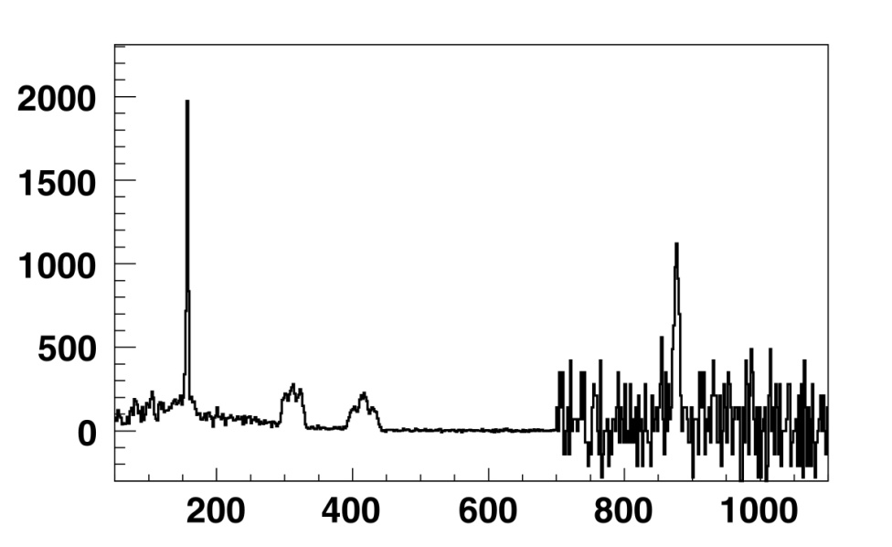
1/ The Experimental Setup : MINIBALL
9-gap radiation background
⁶¹Mn 2.87 MeV/u
Counts
γ-ray energy [keV]
x 70
Counts
γ-ray energy [keV]

Slide 17
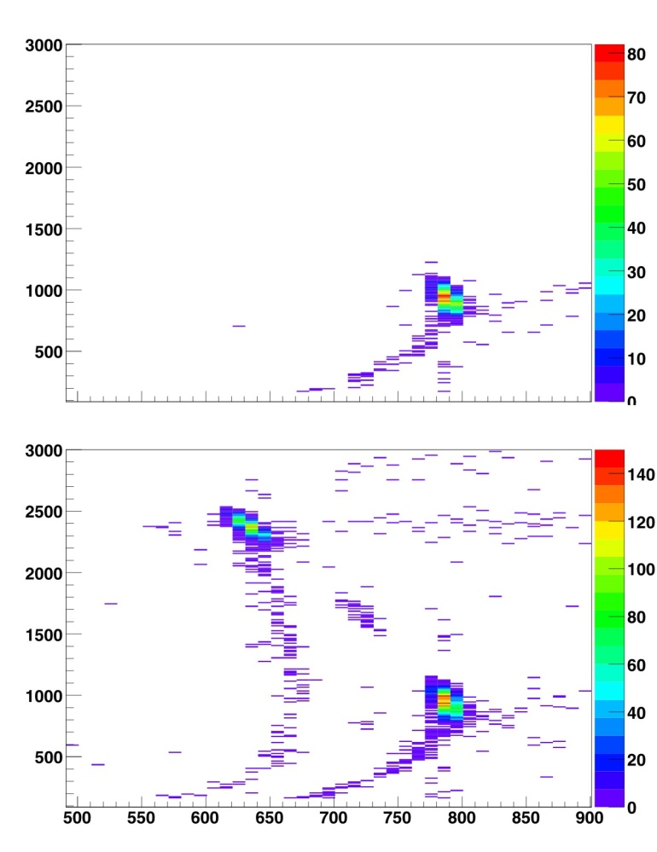
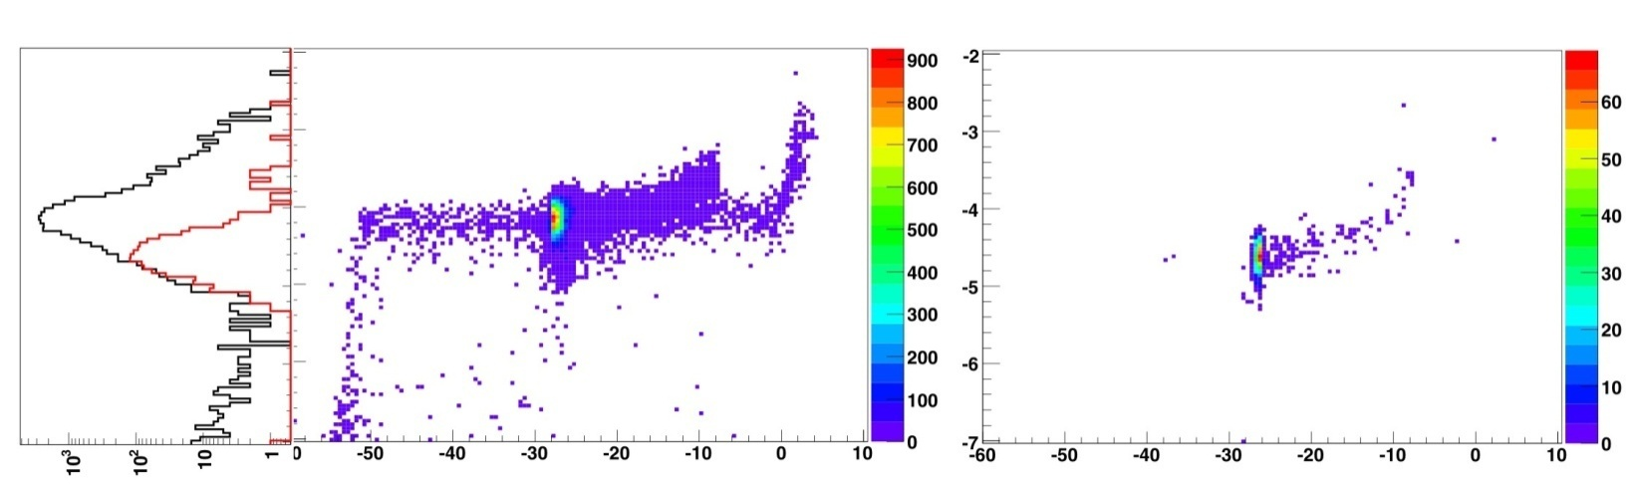
1/ The Experimental Setup : MINIBALL
Beam Diagnostics : Z and A determination
1/ ΔE (gas) – E_{rest} (Si) Telescope (35deg beamline)
No protons - Beamgate open
With protons - Beamgate open
²⁷Na
E_{residual} (Si)
E_{residual} (Si)
²⁷Mg
²⁷Al
²⁷Al
ΔE (gas)
ΔE (gas)
2/ Bragg detector (beamdump Miniball)
with stripper foil after 9-gap
¹⁷O⁸⁺ + ¹⁷F⁸⁺
¹⁷F⁹⁺
~ Z
A
A

Slide 18
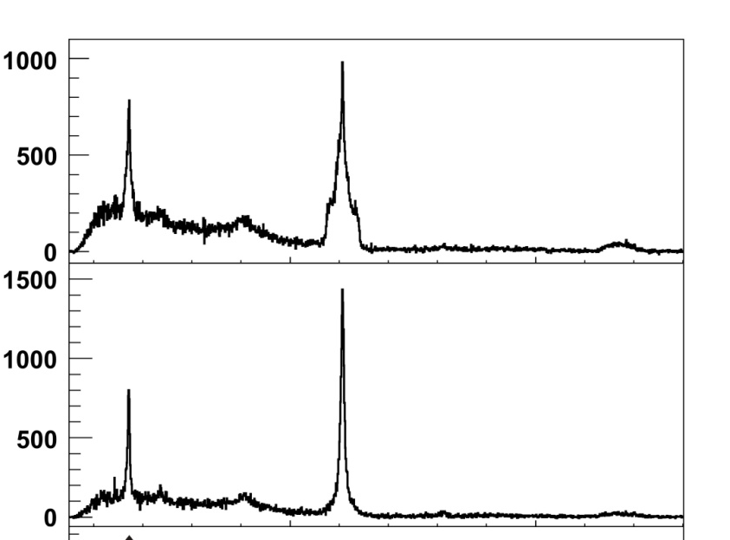
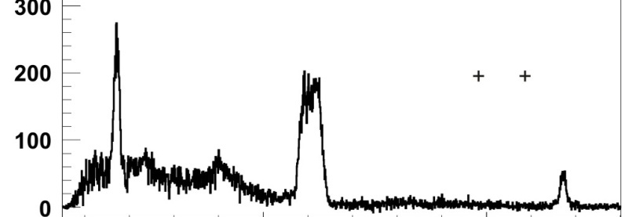

1/ The Experimental Setup : MINIBALL
Determination of B(E2) values
⁷⁴Zn coulex
N_{beam}
N_{target}
Relative measurement
N_{beam} ∼ σ_{beam}(B(E2),Q₂₊,…) unknown
N_{target} ∼ σ_{target}(B(E2),…) known
Counts
Energy
J. Van de Walle et al., submitted to Physical Review C (2008) (⁷⁴⁻⁸⁰Zn coulex)

Slide 19
1/ The Experimental Setup : MINIBALL
Determination of B(E2) values
⁷⁴Zn coulex
N_{beam}
N_{target}
Relative measurement
N_{beam} ∼ σ_{beam}(B(E2),Q₂₊,…) unknown
N_{target} ∼ σ_{target}(B(E2),…) known
!!! possible beam contamination
influences this normalization !!!
Counts
Energy
J. Van de Walle et al., submitted to Physical Review C (2008) (⁷⁴⁻⁸⁰Zn coulex)
Notes:
19

Slide 20
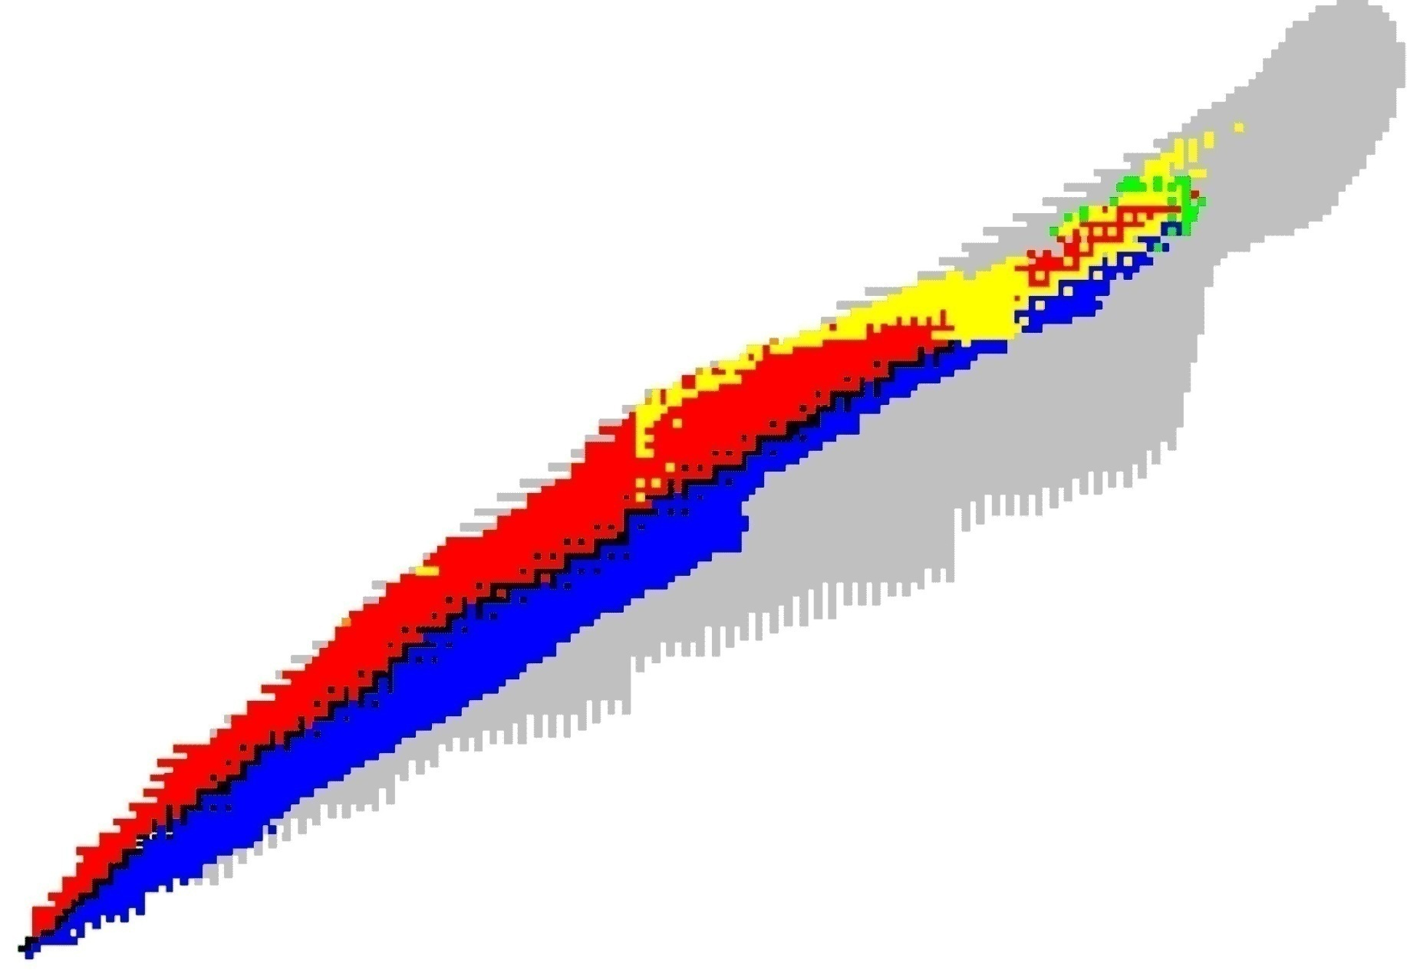
2/ Some Physics Cases : Shell Model Interest
Some physics cases “over the past years” …
Evolution of Shell Structure
the “island of inversion” : ^{30,31,32}Mg (H. Scheit, P. Reiter et al.)
region around ⁶⁸⁻⁷⁸Ni (Z=28, N=40-50) : ⁶⁸Ni, ^{67,69,71,73}Ci, ^{68,70(m)}Cu, ^{74,76,78,80}Zn, ⁶¹Mn, ⁶¹Fe
region around ¹⁰⁰Sn : ^{106,108,110}Sn, ^{100,102,104}Cd (J. Cederkall, A. Ekstrom et al.)
region around ¹³²Sn : ^{138,140,142,144}Xe, ^{122,124,126}Cd, ¹⁴⁰Ba (Th. Kroll, R. Kruecken, Th Behrens et al.)
N=82
Z=82
N=40
N=50
Z=50
^{106,108,110}Sn
^{122,124}Cd
^{138,140}Xe
^{140,148,150}Ba
Z=28
^{74,76,78,80}Zn
^{67,69,71,73}Cu, ⁶⁸Cu, ^{70(m)}Cu
⁶⁸Ni
^{30,31,32}Mg
20

Slide 21
2/ Some Physics Cases : Shell Model Interest
Some physics cases “over the past years” …
Evolution of Shell Structure
the “island of inversion” : ^{30,31,32}Mg (H. Scheit, P. Reiter et al.)
region around ⁶⁸⁻⁷⁸Ni (Z=28, N=40-50) : ⁶⁸Ni, ^{67,69,71,73}Ci, ^{68,70(m)}Cu, ^{74,76,78,80}Zn, ⁶¹Mn, ⁶¹Fe
region around ¹⁰⁰Sn : ^{106,108,110}Sn, ^{100,102,104}Cd (J. Cederkall, A. Ekstrom et al.)
region around ¹³²Sn : ^{138,140,142,144}Xe, ^{122,124,126}Cd, ¹⁴⁰Ba (Th. Kroll, R. Kruecken, Th Behrens et al.)
N=82
Z=82
N=40
N=50
Z=50
^{106,108,110}Sn
^{122,124}Cd
^{138,140}Xe
^{140,148,150}Ba
Z=28
^{74,76,78,80}Zn
^{67,69,71,73}Cu, ⁶⁸Cu, ^{70(m)}Cu
⁶⁸Ni
^{30,31,32}Mg
20

Slide 22
2/ Some Physics Cases : Shell Model Interest
Neutron Rich Cupper isotopes
region around ⁶⁸⁻⁷⁸Ni (Z=28, N=40-50) : ⁶⁸Ni, ^{67,69,71,73}Ci, ^{68,70(m)}Cu, ^{74,76,78,80}Zn, ⁶¹Mn, ⁶¹Fe
50
50
Single particle properties (π2p_{3/2})
Collective properties (νg9/2 filling)
1g_{9/2}
1g_{9/2}
llllllllll
40
40
2p_{1/2}
2p_{1/2}
ll
1f_{5/2}
1f_{5/2}
llllll
2p_{3/2}
l
2p_{3/2}
llll
28
28
1f_{7/2}
llllllll
1f_{7/2}
llllllll
sd-shell
sd-shell
π
ν
J. Van de Walle et al., submitted to Physical Review C (2008) (⁷⁴⁻⁸⁰Zn coulex)
I. Stefanescu et al., Phys. Rev. Lett. 100, 112502 (2008) (^{67,69,71,73}Cu coulex)
N. Bree et al., Phys. Rev. C 78, 047301 (2008) (⁶⁸Ni coulex)
I. Stefanescu et al., Physical Review Letters 98, 122701 (2007) (^{68,70m}Cu coulex)
J. Van de Walle et al., Physical Review Letters 99, 142501 (2007) (⁷⁴⁻⁸⁰Zn coulex)

Slide 23
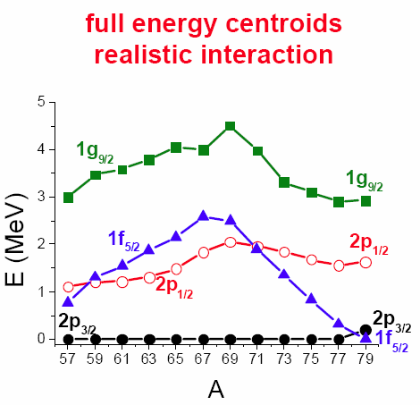
2/ Some Physics Cases : Shell Model Interest
Neutron Rich Cupper isotopes
50
50
Single particle properties (2πp_{3/2})
Collective properties (νg9/2 filling)
Cu isotopes :
1g_{9/2}
1g_{9/2}
llllllllll
40
40
2p_{1/2}
2p_{1/2}
ll
1f_{5/2}
1f_{5/2}
llllll
2p_{3/2}
l
2p_{3/2}
llll
28
28
1f_{7/2}
llllllll
1f_{7/2}
llllllll
sd-shell
sd-shell
π
ν
PhD Thesis A. De Maesschalck, University Gent (2005)
N. Smirnova et al., Phys. Rev. C 69, 044306 (2004).

Slide 24
2/ Some Physics Cases : Shell Model Interest
Neutron Rich Cupper isotopes
50
50
Single particle properties (2πp_{3/2})
Collective properties (νg9/2 filling)
Cu isotopes :
1g_{9/2}
1g_{9/2}
llllllllll
40
40
2p_{1/2}
2p_{1/2}
ll
1f_{5/2}
l
1f_{5/2}
llllll
2p_{3/2}
2p_{3/2}
llll
28
28
1f_{7/2}
llllllll
1f_{7/2}
llllllll
sd-shell
sd-shell
π
ν

Slide 25
2/ Some Physics Cases : Shell Model Interest
Neutron Rich Cupper isotopes
50
50
Single particle properties (2πp_{3/2})
Collective properties (νg9/2 filling)
Cu isotopes :
1g_{9/2}
1g_{9/2}
llllllllll
40
40
2p_{1/2}
l
2p_{1/2}
ll
1f_{5/2}
1f_{5/2}
llllll
2p_{3/2}
2p_{3/2}
llll
28
28
1f_{7/2}
llllllll
1f_{7/2}
llllllll
sd-shell
sd-shell
π
ν

Slide 26
2/ Some Physics Cases : Shell Model Interest
Neutron Rich Cupper isotopes
50
50
Single particle properties (2πp_{3/2})
Collective properties (νg9/2 filling)
Cu isotopes :
1g_{9/2}
l
1g_{9/2}
llllllllll
40
40
2p_{1/2}
2p_{1/2}
ll
1f_{5/2}
1f_{5/2}
llllll
2p_{3/2}
2p_{3/2}
llll
28
28
1f_{7/2}
llllllll
1f_{7/2}
llllllll
sd-shell
sd-shell
π
ν

Slide 27
2/ Some Physics Cases : Shell Model Interest
Neutron Rich Cupper isotopes
50
50
Single particle properties (2πp_{3/2})
Collective properties (νg9/2 filling)
Cu isotopes :
1g_{9/2}
1g_{9/2}
llllllllll
40
40
2p_{1/2}
2p_{1/2}
ll
1f_{5/2}
1f_{5/2}
llllll
7/2⁻
2p_{3/2}
ll
2p_{3/2}
llll
28
28
1f_{7/2}
lllllll
1f_{7/2}
llllllll
sd-shell
sd-shell
π
ν

Slide 28
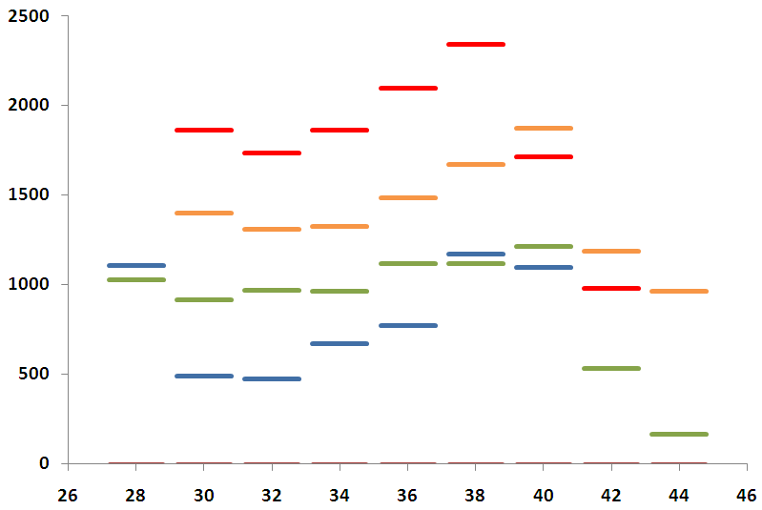
2/ Some Physics Cases : Shell Model Interest
Neutron Rich Cupper isotopes
7/2-
7/2-
5/2-
3/2-
1/2-
Experimental Levels
I. Stefanescu et al., Phys. Rev. Lett. 100, 112502 (2008) (^{67,69,71,73}Cu coulex)

Slide 29
2/ Some Physics Cases : Shell Model Interest
Neutron Rich Cupper isotopes
The observed 1/2⁻ doesn’t seem to be behaving
as a the theoretical single particle level !
7/2-
7/2-
5/2-
3/2-
Experimental Levels !!!
1/2-
I. Stefanescu et al., Phys. Rev. Lett. 100, 112502 (2008) (^{67,69,71,73}Cu coulex)

Slide 30
2/ Some Physics Cases : Shell Model Interest
Neutron Rich Cupper isotopes
The observed 1/2⁻ doesn’t seem to be behaving
as a the theoretical single particle level !
Whereas 5/2- behaves much more “single particle like …”
7/2-
7/2-
5/2-
3/2-
Experimental Levels !!!
1/2-
I. Stefanescu et al., Phys. Rev. Lett. 100, 112502 (2008) (^{67,69,71,73}Cu coulex)

Slide 31
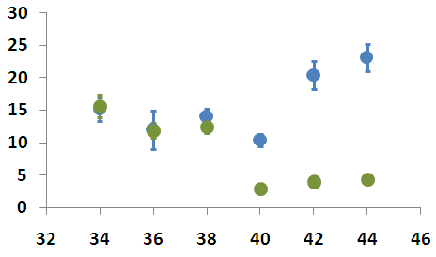
2/ Some Physics Cases : Shell Model Interest
Neutron Rich Cupper isotopes
B(E2,J_{i}→g.s.) [W.u.]
The observed 1/2⁻ doesn’t seem to be behaving
as a the theoretical single particle level !
Whereas 5/2- behaves much more “single particle like …”
Indeed … first indication is B(E2) …
But we need S.F. … !
7/2-
7/2-
5/2-
3/2-
Experimental Levels !!!
1/2-
I. Stefanescu et al., Phys. Rev. Lett. 100, 112502 (2008)
Notes:
31

Slide 32
2/ Some Physics Cases : Shell Model Interest
Neutron Rich Cupper isotopes
7/2-
7/2-
5/2-
3/2-
1/2-
I. Stefanescu et al., Phys. Rev. Lett. 100, 112502 (2008)
Notes:
32

Slide 33
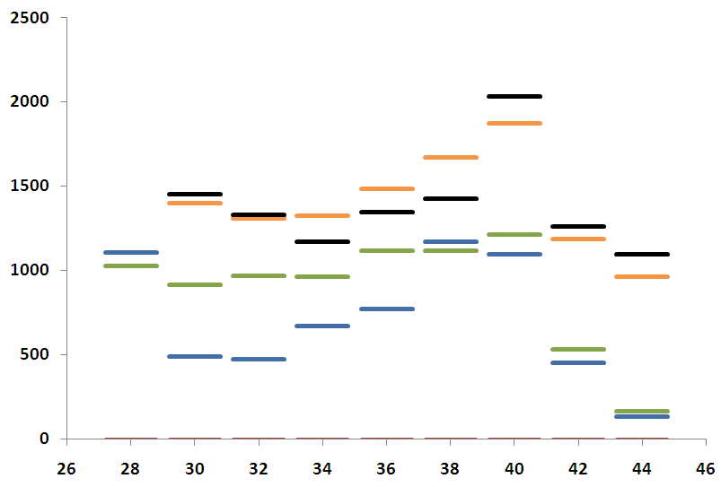
2/ Some Physics Cases : Shell Model Interest
Neutron Rich Cupper isotopes
Nickel 2+ ⊗ 3/2- = 1/2- ,3/2-,5/2-, 7/2-
“weak coupling model”
Nickel J_{i}=2+
7/2-
5/2-
3/2-
1/2-
I. Stefanescu et al., Phys. Rev. Lett. 100, 112502 (2008)
Notes:
33

Slide 34
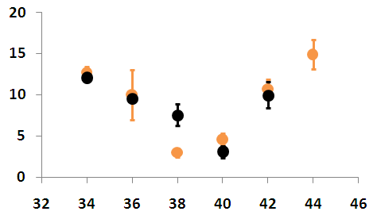
2/ Some Physics Cases : Shell Model Interest
Neutron Rich Cupper isotopes
Nickel 2+ ⊗ 3/2- = 1/2- ,3/2-,5/2-, 7/2-
“weak coupling model”
Nickel J_{i}=2+
7/2-
B(E2,J_{i}→g.s.) [W.u.]
5/2-
3/2-
1/2-
I. Stefanescu et al., Phys. Rev. Lett. 100, 112502 (2008)
Notes:
34

Slide 35
2/ Some Physics Cases : Shell Model Interest
Neutron Rich Zinc isotopes
- UCx + RILIS + quartz line
3E3 pps
4 days running time
2.87 MeV/u on 2.0 mg/cm² ¹⁰⁸Pd
Doppler Correction crucial
J. Van de Walle et al., submitted to Physical Review C (2008)
J. Van de Walle et al., Physical Review Letters 99, 142501 (2007)
Notes:
35

Slide 36
2/ Some Physics Cases : Shell Model Interest
N=50 systematics : B(E2) and E(2+)
Global systematics : B(E2) and E(2+)
J. Van de Walle et al., submitted to Physical Review C (2008)
J. Van de Walle et al., Physical Review Letters 99, 142501 (2007)
Notes:
36

Slide 37
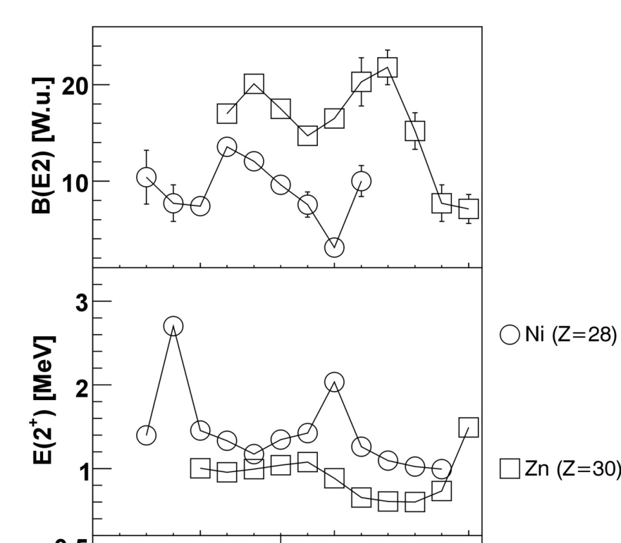
2/ Some Physics Cases : Shell Model Interest
Iron isotopes
Increased collectivity for Z>28 and 38<N<44
50
50
1g_{9/2}
1g_{9/2}
llllllllll
40
40
2p_{1/2}
2p_{1/2}
ll
1f_{5/2}
1f_{5/2}
llllll
Neutron Number
2p_{3/2}
ll
2p_{3/2}
llll
28
28
1f_{7/2}
llllllll
1f_{7/2}
llllllll
sd-shell
sd-shell
π
ν

Slide 38
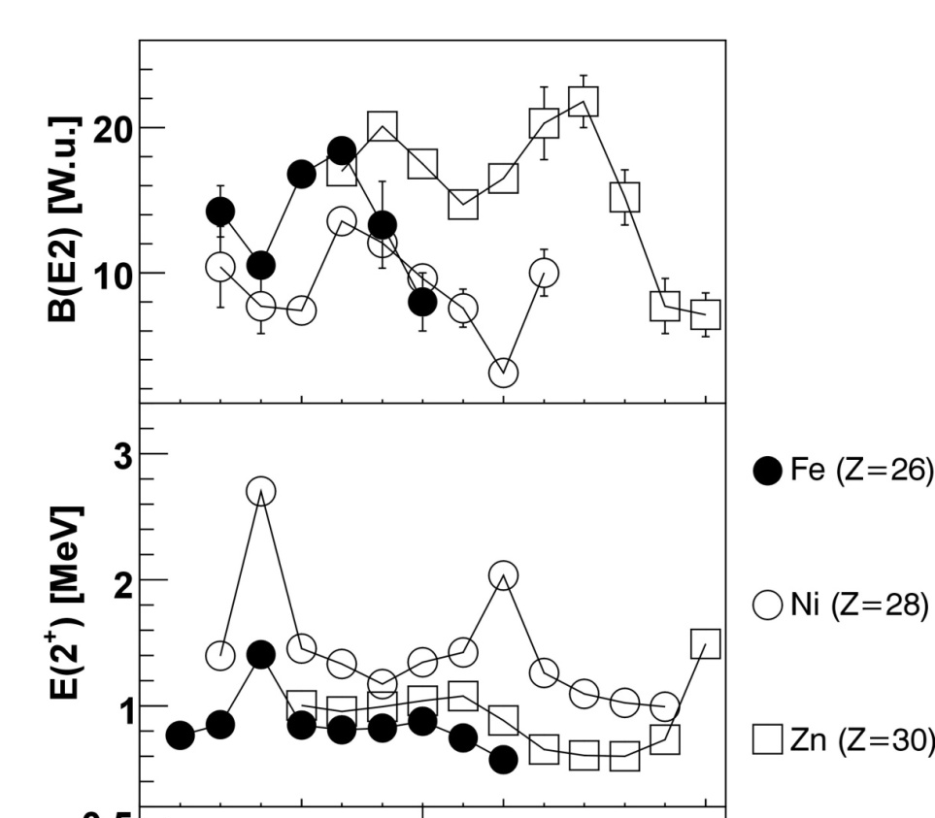
2/ Some Physics Cases : Shell Model Interest
Iron isotopes
Increased collectivity for Z>28 and 38<N<44
ALSO for Z<28, ex. Z=26 (Iron)
And 36<N< ??
50
50
1g_{9/2}
1g_{9/2}
llllllllll
40
40
2p_{1/2}
2p_{1/2}
ll
1f_{5/2}
1f_{5/2}
llllll
Neutron Number
2p_{3/2}
2p_{3/2}
llll
28
28
1f_{7/2}
llllll
1f_{7/2}
llllllll
sd-shell
sd-shell
π
ν

Slide 39
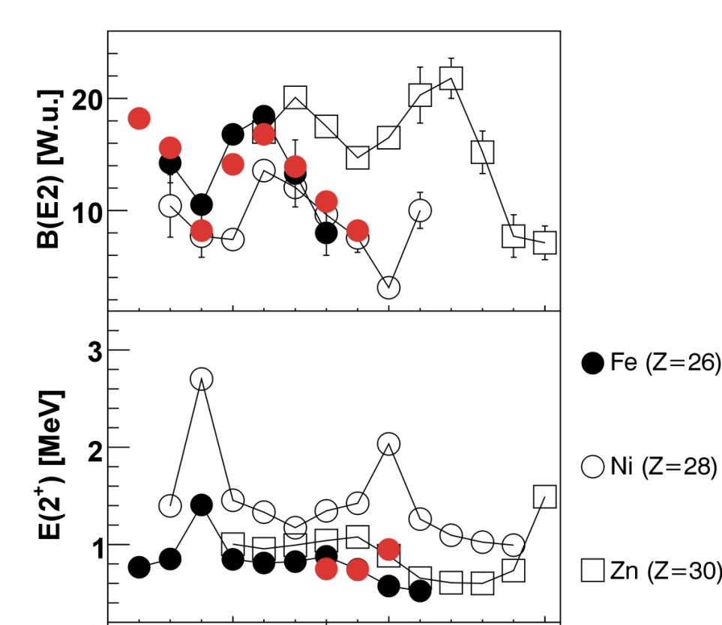
2/ Some Physics Cases : Shell Model Interest
Iron isotopes
Calculations from Caurier et al.
EPJA, 15, 145-150 (2002)
pf-shell (KB3G interaction )
Neutron Number

Slide 40
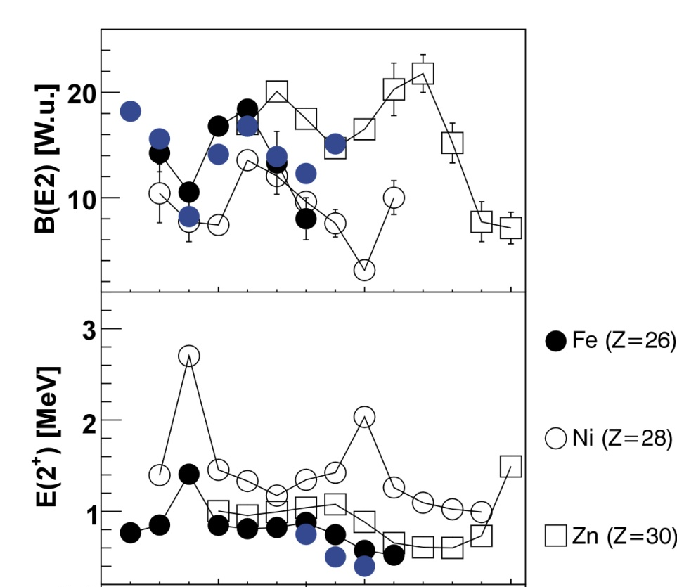
2/ Some Physics Cases : Shell Model Interest
Iron isotopes
Calculations from Caurier et al.
EPJA, 15, 145-150 (2002)
pf-shell (KB3G interaction )
pfgd (⁵²Ca core)
How do the 1g_{9/2} and possibly 2d_{5/2} neutron orbitals influence the quadrupole collectivity below Z=28 ?
Neutron Number

Slide 41
2/ Some Physics Cases : Shell Model Interest
Iron isotopes
Calculations from Caurier et al.
EPJA, 15, 145-150 (2002)
pf-shell (KB3G interaction )
pfgd (⁵²Ca core)
How do the 1g_{9/2} and possibly 2d_{5/2} neutron orbitals influence the quadrupole collectivity below Z=28 ?
Neutron Number
… BUT

Slide 42
2/ Some Physics Cases : Shell Model Interest
Iron isotopes
Calculations from Caurier et al.
EPJA, 15, 145-150 (2002)
pf-shell (KB3G interaction )
pfgd (⁵²Ca core)
How do the 1g_{9/2} and possibly 2d_{5/2} neutron orbitals influence the quadrupole collectivity below Z=28 ?
Neutron Number
… BUT no Fe beam @ ISOLDE …
First test with ⁶¹Mn in-trap decay to ⁶¹Fe

Slide 43
2/ Some Physics Cases : Shell Model Interest
⁶¹Mn,⁶¹Fe
Coulomb excitation ⁶¹Mn
Trapping for 30 ms
Charge Breeding for 28 ms
Notes:
43

Slide 44
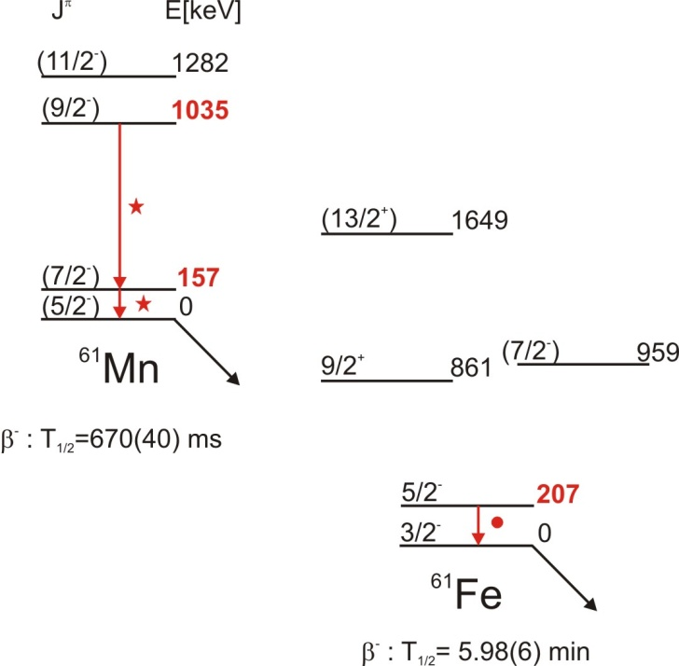
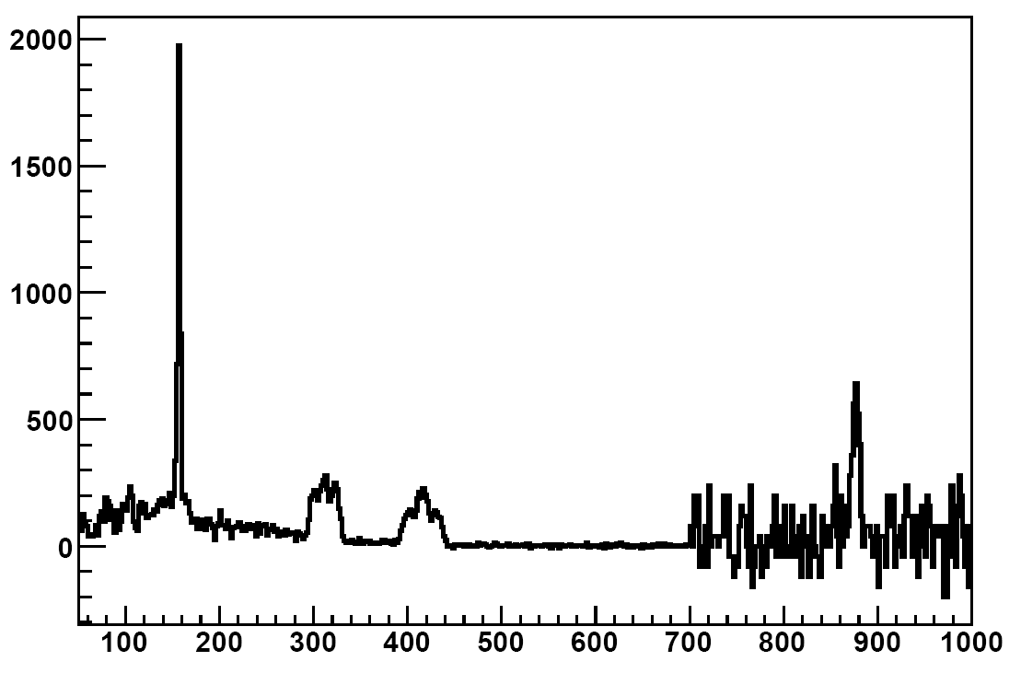
2/ Some Physics Cases : Shell Model Interest
⁶¹Mn,⁶¹Fe
Coulomb excitation ⁶¹Mn
J.J. Valiente-Dobon et al., PRC 78, 024302 (2008)
157 keV : 33(2) W.u. (preliminary)
Counts
⁶¹Mn
Charge breeding time =
Trapping time = 28 ms
- Measuring time = 3.5h
- On average 1x10⁵ pps
⁶¹Mn
¹⁰⁹Ag
312 keV 415 keV
X 40
Energy [keV]
Notes:
44

Slide 45
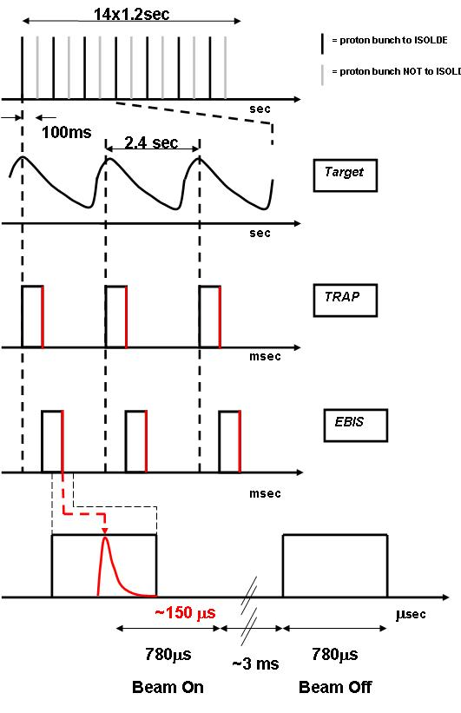
2/ Some Physics Cases : Shell Model Interest
Trapping for 200 ms (up to 900 ms)
Charge Breeding for 28 ms
Notes:
45

Slide 46
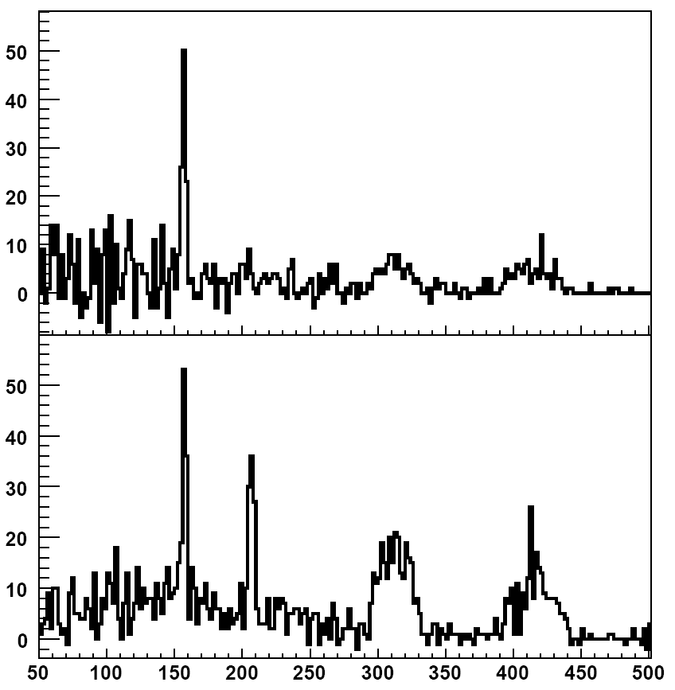
2/ Some Physics Cases : Shell Model Interest
Counts
⁶¹Mn
No ⁶¹Fe coulex ???
Energy [keV]
Notes:
46

Slide 47
2/ Some Physics Cases : Shell Model Interest
Trapping for 200 ms (up to 900 ms)
Charge Breeding for 298 ms
Notes:
47

Slide 48
2/ Some Physics Cases : Shell Model Interest
207 keV : 19(4) W.u. (preliminary)
Counts
⁶¹Mn
⁶¹Fe
Energy [keV]
Notes:
48

Slide 49
2/ Some Physics Cases : Shape Co-existence
Some physics case “over the past years” …
Shape Co-existence
⁷⁰Se and ⁹⁶Sr (A.M. Hurst et al. PRL 98, 072501 (2007), E. Clement et al, 2007))
^{202,204}Rn : A. Robinson, this session
^{182,184,186,188}Hg : A. Petts, this session
N=82
^{182,184,186,188}Hg
Z=82
N=40
N=50
Z=50
⁷⁰Se
⁹⁶Sr
Z=28
20

Slide 50
2/ Some Physics Cases : Shape Co-existence
The Quadrupole Moment
Determining the sign and magnitude of the spectroscopic Quadrupole Moment … How ?

Slide 51
2/ Some Physics Cases : Shape Co-existence
The Quadrupole Moment
Determining the sign and magnitude of the spectroscopic Quadrupole Moment … How ?
Combining lifetime measurements and Coulomb excitation
  ☹ Accurate Lifetime measurement needed (non-trivial for rare isotopes)
  Low statistics in Coulomb excitation

Slide 52
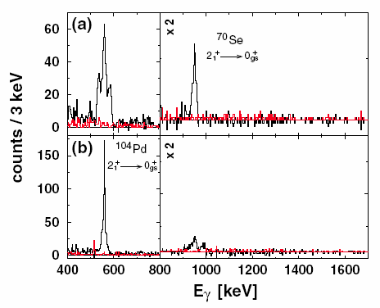
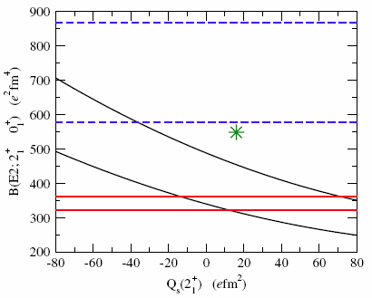
2/ Some Physics Cases : Shape Co-existence
The Quadrupole Moment
Determining the sign and magnitude of the spectroscopic Quadrupole Moment … How ?
Combining lifetime measurements and Coulomb excitation
  ☹ Accurate Lifetime measurement needed (non-trivial for rare isotopes)
  Low statistics in Coulomb excitation
  Ex. : the case of ⁷⁰Se …
A.M. Hurst et al. PRL 98, 072501 (2007)
J. Ljungvall et al. PRL 100, 102502 (2008)

Slide 53
2/ Some Physics Cases : Shape Co-existence
The Quadrupole Moment
Determining the sign and magnitude of the spectroscopic Quadrupole Moment … How ?
Combining lifetime measurements and Coulomb excitation
  ☹ Accurate Lifetime measurement needed (non-trivial for rare isotopes)
  Low statistics in Coulomb excitation
  Ex. : the case of ⁷⁰Se …
A.M. Hurst et al. PRL 98, 072501 (2007)
J. Ljungvall et al. PRL 100, 102502 (2008)

Slide 54
2/ Some Physics Cases : Shape Co-existence
The Quadrupole Moment
Determining the sign and magnitude of the spectroscopic Quadrupole Moment … How ?
Combining lifetime measurements and Coulomb excitation
  ☹ Accurate Lifetime measurement needed (non-trivial for rare isotopes)
  ☺ Low statistics in Coulomb excitation
From the sensitivity to diagonal matrix element in Coulex ( ⇒ Q₂₊= 0.7479 <2⁺||M(E2)||2⁺>)
  No external input needed
  ☹ High statistics needed

Slide 55
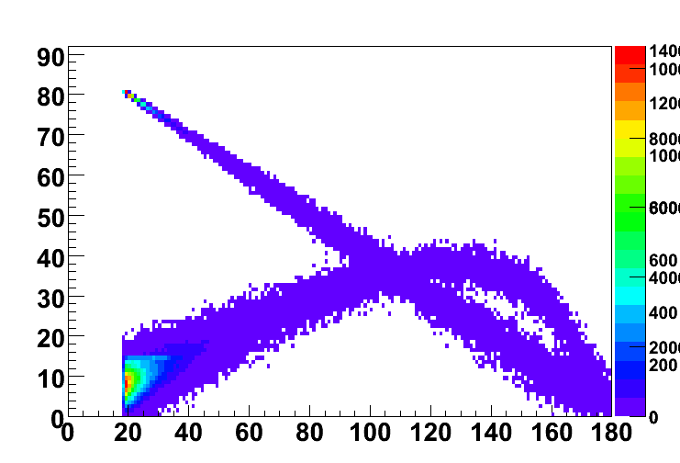
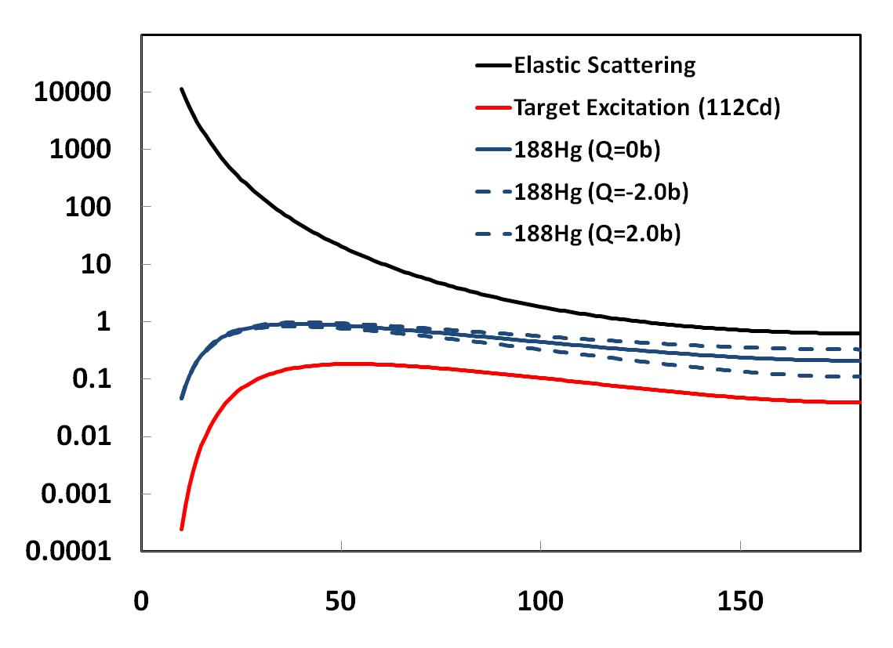
2/ Some Physics Cases : Shape Co-existence
The Quadrupole Moment
Determining the sign and magnitude of the spectroscopic Quadrupole Moment … How ?
Combining lifetime measurements and Coulomb excitation
From the sensitivity to diagonal matrix element in Coulex ( ⇒ Q₂₊= 0.7479 <2⁺||M(E2)||2⁺>)
^{simulation}
LABORATORY angle
Diff Cross Section
(b/srad)
Center-of-mass angle

Slide 56
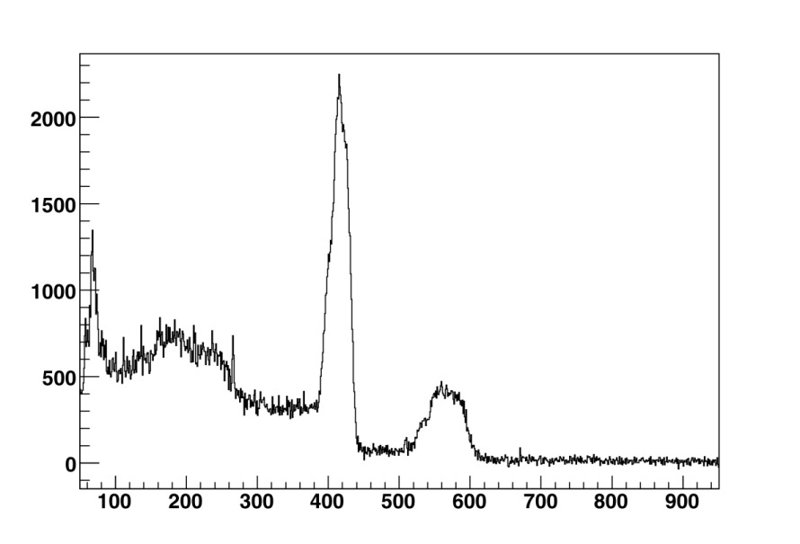
2/ Some Physics Cases : Shape Co-existence
The Quadrupole Moment
Determining the sign and magnitude of the spectroscopic Quadrupole Moment … How ?
Combining lifetime measurements and Coulomb excitation
From the sensitivity to diagonal matrix element in Coulex ( ⇒ Q₂₊= 0.7479 <2⁺||M(E2)||2⁺>)
Highest statistics Coulex ever @ REX
( > 60.000 counts 2⁺→0⁺ )
N. Bree and A. Petts
^{simulation}
413 keV (¹⁸⁸Hg)
LABORATORY angle
592 keV (¹⁸⁸Hg) +
558 keV (¹¹⁴Cd)
counts
Energy [keV]
Diff Cross Section
(b/srad)
1208
4⁺
1005
4⁺
881
2⁺
592
824
0⁺
413
2⁺
413
0
0⁺
Center-of-mass angle

Slide 57
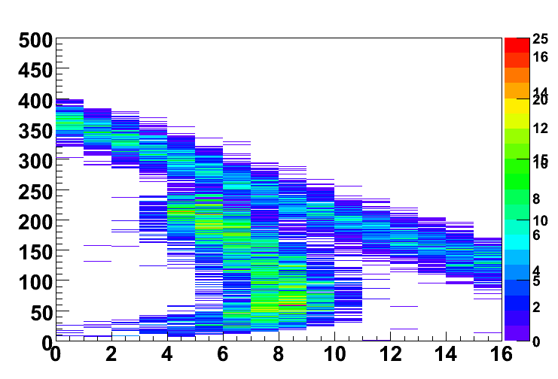
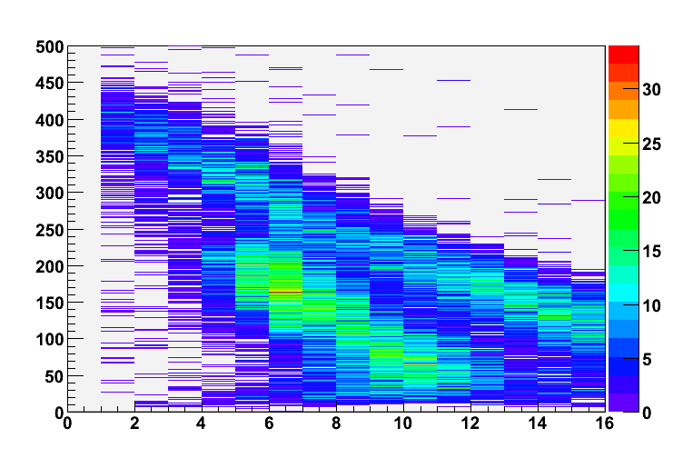
2/ Some Physics Cases : Shape Co-existence
The Quadrupole Moment
Determining the sign and magnitude of the spectroscopic Quadrupole Moment … How ?
Combining lifetime measurements and Coulomb excitation
From the sensitivity to diagonal matrix element in Coulex ( ⇒ Q₂₊= 0.7479 <2⁺||M(E2)||2⁺>)
^{simulation}
^{simulation}
LABORATORY angle
Energy [MeV]
Diff Cross Section
(b/srad)
^{Experiment}
Energy [MeV]
LABORATORY angle (strip number)
Center-of-mass angle

Slide 58
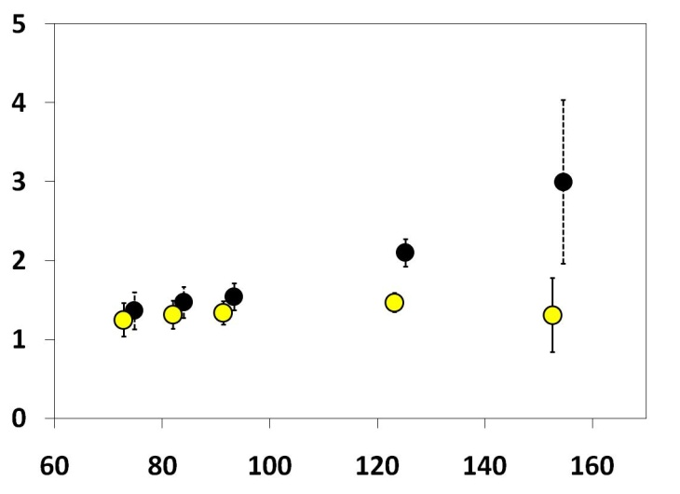
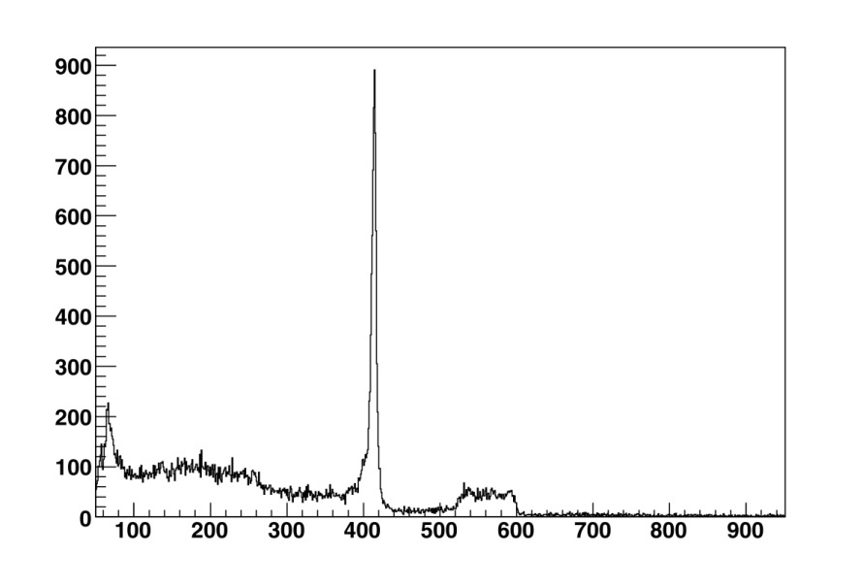
2/ Some Physics Cases : Shape Co-existence
The Quadrupole Moment
Determining the sign and magnitude of the spectroscopic Quadrupole Moment … How ?
Combining lifetime measurements and Coulomb excitation
From the sensitivity to diagonal matrix element in Coulex ( ⇒ Q₂₊= 0.7479 <2⁺||M(E2)||2⁺>)
PRELIMINARY
Analysis by N. Bree (KU Leuven)
Q₂₊ = +1.5 b (oblate)
Q₂₊ = 0 b (spherical)
413 keV (¹⁸⁸Hg)
592 keV (¹⁸⁸Hg) +
558 keV (¹¹⁴Cd)
Diff Cross Section
(b/srad)
1208
4⁺
1005
4⁺
881
2⁺
592
824
0⁺
413
2⁺
413
0
0⁺
Center-of-mass angle

Slide 59
2/ Some Physics Cases : Shape Co-existence
The Quadrupole Moment
Determining the sign and magnitude of the spectroscopic Quadrupole Moment … How ?
Combining lifetime measurements and Coulomb excitation
From the sensitivity to diagonal matrix element in Coulex ( ⇒ Q₂₊= 0.7479 <2⁺||M(E2)||2⁺>)
Coulomb excitation on two different targets
  Choice of targets is difficult
  Statistics in beam excitation on both targets

Slide 60
Conclusions
- 5 successfull experiments this year.
many more to come next year ...

Slide 61
Conclusions
- 5 successfull coulex experiments this year : Mn, Rn, Hg, Cd, Cu ...
physics results have been published and are being prepared for publication
(... not necessarily complete !)
Coulomb excitation of neutron-rich beams at REX-ISOLDE
H. Scheit et al., European Physical Journal A 25, 397-402 (2005)
"Safe" Coulomb Excitation of Mg
O. Niedermaier et al., Physical Review Letters 94, 172501 (2005)
The neutron-rich Mg isotopes: first results from MINIBALL at REX-ISOLDE
O. Niedermaier, et al., Nuclear Physics A 752, 273-278 (2005)
First use of post-accelerated isomeric beams for Coulomb excitation studies of odd-odd nuclei around N=40
G. Georgiev et al., International Journal of Modern Physics E 15, 1505 (2006)
Coulomb Excitation of 88Kr and 92Kr in inverse kinematics
D. Mucher et al., Progress in Particle and Nuclear Physics 59, 361-363 (2007)
Measurement of the Sign of the Spectroscopic Quadrupole Moment for the 2+1 State in 70Se : No Evidence for Oblate Shape
A. Hurst et al., Physical Review Letters 98, 072501 (2007)
Coulomb excitation of the odd-odd nuclei 68,70Cu; first use of post-accelerated isomeric beams
I. Stefanescu et al., Physical Review Letters 98, 122701 (2007)
Sub-Barrier Coulomb Excitation of 110Sn and its Implications for the 100Sn Shell Closure
J. Cederkall et al., Physical Review Letters 98, 172501 (2007)
Coulomb Excitation of Neutron Rich Zn isotopes : First Observation of the 2+1 State in 80Zn
J. Van de Walle et al., Physical Review Letters 99, 142501 (2007)
Interplay between single-particle and collective effects in the odd-A Cu isotopes beyond N=40
I. Stefanescu et al., Phys. Rev. Lett. 100, 112502 (2008)
0+gs→2+1 transition strengths in 106Sn and 108Sn
A. Ekström et al., Phys. Rev. Lett. 101, 012502 (2008)
Coulomb excitation of 68Ni40 at “safe” energies
N. Bree et al., Phys. Rev. C 78, 047301 (2008)
Low Energy Coulomb Excitation of Neutron Rich Zinc isotopes
J. Van de Walle et al., submitted to Physical Review C (2008)
In-Trap Decay of 61Mn and Coulomb Excitation of 61Mn and 61Fe
J. Van de Walle et al., in preparation for Eur. Phys. J. A (2008)
...

Slide 62
Conclusions
- 5 successfull experiments this year.
- physics results have been published and are being prepared for publication
Some online references :
www.miniball.york.ac.uk
isolde.web.cern.ch/ISOLDE
Tests with stable beams (end nov. or 2009)
In-trap decay with REXTRAP under investigation
Transfer reactions using MINIBALL starting now
(see talk Wednesday, V. Bildstein and K. Wimmer)

