Slide 1
Beam-beam Effects in Linear Colliders
Daniel Schulte

Slide 2
Generic Linear Collider
Single pass poses luminosity challenge
Low emittances are produced in the damping rings
They must be maintained with limited degradation
The beam delivery system (BDS) squeezes the beam as much as possible

Slide 3
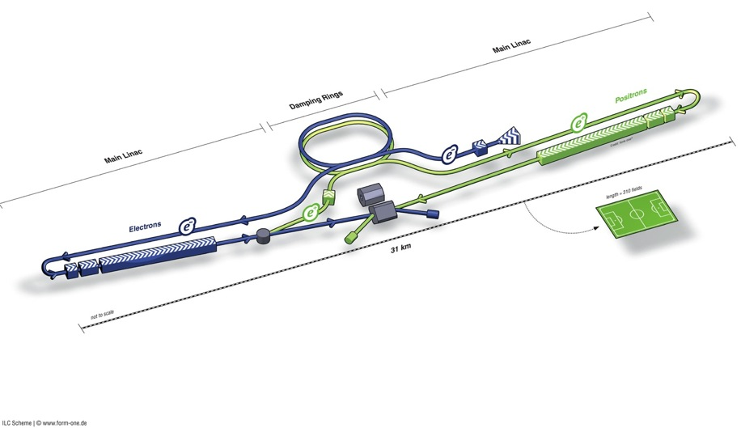
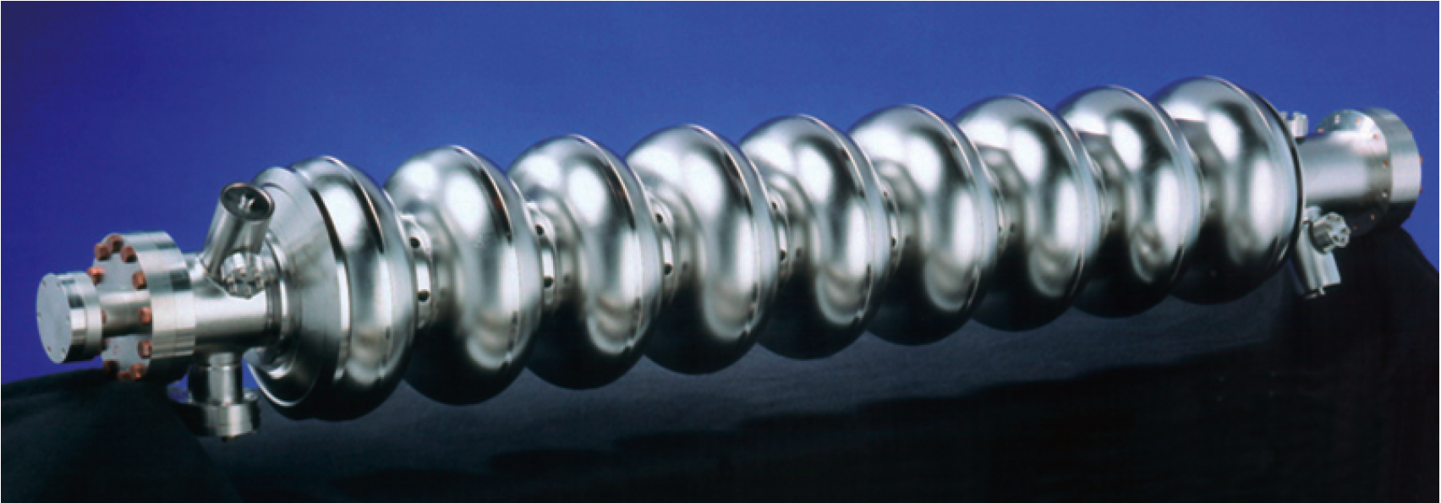
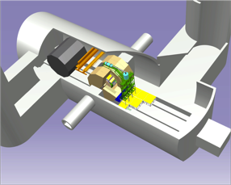
ILC
Damping Rings
BDS (beam delivery system)
Ring to Main Linac (RTML)
(w. bunch compressors)
e+ Main Linac
e- Main Linac
E+ source
Parameters | Value
C.M. Energy | 500 GeV
Peak luminosity | 1.8 x10³⁴ cm⁻²s⁻¹
Beam Rep. rate | 5 Hz
Pulse duration | 0.73 ms
Average current | 5.8 mA (in pulse)
E gradient in SCRF acc. cavity | 31.5 MV/m +/-20% Q₀ = 1E10

Slide 4
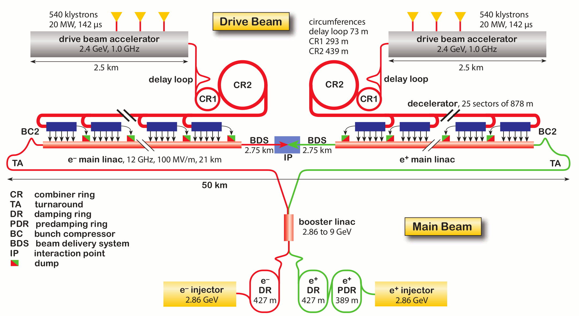
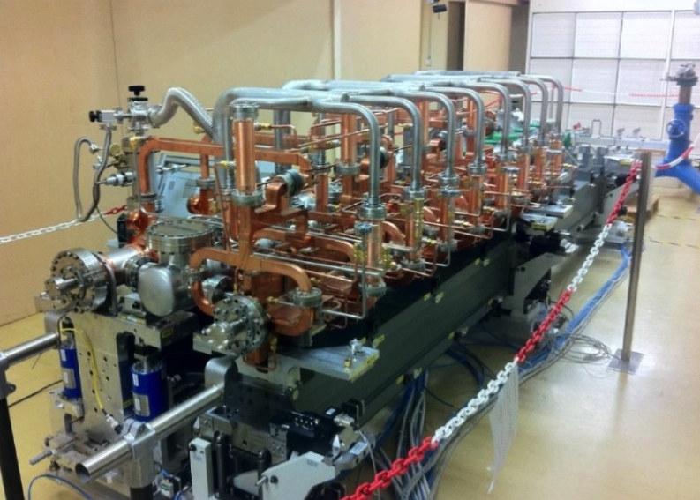
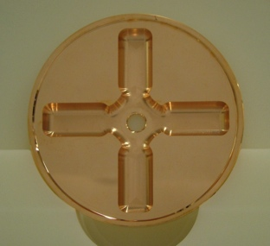
CLIC (at 3TeV)
Drive beam time structure - initial
Drive beam time structure - final
240 ns
240 ns
5.8 μs
140 μs train length - 24 × 24 sub-pulses
4.2 A - 2.4 GeV – 60 cm between bunches
24 pulses – 101 A – 2.5 cm between bunches

Slide 5
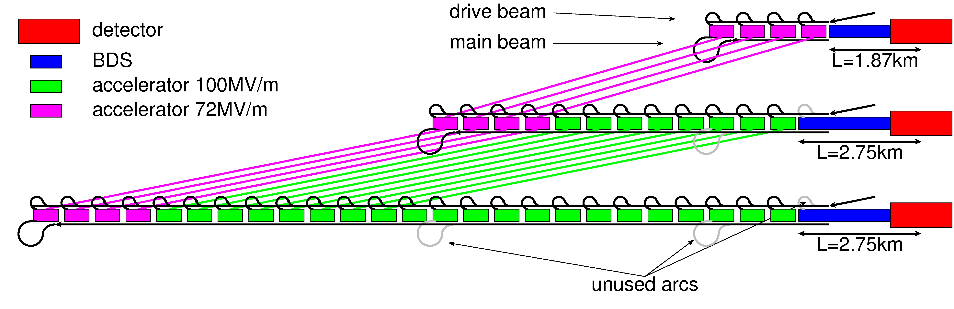
CLIC Staged Approach
  First stage: E_{cms}=380Gev, L=1.5x10³⁴cm⁻²s⁻¹, L_{0.01}/L>0.6
Second stage: E_{cms}=O(1.5TeV)
Final stage: E_{cms}=3TeV, L_{0.01}=2x10³⁴cm⁻²s⁻¹, L_{0.01}/L>0.3

Slide 6
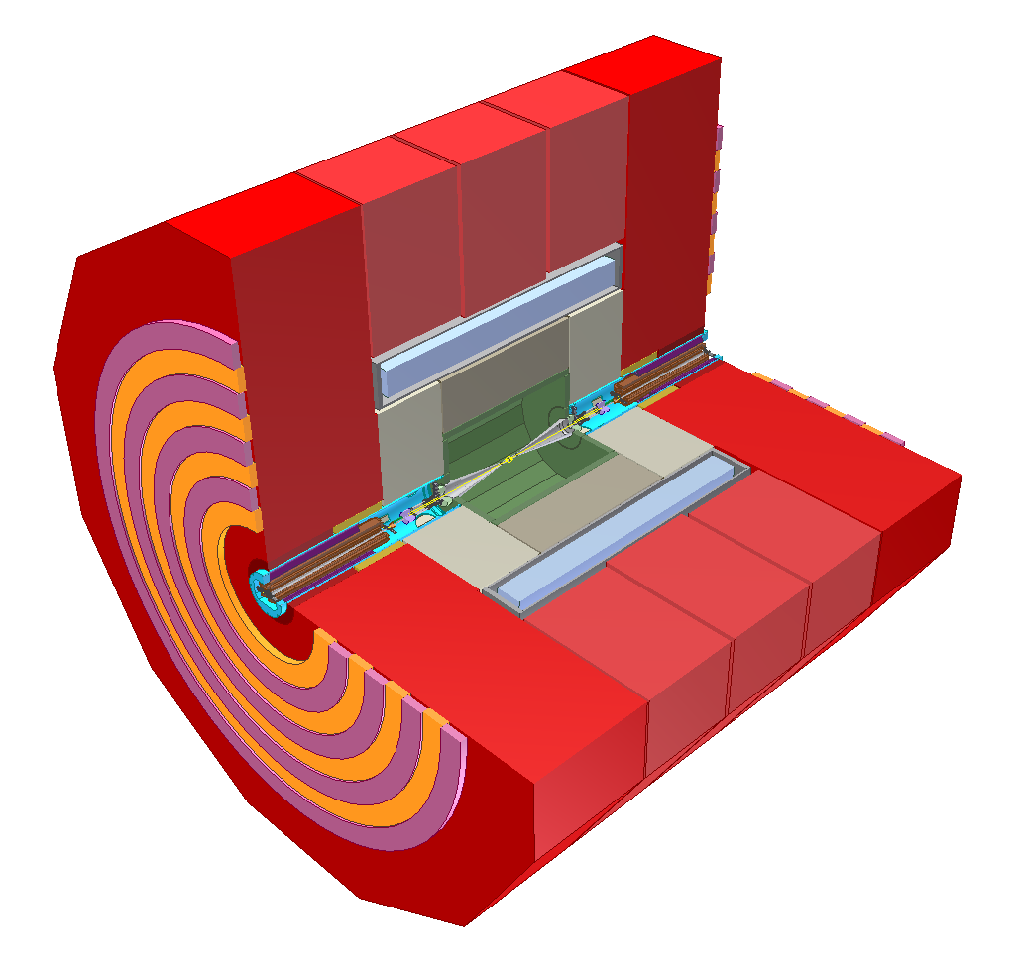
Linear Collider Experiment
10⁹ readout cells
Field return and muon particle identification
Final steering
of nm-size beams
B-field for momentum and charge measurement
Energy measurement of (charged and) neutral particles
6 m
Measure momentum
and charge of charged particles
Measure vertex and
Short-lived particles
L. Linssen

Slide 7
Note: ILC TDR
http://www.linearcollider.org/ILC/Publications/Technical-Design-Report

Slide 8
Note: CLIC CDR
Vol 1: The CLIC accelerator and site facilities
- CLIC concept with exploration over multi-TeV energy range up to 3 TeV
- Feasibility study of CLIC parameters optimized at 3 TeV (most demanding)
- Consider also 500 GeV, and intermediate energy range
- https://edms.cern.ch/document/1234244/
Vol 2: Physics and detectors at CLIC
- Physics at a multi-TeV CLIC machine can be measured with high precision, despite challenging background conditions
- External review procedure in October 2011
- http://arxiv.org/pdf/1202.5940v1
Vol 3: “CLIC study summary”
- Summary and available for the European Strategy process, including possible implementation stages for a CLIC machine as well as costing and cost-drives
- Proposing objectives and work plan of post CDR phase (2012-16)
- http://arxiv.org/pdf/1209.2543v1
In addition a shorter overview document was submitted as input to the European Strategy update, available at:
http://arxiv.org/pdf/1208.1402v1
Input documents to Snowmass 2013 has also been submitted:
http://arxiv.org/abs/1305.5766 and
http://arxiv.org/abs/1307.5288
ILC costing 500 GeV
CLIC costing 500 GeV
8

Slide 9
ILC and CLIC Main Parameters
Parameter | Symbol [unit] | SLC | ILC | CLIC | CLIC
Centre of mass energy | E_{cm} [GeV] | 92 | 500 | 380 | 3000
Geometric luminosity | L_{geom} [10³⁴cm⁻²s⁻¹] | 0.00015 | 0.75 | 0.8 | 4.3
Total luminosity | L [10³⁴cm⁻²s⁻¹] | 0.0003 | 1.8 | 1.5 | 6
Luminosity in peak | L_{0.01} [10³⁴cm⁻²s⁻¹] | 0.0003 | 1 | 0.9 | 2
Gradient | G [MV/m] | 20 | 31.5 | 72 | 100
Particles per bunch | N [10⁹] | 37 | 20 | 5.2 | 3.72
Bunch length | σ_{z} [μm] | 1000 | 300 | 70 | 44
Collision beam size | σ_{x,y} [nm/nm] | 1700/600 | 474/5.9 | 149/2.9 | 40/1
Emittance | ε_{x,y} [μm/nm] | ~3/3000 | 10/35 | 0.95/30 | 0.66/20
Betafunction | β_{x,y} [mm/mm] | ~100/10 | 11/0.48 | 8.2/0.1 | 6/0.07
Bunches per pulse | n_{b} | 1 | 1312 | 352 | 312
Distance between bunches | Δz [ns] | - | 554 | 0.5 | 0.5
Repetition rate | f_{r} [Hz] | 120 | 5 | 50 | 50
There are more parameter sets for ILC and CLIC at different energies
CLIC at 3TeV has higher order optics and radiation effects

Slide 10
Luminosity and Parameter Drivers
Can re-write normal luminosity formula
(note: no crossing angle assumed)
Beam power
Luminosity
spectrum
Beam Quality
(+bunch length)
Somewhat simplified view

Slide 11
Note: Crossing Angle
Have crossing angles
ILC: 14mradian
CLIC: 20mradian
to reduce effects of parasitic crossings
to extract the spent beam cleanly
Luminosity with crossing angle
0.1-0.2
Use crab cavities:
Can ignore crossing angle for beam-beam calculation
But not in detector design

Slide 12
Beam-beam Effect
Bunches are squeezed strongly to maximise luminosity
Electron magnetic fields are very strong
CLIC at 3TeV
Beam particles travel on curved trajectories
They emit photons (O(1)) (beamstrahlung)
L_{0.01}
They collide with less than nominal energy
L
Request from physics
L_{0.01}/L>0.6 below 500GeV
L_{0.01}/L>0.3 at 3TeV

Slide 13
Beam Focusing
Very flat beam
Note: The colliding beams are flat to reduce beamstrahlung, we will see later why
Deflection easy to calculate for
small offset to the axis
no initial angle
negligible change of trajectory
In each plane core of beam is focused to one point
Previous lecture showed

Slide 14
Disruption Parameter
We define the disruption parameters to compare the focal length of the bunch to its length
Particles do not move much in beam
Thin lens approximation is OK
Analytic calculation possible
Weak-strong simulation sufficient
Typical for x-plane
Particles do move in beam
thin lens assumption has been wrong
Analytic calculation tough
Strong-strong simulation required
Typical for y-plane

Slide 15
Typical Disruption
Parameter | Symbol [unit] | SLC | ILC | CLIC | CLIC
Centre of mass energy | E_{cm} [GeV] | 92 | 500 | 380 | 3000
Particles per bunch | N [10⁹] | 37 | 20 | 5.2 | 3.72
Bunch length | σ_{z} [μm] | 1000 | 300 | 70 | 44
Collision beam size | σ_{x,y} [nm/nm] | 1700/600 | 474/5.9 | 149/2.9 | 40/1
Vertical emittance | ε_{x,y} [nm] | 3000 | 35 | 40 | 20
Horizontal disruption | D_{x} | 0.6 | 0.3 | 0.24 | 0.2
Vertical disruption | D_{y} | 1.7 | 24.3 | 12.5 | 7.6
Need to resort to strong-strong simulation

Slide 16
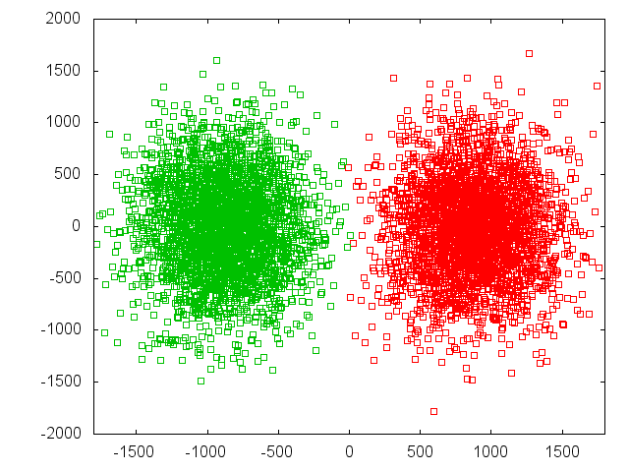
Simulation Codes
Need strong-strong code
CAIN (K. Yokoya et al.)
GUINEA-PIG (D. Schulte et al.)
Beams => macro particles
Beams => slices
Slices => cells
The simulation is performed in a number of time steps in each of them
The macro-particle charges are distributed over the cells
  The forces at the cell locations are calculated
  The forces are applied to the macro particles
  The particles are advanced
X direction
ILC
Z direction
All simulation performed with GUINEA-PIG
Predicted focal points
(for beam centre)

Slide 17
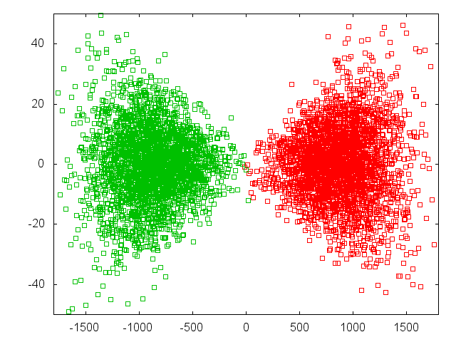
Simulation Codes
Beam-beam force switched off
Need strong-strong code
CAIN (K. Yokoya et al.)
GUINEA-PIG (D. Schulte et al.)
Beams => macro particles
beams => slices
Slices => cells
The simulation is performed in a number of time steps in each of them
The macro-particle charges are distributed over the cells
  The forces at the cell locations are calculated
  The forces are applied to the macro particles
  The particles are advanced
Y direction
Z direction

Slide 18
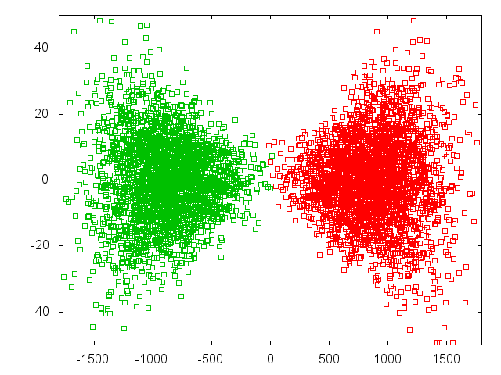
Simulation Codes
Beam-beam force switched off
Need strong-strong code
CAIN (K. Yokoya et al.)
GUINEA-PIG (D. Schulte et al.)
Beams => macro particles
beams => slices
Slices => cells
The simulation is performed in a number of time steps in each of them
The macro-particle charges are distributed over the cells
  The forces at the cell locations are calculated
  The forces are applied to the macro particles
  The particles are advanced
Y direction
Z direction

Slide 19
The Spent Beam
Particles move little in the horizontal plane
Can see the field profile
They start to oscillate in the vertical plane
=> Final angle depends also on the phase that they happen to have at the end of the collision

Slide 20
Beamstrahlung
Similar to synchrotron radiation
From local trajectory curvature calculate critical
Define beamstrahlung parameter Upsilon
Average Upsilon is approximately given by

Slide 21
Beamstrahlung Power Spectrum
Classical regime
Power
[a.u.]
ILC Υ=0.06
CLIC at 380GeV Υ=0.17
Quantum regime
CLIC at 3TeV Υ=5
The spectrum is given by
With modified Bessel functions
and

Slide 22
Photons in the Classical Regime
Number of photons
Dominates L/L_{0.01}
Energy of photons
Defines shape of tail
Determined by beamstrahlung

Slide 23
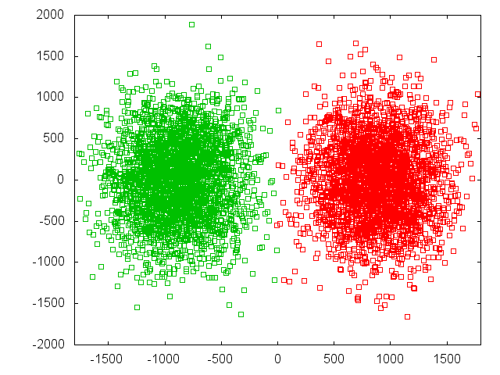
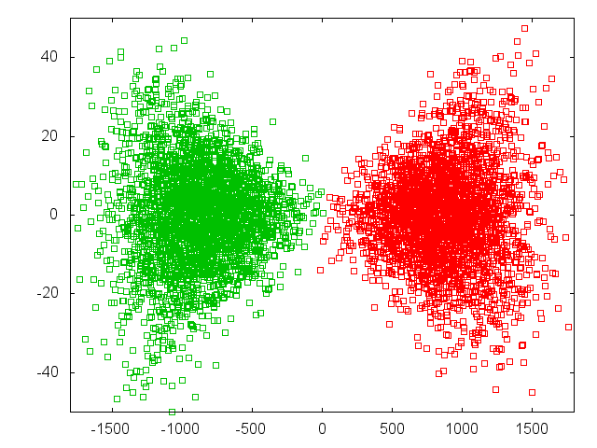
Photon Production
Horizontal plane
Vertical plane

Slide 24
ILC and CLIC Main Parameters
Parameter | Symbol [unit] | ILC | CLIC | CLIC
Centre of mass energy | E_{cm} [GeV] | 500 | 380 | 3000
Total luminosity | L [10³⁴cm⁻²s⁻¹] | 1.8 | 1.5 | 6
Luminosity in peak | L_{0.01} [10³⁴cm⁻²s⁻¹] | 1 | 0.9 | 2
Particles per bunch | N [10⁹] | 20 | 5.2 | 3.72
Bunch length | σ_{z} [μm] | 300 | 70 | 44
Collision beam size | σ_{x,y} [nm/nm] | 474/5.9 | 149/2.9 | 40/1
Vertical emittance | ε_{x,y} [nm] | 35 | 40 | 20
Photons per beam particle | n_{γ} | 1.9 | 1.5 | 2.1
Average photon energy | <E_{γ}/E₀> [%] | 2.4 | 4.5 | 13
Photon numbers and L_{0.01}/L are similar for ILC and CLIC at low energies
Average photon energy does not seem to matter too much for L_{0.01}

Slide 25
Luminosity Spectrum
Luminosity spectrum for ILC,
CLIC at 380GeV looks similar
(beam energy spread is ignored)
Luminosity L_{0.01} above 99% of nominal CMS energy is
L_{0.01}/L = 60%
For CLIC380, this has been the design criterion
But why did the experiments chose L_{0.01}/L > 60%?

Slide 26
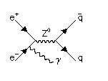
Note: Initial State Radiation
Electrons often emit a photon before the collision
Initial State Radiation
The electron can be replaced by a spectrum of electrons
This yields a luminosity spectrum
About 65% probability of collision with more than 99% of nominal energy

Slide 27
Luminosity Spectrum
Design value
L_{0.01}/L=60%
The total luminosity L varies strongly with beta-function
But L_{0.01} does not change so much
Hard to push beta-functions
That low
So tend to use L_{0.01}/L=60% as criterion
Reasonable compromise for most physics studies

Slide 28
Vertical Beamsize
Using the naïve luminosity calculation with beta-function at the IP we find that the luminosity can be increased by reducing β_{y}
There are two limits:
The lattice design tends to find a practical lower limit a bit below β_{y}=100 μm
CLIC at 3TeV has β_{y}=70 μm but strong geometric aberrations
Not excluded that this can be improved but people worked on it for years
Luminosity actually increases not as predicted

Slide 29
Hourglass Effect
Taking into account hourglass effect
Luminosity does not improve much below β_{y} < σ_{z}
For flat beams, the optimum is around β_{y} = 0.25 x σ_{z}
Note: This is different for round beams

Slide 30
Beam-beam Effects
Including pinch effect
There is an optimum value for beta
For smaller beta-function the geometric luminosity increases but the enhancement is reduced
Small beta-functions lead to
High chromaticity
Optics is difficult
Large divergence
Quadrupole aperture is limited
ILC choice
CLIC choice

Slide 31
Waist Shift
Focusing before IP leads to more luminosity (D.S.)
For CLIC and ILC ~10% luminosity gain

Slide 32
Note: ILC Full Optimisation
For ILC could consider smaller vertical beta-functions
Smaller beta-functions profit more from waist shift
0.24mm seems best
Would gain 15% luminosity
But still more difficult to produce (larger divergence)
And tolerances become tighter

Slide 33
Luminosity and Offset
Luminosity loss for rigid bunches with offset
Actual loss depends strongly on disruption
Note: the simulations suffer from noise (use of macroparticles)
Need to enforce symmetric charge distribution to simulate high disruption
Can you trust the results in real life?

Slide 34
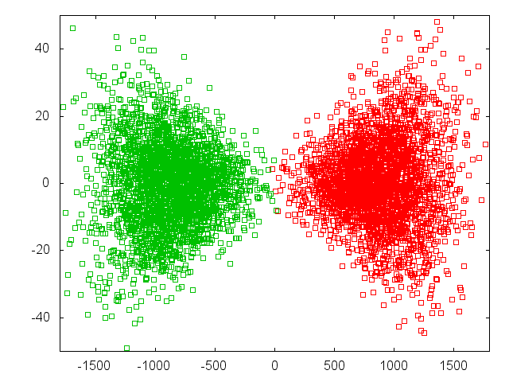
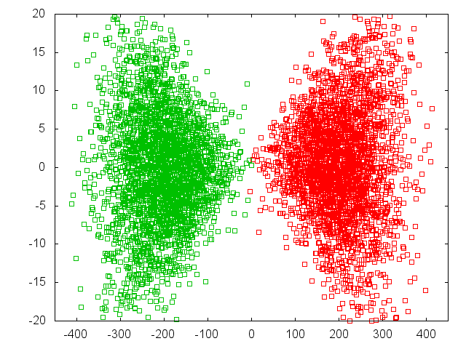
Luminosity and Offset
Luminosity loss for beam offsets depends strongly on disruption parameter
Δy = 0.4 σ_{y}
L = 0.71 L₀ D_{y}~24
L = 0.92 L₀ D_{y}~12
92%
71%
ILC
CLIC

Slide 35
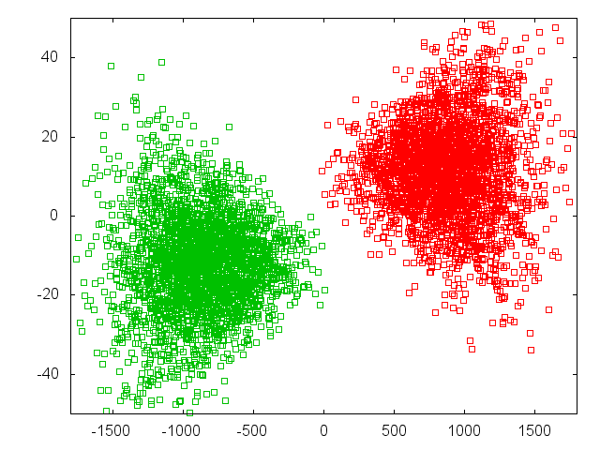
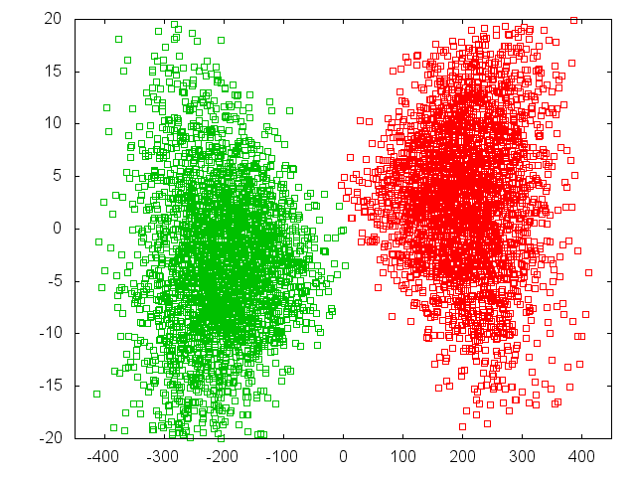
Luminosity and Offset
Luminosity loss for beam offsets depends strongly on disruption parameter
Δy = 2 σ_{y}
L = 0.38 L₀
L = 0.59 L₀
59%
38%
ILC
CLIC at 380GeV

Slide 36
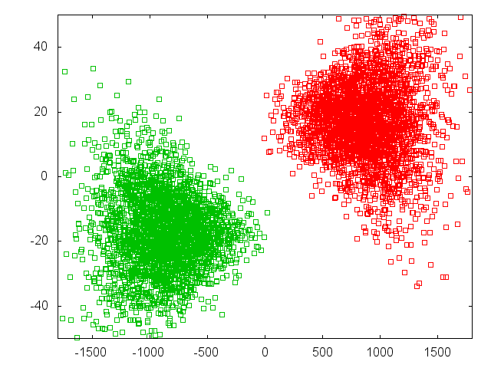
Luminosity and Offset
Luminosity loss for beam offsets depends strongly on disruption parameter
Δy = 4 σ_{y}
L = 0.26 L₀
26%
ILC

Slide 37
Beam-beam Deflection
Strong deflection allows to easily measure and correct offset
In CLIC an offset Δ_{y} = 0.1σ_{y} = 0.1nm
3m downstream of IP 40μm beam offset
Get great signals for the BPMs

Slide 38
Note: The Banana Effect
a) Wakefields+dispersion can create banana-shaped bunch in main linac
b) Do not model with projected emittance
c) The correct shape should be used
For large disruption (ILC) banana can reduce luminosity
Study done for TESLA
Similar disruption as ILC

Slide 39
CLIC 3TeV Beamstrahlung
Goal is to maximise L_{0.01}
And L_{0.01}/L > 0.3
CLIC parameter choice

Slide 40
Coherent Pair Creation
Beam fields in the rest system of a photon can reach the Schwinger Critical Field
The quantum electrodynamics becomes non-linear
A photon in a very strong field can form an electron-positron pair
Coherent pair creation
Produce 6.8x10⁸ pairs
Average particle energy 0.3TeV

Slide 41
Spent Beam Divergence
Beam particles are focused by oncoming beam
Photons are radiated into direction of beam particles
Coherent pair particles can be focused or defocused by the beams but deflection limited due to their high energy
-> Extraction hole angle should be significantly larger than 6mradian
We chose 10mradian for CLIC
-> 20mradian crossing angle
ILC requires 14mradian crossing angle
CLIC

Slide 42
CLIC Inner Detector Layout
The last focusing magnet of the machine is inside of the detector
A. Seiler

Slide 43
CLIC Inner Detector Layout
Increased ratio x/s
10mradian
For the beam
10mradian
To fit the quadrupole

Slide 44
Electron-Positron Pair Production
Colliding photons can produce electron-positron pairs (incoherent pair production)
O(10⁵) per bunch crossing
Note: beamsize effect gives some reduction, ignored here
Also muons can be produced, but small rate

Slide 45
ILC and CLIC Main Parameters
Parameter | Symbol [unit] | ILC | CLIC | CLIC
Centre of mass energy | E_{cm} [GeV] | 500 | 380 | 3000
Total luminosity | L [10³⁴cm⁻²s⁻¹] | 1.8 | 1.5 | 6
Luminosity in peak | L_{0.01} [10³⁴cm⁻²s⁻¹] | 1 | 0.9 | 2
Particles per bunch | N [10⁹] | 20 | 5.2 | 3.72
Bunch length | σ_{z} [μm] | 300 | 70 | 44
Collision beam size | σ_{x,y} [nm/nm] | 474/5.9 | 149/2.9 | 40/1
Vertical emittance | ε_{x,y} [nm] | 35 | 40 | 20
Photons per beam particle | n_{γ} | 1.9 | 1.5 | 2.1
Average photon energy | <E_{γ}/E₀> [%] | 2.4 | 4.5 | 13
Coherent pairs | N_{coh} | - | - | 6.8x10⁸
Their energy | E_{coh} [TeV] | - | - | 2.1x10⁸
Incoherent pairs | N_{incoh} | 196x10³ | 58x10³ | 300x10³
Their energy | E_{incoh} [TeV] | 484 | 187 | 2.3x10⁴

Slide 46
Incoherent Pairs
ϑ₀
r B_{z}
Incoherent pairs can be strongly deflected by the
Maximum deflection angle depends on their energy
Not to scale

Slide 47
Impact on Vertex Detector
To vertex detector can identify particles originating from decays of other particles
Secondary particles
B-meson
Need a certain angular coverage
Hit density from pairs depends on radius and field
Edge is due to beam-beam deflection
Limit O(1mm⁻²)
e⁺
e⁻

Slide 48
Conclusion
Beam-beam effects have critical impact on luminosity in linear colliders
  Strong pinching enhances luminosity
  Simulations tool are important
  Beamstrahlung requires flat beams and gives lower limit on horizontal size
    Has impact on experiment performance
  For high disruption collisions can be unstable
    Very good beam-beam stability is required
  Non-linear QED can appear at high energies
    Beam charge can increase by O(10%)
Machine background poses important constraints on the experiment
  Minimum vertex detector radius is given by beam parameters

Slide 49
Reserve

Slide 50
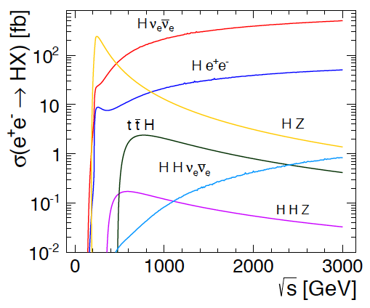
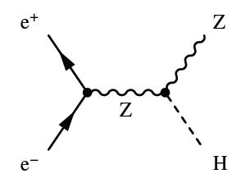
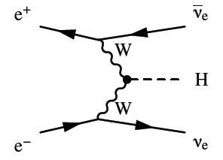
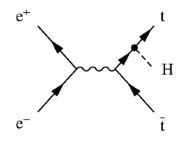
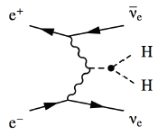

Higgs Physics in e+e- Collisions
Precision Higgs measurements
Model-independent
  Higgs couplings
  Higgs mass
Large energy span of linear colliders allows to collect a maximum of information:
  ILC: 500 GeV (1 TeV)
  CLIC: ~350 GeV – 3 TeV

Slide 51
Invisible Higgs Decays
Can we check that the Higgs does not decay into something invisible, e.g. neutrinos?
Yes, missing mass (or recoil mass) analysis:
1) Measure the Z, e.g. from produced jets
2) Subtract Z momentum from initial state
(E_{cm},0,0,0)-(E_{Z}, P_{Z,x}, P_{Z,y}, P_{Z,z})=(E_{H}, P_{H,x}, P_{H,y}, P_{H,z})
3) Result is mass and momentum of other particle
Even if we do not see it
So we know the missing particle

Slide 52
Automatic Parameter Determination
Structure design fixed by few parameters
a₁,a₂,d₁,d₂,N_{c},φ,G
Beam parameters derived automatically to reach specific energy and luminosity
Consistency of structure with RF constraints is checked
Repeat for 1.7 billion cases
Design choices and specific studies
Use 50Hz operation for beam stability
Scale horizontal emittance with charge to keep the same risk in damping ring
Scale for constant local stability in main linac, i.e. tolerances vary but stay above CDR values
BDS design similar to CDR, use improved β_{x}-reach as reserve
…

Slide 53
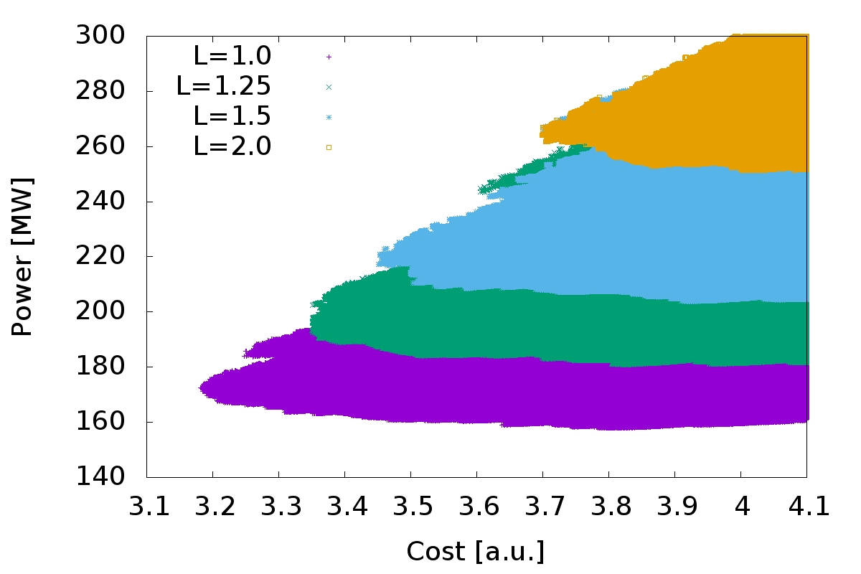
Optimisation at 380GeV
S=1.1
L=1.0x10³⁴cm⁻²s⁻¹
L=1.25x10³⁴cm⁻²s⁻¹
L=1.5x10³⁴cm⁻²s⁻¹
L=2.0x10³⁴cm⁻²s⁻¹
Many thanks to the rebaselining team that provided the models that are integrated in the code
Luminosity goal significantly impact minimum cost
For L=1x10³⁴cm⁻²s⁻¹ to L=2x10³⁴cm⁻²s⁻¹ :
Costs 0.5 a.u.
And O(100MW)
Cheapest machine is close to lowest power consumption => small potential for trade-off

Slide 54
Generic Linear Collider
Power
Physics
Power
Can reach high electron-positron centre-of-mass energies
almost no synchrotron radiation
Single pass, hence two main challenges
gradient
luminosity

Slide 55
Note: Luminosity Enhancement
Parameter | Symbol [unit] | ILC | CLIC | CLIC
Centre of mass energy | E_{cm} [GeV] | 500 | 380 | 3000
Total luminosity | L [10³⁴cm⁻²s⁻¹] | 1.8 | 1.5 | 6
Luminosity in peak | L_{0.01} [10³⁴cm⁻²s⁻¹] | 1 | 0.9 | 2
Particles per bunch | N [10⁹] | 20 | 5.2 | 3.72
Bunch length | σ_{z} [μm] | 300 | 70 | 44
Collision beam size | σ_{x,y} [nm/nm] | 474/5.9 | 149/2.9 | 40/1
Vertical emittance | ε_{x,y} [nm] | 35 | 40 | 20
Geometric luminosity | L_{geom} [10³⁴cm⁻²s⁻¹] | 0.75 | 0.8 | 4.3
Enhancement factor | H_{D} | 2.4 | 1.9 | 1.5

Slide 56
Top Production at Threshold
K. Seidel et al. arXiv:1303.3758
Top production at threshold is strongly affected by beam energy spread and beamstrahlung
For L_{0.01} > 0.6 L impact of beamstrahlung is comparable to ISR
But depends on physics

Slide 57
Note: Travelling Focus
Travelling focus (Balakin):
We focus each slice of the beam on one point of the oncoming beam, e.g. 2σ_{z} before the centre
The beam-beam forces keep the beam small
Additional gain of 10% in luminosity

Slide 58
Note: ILC with β_{y}=0.24mm
Even stronger offset dependence for smaller beta-function
So in practice less gain than expected

