Slide 1
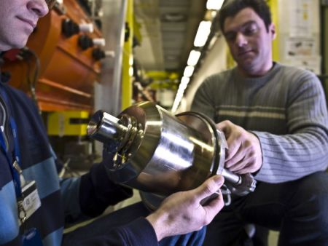
Ion Source and LEBT
Ion Sources
Producing large number of ions
Extraction
Transporting
Protons
H-
Ions
Richard Scrivens, BE Dept, CERN
November 2015
Image Curtesy of PIE Scientific
Notes:
Essential part of Particle Accelerators
Accelerator Designer would like to design accelerator and then give source parameters
Not the case – often the source is the limit, hence the whole chain is a compromise.
Will talk about e and Ion Source.
Will NOT talk about exotic sources (p-, e+, muon, pion etc)

Slide 2
Ion Sources
Producing large number of ions
Extraction
Transporting
Protons
H-
Ions

Slide 3
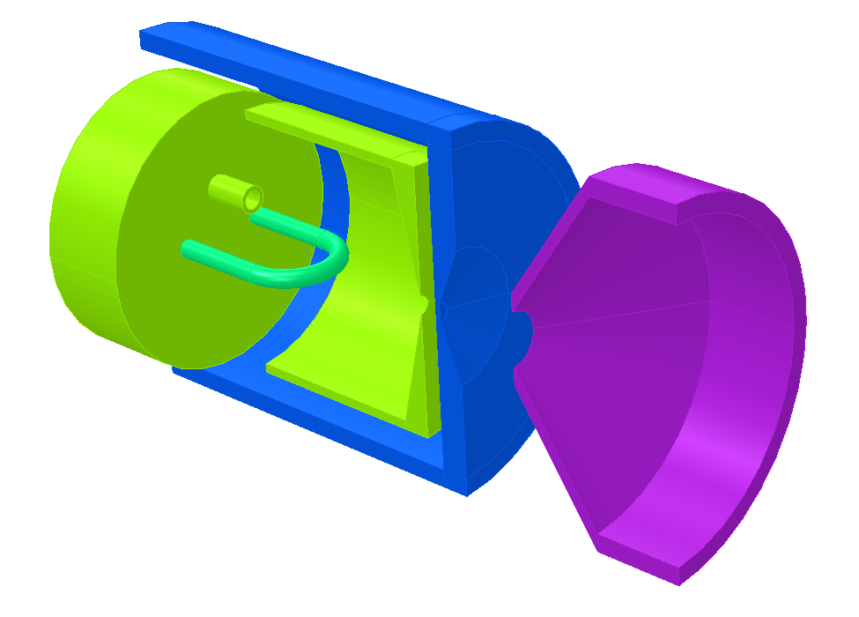
Ion Sources - Basics
An Ion Source requires an “ion production” region and an “ion extraction” system.
In most (but not all) cases, ion production occurs in a plasma.
A plasma or discharge chamber
A hole to let the ions out!
Material input
Power to create a plasma / discharge
An extraction system

Slide 4
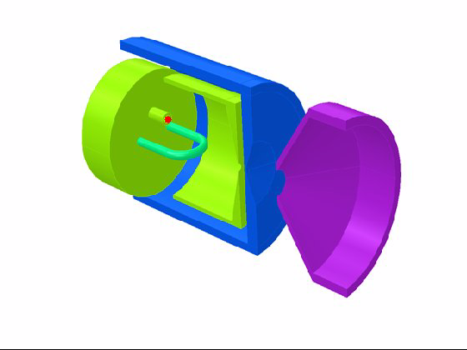
Ion Sources - Basics

Slide 5
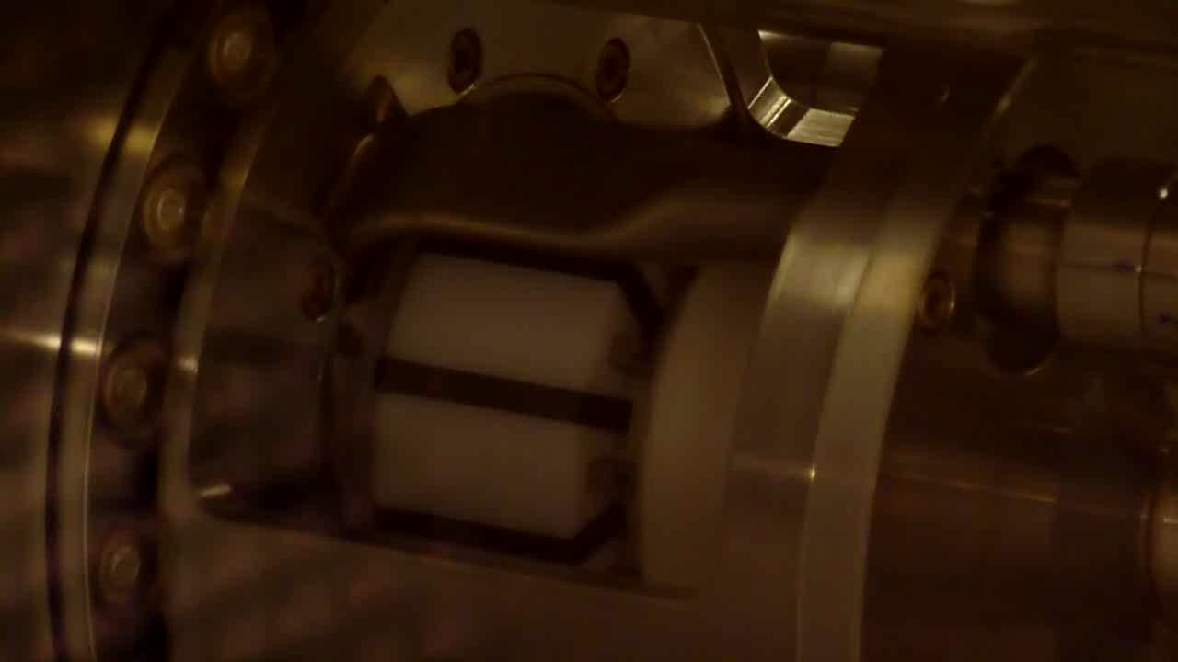
Ion Sources - Basics
Hydrogen plasma (for protons or H-) from an RF source.
Hydrogen plasma emits a pink light from an atomic transition.

Slide 6
Ion Sources
Producing large number of ions
Extraction
Transporting
Protons
H-
Ions

Slide 7
How do we assess intensity?
Source and Linac experts usually think of beam intensity in electrical current terms.
High intensity beams for particle accelerators are of the order of 100mA = 6x10¹⁷ 1+ charges per second.
Multiply-charged ions have fewer ions for the same electrical current. Sometimes particle Amps are used (pA) where the electrical current is divided by the charge state.
When injecting into a synchrotron, the beam is only useful for a fraction of the synchrotron cycle.
The beam emittance is first formed at the ion source, and can be critical for some applications.
The minimum emittance of the source is limited by the aperture (r), and the ion temperature in the plasma (T_{i})
Smallest possible emittance from a plasma

Slide 8
Plasma Density Limitations
Particle accelerators must work under vacuum, whereas ion sources need a gas (or a vapour).
For protons (or H-) we have to start with H2 gas.
It is not very feasible to operate on ion source above 1mbar gas pressure and keep the following accelerator under vacuum.
N_{molecules} @1mbar = 2.7x10¹⁶ /cm³
The plasma density is limited by many processes:
  Increased plasma density leads to higher ion losses.
  Increase plasma heating raises plasma temperature, increasing losses.
  Increased plasma heating (electrons) can eventually reduce cross section for ion production.

Slide 9
Plasma Density Limitations
The plasma density is limited by many processes:
  Increased plasma density leads to higher ion losses.
  Increase plasma heating raises plasma temperature, increasing losses.
  Increased plasma heating (electrons) can eventually reduce cross section for ion production.
Wall
Unequal velocities (faster electrons), plasma charges to produce a positive potential in the plasma – ions are lost fast to the walls.
n v_{i}
n v_{i}
n v_{i}
n v_{e}
n v_{e}
n v_{e}
Unequal velocities not a problem

Slide 10
Ion Sources – Electron Impact Ionization
In many ion sources we use electron impact ionization.
We need to create electrons, accelerate them to a few times the ionization potential of the material, and get them to interact with atoms.
Ionization Cross Section by Electron Impact
Alternative methods for ion generation are:
Photo-ionization
Surface interactions.
R. Rejoub, B. G. Lindsay, and R. F. Stebbings, Phys. Rev. A 65, 042713 (2002)
Except H: Y.-K. Kim and M.E. Rudd, Phys. Rev. A 50, 3954 (1994)
The plot shows the cross section for ionization by electron impact on a selection of neutral atoms, as a function of the impacting electron energy.
There is a minimum required electron energy (the ionization energy of the ion) and the cross section peaks at approximately 3x this energy.

Slide 11
Ion Sources
Producing large number of ions
Extraction
Transporting
Protons
H-
Ions

Slide 12
Extraction – Child Langmuir
Child-Langmuir law (3/2 power law) gives the limit of current density that can be removed from a surface.
Well adapted to electrons extracted from a cathode, but also relevant for the extraction of ions.
Need electric field to remove electrons from surface.
Electrons set up their own space charge field.

Slide 13
Extraction – Child Langmuir
These electrons create an electric field
;
That repels these electrons
CATHODE
ANODE
;
v
E

Slide 14
Extraction – Child Langmuir
E = initially applied E field
Current density is limited (e.g. protons ~600mA/cm²).
Increase the aperture to increase the current.
Requires a larger plasma and more power.
Increases the emittance.
Increase the field.
Plasmas lead to lots of neutrals, charge particles and UV light, all bad for high voltages.
RF fields cannot be used for acceleration
  βλ of the source RF cavity would be too short for plasma ions.
  Plasma electrons need to be heavily suppressed by magnetic fields.

Slide 15
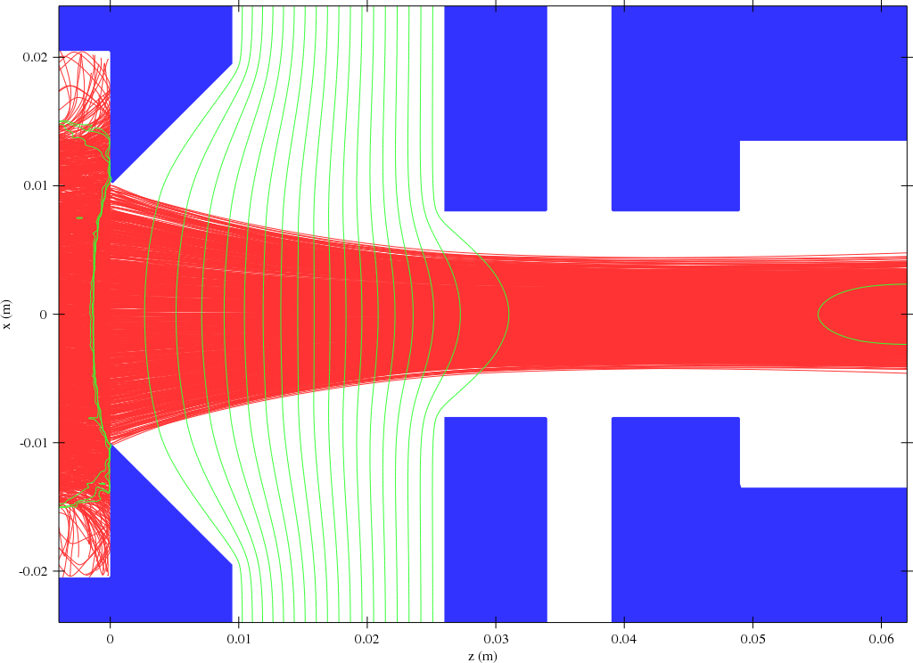
Extraction – Child Langmuir
Real life source do not use parallel plates. The ions have to come out of an open hole.
The ions also have to transit from a plasma (where the space charge is shielded by electrons) to the beam, where electrons have been removed.
Shaping the extraction system electrodes can give a focusing force to compensate for the transverse space charge forces.

Slide 16
Ion Sources
Producing large number of ions
Extraction
Transporting
Protons
H-
Ions

Slide 17
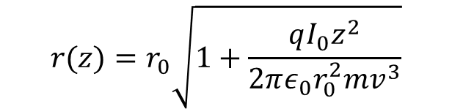
Low Energy Beam Transport
Direct space charge becomes very strong at low energy.
We can estimate the effect using a simple beam space charge growth equation (approximate equation, uniform density cylindrical beam, non-relativistic).
$$r(z)=r_{0}\sqrt{1+\frac{qI_{0}z^{2}}{2πε_{0}r_{0}^{2}mv^{3}}}$$

Slide 18
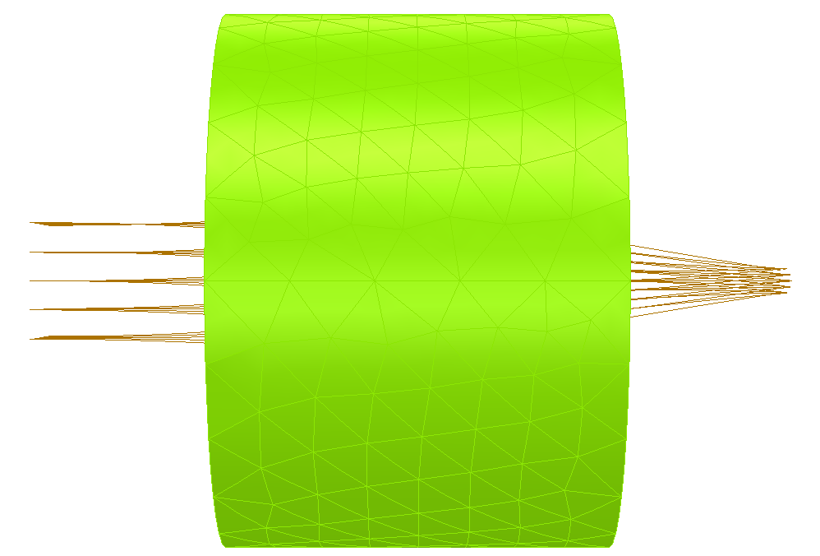

LEBT - Focusing
Overcoming the space charge requires strong focusing.
This can be supplied by solenoids, focusing in H+V planes simultaneously.
The solenoid also couples the planes.
  Not a problem if the beam is circularly symmetric.
  or constrains the rotation of the beam to nπ/2 .

Slide 19
LEBT – Space Charge Compensation
Space charge compensation can be used to reduce the strength of the self induced electric field.
It can be done in several ways, e.g. :
  Capture particles of the opposite charge in the beam.
  Co-propagate (forwards or backwards) an opposite charge beam.
  Use a compensating electrode/wire.
E
V
V
e.g. Gas atom ionized by beam
Co-propagated beam
Compensating wire

Slide 20
LEBT – Space Charge Compensation
The most commonly used technique is rest gas compensation.
The time to produce the same compensating particle density, as the beam density is:
This is the characteristic time, but does not tell the whole story.
Cross sections can be difficult to find for some beam-target combinations (some in http://www-cfadc.phy.ornl.gov/redbooks/one/1.html ORNL CFADC redbooks).
Electrons from chamber walls are also a important source.
τ time to accumulate full compensation
n_{g} gas density
v_{b} beam velocity
σ_{bi} cross section beam ionization

Slide 21
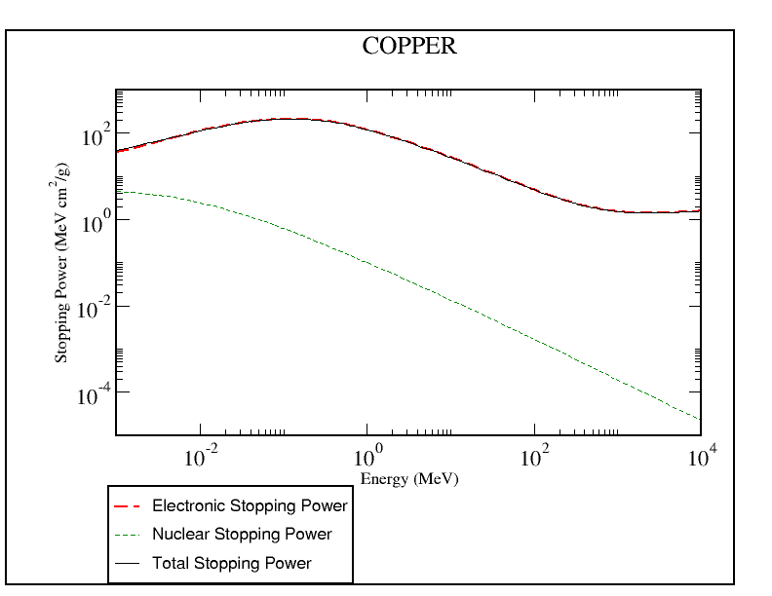
LEBT – Beam Induced Effects
Projects demanding the highest average intensity can be searching for 100mA proton beams at 100keV energy.
Corresponding beam power is 10kW.
At this energy, the energy loss rate in copper is ~2000 MeV cm⁻¹ (from NIST PSTAR database).
So protons are stopped in ~500nm in copper.
As the beam energy is deposited in such a thin later on surfaces, the heat must spread very quickly to avoid melting (if it didn’t, copper surfaces would melt in microseconds) – high thermal conductivity is essential.
The plot shows the stopping power for a proton entering copper, taken from the online NIST database.,
PSTAR - NIST

Slide 22
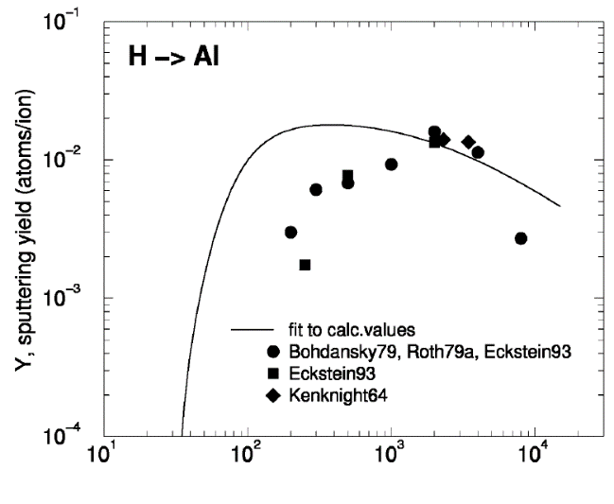
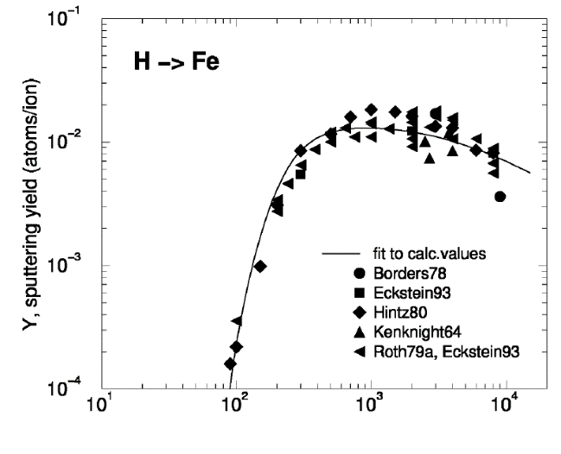
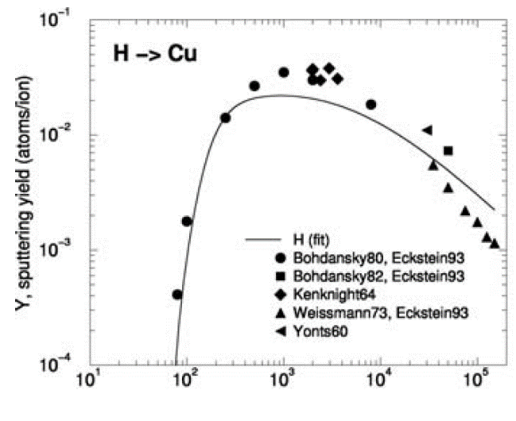
LEBT – Beam Induced Effects
Even if the beam does not melt material, it can be sputtered.
A 100mA, 100keV DC proton beam sputters ~0.3 g/year – multiplied by the duty factor and loss fraction.
Sources do not produce mono-type beams. Unwanted particles can be a high fraction (sometimes even more than the wanted beam).
Energy (eV)
Sputtering rates of Hydrogen Atoms onto selected materials [Sputtering by Particle Bombardment Topics in Applied Physics, 2007, Volume 110/2007, 33-187, DOI: 10.1007/978-3-540-44502-9_3]

Slide 23
Ion Sources
Producing large number of ions
Extraction
Transporting
Protons
H-
Ions

Slide 24
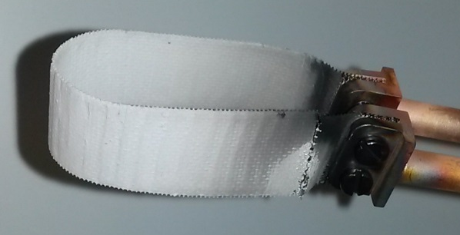

The Cathode Problem
Many ion sources work on the gas discharge model (cathode and anode separated by a gas).
For high intensities, the density of the gas is high, and ions created can return to the cathode, causing sputtering.
In order to run ion sources in DC mode, with high reliability, cathode/anode discharges have to be avoided (cathodes are strongly sputtered by ions formed in dense gas discharges).
Hence, high intensity sources often require to move to RF/Microwave discharges in order to remove the cathode.
Failed cathode of the CERN duoplasmatron

Slide 25
Electron Cyclotron Resonance Ion Sources
High intensity proton sources using ECR resonance heating.
Electrons in a magnetic field gyrate with a fixed frequency.
Match an injected microwave frequency to this electron gyration frequency, and the electron will be accelerated.
This technique removes the need for a cathode. Ions still bormbard surfaces, but they are spread over more of the chamber, and plasma confinement can reduce them.

Slide 26
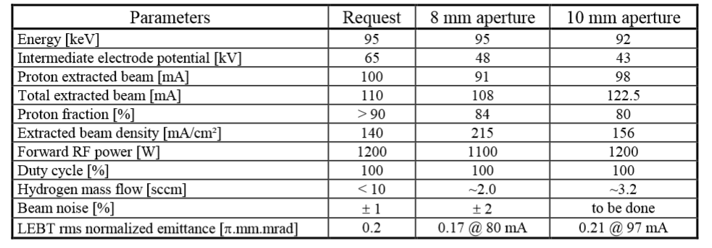
Proton Ion Sources – DC - ECRs
Performance of CEA’s SILHI ECR ion source.
Power efficiency ~ 80 mA/kW, easy to scale to DC operation.
Gobin et al, EPAC 98, http://accelconf.web.cern.ch/AccelConf/e98/PAPERS/MOP09A.PDF

Slide 27
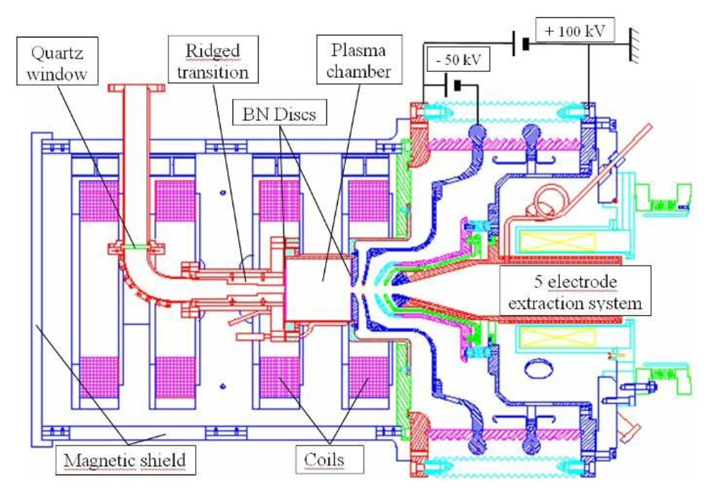
Proton Ion Sources – DC - ECRs
Layout of the SILHI Source for H+ and D+.
Latest review of these sources at the Linac2012 conference:
https://accelconf.web.cern.ch/accelconf/LINAC2012/talks/fr1a02_talk.pdf

Slide 28
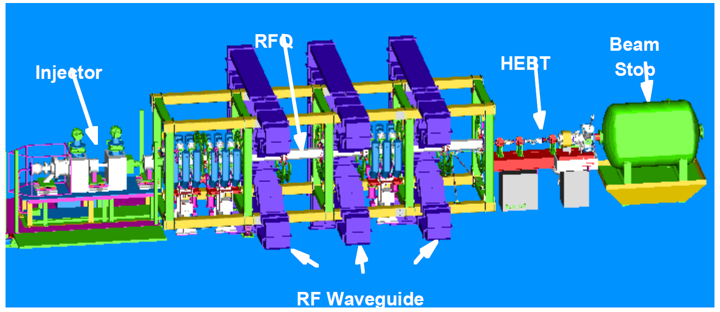
Proton Ion Sources – DC - ECRs
Also the LEDA demonstration in Los Alamos produced a ~100mA CW H+ .
It ran from 1999-2001 for studies on high power beams, e.g.:
Beam instrumentation
Halo formation.
Smith et al, EPAC 00, http://accelconf.web.cern.ch/AccelConf/e00/PAPERS/THP3A05.pdf
And
Young et al, Linac2000, http://accelconf.web.cern.ch/AccelConf/l00/papers/TU201.pdf

Slide 29
Proton Ion Sources – Higher Intensity Pulsed.
ECR ion sources have not been demonstrated much above 100mA.
If the duty factor is low, cathode driven sources are a possibility.
CERN’s duoplasmatron source can deliver >200mA of protons @50us pulses / 1.2Hz for ~1 year.
The plot shows the beam intensity out of the CERN Linac2 proton source. It includes H2+ and H3+, but H+ is ~200mA.
Scrivens et al, http://accelconf.web.cern.ch/AccelConf/IPAC2011/papers/thps025.pdf

Slide 30
Ion Sources
Producing large number of ions
Extraction
Transporting
Protons
H-
Ions

Slide 31
Negative Ion Sources – Sources
Negative ions have an additional electron attached.
Ions that have a positive electron affinity are stable.
 | Electron Affinity (eV)
H | 0.7542
He | <0
Li | 0.6182
Be | <0
B | 0.277
C | 1.2629
N | <0
O | 1.462
F | 3.399

Slide 32
Negative Ion Sources – Uses of Negative Ions
Main uses of negative hydrogen ions are:
Charge Exchange Injection
Charge Exchange Extraction
p
p
H-
foil
HV terminal
H- -> p
H-
Gas Neutraliser
H0
B field
E
E
H- -> p

Slide 33
Negative Ion Sources – Production Methods
Method 1
Ions can be produced from a plasma with several processes
AB + e → A- + B A + B → A- + B+
AB* + e → A- + B A+ + B → A- + B2+
Ions can be produced from a surface
A low work function material is heated, the thermally higher energy electrons can overlap the atoms on the surface. There is a probability a desorbed atom will be negatively charged.
Material
e.g. LaB6
Φs=2.6V
Energy
Method 2
Passed through a charge exchange cell

Slide 34
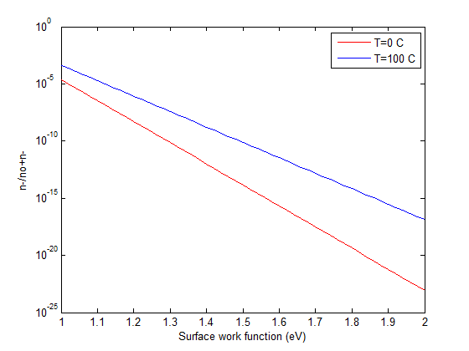
Negative Ion Sources – Surface Production
The highest intensity negative hydrogen ion sources are using surface production with a cesiated surface.
The following approximate formula gives the probability of negative in production.
The source requires that hydrogen strikes the surface, and is then desorbed (thermally, or by ion bombardment) as a negative ion.
The cesiated surface is difficult to maintain in a stable situation.
The presence of heavy cesium causes sputtering.
The plot shows the production probability for negative hydrogen, relative to neutral hydrogen, from a low work function surface.

Slide 35
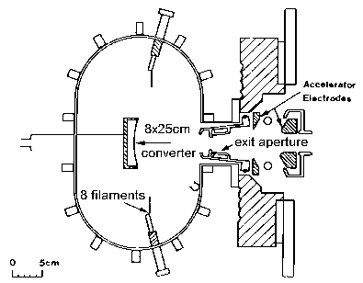
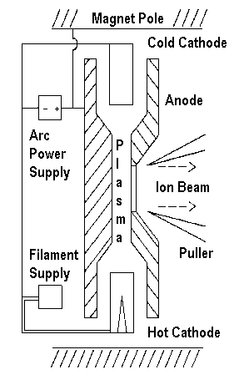
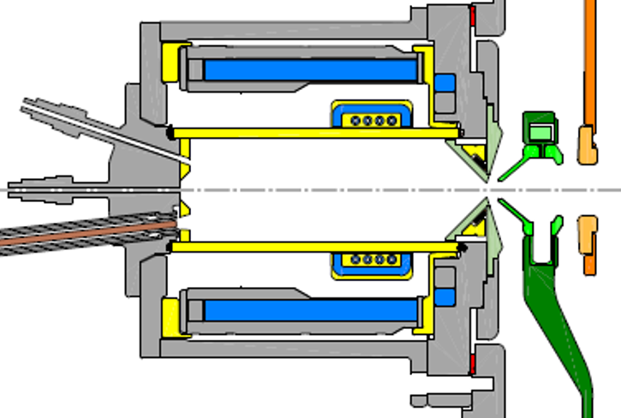
Negative Ion Sources – Surface Production
Valid technique many types of ion source, a few examples given.
Power efficiencies H- production are much lower 1-10 mA/kW
Surface Convertor
Penning
RF – Low frequency

Slide 36
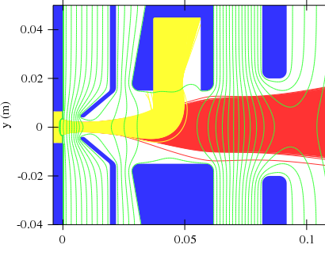
Negative Ion Sources – Extraction
The negatively charged ions have a high cross section for de-ionization.
So the distance travelled is typically only a few millimetres.
Only the surfaces close to extraction are useful.
Extraction of negative ions also leads to extraction of electrons.
Quasi-Neutrality in plasmas leads to an equal positive and negative density:
  If most of the negative the charge is still electrons, J=nve => high current density of electrons for extraction.
  P = V x I means there can be a high power in the electron beam.
-45kV
-25kV
-35kV
0kV

Slide 37
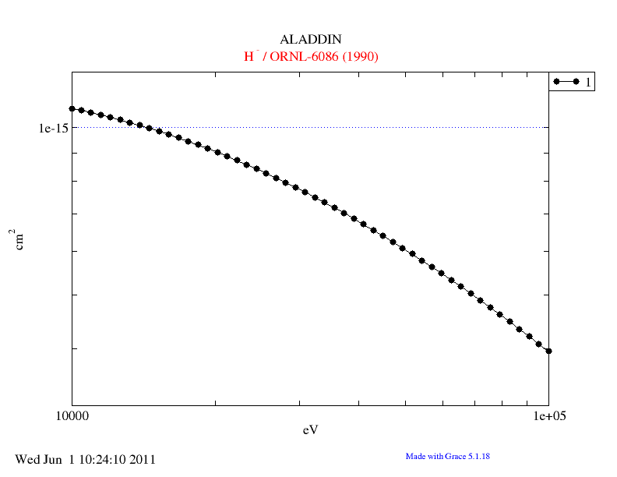
Negative Ion Sources – Transport
The negatively charged ions can easily be gas-stripped during beam transport.
Space charge compensation requires positive ions. These must come from the gas (and not from surfaces).
The plot shows the cross section for stripping of a H- ion, by an H₂ atom (which will be the typical composition of the residual gas).

Slide 38
Other Ions - Sources
All atoms can be ionized, but to produce high intensities there are a few important points for the source.
The ion base material can be more difficult to enter into the source, and maintain a high pressure for a dense plasma.
As the ion mass increases, the particle density (not charge density) that can be extracted and transported reduces.
Assuming the same extraction conditions,
Higher mass and higher charge lead to LESS particle current.
Note this is assuming all the particles are in 1 charge state.

Slide 39
Other Ions - Sources
The maximum current density that can be extracted from a plasma (in a parallel electrode case):
J_{C-L} @ 6kV/mm at 100kV
For 1+ ions.
or
E=Extraction Field, V=Extraction voltage
Assuming the same extraction conditions,
Higher mass and higher charge lead to LESS particle current.
Note this is assuming all the particles are in 1 charge state.

Slide 40
Other Ions - 1+ Sources
For 1+ ions, a dense cool plasma is required.
Cathode discharge, Penning and RF sources do not have resonant electron heating, and therefore keep the plasma cool.
The source can be quite efficient, ions are less likely to be wasted in the wrong charge-state.
Ions | Intensity 1+ (mA) | Source Type | REF
He | 120 | Duopigatron | Wolf 2.3
Al | 22 | PIG Sputter | Wolf Ch2.5
Ar | 27 | RF | Wolf Ch2.5
Fe | 3 | PIG Sputter | Wolf Ch2.5
Kr | 29 | RF | Wolf Ch2.5
Nb | 0.7 | PIG Sputter | Wolf Ch2.5
Xe | 22 | RF | Wolf Ch2.7

Slide 41
Other Ions - 1+ Acceleration
Low q ions are harder to accelerate and bend/focus, and therefore expensive to build.
(E = q x V ; ρ = p / qB).
Converting them to high q (stripping) is:
  Inefficient (usually produces many ions of the wrong state).
  Requires thin foils at low energy (high powers deposited), or gas stripping (inefficient conversion rate).

Slide 42
Other Ions - q+ Sources
So for cost and acceleration efficiency reasons => use more highly charged ions.
For low charge state ions (ionization potential <100 eV) the same sources as 1+ are often used.
For highly charged ion, must move to high temperature plasma sources.
  ECR: Resonant electron heating with good confinement leads to high electron temperatures.
  EBIS (Electron Beam Ion Source): Ion trapped in a few keV high density electron beam, ionization up to electron beam energy.
  Laser Plasma: High power focused laser pulses (short in length) creates a dense hot plasma on a target surface, containing high charge states.

Slide 43
Ion Source – ECR – High charge states
Singly, multiply and highly charged ions can be produced by these sources (although the source construction will influence this).
A → A+ → A2+ → A3+ → AQ+
Stepwise ionization.
Gaseous ions are easily made. Metallic ions come from an OVEN or from a compound gas (e.g UF6 for uranium).
In the afterglow mode, the ion intensity increases AFTER switching off the micro-waves.
High charge states requires low residual gas/vapour pressures to avoid recombination. Hence low ion densities.

Slide 44
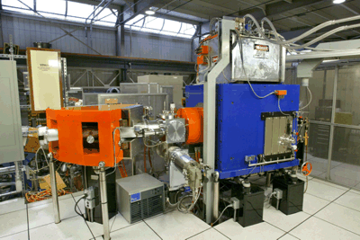
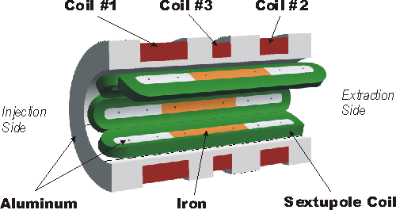
Ion Source – ECR – High charge states
Plasma density increases with frequency and associated magnetic field.
Example: VENUS source and Berkeley, Ca, uses superconducting solenoid and sextapole magnets.
Ions | Charge State | Intensity (µA)
He | 2+ | 11000
O | 6+ | 3000
Ar | 11+ | 860
Bi | 31+ | 300
BI | 50+ | 5.3
U | 33+ | 450
U | 50+ | 13
Ca | 11+ | 400
Table from:
http://accelconf.web.cern.ch/AccelConf/ECRIS2012/papers/thxo02.pdf

Slide 45
Summary
The limitations of ion sources are varied.
  Protons are limited by the current density that can be extracted.
  Several limitations come together for H-
    High power density required into the plasma.
    H- ions do not easily survive in dense plasmas.
    Electron extraction perturbs beam.
  For other ions, low charge state sources offer the best route to high ion intensities, but the acceleration is costly.

Slide 46
Further Reading
Handbook of Ion Source, B. Wolf, Boca Raton, FL: CRC Press, 1995
Ion Sources, Zhang Hua Shun, Berlin: Springer, 1999.
The Physics and Technology of Ion Source, I. G. Brown, New York, NY: Wiley, 1989
Large Ion Beams: Fundamentals of Generation and Propagation, T. A .Forrester, New York, NY: Wiley, 1988
CAS – 5th General School (CERN 94-01 ) and Cyclotrons, Linacs… (CERN-96-02 )

Slide 47
Thank you for your attention.

Slide 48
A: Richardson-Dushman constant
B: Magnetic field
D: Diffusion rate
E: Particle Kinetic Energy
E: Electric field
J: Current density
m: Particle Mass
n: Particle density
q: Charge
Q: Charge State
r: Radius
T: Temperature
U,V: Voltage
v: Particle velocity
v_{drift}: Particle drift velocity
Z: Distance along z-axis
β: Relativistic beta
γ: Relativistic gamma
ε₀: Electrical Permittivity
φ_{s}: Work Function (Voltage)
ν: Collision Frequency
ρ_{c}: Cyclotron Radius
ω_{c}: Cyclotron Frequency

