Slide 1
(SOME) EFFECTS NEAR TRANSITION
E. Métral (CERN)

Slide 2
(SOME) EFFECTS NEAR TRANSITION
E. Métral (CERN)
Transition energy

Slide 3
(SOME) EFFECTS NEAR TRANSITION
E. Métral (CERN)
Transition energy
Longitudinal beam dynamics “far” below or above transition

Slide 4
(SOME) EFFECTS NEAR TRANSITION
E. Métral (CERN)
Transition energy
Longitudinal beam dynamics “far” below or above transition
Transition crossing (with the example of the CERN PS machine)

Slide 5
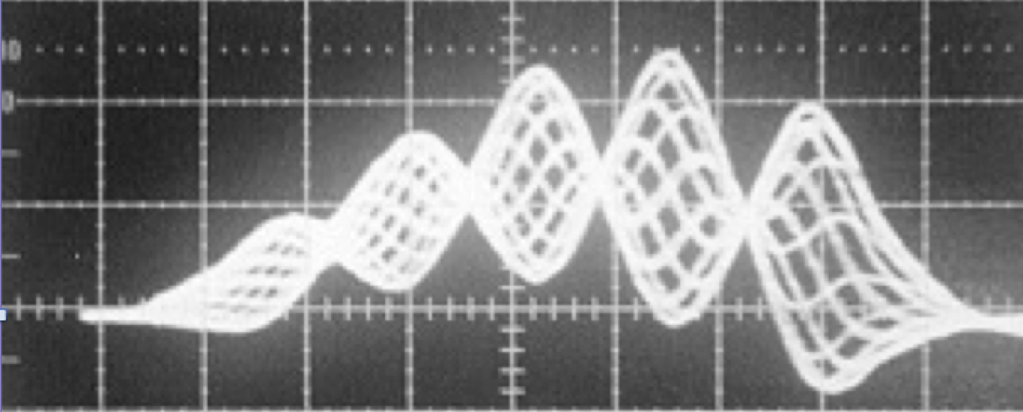
(SOME) EFFECTS NEAR TRANSITION
E. Métral (CERN)
Transition energy
Longitudinal beam dynamics “far” below or above transition
Transition crossing (with the example of the CERN PS machine)
Transverse (slow) head-tail instability

Slide 6
(SOME) EFFECTS NEAR TRANSITION
E. Métral (CERN)
Transition energy
Longitudinal beam dynamics “far” below or above transition
Transition crossing (with the example of the CERN PS machine)
Transverse (slow) head-tail instability
Fast (vertical) single-bunch instability

Slide 7
(SOME) EFFECTS NEAR TRANSITION
E. Métral (CERN)
Transition energy
Longitudinal beam dynamics “far” below or above transition
Transition crossing (with the example of the CERN PS machine)
Transverse (slow) head-tail instability
Fast (vertical) single-bunch instability
  Crossing transition in the CERN PS

Slide 8
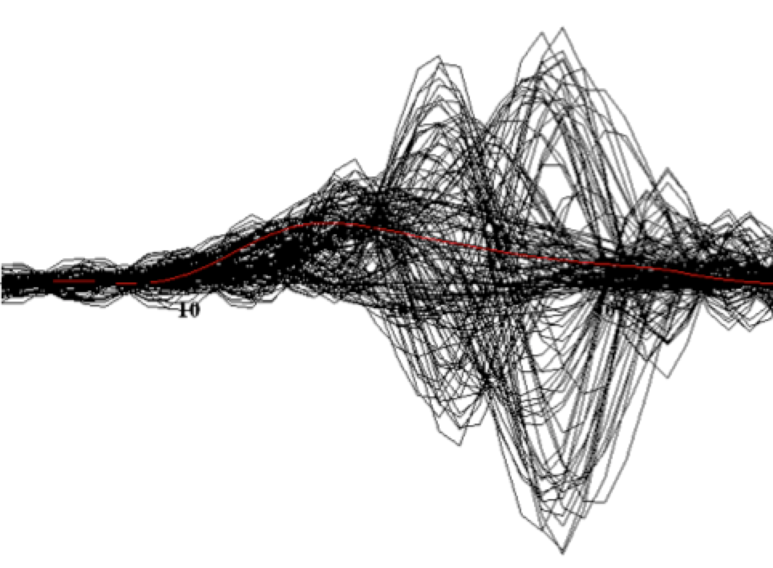
(SOME) EFFECTS NEAR TRANSITION
E. Métral (CERN)
Transition energy
Longitudinal beam dynamics “far” below or above transition
Transition crossing (with the example of the CERN PS machine)
Transverse (slow) head-tail instability
Fast (vertical) single-bunch instability
  Crossing transition in the CERN PS
  Injecting just above transition in the CERN SPS

Slide 9
(SOME) EFFECTS NEAR TRANSITION
E. Métral (CERN)
Transition energy
Longitudinal beam dynamics “far” below or above transition
Transition crossing (with the example of the CERN PS machine)
Transverse (slow) head-tail instability
Fast (vertical) single-bunch instability
  Crossing transition in the CERN PS
  Injecting just above transition in the CERN SPS
Conclusion

Slide 10
TRANSITION ENERGY (1/3)
Momentum compaction factor

Slide 11
TRANSITION ENERGY (1/3)
Momentum compaction factor

Slide 12
TRANSITION ENERGY (1/3)
Momentum compaction factor
Machine circumference
Horizontal dispersion
Beam momentum
Bending radius

Slide 13
TRANSITION ENERGY (1/3)
Momentum compaction factor
Machine circumference
Horizontal dispersion
Beam momentum
Bending radius
=> Parameter coming from the accelerator lattice

Slide 14
TRANSITION ENERGY (1/3)
Momentum compaction factor
Machine circumference
Horizontal dispersion
Beam momentum
Bending radius
=> Parameter coming from the accelerator lattice
  In most circular machines, α_{p} > 0

Slide 15
TRANSITION ENERGY (1/3)
Momentum compaction factor
Machine circumference
Horizontal dispersion
Beam momentum
Bending radius
=> Parameter coming from the accelerator lattice
Gamma transition
  In most circular machines, α_{p} > 0

Slide 16
TRANSITION ENERGY (1/3)
Momentum compaction factor
Machine circumference
Horizontal dispersion
Beam momentum
Bending radius
=> Parameter coming from the accelerator lattice
Gamma transition
  In most circular machines, α_{p} > 0
  However, α_{p} < 0 is also possible (e.g. CERN LEAR machine) => Called “Negative Momentum Compaction” (NMC) or “Imaginary γ_{t}” lattice

Slide 17
TRANSITION ENERGY (2/3)
  Assume α_{p} > 0

Slide 18
TRANSITION ENERGY (2/3)
  Assume α_{p} > 0
    dp > 0 => dC > 0

Slide 19
TRANSITION ENERGY (2/3)
  Assume α_{p} > 0
    dp > 0 => dC > 0
    dp > 0 => dv > 0

Slide 20
TRANSITION ENERGY (2/3)
  Assume α_{p} > 0
    dp > 0 => dC > 0
    dp > 0 => dv > 0
  => What happens to the revolution frequency f_{rev} = v / C?

Slide 21
TRANSITION ENERGY (2/3)
  Assume α_{p} > 0
    dp > 0 => dC > 0
    dp > 0 => dv > 0
    At (very) high energy, v ≈ clight and remains constant => f_{rev} 
  => What happens to the revolution frequency f_{rev} = v / C?

Slide 22
TRANSITION ENERGY (2/3)
  Assume α_{p} > 0
    dp > 0 => dC > 0
    dp > 0 => dv > 0
    At (very) high energy, v ≈ clight and remains constant => f_{rev} 
    At low energy, v increases faster than C => f_{rev} 
  => What happens to the revolution frequency f_{rev} = v / C?

Slide 23
TRANSITION ENERGY (2/3)
  Assume α_{p} > 0
    dp > 0 => dC > 0
    dp > 0 => dv > 0
    At (very) high energy, v ≈ clight and remains constant => f_{rev} 
    At low energy, v increases faster than C => f_{rev} 
  => What happens to the revolution frequency f_{rev} = v / C?
There is an energy for which the velocity variation is compensated by the trajectory variation (i.e. df_{rev} = 0):
=> TRANSITION ENERGY

Slide 24
TRANSITION ENERGY (3/3)
Slip factor

Slide 25
TRANSITION ENERGY (3/3)
Slip factor

Slide 26
TRANSITION ENERGY (3/3)
Slip factor
Relativistic mass factor of the beam

Slide 27
TRANSITION ENERGY (3/3)
Slip factor
Relativistic mass factor of the beam
    η < 0 below transition

Slide 28
TRANSITION ENERGY (3/3)
Slip factor
Relativistic mass factor of the beam
    η < 0 below transition
    η = 0 at transition => Isochronous condition

Slide 29
TRANSITION ENERGY (3/3)
Slip factor
Relativistic mass factor of the beam
    η < 0 below transition
    η = 0 at transition => Isochronous condition
    η > 0 above transition

Slide 30
LONGITUDINAL BEAM DYNAMICS
“FAR” BELOW OR ABOVE TRANSITION (1/2)
(Bucket) separatrices:

Slide 31
LONGITUDINAL BEAM DYNAMICS
“FAR” BELOW OR ABOVE TRANSITION (1/2)
(Bucket) separatrices: Below transition

Slide 32
LONGITUDINAL BEAM DYNAMICS
“FAR” BELOW OR ABOVE TRANSITION (1/2)
(Bucket) separatrices: Below transition

Slide 33
LONGITUDINAL BEAM DYNAMICS
“FAR” BELOW OR ABOVE TRANSITION (1/2)
(Bucket) separatrices: Below transition

Slide 34
LONGITUDINAL BEAM DYNAMICS
“FAR” BELOW OR ABOVE TRANSITION (1/2)
(Bucket) separatrices: Below transition
Above transition

Slide 35
LONGITUDINAL BEAM DYNAMICS
“FAR” BELOW OR ABOVE TRANSITION (1/2)
(Bucket) separatrices: Below transition
Above transition

Slide 36
LONGITUDINAL BEAM DYNAMICS
“FAR” BELOW OR ABOVE TRANSITION (1/2)
(Bucket) separatrices: Below transition
Above transition

Slide 37
LONGITUDINAL BEAM DYNAMICS
“FAR” BELOW OR ABOVE TRANSITION (2/2)
Particle trajectories:

Slide 38
LONGITUDINAL BEAM DYNAMICS
“FAR” BELOW OR ABOVE TRANSITION (2/2)
Particle trajectories: Below transition

Slide 39
LONGITUDINAL BEAM DYNAMICS
“FAR” BELOW OR ABOVE TRANSITION (2/2)
Particle trajectories: Below transition

Slide 40
LONGITUDINAL BEAM DYNAMICS
“FAR” BELOW OR ABOVE TRANSITION (2/2)
Particle trajectories: Below transition

Slide 41
TRANSITION CROSSING (1/9)
“Far” below or above transition ⬄ Adiabaticity condition

Slide 42
TRANSITION CROSSING (1/9)
“Far” below or above transition ⬄ Adiabaticity condition
“Close” to transition, the adiabaticity condition is not satisfied => Non-adiabatic synchrotron motion

Slide 43
TRANSITION CROSSING (1/9)
“Far” below or above transition ⬄ Adiabaticity condition
“Close” to transition, the adiabaticity condition is not satisfied => Non-adiabatic synchrotron motion
  When the time is close enough to transition, the particle will not be able to catch up with the rapid modification of the bucket shape

Slide 44
TRANSITION CROSSING (1/9)
“Far” below or above transition ⬄ Adiabaticity condition
“Close” to transition, the adiabaticity condition is not satisfied => Non-adiabatic synchrotron motion
  When the time is close enough to transition, the particle will not be able to catch up with the rapid modification of the bucket shape
  Nonadiabatic time

Slide 45
TRANSITION CROSSING (1/9)
“Far” below or above transition ⬄ Adiabaticity condition
“Close” to transition, the adiabaticity condition is not satisfied => Non-adiabatic synchrotron motion
  When the time is close enough to transition, the particle will not be able to catch up with the rapid modification of the bucket shape
  Nonadiabatic time

Slide 46
TRANSITION CROSSING (1/9)
“Far” below or above transition ⬄ Adiabaticity condition
“Close” to transition, the adiabaticity condition is not satisfied => Non-adiabatic synchrotron motion
  When the time is close enough to transition, the particle will not be able to catch up with the rapid modification of the bucket shape
  Nonadiabatic time
~ 2 ms for the
nTOF bunch in the CERN PS

Slide 47
TRANSITION CROSSING (2/9)
nTOF bunch in the CERN PS

Slide 48
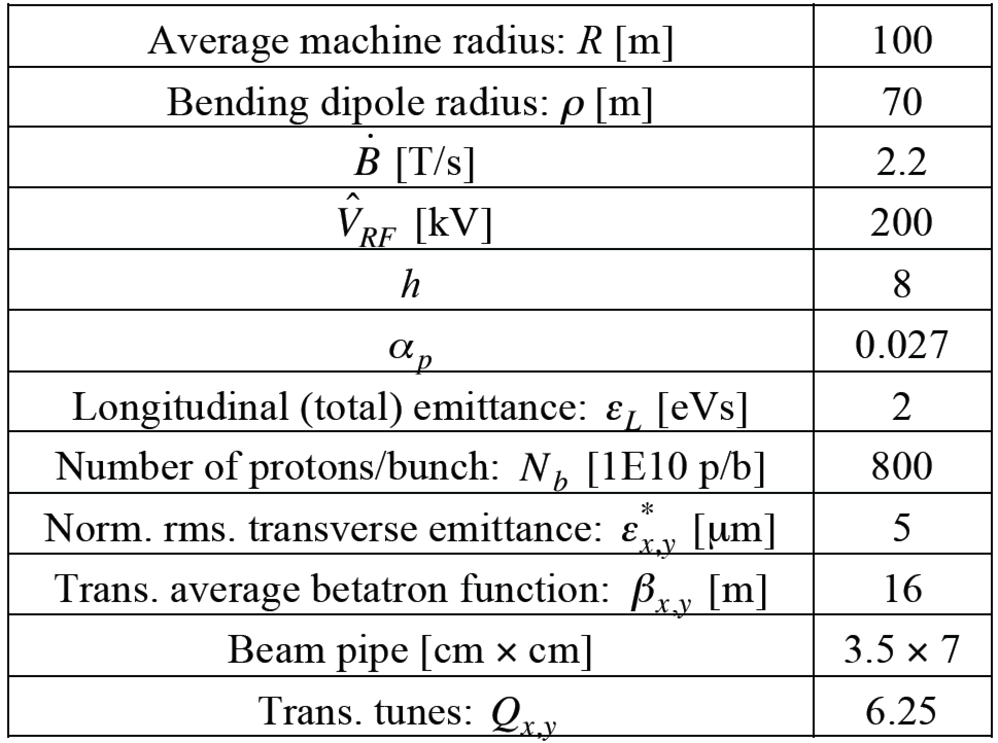
TRANSITION CROSSING (2/9)
nTOF bunch in the CERN PS

Slide 49
TRANSITION CROSSING (2/9)
nTOF bunch in the CERN PS
=> γ_{t} ≈ 6.1

Slide 50
TRANSITION CROSSING (3/9)

Slide 51
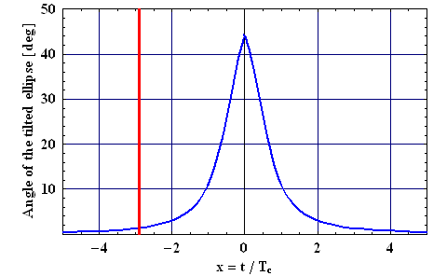
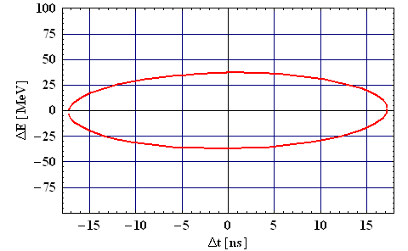
TRANSITION CROSSING (3/9)

Slide 52
TRANSITION CROSSING (4/9)
Longitudinal mismatch (due to the longitudinal Space Charge): IN STATIC

Slide 53
TRANSITION CROSSING (5/9)
Longitudinal mismatch (due to the longitudinal Space Charge): IN DYNAMIC (i.e. crossing transition)

Slide 54
TRANSITION CROSSING (6/9)
Longitudinal mismatch (due to the inductive part of the longitudinal Broad-Band impedance): IN DYNAMIC (i.e. crossing transition)

Slide 55
TRANSITION CROSSING (7/9)
Remedies

Slide 56
TRANSITION CROSSING (7/9)
Remedies
  Avoid crossing transition in the design phase => α_{p} < 0

Slide 57
TRANSITION CROSSING (7/9)
Remedies
  Avoid crossing transition in the design phase => α_{p} < 0
  If transition crossing cannot be avoided, the “γ_{t} jump” is the only (known) method to overcome all the intensity limitations => Artificial increase of the transition crossing speed by means of fast pulsed quadrupoles (at non zero dispersion locations)

Slide 58
TRANSITION CROSSING (7/9)
Remedies
  Avoid crossing transition in the design phase => α_{p} < 0
  If transition crossing cannot be avoided, the “γ_{t} jump” is the only (known) method to overcome all the intensity limitations => Artificial increase of the transition crossing speed by means of fast pulsed quadrupoles (at non zero dispersion locations)

Slide 59
TRANSITION CROSSING (7/9)
Remedies
  Avoid crossing transition in the design phase => α_{p} < 0
  If transition crossing cannot be avoided, the “γ_{t} jump” is the only (known) method to overcome all the intensity limitations => Artificial increase of the transition crossing speed by means of fast pulsed quadrupoles (at non zero dispersion locations)
Effective crossing speed ~ 50 times faster with the γ_{t} jump

Slide 60
TRANSITION CROSSING (8/9)
  Asymmetric or symmetric γ_{t} jump?

Slide 61
TRANSITION CROSSING (8/9)
  Asymmetric or symmetric γ_{t} jump?

Slide 62
TRANSITION CROSSING (8/9)
  Asymmetric or symmetric γ_{t} jump?

Slide 63
TRANSITION CROSSING (9/9)

Slide 64
TRANSITION CROSSING (9/9)

Slide 65
TRANSVERSE (SLOW) HEAD-TAIL INSTABILITY (1/2)
If the sign of the chromaticity (which is equal to ~ -1 for an uncorrected machine like the PS) is not changed (in both transverse planes) above transition, a (single-bunch) head-tail instability may develop

Slide 66
TRANSVERSE (SLOW) HEAD-TAIL INSTABILITY (1/2)
If the sign of the chromaticity (which is equal to ~ -1 for an uncorrected machine like the PS) is not changed (in both transverse planes) above transition, a (single-bunch) head-tail instability may develop
  This instability can be damped through Landau damping using octupoles, which introduce some amplitude detunings. This method was first used in the past to stabilize the PS beams

Slide 67
TRANSVERSE (SLOW) HEAD-TAIL INSTABILITY (1/2)
If the sign of the chromaticity (which is equal to ~ -1 for an uncorrected machine like the PS) is not changed (in both transverse planes) above transition, a (single-bunch) head-tail instability may develop
  This instability can be damped through Landau damping using octupoles, which introduce some amplitude detunings. This method was first used in the past to stabilize the PS beams
  However, the better method of changing the sign of the chromaticities (and keeping them to small positive values) by acting on the optics with sextupoles was then adopted, and it has become a routine operation at the CERN PS for many years

Slide 68
TRANSVERSE (SLOW) HEAD-TAIL INSTABILITY (1/2)
If the sign of the chromaticity (which is equal to ~ -1 for an uncorrected machine like the PS) is not changed (in both transverse planes) above transition, a (single-bunch) head-tail instability may develop
  This instability can be damped through Landau damping using octupoles, which introduce some amplitude detunings. This method was first used in the past to stabilize the PS beams
  However, the better method of changing the sign of the chromaticities (and keeping them to small positive values) by acting on the optics with sextupoles was then adopted, and it has become a routine operation at the CERN PS for many years
      => The chromatic frequency should be (slightly) positive to avoid the head-tail mode 0 (most critical) from developing

Slide 69
TRANSVERSE (SLOW) HEAD-TAIL INSTABILITY (1/2)
If the sign of the chromaticity (which is equal to ~ -1 for an uncorrected machine like the PS) is not changed (in both transverse planes) above transition, a (single-bunch) head-tail instability may develop
  This instability can be damped through Landau damping using octupoles, which introduce some amplitude detunings. This method was first used in the past to stabilize the PS beams
  However, the better method of changing the sign of the chromaticities (and keeping them to small positive values) by acting on the optics with sextupoles was then adopted, and it has become a routine operation at the CERN PS for many years
      => The chromatic frequency should be (slightly) positive to avoid the head-tail mode 0 (most critical) from developing

Slide 70
TRANSVERSE (SLOW) HEAD-TAIL INSTABILITY (2/2)
Example of transverse (slow) head-tail instability observed in the CERN PS at injection (below transition)

Slide 71
TRANSVERSE (SLOW) HEAD-TAIL INSTABILITY (2/2)
Example of transverse (slow) head-tail instability observed in the CERN PS at injection (below transition)
  Consecutive traces at a pick-up superimposed

Slide 72
TRANSVERSE (SLOW) HEAD-TAIL INSTABILITY (2/2)
Example of transverse (slow) head-tail instability observed in the CERN PS at injection (below transition)
  Consecutive traces at a pick-up superimposed
  Standing-wave patterns with 4 nodes (called “mode 4”)

Slide 73
TRANSVERSE (SLOW) HEAD-TAIL INSTABILITY (2/2)
Example of transverse (slow) head-tail instability observed in the CERN PS at injection (below transition)
  Consecutive traces at a pick-up superimposed
  Standing-wave patterns with 4 nodes (called “mode 4”)
Measurements

Slide 74
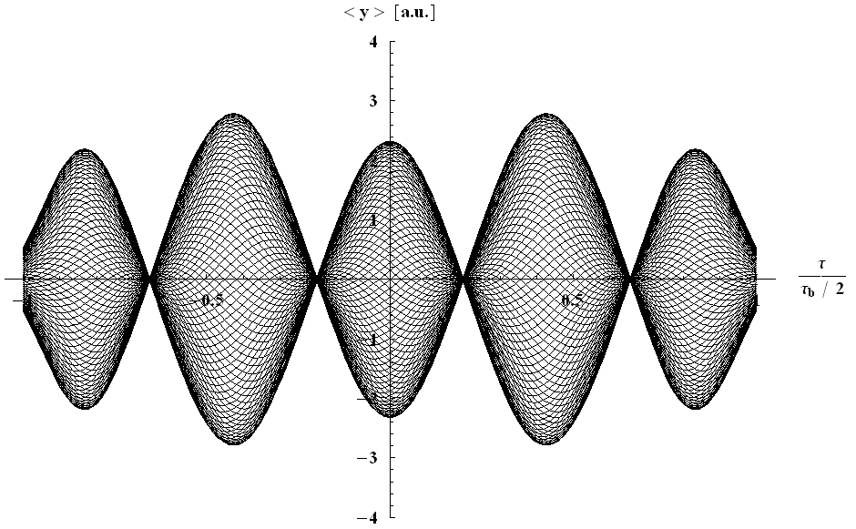

TRANSVERSE (SLOW) HEAD-TAIL INSTABILITY (2/2)
Example of transverse (slow) head-tail instability observed in the CERN PS at injection (below transition)
  Consecutive traces at a pick-up superimposed
  Standing-wave patterns with 4 nodes (called “mode 4”)
Measurements
Analytical prediction
(for a bunch going through the centre of the pick-up)

Slide 75
FAST (VERTICAL) SINGLE-BUNCH INSTABILITY (1/14)
A simple formula is obtained from 5 seemingly diverse formalisms (in the absence of space charge and transverse feedback), assuming i) a Broad-Band impedance and ii) the long-bunch regime:

Slide 76
FAST (VERTICAL) SINGLE-BUNCH INSTABILITY (1/14)
A simple formula is obtained from 5 seemingly diverse formalisms (in the absence of space charge and transverse feedback), assuming i) a Broad-Band impedance and ii) the long-bunch regime:
  Coasting-Beam approach with peak values

Slide 77
FAST (VERTICAL) SINGLE-BUNCH INSTABILITY (1/14)
A simple formula is obtained from 5 seemingly diverse formalisms (in the absence of space charge and transverse feedback), assuming i) a Broad-Band impedance and ii) the long-bunch regime:
  Coasting-Beam approach with peak values
  Fast Blow-Up

Slide 78
FAST (VERTICAL) SINGLE-BUNCH INSTABILITY (1/14)
A simple formula is obtained from 5 seemingly diverse formalisms (in the absence of space charge and transverse feedback), assuming i) a Broad-Band impedance and ii) the long-bunch regime:
  Coasting-Beam approach with peak values
  Fast Blow-Up
  Beam Break-Up

Slide 79
FAST (VERTICAL) SINGLE-BUNCH INSTABILITY (1/14)
A simple formula is obtained from 5 seemingly diverse formalisms (in the absence of space charge and transverse feedback), assuming i) a Broad-Band impedance and ii) the long-bunch regime:
  Coasting-Beam approach with peak values
  Fast Blow-Up
  Beam Break-Up
  Post Head-Tail

Slide 80
FAST (VERTICAL) SINGLE-BUNCH INSTABILITY (1/14)
A simple formula is obtained from 5 seemingly diverse formalisms (in the absence of space charge and transverse feedback), assuming i) a Broad-Band impedance and ii) the long-bunch regime:
  Coasting-Beam approach with peak values
  Fast Blow-Up
  Beam Break-Up
  Post Head-Tail
  Transverse Mode-Coupling Instability (TMCI)

Slide 81
FAST (VERTICAL) SINGLE-BUNCH INSTABILITY (2/14)
Example of TMCI

Slide 82
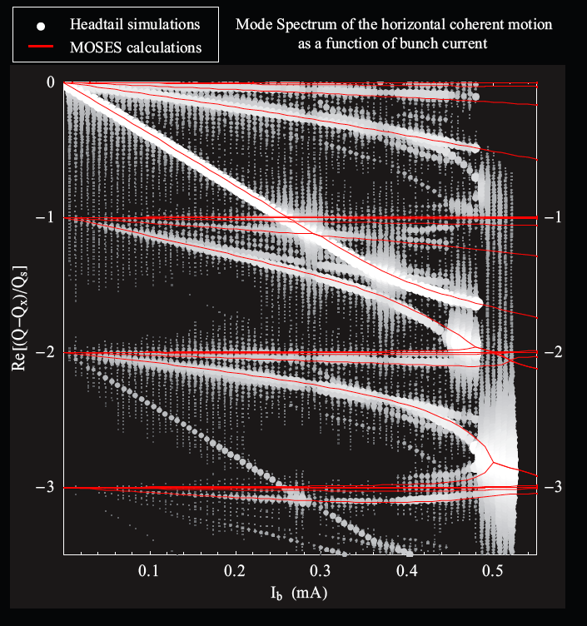
FAST (VERTICAL) SINGLE-BUNCH INSTABILITY (2/14)
Example of TMCI
Q_{s}
(Synchrotron tune)
Courtesy of Benoit Salvant

Slide 83
FAST (VERTICAL) SINGLE-BUNCH INSTABILITY (2/14)
Example of TMCI
Q_{s}
(Synchrotron tune)
Courtesy of Benoit Salvant

Slide 84
FAST (VERTICAL) SINGLE-BUNCH INSTABILITY (2/14)
Example of TMCI
Q_{s}
(Synchrotron tune)
Courtesy of Benoit Salvant

Slide 85
FAST (VERTICAL) SINGLE-BUNCH INSTABILITY (2/14)
Example of TMCI
Synchrotron period
Instability
rise-time
Q_{s}
(Synchrotron tune)
Courtesy of Benoit Salvant

Slide 86
FAST (VERTICAL) SINGLE-BUNCH INSTABILITY (2/14)
Example of TMCI
Synchrotron period
Instability
rise-time
Q_{s}
(Synchrotron tune)
Courtesy of Benoit Salvant

Slide 87
FAST (VERTICAL) SINGLE-BUNCH INSTABILITY (2/14)
Example of TMCI
Synchrotron period
Instability
rise-time
Q_{s}
(Synchrotron tune)
Q_{s}➔0 approaching transition
Courtesy of Benoit Salvant

Slide 88
FAST (VERTICAL) SINGLE-BUNCH INSTABILITY (3/14)
i) 1st assumption: Broad-Band impedance

Slide 89
FAST (VERTICAL) SINGLE-BUNCH INSTABILITY (3/14)
i) 1st assumption: Broad-Band impedance
Real part
Imaginary part

Slide 90
FAST (VERTICAL) SINGLE-BUNCH INSTABILITY (3/14)
i) 1st assumption: Broad-Band impedance
Real part
Imaginary part

Slide 91
FAST (VERTICAL) SINGLE-BUNCH INSTABILITY (4/14)
ii) 2nd assumption: long-bunch regime

Slide 92
FAST (VERTICAL) SINGLE-BUNCH INSTABILITY (4/14)
ii) 2nd assumption: long-bunch regime

Slide 93
FAST (VERTICAL) SINGLE-BUNCH INSTABILITY (5/14)
Simple formula (with the 2 assumptions):

Slide 94
FAST (VERTICAL) SINGLE-BUNCH INSTABILITY (5/14)
Simple formula (with the 2 assumptions):

Slide 95
FAST (VERTICAL) SINGLE-BUNCH INSTABILITY (5/14)
Simple formula (with the 2 assumptions):
Try to decrease the impedance and/or increase the resonance frequency => Impedance reduction campaign

Slide 96
FAST (VERTICAL) SINGLE-BUNCH INSTABILITY (5/14)
Simple formula (with the 2 assumptions):
Try to decrease the impedance and/or increase the resonance frequency => Impedance reduction campaign
Change the optics to increase
the betatron tune (decrease the beta function at critical impedances) and/or go further away from transition => New optics needed

Slide 97
FAST (VERTICAL) SINGLE-BUNCH INSTABILITY (5/14)
Simple formula (with the 2 assumptions):
Increase the beam longitudinal emittance (when possible)
Try to decrease the impedance and/or increase the resonance frequency => Impedance reduction campaign
Change the optics to increase
the betatron tune (decrease the beta function at critical impedances) and/or go further away from transition => New optics needed

Slide 98
FAST (VERTICAL) SINGLE-BUNCH INSTABILITY (5/14)
Simple formula (with the 2 assumptions):
- Increase the
chromatic frequency
- Chromaticity jump in case transition has
to be crossed
Increase the beam longitudinal emittance (when possible)
Try to decrease the impedance and/or increase the resonance frequency => Impedance reduction campaign
Change the optics to increase
the betatron tune (decrease the beta function at critical impedances) and/or go further away from transition => New optics needed

Slide 99
FAST (VERTICAL) SINGLE-BUNCH INSTABILITY (5/14)
Simple formula (with the 2 assumptions):
- Increase the
chromatic frequency
- Chromaticity jump in case transition has
to be crossed
Increase the beam longitudinal emittance (when possible)
Try to decrease the impedance and/or increase the resonance frequency => Impedance reduction campaign
Change the optics to increase
the betatron tune (decrease the beta function at critical impedances) and/or go further away from transition => New optics needed
* No dependence on Q_{s}!

Slide 100
FAST (VERTICAL) SINGLE-BUNCH INSTABILITY (6/14)
In the PS

Slide 101
FAST (VERTICAL) SINGLE-BUNCH INSTABILITY (6/14)
In the PS: even in the presence of the γ_{t} jump, together with the change of the sign of both chromaticities when transition is crossed, a fast vertical single-bunch instability is observed (with the nTOF bunch) when no longitudinal emittance blow-up is applied before transition

Slide 102
FAST (VERTICAL) SINGLE-BUNCH INSTABILITY (6/14)
In the PS: even in the presence of the γ_{t} jump, together with the change of the sign of both chromaticities when transition is crossed, a fast vertical single-bunch instability is observed (with the nTOF bunch) when no longitudinal emittance blow-up is applied before transition
Σ, ΔR, ΔV signals
Tail unstable
Head stable
~ 700 MHz
Time (10 ns/div)

Slide 103
FAST (VERTICAL) SINGLE-BUNCH INSTABILITY (6/14)
In the PS: even in the presence of the γ_{t} jump, together with the change of the sign of both chromaticities when transition is crossed, a fast vertical single-bunch instability is observed (with the nTOF bunch) when no longitudinal emittance blow-up is applied before transition
Σ, ΔR, ΔV signals
Tail unstable
Head stable
~ 700 MHz
Time (10 ns/div)
=> Instability suppressed by increasing the longitudinal emittance

Slide 104
FAST (VERTICAL) SINGLE-BUNCH INSTABILITY (7/14)
=> Similar observation on other beams (e.g. below with the beam for the Antiproton Decelerator) when the longitudinal emittance is too small

Slide 105
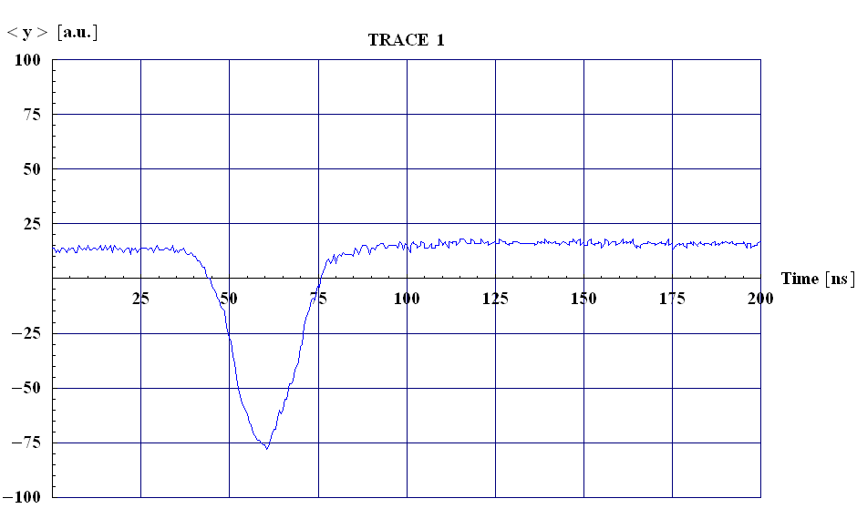
FAST (VERTICAL) SINGLE-BUNCH INSTABILITY (7/14)
=> Similar observation on other beams (e.g. below with the beam for the Antiproton Decelerator) when the longitudinal emittance is too small
Courtesy of Rende Steerenberg

Slide 106
FAST (VERTICAL) SINGLE-BUNCH INSTABILITY (8/14)
In the SPS

Slide 107
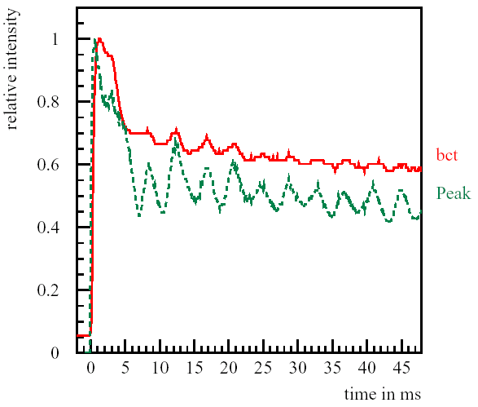
FAST (VERTICAL) SINGLE-BUNCH INSTABILITY (8/14)
In the SPS

Slide 108
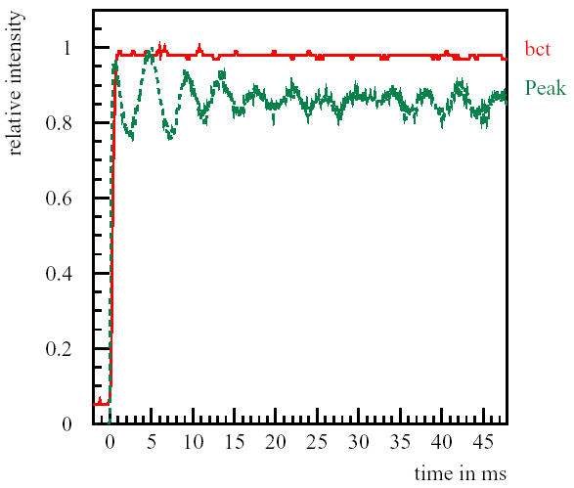
FAST (VERTICAL) SINGLE-BUNCH INSTABILITY (8/14)
In the SPS
Instability (initially)
suppressed by increasing
the chromaticity

Slide 109
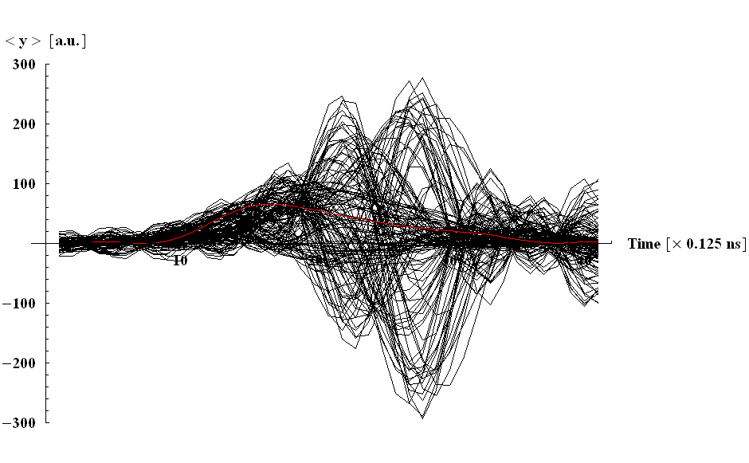

FAST (VERTICAL) SINGLE-BUNCH INSTABILITY (9/14)
⇒ Travelling-wave pattern along the bunch
Head
Tail
1st trace (in red) = turn 2
Last trace = turn 150
Every turn shown

Slide 110
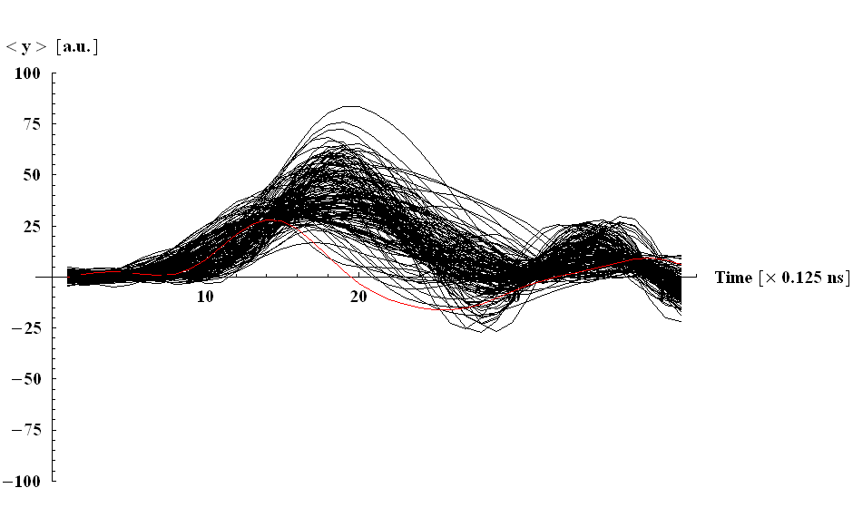

FAST (VERTICAL) SINGLE-BUNCH INSTABILITY (10/14)
1st trace (in red) = turn 2
Last trace = turn 150
Every turn shown

Slide 111
FAST (VERTICAL) SINGLE-BUNCH INSTABILITY (11/14)
γ_{t} was recently modified in the SPS to increase the TMCI intensity threshold above the foreseen intensities for the future upgrade

Slide 112
FAST (VERTICAL) SINGLE-BUNCH INSTABILITY (11/14)
γ_{t} was recently modified in the SPS to increase the TMCI intensity threshold above the foreseen intensities for the future upgrade
Simple rough estimate of γ_{t} for machines made of simple FODO cells:

Slide 113
FAST (VERTICAL) SINGLE-BUNCH INSTABILITY (11/14)
γ_{t} was recently modified in the SPS to increase the TMCI intensity threshold above the foreseen intensities for the future upgrade
Simple rough estimate of γ_{t} for machines made of simple FODO cells:
  Approximating the machine radius by the bending radius, yields

Slide 114
FAST (VERTICAL) SINGLE-BUNCH INSTABILITY (11/14)
γ_{t} was recently modified in the SPS to increase the TMCI intensity threshold above the foreseen intensities for the future upgrade
Simple rough estimate of γ_{t} for machines made of simple FODO cells:
  Approximating the machine radius by the bending radius, yields

Slide 115
FAST (VERTICAL) SINGLE-BUNCH INSTABILITY (11/14)
γ_{t} was recently modified in the SPS to increase the TMCI intensity threshold above the foreseen intensities for the future upgrade
Simple rough estimate of γ_{t} for machines made of simple FODO cells:
  Approximating the machine radius by the bending radius, yields
  Inserting this in the definition of α_{p} (and then expressing γ_{t}) yields

Slide 116
FAST (VERTICAL) SINGLE-BUNCH INSTABILITY (11/14)
γ_{t} was recently modified in the SPS to increase the TMCI intensity threshold above the foreseen intensities for the future upgrade
Simple rough estimate of γ_{t} for machines made of simple FODO cells:
  Approximating the machine radius by the bending radius, yields
  Inserting this in the definition of α_{p} (and then expressing γ_{t}) yields

Slide 117
FAST (VERTICAL) SINGLE-BUNCH INSTABILITY (11/14)
γ_{t} was recently modified in the SPS to increase the TMCI intensity threshold above the foreseen intensities for the future upgrade
Simple rough estimate of γ_{t} for machines made of simple FODO cells:
  Approximating the machine radius by the bending radius, yields
  Inserting this in the definition of α_{p} (and then expressing γ_{t}) yields
    => If one wants to modify γ_{t}, (increase or decrease its value) one should modify the horizontal tune

Slide 118
FAST (VERTICAL) SINGLE-BUNCH INSTABILITY (12/14)
TMCI intensity threshold with the old (Q26) optics at injection: ~ 1.7 10¹¹ p/b

Slide 119
FAST (VERTICAL) SINGLE-BUNCH INSTABILITY (12/14)
TMCI intensity threshold with the old (Q26) optics at injection: ~ 1.7 10¹¹ p/b
Predictions going from Q26 to the new (Q20) optics:

Slide 120
FAST (VERTICAL) SINGLE-BUNCH INSTABILITY (12/14)
TMCI intensity threshold with the old (Q26) optics at injection: ~ 1.7 10¹¹ p/b
Predictions going from Q26 to the new (Q20) optics:
  Q26:

Slide 121
FAST (VERTICAL) SINGLE-BUNCH INSTABILITY (12/14)
TMCI intensity threshold with the old (Q26) optics at injection: ~ 1.7 10¹¹ p/b
Predictions going from Q26 to the new (Q20) optics:
  Q26:
  Q20:

Slide 122
FAST (VERTICAL) SINGLE-BUNCH INSTABILITY (12/14)
TMCI intensity threshold with the old (Q26) optics at injection: ~ 1.7 10¹¹ p/b
Predictions going from Q26 to the new (Q20) optics:
  Q26:
  Q20:
  => A gain of a factor 0.0362 / 0.0162 ≈ 2.2 in the intensity threshold was expected

Slide 123
FAST (VERTICAL) SINGLE-BUNCH INSTABILITY (13/14)
Measurements
=> Good agreement with simple formula

Slide 124
FAST (VERTICAL) SINGLE-BUNCH INSTABILITY (13/14)
Measurements
=> Good agreement with simple formula
Courtesy of Benoit Salvant et al.

Slide 125
FAST (VERTICAL) SINGLE-BUNCH INSTABILITY (13/14)
Measurements
=> Good agreement with simple formula
Courtesy of Benoit Salvant et al.
Courtesy of Hannes Bartosik et al.

Slide 126
FAST (VERTICAL) SINGLE-BUNCH INSTABILITY (13/14)
Gain of a factor
4.5 / 1.7 ≈ 2.6
Measurements
=> Good agreement with simple formula
Courtesy of Benoit Salvant et al.
Courtesy of Hannes Bartosik et al.

Slide 127
FAST (VERTICAL) SINGLE-BUNCH INSTABILITY (14/14)
Very good agreement between measurements and simulations

Slide 128
FAST (VERTICAL) SINGLE-BUNCH INSTABILITY (14/14)
Very good agreement between measurements and simulations
Courtesy of Hannes Bartosik et al.

Slide 129
FAST (VERTICAL) SINGLE-BUNCH INSTABILITY (14/14)
Very good agreement between measurements and simulations
Courtesy of Hannes Bartosik et al.

Slide 130
FAST (VERTICAL) SINGLE-BUNCH INSTABILITY (14/14)
Very good agreement between measurements and simulations
Courtesy of Hannes Bartosik et al.
=> Intensity threshold with the new (Q20) optics: ~ 4.5 10¹¹ p/b

Slide 131
CONCLUSION (1/2)
Stability of synchrotron motion (when crossing transition):

Slide 132
CONCLUSION (1/2)
Stability of synchrotron motion (when crossing transition):

Slide 133
CONCLUSION (1/2)
Stability of synchrotron motion (when crossing transition):
Head-Tail instability (when crossing transition): change the sign of the chromaticity (both planes) => Positive chromatic frequency

Slide 134
CONCLUSION (1/2)
Stability of synchrotron motion (when crossing transition):
Head-Tail instability (when crossing transition): change the sign of the chromaticity (both planes) => Positive chromatic frequency

Slide 135
CONCLUSION (1/2)
Stability of synchrotron motion (when crossing transition):
Head-Tail instability (when crossing transition): change the sign of the chromaticity (both planes) => Positive chromatic frequency
  Transverse Mode-Coupling Instability => With the 2 assumptions: i) Broad-Band impedance and ii) long-bunch regime (effects of space charge and transverse feedback still under discussion…)

Slide 136
CONCLUSION (1/2)
Stability of synchrotron motion (when crossing transition):
Head-Tail instability (when crossing transition): change the sign of the chromaticity (both planes) => Positive chromatic frequency
  Transverse Mode-Coupling Instability => With the 2 assumptions: i) Broad-Band impedance and ii) long-bunch regime (effects of space charge and transverse feedback still under discussion…)
  Impedance reduction

Slide 137
CONCLUSION (1/2)
Stability of synchrotron motion (when crossing transition):
Head-Tail instability (when crossing transition): change the sign of the chromaticity (both planes) => Positive chromatic frequency
  Transverse Mode-Coupling Instability => With the 2 assumptions: i) Broad-Band impedance and ii) long-bunch regime (effects of space charge and transverse feedback still under discussion…)
  Impedance reduction
  Increase longitudinal emittance (as in the PS)

Slide 138
CONCLUSION (1/2)
Stability of synchrotron motion (when crossing transition):
Head-Tail instability (when crossing transition): change the sign of the chromaticity (both planes) => Positive chromatic frequency
  Transverse Mode-Coupling Instability => With the 2 assumptions: i) Broad-Band impedance and ii) long-bunch regime (effects of space charge and transverse feedback still under discussion…)
  Impedance reduction
  Increase longitudinal emittance (as in the PS)
  Increase the |slip factor| (as in the SPS) and/or the tune

Slide 139
CONCLUSION (1/2)
Stability of synchrotron motion (when crossing transition):
Head-Tail instability (when crossing transition): change the sign of the chromaticity (both planes) => Positive chromatic frequency
  Transverse Mode-Coupling Instability => With the 2 assumptions: i) Broad-Band impedance and ii) long-bunch regime (effects of space charge and transverse feedback still under discussion…)
  Impedance reduction
  Increase longitudinal emittance (as in the PS)
  Increase the |slip factor| (as in the SPS) and/or the tune
  Increase the chromatic frequency (below or above transition)

Slide 140
CONCLUSION (1/2)
Stability of synchrotron motion (when crossing transition):
Head-Tail instability (when crossing transition): change the sign of the chromaticity (both planes) => Positive chromatic frequency
  Transverse Mode-Coupling Instability => With the 2 assumptions: i) Broad-Band impedance and ii) long-bunch regime (effects of space charge and transverse feedback still under discussion…)
  Impedance reduction
  Increase longitudinal emittance (as in the PS)
  Increase the |slip factor| (as in the SPS) and/or the tune
  Increase the chromatic frequency (below or above transition)
  “Chromaticity jump” when transition needs to be crossed => Not only the sign needs to be changed (for Head-Tail reason) but the shape could be optimised (for TMCI reason)

Slide 141
CONCLUSION (2/2)
Increasing the |slip factor| also helps for i) the Longitudinal Mode-Coupling Instability and ii) the fast single-bunch electron cloud instability

Slide 142
CONCLUSION (2/2)
Increasing the |slip factor| also helps for i) the Longitudinal Mode-Coupling Instability and ii) the fast single-bunch electron cloud instability
Attractive operation of synchrotrons under an isochronous or quasi-isochronous condition to (naturally) achieve very short bunches

Slide 143
CONCLUSION (2/2)
Increasing the |slip factor| also helps for i) the Longitudinal Mode-Coupling Instability and ii) the fast single-bunch electron cloud instability
Attractive operation of synchrotrons under an isochronous or quasi-isochronous condition to (naturally) achieve very short bunches
=> Requires

Slide 144
CONCLUSION (2/2)
Increasing the |slip factor| also helps for i) the Longitudinal Mode-Coupling Instability and ii) the fast single-bunch electron cloud instability
Attractive operation of synchrotrons under an isochronous or quasi-isochronous condition to (naturally) achieve very short bunches
=> Requires
    An accurate control of the first high-order component of the momentum compaction factor to provide the necessary momentum acceptance

Slide 145
CONCLUSION (2/2)
Increasing the |slip factor| also helps for i) the Longitudinal Mode-Coupling Instability and ii) the fast single-bunch electron cloud instability
Attractive operation of synchrotrons under an isochronous or quasi-isochronous condition to (naturally) achieve very short bunches
=> Requires
    An accurate control of the first high-order component of the momentum compaction factor to provide the necessary momentum acceptance

Slide 146
CONCLUSION (2/2)
Increasing the |slip factor| also helps for i) the Longitudinal Mode-Coupling Instability and ii) the fast single-bunch electron cloud instability
Attractive operation of synchrotrons under an isochronous or quasi-isochronous condition to (naturally) achieve very short bunches
=> Requires
    An accurate control of the first high-order component of the momentum compaction factor to provide the necessary momentum acceptance
    Effective ways to damp all the collective instabilities

Slide 147
REFERENCES
E. Métral and D. Möhl, Transition Crossing, Volume I of "Fifty years of the CERN Proton Synchrotron”, CERN–2011–004, June 2011, p. 59
(http://project-ps50.web.cern.ch/project-PS50/Document_proof/for-printer/cern2011-004.pdf)
and all the references therein
Detailed studies for the CERN PS => Sandra Aumon, High Intensity Beam Issues in the CERN PS, CERN-THESIS-2012-261
(http://cds.cern.ch/record/1517412/files/CERN-THESIS-2012-261_2.pdf).
Supervisor: Simone Gilardoni
Detailed studies for the CERN SPS => Hannes Bartosik, Beam Dynamics and Optics Studies for the LHC Injectors Upgrade, CERN-THESIS-2013-25
(http://cds.cern.ch/record/1644761/files/CERN-THESIS-2013-257.pdf).
Supervisor: Yannis Papaphilippou

