Slide 2
Numerical Methods II
Kevin Li
With acknowledgements to:
H. Bartosik, X. Buffat, L.R. Carver, S. Hegglin, G. Iadarola, L. Mether, E. Metral, N. Mounet, A. Oeftiger, A. Romano, G. Rumolo, B. Salvant, M. Schenk

Slide 3
Outline
Introduction to macroparticle models –
implementations, applications and examples
Part 1 – numerical modelling
  Initialisation
  Simple tracking
  Chromaticity and detuning
  Wakefields with examples
    Constant wakes
    Dipole wakes
    TMCI & headtail modes
Part 2 – electron cloud
  Modelling of e-cloud interactions
  PIC solvers
  Application for e-cloud instabilities
Notes:
Perhaps other way round

Slide 4
Outline
Introduction to macroparticle models –
implementations, applications and examples
Part 1 – numerical modelling
  Initialisation
  Simple tracking
  Chromaticity and detuning
  Wakefields with examples
    Constant wakes
    Dipole wakes
    TMCI & headtail modes
Part 2 – electron cloud
  Modelling of e-cloud interactions
  PIC solvers
  Application for e-cloud instabilities
Notes:
Perhaps other way round

Slide 5



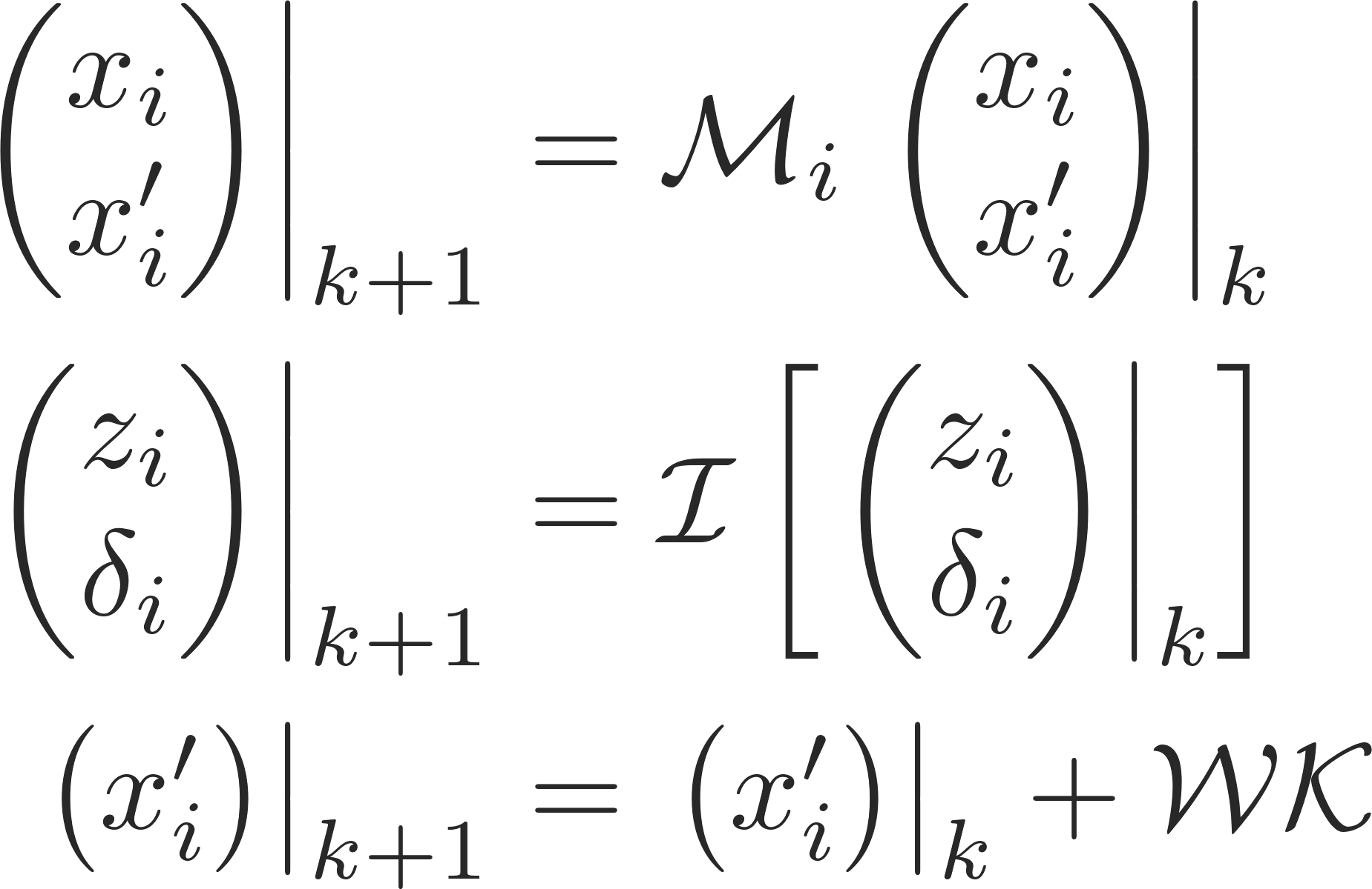
Summary – where are we?
We are now ready to track a full turn including the interaction with wake fields
Initialise a macroparticle distribution with a given emittance
Update transverse coordinates and momenta according to the linear periodic transfer map – adjust the individual phase advance according to chromaticity and detuning with amplitude
Update the longitudinal coordinates and momenta according to the leap-frog integration scheme
Update momenta only (apply kicks) according to wake field generated kicks
Repeat turn-by-turn…
Wakefield

Slide 6
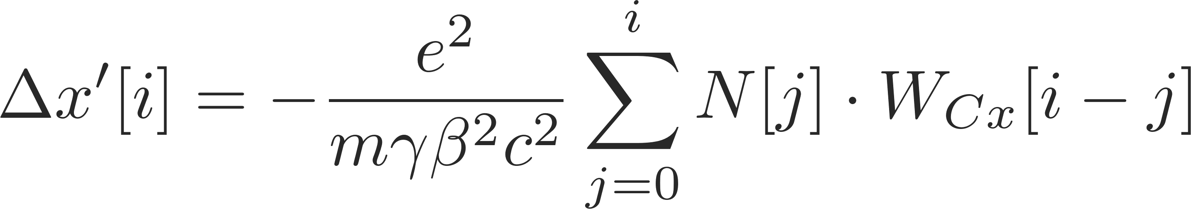
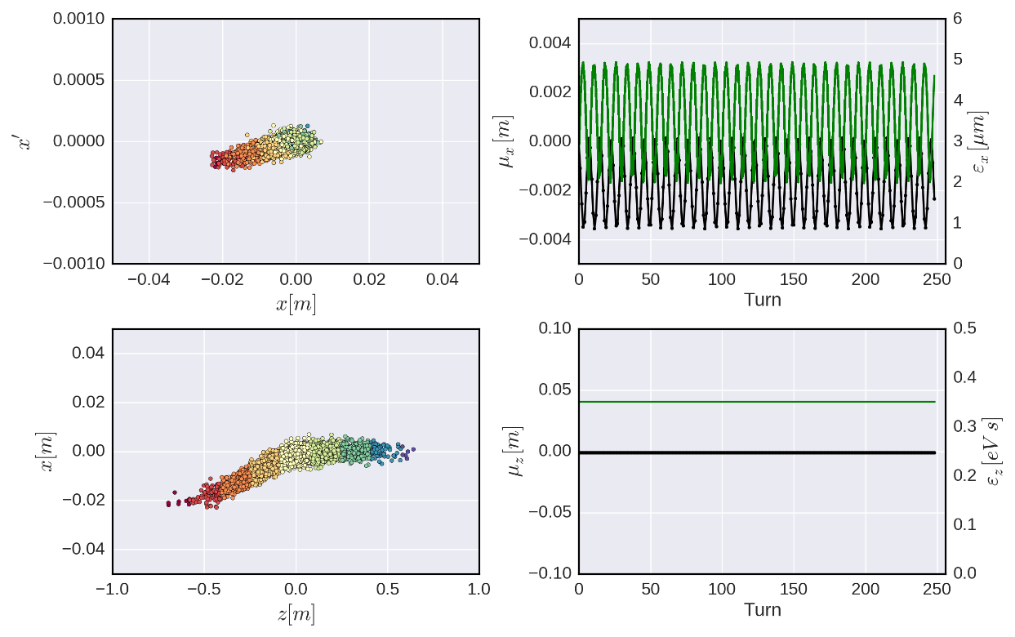
Examples – constant wakes
Dipolar term → orbit kick
Slice dependent change of closed orbit
(if line density does not change)

Slide 7
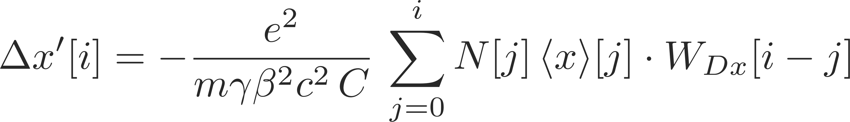
Examples – dipole wakes
Dipolar term → orbit kick
Offset dependent orbit kick
→ kicks can accumulate
With synchrotron motion we can get into a feedback loop
Without synchrotron motion:
kicks accumulate turn after turn – the beam is unstable → beam break-up in linacs
With synchrotron motion:
  Chromaticity = 0
    Synchrotron sidebands are well separated → beam is stable
    Synchrotron sidebands couple → (transverse) mode coupling instability
  Chromaticity ≠ 0
    Headtail modes → beam is unstable (can be very weak and often damped by non-linearities)

Slide 8
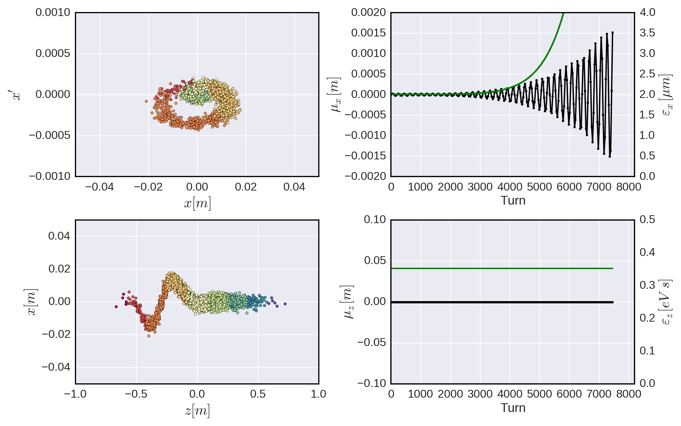
Dipole wakes – beam break-up

Slide 9
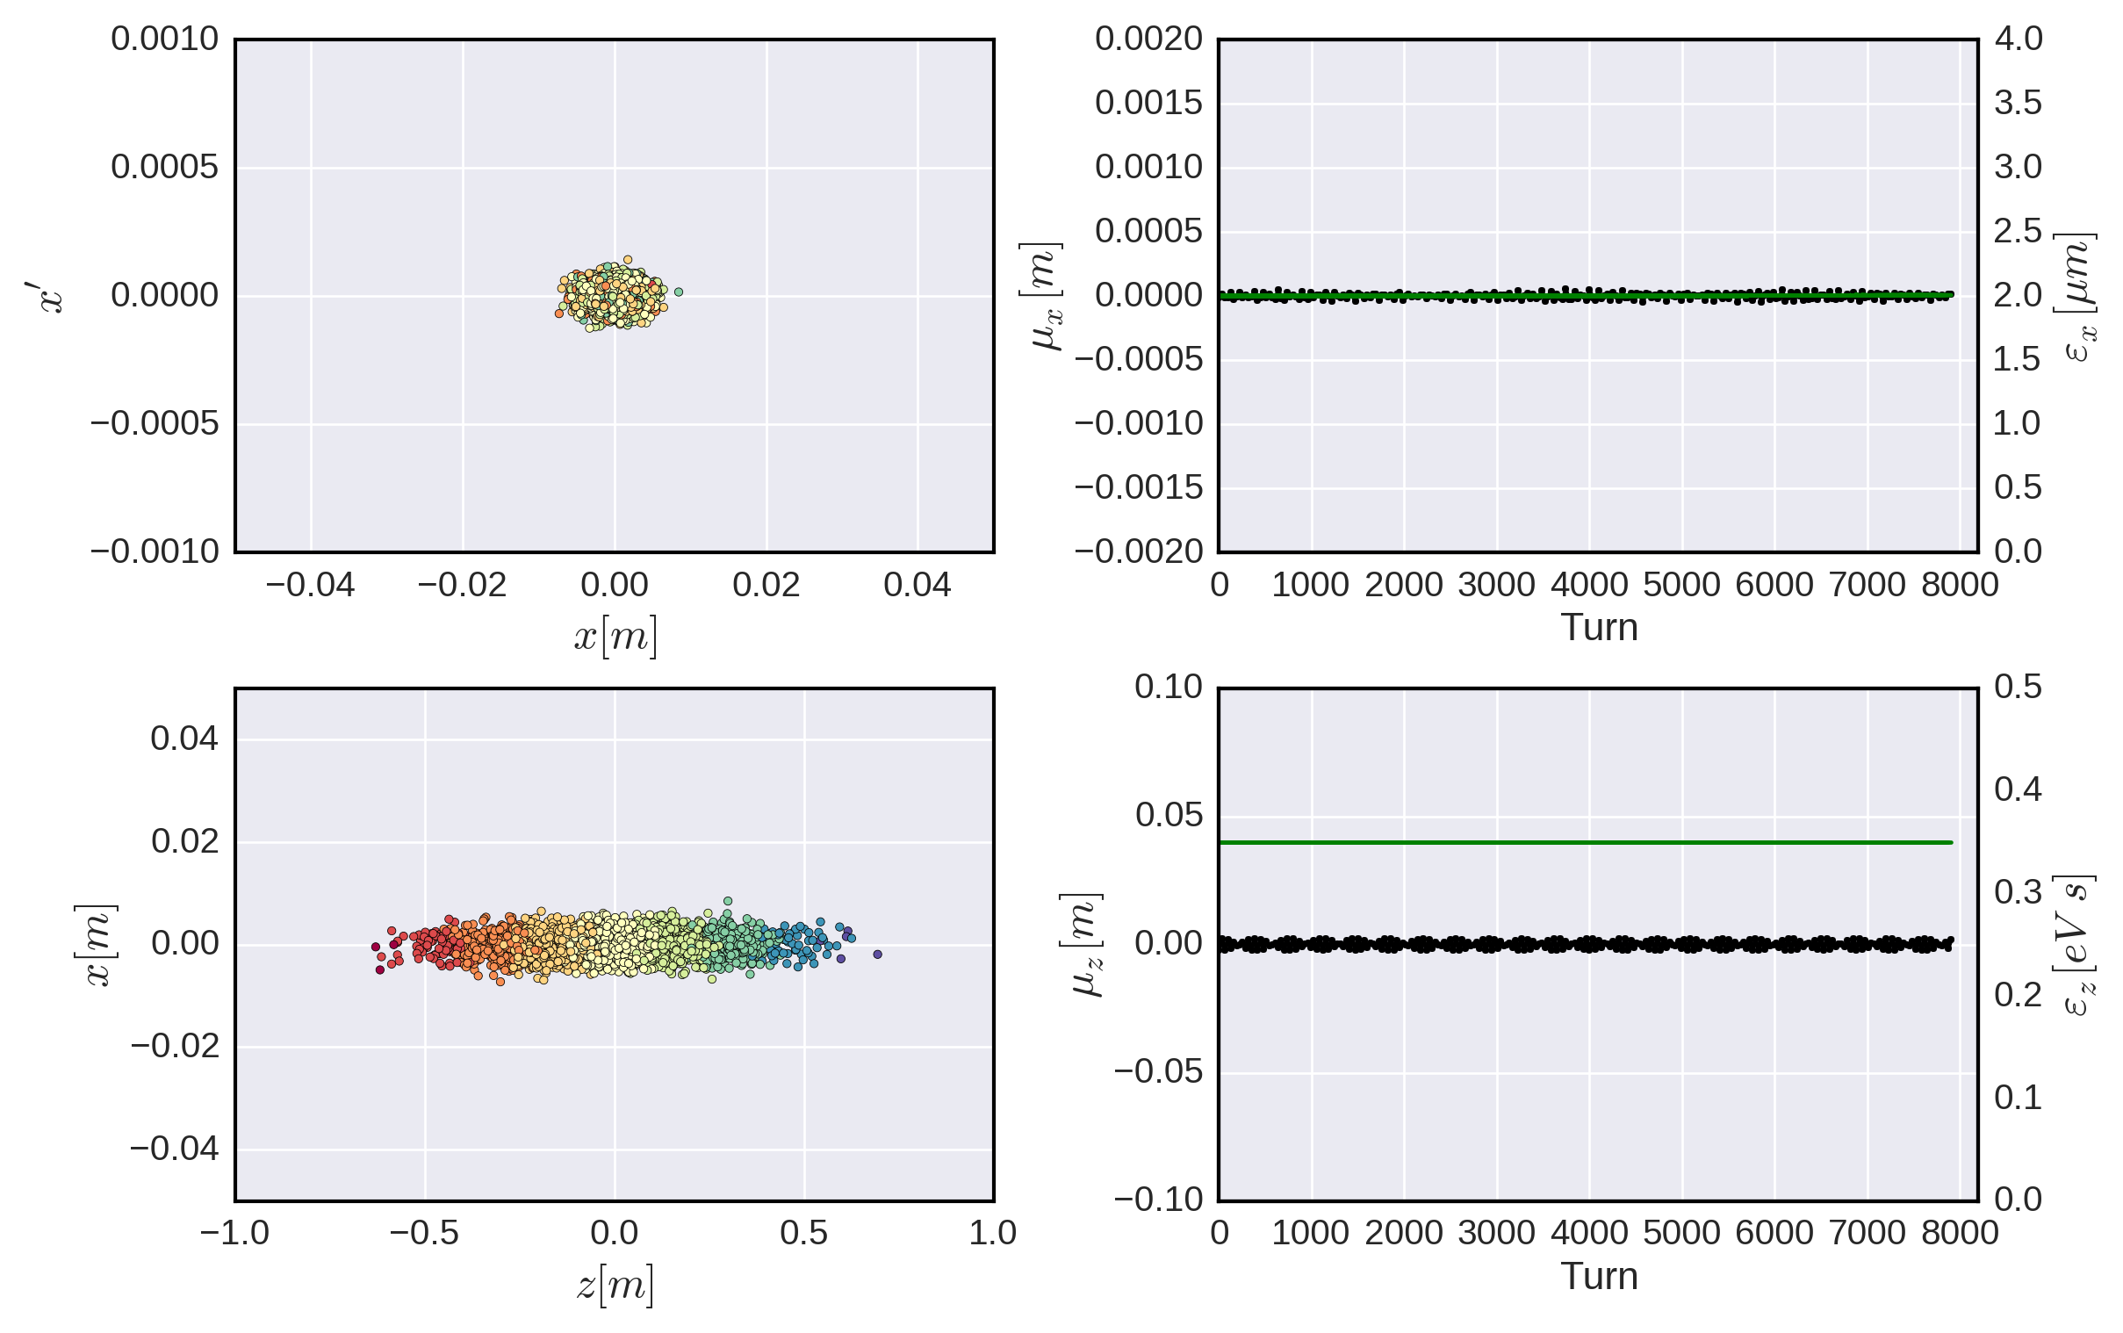
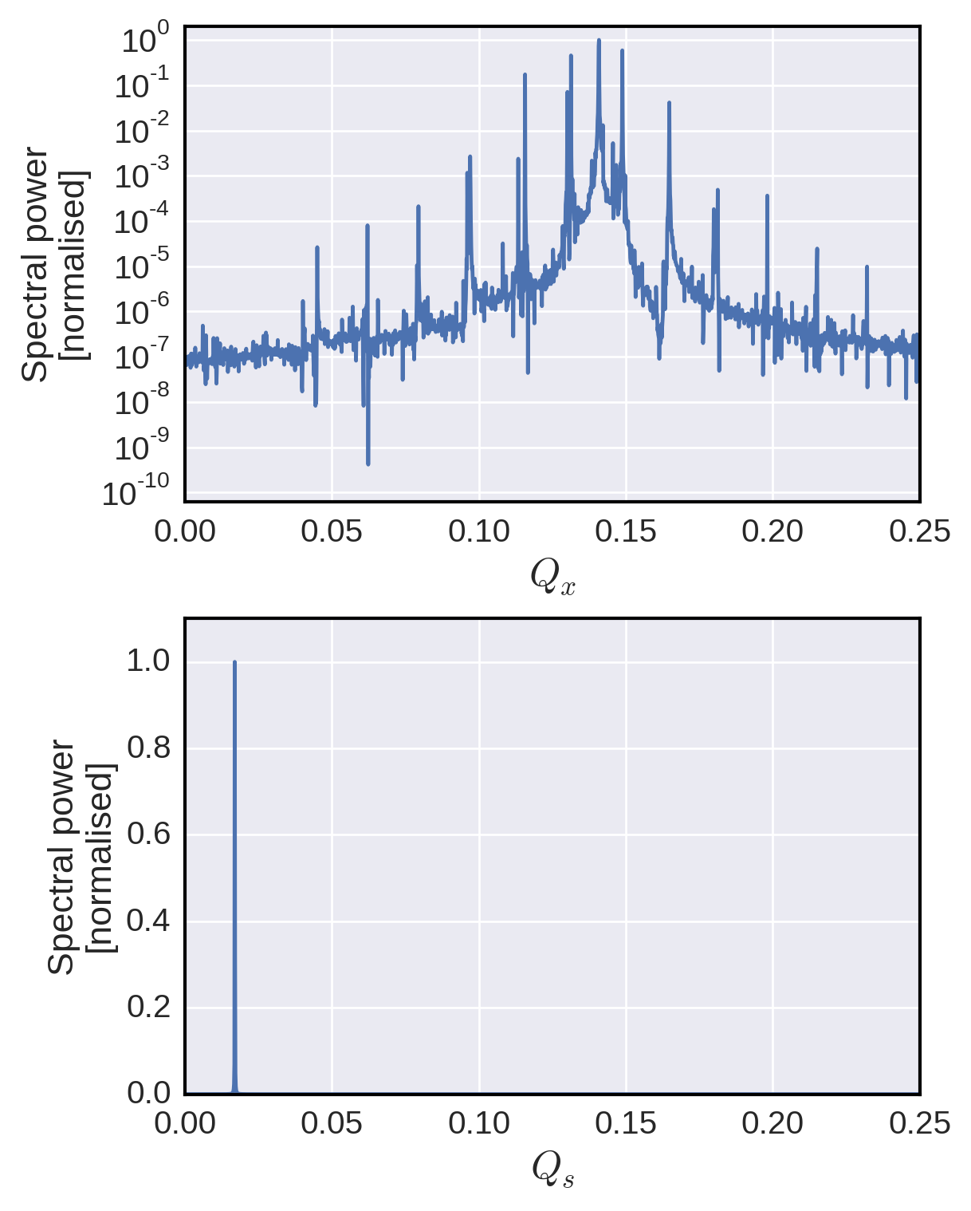
Dipole wakes – TMCI below threshold
As the intensity increases the coherent modes shift – here, modes A and B are approaching each other
Mode A
Mode B

Slide 10
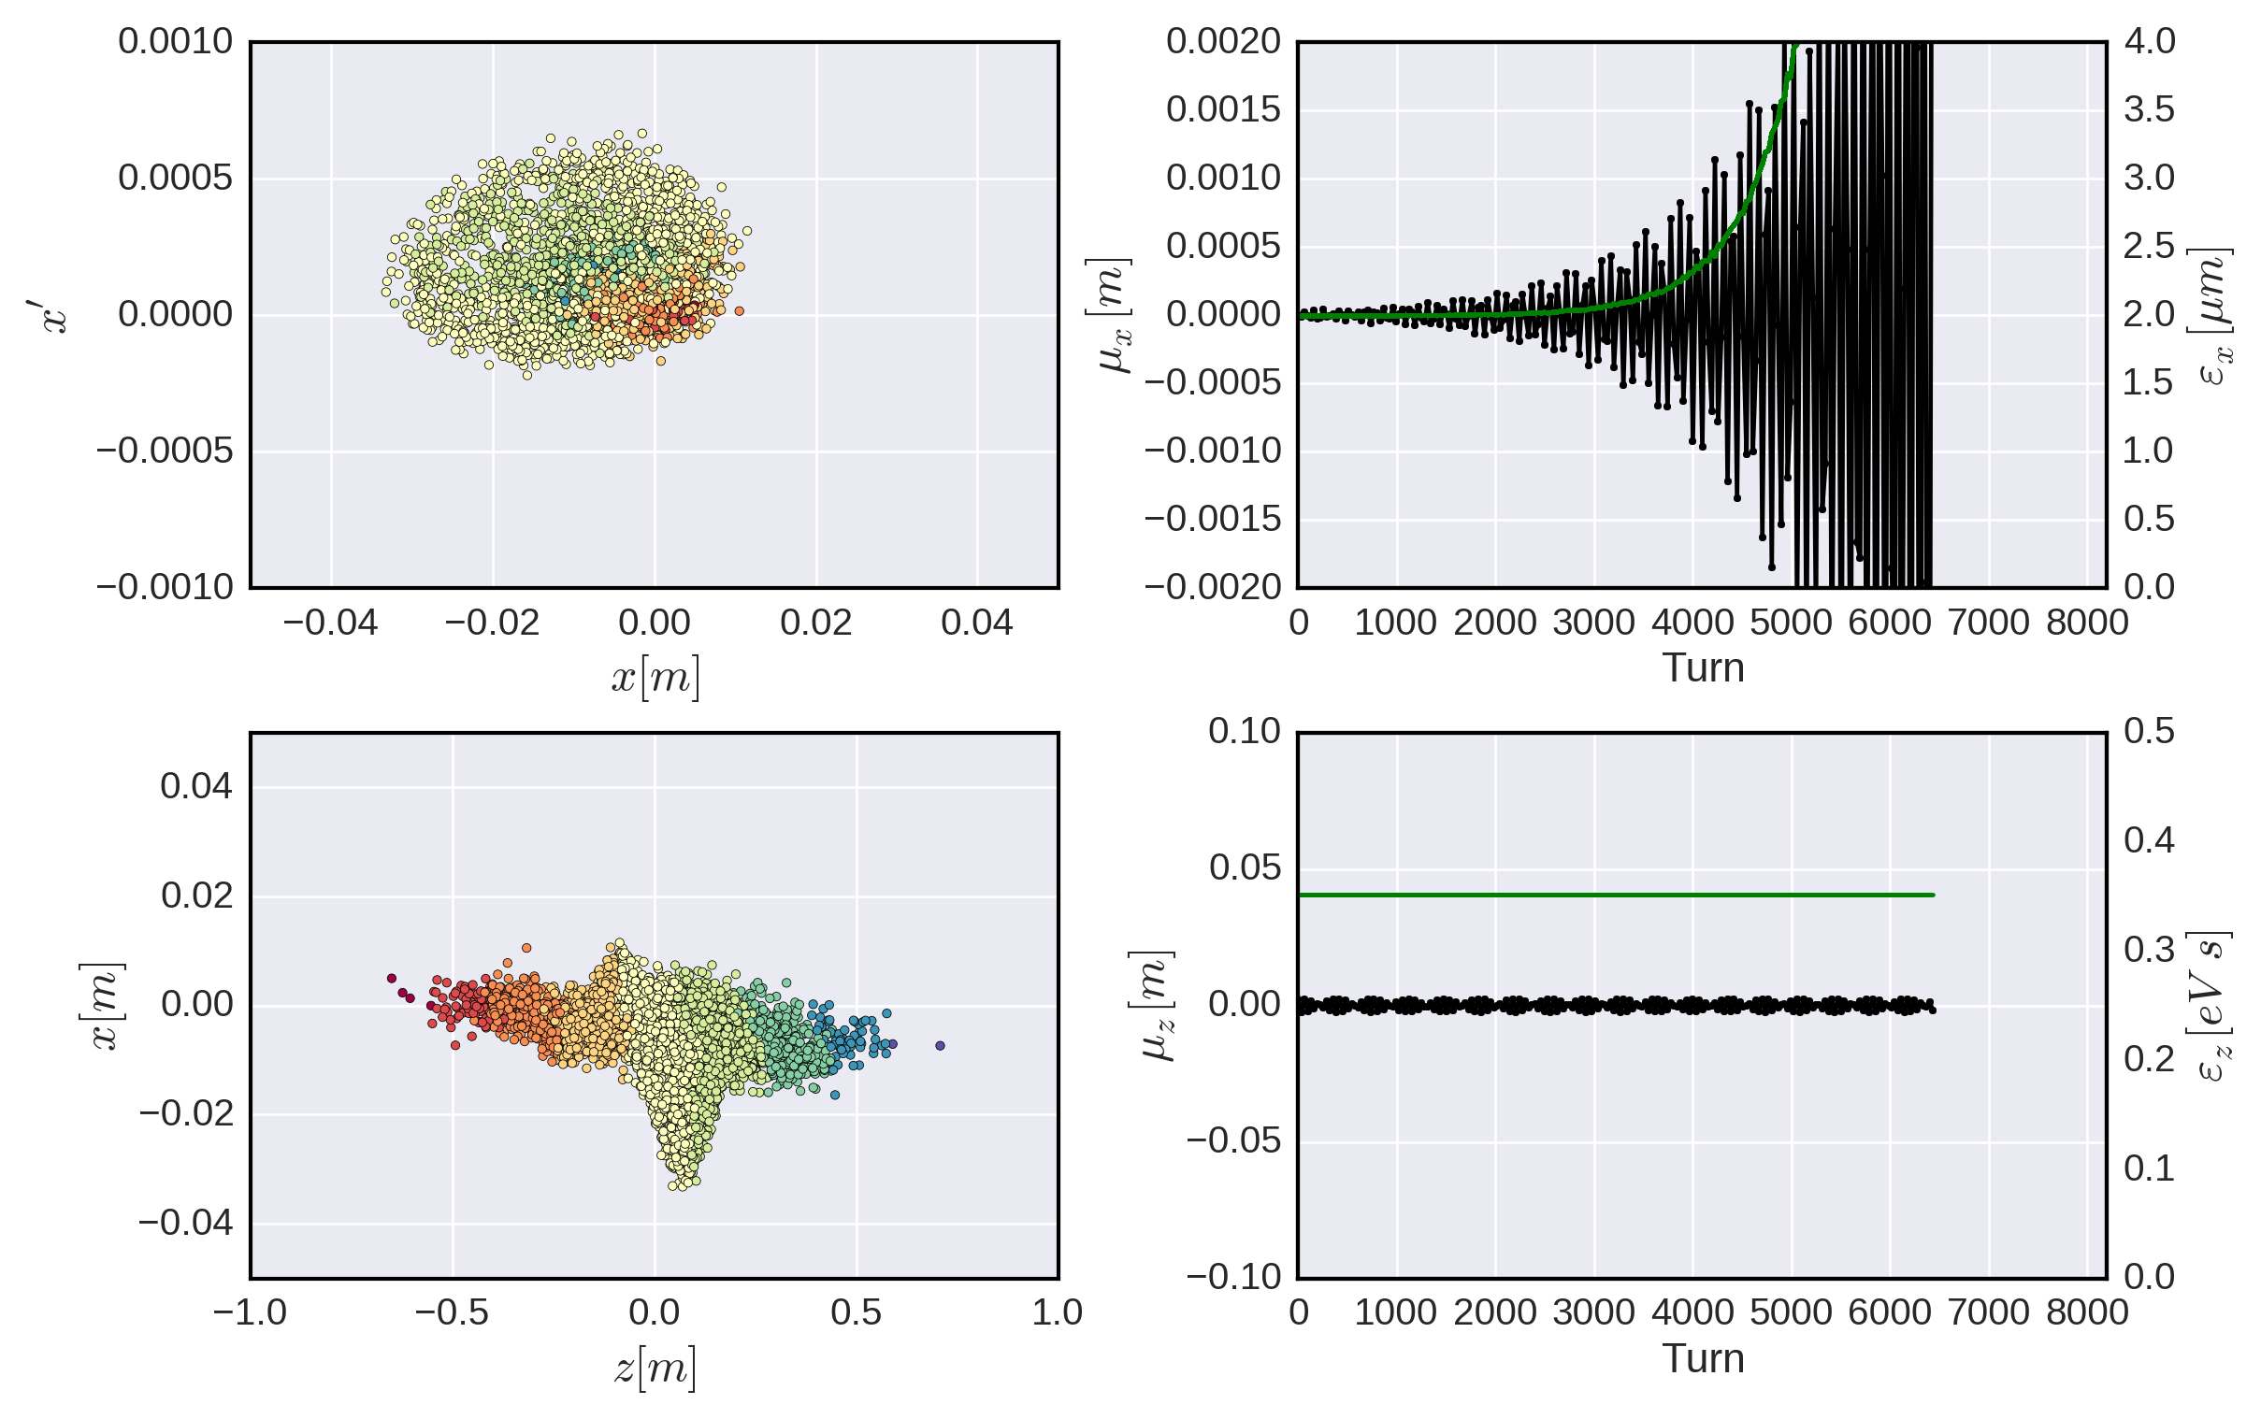
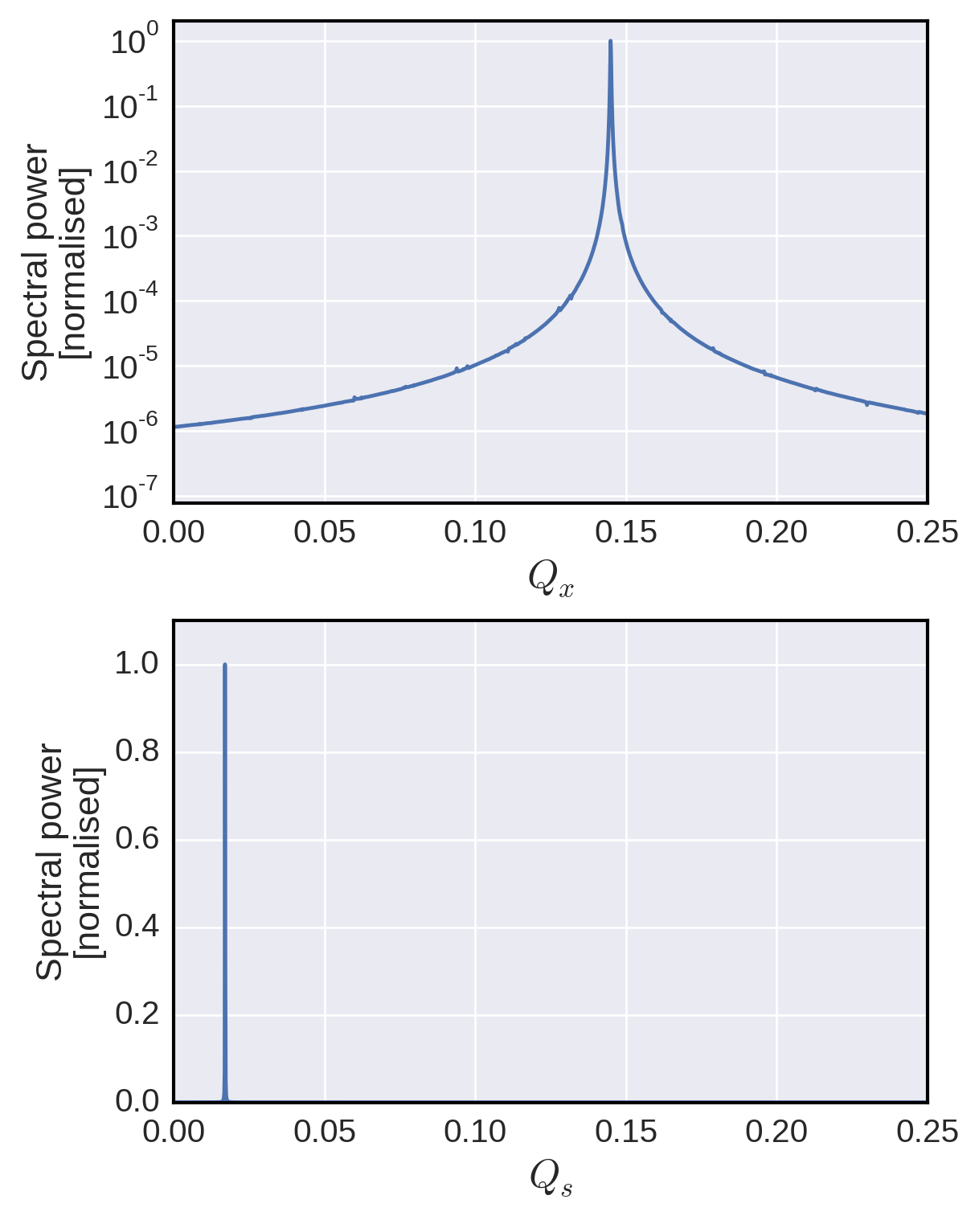
Dipole wakes – TMCI above threshold
When the two modes merge a fast coherent instability arises – the transverse mode coupling instability (TMCI) which often is a hard intensity limit in many machines
Mode A
Mode B

Slide 11
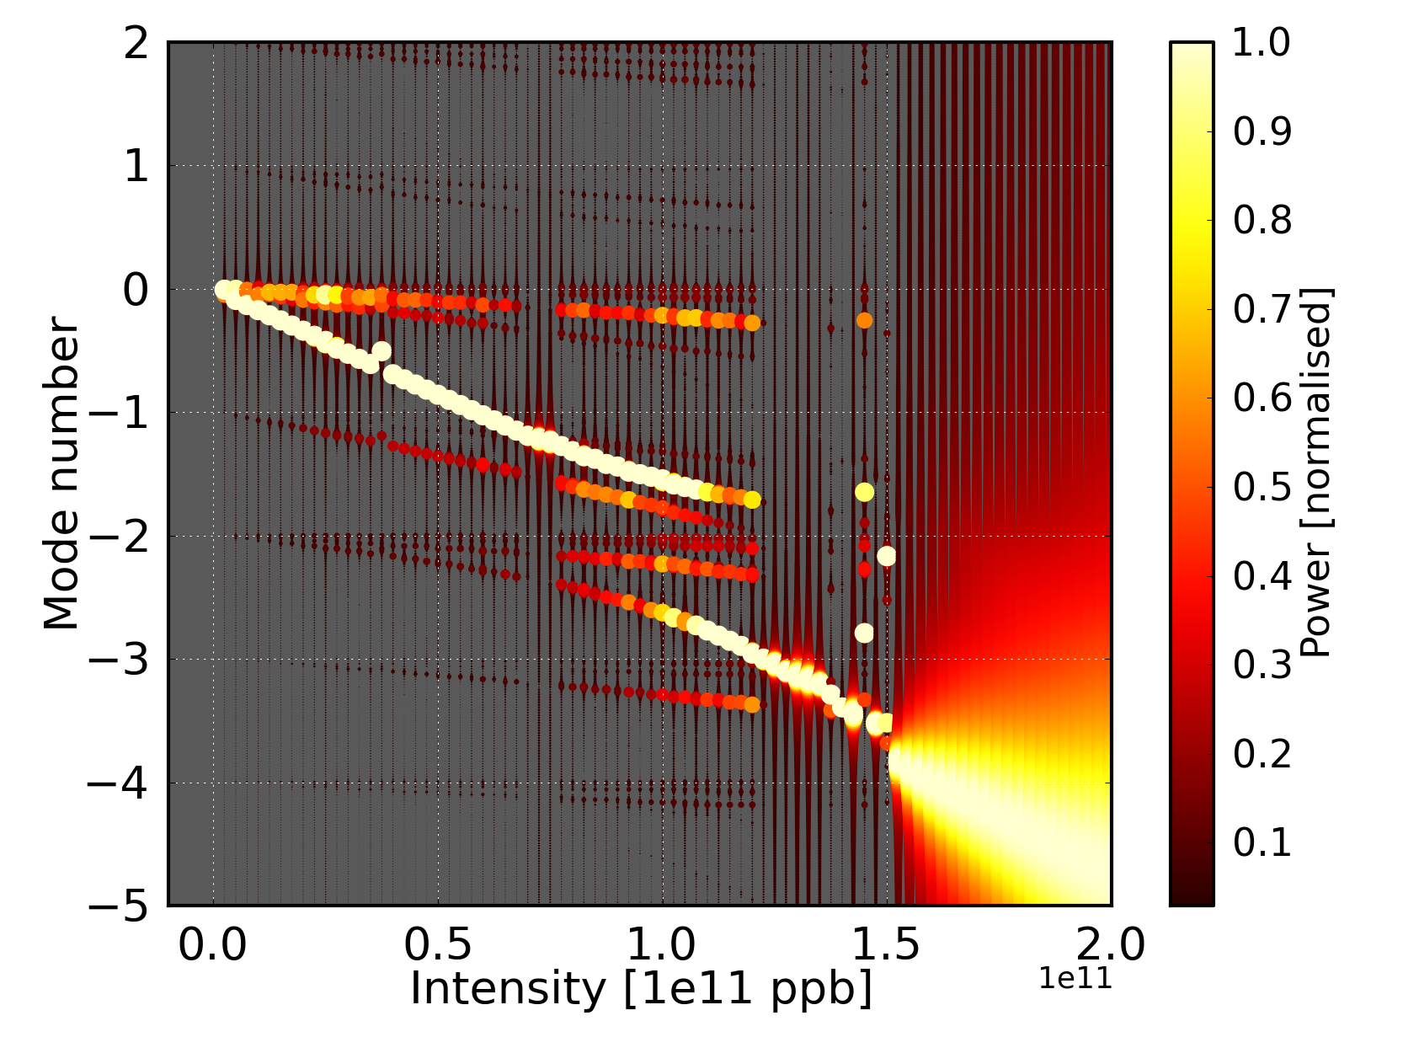
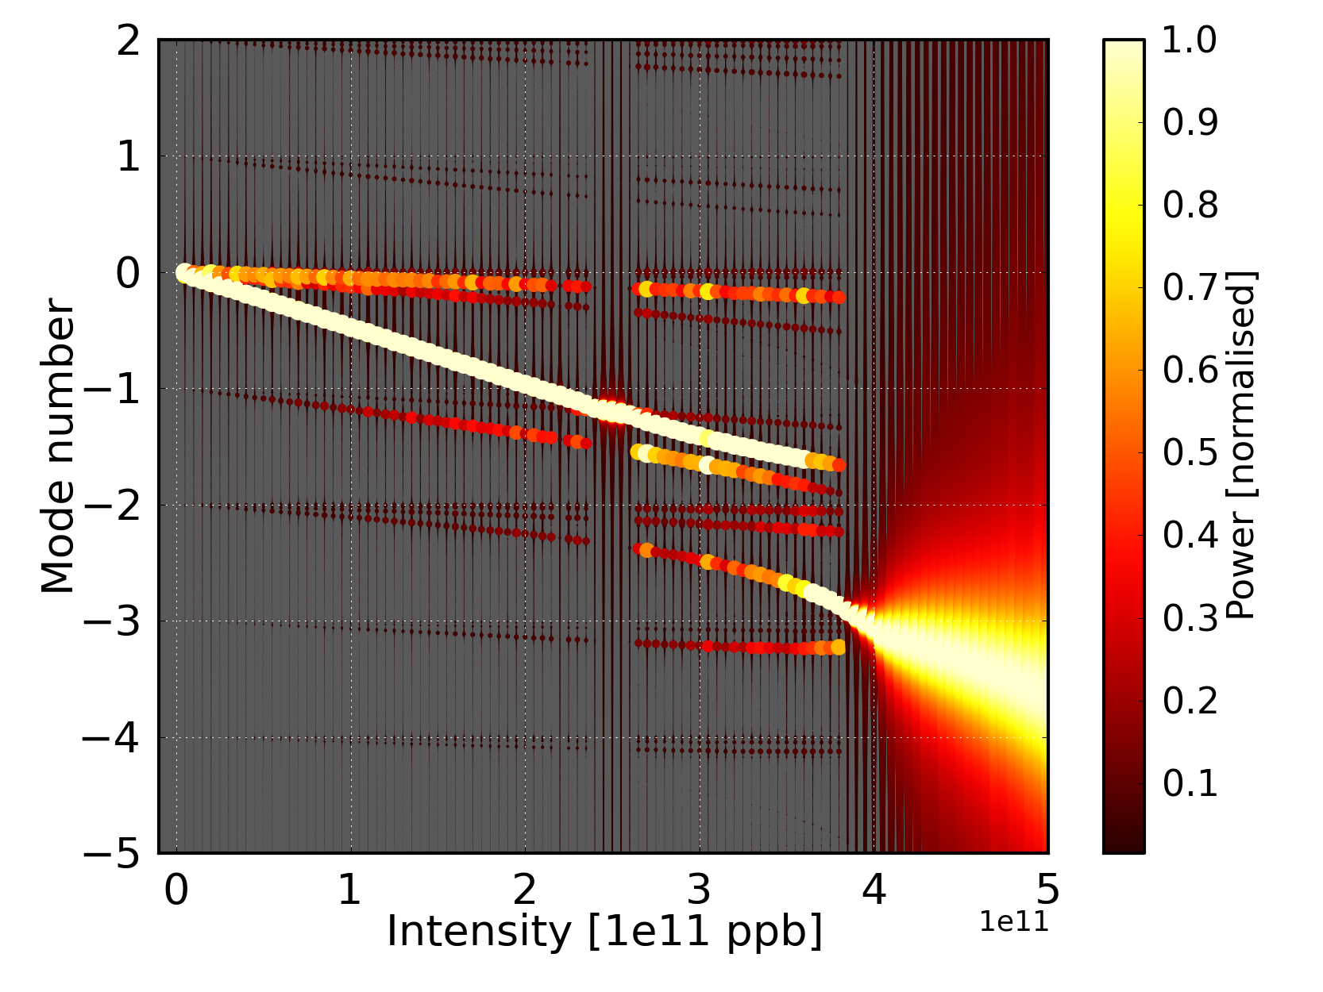
Raising the TMCI threshold – SPS Q20 optics
In simulations we have the possibility to perform scans of variables, e.g. we can run 100 simulations in parallel changing the beam intensity
We can then perform a spectral analysis of each simulation…
… and stack all obtained plot behind one another to obtain…
… the typical visualization plots of TMCI
Qs
Q 26 – Qs = 0.0059
Qs
Q 20 – Qs = 0.017
TMCI threshold
TMCI threshold

Slide 12
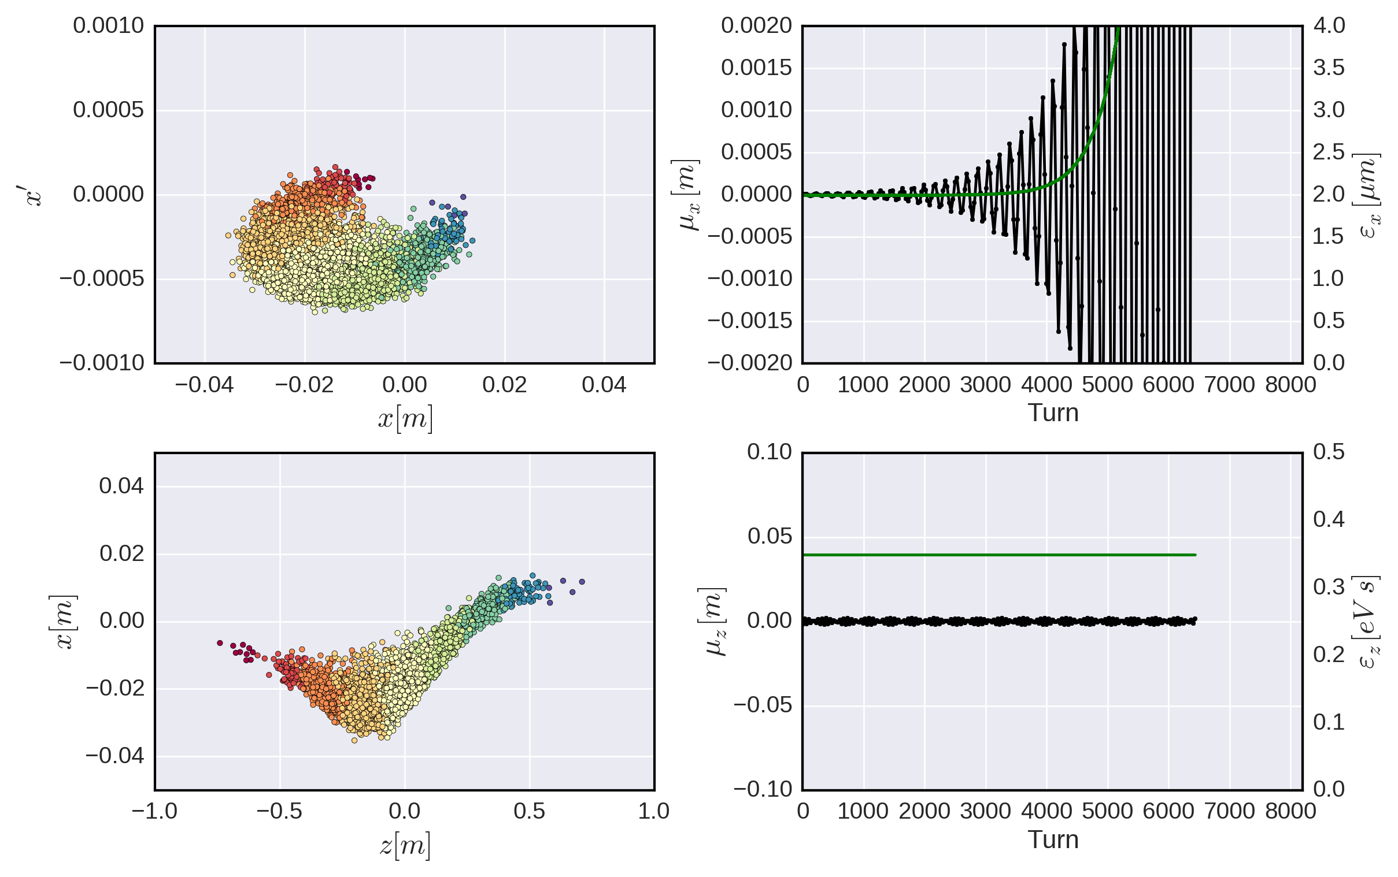
Dipole wakes – headtail modes
As soon as chromaticity is non-zero, another ‘resonant’ condition can be met as particles now ‘synchronize’ their betatron motion with the synchrotron motion
Headtail modes arise – the order of the respective mode depends on the chromaticity together with the impedance and bunch spectrum

Slide 13
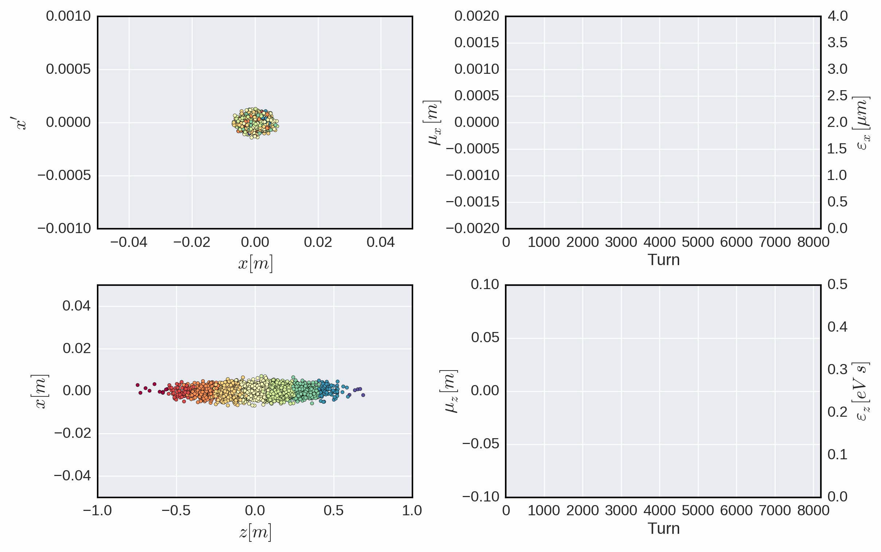
Dipole wakes – headtail modes

Slide 14
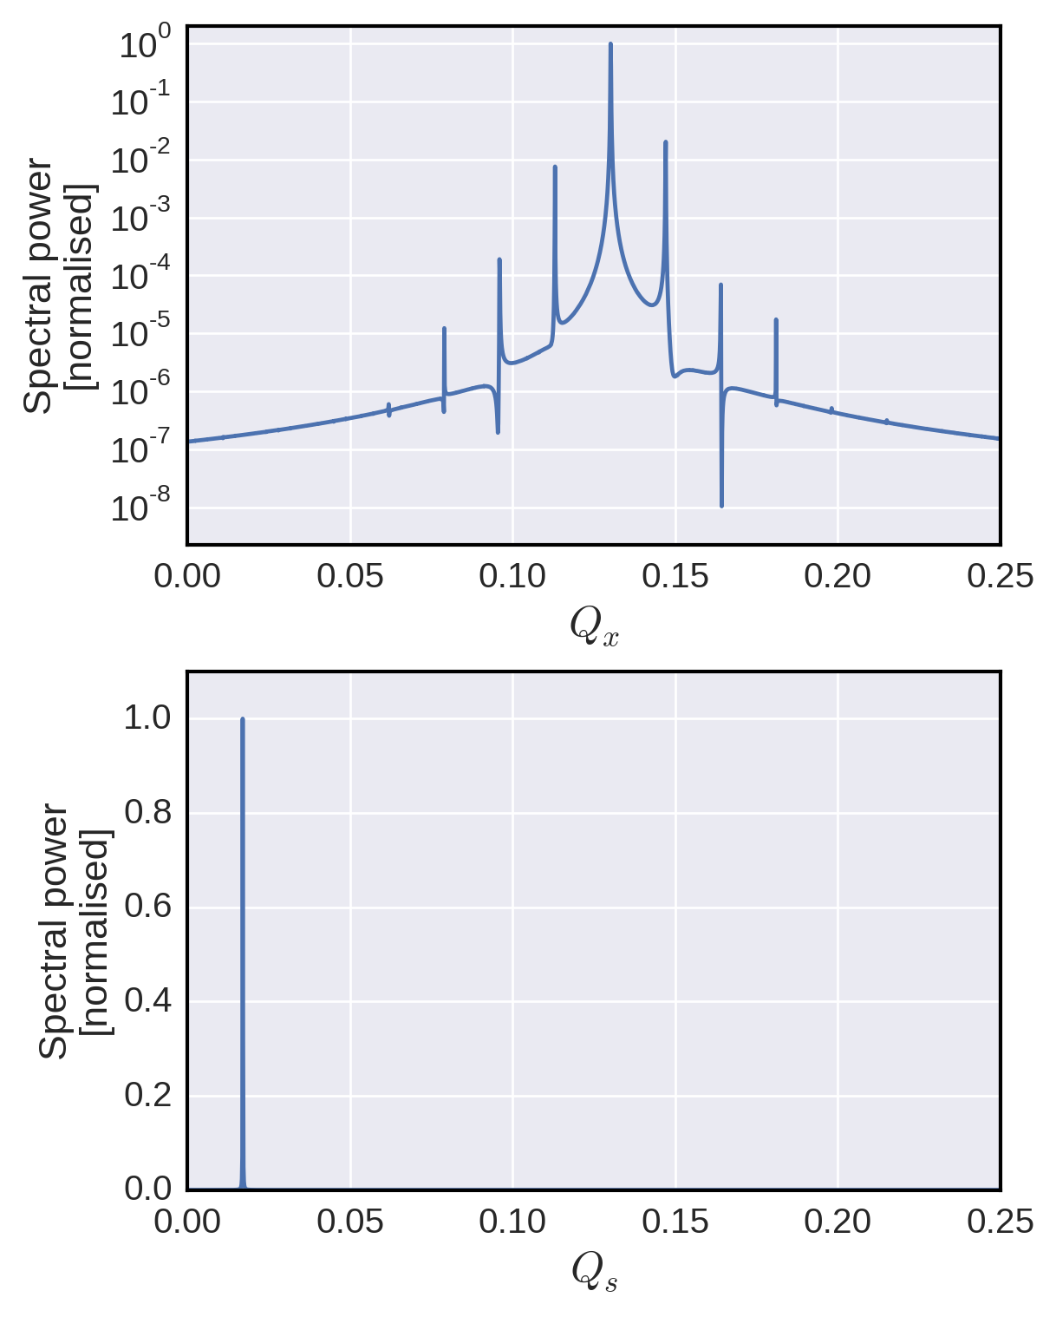
Dipole wakes – headtail modes

Slide 15
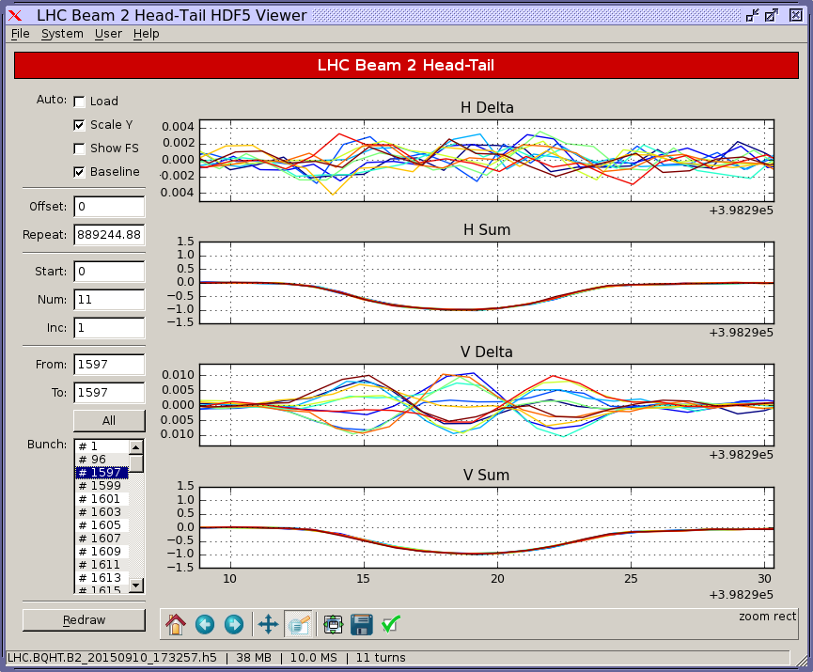
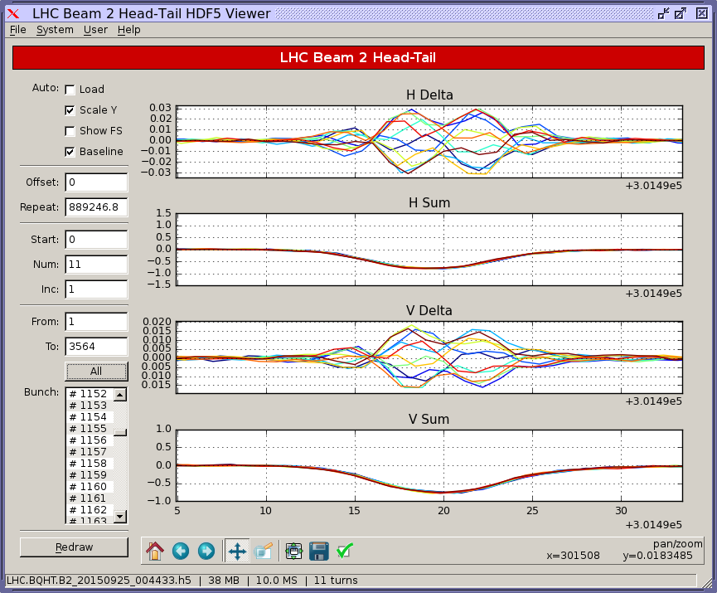
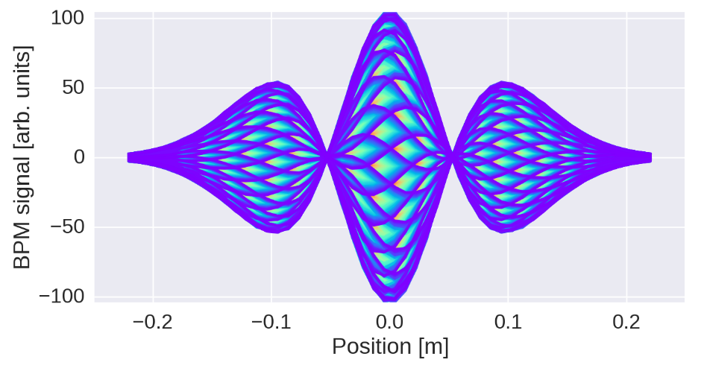
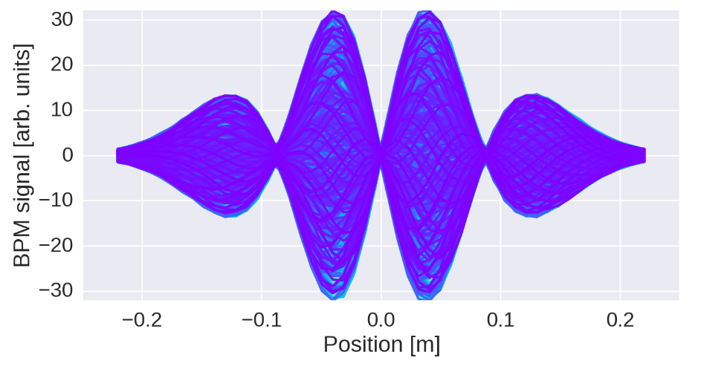
Example: Headtail modes in the LHC
Lower chroma – mode 2
Higher chroma – mode 3

Slide 16
End of part I
Numerical methods allow us
  to study conditions not realizable in a machine
  to disentangle effects
  to use unprecedented analysis tools
Macroparticle models closely resemble real systems and are relatively easy to implement
We have learned how to model and implement macroparticle simulations to study intensity effects in circular accelerators

Slide 17
Outline
Introduction to macroparticle models –
implementations, applications and examples
Part 1 – numerical modelling
  Initialisation
  Simple tracking
  Chromaticity and detuning
  Wakefields with examples
    Constant wakes
    Dipole wakes
    TMCI & headtail modes
Part 2 – electron cloud
  Modelling of e-cloud interactions
  PIC solvers
  Application for e-cloud instabilities
Notes:
Perhaps other way round

Slide 18
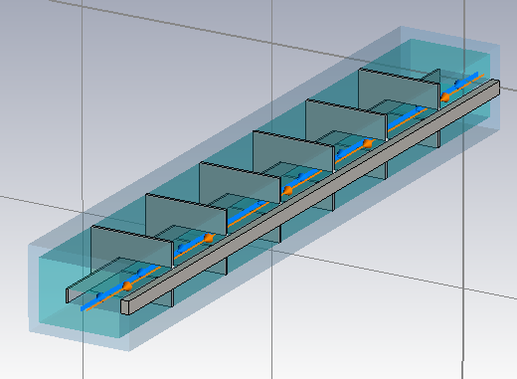
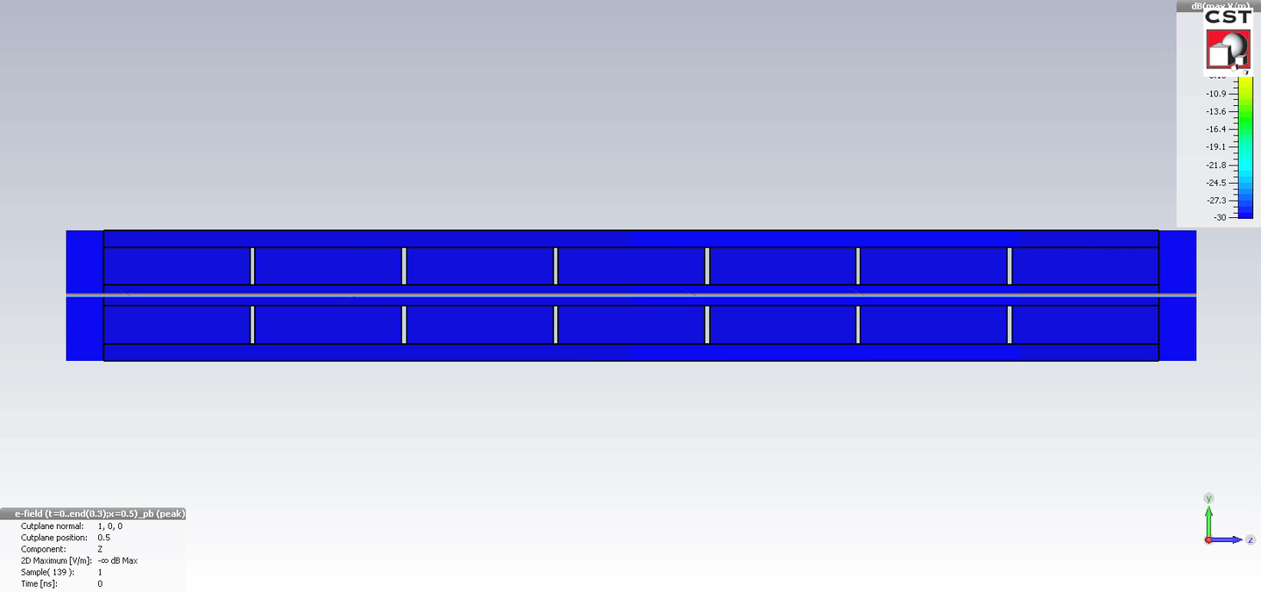
Accelerator beam system - wakefields
Our first ‘real’ collective interaction from impedances

Slide 19


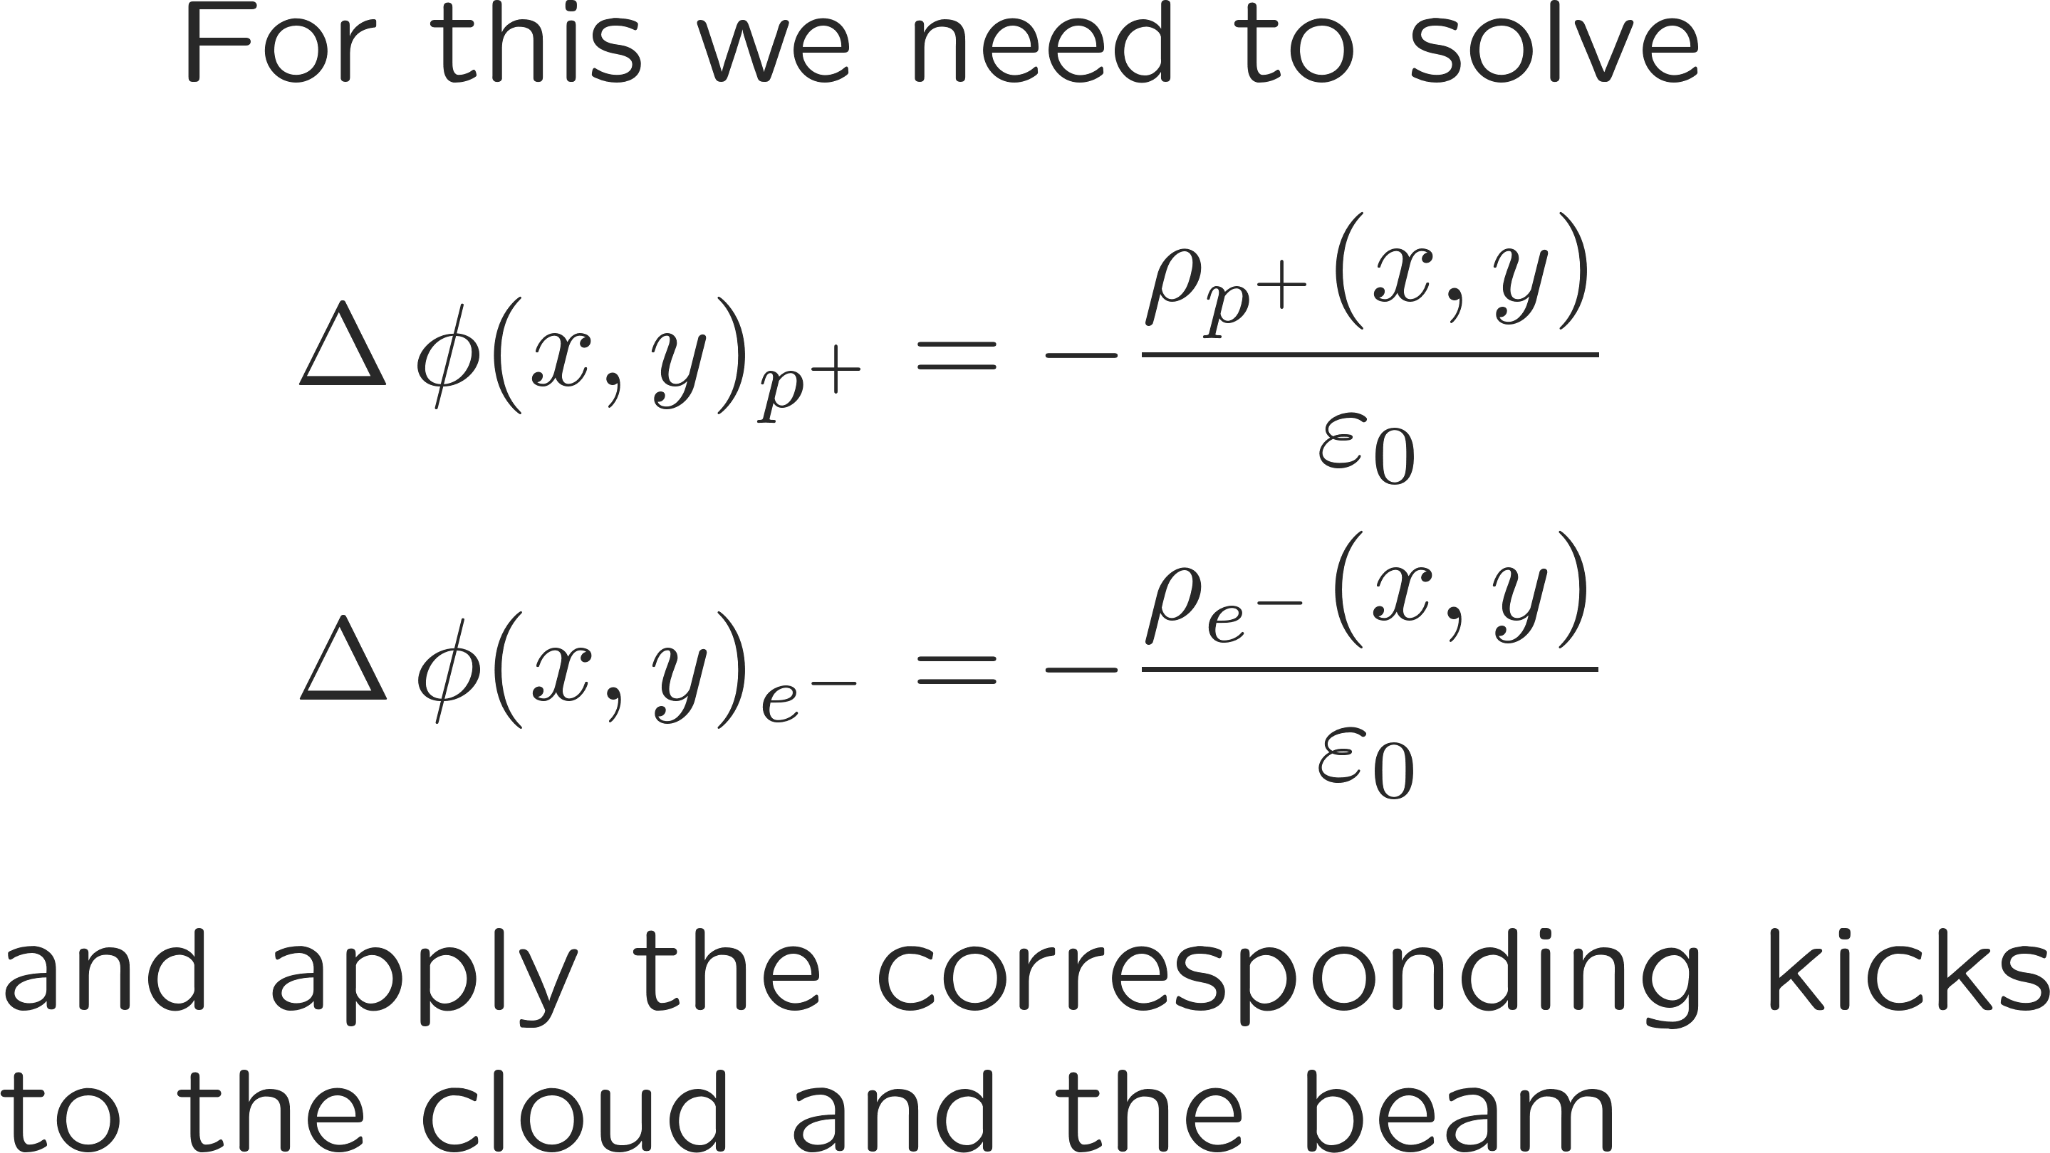
Accelerator beam system – electron clouds
Two stream collective interaction – much more involved
Approximations here:
The beam is ultra-relativistic
The electron velocity is well below c
The electron cloud has a low aspect ratio

Slide 20
Accelerator beam system – electron clouds
count | x | x’ | y | y’
0 | … | … | … | …
1 | … | … | … | …
2 | … | … | … | …
3 | … | … | … | …
4 | … | … | … | …
5 | … | … | … | …
6 | … | … | … | …
count | x | y | phi
0 | … | … | …
1 | … | … | …
2 | … | … | …
3 | … | … | …
4 | … | … | …
5 | … | … | …
6 | … | … | …
More memory, more computation steps – overall more challenging
count | x | y | phi
0 | … | … | …
1 | … | … | …
2 | … | … | …
3 | … | … | …
4 | … | … | …
5 | … | … | …
6 | … | … | …
Two macroparticle systems now need to be solved simultaneously
The electric field evaluation usually is the most time-consuming step and should be done efficiently
Keep track of macroparticle systems and fields
count | x | x’ | y | y’ | z | delta
0 | … | … | … | … | … | …
1 | … | … | … | … | … | …
2 | … | … | … | … | … | …
3 | … | … | … | … | … | …
4 | … | … | … | … | … | …
5 | … | … | … | … | … | …
6 | … | … | … | … | … | …

Slide 21
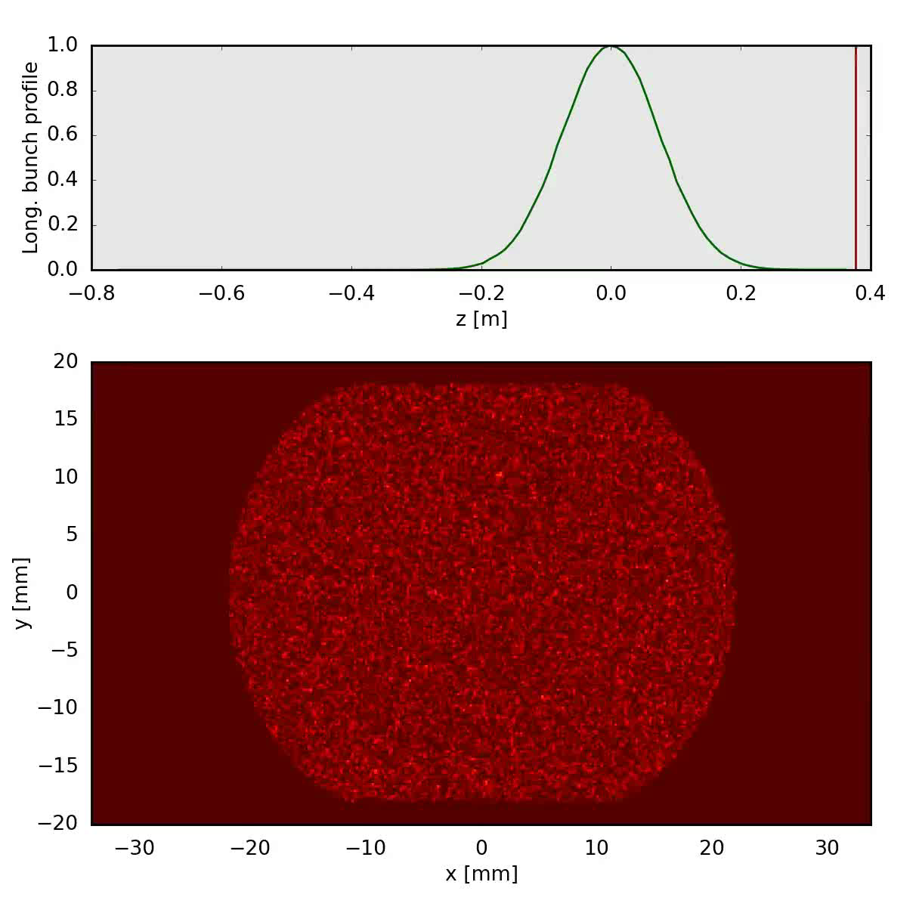
Electron clouds in a drift section
Two stream collective interaction – much more involved
Beam passage leads to a pinch of the cloud which in turn acts back on the beam – differently each turn

Slide 22
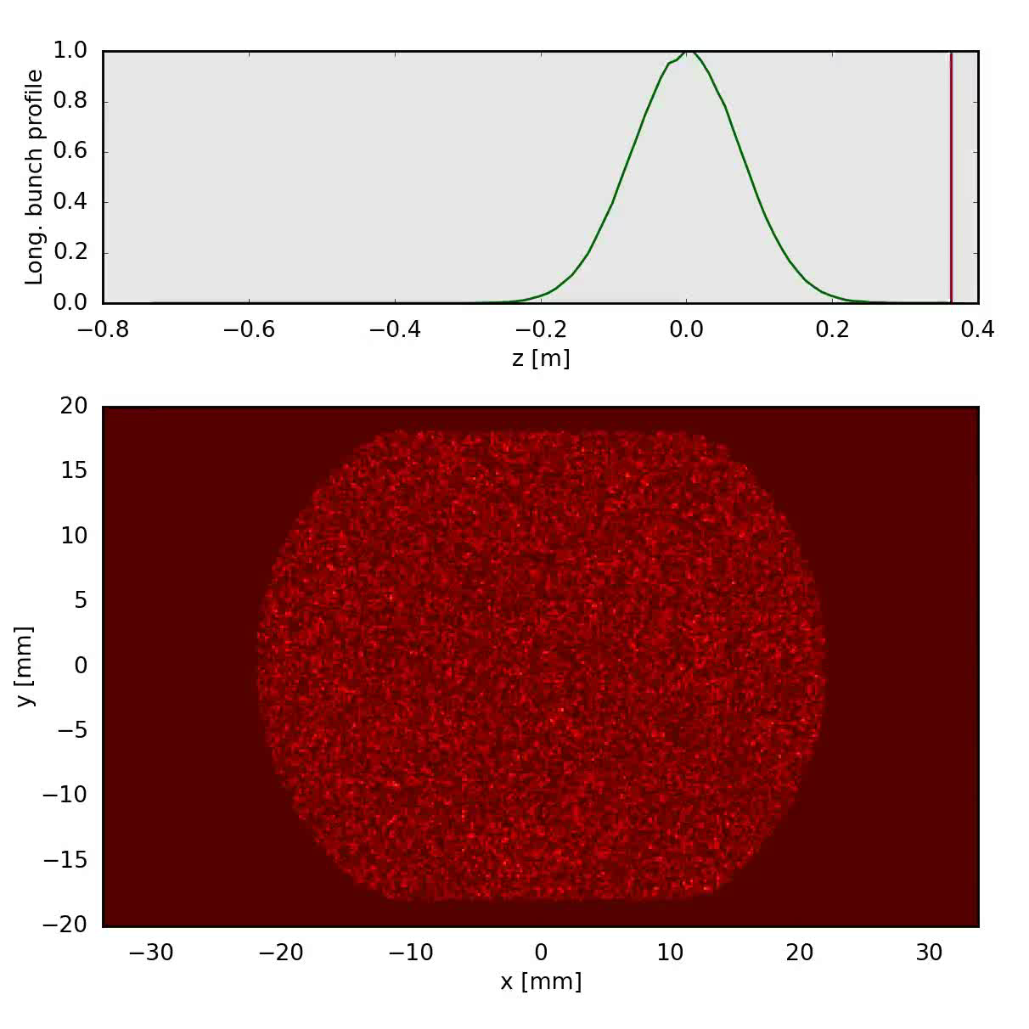
Electron clouds in a bending magnet
Two stream collective interaction – much more involved
Beam passage leads to a pinch of the cloud which in turn acts back on the beam – differently each turn

Slide 23

Electron clouds in a quadrupole magnet
Two stream collective interaction – much more involved
Beam passage leads to a pinch of the cloud which in turn acts back on the beam – differently each turn

Slide 24
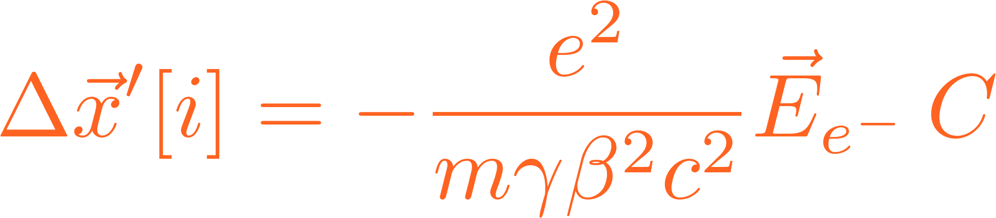
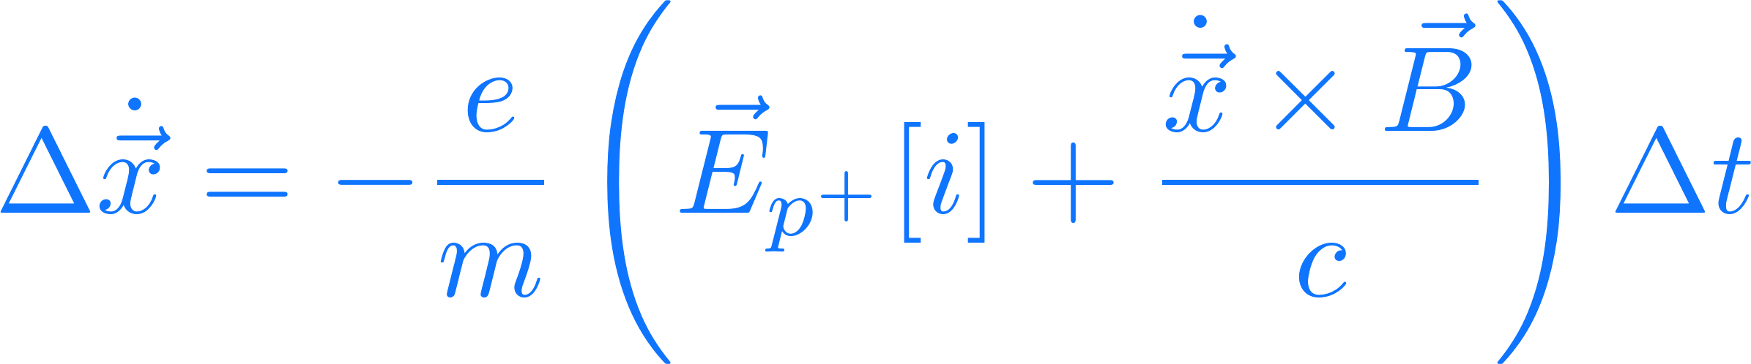
Accelerator-beam system – e-cloud
Particles in/fields from slice i
Basic loop of tracking with wake fields:
  Transport beam along segment to interaction point
  Perform e-cloud interaction – requires electric fields from macroparticle distributions
  Electric field computation in this case conveniently handled with Particle-In-Cell algorithm

Slide 25
E-cloud beam system
PIC stands for Particle-In-Cell
We use this method to compute fields generated by particles to solve e.g. the Poisson equation
Electron motion occurs at the time scale of a slice of a bunch length → track single slices through the e-cloud and apply integrated kicks

Slide 26
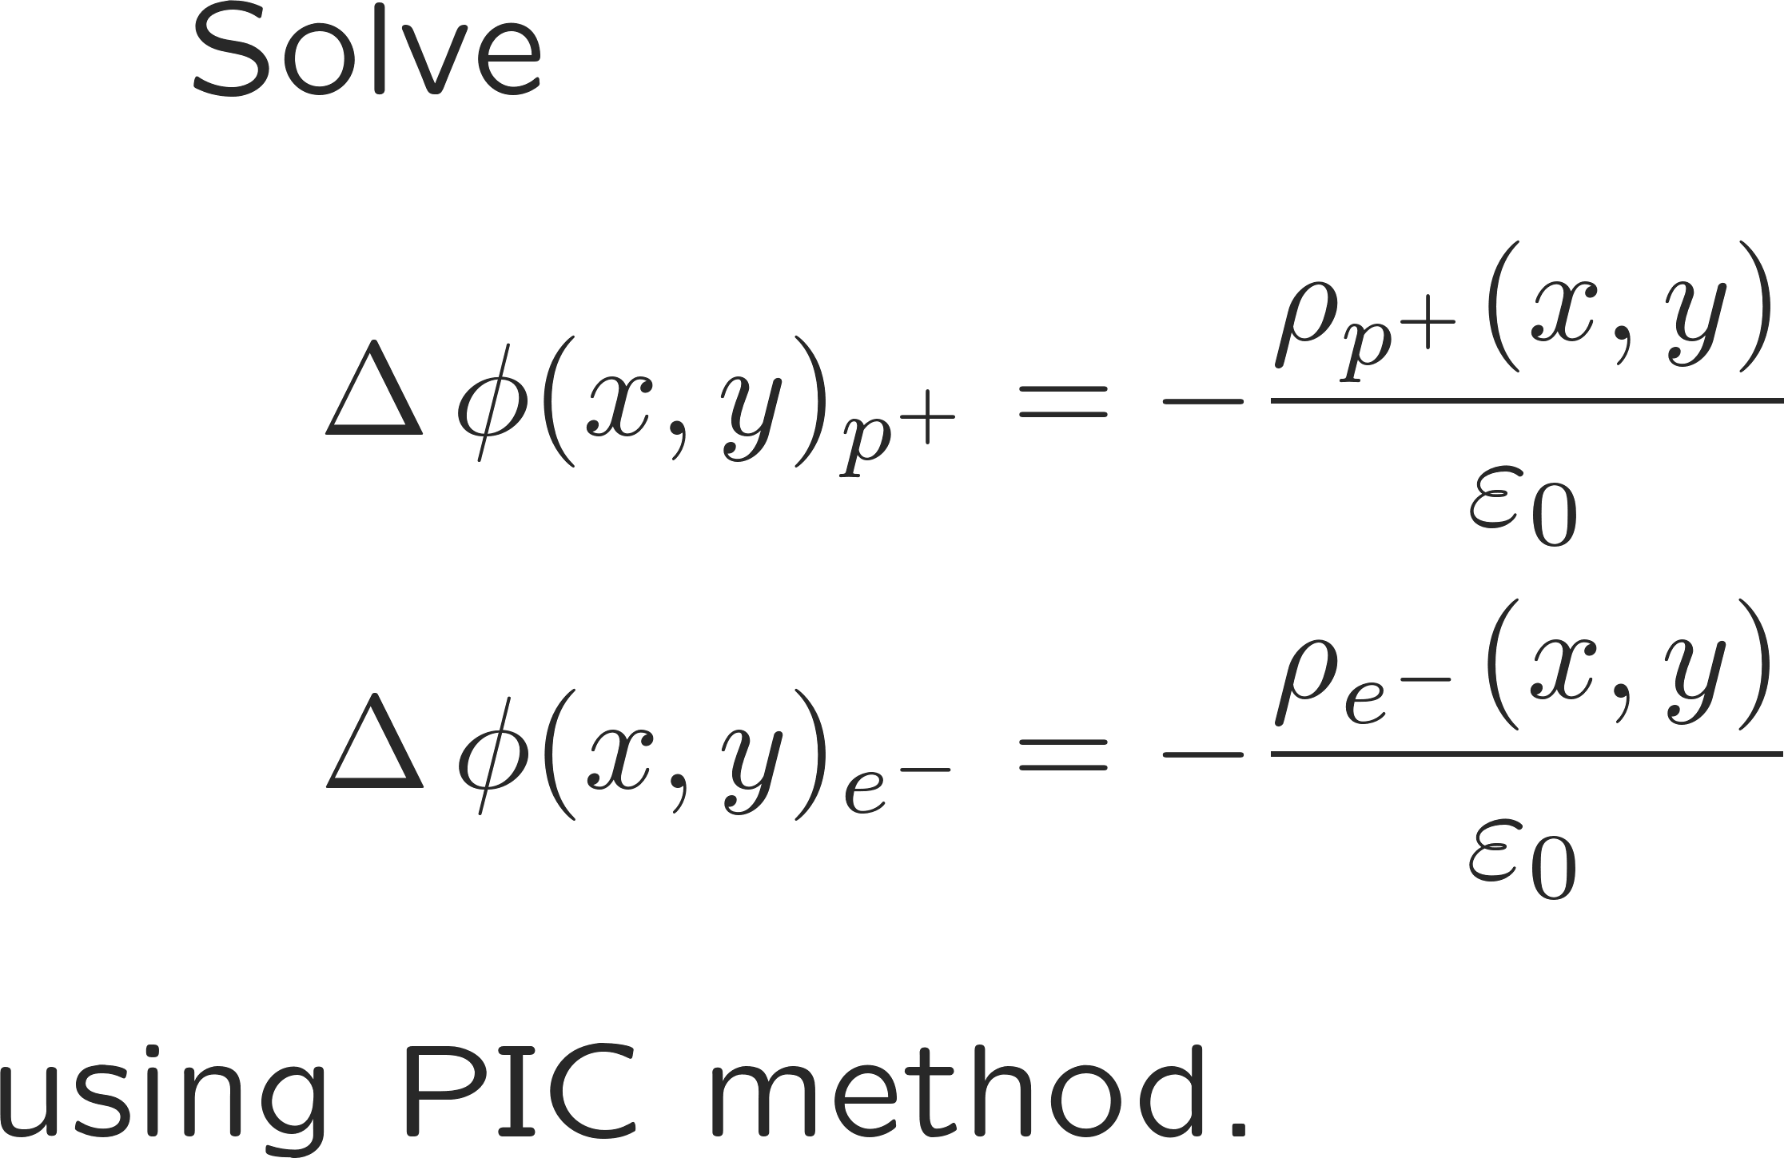
E-cloud beam system
PIC stands for Particle-In-Cell
We use this method to compute fields generated by particles to solve e.g. the Poisson equation
Electron motion occurs at the time scale of a slice of a bunch length → track single slices through the e-cloud and apply integrated kicks
  Compute electric fields from one slice and from e-cloud
  Apply kicks to protons
  Advance electrons by one slice length – this is a multi-scale dynamics problem (fast cyclotron motion superposed to slower guiding center drift) → Boris algorithm for tracking (per macroparticle)
  Track next slice through e-cloud

Slide 27
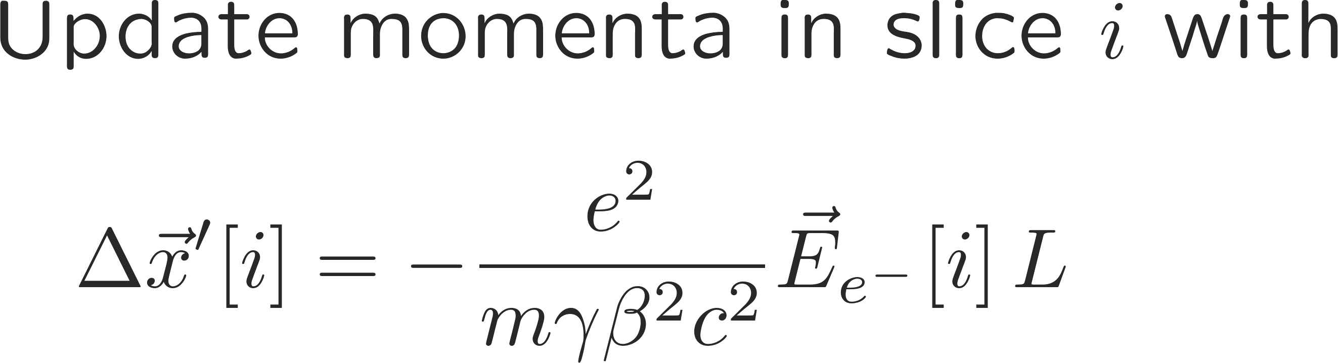
E-cloud beam system
PIC stands for Particle-In-Cell
We use this method to compute fields generated by particles to solve e.g. the Poisson equation
Electron motion occurs at the time scale of a slice of a bunch length → track single slices through the e-cloud and apply integrated kicks
  Compute electric fields from one slice and from e-cloud
  Apply kicks to protons
  Advance electrons by one slice length – this is a multi-scale dynamics problem (fast cyclotron motion superposed to slower guiding center drift) → Boris algorithm for tracking (per macroparticle)
  Track next slice through e-cloud

Slide 28
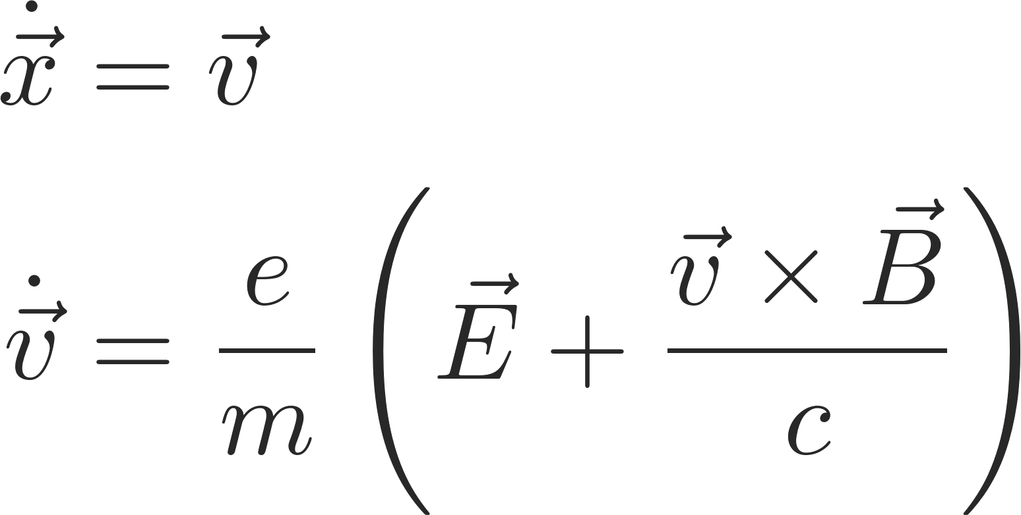
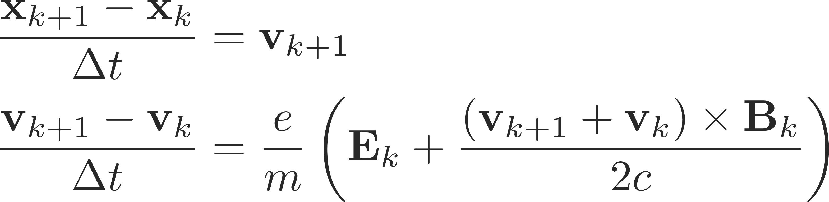
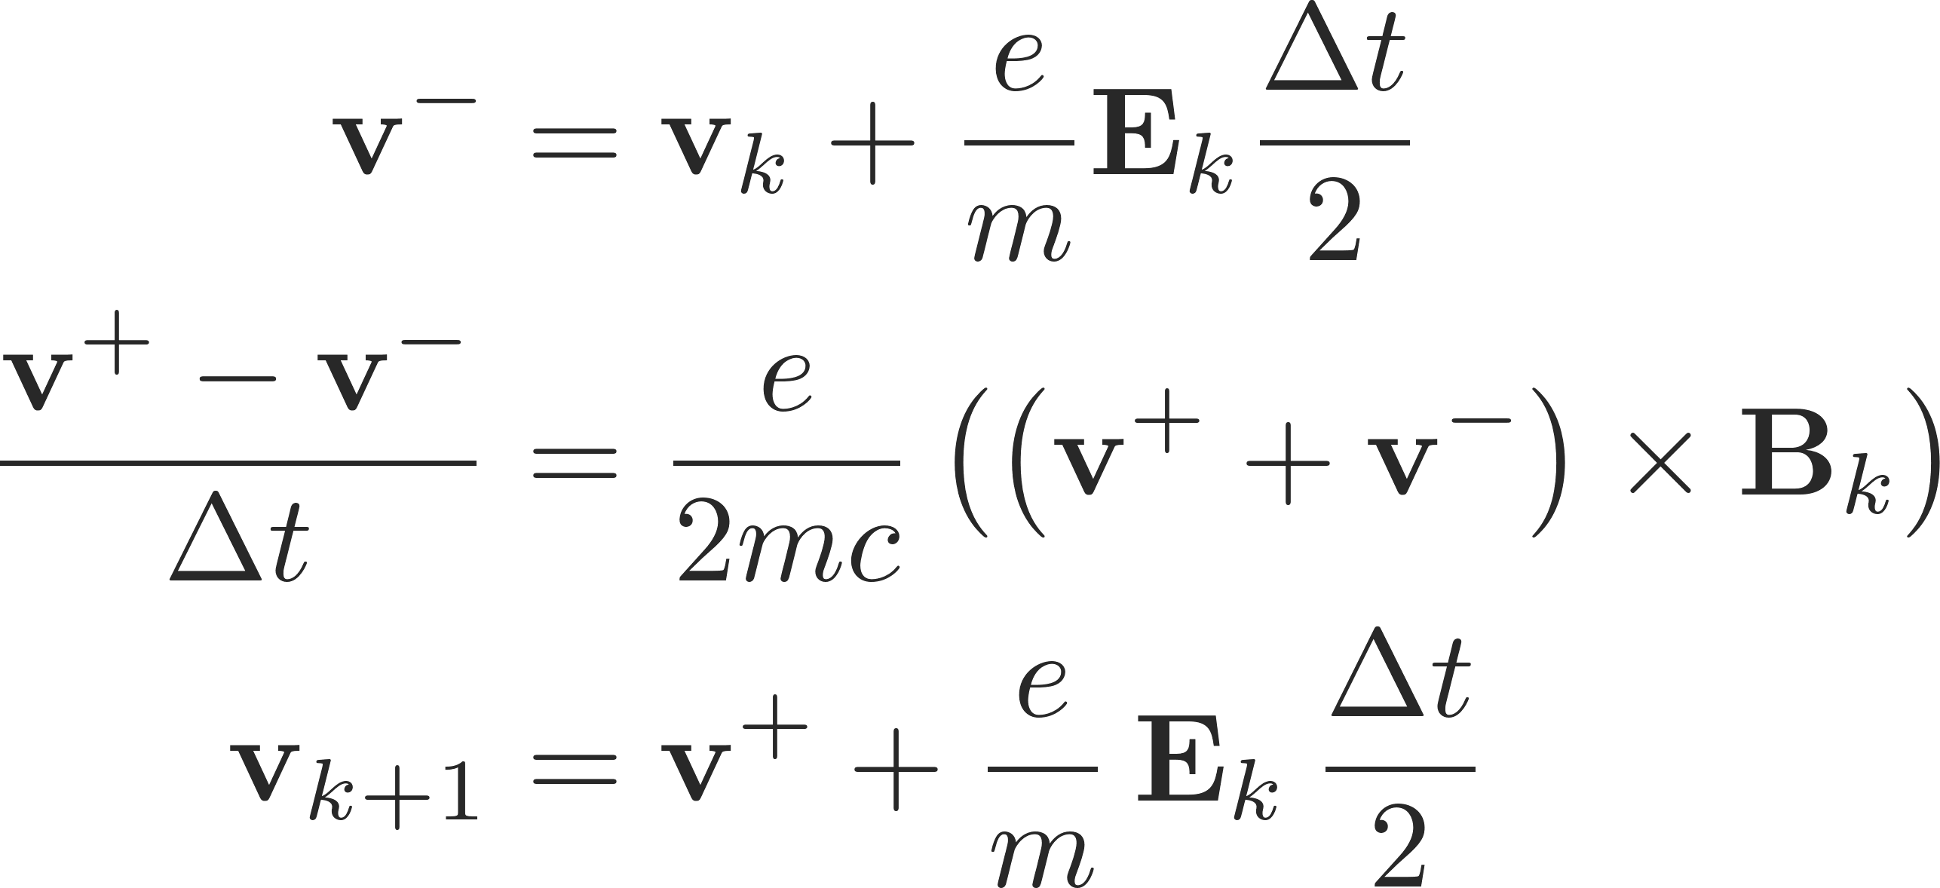
E-cloud beam system
PIC stands for Particle-In-Cell
We use this method to compute fields generated by particles to solve e.g. the Poisson equation
Electron motion occurs at the time scale of a slice of a bunch length → track single slices through the e-cloud and apply integrated kicks
  Compute electric fields from one slice and from e-cloud
  Apply kicks to protons
  Advance electrons by one slice length – this is a multi-scale dynamics problem (fast cyclotron motion superposed to slower guiding center drift) → Boris algorithm for tracking (per macroparticle)
  Track next slice through e-cloud
  C. Birdsall and A. Langdon, Plasma Physics Via Computer Simulation (McGraw-Hill, Inc., New York, 1985)
  Hong Qin et al. , Why is Boris algorithm so good?, Physics of Plasmas 20, 084503 (2013)

Slide 29
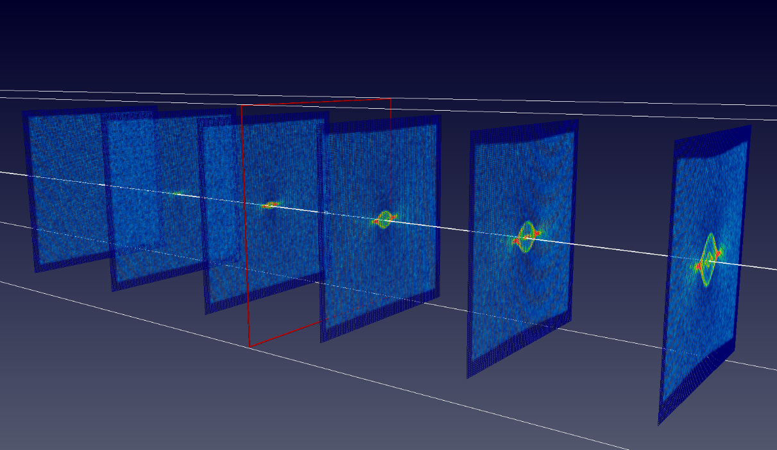
E-cloud beam system
PIC stands for Particle-In-Cell
We use this method to compute fields generated by particles to solve e.g. the Poisson equation
Electron motion occurs at the time scale of a slice of a bunch length → track single slices through the e-cloud and apply integrated kicks
  Compute electric fields from one slice and from e-cloud
  Apply kicks to protons
  Advance electrons by one slice length – this is a multi-scale dynamics problem (fast cyclotron motion superposed to slower guiding center drift) → Boris algorithm for tracking (per macroparticle)
  Track next slice through e-cloud
Slice index
n-1
i
1
E-cloud at slice index
t

Slide 30
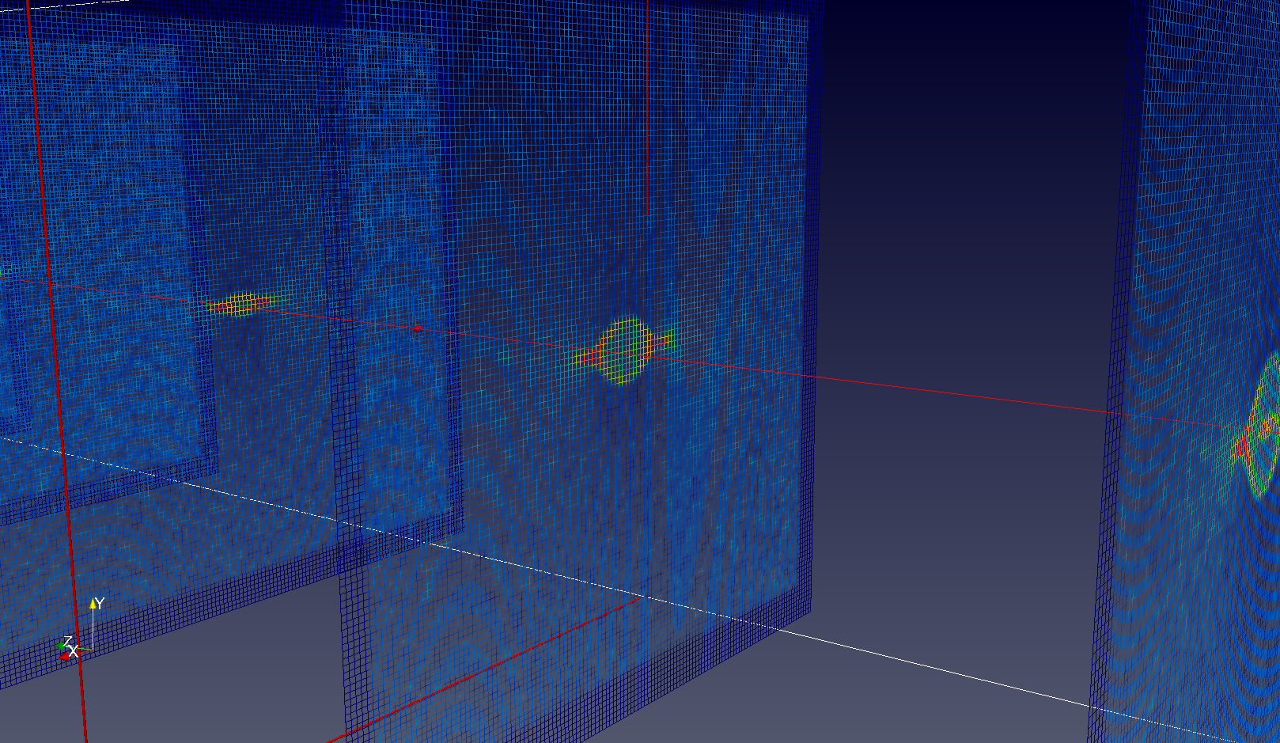
E-cloud beam system
PIC stands for Particle-In-Cell
We use this method to compute fields generated by particles to solve e.g. the Poisson equation
Electron motion occurs at the time scale of a slice of a bunch length → track single slices through the e-cloud and apply integrated kicks
  Compute electric fields from one slice and from e-cloud
  Apply kicks to protons
  Advance electrons by one slice length – this is a multi-scale dynamics problem (fast cyclotron motion superposed to slower guiding center drift) → Boris algorithm for tracking (per macroparticle)
  Track next slice through e-cloud
Slice index
n-1
i
1
E-cloud at slice index
t

Slide 31
Outline
Introduction to macroparticle models –
implementations, applications and examples
Part 1 – numerical modelling
  Initialisation
  Simple tracking
  Chromaticity and detuning
  Wakefields with examples
    Constant wakes
    Dipole wakes
    TMCI & headtail modes
Part 2 – electron cloud
  Modelling of e-cloud interactions
  PIC solvers
  Application for e-cloud instabilities
Notes:
Perhaps other way round

Slide 32
PIC solvers in brief
  In many of our codes, Particle in Cell (PIC) algorithms are used to compute the electric field generated by a set of charged particles in a set of discrete points (can be the locations of the particles themselves, or of another set of particles)
  The solution typically consists of 4 stages:
    Charge scatter from macroparticles (MPs) to grid (reduction of macroparticles)
    Calculation of the electrostatic potential at the nodes
    Calculation of the electric field at the nodes (gradient evaluation)
    Field gather from grid to MPs
Notes:
changing with energy

Slide 33
PIC solvers in brief
  The solution typically consists of 4 stages:
    Charge scatter from macroparticles (MPs) to grid (reduction of macroparticles)
    Calculation of the electrostatic potential at the nodes
    Calculation of the electric field at the nodes (gradient evaluation)
    Field gather from grid to MPs
Internal nodes
External nodes (optional)
Uniform square grid
Notes:
changing with energy

Slide 34
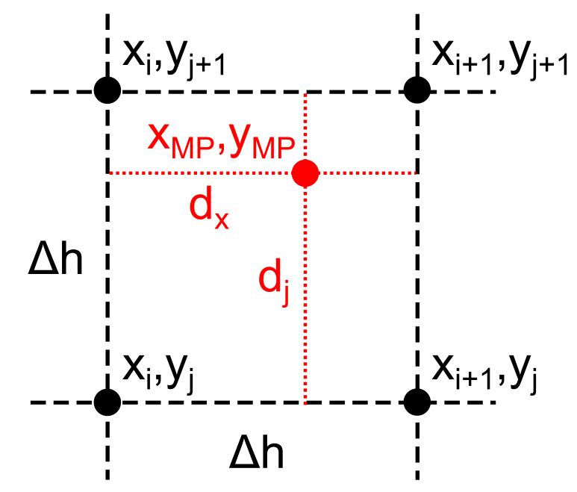
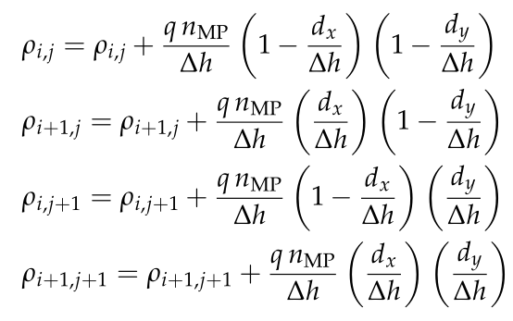
PIC solvers – basic steps
  The solution typically consists of 4 stages:
    Charge scatter from macroparticles (MPs) to grid (reduction of macroparticles)
    Calculation of the electrostatic potential at the nodes
    Calculation of the electric field at the nodes (gradient evaluation)
    Field gather from grid to MPs
Notes:
changing with energy

Slide 35
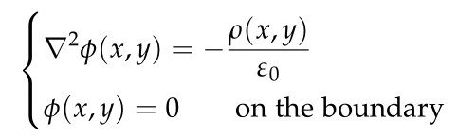
PIC solvers – basic steps
  The solution typically consists of 4 stages:
    Charge scatter from macroparticles (MPs) to grid (reduction of macroparticles)
    Calculation of the electrostatic potential at the nodes
    Calculation of the electric field at the nodes (gradient evaluation)
    Field gather from grid to MPs
  Different numerical approaches exist to solve these types of equations each with its own advantages and drawbacks:
    Open space FFT solver (explicit, very fast but open boundaries)
    Rectangular boundary FFT solver (explicit, very fast but only rectangular boundaries)
    Finite Difference implicit Poisson solver (arbitrary chamber shape, sparse matrix, possibility to use Shortley Weller boundary refinement, KLU fast routines, computationally more demanding)
    Dual or multi-grid in combination with direct or iterative solvers
  Boundary conditions (e.g., perfectly conducting, open, periodic)
Notes:
changing with energy

Slide 36


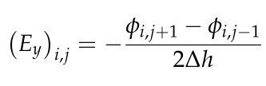
PIC solvers – basic steps
  The solution typically consists of 4 stages:
    Charge scatter from macroparticles (MPs) to grid (reduction of macroparticles)
    Calculation of the electrostatic potential at the nodes
    Calculation of the electric field at the nodes (gradient evaluation)
    Field gather from grid to MPs
Notes:
changing with energy

Slide 37
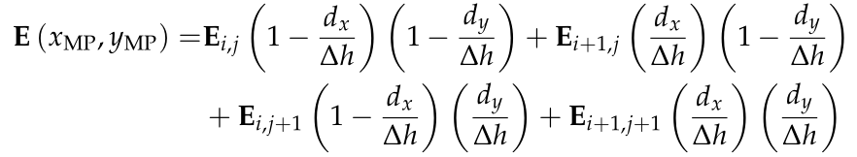
PIC solvers – basic steps
  The solution typically consists of 4 stages:
    Charge scatter from macroparticles (MPs) to grid (reduction of macroparticles)
    Calculation of the electrostatic potential at the nodes
    Calculation of the electric field at the nodes (gradient evaluation)
    Field gather from grid to MPs
Notes:
changing with energy

Slide 38
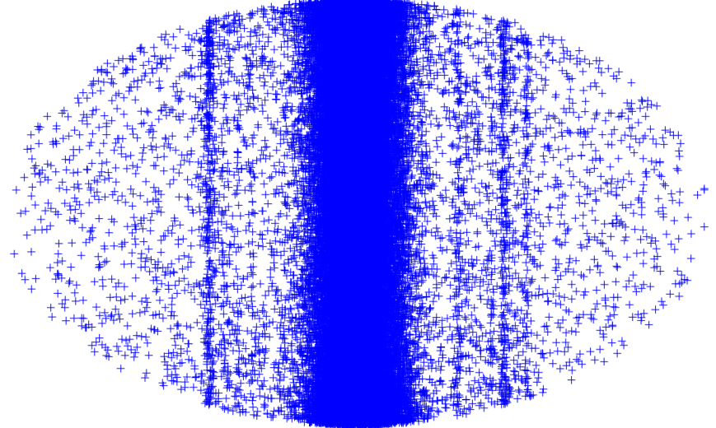
Numerical model of electron cloud effects
Instability problem
Build-up problem
s
Multi-bunch beam
Primary and secondary electron production, chamber properties
Noise
Equations of motion of the beam particles
E-cloud build up
x
y

Slide 39
Numerical model of electron cloud effects
A self-consistent treatment requires the combination of an instability and a build-up code
Becomes easily possible with modular structure and good design of codes (e.g. object orientation)
PyHEADTAIL
PyECLOUD
PyHEADTAIL
Transverse tracking
  → with Q’, octupoles etc.
Longitudinal tracking
Transverse feedback
Impedances
Space charge
…
v
Transverse tracking
  → with Q’, octupoles etc.
Longitudinal tracking
Transverse feedback
Impedances
Space charge
…
Initial e- distribution
(from build-up sim.)
For each slice
Generate seed e⁻
Beam
Slicer
Evaluate beam slice electric field (Particle in Cell)
Evaluate the e⁻ electric field
(Particle in Cell)
Apply kick on the beam particles
Beam
Compute e⁻ motion (t->t+Δt)
(possibly with substeps)
Detect impacts and generate secondaries
Legend: From instability code – From build-up code – Interaction between the two codes

Slide 40
Numerical model of electron cloud effects
Coupled bunch electron cloud instability naturally needs a self-consistent solution of the electron cloud problem
  A broad time scale to cover, currently working on the problem
For the moment we simulate the two branches separately (similar to what is done for impedances):
  Electron cloud build up
    Multi-bunch
    Usually single passage, single turn or just few turns
  Electron cloud instability
    Single bunch
    Multi-turn, or even multi-kick multi-turn
Build up simulation
Instability simulation
Information on how many electrons interact with a bunch:
central density
detailed distribution
ECLOUD, PyECLOUD, POSINST, CSEC, …
HEADTAIL, PyHEADTAIL, CMAD, PEHTS, …

Slide 41
Numerical model of electron cloud effects
In principle both coherent instability and incoherent emittance growth could be predicted by these simulations
Evolution of a beam interacting with an electron cloud depends on a significant number of parameters in a non-trivial way
  Bunch length (longitudinal emittance)
  Beam transverse sizes (emittances and beta functions at the electron cloud location)
  Beam energy
  Beam current (number of particles per bunch)
  Chromaticity
  Magnetic field (field-free, dipole, quadrupole)
  Electron cloud density and distribution (in reality determined by many of the above parameters, but can be set independently in simulations)

Slide 42
Outline
Introduction to macroparticle models –
implementations, applications and examples
Part 1 – numerical modelling
  Initialisation
  Simple tracking
  Chromaticity and detuning
  Wakefields with examples
    Constant wakes
    Dipole wakes
    TMCI & headtail modes
Part 2 – electron cloud
  Modelling of e-cloud interactions
  PIC solvers
  Application for e-cloud instabilities
Notes:
Perhaps other way round

Slide 43
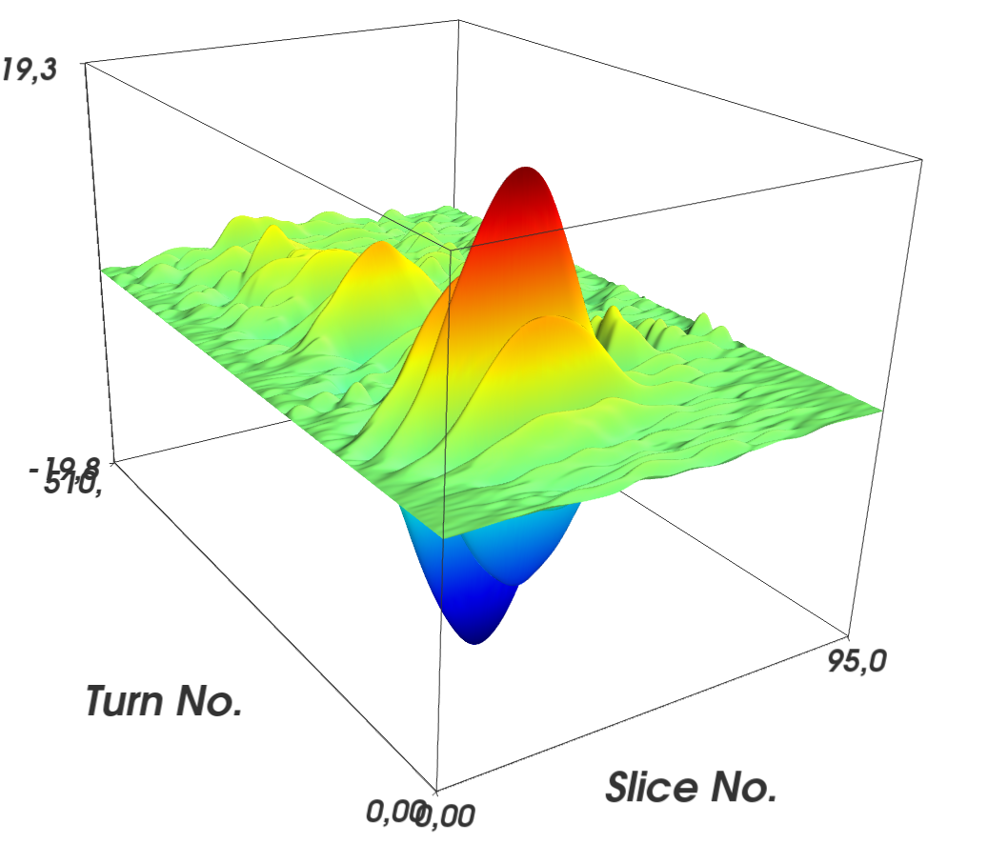
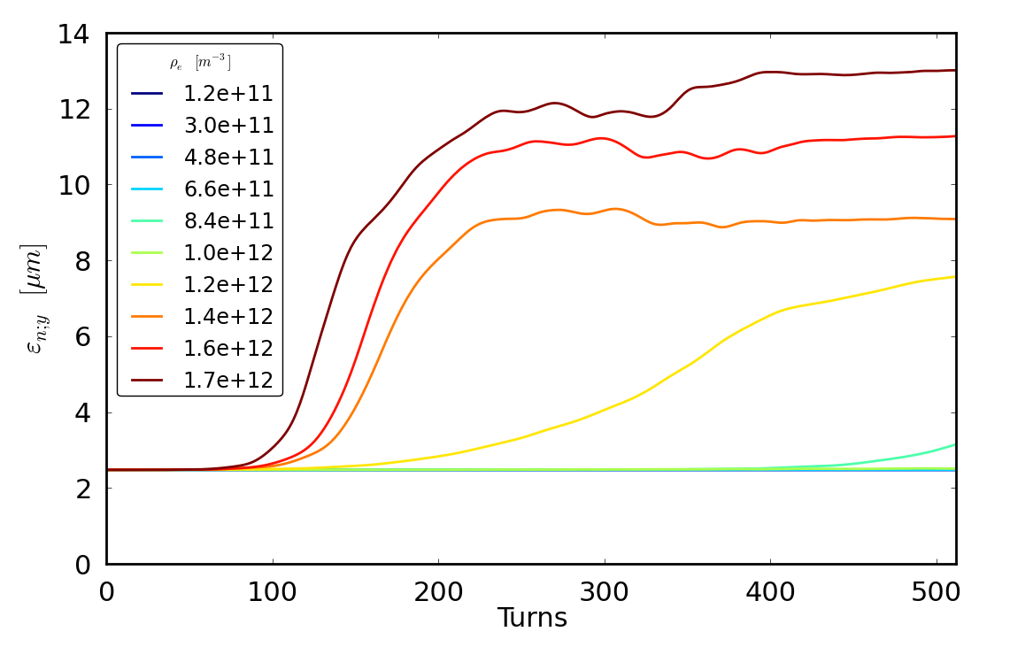
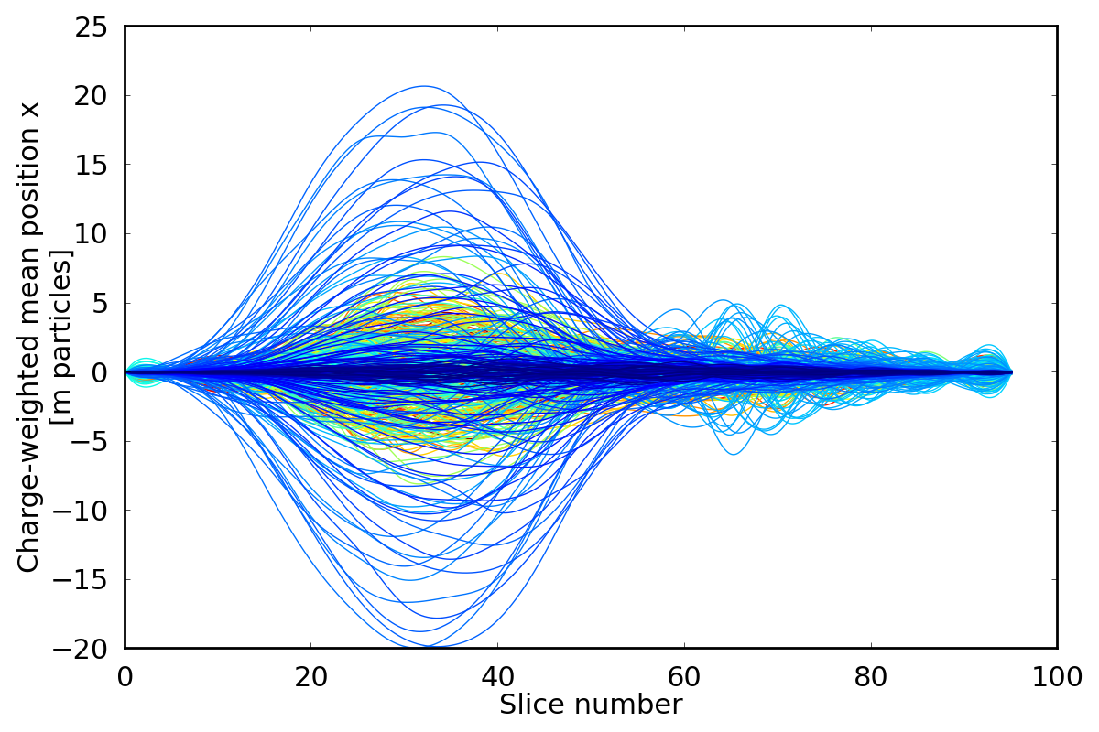
Electron cloud induced instabilities
Typical e-cloud simulation try to identify the e-cloud central density threshold for an instability
Scans in the central density are performed until an exponential growth can be observed in the emittance
Coherent instabilities occur when a certain central cloud density threshold is breached
This leads to coherent intra bunch motion which grows exponentially
A consequence is emittance blow-up and losses

Slide 44
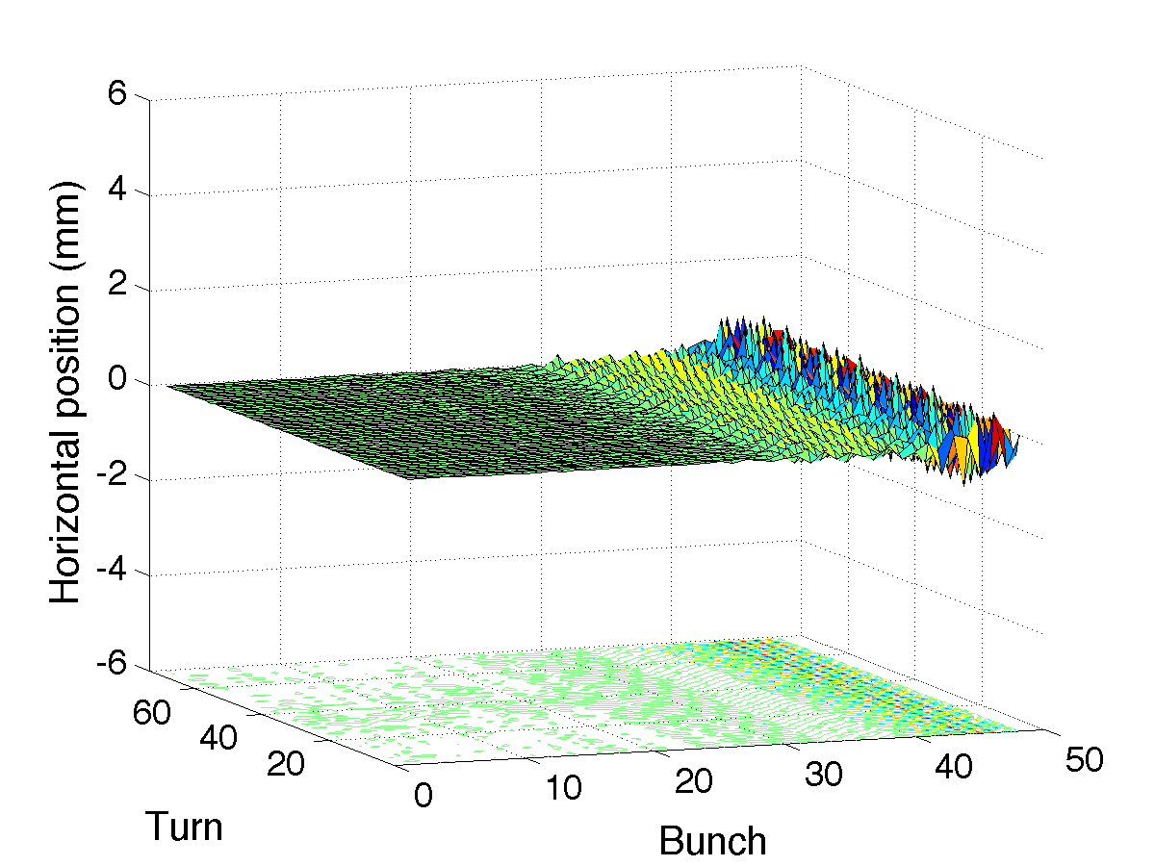
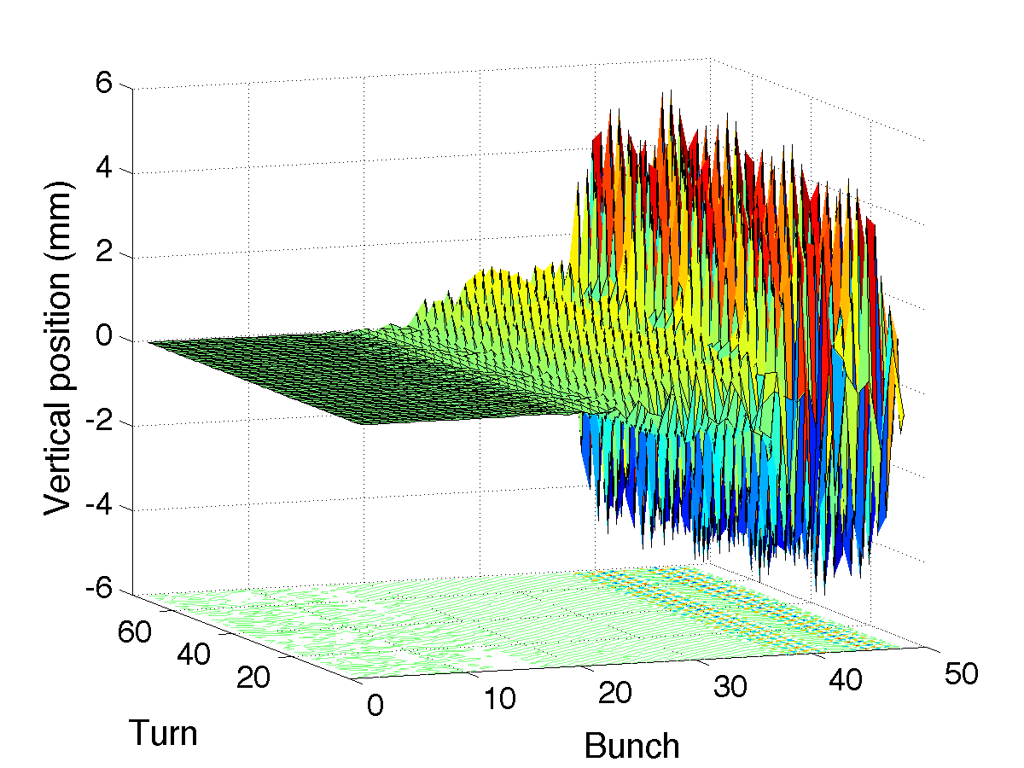
Ex. of coherent e-cloud effects in the LHC
First injection of 48 bunches of 25 ns beam into the LHC in 2011
Beam was dumped twice due to a violent instability in the vertical plane, causing losses above the interlock threshold
Some motion only
for last bunches …
~ bunch 25 is the first unstable
up to ±5mm

Slide 45
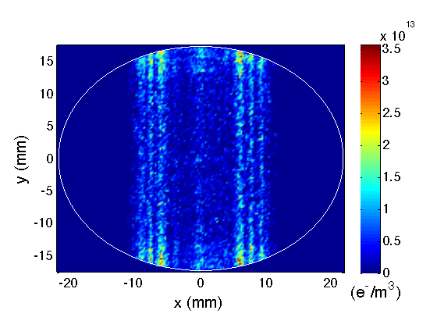
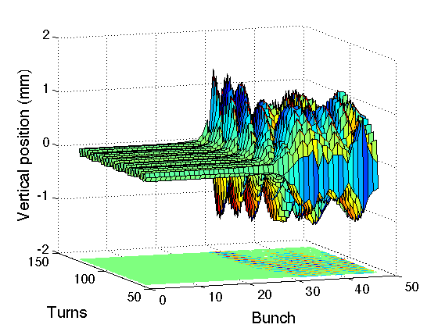
Ex. of coherent e-cloud effects in the LHC
48b injection test (26/08/11)
Headtail silation 1
48x
Headtail 1
PyECLOUD e⁻ distribution (δ_{max}=2.1)
Some motion only
for last bunches …
bunch 48
48x HEADTAIL simulations reveal the onset of instability
~ bunch 25 is the first unstable
up to ±5mm

Slide 46
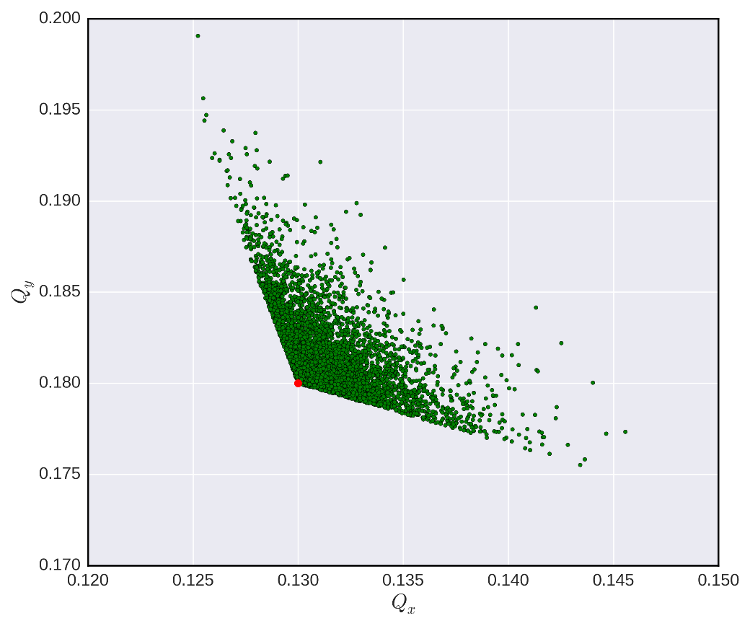
Ex. of incoherent e-cloud effects in the LHC
Remember tune footprint from octupoles in Part I

Slide 47
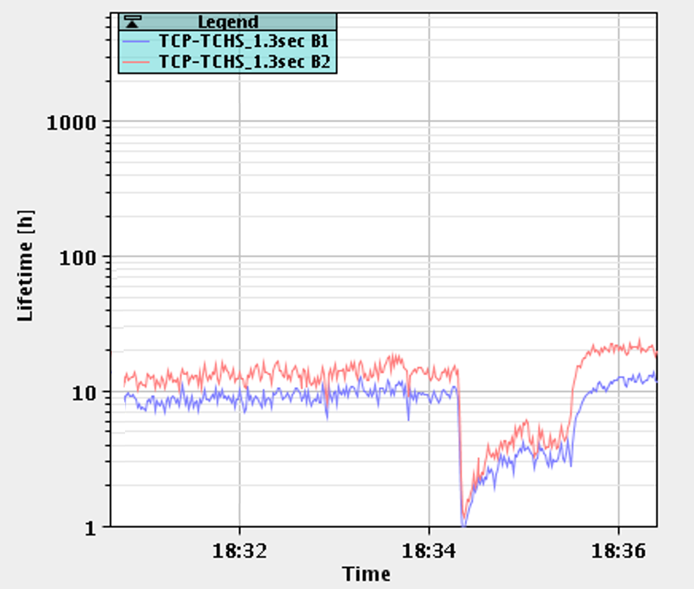
Ex. of incoherent e-cloud effects in the LHC
Q’v=15
Qv=.305
Q’v=10
Qv=.305
Q’v=15
Qv=.300

Slide 48
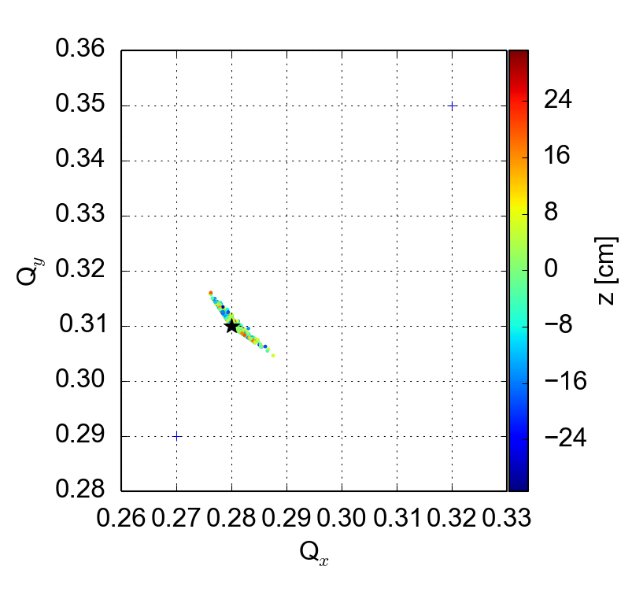
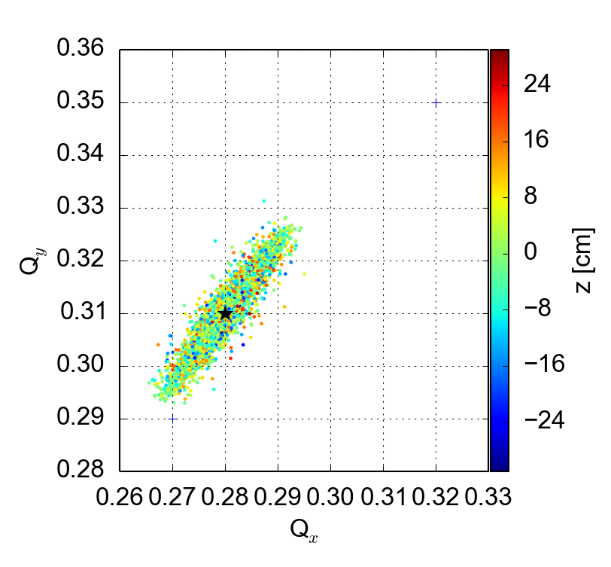
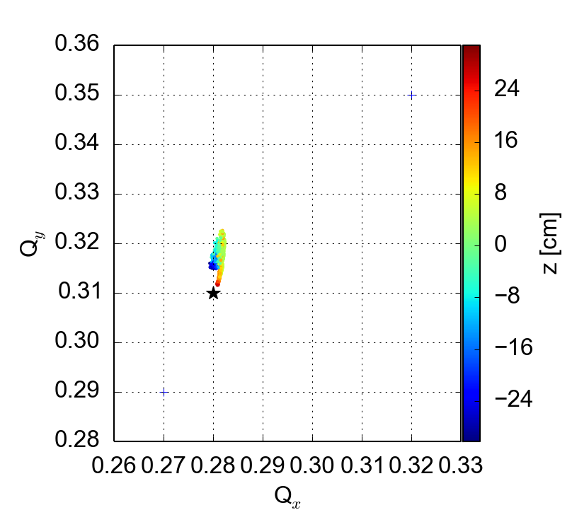

Ex. of incoherent e-cloud effects in the LHC
Macroparticle simulations allow to obtain tune footprint from all effects separated
… as well as from all effects combined
Octupole knob at -1.5
Q’=0/0, no e-cloud
Octupole knob at -1.5
Q’=15/20, no e-cloud
Resonance line
Octupole knob at 0
Q’=0/0, 5 x 10¹¹ e/m³
Octupole knob at -1.5
Q’=15/20, 5 x 10¹¹ e/m³
A. Romano et al

Slide 49
Ex. of incoherent e-cloud effects in the LHC
Macroparticle simulations allow to obtain tune footprint from all effects separated
… as well as from all effects combined
… to identify the source of incoherent losses in the LHC
Octupole knob at -1.5
Q’=0/0, no e-cloud
Octupole knob at -1.5
Q’=15/20, no e-cloud
Resonance line
Q’v=15
Qv=.305
Q’v=10
Qv=.305
Q’v=15
Qv=.300
Octupole knob at 0
Q’=0/0, 5 x 10¹¹ e/m³
Octupole knob at -1.5
Q’=15/20, 5 x 10¹¹ e/m³
A. Romano et al

Slide 50
Vlasov solvers
No time this time…

Slide 51
End part II

Slide 52
Backup

Slide 53

Electron clouds in a bending magnet
The electrons exhibit different transverse (x,y) distributions, according to the type of region in which the electron cloud is formed
  In dipole regions, the electron motion is confined along the lines of the magnetic field. Example: snaposhots of multipacting in the dipole of an LHC arc cell during bunch passage and including secondary production.

Slide 54

Electron clouds in a quadrupole magnet
The electrons exhibit different transverse (x,y) distributions, according to the type of region in which the electron cloud is formed
  In quadrupole regions, the electrons tend to multipact along the pole-to-pole lines of the cross section (example: snapshots of multipacting in an LHC arc quadrupole). Multipacting thresholds are usually lower in quadrupoles because electrons survive long thanks to trapping due to the magnetic gradient.

Slide 55




Basic stages of a PIC algorithm
  Standard Particle In Cell (PIC) → 4 stages:
  Charge scatter from macroparticles (MPs) to grid
  Calculation of the electrostatic potential at the nodes
  Calculation of the electric field at the nodes (gradient evaluation)
  Field gather from grid to MPs
Internal nodes:
External nodes:
Can be written in matrix form:
A is sparse and depends only on chamber geometry and grid size
→ It can be computed and LU factorized in the initialization stage to speed up calculation

Slide 56
Electron space charge evaluation in PyECLOUD
  With this approach a curved boundary is approximated with a staircase
  Can we do better?

Slide 57


The Shortley - Weller method
  Refined approximation of Laplace operator at boundary nodes:
  Usual 5-points formula at internal nodes:
  O(h²) truncation error is preserved
  (see: N. Matsunaga and T. Yamamoto, Journal of Computational and Applied Mathematics 116 – 2000, pp. 263–273)

Slide 58


The Shortley - Weller method
  Sorry for the change of notation…
  Refined gradient evaluation at boundary nodes:
  Usual central difference for gradient evaluation at internal nodes:

Slide 59



The Shortley - Weller method
  Tricky implementation:
  Boundary nodes need to be identified, distances from the curved boundary need to be evaluated
    PyECLOUD impact routines have been employed (some refinement was required since they are optimized for robustness while here we need accuracy)
  Nodes too close to the boundary can lead to ill conditioned A matrix → we identify them and impose U=0
    Special treatment for gradient evaluation is needed at these nodes
  Since chamber geometry and grid size stay constant along the simulation most of the boundary treatment can be handled in the initialization stage

Slide 60


The Shortley - Weller method
  Tricky implementation:
  Boundary nodes need to be identified, distances from the curved boundary need to be evaluated
    PyECLOUD impact routines have been employed (some refinement was required since they are optimized for robustness while here we need accuracy)
  Nodes too close to the boundary can lead to ill conditioned A matrix → we identify them and impose U=0
    Special treatment for gradient evaluation is needed at these nodes
  Since chamber geometry and grid size stay constant along the simulation most of the boundary treatment can be handled in the initialization stage
  Field map extrapolated outside the chamber to simplify field gather for particle close to the chamber’s wall

Slide 61
Dual grid
Alternative approach: use a dual grid solver
  Basic idea
    Keep inner grid around beam fixed, to keep beam resolution constant
    Scale second grid around maximum ion trajectory, to keep track of all ions
  Implementation
    Implementation is very explicit and quite rigid
    But fast to implement and consistent with current PIC routines
    Requires that grids must be matched at border, such that the outer edge of the inner grid coincides with a cell edge in the larger grid
  Gives good & consistent beam resolution at smaller computational cost

