Slide 1




BEAM LOSS CONSEQUENCES
Francesco Cerutti
on Intensity Limitations in Particle Beams
CERN November 2015

Slide 2
BEAM LOSSES
on beam intercepting devices (targets, collimators, dumps, stoppers, stripping foils, … )
  regular
  accidental: smearing failures, injection mis-steering, asynchronous beam dump, top-off
diffused
  synchrotron radiation, beam-gas interaction, gas bremsstrahlung
debris from regular collisions at the interaction points
on unexpected obstacles (UFO, ULO, … )

Slide 3
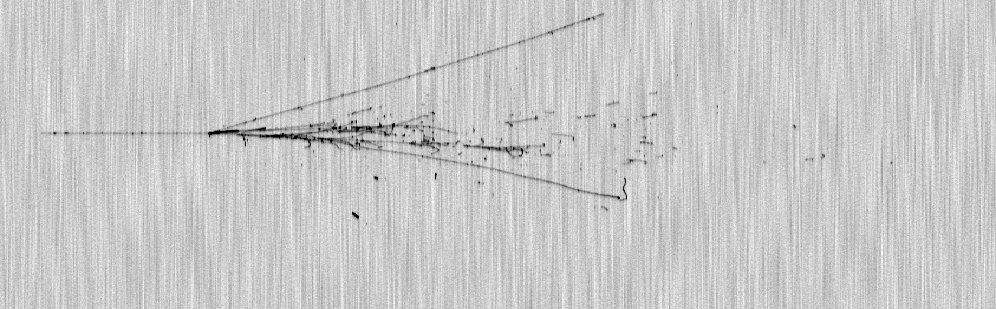
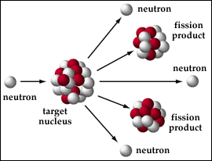
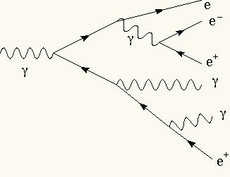
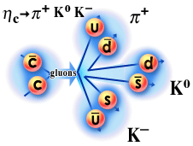
INTERACTION WITH (ACCELERATOR) MATERIAL:
the microscopic view
6 GeV proton in liquid argon
ionization
low energy neutron
reaction
multiple scattering
hadron-nucleus
reaction
electromagnetic
shower
particle decay
interplay of many physical processes described by different theories/models

Slide 4
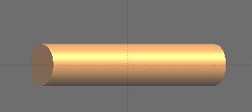
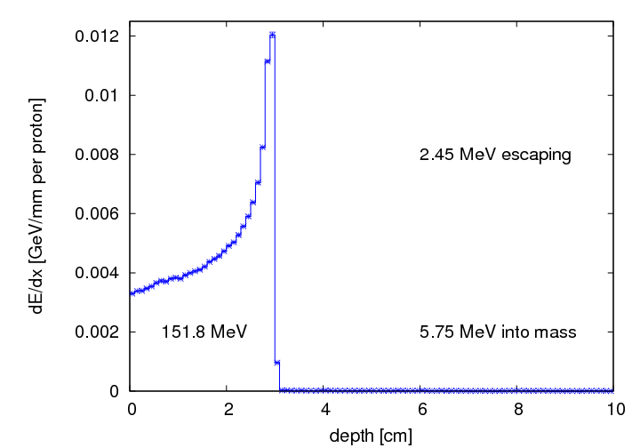
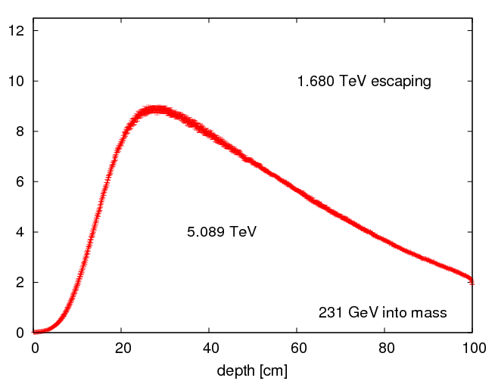
INTERACTION WITH ACCELERATOR MATERIAL:
the macroscopic view
LINAC4
and LHC
proton beam on a 1 m long and 10 cm radius copper rod
160 MeV
7 TeV
ionization
electromagnetic shower

Slide 5
CONSEQUENCES
Heating energy deposition (integral power)
Thermal shock energy deposition (power density)
Quenching energy deposition (power density)
Deterioration energy deposition (dose), particle fluence, DPA
Oxidation, radiolysis, ozone production energy deposition
Gas production residual nuclei production
Single event effects in electronic devices high energy hadron fluence [+ neutron fluence, energy deposition (dose)]
Shielding requirements particle fluence (prompt dose equivalent)
Access limitations, radioactive waste, air activation residual dose rate and activity
Beam Loss Monitors (BLM) energy deposition
Radiation Monitors (RadMon) thermal neutron and high energy hadron fluence
Tumor cell destruction energy deposition (dose, biological dose)
relevant macroscopic quantity

Slide 6
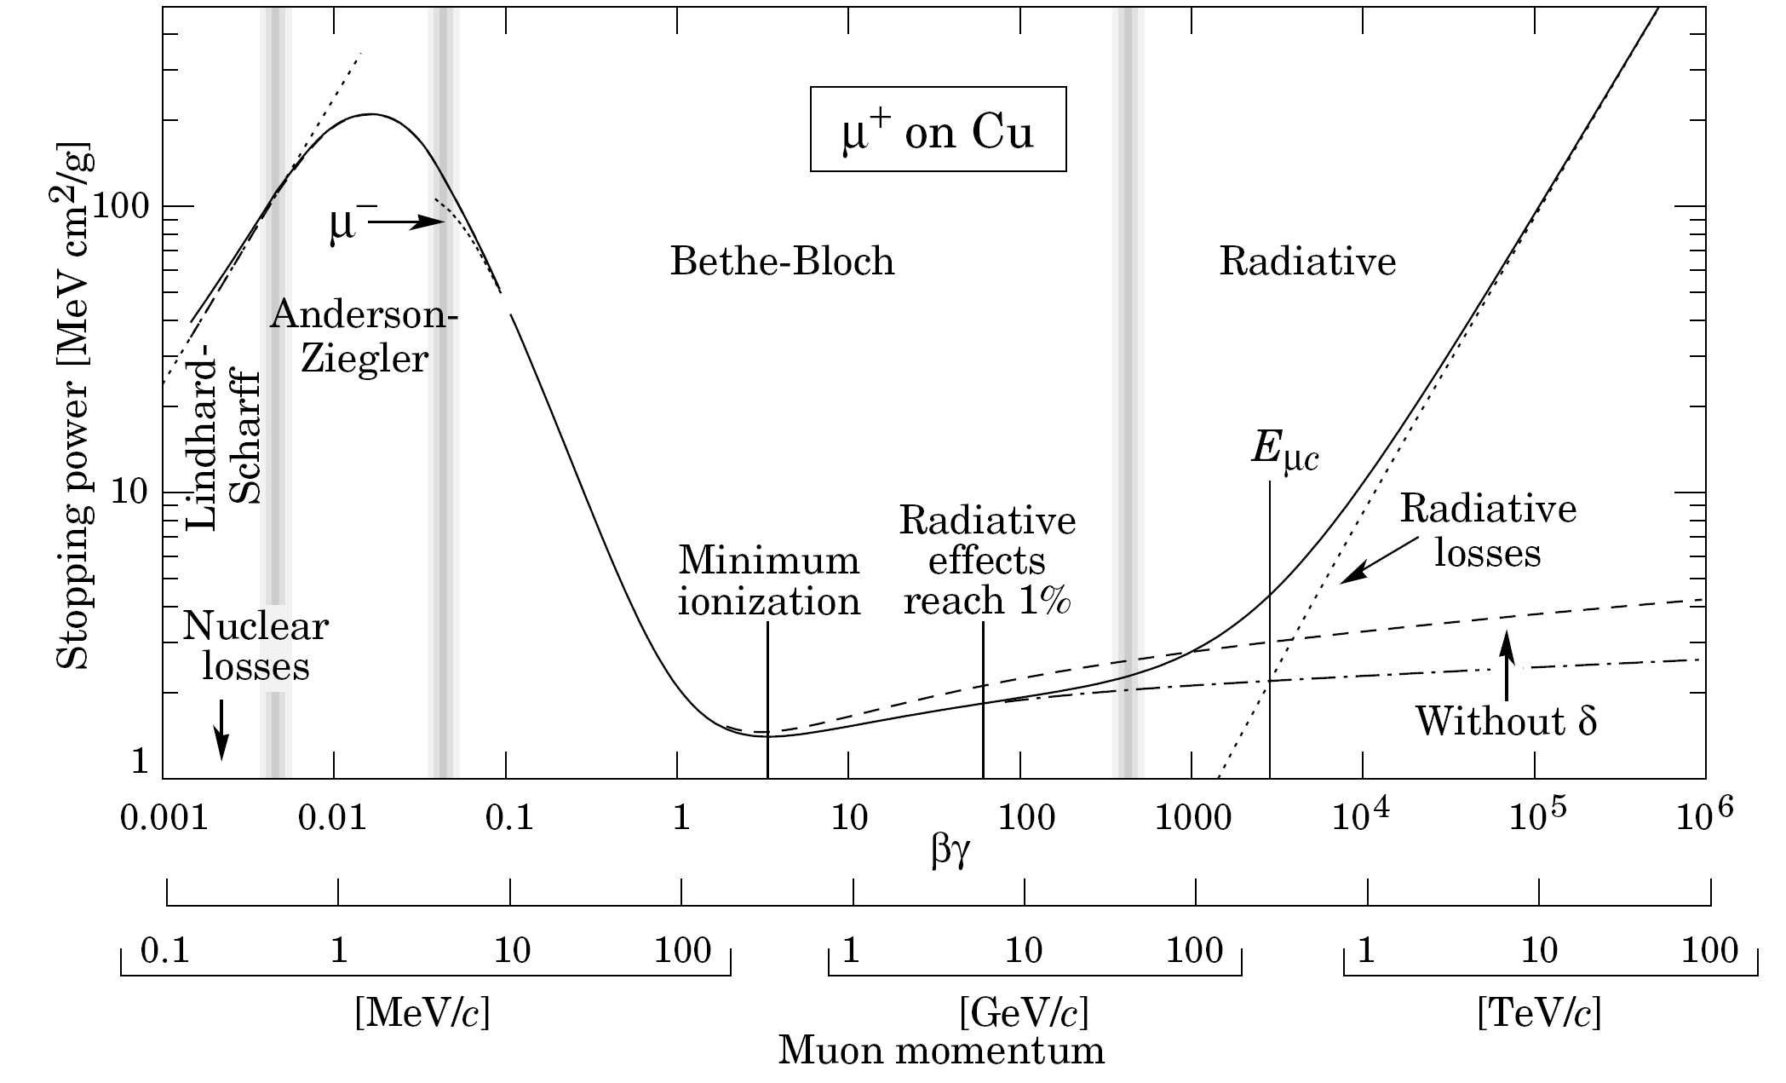
ENERGY LOSS BASICS [I]
mean energy loss rate
C. Amsler et al.,
Phys. Lett. B667 (2008) 1
ionization
bremsstrahlung
shell, Barkas, Mott corrections
20 MeV for e ⁻ on Cu
effective charge for low energy high Z ions

Slide 7
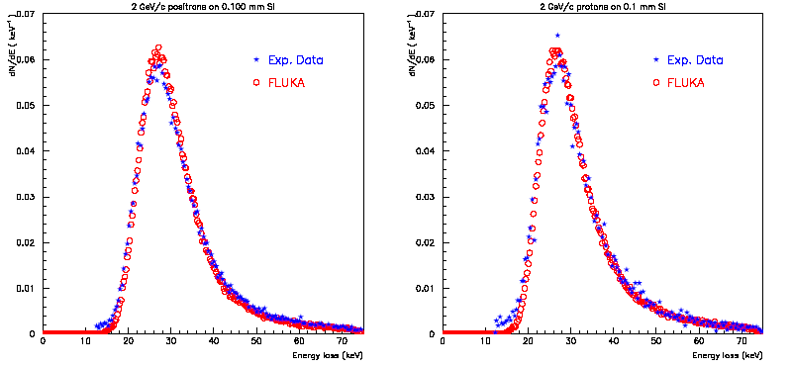
ENERGY LOSS BASICS [II]
ionization energy loss fluctuations
2 GeV/c beams
on 0.1mm Si
protons
energy deposition
J.Bak et al.,
Nucl. Phys. B
288 (1987) 681
200 MeV protons in water
positrons

Slide 8
3 MeV PROTON DUMP
Intensity: 65mA over 100μs
Beam size: 4.5mm σ_{x} = σ_{y}
tilting
orthogonal impact
beam
graphite
C. Maglioni, V. Vlachoudis, EDMS 1182648
85% gain!
z
y

Slide 9
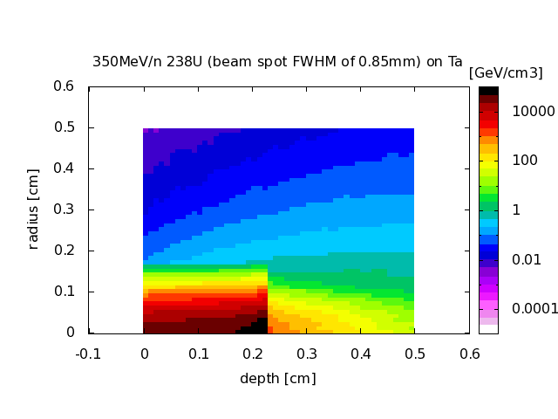
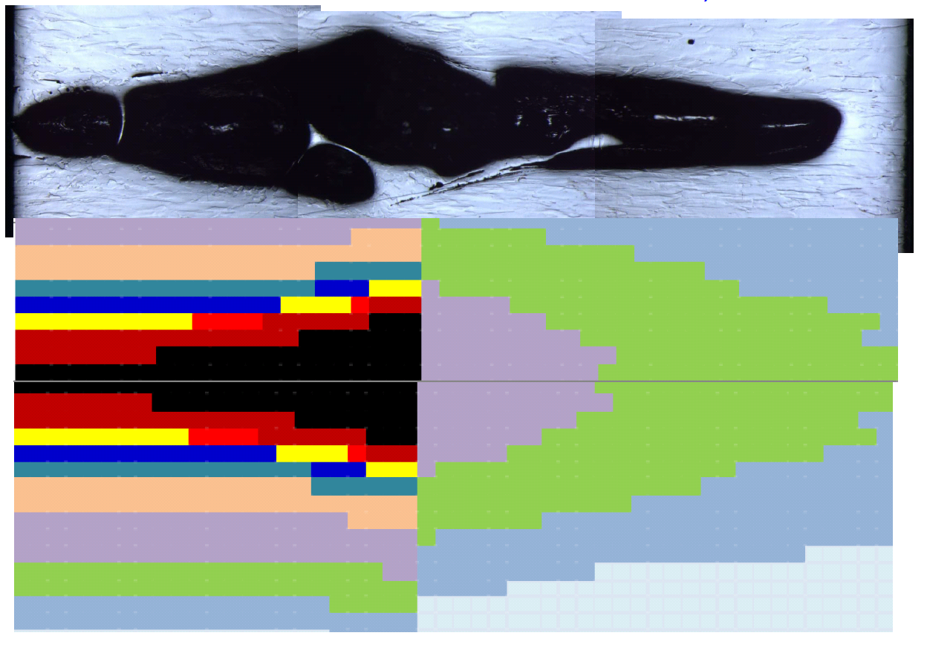
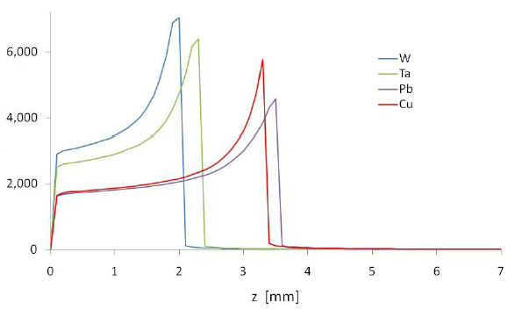
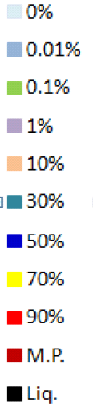
HIGH Z ION BEAMS
350 MeV/n ²³⁸U
Intensity: 2.4 10⁹ ions per pulse
Beam size: 0.85 mm FWHM
tantalum target
GSI S-334 experiment (courtesy of J. Lettry)
two pulses
per beam particle
dE/dz [10 MeV/mm]
one pulse
1 mm

Slide 10
HIGH ENERGY PROTON BEAMS
Beam particles cannot come to rest
and are lost by nuclear non-elastic interaction …
Fe 7.9 26 1.76 15.1
… generating neutral pions whose decay
initiates electromagnetic showers

Slide 11
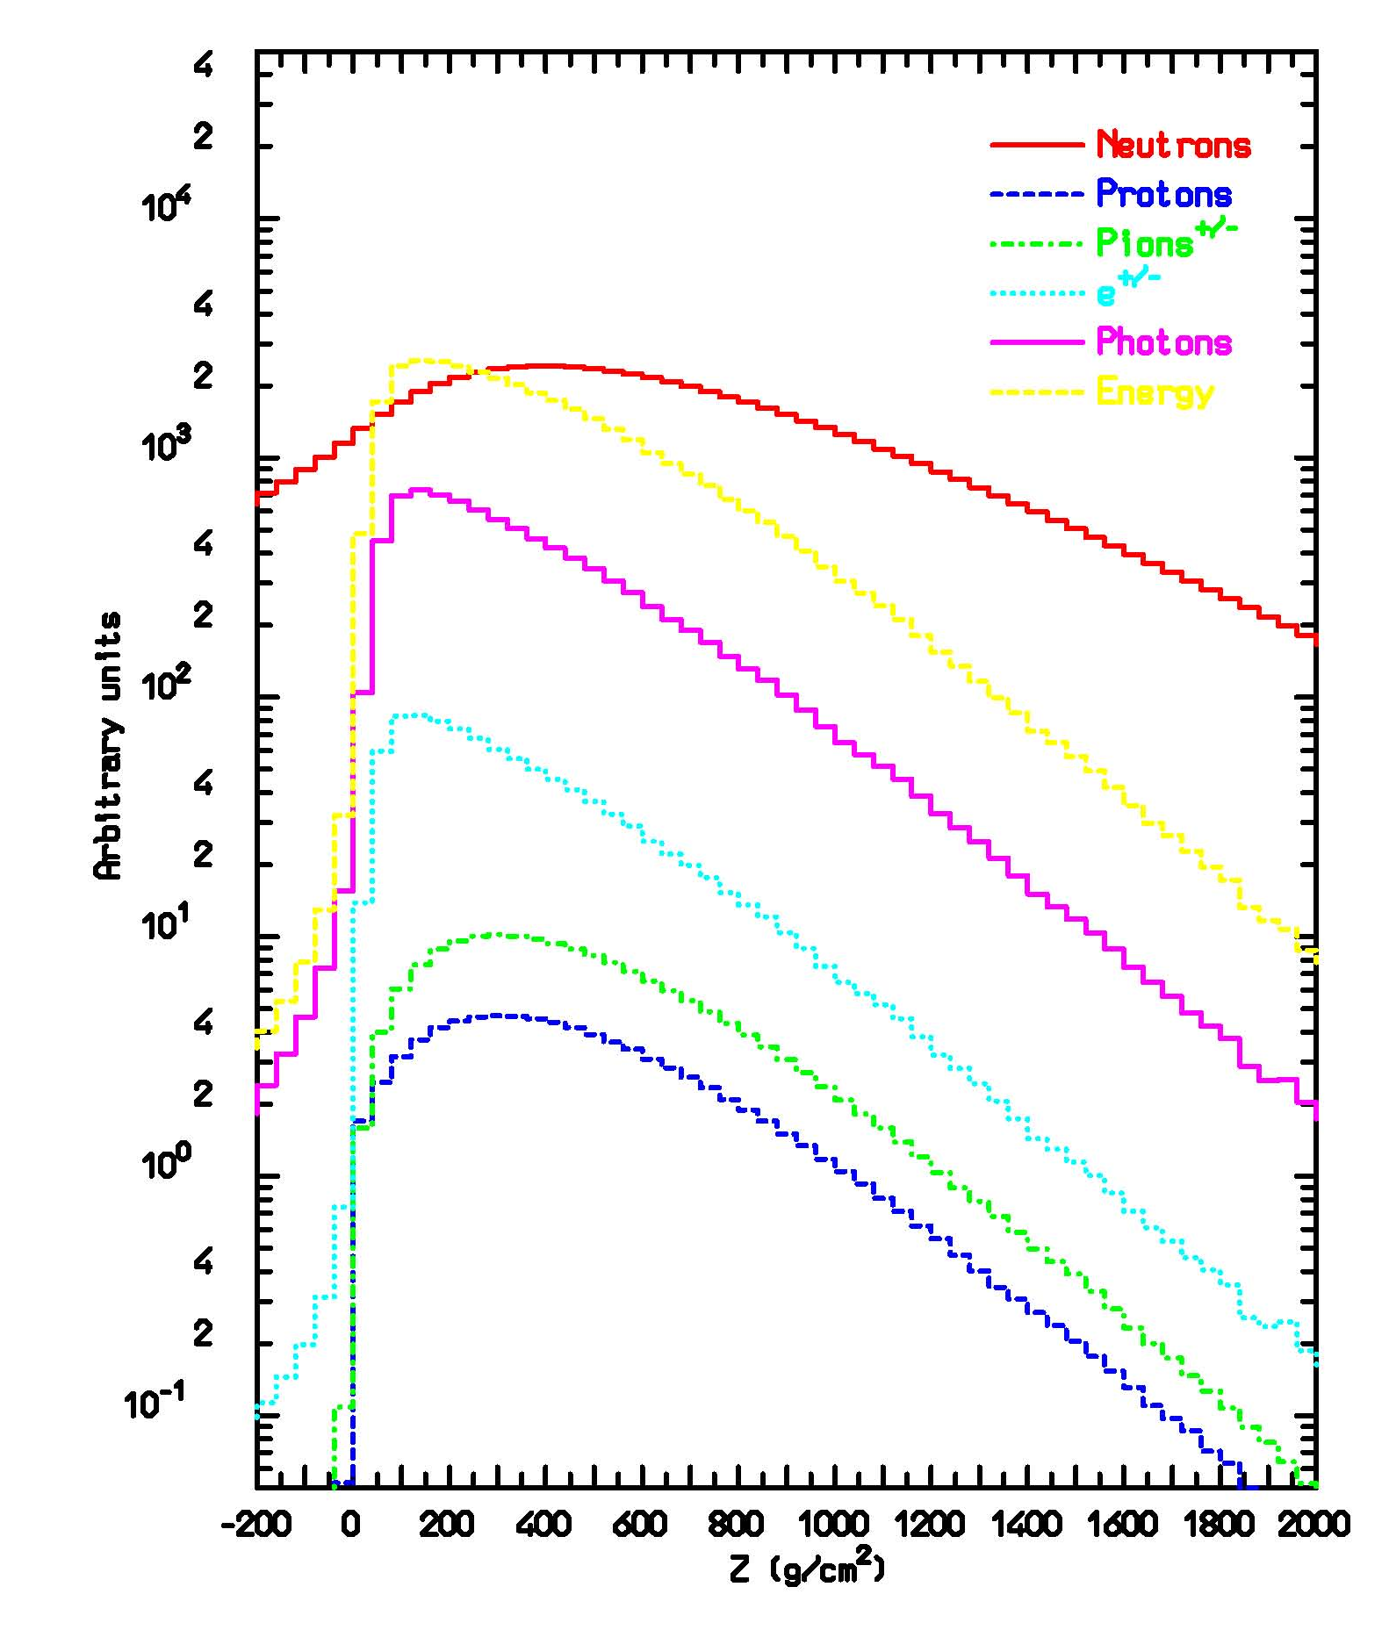
HADRONIC AND ELECTROMAGNETIC SHOWERS
particle fluence and energy deposition development
space-averaged particle spectra
100 GeV protons on lead
100 GeV protons on iron

Slide 12
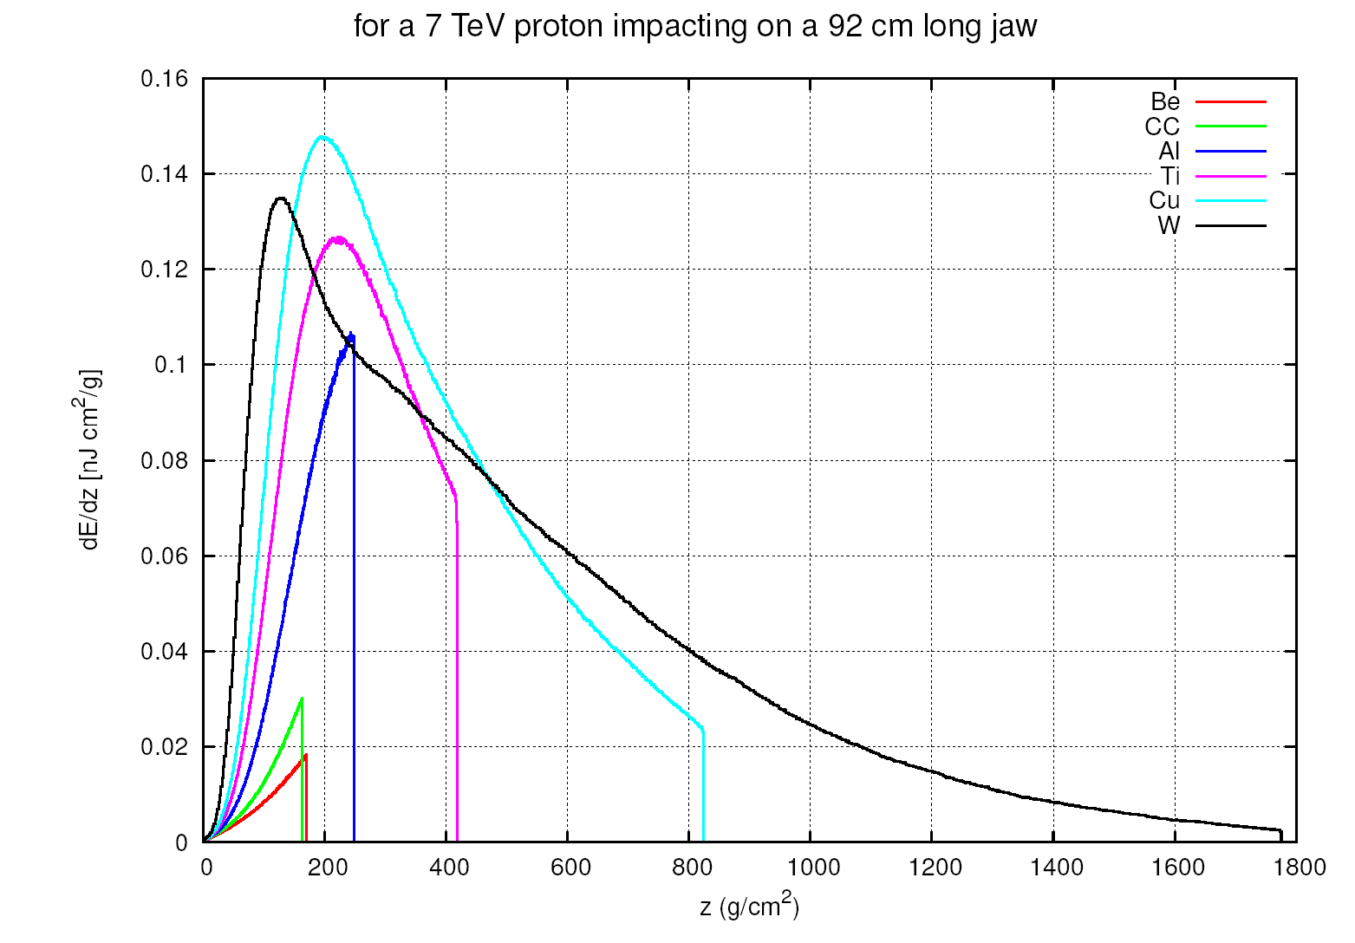
ENERGY DEPOSITION
transversally integrated
[different from peak density profile, which depends on beam size]

Slide 13
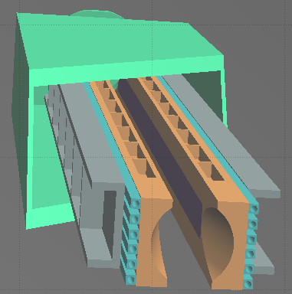
5 TeV PROTON BUNCH ON TERTIARY COLLIMATOR [I]
Intensity: 1.3 10¹¹ p
Beam size: 1.75 μm rad norm. emittance (0.3 mm σ_{x} and 0.19 mm σ_{y})

Slide 14
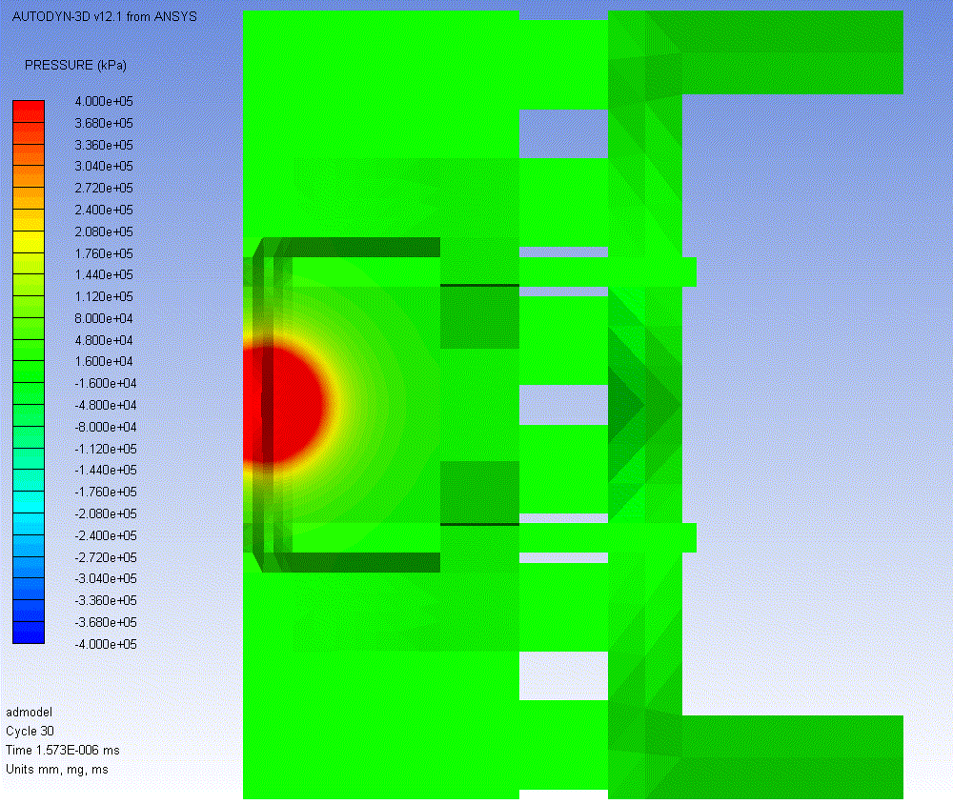
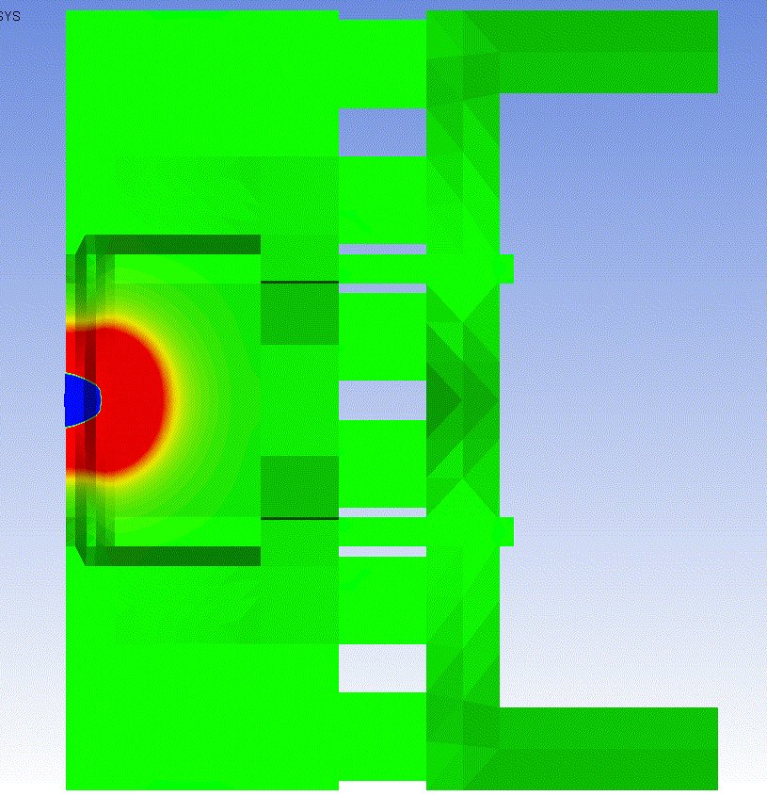
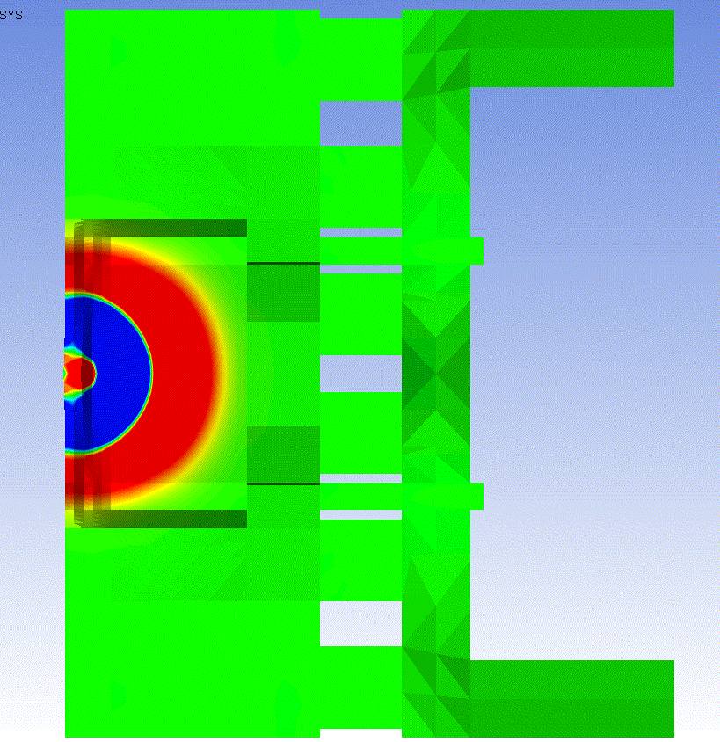
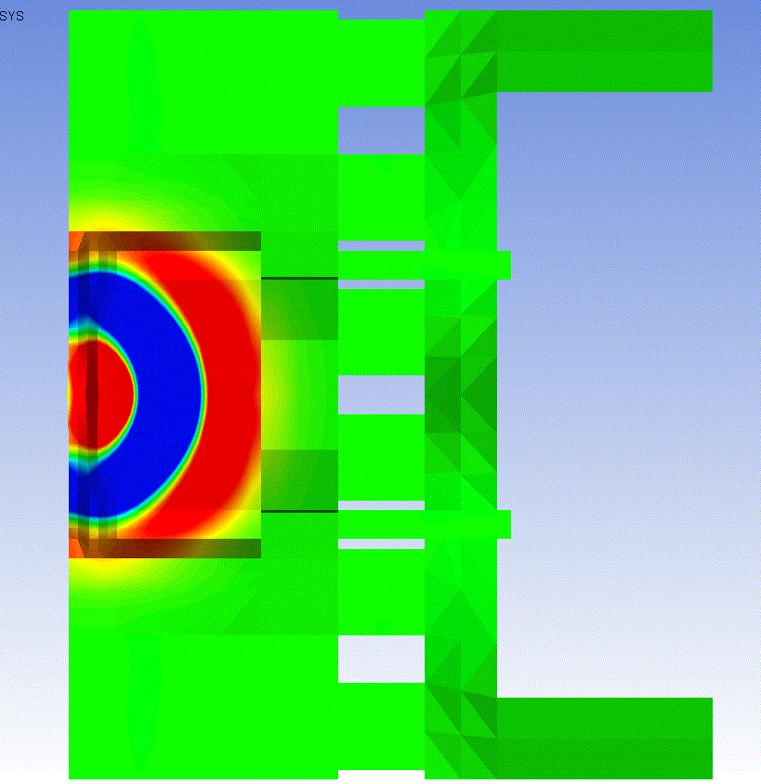
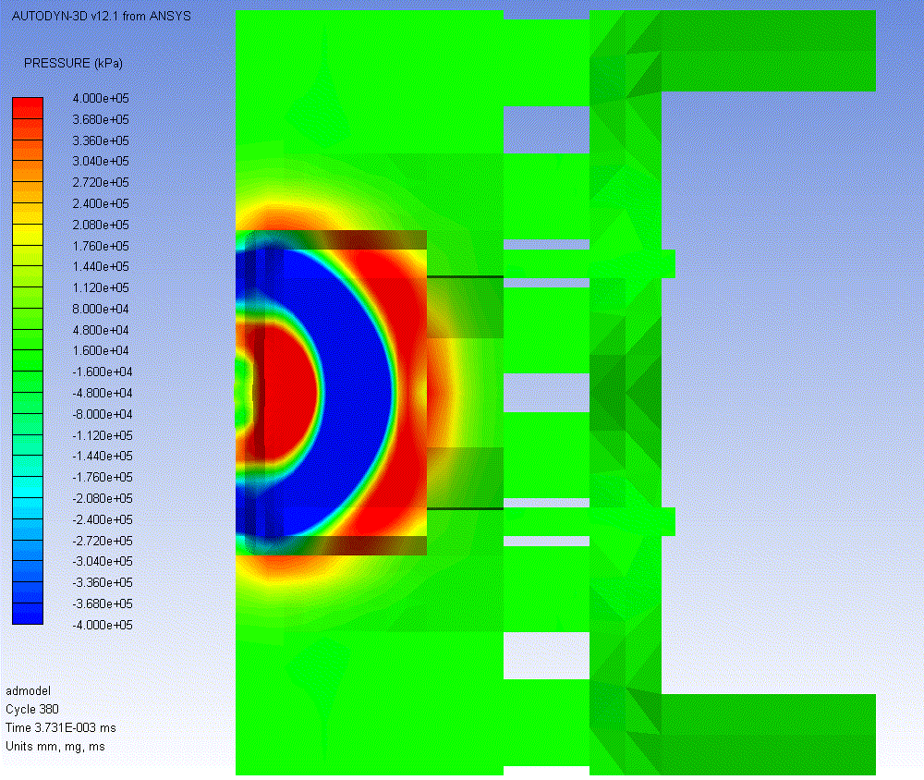
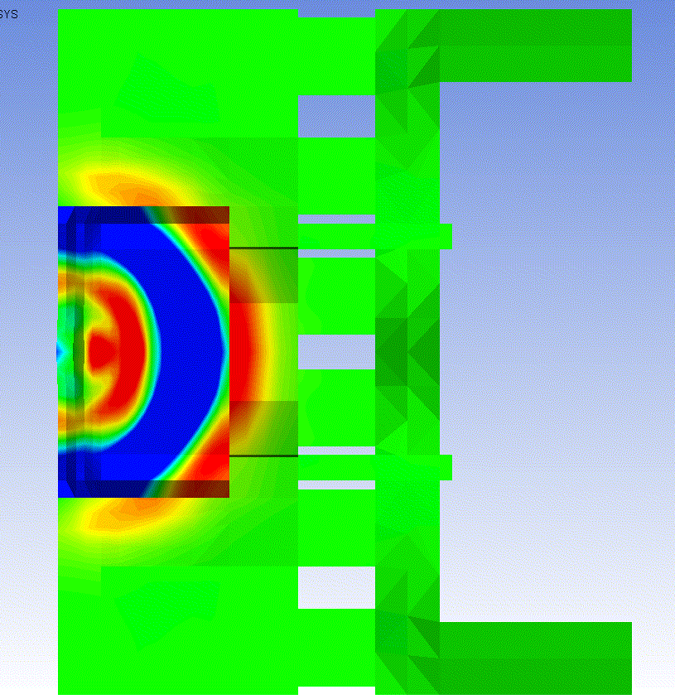
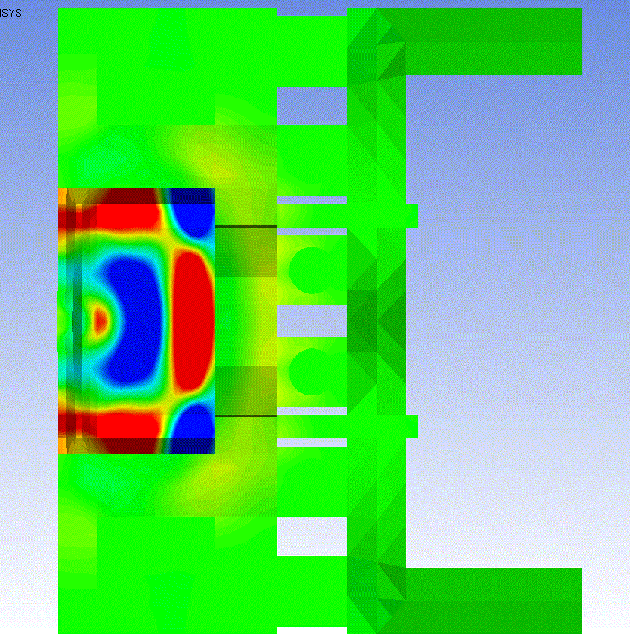
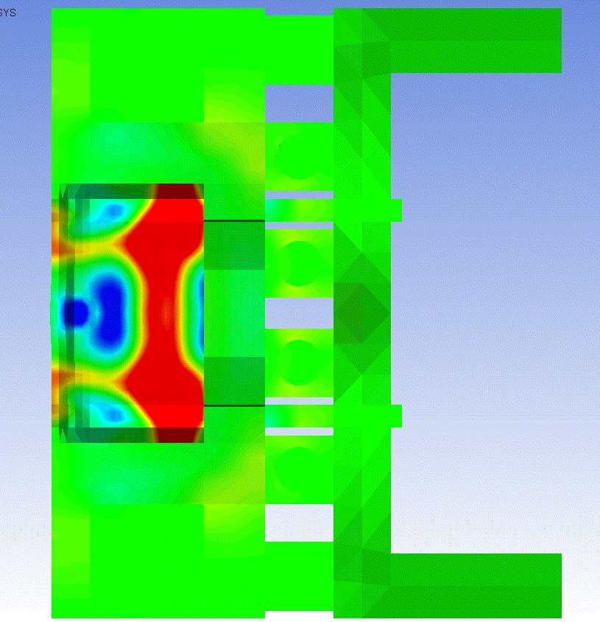
5 TeV PROTON BUNCH ON TERTIARY COLLIMATOR [I]
Intensity: 1.3 10¹¹ p
Beam size: 1.75 μm rad norm. emittance (0.3 mm σ_{x} and 0.19 mm σ_{y})
shock wave propagation
courtesy of A. Bertarelli and his team
t = 1 ns
t = 85 ns
t = 2.8 μs
t = 3.2 μs
P_{max}
2.2 GPa
P_{max}
30 GPa
Compression Wave (red)
+ Rarefaction Wave (blue)
Compression Wave
reaches W-Cu interface
t = 3.7 μs
t = 4.2 μs
t = 5.6 μs
t = 6.6 μs
P_{max}
160 MPa
P_{max}
500 MPa
Compression Wave
reaches Cu-Ni Pipes
Compression Wave bouncing back in W jaw

Slide 15
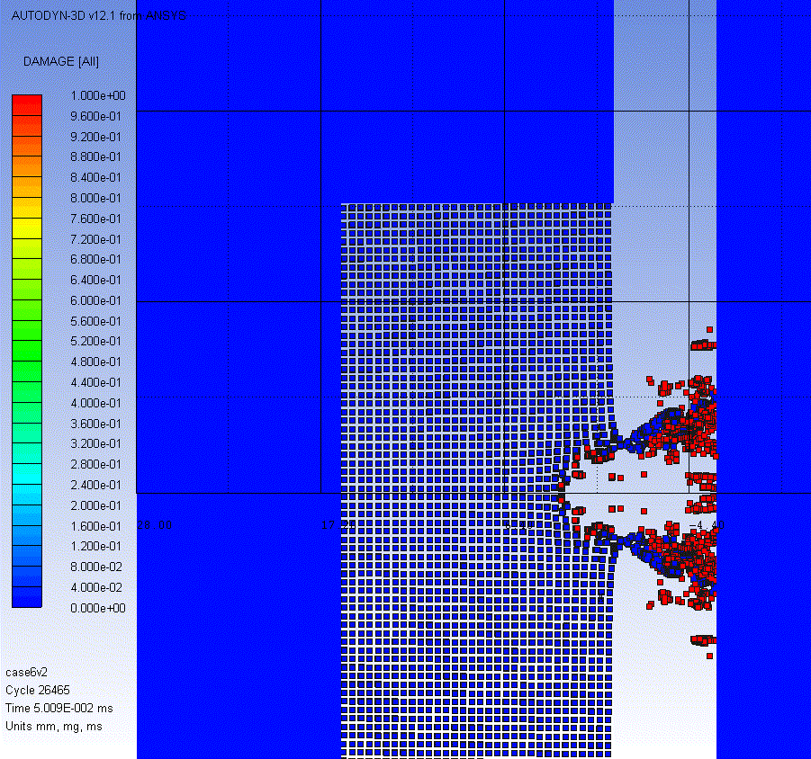
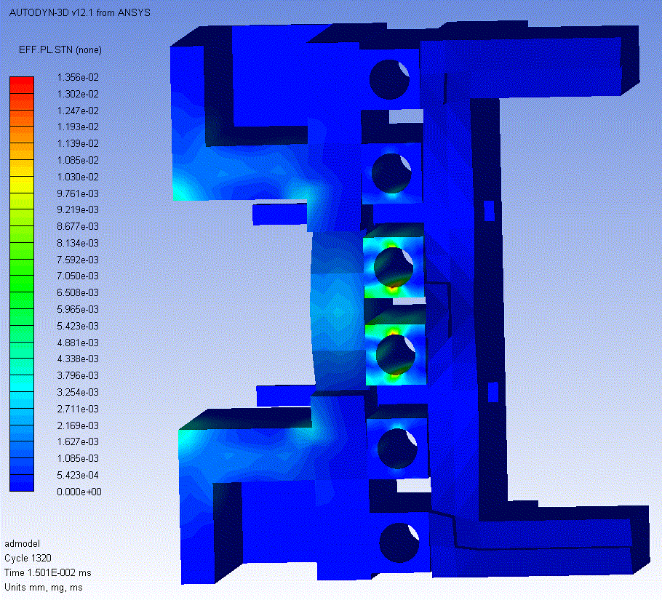
5 TeV PROTON BUNCH ON TERTIARY COLLIMATOR [III]
Intensity: 1.3 10¹¹ p
Beam size: 1.75 μm rad norm. emittance
(0.3 mm σ_{x} and 0.19 mm σ_{y})
courtesy of A. Bertarelli and his team
Plastic Strain
Max 1.4%
(on Water Pipes)
~8 mm
Particle spray on the opposite jaw Sticking droplets?

Slide 16
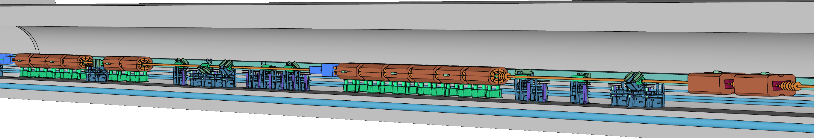
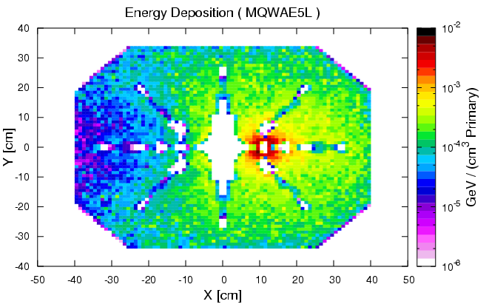
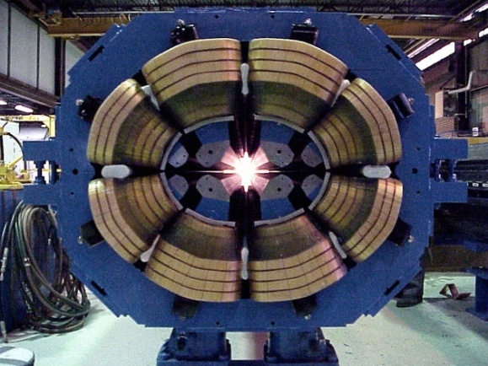
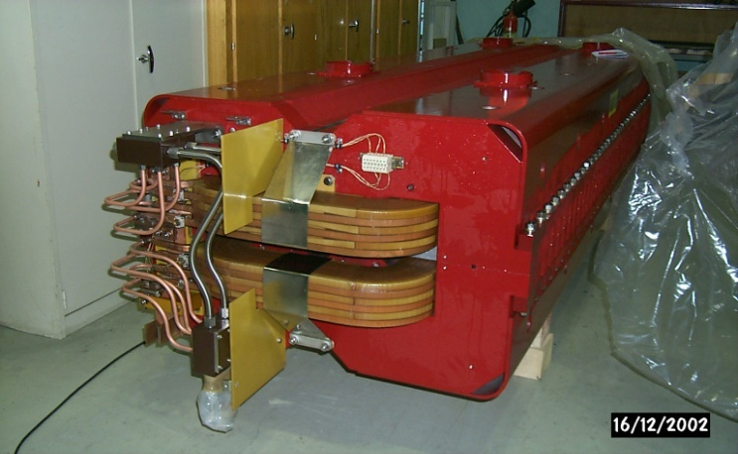
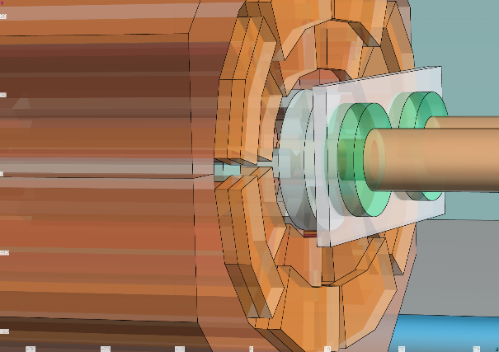
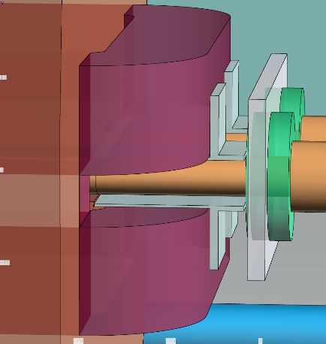
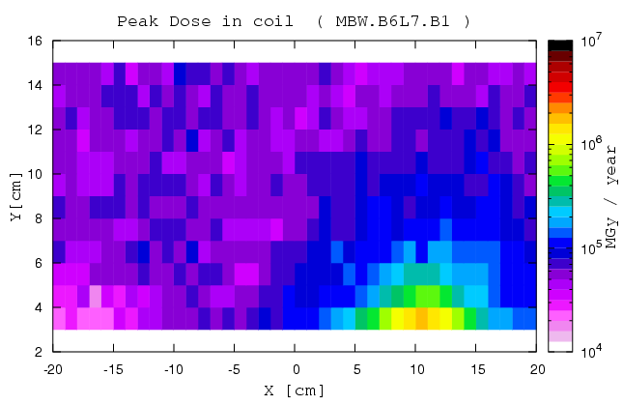
6.5 TeV PROTON BEAM REGULAR CLEANING
Cumulated losses: 1.15 10¹⁶ p per year on the betatron cleaning insertion collimators
shower from the collimators
passive absorbers
warm magnets
~2MGy
additional factor 3
peak dose reduction provided by tungsten masks
~3MGy

Slide 17
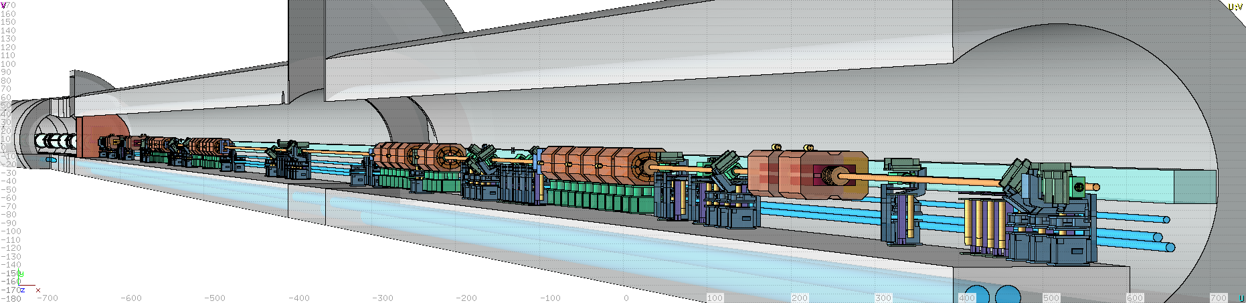
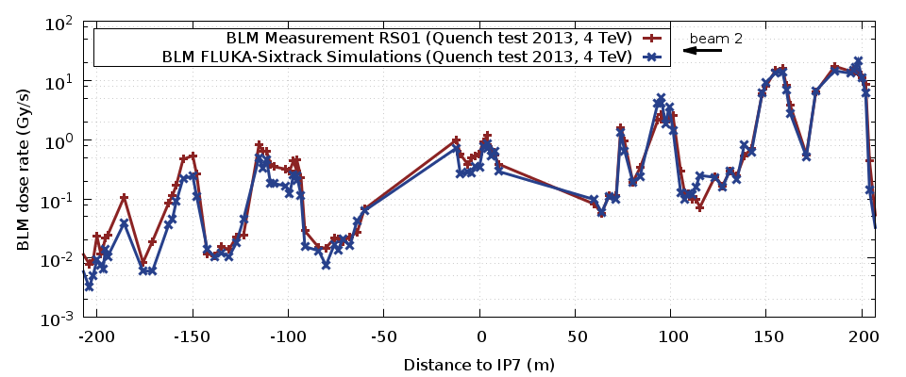
LOSS PATTERN MEASUREMENT AND PREDICTION
Loss rate: 1 MW on the betatron cleaning insertion collimators
TCP
TCP B1
IP7
Q4
Q5

Slide 18
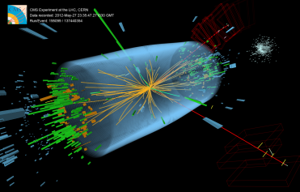
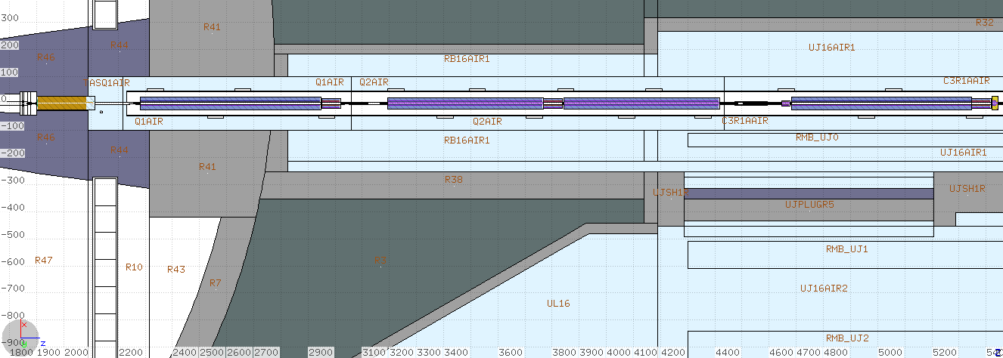
THE LHC 14 TeV CoM COLLISION DEBRIS
proton-proton collisions
Instantaneous luminosity: 10³⁴ cm⁻² s⁻¹
950 W towards each (L&R) side
right of ATLAS
150 W absorbed in the TAS
650 W going through the TAS
of which
150 W absorbed in the triplet
cold magnets

Slide 19
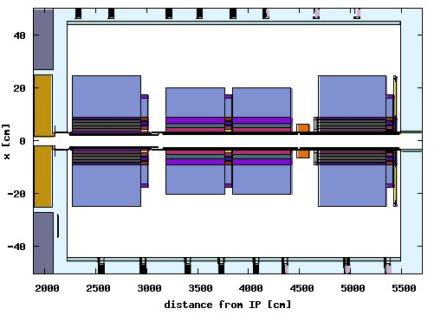
DEBRIS CAPTURE IN THE “TRIPLET”
right of ATLAS
lost in Q1
end of the
TAS shadow

Slide 20
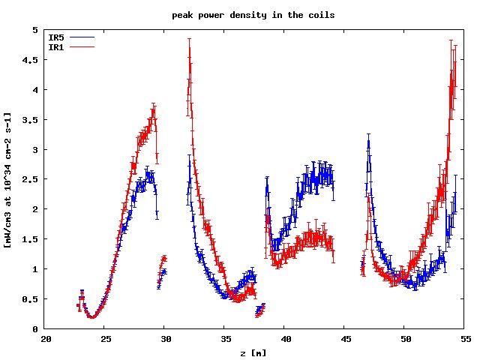
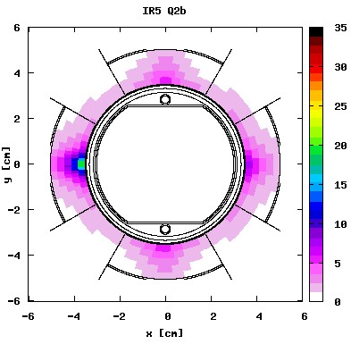
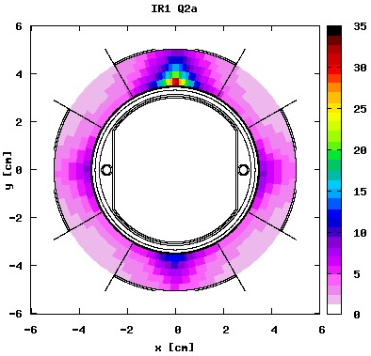
MARGIN TO QUENCH
round optics
142.5 μrad half crossing angle
x
peak dose [MGy] after 300 fb⁻¹, relevant for triplet (i.e. coil insulator) lifetime
V crossing in ATLAS (IR1)
H crossing in CMS (IR5)
x
different behavior reflecting the crossing plane variation for the same
magnetic configuration of the triplet (FDF in the horizontal plane for
positively charged particles coming from the IP)
- IR1 triplet (Q2a) reaches the design limit at nominal luminosity

Slide 21
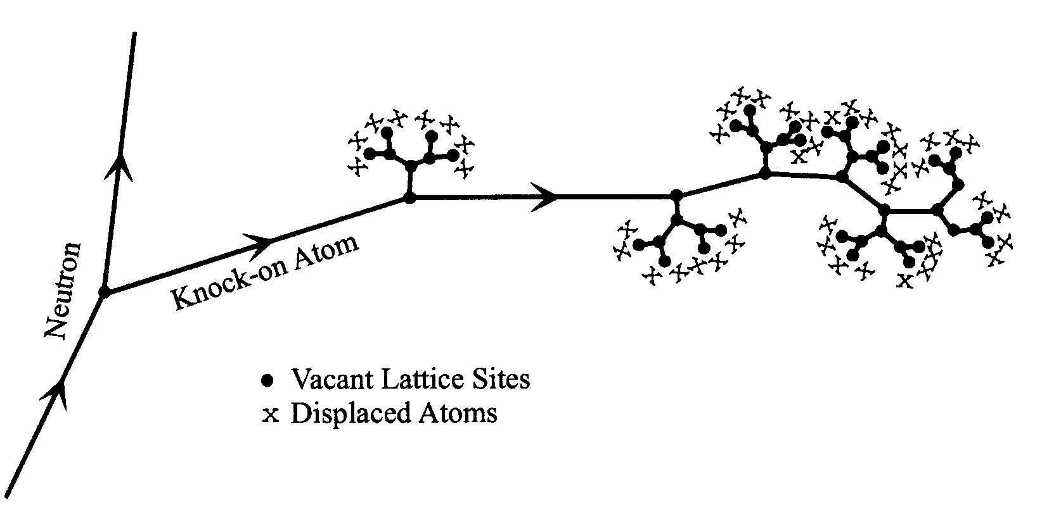
DISPLACEMENTS PER ATOM
It is a “measure” of the amount of radiation damage in inorganic materials
0.3 dpa means that on average 3 atoms out of 10 have been displaced once from their site within the structural lattice
Displacement damage can be induced by all particles
produced in the hadronic cascade, including high energy photons
(through photonuclear reactions).
It is directly related to energy transfers to atomic nuclei
i.e. (restricted) NIEL
nuclear stopping power
partition function S_{n}/(S_{n}+S_{e})
¹⁶O in Silicon
¹⁰⁷Ag
in Gold
total kinetic
S_{n}/S is going down with energy and up with charge
→ NIEL/DPA are dominated by low energy heavy recoils!

Slide 22
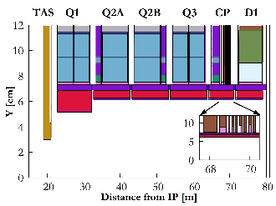
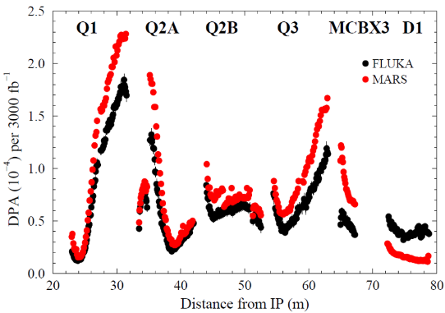
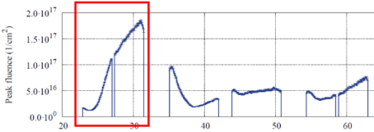
SUPERCONDUCTOR DEGRADATION
Nb₃Sn coils
tracklength fraction [%]
photons | 88
electrons/positrons | 7
neutrons | 4
pions | 0.45
protons | 0.15
HL-LHC
Integrated luminosity: 3000 fb⁻¹
[N. Mokhov
and his team]
dominant contribution to DPA
from recoils by low energy (<20 MeV) neutrons

Slide 23
HYDROGEN AND HELIUM GAS PRODUCTION
Spallation reactions induced by protons, neutrons, pions, … produce a variety of particles including protons (¹H), deuterons (²H) , tritons (³H), ³He, and alphas (⁴He). The least energetic of these products (which are also the most abundant) can stop in the target assembly giving rise to a hydrogen and helium buildup.
These gases can lead to grain boundary embrittlement and accelerated swelling.
In the case of the CNGS target, for 1.4 10²⁰ protons on target one expects about 4 10²¹ H atoms.
Assuming that all H atoms are desorbed from the target solid structures, this corresponds to ∼150 ml of atomic H at atmospheric pressure (75 ml if we assume they combined into molecules).

Slide 24
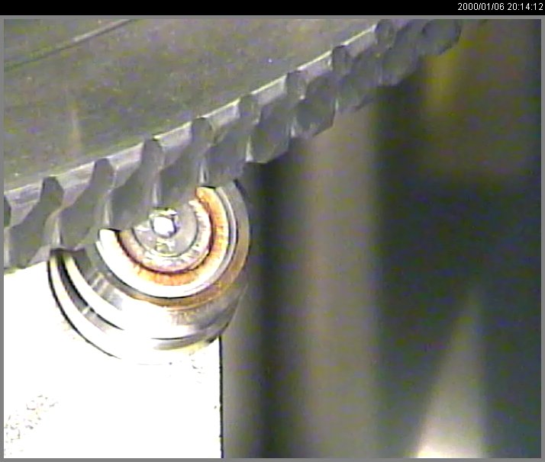
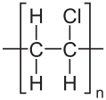
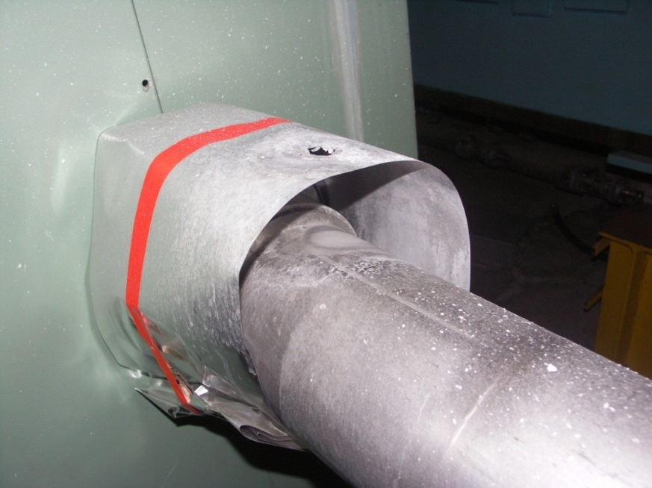
REDOX
Ionising radiation creates radicals chemically active
Ball bearings exposed
to hadronic showers in air
energy deposition
PVC dehydrochlorination by X and γ-rays
Cl⁻ ions react with water droplets and create a very corrosive environment

Slide 25
OZONE PRODUCTION
conversion factor
deposited power
[NCRP Report 51, LEP Note 379]
under the assumption of no O₃ decomposition
(yielding in the τ expression a neglected term kP_{eV}/V with k decomposition constant
equal to 1.4 10⁻¹⁶ cm³/eV)

Slide 26
ELECTRONICS FAILURES [I]
CNGS 2007 physics run, 8 10¹⁷ protons on target delivered ( ≈2% of a nominal CNGS year )
Gy per 4.5 10¹⁹ p.o.t.
Predicted dose levels
[in agreement with measurements]
Electronics
Ventilation Units
CV,crane,
fire controls
Single event upsets in ventilation electronics caused ventilation control failure and interruption of communication

Slide 27
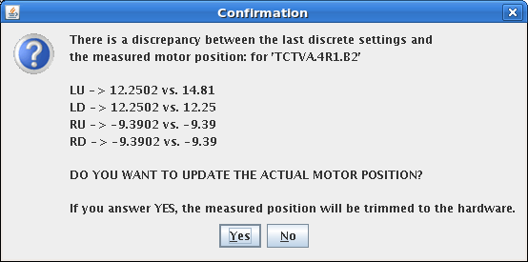
ELECTRONICS FAILURES [II]
collimator controls

Slide 28
MAIN RADIATION EFFECTS ON ELECTRONICS
 |  |  | relevant physical quantity the effect is scaling with
Single Event effects (Random in time) | Single Event Upset (SEU) | Memory bit flip (soft error) Temporary functional failure | High energy hadron fluence [cm⁻²] (but also thermal neutrons!)
 | Single Event Latchup (SEL) | Abnormal high current state Permanent/destructive if not protected | High energy hadron fluence [cm⁻²]
Cumulative effects (Long term) | Total Ionizing Dose (TID) | Charge build-up in oxide Threshold shift & increased leakage current Ultimately destructive | Ionizing dose [Gy]
 | Displacement damage | Atomic displacements Degradation over time Ultimately destructive | Silicon 1 MeV-equivalent neutron fluence [cm⁻²] {NIEL -> DPA}

Slide 29
HOW HIGH ENERGY HADRONS?
>20 MeV
plus
²⁸Si(n,xα) cross section
5 MeV

Slide 30

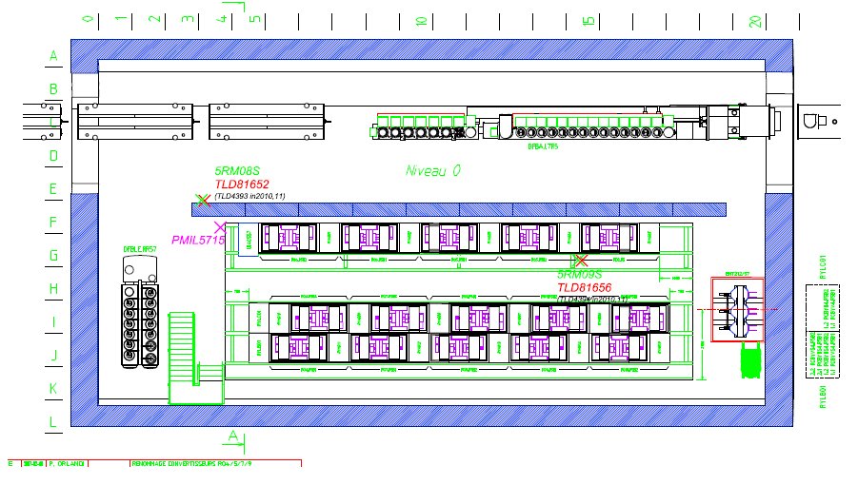

MONITORING AND BENCHMARKING
RadMons
th
ev
qe
F_{H>20MeV} [cm⁻²] (L₂₀₁₂) | 5RM08S | 5RM09S
FLUKA | 6.1 10⁸ | 3.0 10⁷
DATA | 4.56 10⁸ (256 upsets) | 4.32 10⁷ (25 upsets)
Agreement within 30%

Slide 31

RADIATION LEVELS
Sea Level
Avionic
ISS
Space & Deep Space
FCCee
FCCee
LHC + Experiments
FCCee
COTS Systems
Hardened Electronics
Electronics
Custom Boards with COTS
Damage

Slide 32

17 GeV ELECTRON BEAM ENVIRONMENT
dump of the Linear Coherent Light Source @ SLAC
[rad=0.01Gy]
courtesy of M. Santana-Leitner
= 10 Gy
dose limit
role of photoneutrons!

Slide 33

MITIGATION/PREVENTION STRATEGY
identify forbidden regions
relocate
design shielding
install radiation resistant equipment
2007
10⁷ ÷ 10⁹ heh/cm²
high energy hadron fluence
per nominal CNGS year
2008
< 10⁶ heh/cm²
CNGS radiation issues solved
during shutdown 2007-2008

Slide 34


FACILITY SHIELDING DESIGN
For radiation protection purposes, depending on the aspects to be considered,
particle fluence in a given location is transformed into effective dose or ambient dose equivalent (Sv)
through the use of respective sets of conversion coefficients, which are a function of particle type and energy.
Prompt dose equivalent outside a radiation facility, reflecting the relevant radiation level in a public space during normal or accidental operation of the facility, is the quantity to minimize below acceptable limits.
top view of the ISR tunnel on the side of the n_TOF EAR-2 vertical beam line
(for neutrons from 1.6 10¹² Hz 20 GeV/c protons on lead)
I. Bergström, V. Vlachoudis, J. Vollaire
0.5 μSv/h classification limit
with default* shielding
with improved† shielding
* 80 cm thick 2m high concrete block
† triple concrete volume + two iron plates

Slide 35
ACTIVATION
A high energy nuclear reaction on a high Z nucleus fills roughly the whole charge and mass intervals of the nuclide chart

Slide 36

DELAYED RADIATION FROM RADIOACTIVE DECAY
Bateman equations
$$\frac{dN_{n}}{dt}=P_{n}+{{(b}_{n−1,n}∙λ}_{n−1}∙N_{n−1})−λ_{n}∙N_{n}$$
production
rate
growth by parent decay
decay
which are solved for a given irradiation profile at different cooling times
…
I_{n}, (Δt)_{n}
I, Δt
0, Δt
1h
…
1h
8h
1d
7d
etc.
yielding (specific) activities [Bq(/g)] – to be compared to legal exemption limits –
and residual dose rates [uSv/h] by the decay radiation (mainly electromagnetic)

Slide 37




DURING SHUTDOWN
HL-LHC final focus triplet around ATLAS and CMS 900fb⁻¹ between Long Shutdowns
@ 40 cm
SM
SM
[C. Adorisio and S. Roesler,
HL-LHC TC, Sep 30, 2014]

Slide 38


AIR ACTIVATION
The activity of an air radioisotope (⁷Be, ¹¹C, ¹³N, ¹⁵O, ³⁸Cl, ³⁹Cl, etc.) in the irradiation area
at the end of the irradiation period T is
where $m_{on}$ is the relative air exchange rate during irradiation,
i.e. the fraction of the air volume renewed per unit time
and $A_{S}$ is the saturation activity
production cross section
irradiated air volume
differential fluence rate of (hadron) particles (P=p,n,π±)
air atom density (T=¹²C,¹⁴N,¹⁶O,⁴⁰Ar)
Amount of activity released into atmosphere all along the irradiation period
($t_{on}$ is the time taken by the air flux to reach the release point from the irradiated area)
Amount of activity released into atmosphere after the end of the irradiation
($m_{off}$ and $t_{off}$ as $m_{on}$ and $t_{on}$ but referring to the shutdown period)

Slide 39





HUMAN MATTERS
not just damage
proton therapy (tumor cell destruction)
K. Parodi et al., PMB52, 3369 (2007)
2 Field
1 Field
TP Dose
MC PET
Meas. PET
MC Dose

Slide 40
CREDITS
In addition to explicit references, work of and material from
I. Besana, V. Boccone, M. Brugger, L.S. Esposito, A. Ferrari,
A. Lechner, R. Losito, A. Mereghetti, N. Mokhov, S. Roesler,
P.R. Sala, L. Sarchiapone, E. Skordis, A. Tsinganis, V. Vlachoudis
CERN FLUKA TEAM and FLUKA COLLABORATION
CERN COLLIMATION TEAM, CERN MAGNET GROUP,
and CERN RADIATION PROTECTION TEAM

