Slide 1
Vacuum issues
CAS INTENSITY LIMITATIONS
Paolo Chiggiato, CERN

Slide 2
Outline
Safety issues
Beam induced desorption (gas load) and multipacting
Mitigations other than beam conditioning
Heating
Conclusions

Slide 3
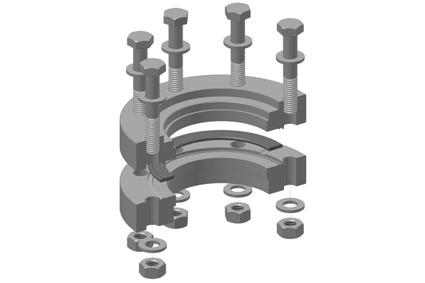
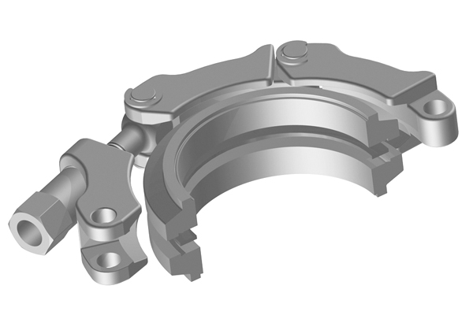
Safety issues
Higher intensity means higher losses and higher doses of intercepted particles in collimators and dumps
From the very beginning, layout and equipment exposed to the beam have to be designed so that the collective radioactivity dose is minimized in the spirit of the ALARA procedure.
For example, the localization of components that require regular maintenance have to be selected with care.
Components have to be easily and reliably operated by the personnel.
An example:
Courtesy of Vacom
Courtesy of Vacom
Quick connect ConFlat flange
Standard ConFlat flange

Slide 4
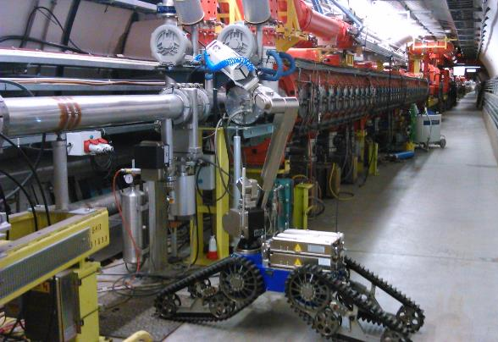
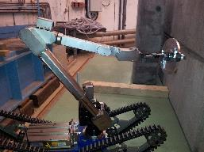
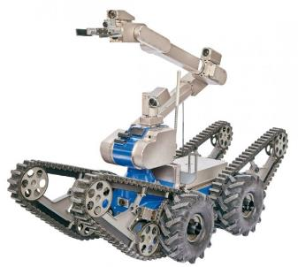
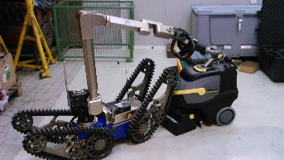
Safety issues: robot intervention
Use of robot for:
  Inspection of equipment
  Leak detection
  Removal of clamps
  Cleaning
  Install flanges (12 mSv/h)
- The design of accelerators should facilitate robotic interventions.
- Robotic intervention for vacuum activities is already a reality.
- During the Long Shutdown 1, Telemax was used in the SPS and its experimental lines
Telemax
Courtesy of J. A. Somoza Ferreira
Leak detection with remote operated robot

Slide 5
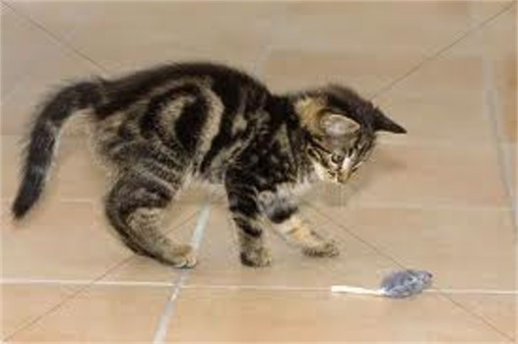

Safety issues: robot intervention
Costs
Need of trained personnel
Time consuming
Remote operation
Example: remove 1 clamp
Human with torque wrench: 2-3 minutes
Human with cordless impact wrench: 20-30 seconds
Robot: 15-30 minutes
Limiting factors
Plenty of development for the next generation of designers of high-intensity accelerators

Slide 6
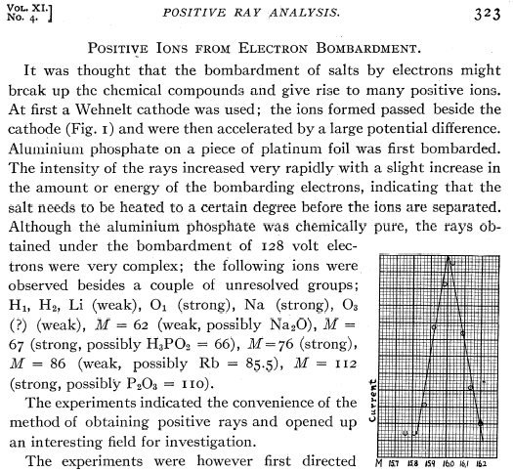
Gas load: beam induced desorption
The impingement of electron/photon/ions on surfaces can result in ion and neutral gas desorption.
In 1918, Dempster observed ion desorption from electron bombarded salts (Phys. Rev. 11, 323)

Slide 7
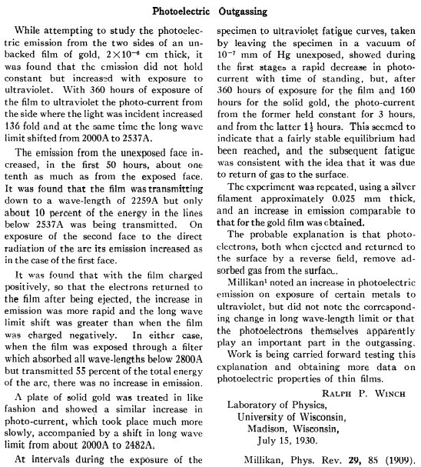
Gas load: beam induced desorption
Millikan reported the first evidence of photon induced desorption in 1909 during the measurement of the photoelectric current of metals exposed to ultraviolet radiation.
The first interpretation is given by Winch in 1930 (Phys. Rev. 36, 601).
He was the first to see the implication of photoelectrons on photon induced desorption.

Slide 8
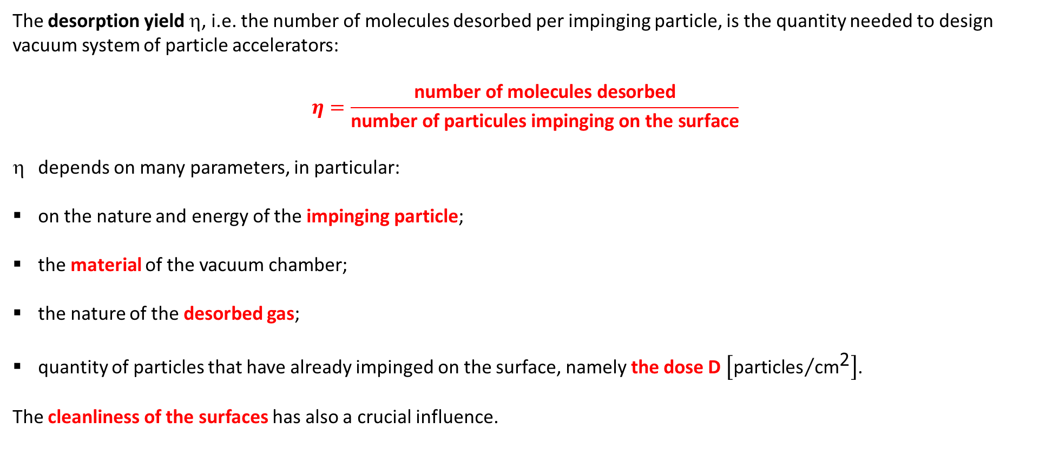
Gas load: beam induced desorption
The desorption yield η, i.e. the number of molecules desorbed per impinging particle, is the quantity needed to design vacuum system of particle accelerators:
$$η=\frac{\text{number} \text{of} \text{molecules} \text{desorbed}}{\text{number} \text{of} \text{particules} \text{impinging} \text{on} \text{the} \text{surface}}$$
depends on many parameters, in particular:
on the nature and energy of the impinging particle;
the material of the vacuum chamber;
the nature of the desorbed gas;
quantity of particles that have already impinged on the surface, namely the dose D $\left[{\text{particles}}/{{\text{cm}}^{\text{2}}}\right]$.
The cleanliness of the surfaces has also a crucial influence.

Slide 9
Gas load: Electron Stimulated Desorption (ESD)
In general, ESD is correlated with beam induced multipacting (ecloud in beampipes and multipacting in RF systems).
The penetration depth of electrons kicked by beams is lower than 1 nm. ESD strongly depends on the chemical composition of the oxide layer (typical thickness is 1-10 nm).
Universal curve for inelastic mean free path as a function of electron kinetic energy.
M. Seah and W. Dench, Surf, Interface Anal. 1(1979)2

Slide 10
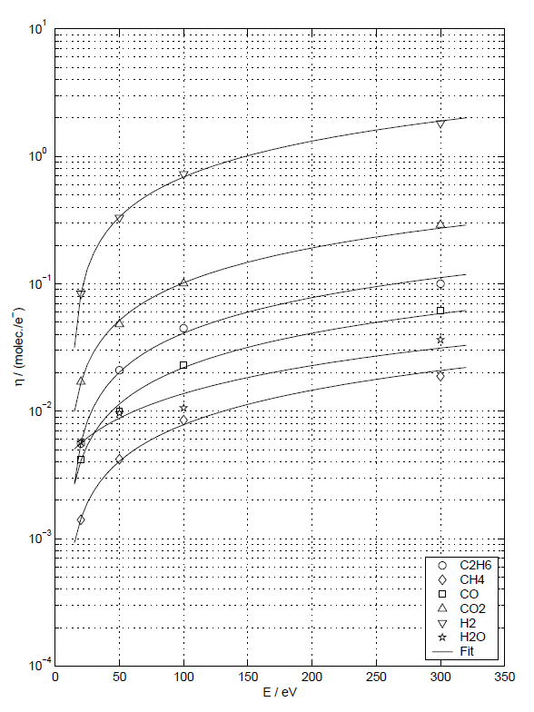
Gas load: ESD, selected case 1
E_{e}=300 eV
OFHC copper, cleaned following CERN recipe, stored in plastic bag for weeks, 24 h pumping, not baked in situ.
η=f(E) at D_{e}= 1.4x10¹⁴ e⁻ cm⁻²
η_{H2}(10¹⁸ e⁻cm⁻²)= 6x10⁻³
η_{CO}(10¹⁸ e⁻cm⁻²)= 5x10⁻⁴
10¹⁸
F. Billard, N. Hilleret, G. Vorlaufer, CERN, Vacuum Technical Note 00-32

Slide 11
Gas load: ESD, selected case 2
AISI 316 LN cleaned following CERN recipes, baked in situ at 150°C for 24 h + 300°C for 2 h.
The desorbed quantity of H₂, CO and CO₂ is much larger than one monolayer.
1 ML of H₂ ≈ 2x10¹⁵ molecules cm⁻²
η
Q
J. Gómez-Goñi and A. G. Mathewson, J. Vac. Sci. Technol. A 15, 3093 (1997)

Slide 12
Electron multipacting: Secondary Electron Yield (SEY)
Energy of secondary electrons
Secondary electron yield δ
Primary electron energy [eV]
D. R. Grosso et al., Proc. of EPAC08, p. 1619, Genova, Italy
V. Baglin et al., Proc. of EPAC 2000, p. 217, Vienna, Austria

Slide 13
Electron multipacting: SEY, beam scrubbing
10⁻³ to 10⁻² C/mm² are required to fulfil the LHC design: δ_{MAX}<1.3
ESD
D=10⁻² C mm⁻²
ESD→ ≈10³ reduction
SEY→ ≈ 50% reduction
δ_{i}
H₂
Primary Electron
Energy
δ_{max}
CO₂
CO
LHC design:
δmax < 1.3
CH₄
10⁻² C mm⁻²
Electron Dose [C mm⁻²]
Courtesy of Vincent Baglin

Slide 14
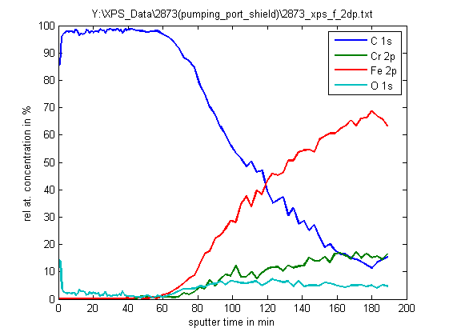
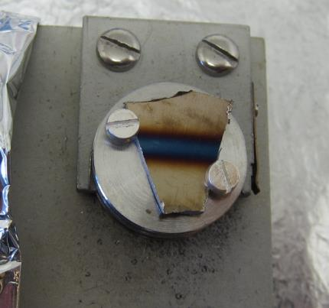
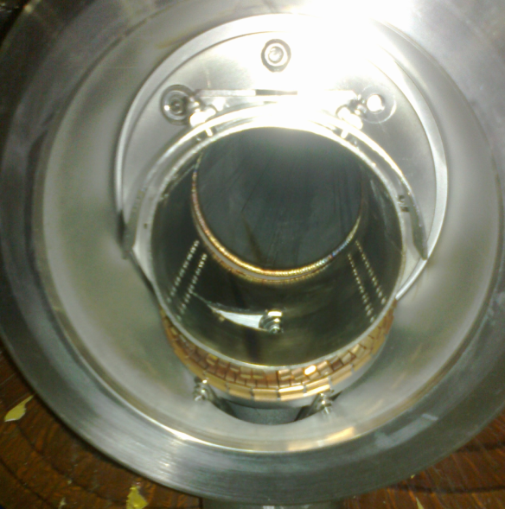
Electron multipacting: SEY, beam scrubbing
Courtesy of Mauro Taborelli
Dark stripe ⟹ Thick Carbon Layer
25 mm
Piece cut from the shield, …as clean as possible

Slide 15
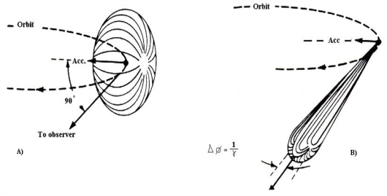
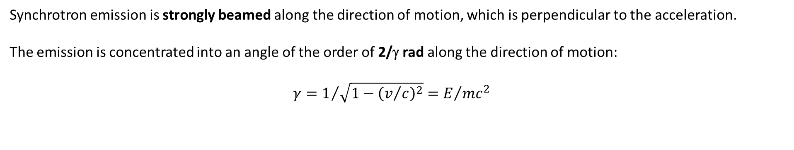
Gas load: Photon Stimulated Desorption (PSD)
Synchrotron emission is strongly beamed along the direction of motion, which is perpendicular to the acceleration.
The emission is concentrated into an angle of the order of 2/γ rad along the direction of motion:
${γ=1}/{\sqrt{1−{\left(v/c\right)}^{2}}}=E/{mc^{2}}$
15

Slide 16
Gas load: PSD, power
A particle of charge ‘e’, energy E and rest mass m₀, moving on a circular orbit (radius ρ) radiates electromagnetic radiation with the following power P_{rad}:
where ε₀ and c are the vacuum permittivity and the speed of light, respectively.
The emitted power depends strongly on the beam energy, the radius of the bent trajectory, and the mass of the charged particle.
Consequently, electrons emit much more synchrotron radiation power than protons for the same bending radius and energy:

Slide 17
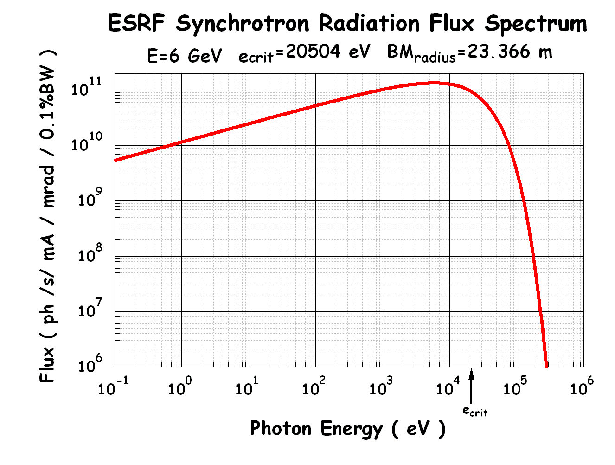
Gas load: PSD, critical energy
Synchrotron radiation from bending magnets has a very broad energy spectrum, which is characterised by the critical energy ε_{C}:
The critical energy subdivide the photon spectrum in two parts of equal emitted power.
For electrons
For protons

Slide 18
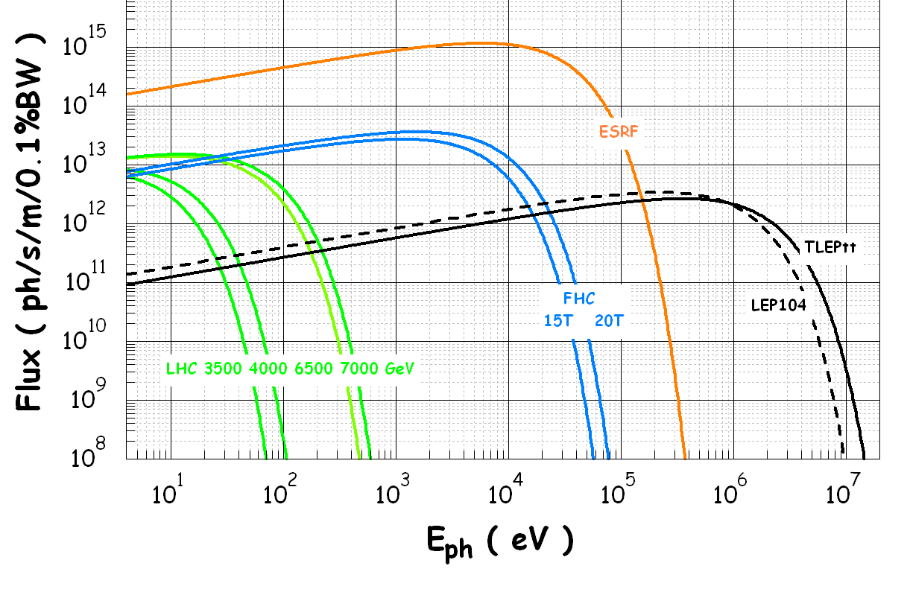
Gas load: PSD, spectra
Courtesy of Roberto Kersevan

Slide 19
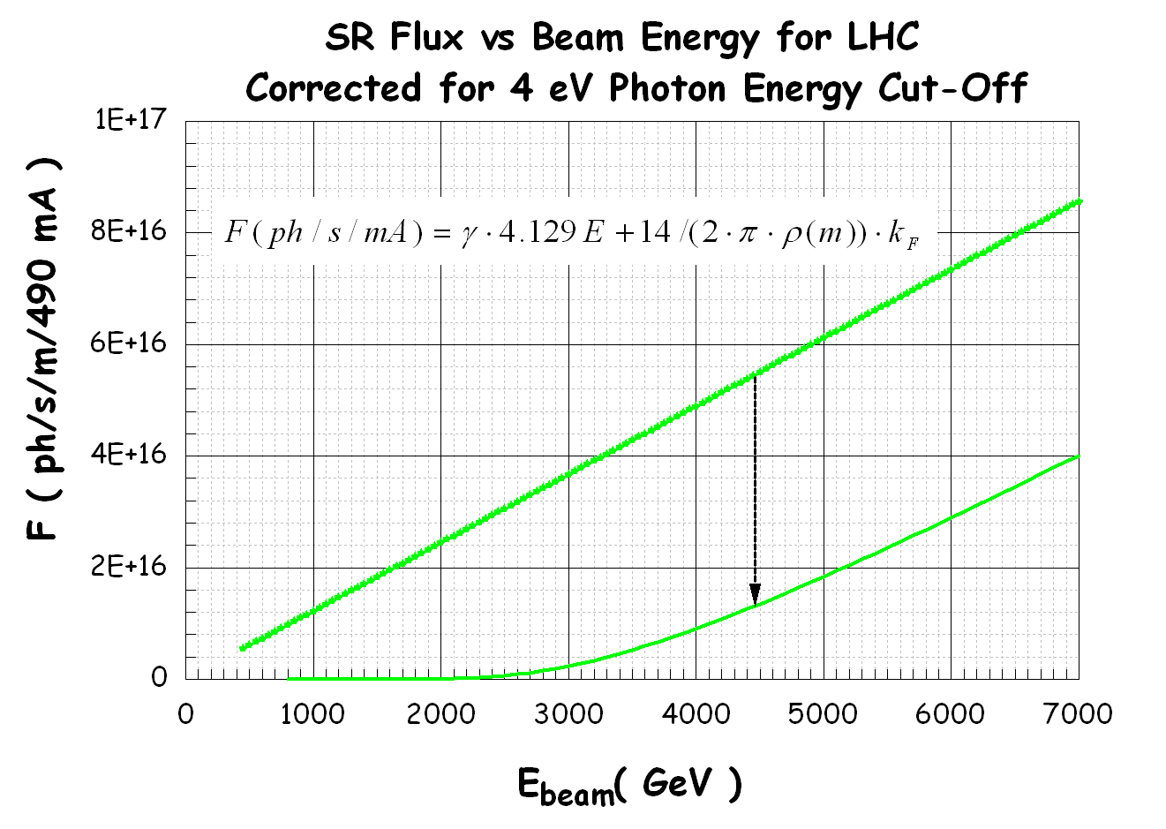
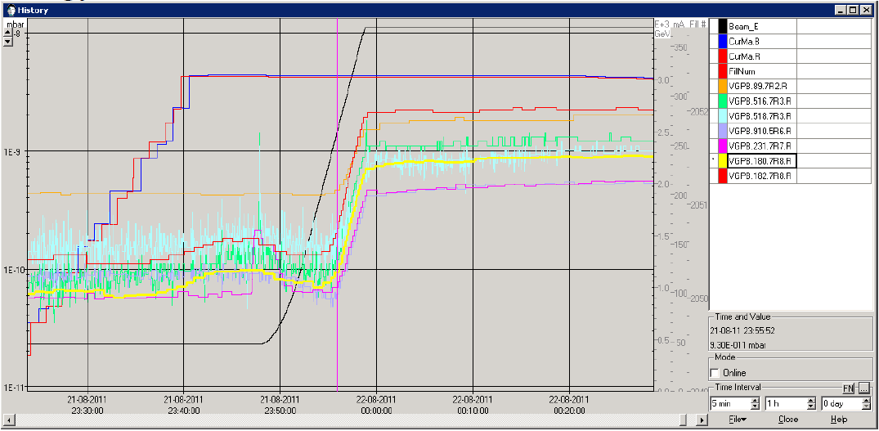
Gas load: PSD, cut-off energy
Correction for the cut-off energy of the photons: 4 eV (work function); below this value there is no photoelectron emission and no SR-induced desorption.
Courtesy of Roberto Kersevan
Note the onset of pressure rise at 2 TeV, as seen by the vacuum gauges in the LHC during energy ramp.

Slide 20
Gas load: PSD, impinging photons
It can be shown that the number of emitted photon per unit time:
Mean photon energy: max of the distribution
For electrons
The linear flux, i.e. the emitted photons per second and meter, is given by
For electrons

Slide 21
Gas load: PSD, LHC
For both electron and proton beams
For LHC:
γ = 7460.52
ρ = 2804.95 m
I = 490 mA
For FCC-hh (50 TeV, 15 T):
γ = 53289
ρ = 11118.8 m
I = 490 mA

Slide 22
Gas load: PSD, dependence on critical energy
10⁻²
Above 60 keV, the Compton scattering plays a predominant effect in the interaction of photons with the material of the vacuum chamber.
The high number of energetic recoil electrons and scattered photons increase the desorption yields.
10⁻³
Desorption Yield
10⁻⁴
10⁻⁵
Courtesy of O. Gröbner
10⁻⁶
10
100
1000
10000
100000
Critical Energy [eV]

Slide 23
Gas load: PSD, dependence on dose
For doses higher than 10²⁰ photons/m doses, η_{ph} varies as a power law function of the dose:
J. Gomez-Goñi et al, J. Vac. Sci. Technol. A 12, 1714 (1994)
Critical energy: 3.75 KeV
Critical energy: 3.75 KeV
OFHC copper, baked in situ at 150°C for 24 h

Slide 24
Gas load: PSD, dependence on incidence angle
Photo-desorption yields depend on the incidence angle
O. Gröbner et al., Vacuum 33(1983)397
The photodesorption yield is higher when the angle of incidence is lower.
In most of the accelerators the incidence is at grazing angle.
φ
11 mrad

Slide 25
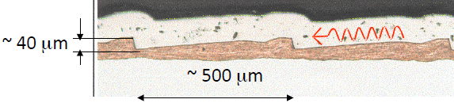
Gas load: PSD, LHC
In the LHC beam screen, the inner wall was machined so that photons impinge nearly perpendicularly onto the copper layer.
Desorption yield, photoelectron yield and photon reflectivity are reduced.
11 mrad
LHC sawtooth
V. Baglin et al., EPAC 1998

Slide 26
Gas load: Ion Stimulated Desorption (ISD)
There are two sources of energetic ions:
Beam particles may collide with the residual gas and create ions (H₂⁺, CH₄⁺, CO⁺, CO₂⁺, etc.). If the beam is positively charged, the ions are accelerated by the beam potential and collide on the nearby walls with energy between 1 eV to several KeV. The collisions result in gas desorption.
When heavy ions are accelerated, beam losses may lead to collision of high-energy heavy ions with the wall of the vacuum system. Typical ions are Pb⁵³⁺, U⁷³⁺, and Ar¹⁰⁺. Experimental studies have been carried out with beam energy in the range from 1 MeV/nucleon to 100 GeV/nucleon. The desorption yields may be orders of magnitude higher than those for residual-gas ions.

Slide 27
Gas load: ISD, residual-gas ions
Ions are more effective in desorbing gas than electrons. Typical η_{i} values for baked copper and ion energy of about 1 KeV are about 1 for H₂ and CO; 5 and 10 times lower for CO₂ and CH₄, respectively.
G. Hulla, PhD Thesis, Technischen Universität Wien, 2009

Slide 28
Gas load: ISD, residual-gas ions
Ion impact energy in LHC beam screen as a function of proton beam current
H₂⁺
He⁺
CH₄⁺
CO₂⁺ CO⁺
O. Gröbner, https://cdsweb.cern.ch/record/455985/files/p291.pdf

Slide 29
Gas load: ISD, residual-gas ions, conditioning
G. Hulla, PhD Thesis, Technischen Universität Wien, 2009

Slide 30
Gas load: ISD, ion-induced pressure instability
Ion induces desorption can trigger a rapid pressure rise in vacuum chambers where positive beams circulate.
This phenomenon was shown first at the CERN ISR when increasing the proton current to about 1 A.
The pressure rise is generated by a positive feedback process that can be depicted with the following block diagram.
The residual gas is ionised by the positive-particle beam
The ionised molecules are accelerated by the beam potential
The ions collide on the surface and extract gas

Slide 31
Gas load: ISD, ion-induced pressure instability
Critical current:
Gas | σ_{i} [10⁻¹⁸ cm²] 26 GeV | σ_{i} [10⁻¹⁸ cm²] 7 TeV
H₂ | 0.22 | 0.37
He | 0.23 | 0.38
CH₄ | 1.2 | 2.1
CO | 1.0 | 1.8
CO₂ | 1.1 | 2.0
Ar | 1.6 | 2.8
O. Gröbner, The LHC vacuum system
https://cdsweb.cern.ch/record/455985/files/p291.pdf
Example:
For an effective pumping speed of 100 l s⁻¹m⁻¹ and an ionisation cross section of 10⁻¹⁸ cm² (CO ionised by protons at 26 GeV), the critical current is about 160 A if the desorption yield is 1.
For the LHC (0.45 A), the critical pumping speed is about 0.3 l s⁻¹ m⁻¹: there is more than a factor 100 of margin!

Slide 32
Mitigation
We have seen that :
Stimulated desorption
Secondary electron and photoelectron emission
are reduced by beam conditioning.
Other mitigation are available today:
thin-film coating
change of the surface morphology
axial magnetic field
clearing electrodes
Thin films
NEG^{(*)}
TiN
a-C
Surface morphology
Grooves
LESS^{(**)}
(*) Non-Evaporable Getter
(**) Laser Engineered Surface Structures

Slide 33
Mitigation: TiN coating
Already implemented in the SNS accumulator ring by BNL.
  P. He et al, Proceedings of EPAC 2004, p. 1804, Lucerne
Early papers:
  H. Padamsee and A. Jashi, J. of Appl. Phys. 50, 1112 (1979)
  M.A. Allen and P.B. Wilson, Proceedings of the Ninth Int. Conf. on High Energy Accelerators, Stanford, 1974, p. 92
- Used as main ecloud mitigator in super-KEKB
Courtesy of Kyo Shibata, KEK

Slide 34
Mitigation: TiN coating
Courtesy of Kyo Shibata, KEK
Courtesy of Y. Suetsugu, KEK (LER2010, CERN)
The SEY of TiN can be reduced much faster than the one of bare Al alloys.
The morphology of the film could have a crucial role in reducing the SEY.
TiN is known to have also a lower photoelectron yield than traditional materials.

Slide 35
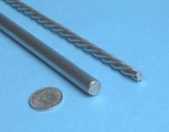
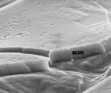
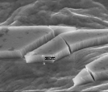
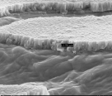
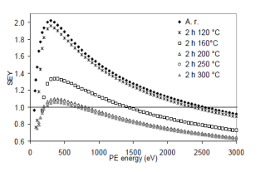
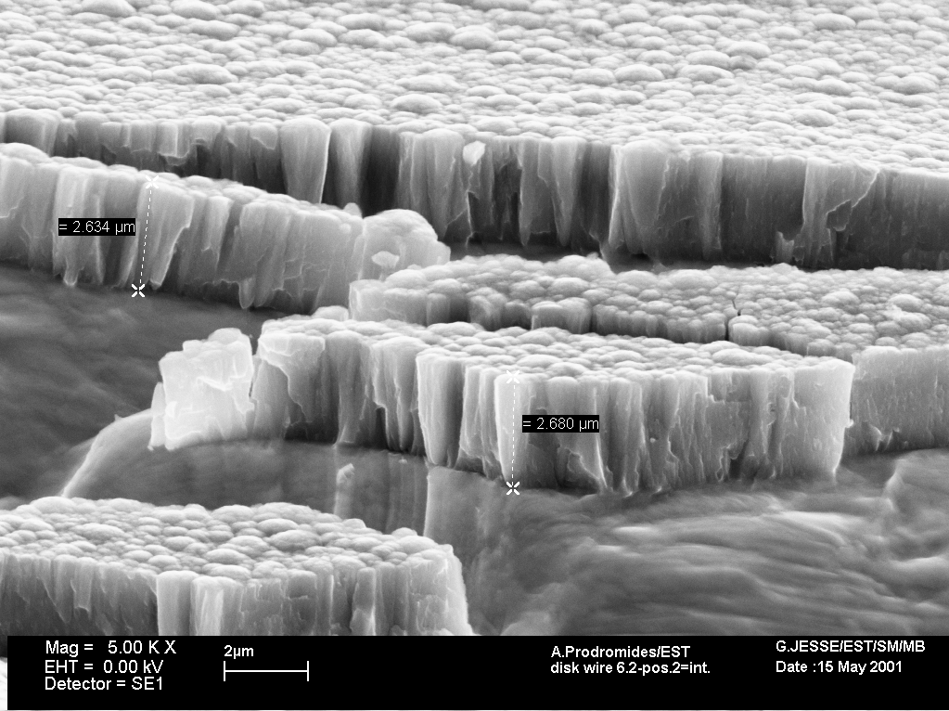
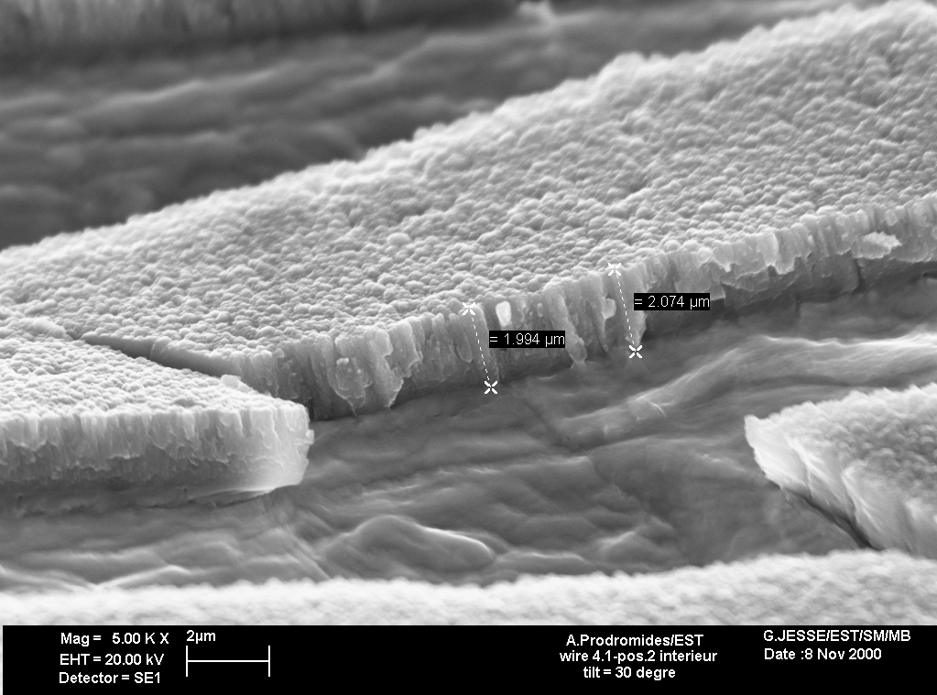
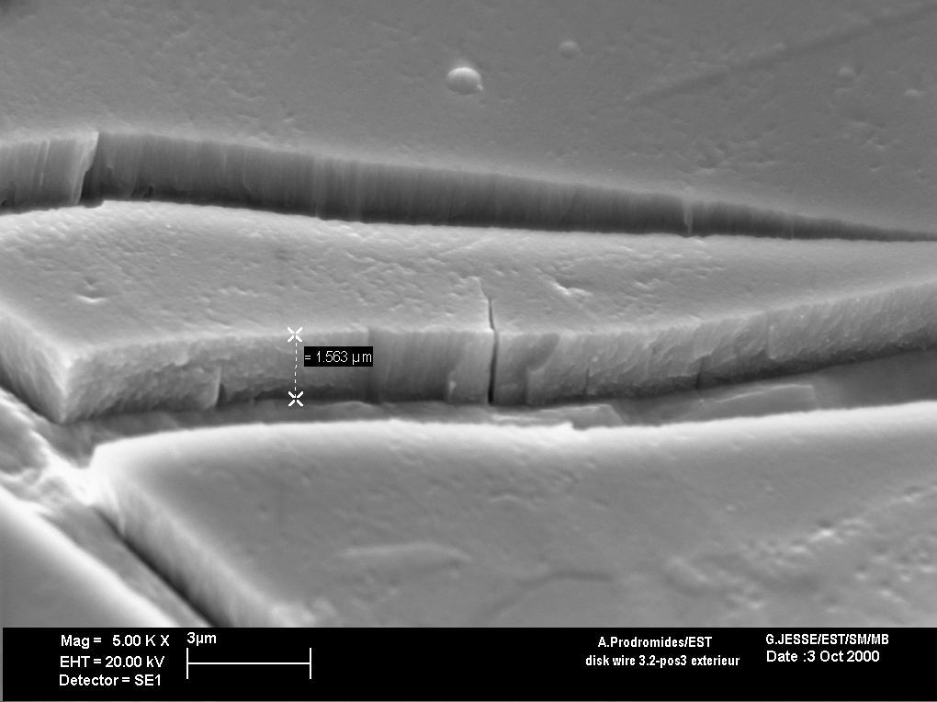
A. Prodromides et al., Vacuum 60(2001)35
Coatings: Ti-Zr-V
Microstructure of Ti-Zr-V films coated on Cu at different temperatures
C. Benvenuti et al., Vacuum 71(2003)307
Ti
Mitigation: Ti-Zr-V coating
100°C
150°C
200°C
1 μm
V
Zr
250°C
300°C
350°C
Courtesy of Nicola Black
M. Taborelli et al.
Appl. Surf. Sci. 172 (2001) 95-102
P. Chiggiato and R. Kersevan, Vacuum 60(2001)67

Slide 36
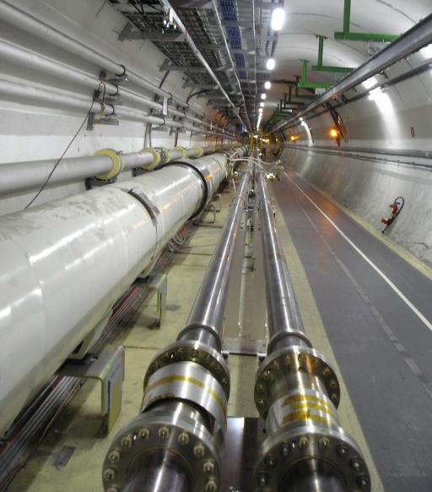
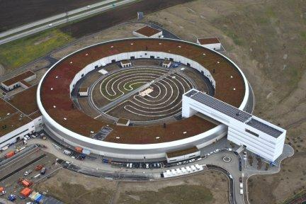
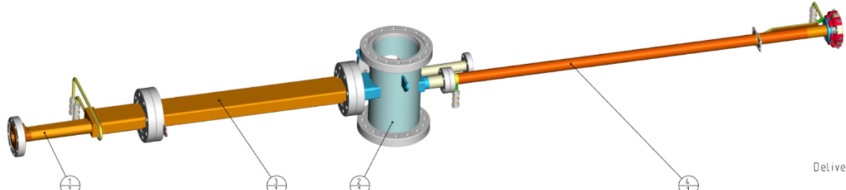
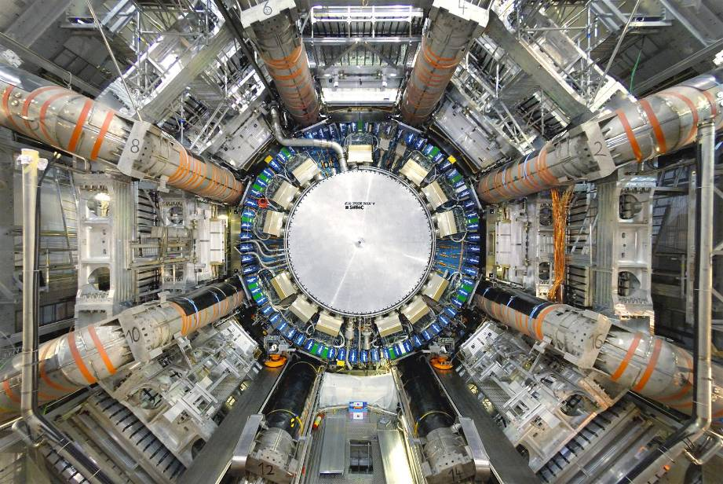
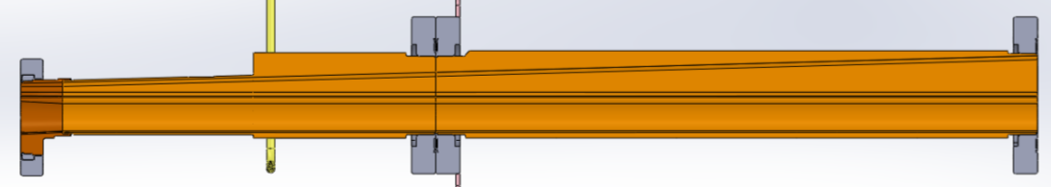
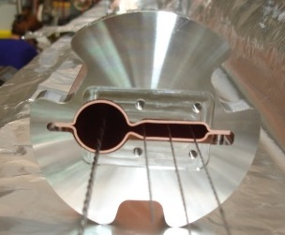
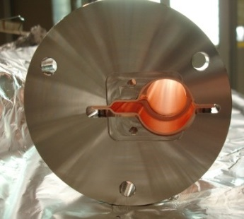
MAX IV - 3 GeV storage ring:
Circumference 528 m, 20 sectors.
MAX IV at Lund (S)
LHC Long Straight Sections
Mitigation: Ti-Zr-V coating
Courtesy of Marek Grabki
B
0.735 m
C
A
Photon
beam
Electron
beam
A
C
B
Ø22
Ø25
7
3
5

Slide 37
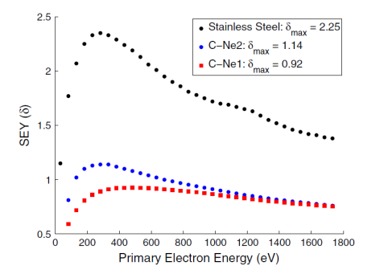
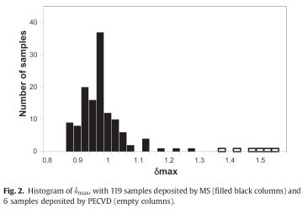
Mitigation: a-C coating
Ti-Zr-V film coating have δ_{max}≈1.1 after activation at temperature higher than 180°C (24h).
But they cannot be applied to unbaked vacuum chambers like those of the LHC’s injectors.
Carbon coatings deposited by sputtering are a valid solution
  C. Yin Vallgren et al, PRST AB, 14, 071001 (2011).
  P. Costa Pinto et al., Vacuum 98 (2013) 29
0.2 μm

Slide 38
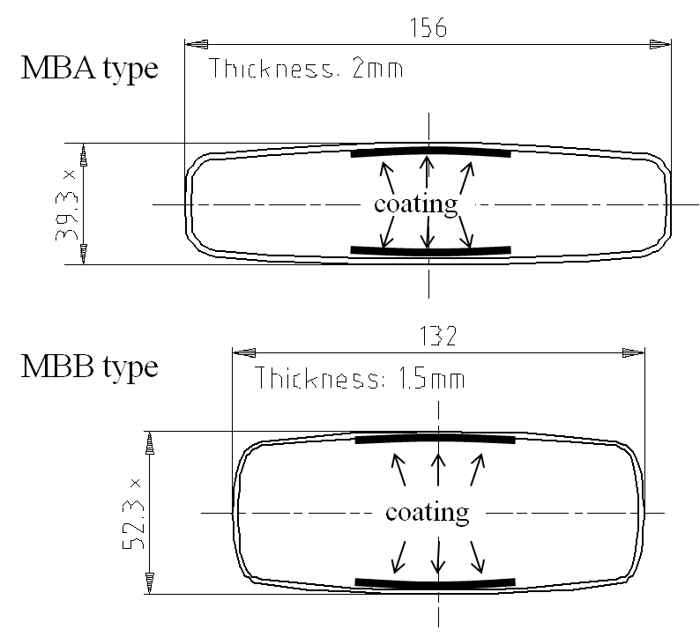
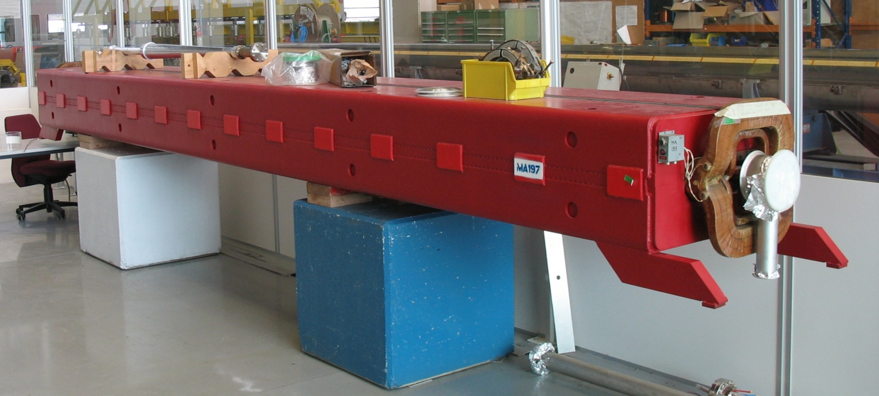
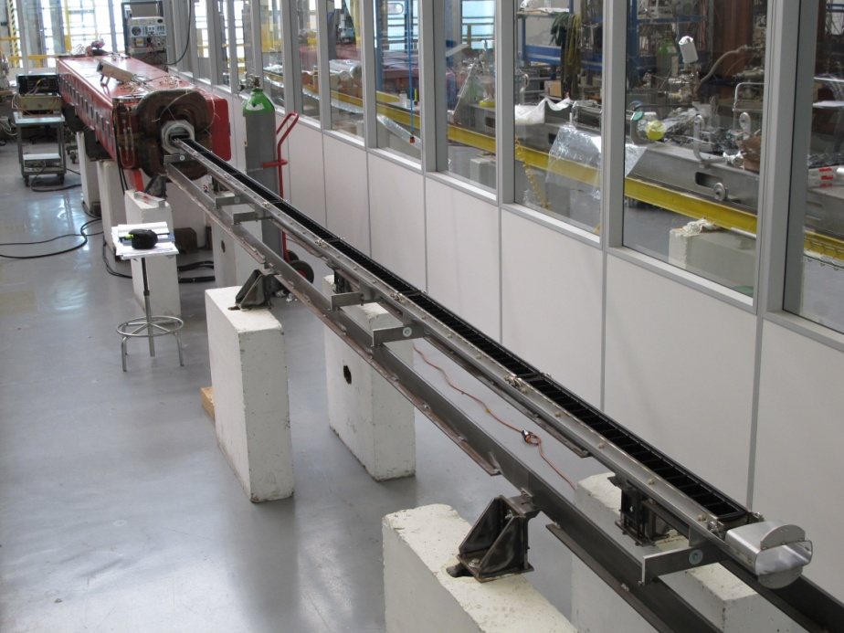
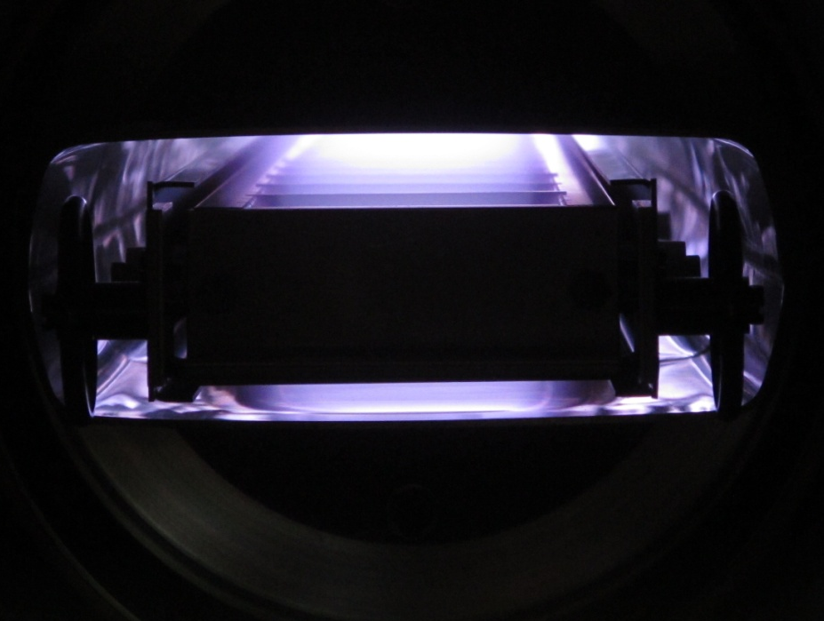
Mitigation: a-C coating
6.5 meter
Coating by hollow cathode sputtering
Courtesy of Pedro Costa Pinto
6.5 meter

Slide 39
Mitigation: Machined Grooves
Courtesy of Y. Suetsugu, KEK
Primary e⁻
Secondary e⁻

Slide 40
Mitigation: Machined Grooves
Simulations
The sharpest structure gives the lowest SEY.
α
L. Wang et al., SLAC-PUB-12641 July 2007, presented at PAC 2007
M. Pivi, paf-spsu.web.ch

Slide 41
Mitigation: Laser Engineered Surface Structures
Physics Today, February 2013
R. Valizadeh, Appl. Phys. Lett. 105, 231605 (2014)

Slide 42
Mitigation: Laser Engineered Surface Structures
Stainless steel
Copper
R. Valizadeh, Appl. Phys. Lett. 105, 231605 (2014)

Slide 43
Heating issues
Bernhard Holzer, in one of the previous CAS:
‘’There are no collective instabilities and there is no heating,
if the following conditions are fulfilled:
  the beam is ultra relativistic
  the vacuum chamber is smooth
  the vacuum chamber material is perfectly conducting.
Unfortunately these conditions are not realistic.’’
B. Holzer, HOMS and Heating, CAS Superconductivity for Accelerators, 2013
CERN Yellow Report CERN-2014-005, pp.97-110

Slide 44
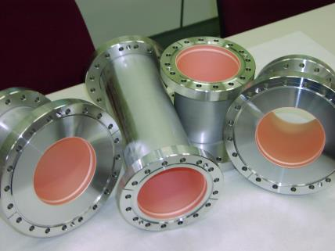
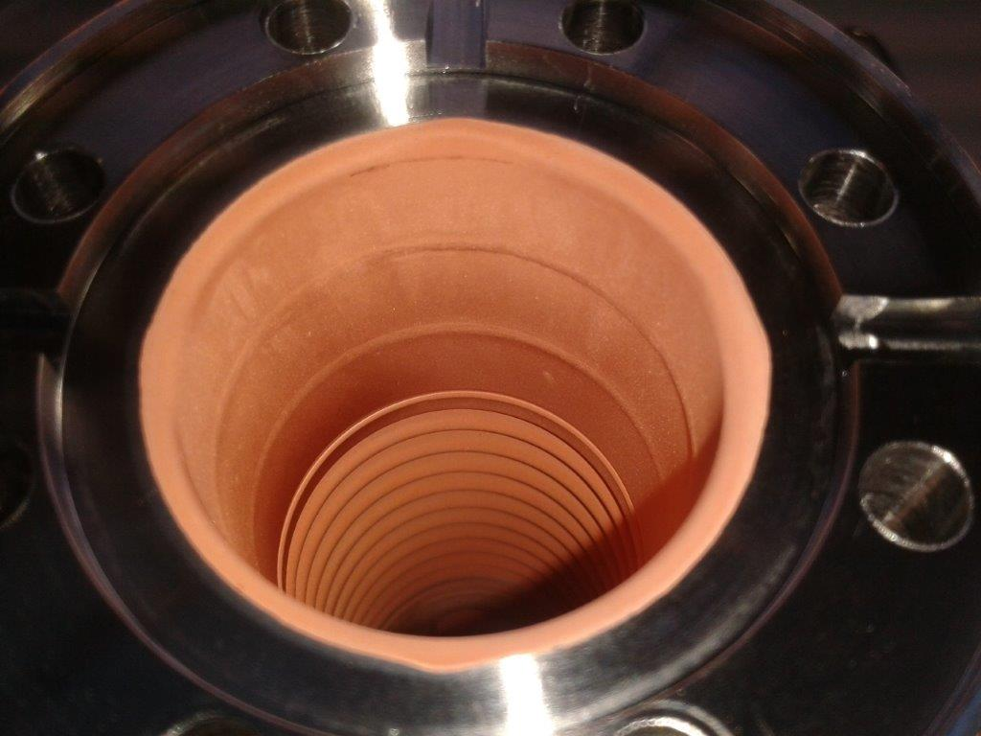
Heating issues: reduction of beam pipe electrical resistance
When the beam pipe has a small diameter and it is not made of copper, copper electroplating is applied.

Slide 45
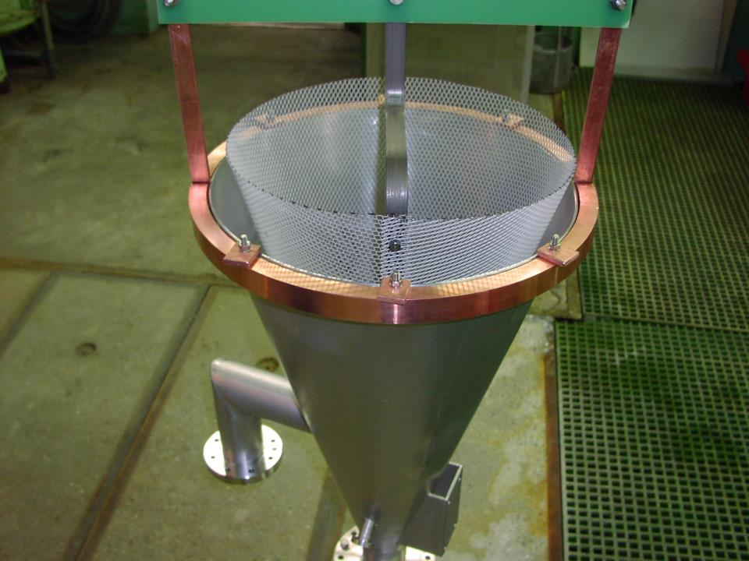
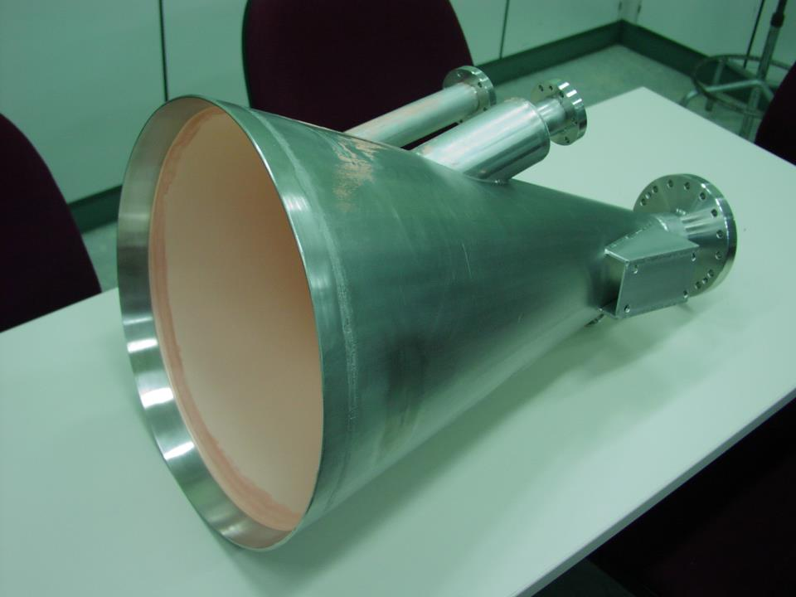
Heating issues: reduction of beam pipe electrical resistance
Cu atoms are provided by a Cu sulphate acid bath. The Cu layer on stainless steel needs an adherence layer of Ni and a final neutralisation and passivation.
For the LHC, electroplating was applied to vacuum chambers as long as 5 m (≈5 cm diameter).

Slide 46
Heating issues: smoother beam pipe transitions
Cu-Be fingers ensure short-path electrical contacts and ‘geometrical uniformity’ between two LHC beam screens
Au coated Cu-Be fingers for
electrical and geometrical continuity
Bellow for compensation of thermal expansion and small misalignment
Electrical contacts
Rh coating to avoid cold welding

Slide 47
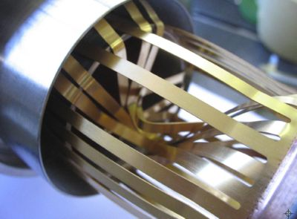
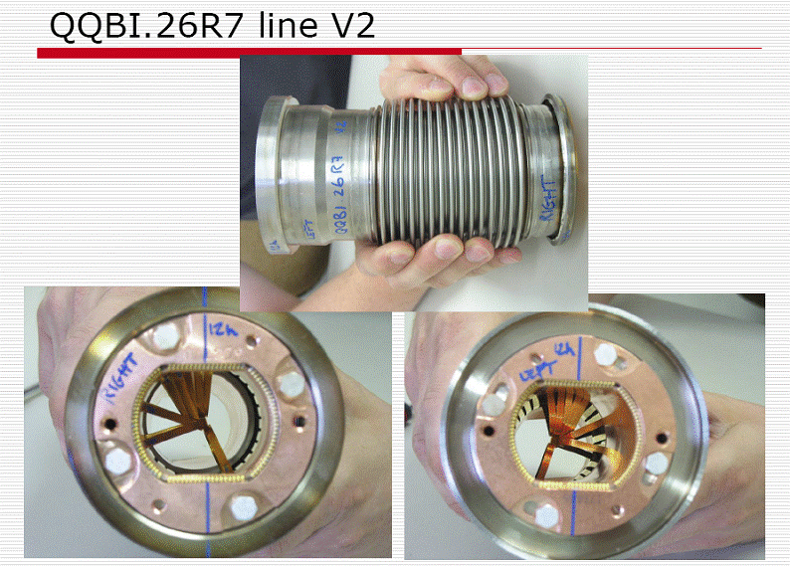

Heating issues: smoother beam pipe tran.
RF ball

Slide 48


Heating issues: smoother beam pipe transitions
During the LS1, 1800 X-ray tomography were carried out
92 non-conformities were recorded, mostly on two families of RF fingers: circular and elliptical (VMTSA)

Slide 49
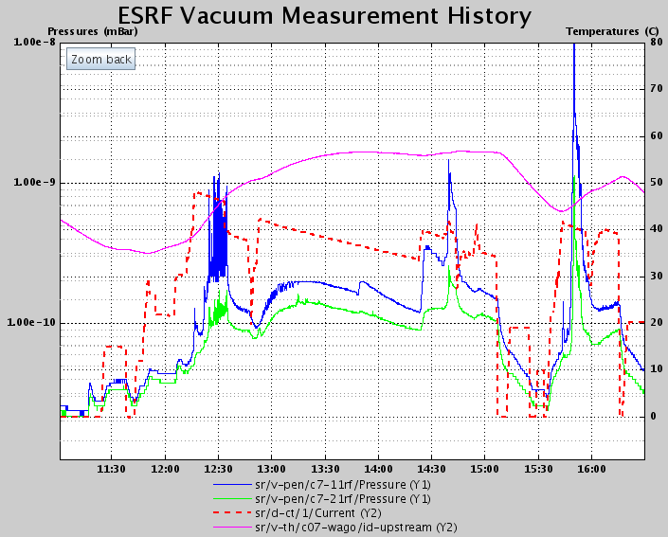
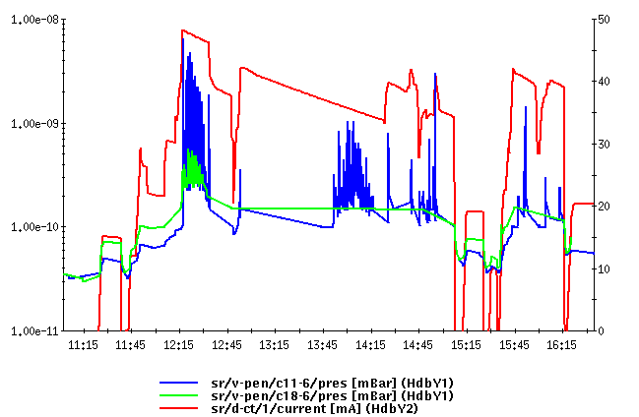
Heating issues: smoother beam pipe transitions
Pressure spikes
ESRF issues with RF fingers
Beam losses
Pressure spikes
Beam losses
SR cavity3 : RF fingers on the upstream bellow
RF fingers problems on CV11 in ( 4x 10mA )
Pressure spikes affecting the beam lifetime, increasing the bremsstrahlung dose to beamlines (important safety aspect), potentially preventing operation (fingers can melt and go in the way of the beam).
New/improved design had to be studied. Long procurement time.
Courtesy of Roberto Kersevan

Slide 50

Heating issues: smoother beam pipe transitions
HOM in LER (KEK)
KEK: Pressure rise was observed for beam currents higher than ~800 mA (LER).
  Pressure rises rapidly against the current.
  But it has a hysteresis behavior (heating)
  Insensitive to bunch fill pattern
  Vacuum scrubbing proceeds slowly
Characteristics
  Only near special vacuum components, i.e. movable masks (collimators) → big HOM sources (several kW)
  Temperature of NEG chamber near mask is higher than other ones (estimated temperature > 150 °C)
  Pressure distribution is almost same as the temperature’s
  Desorbed gas is H₂
Courtesy of Y. Suetsugu, KEKB Vacuum Group, 2003

Slide 51




RF masks worked but
not perfectly
Courtesy of Y. Suetsugu, KEKB Vacuum Group, 2003

Slide 52


Heating issues: smoother beam pipe transitions
HOM dampers were installed near movable masks
The HOM dampers damp preferentially the TE11 mode
SiC Absorbers
View from beam side
Attention! Good HOM dampers could be very bad for vacuum due to high thermal outgassing;
for example ferrites…
Courtesy of Y. Suetsugu, KEKB Vacuum Group, 2003
Long Slot

Slide 53
Conclusions
Safety of the personnel, in particular with respect to radioactivity dose, must be your first thought when designing high-intensity accelerators.
The gas load is a challenge: high-intensity beams induce gas desorption by electrons, photons and ions.
Beam-induced particle bombardment (beam conditioning) is efficient in reducing desorption, SEY and photoelectron yields.
We have in our hands several mitigation techniques for both gas load and electron multipacting; they should be considered from the first phase of design.
Surface smoothness and continuity can be improved. There is margin for a better design, optimisation and additional development.

Slide 54
END

