Slide 1

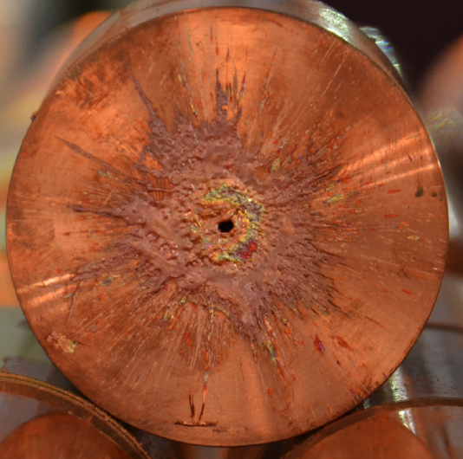
Machine Protection
Rüdiger Schmidt, CERN
CAS on Intensity Limitations in Particle Beams
Geneva, November 2015

Slide 2
0. 6 m
Copper part of a target at a depth of 0.6 m, irradiated with one SPS beam pulse (1.5 MJ, 7 µs, 450 GeV, 0.2 mm)

Slide 3
Outline
Particle beams and damage mechanisms
Hazards and Risks
Hazards when operating with particle beams
Worst case scenario
Machine Protection and Interlocks
See also material in Joint International Accelerator School on
"Beam Loss and Accelerator Protection"
http://uspas.fnal.gov/programs/JAS/JAS14.shtml Proceeding to be published by 2016

Slide 4
Protection from Energy and Power
Risks come from Energy stored in an accelerator (Joule), and Power when operating an accelerator (Watt)
  “Very powerful accelerator” … the power flow needs to be controlled
Particle accelerators use large amount of power (few to many MW)
  Where does the power go in case of failure?
An uncontrolled release of energy or power flow can lead to unwanted consequences
  Damage of equipment and loss of time for operation
  Risk of activation of equipment when operating with particle beams
This is a particular challenge for complex systems such as accelerators

Slide 5
Direct energy transfer from beam to equipment
Regular particle losses during operation
  Particle losses due to residual gas
  Particle losses due to collisions (in a collider)
  Particles losses at the aperture (e.g. due to emittance growth and other effects)
  Particle beams directed onto a target
Accidental particle losses - due to a large number of possible failure mechanisms
  Particles can be deflected into the aperture
  Targets, collimators and beam dumps: beam characteristics not matching the target, e.g. beam size at a spallation target too small
Machine protection is essentially to prevent consequences of accidental beam losses

Slide 6
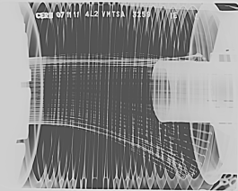

Indirect energy transfer from beam to equipment
Power deposited by electromagnetic interaction between beam and environment (RF, beam instrumentation, vacuum chamber, kicker magnets, …)
  Depends on the beam intensity and bunch structure
  Depends on the impedance
Power of synchrotron radiation emitted by the beam
  For electron / positron accelerators
  The power increases with the particle energy: $P=const×E^{4}$
  The power of synchrotron radiation can be very high (10s of MW)
  The radiation can be very focused
  Wiggler and undulator magnets can increase the power by orders of magnitude (e.g. for FELs)
  Normally, this is considered in the design of the accelerator and experiments – however, there are a number of failure scenario that can lead to accidents
The metallic coating on the fingers had melted, temperature had reached more than 800 C.
B.Salvant

Slide 7
Particle losses and consequences

Slide 8
Beam loss and consequences
Charged particles moving through matter interact with electrons of atoms in the material, exciting or ionizing the atoms => energy loss of traveling particle described by Bethe-Bloch formula.
If the particle energy is high enough, it leads to particle cascades in materials, increasing the deposited energy
  The maximum energy deposition can be deep in the material at the maximum of the hadron / electromagnetic shower
The energy deposition leads to a temperature increase
  Superconducting magnets could quench (beam loss of ~mJ to J)
  Superconducting cavities performance degradation by some 10 J
  Material can vaporise, melt, deform or lose its mechanical properties
  Risk to damage sensitive equipment for less than one kJ, risk for damage of any structure for some MJ (depends on beam size)
  Activation of material, risk for hand-on-maintenance
  Single event upsets in electronics equipment

Slide 9
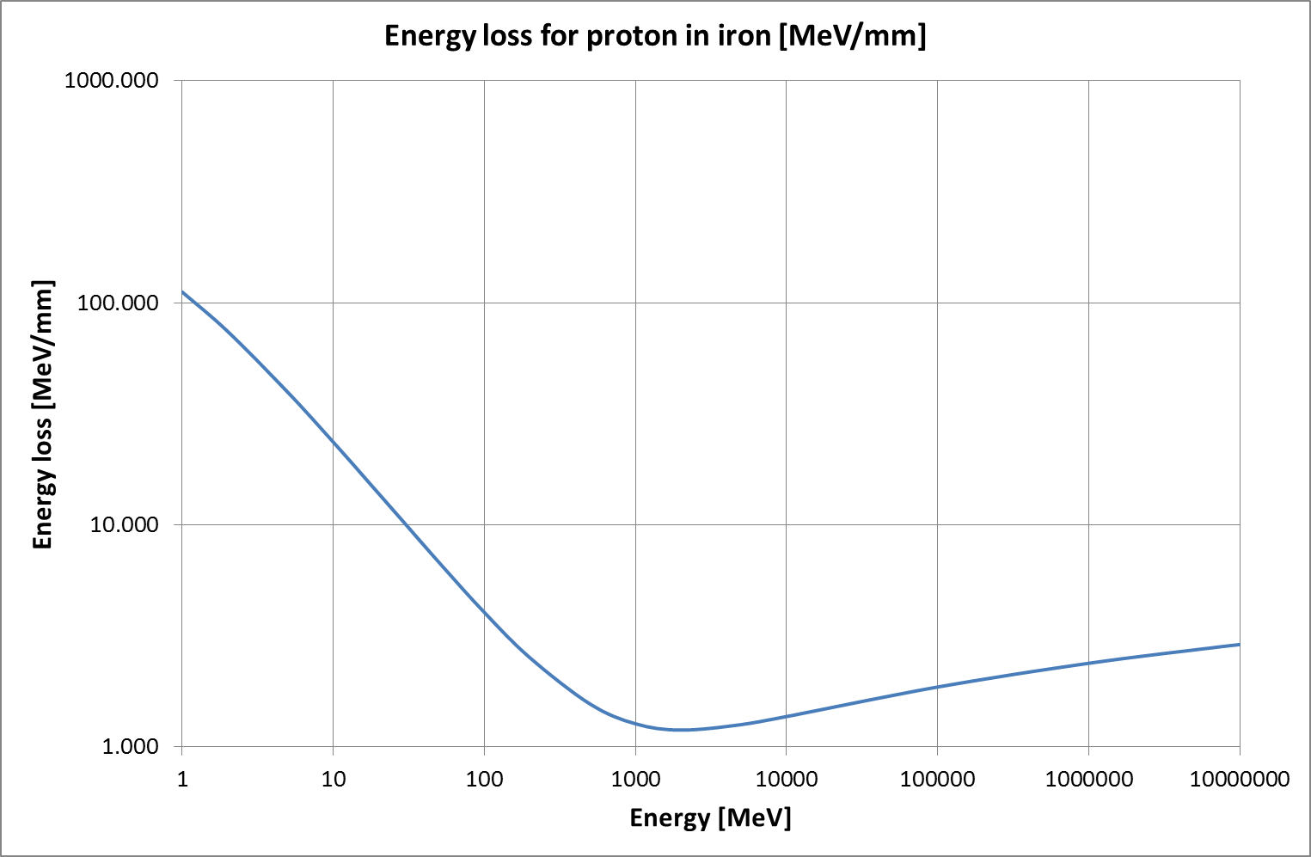
Energy loss: example for one proton in iron
(stainless steel, copper very similar)
From Bethe-Bloch formula.
Energy loss for a high energy particle entering a target
Low energy few MeV, beam transport, RFQ for many machines
SNS - ESS 1 – 3 GeV
LHC 7 TeV

Slide 10
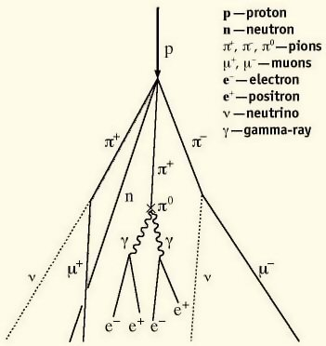
Heating of material with high energy protons
Nuclear inelastic interactions (hadronic shower)
  Creation of pions when going through matter
  Causes electromagnetic shower through decays of pions
  Exponential increase in number of created particles
  Final energy deposition to by a large number of electromagnetic particles
  Scales roughly with total energy of incident particle
  Energy deposition maximum deep in the material
  Energy deposition is a function of the particle type, its momentum and parameters of the material (atomic number, density, specific heat)
  No straightforward expression to calculate energy deposition
  Calculation by codes, such as FLUKA, GEANT or MARS
http://williamson-labs.com/ltoc/cbr-tech.htm

Slide 11
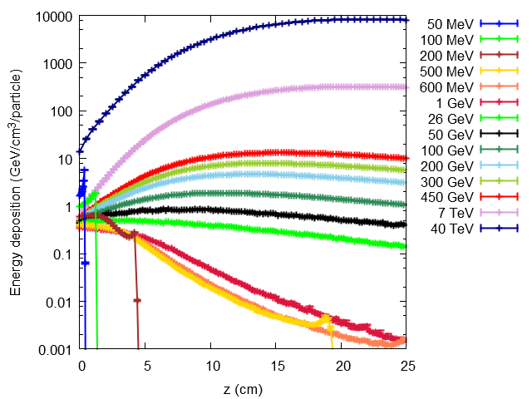
Proton energy deposition for different energies
40 TeV
7 TeV
450 GeV
50 MeV
26 GeV
1 GeV
Simulations with FLUKA, beam impact on a copper target
100 MeV
200 MeV
F.Burkart + V.Chetvertkova

Slide 12
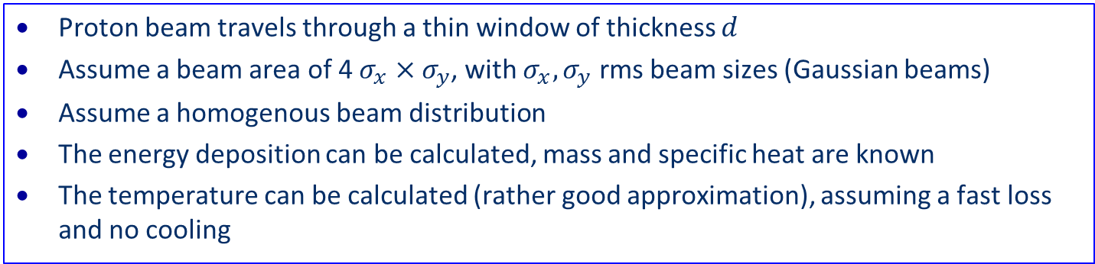
Beam loss and consequences
Proton beam travels through a thin window of thickness $d$
Assume a beam area of 4 $σ_{x}×σ_{y}$, with $σ_{x}, σ_{y}$ rms beam sizes (Gaussian beams)
Assume a homogenous beam distribution
The energy deposition can be calculated, mass and specific heat are known
The temperature can be calculated (rather good approximation), assuming a fast loss and no cooling

Slide 13
Heating of material with low energy protons
(3 MeV)

Slide 14
Damage of a pencil 7 TeV proton beam (LHC)
copper
Copper
graphite
graphite

Slide 15
Beam loss and consequences
Calculate the response of the material (deformation, melting, …) to beam impact (mechanical codes such as ANSYS, hydrodynamic codes such as BIG2 and others)
Beams at very low energy have limited power…. however, the energy deposition is very high, and can lead to (limited) damage in case of beam impact
  Issue at the initial stage of an accelerator, after the source, low energy beam transport and RFQ
  Limited impact (e.g. damaging the RFQ) might lead to long downtime, depending on spare situation
Beams at very high energy can have a tremendous damage potential
  For LHC, damage of metals for ~10¹⁰ protons at top energy (7 TeV)
  One LHC bunch has about 1.5∙10¹¹ protons, in total up to 2808 bunches
  In case of catastrophic beam loss, possibly damage beyond repair

Slide 16
What accelerators?

Slide 17
Energy versus momentum

Slide 18
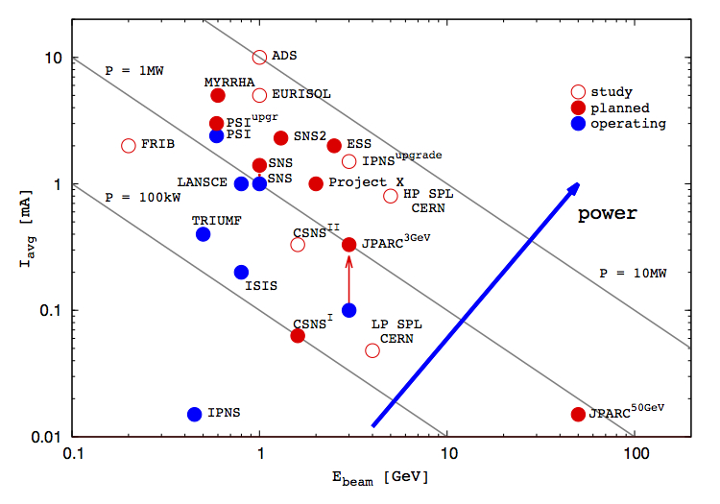
High Intensity Proton Accelerators
P=1MW

Slide 19
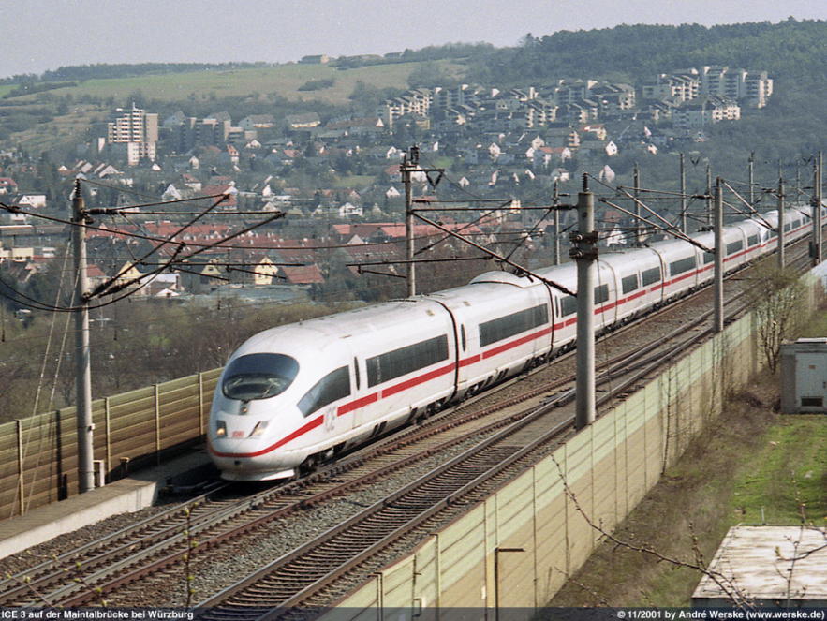
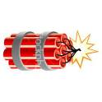


What does it mean ……… MJoule ?
The energy of an 200 m long fast train at 155 km/hour corresponds to the energy of 360 MJ stored in one LHC beam.
90 kg of TNT
360 MJ: the energy stored in one LHC beam corresponds approximately to…
8 litres of gasoline
It matters most how easy and fast the energy is released !!
15 kg of chocolate

Slide 20
Hazards and Risks
Synchrotrons
Linear accelerators

Slide 21
Hazard and Risk
Hazard: a situation that poses a level of threat to the machine. Hazards are dormant or potential, with only a theoretical risk of damage. Once a hazard becomes "active“: incident / accident.
Consequences and Probability of an accident create Risk:
Risk = Probability ∙ Consequences
Related to complex research instruments
Consequences of a failure in a hardware systems or uncontrolled beam loss (in €, downtime, radiation dose to people, reputation)
Probability of such event
The higher the Risk, the more Protection is required
Notes:
21

Slide 22
Hazards related to particle beams
Accidental beam losses due to failures: understand hazards, e.g. mechanisms for accidental beam losses
  Hazards become accidents due to a failure, machine protection systems mitigate the consequences
Understand mechanisms for damage of components by direct beam loss
Regular beam losses during operation
  To be considered since this leads to activation of equipment and possibly quenches of superconducting magnets
  Radiation induced effects in electronics (Single Event Effects)
Understand effects from electromagnetic fields and synchrotron radiation that potentially lead to damage of equipment

Slide 23
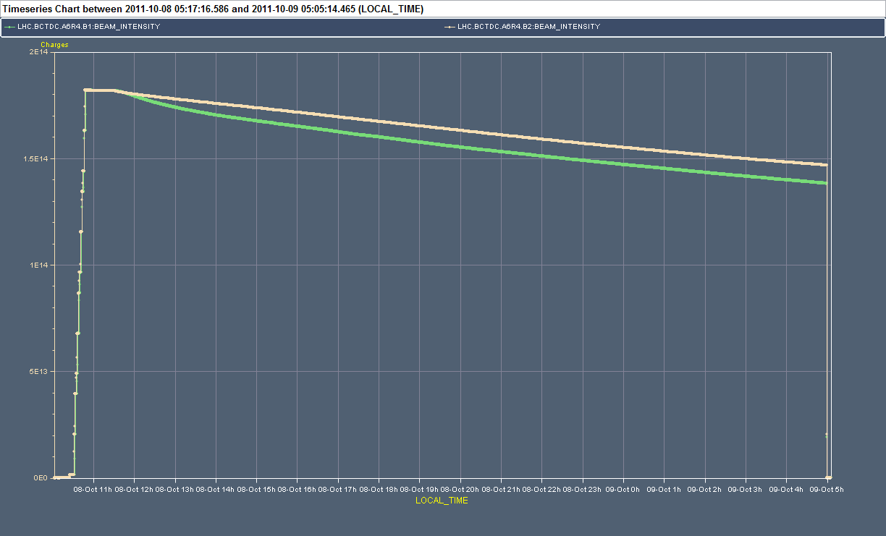
Luminosity fill in 2011 (18 hours)
3.5 TeV / 100 MJoule
Luminosity: start collisions
Energy ramp
Beam dump
Injection of 1380 bunches per beam in batches of 144 bunches
0.45 TeV / 13 MJoule

Slide 24
Layout of beam dump system in IR6
LHC Layout
eight arcs (sectors)
eight long straight section (about 700 m long)
IR5:CMS
IR4: RF + Beam instrumentation
IR6: Beam dumping system
IR3: Moment Beam Cleaning (warm)
IR7: Betatron Beam Cleaning (warm)
IR2: ALICE
IR8: LHC-B
IR1: ATLAS
24

Slide 25
Layout of beam dump system in IR6
Injection of batches with up to 288 bunches, 2 MJ
IR5:CMS
IR4: RF + Beam instrumentation
IR6: Beam dumping system
IR3: Moment Beam Cleaning (warm)
IR7: Betatron Beam Cleaning (warm)
IR2: ALICE
IR8: LHC-B
IR1: ATLAS
Injection
Injection
Beams from SPS
25

Slide 26
Layout of beam dump system in IR6
Operation with stored beam, up to 362 MJ per beam
IR5:CMS
IR4: RF + Beam instrumentation
IR6: Beam dumping system
IR3: Moment Beam Cleaning (warm)
IR7: Betatron Beam Cleaning (warm)
IR2: ALICE
IR8: LHC-B
Detection of beam losses with >3600 monitors around LHC
Many other systems can detect failures
IR1: ATLAS
26

Slide 27
Layout of beam dump system in IR6
Extraction of the beam into the beam dump blocks, after the end of a luminosity run, and in case of failure
Beam dump blocks
IR5:CMS
Signal to kicker magnet
IR4: RF + Beam instrumentation
IR6: Beam dumping system
IR3: Moment Beam Cleaning (warm)
IR7: Betatron Beam Cleaning (warm)
IR2: ALICE
IR8: LHC-B
IR1: ATLAS
27

Slide 28

Protection at injection
LHC vacuum chamber
LHC circulating beam
Transfer line vacuum chamber
Circulating beam in LHC

Slide 29
Protection at injection
LHC circulating beam
LHC injected beam
Beam from SPS
Injection Kicker
Beam injected from SPS and transfer line

Slide 30
Protection at injection
LHC circulating beam
Beam from SPS
Major damage to superconducting magnets, vacuum pipes, possibly LHCb / Alice experiments
Injection Kicker
Kicker failure (no kick)

Slide 31
Protection at injection
phase advance 90⁰
LHC circulating beam
Beam from SPS
Injection Kicker
Injection absorber
(TDI) ~7σ
Set of transfer line collimators (TCDI) ~5σ
Beam absorbers take beam in case of kicker misfiring
Transfer line collimators ensure that incoming beam trajectory is ok

Slide 32
Protection at injection
This type of kicker failure happened several times: protection worked
phase advance 90⁰
LHC circulating beam
LHC circulating beam
Circulating beam – kicked out
Injection Kicker
Injection absorber
(TDI) ~7σ
Set of transfer line collimators (TCDI) ~5σ
Beam absorbers take beam in case of kicker misfiring on circulating beam

Slide 33
Layout of beam dump system in IR6
To get rid of the beams (also in case of emergency!), the beams are ‘kicked’ out of the ring by a system of kicker magnets send into a dump block !
Ultra-high reliability system !!
Septum magnets deflect the extracted beam vertically
Kicker magnets to paint (dilute) the beam
Beam dump block
15 fast ‘kicker’ magnets deflect the beam to the outside
about 700 m
about 500 m
The 3 μs gap in the beam gives the kicker time to reach full field.
quadrupoles
Beam 2

Slide 34
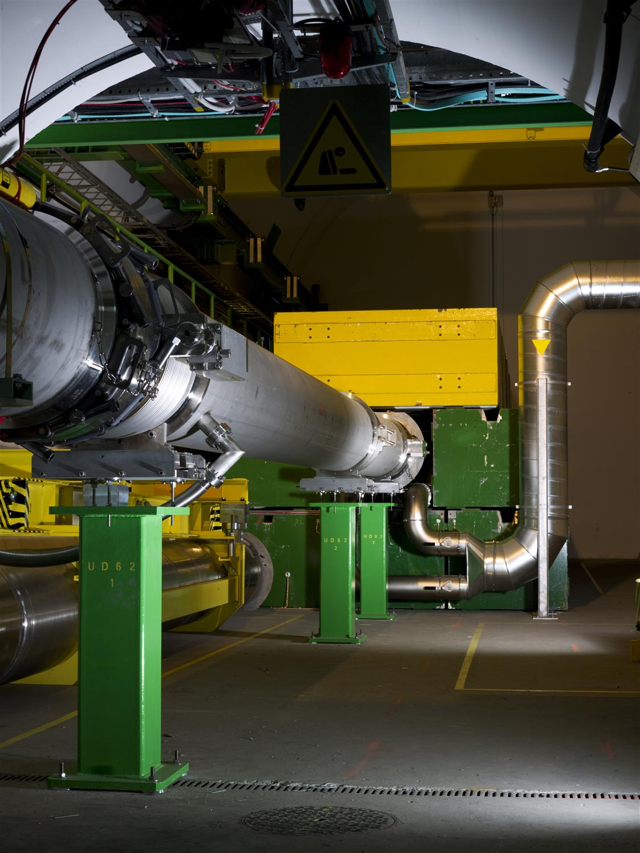
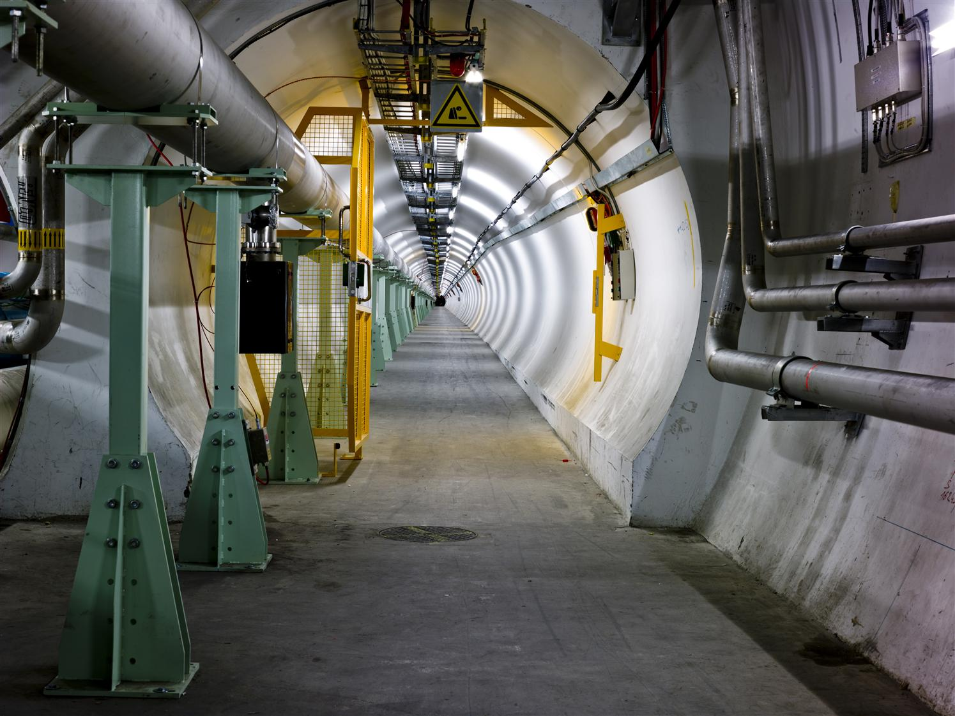
Beam dump line
700 m long tunnel to beam dump block- beam size increases
Beam dump block

Slide 35
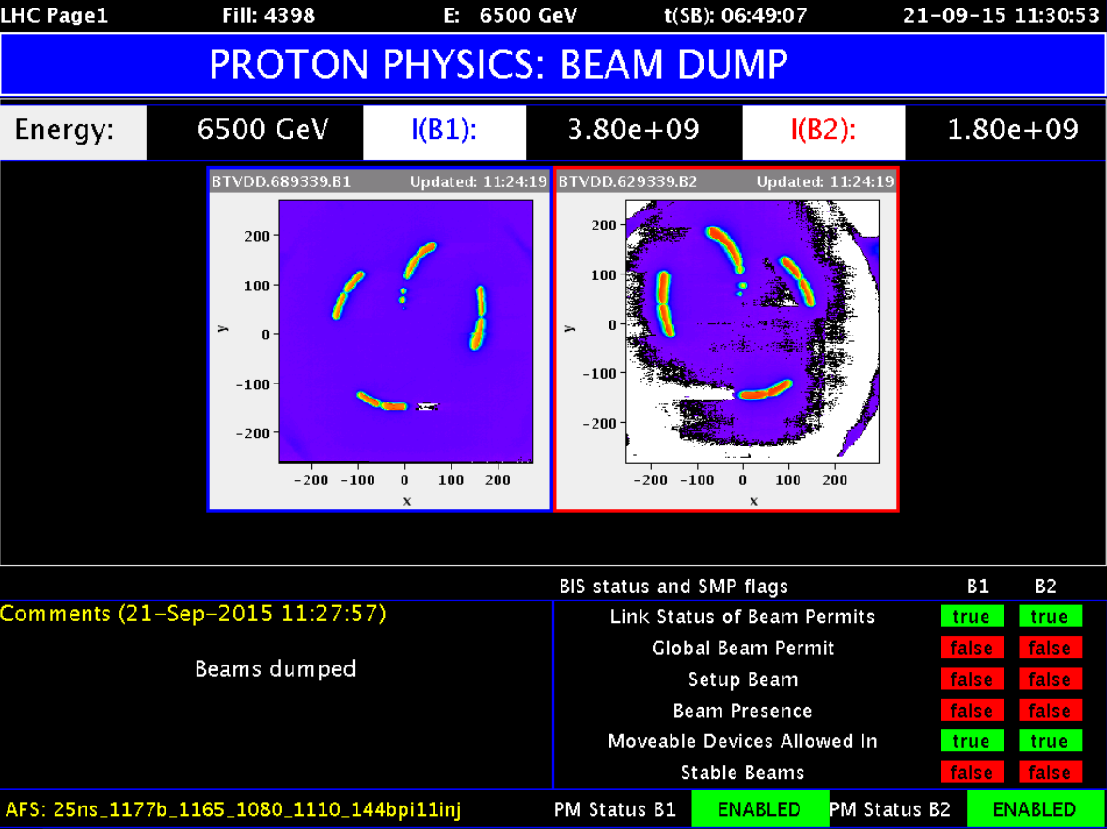
Beam dump with 1380 bunches
Beam spot at the end of the beam dumping line, just in front of the beam dump block

Slide 36
ESS Lund / Sweden – 5 MW beam power
~ 500 m
352.21 MHz
704.42 MHz
Target
2.4 m
4.0 m
3.6 m
32.4 m
58.5 m
113.9 m
227.9 m
HEBT & Upgrade
Source
LEBT
RFQ
MEBT
DTL
Spokes
Medium β
High β
75 keV
3 MeV
78 MeV
200 MeV
628 MeV
2500 MeV
Low energy beam transport
RFQ
352.2 MHz
Medium energy beam transport
Drift tube linac with
4 tanks
Super-conducting cavities
High energy beam transport
Power of
5000 kW
Operating with protons
Operation with beam pulses at a frequency of 14 Hz
Pulse length of 2.86 ms
Average power of 5 MW
Peak power of 125 MW
One pulse = 357 kJ
Example for a high intensity linear accelerator (similar to SNS and J-PARC)

Slide 37
ESS Lund / Sweden – 5 MW beam power
~ 500 m
352.21 MHz
704.42 MHz
Target
2.4 m
4.0 m
3.6 m
32.4 m
58.5 m
113.9 m
227.9 m
HEBT & Upgrade
Source
LEBT
RFQ
MEBT
DTL
Spokes
Medium β
High β
75 keV
3 MeV
78 MeV
200 MeV
628 MeV
2500 MeV
Low energy beam transport
RFQ
352.2 MHz
Medium energy beam transport
Drift tube linac with
4 tanks
Super-conducting cavities
High energy beam transport
Power of
5000 kW
The energy stored in the beam at a given moment is relatively small
Low energy part
Medium energy part
High energy part
In case of a failure, the beam needs to be switched off at the source
Operating with protons
Operation with beam pulses at a frequency of 14 Hz
Pulse length of 2.86 ms
Average power of 5 MW
Peak power of 125 MW
One pulse = 357 kJ

Slide 38
ESS Lund / Sweden – 5 MW beam power
~ 500 m
352.21 MHz
704.42 MHz
Target
2.4 m
4.0 m
3.6 m
32.4 m
58.5 m
113.9 m
227.9 m
HEBT & Upgrade
Source
LEBT
RFQ
MEBT
DTL
Spokes
Medium β
High β
75 keV
3 MeV
78 MeV
200 MeV
628 MeV
2500 MeV
Low energy beam transport
RFQ
352.2 MHz
Medium energy beam transport
Drift tube linac with
4 tanks
Super-conducting cavities
High energy beam transport
Power of
5000 kW
In between two pulses (about 70 ms), ensure that the parameters of the accelerator allow for correct beam transmission – or do not start with the next pulse.
If something is wrong and not detected before the pulse by monitors, stop beam as soon as possible
Operating with protons
Operation with beam pulses at a frequency of 14 Hz
Pulse length of 2.86 ms
Average power of 5 MW
Peak power of 125 MW
One pulse = 357 kJ

Slide 39
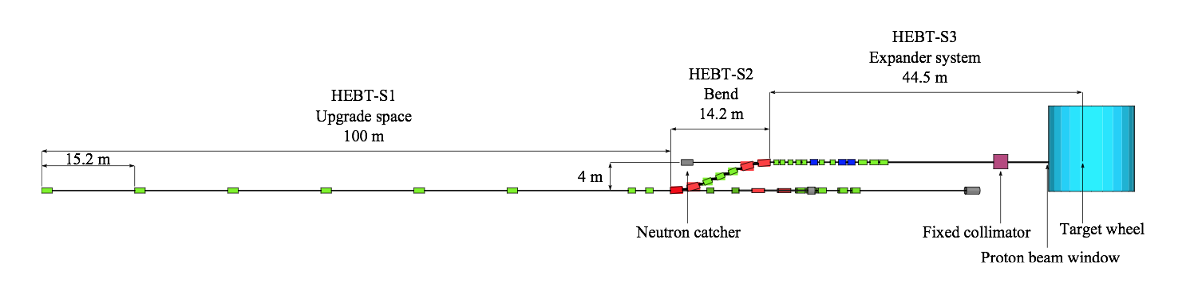
Example for a failure at ESS
~ 160 m following the sc cavities
HEBT-S2
5 MW Beam
Bending magnet in an accelerator deflecting the beam
Assume that the power supply for the bend in HEBT-S2 fails and the magnets stops deflecting the beam
  Probability: MTBF for power supply is 100000 hours = 15 years
The beam is not deflected and hits the vacuum chamber
  Consequences: what is expected to happen? Damage of magnet, vacuum pipe, possibly pollution of superconducting cavities

Slide 40
Accelerators that require protection systems I
Hadron synchrotrons with large stored energy in the beam
  Colliders using protons / antiprotons (RHIC, LHC, FCC)
  Synchrotrons accelerating beams for fixed target experiments (SPS)
High power proton accelerators (e.g. spallation sources) with beam power of some 10 kW to above 1 MW
  Risk of damage and activation
  Spallation sources, up to (and above) 1 MW beam power (SNS, ISIS, PSI cyclotron, JPARC, and in the future ESS, FRIB, MYRRHA and IFMIF)
Synchrotron light sources and FELs with high intensity beams and secondary photon beams
  LCLS, FLASH 90 kW, European XFEL 600 kW, JLab FEL 1.5 MW,
Energy recovery linacs
  Daresbury prototype: one bunch train cannot damage equipment, but next train must not leave the (injector) station
Notes:
40

Slide 41
Accelerators that require protection systems II
Linear e+e- colliders / accelerators with very high beam power densities due to small beam size
  High average power in linear accelerators: ILC 11 MW, CLIC
  One beam pulse can lead already to damage
“Any time interval large enough to allow a substantial change in the beam trajectory of component alignment (~fraction of a second), pilot beam must be used to prove the integrity” from Next Linear Collider paper 1999
Notes:
41

Slide 42
Worst case accidents
Proton collider

Slide 43




Hydrodynamic tunnelling
The beam impacts on a target, e.g. due to a failure of the injection of extraction kicker
For LHC, bunches arrive every 25 or 50 ns
The time structure of the beam plays an essential role
The first bunches arrive, deposit their energy, and lead to a reduction of the target material density
Bunches arriving later travel further into the target since the material density is reduced (predicted already for SSC, N.Mokhov et al.)
Copper or carbon target

Slide 44
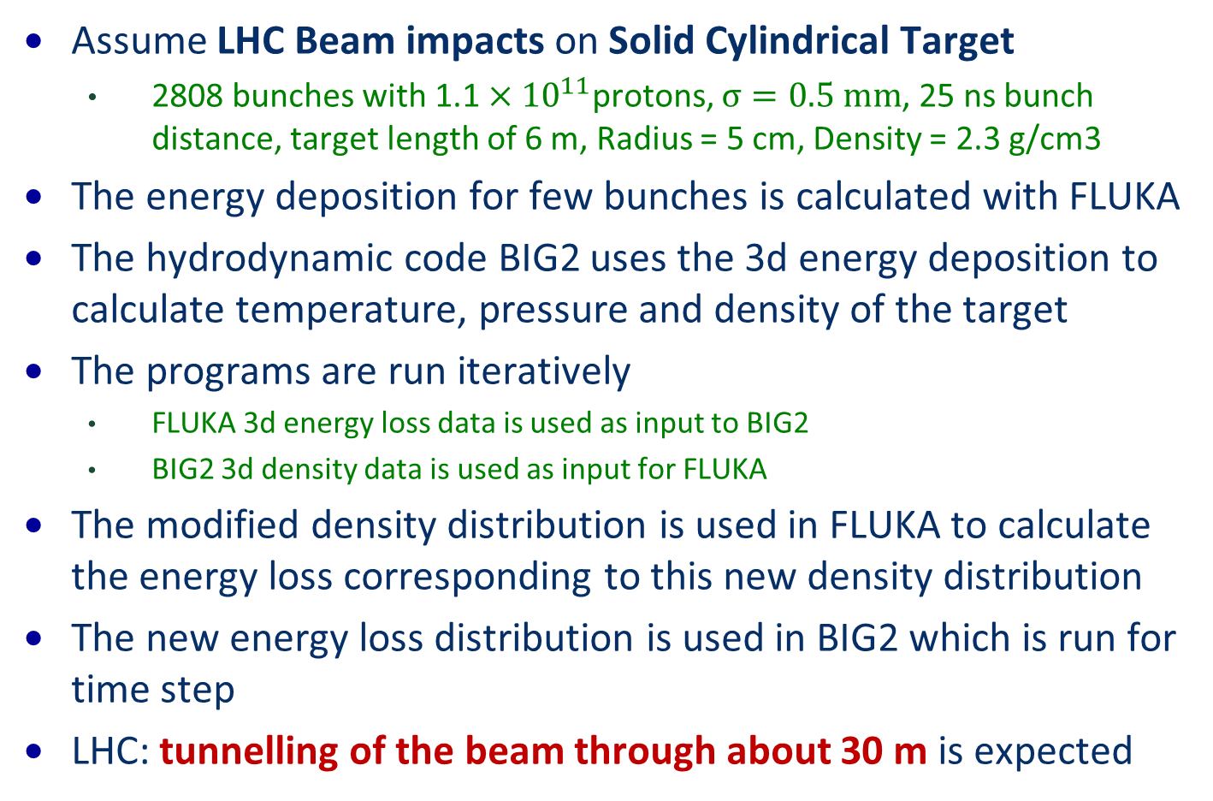
How to perform calculations?
Assume LHC Beam impacts on Solid Cylindrical Target
  2808 bunches with$\text{1.1}×{10}^{11}$protons, $σ=0.5 mm$, 25 ns bunch distance, target length of 6 m, Radius = 5 cm, Density = 2.3 g/cm3
The energy deposition for few bunches is calculated with FLUKA
The hydrodynamic code BIG2 uses the 3d energy deposition to calculate temperature, pressure and density of the target
The programs are run iteratively
  FLUKA 3d energy loss data is used as input to BIG2
  BIG2 3d density data is used as input for FLUKA
The modified density distribution is used in FLUKA to calculate the energy loss corresponding to this new density distribution
The new energy loss distribution is used in BIG2 which is run for time step
LHC: tunnelling of the beam through about 30 m is expected

Slide 45
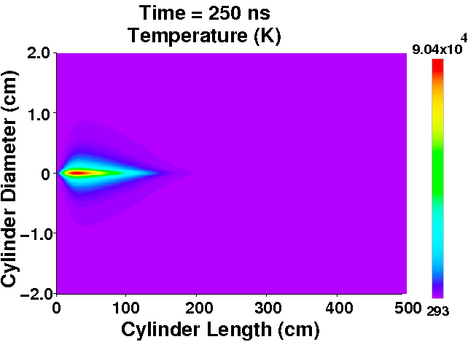
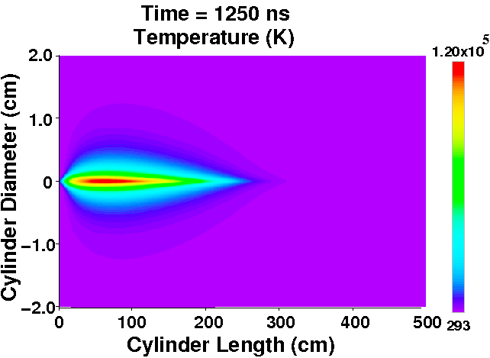
FCC: Temperature profile
FCC 100 km long accelerator.
Particle energy of 40 TeV.
Copper, Length = 5 m, Radius = 2 cm.
The simulation took about 15 months.
90.400 K
120.000 K
Naeem Tahir, Florian Burkart

Slide 46
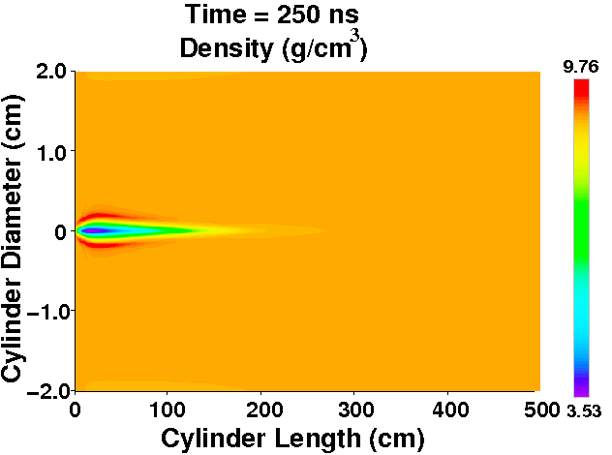
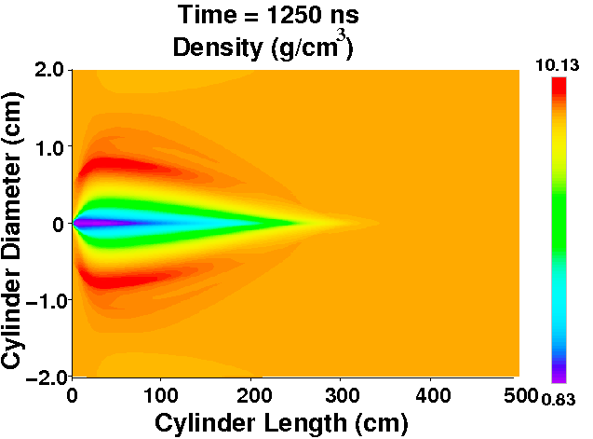
Density profile
3.5 g/cc
0.83 g/cc

Slide 47
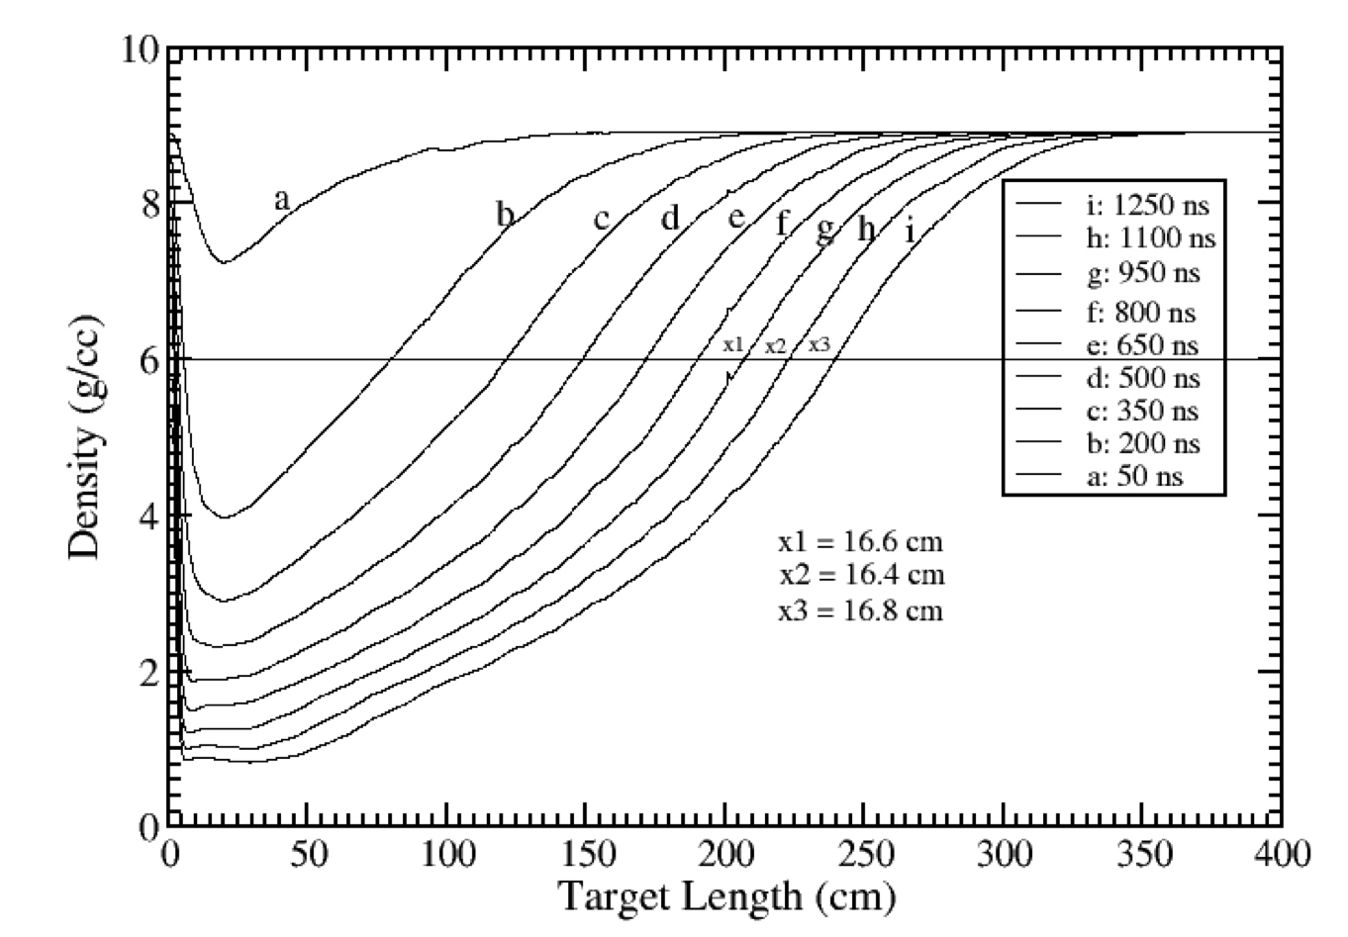
Density profile on axis
t_{beam} = 270 µs
L = v * t_{beam} = 297m (40 TeV protons)

Slide 48
Principle of the code validation experiment using a copper target
Target 3
beam
Target 2
beam
Target 1
beam
Copper Target length of about 2 m
Target 1: 144 bunches ~1.9E11@50ns, 2.0mm σ -> no tunnelling expected
Target 2: 108 bunches ~1.9E11@50ns, 0.2mm σ -> tunnelling expected
Target 3: 144 bunches ~1.9E11@50ns, 0.2mm σ -> tunnelling expected
Juan Blanco, Florian Burkart, et al.

Slide 49
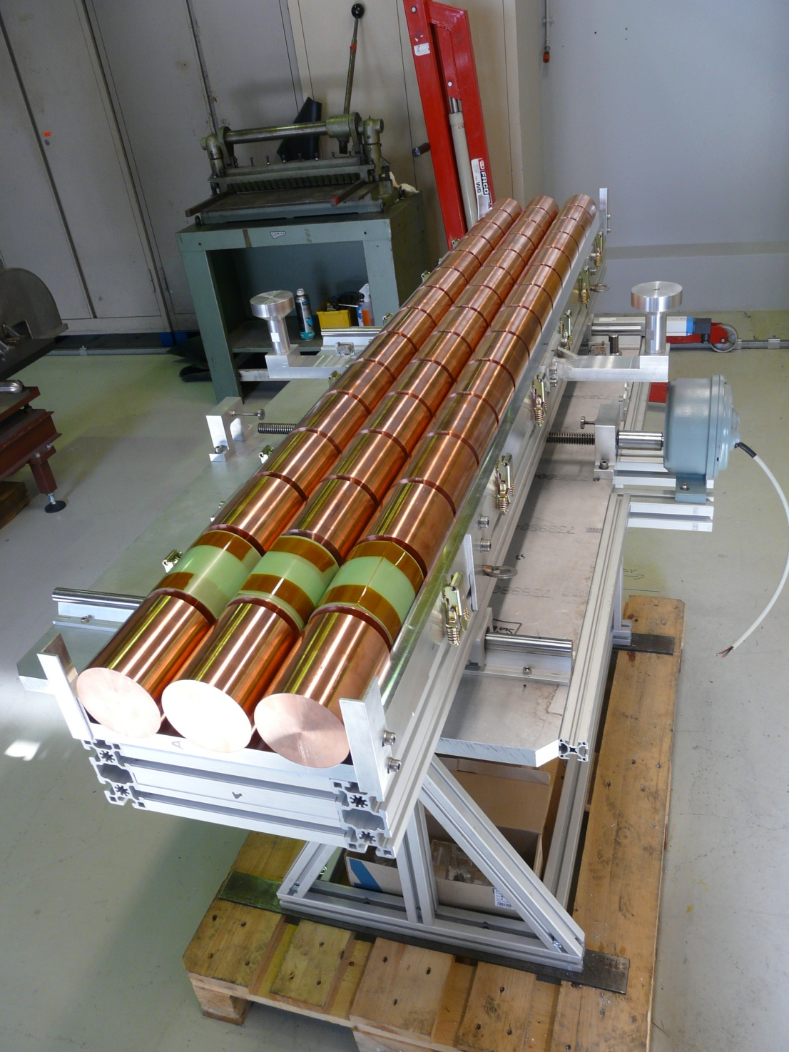
Copper target before the experiment
The range of the beam in target 3 is larger than in target 1 and 2
Clear indication for tunnelling

Slide 50
Machine Protection

Slide 51

Analysing need for machine protection
Identify hazard and estimate risk
Is protection required?
YES
NO
Is protection possible?
NO
YES
Is the risk acceptable?
Start design of the protection system
Great, nothing needed, simplifies life and increases system availability
Transverse deflecting devices in an accelerator that can deflect the beam by a large angle within about one turn
Superconducting magnet coils with too little copper to NbTi ratio
NO
YES
Back to drawing board

Slide 52
Classification of failures
Type of the failure
  Hardware failure (power converter trip, magnet quench, AC distribution failure such as thunderstorm, object in vacuum chamber, vacuum leak, RF trip, kicker magnet misfires, .…)
  Controls failure (wrong data, wrong magnet current function, trigger problem, timing system, feedback failure, ..)
  Operational failure (chromaticity / tune / orbit wrong values, …)
  Beam instability (due to too high beam current / bunch current / e-clouds)
Failures in the injectors and transfer lines to be considered
Parameters for the failure
  Probability for the failure
  Damage potential
  Time constant for beam loss
Risk = Probability * Consequences

Slide 53
Multi passage beam loss in a synchrotron
Very fast beam loss (few ms)
  Large number of possible failures, mostly in the magnet powering system, with a typical time constant of some ms to many seconds
Fast beam loss (some 10 ms to seconds)
  Beam instabilities
Slow beam loss (many seconds)
Detect failure and trigger beam dump
Notes:
53

Slide 54
Single passage beam loss
Single-passage beam loss in an accelerator complex (ns - μs)
Linear accelerators
  Beam is injected, but there is a failure present in the accelerator
  Before a pulse, ensure that the parameters of the accelerator allow for correct beam transmission
  If something is wrong and not detected before the pulse, stop beam as soon as possible at the source
Transfer lines between accelerators (e.g. SPS to LHC)
  Before a transfer, ensure that the parameters of the accelerator allow for correct beam transmission
  Use beam absorbers to capture mis-steered beam
Failures of kicker magnets (injection, extraction, special kicker magnets, for example for diagnostics)
  Use beam absorbers to capture mis-steered beam
Notes:
54

Slide 55







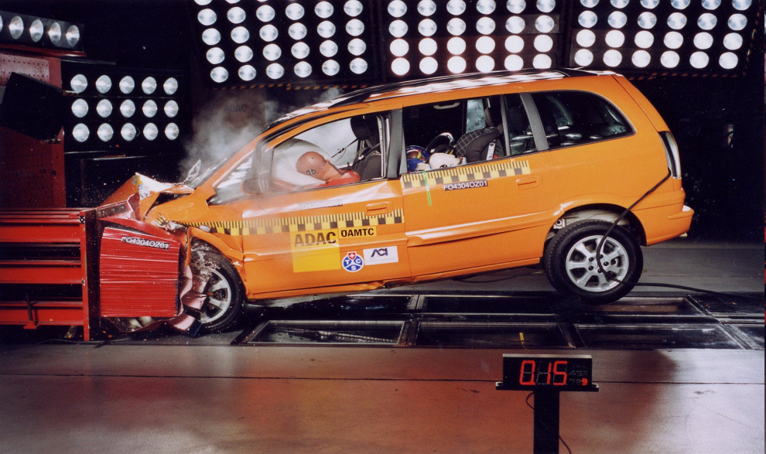
Active and Passive Protection
Active protection
A sensor detects a dangerous situation
An action is triggered by an actuator
The energy stored in the system is safely dissipated
Passive protection
Preferred if possible to operate without active protection
Active protection not possible, e.g. the reaction time is too short
Monitors fail to detect a dangerous situation (redundancy)

Slide 56
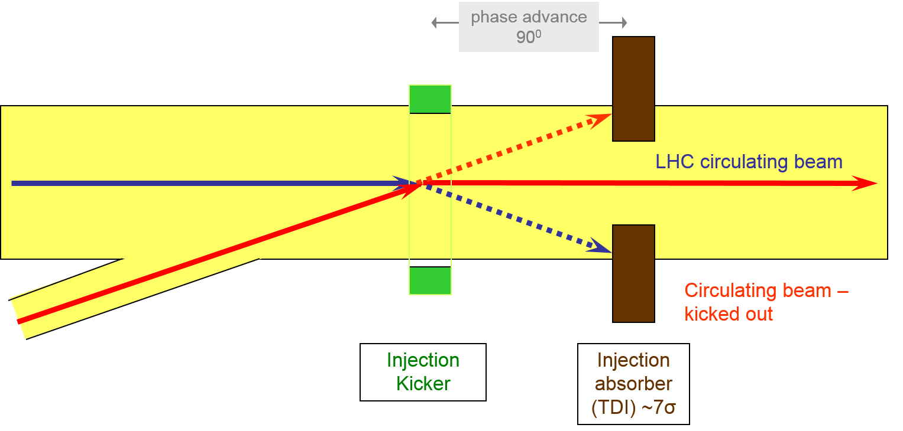
Passive protection
Passive protection
Is always necessary when the time required for the response is too short (…remember the limitation of the speed of light)
One example is the fast injection of a high intensity beam into a synchrotron with a fast kicker magnet
  If beam can damage hardware, protection absorbers are required
  For movable absorbers: need to be made sure that they are at the correct position of the absorber with respect to the beam during injection

Slide 57
LHC strategy for machine protection
Definition of aperture by collimators.
Beam Cleaning System
Passive protection by beam absorbers and collimators for specific failure cases.
Collimator and Beam Absorbers
Early detection of equipment failures generates dump request, possibly before beam is affected.
Powering Interlocks
Fast Magnet Current change Monitor
Active monitoring of the beams detects abnormal beam conditions and generates beam dump requests down to a single machine turn.
Beam Loss Monitors
Other Beam Monitors
Reliable operation of beam dumping system for dump requests or internal faults, safely extracting beams onto the external dump blocks.
Beam Dumping System
Stop beam at source
Reliable transmission of beam dump requests to beam dumping system. Active signal required for operation, absence of signal is considered as beam dump request and injection inhibit.
Beam Interlock System

Slide 58
Three Principles for Machine Protection
Protect the equipment (machine protection systems + interlock systems)
Protect the process (high availability systems)
  Machine protection systems will always contribute to downtime
  Protection action ONLY if a hazard becomes active (e.g. something went wrong threatening to damage equipment)
Provide the evidence (post mortem, logging of data)
  Provide post mortem buffers in equipment (record data, and stop after protection action kicks in) – 70% of LHC luminosity fills dumped prematurely
  Synchronisation of different systems is ultra – critical, to understand what happened
  Post operational checks by the controls system

Slide 59
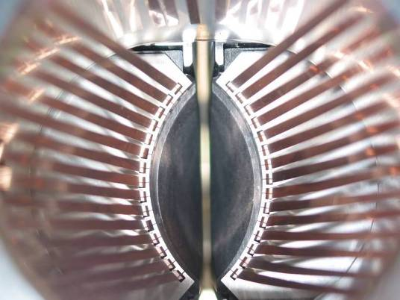
RF contacts for guiding image currents
View of a two sided collimator
about 100 collimators are installed in LHC
2 mm
Beam spot
length about 120 cm
Ralph Assmann, CERN

Slide 60
Betatron beam cleaning
Primary
collimator
Secondary
collimators
Shower
absorbers
Tertiary
collimators
SC
Triplet
Cold aperture
Tertiary beam halo
+ hadronic showers
Circulating beam
Arc(s)
Cleaning insertion
Arc(s)
IP
About 99.99% of the particle lost are captured in the cleaning insertion
Illustration drawing

Slide 61
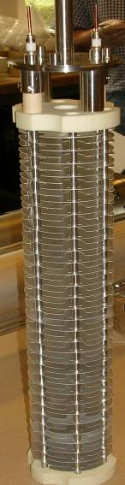
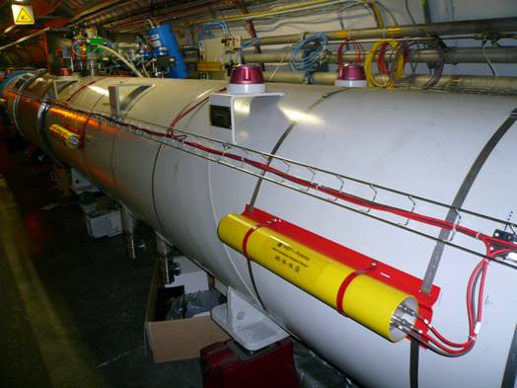
Beam Loss Monitors
Ionization chambers to detect beam losses:
  Reaction time ~ ½ turn (40 μs)
  Very large dynamic range (> 10⁶)
There are ~3600 chambers distributed over the ring to detect abnormal beam losses and if necessary trigger a beam abort !
Very important beam instrumentation!

Slide 62
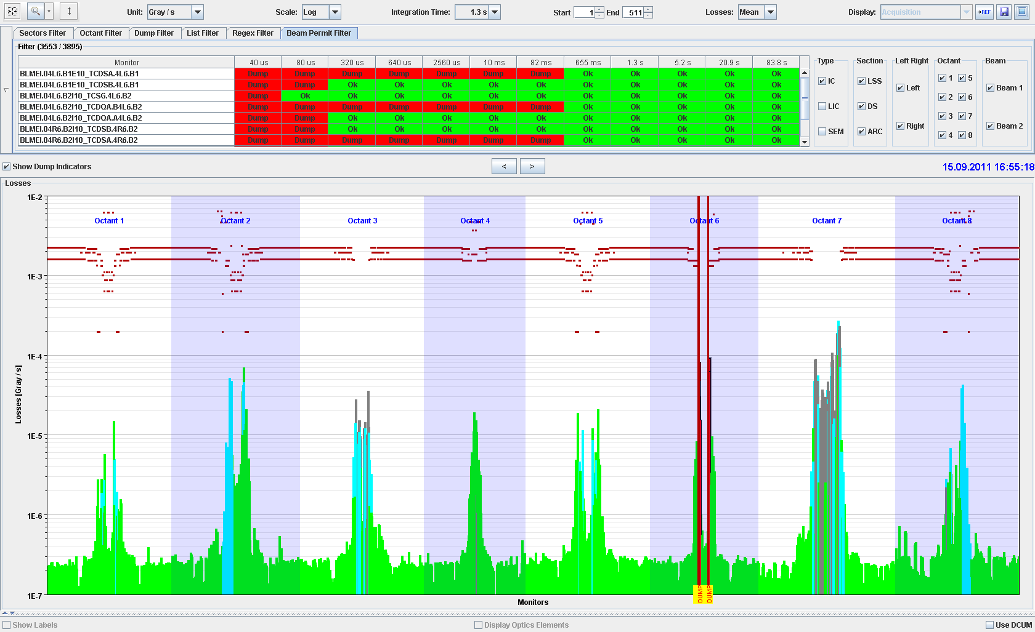
BLM system: beam losses before collisions
ATLAS Experiment
ALICE Experiment
MomentumCleaning
RF and
BI
CMS Experiment
Beam
dump
Betatron Cleaning
LHCb Experiment

Slide 63
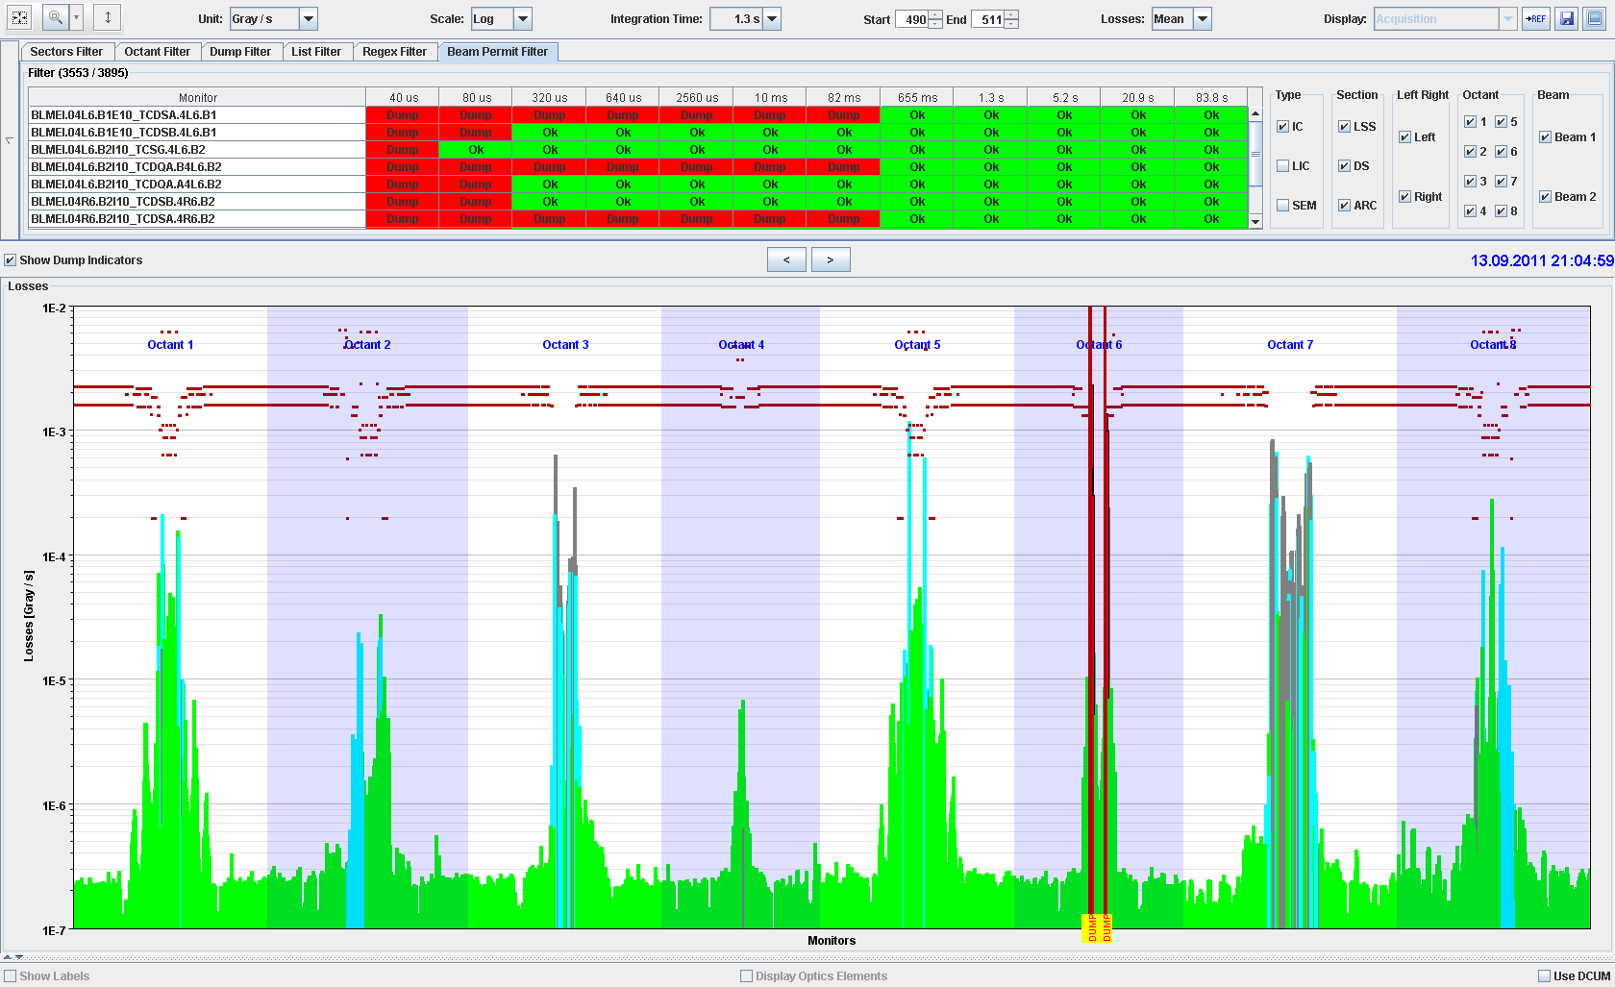
Continuous beam losses during collisions
ATLAS Experiment
ALICE Experiment
MomentumCleaning
RF and
BI
CMS Experiment
Beam
dump
Betatron Cleaning
LHCb Experiment

Slide 64
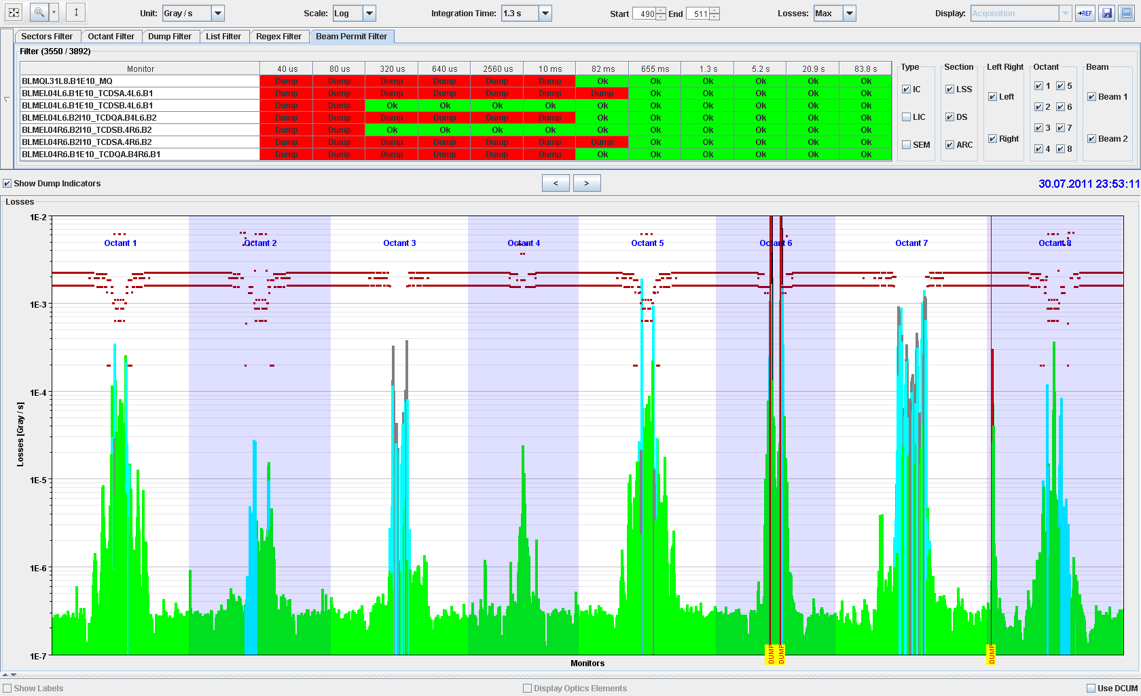
Accidental beam losses during collisions
ATLAS Experiment
ALICE Experiment
MomentumCleaning
RF and
BI
CMS Experiment
Beam
dump
Betatron Cleaning
LHCb Experiment

Slide 65
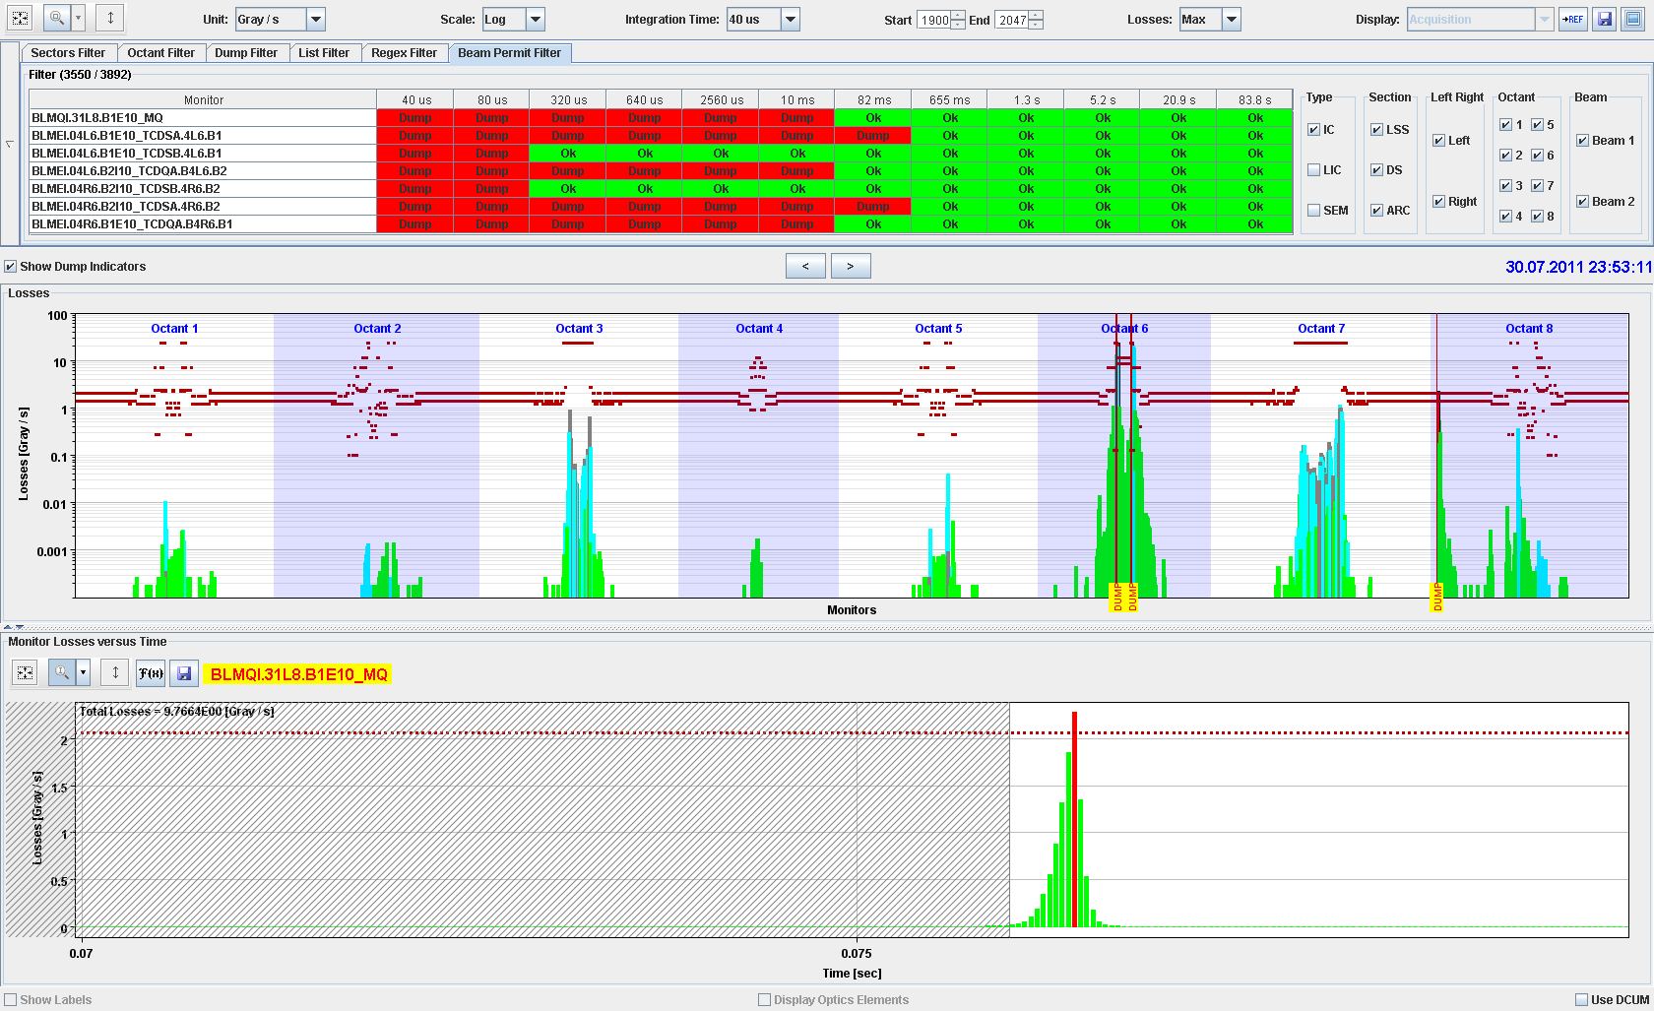

Accidental beam losses : UFOs

Slide 66
High power accelerators …
Operate with beam power of 1 MW and more
SNS – 1 MW, PSI cyclotron – 1.3 MW, ESS – planned for 5 MW, FRIB (ions) – planned for 0.4 MW
ESS (4 % duty cycle): in case of an uncontrolled beam loss during 1 ms, the deposited energy is up to 130 kJ, for 1 s it is up to 5 MJ
Inhibit the beam after detecting uncontrolled beam loss – how fast?
The delay between detection and “beam off” to be considered

Slide 67
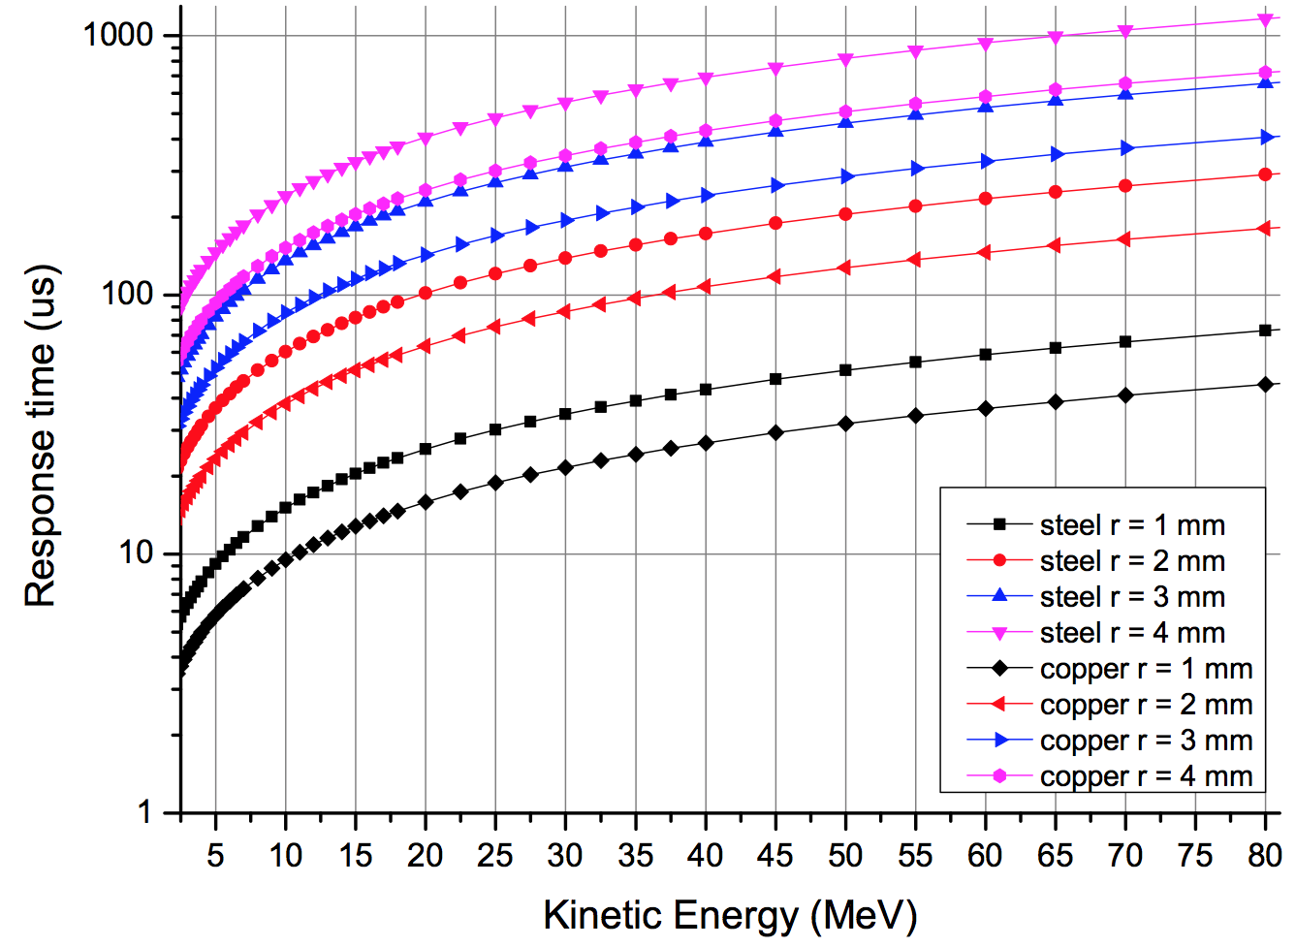
Example for ESS
Example:
After the DTL normal conducting linac, the proton energy is 78 MeV. In case of a beam size of 2 mm radius, melting would start after about 200 µs.
Inhibiting beam should be in about 10% of this time.
Time to melting point
Time to melting point [µs]
L.Tchelidze
inhibit beam interlock signal
source
dT = dT_detect failure + dT_transmit signal + dT_inhibit source + dT_beam off

Slide 68
Interlock Systems

Slide 69
  LHC Interlock Systems and inputs
LHC
Devices
LHC
Devices
Environmental
parameters
BTV screens
Mirrors
LHC
Devices
Movable Devices
BCM
Beam Loss
Experimental Magnets
Collimator
Positions
Timing
SMP
Software
Interlocks
SEQ via
GMT
CCC
Operator Buttons
Experiments
Transverse Feedback
Beam
Aperture
Kickers
Collimation
System
FBCM
Lifetime
BTV
MKI
Beam
Dumping System
Beam Interlock System
Safe
Beam
Flag
32
8
12
Injection BIS
PIC essential
+ auxiliary
circuits
WIC
FMCM
RF
System
BLM
BPM in IR6
Access
System
Vacuum
System
Timing System
(PM)
Magnets
Power Converters
Monitors in arcs
(several 1000)
Doors
EIS
Vacuum
Valves
(~300)
Access
Safety
Blocks
RF /e-Stoppers
Monitors
aperture limits
(some 100)
QPS
(several 10000)
Power
Converters
~1800
AUG
UPS
Cryo
OK
In total, several 10k interlock channels

Slide 70
  Beam Interlock Systems
LHC
Devices
LHC
Devices
Environmental
parameters
BTV screens
Mirrors
LHC
Devices
Movable Devices
BCM
Beam Loss
Experimental Magnets
Collimator
Positions
Timing
SMP
Software
Interlocks
SEQ via
GMT
CCC
Operator Buttons
Experiments
Transverse Feedback
Beam
Aperture
Kickers
Collimation
System
FBCM
Lifetime
BTV
MKI
Beam
Dumping System
Beam Interlock System
Safe
Beam
Flag
32
8
12
Injection BIS
PIC essential
+ auxiliary
circuits
WIC
FMCM
RF
System
BLM
BPM in IR6
Access
System
Vacuum
System
Timing System
(PM)
Magnets
Power Converters
Monitors in arcs
(several 1000)
Doors
EIS
Vacuum
Valves
(~300)
Access
Safety
Blocks
RF /e-Stoppers
Monitors
aperture limits
(some 100)
QPS
(several 10000)
Power
Converters
~1800
AUG
UPS
Cryo
OK
In total, several 10k interlock channels

Slide 71
  Powering Interlock Systems
LHC
Devices
LHC
Devices
Environmental
parameters
BTV screens
Mirrors
LHC
Devices
Movable Devices
BCM
Beam Loss
Experimental Magnets
Collimator
Positions
Timing
SMP
Software
Interlocks
SEQ via
GMT
CCC
Operator Buttons
Experiments
Transverse Feedback
Beam
Aperture
Kickers
Collimation
System
FBCM
Lifetime
BTV
MKI
Beam
Dumping System
Beam Interlock System
Safe
Beam
Flag
32
8
12
Injection BIS
PIC essential
+ auxiliary
circuits
WIC
FMCM
RF
System
BLM
BPM in IR6
Access
System
Vacuum
System
Timing System
(PM)
Magnets
Power Converters
Monitors in arcs
(several 1000)
Doors
EIS
Vacuum
Valves
(~300)
Access
Safety
Blocks
RF /e-Stoppers
Monitors
aperture limits
(some 100)
QPS
(several 10000)
Power
Converters
~1800
AUG
UPS
Cryo
OK
In total, several 10k interlock channels

Slide 72
  Software Interlock System
LHC
Devices
LHC
Devices
Environmental
parameters
BTV screens
Mirrors
LHC
Devices
Movable Devices
BCM
Beam Loss
Experimental Magnets
Collimator
Positions
Timing
SMP
Software
Interlocks
SEQ via
GMT
CCC
Operator Buttons
Experiments
Transverse Feedback
Beam
Aperture
Kickers
Collimation
System
FBCM
Lifetime
BTV
MKI
Beam
Dumping System
Beam Interlock System
Safe
Beam
Flag
32
8
12
Injection BIS
PIC essential
+ auxiliary
circuits
WIC
FMCM
RF
System
BLM
BPM in IR6
Access
System
Vacuum
System
Timing System
(PM)
Magnets
Power Converters
Monitors in arcs
(several 1000)
Doors
EIS
Vacuum
Valves
(~300)
Access
Safety
Blocks
RF /e-Stoppers
Monitors
aperture limits
(some 100)
QPS
(several 10000)
Power
Converters
~1800
AUG
UPS
Cryo
OK
In total, several 10k interlock channels

Slide 73
MP systems: design recommendations
Avoid (unnecessary) complexity for protection systems
Failsafe design
  Detect internal faults
  Possibility for remote testing, for example between two runs
Critical equipment should be redundant (possibly diverse)
Critical processes not by software and operating system
No remote changes of most critical parameters
Calculate safety / availability / reliability
  Use methods to analyse critical systems and predict failure rate
Managing interlocks
  Bypassing of interlocks is common practice (keep track!)
  LHC: bypassing of some interlocks possible for “setup beams”
Time stamping for all system with adequate synchronisation

Slide 74
Summary
Machine protection…….
requires the understanding of many different type of failures that could lead to beam loss
requires comprehensive understanding of all aspects of the accelerator (accelerator physics, operation, equipment, instrumentation, functional safety)
touches many aspects of accelerator construction and operation
includes many systems
is becoming increasingly important for future projects, with increased beam power / energy density (W/mm² or J/mm² ) and increasingly complex machines

Slide 75


Slide 76
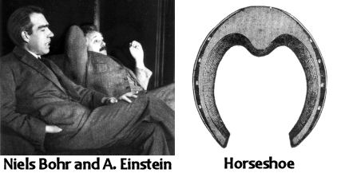
Important tool for you working on protection
Einstein was visiting in the home of Nobel Prize winner Niels Bohr, the famous atom scientist.
As they were talking, the friend kept glancing at a horseshoe hanging over the door. Finally, unable to contain his curiosity any longer, he demanded:
“Niels, it can’t possibly be that you, a brilliant scientist, believe that foolish horseshoe superstition! ? !”
“Of course not,” replied the scientist. “But I understand it’s lucky whether you believe in it or not.”

Slide 77
Acknowledgement
Many colleagues at CERN, working on machine protection and interlocks
Several colleagues from other labs – profiting from their experience and many discussions, in particular from DESY, BNL and ESS
A special thanks to some of my colleagues at CERN, e.g. Bruno Puccio, Jörg Wenninger, Markus Zerlauth and Daniel Wollmann,

Slide 78
Reserve

Slide 79
CERN-LINAC 4 during commissioning at 3 MeV
December 2013 a vacuum leak on a below developed in the MEBT line.
The analysis showed that the beam has been hitting the bellow during a special measurement (with very small beams in vertical but large in horizontal), ~16% of the beam were lost for about 14 minutes and damaged the bellow. The consequences were minor. Beam power – a few W.
A.Lombardi

Slide 80
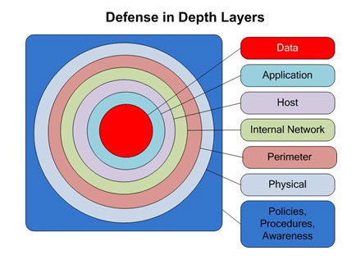
Machine Protection and Controls
Hardware interlock
Redundant Hardware interlock
Software interlock
Respect operation boundaries
Regular testing
Policies and procedures
Safety culture and awareness

Slide 81
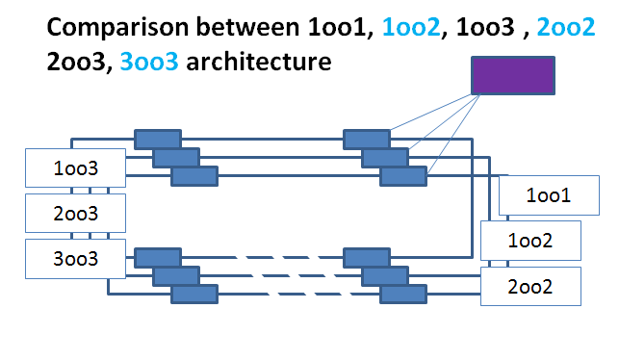
Machine Protection and Availability
If the only objective is to maximising safety, this risks to reduce the overall availability – find a reasonable compromise
For protection system: majority voting to be considered to increase failure tolerance
Optimum has been found with 2oo3 voting systems
Prototype powering interlock system developed for ITER
CIS
QD
PC
FDU
S. Wagner
Downtime for repairs due to insufficient protection systems
Downtime dominated by too complex Protection Systems

Slide 82
Design guidelines for protection systems
Having a vision to the operational phase of the system helps….
Test benches for electronic systems should be part of the system development
  Careful testing in conditions similar to real operation
Reliable protection does not end with the development phase. Documentation for installation, maintenance and operation of the MPS
The accurate execution of each protection function must be explicitly tested during commissioning
Requirements are established for the test interval of each function
Most failure are due to power supplies, mechanical parts and connectors

Slide 83
The LHC machine need protection systems, but….
Machine Protection is not an objective in itself, it is to
maximise operational availability by minimising down-time (quench, repairs)
avoid expensive repair of equipment and irreparable damage
Side effects from LHC Machine Protection System compromising
operational efficiency must be minimised
Operations workshop
R.Schmidt - Villars 30/01/2001
Qualitative
Downtime dominated by too complex Protection Systems
Downtime for repairs due to insufficient protection systems

Slide 84
Approach to designing a protection system
Identify hazards: what failures can have a direct impact on beam parameters and cause loss of particles (….hitting the aperture)
Classify the failures in different categories
Estimate the risk for each failure (or for categories of failures)
Work out the worst case failures
Identify how to prevent the failures or mitigate the consequences
Design systems for machine protection
……then back to square 1
….starting in the early design phase, continuous effort, not only once….

Slide 85
Example for LHC: SPS, transfer line and LHC
Beam is accelerated in SPS to 450 GeV (288 bunches, stored energy of 3 MJ)
Beam is transferred from SPS to LHC
Beam is accelerated in LHC to high energy (stored energy of 362 MJ)
IR8
Injection kicker
Fast extraction kicker
Transfer line 3 km
SPS
6911 m
450 GeV
3 MJ transfer to LHC
Injection kicker
LHC
IR2
Fast extraction kicker
1 km
Transfer line

Slide 86
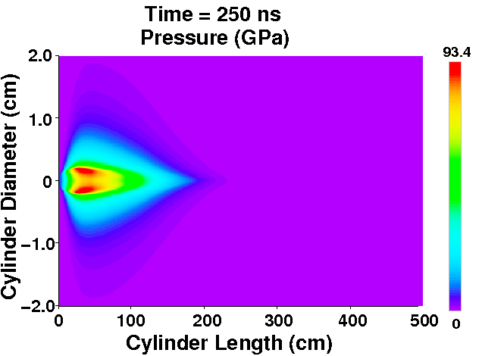
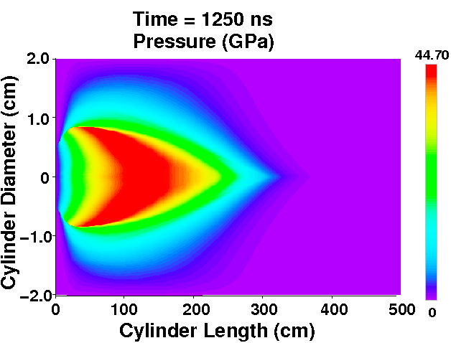
Pressure profile
93.4 GPa
44.7 GPa

Slide 87
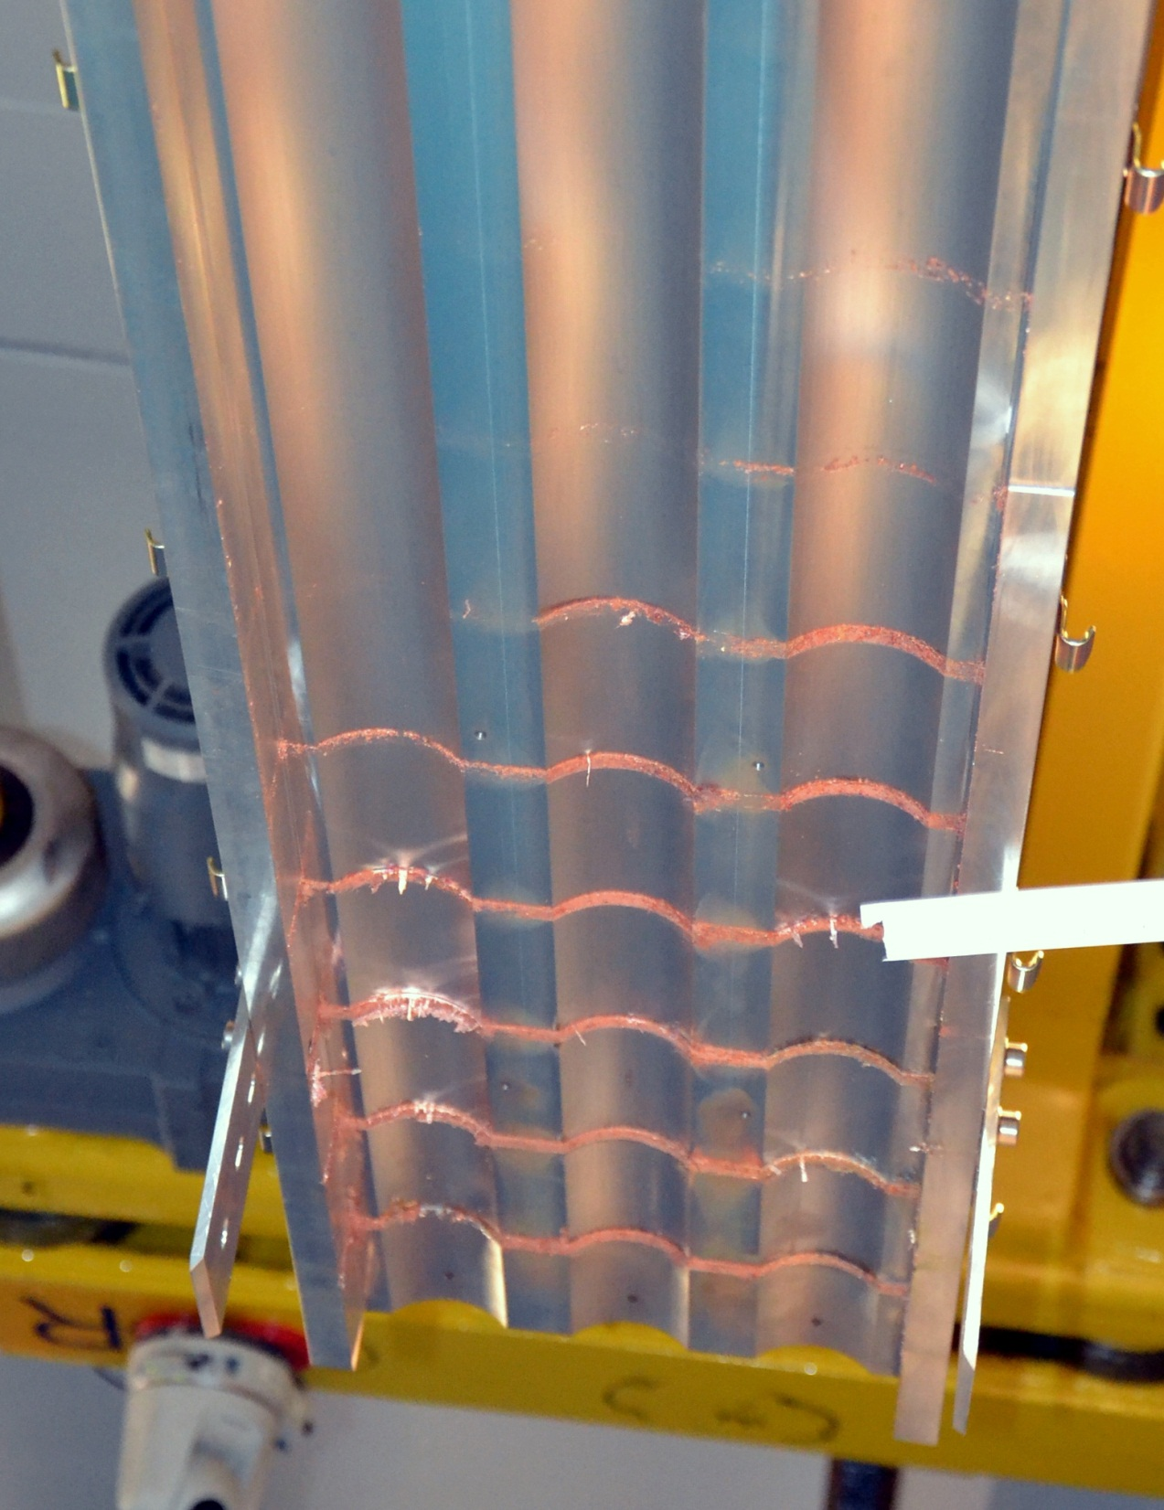
Cover target 1
Cover target 2
Cover target 3
Block 8
Block 8
Cover of the targets: the molten copper escapes between the targets and leaves clear traces on the cover
The range of the beam in target 3 is larger than in target 1 and 2
Clear indication for tunnelling

Slide 88
Strategy for protection and related systems
Avoid that a specific failure can happen
Detect failure at hardware level and stop beam operation
Detect initial consequences of a failure with beam instrumentation ….before it is too late…
Stop beam operation
  extract beam into beam dump block
  inhibit injection
  stop beam by beam absorber / collimator
Elements in the protection systems
  equipment monitoring and beam monitoring
  extraction protection
  Injection protection
  collimators and beam absorbers
  beam interlock systems linking different systems

Slide 89
Reaction time for Interlock systems
Fast interlock systems
  Reaction time can be down to some ns (typically µs)
Slow interlock systems
  From seconds down to several milliseconds
Interlock systems based on hardware (Electronics / Asics)
Interlock systems including intelligent controllers (FPGA Field Programmable Gate Array)
  Extremely fast, ns
PLCs Programmable Logic Controllers (standard and safety PLCs)
  Milliseconds to hundred milliseconds (safety PLCs)
Software interlock systems
  In the order of one second

Slide 90
Interlocks systems: other considerations
Protection Integrity Level (PIL)
  Derived from Safety Integrity Level (SIL) - IEC 61508
  PIL1 to PIL4: PIL1…lowest risk, PIL4…highest risk
Radiation environment (e.g. Single Event Effects)
Communication layer
  Current loops, frequency loops, use of intelligent network such as Profibus, Profisafe, Ethernet, …..
  Electrical, optical, wireless in the future (?)
Time for development (in-house design of electronics, buying and programming PLCs, ….)
Lab environment
  Lab standards
  Competence in the lab and maintainability
Cost
M. Kwiatkowski B. Todd

Slide 91
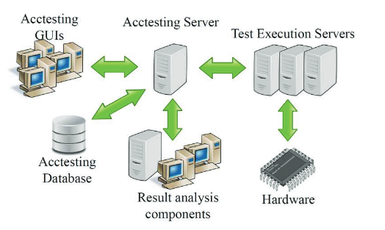
Commissioning and Testing
Design of the protection system: testing to be considered.
  Correct commissioning and regular testing of protection system is vital to ensure reliable operation.
  Repeated testing is very time consuming, can be extremely boring and prone to errors, in particular if done by humans.
  Consider partial commissioning of accelerator (e.g. linacs)
Automatic test procedures and automatic validation of the results via the controls system
Framework for automatic testing used for LHC magnet system commissioning, about 10k tests performed.
A.Gorzawski
Acctesting framework

Slide 92
Machine Protection and Controls

Slide 93
Other aspects
Several million parameters for the protection systems
  Many parameters can only be defined with operational experience
  Management of critical parameters
  Access to these parameters
  Ensure that parameters in database are the same as in hardware
(Cyber) security – access to critical parameters
  Highest PIL: not possible to modify parameters via controls system
  Medium PIL: parameter can be changed via the control system, but strict controls for parameter changes, e.g. two people role
  Low PIL: parameter can be changed via the control system
Several 10k interlock channels that can prevent operation
  Nightmare for starting-up of a system, in particular, if the risk is (close to) zero
  Option for bypassing of interlocks to be included in the design

