Slide 2

Electron cloud effects
Giovanni Rumolo
Many thanks to H. Bartosik, G. Iadarola, K. Li, L. Mether, A. Romano, M. Schenk
CAS on Intensity Limitations in Particle Beams, 3-11 November, 2015
http://indico.cern.ch/event/362960/

Slide 3
Electron cloud effects in accelerators
Primary sources of electrons in the vacuum chamber of accelerators: General concepts
Formation of the electron clouds for bunched beams
  Modeling of the impact of electrons against the chamber wall: Secondary electron emission & reflection
  Build up process due to multipacting
  Interaction with the beam: transverse beam instability and incoherent effects
  Simulation techniques
Machine/beam observables related to electron clouds
Mitigation and cures
Important impact of electron cloud on the design/upgrade of high intensity machines

Slide 4
The instability loop
Multi-bunch beam
s
Equations of motion of the beam particles
Interaction with the external environment
Additional electromagnetic field acting on the beam, besides RF and external magnetic fields

Slide 5
Reminder
Interaction of the beam with the external environment
The electron cloud
  Electron production and accumulation
  Poisson’s equation with
    The electron cloud as the source term
    Boundary conditions given by the chamber in which the electron cloud builds up
Additional electromagnetic field acting on the beam, besides RF and external magnetic fields

Slide 6
Primary generation
Generation of charged particles inside the vacuum chamber
(primary, or seed, electrons)
Residual gas ionization
Desorption from the losses on the wall
Photoelectrons from synchrotron radiation
Gas ionization and wall desorption produce both electrons and ions (the former one with the same rate, the second one with different rates depending on the desorption yields), photoemission is only a source of electrons
The dominant mechanism depends upon the beam type and parameters, the vacuum level, the design (material, shape), roughness and cleanness of the inner surface of the beam pipe, etc.

Slide 7
Primary generation
Generation of charged particles inside the vacuum chamber
(primary, or seed, electrons)
Residual gas ionization
Desorption from the losses on the wall
Photoelectrons from synchrotron radiation

Slide 8
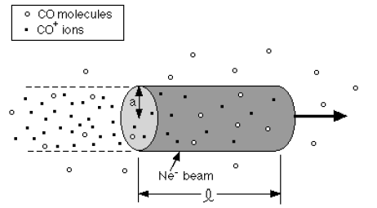
Residual gas ionization
The number of electron/ion pairs created via scattering per unit length (λ=dN_{ion}/ds = dN_{el}/ds) depends on the partial pressures of the components of the residual gas (P_{n}), the cross section of the ionization process for each of these species (σ_{n}), the number of particles per bunch (N_{b}). We can assume room temperature T=300 K

Slide 9
Residual gas ionization
A list of features of charge production through ionization of the residual gas:
  Electron/ion pair production, all basically at rest in the volume swept by the passing beam
  The amount of produced pairs is mainly determined by the quality of the vacuum and the beam intensity.
  Weak dependency on the beam energy through the cross section of the ionization process (the ionization cross section does not vary significantly in the ranges of energy usually covered in accelerators).
  The composition of the rest gas is only important in machines operating with negatively charged particles → some ions can be trapped by the beam and accumulate, while some others can escape.
  In some regimes, ionization can be caused not only by scattering, but also by the electric field, becoming a severe source of primaries (e.g. CLIC Main Linac)

Slide 10
Residual gas ionization
A list of features of charge production through ionization of the residual gas:
  Electron/ion pair production, all basically at rest in the volume swept by the passing beam
  The amount of produced pairs is mainly determined by the quality of the vacuum and the beam intensity.
  Weak dependency on the beam energy through the cross section of the ionization process (the ionization cross section does not vary significantly in the ranges of energy usually covered in accelerators).
  The composition of the rest gas is only important in machines operating with negatively charged particles → some ions can be trapped by the beam and accumulate, while some others can escape.
  In some regimes, ionization can be caused not only by scattering, but also by the electric field, becoming a severe source of primaries (e.g. CLIC Main Linac)
Residual gas ionization is the primary mechanism responsible for both electron cloud formation in machines with positively charge particles (at least in certain regimes) and for ion production in machines with negatively charged particles!

Slide 11
Primary generation
Generation of charged particles inside the vacuum chamber
(primary, or seed, electrons)
Residual gas ionization
Desorption from the losses on the wall
Photoelectrons from synchrotron radiation

Slide 12
Photoemission
cross sectional view (x,y)
view from above (x,s)
When the beam is bent in a dipole magnet, it emits synchrotron radiation in the horizontal plane (bending plane)
When the synchrotron radiation hits the beam pipe
  partly it produces electron emission within a 1/γ angle from the point where it impinges
  partly it is reflected inside the pipe and hits at different locations, too, producing electrons with a more complex azimuthal distribution.

Slide 13
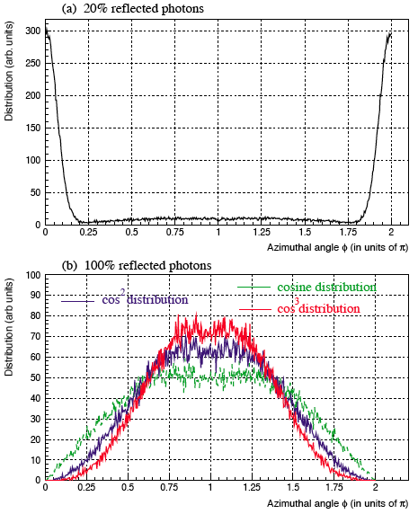
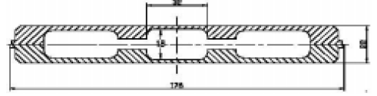
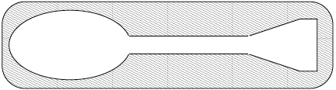
Photoemission
The vacuum chamber in dipoles can be designed in such a way as to absorb the direct synchrotron radiation into an antechamber (one sided in arcs, two-sided in wigglers). This solution is adopted in many synchrotron light sources (especially for heat load) and foreseen for wigglers in positron damping rings of linear colliders
The surface directly hit by synchrotron radiation can be also machined in a way as to change the azimuthal distribution of the reflected radiation.
  With smooth chamber it is assumed to be uniform on the beam pipe
  E.g. with saw-tooth shape, distributions can be more like cos² or cos³
Percents of directly absorbed and reflected radiation come from lab measurements.

Slide 14
Photoemission
The rate of electron production (λ=dN_{el}/ds) is given by the number of photons per beam particle per meter multiplied by the number of beam particles and by the photoemission yield of the surface, which depends on the energy of the photons (Y)
An effective photoemission yield (Y*) is used, which usually takes into account also of the antechamber or absorbers (e.g. Y*=0.1 Y if we know that 90% of the radiation goes into the antechamber)
When bent in a dipole on a path length L, a beam produces electrons at a rate given by the following formula.
is the fine structure constant, γ the relativistic factor of the beam, L the total length over which there is emitted radiation.
Y* depends on the energy of the photons (it becomes negligible if the critical photon energy is below the work function of the metal, then grows proportionally with this energy, i.e. with the third power of γ)

Slide 15
Primary generation
Generation of charged particles inside the vacuum chamber
(primary, or seed, electrons)
Residual gas ionization
Desorption from the losses on the wall
Photoelectrons from synchrotron radiation

Slide 16
Beam particle loss
lost particle
ions
neutrals
electrons
Electrons, neutrals and ions can be also produced as a result of slow beam particle losses on the walls of the beam pipe..
The different species are produced with rates dependent on their specific desorption yields. The types of ions desorbed depend on the material and surface of the pipe wall
Desorption rates are functions of the beam energy and of the angle of incidence. The incidence is mainly considered to be grazing (shallow angles)
Neutrals degrade the vacuum and contribute to the value of the dynamic pressure, i.e. the pressure in the beam pipe in presence of circulating beam. When the increased pressure causes in turn an increase of beam losses, this process may diverge, triggering a so-called pressure runaway (i.e. a vacuum instability)

Slide 17
Beam particle loss
Beam particle loss takes place because of
  Diffusion, emittance growth (IBS, scattering, bremsstrahlung, Touschek, beam-beam, noise excitation, resonance crossing, …), which cause the particles to exit the dynamic aperture and eventually hit the physical aperture.
  Uncaptured beam lost at the beginning of the accelerating ramp.
Diffusion losses are concentrated at the significant aperture restriction points. Capture losses, but also e.g. losses of ions having undergone charge exchange processes (stripping/capture), usually happen downstream from the bending magnets. Both can be intercepted with purposely designed collimators.
An estimate of the average beam losses is based on the percent of beam lost over a certain number of turns, which can be roughly translated in number of beam particles lost per meter (n’) though the desorption yield η_{el}

Slide 18
Electron cloud formation
Electrons can strongly affect the performance of machines operating with positively charged particles (positrons, protons, heavy ions). There are observations of electron accumulation also for electron machines.
Coasting (continuous) beams
  Electrons emitted at the pipe surface are accelerated and decelerated in the beam field, and come to the other side of the pipe with a zero net energy gain → no contribution to accumulation
  Ionization electrons are trapped and move with high frequency. Their accumulation around the beam to the neutralization level may endanger stability.
Bunched beams
  Trains of short bunches: under certain conditions, a process of multi-bunch multiplication is possible through the secondary electron emission, i.e. the electrons generated with the mechanisms so far considered (called primary) seed an avalanche process that leads to very high electron densities inside the beam pipe
  Trains of long bunches: they can behave partly like coasting beams, with the advantage of having clearing gaps. However, again due to secondary electron emission, they may suffer from the so called trailing edge multipacting, which can cause intolerable electron accumulation especially at the tail of this type of bunches

Slide 19
Electron cloud formation
Generation of charged particles inside the vacuum chamber
(primary, or seed, electrons)
Acceleration of primary electrons in the beam field
Secondary electron production when hitting the wall

Slide 20
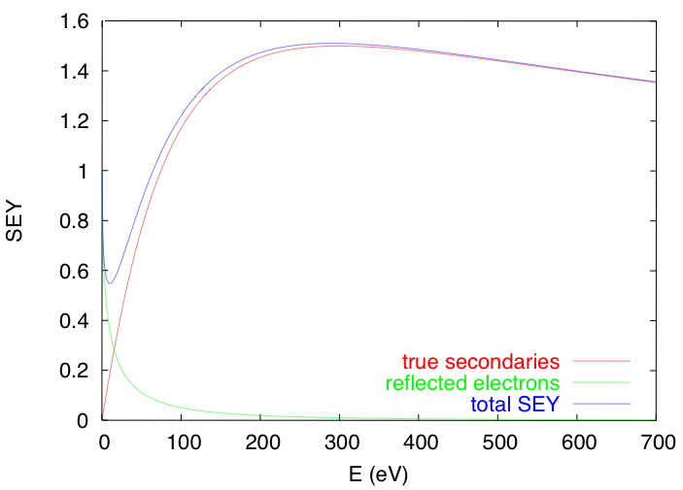
Electron cloud formation
When electrons hit the pipe wall, they do not just disappear…..
  High energy electrons easily survive and actually multiply through secondary electron emission
  Low energy electrons tend to survive long because they are likely to be elastically reflected.
Secondary electron emission is governed by the curve below
θ
E_{p}
secondaries
elastically reflected
An important set of model parameters

Slide 21
Electron cloud formation
When electrons hit the pipe wall, they do not just disappear…..
  High energy electrons easily survive and actually multiply through secondary electron emission
  Low energy electrons tend to survive long because they are likely to be elastically reflected.
Secondary electron emission is governed by the curve below
θ
E_{p}

Slide 22
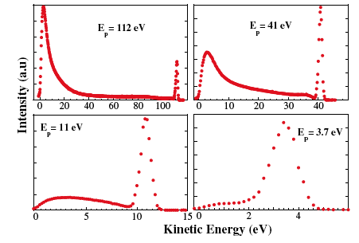
Electron cloud formation
Elastically reflected electrons, and their relevance at very low energies, have been measured (Cimino & Collins, 2004)
From these measurements both secondary emission and elastic reflection have been fully characterized → high probability of elastic reflection of electrons at low energy for technical surfaces

Slide 23
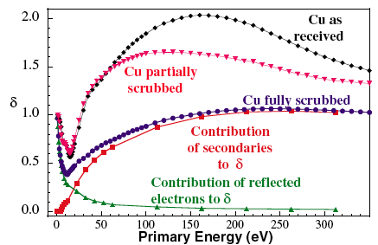
Electron cloud formation
Elastically reflected electrons, and their relevance at very low energies, have been measured (Cimino & Collins, 2004)
From these measurements both secondary emission and elastic reflection have been fully characterized → high probability of elastic reflection of electrons at low energy for technical surfaces
The SEY decreases in time… An effect of what we call “surface scrubbing”

Slide 24
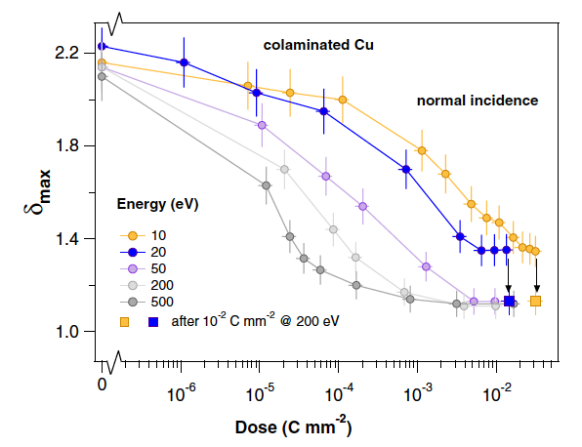
Electron cloud formation
The SEY can be lowered by electron bombardment (scrubbing effect, efficiency depends on the deposited dose) or by radiation bombardment (conditioning effect). Also the PEY decreases by radiation.
Measured in the lab by bombarding a surface with electrons with different energies
Scrubbing efficiency depends on the electron energy!

Slide 25
Electron cloud formation
The SEY can be lowered by electron bombardment (scrubbing effect, efficiency depends on the deposited dose) or by radiation bombardment (conditioning effect). Also the PEY decreases by radiation.
Directly observed also in accelerator: Stainless Steel SEY decreases from above 2 to ~1.6 in the SPS after relatively high electron bombardment. Other materials, like the TiN, rely on conditioning to rapidly get very low maximum SEY (even below 1)
Schematic view of the in-situ SEY detector installed in the SPS

Slide 26
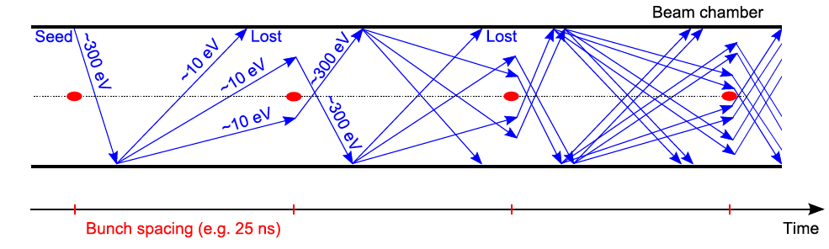
Electron cloud formation:
Principle of multipacting
The circulating beam particles produce “primary or seed electrons”, which are attracted by the passing particle bunch and can be accelerated to energies up to several hundreds of eV.
When an electron with this energy impacts the wall, “secondary electrons” are likely to be emitted.
Secondaries have energies up to few tens of eV
  Some impact the wall with these energies and are either absorbed or elastically reflected
  Some are again accelerated in the next bunch’s field and will produce more secondaries

Slide 27
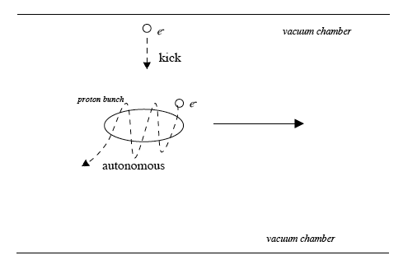
Electron cloud formation:
Principle of multipacting
The picture proposed on the previous slide, though instructive, is simplified, because electrons actually fill the pipe and evolve differently according to their positions when the bunch arrives
Critical parameters are bunch charge, spacing, chamber radius. While in general higher bunch charges and shorter spacings tend to facilitate multipacting, it is finally the combination of these three numbers to determine how low is the SEY threshold above which multipacting occurs
Electrons close to the beam and with low velocities are in autonomous regime, i.e. they oscillate around the bunch. The frequency of this oscillation, as well as the number of oscillations per bunch passage, are two important parameters!
Electrons far enough from the beam are in kick regime, i.e. they just feel a strong electric kick when a bunch passes

Slide 28
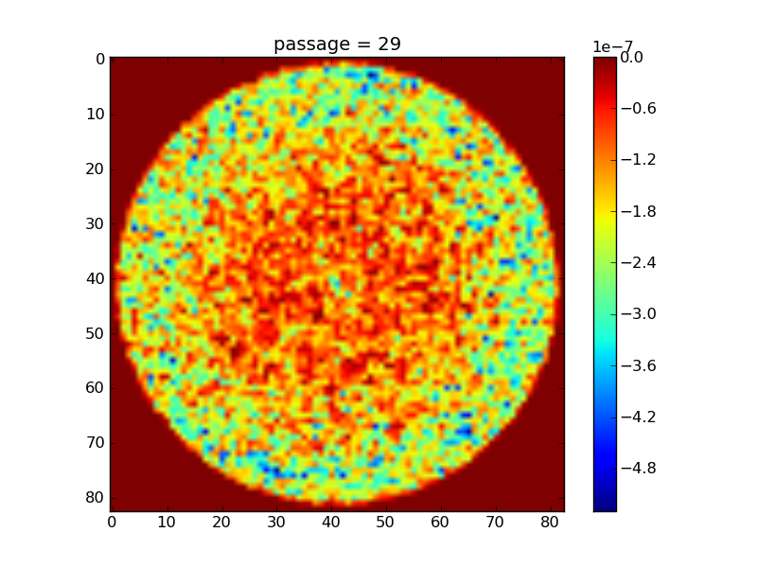
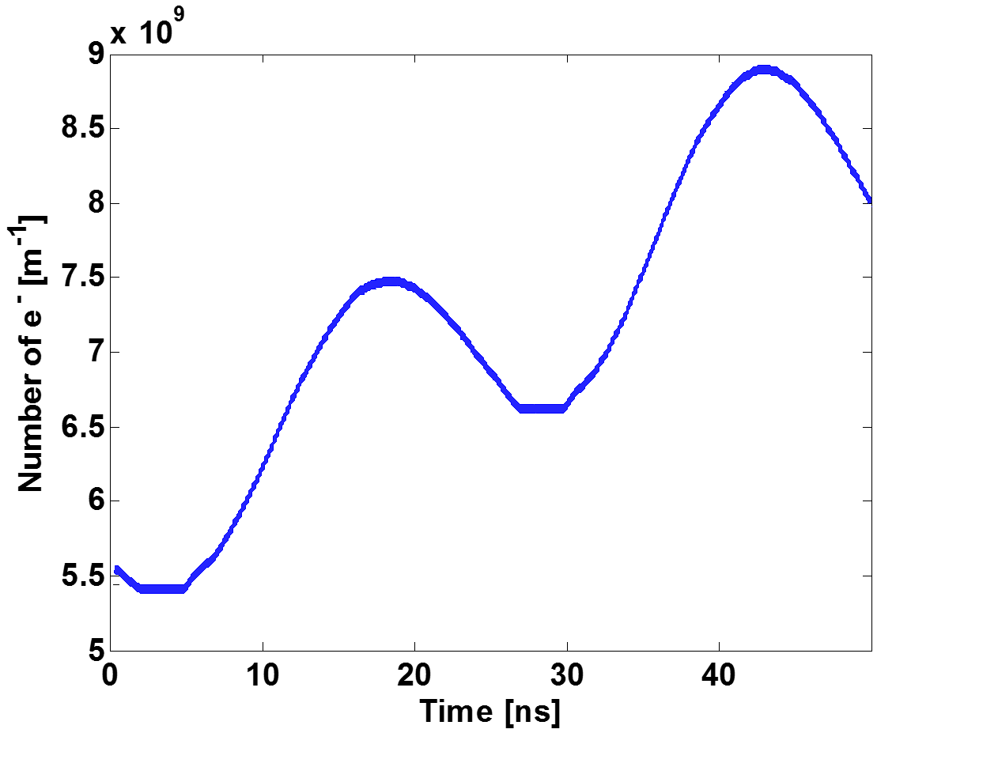
Electron cloud formation:
Illustration of multipacting
  Beam pipe transverse cut

Slide 29
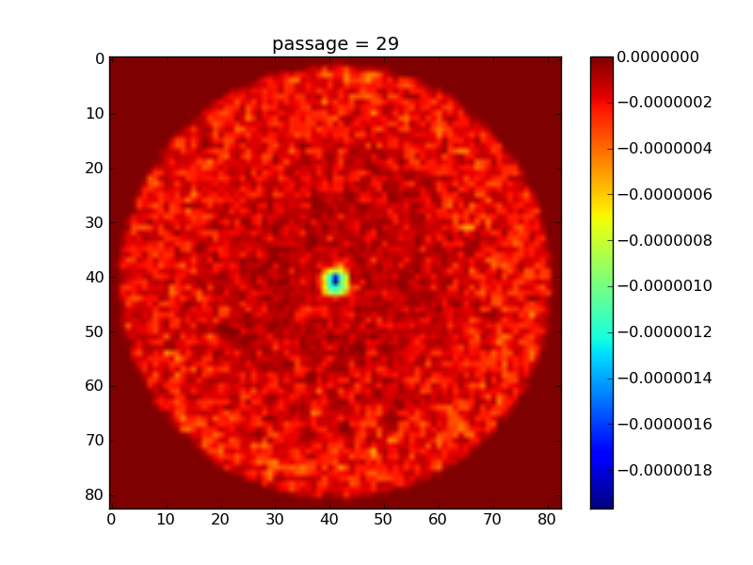
Electron cloud formation:
Illustration of multipacting
  Beam pipe transverse cut
  During the bunch passage the electrons are accelerated by the beam “pinched” at the center of the beam pipe

Slide 30
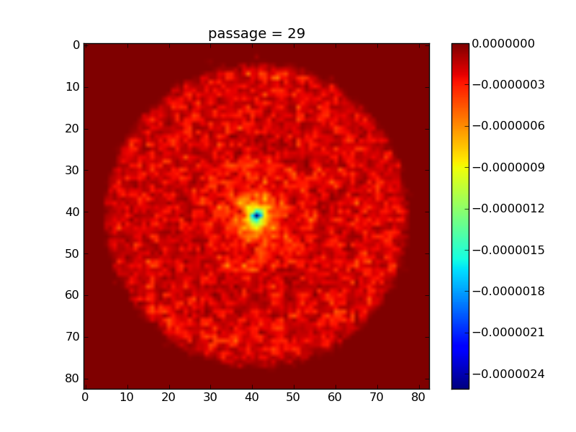
Electron cloud formation:
Illustration of multipacting
  Beam pipe transverse cut
  During the bunch passage the electrons are accelerated by the beam “pinched” at the center of the beam pipe

Slide 31
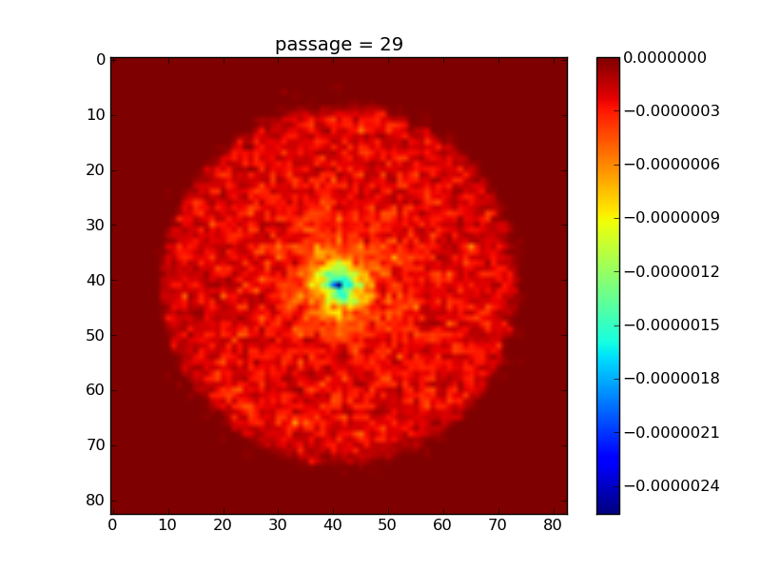
Electron cloud formation:
Illustration of multipacting
  Beam pipe transverse cut
  During the bunch passage the electrons are accelerated by the beam “pinched” at the center of the beam pipe

Slide 32
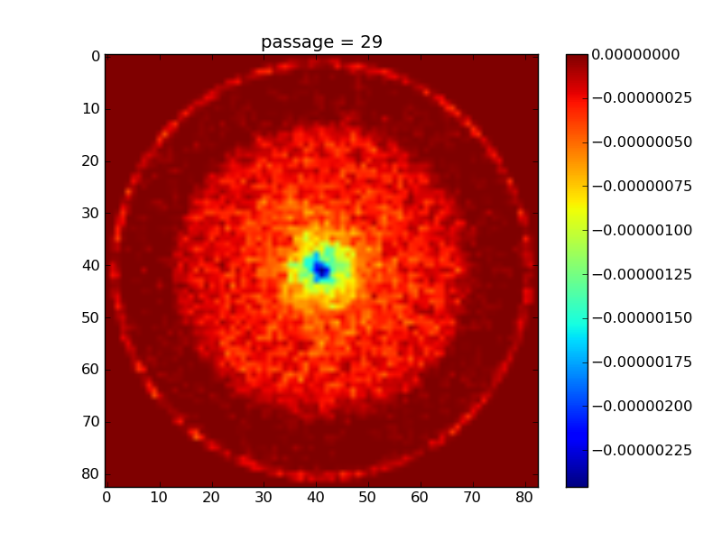
Electron cloud formation:
Illustration of multipacting
  Beam pipe transverse cut
  During the bunch passage the electrons are accelerated by the beam “pinched” at the center of the beam pipe

Slide 33
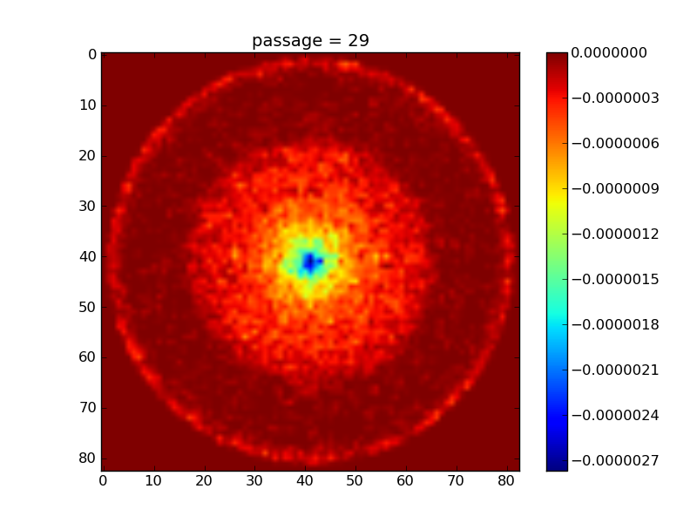
Electron cloud formation:
Illustration of multipacting
  Beam pipe transverse cut
  After the bunch passage electrons hit the wall (with E~100eV)
  If Secondary Electron Yield (SEY) of the surface is large enough, secondary electrons can be generated

Slide 34
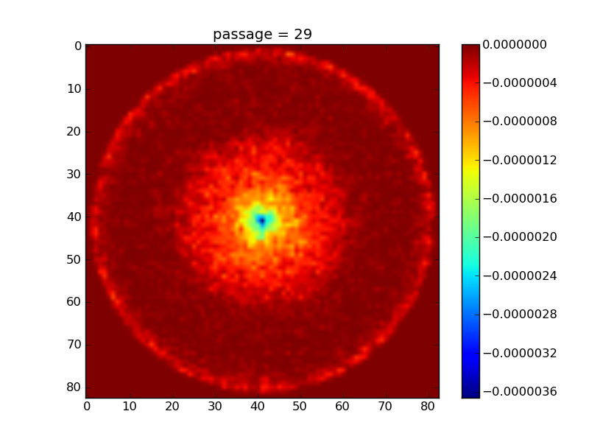
Electron cloud formation:
Illustration of multipacting
  Beam pipe transverse cut
  After the bunch passage electrons hit the wall (with E~100eV)
  If Secondary Electron Yield (SEY) of the surface is large enough, secondary electrons can be generated

Slide 35
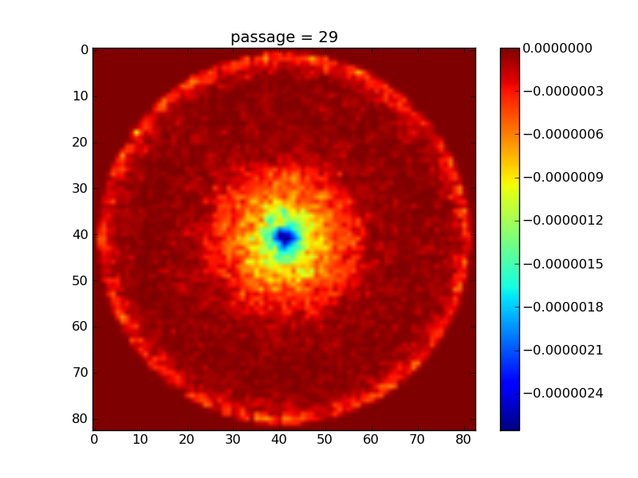
Electron cloud formation:
Illustration of multipacting
  Beam pipe transverse cut
  After the bunch passage electrons hit the wall (with E~100eV)
  If Secondary Electron Yield (SEY) of the surface is large enough, secondary electrons can be generated

Slide 36
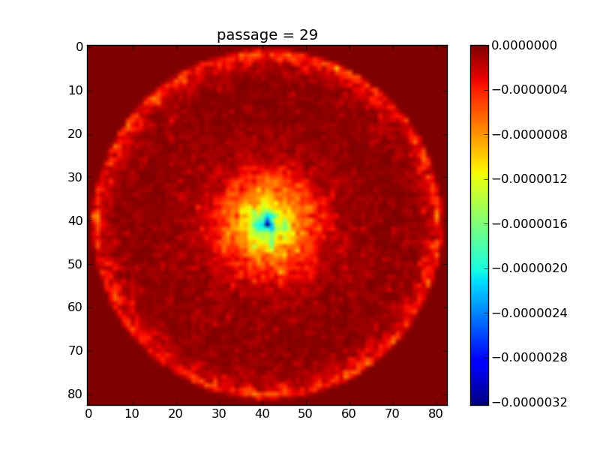
Electron cloud formation:
Illustration of multipacting
  Beam pipe transverse cut
  After the bunch passage electrons hit the wall (with E~100eV)
  If Secondary Electron Yield (SEY) of the surface is large enough, secondary electrons can be generated

Slide 37
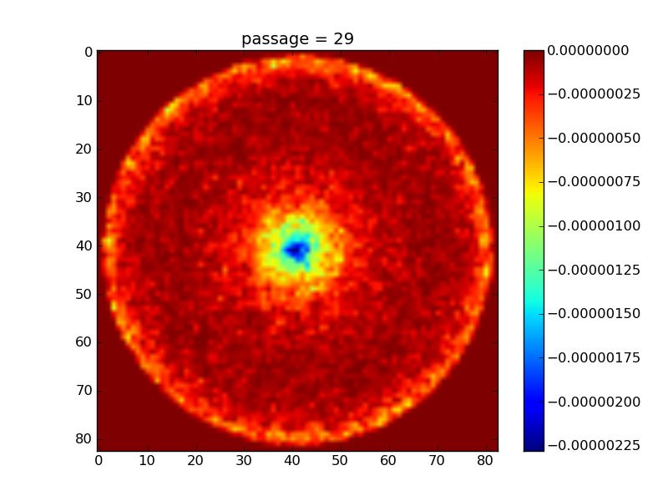
Electron cloud formation:
Illustration of multipacting
  Beam pipe transverse cut
  After the bunch passage electrons hit the wall (with E~100eV)
  If Secondary Electron Yield (SEY) of the surface is large enough, secondary electrons can be generated

Slide 38
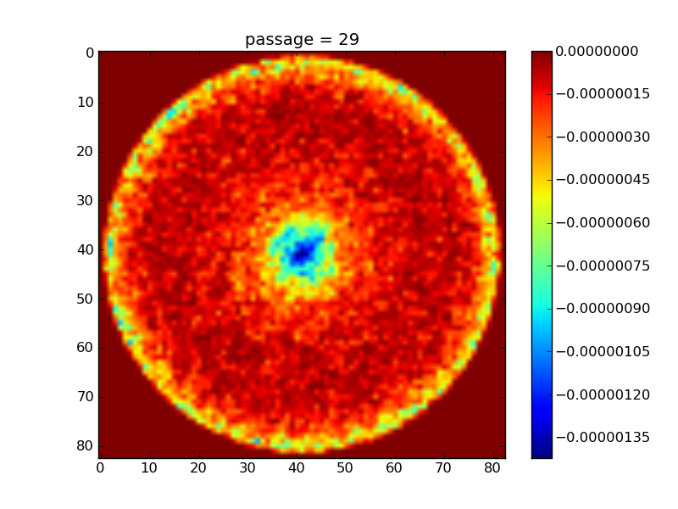
Electron cloud formation:
Illustration of multipacting
  Beam pipe transverse cut
  After the bunch passage electrons hit the wall (with E~100eV)
  If Secondary Electron Yield (SEY) of the surface is large enough, secondary electrons can be generated

Slide 39
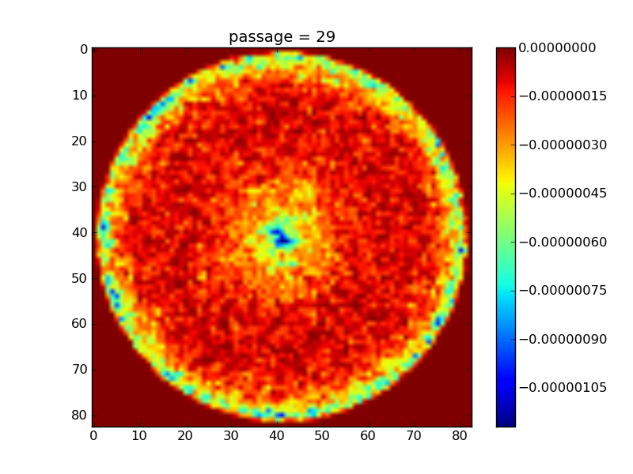
Electron cloud formation:
Illustration of multipacting
  Beam pipe transverse cut
  After the bunch passage electrons hit the wall (with E~100eV)
  If Secondary Electron Yield (SEY) of the surface is large enough, secondary electrons can be generated

Slide 40
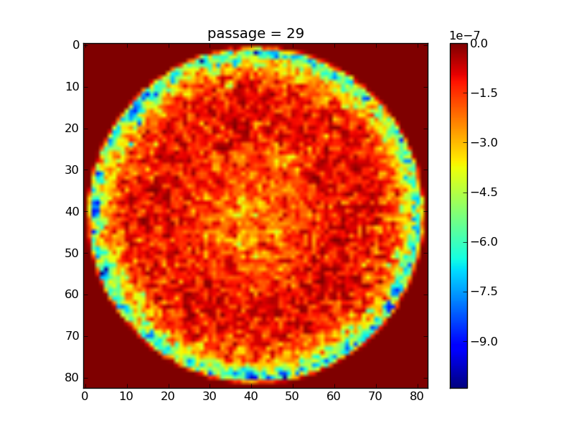
Electron cloud formation:
Illustration of multipacting
  Beam pipe transverse cut
  After the bunch passage electrons hit the wall (with E~100eV)
  If Secondary Electron Yield (SEY) of the surface is large enough, secondary electrons can be generated

Slide 41
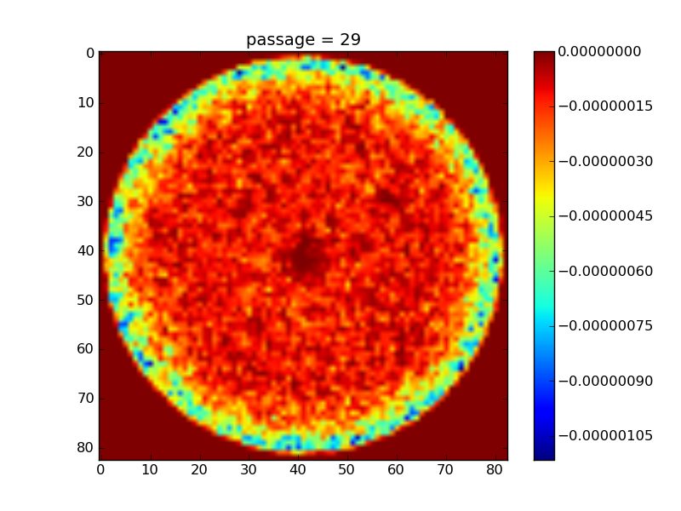
Electron cloud formation:
Illustration of multipacting
  Beam pipe transverse cut
  After the bunch passage electrons hit the wall (with E~100eV)
  If Secondary Electron Yield (SEY) of the surface is large enough, secondary electrons can be generated

Slide 42
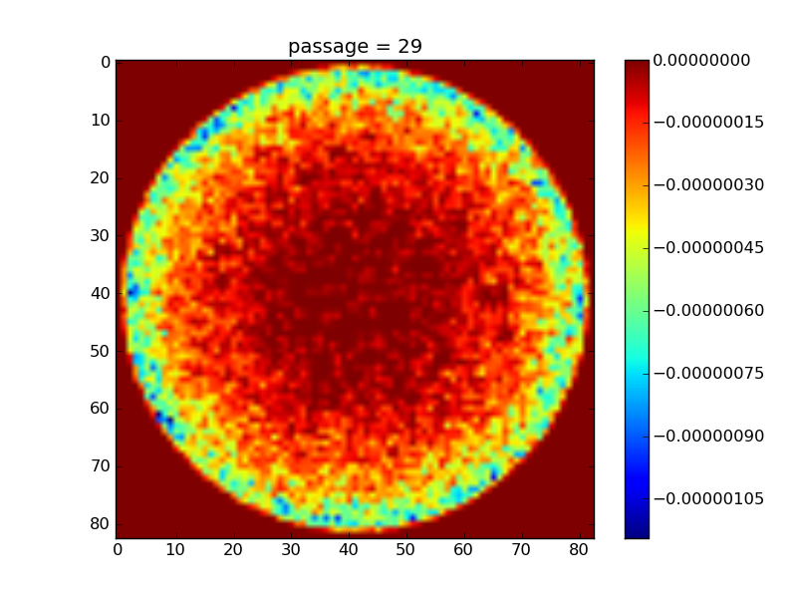
Electron cloud formation:
Illustration of multipacting
  Beam pipe transverse cut
  After the bunch passage electrons hit the wall (with E~100eV)
  If Secondary Electron Yield (SEY) of the surface is large enough, secondary electrons can be generated

Slide 43
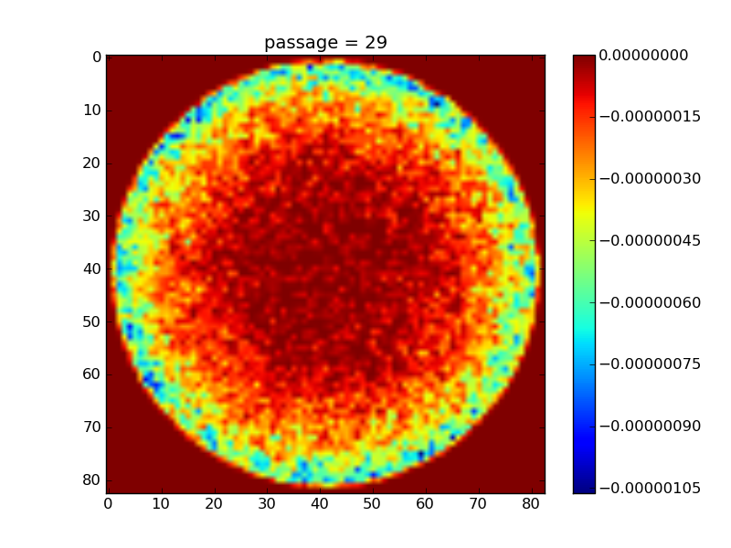
Electron cloud formation:
Illustration of multipacting
  Beam pipe transverse cut
  After the bunch passage electrons hit the wall (with E~100eV)
  If Secondary Electron Yield (SEY) of the surface is large enough, secondary electrons can be generated

Slide 44
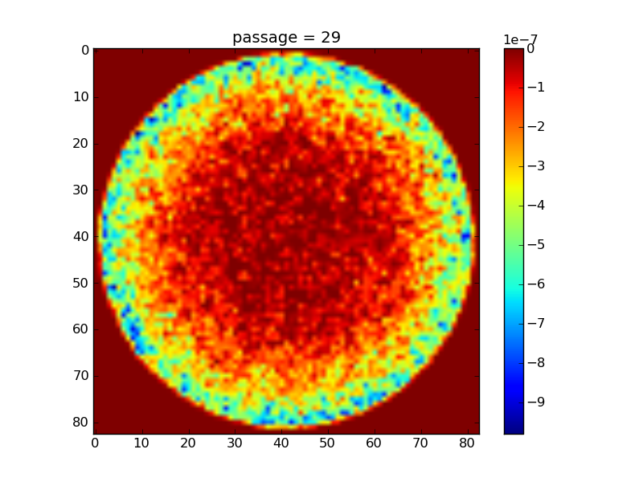
Electron cloud formation:
Illustration of multipacting
  Beam pipe transverse cut
  Secondary electrons, emitted with low energies (E~1eV), are absorbed without generation of further secondaries
  Total number of electrons begins decaying at this stage

Slide 45
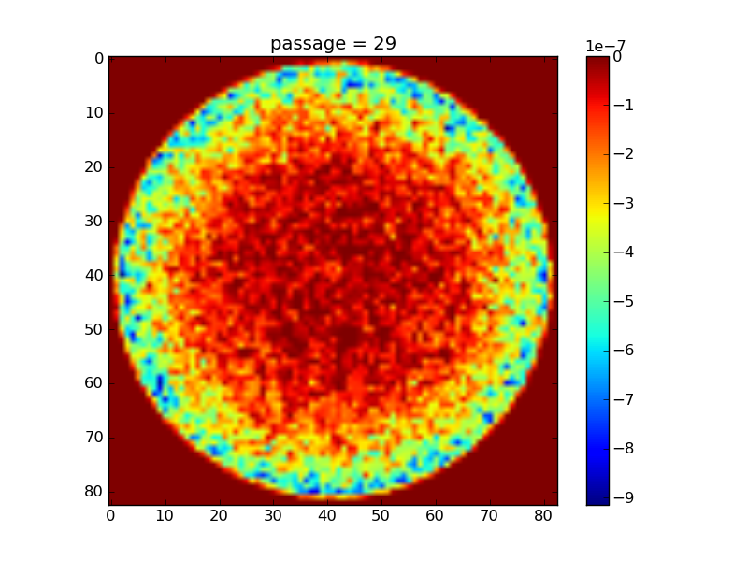
Electron cloud formation:
Illustration of multipacting
  Beam pipe transverse cut
  Secondary electrons, emitted with low energies (E~1eV), are absorbed without generation of further secondaries
  Total number of electrons begins decaying at this stage

Slide 46
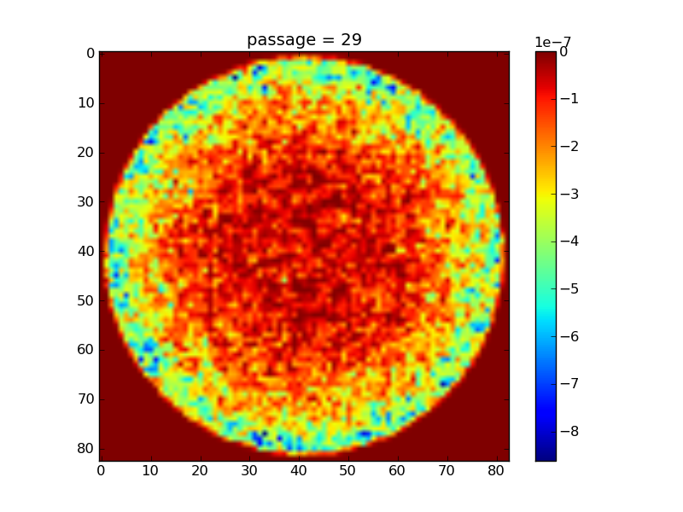
Electron cloud formation:
Illustration of multipacting
  Beam pipe transverse cut
  Secondary electrons, emitted with low energies (E~1eV), are absorbed without generation of further secondaries
  Total number of electrons begins decaying at this stage

Slide 47
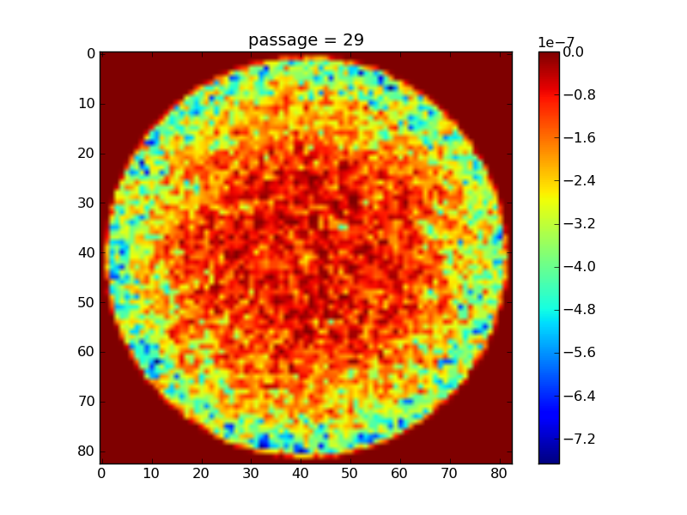
Electron cloud formation:
Illustration of multipacting
  Beam pipe transverse cut
  Secondary electrons, emitted with low energies (E~1eV), are absorbed without generation of further secondaries
  Total number of electrons begins decaying at this stage

Slide 48
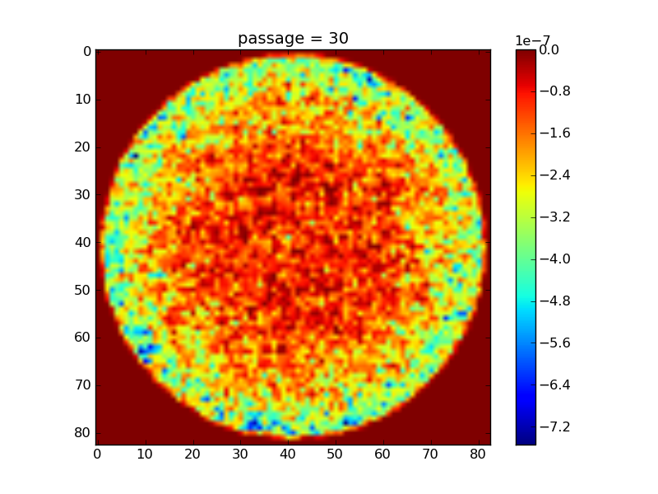
Electron cloud formation:
Illustration of multipacting
  Beam pipe transverse cut
  Secondary electrons, emitted with low energies (E~1eV), are absorbed without generation of further secondaries
  Total number of electrons begins decaying at this stage

Slide 49
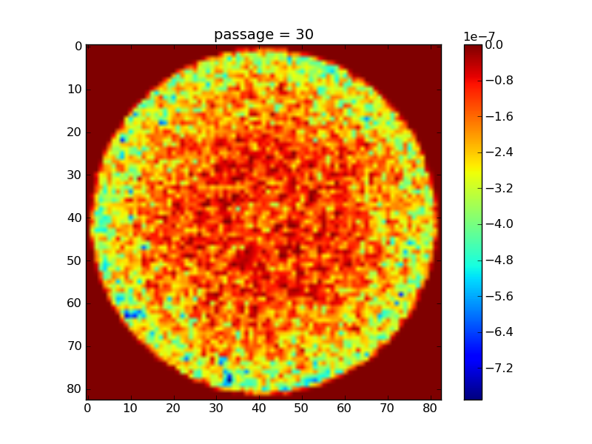
Electron cloud formation:
Illustration of multipacting
  Beam pipe transverse cut
  Secondary electrons, emitted with low energies (E~1eV), are absorbed without generation of further secondaries
  Total number of electrons begins decaying at this stage

Slide 50
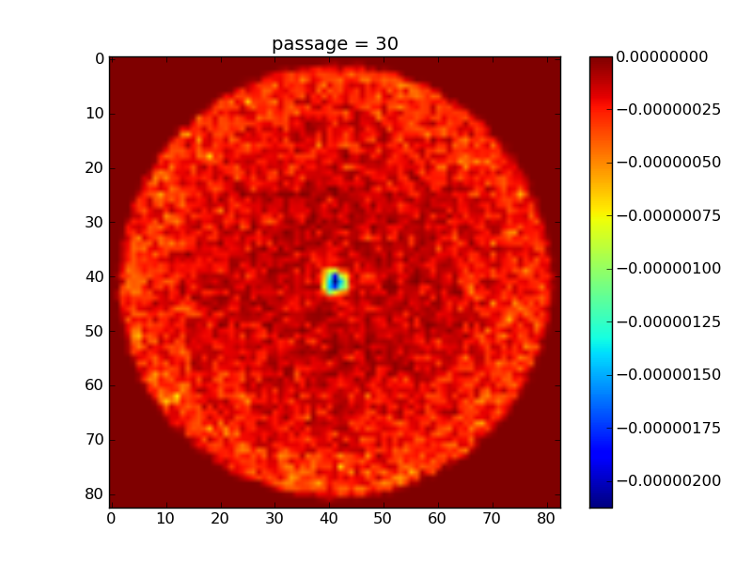
Electron cloud formation:
Illustration of multipacting
  Beam pipe transverse cut
  Another bunch passage can interrupt the decay before reaching the initial value
  This could lead to exponential growth of the number of electrons

Slide 51
Electron cloud formation:
Illustration of multipacting
  Beam pipe transverse cut
  Another bunch passage can interrupt the decay before reaching the initial value
  This could lead to exponential growth of the number of electrons

Slide 52
Electron cloud formation:
Illustration of multipacting
  Beam pipe transverse cut
bunch spacing
ΔN_{ed} depends on pipe radius
ΔN_{eg} depends on bunch charge and SEY
  Electron cloud effect is strongly dependent on bunch spacing, bunch charge and pipe radius!

Slide 53

Electron cloud formation:
A model for the multipacting process
n_{i}=n(t_{i})
n_{i+1}=n(t_{i+1})
t_{i}
t_{i+1}
Number of primary electrons generated by the bunch passage
Energy spectrum of the electrons impacting the wall at time t
SEY of the chamber inner surface

Slide 54



Electron cloud formation:
A model for the multipacting process
n_{i}=n(t_{i})
n_{i+1}=n(t_{i+1})
t_{i}
t_{i+1}
Defining a normalized integrated spectrum over the bunch spacing

Slide 55
Electron cloud formation:
A model for the multipacting process
As long as the interaction between electrons stays negligible, the normalized integrated spectrum does not depend on the bunch index
No exponential growth, only equilibrium between seed generation and loss to the walls
Exponential growth!

Slide 56
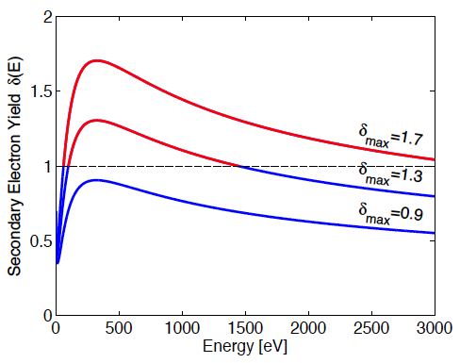
Electron cloud formation:
A model for the multipacting process
Let’s have a closer look to δ_{eff}
Whether δ_{eff} is below or above unity depends on whether the energy spectrum φ(E) overlaps more with the absorber region of the SEY curve (δ(E)<1) or the emitter region (δ(E)>1)
Absorber region is for low energies and possibly above a certain energy value, depending on E_{max} and δ_{max}
If δ_{max}<1, there is obviously no emitter region

Slide 57
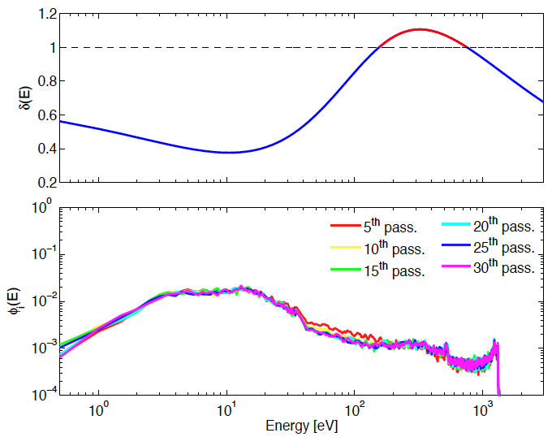
Electron cloud formation:
Application of the model (1)
25 ns beam with 10¹¹ p/b generates electrons due to gas ionization
The energy spectrum φ(E) is computed bunch by bunch through a simulation and is shown here below together with δ(E)
b=22 cm
δ_{max}= 1.1
E_{max} = 300 eV
R₀ = 0.6

Slide 58
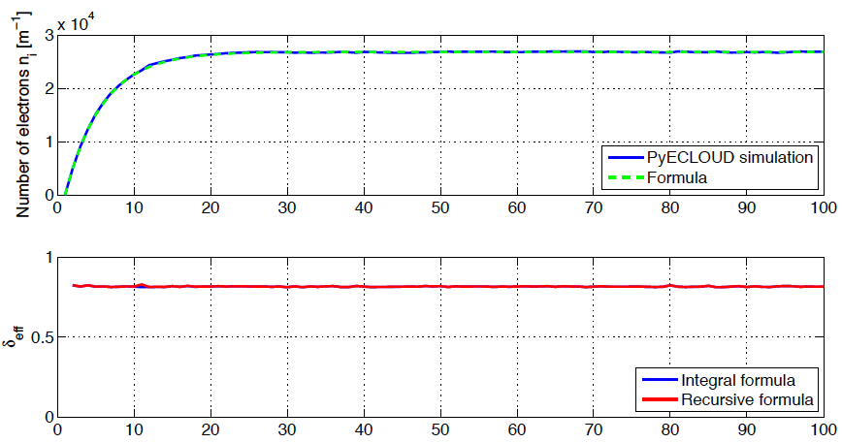
Electron cloud formation:
Application of the model (1)
b=22 cm
δ_{max}= 1.1
E_{max} = 300 eV
R₀ = 0.6

Slide 59
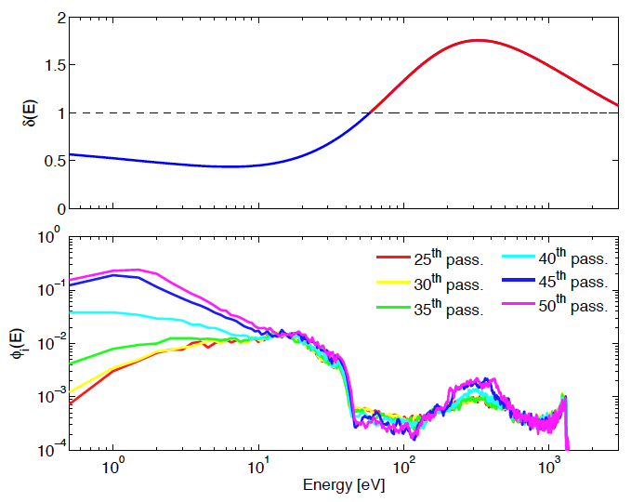
Electron cloud formation:
Application of the model (2)
25 ns beam with 10¹¹ p/b generates electrons due to gas ionization
The energy spectrum φ(E) is computed bunch by bunch through a simulation and is shown here below together with δ(E)
b=22 cm
δ_{max}= 1.7
E_{max} = 300 eV
R₀ = 0.6
First of all, it is clear that the spectrum φ(E) stays constant only up to about the passage of the 35th bunch (the approximation that the spectrum only depends on the bunch field does not hold anymore)
After that, there is an enhancement of low energy electrons.

Slide 60
Electron cloud formation:
Application of the model (2)
25 ns beam with 10¹¹ p/b generates electrons due to gas ionization
The normalized integrated energy spectrum φ(E) is computed through a simulation and is shown here below together with δ(E)
b=22 cm
δ_{max}= 1.7
E_{max} = 300 eV
R₀ = 0.6

Slide 61
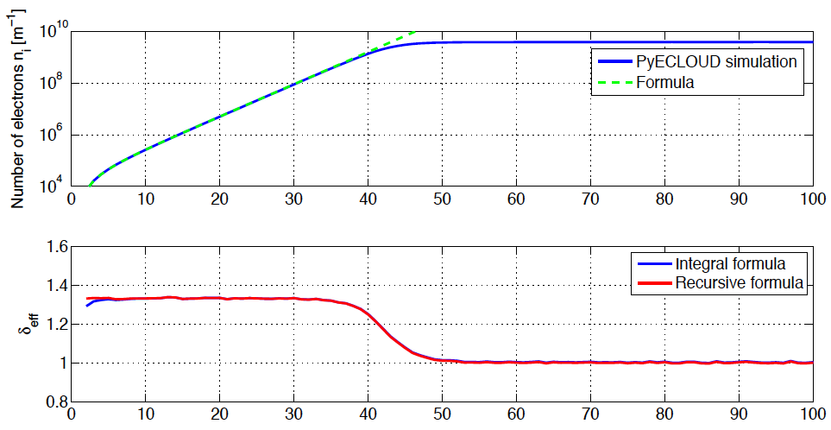
Electron cloud formation:
Application of the model (1)
b=22 cm
Exponential growth
δ_{max}= 1.7
E_{max} = 300 eV
R₀ = 0.6

Slide 62
Electron cloud formation:
Application of the model (2)
b=22 cm
Saturation of the build up
δ_{max}= 1.7
E_{max} = 300 eV
R₀ = 0.6
In saturation, the interaction between electrons becomes important and the electron cloud itself repels the electrons coming from the wall, preventing them from being accelerated in the beam field and producing more secondaries.
In this phase, δ_{eff} decreases until it becomes 1 and the cloud has reached an equilibrium

Slide 63
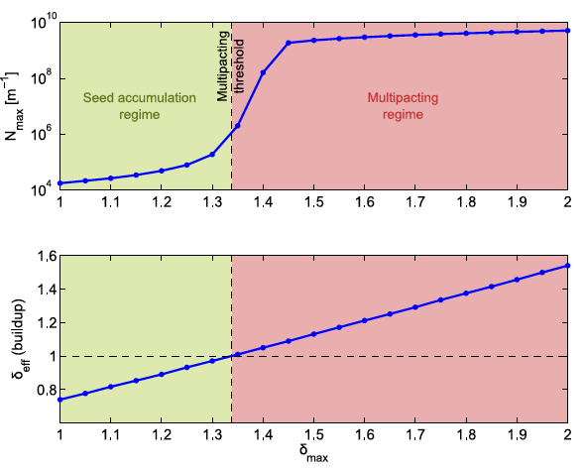
The multipacting threshold
The equilibrium electron densities found in the two cases differ by many orders of magnitude (10⁴ e/m without multipacting and 10⁹ e/m with multipacting)
Between these two cases we do not expect a smooth variation
  Abrupt transition between the two regimes (determined by δ_{eff}=1): multipacting threshold
  The electron density depends on the number of seeds and on δ_{max} when there is no multipacting, while it will hardly depend on either with strong multipacting

Slide 64
The electron distribution
The electrons exhibit different transverse (x,y) distributions, according to the type of region in which the electron cloud is formed
  In field free regions, the electrons tend to spread uniformly across the pipe section (rigorously true only in circular chambers)

Slide 65
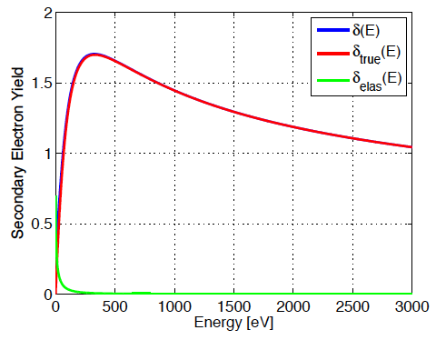
The electron distribution
The electrons exhibit different transverse (x,y) distributions, according to the type of region in which the electron cloud is formed
  In dipole regions, the electron motion is confined along the lines of the magnetic field, and the cloud develops along one central or two side stripes, depending on the beam current and the position of E_{max} in the curve of the SEY.
e⁻
B

Slide 66
The electron distribution
The electrons exhibit different transverse (x,y) distributions, according to the type of region in which the electron cloud is formed
  In dipole regions, the electron motion is confined along the lines of the magnetic field, and the cloud develops along one central or two side stripes, depending on the beam current and the position of E_{max} in the curve of the SEY.
e⁻
B

Slide 67
The electron distribution
The electrons exhibit different transverse (x,y) distributions, according to the type of region in which the electron cloud is formed
  In dipole regions, the electron motion is confined along the lines of the magnetic field, and the cloud develops along one central or two side stripes, depending on the beam current and the position of E_{max} in the curve of the SEY.
e⁻
B

Slide 68
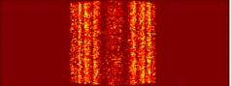
The electron distribution
The electrons exhibit different transverse (x,y) distributions, according to the type of region in which the electron cloud is formed
  In dipole regions, the electron motion is confined along the lines of the magnetic field, and the cloud develops along one central or two side stripes, depending on the beam current and the position of E_{max} in the curve of the SEY.

Slide 69
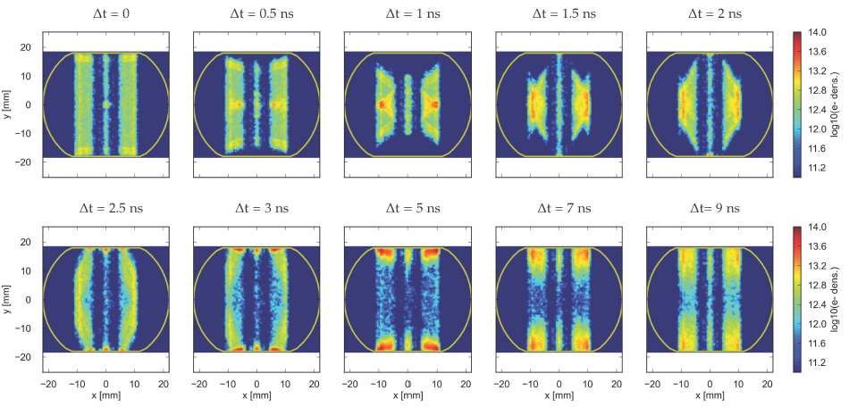
The electron distribution
The electrons exhibit different transverse (x,y) distributions, according to the type of region in which the electron cloud is formed
  In dipole regions, the electron motion is confined along the lines of the magnetic field. Example: snaposhots of multipacting in the dipole of an LHC arc cell during bunch passage and including secondary production.

Slide 70
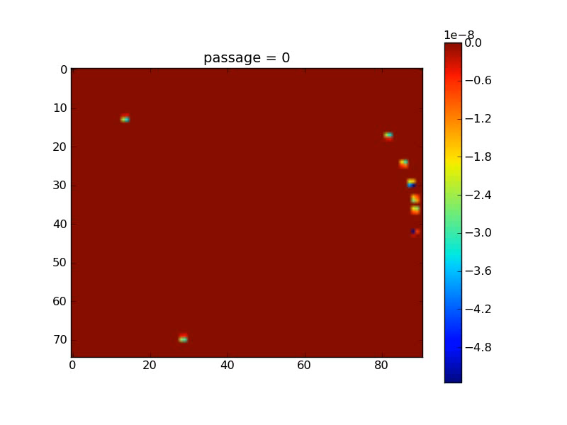
The electron distribution

Slide 71
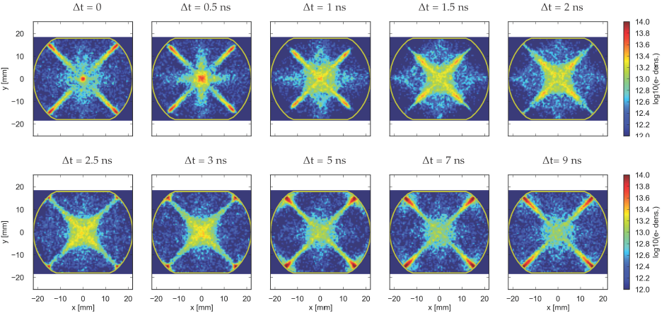
The electron distribution
The electrons exhibit different transverse (x,y) distributions, according to the type of region in which the electron cloud is formed
  In quadrupole regions, the electrons tend to multipact along the pole-to-pole lines of the cross section (example: snapshots of multipacting in an LHC arc quadrupole). Multipacting thresholds are usually lower in quadrupoles because electrons survive long thanks to trapping due to the magnetic gradient.

Slide 72
Effects of the electron cloud
Generation of charged particles inside the vacuum chamber
(primary, or seed, electrons)
Acceleration of primary electrons in the beam field
Secondary electron production when hitting the wall
Avalanche electron multiplication
After the passage of several bunches, the electron distribution inside the chamber reaches a stationary state (electron cloud) → Several effects associated

Slide 73
Effects of the electron cloud
The presence of an electron cloud inside an accelerator ring is revealed by several typical signatures
Fast pressure rise, outgassing
Additional heat load
Baseline shift of the pick-up electrode signal
Tune shift
  Coherent along the train
  Incoherent within the bunch
Coherent instability
  Single bunch effect affecting the last bunches of a train
  Coupled bunch effect
Beam size blow-up and emittance growth
Luminosity loss in colliders
Energy loss measured through the synchronous phase shift
Active monitoring: signal on dedicated electron detectors (e.g. strip monitors), retarding field analysers, shielded pick-ups
Machine observables
Beam observables

Slide 74
Machine observables
Electrons hitting the chamber wall with ‘stationary’ energy spectrum Φ (defined by δ_{eff}=1) are revealed through
1) Dynamic pressure rise
Beam chamber
Outgassing rate: produced gas molecules per unit time and unit length
Bunch spacing
Desorption yield for electrons of the inner wall surface (should be different for different gas species)
n represents the number of electrons present in the chamber at the arrival of bunch i at saturation
The term dn_{mol}/dt is a term of production in the vacuum equations and determines the pressure rise

Slide 75
Machine observables
Electrons hitting the chamber wall with ‘stationary’ energy spectrum Φ (defined by δ_{eff}=1) are revealed through
2) Heat load
Beam chamber
Power deposited on the inner wall per unit length
Bunch spacing
The power deposited on the wall can be quantified
Locally, through temperature rise or reaction from cooling system (significant for cryogenic devices)
Globally, through the stable phase shift, as the power lost by the beam has to be compensated by the RF system

Slide 76
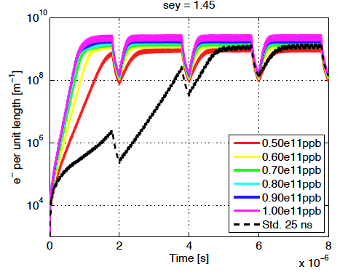
Beam effects along the train
Since the build up happens along the bunch train, the electron cloud becomes visible only from a certain bunch number, i.e. it affects bunches at the tail of the train
Examples
  Coherent tune shift due to the extra-focusing effect of the electron cloud (positive detuning)
  Stable phase shift along the train, as the energy lost by a bunch depends on the density of the electron cloud it interacts with.

Slide 77
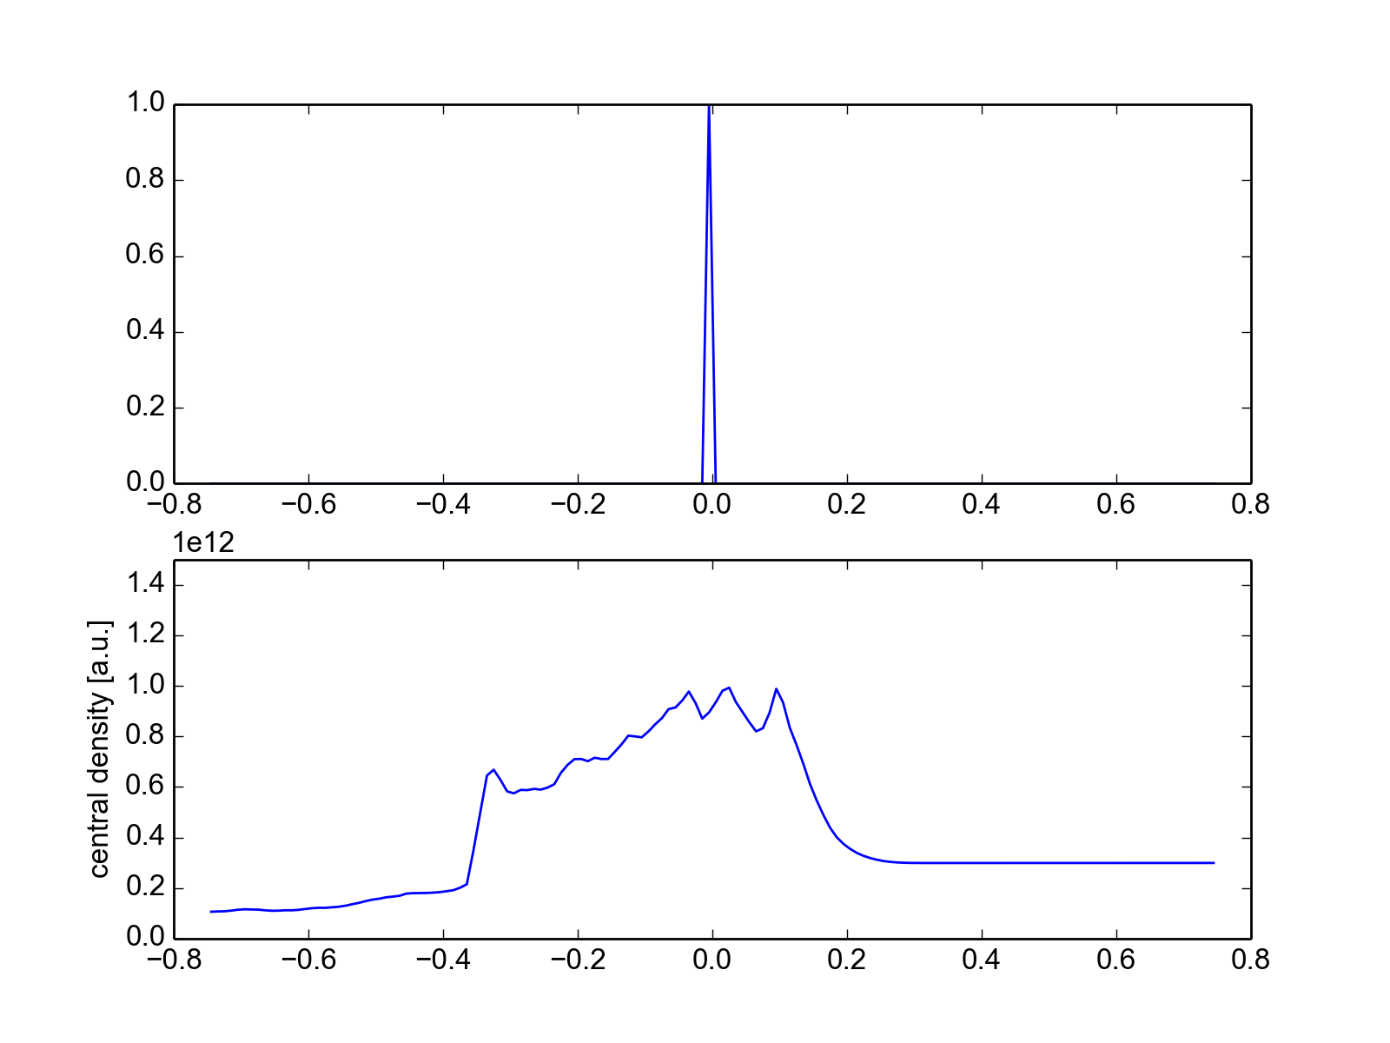
The electron pinch: intra-bunch effects
z-dependent electron density on axis
Tail
Head
When the bunch arrives the electrons are drawn in and perform a fraction, one or more nonlinear oscillations according to their initial amplitudes (electron pinch)
This process results into an increasing electron density seen by particles along the passing bunch (mainly due to the electrons close to the beam → central density is important)
  Can create head-tail coupling
  Can create a z-dependent tune spread along the bunch (tune footprint of the electron cloud).

Slide 78
Single bunch electron cloud instability
y
z
A beam going through an electron cloud focuses the electrons (pinch), so that the central density of electrons changes along the bunch
Since electrons are drawn toward the bunch local centroid, this is the mechanism that can couple head and tail of a bunch
While the bunch is perfectly centered on the pipe axis, the pinch also happens symmetrically and no coherent kick is generated along the bunch

Slide 79
Single bunch electron cloud instability
If the head of the bunch is slightly displaced by an amount Δy_{head} , an asymmetric pinch will take place, resulting into a net kick felt by the bunch tail Δy’_{tail}

Slide 80
Single bunch electron cloud instability
After several turns (passages through the electron cloud), the “perturbation” in the head motion transfers to the bunch tail, and its amplitude may grow under some conditions

Slide 81
Single bunch electron cloud instability
y
z
After a number of turns much larger than the synchrotron period, the unstable coherent motion has propagated to the whole bunch
Intra-bunch motion
Emittance blow up
Examples will be shown in K. Li’s lecture

Slide 82
Coupled bunch electron cloud instability
A similar mechanism can also be responsible for bunch-to-bunch coupling, but it is more complicated because it involves electron motion between bunches (with secondary emission)
Dipoles, through the presence of the stripes, may facilitate this mechanism in the horizontal plane

Slide 83
Electron cloud incoherent effects
y
z
Even when the electron density is not sufficient to drive a head-tail or bunch-to-bunch instability, the electron pinch is the origin of a z-dependent tune spread along the bunch
Particles at the bunch head see the tune shift associated to the unpinched electron cloud, particles at the z locations where the electrons are pinched see the largest tune deviation (at least for a short enough bunch …)
Gives rise potentially to incoherent effects (slow loss, emittance growth)

Slide 84
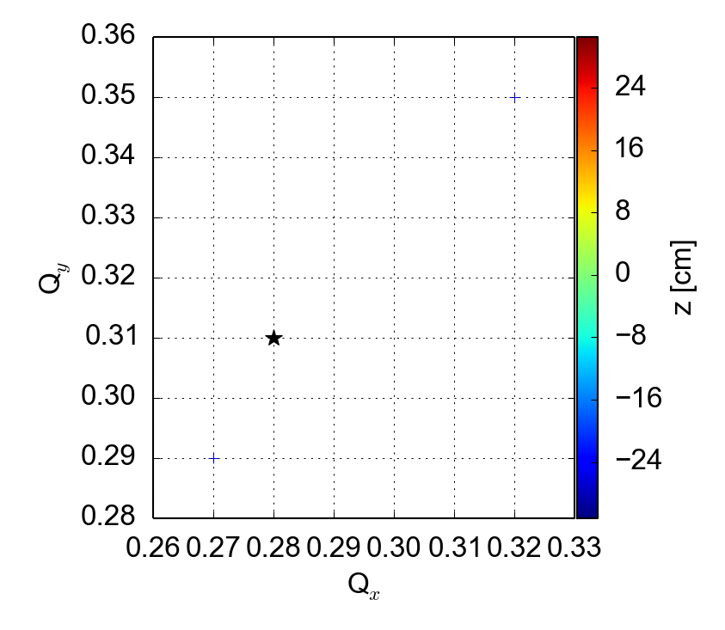
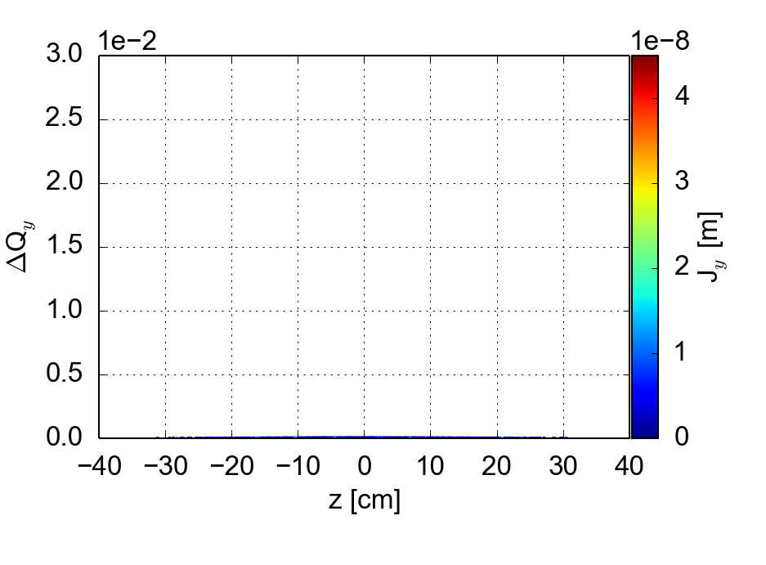
Tune footprint from electron cloud in dipoles
Example: LHC @450 GeV
    LHC nominal intensity 1.15e11 ppb
    Uniform initial distribution of the e-cloud
    The EC density is scanned between 0 and 10e11 e-/m³
No ecloud, Q’= 0/0, octupole current @ 0 A

Slide 85
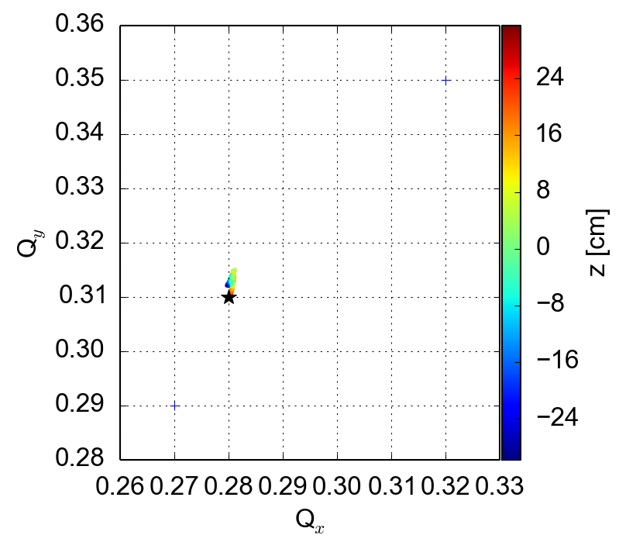

Tune footprint from electron cloud in dipoles
Example: LHC @450 GeV
    LHC nominal intensity 1.15e11 ppb
    Uniform initial distribution of the e-cloud
    The EC density is scanned between 0 and 10e11 e-/m³
2e11 e-/m³, Q’= 0/0, octupole current @ 0 A

Slide 86

density of e- in the middle of the bunch
Every peak of e- density has an higher detuning of particles with smaller Jy

Slide 87


Tune footprint from electron cloud in dipoles
Example: LHC @450 GeV
    LHC nominal intensity 1.15e11 ppb
    Uniform initial distribution of the e-cloud
    The EC density is scanned between 0 and 10e11 e-/m³
4e11 e-/m³, Q’= 0/0, octupole current @ 0 A

Slide 88


Tune footprint from electron cloud in dipoles
Example: LHC @450 GeV
    LHC nominal intensity 1.15e11 ppb
    Uniform initial distribution of the e-cloud
    The EC density is scanned between 0 and 10e11 e-/m³
6e11 e-/m³, Q’= 0/0, octupole current @ 0 A

Slide 89


Tune footprint from electron cloud in dipoles
Example: LHC @450 GeV
    LHC nominal intensity 1.15e11 ppb
    Uniform initial distribution of the e-cloud
    The EC density is scanned between 0 and 10e11 e-/m³
8e11 e-/m³, Q’= 0/0, octupole current @ 0 A

Slide 90

Tune footprint from electron cloud in dipoles
Example: LHC @450 GeV
    LHC nominal intensity 1.15e11 ppb
    Uniform initial distribution of the e-cloud
    The EC density is scanned between 0 and 10e11 e-/m³
10e11 e-/m³, Q’= 0/0, octupole current @ 0 A

Slide 91


Tune footprint from electron cloud in dipoles
Example: LHC @450 GeV
    LHC nominal intensity 1.15e11 ppb
    Uniform initial distribution of the e-cloud
    The octupole is turned on
Q_{H,V}’= 0/0, octupole current @ 20 A
No ecloud
5e11 e-/m³

Slide 92


Tune footprint from electron cloud in dipoles
Example: LHC @450 GeV
    LHC nominal intensity 1.15e11 ppb
    Uniform initial distribution of the e-cloud
    The chromaticity is set to 15/20
Q_{H,V}’= 15/20, octupole current @ 20 A
No ecloud
5e11 e-/m³

Slide 93
Machine observations (historical)
Novosibirsk proton storage ring (1967) Unusual transverse instabilities occurred for bunched and unbunched beams. Model of coupled electron/beam centroid oscillation.
CERN ISR (1970s) Coasting beam instability and fast pressure rise for bunched proton beam.
Los Alamos PSR (1988) Fast instability with beam loss above a threshold current (for bunched and unbunched beams)
KEK PF (1989) Multibunch instability for positron bunch trains.

Slide 94
Machine observations (historical)
CERN 1997
Crash program is launched to study electron clouds because it is suspected that they may endanger LHC operation
SPS and PS (since 1999)
Evidence for electron cloud with LHC type beams (pressure rise, signals at the PUs, instability)
KEKB and PEP-II (1999)
E-cloud induced tune shifts along bunch train and instabilities.
RHIC (2002)
Pressure rise, tune shift, still unexplained instabilities (at transition). Electron detectors installed.

Slide 95
Machine observations (historical)
Tevatron, SNS, DaΦne (2003-2008)
Several signatures of electron cloud, like pressure rise or beam instabilities, are noticed in high intensity operation. Even ANKA suspects electron cloud to justify vacuum degradation and heating in the superconducting wiggler.
Cesr-TA (2008 → 2014)
A program to study specifically electron cloud issues is launched. Thanks to its tunability, the ring is used with positrons to study e-cloud and benchmark simulation codes.
LHC (2010-2015 → …)
Electron cloud appeared first as pressure rise in some common chambers with 150 ns beams. Then also as heat load in cold sectors and beam degradation with 75 and 50 ns (improved by scrubbing). It still dominates beam dynamics with 25 ns beams!

Slide 96
Examples of machine observations: SPS
SPS 2001
The electron cloud signal first appeared in the SPS on the signal from a pick up as a shift of the baseline (depending on the charge collected by the electrodes)
Correlation with train structure, length, gap were immediately apparent.

Slide 97


Examples of machine observations: KEK-LER
Vertical beam size blow up observed with a streak camera
Train head
Train tail
The electron cloud causes beam size blow up (through instability and incoherent effects) that manifests itself at the tail of the bunch train
Above an example of yz beam scan done in the KEK-LER

Slide 98
Examples of machine observations: KEK-LER
Bunch-by-bunch tune shift from the e-cloud:
The electron cloud causes a positive tune shift along the bunch train (if we could measure along the bunch, the tune shift would be also modulated along the bunch)
Above an example tune shift along the train in the KEK-LER, for three different bunch spacings

Slide 99


Examples of machine observations: Cesr-TA
Horizontal and vertical tune shifts along a 46 bunch train in Cesr-TA (Cornell facility presently used for electron cloud studies) taken during a positron run
Dependence on the beam current is shown, clearly pointing to stronger electron cloud for higher currents.

Slide 100

Examples of machine observations: RHIC
The electron cloud measured the Interaction Region (IR) of the BNL-RHIC.
The electron cloud only builds up when both beams come to the IR (requires therefore a shorter bunch spacing than the one in single ring)

Slide 101

Examples of machine observations: LHC
150 ns beams
  Routine operation with 150ns beams started in Summer 2010
  Electron cloud made its first appearance in the common beam pipes, for effectively lower bunch spacings
150 ns - 450 GeV
Beam 1
Beam 2
ΔP₁
ΔP₂

Slide 102



Examples of machine observations: LHC
Day 1 – 300 bunches
Day 3 – 800 bunches
Instabilities and emittance growth observed during the first part of the scrubbing run with 50 ns beams
No significant sign left at the end of the scrubbing

Slide 103
Examples of machine observations: LHC
The slope of the beam average phase shift with intensity has gradually decreased over the period of the scrubbing run with 50 ns beams
The slope Δφ_{s}/ΔN has lost one order of magnitude thanks to scrubbing!

Slide 104


Examples of machine observations: LHC
Some motion only
for last bunches …
~ bunch 25 is the first unstable
up to ±5mm
First injection of 48 bunches of 25 ns beam into the LHC in 2011
Beam was dumped twice due to a violent instability in the vertical plane, causing losses above the interlock threshold

Slide 105

Examples of machine observations: LHC
First injection of 25 ns beams in 2012!
Beam 1 Total Intensity
Beam 2 Total Intensity
Bunch-by-bunch intensity Beam 1
Bunch-by-bunch intensity Beam 2

Slide 106
Examples of machine observations: LHC
Heat load on the beam screen of the cold dipoles
Beam 1
Beam 2
Heat load in Sector 5 – 6

Slide 107

Examples of machine observations: LHC
Bunch-by-bunch phase shift reveals the shape of the e-cloud build up
Larger electron cloud at 4 TeV is due to photoelectrons
11 trains of 72b (25 ns spacing)

Slide 108


Examples of machine observations: LHC
Incoherent losses on trailing bunches due to working point close to third order integer and large tune spread from chormaticity and electron cloud
Cured by moving down the vertical tune
QV =.297
QV =.297
QV =.305

Slide 109



Mitigation/suppression techniques
Tolerate e-cloud, if possible, but damp the instability: feedback system
Clearing electrodes installed along the vacuum chambers (only local, impedance, aperture restriction)
Solenoids (only applicable in field-free regions without equipment)
Machine scrubbing during operation
Limited by reachable SEY
Operation with degraded beam for some time
Possible Solutions
Applying on the wall thin films with intrinsically low SEY
NEG coating (helps vacuum)
C coating (no activation)
Surface roughness to stop secondary electrons
Grooves
Rough material coating
Sponges

Slide 110
Mitigation/suppression techniques
Tolerate e-cloud, if possible, but damp the instability: feedback system
Clearing electrodes installed along the vacuum chambers (only local, impedance, aperture restriction)
Solenoids (only applicable in field-free regions without equipment)
Machine scrubbing during operation
Limited by reachable SEY
Operation with degraded beam for some time
Possible Solutions
Applying on the wall thin films with intrinsically low SEY
NEG coating (helps vacuum)
C coating (no activation)
Surface roughness to stop secondary electrons
Grooves
Rough material coating
Sponges
Outgassing, impedance !!

Slide 111

Mitigation/suppression: Solenoids
Solenoids have been successfully used at the LER of KEKB
Switching them on drastically reduces the beam size blow up as well as the tune shift along the batch

Slide 112

Mitigation/suppression: Solenoids
Also at RHIC the beneficial effect of the solenoids has been observed
By changing the intensity of the magnetic field, the electron cloud could be efficiently suppressed in a region with an electron detector.

Slide 113


Mitigation/suppression: Solenoids
150 ns beams
  Routine operation with 150ns beams started in Summer 2010
  Electron cloud made its first appearance in the common beam pipes, for effectively lower bunch spacings
  Installation of solenoids could suppress the effect through the solenoid field
Solenoid ON
A4L1
Solenoid ON
A4R1
Beam Intensity
After 20 min
ΔP ≈10⁻⁸
After 20 min
ΔP ≈8·10⁻⁹
Remove multipacting
Still primary electrons

Slide 114



Mitigation/suppression: Grooves
zoom
To reduce the effective SEY, the inner surface of the beam pipe can be grooved, so that emitted electrons remain trapped
Figure shows the effective SEY as a function of the groove angle and period, for a sample having δ_{max}=1.74 at E_{max}=330 eV

Slide 115


Mitigation/suppression: Grooves
Once angle and period are fixed, the efficiency of the grooving to reduce the SEY is found to depend on the shape of the tips.
This solution raises the following concerns:
  Impedance enhancement (beam stability)
  Increased surface, which would make pumping more difficult (good vacuum)

Slide 116


Mitigation/suppression: a-C coating
To reduce the effective SEY, the inner surface of the beam pipe can be coated with a-C
It is possible to reach values of δ_{max} below 1, measured in the laboratory …

Slide 117


Mitigation/suppression: a-C coating
To reduce the effective SEY, the inner surface of the beam pipe can be coated with a-C
It is possible to reach values of δ_{max} below 1, measured in the laboratory and also verified by measurements at an electron cloud detector in the SPS

Slide 118


Mitigation/suppression: Scrubbing
Over the two scrubbing runs of LHC with 50 and 25 ns beams in 2015, the SEY was estimated to decrease from 2.3 to ~1.4, and the intensity was ramped up
Scrubbing is fast in the early phase, but it then becomes much slower due to the nature of the process (more scrubbing → less electron cloud → less electron dose)

Slide 119

Mitigation/suppression: Scrubbing
Over the two scrubbing runs of LHC with 50 and 25 ns beams in 2015, the SEY was estimated to decrease from 2.3 to ~1.4
Scrubbing is fast in the early phase, but it then becomes much slower due to the nature of the process (more scrubbing → less electron cloud → less electron dose)

Slide 120

Mitigation/suppression: Scrubbing
Over the two scrubbing runs of LHC with 50 and 25 ns beams in 2015, the SEY was estimated to decrease from 2.3 to ~1.4, and the intensity was ramped up
Fortunately, in LHC we keep scrubbing also while producing physics …
The normalised heat load in the beam screen of the arcs goes steadily down!

Slide 121

Mitigation/suppression: Scrubbing
A direct comparison between a fill at the beginning of the intensity ramp up and just before the end of the proton run (~2 months) reveals clear scrubbing
Heat load in the arcs reduced by 30 to 60% according to the sector!

Slide 122

Mitigation/suppression: Scrubbing
A direct comparison between a fill at the beginning of the intensity ramp up and just before the end of the proton run (~2 months) reveals clear scrubbing
Even more visible in the arc dipoles, where the electron cloud has died out at 450 GeV!

Slide 123

Numerical model of electron cloud effects
s
Multi-bunch beam
Primary and secondary electron production, chamber properties
Noise
Equations of motion of the beam particles
E-cloud build up
x
y

Slide 124
Numerical model of electron cloud effects
s
Multi-bunch beam
Primary and secondary electron production, chamber properties
Noise
Equations of motion of the beam particles
E-cloud build up
x
The instability problem
y
The build up problem

Slide 125
Numerical model of electron cloud effects
Coupled bunch electron cloud instability naturally needs a self-consistent solution of the electron cloud problem
  A broad time scale to cover, cutting edge research
For the moment we simulate the two branches separately (similar to what is done for impedances):
  Electron cloud build up
    Multi-bunch
    Usually single passage, single turn or just few turns
  Electron cloud instability → K. Li’s lecture
    Single bunch
    Multi-turn, or even multi-kick multi-turn
Build up simulation
Instability simulation
Information on how many electrons interact with a bunch:
central density
detailed distribution

Slide 126
Numerical model of electron cloud effects
Coupled bunch electron cloud instability naturally needs a self-consistent solution of the electron cloud problem
  A broad time scale to cover, cutting edge research
For the moment we simulate the two branches separately (similar to what is done for impedances):
  Electron cloud build up
    Multi-bunch
    Usually single passage, single turn or just few turns
  Electron cloud instability → K. Li’s lecture
    Single bunch
    Multi-turn, or even multi-kick multi-turn
Build up simulation
Instability simulation
Information on how many electrons interact with a bunch:
central density
detailed distribution
ECLOUD, PyECLOUD, POSINST, CSEC, …
HEADTAIL, PyHEADTAIL, CMAD, PEHTS, …

Slide 127
Numerical modeling: electron cloud build up
t=t+Δt
Generate seed e⁻
Evaluate the electric field of beam at macroparticles’ location
Evaluate the e⁻ space charge
electric field
Move macroparticles (t → t+Δt)
Detect impacts and generate secondaries

Slide 128
Numerical modeling: electron cloud build up
t=t+Δt
Generate seed e⁻
Evaluate the electric field of beam at macroparticles’ location
  Evaluate the number of seed e⁻ to be generated during the current time step and generate macroparticles:
  Residual gas ionization and photoemission are implemented
  Theoretical/empirical models are used to determine macroparticle space and energy distributions
Evaluate the e⁻ space charge
electric field
Move macroparticles (t → t+Δt)
Detect impacts and generate secondaries

Slide 129
Numerical modeling: electron cloud build up
t=t+Δt
Generate seed e⁻
Evaluate the electric field of beam at macroparticles’ location
  The field map for the relevant chamber geometry and beam shape is pre-computed on a suitable rectangular grid and loaded from file in the initialization stage
  When the field at a certain location is needed a linear (4 points) interpolation algorithm is employed
Evaluate the e⁻ space charge
electric field
Move macroparticles (t → t+Δt)
Detect impacts and generate secondaries

Slide 130
Numerical modeling: electron cloud build up
t=t+Δt
Generate seed e⁻
Evaluate the electric field of beam at macroparticles’ location
  Use of PIC algorithm for e⁻ space charge field
  Poisson equation:
Evaluate the e⁻ space charge
electric field
with
on the boundary
Move macroparticles (t → t+Δt)
  The electric field, given by:
Detect impacts and generate secondaries
  is calculated on the grid points and interpolated at the macroparticles’ positions

Slide 131
Numerical modeling: electron cloud build up
t=t+Δt
Generate seed e⁻
Evaluate the electric field of beam at macroparticles’ location
Evaluate the e⁻ space charge
electric field
Move macroparticles (t → t+Δt)
Detect impacts and generate secondaries

Slide 132
Numerical modeling: electron cloud build up
t=t+Δt
Generate seed e⁻
Evaluate the electric field of beam at macroparticles’ location
  The equation of motion is integrated to update macroparticles’ position and momentum:
Evaluate the e⁻ space charge
electric field
Move macroparticles (t → t+Δt)
  Boris tracker is used for efficiently and accurately dealing with fast cyclotron motion and slow drift in presence of magnetic gradients
Detect impacts and generate secondaries

Slide 133
Numerical modeling: electron cloud build up
t=t+Δt
Generate seed e⁻
Evaluate the electric field of beam at macroparticles’ location
  When a MP hits the wall the SEY model is employed to generate charge of emitted charge. Energy and angle also come from theoretical/experimental models.
  According to the number of emitted electrons, macroparticles can be simply rescaled or new are generated.
Evaluate the e⁻ space charge
electric field
Move macroparticles (t → t+Δt)
Detect impacts and generate secondaries

Slide 134
Numerical modeling: electron cloud build up
Electron cloud build up simulations pose several challenges:
Management of the macroparticle size
  The number of electrons in an electron cloud simulation varies by several orders of magnitude
  The size of macroparticles needs to be adapted during the simulation to keep the number of macroparticles reasonable, but conserving the phase space of the ensemble
Tracking in arbitrary magnetic field configurations and time varying electric fields
Accurate beam field and electron space charge computation
  Due to all the surface effects, the e⁻ dynamics in proximity of the wall is crucial, therefore the electric field calculation must be accurate also close to the EM boundary
CAS – Electron Cloud

Slide 135
Numerical modeling: electron cloud build up
A sample result of simulated build up, plotted as energy deposition on the chamber due to the electrons as a function of the bunch passage

Slide 136

Numerical modeling: electron cloud build up
Simulations can be used to infer the SEY of a surface from heat load measurements in known beam conditions ..

Slide 137

Numerical modeling: electron cloud build up
Data
Simulation
.. or to determine the bunch-by-bunch phase shift

Slide 138

Numerical modeling: electron cloud build up
Data
Simulation
.. or to determine the bunch-by-bunch phase shift

Slide 139
Summary of electron cloud effects
Electron clouds can build up in accelerators operating with beams of positively charged particles in some parameter ranges.
  Several detrimental effects:
    Pressure rise & heat load
    Energy loss, beam instability, poor beam lifetime, emittance blow up
  Mitigation/suppression strategies exist and can be applied to both running and new machines
    Machine scrubbing
    Surface coating with low SEY materials or surface machining
    Solenoids, clearing electrodes
  Well-established numerical models exist to model separately electron cloud build up and beam instability (single bunch)

Slide 140
Thank you for your attention

