Slide 1







SLIM project:
A Stiff Longeron for ITK Modules
Collaboration of:
Valery AKHNAZAROV
Diego ALVAREZ
Christophe BAULT
Andrea CATINACCIO
Daniel DOBOS
Heinz PERNEGGER
Danilo GIUGNI
Franck CADOUX
Noemi CALACE
Yannick FAVRE
Didier FERRERE
Sergio GONZALEZ SEVILLA
Giuseppe IACOBUCCI
Sébastien MICHAL
Maarten WEBER
Eric VIGEOLAS
Didier LAPORTE
Bart VERLAAT
Forum on Tracking Detector Mechanics
June, 15th 2015

Slide 2
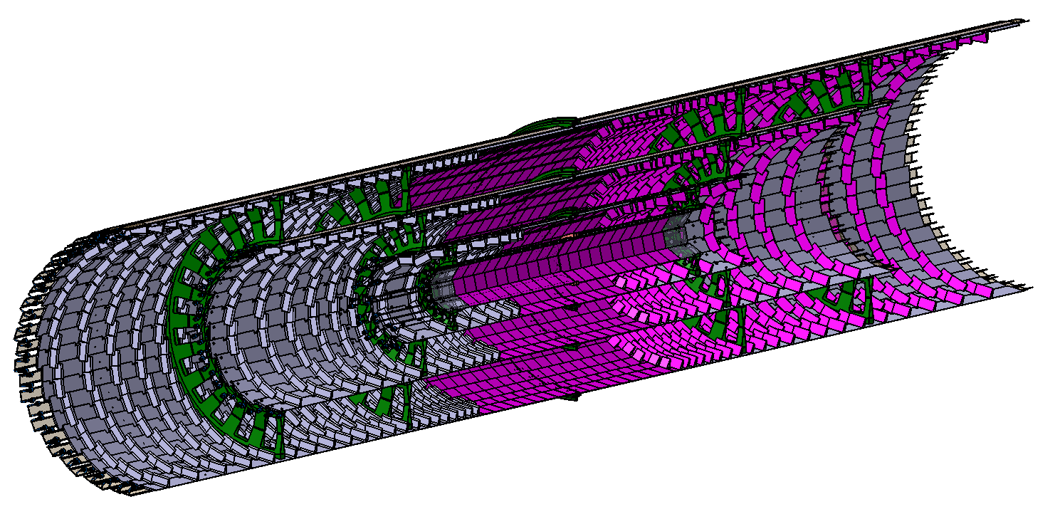
INTRODUCTION
What motivated this new concept?
  Strongly reduce silicon surface with tilted modules (slide 6)
  Less material
  Less heat load
  Less services
  Lower cost
  Modularity
SLIM is compatible with any pixel sensor technology
  Optimization made for most demanding thermal performances
  Now looking into extended layout with SLIM (from layer 3 to 6 and larger η)
ATLAS ALPINE
CMS TRACKER

Slide 3
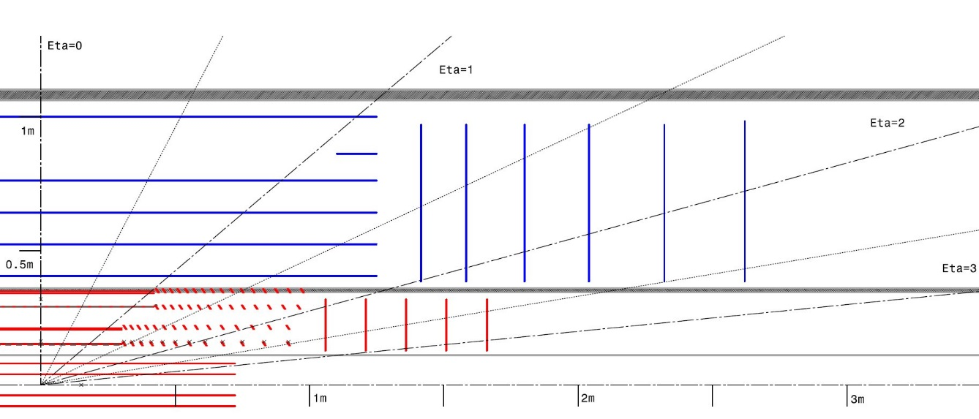
SLIM LAYOUT
ATLAS upgrade tracker layout is not yet fixed
  A 5 layers pixel is the most probable layout for ATLAS ITK
  A 6 layers pixel could be also considered depending on sensor technology
  Pixel staves and disks location are not fixed
  We have considered a conservative two meters long stave at different radii:
  (R=160, 200, 300 and 340 mm)
SLIM implementation
Layers 3 up to 6
Removable layers 1 and 2

Slide 4
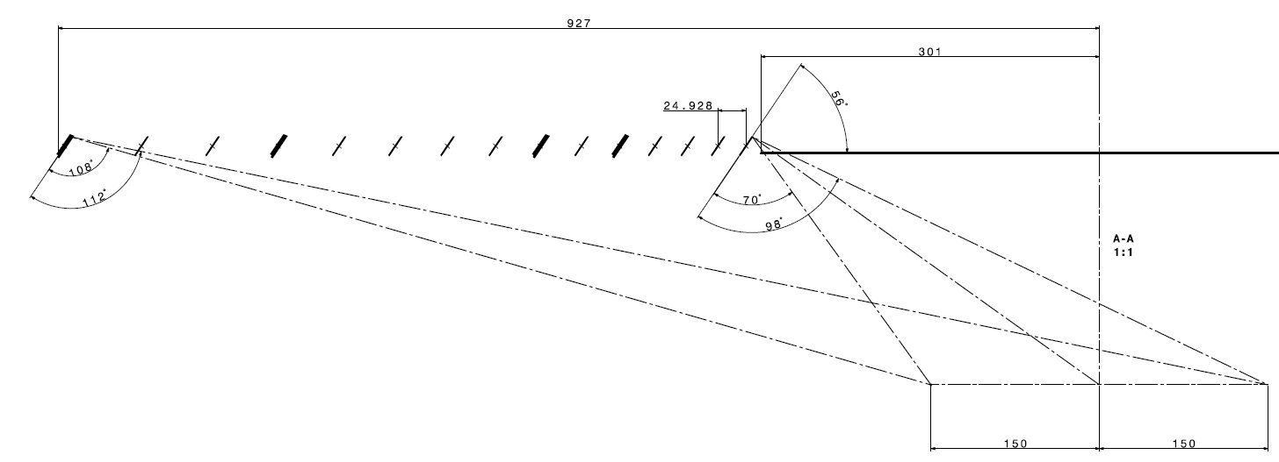
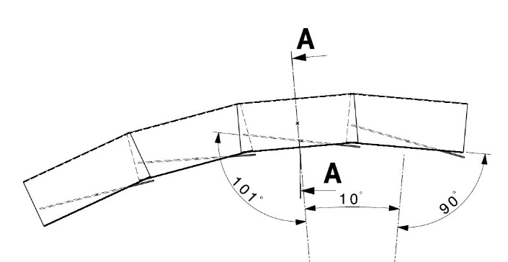
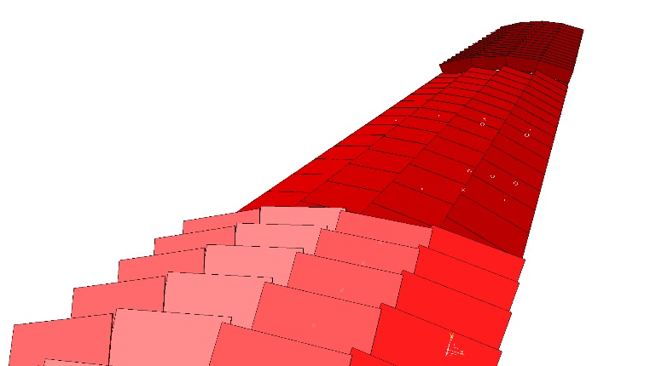
SLIM LAYOUT
Layer 4
Modules implementation
  Layout must be fully hermetic for 1 GeV tracks at IP +- 150 mm
  SLIM layout has barrel modules types (40x40) and tilted modules (20x40mm)
  Transition barrel-tilted: distance between modules >20mm (silicon surface optimized)
  1 angle of 56° for all tilted modules→ rationalize production
    Could be changed with respect to layer: more types of supports
  Barrel module inclined at 11° (Lorentz angle)
  Tilted modules are staggered in Z
Nominal
-4mm
Nominal
IP
Nominal
-4mm
Nominal
Layer 4

Slide 5
SLIM LAYOUT
I-beam concept:
  Combine two layers together for material optimization and mechanichal stability
  Module width variation to couple with the change in radius
SLIM concept:
  Modules implemented on both sides of the carbon structure
  Could also be implemented for a single layer
  Same modules width but different type of structure
    L34: 2 types of longeron
    L56: 3 types of longeron

Slide 6
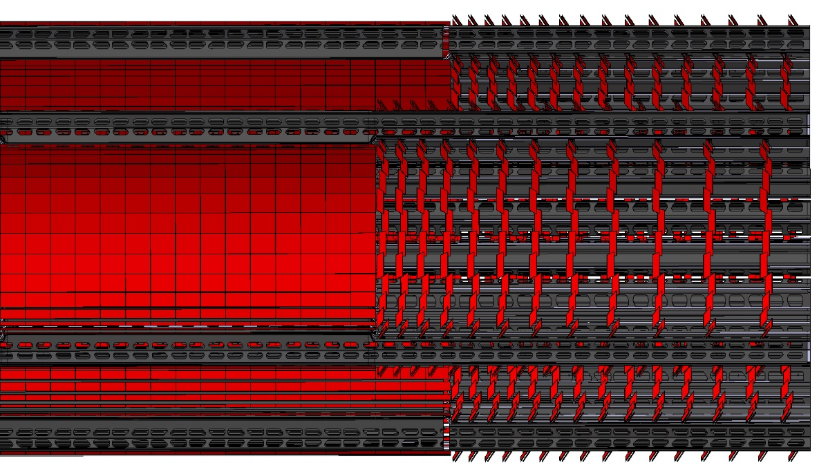
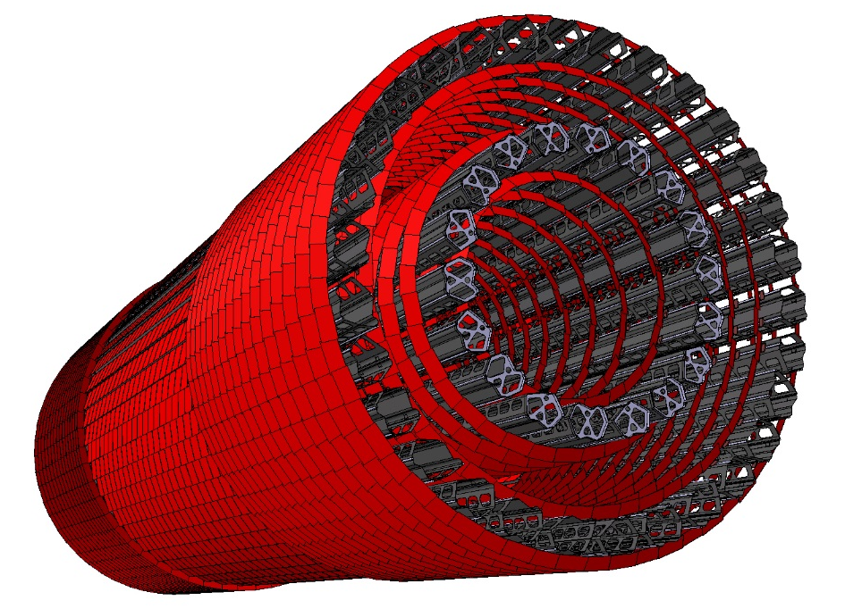
SLIM GLOBAL LAYOUT
 |  | SLIM |  |  |  | CLASSIC
Layers | Radius (mm) | Number of Cooling Lines | Number of tilted modules | Number of Barrel modules | Total SLIM surface (m2) | Number of stave | Stave area (mm²) | Total area (m²) | Ratio | Saved surface (m²) For a 2 m long stave
3rd | 160 | 27 | 24 | 15 | 1.2 | 26 | 80000 | 2.1 | 0.56 | 0.9
4th | 200 | 36 | 30 | 15 | 1.7 | 34 | 80000 | 2.7 | 0.64 | 1.0
5th | 300 | 50 | 28 | 21 | 2.8 | 50 | 80000 | 4 | 0.70 | 1.2
6th | 340 | 60 | 32 | 21 | 3.6 | 57 | 80000 | 4.6 | 0.78 | 1.0

Slide 7

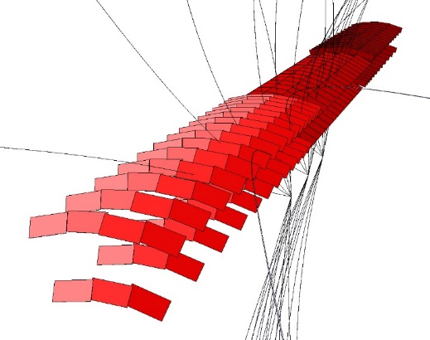
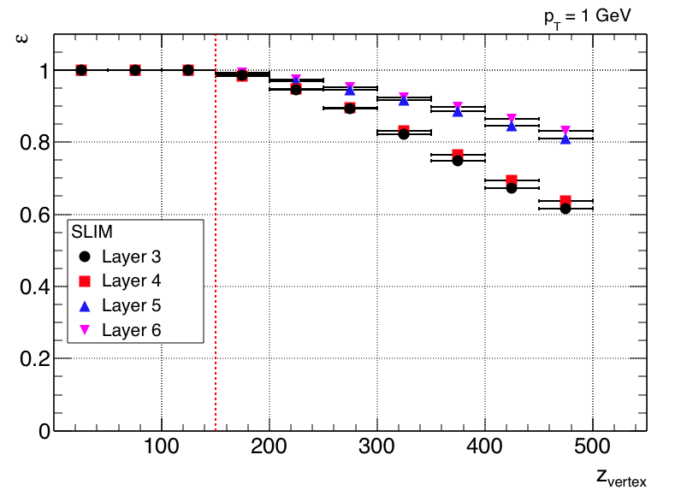
SLIM HERMETICITY
CATIA tracks (first approach validation)
FATRAS simulation (Noemi CALACE, Sergio GONZALEZ SEVILLA)
  Each layer is 100% hermetic with a vertex smearing of +-150 mm
Number of hits

Slide 8

COOLING
Based on:
  Modules distribution from CAD
  A maximum heat flux of 0.5 W.cm⁻²
  240 W total
Pipe inner diameter from Ø2 to Ø2.5 mm
Bart VERLAAT
Pipe 2mm ID

Slide 9
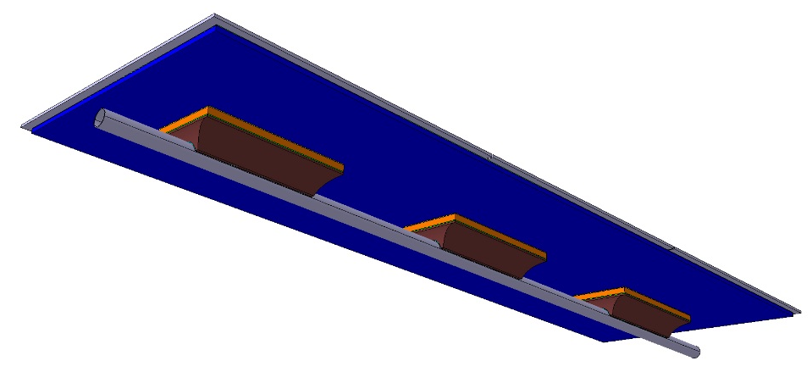
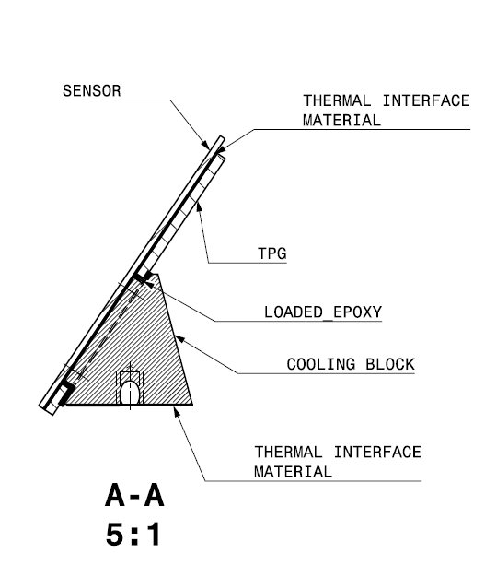
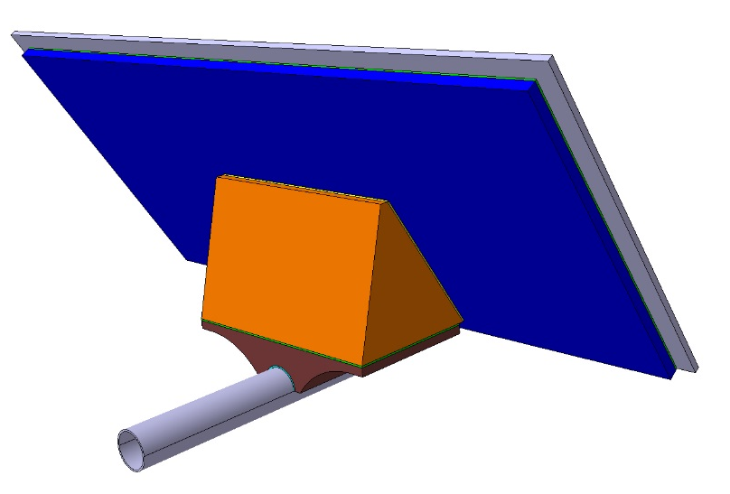
CELL DESIGN
Modularity: cell
Two types: Barrel and tilted cells
Optimized thermal flux between cooling block – Thermal Pyrolitic Graphite (TPG)
Positionning
TPG
Cooling blocks
TPG
SENSOR
Base block

Slide 10
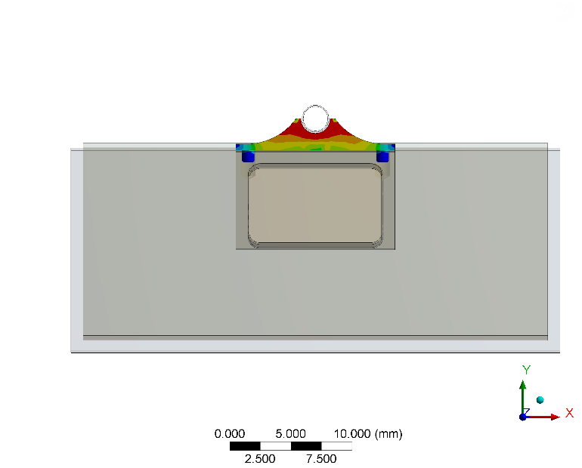
BLOCKS
Must fullfill:
  High thermal performance and low material budget
    Aluminium-carbon composite material
  A precise relative positionning of the two blocks
    Pin and holes (d8/H7)
  An efficient and reversible thermal connection
    Bi-phase material
  A safe mating
    Screw
    Glue dots
    Clip

Slide 11
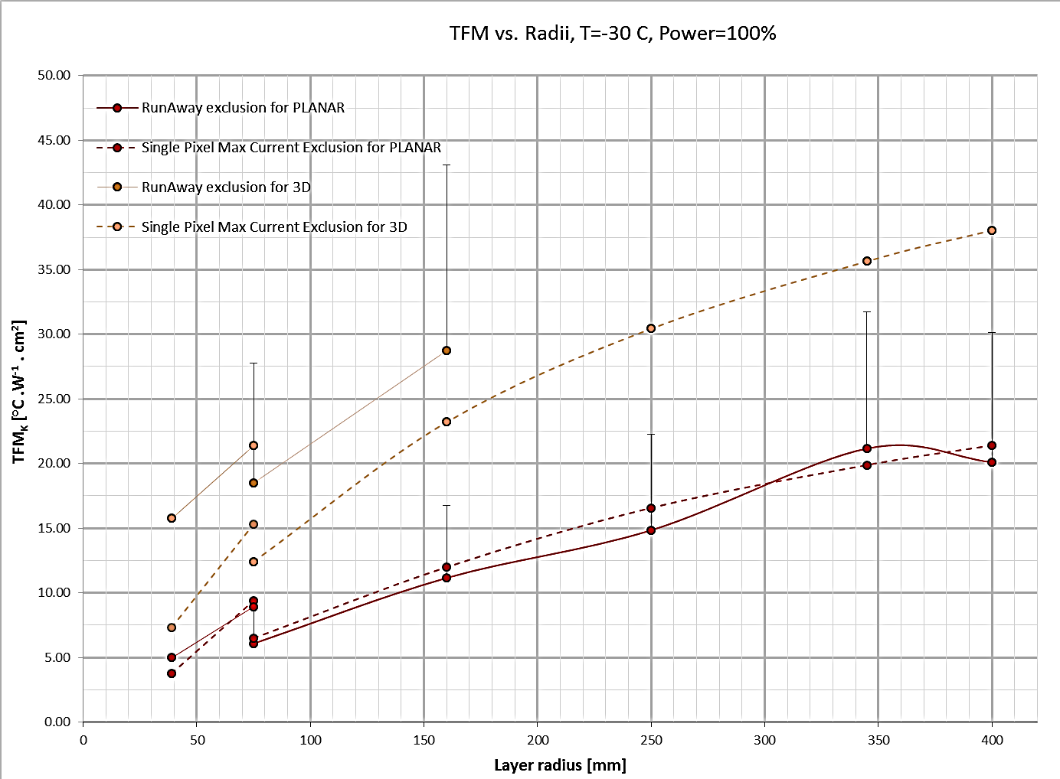

THERMAL FEA
The Thermal Figure of Merit (TFM) is an useful parameter to quote the thermal performances of a local support:
TFM_{TOT} = ΔT/Φ [°C.cm².W⁻¹] where:
ΔT = T_{MAX} –T_{EV}
Φ= Module Heat flow (FE+Sensor)
The TFM has two contributions: conductive and convective
  TFM_{TOT}= TFM_{K}+TFM_{HTC}
Target for planar is a TFM_{k:}
  $14 °C.W^{−1}.{cm}^{2}$ for layer 3-4
  20 $°C.W^{−1}.{cm}^{2}$ for layer 5-6
Danilo GIUGNI

Slide 12
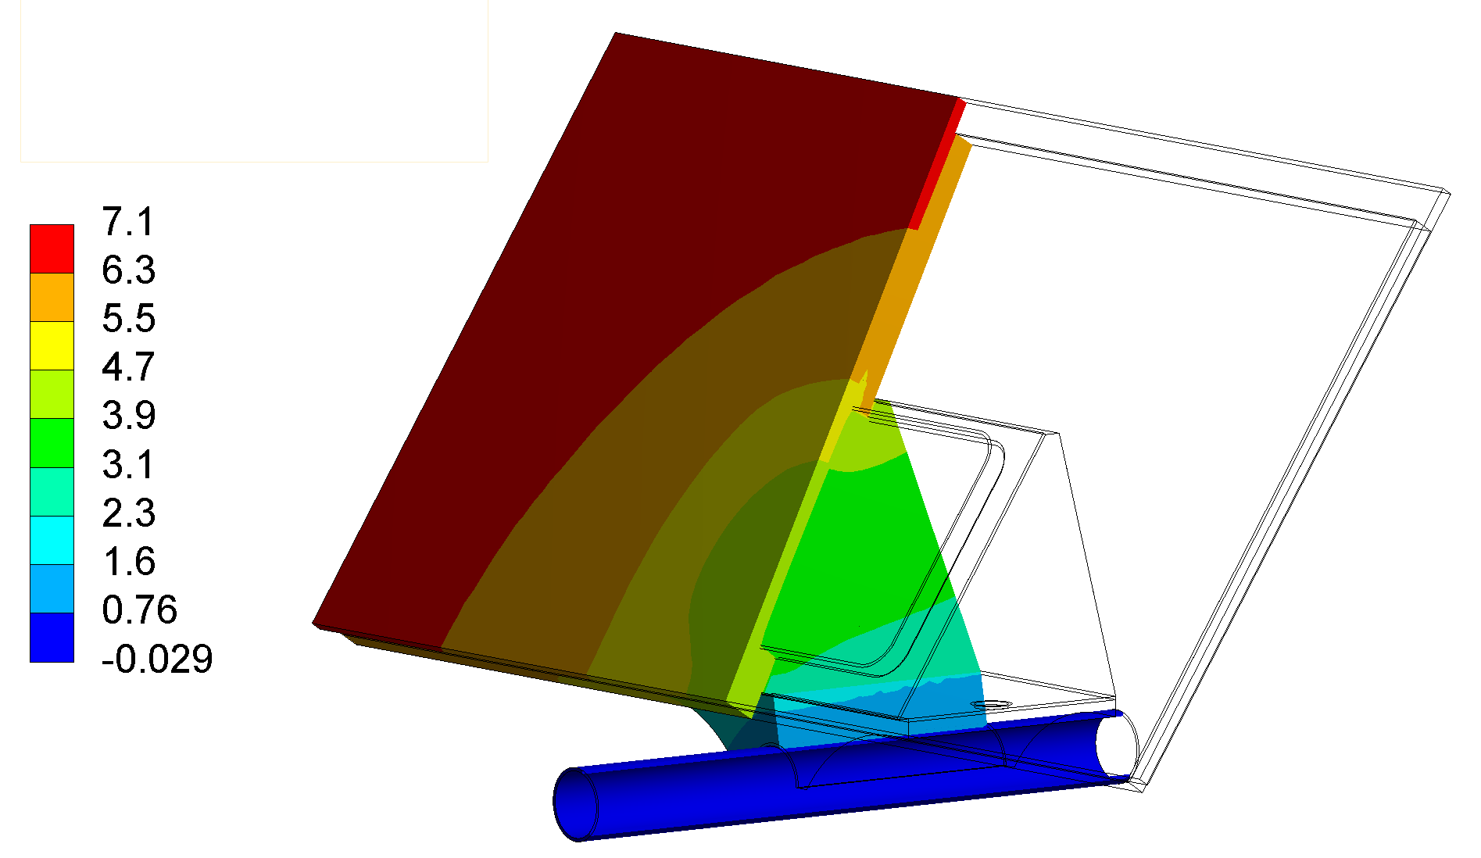
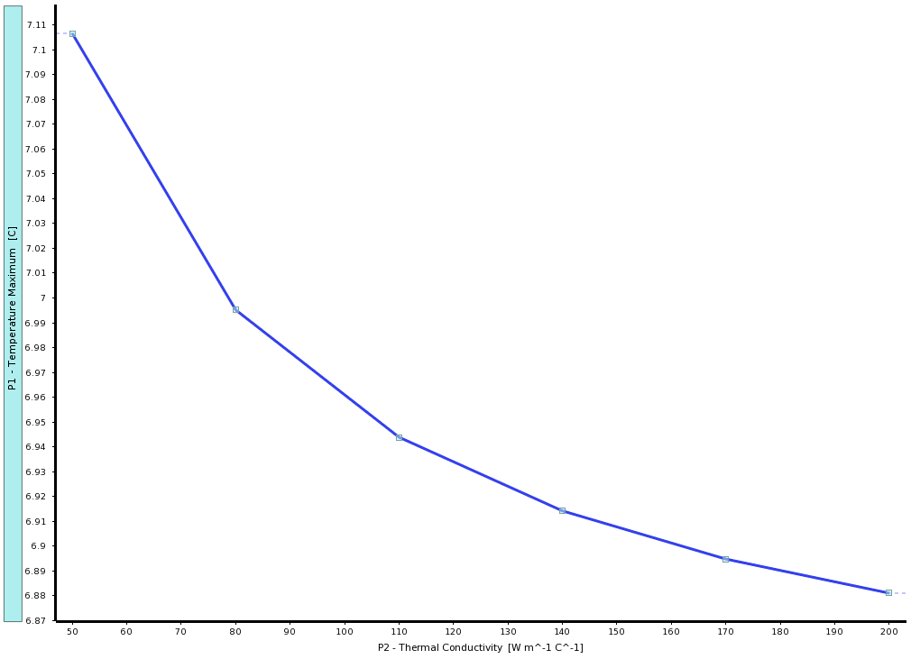
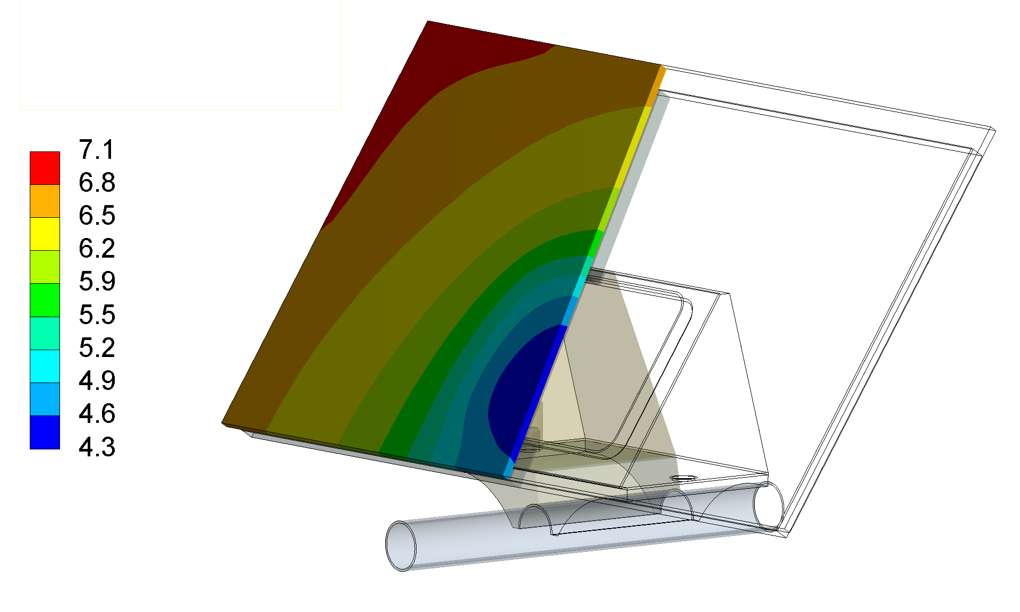

THERMAL FEA
Material | Kx | Ky | Kz
SILICON | 150
TIM | 5
TIM SENSOR | 1.4
COOLING BLOCK | 230 | 230 | 120
LOADED EPOXY | 1.5
TPG | 1500 | 1500 | 15
TITANIUM | 20
SOLDER | 50
$Q=0.5 W.{cm}^{−2}$
$TFM=\frac{7.1°C}{{0.5 W.cm}^{−2}}=14.2 °C.W^{−1}.{cm}^{2}$
Modules ∆T= 2.8 °C
TEMP °C
Sensibility study of the solder joint

Slide 13
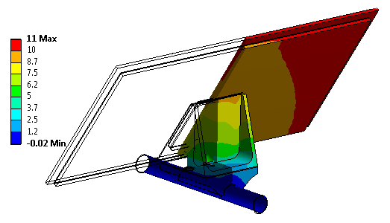
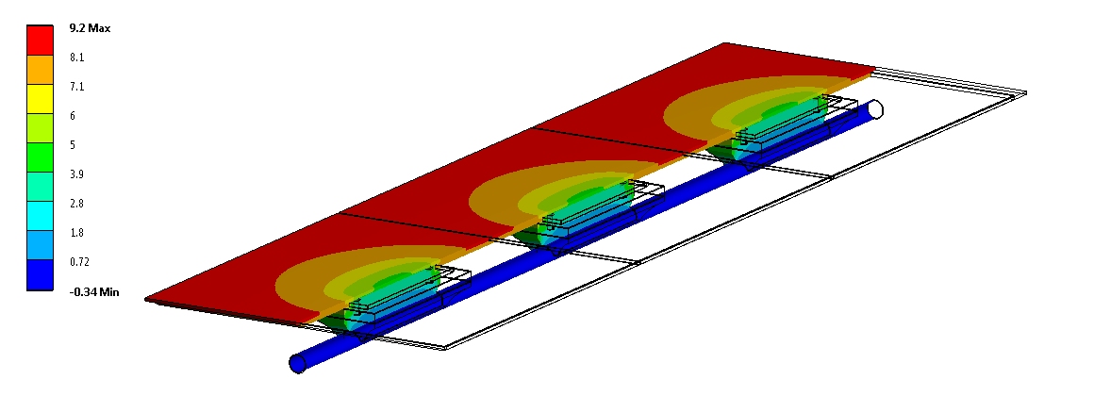


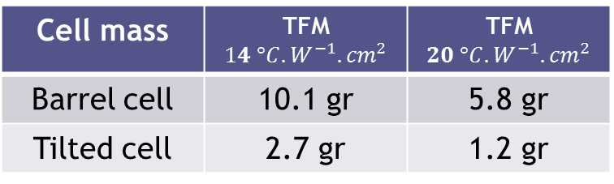

CELL MASS / TFM
What would be a cell mass with a TFM of $20 °C.W^{−1}.{cm}^{2}$ for layer 5-6?
  Thinner TPG (0.6mm→0.4mm)
  Smaller blocks + carbon/carbon composite
$$TFM=22.°C.W^{−1}.{cm}^{2}$$
Cell mass | TFM $14 °C.W^{−1}.{cm}^{2}$ | TFM $20 °C.W^{−1}.{cm}^{2}$
Barrel cell | 10.1 gr | 5.8 gr
Tilted cell | 2.7 gr | 1.2 gr
Structural part of the Cell
TEMP °C
$$TFM=18.°C.W^{−1}.{cm}^{2}$$

Slide 14
CELL MASS / TFM
Layer | Radius | Cooling Line | Modules Tilted | Modules barrel | TFM (°C.W-1.Cm2) | Mass per CL (gr)
3 | 160 | 27 | 24 | 15 | 14 | 157
4 | 200 | 36 | 30 | 15 | 14 | 171
5 | 300 | 50 | 28 | 21 | 20 | 129
6 | 340 | 60 | 32 | 21 | 20 | 137

Slide 15
LONGERON DESIGN
Longeron is made of a single CFRP structure.
K13C fiber [20, -20, 90, -20, 20]
Thickness: 0.325 mm
3 sections (similar to Inner tubes of IBL)
  Straight central section: 560 mm
  2 external section with section transition: 720 mm long
Or straigth section with spacer in the central region
Stiffener are locating along the longeron
Bonding jig will give the overall straightness

Slide 16
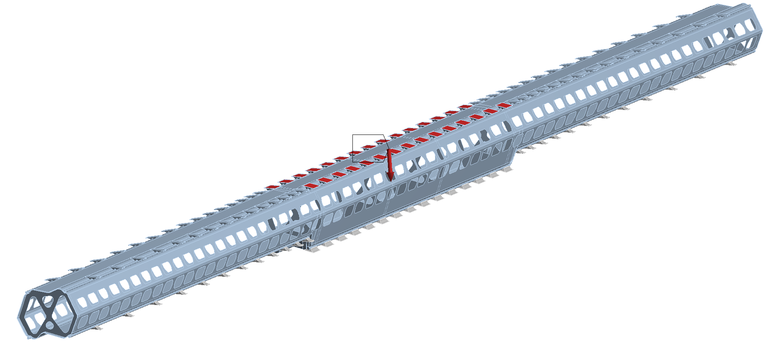
LONGERON MECHANICAL FEA
100 µm deflection requirement
L34 square stave
  3.15 grams per tilted cell
  11.5 grams per barrel cell
Longeron of 2 m and 1.6 m
Length (m) | Barrel top Base block | Barrel bot Base block | Tilted top Base block | Tilted bot Base block
1.6 | 30 3.45 N | 30 3.45 N | 52 1.638 N | 40 1.26 N
2 | 30 3.45 N | 30 3.45 N | 60 1.89 N | 48 1.51 N
Number of base blocks
Corresponding Load
3.45 N

Slide 17


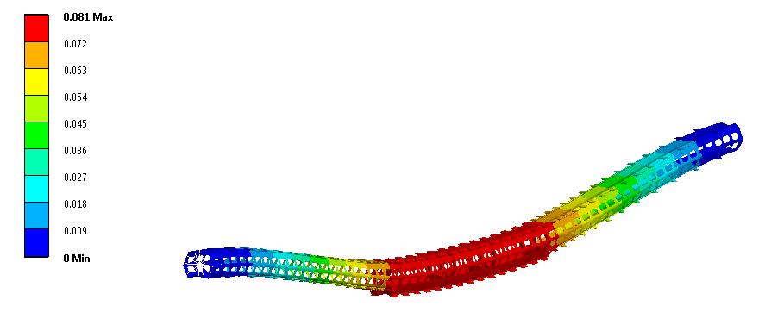
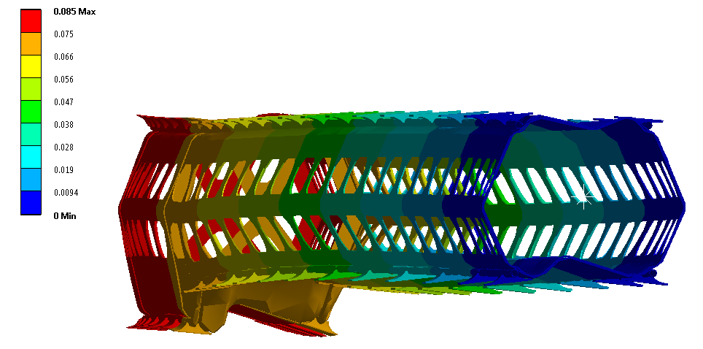
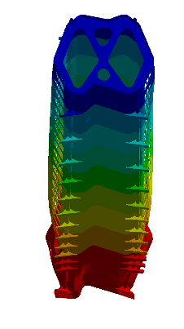
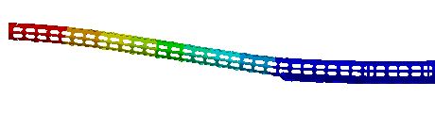
LONGERON MECHANICAL FEA
2 m long stave
K13 plies [20, -20, 90, -20, 20]
0.325 mm thick
LAYUP | Utot SIMPLY SUPPORTED (mm) | Utot FIXED (mm)
[0,45,90,-45,0] | 0.33 0.14 | 0.09 0.05
[20,-20,90,-20,20] | 0.29 0.12 | 0.08 0.04
[90,18,-18,0,-18,18,90] | 0.24 0.09 | 0.07 0.04
81µm
Vertical load
2 m
1.6 m
85µm
Lateral load

Slide 18
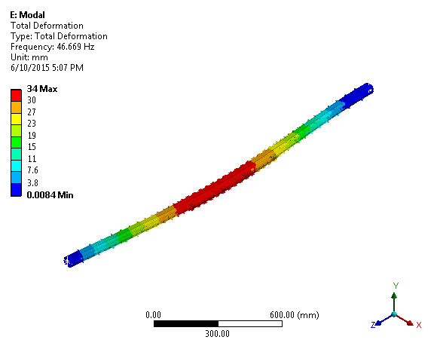
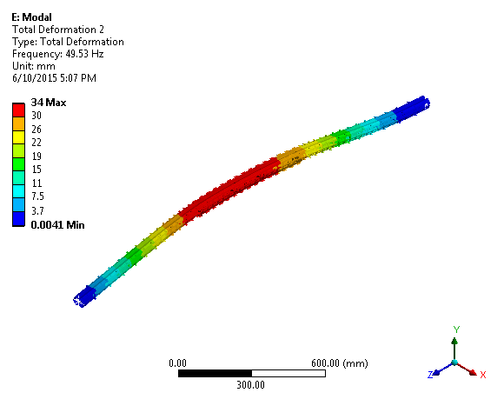
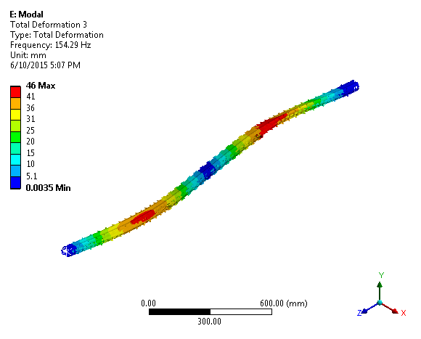
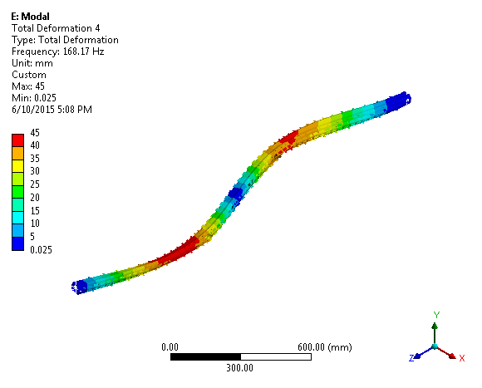
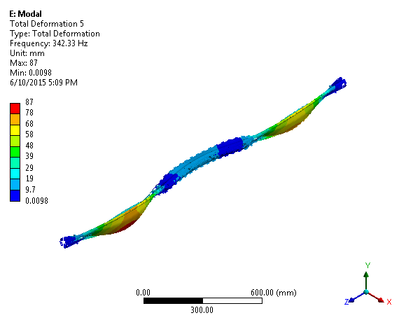
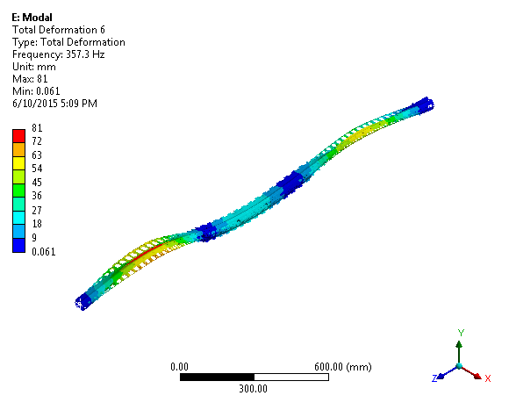
MODAL ANALYSIS
Mode | Frequ (Hz)
1 | 47
2 | 50
3 | 154
4 | 168
5 | 342
6 | 357
Simply supported beam

Slide 19
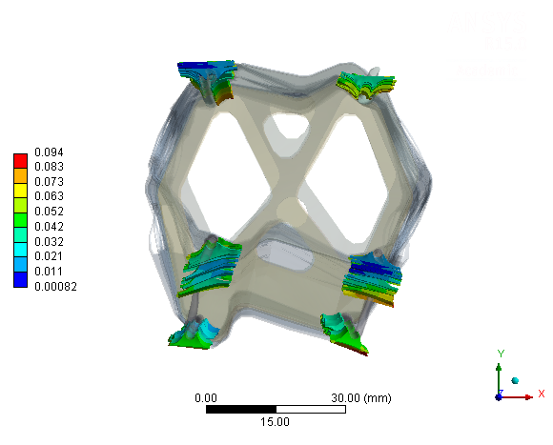
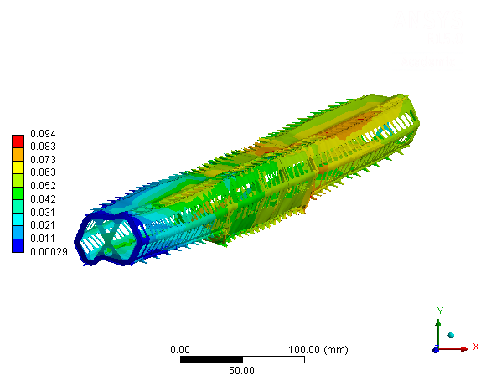
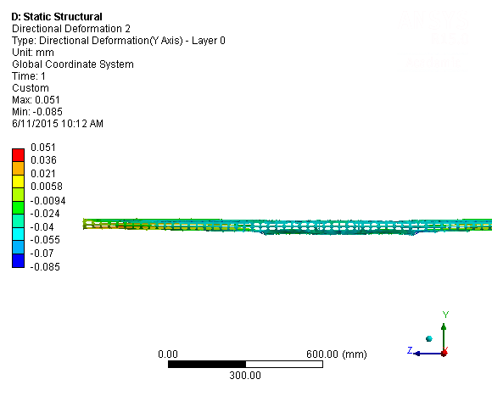
THERMO-MECHANICAL BEHAVIOR
2 m long stave
K13 plies [20, -20, 90, -20, 20]
60°C ∆T
Only thermo-mechanical effect
1.5 µm / °C
Deformation (mm) | U tot | Ux | Uy | Uz
Simply supported | 0.19 | 0.17 | 0.2 | 0.08
Fixed | 0.09 | 0.03 | 0.14 | 0.08

Slide 20
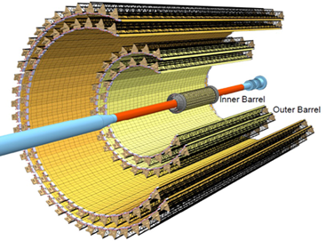
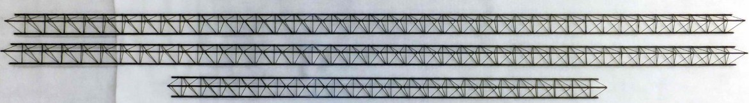
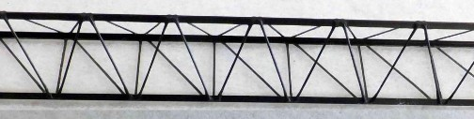
Design Concept: Truss Structure
“Longeron” concept substituted by a CFRP truss structure
  Extremely light and mechanically efficient
  Proven technology (e.g. ALICE ITS)
Module layout identical to current SLIM concept
Initial feasibility studies focus on 5th Pixel layer
  Baseline solution: Thermal management following UniGe philosophy
    Simplified & lighter support structure
  Alternative proposal: Thermal management based on flexible strap
    Modules fixed to structure via CFRP supports (i.e. positioning)
    “Floating” cooling lines (decoupled thermo-mechanical behaviour)
ALICE ITS
PH-DT Engineering office

Slide 21
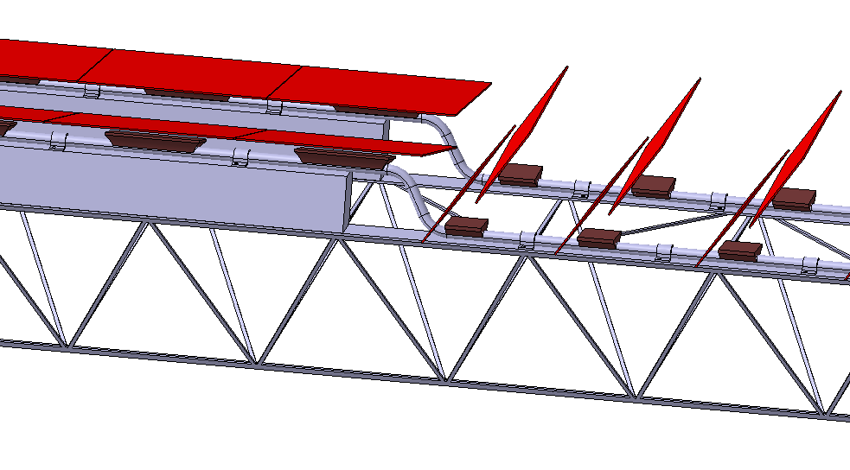
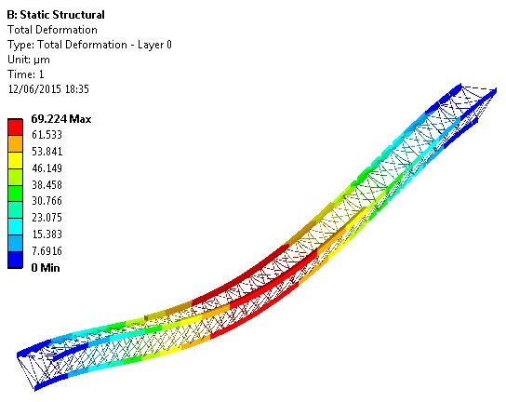
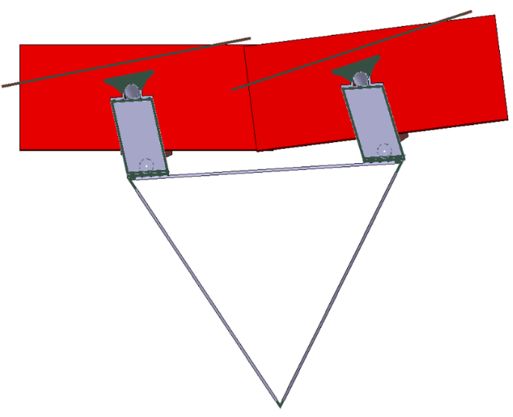
Baseline Solution
Cooling lines + cooling pads attached to truss structure:
  Adhesive bonding (CFRP skin or sandwich to increase area and facilitate bonding)
  Mechanical fixation system
Preliminary FE Analysis
  End vertex fully constrained
  Mass per cooling line: 160g
  Cross members: M55J
  Longitudinal Fibres: K13D
Sandwich structure in the barrel section to accommodate bent pipe
Mass of Truss Structure: ~ 55g
PH-DT Engineering office

Slide 22
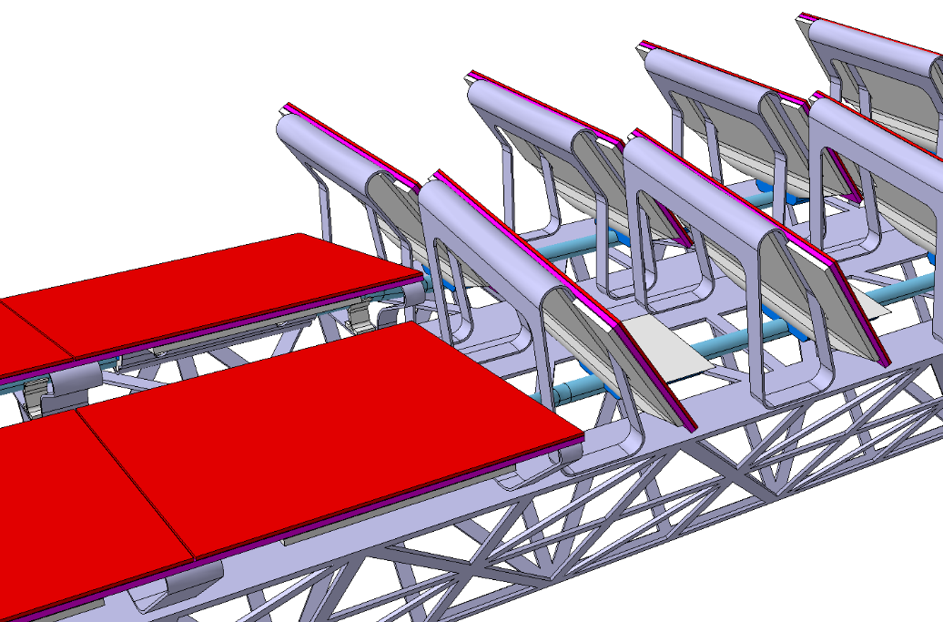
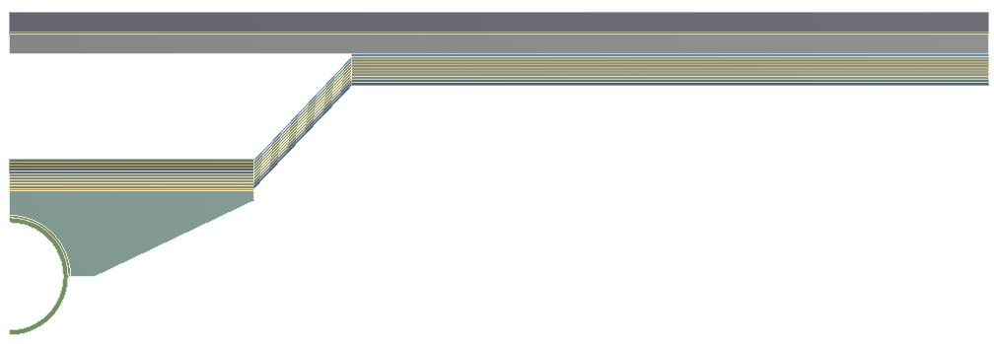
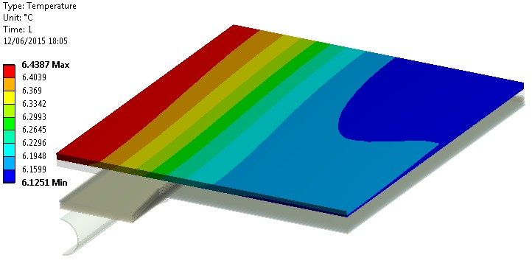
Alternative Solution: Flexible Thermal Strap
Flexible thermal strap for heat management
  TPG plate behind module to minimise ΔT within sensor
  Layered PGS connecting TPG and cooling pads (floating pipes)
Modules positioned on truss structure via CFRP local supports
Prototyping and thermal testing currently underway
  Proof of concept
  Characterisation of thermal interfaces
400µm TPG plate
Layered PGS
Al Cooling pad
PH-DT Engineering office

Slide 23
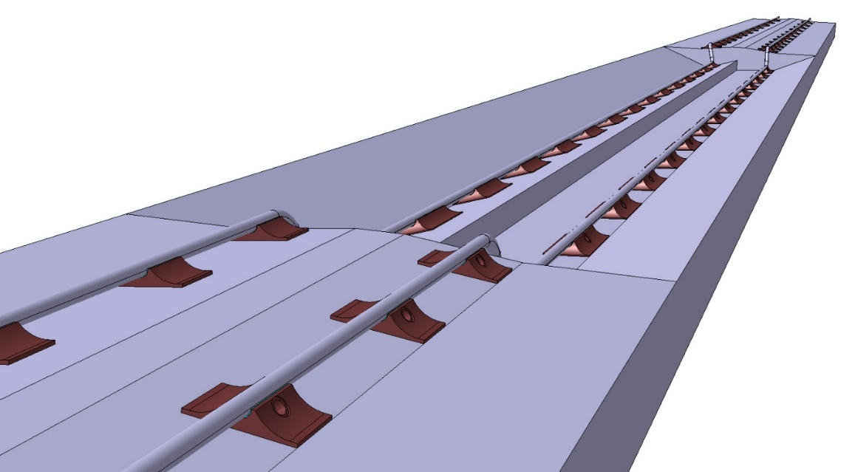
LONGERON ASSEMBLY
Cooling Line soldering
  Jig with base blocks precisely positionned
  CERN central workshop
CL bonding
  Base block and CL bonded to longeron
    Stability and precision of modules location

Slide 24
SLIM services
Stave flex running along the longeron
  Not bonded
Module flex with pigtail
  Flex
    Check the rigidity / shape
  Bundle
Micro connector
Stave flex
Stave flex

Slide 25
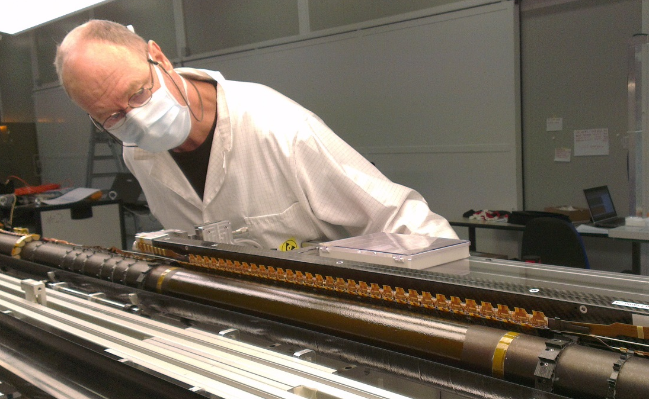
STAVE INTEGRATION
IBL experience on integration stand
Stave extracted radially with a combined kinematic

Slide 26
STAVE INTEGRATION

Slide 27
STAVE INTEGRATION

Slide 28
STAVE INTEGRATION

Slide 29
STAVE INTEGRATION

Slide 30
STAVE INTEGRATION

Slide 31
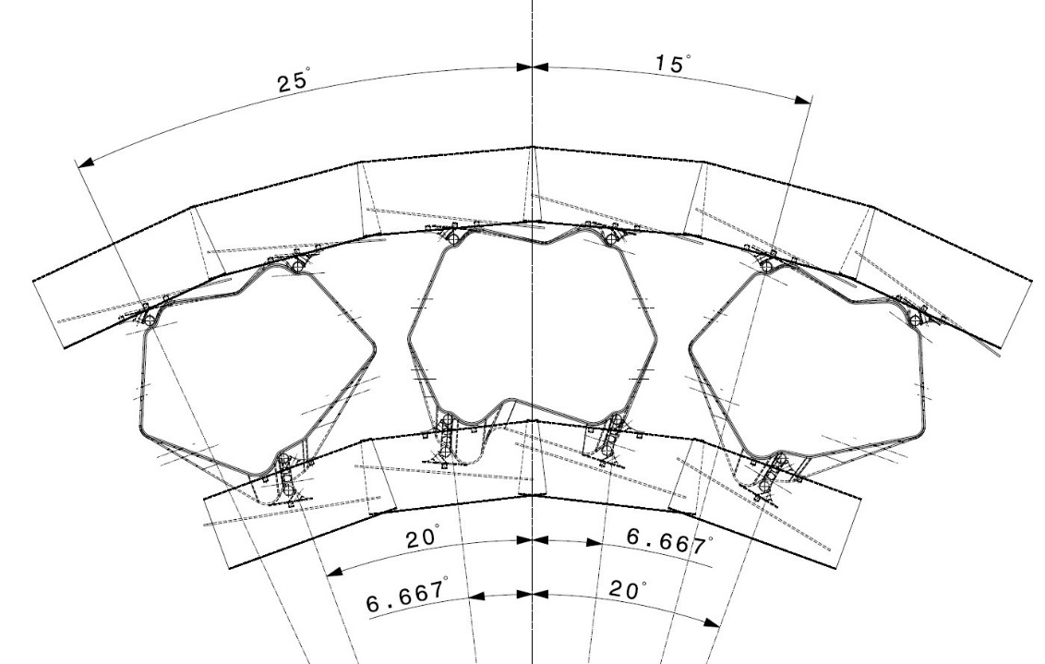
MATERIAL BUDGET
Tool based on CAD geometry developed by our colleague from
https://indico.cern.ch/event/363327/contribution/49
Consider a 2 m long staves of L3/4
  Most demanding TFM
  Without electrical services
Scan from -25 to +15 °

Slide 32
MATERIAL BUDGET IP Z=0
Material budget for two layers
  1.74 % X0 per layer
Cooling block: 50 % of barrel module in Z
Average
3.47

Slide 33
MATERIAL BUDGET IP at Z=+18 mm
Material budget for two layers
  1.05 % X0 per layer
Average
2.11

Slide 34
MATERIAL BUDGET
2m long stave L34
100 % barrel vs slim tilted
Transition barrel/ tilted

Slide 35
MATERIAL BUDGET
SLIM compared to scale IBL
  Radius=164 mm and 2 m long stave
  Only local supports, no silicon
IBL rescale
IBL initial position

Slide 36
Outline of the SLIM concept
Features:
  Adaptive design for outermost layers
    Mass & TFM vs radius
    Sensor type
  High mechanical stability
  High degree of modularity
    Stave and cell module replacement
    Loading eased on smaller object
  Lower surface and consequently lower cost
  Longer staves save material budget at higher eta
  SLIM move the transition between stave to disk at higher eta with low cost of material and silicon surface
To be investigated:
  Mass – to be optimized
  Services design and integration
    Key feature: thermo-mechanical behavior of the flex.

Slide 37
Summary & Future Plan
SLIM is a new Local Support, layout and integration concept
SLIM can be implemented from 3rd up to 6th layers
Concept is compliant with the most demanding requirements
  TFM
  Mechanical stability
  Hermeticity...
Modularity is a plus for integration versus rework
Remaining work
  End flange design
  Longeron optimization
  Integration into pixel
  Service design...
Prototyping plan
  Thermo-mechanical
    Longeron
    Tilted and barrel cells
  Mechanical
    Barrel (integration)
    Cell fabrication and assembly (jig)

Slide 38
THANK YOU FOR YOUR ATTENTION

Slide 39
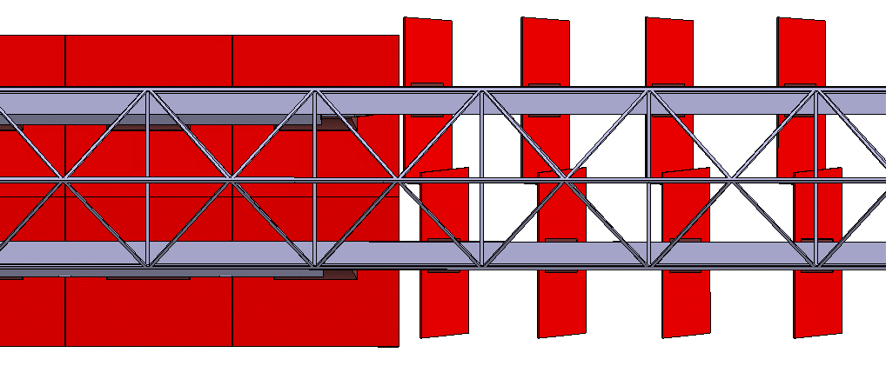


CFRP Truss Structure: Baseline Solution

Slide 40



CFRP Truss Structure: Alternative Solution

Slide 41









Flexible Thermal Strap: ¼ Barrel Module
TFM ~ 11$\frac{℃ {cm}^{2}}{W}$
TFM ~ 11$\frac{℃ {cm}^{2}}{W}$
(0.6W/cm²)
(0.6W/cm²)
TFM ~ 12.3$\frac{℃ {cm}^{2}}{W}$
(0.6W/cm²)

Slide 42
SLIM MASS ESTIMATE
2 m long stave
Based on CAD volume
Mass (gr) | Tilted Cell TFM 14 | Barrel Cell TFM 14 | Titled Cell TFM 20 | Barrel Cell TFM 20
Structural | 2.7 | 10.1 | 1.2 | 5.75
Struct+sensor | 3.5 | 14.6 | 2 | 10.5
LAYER | NUMBER OF SLIM COOLING LINE | TILTED CELL | BARREL CELL
3rd | 27 | 24 | 5
4th | 36 | 30 | 5
5th | 50 | 28 | 7
6th | 60 | 32 | 7
LAYER COUPLE | LONGERON TYPE | NB LONGERON | LONGERON MASS (gr) | BARREL CELL MASS STRUCT PER CL | BARREL CELL MASS PER CL | TILTED CELL MASS STRUCT PER CL | TILTED CELL MASS PER CL | CL MASS | NB OF CL | TOTAL STAVE STRUCT MASS (gr) | TOTAL STAVE MASS (gr) | TOTAL STRUCT MASS PER LAYER | TOTAL MASS PER LAYER
L34 | type1 | 9 | 155.5 | 50.5 | 73.2 | 75.3 | 97.6 | 6.0 | 2 | 661.2 | 834.3 | 5951.1 | 7508.3
 |  |  |  | 50.5 | 73.2 | 64.6 | 83.6 | 6.0 | 2
 | type2 | 9 | 136.0 | 50.5 | 73.2 | 75.3 | 97.6 | 6.0 | 2 | 520.7 | 652.1 | 4686.6 | 5868.8
 |  |  |  | 50.5 | 73.2 | 64.6 | 83.6 | 6.0 | 1
 |  |  |  |  |  |  |  |  |  |  | TOT | 10637.8 | 13377.2
L56 | type1 | 10 | 156.2 | 40.3 | 73.8 | 37.8 | 63.2 | 6.0 | 2 | 482.8 | 712.1 | 4828.0 | 7121.0
 |  |  |  | 40.3 | 73.8 | 33.1 | 55.3 | 6.0 | 2
 | type2 | 10 | 140.5 | 40.3 | 73.8 | 37.8 | 63.2 | 6.0 | 2 | 467.1 | 696.4 | 4670.6 | 6963.6
 |  |  |  | 40.3 | 73.8 | 33.1 | 55.3 | 6.0 | 2
 | type3 | 10 | 105.3 | 40.3 | 73.8 | 37.8 | 63.2 | 6.0 | 2 | 352.6 | 526.1 | 3525.6 | 5261.2
 |  |  |  | 40.3 | 73.8 | 33.1 | 55.3 | 6.0 | 1
 |  |  |  |  |  |  |  |  |  |  | TOT | 13024.1 | 19345.8

Slide 43

MATERIAL BUDGET Z=0
How minize the material impact of cooling block
  Aluminium-Carbon Fiber composite
  Carbon-carbon composite
  Al-Diamond
  Al-Be
Material | Kx (w.m-1.k-1) | Ky | Kz | X0 (mm)
Al-Cf | 220 | 220 | 120 | 139
CC2D | 250 | 250 | 10 | 218
Al-Diamond | 400-450 |  |  | ?
Al-Be | 210 |  |  | 243.8

