Slide 1
High Power IOTs
Chiara Marrelli
Morten Jensen
www.europeanspallationsource.se
2nd Eucard-2 Annual meting, Barcelona, 23 April 2015

Slide 2
The Inductive Output Tube
Invented in 1938 by Andrew V. Haeff as a source for radar
To overcome limitation of output power and efficiency by grid and anode interception
The energy of the electron beam is extracted trough a resonant cavity
Achieved: 100 W at 450 MHz, 10 dB power gain and 35% efficiency
Used first in 1939 to transmit television images from the Empire State Building to the New York World Fair
IOTs then lay dormant
  Intense competition with velocity modulated tubes (klystron had just been invented by the Varian brothers)
  Difficult to manufacture
  Low gain
The IOT is often described as a cross between a klystron and a triode hence Eimac’s trade name ‘Klystrode’

Slide 3
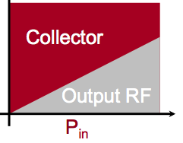

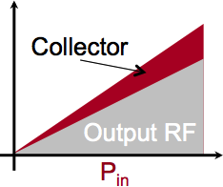
The Main Principles
Klystron
(Velocity modulated)
RF input
RF output
Cathode
(DC Beam)
Collector
IOT
(Density modulated)
RF input
Biased Control Grid
RF output

Slide 4
IOTs highlights
The current also depends on the grid voltage.
As a result, the tube does not saturate as fast as a klystron
High efficiency at point of operation
Efficiency drops slowly at reduced output power
Good Linearity
Because there is no velocity modulation, extraction efficiency can be high (small velocity spread in the beam): 70-75% are typical values
The device is short, so pushing factor is small
Collector only ever handles spent RF beam (e.g. at Eff. 50% P_{Coll} = RF power)
Good for machines which require the amplifier to operate at different power levels
  varying power loads
  Non uniform power profiles
  Margins for overhead for regulation
  One-to-one relationship with amplifier to accelerating structure
Proton Linacs in particular can benefit and circulating machines with high regulation requirements
Drawbacks: Gain is low (20-23 dB). This is a smaller problem than a few years ago thanks to the improvement in solid state technology.
Frequency is limited to about 1.3 GHz

Slide 5
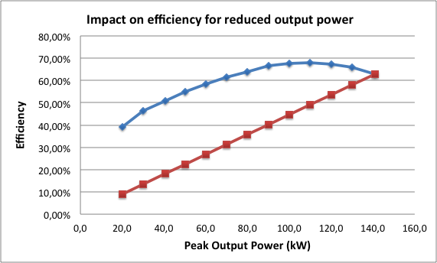
Efficiency comparison of Klystrons and IOTs
IOT measurements courtesy of M. Boyle, L3
Based on broadcast IOT L-4444
System setup limited by drive power and beam voltage
IOT setup for maximum gain (not efficiency) without breakdown
IOT
Difference represents the power saving
Klystron
Klystron assumed to have same saturated efficiency as the IOT
No optimisation of coupling, voltages, perveance for different power levels

Slide 6
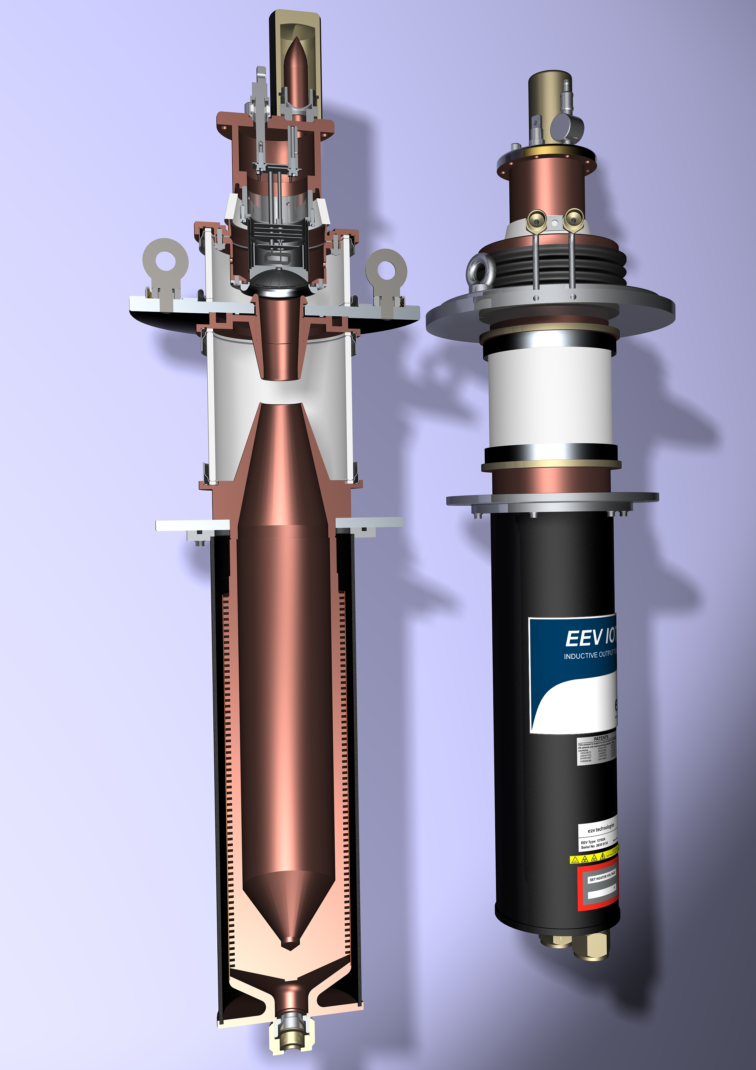
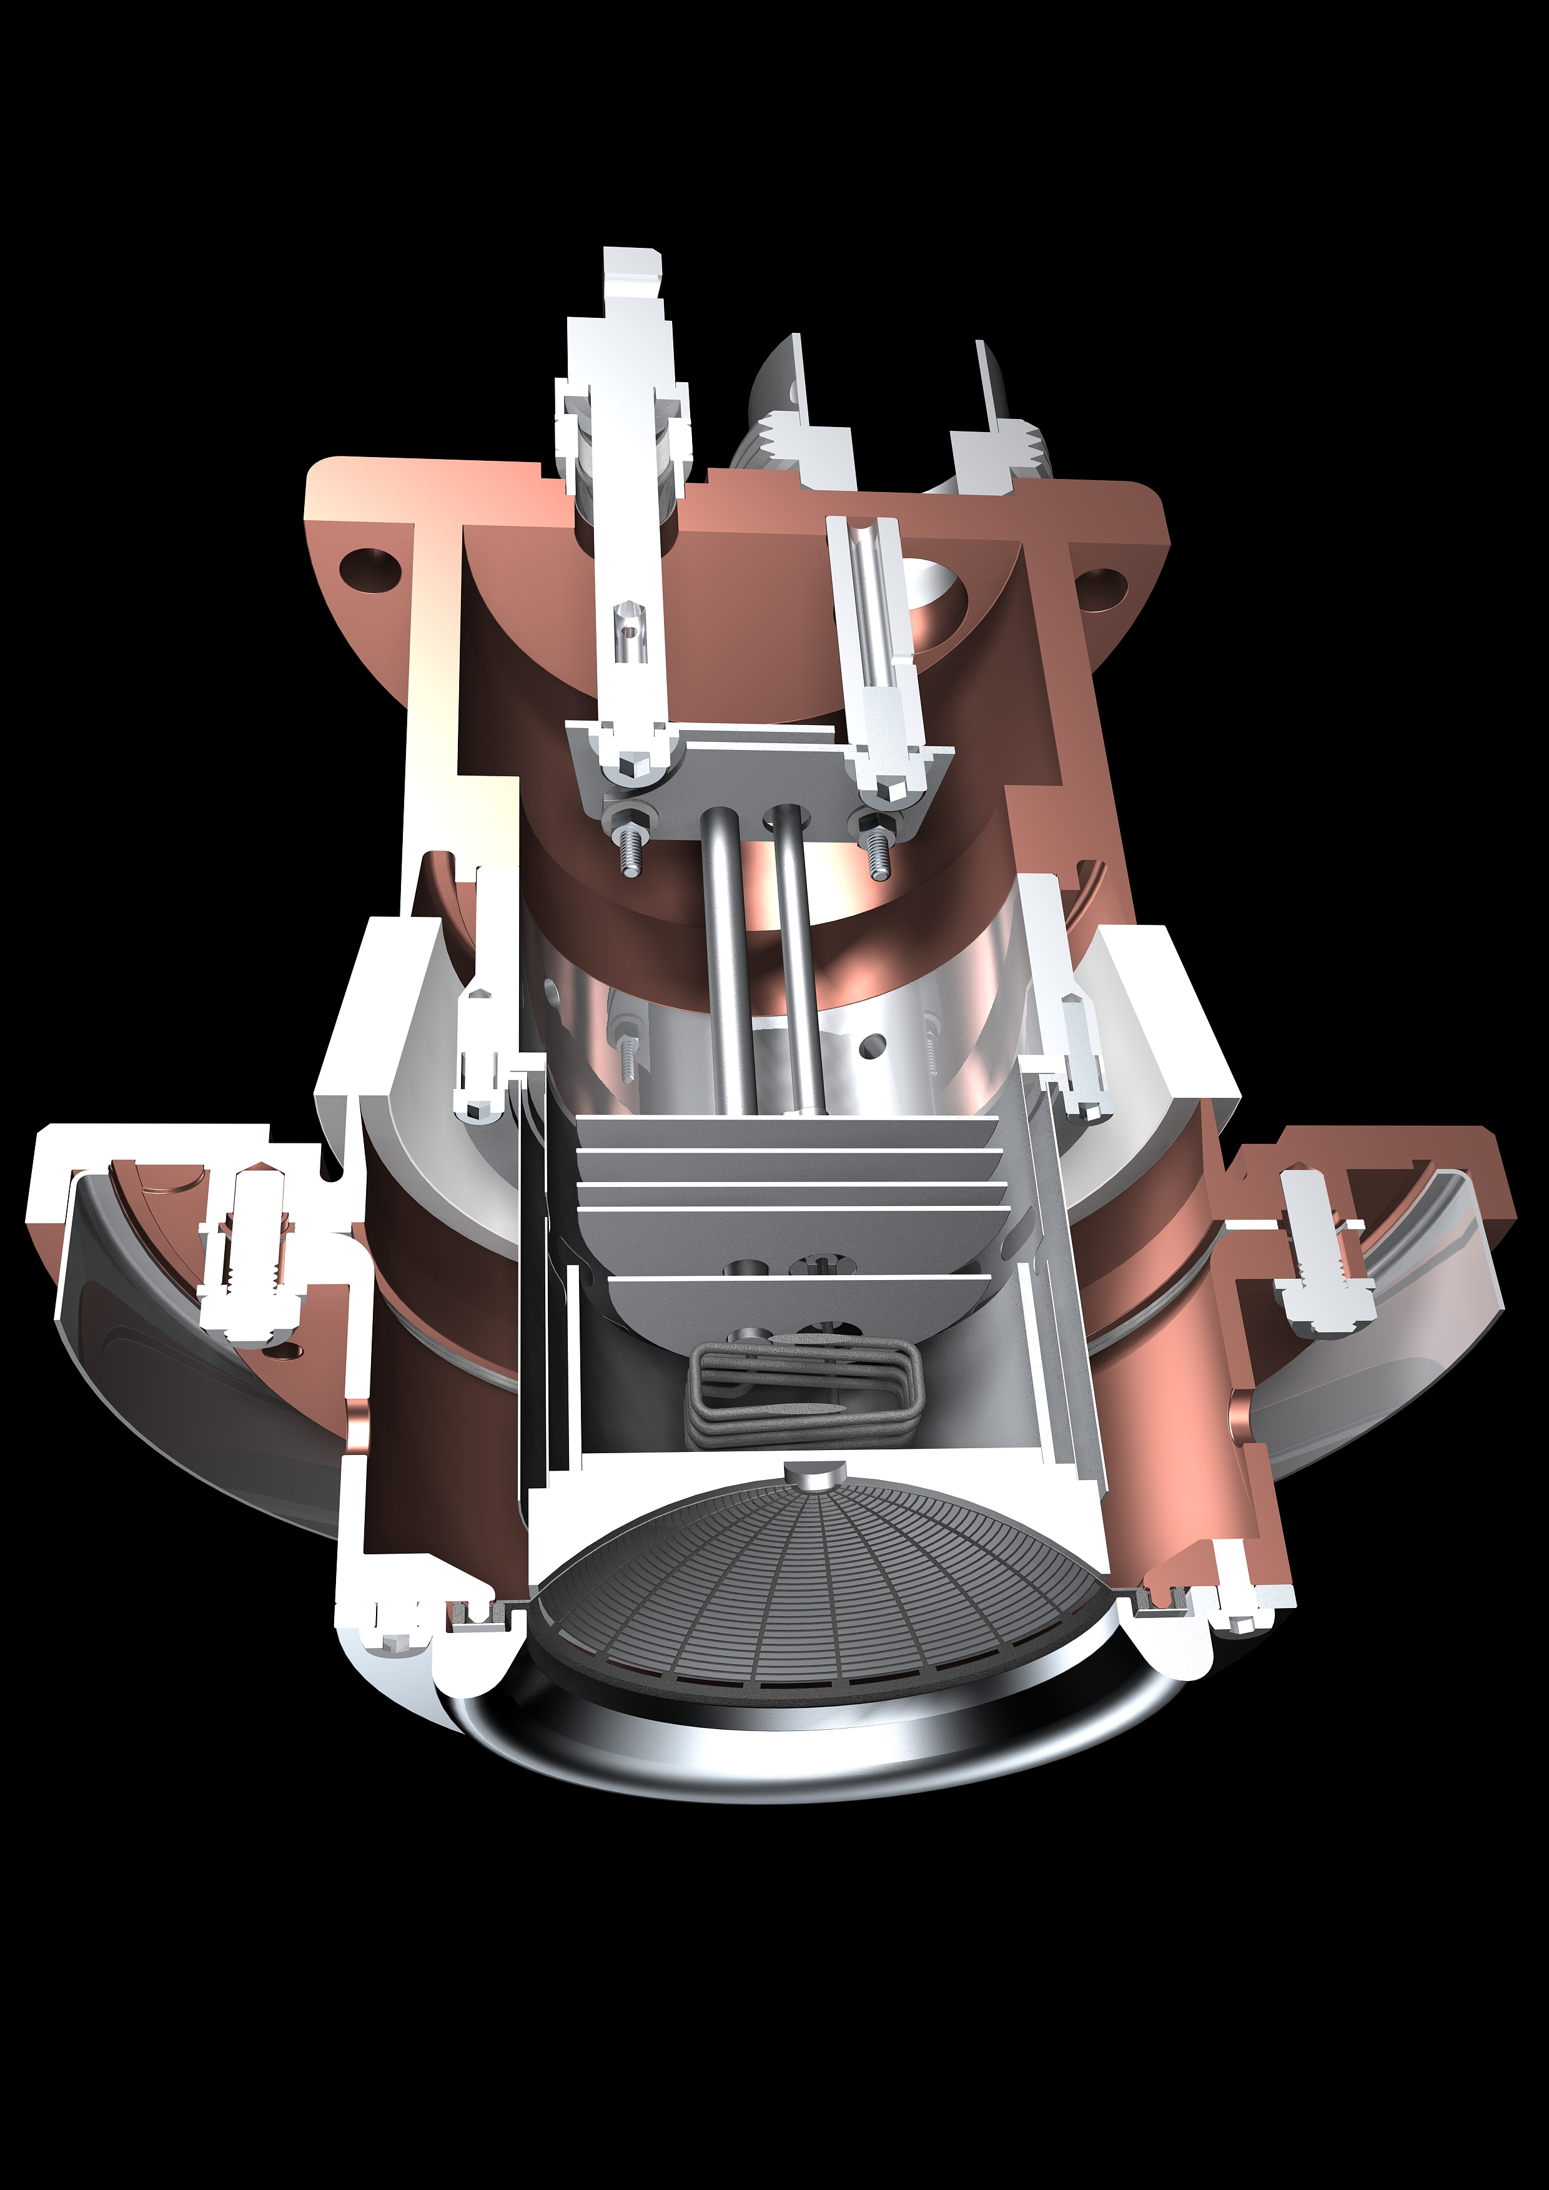
Typical Broadcast IOT
Courtesy of e2v
Output ceramic. External output cavity is not shown
Cathode-grid assembly

Slide 7
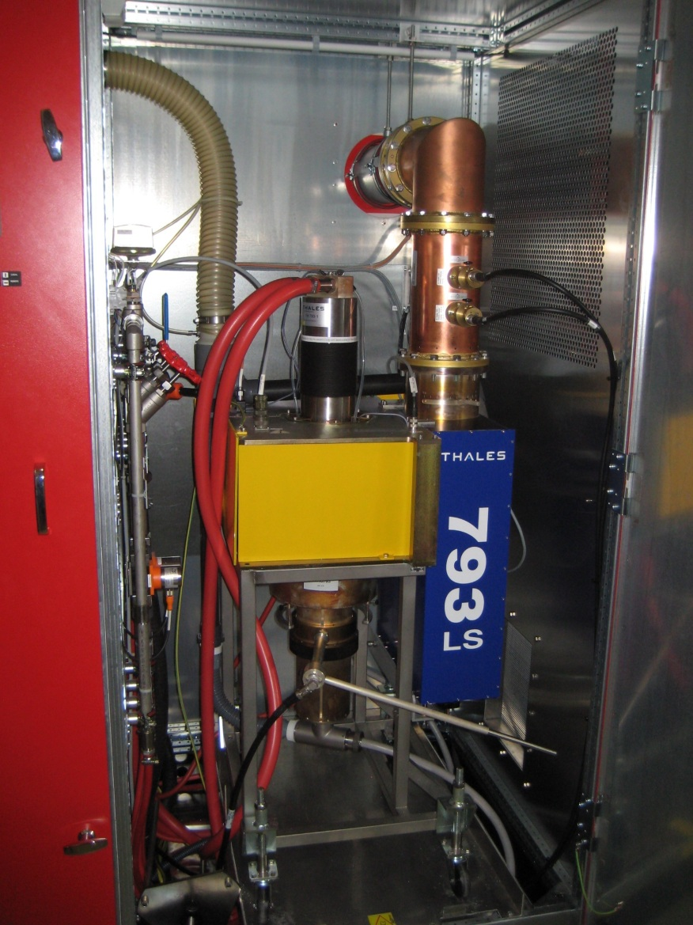
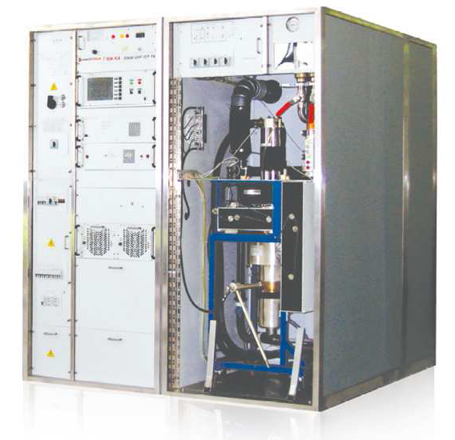

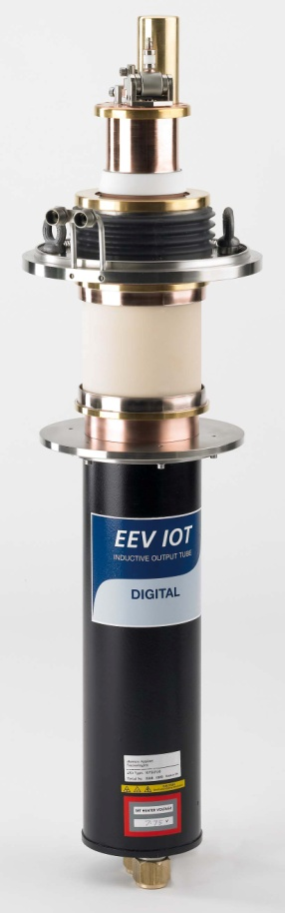
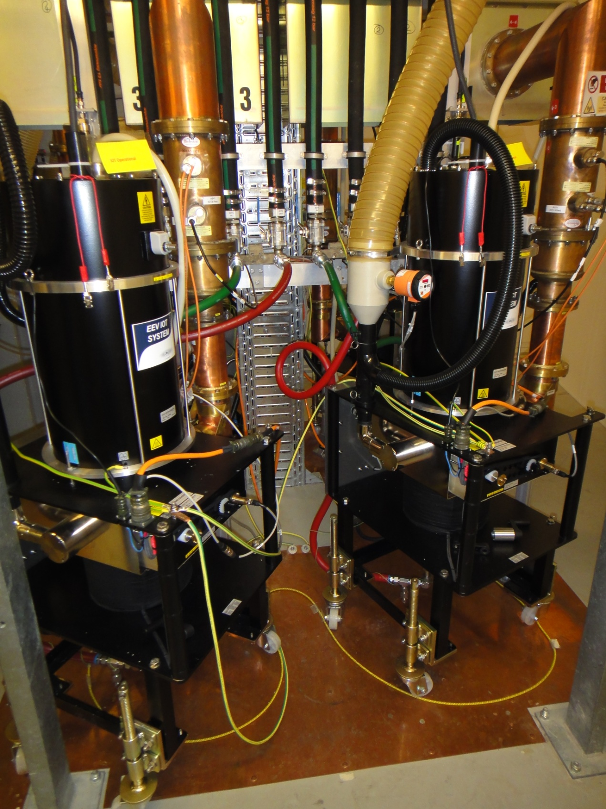

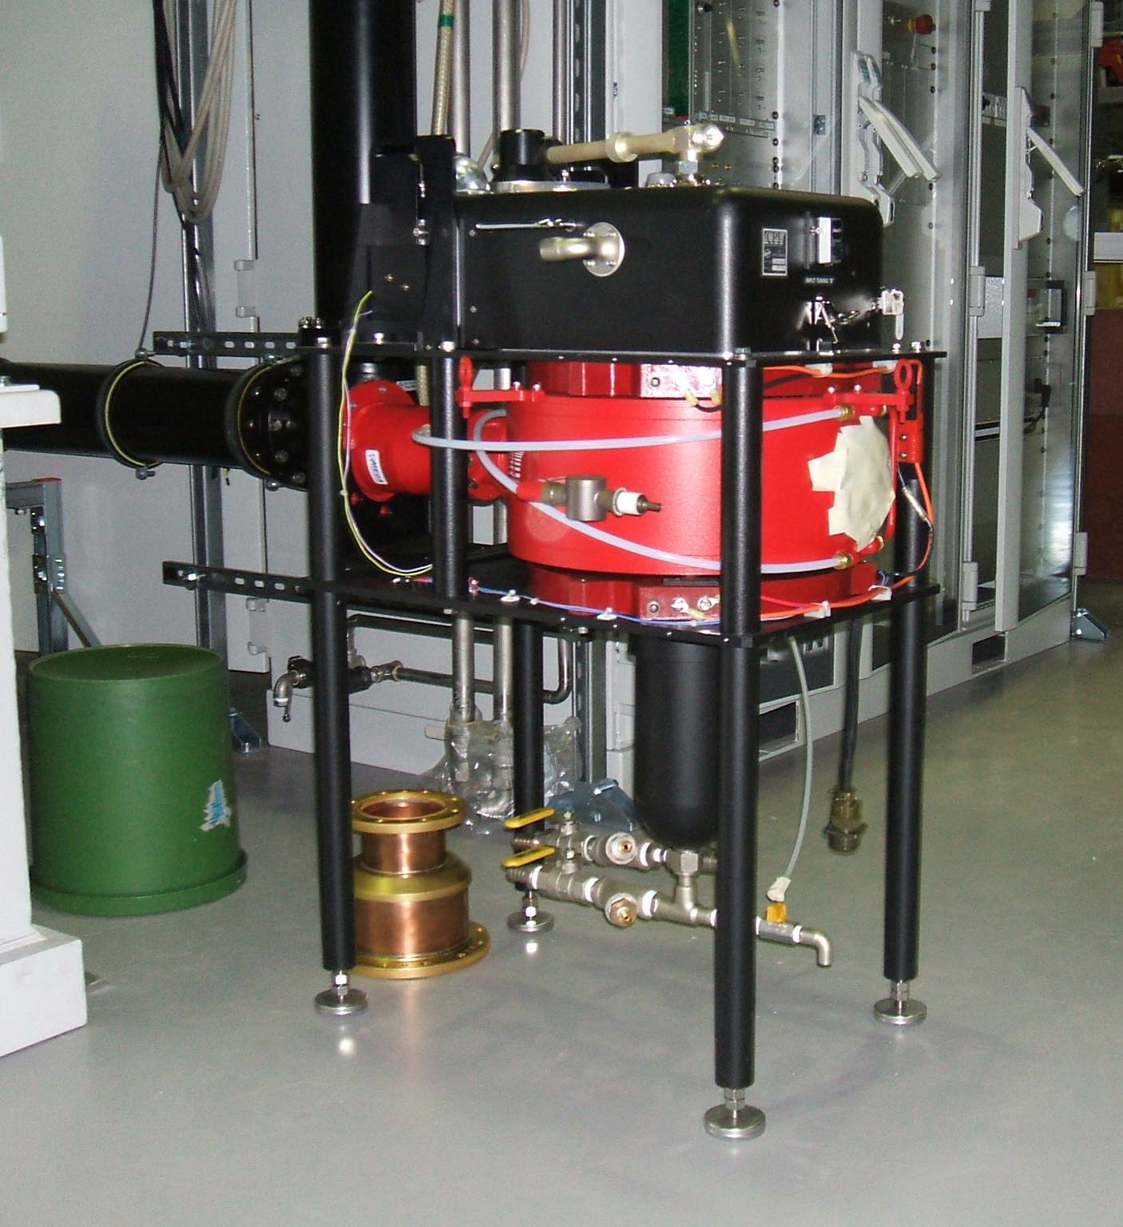
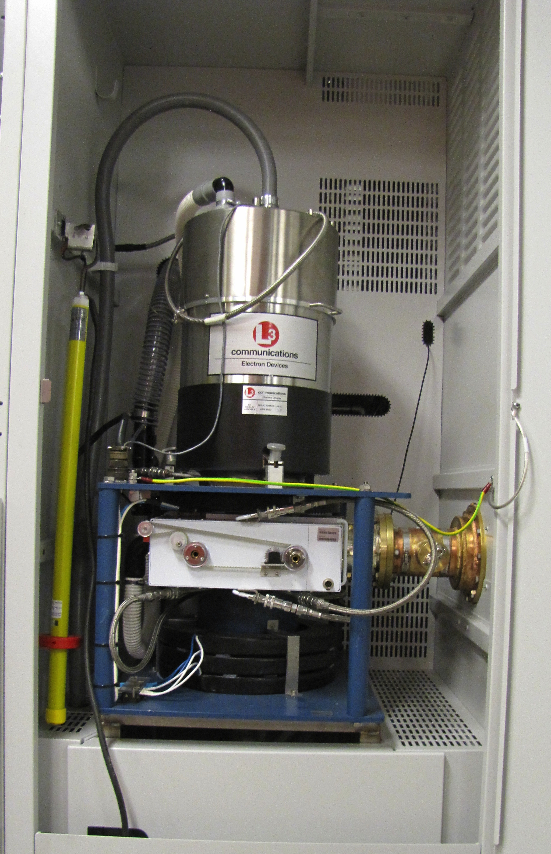
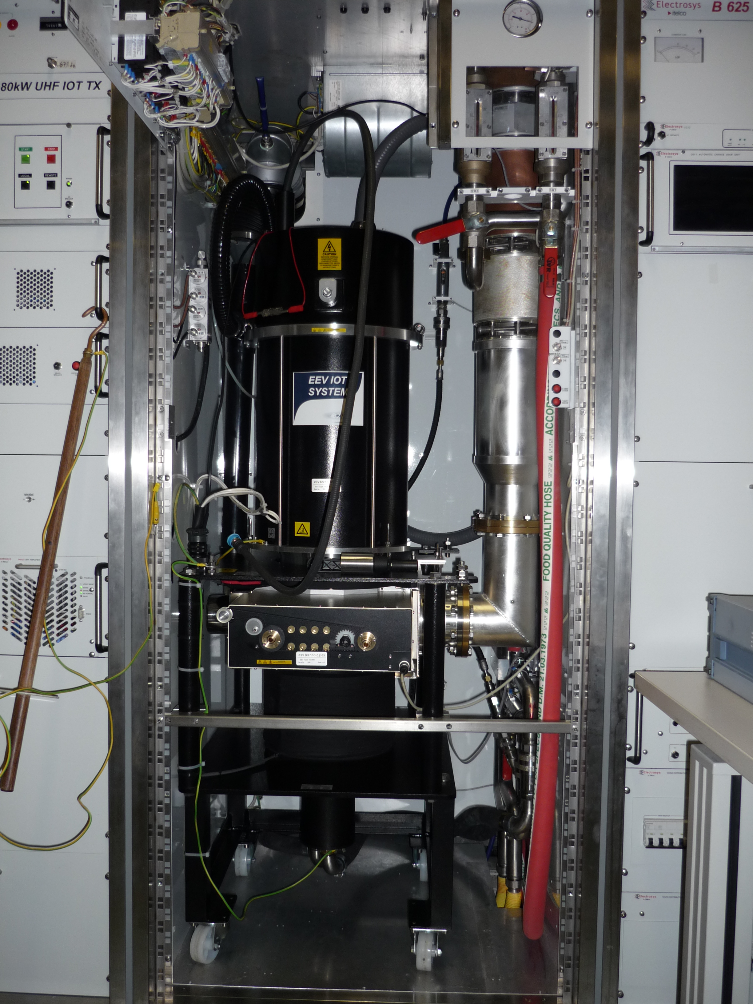
Selection of facilities using IOTs
Three 500 MHz 300 kW amplifiers for Storage Ring: 4 x 80 kW IOT combined
One 80 kW for the Booster
IOTs from E2V
6 RF plants of 160 kW
500 MHz
2 IOTs combined per cavity
IOTs from Thales and L3
CERN
800 MHz
60 kW
Thales IOT
Metrology Light Source
(Willy Wien Laboratory)
CPI 90 kW IOT (K5H90W1)
Elettra
500 MHz
150 kW IOT based amplifier for Combination of 2x80 kW
Thales - E2V
NSLS II (BNL)
L3 IOT, 500 MHz 80 kW CW
7

Slide 8
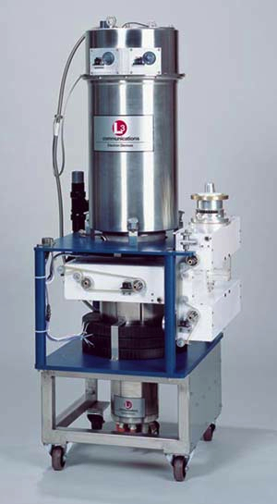

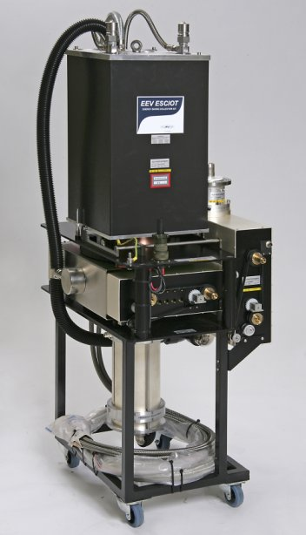
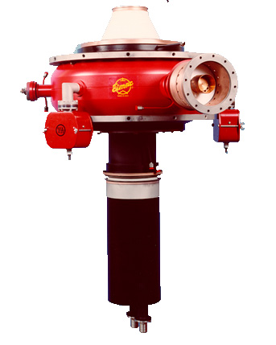


Other IOT technology
IOTs designed for various applications
But series production has been < 100 kW
267 MHz
300 kW CW
Depressed collector IOTs
L3 wide band IOT

Slide 9
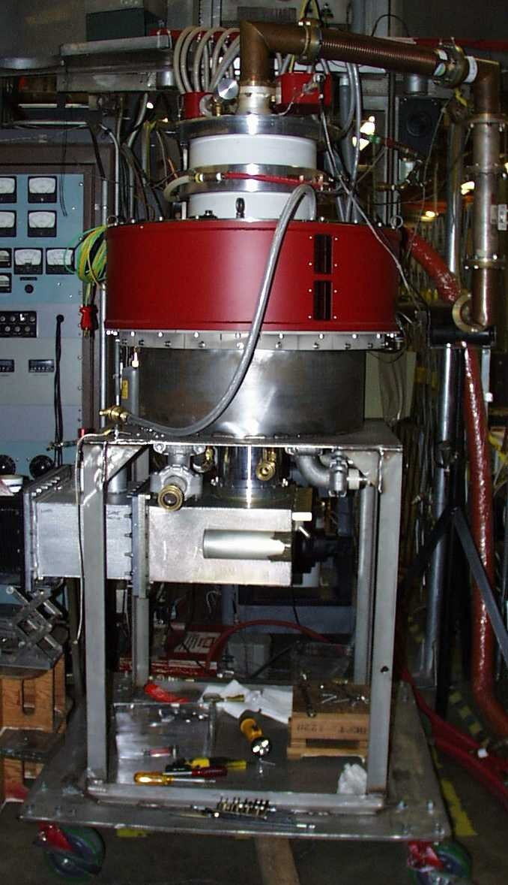

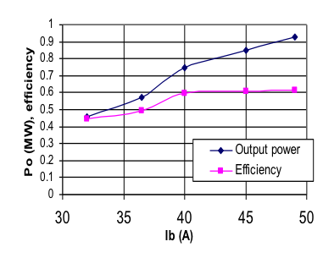
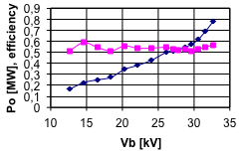
700 MHz HOM IOT Experience
Commissioned from Los Alamost NL to CPI for the APT proton accelerator
RF Input
Power Output 1000 kW (min)
Beam Voltage 45 kV (max)
Beam Current 31 A (max)
Frequency 700 MHz
1dB Bandwidth ± 0.7 MHz (min)
Gain 23 dB (min)
Efficiency 71 % (min)
Diameter 30/76 in/cm
Height 51/130 in/cm
Weight 1000/450 lbs./kg
Collector Coolant Flow 220 gpm
Body Coolant Flow 10 gpm
O/P Window Cooling (Air) 35 cfm
@ 31kV
Gun
Solenoid,
O/P Cavity
RF Output
Test Results
(pulsed)
Collector
The APT project was abandoned in 1999 and with it the idea of a super-power IOT…..
  VHP-8330A IOT

Slide 10
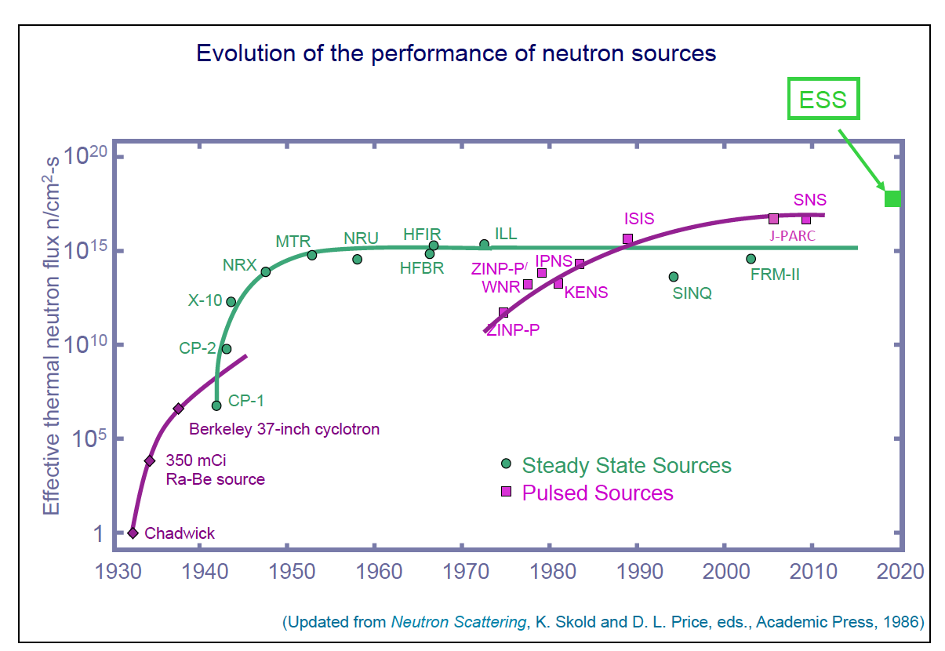
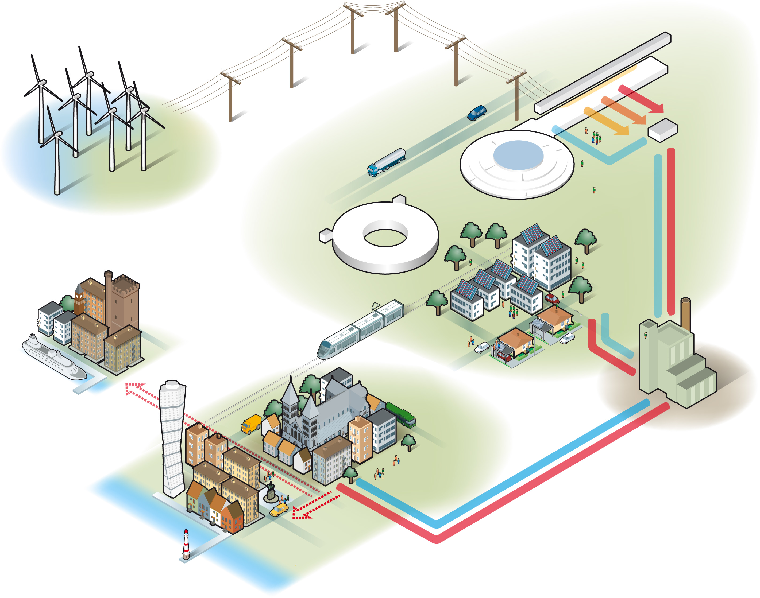

The ESS project
ESS is a neutron spallation source for neutron scattering measurements.
The neutrons are produced by a 2 GeV proton beam impacting on a tungsten target.
The proton linac will be the most powerful ever built and it will require over 150 RF sources.
ESS accelerator parameters:
  Average beam power: 5 MW
  Pulse length: 2.86 ms
  Peak beam power: 125 MW
  Pulse repetition rate: 14 Hz
  Proton energy: 2 GeV
  Peak beam current: 62.5 mA
  High availability: >95%
  Flexible design for a future power upgrade
ESS will be a “green” facility: this means that it must guarantee at the same time:
Machine reliability
Energy efficiency

Slide 11
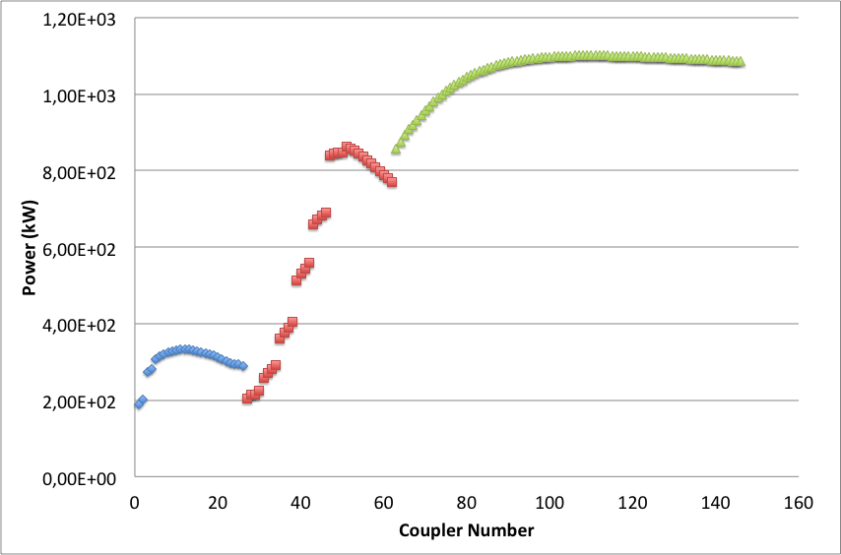
The ESS accelerator
352.21 MHz
704.42 MHz
2.4 m
4.5 m
3.6 m
40 m
54 m
75 m
174 m
Target
Source
LEBT
RFQ
MEBT
DTL
Spokes
Medium β
High β
HEBT & Contingency
75 keV
3.6 MeV
90 MeV
220 MeV
570 MeV
2000 MeV
Normal-conducting Linac:
1 RFQ: 1.6 MW at 352 MHz required in input + 30% (overhead + losses);
5 DTL tanks (2 couplers/DTL): 2.2 MW at 352 MHz required in input + 30% (overhead + losses);
 | Energy (MeV) | Frequency (MHz) | No. of Cavities | βg | Temp (°K) | RF power (kW)
Source | 0.075 | - | 0 | – | ~300 | –
LEBT | 0.075 | - | 0 | – | ~300 | –
RFQ | 3.6 | 352.21 | 1 | – | ~300 | 1600**
MEBT | 3.6 | 352.21 | 3 | – | ~300 | 20**
DTL | 90 | 352.21 | 5 | – | ~300 | 2200**
Spoke | 220 | 352.21 | 26 (2/CM) | 0.5 βopt | ~2 | 330**
Medium β | 570 | 704.42 | 36 (4/CM) | 0.67 | ~2 | 870**
High β | 2000 | 704.42 | 84 (4/CM) | 0.86 | ~2 | 1100**
HEBT | 2000 | – | 0 | – | ~300 | –
Superconducting Linac (97%):
84 High β cavities
26 spoke cavities
36 Medium β cavities
Total High Power RF: 133 MW peak (4% duty) plus overhead
90 MW to High Beta Section!
** Plus overhead for control

Slide 12
An IOT for ESS
Parameter |  | Comment
Frequency | 704.42 MHz | Bandwidth > +/- 0.5 MHz
Maximum Power | 1.2 MW | Average power during the pulse
RF Pulse length | Up to 3.5 ms | Beam pulse 2.86 ms
Duty factor | Up to 5% | Pulse rep. frequency fixed to 14 Hz
Efficiency | Target > 65%
High Voltage | Low | Expected < 50 kV
Design Lifetime | > 50,000 hrs
Work is being carried out in collaboration with CERN
ESS to procure prototypes
CERN to make space and utilities available for testing
3.3 MW power reduction by using IOTs for High Beta
Target: Approval for ESS series production in 2017/18

Slide 13
Two IOTs to be delivered in 2016
Two Multi-Beam IOTs being designed
  Thales/CPI Consortium
  L3
Contracts signed in September 2014
Project duration: 24 months
Long term testing at CERN
Approval for series tender 2017/18

Slide 14
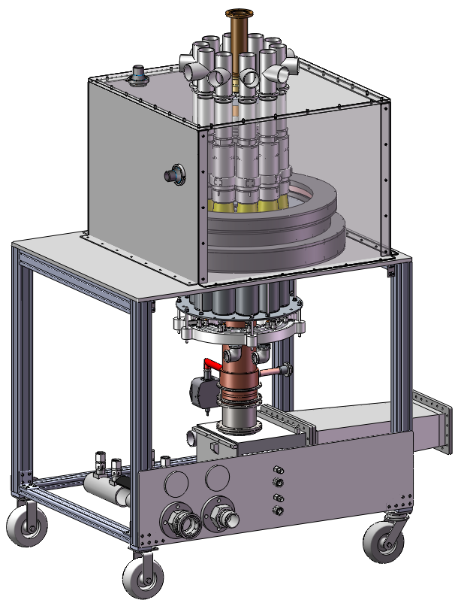
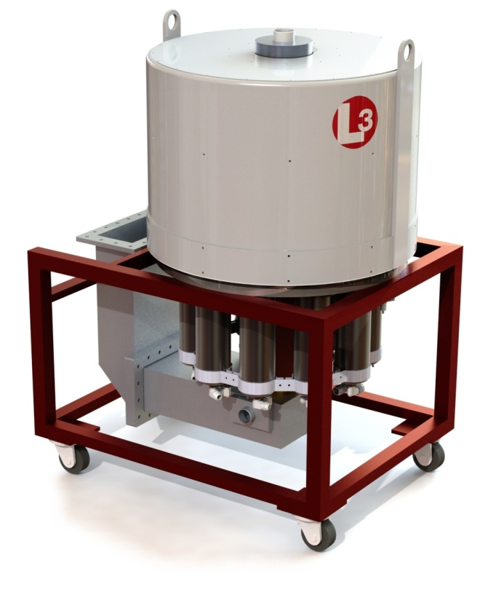


Multi-Beam IOTs for ESS
Multi-Beam IOT
10 beams
1.2 MW
704.42 MHz

Slide 15
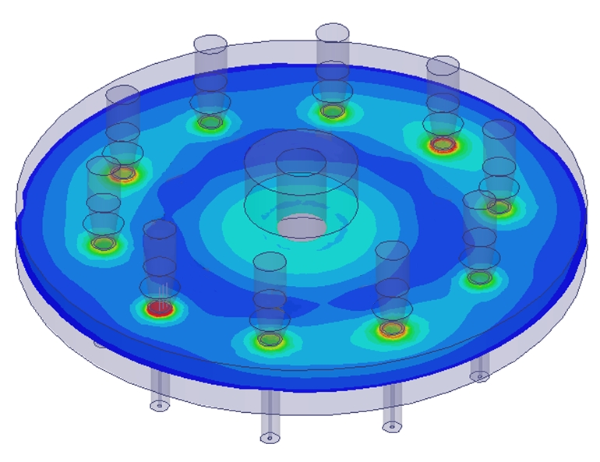
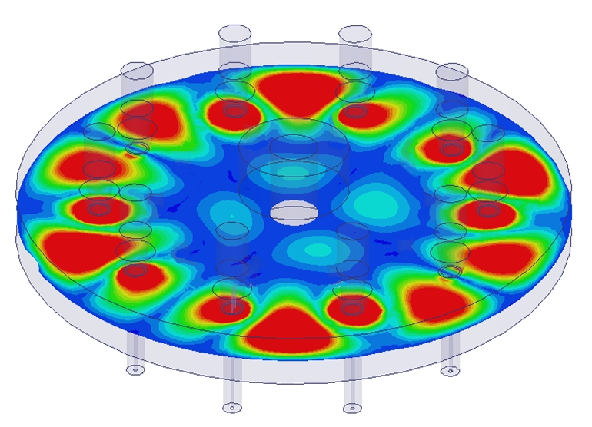
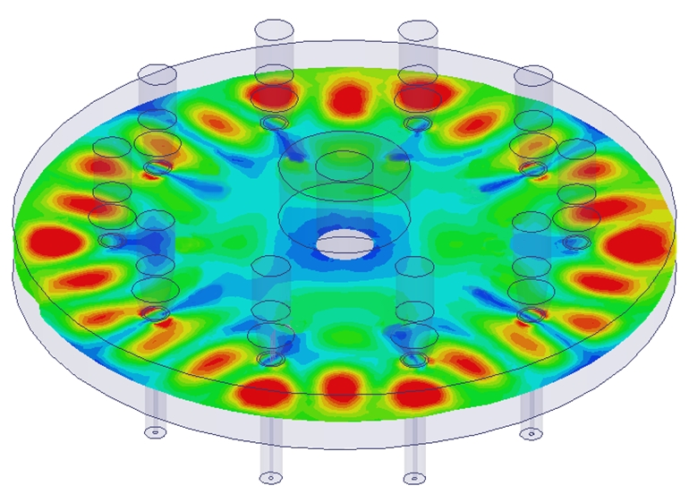
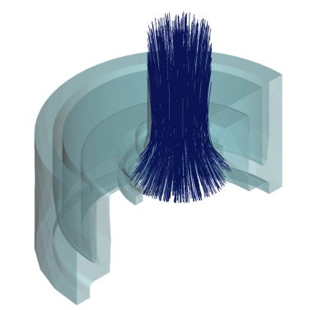
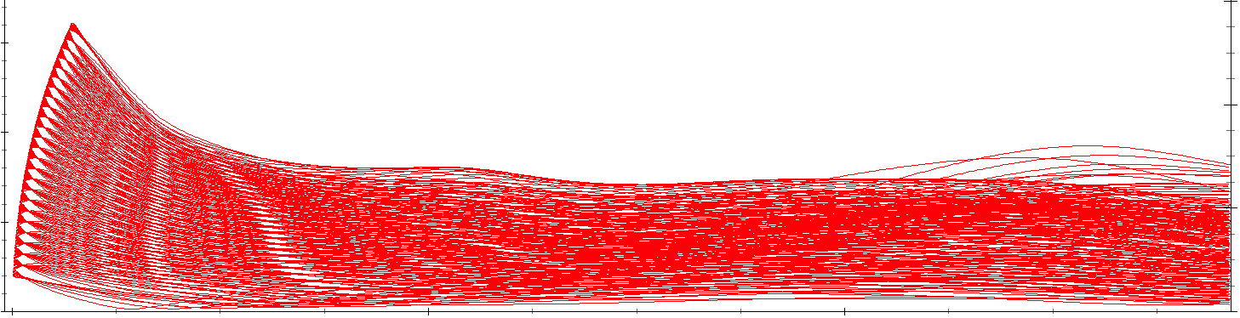
Output Cavity and DC Beam Studies
Courtesy of L3 Communications
Ten beams on a single bolt circle
Output cavity supports a large number of modes
HFSS used to map modes near harmonics of the drive frequency
Fundamental
Near Second Harmonic
Near Third Harmonic
TM_{1,0,0} at 704 MHz
TM_{1,24,0} at 2124 MHz
TM_{1,16,0} at 1417 MHz
Beam transport simulations

Slide 16
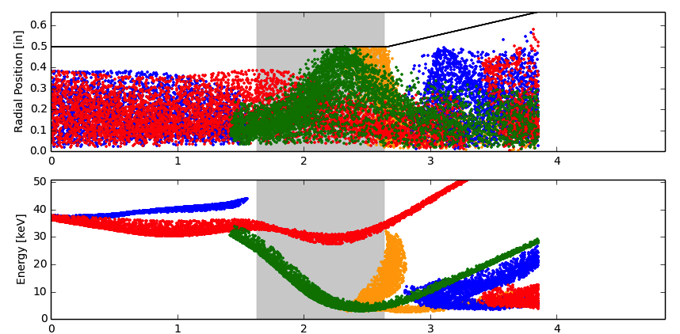
Beam transport and RF Interactions
Courtesy of L3 Communications
Beam profile
imported here
Propagated in the presence of the magnetic field imported from Maxwell
Output
Gap
Drift tunnel
Drift tunnel taper
Particles shown at 4 phases of an RF cycle

Slide 17
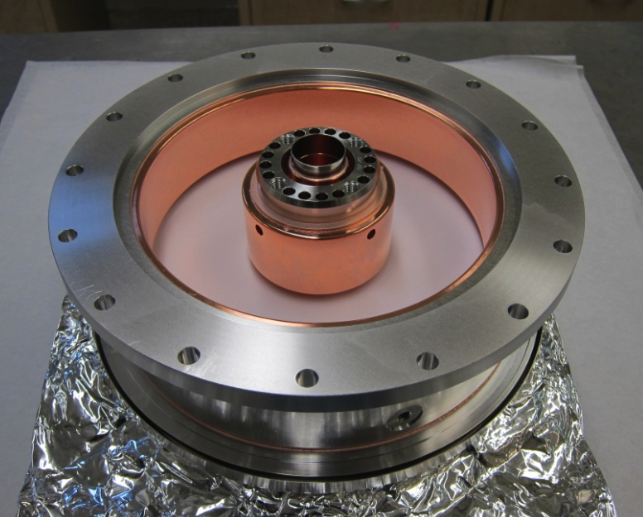
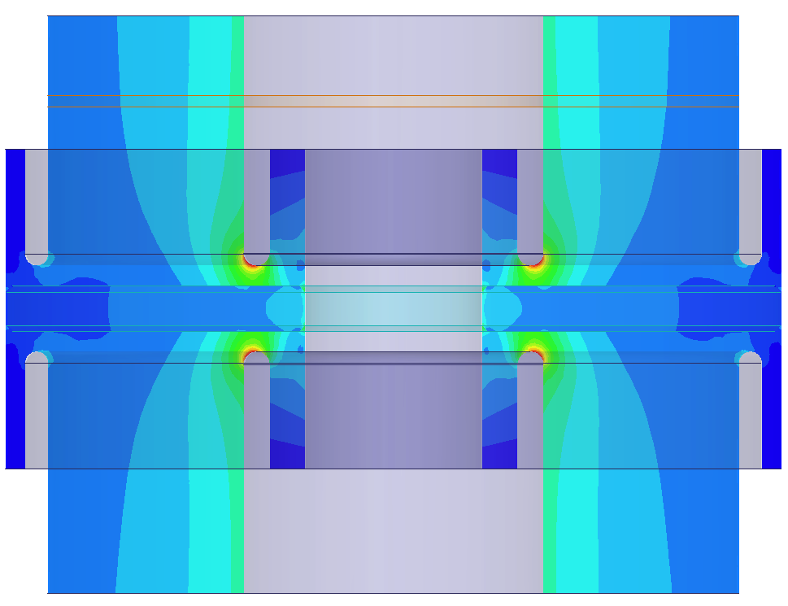
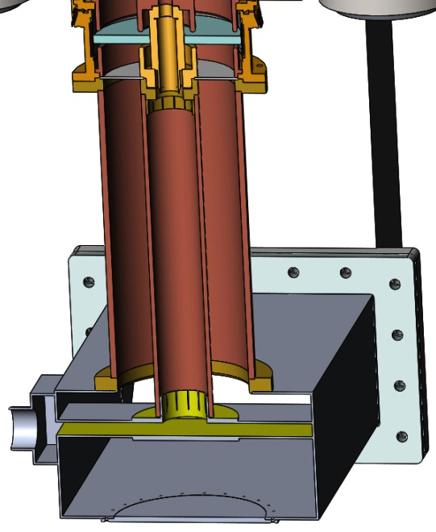
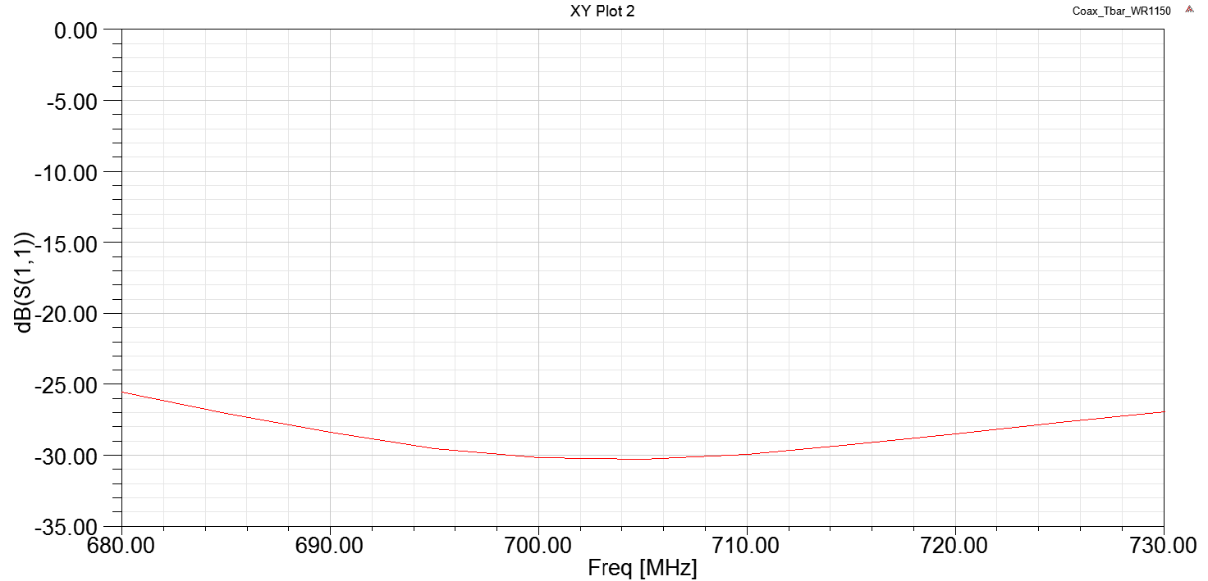
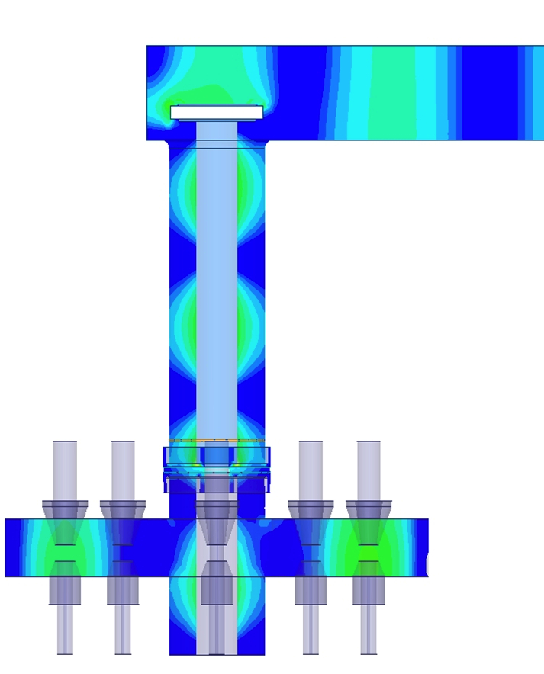
RF Output Circuit and Output Window
Courtesy of L3 Communications
Air cooled SLAC design Coaxial window from B-factory klystron
  1.2 MW CW operation, 476 MHz
  TiN coated and has modest peak electric field
T-bar Coax-to-Waveguide transition in air
Design was rescaled
for 704 MHz using HFSS
SLAC Proprietary
Concept provided by SLAC
Return Loss = -30 dB at 704 MHz

Slide 18
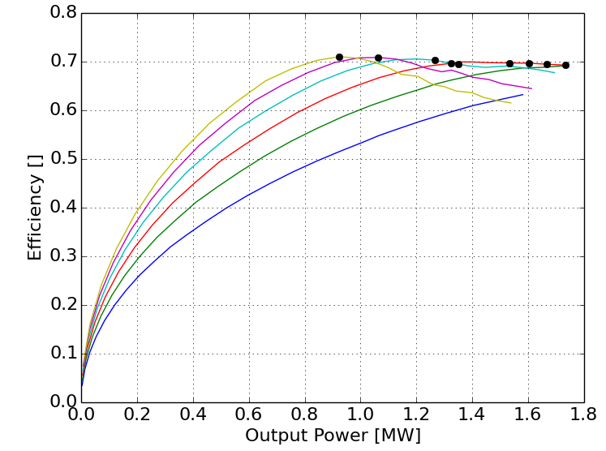
Operational Optimisations
Courtesy of L3 Communications
1.3 MW
Efficiency=70%
Power and Efficiency
Impact of HV
Plot shows maximum achievable efficiency for various operating points
Increased beam voltage provides for better performance
  Increases gain
  Increases efficiency
  Decreases body current
Simulations are for 10 beams

Slide 19
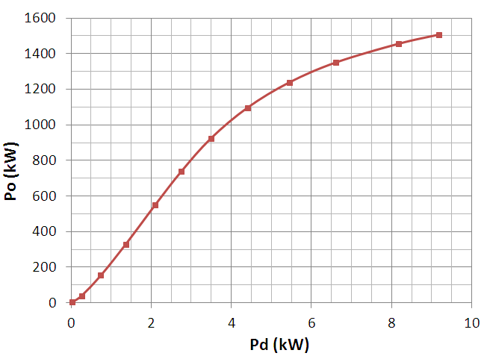
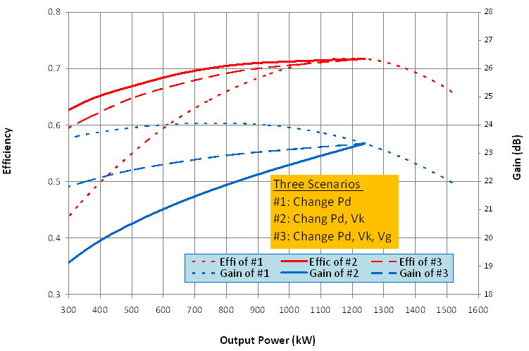
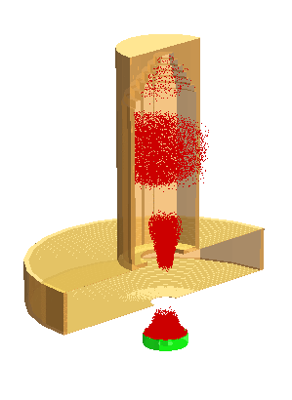

MAGIC Prediction of MB-IOT Performance
Courtesy of Thales and CPI
Power Transfer Curve
Efficiency & Gain vs Output Power
1.2 MW
Efficiency
Gain
V_{k} = 48 kV
Class-C
MAGIC-3D simulation of one beam with MB-IOT off-axis B-field
At 1.2 MW, η = 72% with V_{k} = 48 kV
At 600 kW
  η = 59% with V_{k} = 48 kV
  η = 68% with V_{k} = 34 kV

Slide 20
Conclusions and Future Prospects
ESS requires 1.2 MW plus overhead:
Short development time available
Preference for low voltage
‘Proven’ technology
Factor of 10 up in power
High voltage, 1 MW, single cathode
10 MW MBIOT by combination of 1 MW tubes
What else could we achieve?
More power
Higher efficiency
Better reliability
Smaller footprint, etc.
Grid controlled emission with bunch forming cavities
HE-IOT (from 75% to…. 90% )
Grid controlled emission + “rotating” cavity + output cavity
Example:
MBIOT development for ESS

Slide 21
Acknowledgements
Special thanks to:
Thales, CPI and L3 for agreeing to publish some of the design details, calculations and predictions

