Slide 1
HPC pilot @NRC KI supercomputer

Slide 2
One Pilot – One Task

Slide 3
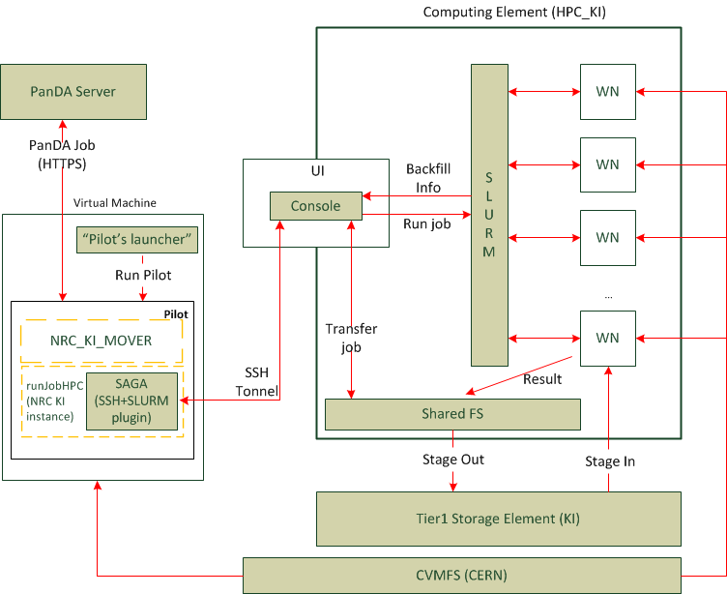
One Pilot – Many Tasks

Slide 4
Components to implement
RunJobKurchatovHPC (requests jobs, checks resources, run Payload) uses SAGA SSH+SLURM plugin for the communication with the Kurchatov supercomputer.
KISiteMover (makes staging In/Out operations on the supercomputer). Not implemented yet.
Pilot’s launcher. Runs Pilots successively one after another.

