Slide 1
WLCG Tier-1 and Applications @ ASGC
Simon C. Lin
Academia Sinica Grid Computing Centre
30 January 2015
JINR, Dubna

Slide 2
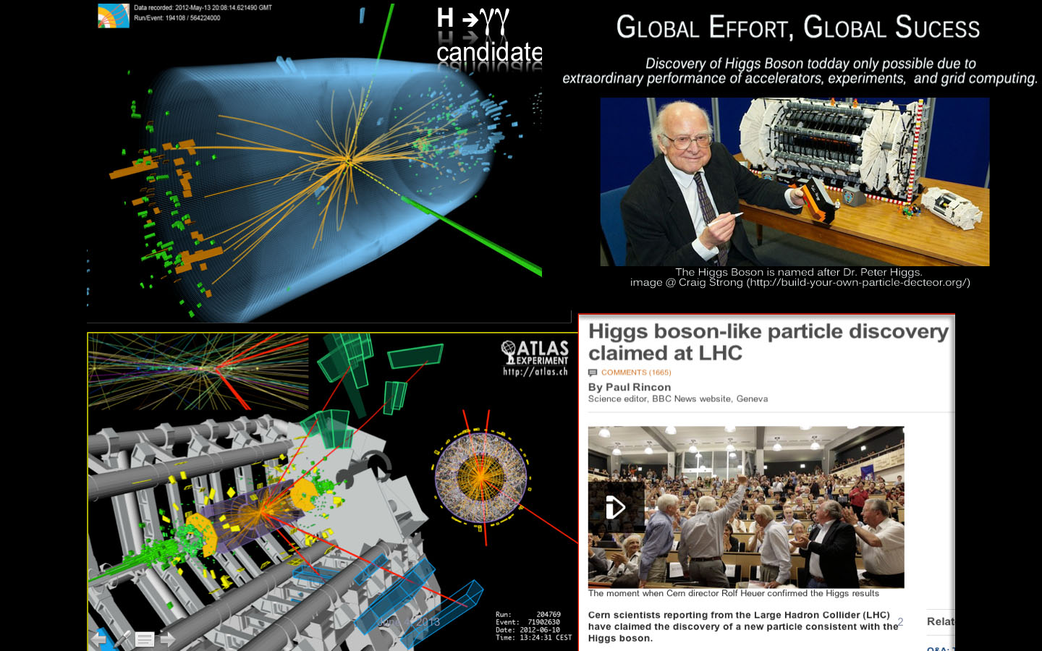
Global Science Achievement
Accelerator, Detector & Grid

Slide 3
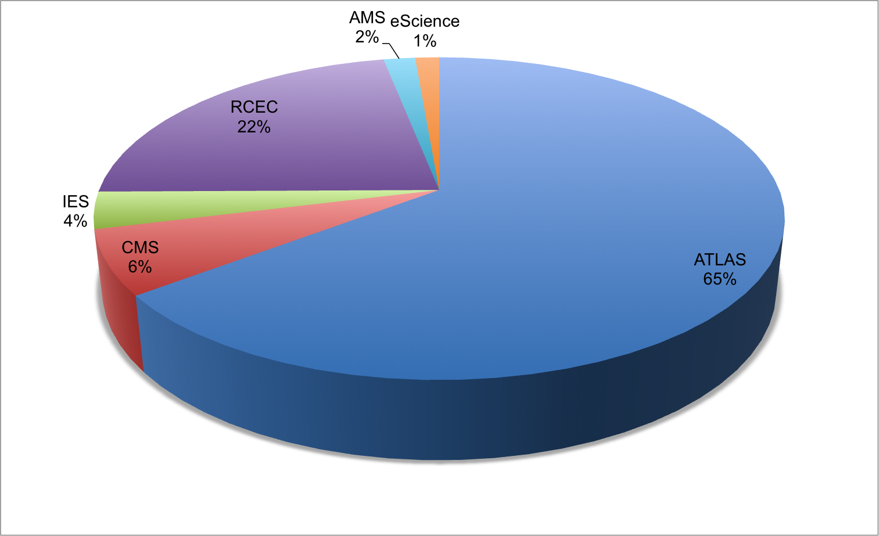
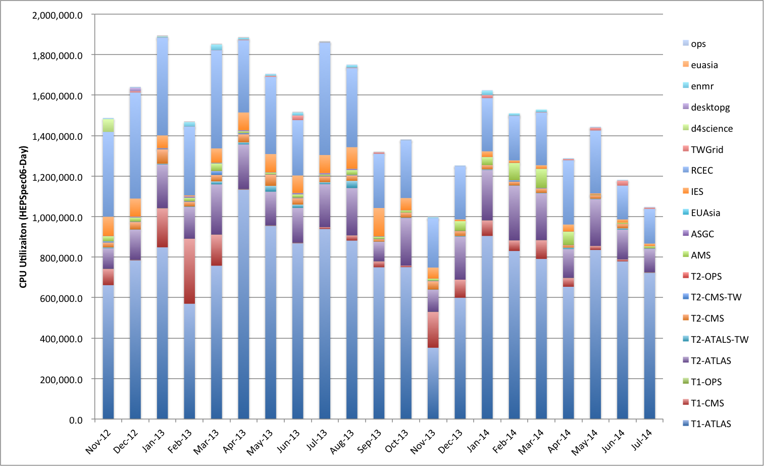
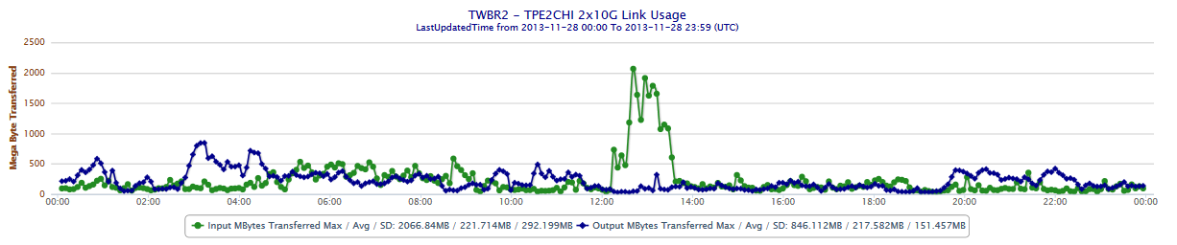
Resource Utilization at ASGC, 1st T1
WLCG: Total data in and out of Taiwan: 33,418 TB
7,082(2010) → 6,098 (2011) → 9,431 (2012) → 10,806 (2013) → 12 (2014)
10% data is processed in Taiwan
CPU: ATLAS(65%), RCEC(22%), CMS(6%), IES(4%), AMS(2%)
16 Gb/s inbound performance reached in ASGCNet 20Gb link to Europe
CPU Utilization in Nov.2012 – Jul.2014
3

Slide 4
ASGC Resources (Jan. 2015)
Resource Groups | CPU (#Cores) | Disk (TB) | Tape (TB) | Inter-connection | User Groups
World Wide Grid | 5,508 | 5,640 | 4,000 | 10GbE Storage Server | WLCG, EUAsiaGrid, EGI, e-Science
HPC | 10,212 | 3,356 | 0 | 10GbE+IB (DDR, QDR): 5120 HPC-10G: 1956 NUWA: 1984 TCCIP: 1152 | HPC, ES, EC, Physics, LS
Cloud & Elastic System | 4,076 | 3,600 | 0 | 10GbE + 10GbE Storage | Cloud and Elastic Resources: AMS
Notes:
CPU Cores: 19,796
Disk: 12.5PB

Slide 5
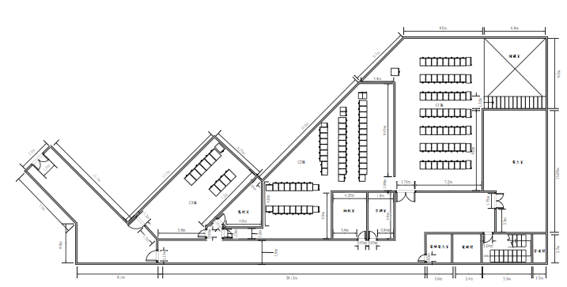
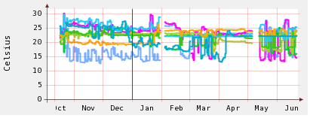
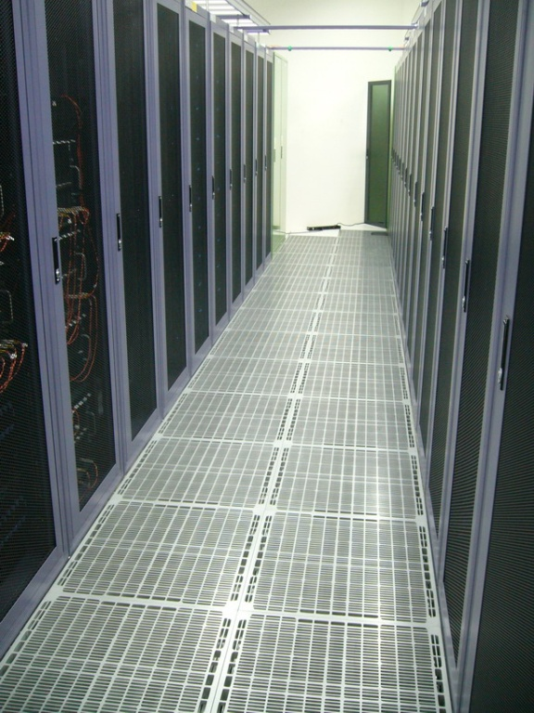
ASGC Computing Center
Cooling Power : CPU Power
Summer 1 : 1.4
Winter 1 : 2
Total Capacity
  2MW, 400 tons AHUs
  93 racks
  ~ 800 m²
Resources
  20,000 CPU Cores
  12.5 PB Disk
  4 PB Tape
Rack Space Usage (Racks)
  AS e-Science: 54.1 (58.4%)
  ASCC: 8.4 (9.0%)
  IPAS: 6.0 (6.3%)
  Free: 24.5 (26.3%)
Monitoring the power consumption and temperature of every piece of equipment every 10 seconds.

Slide 6
ASGC on WLCG Technology
Areas | Activities
Distributed Computing | Diane, Ganga, Panda, JEDI, CVMFS, Ceph
Distributed Data Management | DPM, SRM-SRB/iRODS, Rucio, EOS
Information System Monitoring | GStat
Experiment Computing | ATLAS, CMS
Cloud Core Technology | VMIC, Distributed Cloud, OpenStack, Cloud Accounting
Networking | LHCOPN, LHCONE, SDN
Regional Support | APROC, APGridPMA
Data Center | Intelligent & energy saving Center, system efficiency
High Level Coordination | GDB, MB, CB, C/RRB
6

Slide 7
Asia Pacific Regional Operation Centre (APROC)
Extending the infrastructure and maximize the availability from 2005: Support 38 sites in 16 countries to join the World Wide Grid and e-Science collaborations
  Australia, China, Hong Kong, India, Indonesian, Iran, Japan, Korea, Malaysia, New Zealand, Pakistan, Philippine, Singapore, Thailand, Vietnam, and Taiwan
Training, Workshop and Internship Program (from 2003)
  Host International Symposium on Grid & Cloud (ISGC) annually
  Coordinate 65 events in 9 countries (IN, KR, MN, MY, PH, SG, VN, TH and TW)
  Internship: 10 persons from DE, IN, JP, KR, MY and PK

Slide 12
Training, Workshop and GridCamp Events
 | Grid Technology | E-Science Applications | Others
2013 | TW(dCache, DPM, security, EMI, GridCamp) | TH(gWRF), TW(WeNMR) | TW(CHAIN-REDS)
2012 | TW(iRODS, VC, FIM, Cloud) | TW(WeNMR) | TW(CHAIN)
2011 | TW(iRODS, IDGF, IGTF) | TW(NDM, Life Sci), MN | TW(OGF31)
2010 | TW(gLite, VC, Security, iRODS) | TW(Social Simulation) | TW(EUAsiaGrid)
2009 | VN(Grid), TW(Grid, iRODS, Security, GridCamp) | MY(e-Science) | TW(EUAsiaGrid)
2008 | KR, PH, TW(EGEE, iRODS) | TW(WLCG) | TW(EUAsiaGrid)
2007 | VN(Grid), SG(Grid), MY(Grid), TW(EGEE, GridCamp)
2006 | TW(EGEE) | IN(WLCG)
2005 | TW(Grid), TW(Grid @ 2 univ.) | TW(WLCG SC)
2004 | TW(Grid), TW(Grid @ univ.)
2003 | TW(Grid) | TW(BioGrid)
Notes:
Grid Tech:

Slide 13
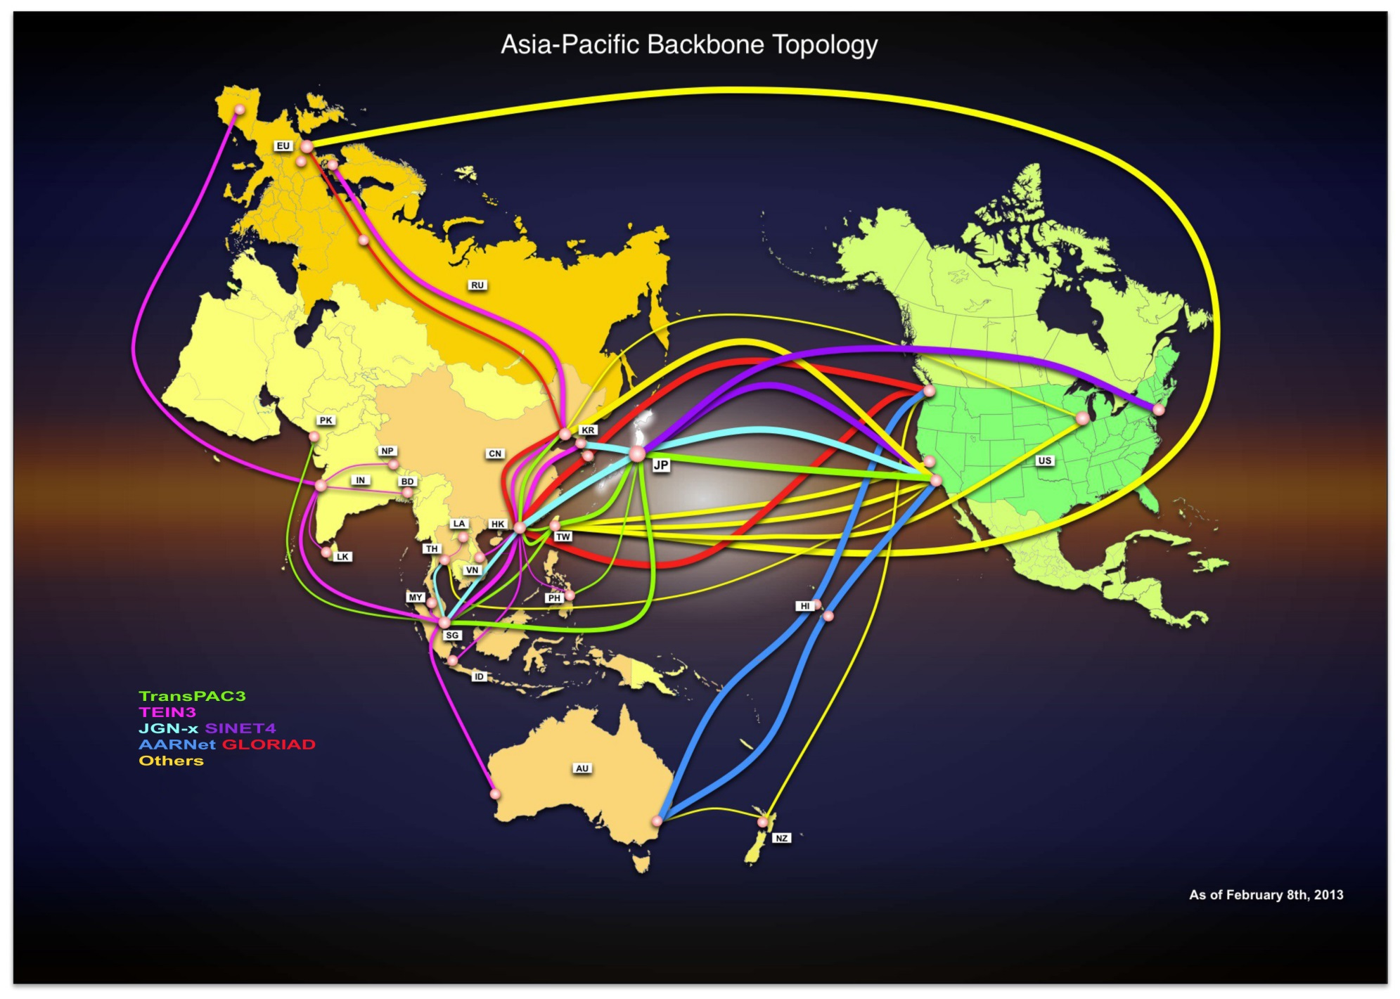
Asia-Pacific Backbone Topology

Slide 14
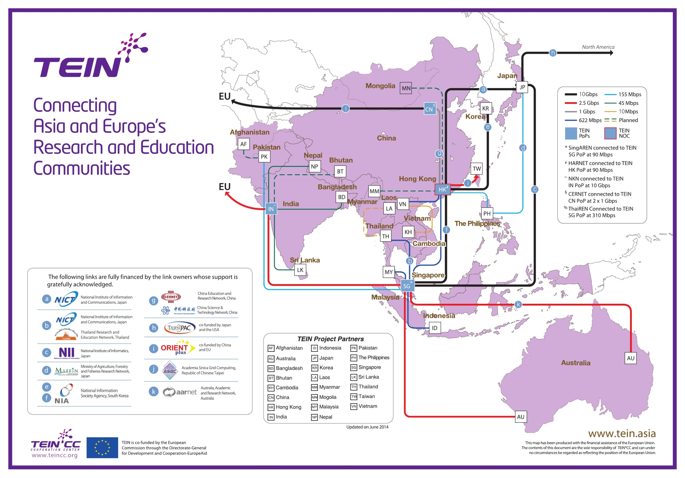
TEIN Network (June 2014)
http://www.tein4.net/tein4/activities/network.do

Slide 15
Regional Networking Matrix
 | AU | CN | HK | IN | JP | KR | SG | TW
AU |  |  | 2.5G |  |  |  | 2.5G (+2.5G)
CN |  |  | 2x2.5G, 2.5G |  |  |  |  | 2x1G
HK | 2.5G | 2x2.5G, 2.5G |  | 2.5G | 10G + 2.5G | 10G | 10G | 2.5G+10G
IN |  |  | 2.5G |  |  |  | 2.5G
JP |  |  | 12.5G |  |  |  | 10G | 2.5G
KR |  |  | 10G
SG | 2.5G (+2.5G) |  | 10G | 2.5G | 10G
TW |  | 1G: CERNET, 1G CSTNET | 2.5G+10G |  | 2.5G

Slide 16
Connectivity between Asia and Other Region
IN
 | US | Europe
AU | 2x40 (2x100G in 2016)
CN | 10G (I2-CERNET2) | 10G (Geant)
HK
IN |  | 2.5G to ES; 10G to Geant
JP | 3x10G to LA, NY, WA; 100G (2016) | 3x10G to Geant
KR | 10G | 10G
SG
TW | 2x10G to Chicago + 5x2.5G | 2x10G to AMX and CERN

Slide 17
Regional HEP Collaborations
Balance of Requirements and Resources
 | Experiments |  |  |  |  | Networking
 | LHC/WLCG (200-4000 MB/s) | AMS/WLCG | BELLE II/DIRAC (1800 MB/s) | BEPC/BES (3PB/5yr) | Neutrino (Daya Bay) (200TB/yr)
AU | ATLAS |  | X |  |  | AARNet
CN | ALICE, ATLAS, CMS, LHCb | 7 | X | X | X | CERNET, CNGI-CERNET2
IN | CMS, ALICE |  | BELLE II, ILC | X |  | NKN, TEIN
JP | ATLAS, ALICE |  | X | X |  | SINET
KR | ALICE (T1), CMS | 2 | X |  |  | KREONET, Gloriad
TH | CMS/WLCG |  |  | X |  | UniNet
TW | ATLAS (T1), CMS | 4 | 4 |  | 1 | ASGCNet, TWAREN
Notes:
SuperKEKB is commissioning from early 2015, and physics run is started in 2018.
100Gb R&E Backbone: TW (2015),

Slide 18
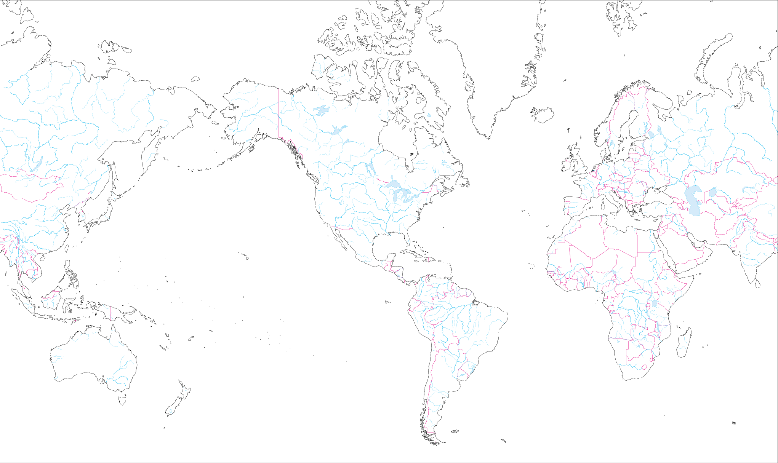
TAIWAN Global R&E Network
10G
Amsterdam
10G
Chicago
622M
Geneva
2.5G
Tokyo
2.5G
Palo Alto
2.5G
Hong
Kong
2.5G
2.5G
New York
2.5G
5G
2.5G
10G
5G
2.5G
LA
2.5G
TAIWAN
10G
ASGCNet
ASNet
TWAREN
TANet

Slide 19
ASGC e-Science Global Network
ESNet
Internet2
STARLight
MYREN
MY
AARNet
AU
SINET
JP
NREN
NP
NISN
(NASA)
GE*2
EARNetIN
10G
GE
CA*Net
GE*2
GE
INHEREN
ID
TEIN
LHCONE
US
LEARN
LX
2.5G
NREN
EU
20G
10G
GEANT
PERN
PK
HK
ASGC
TW
20G
2.5G
(10G)
10G
PREGINet
PH
NORDUnet
NL
GE
SingaREN
SG
GE*2
SURFnet
GE
10G
10G
GE
VinaRen
VN
HKIX
GE
GE
GE
ASNet
20G
CESnet
GE
2.5G
UNINetTH
GE
CERN
CSTNET
CN
GE
APAN-JP
AMS-IX
ASTI
PH
LHC
OPN
HARNet
HK
CERNET
CN
KREONET2
TWAREN/ TANET

Slide 20

















LHCONE: A global infrastructure for the LHC Tier1 Data Center – Tier 2 Analysis Center Connectivity
SimFraU
NDGF-T1a
UVic
UAlb
UTor
NIKHEF-T1
NDGF-T1a
NDGF-T1c
TRIUMF-T1
McGill
SARA
Netherlands
NORDUnet
Nordic
CANARIE
Canada
Korea
CERN-T1
Bill Johnston, ESNet
CERN
Geneva
KISTI
Korea
Chicago
Amsterdam
Geneva
TIFR
India
US LHCNet
SLAC
ESnet
USA
DESY
DE-KIT-T1
KNU
GSI
DFN
Germany
KREONET2
Korea
New York
India
Seattle
FNAL-T1
BNL-T1
GÉANT
Europe
ASGC-T1
Caltech
ASGC
Taiwan
UCSD
NE
Washington
UWisc
UFlorida
SoW
CC-IN2P3-T1
PurU
UNeb
MidW
GRIF-IN2P3
Sub-IN2P3
MIT
Internet2
USA
GLakes
RENATER
France
CEA
NCU
NTU
Harvard
TWAREN
Taiwan
PIC-T1
RedIRIS
Spain
INFN-Nap
CNAF-T1
GARR
Italy
UNAM
LHCONE VPN domain
End sites – LHC Tier 2 or 3 unless indicated as Tier 1
Regional R&E communication nexus
Data communication links, 10, 20, and 30 Gb/s
See http://lhcone.net for details.
CUDI
Mexico
NTU
Chicago

Slide 21
DiCOS: Distributed Cloud OS
Objectives: Scientific Cloud with federated resources
  Scalable distributed computing infrastructure with cloud services and customized workflow on Web
  Energy-saving racks integrated
Features
  Certificate-based Single Sign-On, with flexible proxy lifetime
  Drag and Drop Web interface for distributed data management
    Dropbox-like services is under development
  Job workflow management
  Dynamic job migration with embedded local IaaS mechanism
  L&B, Accounting and Monitoring
    By making use of GLUE2-based information system model

Slide 22
Single Rack Data Center
Effective power usage
  No waste ➔ Non-UPS solution
    Save power, 10% - 20%
  High efficiency ➔ Fanless solution
    Reduce equipment power, 10% - 20%
    Reduce cooling system power, > 50%
Easy to be installed in any office
  Fanless solution ➔ No noise

Slide 23
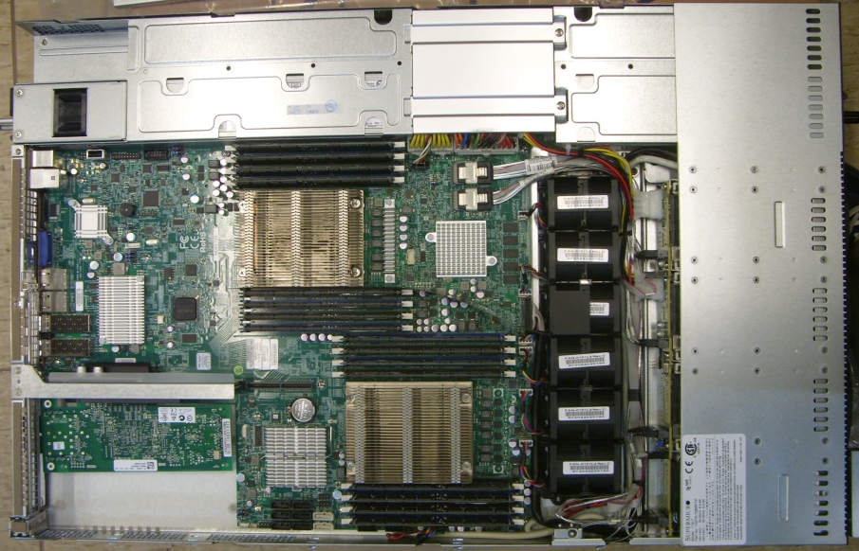
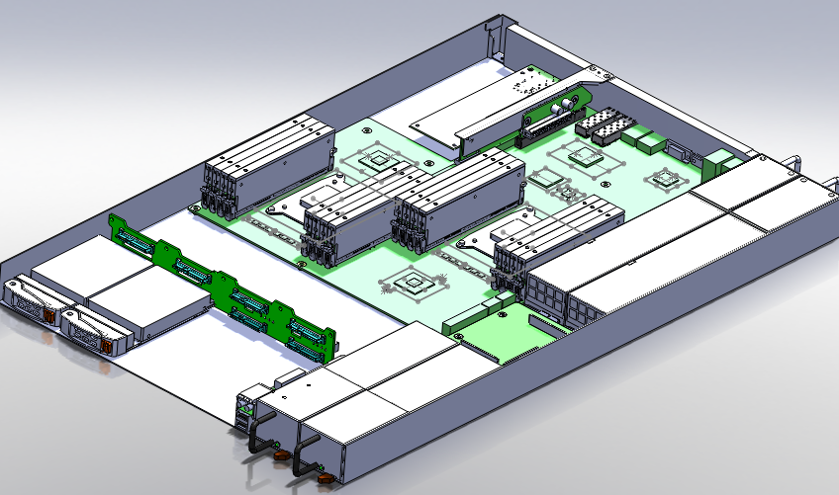
Fanless 1.5U server
Use SuperMicro 1U server with dual Xeon CPU
  E5-2630L, 6 cores
  x16, 8GB DDR3 1333 ECC DIMM
  On board, Ethernet 10G SFP+ & RAID
Status
  The mechanical model of original 1U server was built.
  Fanless thermal design was done and all new parts were built.
  First server is assembled.
  Server height will be 1.5U
Estimated power of 6 fans
  50W to 72W

Slide 24
System Optimization
Goals: Intelligent Operation
  Performance, Cost and Energy Saving, Early Warning and Automation
Storage System and Data Management
  Fast access and maximize throughput of each storage server
  Strategy: Metrics on Distributed analysis pipeline
Computing System
  Smart workload management (Pilot Factory Model) over distributed computing infrastructure (service grid + desktop Grid + Cloud)
  Computing model adaptation and performance tuning
Networking: from DC to international connection
  10Gb backbone between servers
  Dynamic routing and software defined networking
Data Center
  Reduce energy consumption and maximize power efficiency
24
Notes:
Identify performance metrics → find bottleneck and resolution by analysis → automation and early warning
SW and algorithm is not able to take adv of new HW

Slide 25
e-Science for the People
Earthquake, Tsunami, Typhoon, Flood, Pandemic are regional issues and cannot be dealt with by individual countries alone
Based on the science and analytics, loss from natural disasters could be significantly alleviated
Bottom-up approach enables unprecedented collaboration which may provide opportunities to leapfrog for the academia communities in Asia
Interdisciplinary nature will lead to new scientific findings of disaster mitigation
With BigData Analytics and PaaS over the DCI, detailed, quantitative scientific understandings are becoming possible

Slide 26
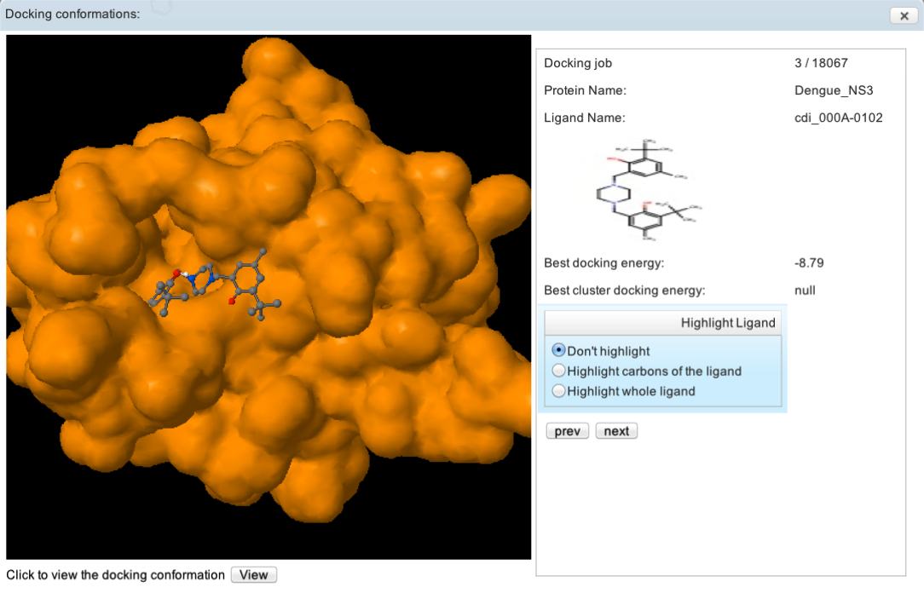
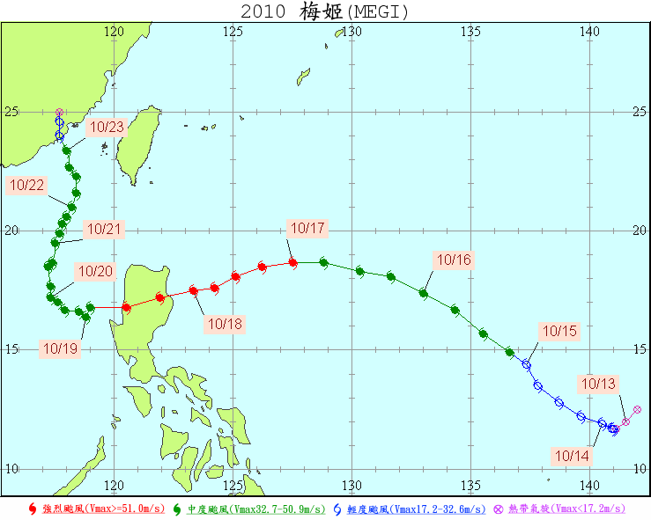
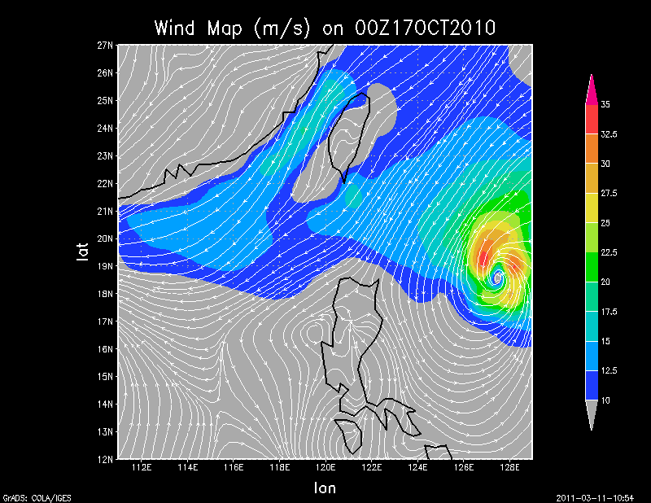
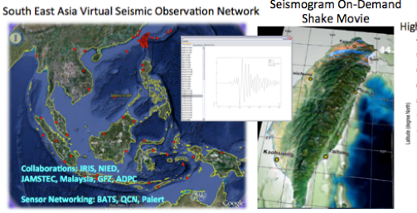
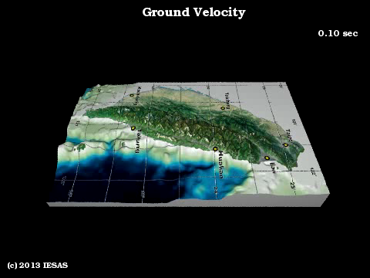
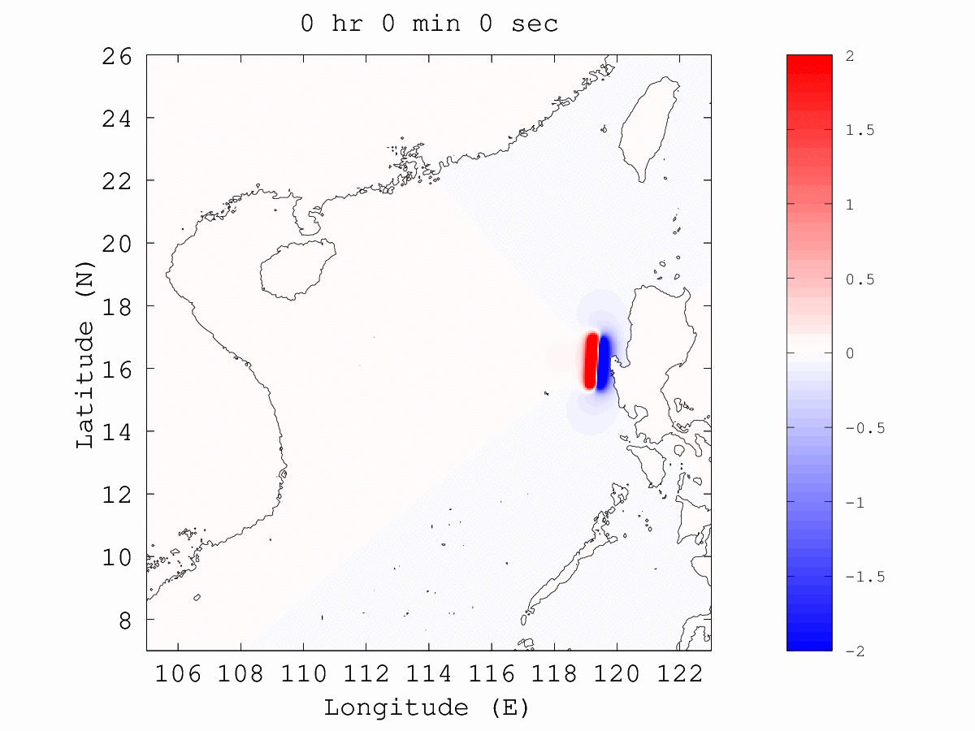
Higgs Search at ATLAS
Alpha Magnetic Spectrometer
Weather/ Climate Changes
Distributed Computing Infrastructure
(HW, SW, Networking)
Drug Discovery Application Portal
Earthquake and Tsunami Early Warning
Notes:
AMS: Search for nuclear antimatter up to TeV and Search for dark matter signatures

Slide 27
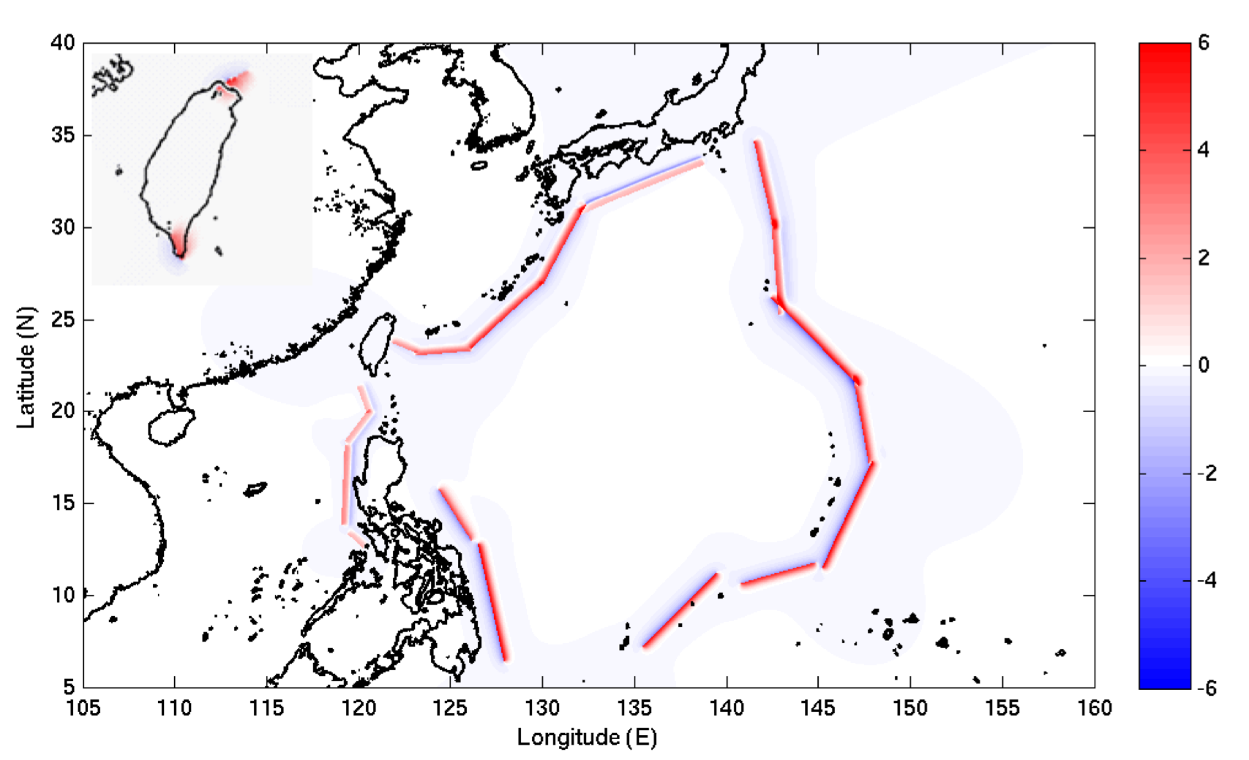
Tsunami Sources of
18 Trench and 4 Fault Segments
18 Trench-type tsunami sources（T1~T18） 4 Fault-type tsunami sources（T19~T22）
54

Slide 28
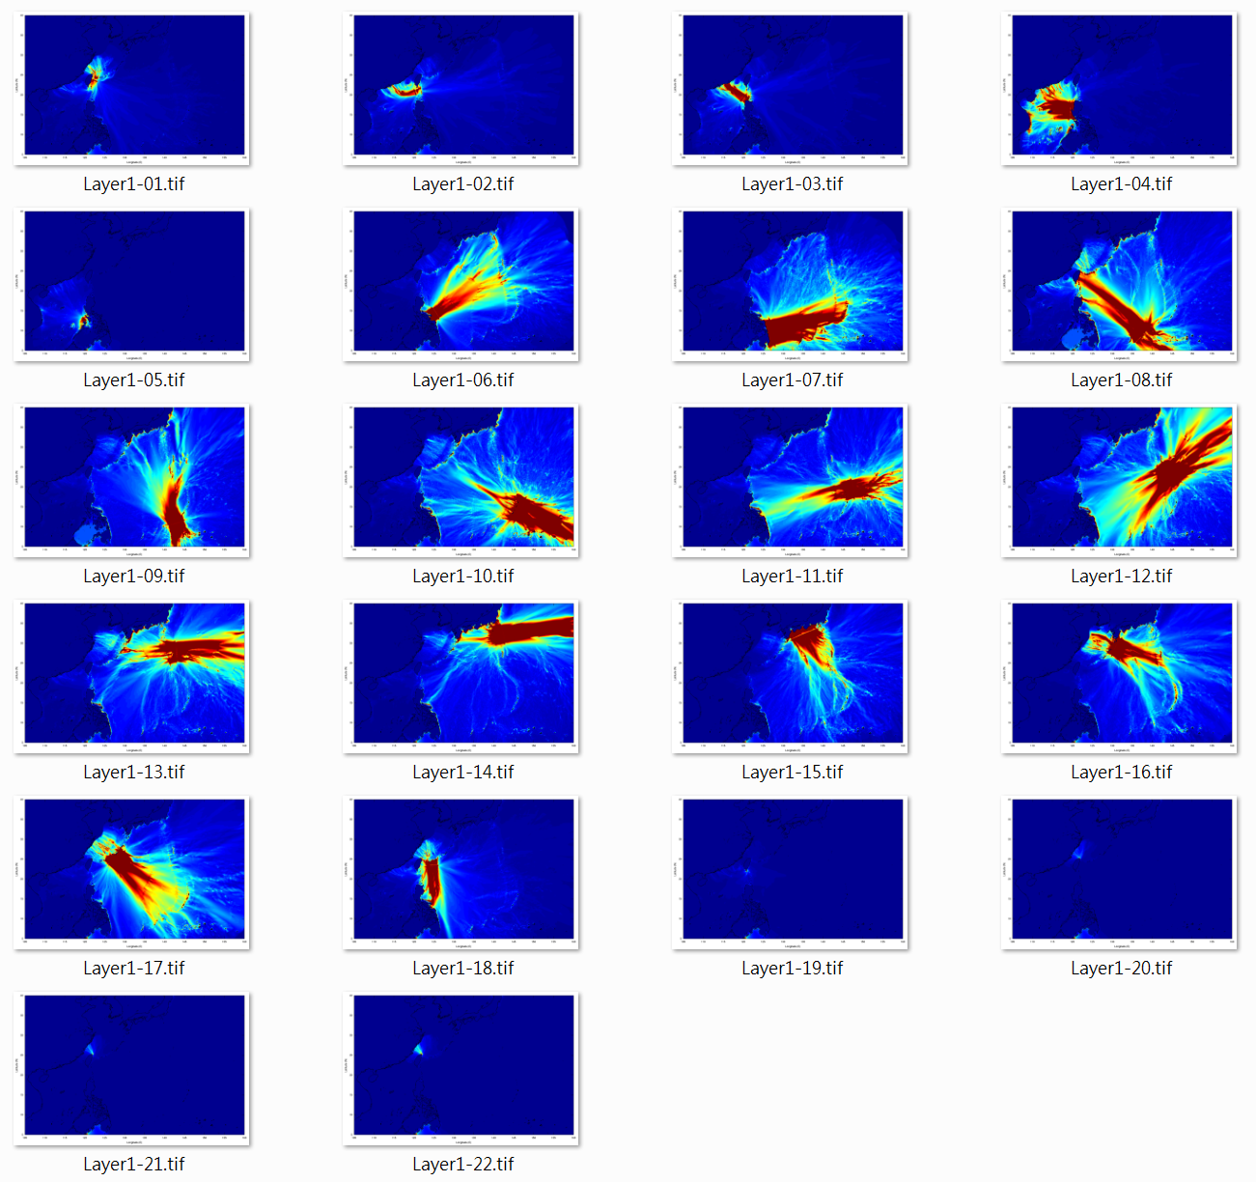
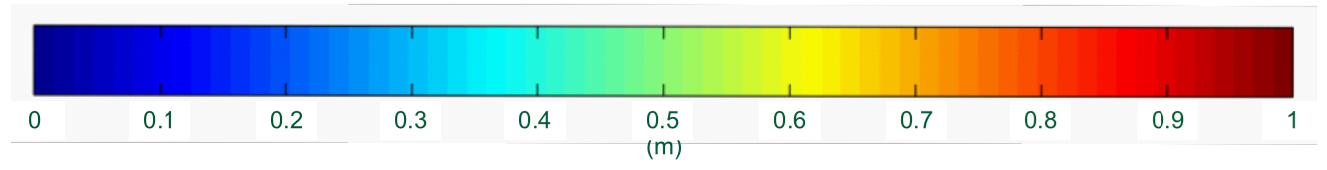
Taiwan has to be aware of the tsunamis from T1, T2, T3, and T8
T1 花蓮外海
T2 馬尼拉海溝1
T3 馬尼拉海溝2
T4
T5
T6
T7
T8 亞普海溝
T9
T10
T11
T12
T13
T14
T15
T16
T17
T18
T19
T20
最大波高(公尺)
T21
T22
55

Slide 29
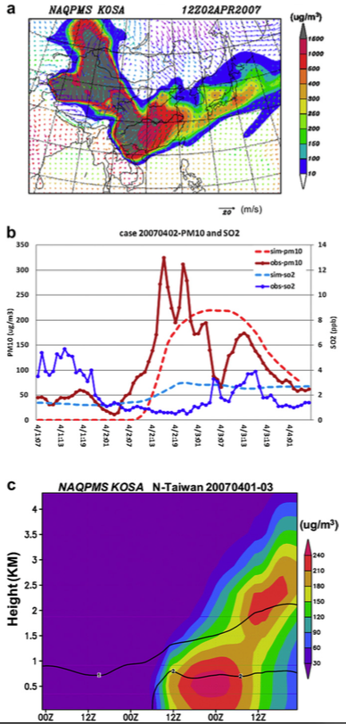
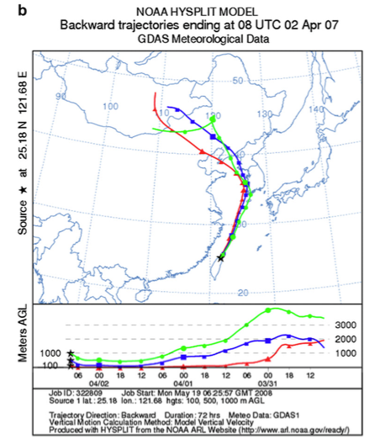
Climate Change: Asian Dust Transportation, Extreme Precipitation, and Urban Heat Island Effects
Source: Prof. Chuan-Yao Lin, RCEC, AS
Notes:
Right: Result of the HYSPLIT model 3-day backward trajectory analysis started at altitudes of 100, 500 and 1000 m at Wan-Li station in northern Taiwan at 0800 UTC (1600 LST) April 2, 2007.
Left: (a) Simulated spatial distribution of dust concentration (colored, unit: mg m3) and wind field at 1200 UTC April 2, 2007. The lower right corner of arrow denotes the scale of wind speed. (b) Temporal variation of observation (solid with dot) and simulation (dashed) PM10 concentration (red) and SO2 concentration (blue) at station WL from 0700 LST, April 1 to 0700 LST, April 4, 2007. (c) Simulated vertical profiles of dust concentration (colored, unit: mg m3) and SO2 (contour, unit: ppb) over northern Taiwan from 0000 UTC April 1 to 2400 UTC April 3, 2007.

Slide 30
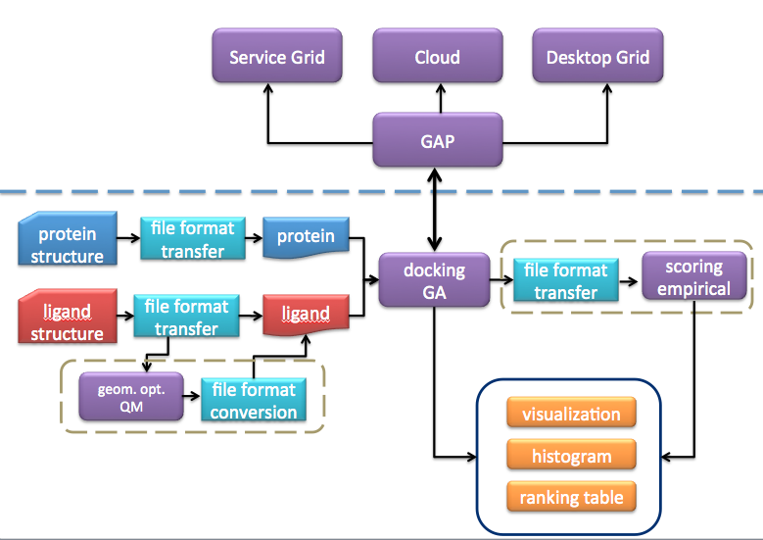
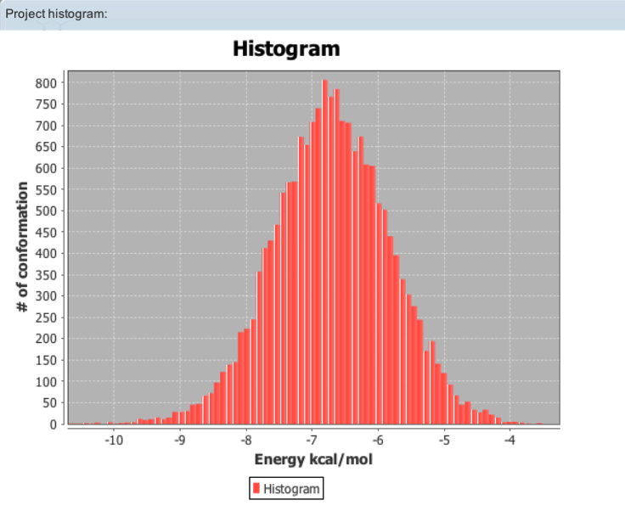
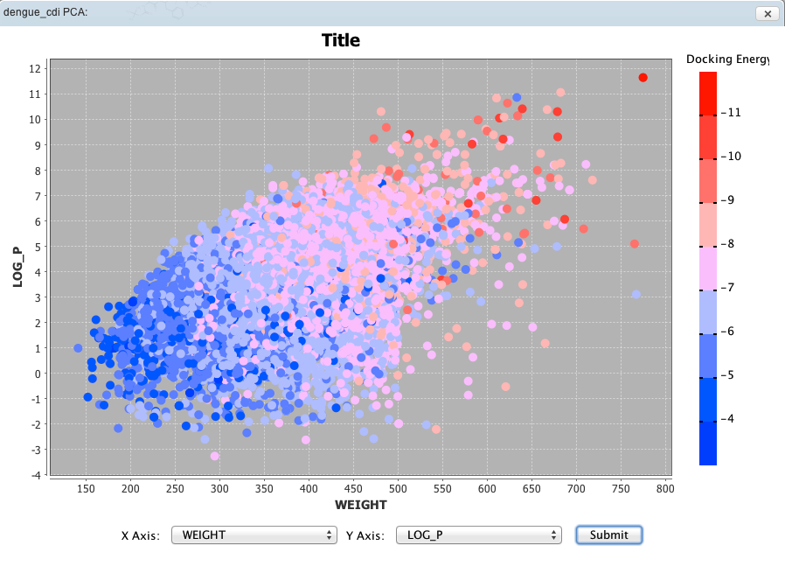
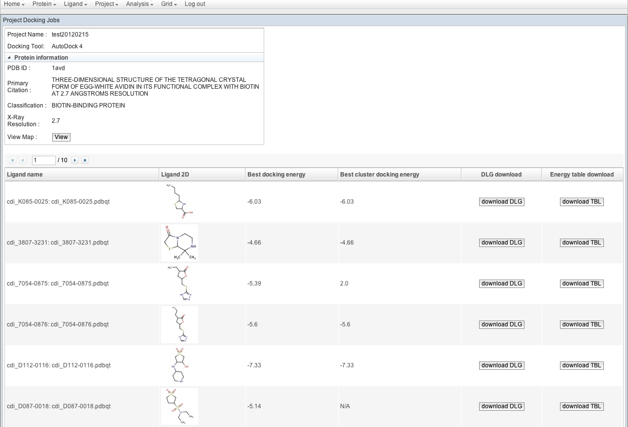
GVSS:
Grid Virtual Screening System
Support biomedical researchers responding to the pandemic disease by high speed assay process on Grids/Clouds.
Must be competitive to the fast in-vitro facility!
Available DB: ZINC (10M ligands), CDI (30K ligand) and Protein (700)
Notes:
Developed by ASGC and Genomic Research Center of Academia Sinica

Slide 31
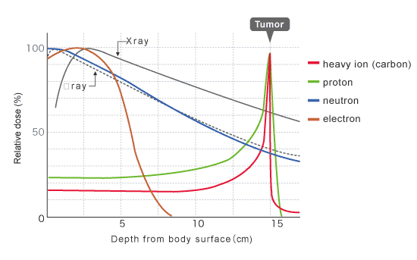
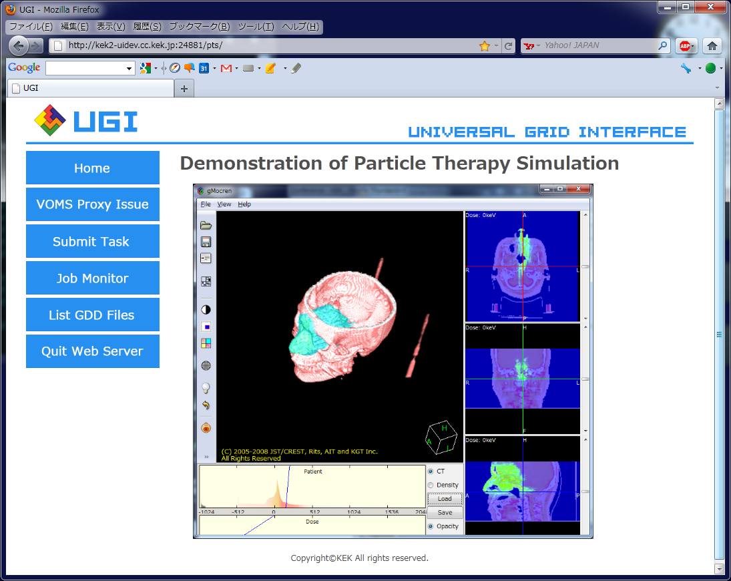
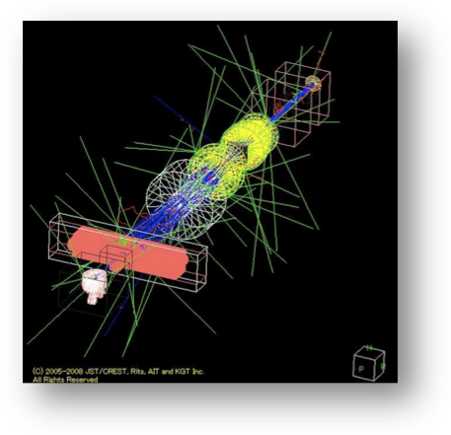
PTSIM
  Ref. 1 Geant4: http://geant4.org
Geant4 Particle Therapy Simulation Framework
    PTSIM : http://wiki.kek.jp/pages/viewpage.action?pageId=5343876
  An application program based on Geant4^{*1}
    Modeling a treatment port
      A beam delivery system and treatment head
      A patient geometry from CT images
      Modifying configuration by using UI commands.
    Providing a common platform to cover different
    facility specifications
  PTSIM users/Activities
    In Japan
      HIBMC, FPHPTC, NPTC, NCC, GHMC, etc.
    In Taiwan, Tutorial in CGU / CGMH in Nov. 2014
    with support of Academia Sinica.
γ
Gunma Univ. Heavy Ion Medical Center
http://heavy-ion.showa.gunma-u.ac.jp/en/therapy02.html
PTSIM
Notes:
Support verification of treatment planning by proton therapy in CGU.
Used to fine tune DCI efficiency
Scalability study by KEK and ASGC

Slide 32
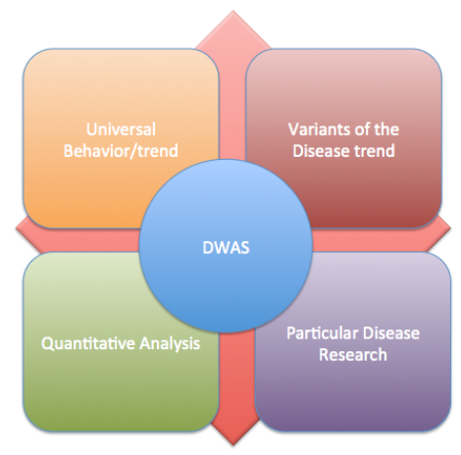
DWAS: Disease Wise Association Study

Slide 33
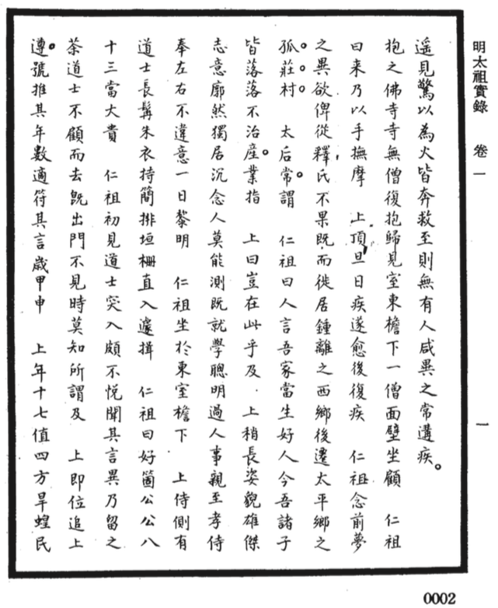
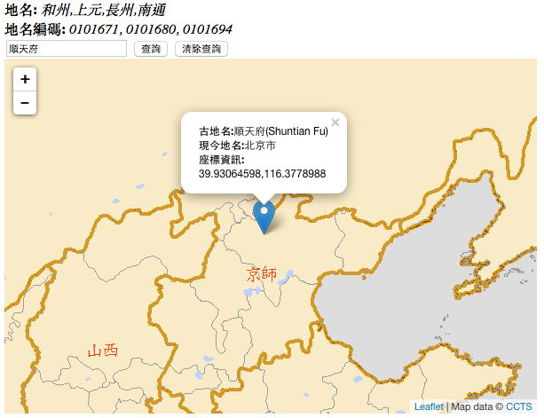
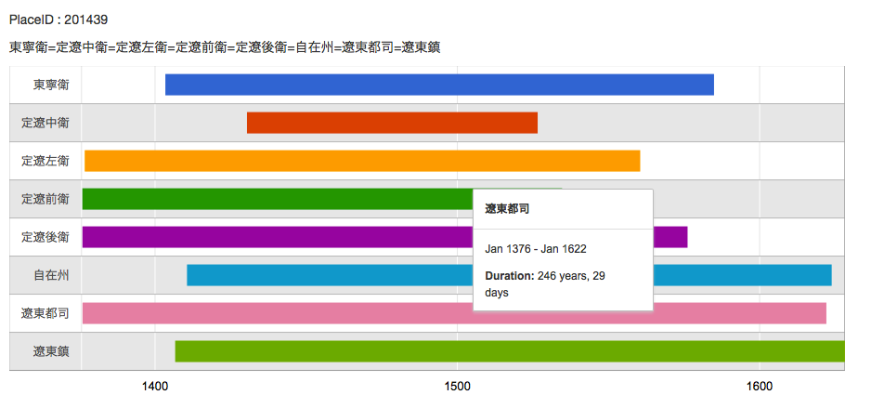
Place Names Recognition from Classic Chinese Texts
Min Shi Lu:
Total Words : 17,132,441
#Place Name in Dictionary: 5,000
#Place Name Identified: ~210,000
Notes:
By the right light source, we can identify the signals in various spectrum and get up to 31 bit resolution in each pixel. In the earlier project, the methodology and the instruments were used to capture the handwriting signals from the both sides of the ancient books and to identify the exact words of both sides. This could be used to restore the information from old artifacts in a non-destructive ways. This technique has been used in restoration of western paintings and wall paintings for quite a long time. In Taiwan, we are using the innovative methods from capture to analysis to enhance the discovery and preservation of cultural heritages such as paintings, writings etc.

Slide 34
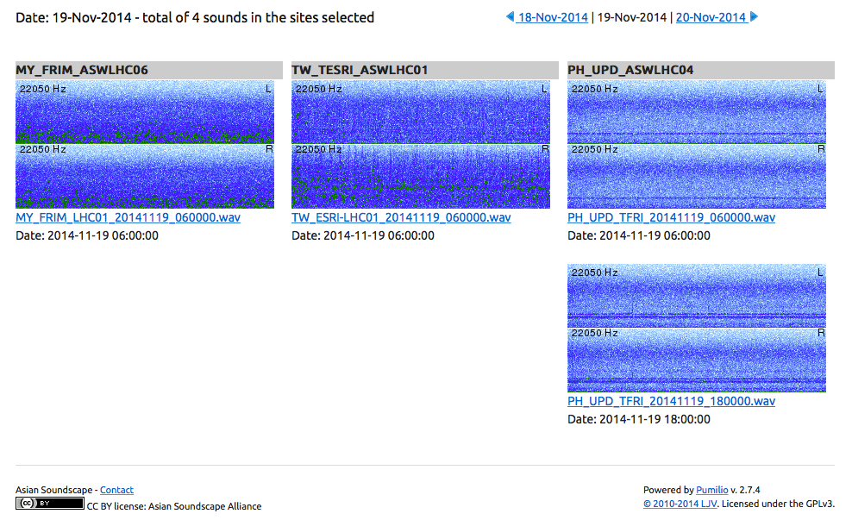
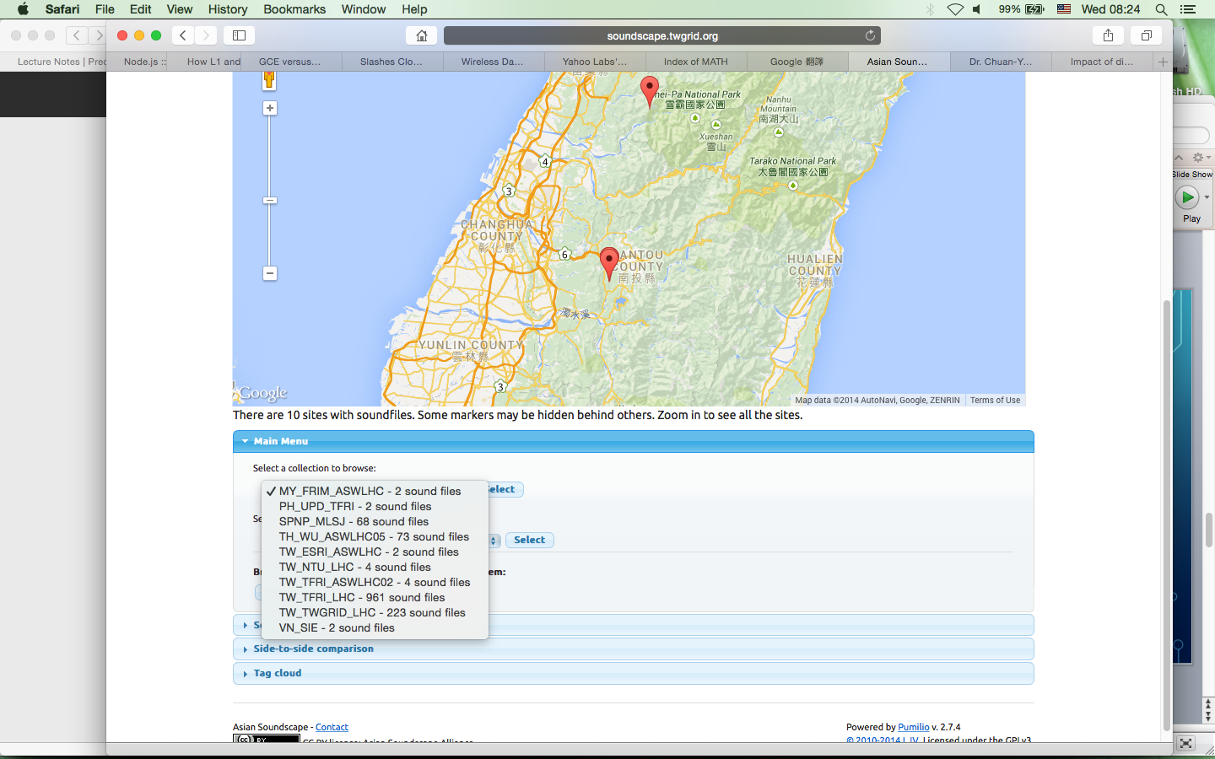
Soundscape: understand the characteristics of soundscape across spatial-temporal scales, by studying impacts of soundscape on human and organism and vice versa
(1TB/site in a year)
Notes:
Research agenda includes: 1) Improve the measurement and quantification of sound; 2) Improve our understanding on the spatial-temporal dynamics of soundscape across scales; 3) Improve our understanding on how important environmental covariates impact sound; 4) Assess the impacts of soundscape on wildlife; 5) Assess the impacts of human on soundscape; 6) Assess soundscape impacts on humans
Challenges: 1) High volume capacity for stable long-term archive; 2) High band width for uploading and downloading acoustic data; 3) High computing performance for visualizing and analyzing binary acoustic data in near real-time; 4) An integrated application platform for managing the metadata (project, location, time), extracted data (spectrograms) , tagged data (species recorded in sound archive), and original sound recording data

Slide 35
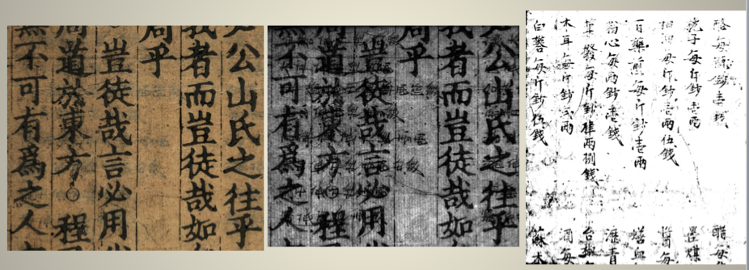
Multispectral Data Analysis for Cultural Preservation
Notes:
By the right light source, we can identify the signals in various spectrum and get up to 31 bit resolution in each pixel. In the earlier project, the methodology and the instruments were used to capture the handwriting signals from the both sides of the ancient books and to identify the exact words of both sides. This could be used to restore the information from old artifacts in a non-destructive ways. This technique has been used in restoration of western paintings and wall paintings for quite a long time. In Taiwan, we are using the innovative methods from capture to analysis to enhance the discovery and preservation of cultural heritages such as paintings, writings etc.

Slide 36
Notes:
Strategy for EGI-Engage

Slide 37
Regional e-Science Collaborations
Started from Big Sciences, the new distributed infrastructure, and human network across countries
Taking advantages of Global collaborations
  Middleware, User Communities and Applications, Operation Technology, etc.
Saving lives by e-Science: Natural Disaster Mitigation (including earth, climate, neglected diseases, etc.) is the common focal point
Towards Big Data Analysis
More countries start to deploy the production applications (Drug Discovery, Earthquake & Tsunami simulation, weather simulation, Climate Changes, etc.) and develop new features according to user requirements.
Vision is to share data, infrastructure, tools, analytics, human resources, etc.

Slide 38
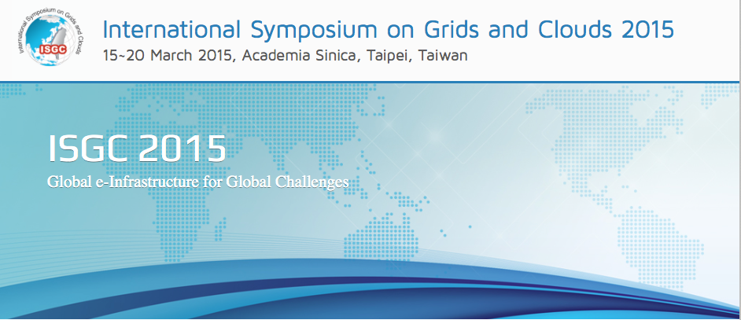
Topics include Physics (including HEP) and Engineering Applications, Biomedicine & Life Sciences Applications, Earth & Environmental Sciences & Biodiversity Applications, Humanities, Arts, and Social Sciences (HASS) Application, Virtual Research Environment (including Middleware, tools, services, workflow, etc.), Data Management, Big Data, Infrastructure & Operations Management, Infrastructure Clouds and Virtualisation, Interoperability, Business Models & Sustainability, Highly Distributed Computing Systems, and High Performance & Technical Computing (HPTC)

Slide 39
Summary
Scalable Distributed Computing Infrastructure
  Fanless single rack is devised as the building block: energy saving and flexibility purposes
  Cloud services are developed for both site level dynamic resources & cross sites easy application environment deployment and migration
  Operation technology developed for architecture & performance optimization, monitoring & analysis, as well as intelligent operation
  Advanced networking capacity and technology are necessary
Wider discipline and multi-disciplinary e-Science applications
  web-based application gateway, by working closely with user communities, is the best recipe.
  Keep improving the system and technology by user feedback and VO domain knowledge
  Towards common data and sharing of analysis tools & methodology
Closer Regional & International Collaborations
  APROC model is essential
  Coordinated by VO and APGI is the best model
e-Science for the People is our principal strategy

